Slide 1
A FLEXIBLE FRAMEWORK FOR FORWARD AND INVERSE MODELING OF STORMWATER LIDS
Arash Massoudieh
Mahdi Maghrebi
The Catholic University of America
Washington, DC

Slide 2
Overview
Why a new framework?
Governing Equations
  Hydraulic
  Particle Transport
  Contaminant transport
  Numerical method
Demonstration cases
  Bioretention (hydraulic)
  Infiltration basin (hydraulic)
  Permeable pavement (hydraulic)
  Wetland/stream (hydraulic + reactive transport)
  Small catchment (hydraulic, transport)
Conclusions

Slide 3
Green Infrastructure modeling
Diverse system configurations
Need to choose/adjust the levels of complexity
The importance of particular processes depends on:
  the goal of simulation
  contaminant of concern
  time scale of interest
Inverse Modeling/Uncertainty assessment

Slide 4
Block-Connector conceptualization
Inflow
A=61.67
A=85.71
A=207.14
Z=158.13
12
10
18
5
19
19
16
Z=158.06
11
Z=157.98
4
18
9
4
15
10
3
3
17
14
9
8
2
2
16
13
24” Engineered soil
8
7
1
6
1
15
12
7
0
Z=157.37
0
14
6” PVC
Slope=0.5%
11
20
5
17
15” Aggregate
A=5, Depth=1000
13
Z=157.22
6
21
Z=157.08
20
24
Z=156.99
Z=157.18
25
Z=157.0
Z=156.53
22
23
24
21
22
23
26
Z=0
Z=156.02
37
A=182.14
A=98.00
A=20.97
Z=155.86
36
45
25
46
43
44
Z=155.72
37
Z=155.66
30
43
35
31
42
36
29
42
35
30
41
34
29
33
34
28
40
41
24” Engineered soil
27
40
33
28
39
32
27
Z=155.05
26
39
38
32
Z=154.9
47
Z=154.78
48
44
31
45
38
Z=154.78
Z=154.82
15” Aggregate
Z=154.67
49
50
51
52
46
47
48
12” PVC
Slope=0.5%
Z=154.73
49
A=100, Depth=10000
Z=0
Z=0

Slide 5
Governing Equations - Hydraulics
Water Balance
Head-Storage constitutive theory
Head-Flow constitutive theory

Slide 6
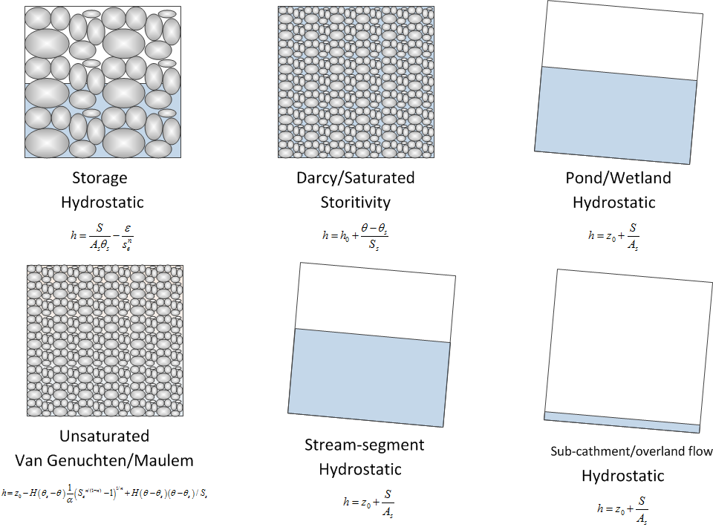
Constitutive Equations
+user-defined blocks

Slide 7
Constitutive Equation (hydraulics)
Constitutive relations are not hard-coded. Default relationships for known elements are available
S-H relationships
 | Soil | Pond | Storage | Catchment | Manhole | Darcy | Stream
Soil |  |  |  | N/A | Pipe |  | N/A
Pond
Storage |  |  |  |  | Pipe |  | N/A
Catchment | N/A |  |  |  |  | N/A
Manhole | Pipe |  | Pipe |  | Pipe | Pipe | Pipe
Darcy |  |  |  | N/A | Pipe
Stream | N/A |  | N/A |  |  | Pipe
Soil | Pond | Storage | Catchment | Manhole | Darcy | Stream

Slide 8
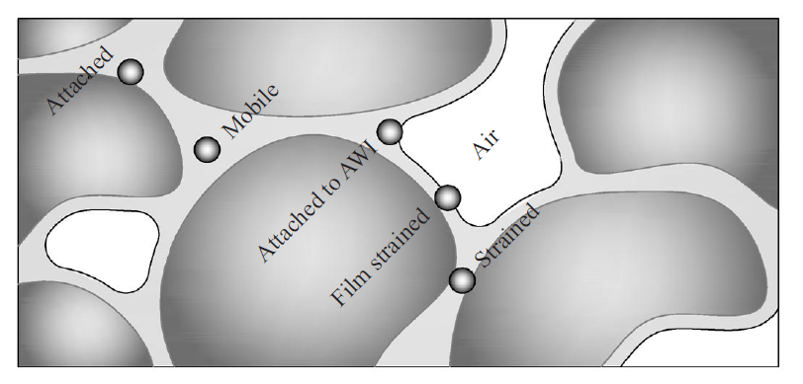
Particle Transport
User-specified number of particle types
User-specified number of phases

Slide 9
Coupled dissolved/particle facilitated constituent fate, reaction and transport
Coupled particle-bound aqueous transport is important because the main removal processes in many LIDs is particle settling/filtration
User-specified number of chemical species
User-specified reaction network

Slide 10
Other processes
Evaporation/Vapor exchange
Build-up (exponential, linear, user-defined)
Wash-off (Diffusive, flow-dependent, user-defined)
Atmospheric Flux (e.g. Aeration)
In progress:
Transpiration and plant uptake
Clogging

Slide 11
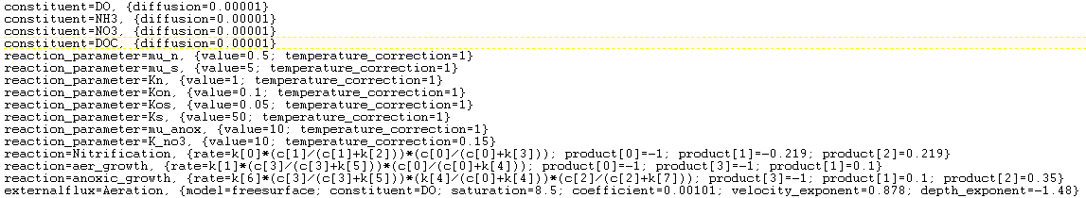
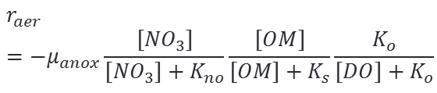


Reactions
$$r_{aer}=−μ_{s}\frac{[OM]}{[OM]+K_{s}}\frac{[DO]}{[DO]+K_{o}}$$
$$r_{nit}=−μ_{n}\frac{[{NH}_{3}]}{[{NH}_{3}]+K_{n}}\frac{[DO]}{[DO]+K_{on}}$$
$$r_{aer}=−μ_{anox}\frac{[{NO}_{3}]}{[{NO}_{3}]+K_{no}}\frac{[OM]}{[OM]+K_{s}}\frac{K_{o}}{[DO]+K_{o}}$$

Slide 12
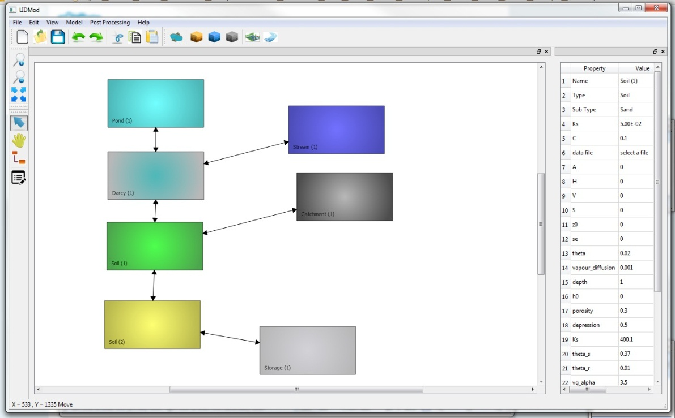
Numerical Algorithm
Implicit, Newton-Raphson with partial Jacobian evaluation
Adaptive time-step
C++
We are working on a GUI

Slide 13
Framework features
User-defined reaction kinetics
User-defined particle-medium interaction/settling
Deterministic (GA) and stochastic (Bayesian-MCMC) parameter estimation
User-defined atmospheric exchange, build-up, wash-off

Slide 14
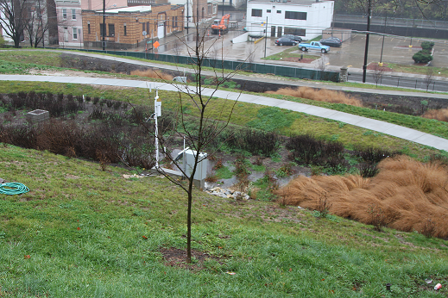
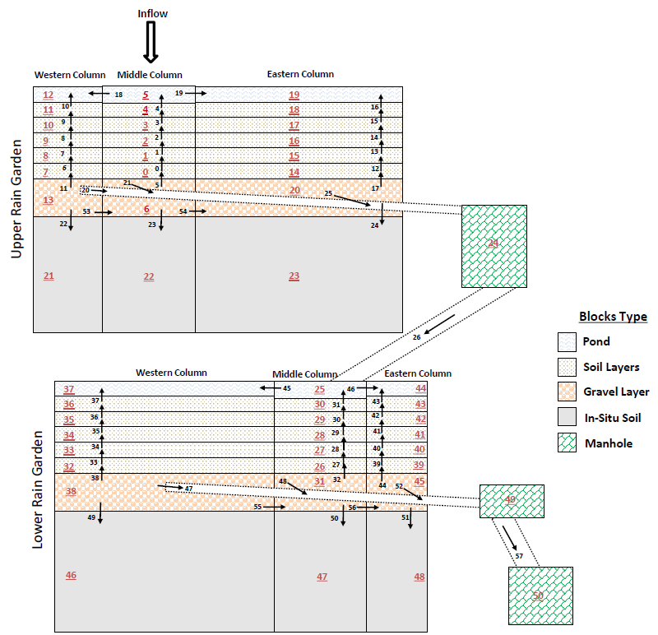
Examples: St. Francis Bio-retention basin, Cincinnati, Ohio

Slide 15
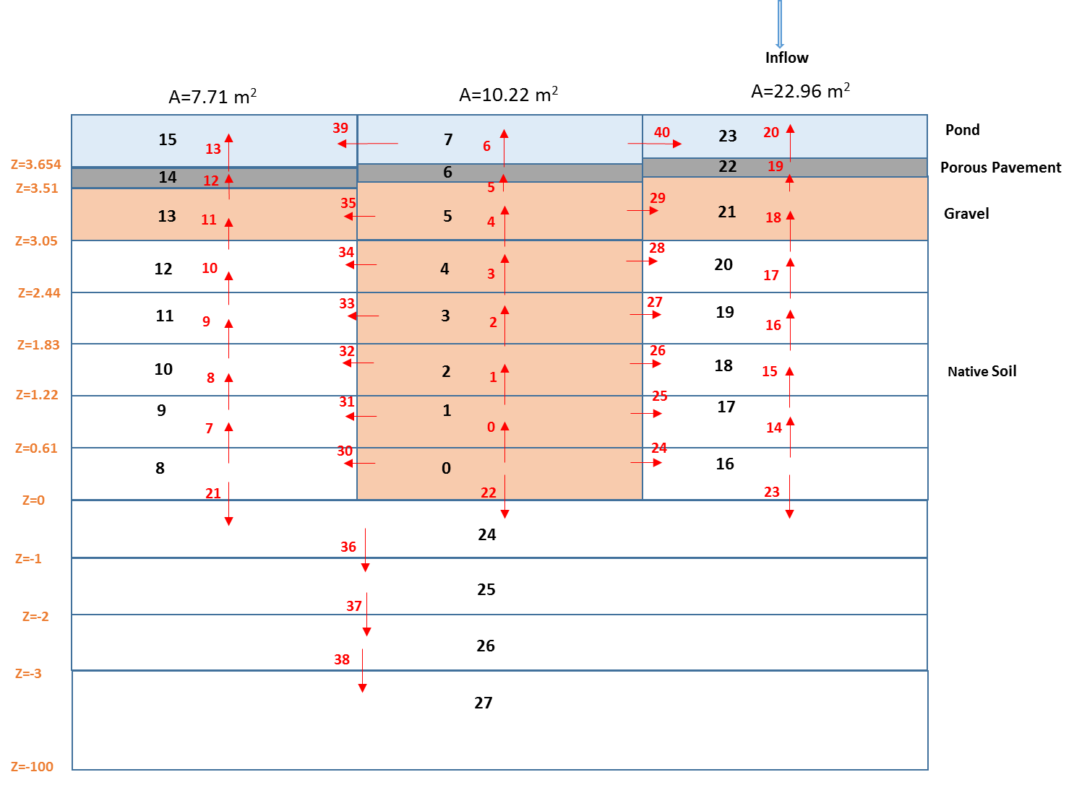
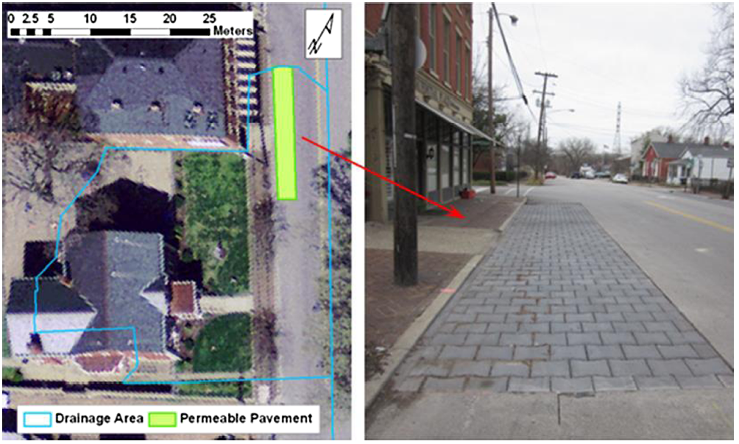
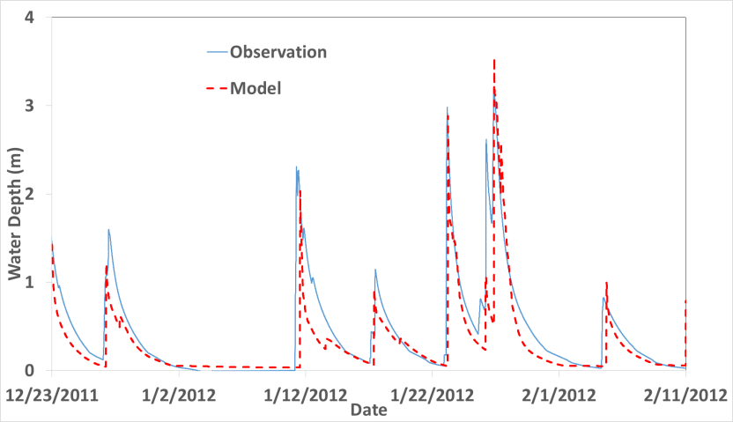
Permeable Pavement System, Louisville, KT
Lee et al., 2005

Slide 16
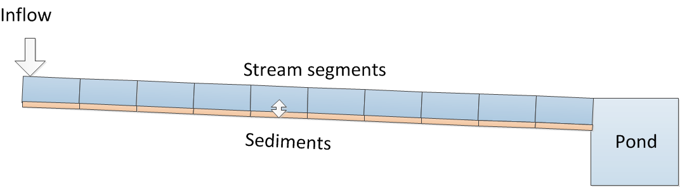



Reactive transport in a stream
Initial DO: 8.5mg/L
Initial NO3: 0
$$r_{aer}=−μ_{s}\frac{[OM]}{[OM]+K_{s}}\frac{[DO]}{[DO]+K_{o}}$$
$$r_{nit}=−μ_{n}\frac{[{NH}_{3}]}{[{NH}_{3}]+K_{n}}\frac{[DO]}{[DO]+K_{on}}$$
$$r_{aer}=−μ_{anox}\frac{[{NO}_{3}]}{[{NO}_{3}]+K_{no}}\frac{[OM]}{[OM]+K_{s}}\frac{K_{o}}{[DO]+K_{o}}$$

Slide 17
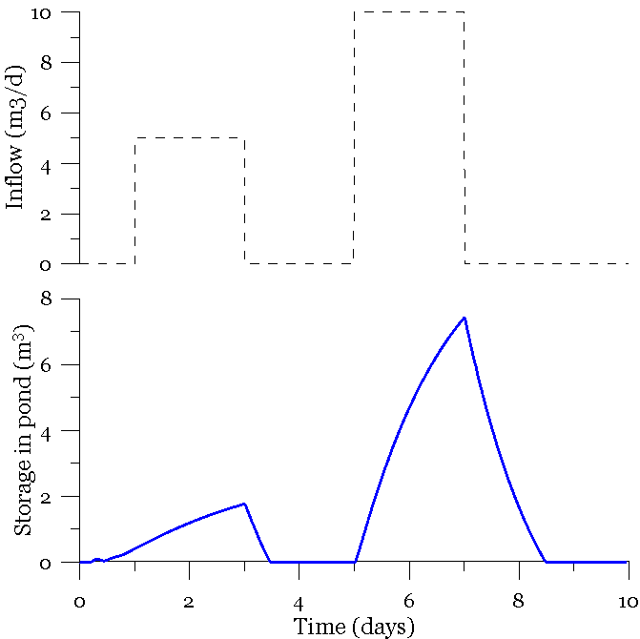
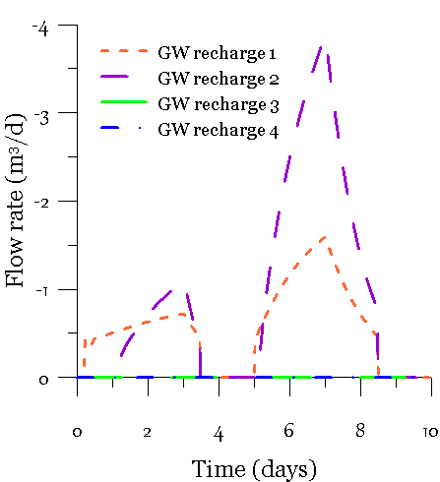
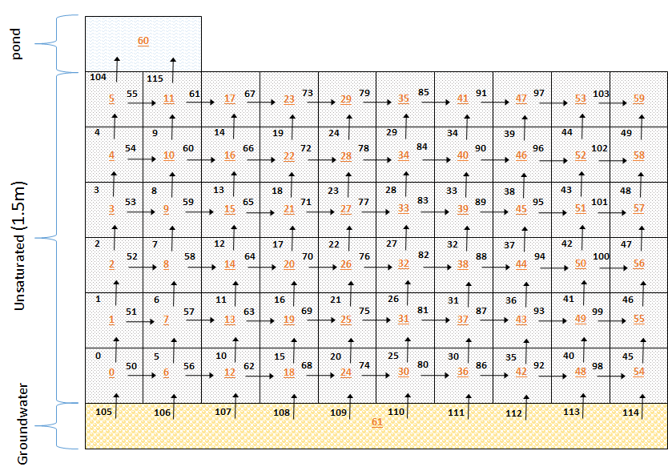
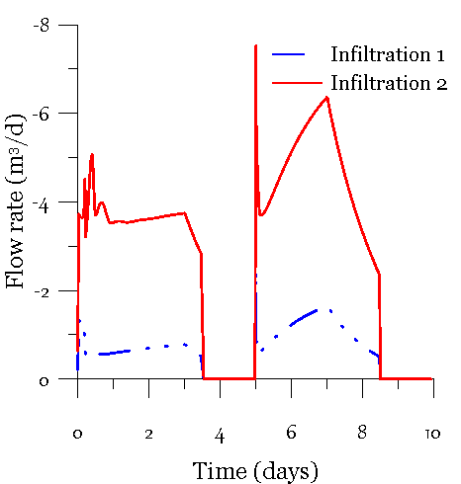
Infiltration Basin and GW recharge
Θ=10̊
2.5 m
Pond
Day 1
Day 3
Day 9

Slide 18
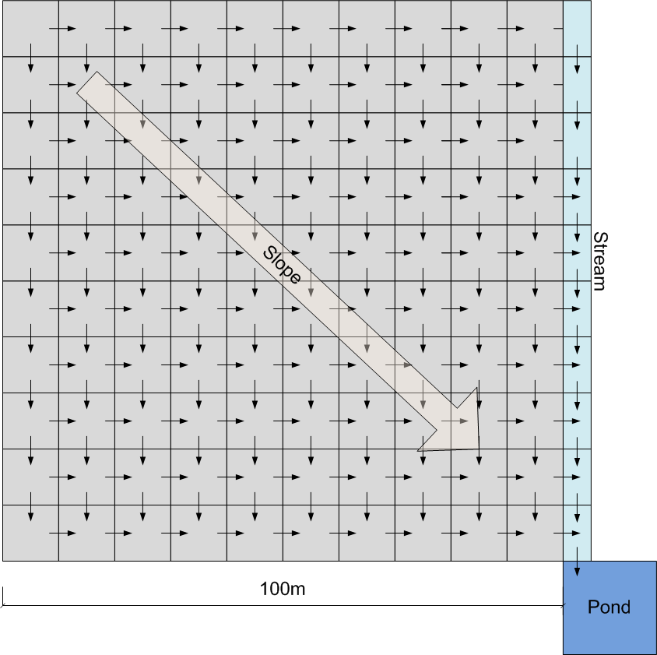
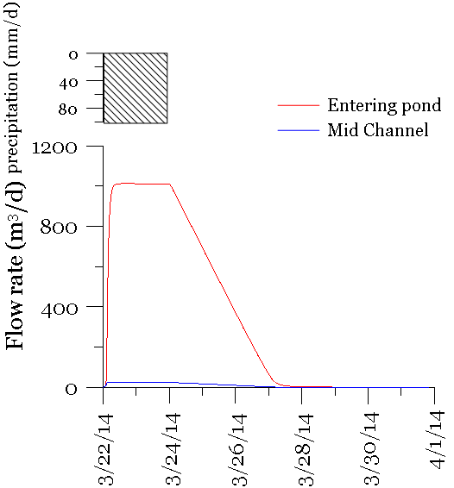
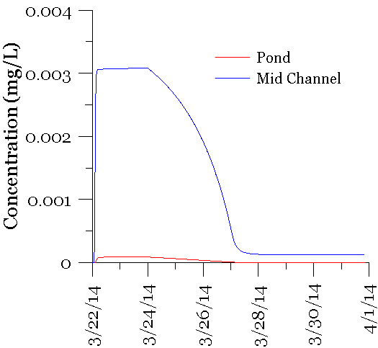
100x100m impervious surface-channel + wash-off
Initial build-up of 1000mg/m² of an imaginary contaminant with diffusive wash-off
Depression storage 0.005m/m²
No infiltration

Slide 19
Summery
LIDMod provide a flexible tool to assess the short-term and long-term performance of LIDs
  User-defined hydraulic relationship
  User-defined particle/colloid transport and retention
  User-defined reactions
  User-defined build-up and wash-off
  User-defined atmospheric exchange
The framework is written to allow easy expansion
Scripting language is liberating but not easy to use for every user
Different level of complexity can be represented
Inverse modeling need more computational speed

Slide 20

Thank you!
If you think you have some applications for the program contact: massoudieh@cua.edu

