Slide 1
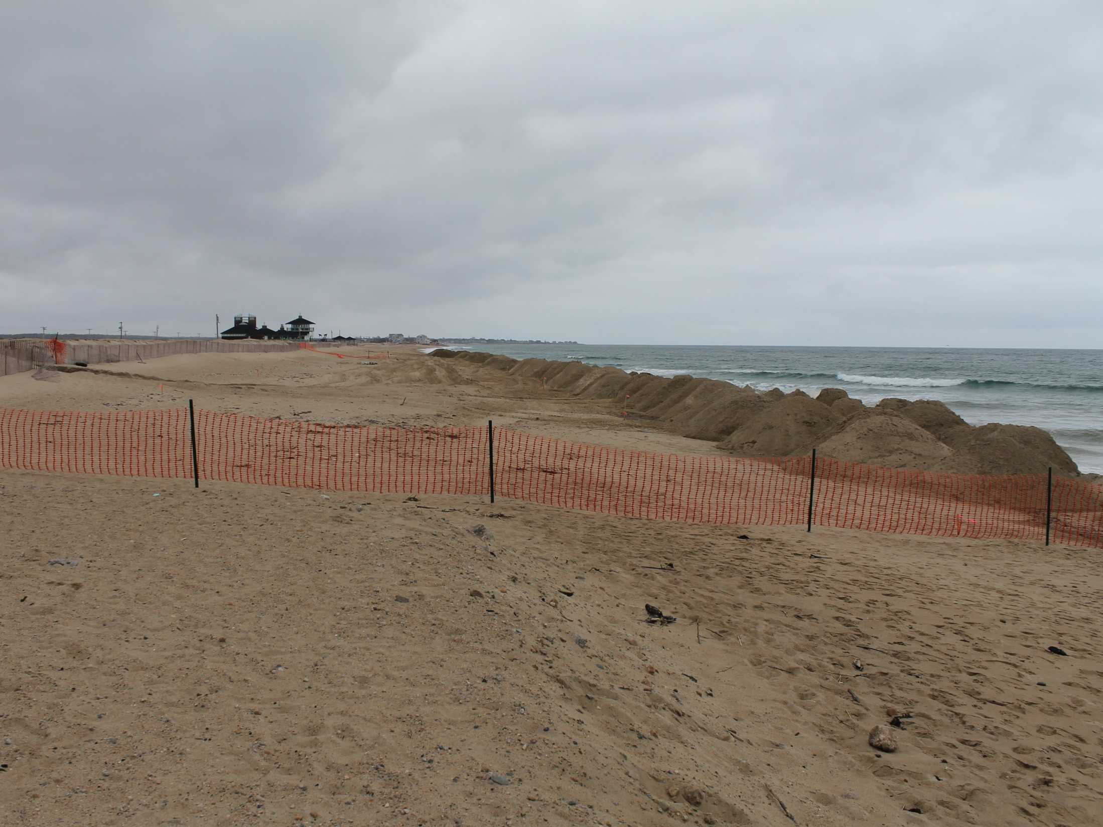


THE MISQUAMICUT STATE BEACH REPLENISHMENT PROJECT: ONE YEAR LATER, MEASURED USING RTK-GPS, DGPS AND BEACH PROFILES
Bryan A. Oakley¹ Janet Freedman², Robert J. Hollis³,
Danni R. Goulet² and Jon C. Boothroyd^{3,4}
Department of Environmental Earth Science, Eastern Connecticut State University
2. RI Coastal Resources Management Council
3. Rhode Island Geological Survey
4. Research Professor Emeritus, Dept. of Geosciences, Univ. of Rhode Island
National meeting of the Geological Society of America
2 November 2015 – Paper 162-9

Slide 2
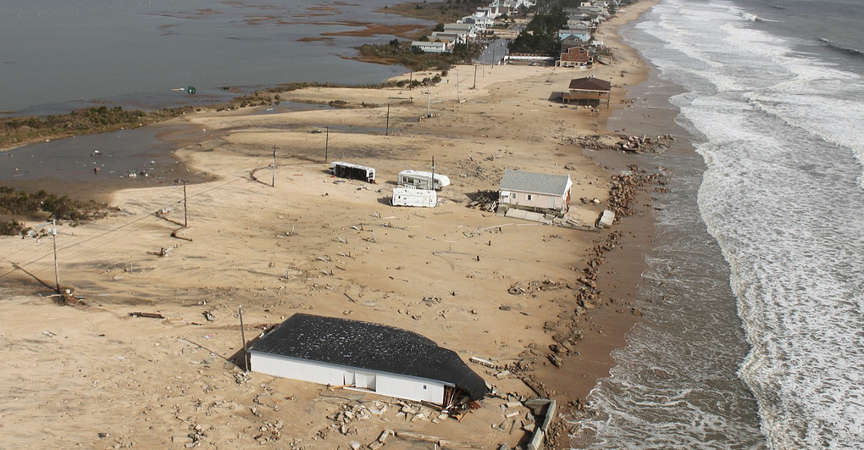
Field and Modeling Approaches to Understanding the Response of Coupled Barrier-Backbarrier Systems to Coastal Change
MISQUAMICUT (WESTERLY), RI – Post Sandy
RIDOT

Slide 3
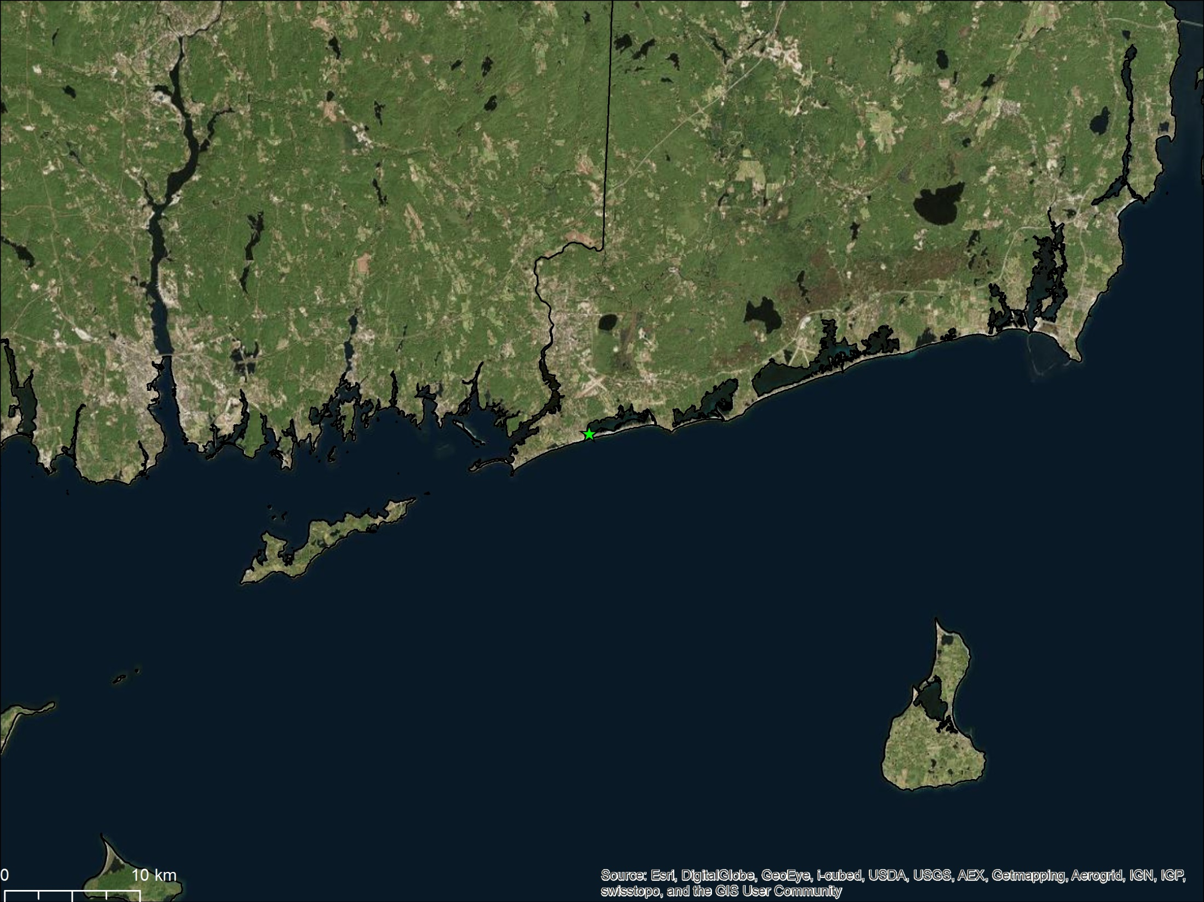
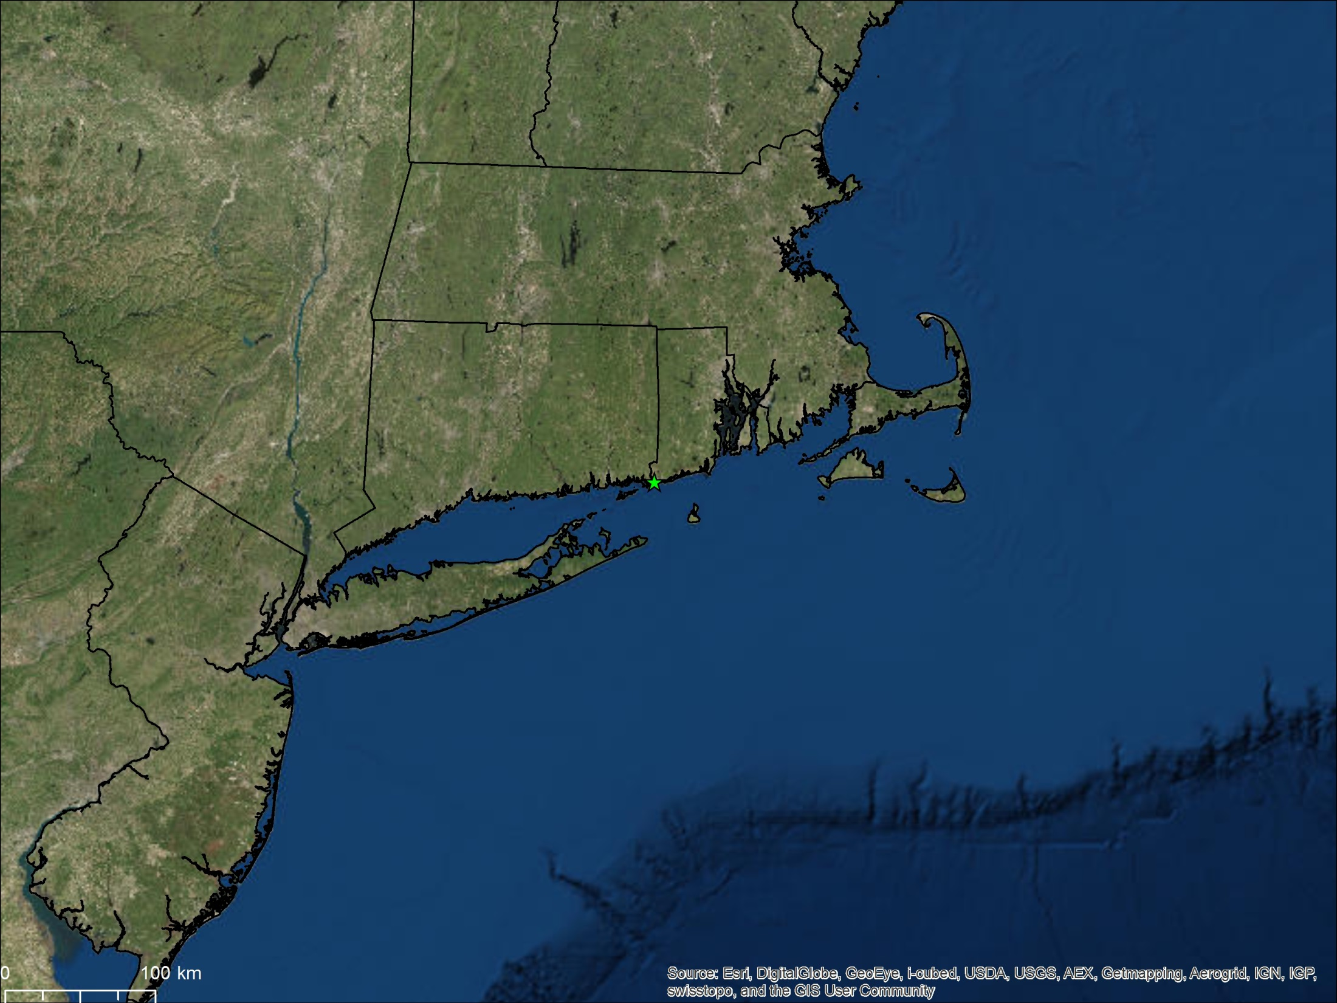
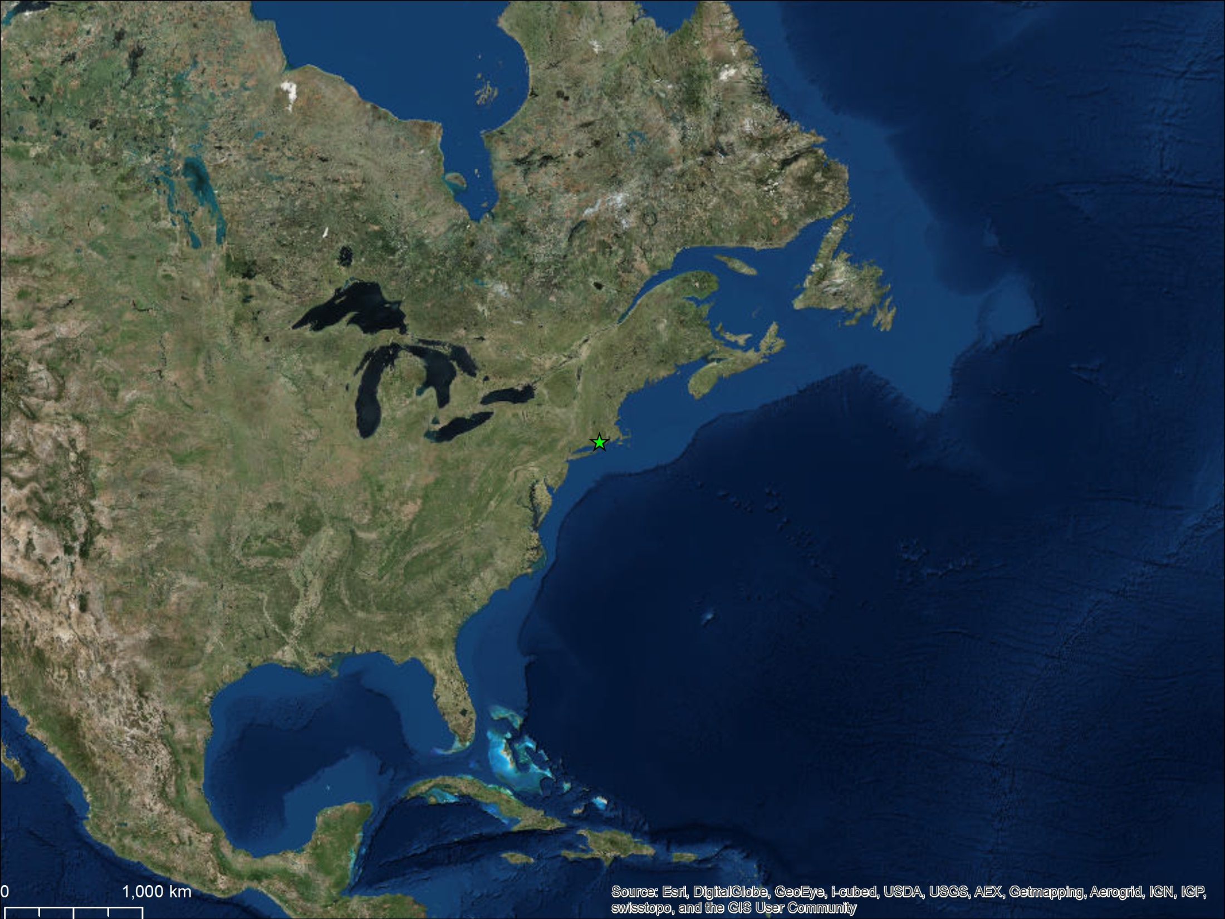
Misquamicut State Beach
Microtidal (0.8-1.2 m), Wave dominated coastline
Hs (Irene)
4.1 m
Hs (Sandy)
9.8 m
Notes:
Microtidal (0.8-1.2m) wave dominated

Slide 4
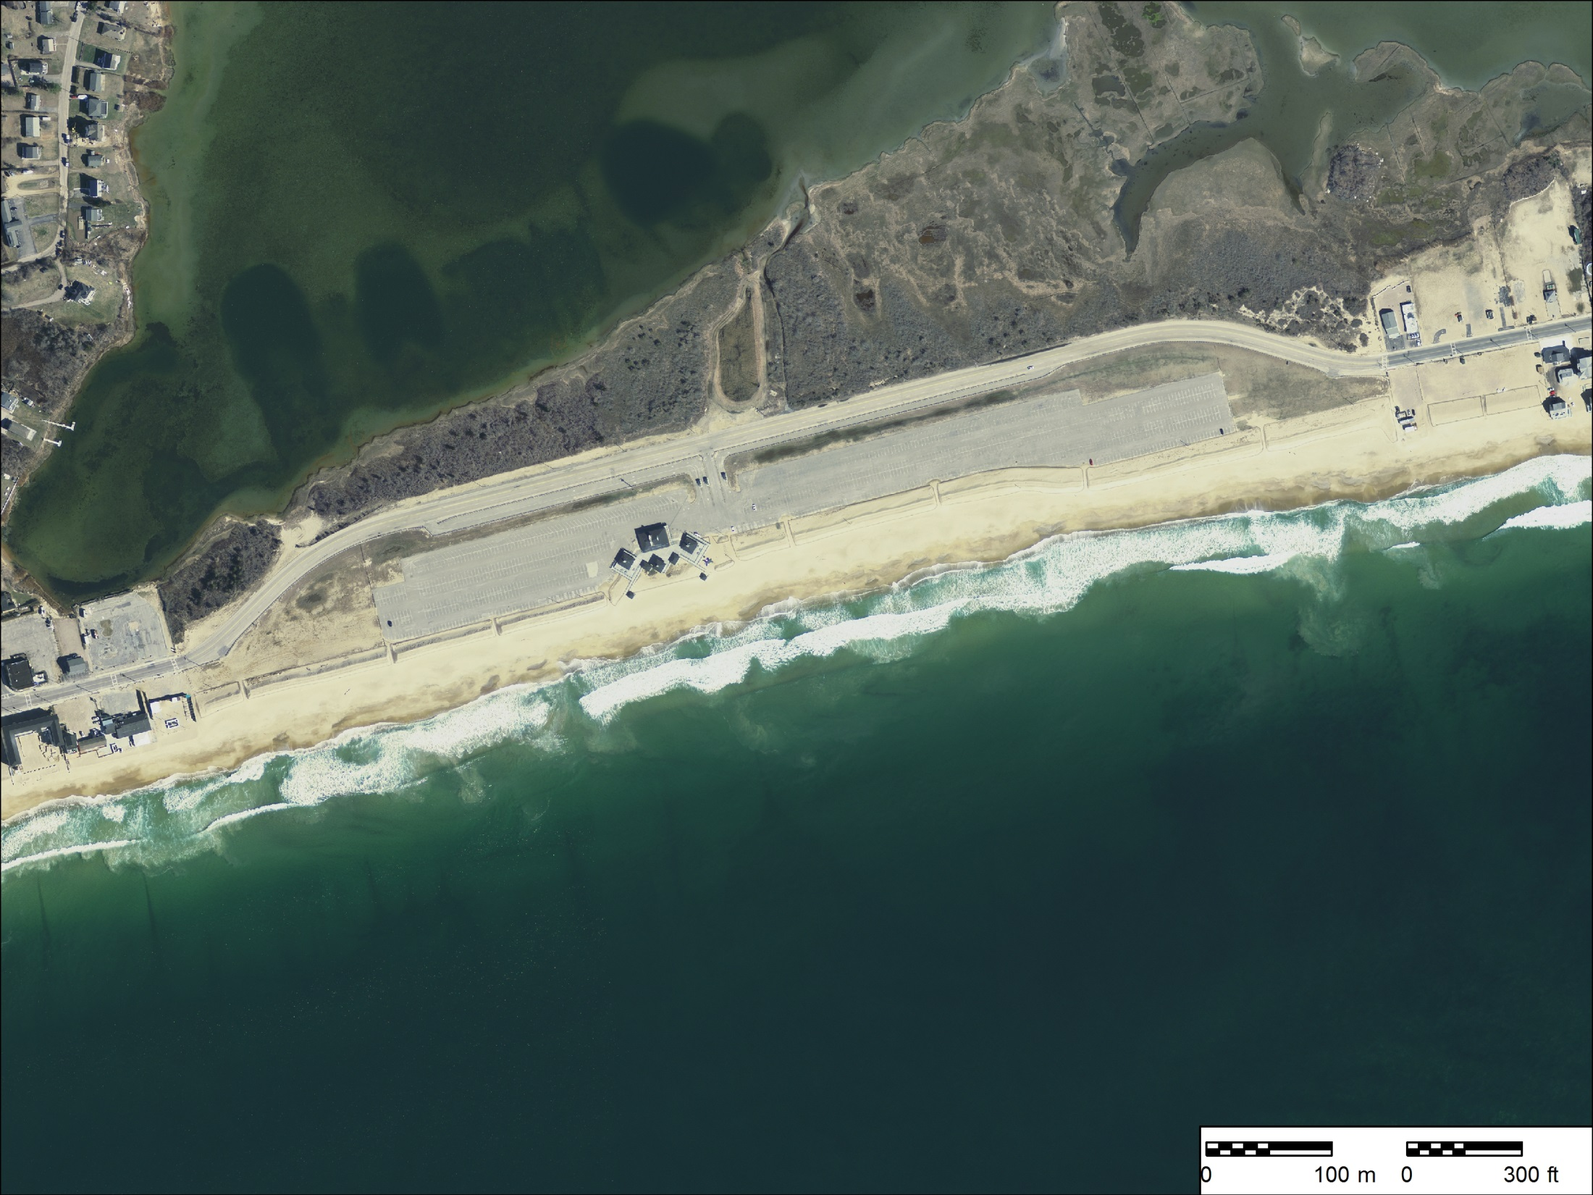
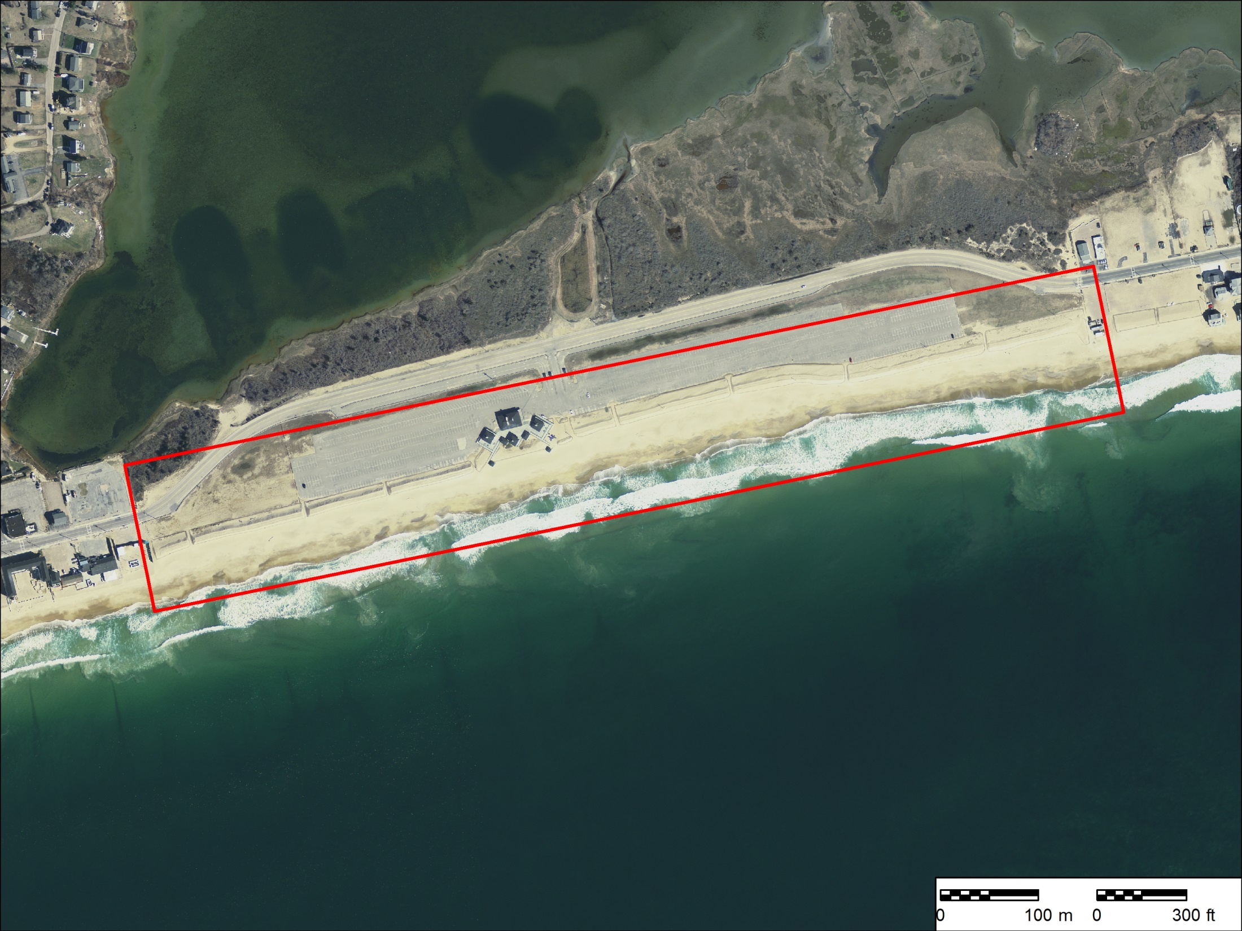

Slide 5
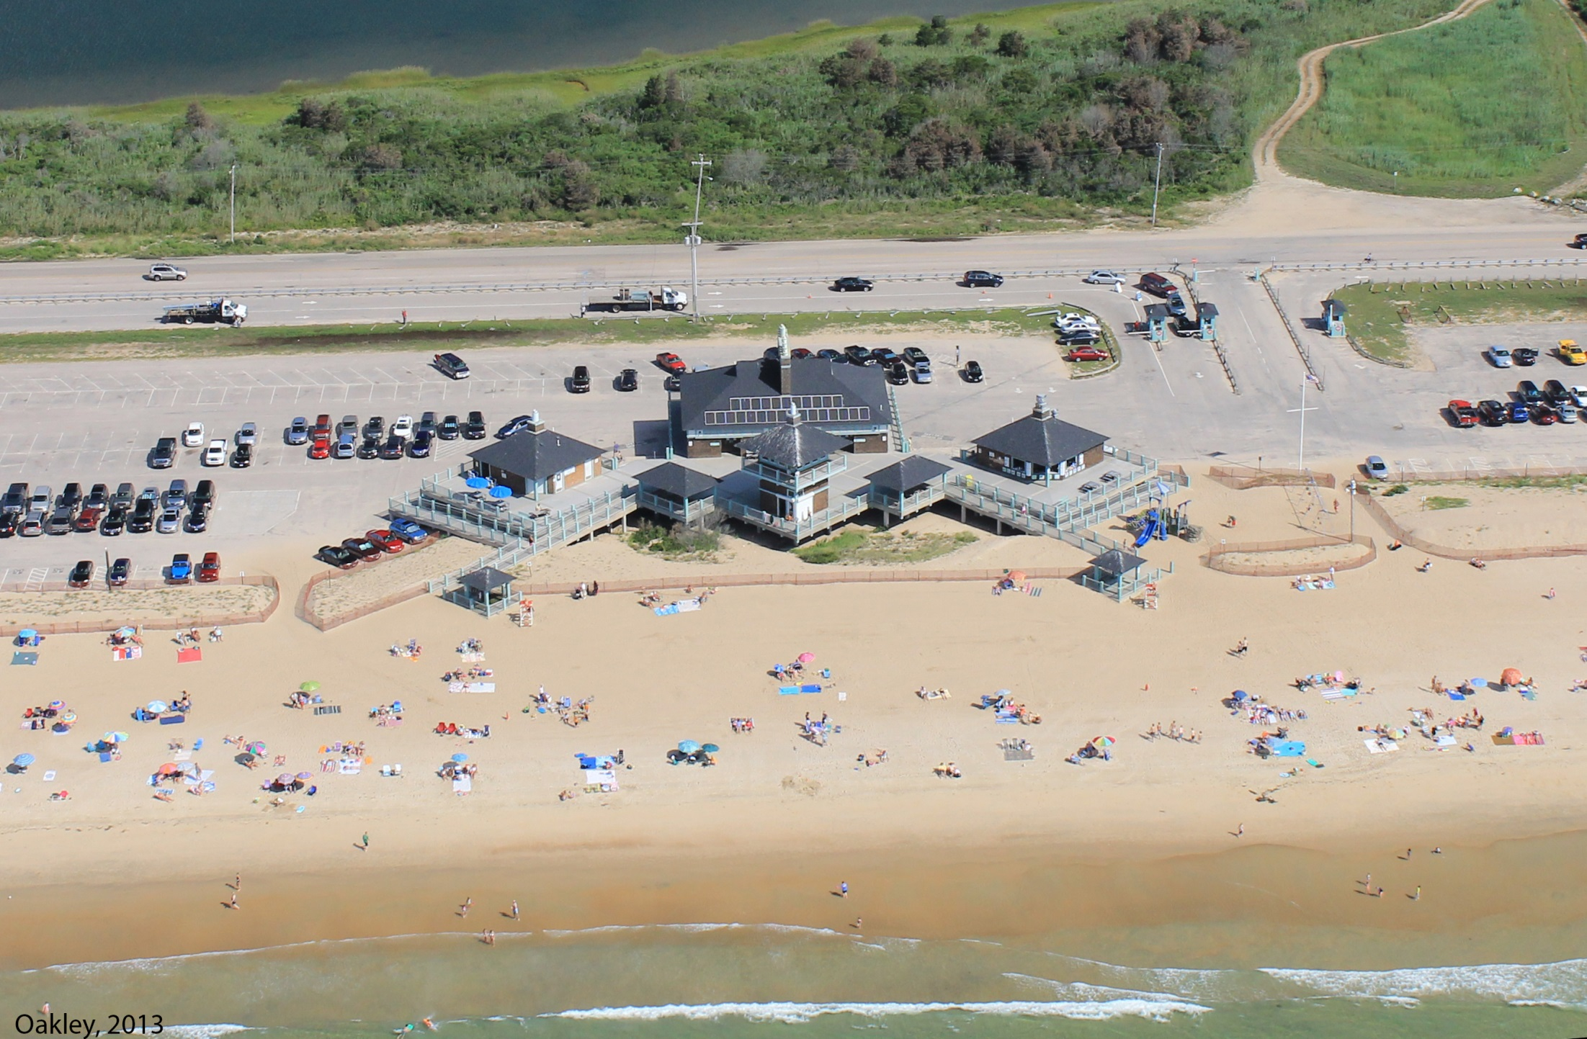
Before replenishment (August, 2013)

Slide 6
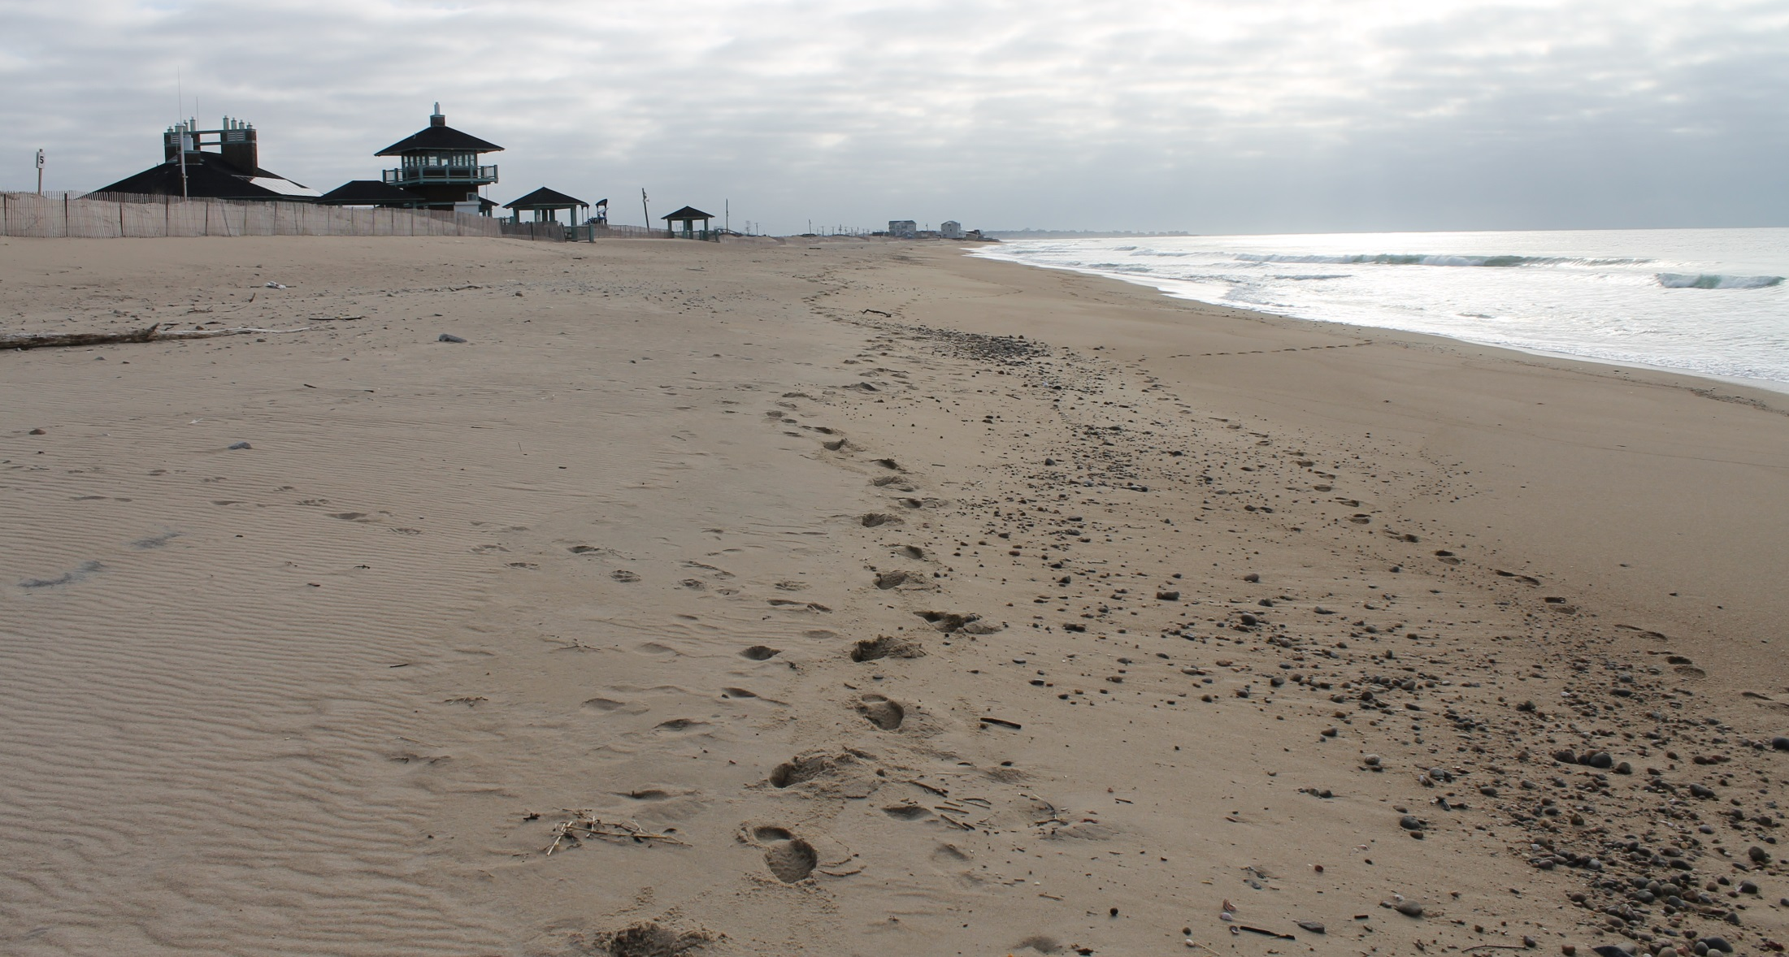
Before replenishment
18 April 2014 – View: East

Slide 7
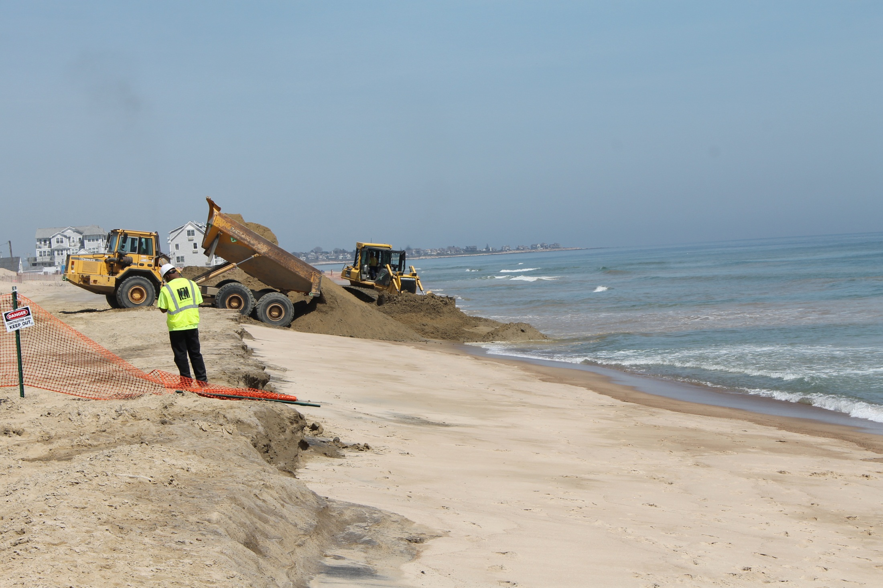
During replenishment
65,000 m³ of sediment added to the berm
$3.1 Million ($47 m⁻³)
Sourced entirely from upland (glacial stratified deposits)
$$$

Slide 8
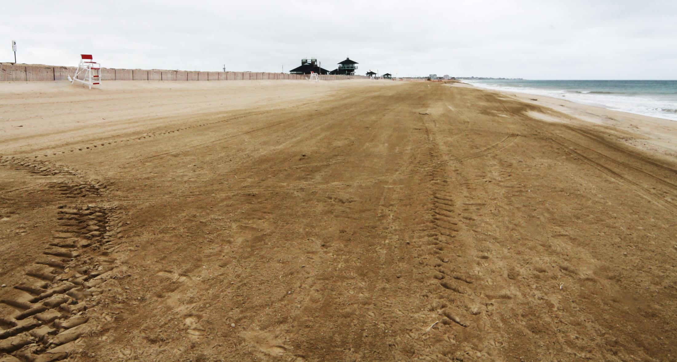
After replenishment
28 May 2014 – View: East

Slide 9

Mapping the position of LHTS using sub-meter handheld DGPS
18 April 2014 (Pre)
30 May 2014 (Post)

Slide 10

Beach profiles using the Modified Emery method (Monthly; pre/post storm)
MSQ-SB-5
MSQ-SB-4
MSQ-SB (3)
MSQ-SB-2
MSQ-SB-1

Slide 11
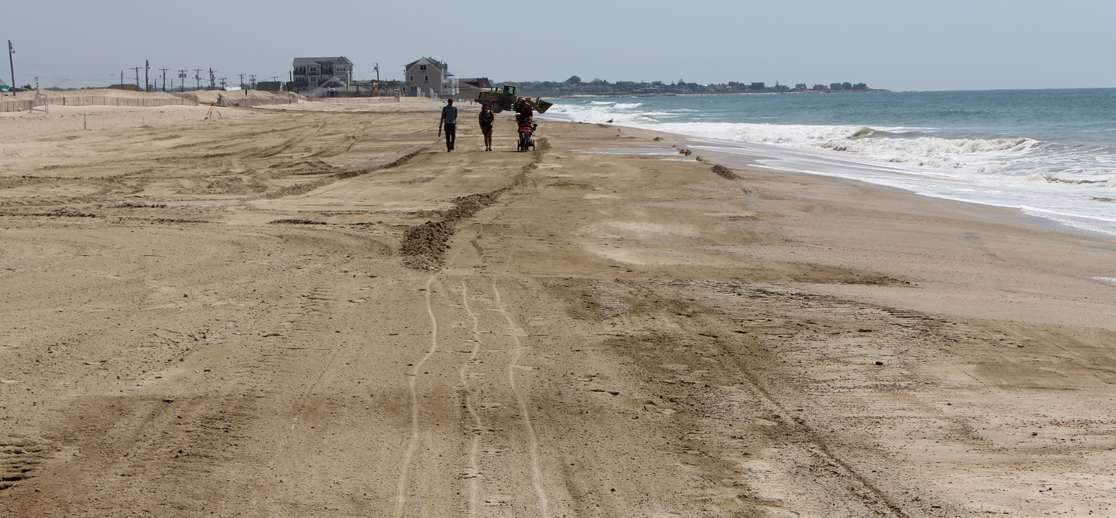
Topographic mapping RTK-GPS (Quarterly)
Last day of Replenishment – 30 May 2014

Slide 12
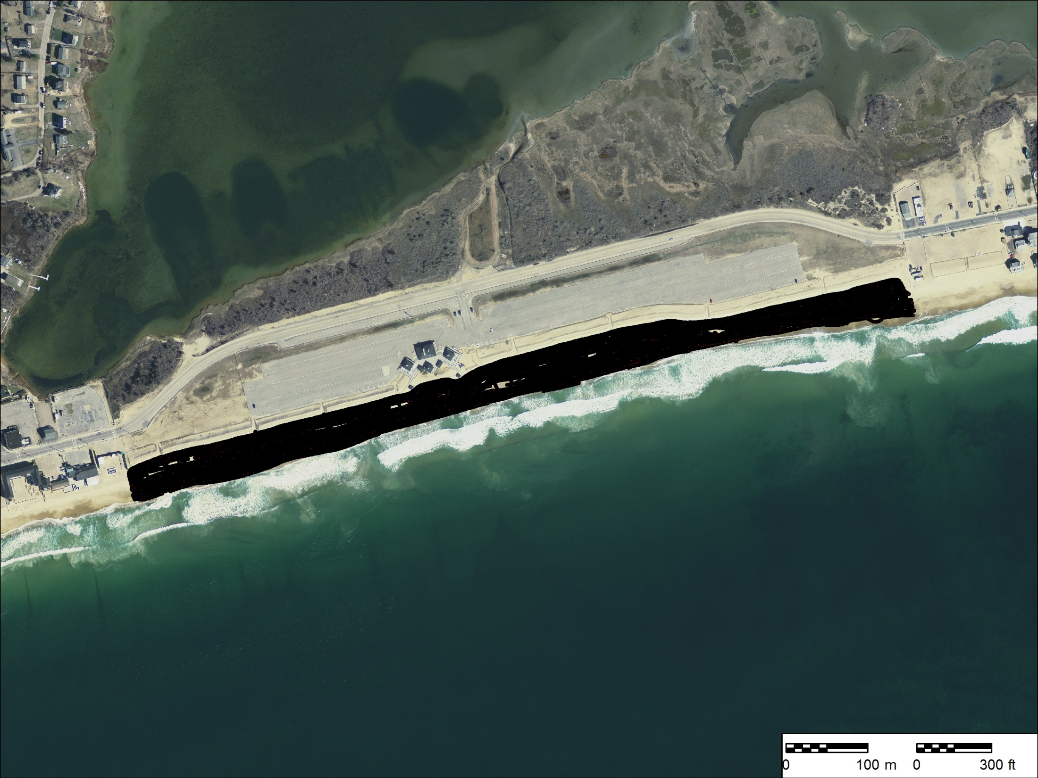
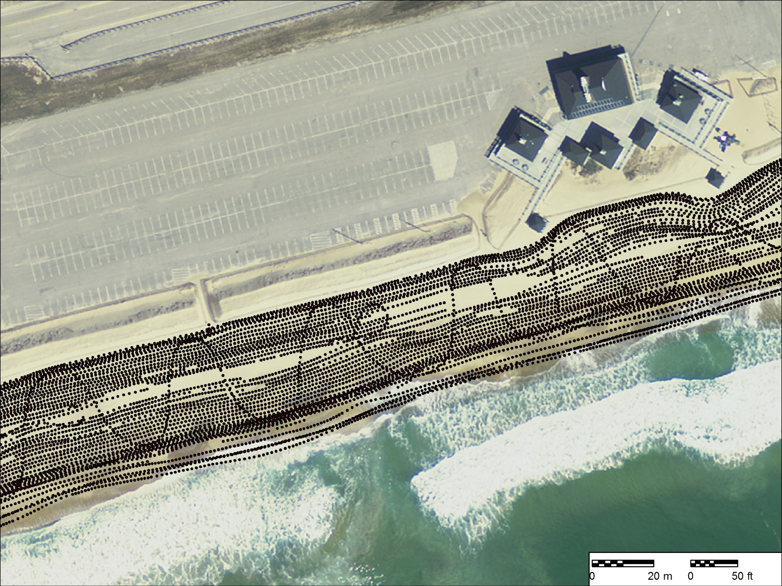
Topographic mapping RTK-GPS (Quarterly)

Slide 13
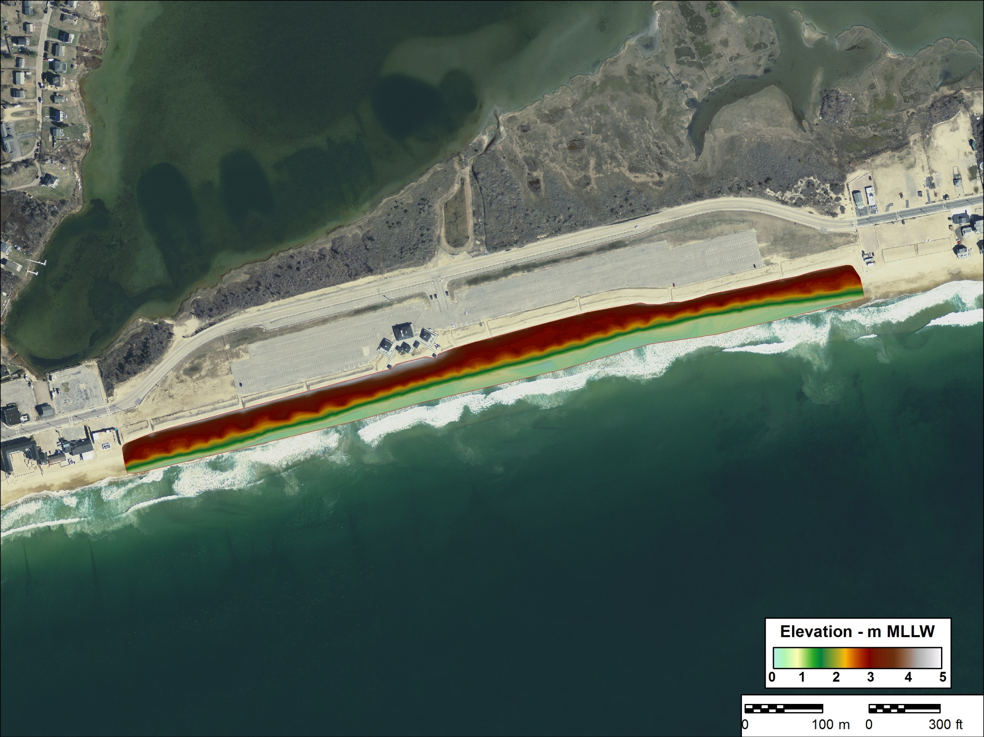
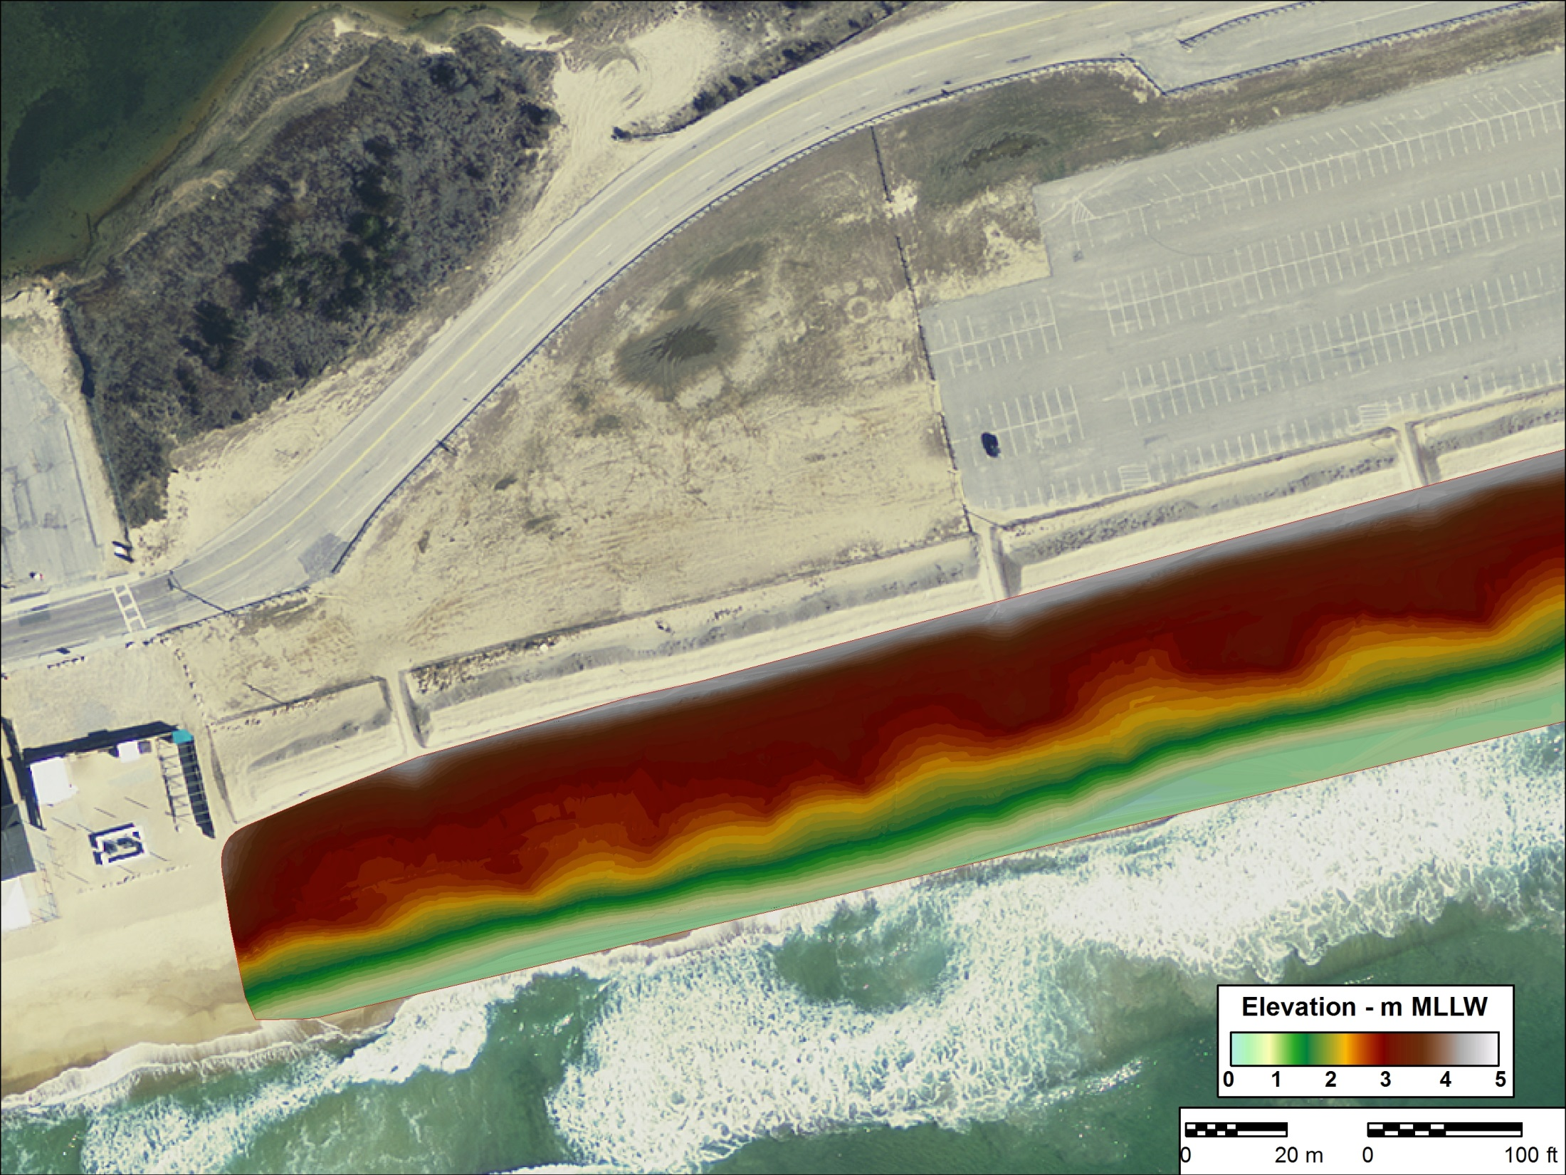
April 2015 Interpolated Surface

Slide 14
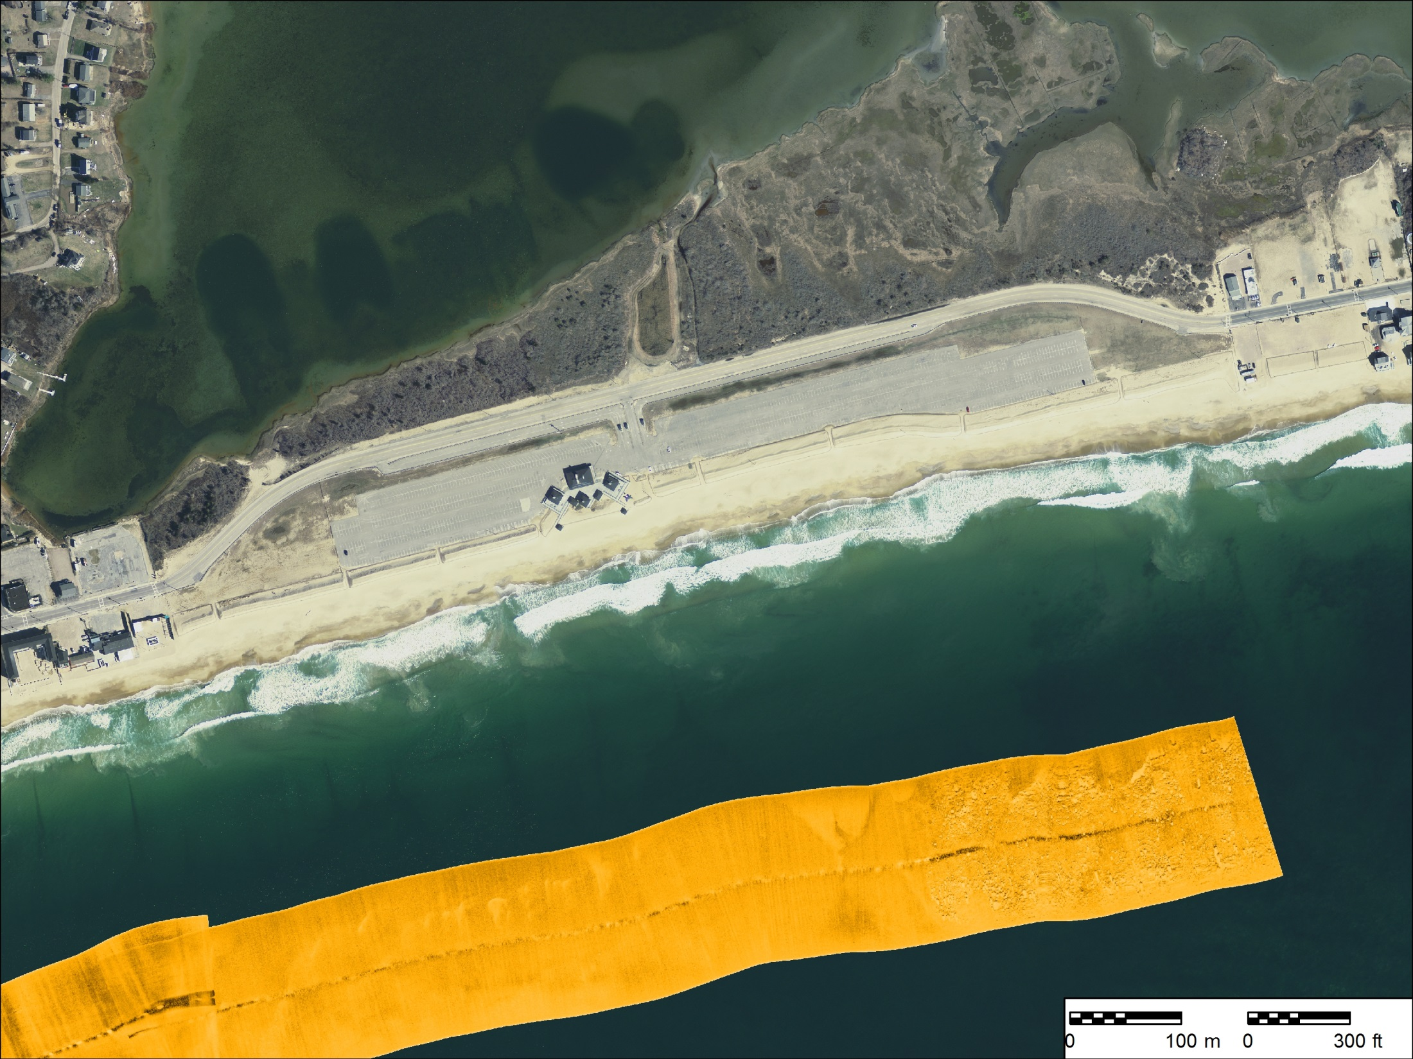
Side-scan sonar mapping of the shoreface (2015-2016)

Slide 15
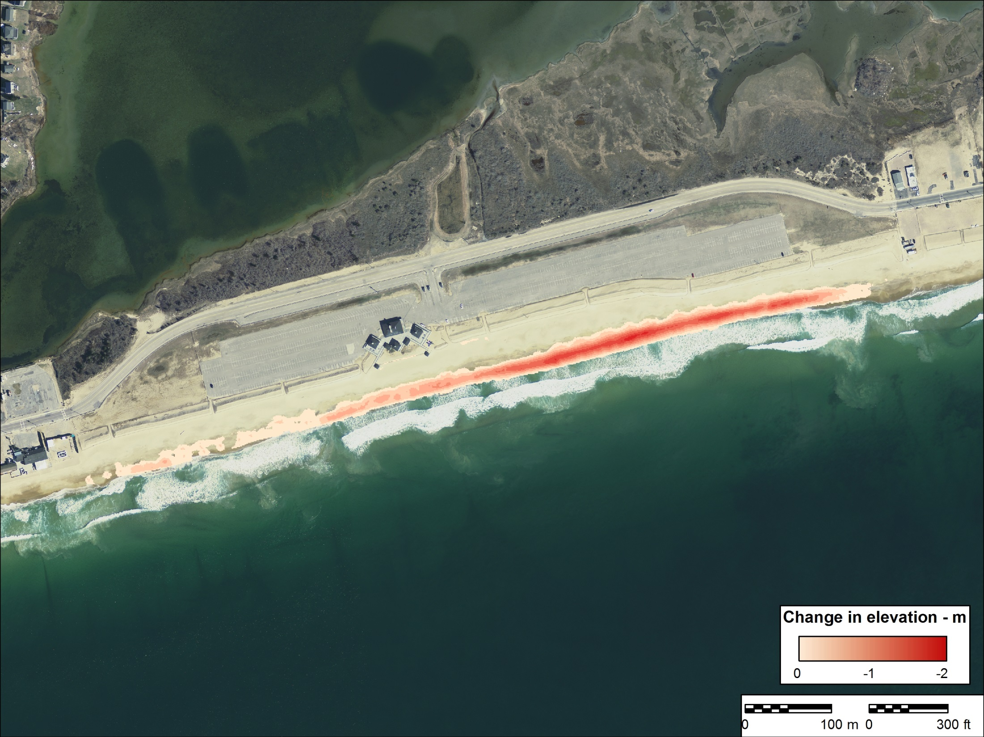
Results – RTK Topographic Surveys
Change in Berm Elevation: 30 May 2014 to 3 April 2015

Slide 16

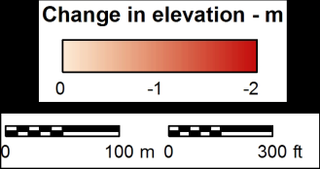
Elevation Change: May 2014 – September 2014
Berm Volume: -11,500 m³ (-18% of replenishment)
Elevation Change: May 2014 – April 2015
Berm Volume: -14,600 m³ (-23% of replenishment)

Slide 17
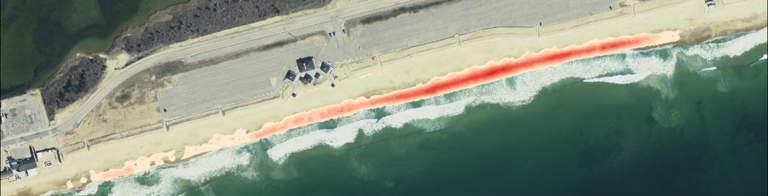
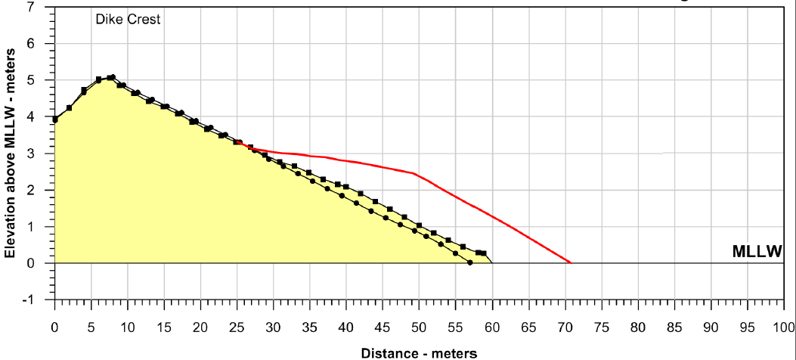
MSQ-SB Plotted Profile
April 2014 – April 2015
Post-Replenishment : 204 m³ m⁻¹
April 2014
162 m³ m⁻¹
April, 2015
168 m³ m⁻¹

Slide 18
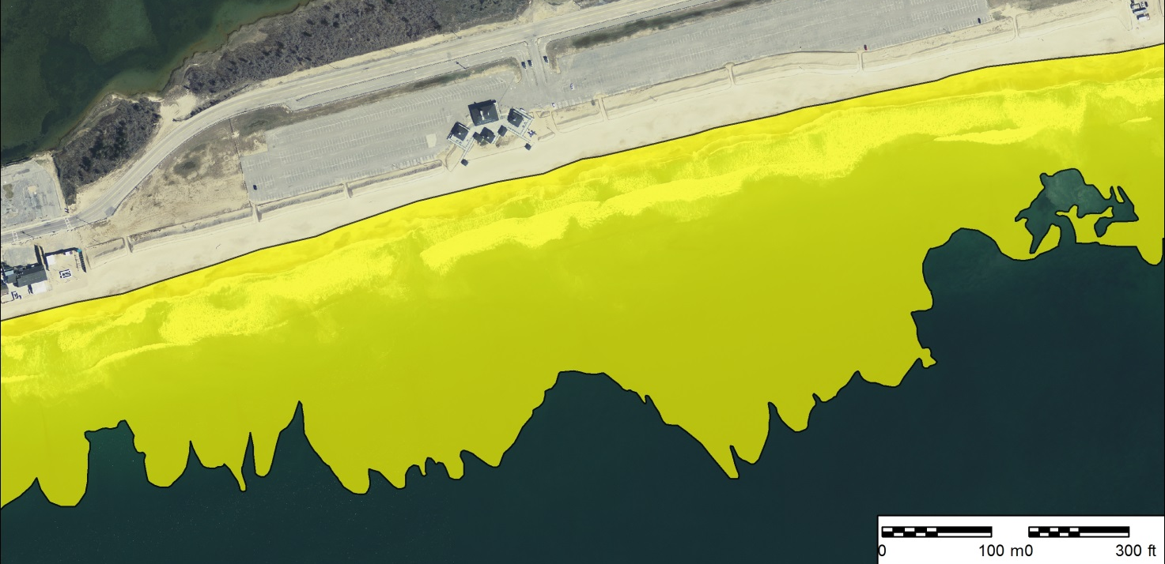
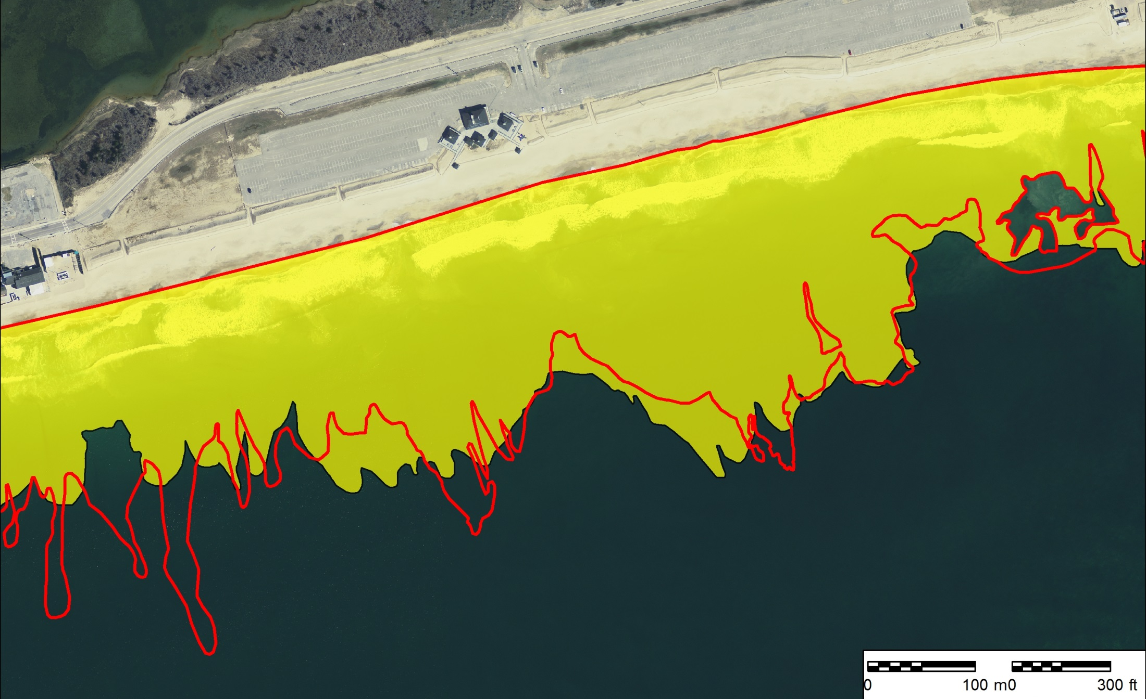
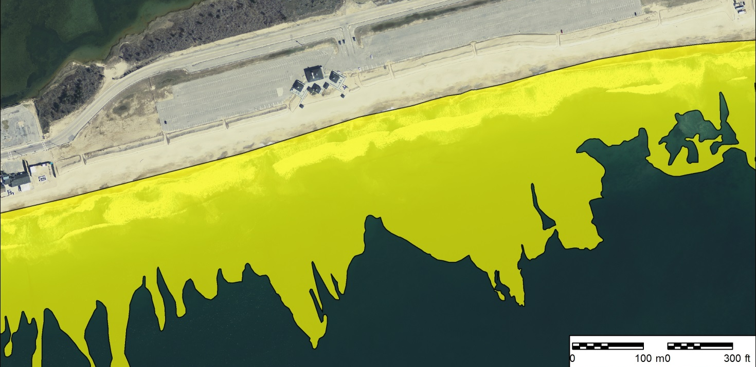
2015
SO WHERE DID THE SEDIMENT GO?
Mapped Extent of
Depositional Platform
Mapped Extent of Depositional Platform: 2008 - 2015
2015
289,000 m²
2008
2008
292,000 m²

Slide 19
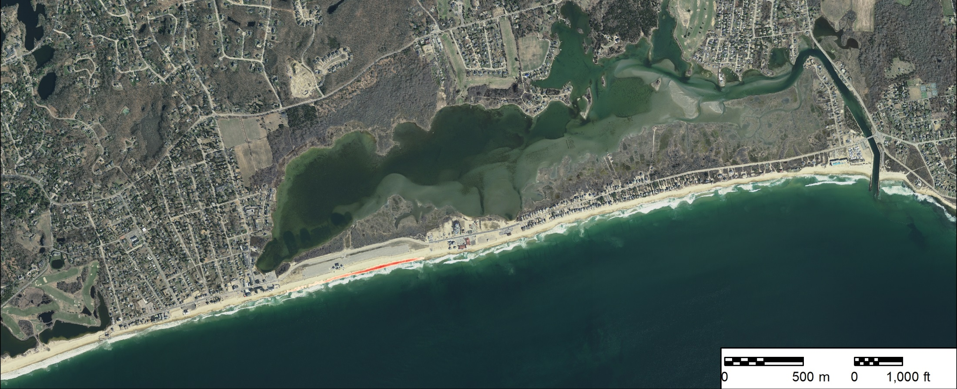
Alongshore transport
Transport by easterly swells (Summer ‘14)
Deposition of replenishment sand on flood tidal delta
Transport west by southwesterly ‘sea breeze’

Slide 20
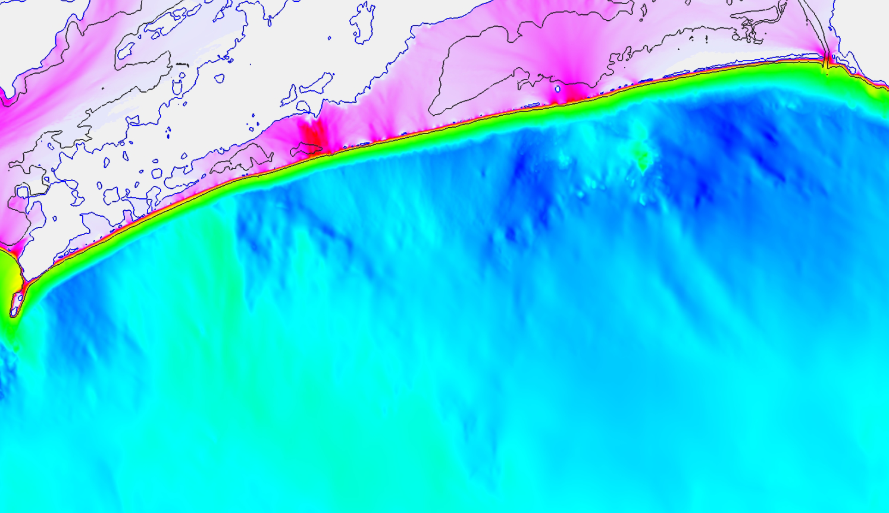
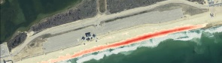

Modeled “1%” significant wave heights – Block Island Sound
Why the differential erosion…
Wave Height (Hs)
0 2 4 6 8
Grilli et al., 2015

Slide 21
Conclusions
~14,000 m³ have been eroded at MSQ-SB, representing 23% of the placed volume during the first 15 months of the project
Alongshore sediment transport has dominated this process
The importance of shoreface processes and local shoreline orientation should be considered when designing beach replenishment projects
With replenishment; ‘Go Big or Go Home’!

Slide 22
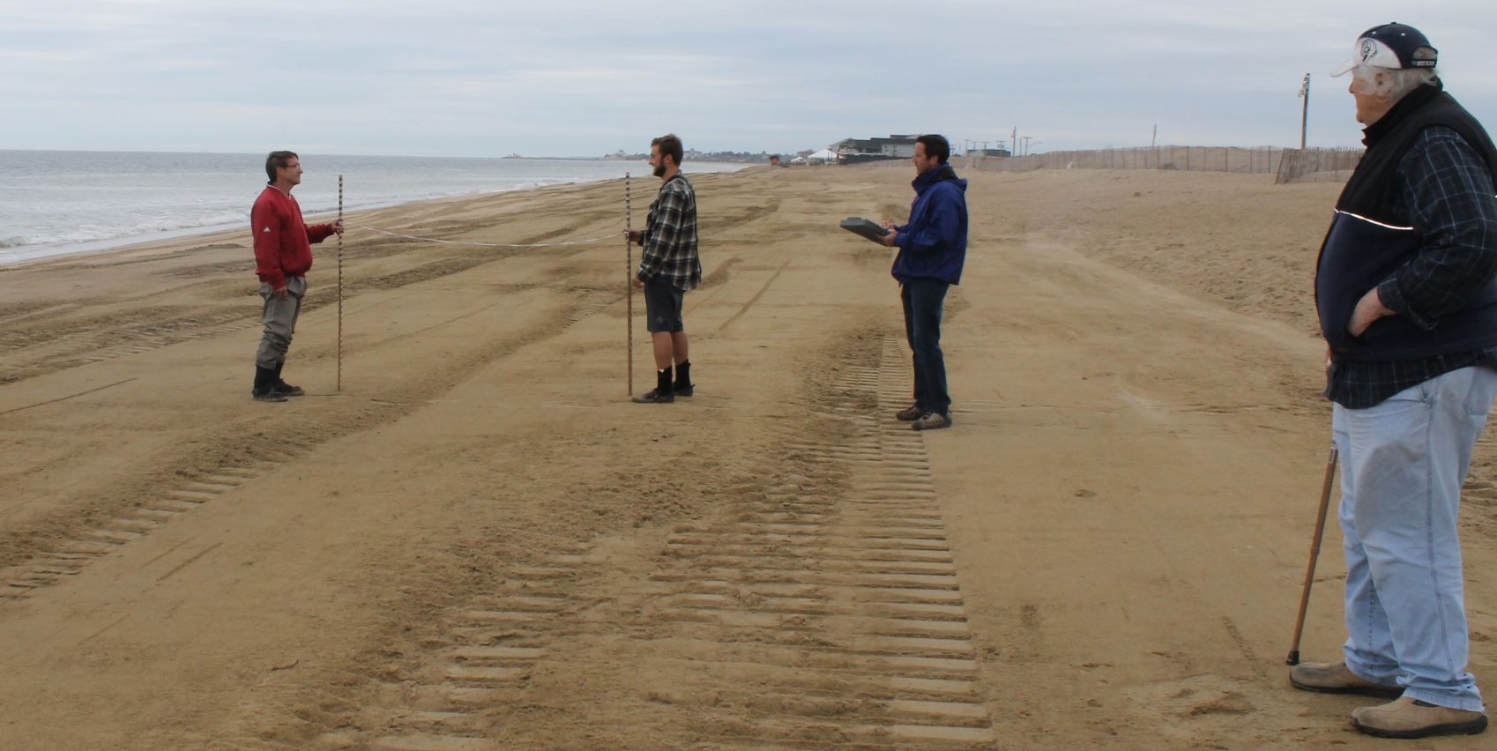
Thanks to:
Josh Bartosiewicz, Tim Ciskowski, Mike Manzi, Amber McDonald Cody Murphy, Brandan Sumeersarnauth (Eastern Undergraduates)
Greg Baribault, Rhode Island Coastal Resources Management Council
Dave Prescott, Save the Bay
Alan Comello (and staff), RI Dept. of Environmental Management
End of presentation

