Slide 1
The Challenges of Implementing and Sustaining Best Practices in the Data Lifecycle for Researchers and Repositories
Shelley Stall
Assistant Director, Enterprise Data Management Maturity, AGU sstall@agu.org
Brooks Hanson
Director, Publications bhanson@agu.org

Slide 2
Data Life Cycle
Planning
Proposals
Collection
Field, Lab,
Models
Refined Data Products
Publishing
Repositories
Re-use
Archive
Repositories

Slide 3
The Data World
High Quality Data Practices
Individual: Data Science Skills
Organizational Practices
Training; Education
Professional Certification
Data Standards
Data Management Processes
Align Publishers/Repositories
COPDESS.org

Slide 4
Overview
Programs at AGU around Data Management Maturity and Training
Progress in Aligning Repositories and Journals in the Earth and Space Sciences
(copdess.org cos.io/top)

Slide 5
Data Management Maturity
Designed to improve data management practices in repositories and institutions by communicating and aligning best practices for small or large data curation efforts.
Involves an assessment of data operations and management at a repository by experts applying a data management maturity framework.
We have partnered with CMMI to deliver and adopt their DMM framework to the Earth and space sciences

Slide 6
Key User Groups
Institutions
Industry
Large Data Facilities and Repositories
Small Data Facilities and Repositories
Research Teams/Projects
Individual Scientists—awareness of best practices
Notes:
The DMM is scalable to any user community.

Slide 7

DMMSM – Capability and Maturity
Capability – “We can do this”
  Specific Practices – “We’re doing it well”
  Work Products – “We’ve documented the processes we are following” (work products, templates, guidelines, standards, etc.)
Maturity – “….and we can prove it”
  Process Stability – “Solid as a rock”
  Ensures Repeatability – “We can replicate research”
    Policy
    Training
    Quality Assurance, etc.
Notes:
The assessment measures to aspects: Capability and Maturity.
Capability – What data management processes you are actually performing and to what level.
Maturity – The mechanisms in place to perform data processes consistently and with high quality.

Slide 9
Progress
Completed assessment of USGS ScienceBase
Working with WHOI BCO-DMO repository
Certified Assessor, Shelley Stall on AGU staff, and partnered with Jeff Gorball, Kingland Systems

Slide 10
Coalition on Publishing Data in the Earth and Space Sciences (COPDESS.org)
An organizational framework for Earth and space science publishers and data facilities to jointly implement and promote common policies and procedures for the publication and citation of data across Earth Science journals.
  Formed in October 2014
  Endorsed a Statement of Commitment, 2015
  2nd meeting October, 2015
  Developing joint best practices between journals and repositories.

Slide 11
Statement of Commitment
COPDESS.org
Reaffirm and ensure adherence to our existing journal and publishing policies…regarding data sharing are archiving...
Earth and space science data should, to the greatest extent possible, be stored in appropriate domain repositories that...follow leading practices, and can provide additional data services.
Released 15 January 2015. Article in Eos.org
Additional signatories welcome

Slide 12
More Actions
Promote referencing of data sets using the Force­11 data citation principles.
Promote and implement links to data sets in publications and corresponding links to journals in data facilities via persistent identifiers. Data sets should ideally be referenced using registered DOI’s.
Promote use of other relevant community permanent identifiers for samples (IGSN), researchers (ORCID), and funders and grants (FundRef).

Slide 13
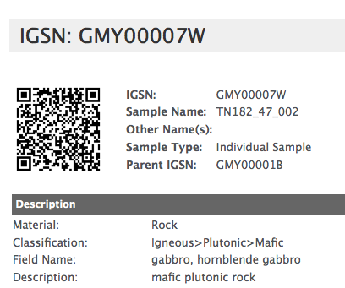
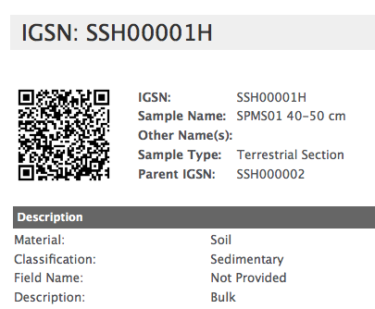
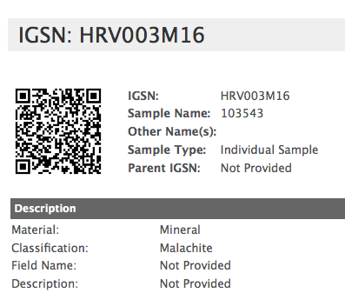
IGSN
Globally unique and persistent identifier for physical samples in the Earth Sciences
  guaranteed to be unique via a centralized control mechanism operated by IGSN e.V.
  resolves to virtual sample representations (sample metadata profiles) managed at federated IGSN Allocating Agents.

Slide 14
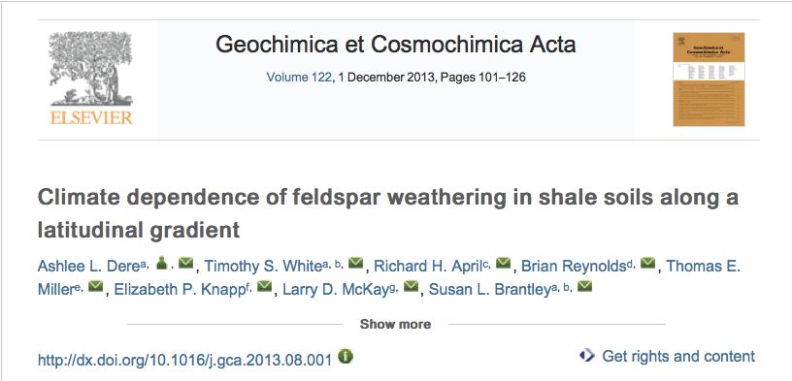
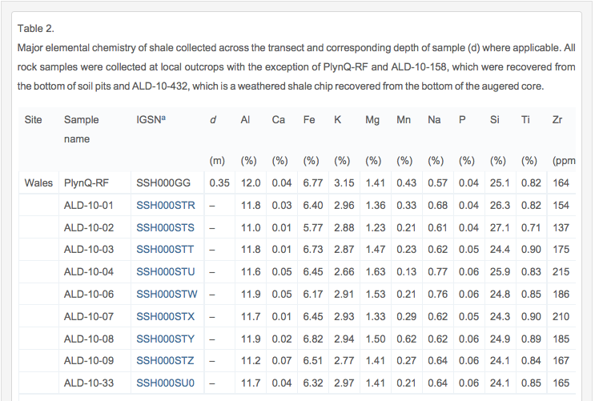
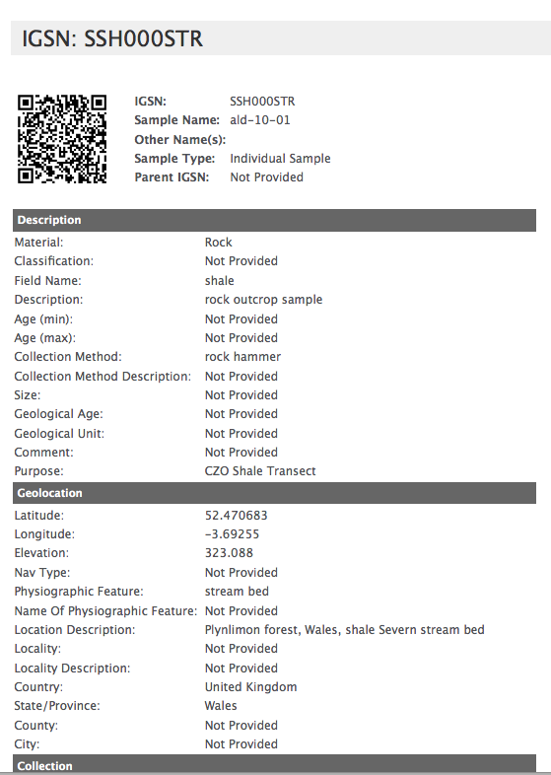
IGSN: Linking Samples, Data, & Publications
Data table in article
Sample profile at IGSN metadata store

Slide 15
Signatories as of October 15
American Astronomical Society
American Geophysical Union
American Meteorological Society
Biological and Chemical Oceanography Data Management Office, Woods Hole Oceangraphic Institution (BCO-DMO)
Center for Open Science
CLIVAR and Carbon Hydrographic Data Office (CCHDO)
Community Inventory of EarthCube Resources for Geosciences Interoperability (CINERGI)
Consortium of Universities for the Advancement of Hydrologic Science, Inc. (CUAHSI)
Continental Scientific Drilling Coordination Office (CSDCO)
COOPEUS
Copernicus Publications
Council of Data Facilities
Dryad
Elsevier
European Geosciences Union
Geochemical Society
Geological Data Center of Scripps Institution of Oceanography
Geological Society of America
Geological Society of London
ICSU World Data System
Incorporated Research Institutions for Seismology (IRIS)
Integrated Earth Data Applications (IEDA)
John Wiley and Sons
LacCore: National Lacustrine Core Facility
Magnetics Information Consortium (MagIC)
Mineralogical Society of America
Neotoma Paleoecology Database
National Snow and Ice Data Center
Nature Publishing Group
OpenTopography
Paleonotological Society
Proceedings of the National Academy of Sciences
Rolling Deck to Repository (R2R) Program
Science
Springer
UNAVCO

Slide 16














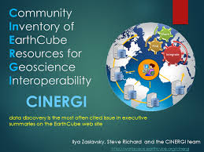




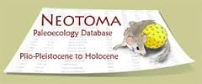
















Slide 17
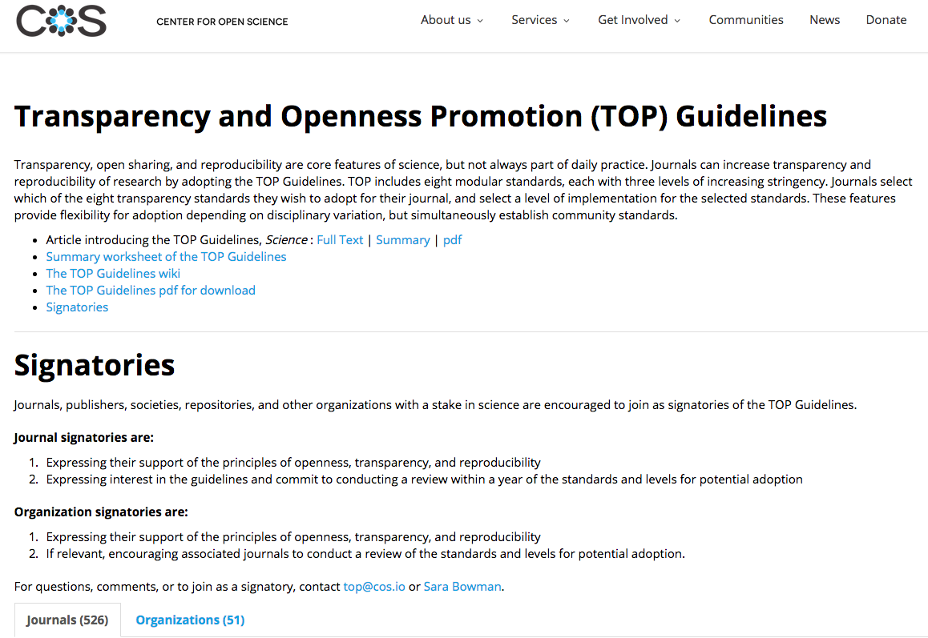
Cos.io/top

Slide 18
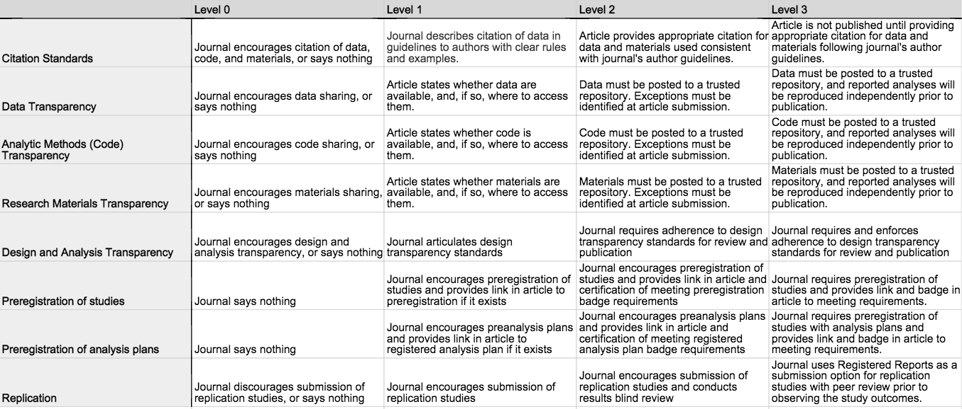
TOP Guidelines

Slide 19
Next Steps
Data Management Maturity assessments are available
Data courses available soon
COPDESS is expanding participation and developing best practices.
Data Fair and AGU Fall Meeting
Outcome of Field Reproducibility Conference is submitted.
Software Reproducibility Conference in February

