Slide 1
Introduction to the Integrated Multi-satellite Retrievals For GPM
(IMERG) Precipitation Datasets
George J. Huffman NASA/GSFC
The GPM Multi-Satellite Team
David T. Bolvin SSAI and NASA/GSFC
Dan Braithwaite Univ. of California Irvine
Kuolin Hsu Univ. of California Irvine
Robert Joyce Innovim and NOAA/NWS/CPC
Chris Kidd ESSIC and NASA/GSFC
Eric J. Nelkin SSAI and NASA/GSFC
Soroosh Sorooshian Univ. of California Irvine
Pingping Xie NOAA/NWS/CPC
Introduction
IMERG Design
Examples
Validation
Future
Final Comments

Slide 2
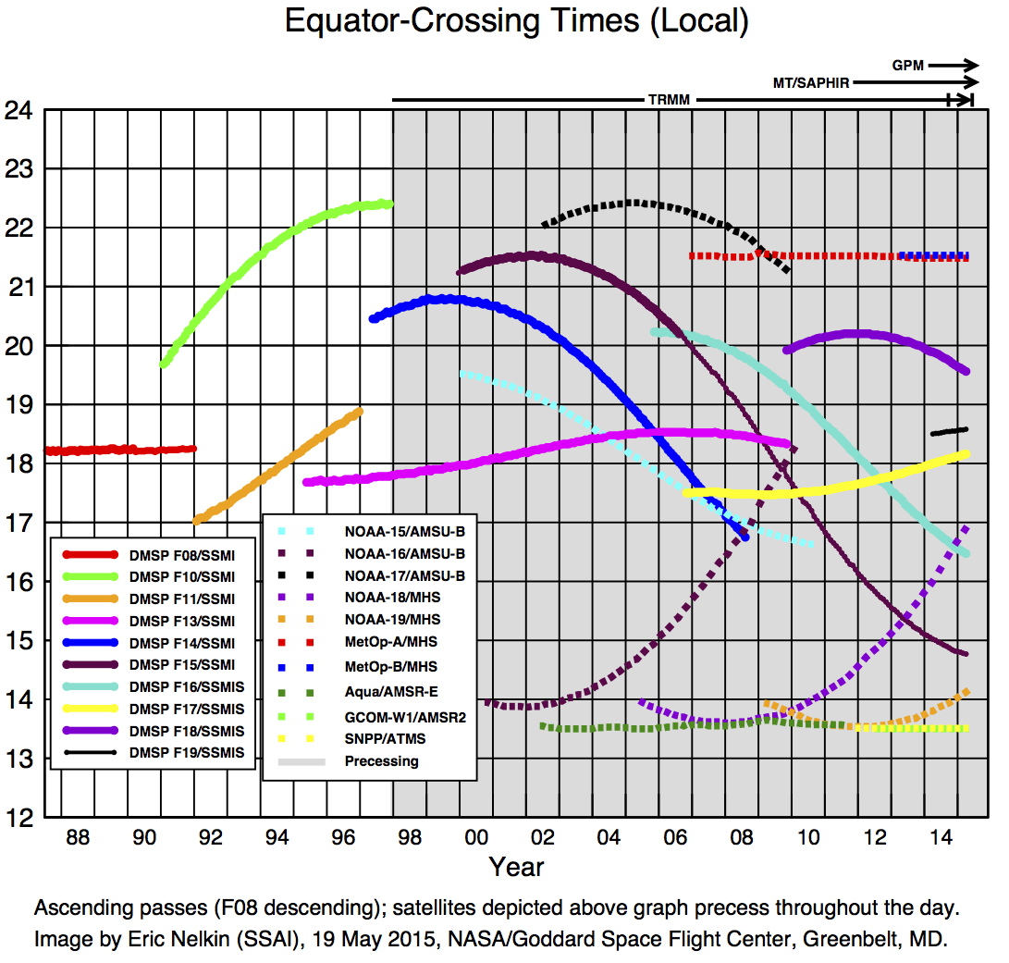
1. INTRODUCTION
A diverse, changing, uncoordinated set of input precip estimates
Goal: seek the longest, most detailed record of “global” precip
Integrated Multi-satellitE Retrievals for GPM (IMERG) is a High-Resolution Precipitation Product
• best snapshot precipitation
• not a Climate Data Record
IMERG is a unified U.S. algorithm that takes advantage of
• KF-CMORPH – NOAA
• PERSIAN-CCS – U.C. Irvine
• TMPA – NASA
• PPS production – NASA

Slide 3
2. IMERG Data Sets
Multiple runs accommodate different user requirements for latency and accuracy
• “Early” – 5(4) hours (flash flooding)
• “Late” – 16(12) hours (crop forecasting)
• “Final” – 3.5 months (research data)
Time intervals are half-hourly and monthly (Final only)
0.1° global CED grid
• PPS will provide subsetting by parameter and location
• initial release covers 60°N-S
User-oriented services
• interactive analysis (GIOVANNNI)
• alternate formats (KMZ, KML, TIFF WRF files, OpenDAP, …)
• area averages
 | Half-hourly data file (Early, Late, Final)
1 | [multi-sat.] precipitationCal
2 | [multi-sat.] precipitationUncal
3 | [multi-sat. precip] randomError
4 | [PMW] HQprecipitation
5 | [PMW] HQprecipSource [identifier]
6 | [PMW] HQobservationTime
7 | IRprecipitation
8 | IRkalmanFilterWeight
9 | probabilityLiquidPrecipitation [phase]
 | Monthly data file (Final)
1 | [sat.-gauge] precipitation
2 | [sat.-gauge precip] randomError
3 | GaugeRelativeWeighting
4 | probabilityLiquidPrecipitation [phase]
Notes:
3
Feasible latency for NRT a subject of study

Slide 4
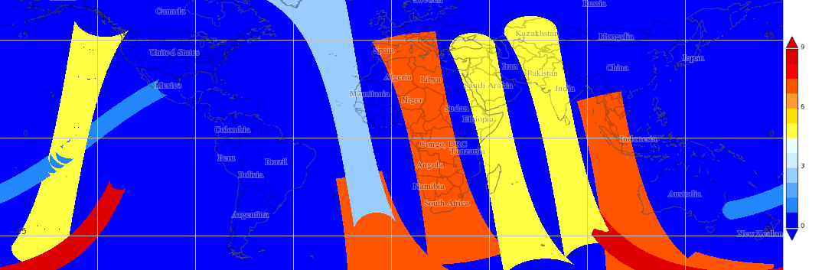
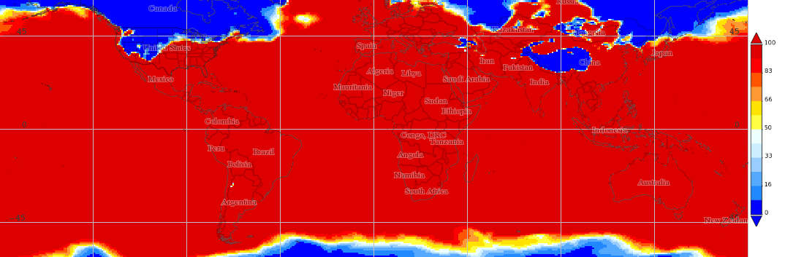
3. EXAMPLES – Data Fields from IMERG Test Data
1430-1500Z 3 April 2014
PMW sensor contributing the data,
selected as imager, then sounder, then closest to center time
AMSR2
TMI
SSMIS
GMI
MHS
probability that precipitation phase is liquid; diagnostic computed from ancillary data
[PMW] HQprecipSource [identifier]
probabilityLiquidPrecipitation [phase] (%)
Notes:
4
Top: Example half-hour coverage, with sensor names.
Bottom: “Diagnostic” means it doesn’t depend on the satellite data.

Slide 5
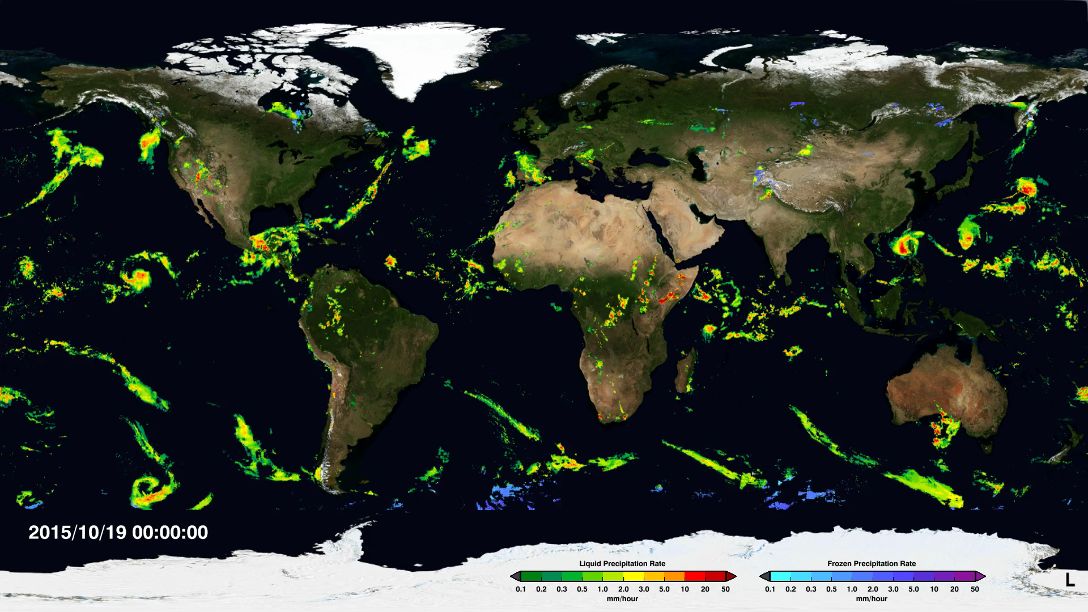
3. EXAMPLES – Recent Week of Early IMERG
Ending 151026 0630Z
[Courtesy Sci. Vis. Studio; http://svs.gsfc.nasa.gov/cgi-bin/details.cgi?aid=4285]
Notes:
5
Snow in blue colors

Slide 6
4. VALIDATION – Release Notes
“Day 1 IMERG Final Run Release Notes”
• an introduction and first cut at comparisons
• a living document
• http://pmm.nasa.gov/sites/default/files/document_files/ IMERG_FinalRun_Day1_release_notes.pdf
• this and all documents hot-linked on the IMERG data access page, accessible on the Level 3 tab on http://pmm.nasa.gov/data-access/downloads/gpm
• specific features, problems, behaviors
• effects due to IMERG’s structure
• cautions due to the input data
• biggest overall issue is that none of the inputs or IMERG are fully GPM-based
Notes:
6

Slide 7
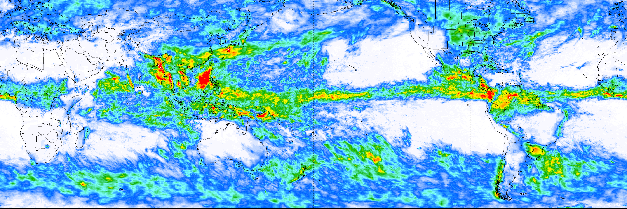
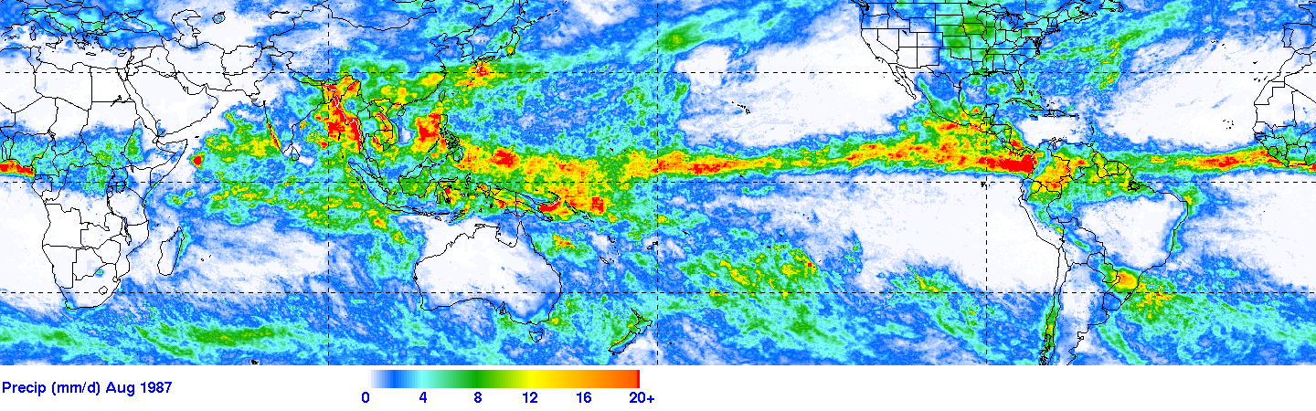
VALIDATION – IMERG Final Run vs. 3B43 for June 2014
Same input satellites, different algorithms, different calibrator
• 2BCMB vs. 2B31
Similar features, but not identical
• features (SPCZ)
• bias (ITCZ)
IMERG Final (mm/d) June 2014
TMPA 3B43 (mm/d) June 2014
Notes:
7
Dashed lines on IMERG show the 50°N,S limits of TMPA

Slide 8
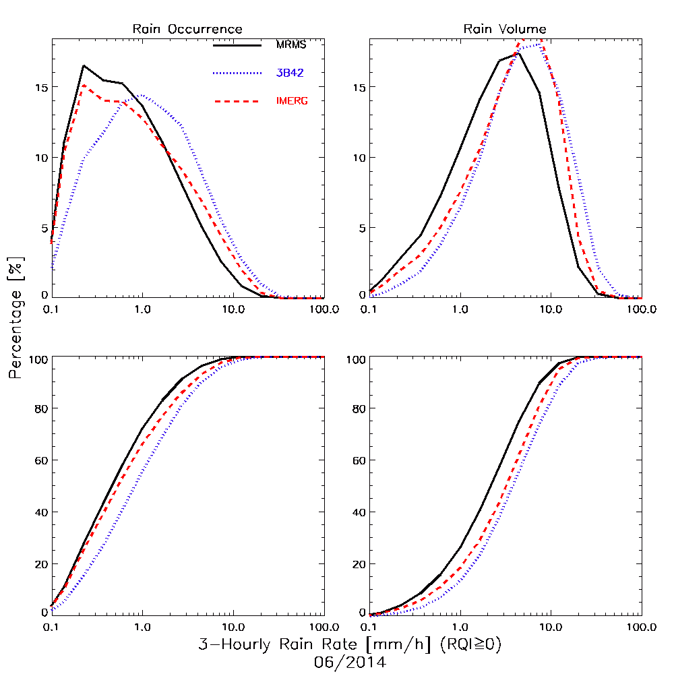
VALIDATION – 3-Hourly, 0.25° IMERG, 3B42, MRMS for 15 June 2014
IMERG better than 3B42 for precip occurrence
IMERG performs modestly better for precip volume
Note: Original footprint GPROF retrievals below 0.1 mm/hr are thresholded to zero
• how this affects IMERG depends on the resolution of the input sensor and subsequent averaging (here 0.25°)
[Courtesy J. Wang
(SSAI; NASA/GSFC 612)]
Notes:
8

Slide 9
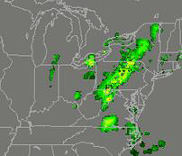
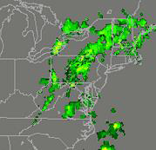
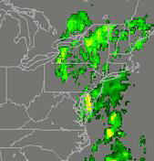
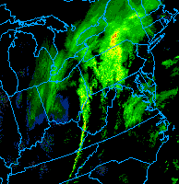
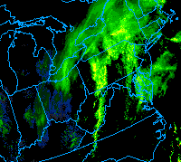
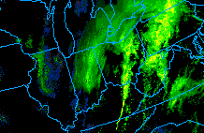
VALIDATION – Snow in IMERG, NWS WSR88D, 12 March 2014
IMERG converted to dBZ, WSR88D in dBZ; both original resolution
Hang-back line in radar missing in IMERG
2-5” of snow with near-blizzard conditions at Cleveland, Ohio around 1900 UTC
IMERG (dBZ)
1700 UTC
1800 UTC
1900 UTC
WSR88D (dBZ)
1700 UTC
1800 UTC
1900 UTC
[Courtesy B. Rose (Weather Channel)]
Notes:
9

Slide 10
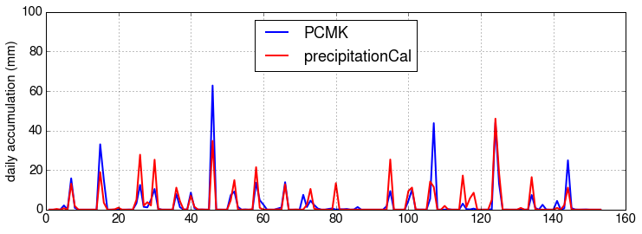
VALIDATION – Daily IMERG and Pocamoke Fine-Scale Grid, April-August 2014
20 surface gauges in a 6x5 km region near Wallops Island, Virginia
Excellent correlation for event occurrence (warm season)
Both over- and under-estimates for largest events
[Courtesy J. Tan (UMBC; WFF)]
Days after 1 April 2014
Notes:
10

Slide 11
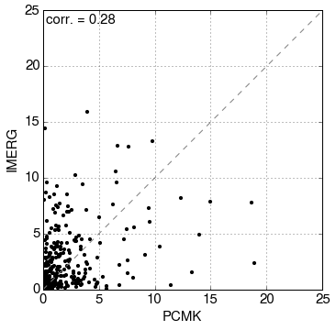
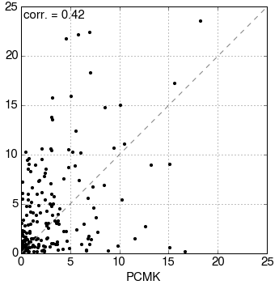
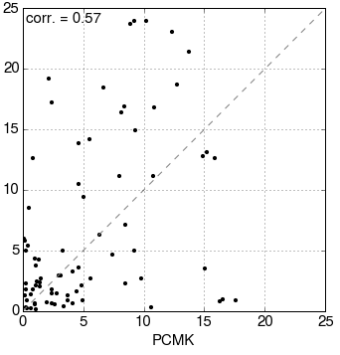
VALIDATION – Accumulations of IMERG and Pocomoke Fine-Scale Grid, April-August 2014
“Triangular distribution” is typical of fine-scale estimates
Time-averaging pulls points towards the 1:1 line
Improvement is slow and depends on events and selection of sensors
1-hour
3-hour
24-hour
[Courtesy J. Tan (UMBC; WFF)]
Notes:
11

Slide 12
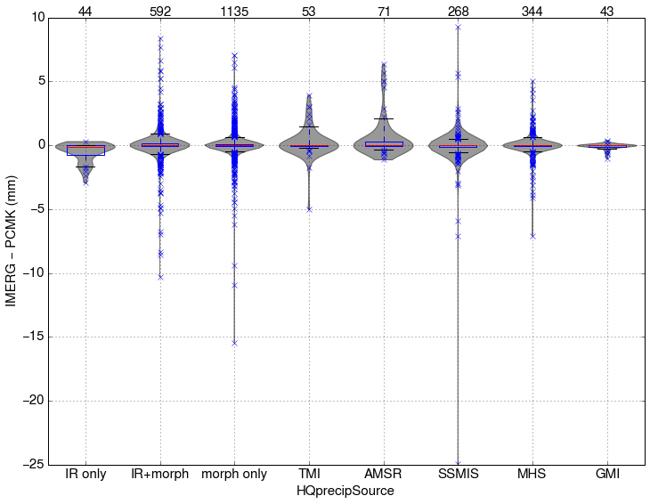
VALIDATION – Half-Hourly IMERG Sources and Pocamoke Fine-Scale Grid, April 2014 – March 2015
“Violin diagram” for individual sources of the half-hourly IMERG estimates
• width shows relative contribution for each difference bin
GMI is best; AMSR
and SSMIS less so
The extra scatter for
no-PMW (interpolated)
is partly driven by the
large number of cases
No-PMW (interpolated)
data are competitive
with the skill for most
of the sensors
Number of cases
[Courtesy J. Tan (UMBC; GSFC)]
Notes:
12
There’s a lot going on here, so you have to be succinct to avoid getting bogged down.
Not sure why AMSR is all positive, but the number o cases is small.
“No PMW” is mostly morphed interpolations, but perhaps also includes some IR. Jackson didn’t analyze that.

Slide 13
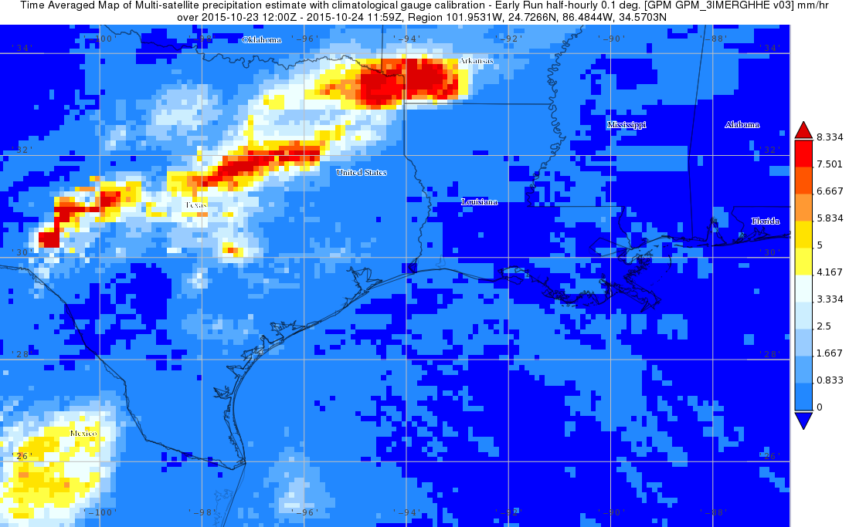
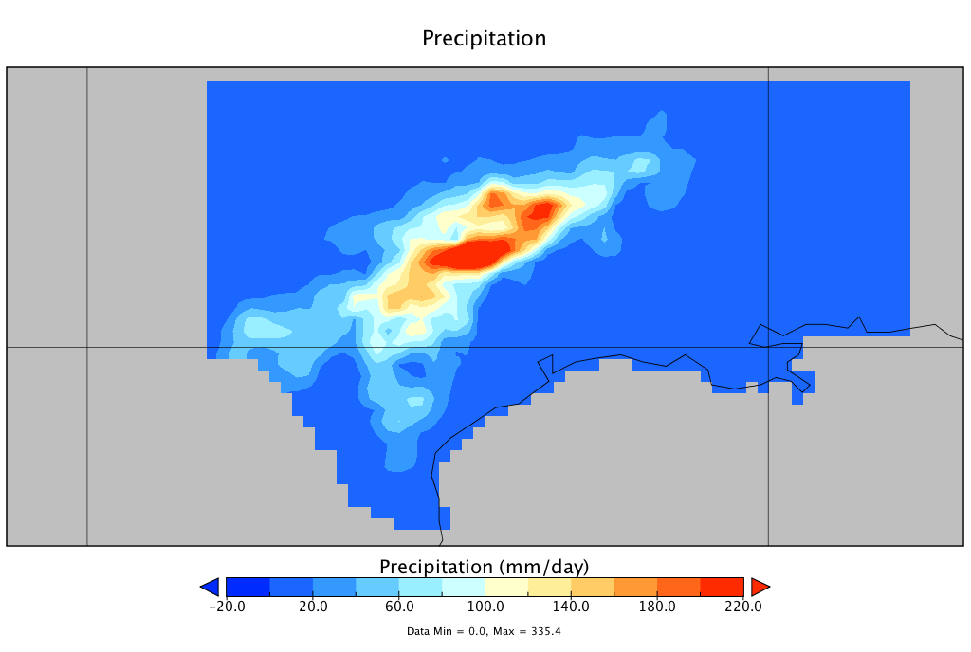
VALIDATION – Pre-Patricia Rains in Texas, 2015 October 23/12Z–24/12Z
IMERG Early Run
CPC Gauge Analysis
0 40 80 120 160 200 (mm/d)
0 40 80 120 160 200
General area of heavy rain is captured by IMERG, but extends further east and west
• are there sufficient gauge data to the west?
Notes:
13

Slide 14
5. FUTURE – Transitioning from TRMM to GPM
IMERG is available
• Final Run for mid-March 2014 to July 2015 and on-going
• Late Run from 7 March 2015
• Early Run from 1 April 2015
Spring 2016: first-generation GPM-based IMERG archive, March 2014–present
Early 2017: first “interim” TRMM/GPM-based IMERG archive, 1998–present
What happens to TMPA now that the TRMM satellite has de-orbited?
• PR products stopped 8 October 2014
• TMI was shut down 8 April 2015
• TMPA-RT uses climatological calibration, so continues to run “as is”
• production TMPA partly depends on PR for calibration
• production switches to climatological calibration with October 2014
• gauge calibration over land should continue to yield consistent results
• climatological calibration over ocean is likely to cause a discontinuity
• plan to continue TMPA into Spring 2017 to support users
• loss of server or legacy sounder estimates could raise issues
Notes:
14

Slide 15
5. FUTURE – The Big Challenges
Extending the analysis to the poles
Estimating the fine-scale errors
• then the grand challenge is aggregating the errors in space/time
Orographic enhancement
Precipitation system growth and decay
Accounting for differences in what different sensors “see”
Notes:
15

Slide 16

6. FINAL COMMENTS
The U.S. Day-1 GPM multi-satellite precipitation algorithm is constructed as a unified U.S. algorithm
IMERG is becoming available
• Final Run for mid-March to July 2015
• Late Run starts 7 March 2015
• Early Run starts 1April 2015
• GPM era reprocessed in Spring 2016
• TRMM-GPM eras reprocessed as “interim” in early 2017
• TMPA to be run until mid-2017
Even the Day-1 datasets are typically an improvement over TMPA
• There is no substitute for seeing how particular IMERG runs work for your application
george.j.huffman@nasa.gov
pmm.nasa.gov
Poster 296-4
Booth 162
Sorting Out the Variety of Precipitation Datasets
Notes:
16
The “Get Data” emblem is on a separate key-stroke.

Slide 17
Reserve Slides
Notes:
17

Slide 18
2. IMERG DESIGN – Processing
IMERG is a unified U.S. algorithm that takes advantage of
• Kalman Filter CMORPH (lagrangian time interpolation) – NOAA
• PERSIANN with Cloud Classification System (IR) – U.C. Irvine
• TMPA (inter-satellite calibration, gauge combination) – NASA
• all three have received PMM support
• PPS (input data assembly, processing environment) – NASA
The Japanese counterpart is GSMaP
Institutions are shown for
module origins, but
• package will be an integrated system
• goal is single code system appropriate for near-real and post-real time
• “the devil is in the details”
UC Irvine
GSFC
CPC
Compute even-odd IR files
(at CPC)
3
IR Image segmentation
feature extraction
patch classification
precip estimation
9
Receive/store
even-odd IR
files
1
Compute IR
displacement vectors
4
Build IR-PMW precip calibration
10
Import PMW data;
grid; calibrate; combine
2
Forward/backward
propagation
5
Recalibrate
precip rate
11
Import mon. gauge;
mon. sat.-gauge
combo.;
rescale short-interval
datasets to monthly
12
8
7
Apply Kalman
filter
Build Kalman
filter weights
Post-RT
RT
13
prototype6
Apply climo. cal.

