Slide 1
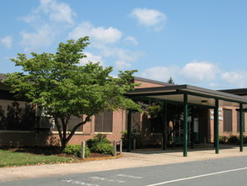
Integrating a cross-curricular approach to an Earth Science curriculum
FLANSBURG, Leah B.A.,
William Monroe High School
540 Monroe Dr., Stanardsville, VA 22973 lflansburg@greenecountyschools.com
Notes:
Move “William Monroe..” down to the next line so your name stands alone.

Slide 2
Earth Science Topics
Geology
Meteorology
Oceanography
Astronomy
Cross these with Fine Arts, Social Studies, Language & Literature
Other sciences and math is a given.
Notes:
I’ve changed the colors of the core topics to make them stand out a bit on the slide. This is purely a visual choice, so feel free to change it back or make them colors you think are more pleasing ☺
Also, left justify “Earth Science Topics” since all of your other slide titles are left justified.

Slide 3
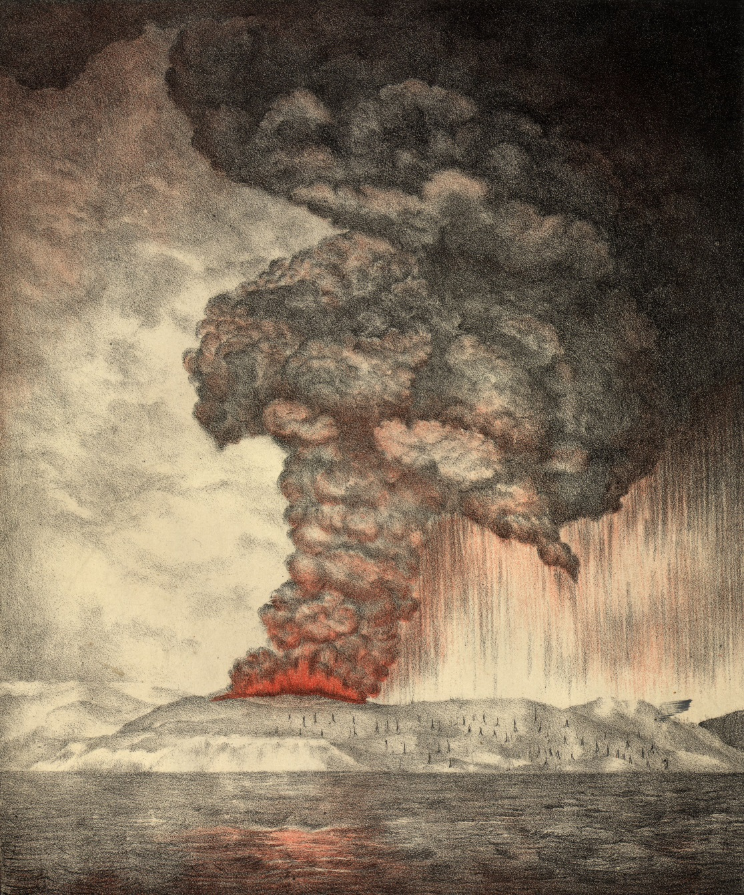
ART
Image 1
The eruption of Krakatoa May-August 1883
Notes:
I have removed the image source link and replaced it with “Image 1”. I realized that a lot of image links are lengthy so this will look cleaner. To compensate, I added a “Image References” slide for you at the end with the first three image links on there for you ☺

Slide 4
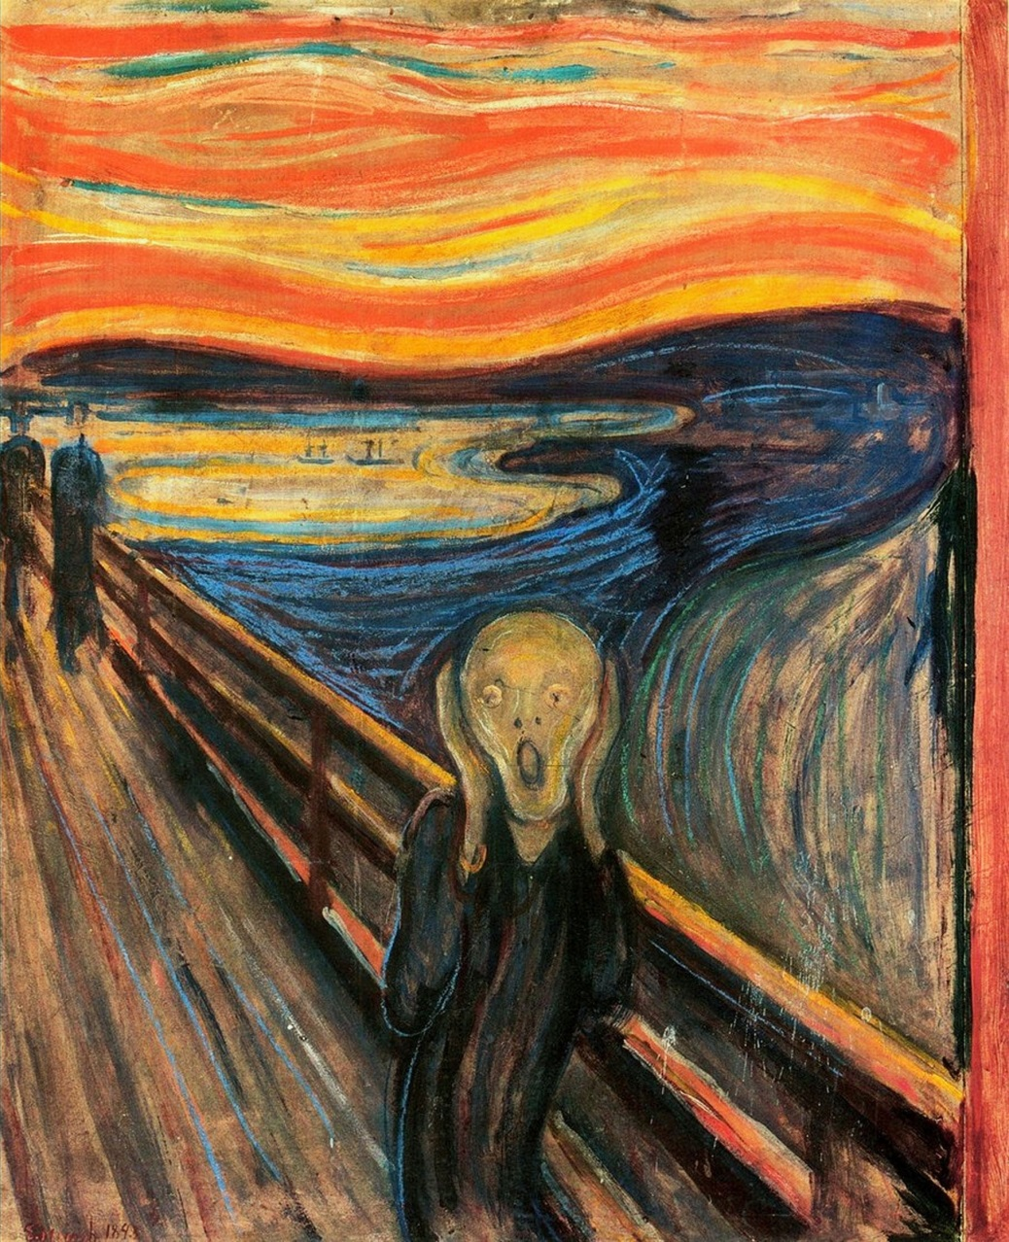
ART
Image 2
Image 2
Edvard Munch’s The Scream 1893
Inspired by the “blood-red” skies over Europe due to volcanic ash and gasses from the eruption of Krakatau in 1883
Notes:
I shrank the image somewhat so it wasn’t quite as distorted.
I also think this may be the “Van Gogh” version of the painting. Here is a link to the original by Munch: http://i.ytimg.com/vi/GHK-d7ToTOI/maxresdefault.jpg

Slide 5
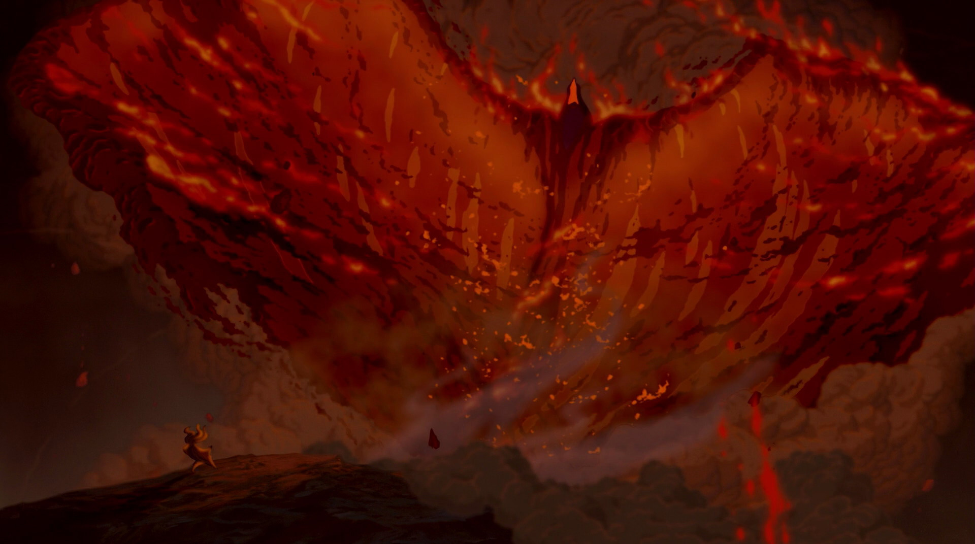
ART
Disney’s Fantasia 2000—”Firebird Suite”
Image 3
Notes:
Aligned picture to center.

Slide 6
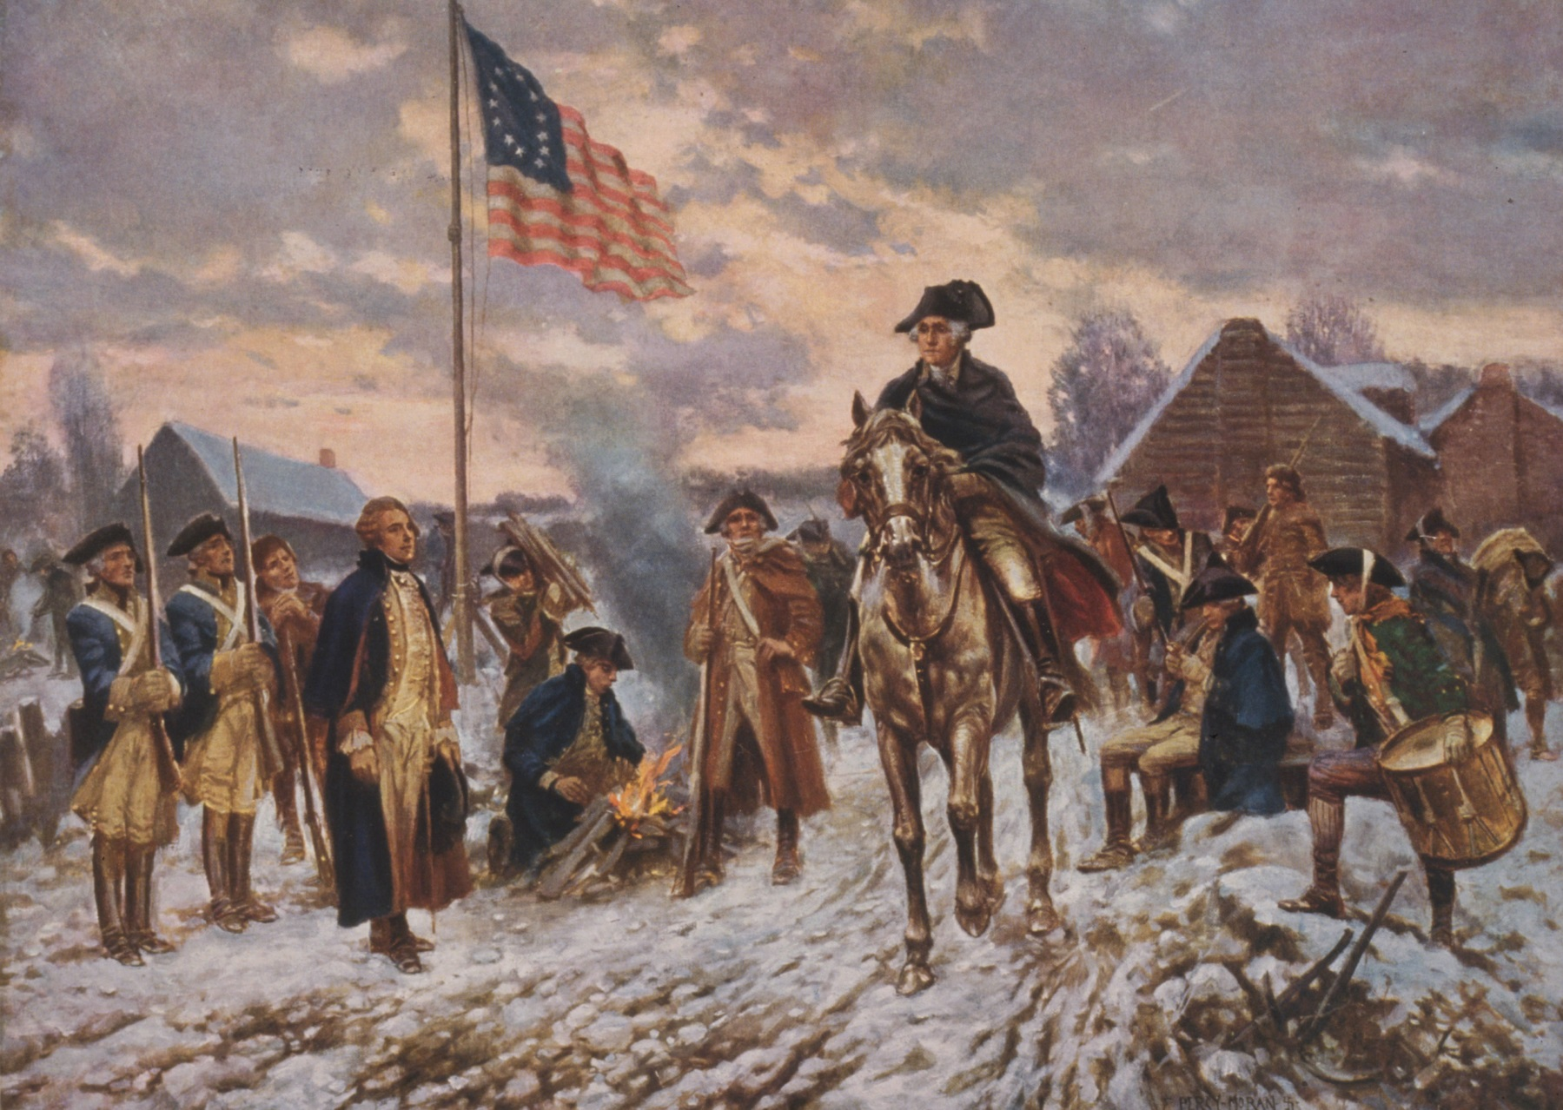
HISTORY
Image 4
Valley Forge—Winter 1777-1778 : Little Ice Age
Notes:
Aligned picture to center.
Also, this picture is very clear and easy to see! But, I think it’s from a video game (“Assassin's Creed”). Any paintings or sketches you could find?

Slide 7
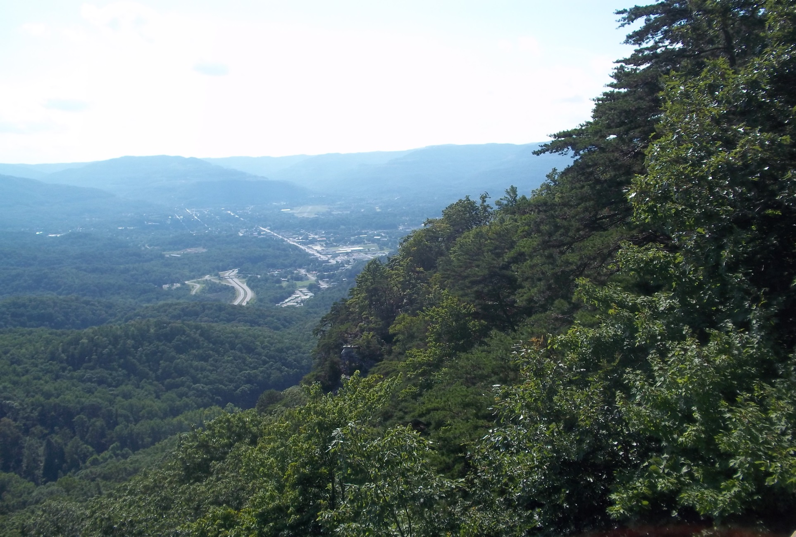
HISTORY
Cumberland Gap and the Middlesboro
Impact Crater (Kentucky)
Photo by L. Flansburg 08/03/2015 4:44 pm
Provided a prime settlement site for emigrants through the Cumberland Gap
Notes:
Created a separate textbox for “Cumberland Gap…” so that it could be on the picture.

Slide 8
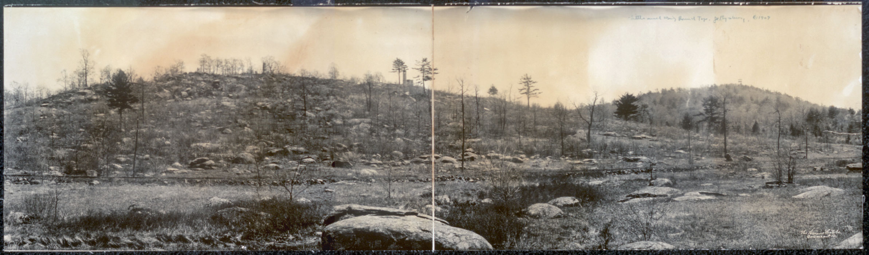
Little Round Top Battle of Gettysburg July 2, 1863
HISTORY
Image 5
Notes:
Aligned picture to center
Took out “Geology of”

Slide 9
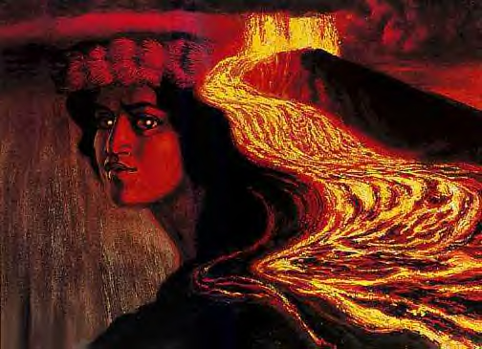
Culture & Religion
No Kahiki mai ka wahine’o Pele,
Mai ka ‘aina mai o Polapola
Mai ka punohu a Kane
Mai ke ao lapa i ka lani.
Translation:
The woman Pele comes from Kahiki
From the land of Polapola
From the rising mist of Kane
From the clouds that move in the sky.
http://www.mythicalrealm.com/legends/pele.html
Image 6
The Hawaiian volcano goddess Pele Artist: Herb Kawainui Kane

Slide 10
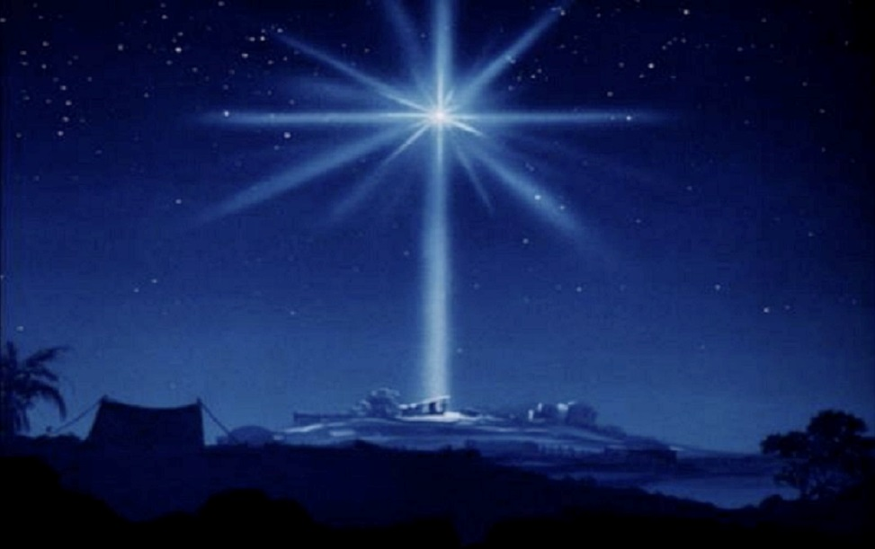
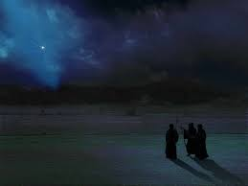
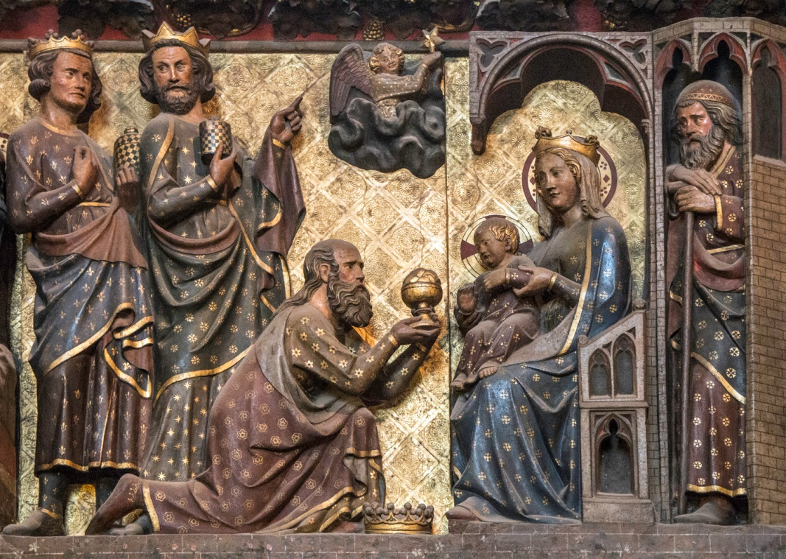
Culture & Religion
The Star of Bethlehem
Image 7
Image 8
Image 9
Notes:
“Culture & Religion” to be consistent.
This was the slide that convinced me to do the “Image References” slide at the end, to make it look cleaner.

Slide 11

Author: Mary Shelly
Culture & Religion
1816
"Year Without a Summer“
The 1815 eruption of Mount Tambora
Image 10

Slide 12
The Project Objectives (Higher-level critical thinking skills)
Examine the relationships between a geoscience event , period of earth history, or discoveries and its influence on the course of human history or its affect on the human condition
Design a poster presentation discussing these relationships
Develop a PowerPoint presentation to illustrate the relationships
Notes:
Great!

Slide 13
Methods
Create a poster illustration on how your assigned geoscience event affected the nature of human existence, either in a specific region or globally, in terms of
culture (art, music, drama, literature, general education of the masses, politics, social interactions, religion)
health
agriculture
natural resources
science
global exploration
technology
any other effect on the human condition that changed the course of history

Slide 14
Methods
2. Develop a PowerPoint of how your specific geoscience event influenced the human condition through pictures, data, historical accounts/memoires, literature, music.
Notes:
Any image you could add to spruce this up? Not necessary though.

Slide 15
Guidelines
Posters
Neat, easily readable from the back of the room
Organized, concise, thorough
PowerPoint
At least one slide to example/ illustrate/describe each affect stated on poster
You will use your poster information to discuss/describe what each slide shows
As few words on slide as possible

Slide 16
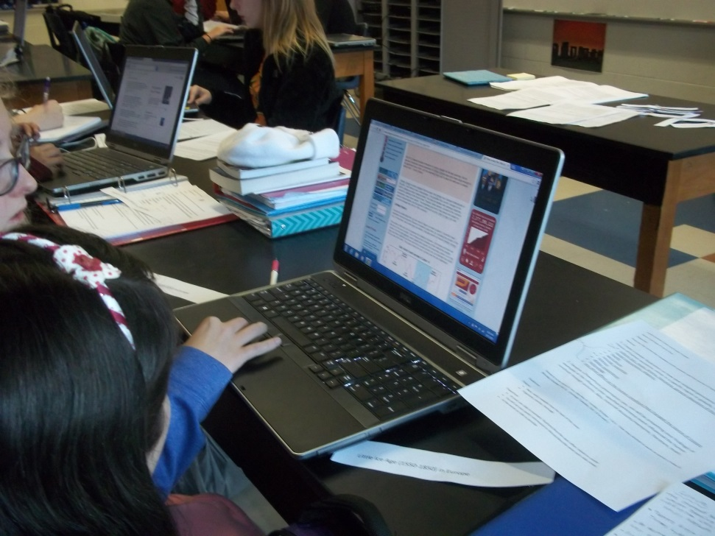
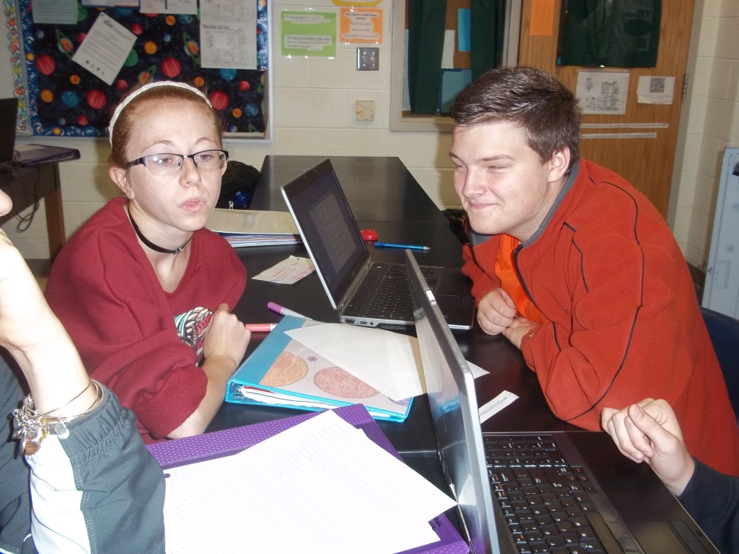
Student Internet Research

Slide 17
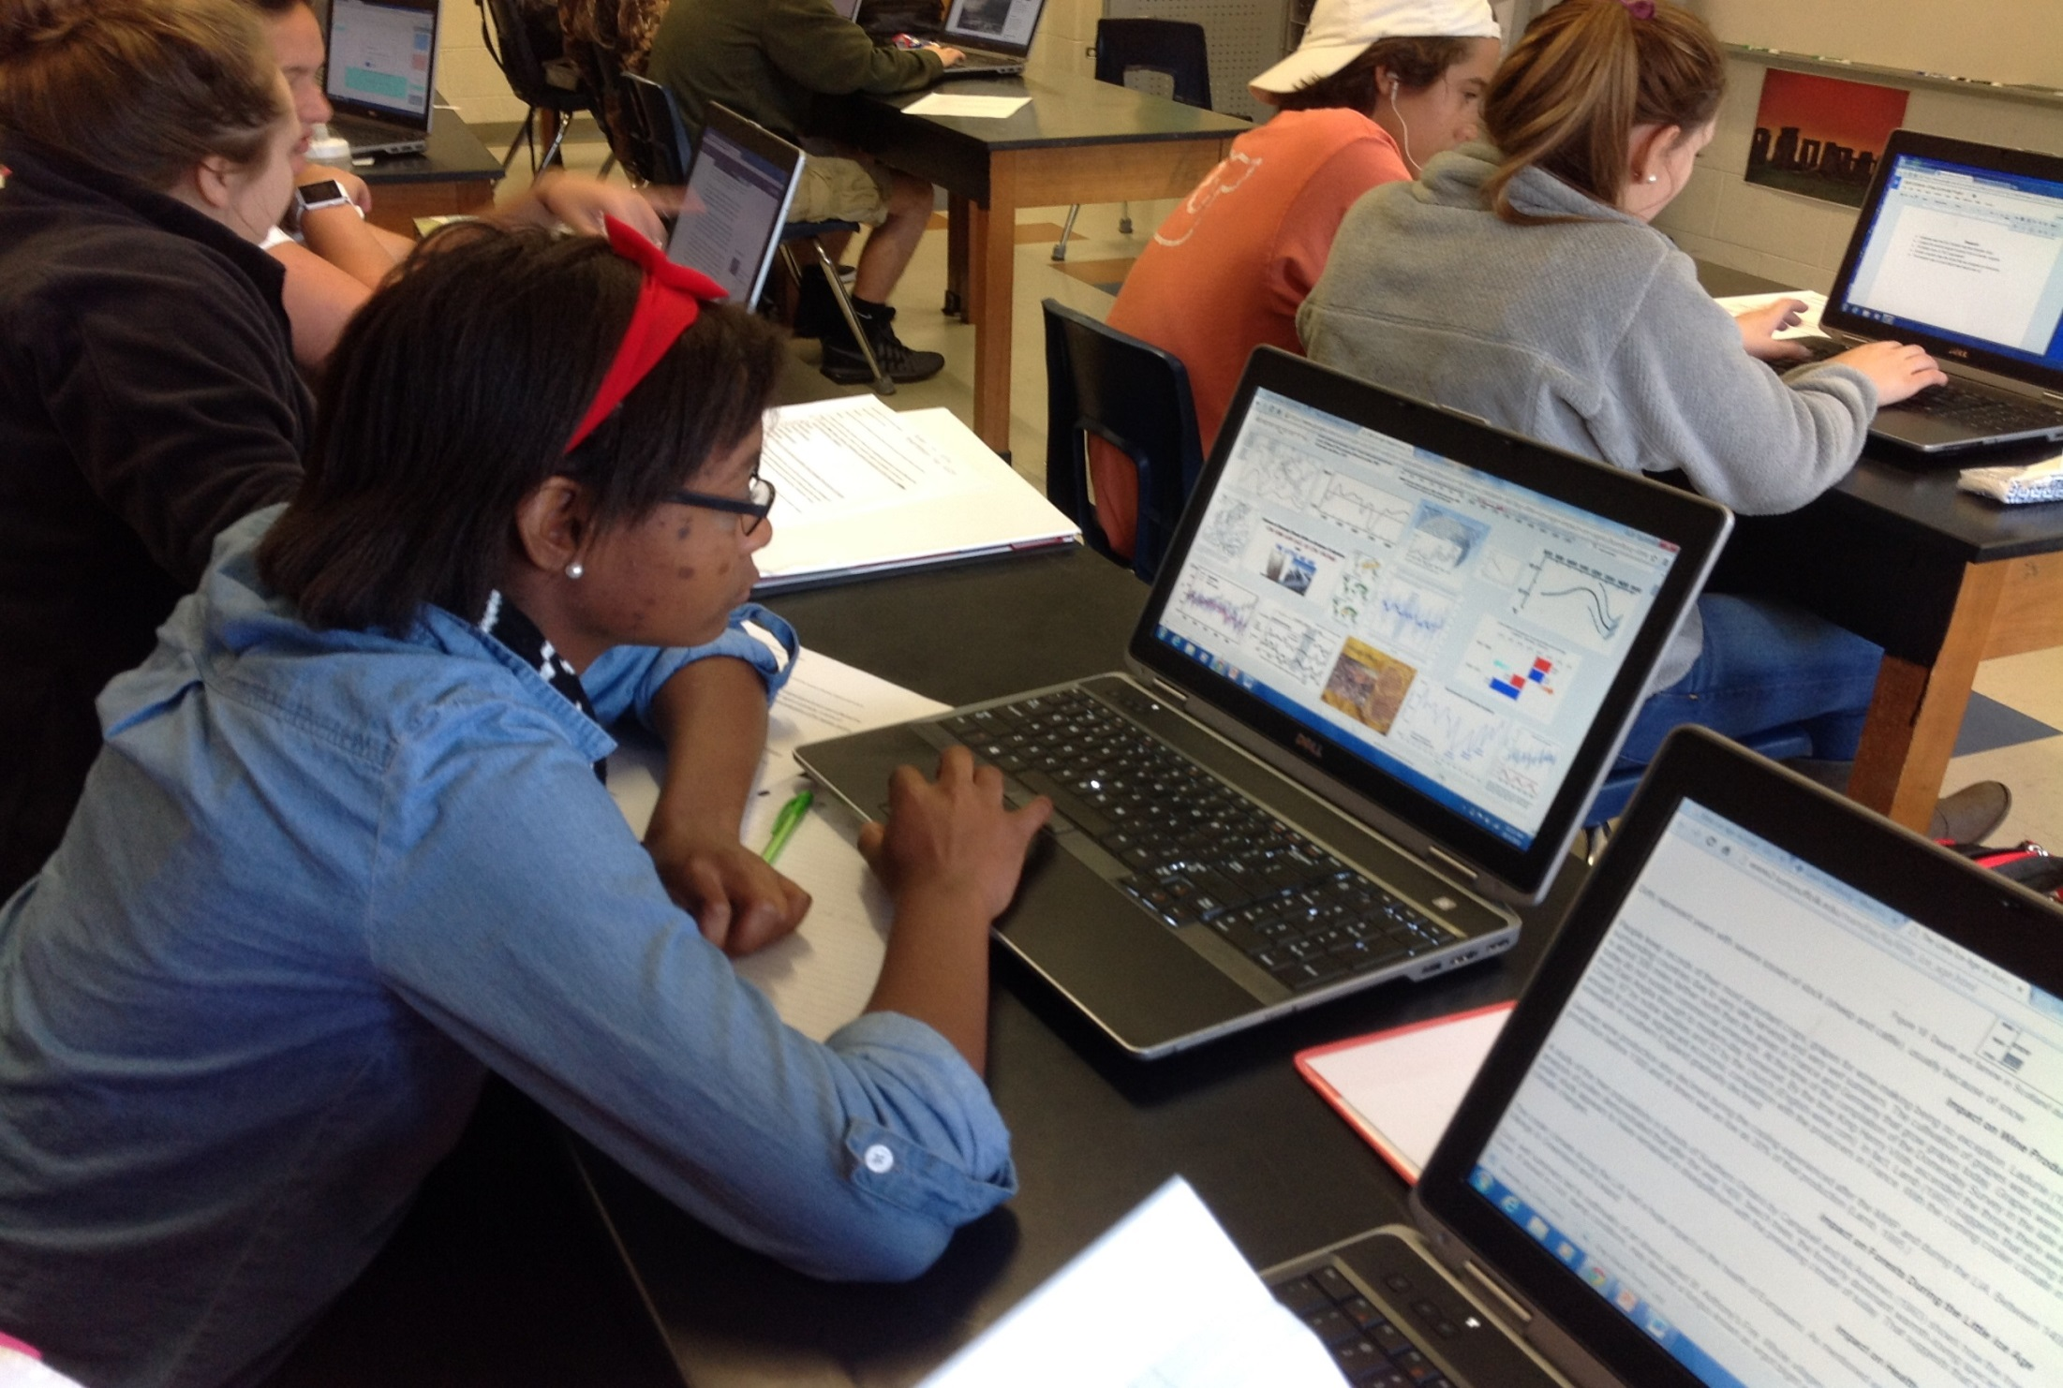
Student Internet Research

Slide 18
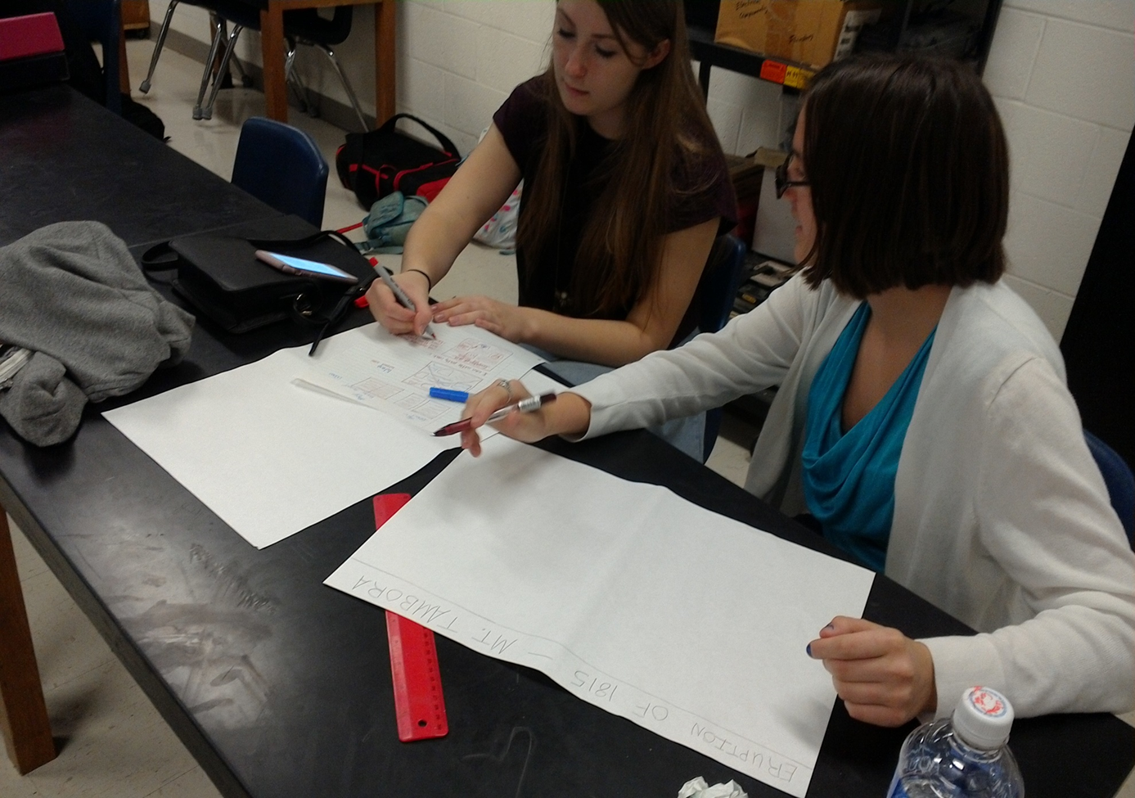
Students Collaborate on their Posters

Slide 19
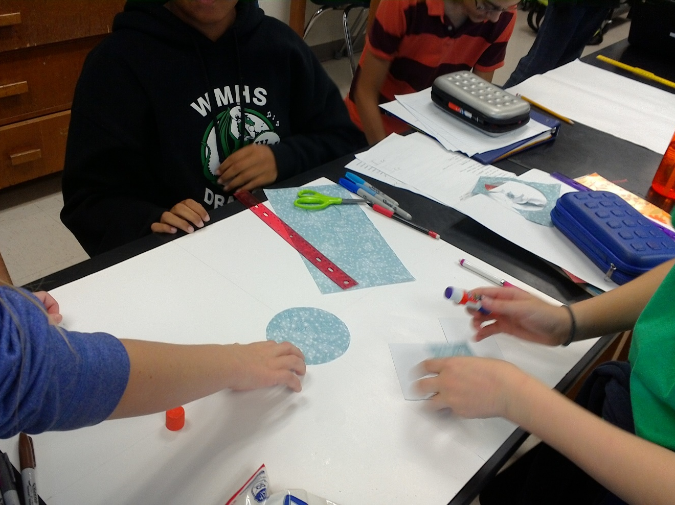
Students Work on their Posters

Slide 20
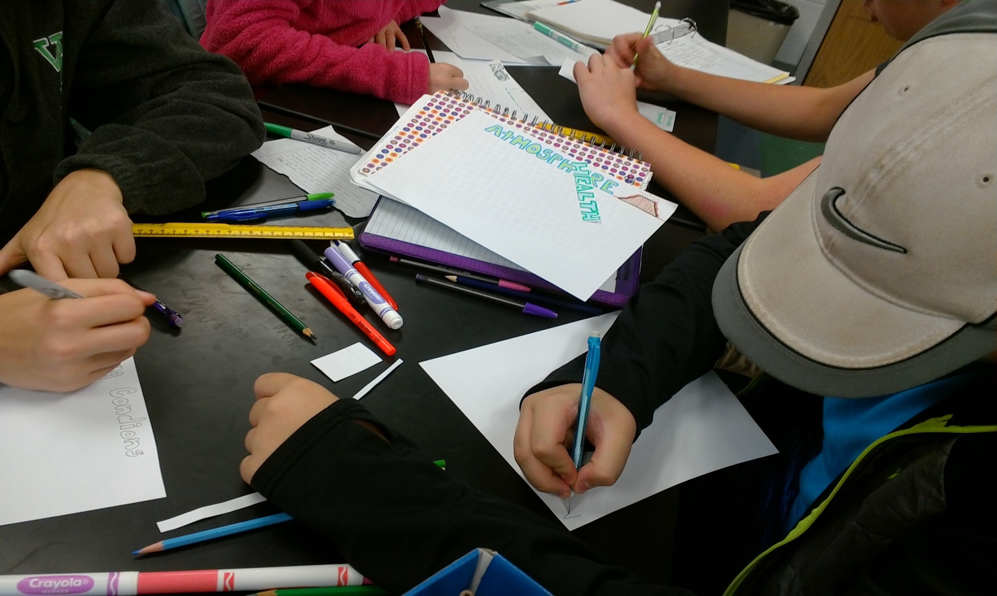
Students Work on their Posters

Slide 21
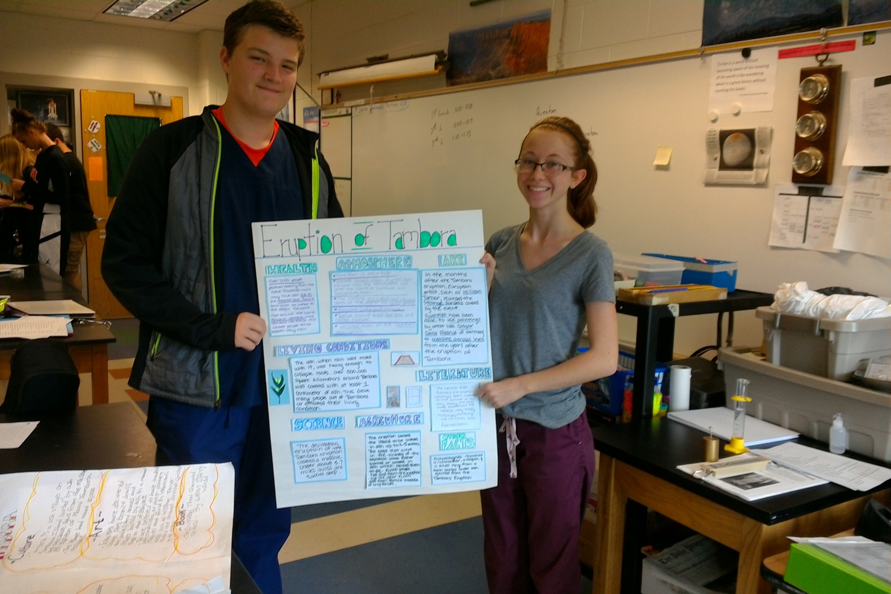
Students Proud of their Work
Notes:
Students Proud of Their Work (no apostrophe is needed)

Slide 22
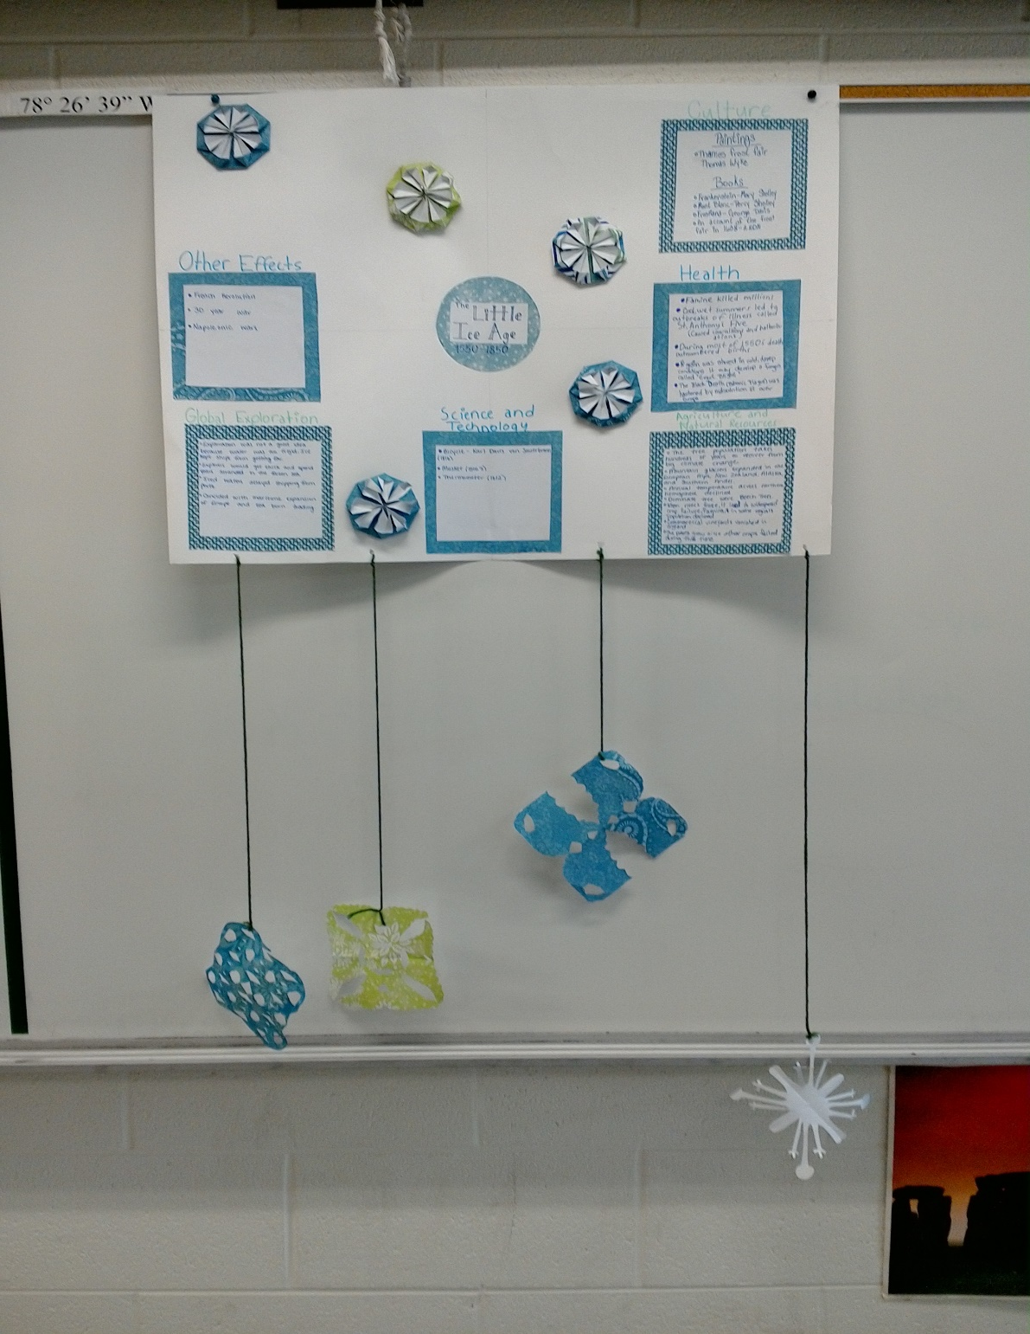
Creativity

Slide 23
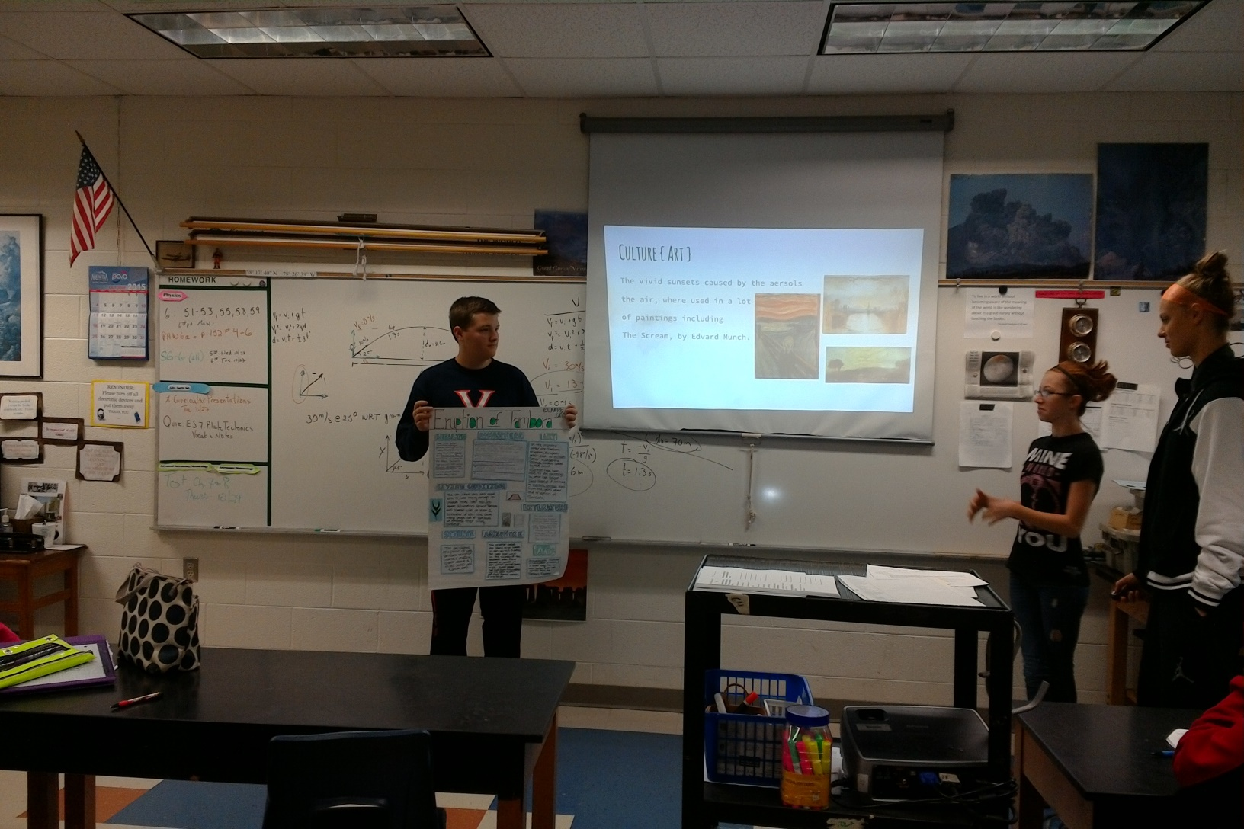
Presentations

Slide 24
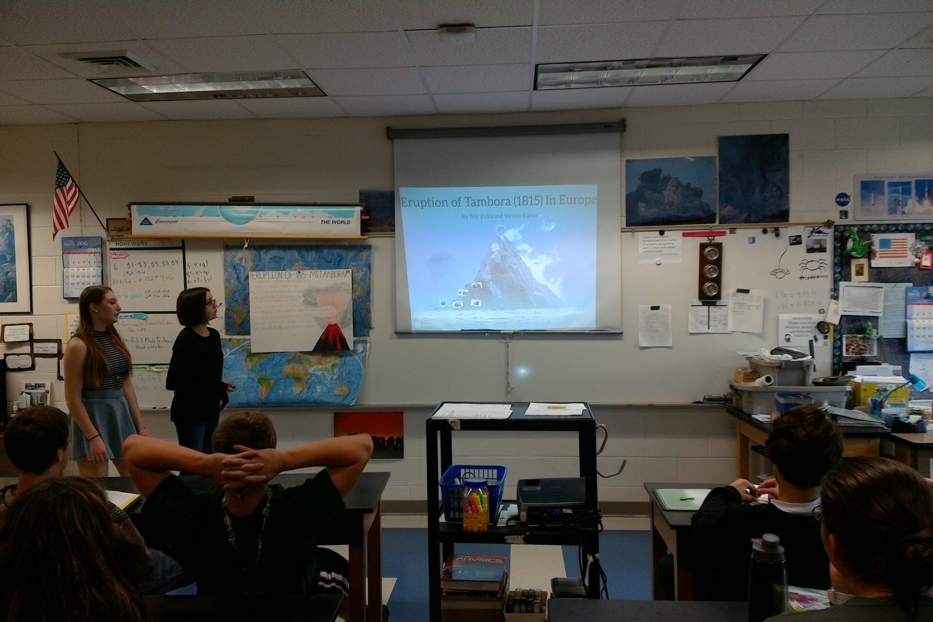
Presentations

Slide 25
Other Methods to Engage Students
Stories
Poems
Art work
Skits
Songs

Slide 26
Implementation Setbacks
Time
Standardized testing limitations
Acceptance
Extra work and planning
Resources
Student resistance/confusion

Slide 27
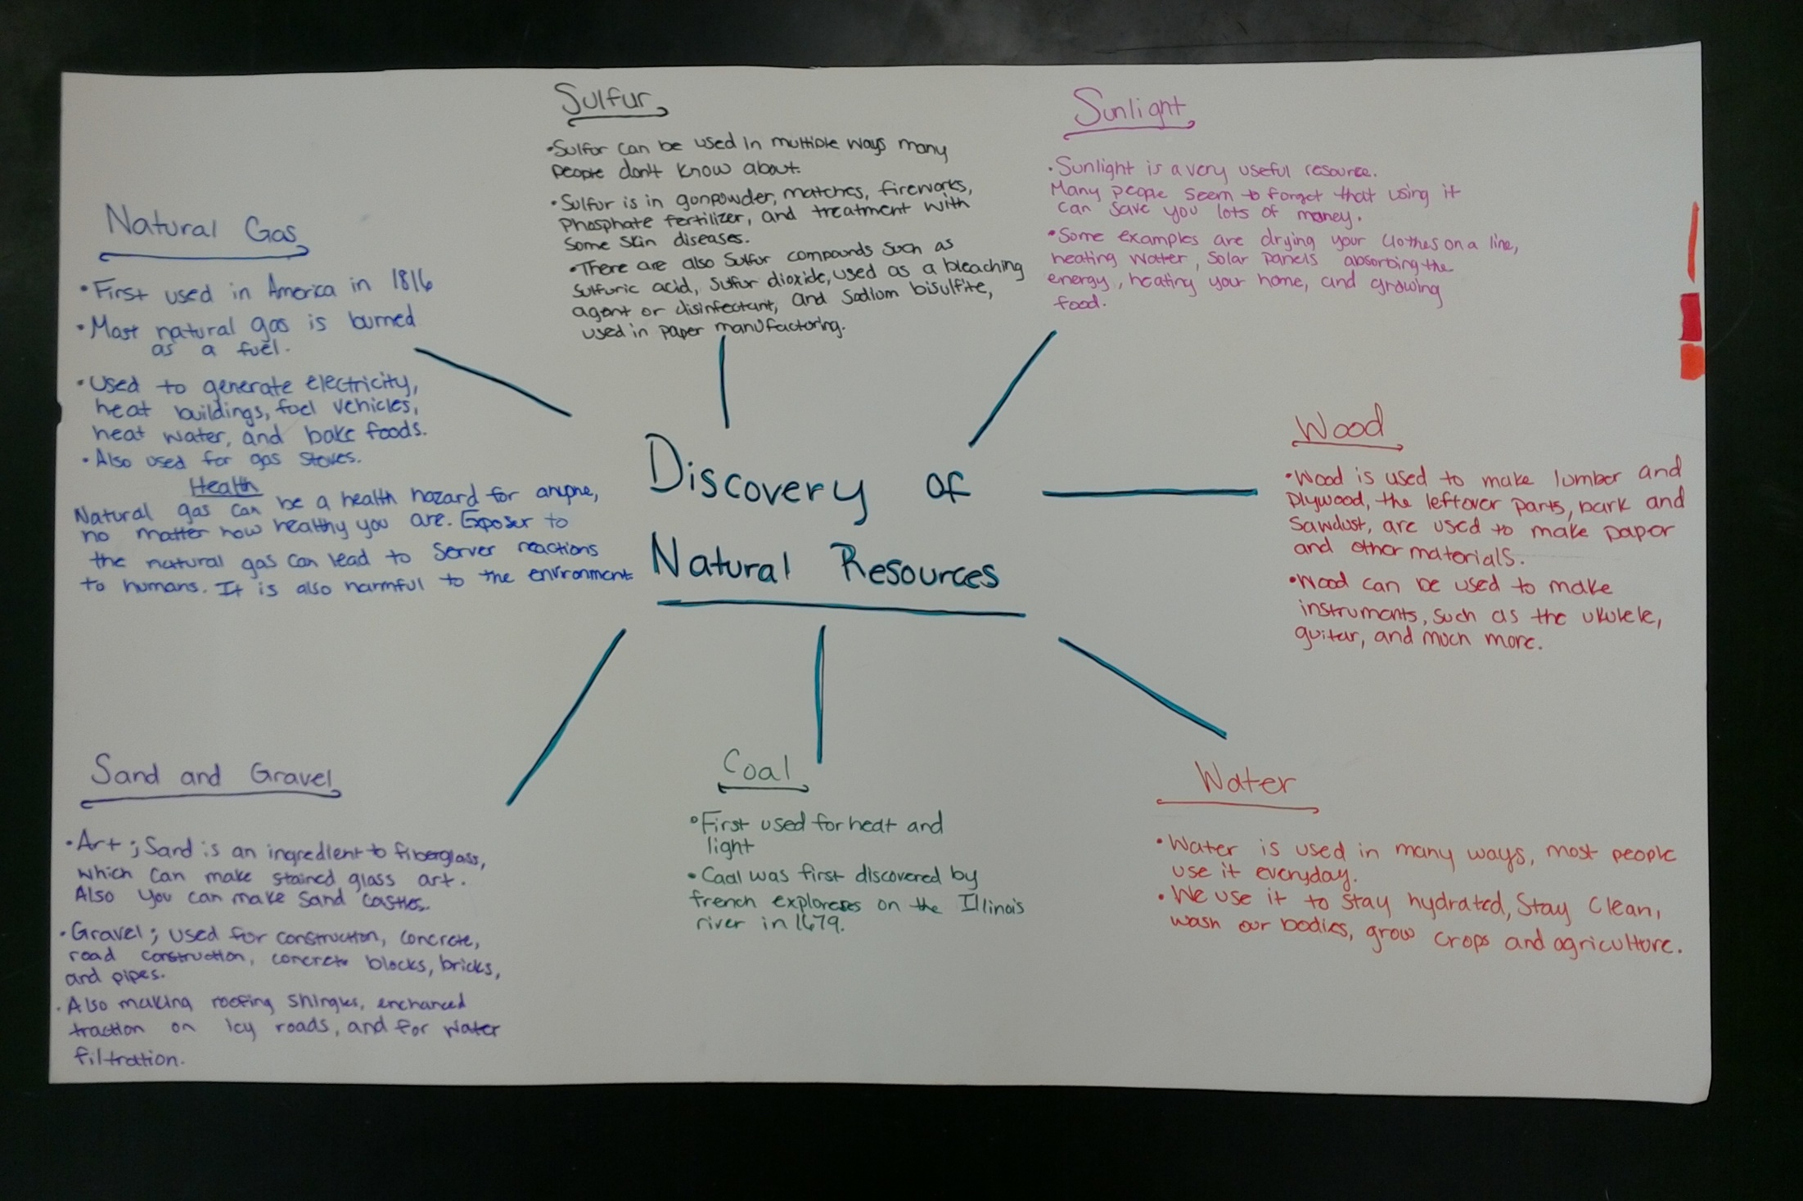
Misunderstanding the Project Objectives

Slide 28
Ideally…
Teaching teams, rather than stand alone departments
Departments collaborate and develop a curriculum to include discussions and activities that integrate other course topics into their curriculum

Slide 29
Significance
Variety and Flexibility
Peer interaction (students and teachers)
Demonstrates the connection of humans and their environment
Improved retention of material
Greater interest
Spurs interest in other subjects

Slide 30
Perhaps most important:
Demonstrates the necessity of geoscience
(Earth Science)
education and its relationship with the world
Notes:
I added an underline to provide emphasis, but this is entirely up to you ☺

Slide 31
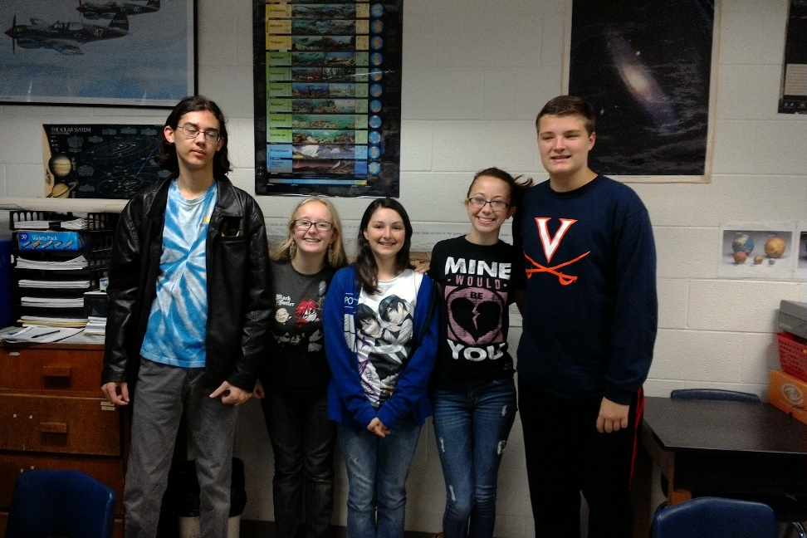
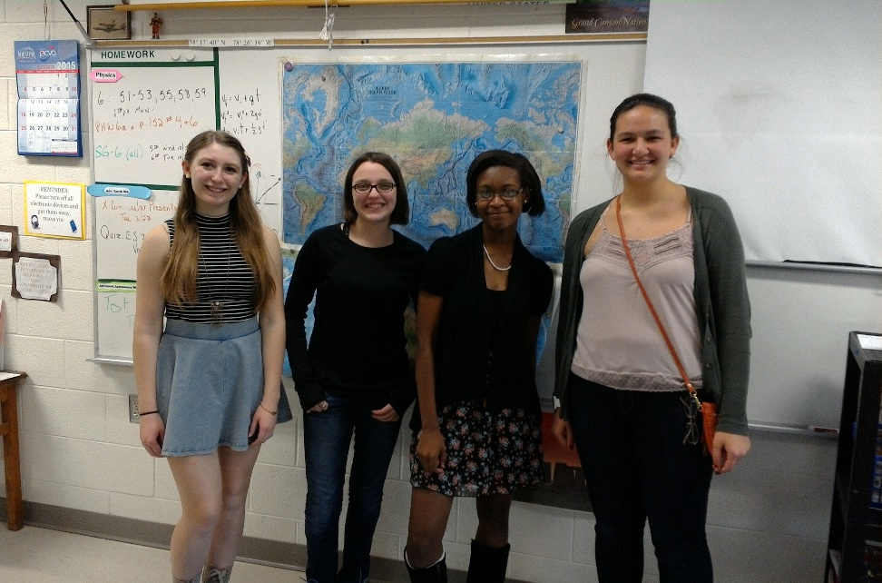
Acknowledgements
2015-2016 Advanced Earth Science students
2015 Southeastern Section Regional Geological Society of America conference—Chattanooga, TN
Megan Flansburg

Slide 32
Image References
https://en.wikipedia.org/wiki/1883_eruption_of_Krakatoa
http://i.ytimg.com/vi/GHK-d7ToTOI/maxresdefault.jpg
http://vignette3.wikia.nocookie.net/disney/images/8/85/Fantasia-disneyscreencaps_com-7466.jpg/revision/latest?cb=20130524153329
http://pabook.libraries.psu.edu/palitmap/ValleyForgeWashingtonWithTroops.jpg
http://www.civilwar.org/battlefields/gettysburg/gettysburg-history-articles/little-round-top.jpg
http://goddessschool.com/projects/Amaris/L1FPPele.html
http://www.toptenz.net/wp-content/uploads/2014/01/star-of-bethlehem.jpg
http://img.wikinut.com/img/3qoj-2v3jblz_dl5/jpeg/0/Star-of-Bethlehem.jpeg
https://62e528761d0685343e1c-f3d1b99a743ffa4142d9d7f1978d9686.ssl.cf2.rackcdn.com/files/67717/area14mp/image-20141218-31028-z1f98z.jpg
http://rarebookschool.org/2009/exhibitions/monster/img/titlepage_large.jpg
Notes:
I’ve done the first 3, so if you like the idea, continue!

