Slide 1

Using Geophysics to Map Bedrock Faults, Dikes, Surficial Geology and Karst Features in the Briery Branch Quadrangle, Rockingham County, Virginia
2015 GSA Annual Meeting in Baltimore, Maryland, Session #57-T65: Utilizing 2-D and 3-D Near-Surface Geophysics to Generate Improved Surface and Subsurface Geologic Maps
Authors:
Brent Waters, Golder Associates, Richmond, VA (bwaters@golder.com)
Daniel Doctor, U.S. Geological Survey, Reston, VA (dhdoctor@usgs.gov)
Joel Maynard, Virginia DEQ, Harrisonburg VA (joel.maynard@deq.virginia.gov)

Slide 2
Introduction
The purpose of this presentation is to demonstrate how geophysics can be used to improve geologic mapping
Which geophysical methods are best for shallow near-surface geologic mapping?
  Audio-Magnetotellurics (AMT)
  Electrical Resistivity Imaging (ERI)
  Ground Penetrating Radar (GPR)
Case Studies Briery Branch Quadrangle, Virginia
  AMT mapping of deep, sub-regional features
  2D ERI mapping of faults and karst features
  GPR to determine the thickness of alluvium
  3D ERI characterization of a sinkhole
Notes:
Geophysics can be used to delineate covered subsurface structures cost effectively. 3 methods used in this project: AMT ERI and GPR.

Slide 3
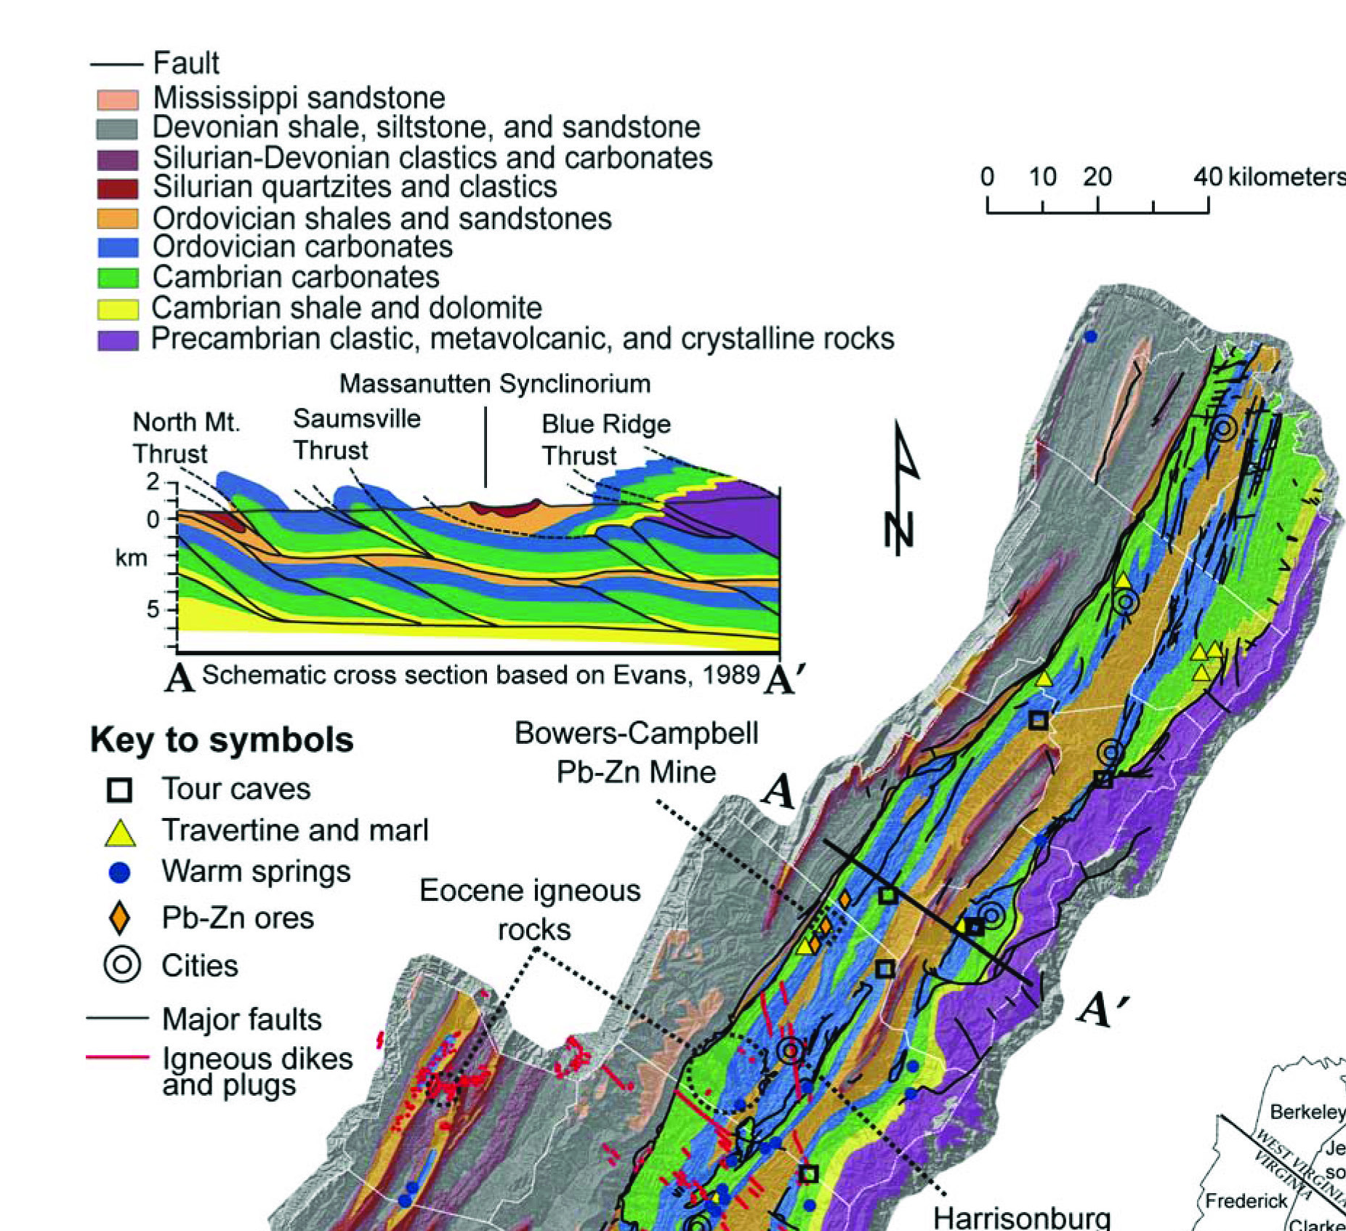
Regional Geologic Setting
Shenandoah Valley – 30 km wide underlain by 7 km thick staked sequence of Cambro-Ordovician carbonates
Bounded by 2 major faults – Blue Ridge and North Mountain
Intruded by diabase dikes
Briery Branch Quadrangle
Source: Evans, 1989, VDGMR, 2003, Doctor et al, 2014
Notes:
Shenandoah valley 30 km wide bounded by BRT to the east and North Mtn fault to the west underlain by 7-8 km of thrust stacked CO carbonates. Briery Branch Quad here west of Harrisonburg

Slide 4
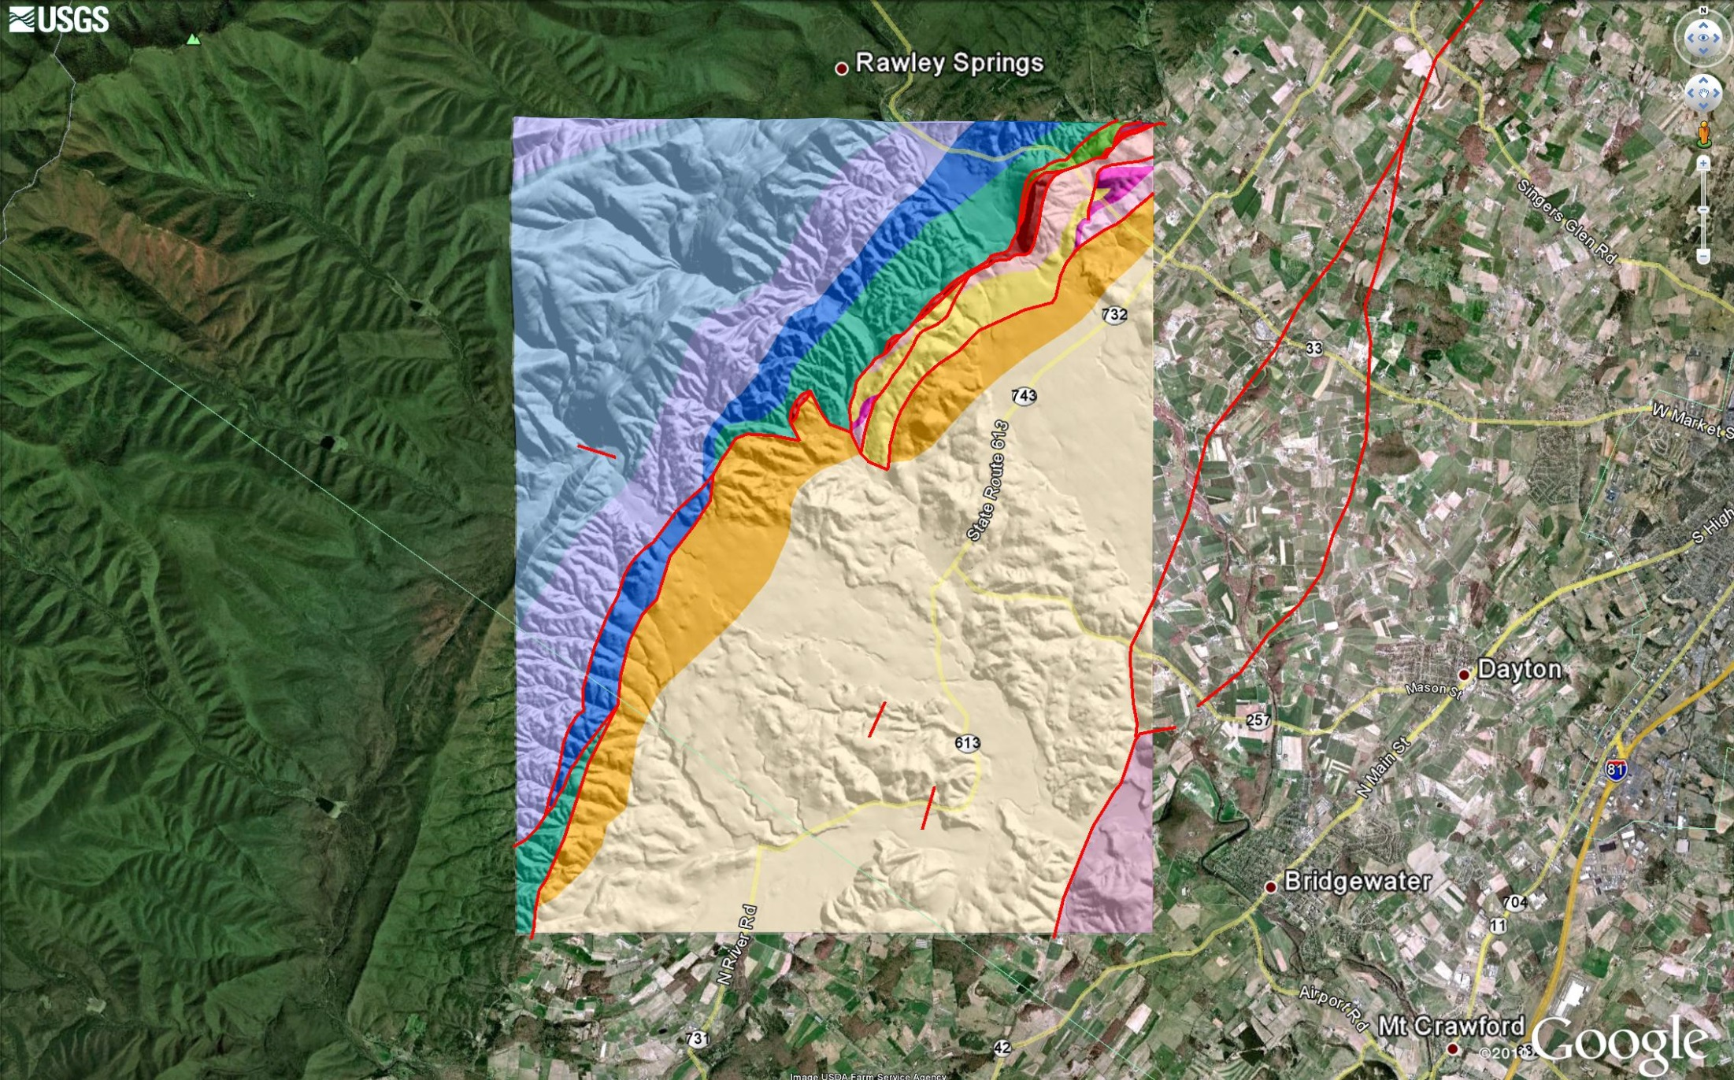
Briery Branch Quadrangle Geologic Map
Silurian-Mississippian
Siliciclastic Bedrock
North Mtn Fault Zone
CO Carbonates
Notes:
North Mtn fault zone juxtaposes CO carbonates over Silurian-Mississippian siliciclastic bedrock.

Slide 5
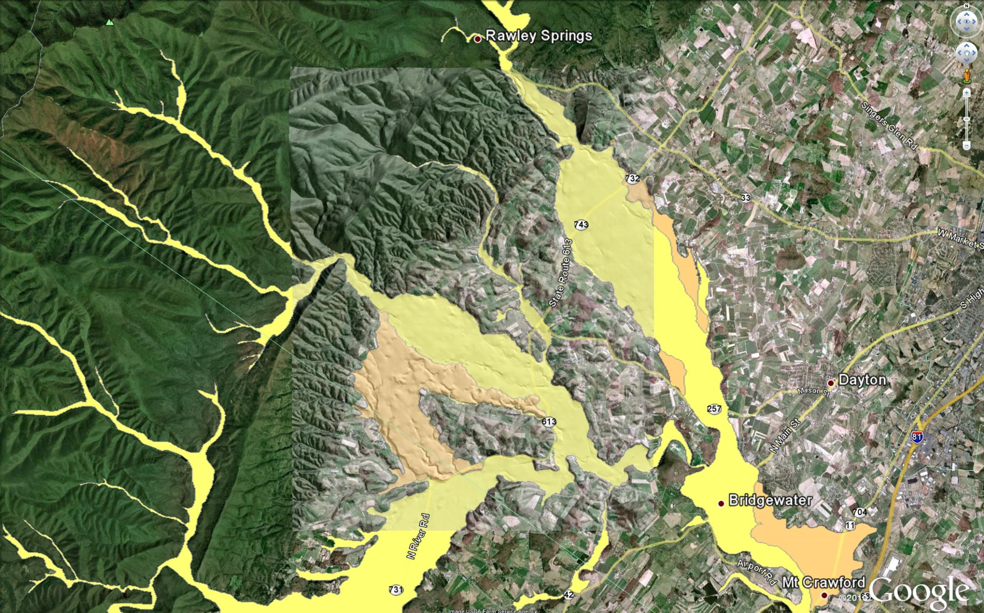
Briery Branch Quadrangle - Surficial Geology
Dry River
Briery Branch
North River
Notes:
Shows how much of the quadrangle is covered by surficial deposits obscuring the underlying bedrock formations and structures. Much of remaining area is obscured by deeply weathered and thick saprolite

Slide 6
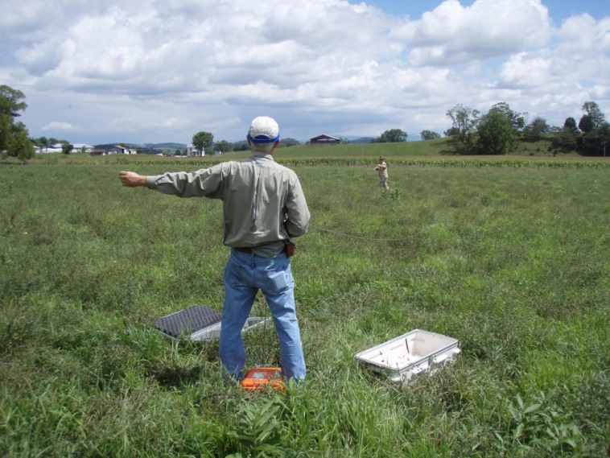
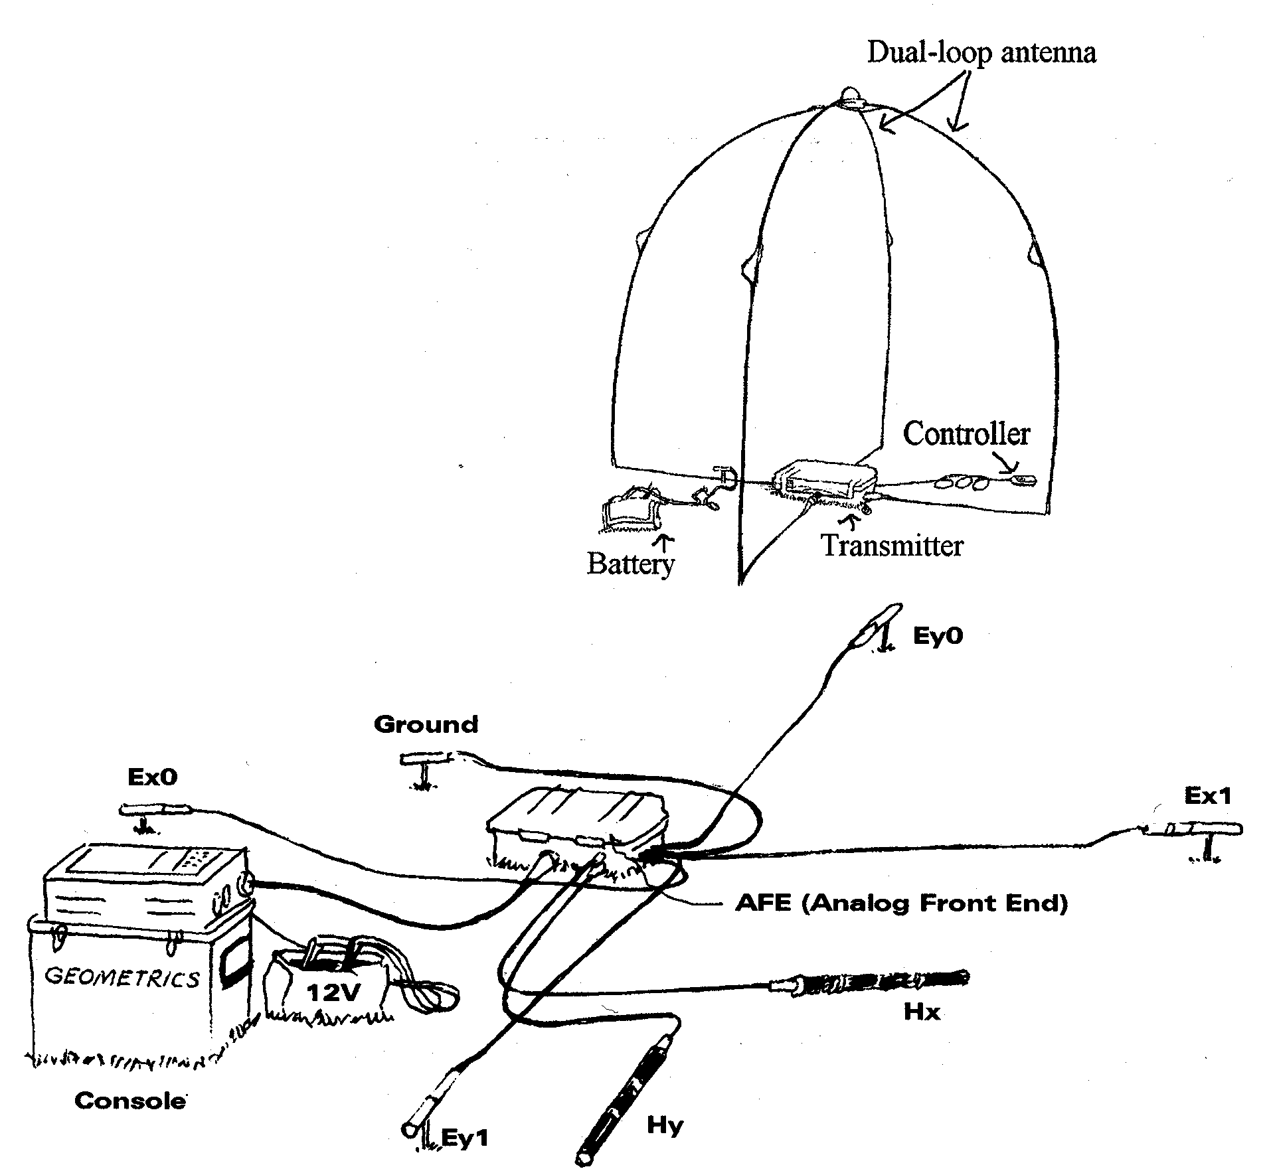
Audio-Magnetoteleurics (AMT)
Magnetotellurics (MT) uses natural electromagnetic energy from lightning sources and solar flares or controlled EM sources. Data are measured and converted to resistivity and then modeled to interpret the geology of the survey area in 3D
Pros: Depth of Investigation 250 to 1,000s of meters, easy setup and measurements, 1D profiles generated every 2 hours, can add controlled source
Cons: 1D data modeled to generate 2D & 3D results, easily affected by cultural noise, depth limited by conductive near surface soil/rock

Slide 7
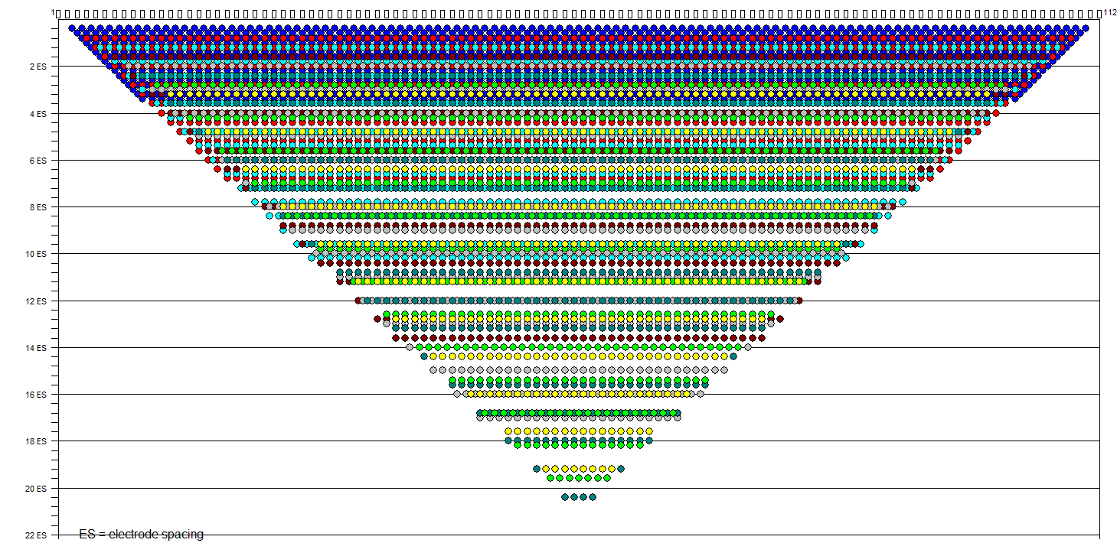
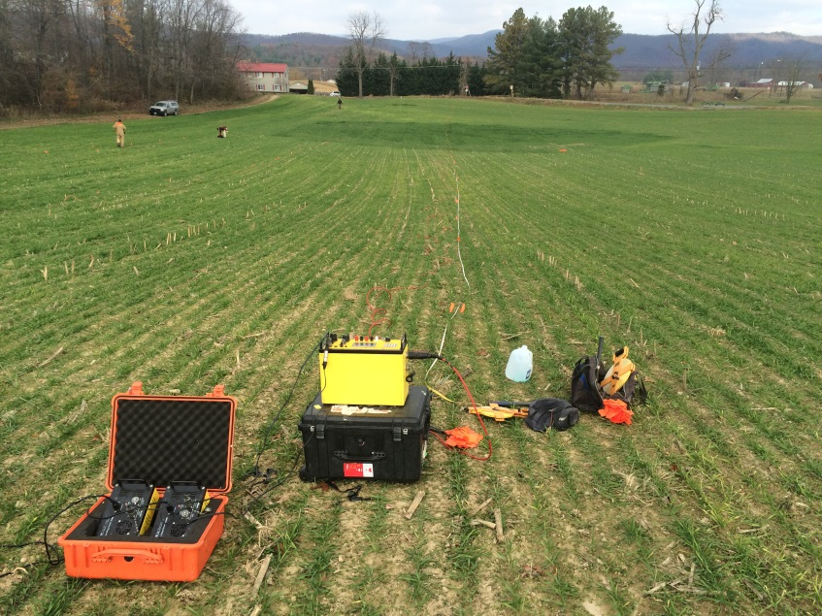
Electrical Resistivity Imaging (ERI)
Electrical resistivity is a measure of how easily electricity flows through a material
Primary properties that affect the resistivity:
  Porosity: shape, size and interconnection of pores
  Water content
  Pore water salinity (electrolytes)
  Conductivity of minerals (clay mineral and metal content
Pros: High data density, full coverage, good for mapping faults, stratigraphy, depth to rock, karst, and groundwater
Cons: Labor intensive, impacted by cultural noise, need intrusive samples to confirm interpretations

Slide 8
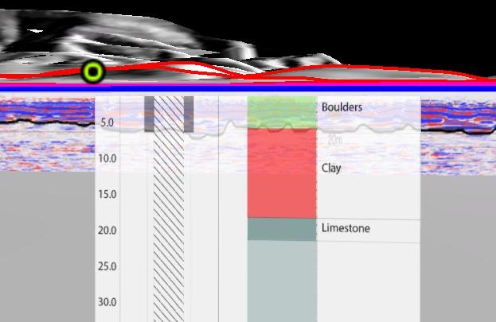
Ground Penetrating Radar (GPR)
GPR uses antennas to transmit and receive very high frequency EM pulses (typically 25 to 1000 MHz, radio-frequency) to/from reflecting objects in the ground
Typically used to locate buried utilities, USTs, voids, top of rock, shallow geologic contacts, rebar in concrete
Depth of investigation limited by conductive soils such as clay
In high resistivity soil (i.e., sand and gravel deposits), low frequency GPR can penetrate to depths of up to 90-100 feet

Slide 9
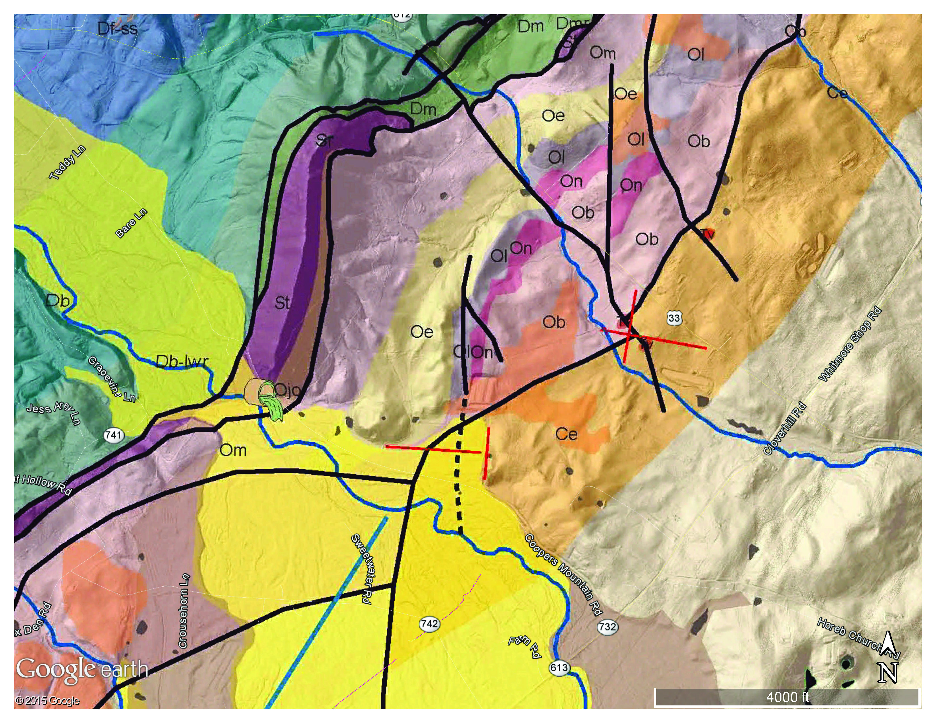
Draft Geologic Map of the North Mtn Fault Zone
North Mtn Fault Zone
Ordovician Carbonates
4
3
Cambrian Carbonates
1
2
ERI Lines
AMT Sections
GPR Lines
Notes:
Here is the draft geologic map of a portion of the briery branch quadrangle, AMT profiles across the fault as projected 1D profiles, ERI lines over thrust fault, transverse fault, diabase dike, alluvium. GPR lines over alluvium

Slide 10
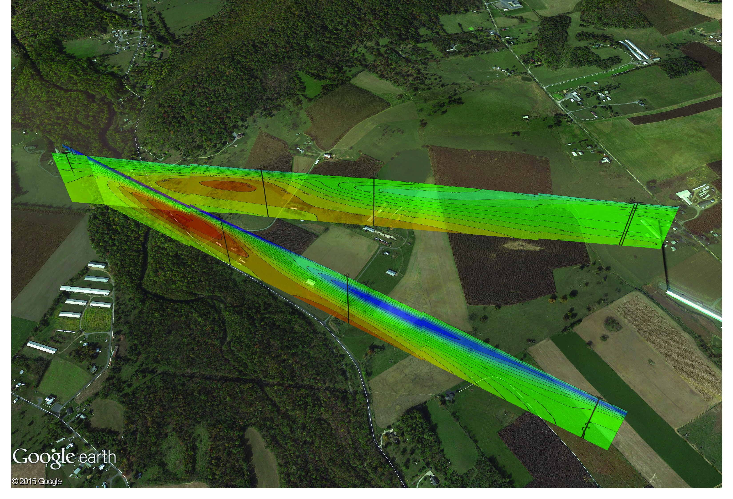
AMT Resistivity Profiles
Mapped Fault
Notes:
Broad mapping of regional differences in resistivity values to depths of 1,000 feet. Assume that a fault separates these different signatures of resistivity.

Slide 11
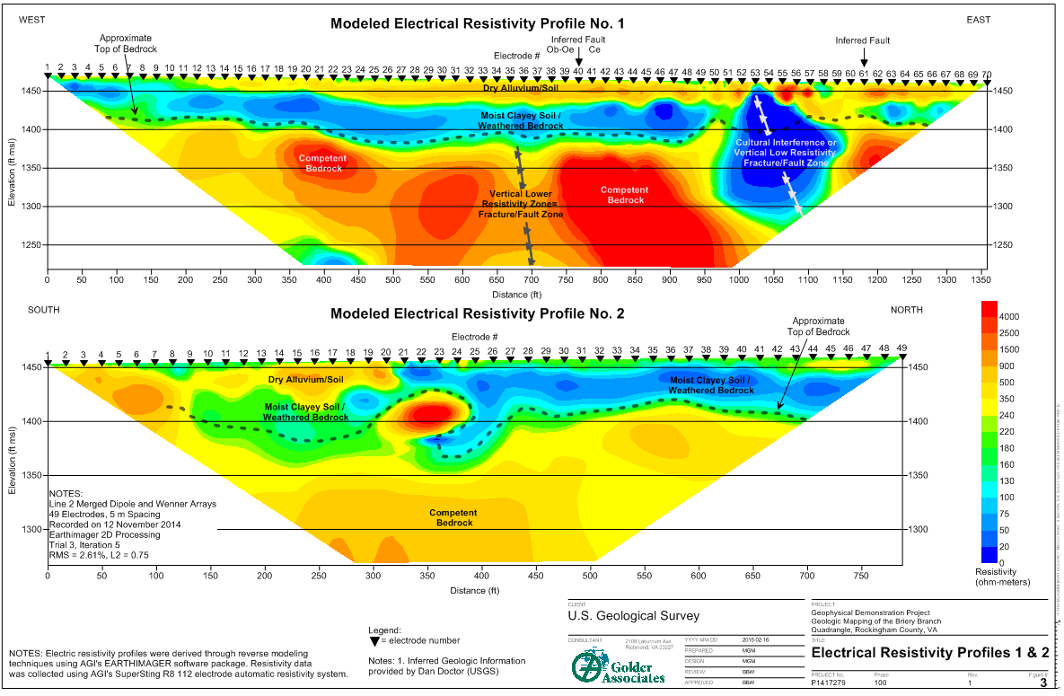
ERI Profiles 1 and 2
Notes:
ERI Line 1 across portion of alluvial fan (high resistivity) over clayey saprolite (low resistivity). Competent limestone bedrock is high resistivity except where fractured and weathered by infiltrating water (low resistivity). Sub-vertical LRZ suspected zone of increased fracturing and weathering, possible fault zone. Very low resistivity area in blue may represent fault zone but also anecdotal evidence of sinkholes filled with debris (metal) may reflect cultural interference of electrical response.
ERI Line 2 clearly shows the transition of alluvial fan deposits and shows a potential karst feature of pinnacled and ledge bedrock. Farm mentioned large sinkhole in this area. Lidar provides some confirmatory evidence.

Slide 12
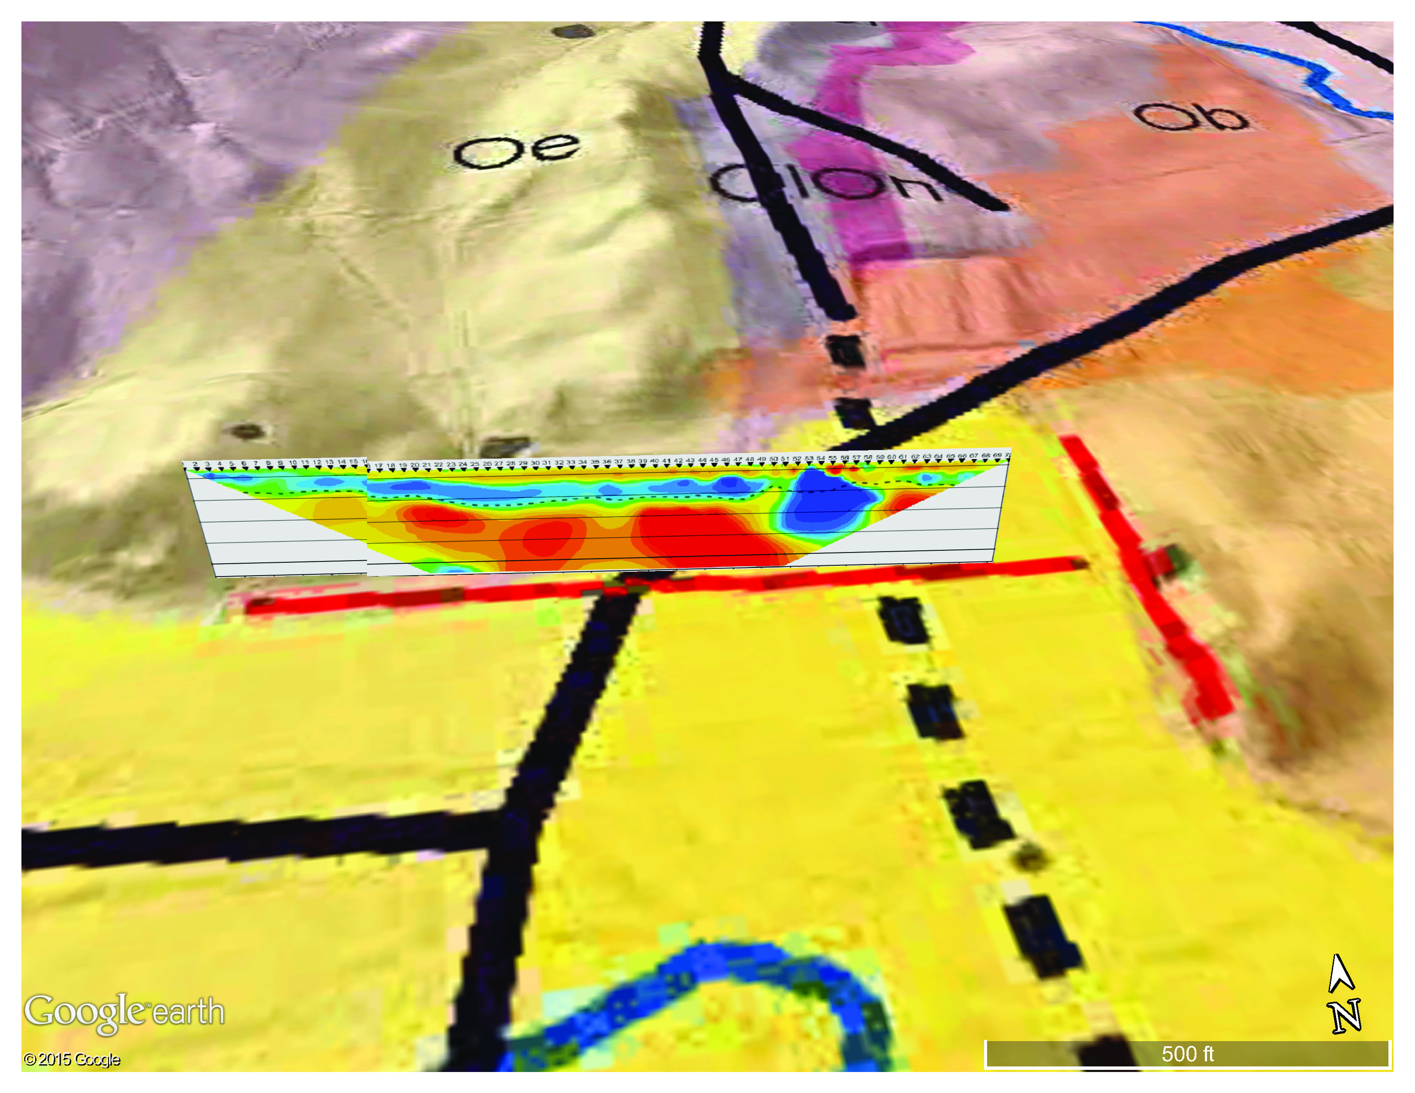
Locating Faults using Geophysics

Slide 13
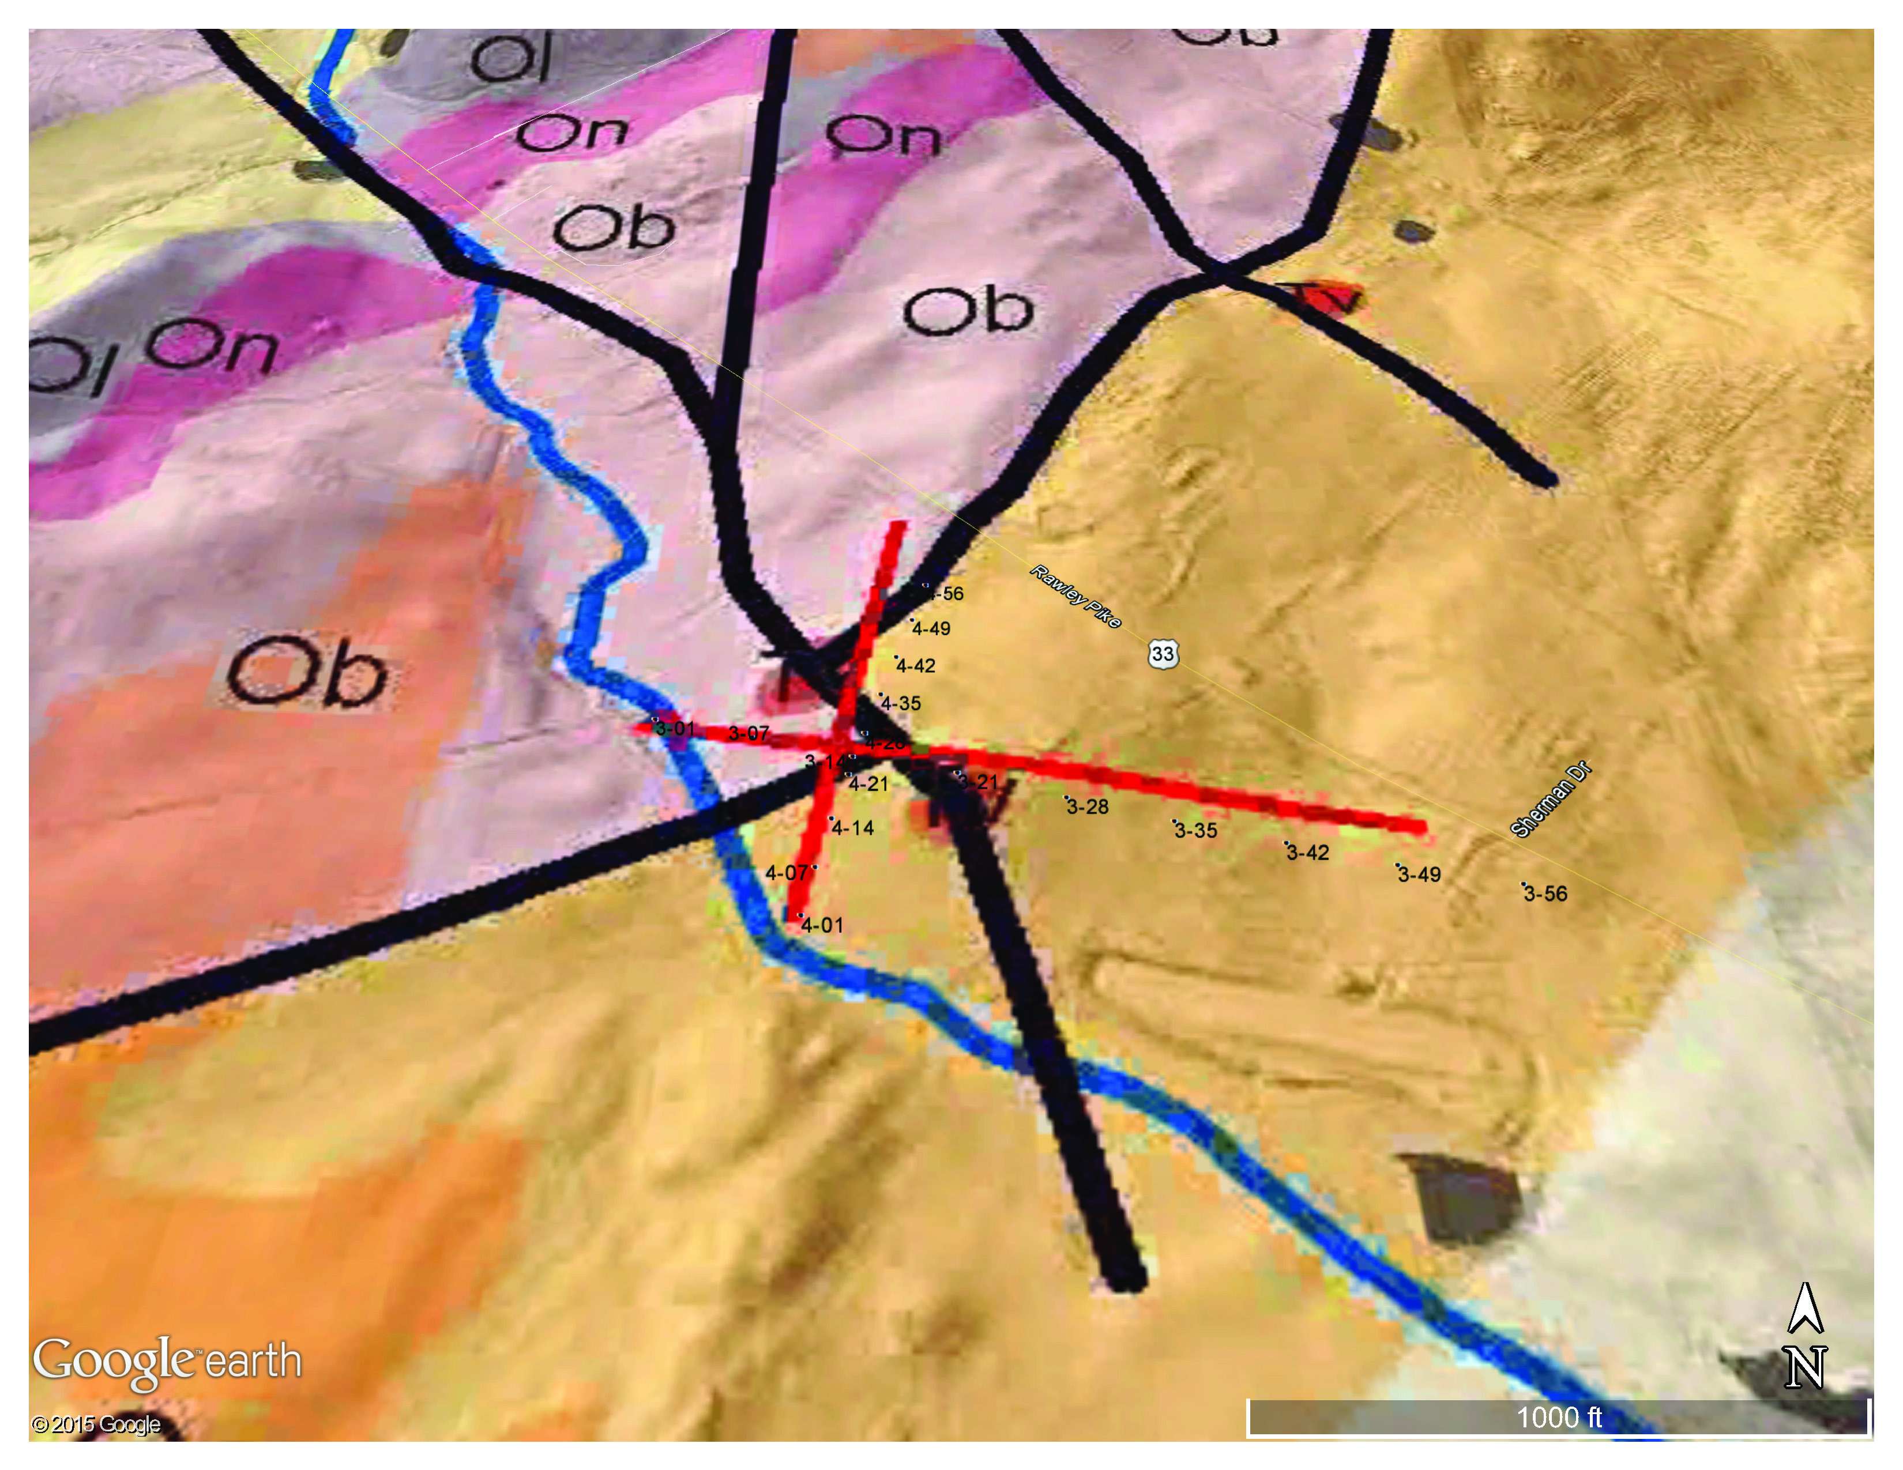
ERI Profiles 3 and 4

Slide 14
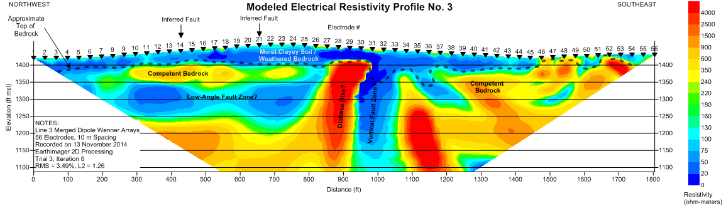
Electrical Resistivity Profile 3
100’
200’
300’
400’
Diabase
Dike
Water-Filled
Fracture Zone
Thrust Fault
500’
600’
Fault Zone
in well
Notes:
Electrical contrast used to map lithologic changes and to delineate potential fault zones characterized by increased fracture porosity and weathering. Suspected north mtn fault zone and associated fracture zones show up as low resistivity, dip steeply back to the southeast. Fault zone mapped in water supply well at 600-700 ft bg. High resistivity basalt/diabase dyke. Possible chill/fracture zone on

Slide 15
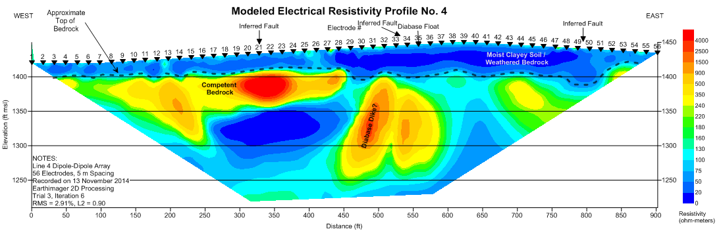
Electrical Resistivity Profile 4
South
North
Diabase
Dike
Fault/Fracture
Zone

Slide 16
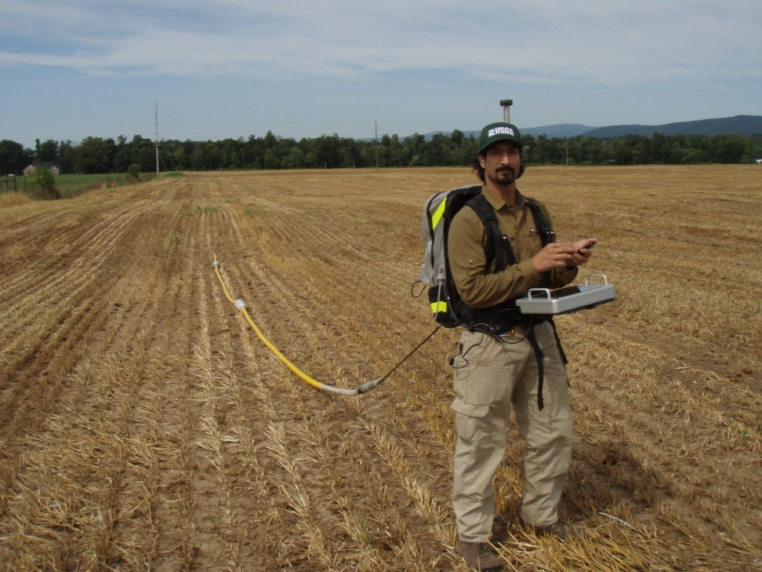
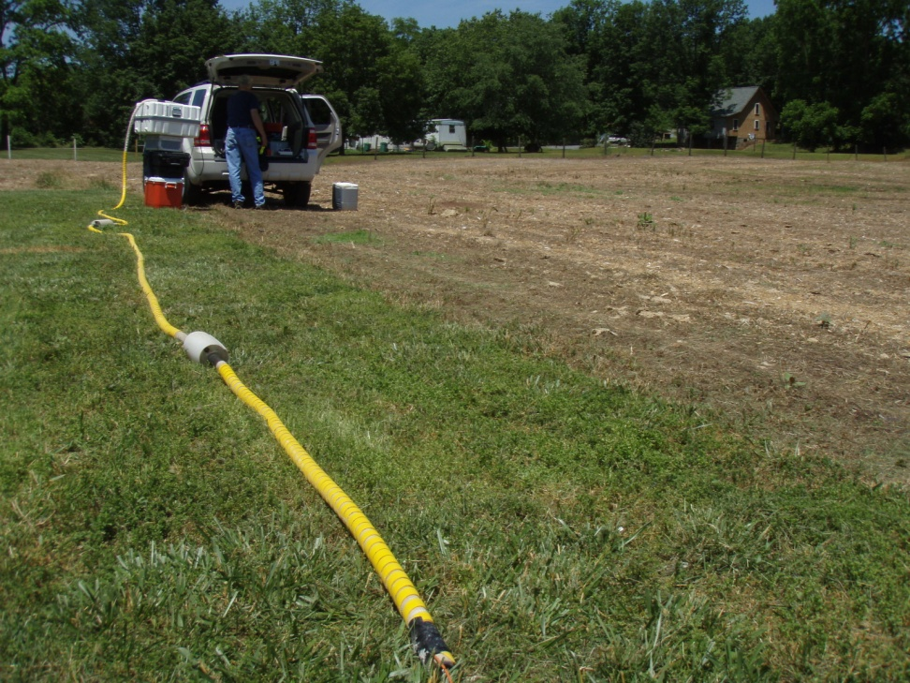
Ground Penetrating Radar (25 MHz)
25 MHz in line antenna
Unshielded
Notes:
Antenna is in-line and parallel, designed for rugged terrain, and ease of deployment
Photo taken just south of Rawley Springs, VA

Slide 17
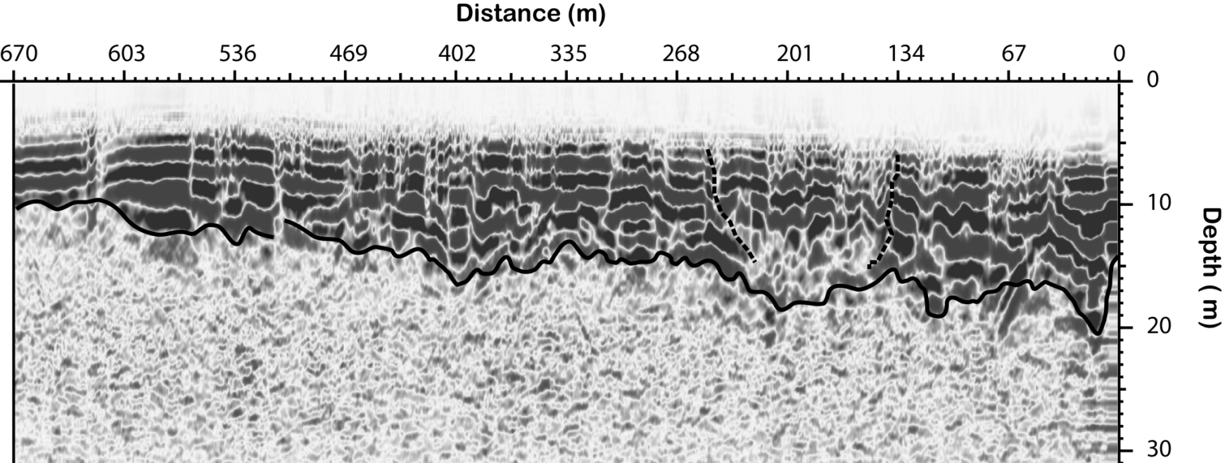
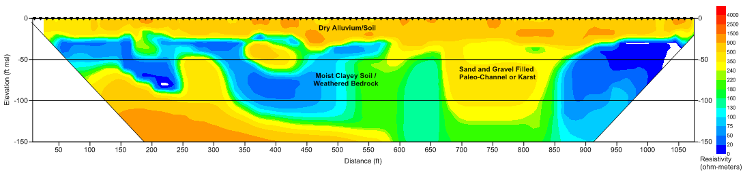
Using GPR and ERI to Map Alluvial Deposits

Slide 18
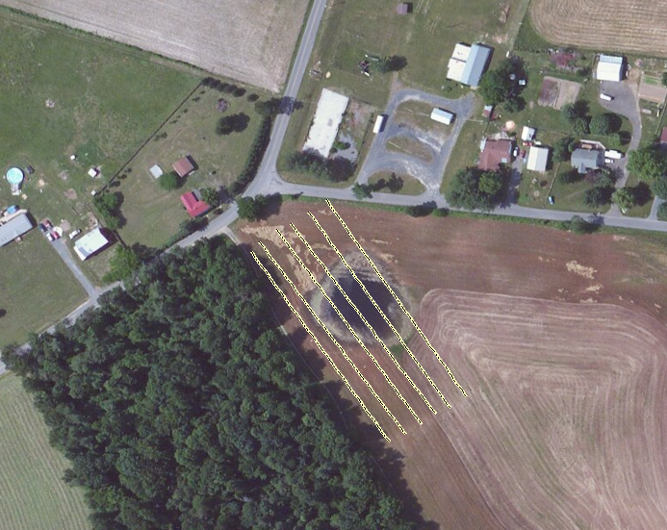
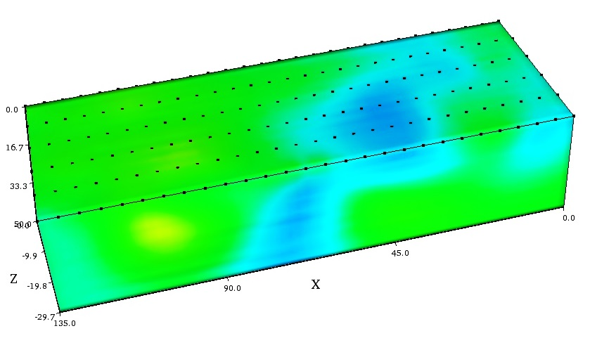
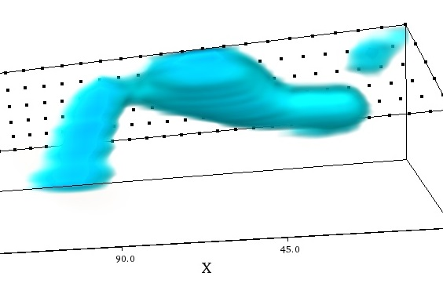
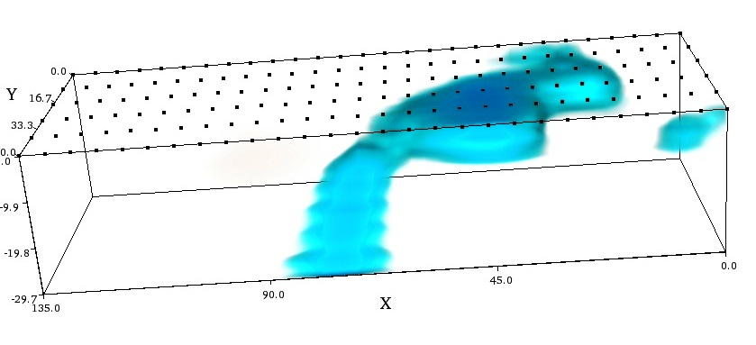
3D Electrical Resistivity Imaging of a Sinkhole
SE
NW

Slide 19
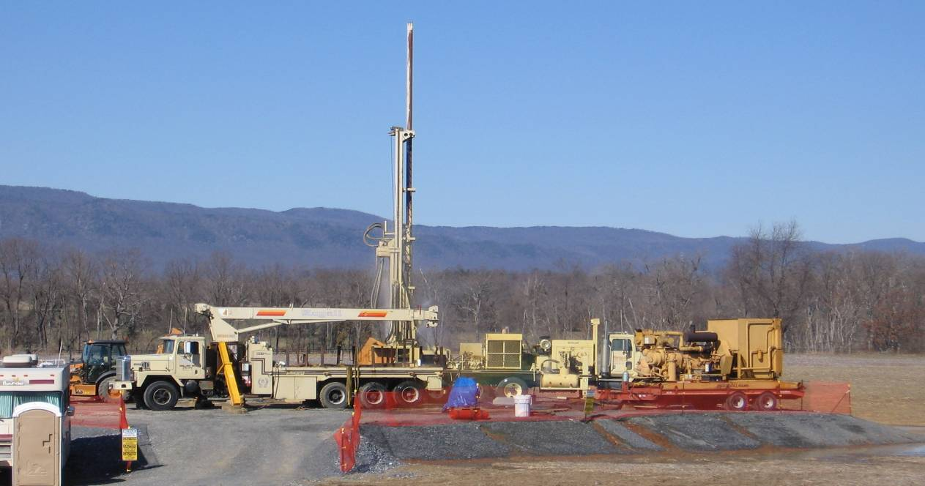
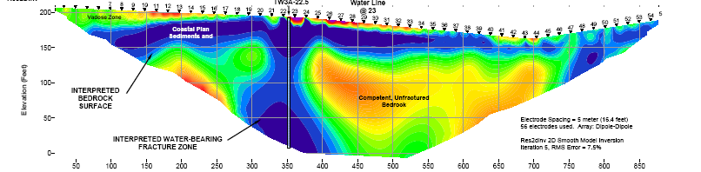
Questions?

