Slide 1
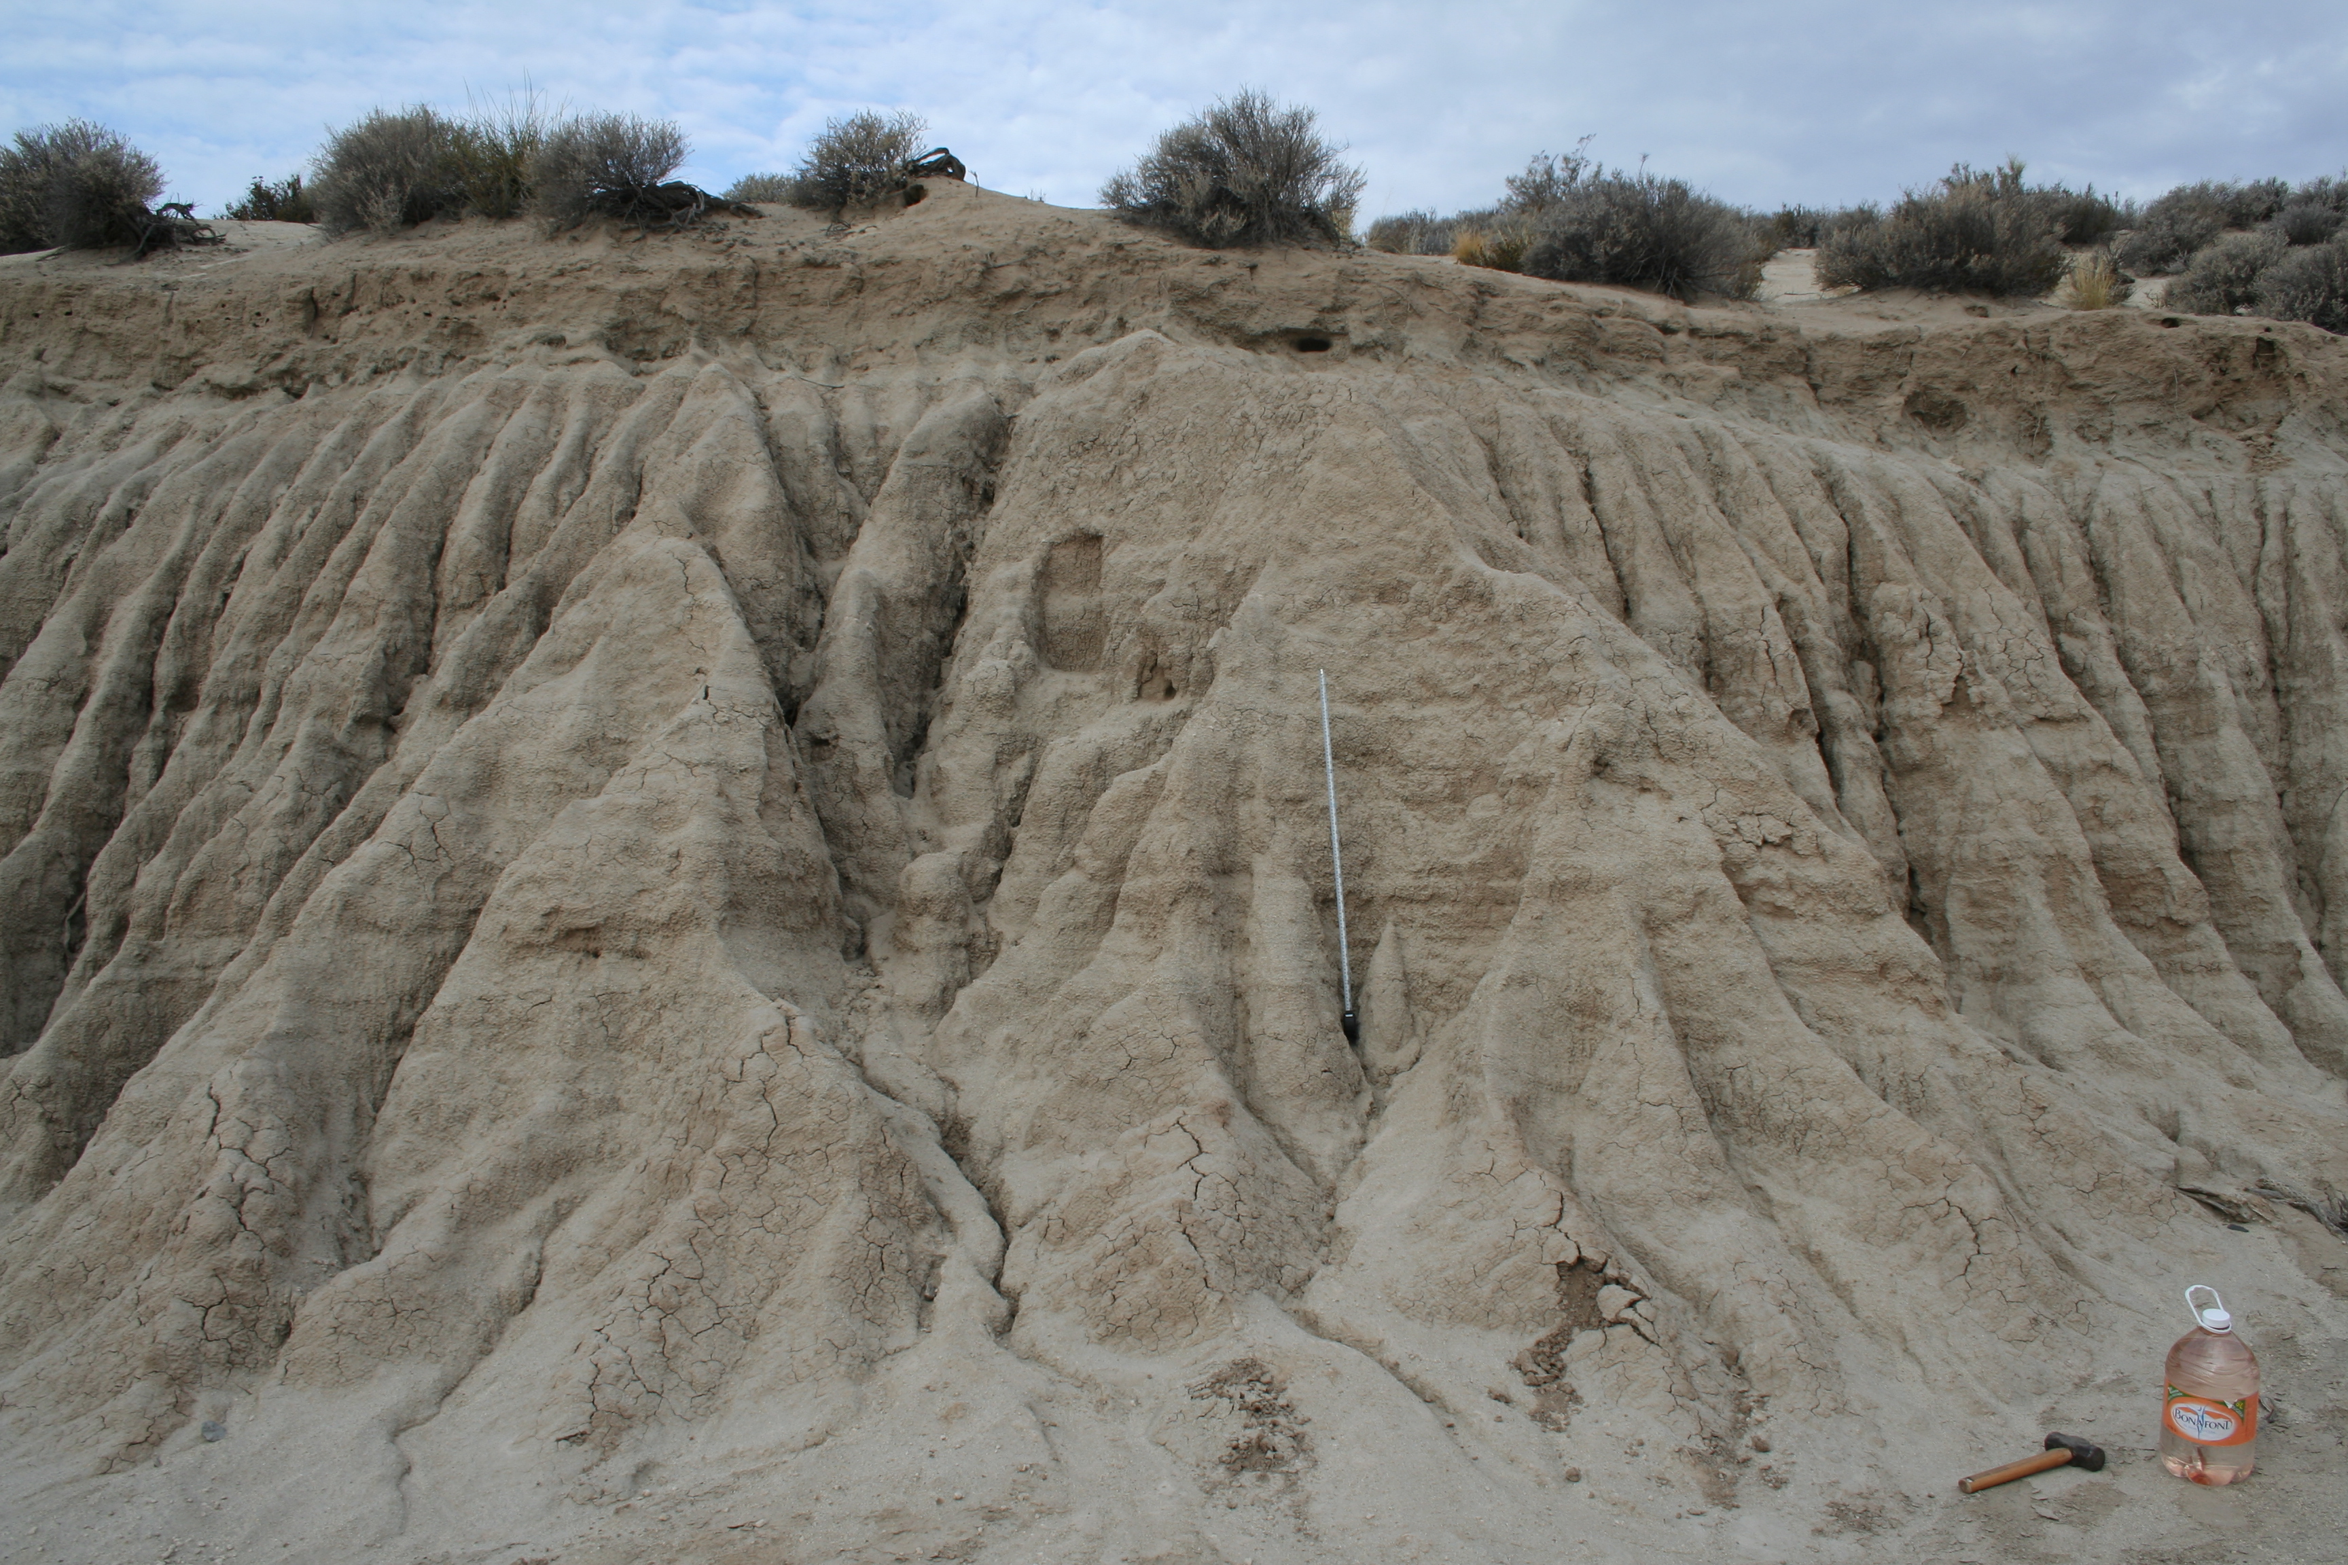


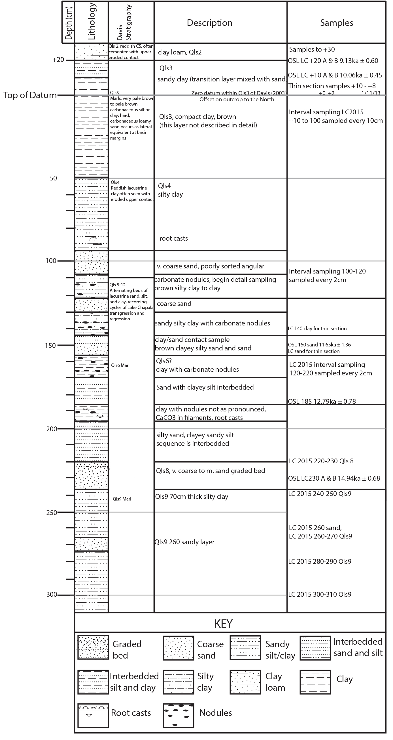
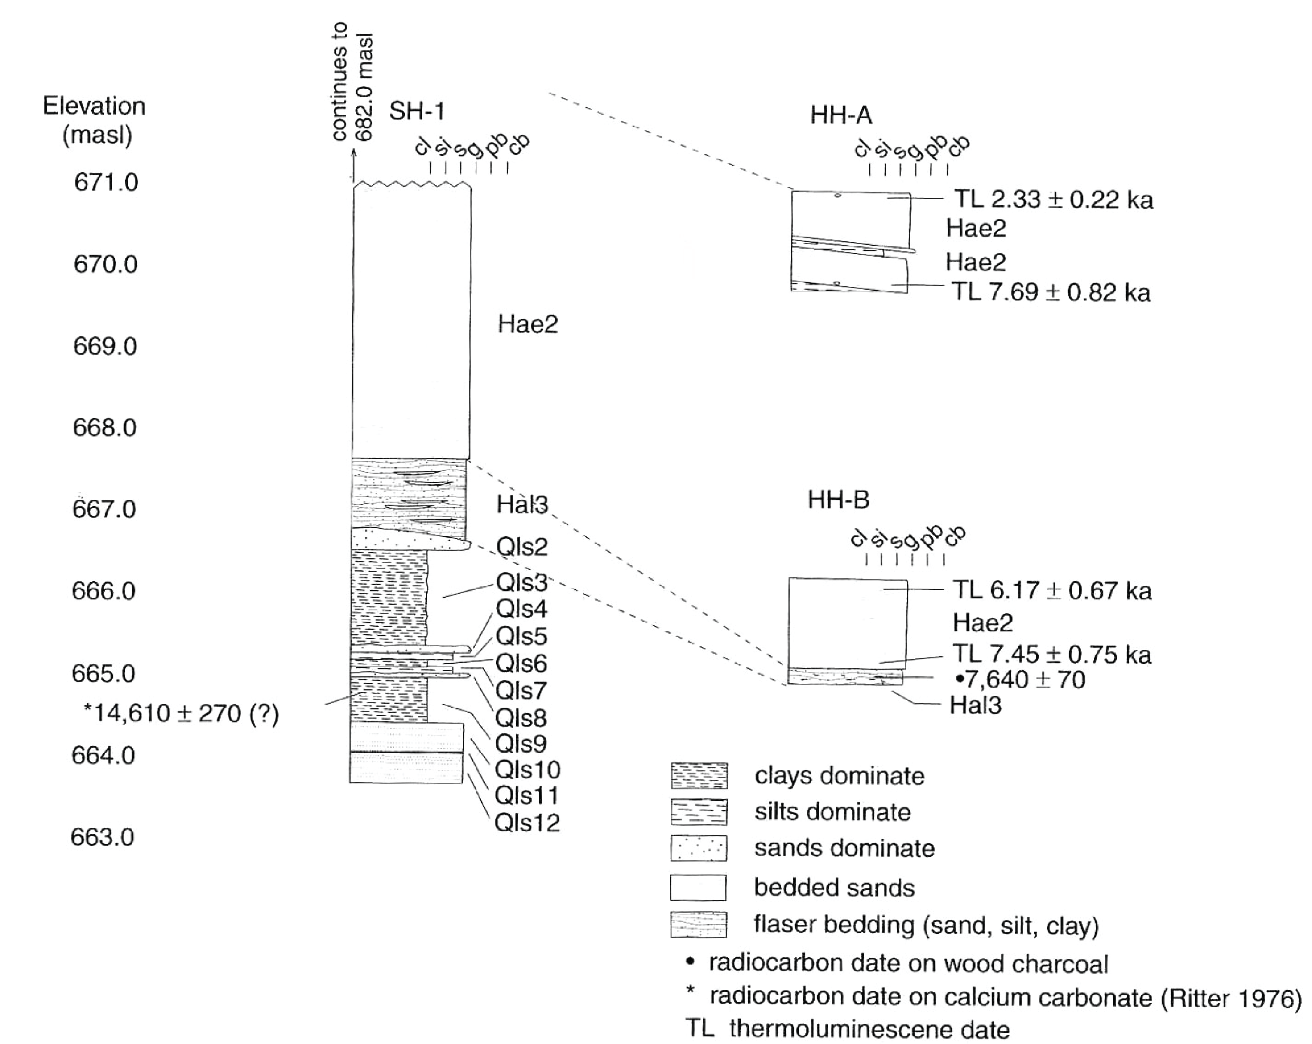
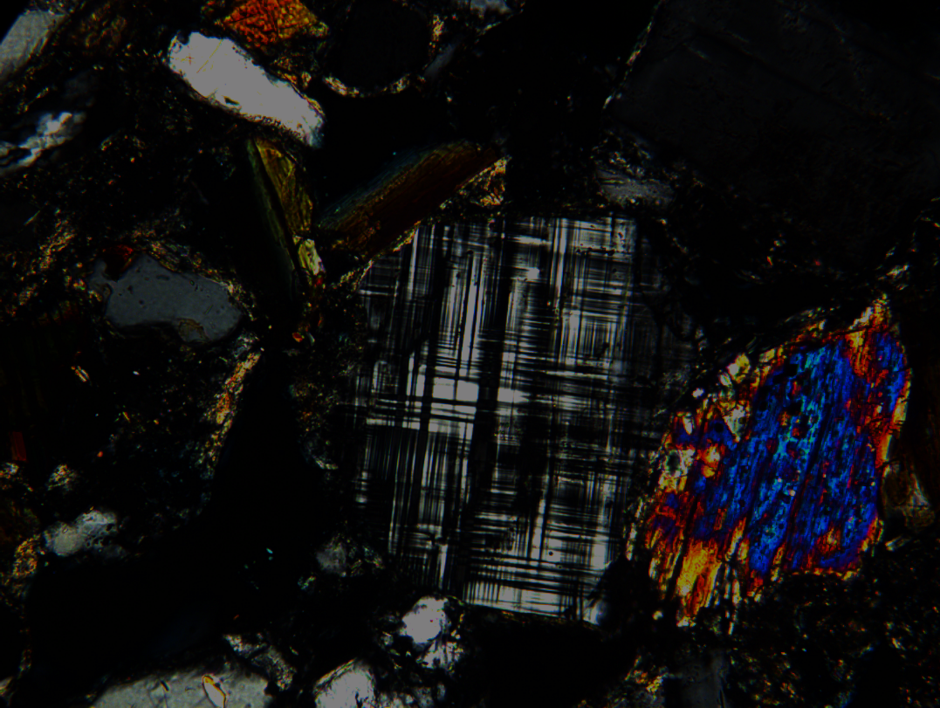
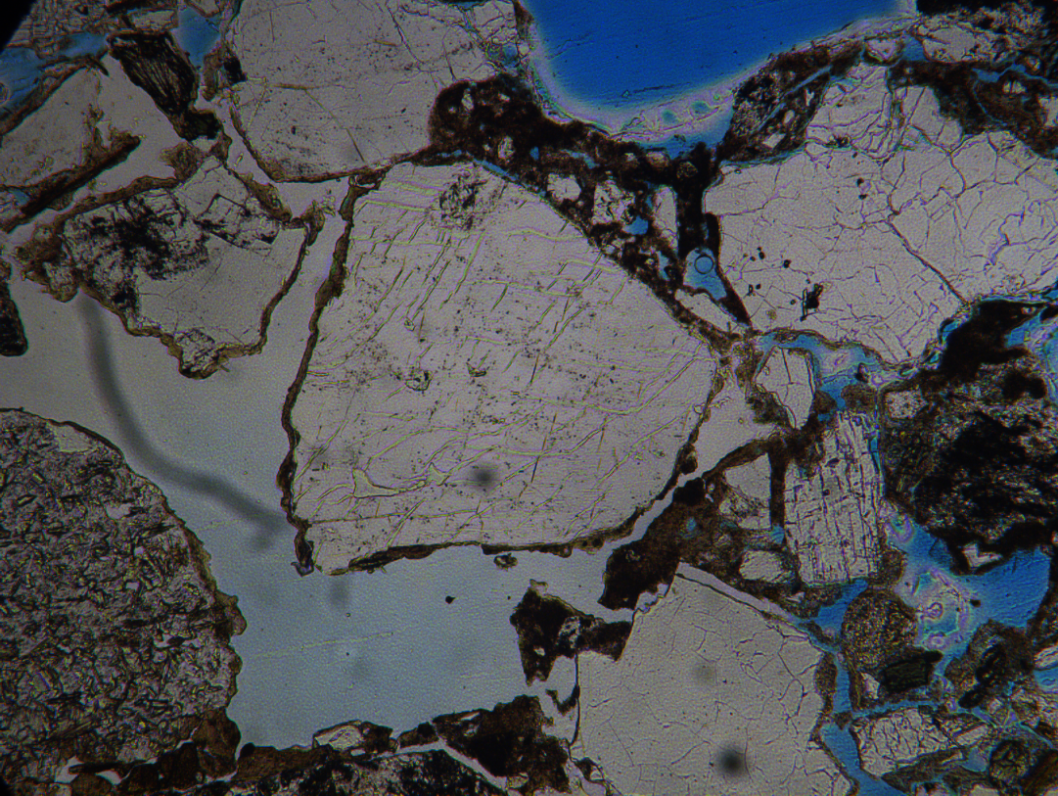
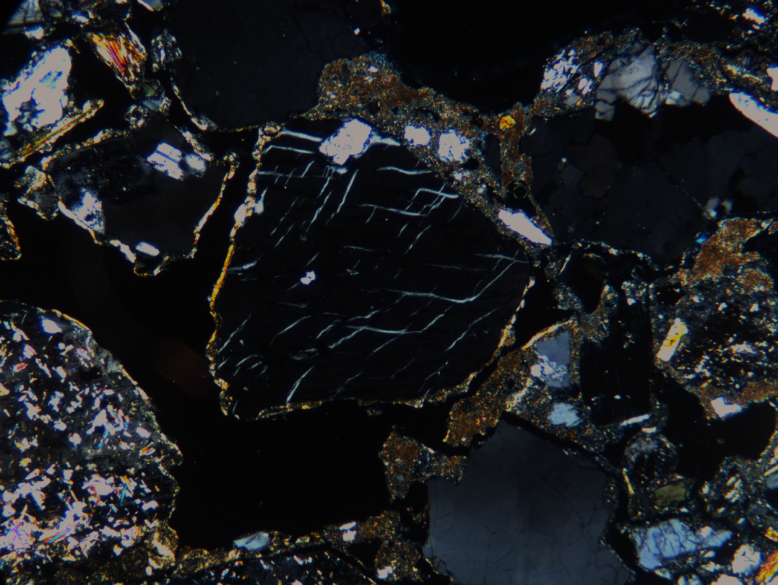
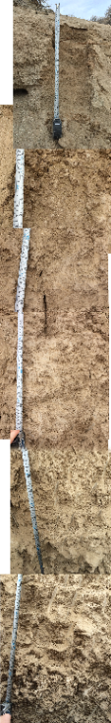
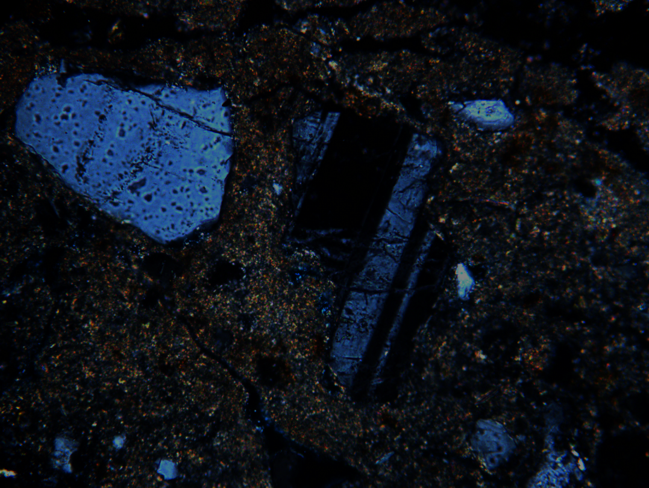
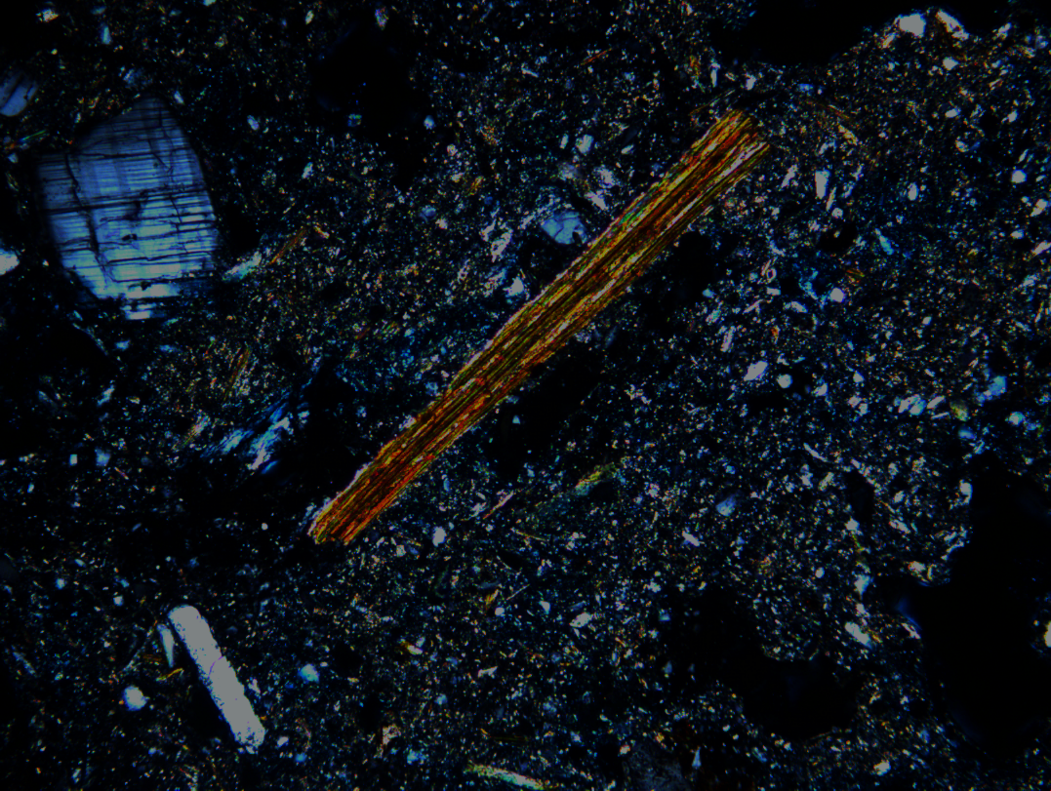
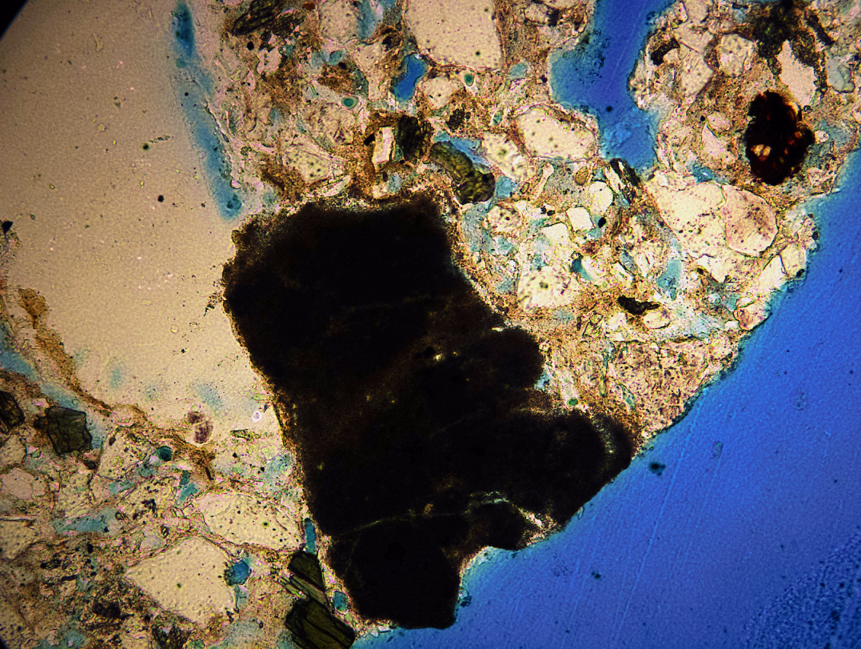
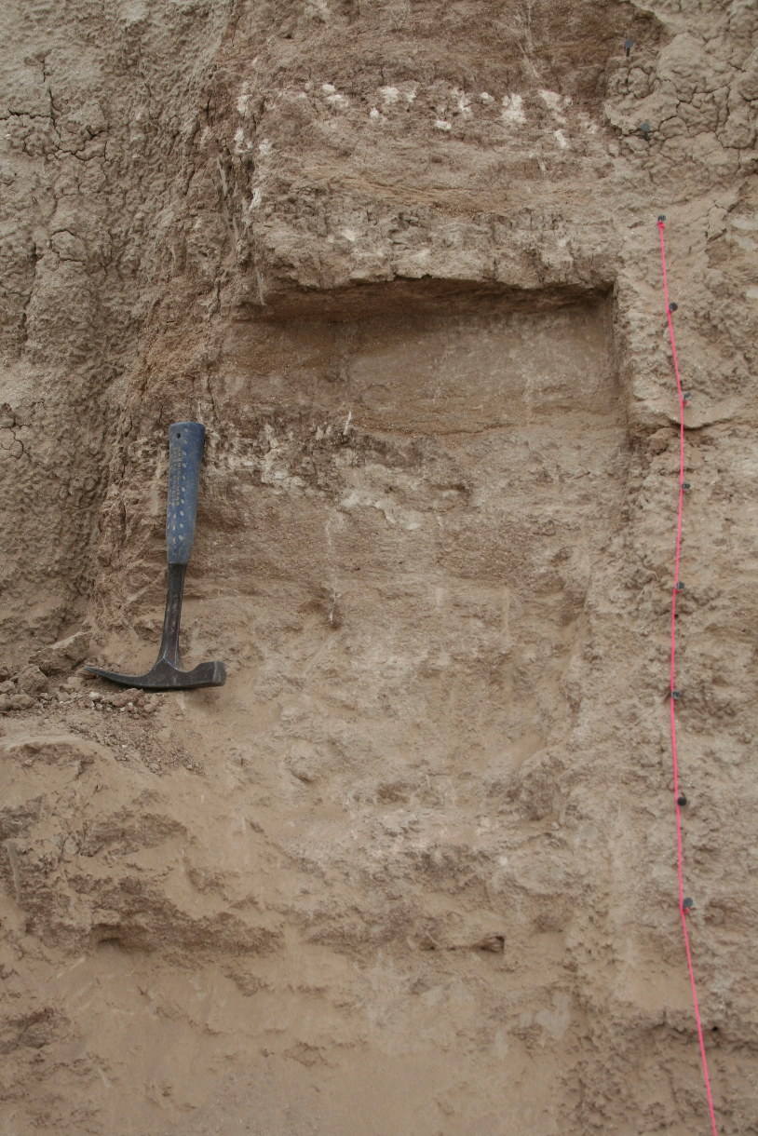
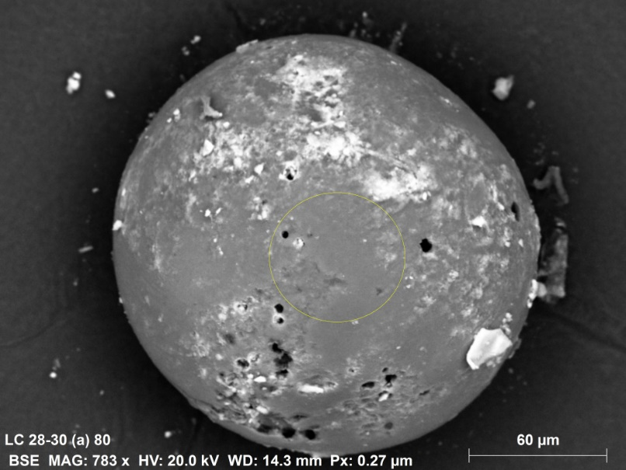
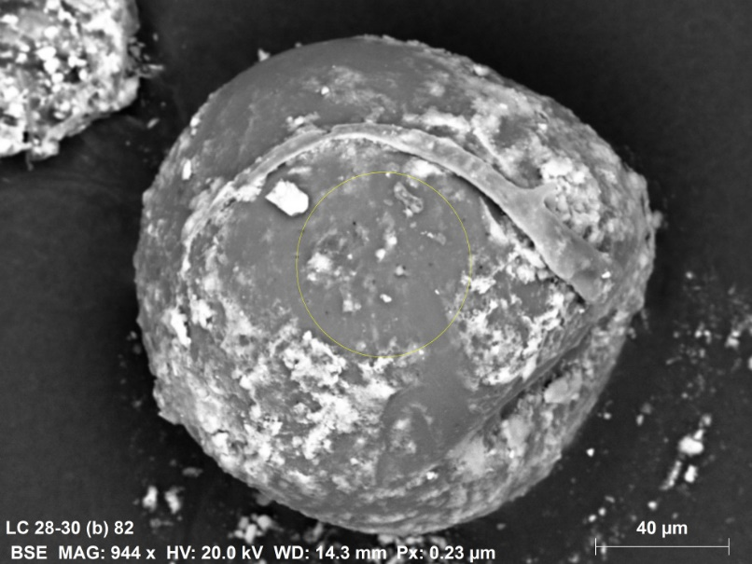
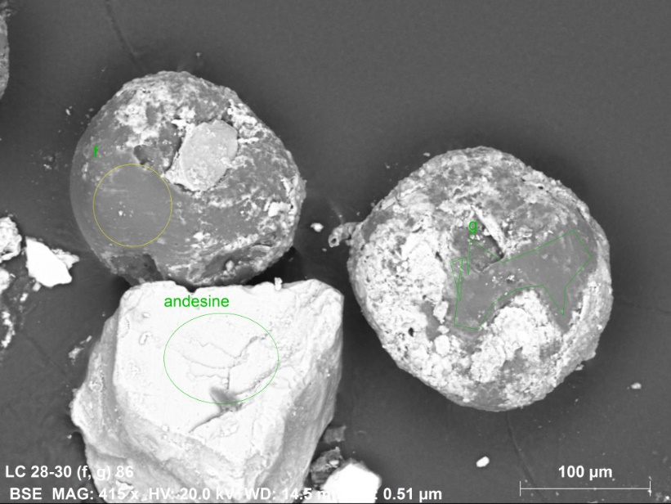
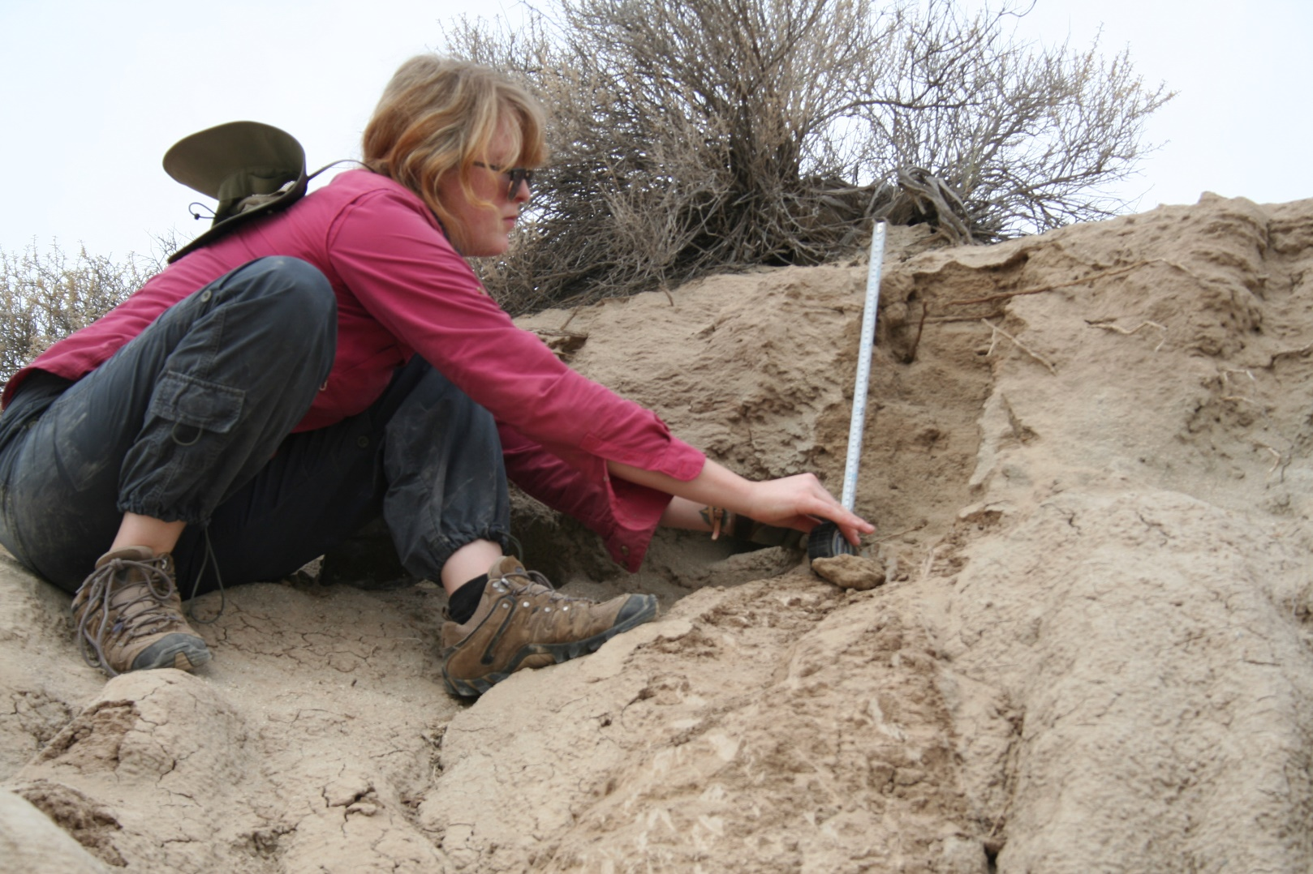
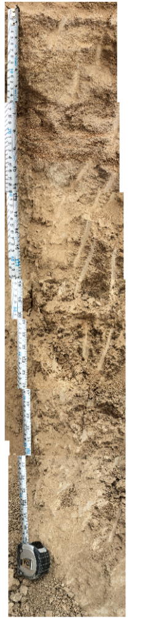
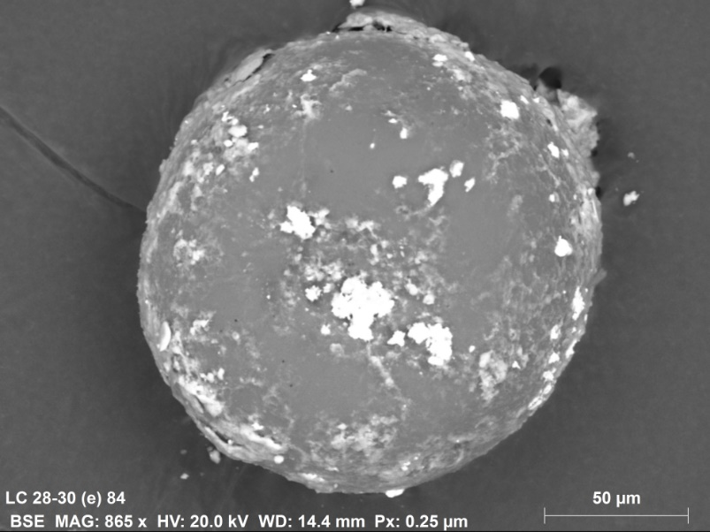
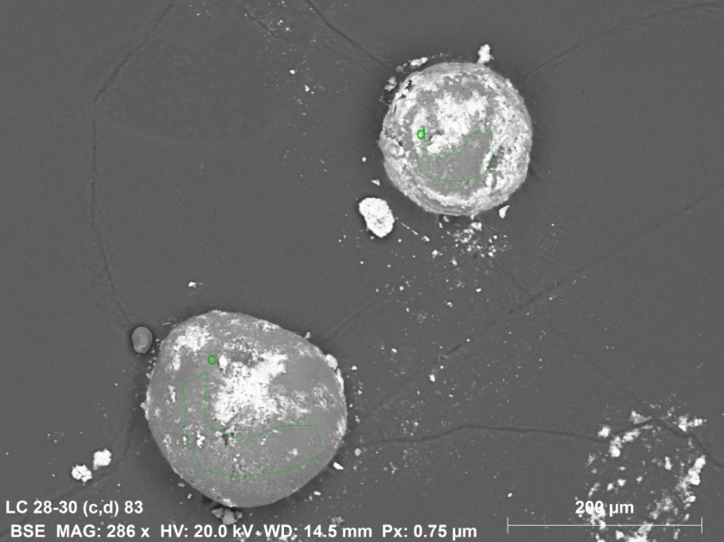
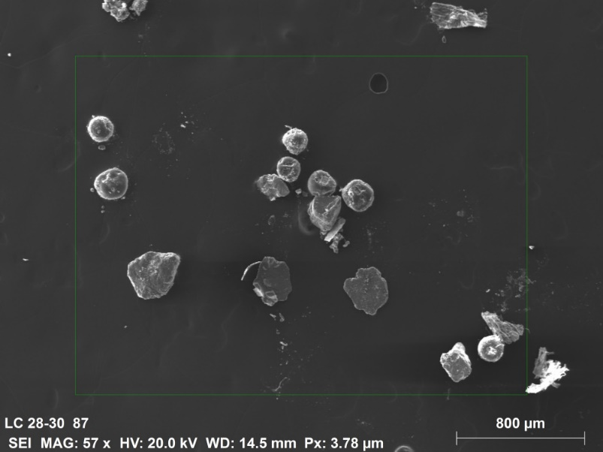
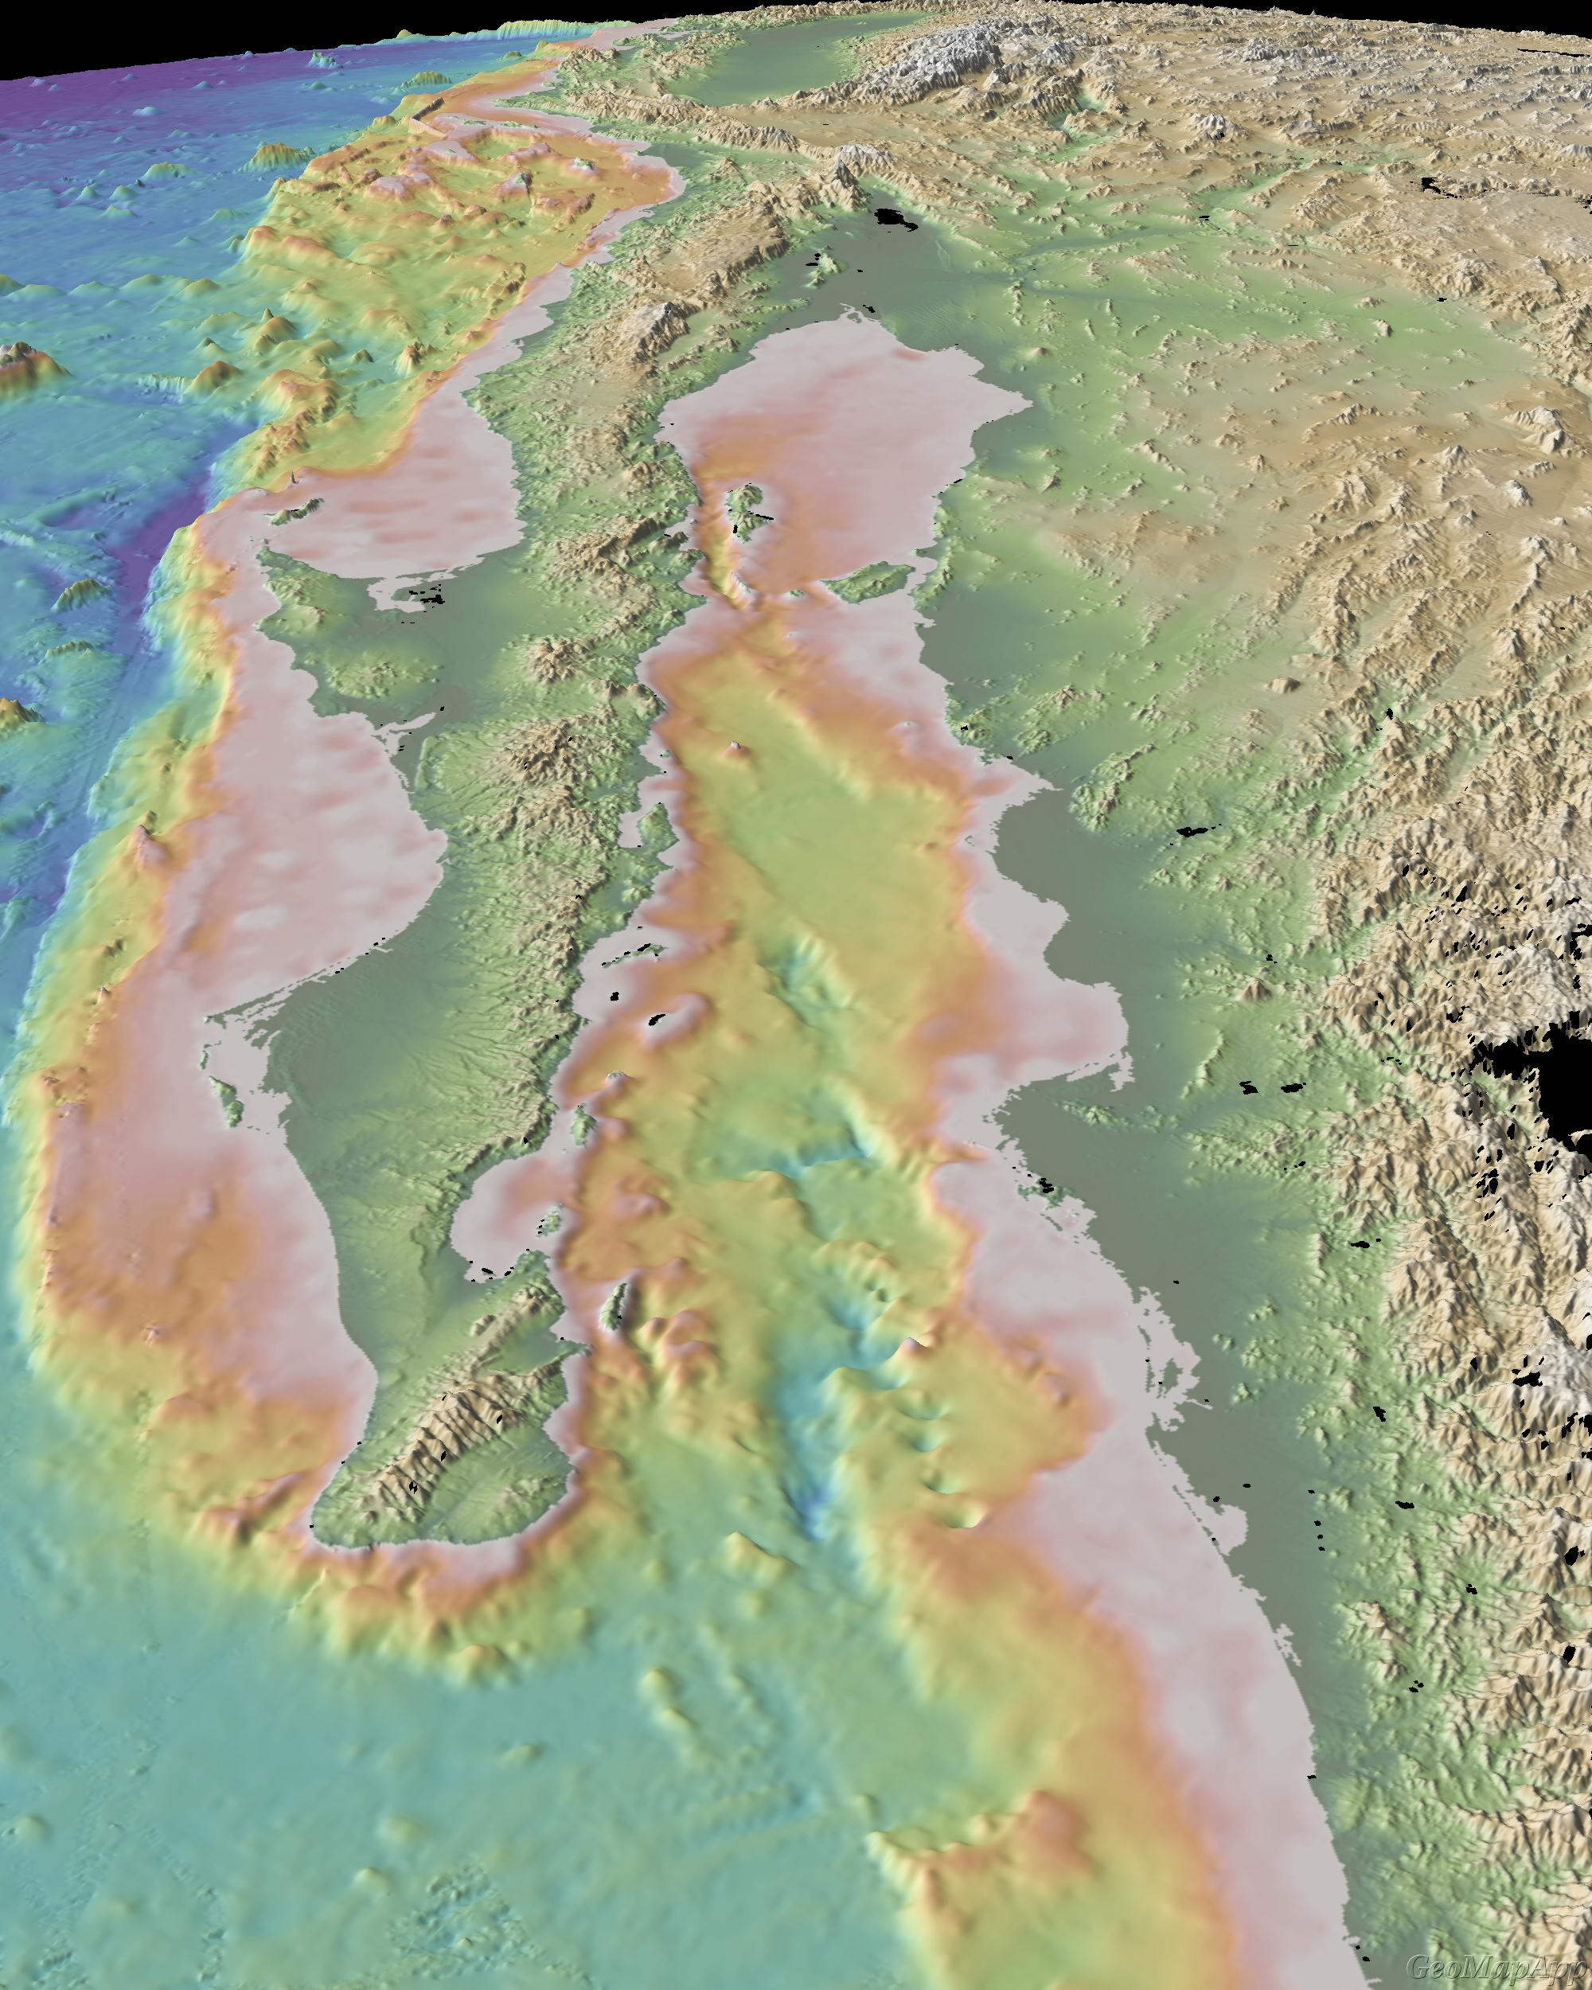
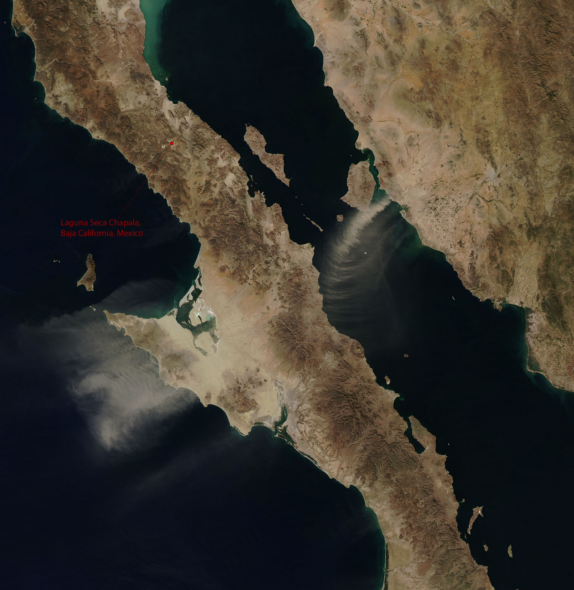
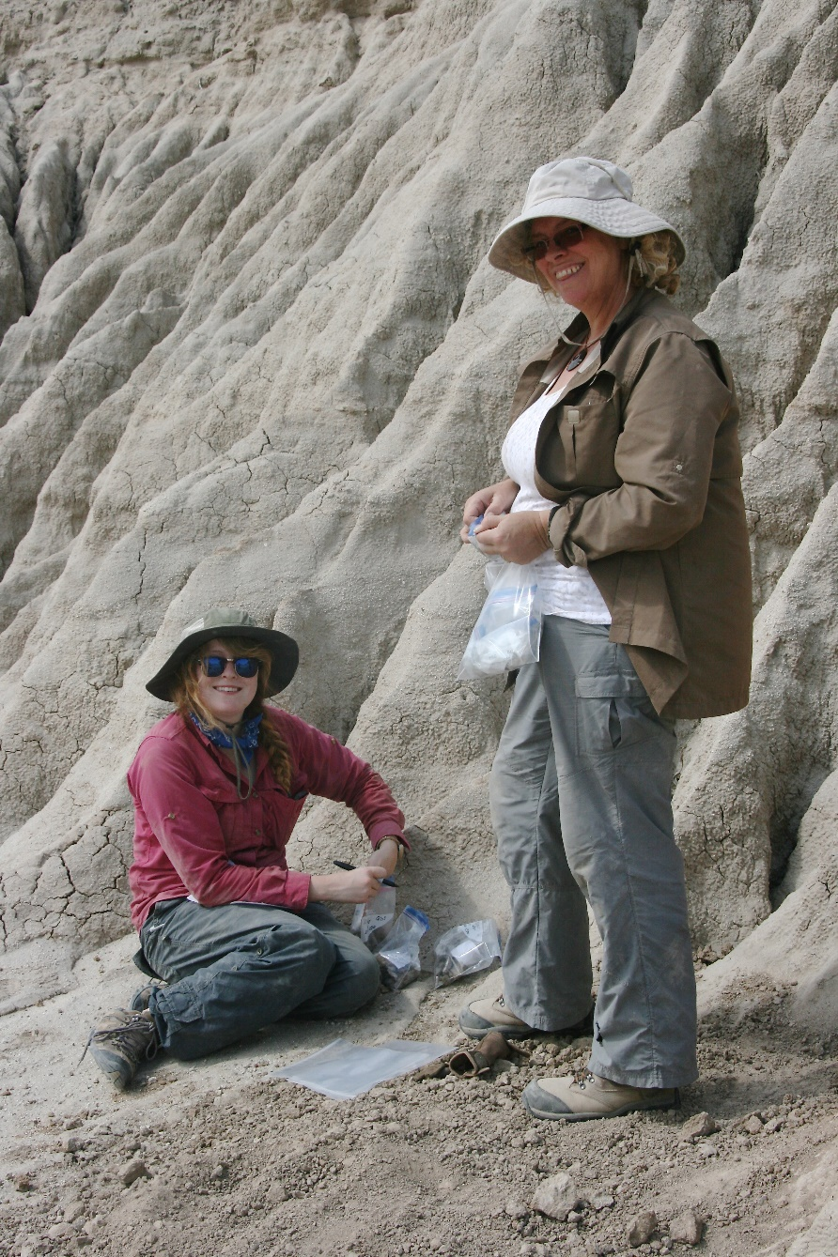
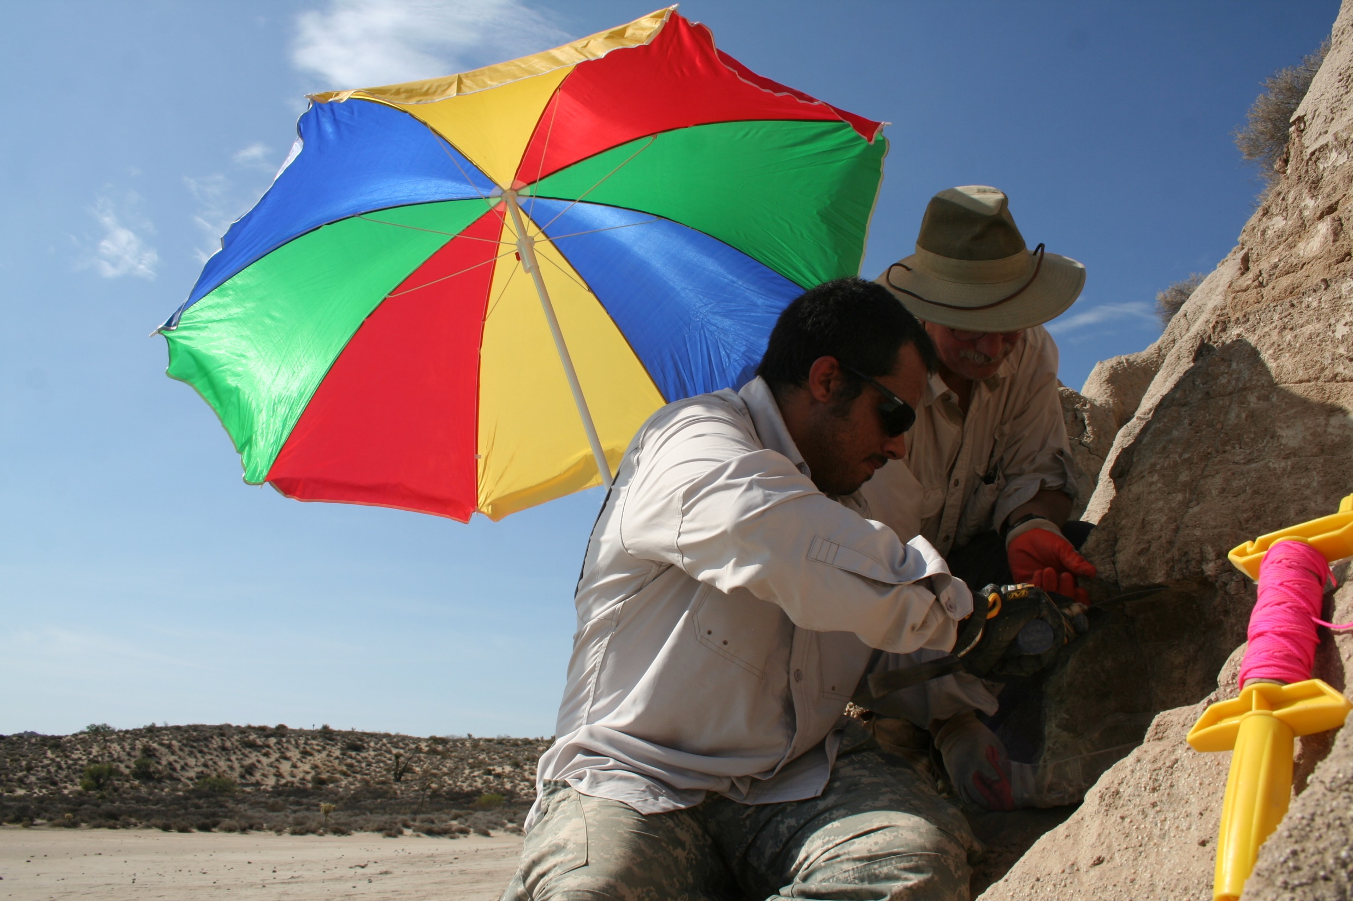
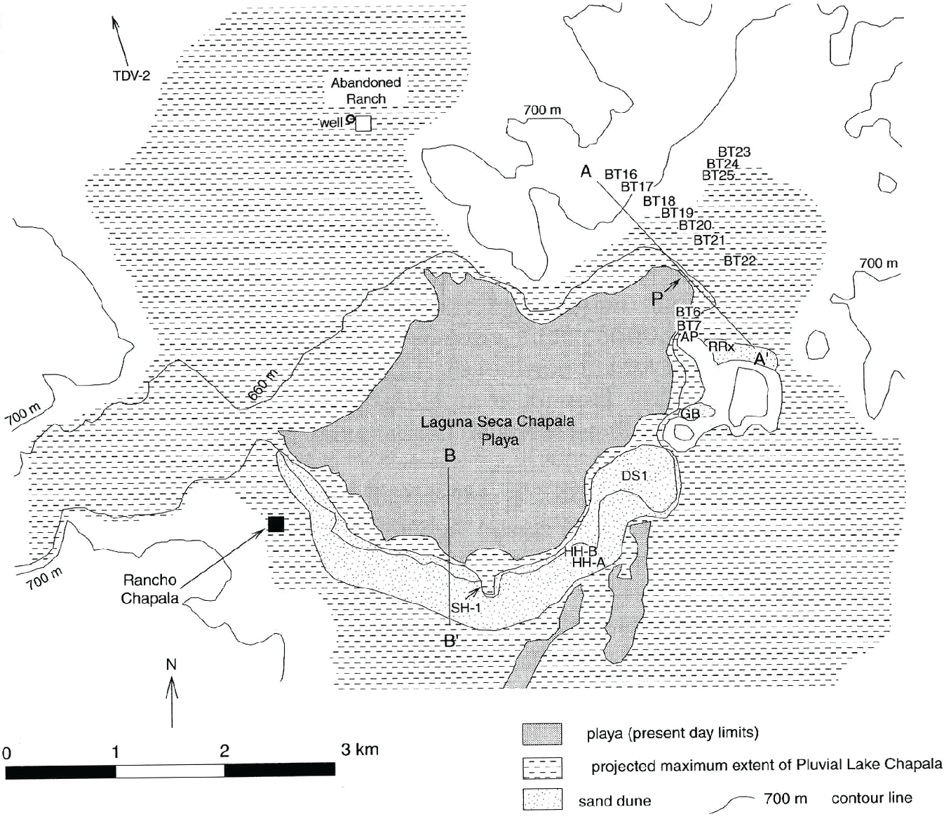
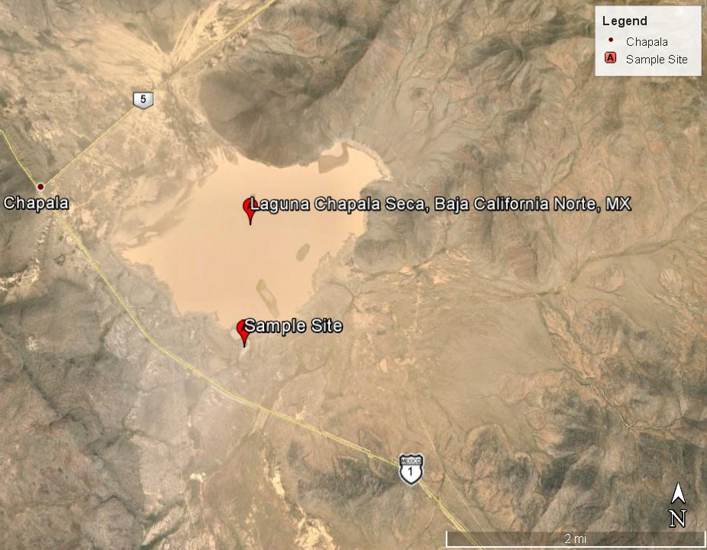
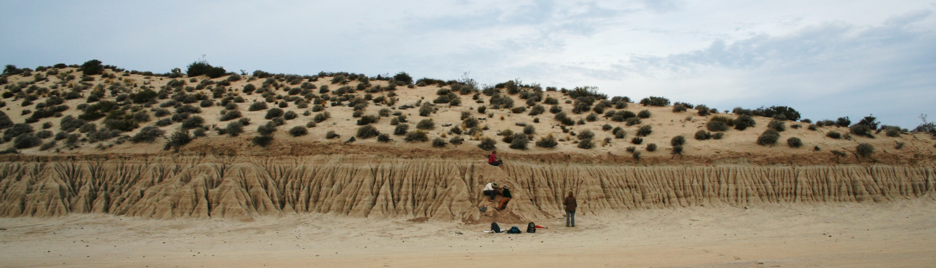
Investigation of the Younger Dryas Event through
Analysis of Sediment from Lake Chapala, Baja California, Mexico
THOMAS, Kaylee; HASKIN, Jesse; NIEMI, Tina; MUROWCHICK, James; and RAAB, L. Mark
DEPARTMENT OF GEOSCIENCES, University of Missouri – Kansas City
Abstract
data
Results
This study examines the sedimentology, stratigraphy, and mineralogy of deposits exposed along the margin of a dry lake basin, Laguna Seca Chapala, in central Baja California, Mexico that previous studies show span the Younger Dryas stadial. The Younger Dryas was an abrupt change in climate that occurred approximately 12.9 ka that is hypothesized to have been triggered by a cometary airburst or impact. A stratigraphy of a 3.4 m section was drawn of an outcrop of lacustrine sediment along the southwest margin of Laguna Seca Chapala. Sediment includes silty clay interbedded with five layers of coarse sand to silty sand that likely represent stages of lower lake levels. Samples were collected every 2 cm across two distinct grain-size boundaries that were bracketed by optically stimulated luminescence and radiocarbon dating reported by Davis (2003) to be between 15 ka and 8 ka. Samples were wet sieved for grain size, botanical, and microfossil analyses. The magnetic fraction was processed with a strong grade 42, neodymium magnet. Samples were examined by scanning electron microscopy (SEM) and energy dispersive spectroscopy (EDS) to search for potential impact markers including magnetic and carbon spherules. Results show that the floated fraction decreased in mass and volume with age, the oldest samples having the smallest amount. SEM analysis of spherules collected in the floated fraction show possible carbonate spherules coated with very fine-grained silicate minerals. The magnetic fraction (primarily detrital magnetite) increased with depth. The magnetic fraction of each sample layer was sieved to isolate the varying sizes and analyzed under an optical microscope in order to find and select possible magnetic spherules with the selected candidates scheduled for further analysis utilizing SEM microscopy. Future testing will include collecting additional samples from Laguna Seca Chapala in August 2015 as well as further examination by SEM for a more precise look at any spherule candidates.
Stratigraphy of lake chapala
+20
m
LC 150 thin section (Unit 9) 20x objective 0.75mm across containing microcline in cross polarized light (CPL)
LC 140 thin section (Unit 8) 5x objective 3mm across showing feldspar altered to orthoclase perthite in plane-polarized light (PPL).
LC 140 thin section (Unit 8) 5x objective 3mm across showing feldspar altered to orthoclase perthite in CPL.
50
Stratigraphic Section (Davis 2003)
LC 156 thin section (Unit 9) 20x objective 0.75mm across containing grain of plagioclase feldspar in CPL.
LC 120 thin section (Unit 6) 10x objective 1.5mm across biotite grain in CPL.
LC 10 thin section (Unit 3) 10x objective 1.5mm across showing oxides (dark brown to black grains) in PPL.
150
Study Area
200
Lake Chapala is in the Laguna Seca Chapala basin located in the central region of the Baja Peninsula of Mexico. Lake Chapala is accessed by driving northeast on Highway México 1 from Bahia de los Angeles.
LC +28 to +30 Float Fraction (Unit 1) SEM photo of possible carbonate spherule or spore.
LC +28 to +30 Float Fraction (Unit 1) SEM photo of possible spore.
LC +28 to +30 Float Fraction (Unit 1) SEM photo of andesine and possible carbonate spherules and/or spores.
Approximate
site location
250
300
Carefully mapping the Qls3 section (2015)
LC +28 to +30 Float Fraction (Unit 1) SEM photo of possible carbonate spherule or spore.
LC +28 to +30 Float Fraction (Unit 1) SEM photo of possible carbonate spherule or spore.
LC +28 to +30 Float Fraction (Unit 1) SEM photo of spherules found with binocular microscopy.
Conclusions
The OSL data previously collected from Lake Chapala shows that the Younger Dryas Event which occurred 12.9ka is likely recorded in the stratigraphic outcrop. The stratigraphy of the lake represents possible cycles of lake stands rising and falling characterized by silty clay and silty sand. The grain size analysis shows that the stratigraphy of the outcrop has a fining upward trend with finer grained sediments representing high lake stands. The sediment is moderately sorted to very well sorted showing that the sediment has undergone transporting and is uniform. The petrographic thin section analysis shows that the majority of the samples contain plagioclase feldspar, quartz, and biotite with a possible matrix of montmorillonite, portraying that the host rock of the samples is volcanic. The feldspars aren’t turbid and the samples contain volcanic clastics and lithic fragments. Microcline was found in sample LC150 which denotes that the host rock of Unit 9 is plutonic. The float fraction contained several microscopic reddish spherules which were ran through the SEM. The data from the SEM is interpreted to likely be carbonate spherules and/or spores. Further research will include a microfossil analysis, examining magnetic microspherule candidates under the SEM, and processing samples gathered in August 2015 which likely cross the Younger Dryas Boundary.
Stratigraphic Section (Niemi 2013; Thomas, Niemi 2015)
Computer generated 3D relief map of
Baja Peninsula (Geomapapp.org)
Location of Laguna Seca Chapala in
Baja California, Mexico (Google Earth images)
Dr. Murowchick and J. Haskin detailed sampling of 120-220 (2015)
Dr. Niemi and K. Thomas sampling (2015)
Methods
We processed and analyzed detailed samples Dr. Tina Niemi and Dr. Jim Murowchick had previously extracted from Lake Chapala sediment above and below what Davis (2003) called Qls3.
A master’s student at UMKC used OSL dating on 5 samples from Qls1, Qls 2, Qls5, Qls6, and Qls9. The student concluded them to be 10.06+/-0.45 ka; 9.13+/-0.60 ka; 11.65+/-1.36 ka 12.79+/-0.78 ka; and 14.94+/-0.68 ka respectively.
Based on the OSL data, we extracted sediment samples every 2cm from 120-220cm which likely crosses the Younger Dryas Boundary and every 10cm from Qls3 and Qls8-9 and created a stratigraphic profile of the lake outcrop.
We analyzed thin sections with optical microscopy under plane polarized light (PPL) and cross polarized light (CPL) to determine sediment composition. The matrix was determined using birefringence under PPL and using 1.52 refractive index oil.
Per protocol of Firestone et al (2006), the sediments were put in a slurry to skim the float (organics) fraction and extract the magnetic fraction using a grade 52 neodymium magnet. The organics were then placed under a binoscope to look for carbon spherules. Spherules found were placed under the SEM (scanning electron microscope). The UMKC Geoscience Department’s sieves were used to determine the sediment sorting and grain size.
Laguna Seca Chapala (Google Earth images)
Laguna Seca Chapala (Davis 2003)
Outcrop of Laguna Seca Chapala (2015)

