Slide 1

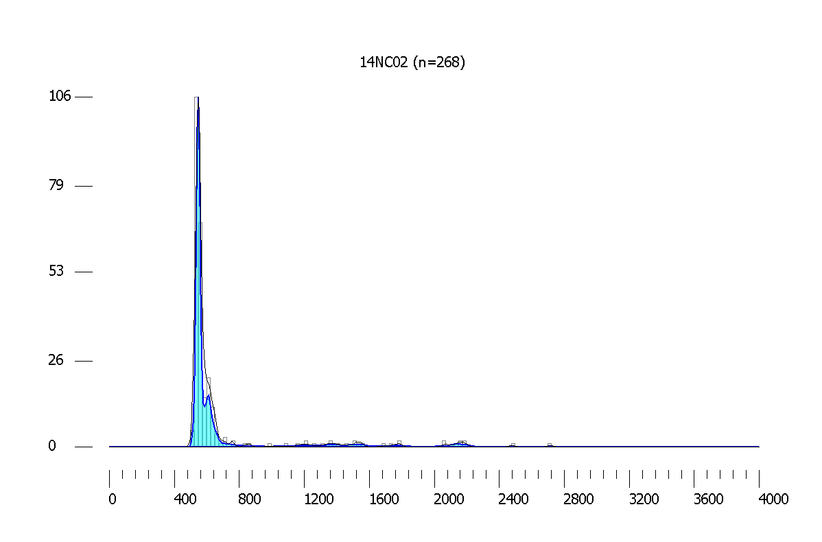
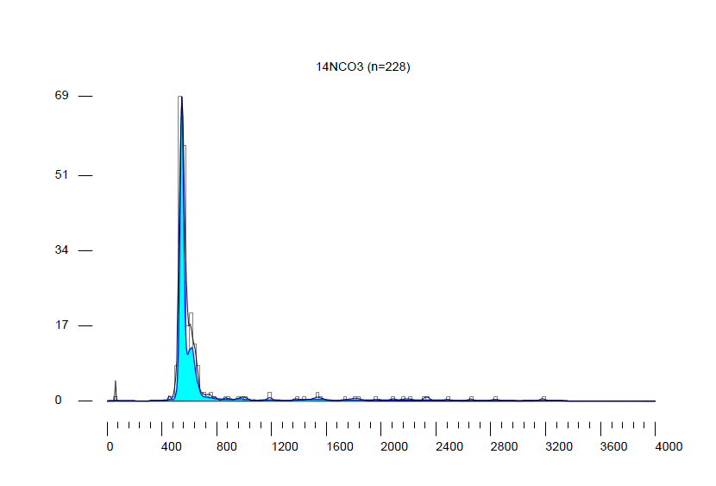

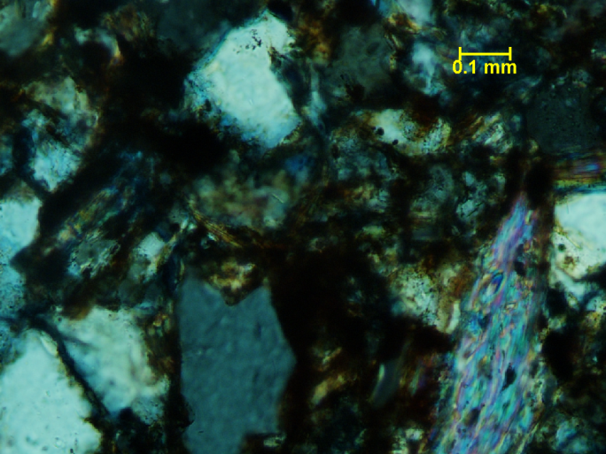
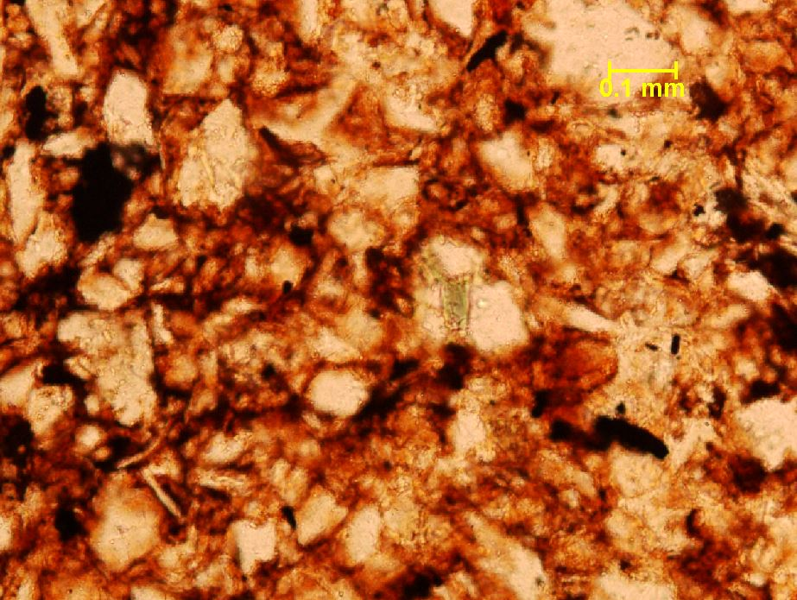

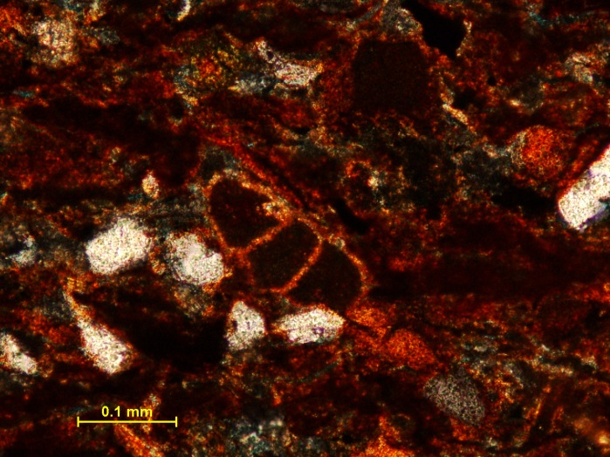
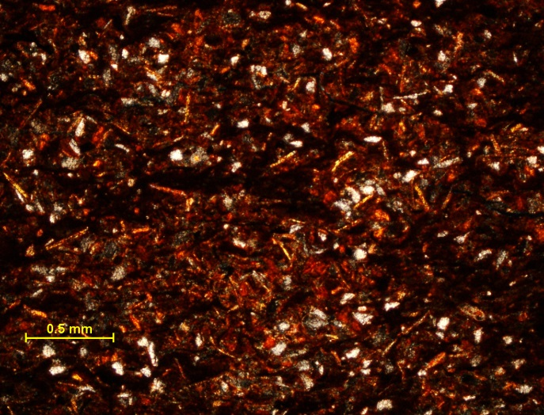
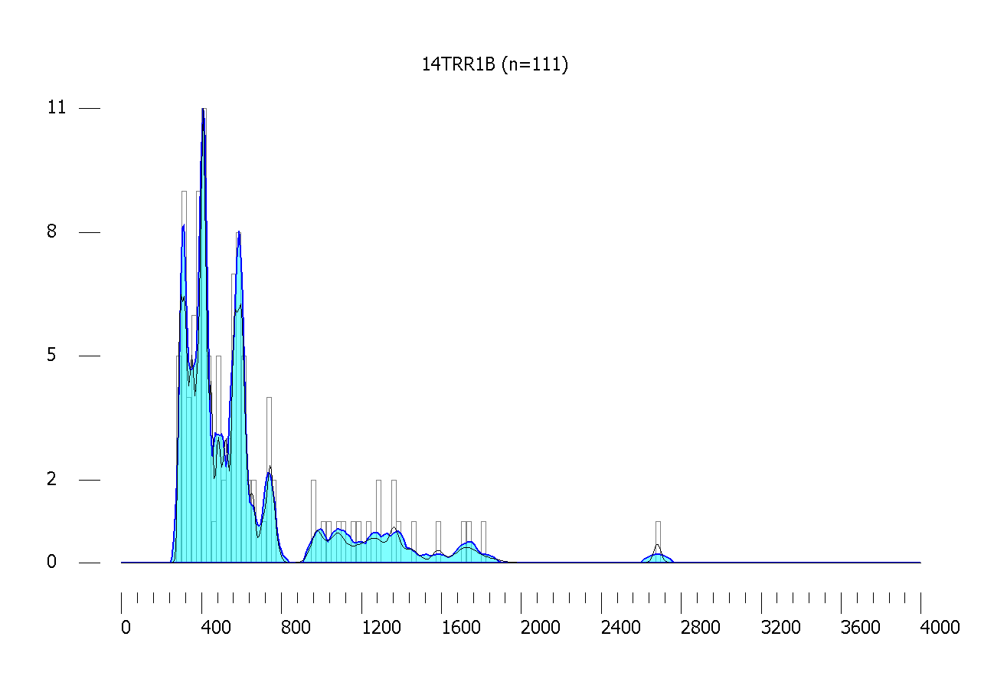
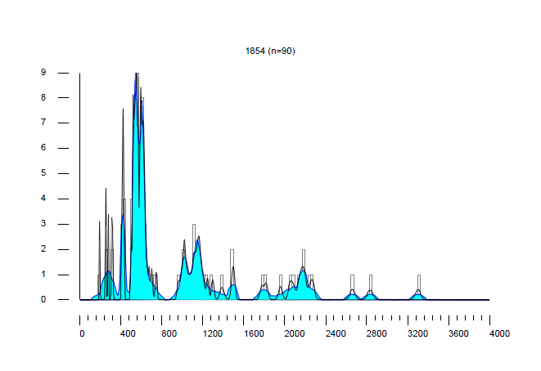


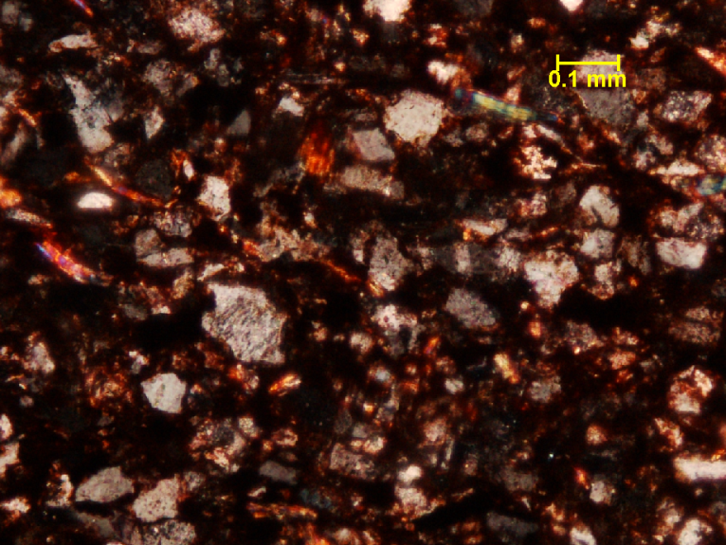
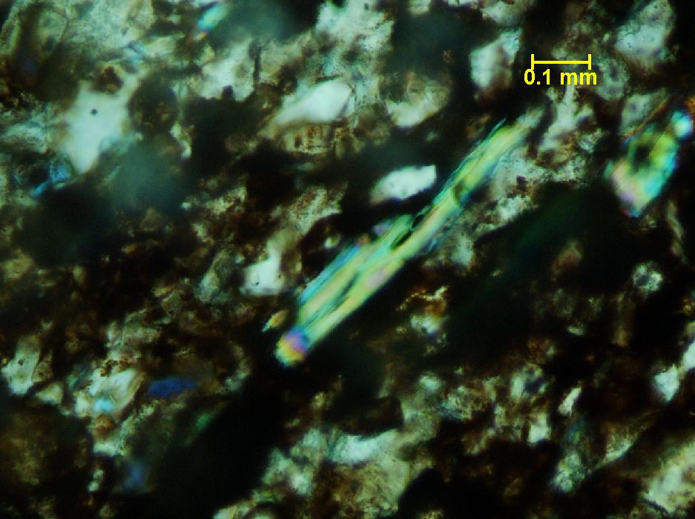


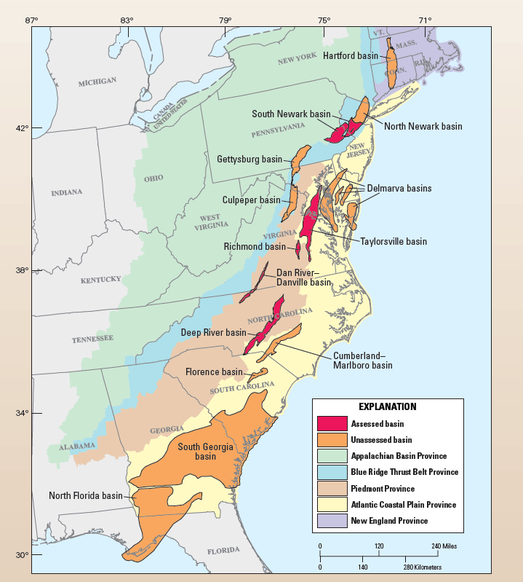
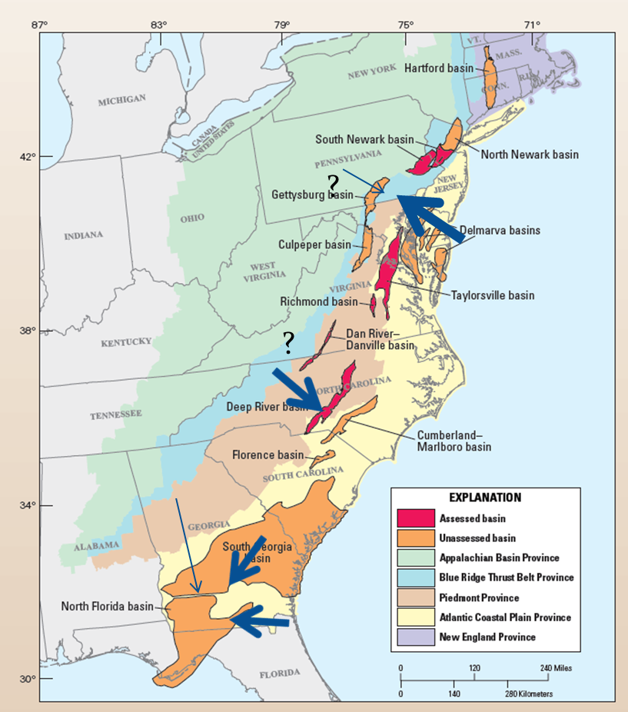
PROVENANCE OF NEWARK SUPERGROUP DEPOSITS IN THE DEEP RIVER SUB-BASIN FROM DETRITAL ZIRCON ANALYSIS
Bowman, S, Wiley, K, and Weislogel, A
Department of Geology and Geography, West Virginia University, Morgantown, WV, 26506
Abstract
Detrital Zircon Age Results
During Late Triassic time, alluvial, fluvial and lacustrine deposition of the Newark Supergroup occurred along the developing U.S. Central Atlantic Margin as the margin transitioned from a post-collisional system to a rift system. Based mainly on stratigraphic analysis and conventional provenance techniques, such as conglomerate clasts counts and sandstone petrology, it has been hypothesized that Newark Supergroup strata were deposited in half-grabens and that basin fill was sourced mainly by erosion of eastern and western basin margins, with some basins becoming stratigraphically linked during the latest stage of preserved deposition. The Deep River sub-basin in North Carolina is the most southerly of the exposed Triassic Central Atlantic rift margin basins. We compare detrital zircon signatures of sandstones from the Carnian Pekin Formation with the Norian Sanford Formation preserved in the Deep River sub-basin in order to characterize the provenance of sediment in the Deep River basin and test for sediment influx from other sub-basins to the north during Late Triassic evolution of Newark Supergroup depositional systems. Approximately 40% of the 300 detrital zircon grains analyzed from each of the Pekin Formation and Sanford Formation samples form an early Cambrian population with a peak at ~546 Ma. Between 7-11% of the zircon in both samples form a late Neoproterozoic population with a peak at ~610 Ma. Each sample yielded just 9 ages that were >2000 Ma. Based on the detrital zircon age signatures, we interpret the source for Deep River sub-basin sediment is likely the Albemarle Group of the Carolina Terrane, which contains volcanogenic sandstone, felsic volcanic rocks, felsic (meta)intrusive rocks and associated metapelites; rocks of the Albemarle Group have recently been shown to yield abundant 540-560 Ma zircon. The petrology of the Albemarle Group is also consistent with the feldspathic litharenite composition of Deep River sandstone framework grains, which suggests a dissected arc provenance. The similarity and unimodal nature of the age distribution of the samples suggests sediment was derived from a local source to the west of the Deep River sub-basin and the drainage system was characterized by a regionally limited and largely static catchment.
Petrography & Sandstone Composition
Deep River Basin, NC
Deep River Basin, NC
Peri-Gondwanan
Peri-Gondwanan
A
B
A) 14NC02. Isotropic inclusions within muscovite at 40X XPL B) 14NC03. Polycrystalline quartz, opaque iron oxide deposits and tourmaline PPL 40X
A
B
442. A) Terrestrial chambered fossil. B) Monocrystalline quartz, muscovite and k-feldspar at 4X XPL
Appalachian
Gettysburg Basin, MD
Tallahassee Graben, FL
Appalachian
Pan African 1 and 2
Grenville
Eburnean/Trans-Amazonian
Triassic Paleogeography ~ 230 Ma
A
12T-RR1. A) biotite and muscovite, plagioclase twinning at 20X XPL. B) at 40X, lathe shaped mica
Major age peaks for the Pekin and Sanford are between 540 and 610 Ma. Major ages for the South Georgia Rift include a similar peak between this interval but has a wider distribution of ages characteristic of a mature, well developed drainage network. Major Peaks for the South Georgia Rift include 266 (Alleghenian), 420 (Taconic), 551-610 (Peri-Gondwanan), 1021-1147 (Grenville) , and 2178 (Eburnean/Amazonian) Ma. The Gettysburg Basin retains a strong Appalachian source with 309 (Alleghenian) and 406 (Taconic) Ma. All basins received substantial sediment input from Ediacaran Gondwanan aged terranes.
Table 1. Normalized modal framework grain composition.
12T-RR1 and 14T-RR1B
Conclusions
● 442
● 14NC02
● 14NC03
● 12T-RR1
14NC02 and 14NC03
B
The Albemarle Arc of the Carolina Terrane is the most probable source for the Deep River Basin (Horton et al., 1991). The South Georgia Rift also retains a similar mode, but has a wider distribution of ages characteristic of a mature, well developed drainage network. The South Georgia Rift contains sourced material derived from a mix of Appalachian and Suwannee source terranes. Future dating will focus on Triassic clastics of the South Georgia Rift in southern Georgia and the Gettysburg Basin in central Maryland and the Dan River Basin of NC and VA.
442
1854
Arkose
Lithic Arkose
Litharenite
(Blakey, 2005)
(Milici et al., 2012)
Acknowledgements
Basin Descriptions
South Georgia Rift Basin: Newark Group (442)
The Basin is infilled with thick packages of red bedded sandstone and shale that is interpreted as Newark Group. Depositional environments for the basin have been interpreted as alluvial fan along the basin margins, with lacustrine infill in the basin center (Chowns and Williams, 1983). The detrital zircon sample for this study was collected from the Tallahassee Graben, which extends from the South Georgia Rift into Southern Florida
Deep River Basin: Sanford Formation (14NC02) and Pekin Formation (14NC03)
The Sanford Formation and Pekin Formation are the youngest and oldest end-member formations composing the Deep River Basin. The depositional setting for this basin is predominately lacustrine and fluvial floodplain. Scoyenia ichnofacies and clam shrimp, Class Conchostraca are found throughout the basin (Clark et al., 2011, and Reid et al., 2011). Gettysburg Basin: New Oxford Formation (12T-RR1 and 14T-RR1B)
Fine grained sandstone to conglomerates are found in Alluvial fan deposits with coarsest sediment proximal to source. Grey shales and fine grained sandstones are present in lacustrine environments between fan deposits (Faill, 2003).
We would like to thank the University of Arizona, University of South Carolina, and The University of Texas for analytical assistance as well as the Georgia Environmental Protection Division for providing Georgia well cuttings.
Relative strength of sediment source area. Heavier lines of correlate to higher population of sediment from general area
References
Suwannee Terrane
Carolina Terrane (Peri-Gondwanan)
Appalachian (Alleghenian, Acadian, and Taconic)
Grenville Terrane
Blakey, R., n.d. Colorado Plateau Stratigraphy and Geology and Global and Regional Paleogeography. N.p. Web. 20 Feb. 2015.
Chowns, T.M., and Williams, C.T., 1983, Pre-Cretaceous rocks beneath the Georgia Coastal Plain – Regional implications, in Gohn, G.S., ed., Studies related to the Charleston, South Carolina, earthquake of 1886 – Tectonics and seismicity: U.S. Geological Survey Professional Paper 1313, p. L1-L42.
Clark, T.W., Taylor, K.B., and Bradley P.J., 2011. Geology, natural gas potential and mineral resources of Lee, Chatham, and Moore Counties, North Carolina: Carolina Geological Society, Field Trip Guidebook, Aberdeen, North Carolina, p. 1-56
Faill, R.T., 2003. The early Mesozoic Birdsboro central Atlantic margin basin in the Mid-Atlantic region, eastern United States
Horton Jr., J.W., Drake, A.A., Rankin, D.W., and Dallmeyer, R.D. 1991. Preliminary tectonostratigraphic terrane map of the central and southern Appalachians. United States Geological Survey, USGS Numbered Series, IMAP 2163
Milici, R.C., Coleman, J.C., Rowan, E.L., Cook, T.A., Charpentier, R.R., Kirschbaum, M.A., Klett, T.R., Pollastro, R, M., Schenk, C, J., 2012, Assessment of undiscovered oil and gas resources of the East Coast Mesozoic basins of the Piedmont, Blue Ridge Thrust Belt, Atlantic Coastal Plain, and New England Provinces, 2011. United States Geological Survey. Fact Sheet 2012-3075.
Park, H., Barbeau Jr., D.L., Rickenbaker, A., Bachmann-Krug, D., and Gehrels, G.E. 2010. Application of foreland basin detrital-zircon geochronology to the reconstruction of the southern and central Appalachian Orogen. The Journal of Geology, v .118, p. 23-44
Reid, J.C., Taylor, K.B., Olsen, P.E., and Patterson, O.F., III, 2011. Natural gas potential of the Sanford sub-basin, Deep River Basin, North Carolina: American Association of Petroleum Geologists Eastern Meeting, Crystal City, Virginia, p. 1-73
From Milici et al., 2011 and Park, et al., 2010

