Slide 1


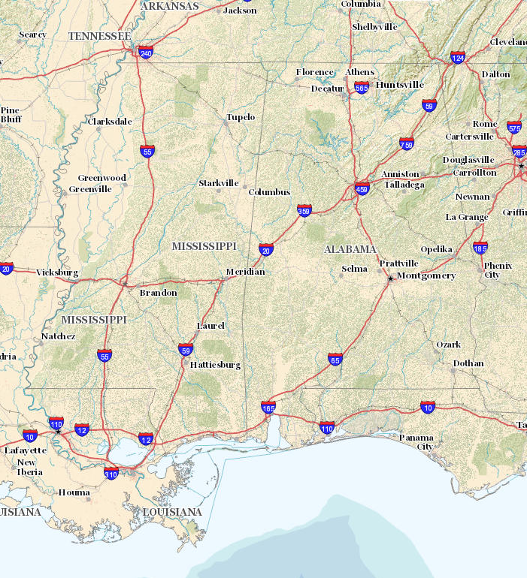
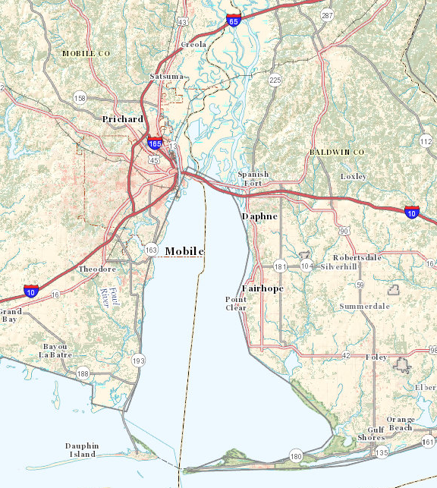
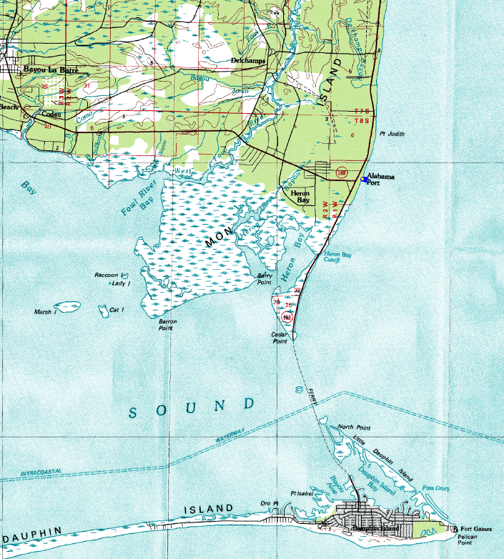
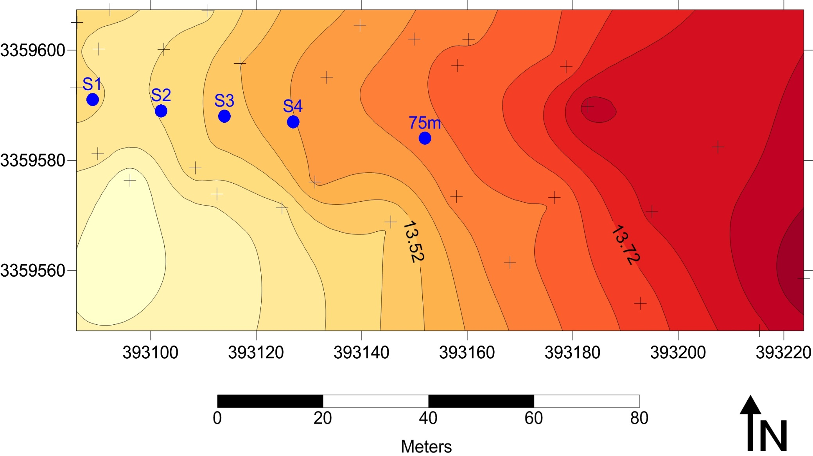
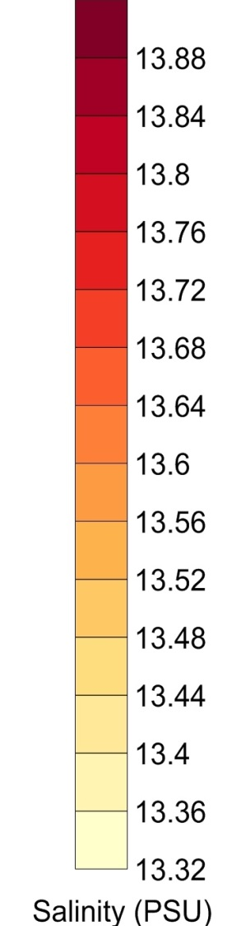
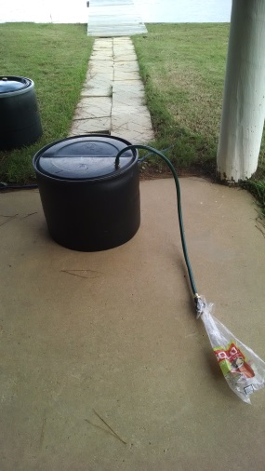
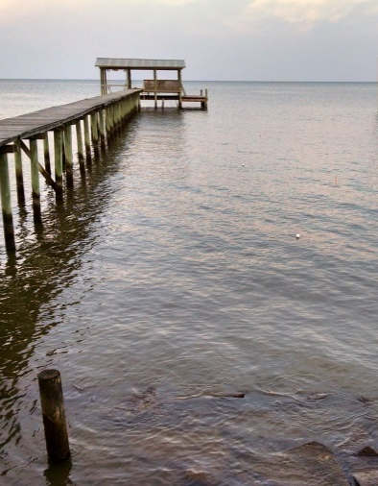

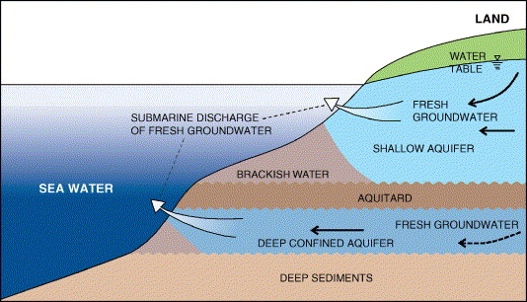
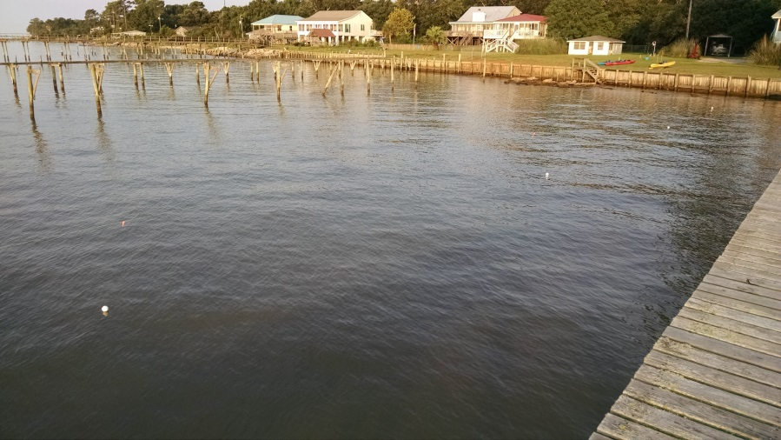
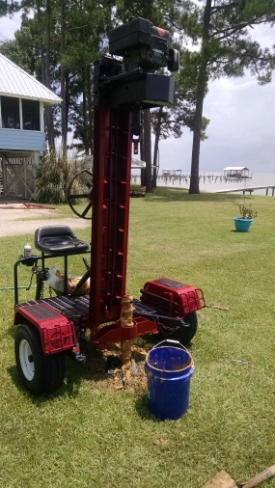
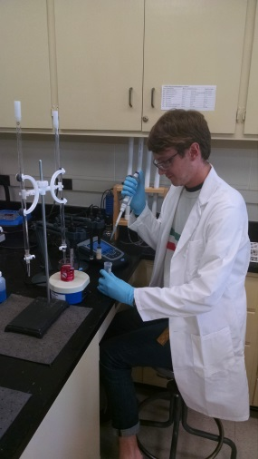

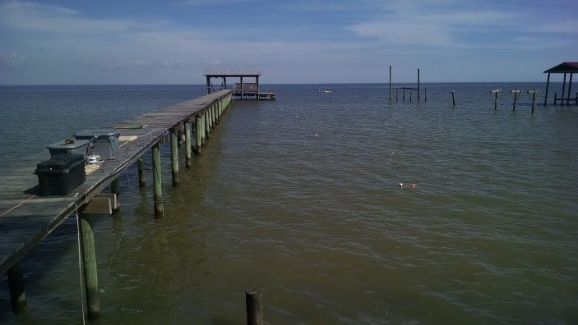
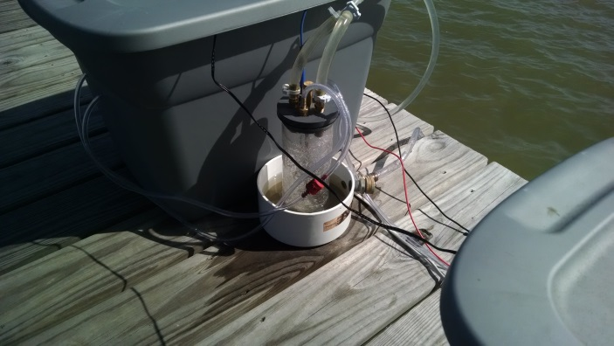
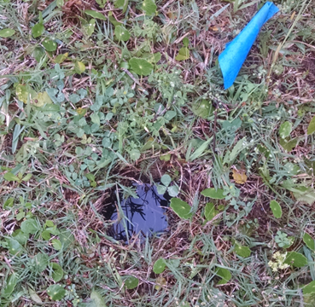
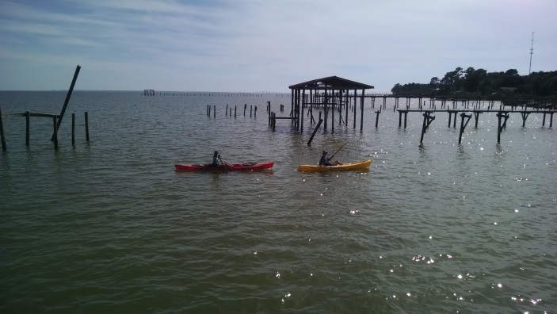

Submarine Groundwater Discharge and Nutrient Dynamics in the Vicinity of Coastal
Residences with Onsite Wastewater Treatment
D. Alex Beebe, Dane J. Leach, and David T. Allison
University of South Alabama, Department of Earth Sciences
Abstract
Materials and Methods
Results: Seepage Zone Delineation
Results: Submarine Discharge and Nutrient Flux
Eutrophication driven by anthropogenically-derived nutrients is a growing threat to the environmental resiliency of coastal waters. Efforts are underway to manage nutrients in surface waters; however, recent studies indicate that coastal nutrient input via submarine groundwater discharge may exceed that of surface water discharge. In particular, septic effluent has been implicated as a significant source of submarine nutrient discharge in coastal developments that lack centralized wastewater collection. In order to gain a better understanding of the links between onsite wastewater treatment and coastal water quality at a residential site located on the coast of Mobile Bay, AL, submarine groundwater discharge and nutrient transport were characterized using a combination of hydrogeologic and oceanographic techniques. Six shallow wells (3-m deep) were installed around a residential site with onsite wastewater treatment to monitor groundwater velocity and nutrient concentrations (ammonia, nitrate, and phosphate) of the surficial coastal aquifer. Lee-type seepage meters were deployed to measure fluxes of submarine groundwater and nutrients to the waters of Mobile Bay throughout the tidal cycle. Results indicate elevated nutrient concentrations in both groundwater and submarine groundwater discharge relative to bay water. Nutrient concentrations in groundwater were highest in the vicinity of the onsite wastewater treatment system. The dominant form of inorganic nitrogen in both groundwater and submarine groundwater discharge was ammonia, thus indicating incomplete nitrification of septic effluent and limited soil cation exchange. In addition, the presence of elevated concentrations of reactive phosphorus in groundwater samples suggests reducing conditions in the aquifer that prohibit iron-phosphate complexation prior to submarine discharge. The average flux of nitrogen to the nearshore environment throughout the tidal cycle was 2.2 x 10⁻³ mol m⁻² d⁻¹ which exceeds previously reported fluxes of nitrogen via submarine groundwater discharge in other Gulf Coast estuaries. Results from this study highlight the impacts of septic effluent from coastal residential development on coastal water quality, particularly in areas with shallow groundwater.
Study Area
Integrated Discharge =
1.92 m³/day per m of shore
Surface Water Salinity Map (Shore is Western Boundary)
Groundwater Flux Measurements
Seepage Zone Delineation
Water
Characterization
Flux
Calculations
A conservative integration of groundwater flux assuming a 100-m seepage zone yields an estimated submarine groundwater discharge of 1.92 m³/day per m of shore. The average submarine groundwater flux (weighted by seepage width) was1.92 cm/day while estimated total inorganic nitrogen flux was 2.2 mmol/ m² per day.
Perpendicular array of four Lee seepage meters with12.5-m spacing
Measurements recorded every 4 hours for 24 hours total (~tidal cycle)
Salinity and conductivity used as proxies for groundwater influence
Two “pier” transects
One kayak transect with automated sonde
Wells installed near and away from septic system
Samples from wells, seepage meters, and surface water analyzed using spectrophotometer
Seepage meter results integrated over seepage zone
Submarine groundwater flux multiplied pollutant concentrations
Discussion and Conclusions
Results indicate that submarine groundwater discharge is tidally influenced and highest near the shore in Mobile Bay. These factors alone suggest a terrestrial component of submarine groundwater discharge and possible transport of septic effluent to the nearshore environment.
Temperature and salinity measurements indicate enhanced groundwater influence within ~ 100 m of the shore (i.e. cooler and fresher water in the absence of nearby surface water contribution).
Nutrient concentrations were elevated in both well and submarine water samples relative to Bay water thus indicating eutrophication potential. The presence of ammonia as the dominant form of nitrogen coupled with low redox potential in groundwater suggests incomplete nitrification of septic effluent.
These results highlight impacts of residential septic effluent on coastal water quality and the need for more robust coastal septic treatment designs.
Introduction
Submarine groundwater discharge (SGD) is defined as any flow of water emanating from the seafloor regardless of its composition, origin, or mechanism driving flow (Burnett et al. 2006).
Despite recognition of SGD as a significant source of water and dissolved materials to the coastal ocean, the link between land-based human activities and submarine pollutant flux remains poorly resolved.
Previous studies have implicated septic effluent as a source of eutrophication to coastal waters, especially when septic lines are located in close proximity to the surficial water table and coastline.
In coastal Alabama, a number of residences that rely upon onsite wastewater treatment (septic) for domestic wastewater management are located directly along the coastline.
Because low topographic relief and high annual rainfall lead to a relatively high regional water table elevation and limited vadose zone, septic system efficiency is expected to be less than ideal.
All three transects indicate a steady increase in salinity with increased distance from the shoreline (eastward). Groundwater influence (indicated by lower salinity) seems to attenuate ~100 m offshore (~100-m seepage zone).
Results: Submarine Groundwater Flux
Results: Biogeochemical Conditions and Water Quality
Future Work
Continued research is currently underway in Mobile Bay to expand upon this study:
Seasonal comparison of submarine groundwater discharge
Comparison of submarine nutrient fluxes from residences with centralized wastewater treatment collection versus residences with antiquated septic systems
Long-term continuous monitoring of submarine groundwater discharge using the natural geochemical tracer, Rn-222
Submarine groundwater discharge schematic (Barnett et al. 2006)
Water table millimeters below surface on 3/13
References
Research Objectives
Burnett, W.C., P.K. Aggarwal, A. Aureli, H. Bokuniewicz, J.E. Cable, M.A. Charette, E. Kontar, S. Krupa, K.M. Kulkarni, A. Loveless, W.S. Moore, J.A. Oberdorfer, J. Oliveira, N. Ozyurt, P. Povinec, A.M.G. Privitera, R. Rajar, R.T. Ramessur, J. Scholten, T. Stielgitz, M. Taniguchi and J.V. Turner, 2006. Quantifying submarine groundwater discharge in the coastal zone via multiple methods. Science of the Total Environment, 367(2).
In order to resolve the effects of human development and onsite wastewater treatment effluent on coastal water quality, the following objectives were completed during the summer of 2015.
Measure the nearshore submarine groundwater flux throughout the entire tidal cycle.
Determine the length of the submarine groundwater seepage face.
Characterize the biogeochemical conditions and water quality in the surficial aquifer and surface water.
Estimate total discharges of water and fluxes of nutrients to Mobile Bay from the study area.
Redfield Ratio (16:1)
Acknowledgements
The authors gratefully acknowledge funding provided through the USA Office of Research and Economic Development’s Research and Scholarly Development Grant Program and the University Committee for Undergraduate Research. In addition, the authors would like to thank volunteer researchers that aided in either field data collection or post-hoc interpretation including: Mary Cave, Taylor Lewis, Jordan Hollinghead, Caroline Borgini, Joseph Patterson, Samuel Barber, and Rachel Beebe. Finally, the authors would like to thank Don and Julie Beebe for providing unrestricted access to the coastal residence.
Seepage meters indicate two trends: (1) Submarine groundwater flux is highest near shore and (2) submarine groundwater flux is tidally influenced due to changes in hydraulic gradient over the tidal cycle
Groundwater near septic tank (Septic) was elevated in nutrients compared to groundwater away from septic tank (Background) and Bay water (Bay). Low redox and high ammonia indicate limited nitrification potential (Septic).

