Slide 1
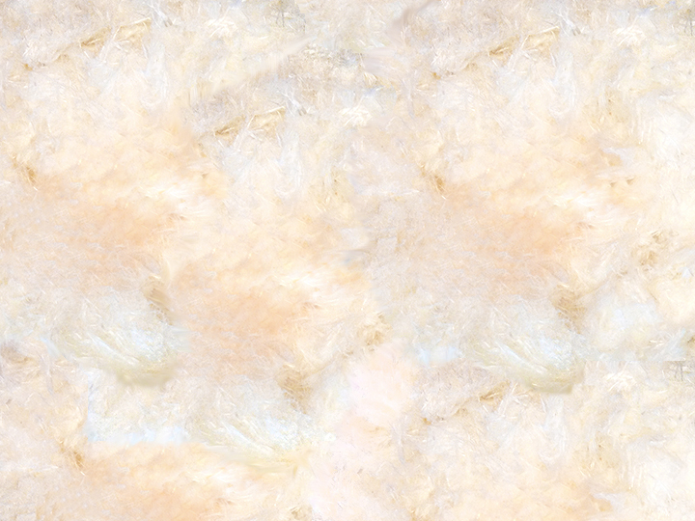

Fungi-Induced Chemical Weathering of Asbestiform Chrysotile
Alexandré J. Fowler
Cara Santelli
Henry Teng

Slide 2
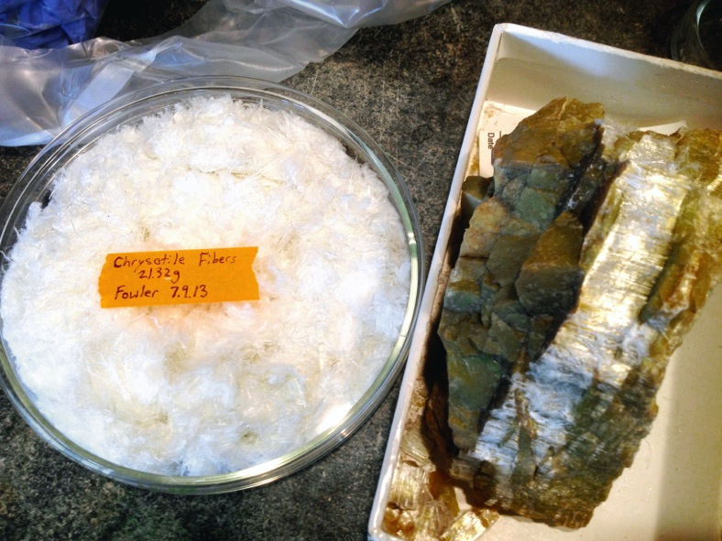
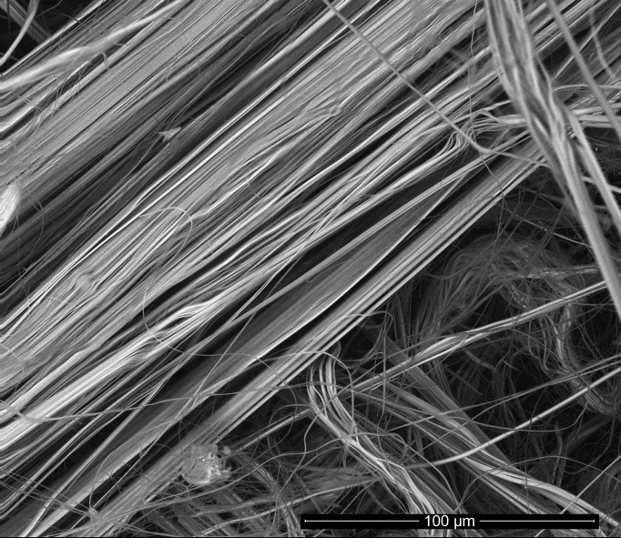
Chrysotile
Mg₃(Si₂O₅)(OH)₄
NMNH 91261
Chrysotile weathering as CO₂ sequestration method via mineral carbonation.
Park & Fan, 2004
Chrysotile weathering and asbestos remediation by microbes?
Dissolution of Mg and Si by fungus: Verticillium leptobactrum
Daghino et al., 2009
Conversion of chrysotile asbestos to non-fibrous amorphous material by lichens.
Favero-Longo et al., 2005
Introduction | References: 11th Edition Report on Carcinogens | Slide 2 of 18

Slide 3
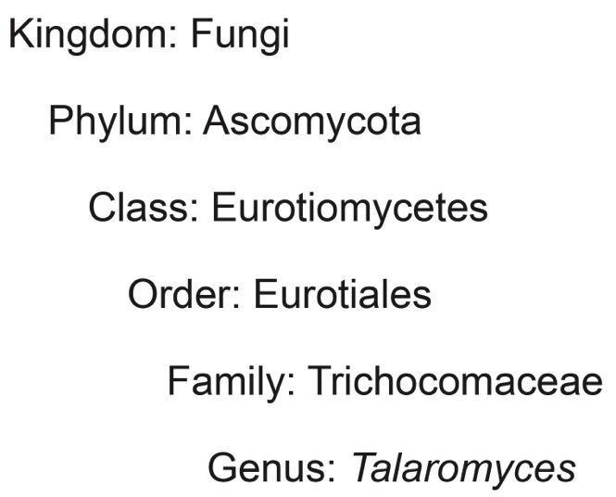
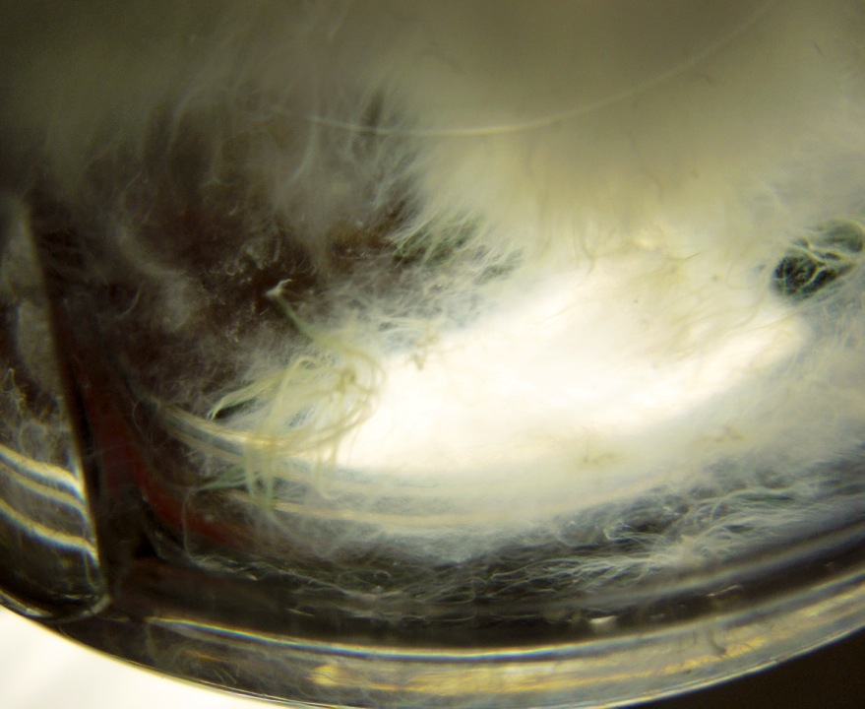
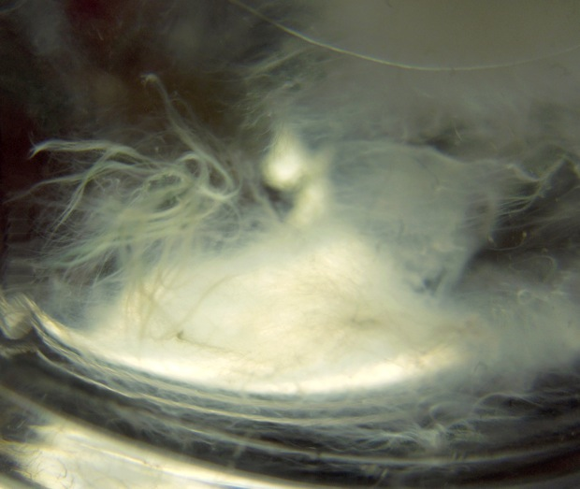
Talaromyces sp.
Isolated from serpentinite soils in Donghai, China
Henry Teng
Li et al., 2015
Introduction | References: Frisvad, 2015 & Encyclopedia of Life | Slide 3 of 18

Slide 4
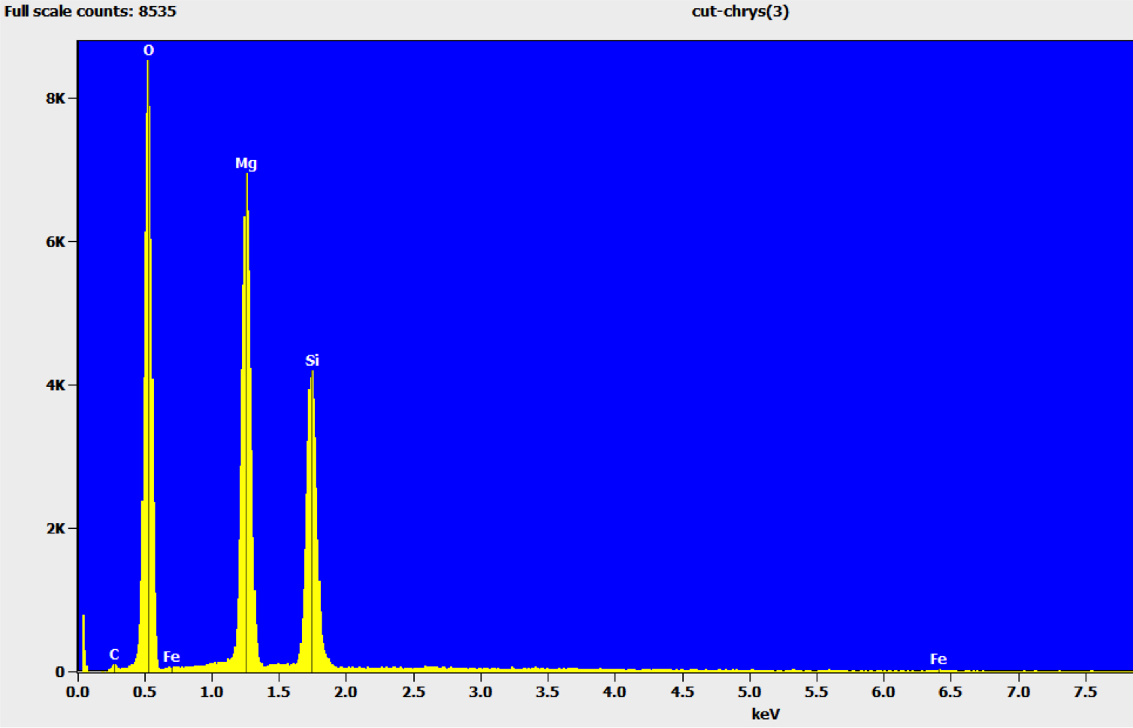
Iron as a Micronutrient
EDS Spectrum NMNH 91261
Chrysotile: Mg₃(Si₂O₅)(OH)₄
Potential trace impurities in chrysotile:
Iron
Aluminum
Nickel
Calcium
Chromium
Manganese
Sodium
Potassium
Introduction | References: 11th Edition Report on Carcinogens Fungal Physiology – David H. Griffin | Slide 4 of 18

Slide 5
Objectives
(1) Compare the biological weathering effect of Talaromyces sp. on chrysotile when bioavailable iron is present or absent in the culture medium
(2) Compare the effect of pH on the in vitro dissolution of chrysotile under biological and abiotic conditions
(3) Determine if biological weathering by Talaromyces sp. is capable of breaking down the structure of chrysotile in vitro
Objectives |  | Slide 5 of 18

Slide 6
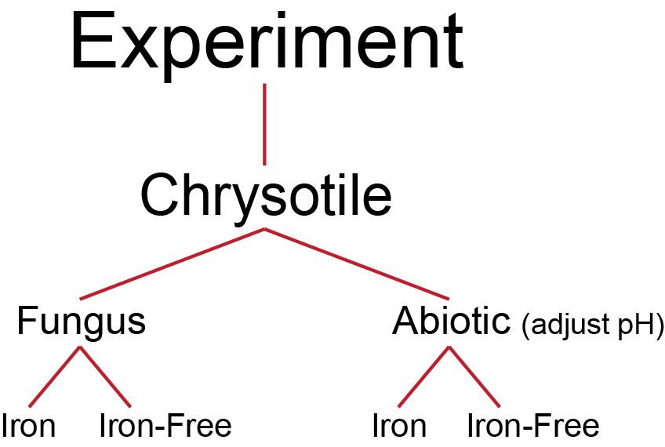
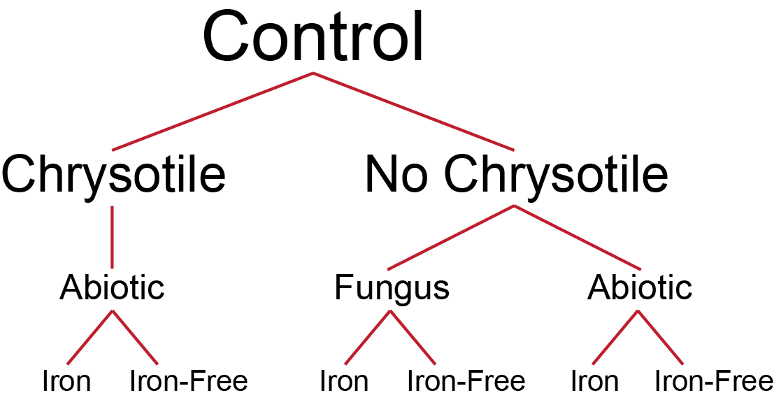
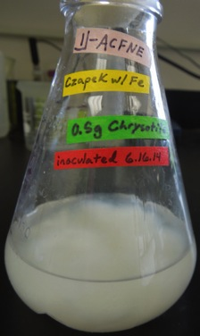
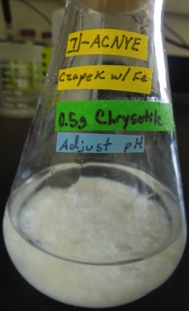
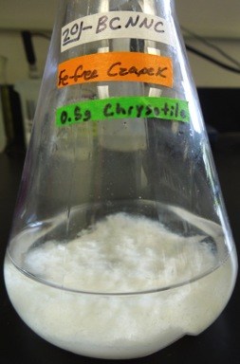
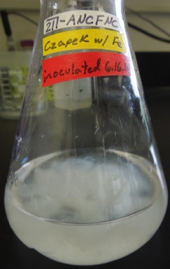
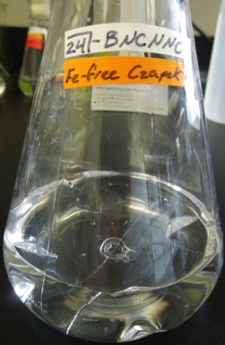
Experimental Setup
Czapek Media: NaNO₃ + KCl + K₂HPO₄ + MgSO₄ + Glucose + 100 ml/L MES buffer
with or without 0.01 g/L FeSO₄
Iron (II)
Methods | References: Daghino et al., 2009 & Li et al., 2015 | Slide 6 of 18

Slide 7
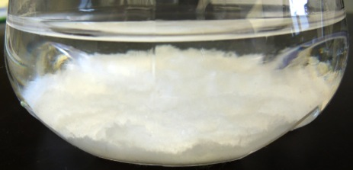
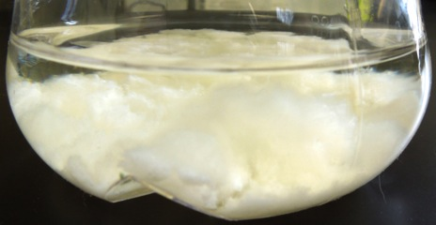
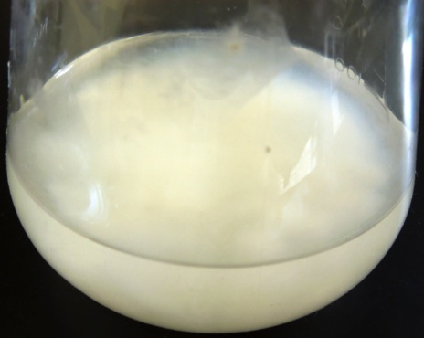
Iron vs. Iron-Free
Day 1
Day 3
Day 18
Results – Objective 1 |  | Slide 7 of 18

Slide 8
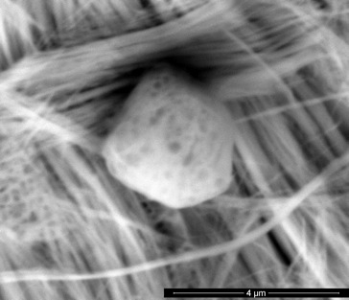
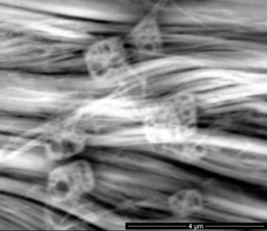
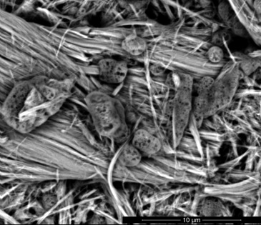
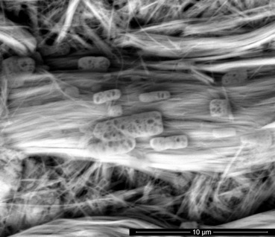
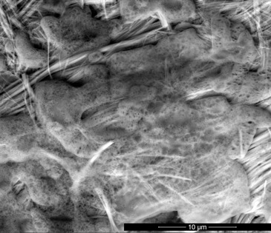
Silica Problems
Experiment
Controls
Results | Flame AA Analysis & SEM | Slide 8 of 18

Slide 9
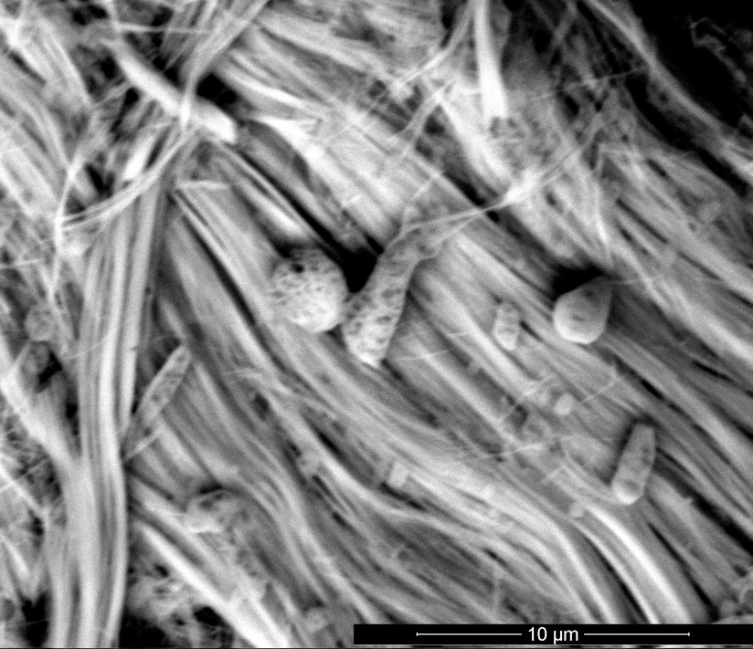
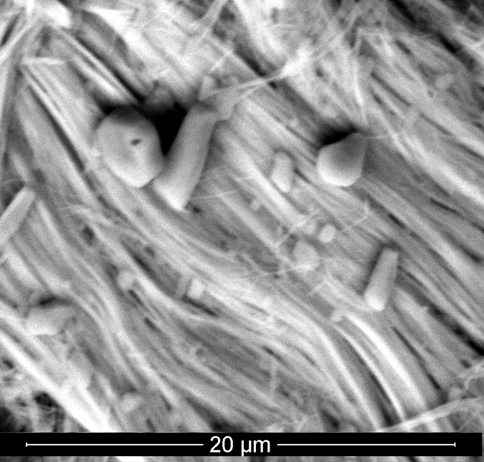
Silica Problems
Silica Precipitates?
Beam Damage After 2 Minutes of Scanning
Results | SEM | Slide 9 of 18

Slide 10
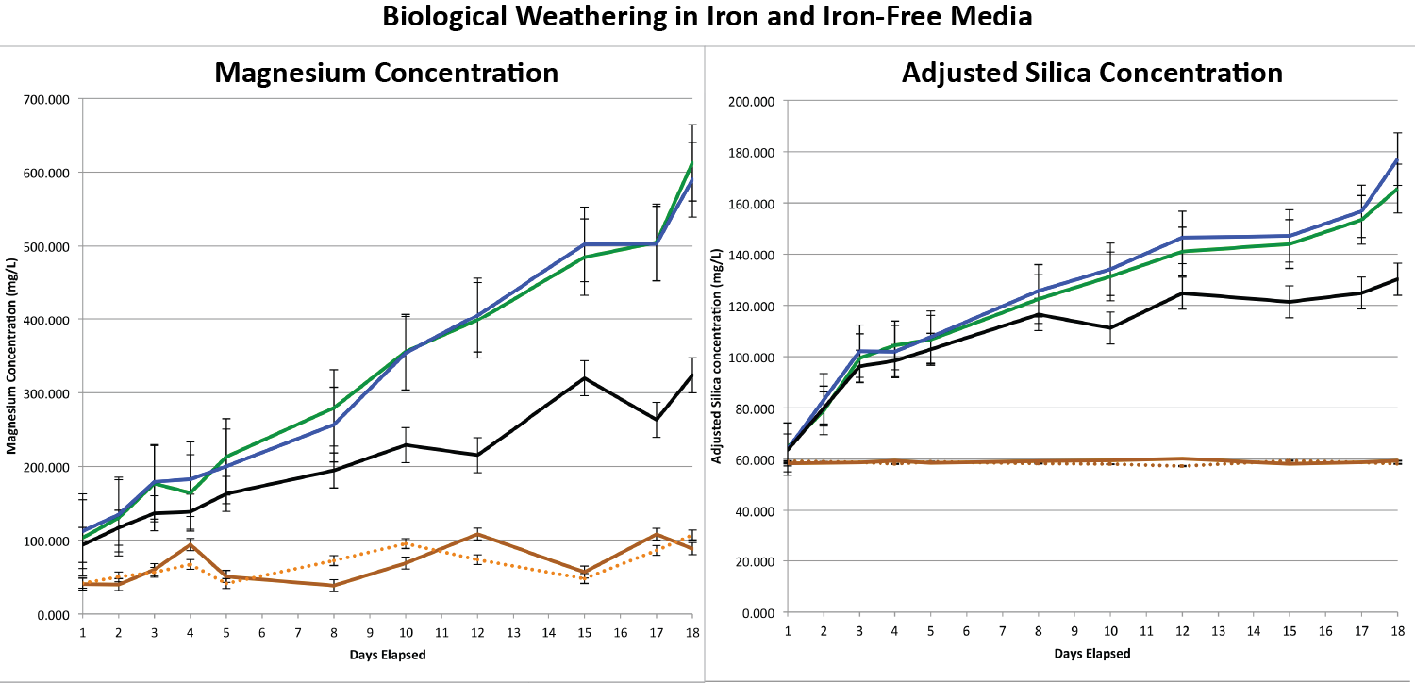
Iron vs. Iron-Free
Chrysotile: Mg₃(Si₂O₅)(OH)₄
Results – Objective 1 | Flame AA Analysis Reference: Daghino et al., 2009 | Slide 10 of 18

Slide 11
Iron vs. Iron-Free
Results – Objective 1 | X-ray Diffraction Analysis | Slide 11 of 18

Slide 12
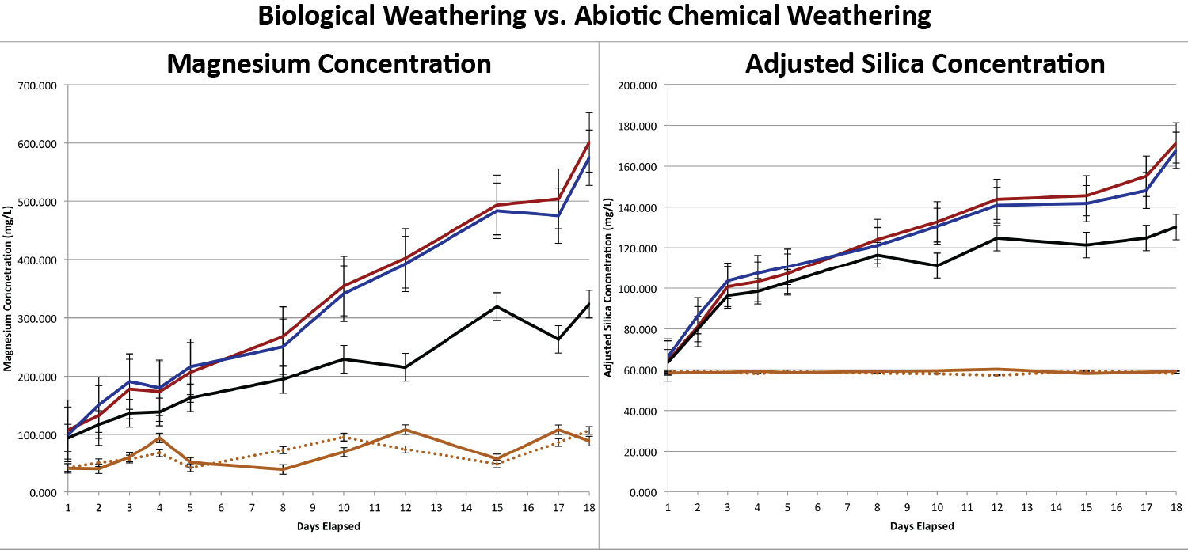
Bio vs. Abiotic
Chrysotile: Mg₃(Si₂O₅)(OH)₄
Results – Objective 2 | Flame AA Analysis | Slide 12 of 18

Slide 13
Bio vs. Abiotic
Results – Objective 2 | X-ray Diffraction Analysis | Slide 13 of 18

Slide 14
Structural Change?
Results – Objective 3 | X-ray Diffraction Analysis | Slide 14 of 18

Slide 15
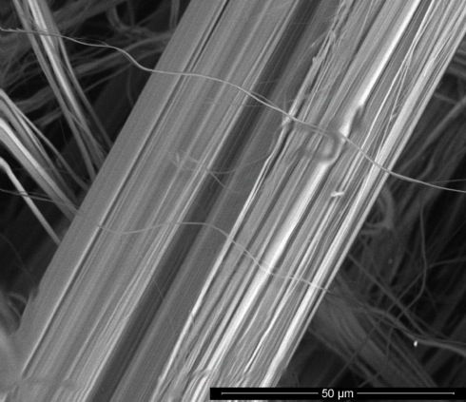
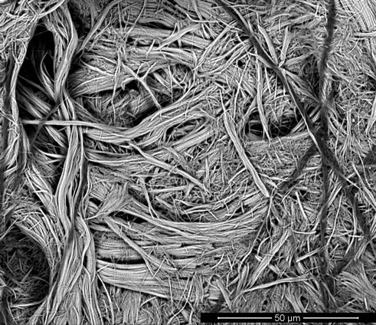
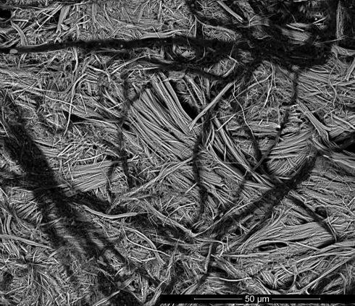
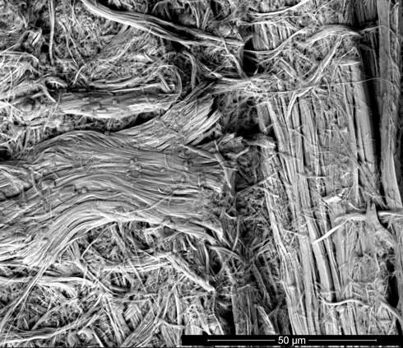
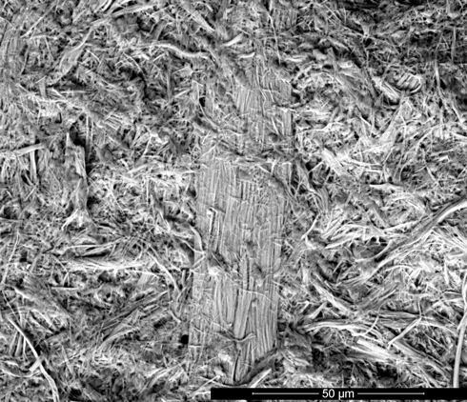
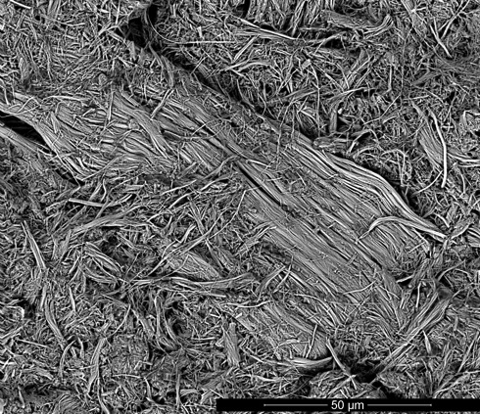
Structural Change?
Biological Weathering
Before Experiment
Iron Media
Iron-Free Media
Hyphae
Abiotic Chemical Weathering
Controls After Experiment
Iron Media
Iron-Free Media
Precipitates
Precipitates
Results – Objective 3 | SEM | Slide 15 of 18

Slide 16
Conclusions
(1) Talaromyces sp. has the same biological weathering effect on chrysotile regardless of the presence or absence of bioavailable iron in the culture medium.
(2) pH has the same effect on the in vitro dissolution of chrysotile under both biological and abiotic conditions.
pH is the controlling factor in biological weathering by Talaromyces sp.
(3) Biological weathering of chrysotile by Talaromyces sp. causes dissolution, but does not break down the structure of chrysotile.
Conclusions |  | Slide 16 of 18

Slide 17
Future Work
(1) How does mineral structure affect the weathering results?
-Lizardite
-Antigorite
(2) How do different species or communities affect chrysotile and other mineral weathering in serpentine soils?
-Species-specific
-Metabolite-specific
Future Work |  | Slide 17 of 18

Slide 18

Funded Jointly by:
Special Thanks to:
Coauthor: Cara Santelli
Coauthor: Henry Teng
Department of Mineral Sciences
Thank You!
Important References:
Daghino, S. et al., 2009, Weathering of chrysotile asbestos by the serpentine rock-inhabiting fungus Verticillium leptobactrum: FEMS Microbiology Ecology, v. 69 no. 1, p. 132–141.
Favero-Longo, S.E. et al., 2005, Chrysotile asbestos is progressively converted into a non-fibrous amorphous material by the chelating action of lichen metabolites: Journal of Environmental Monitoring, no. 7, p. 764–766.
Li, Z., Xu, J., Teng, H.H. et al., 2015, Bioleaching of Lizardite by Magnesium- and Nickel-Resistant Fungal Isolate from Serpentinite Soils–Implication for Carbon Capture and Storage: Geomicrobiology Journal, v. 32, no. 2, p. 181–192.
Park, A.H.A, and Fan, L.S., 2004, CO₂ mineral sequestration: physically activated dissolution of serpentine and pH swing process: Chemical Engineering Science, no. 59, p. 5241–5247.

