Slide 1
Evolution of the Data Librarian
Documenting the Evolving Role of Data Librarians at the University of Michigan Library.
Lori Tschirhart, University of Michigan Library, 11.3.15

Slide 2
Overview
Historical Data Librarian Services
Emerging Research Data Services
Notes:
How I prepared:
Identified data librarians and those providing “functional specialist expertise”, conducted 1 hour interviews and analyzed.

Slide 3
Functional Specialists
Or: Old School Data Librarians
Notes:
Timeline In some fashion or other, services relating to GIS provided for 20+ years
Early work with Geographer community, and Social Science researchers due to local ICPSR relationships
Nature of work focuses on traditional consumer services
Around 2008, there was a moment when GIS, especially data analysis, demand was spreading all over campus, informed by emerging computational tools.
Lots of demand to help non-GIS professionals work with GIS. Call for additional functional specialists

Slide 4
Born of Needs and Opportunities
Development and dissemination of digital spatial data
Census data
GIS & spatial analysis initiatives
Acquisition
Access
Training & Consultation
Notes:
Very early (1990s), geographer community interested in using GIS tools
Library seen as data provider
started supporting ESRI/Census classes, provided GIS software, training, and access for users of data
Back then, ArcGIS ran best on UNIX.
Time went on, and more demand for data services grew: ISR- pop. studies science center, health sciences, climatology/meterorology, Remote Sensing of natural sciences data.
There has long been a desire among campus librarians for 1. a campus data repository 2. data curation supported by library.
For many years there was a part time data librarian
2005, many seeing utility in spatial data, full time data librarian hired.
Focus went to services complementing CSCAR, and assistance with statistical code (finding variables, finding and ripping off code, reading manuals when users were stuck
Spatial data and Census data support were in high demand, services were developed skewing toward social sciences researchers.
Developed 2 labs for support (in areas then known as the map library and architecture library)
Hired another data librarian.
Timeline In some fashion or another, services relating to GIS provided for 20+ years
Early work with Geographer community, and Social Science researchers due to local ICPSR relationships
Nature of work focuses on traditional consumer services
Around 2008, there was a moment when GIS, especially data analysis, demand was spreading all over campus, informed by emerging computational tools.
Lots of demand to help non-GIS professionals work with GIS. Call for additional functional specialists.
In 2007-8 hired another data librarian
In 2011, hired another data librarian.

Slide 5
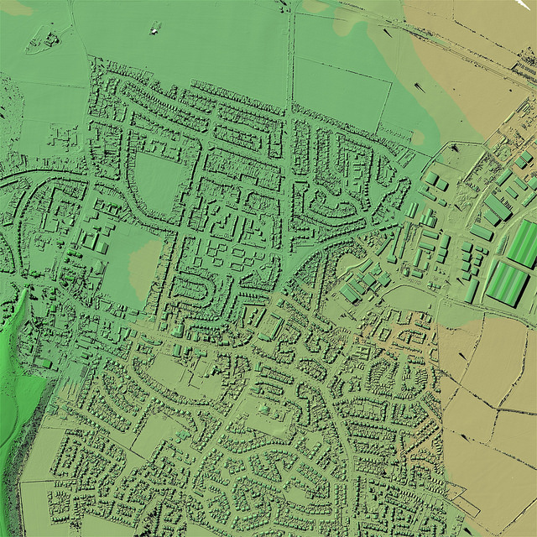
Expertise
Image (doubled): SE6204_DSM_50cm Environment Agency Survey Open Data. CC By 2.0
https://creativecommons.org/licenses/by/2.0/legalcode
Notes:
What they do:
Has always been a negotiation - Lots of users want a production shop
Help people articulate their data need
Keepers of knowledge - know where the publicly available data is
Data Acquisition (parallels to emerging RDS in need for infrastructure
Methodology Assistance
Construction of Datasets
(Help clean/process/reduce noise so that data can be used for a distinct purpose)
Help with Statistics syntax
Expertise with data formats, statistical metrics, the way data is interpreted
Help users make maps (or not make maps if not needed).
Tool selection, training, expertise (some common tools are STATA, SASS, R)

Slide 6
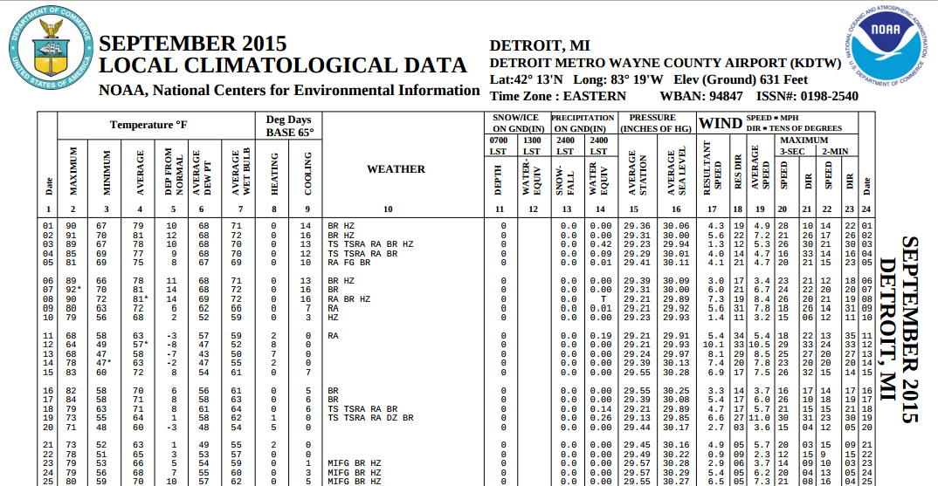
Dedicated staff
Image of September 2015 Local Climatalogical Data for DEtroit, MI from NCDC/NOAA, http://www.ncdc.noaa.gov/IPS/lcd/lcd.html?_finish=0.05751750956233748
Notes:
We currently have 2 data librarians in our Spatial and Numeric Data Services department, along with one Visualization librarian.
One data librarian 8 years in observes:
We’ve done well with what we have, but who ends up getting help can be arbitrary.
What data librarians have been able to help with has changed as skills change, resources are gained,
What is possible in geospatial computing has changed thanks to mobile computing, new media (there is a GPS chip in everyone’s pockets now).
In addition to the services described already, resources are being spent contributing to a CIC Geoportal which provides metadata and points to publicly available data. At a later phase it might also archive data.

Slide 7
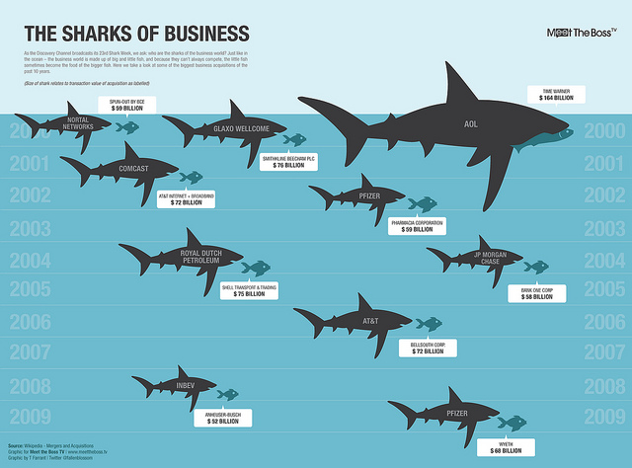
Future Growth Areas
Image: Sharks of Business by GDS Graphics. CC By 2.0, https://creativecommons.org/licenses/by/2.0/legalcode
Notes:
Over ten years, landscape has changed dramatically. Tools are different. Non-traditional software emerging. (tools that don’t have data in them yet vs. tools that come with data). Social explorer is both a database and a set of mapping tools. There is no way to bring in external data.
Opportunity in education and defining service: consumer service can make people think they can do things easily without training.
Ethics - opportunities to let people realize that the data doesn’t tell them what they think it is telling them, differences between using geospatial data and using it well.
Lots of excitement about version control and reproducibility of research.
Data visualization can help all kinds of scholars communicate their findings and advance understanding, and especailly help make sense of big data
Software carpentry workshops (heartened by grad students teaching others about tools used in their labs).
More and more often, campus data users know how to use software
Complex uses of data are emerging. Now less “how do I get this into GIS”. More data is available, more users know how to find it, research is beginning to scale larger with High Performance Computing.

Slide 8
Supporting Functional Specialists
Resources to keep Current
Commitment to infrastructure
Honoring necessary expertise
Thoughtful job posting design
Awareness of spurious correlations (and inadequacies of many statistical models)
Platforms for instructional delivery
Better Education for future generations
Notes:
Consider the notion of data as universe (instead of as discrete data sets)
Communicating about the long view: higher ed landscape that is research pub driven prevents consideration of the long view and lends itself to data getting lost if poorly handled.
Access to collections - required to keep up skills.
Infrastructure is needed to protect sensitive data. ) - purchase, negotation, pointing, hosting, managing servers, figuring it out. Knowledge needs to be maintained about what people are permitted to do what with data, and what we should do with it.
Fight burnout. Some are drawn to promise of data that can neatly tell an answer. There can be a disconnect between talents of data librarians drawn to complex inquiry and dreams of some data consumers (exp. administrators) for quick, clean answers.
No expert can be equally good at all things, so allow data librarians to have expertise by avoiding “kitchen sink” position descriptions. All expertise requires upkeep.
Data librarians will be required to support more collaborative research, so will need assists from those with disciplinary expertise.
Understand that research is now happening on a scale that people don’t understand, and old models are no longer adequate.
Lots of problems facing data driven science. Companies can keep running studies until they eventually get by chance the data that they want.
Consider hypothesis-free science
Consider having more journals be results-blind.

Slide 9
Research Data Services
Or: Subject Specialists engaging in emerging research data management activities
Notes:
Research libraries have been providing services based on resources and needs -
Services offered to meet most pressing needs of local users
Since early 2000s, U-M Library has supported development of RDM services through work of a data librarian and through the library’s strong affiliation with ICPSR (Inter-University Consortium for Political and Social Research) which has a 50+ year history of leadership with data access, curation, and social science analysis methodologies., and through roll out of IR, Deep Blue.
Campus-wide discussions on data also began at this time via a Blue Ribbon Panel commissioned by Associate VP for Research CyberInfrastructure and Chair of Info Tech Council, and the CIO/Associate VP for ITS. The Library was at that table. The panel combined with increased RDM needs motivated the library to develop more comprehensive services.
Created AUL position for Research, with mission to preserve and provide access to traditional and emerging areas of the scholarly record around the research lifecycle.
Also hired 2 CLIR/DLF fellows for environmental scan and assessment of data landscape to inform RDS planning and services.
Participation in ARL/DLF/Duraspace E-Science Institute 2012
Roll out of many initiatives: Emergent Research Working Group (build awareness of campus research around research lifecycle
Datacite Task Force (develop campus approaches for IDing datasets and researchers)
ORCID Task force
Research Lifecycle committee (investigating library’s service model for research and data lifecycles)
Creating of REsearch Data Services Director in 2013 - oversee initiatives and further development of RDS

Slide 10
Born of (Known) Needs
Data Management
Policy
Infrastructure
Connecting researchers with research data
Opportunity
Notes:
Longstanding desire for data libs & subject specialists to collaborate with data things relevant to their disciplines.
Different researchers, among and between disciplines, have different RDM needs. Some librarians here (especially Health Sciences, Engineering, and Science Librarians) have been impacted by grant provider guidelines and mandates that require sharing of data and data management plans. Selectors are learning as they go, some have been conducting targeted interviews and outreach sessions since 2009.
Can be though of science-based
Extending traditional services to help manage/organize/describe/make a consumable product so others have confidence in product for re-use.

Slide 11
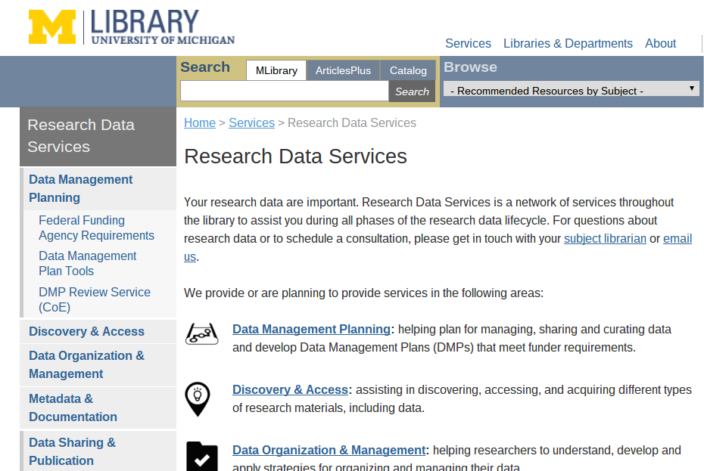
Notes:
Data Management Planning
Discovery and Access, and Acquisition
Data Organization and Management
Metadata and Documentation
Data sharing and publication (and repository)
Preservation
Data Visualization

Slide 12
Key People
AUL for Research
Director of Research Data Services (also Head of Science, Engineering, and Clark Libraries including SAND)
Research Data Services Manager
Research Data Curation Librarian

Slide 13
Enterprise Level Endeavor
Leveraging all subject specialists’ relationships and expertise
Subject specialist providing RDS support
Training trainers
Building a corpus of information about researchers’ RDM needs and practices
Notes:
“scaling to the enterprise”
DMP pilot (College of Engineering)
Data Education Workshops for librarians
Environmental scan of RDM related services already provided
Building a knowledge base to help get familiar with the data landscape.

Slide 14
Informed of (Previously Unknown) Needs
Data Use Cases Task Forces
New work expectations for librarians with liaison responsibilities
Data Interviews with faculty
Notes:
Inform RDS development
Build a corpus.

Slide 15
Supporting RDS providers
Education
Community of Interest
Aligning vision for services with practice
Practical Tools
Assessment
Notes:
Blurry lines
More ambiguity on all sides
More demand, and some users are less skilled at defining their need.

Slide 16
Read about 8 Research Universities’ efforts building support for RDM
Akers, KG, et al. Building Support for Research Data Management: Biographies of Eight Research Universities. International Journal of Digital Curation, 2014. V.9 (2) 171-191. http://dx.doi.org/10.2218/ijdc.v9i2.327

Slide 17
Questions?
Contact:
Lori Tschirhart
ltz@umich.edu

