Slide 1


Quaternary Faulting in Blount County Tennessee and Its Implications for Active Tectonism in the Eastern Tennessee Seismic Zone
Eric Gamble, Randel Tom Cox, and Karim Bouzeid
Robert D. Hatcher and Jacob Glasbrenner
Presented by: Eric Gamble

Slide 2
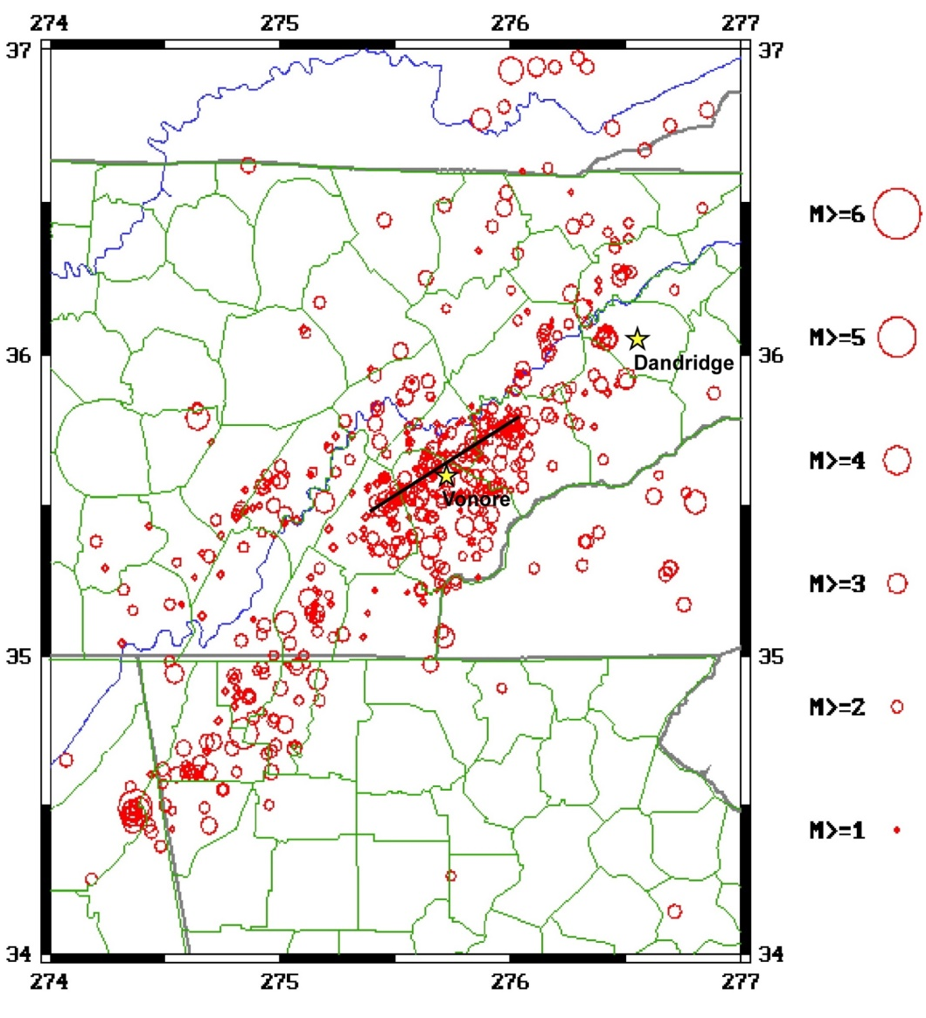
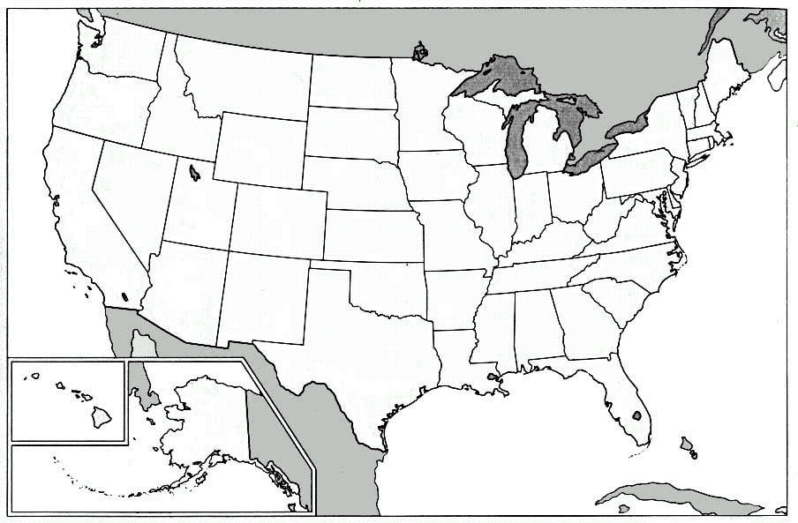
Zone of Seismicity within the ETSZ
Brakebill Island
Epicenters of the East Tennessee seismic zone and the relationship of alignment of seismicity concentration and Quaternary faults along trend of 060° at Vonore, Dandridge, and Brakebill Island in TN.

Slide 3
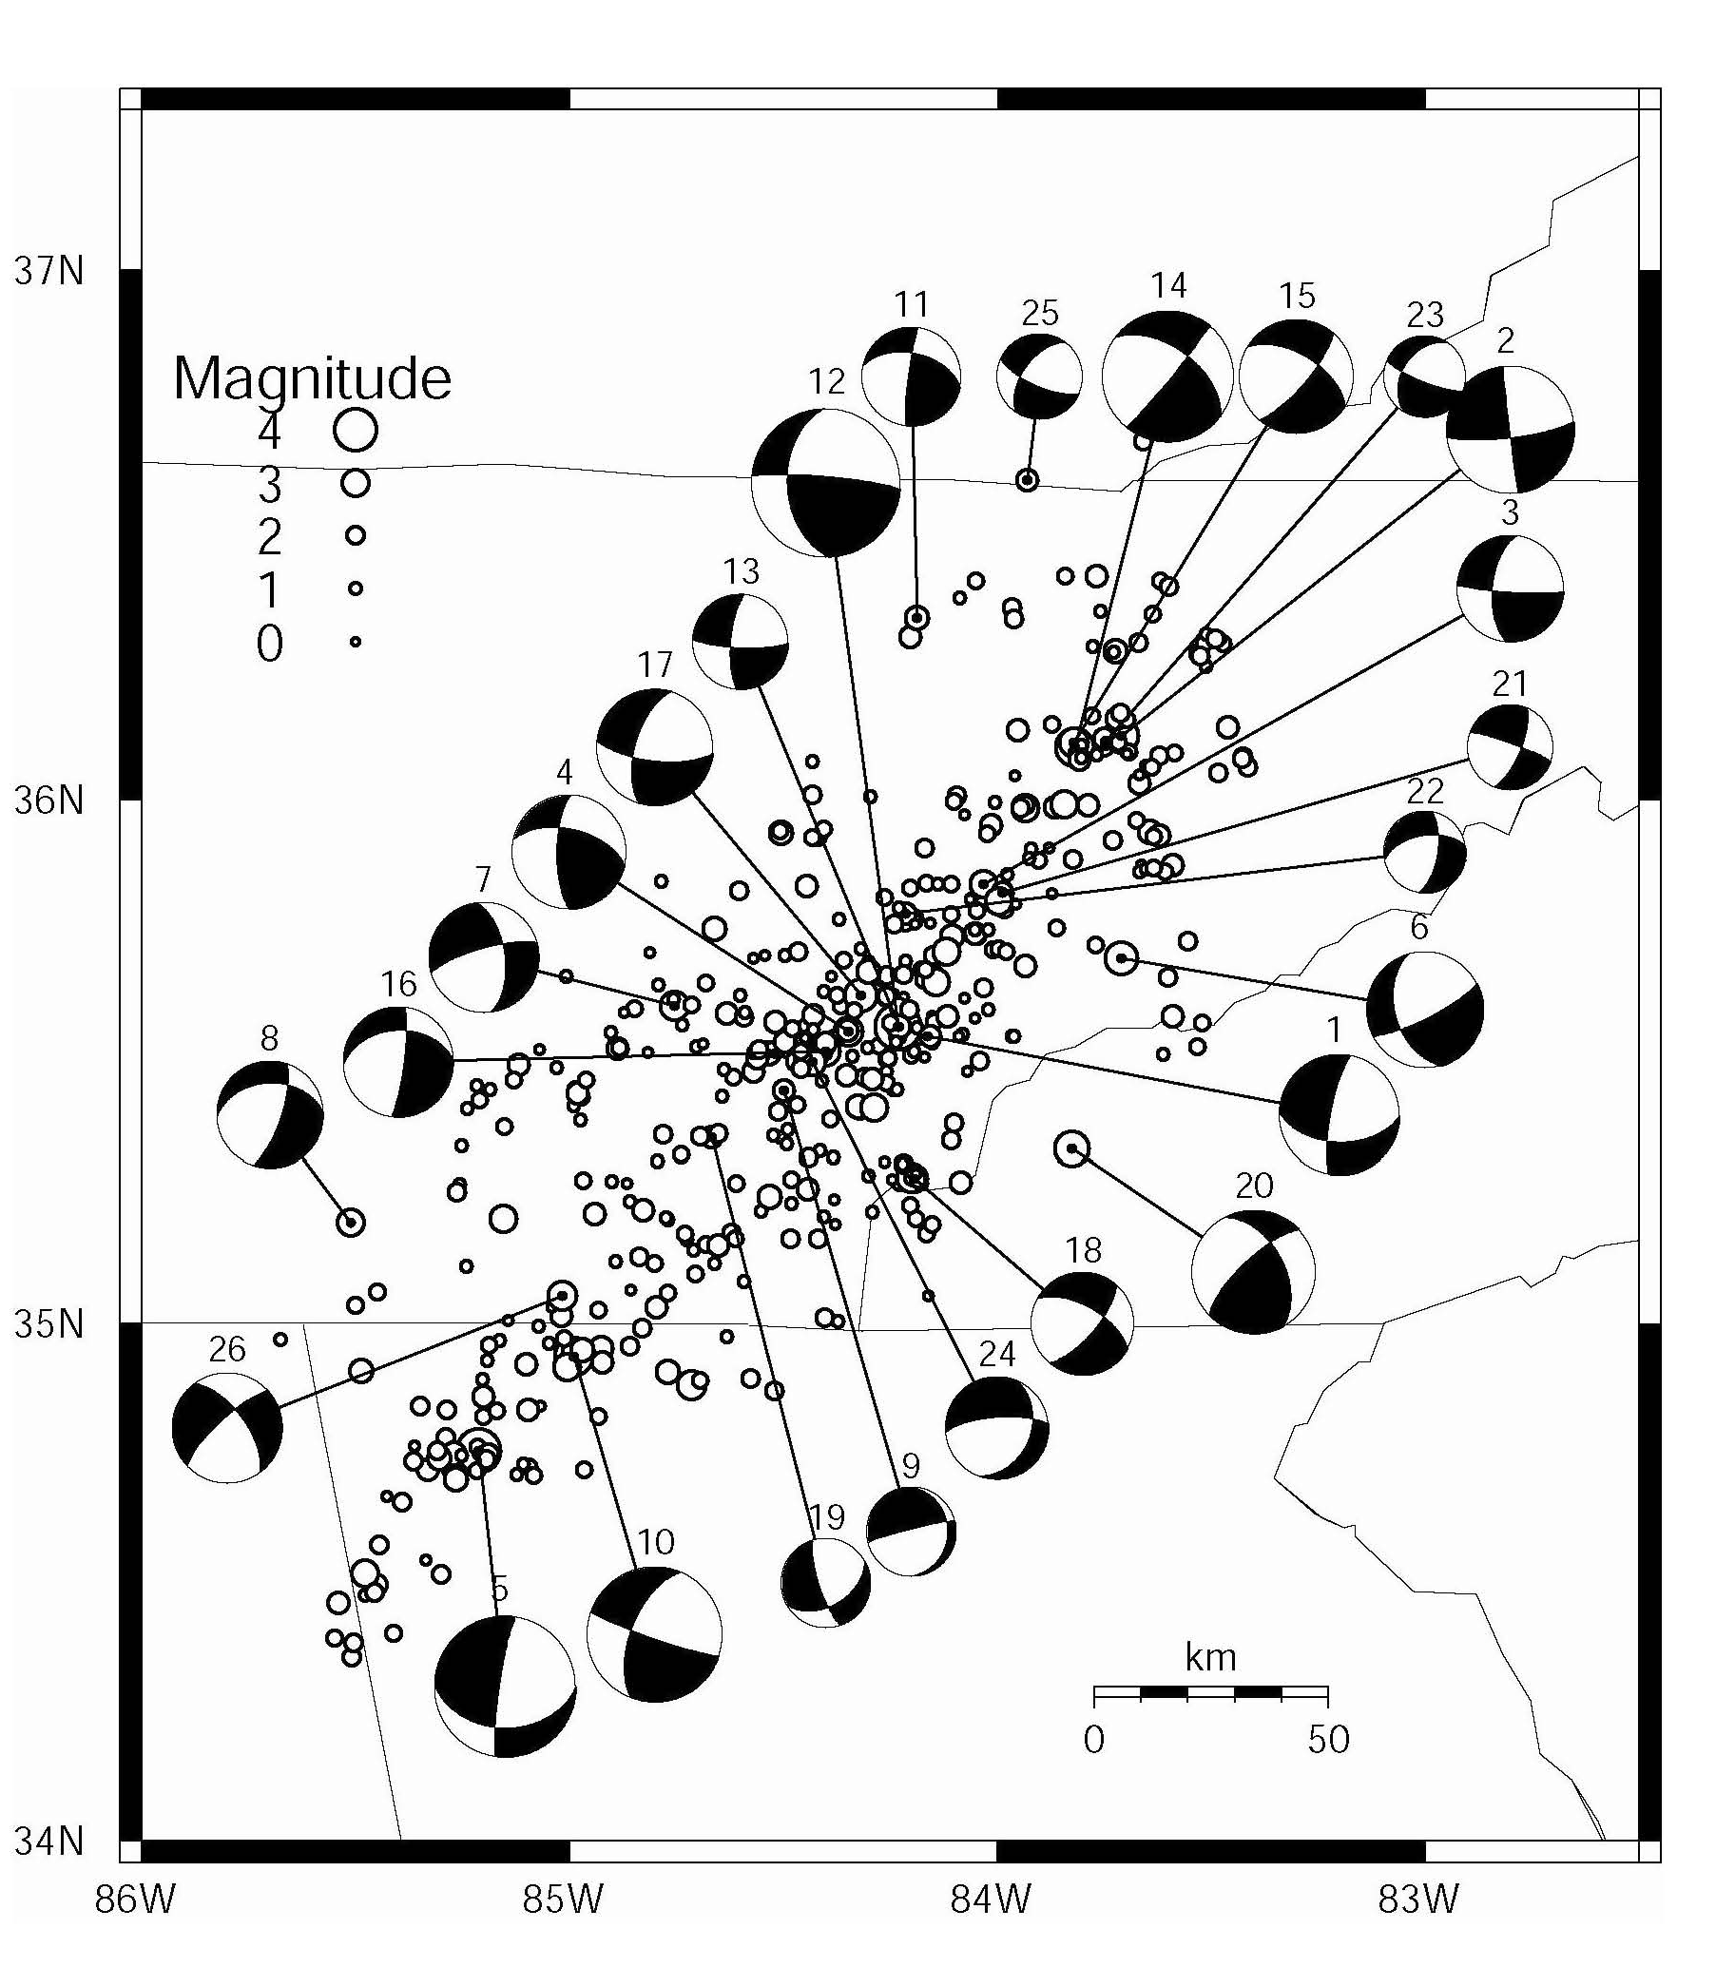
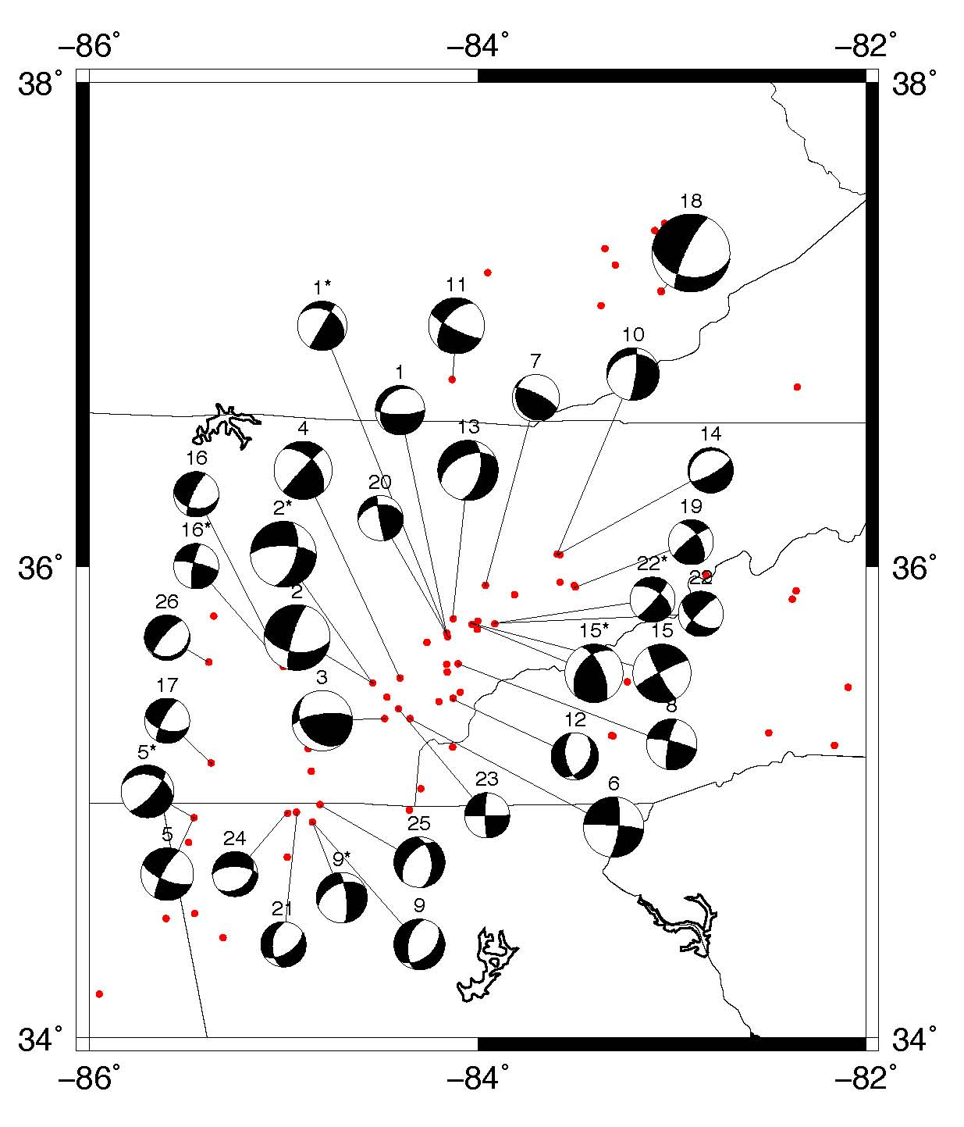
Earthquake focal mechanisms
From Chapman et al, 1997
From the thesis of Matt Cooley 2014
Two studies of earthquake focal mechanisms have nice agreement on the eastern and southern margins of the zone seismicity

Slide 4
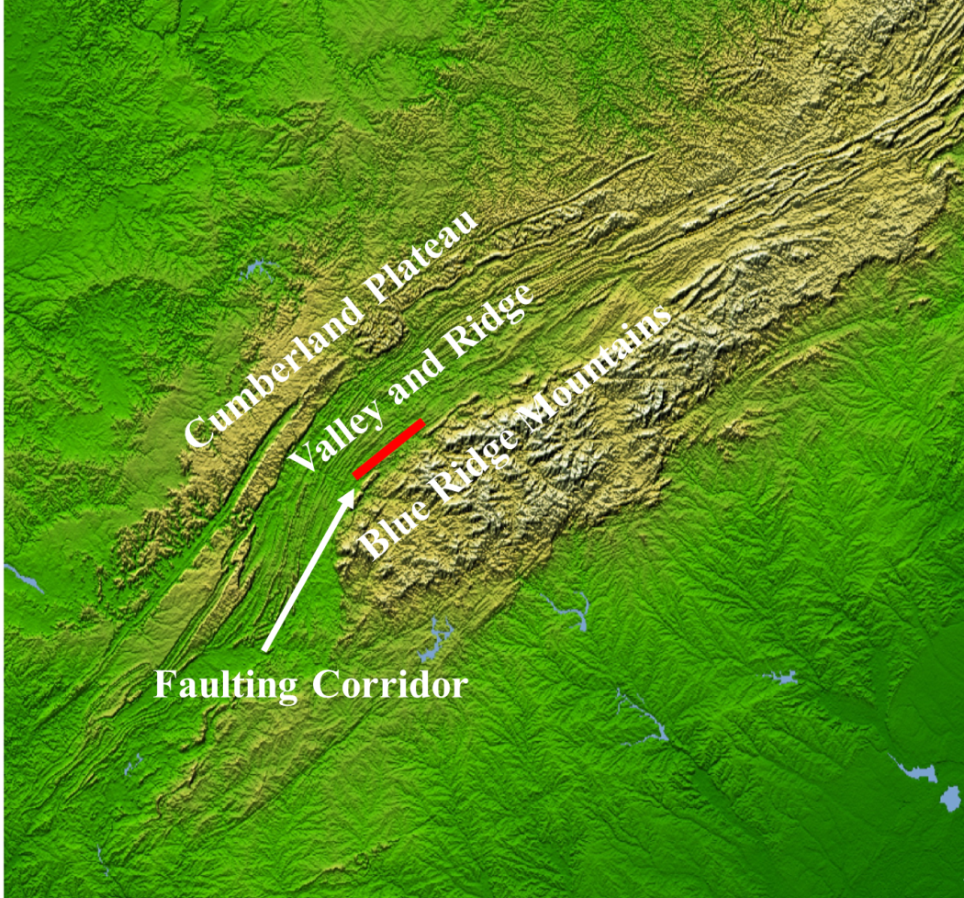
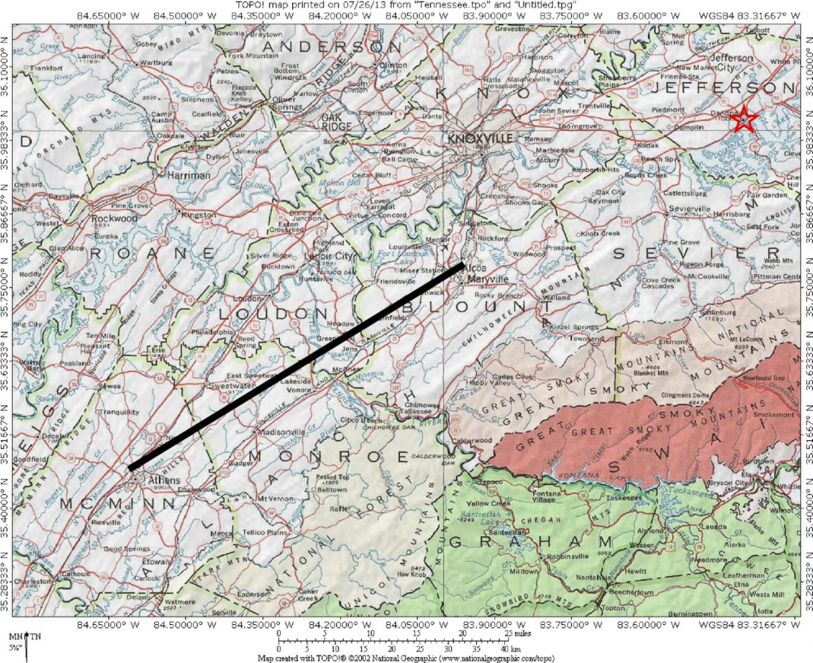
Mapping Area and Regional Setting
N
N
Our previously mapped Quaternary faults and fractures near Vonore, TN
Regional shaded relief map showing 060° zone of seismicity
Recently discovered Brakebill Island Fault in Blount County, TN
Quaternary faults and paleoseismic features Daindridge, TN

Slide 5
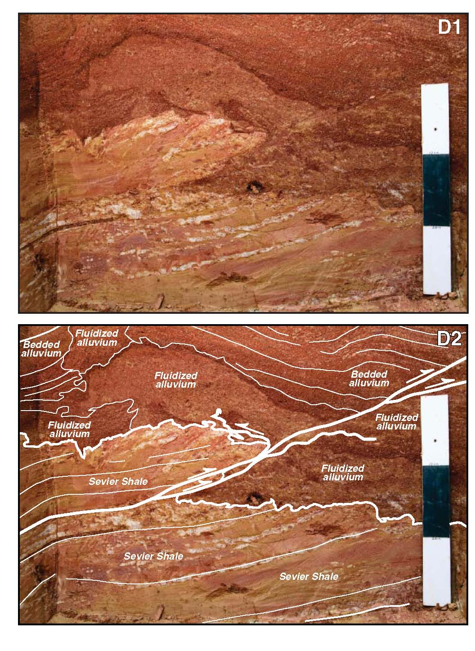

Faulting at Daindridge
Brakebill Island

Slide 6
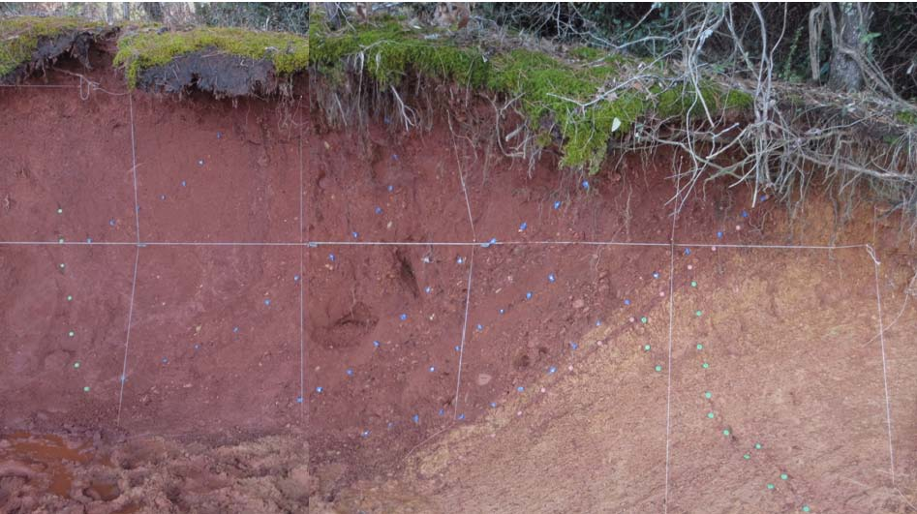
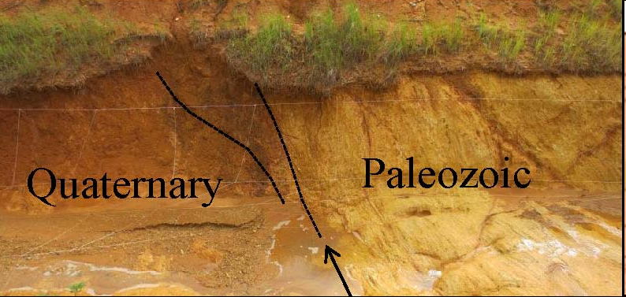
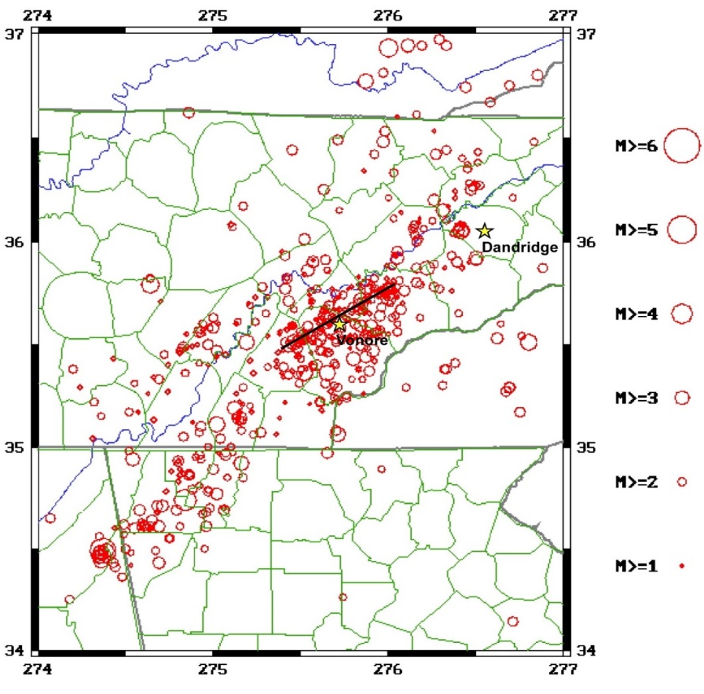
Faulting at Tellico Lake, Vonore, TN
Quaternary
Paleozoic
N
Brakebill Island

Slide 7
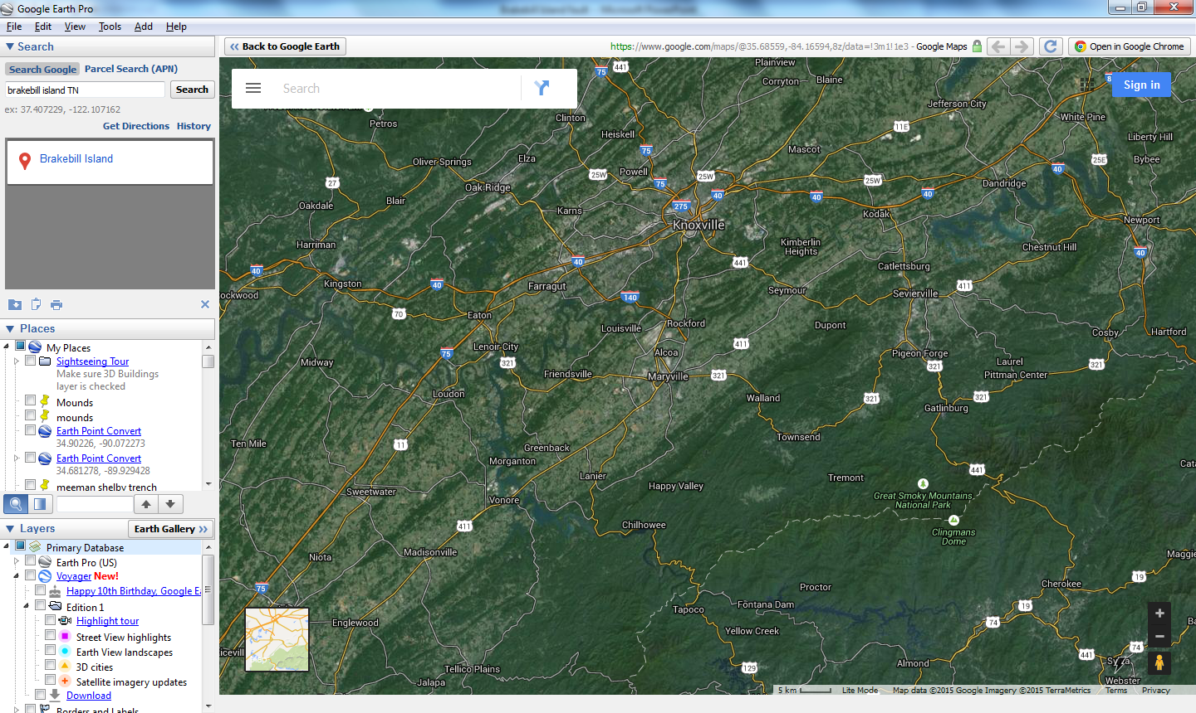
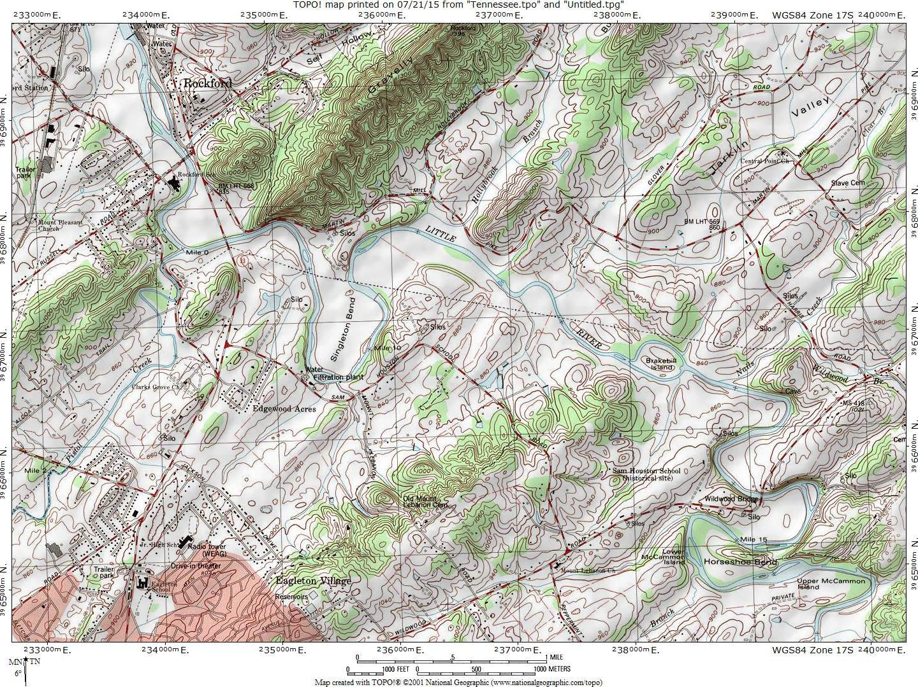
Quaternary faulting in Blount County, TN
Brakebill Island

Slide 8
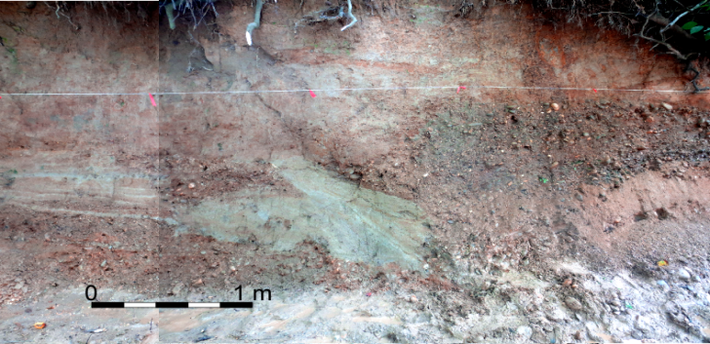

Thrust Faulting at Brakebill Island, Blount County, TN
N
Brakebill Island

Slide 9
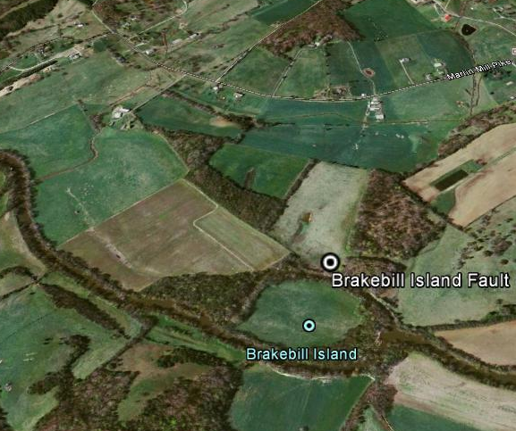
Possible Sandblow Features Present
Possible Sandblow features
F
H
Possible sand blows motivated the survey of the banks of the Little River in Blount Co.

Slide 10
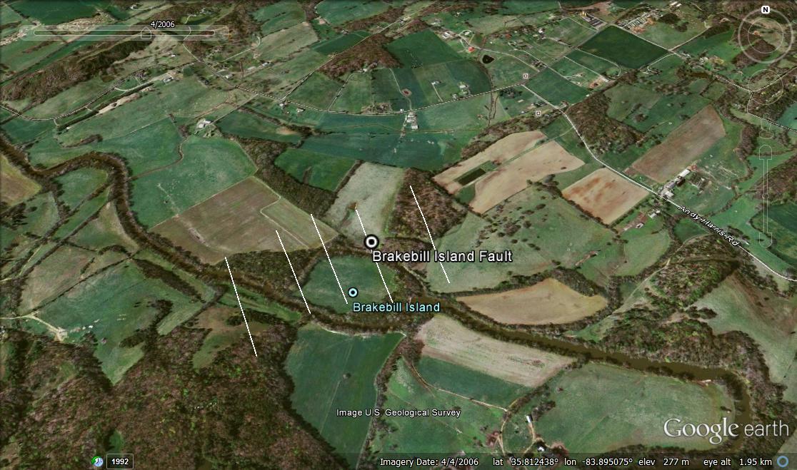
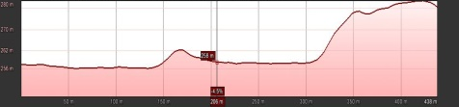
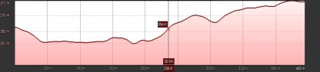
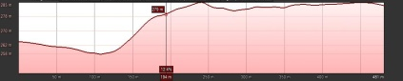
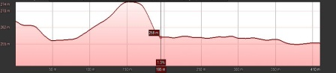
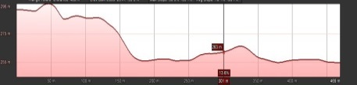

Extent of Brakebill Island Fault
H
H
H
C
B
B’
A
A’
C’
N
A’
H
D
D’
C’
B’
D’
E’
H
E
E’
A
C
B
D
H
0.42 miles
E
H Denotes hanging wall. Black = projection of fault, Profiles A to A’, B to B’, C to C’, D to D’, E to E’ separated by color with no vertical exaggeration.

Slide 11
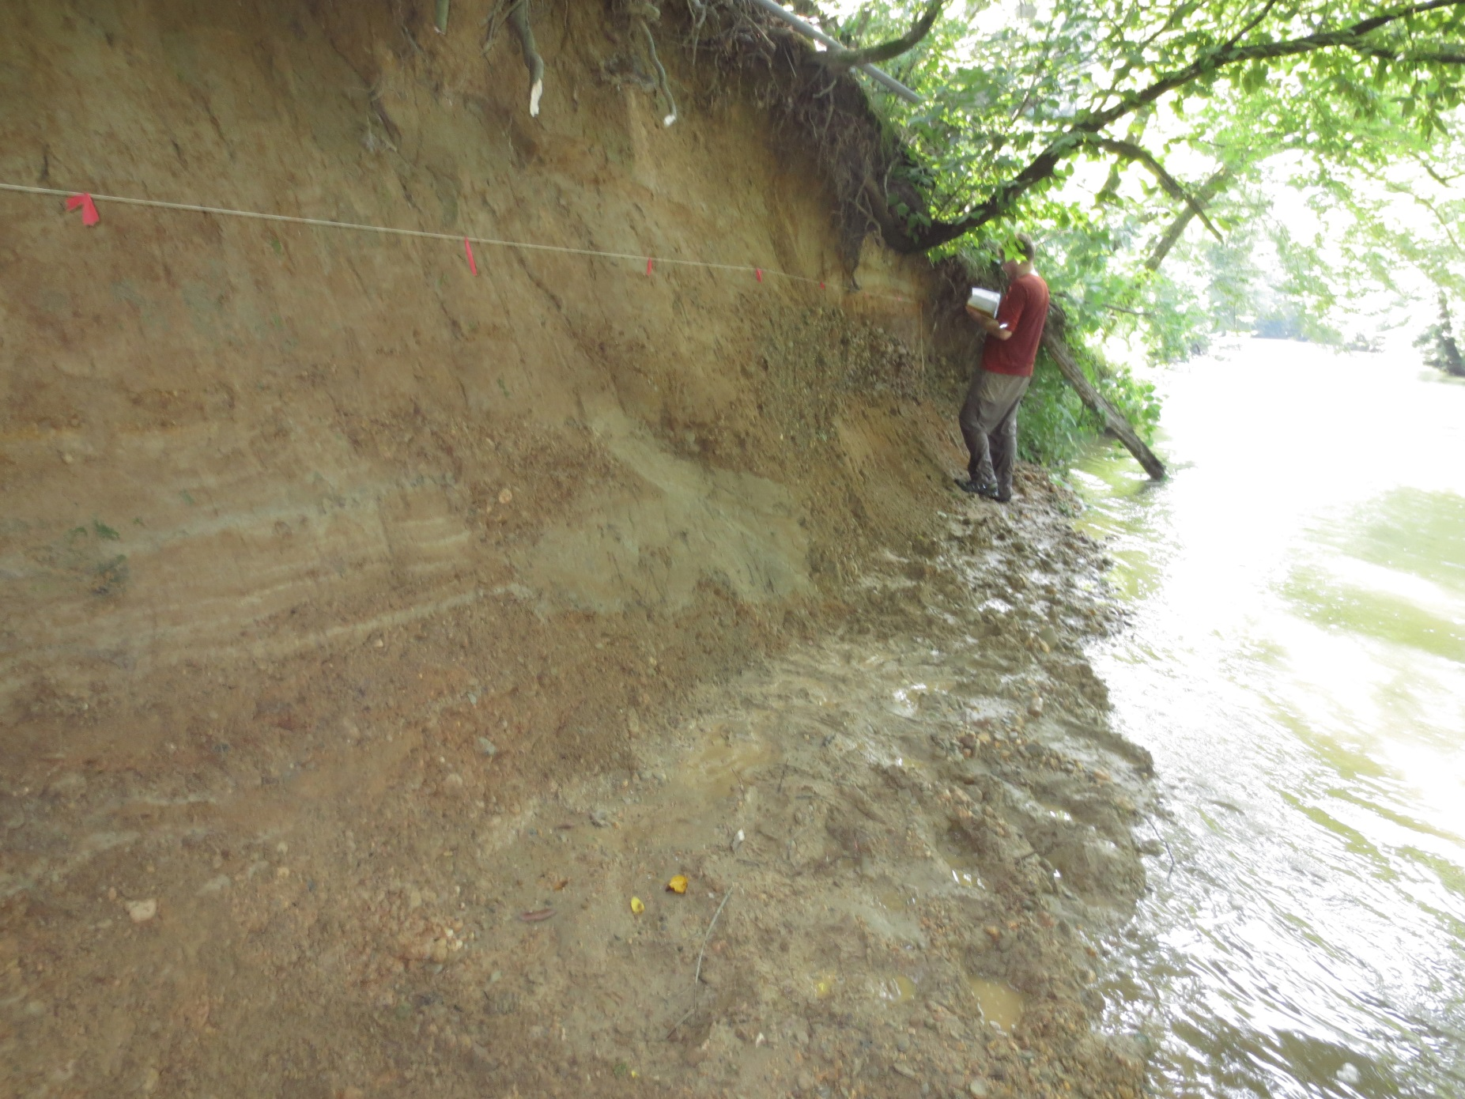
Looking ENE at Little River bank north of Brakebill Island

Slide 12

Possible Liquefaction Features
Thrust through Quaternary alluvium
Looking ENE at Little River bank north of Brakebill Island

Slide 13


Slide 14
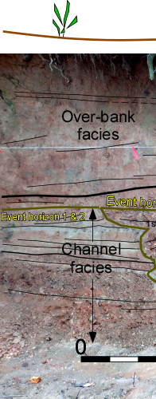
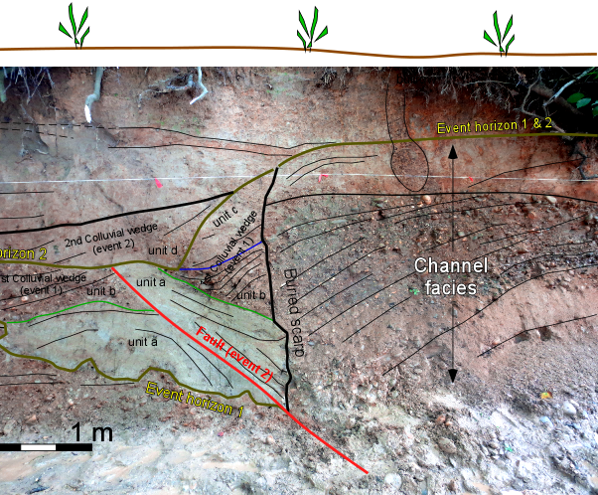
Possible Liquifaction features
OSL samples from pre, syn, and post-faulting strata are being processed.

Slide 15
Deformation steps

Slide 16
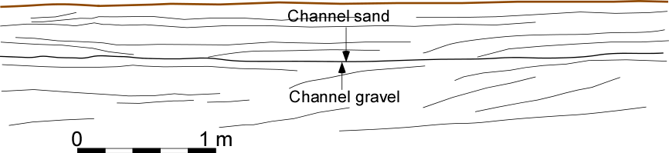
Pre-faulting

Slide 17
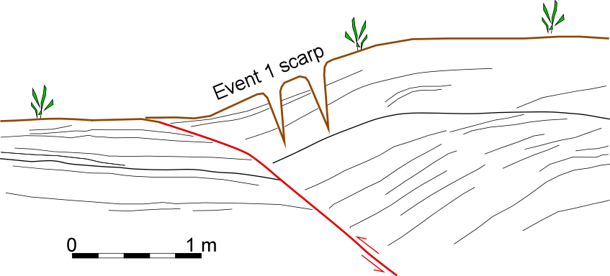
Event 1

Slide 18
55 cm
Event 1

Slide 19
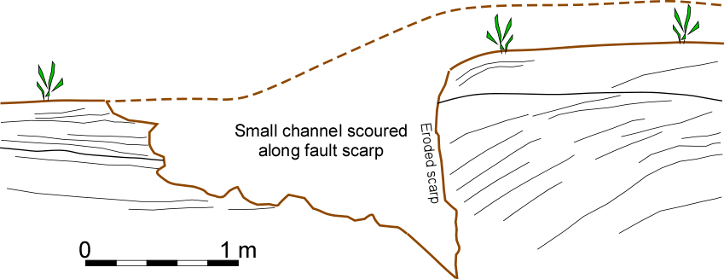

Slide 20
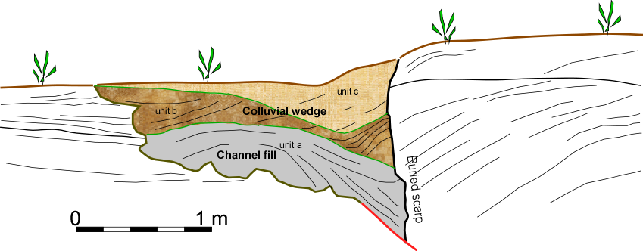
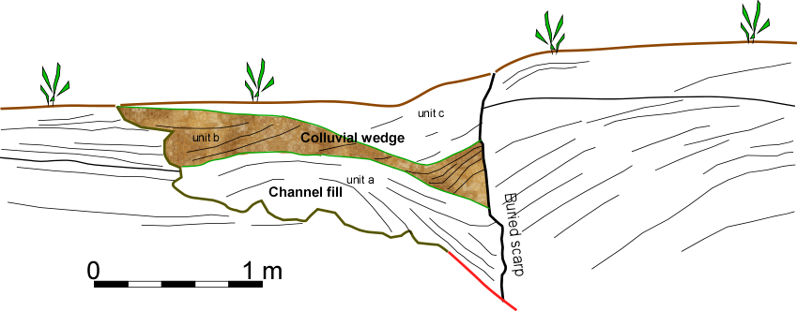
Small channel is filled

Slide 21
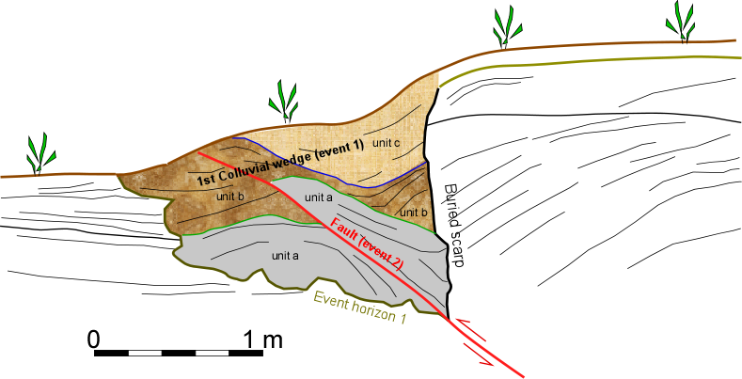
Event 2

Slide 22
30 cm
Event 2

Slide 23
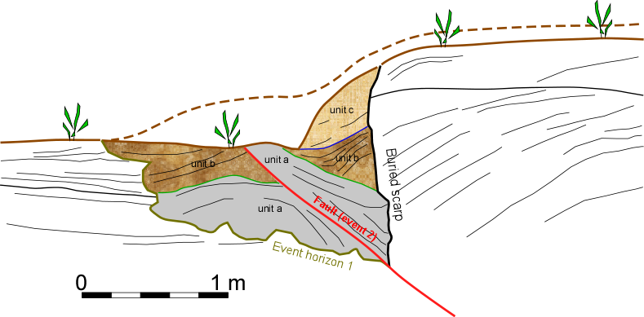
Erosion of event 2 scarp

Slide 24
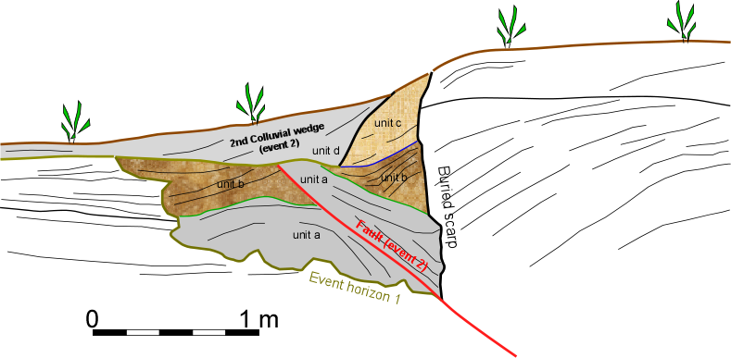
Event 2 colluvial wedge

Slide 25
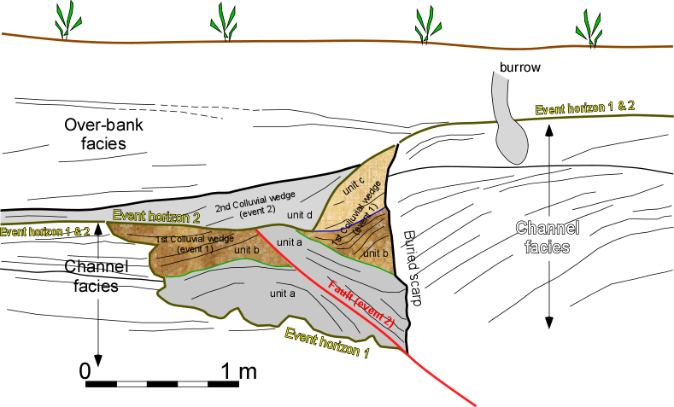

Slide 27
What is the overall picture?
Daindridge, TN Thrust
GAP?
Blount County, TN Thrust
Vonore, TN Thrust
Most exposures of faults have been found overlying Paleozoic shales and shale saprolites
Quaternary
Vonore, TN Normal
Paleozoic

Slide 28
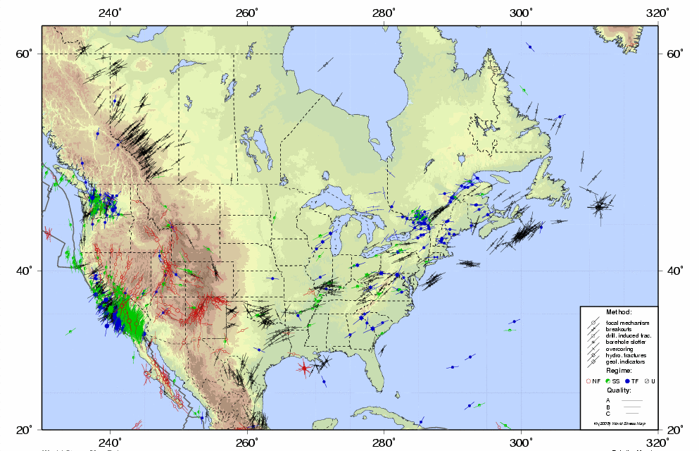
070° SHMAX is exploiting Paleozoic structure during rupture in weaker shales and shale saprolites along a 060° fault at depth.

Slide 29
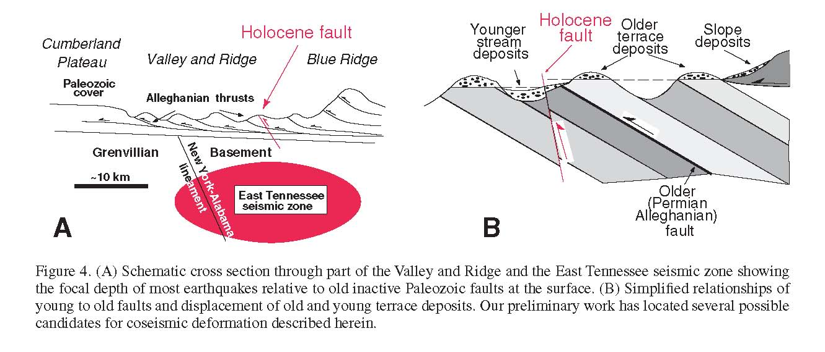
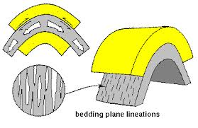

from Hatcher et al, 2012
Qal
Holocene Faults (in Red)
(Older) Permian Alleghanian Thrust (in Black)
C
Possible co-seismic, flexural slip, along near-surface bedding plane faults due to slip along 060° high angle thrust at depth. Model C might apply to Brakebill Island and Daindridge.

Slide 30
Acknowledgements:
University of Memphis
University of Tennessee
The Nuclear Regulatory Commission
The U.S.G.S.
Center for Earthquake Research and Information (Thanks for the truck!)
Special Thanks to:
Ron Counts, Lian Feng, Jerry Batholomew, William Hubber, Taylor Armstrong, Christine Powell, Matt Cooley, Julie Johnson, Roy Van Arsdale, Chris Vanderlip, Chris Loyacano, Dan Larsen, Alex Ward

