Slide 1
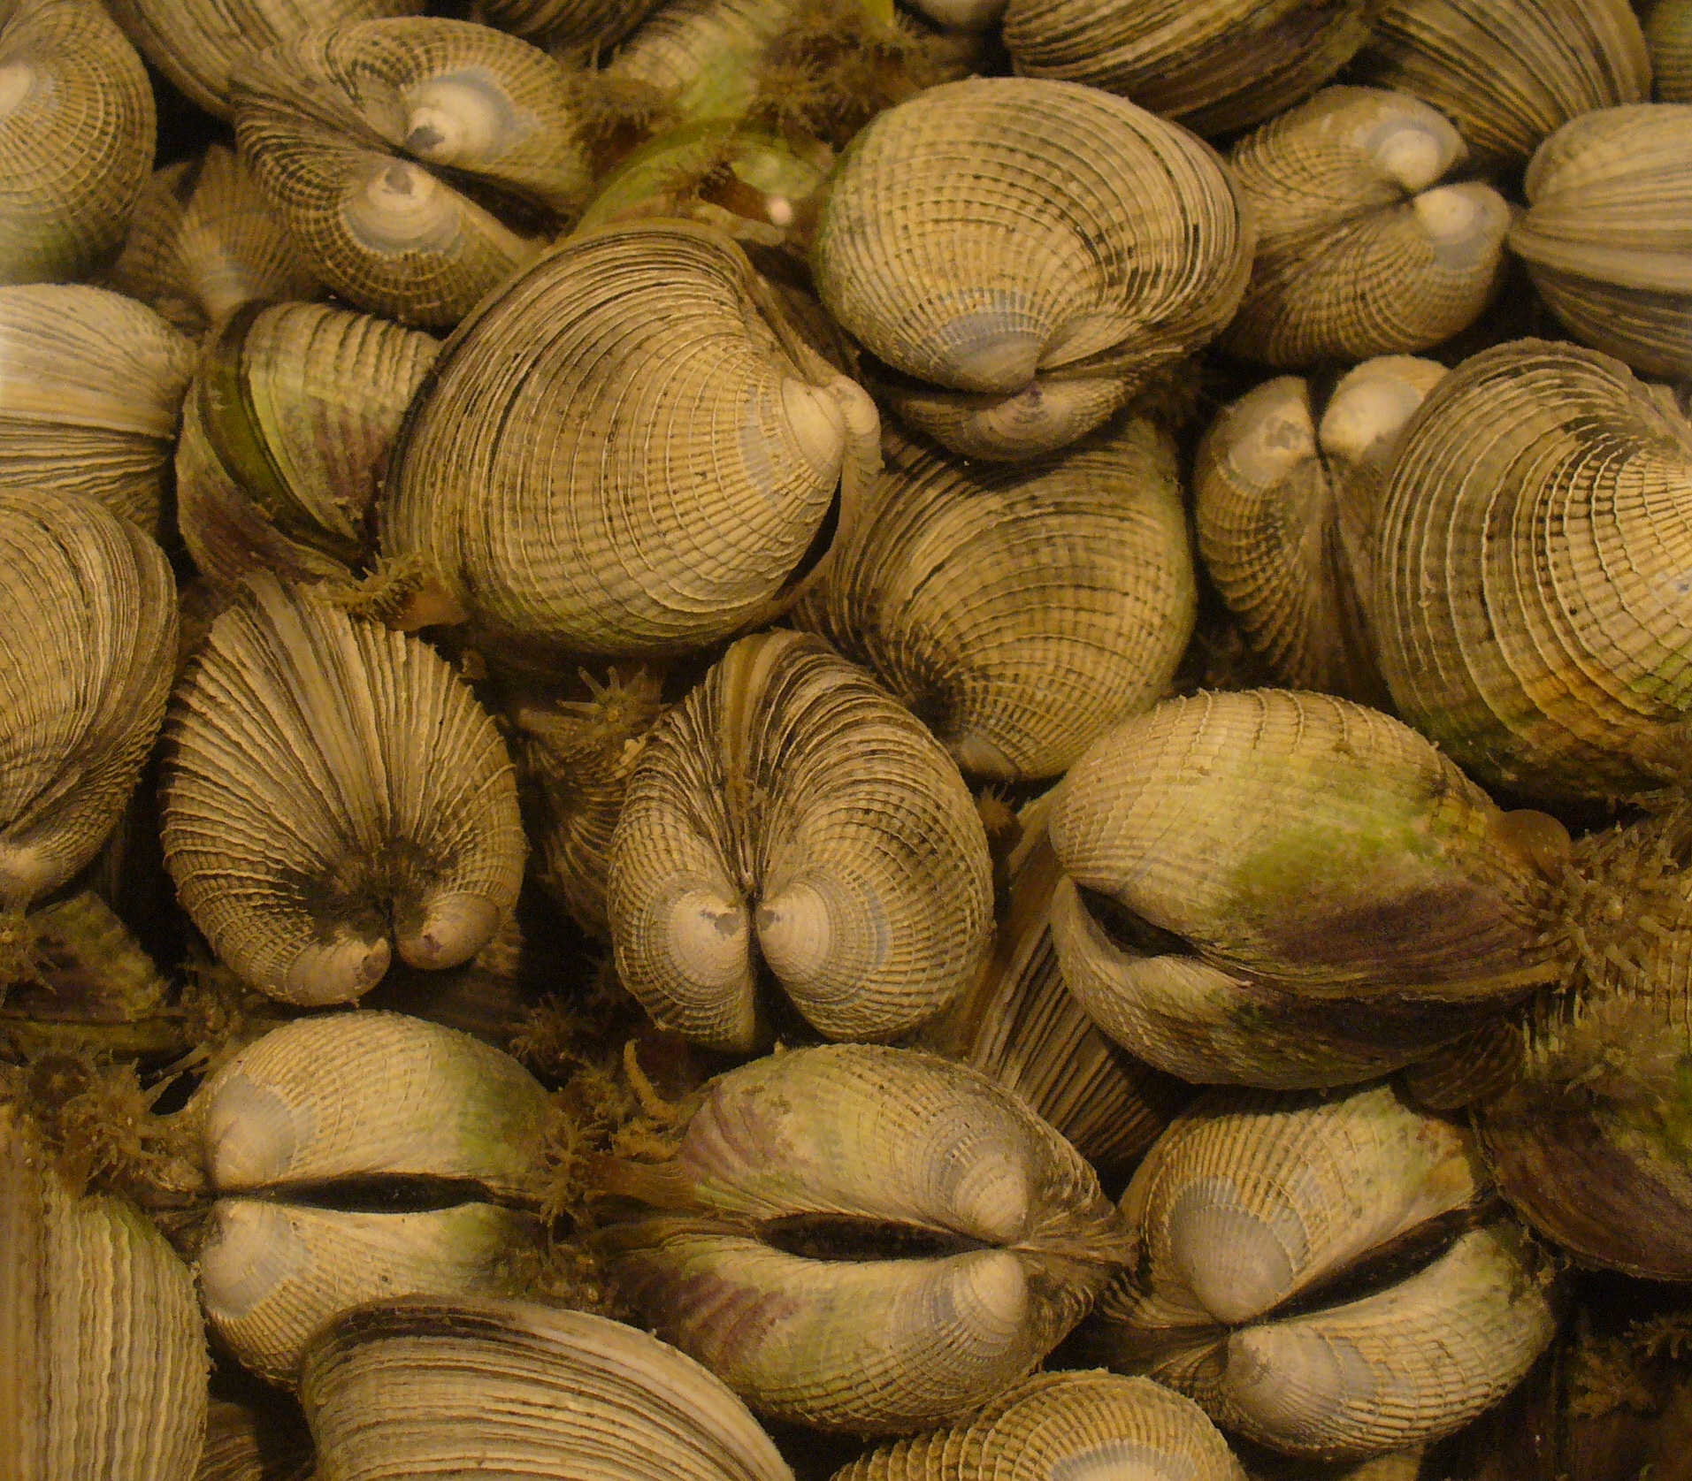
Environmental Controls on Bivalve Skeletal Growth
Dan Killam
UC Santa Cruz
Notes:
I’m here to talk about our two-valved friends the bivalves, specifically focusing on their shells as a record of their physiology

Slide 2
Sclerochronology and growth seasonality
Seasonal growth of bivalves produces alternating bands of fast and slow growth
“Ticks” of the bivalve’s growth clock frequently used for reconstructing environmental timeseries
Also a record of physiological tolerances of the organism itself

Slide 3
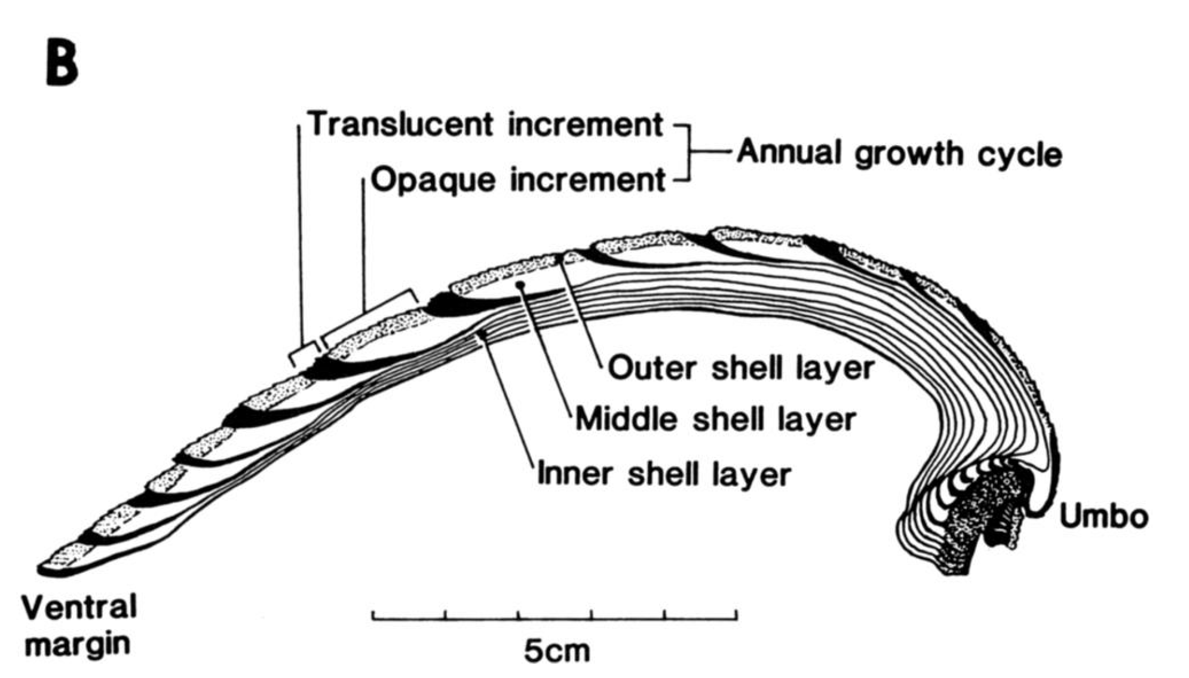
Light: white, opaque, CaCO₃-rich
Fast growth
Jones and Quitmyer 1996
Dark: transparent, organic-rich
Slow growth

Slide 4
Growth seasonality as a vital effect
Bivalve growth is thought to be limited by numerous factors
Food supply
Seasonal spawning (energy redirected to reproductive processes)
Salinity and turbidity
Temperature stress
Notes:
Though bivalves are excellent environmental recorders, each species must be vetted to determine growth seasonality
We propose that temperature is the primary determinant of when bivalves grow their shells

Slide 5
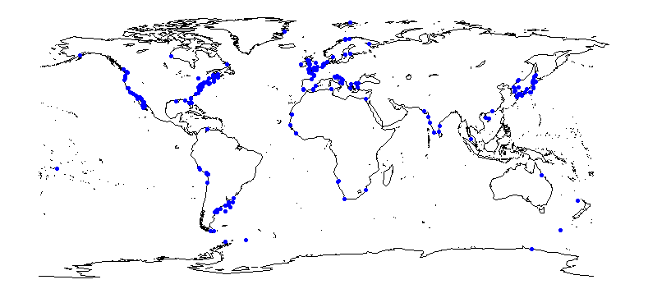
Modern ground-truthing
Construct database of modern seasonal growth sourced from literature
>80 species, 279 observations

Slide 6
Distribution of shutdowns
Winter shutdowns become more prevalent poleward
Summer shutdowns become more common towards equator

Slide 7
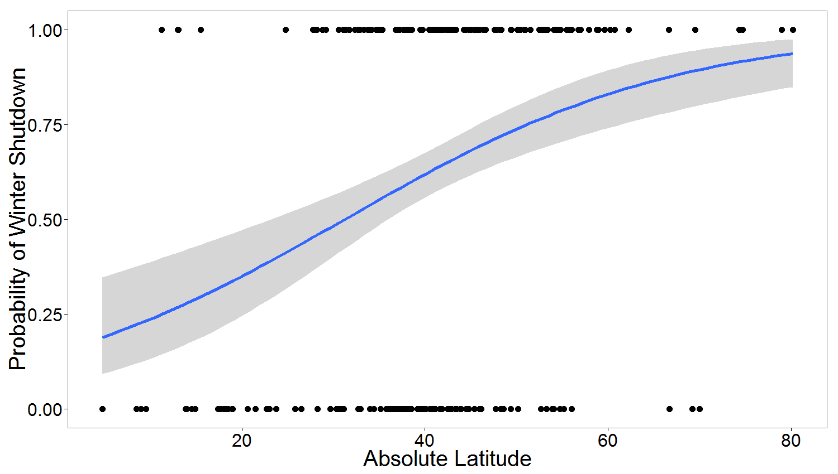
Comparing Winter Shutdown to Latitude
Significant relationship between latitude and odds of winter shutdown, equal to 5.6% increase in odds per degree latitude
Takeaway: winter shutdown is correlated to latitude

Slide 8
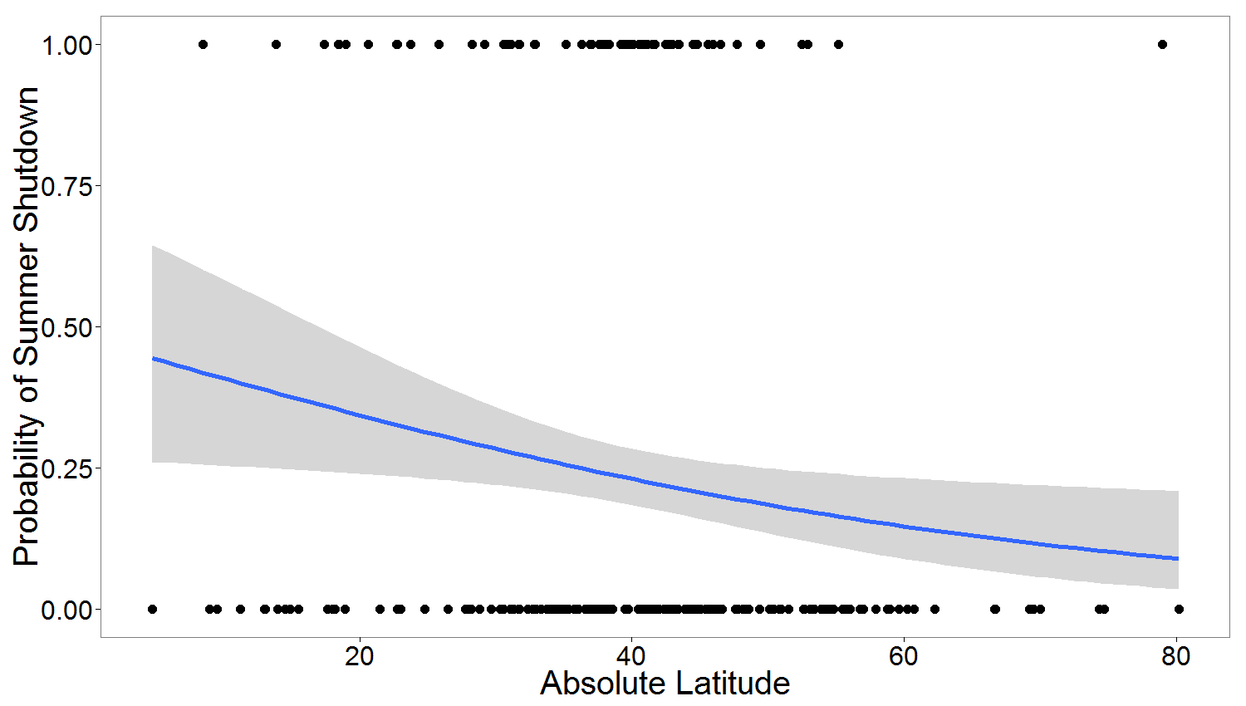
Comparing Summer Shutdown to Latitude
Summer shutdowns, concentrated at low temperate latitudes, are not well-fitted by a logistic model
Takeaway: summer shutdown is not correlated to latitude

Slide 9
Comparing Summer Shutdown to Latitude
Summer shutdowns, concentrated at low temperate latitudes, are not well-fitted by a logistic model
Takeaway: summer shutdown is not correlated to latitude
Are these species range/depth restricted?
Why do these individuals not shut down?

Slide 10
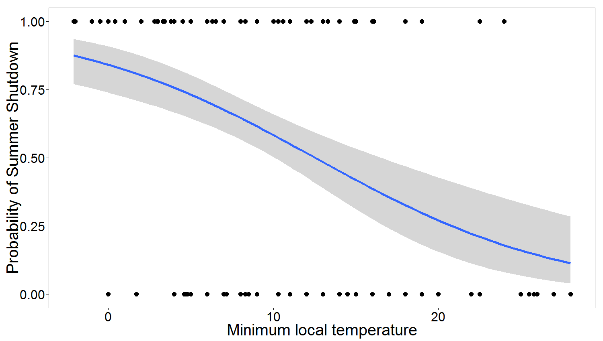
Winter shutdown vs minimum local temperature
12.5% lower odds of shutdown per additional degree Celsius
More significant relationship than latitude alone, even with lower number of measurements

Slide 11
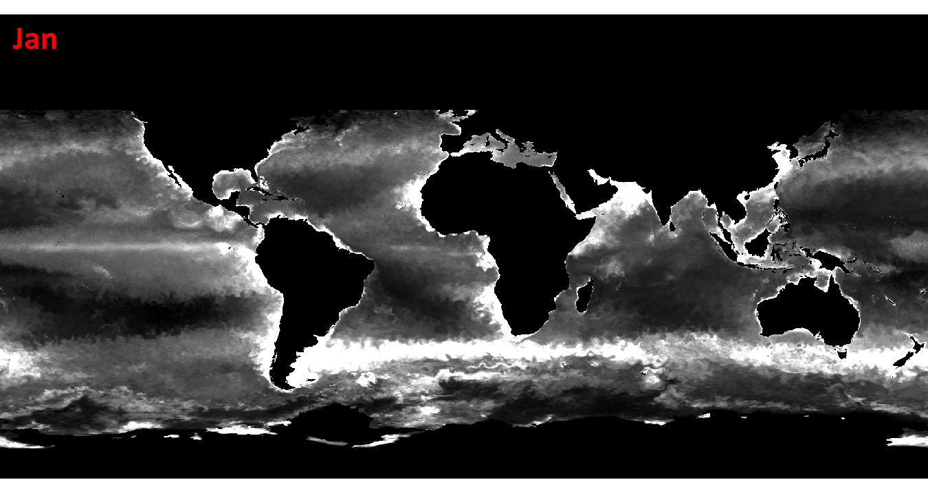
Vertically Generalized Production Model: Calculates net primary production based on remote sensed ocean color and SST while correcting for cloud cover and turbidity
ChlA concentration (mg/m³) for >70 sites
Notes:
Some studies took Chlorophyll A measurements (food supply proxy), but poorly standardized and sparse coverage

Slide 12
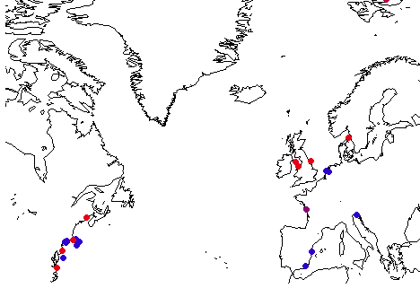
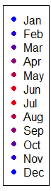
Starving in the summer?
Map of North Atlantic observations of winter shutdown, color coded by lowest month of productivity
Many coastal stations actually have nutrient minimum in the summer when their growth is greatest

Slide 13
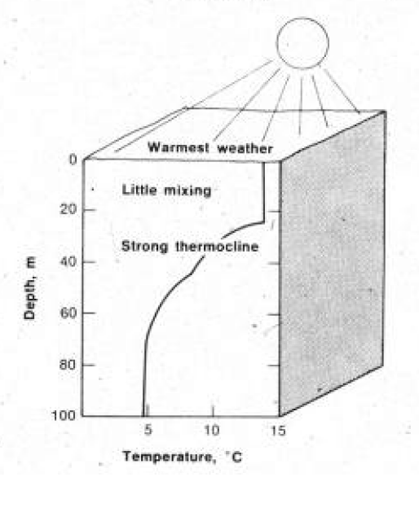
What’s happening with chlorophyll?
In warm months, thermal stratification cuts off nutrient mixing from upwelling
Plankton productivity is therefore often limited in the warmest months
Yet these months are the most productive for bivalve skeletal growth in most species

Slide 14
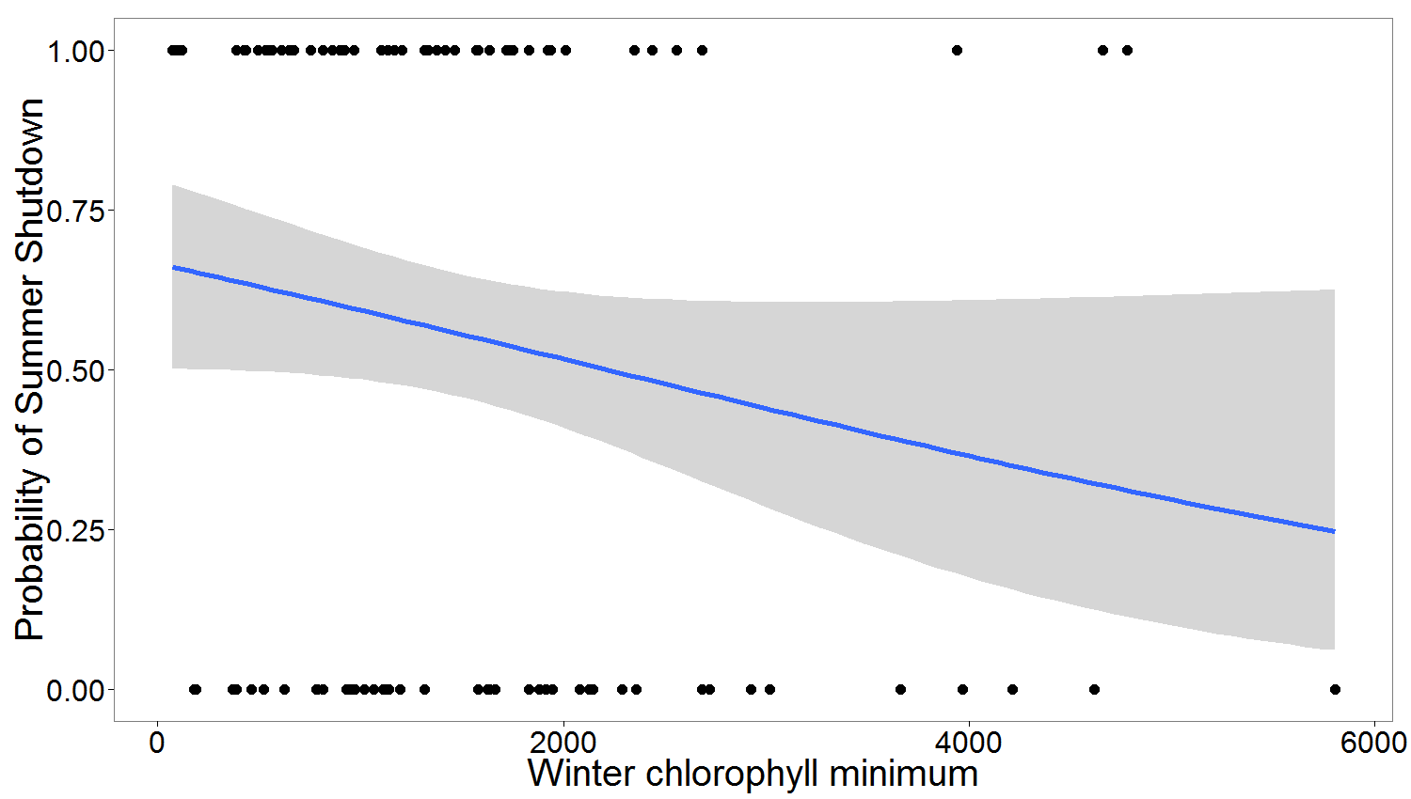
Winter shutdown vs winter chlorophyll minimum
Low winter Chlorophyll A concentration has no significant relationship to occurrence of winter shutdown

Slide 15
Winter shutdown vs winter chlorophyll minimum
When latitude, temperature and chlorophyll data are combined for a multinomial logistic regression, only winter low temperature shows a significant relationship with winter shutdown

Slide 16
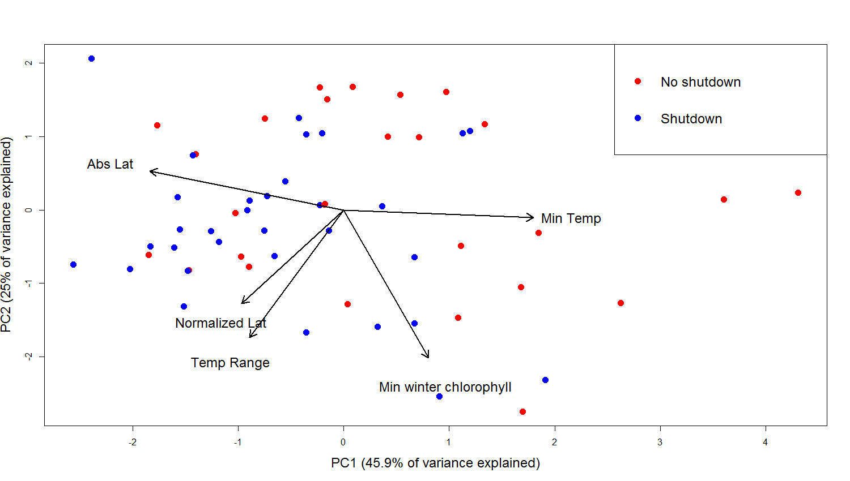
Principal Components Analysis
Shutdown and no shutdown mostly group together based on their latitude of occurrence and minimum local temperature
Minimum winter chlorophyll A explains very little of the variance

Slide 17
Conclusions
Logistic regression shows that temperature and latitude are better predictors of winter shutdown than food availability
High temperatures do not inhibit bivalve seasonal shell growth
Dark growth bands in Northern bivalves largely triggered by low temperature

Slide 18
Acknowledgments
Sarah Sullivan for data entry
UC Santa Cruz Earth and Planetary Sciences
>250 teams who published this literature from 1904-present
VGPM from Behrenfeld, MJ; PG Falkowski. “Photosynthetic rates derived from satellite-based chlorophyll concentration.” Limnology and Oceanography, 1997.

Slide 19
Conclusions
Logistic regression shows that temperature and latitude are better predictors of winter shutdown than food availability
High temperatures do not inhibit bivalve seasonal shell growth
Dark growth bands in Northern bivalves largely triggered by low temperature

