Slide 1

The Sturgeon Falls gabbroic intrusion and its relation with the metalliferous sulfide rocks of the Penokean Volcanic Belt
Joyashish Thakurta
Jonathan Haynes
Anthony Boxleiter
Western Michigan University
Kalamazoo, MI 49008

Slide 2
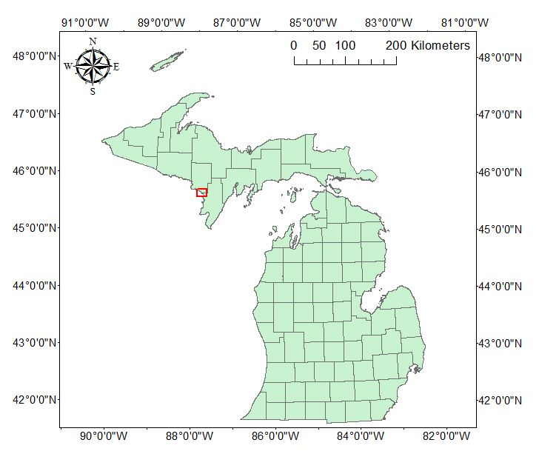
Location of Sturgeon Falls intrusion
The Sturgeon Falls intrusion is located in Dickinson and Menominee Counties in the Upper Peninsula of Michigan

Slide 3
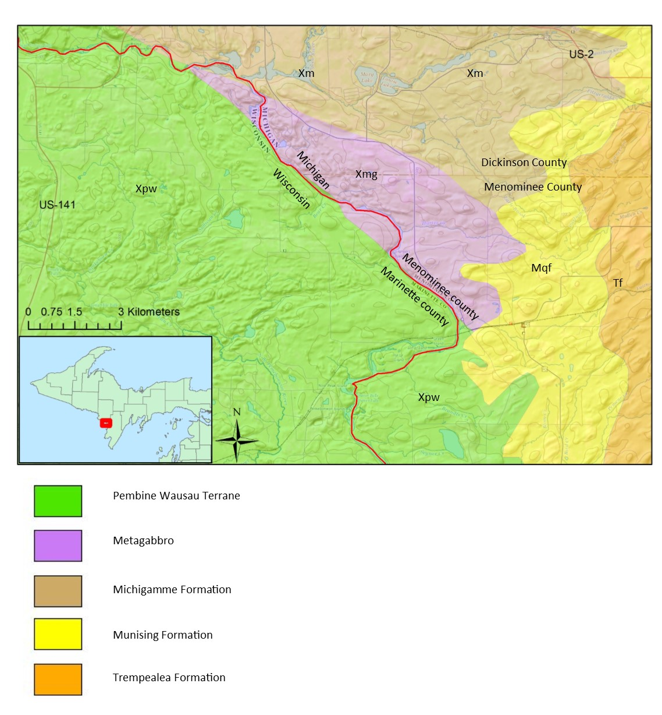
Schematic map of the region surrounding the SFIB

Slide 4
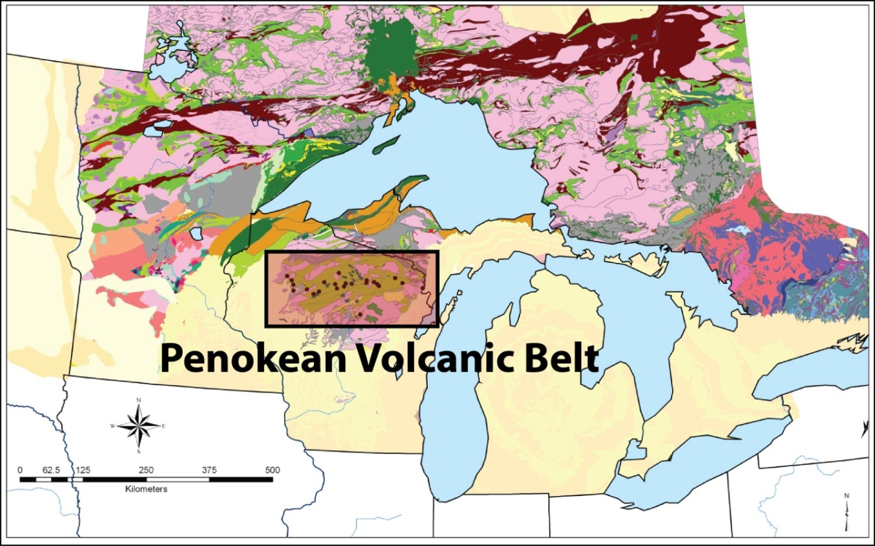
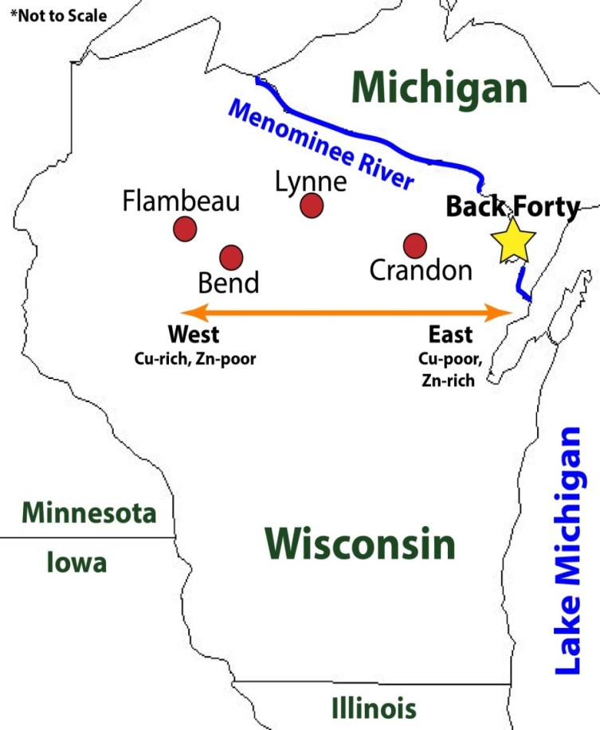
Location of the Penokean Volcanic Belt in Northern Wisconsin and the Michigan Upper Peninsula
Deposit | Tonnage (million tonnes) | Zn (wt. %) | Cu (wt. %) | Au (g/t) | Ag (g/t)
Crandon | 67 | 5.6 | 1.04 | 1.1 | 39
Lynne | 5.6 | 9.27 | 0.47 | 0.7 | 74
Flambeau | 5.8 | - | 4.0 | 1.7 | 31
Bend | 3.5 | - | 1.9 | 2.8 | 12
Back Forty | 15.1 | 3.0 | 0.3 | 2.0 | 24

Slide 5
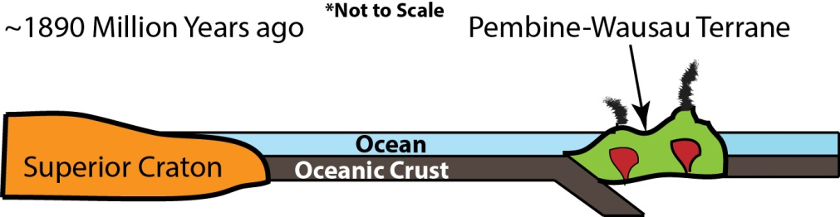
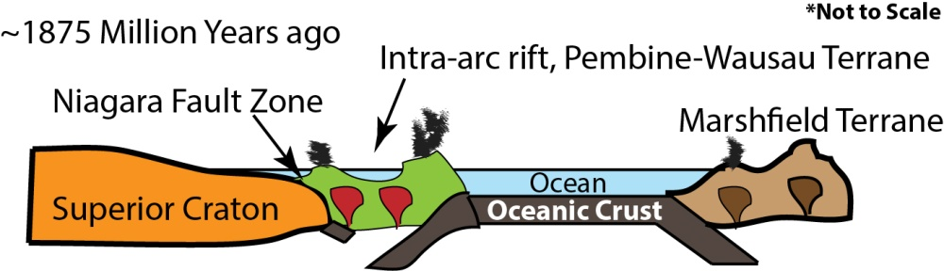
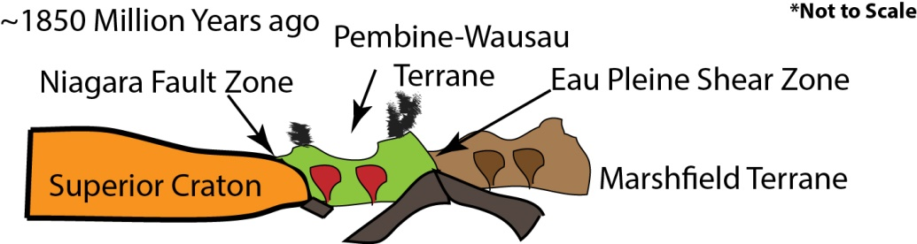
The Penokean Orogeny
Adapted from Schulz and Cannon, 2007

Slide 6
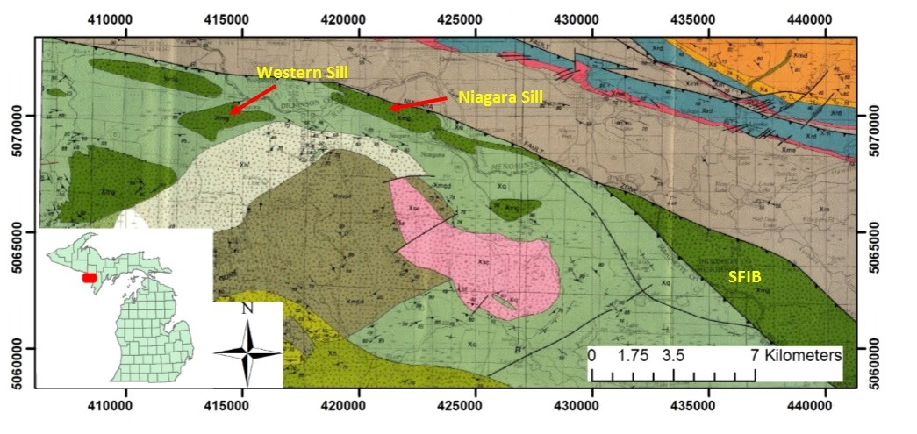
Map of gabbroic sills near the Sturgeon Falls intrusion. Adapted from Sims and Schulz (1993). Coordinates are UTM NAD 83, Zone 16N
In the absence of direct radiometric age, the relative age of the Sturgeon Falls unit is determined to be between 1.86 and 1.89 Ga.

Slide 7
Age of Sturgeon Falls intrusion
Sims and Schulz (1993) concluded that the Niagara Fault is younger than the Sturgeon Falls and other co-magmatic sills.
The minimum age of the Niagara Fault is 1.83Ga. Pembine-Wausau Terrane collided with the Superior Craton, at 1.86Ga (Schulz and Schneider, 2005).
The Sturgeon Falls unit is intrusive into the Quinnesec Formation, which is intruded by the Twelve Foot Falls Quartz Diorite, dated at 1.889 Ga.
Therefore, the relative age range of the Sturgeon Falls intrusion is 1.86-1.89 Ga

Slide 8
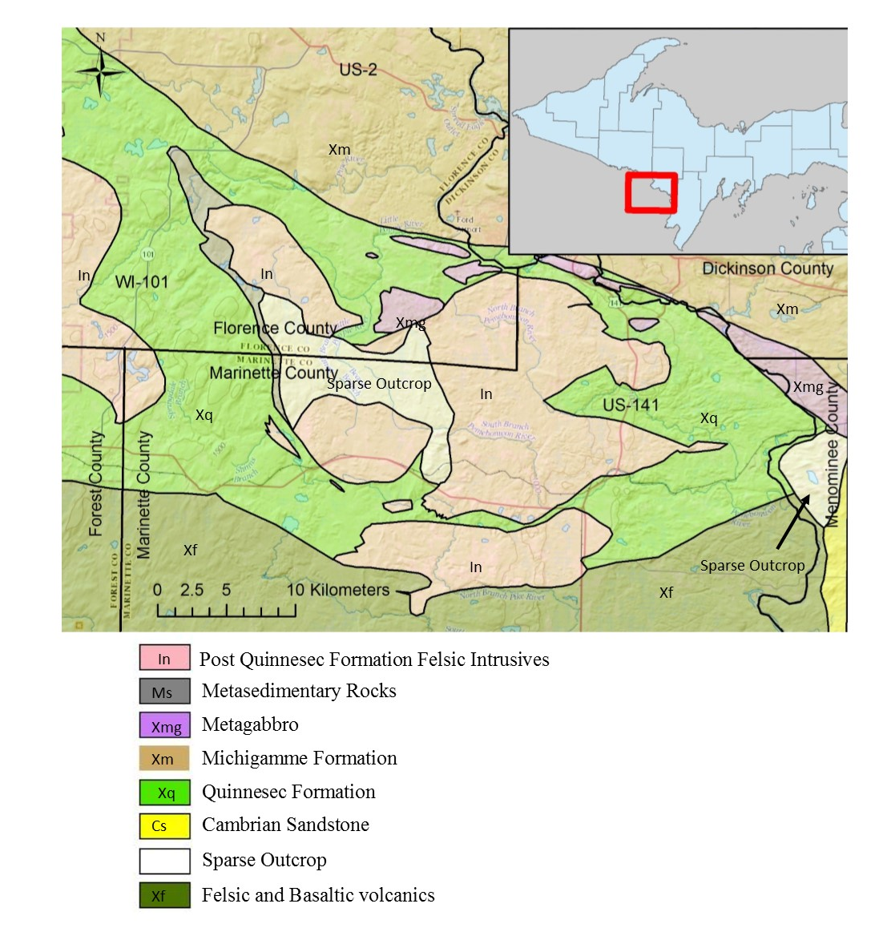

Slide 9
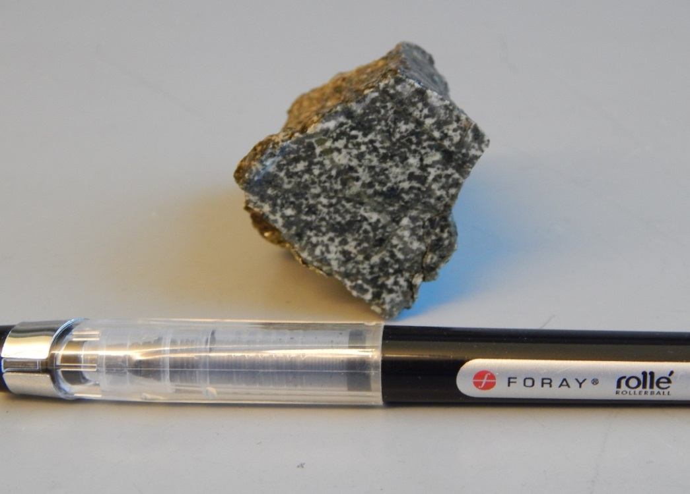
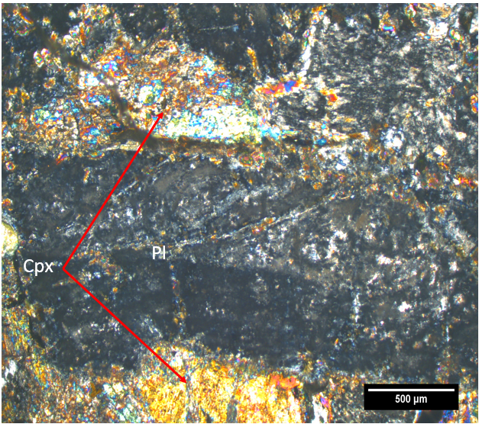
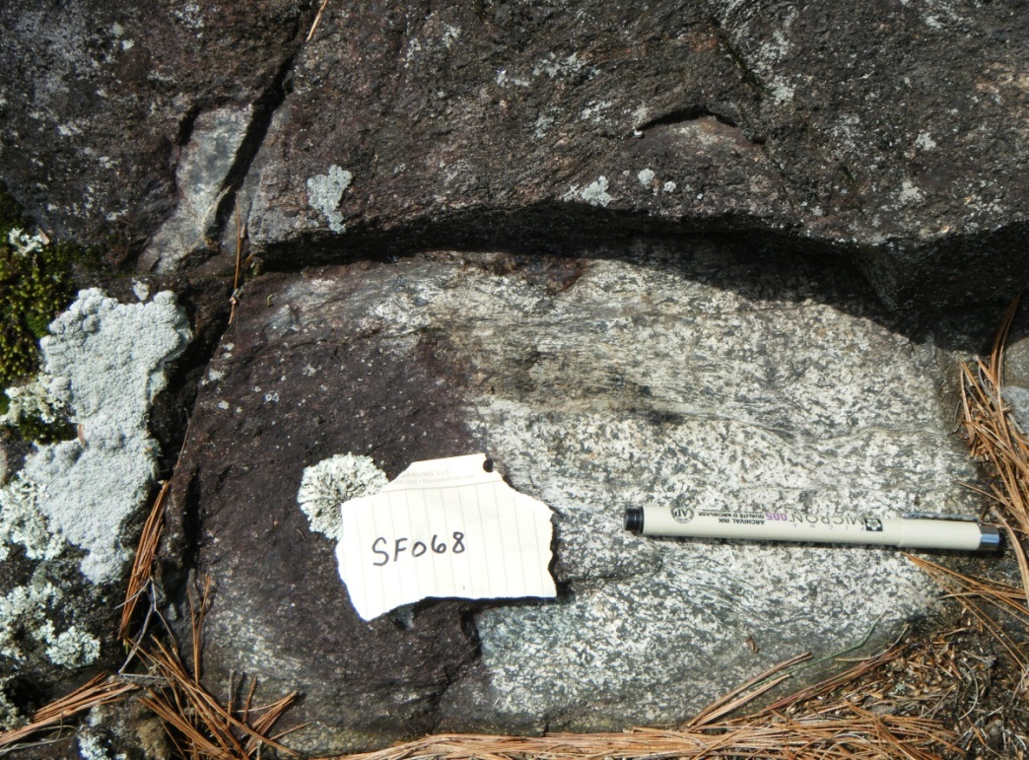
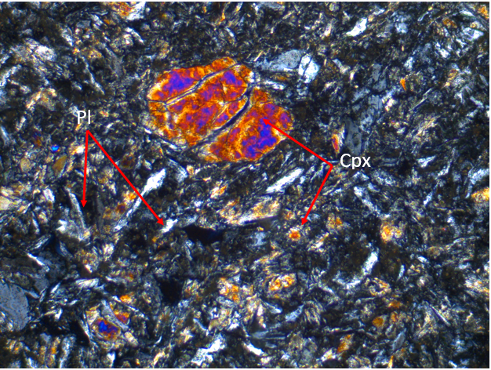
Highly altered plagioclase and clinopyroxene

Slide 10
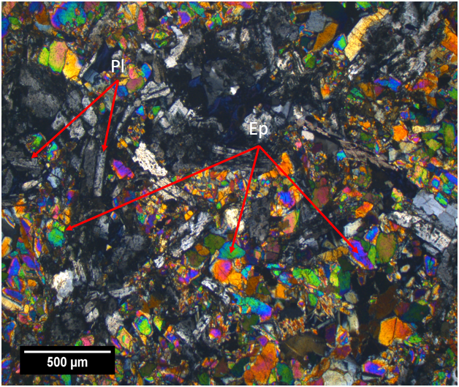
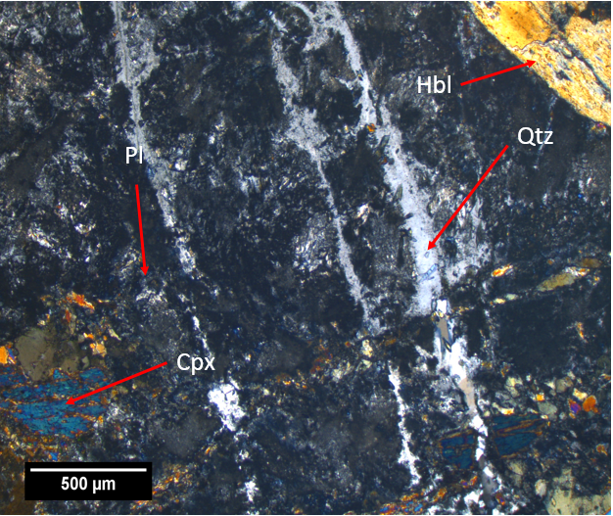
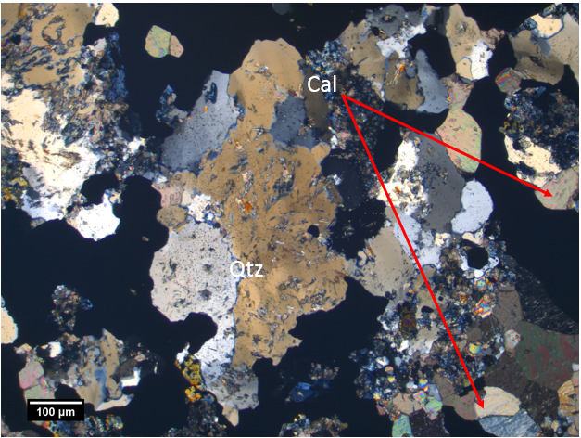
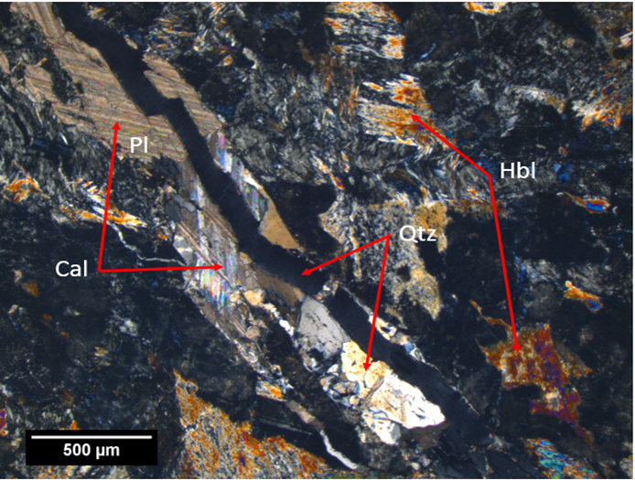
Patches of epidote
Quartz Veins
Calcite, quartz and sulfide mineral bearing hydrothermal vein

Slide 11
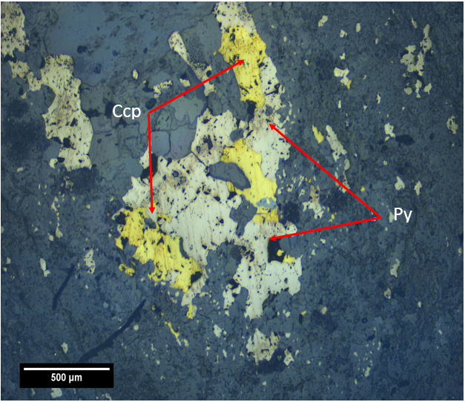
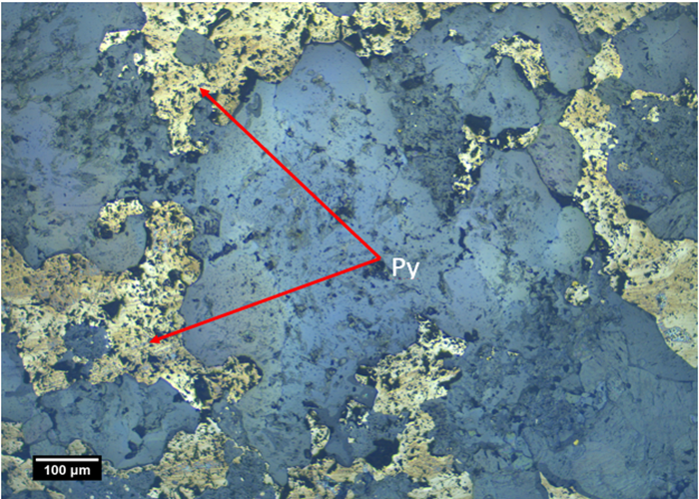
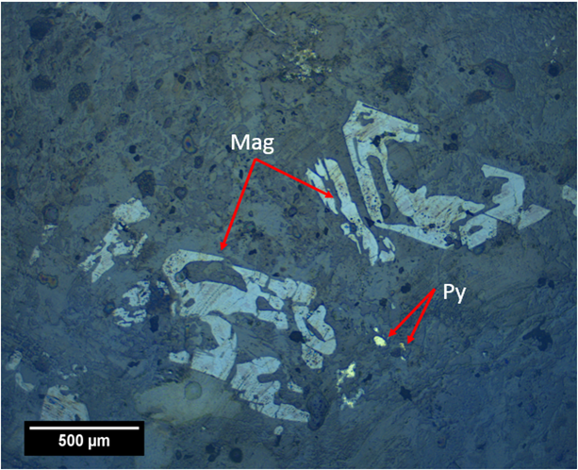
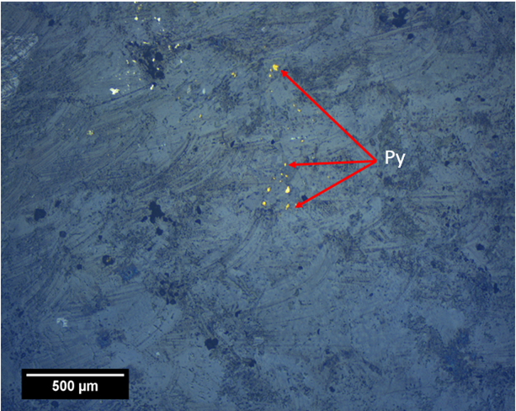
Reflected light photomicrographs showing pyrite and pyrrhotite

Slide 12
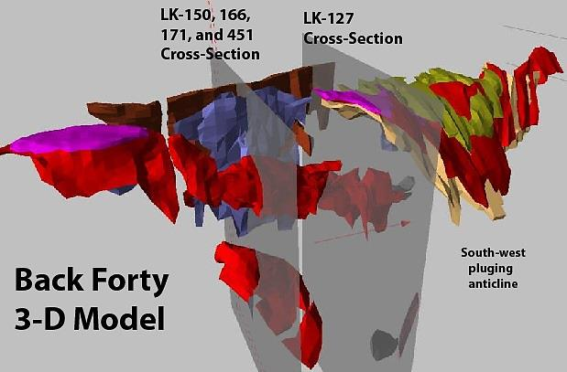
The Back Forty VMS deposit
Source: Aquila Resources Inc.
The Back Forty Zn-Cu deposit is the eastern-most Volcanogenic Massive Sulfide Deposit (VMS) in the Penokean Volcanic Belt (PVB). It is located along the east side of the Menominee River in Menominee County, Michigan.

Slide 13
The Back Forty VMS deposit
The Back Forty is characterized by massive, disseminated and stringer sulfide mineralization hosted within felsic-dominated volcanic rocks, consistent with the bimodal-felsic, or Kuroko-type, VMS model.
The host rocks are coarse and fine-ash crystal tuff interlayered with lithic lapilli-tuff consisting of lithic fragments and xenocrysts of quartz, alkali and plagioclase feldspars within a finer grained, sericite and chlorite altered groundmass.

Slide 14
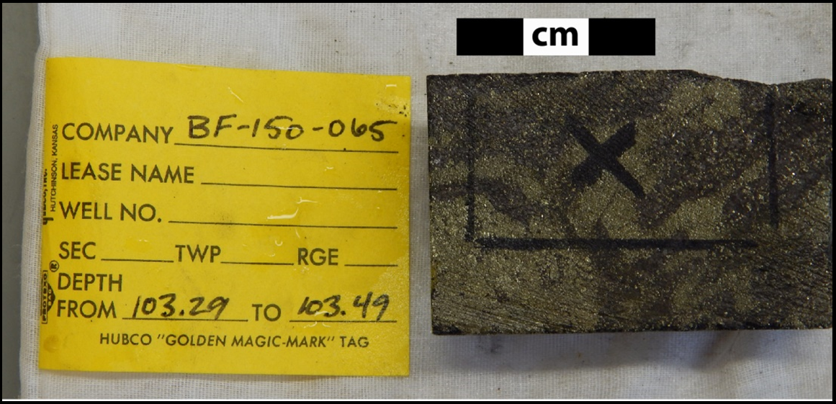
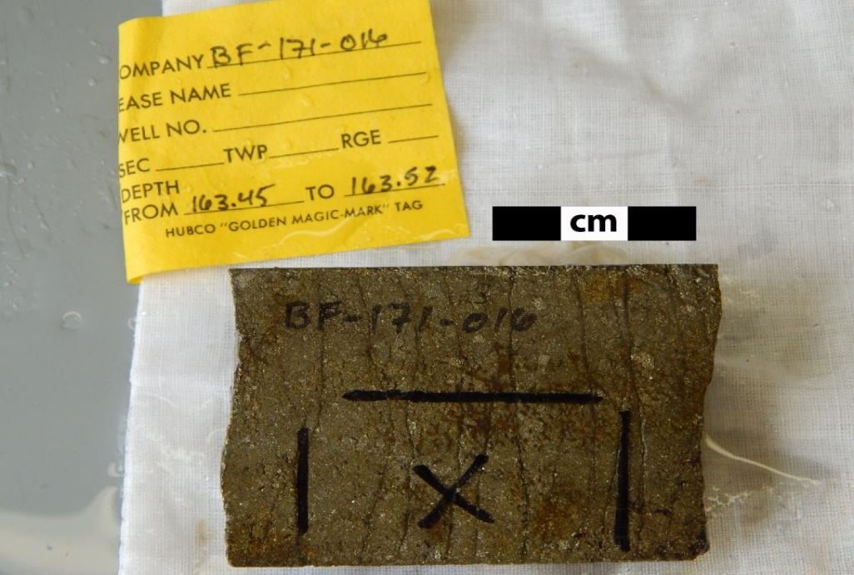
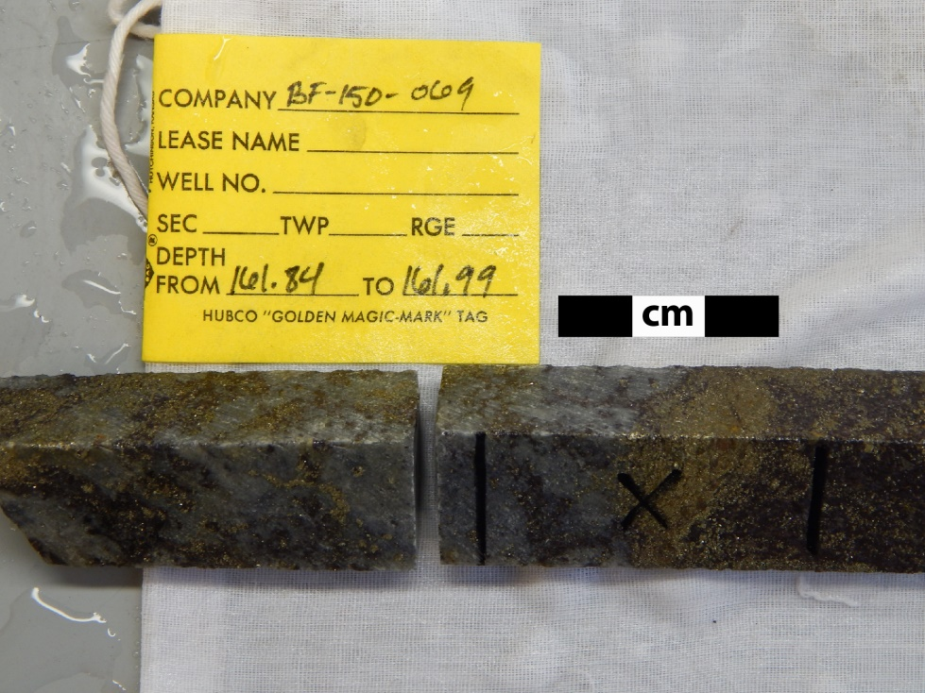
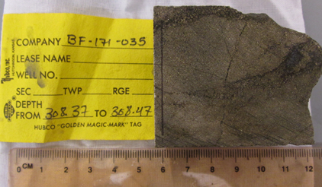
Massive and semi-massive sulfides in drill cores

Slide 15
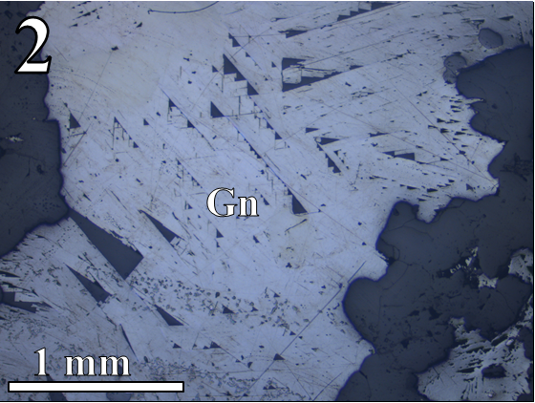
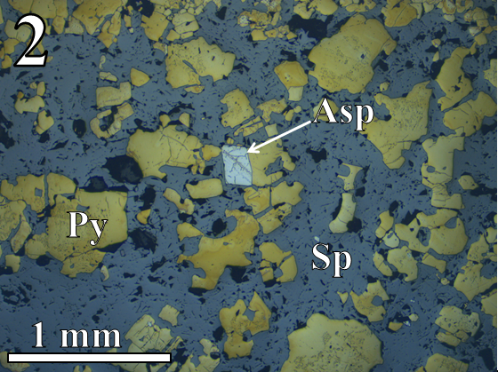
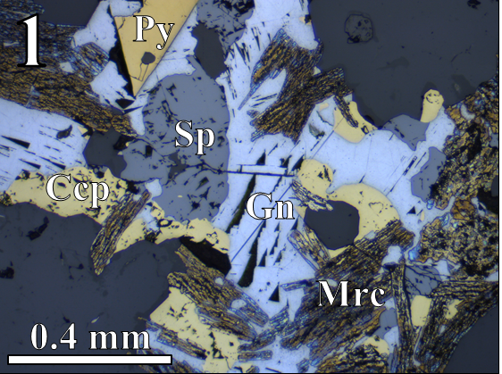
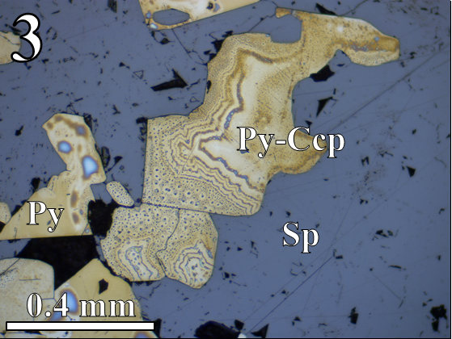
Textures of sulfide minerals in massive sulfide zones

Slide 16
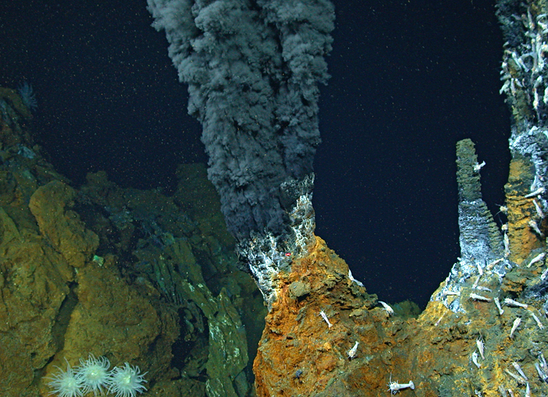
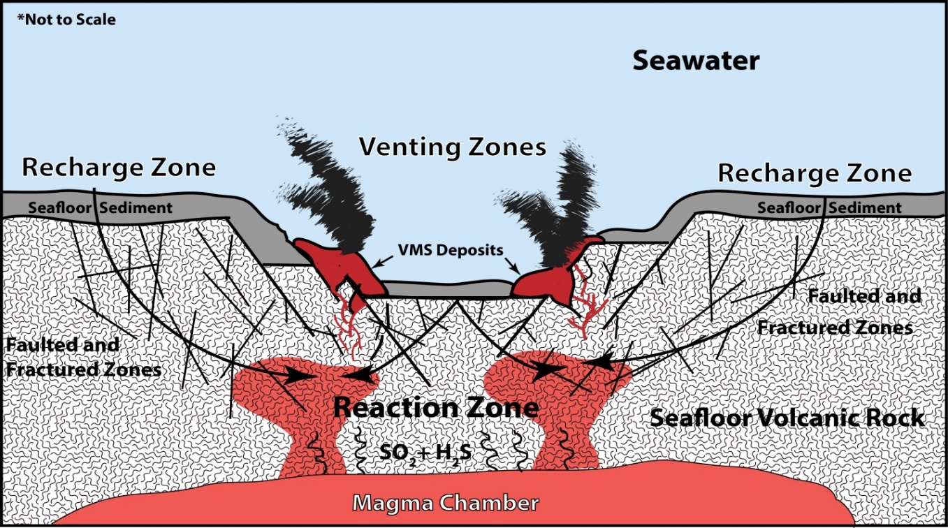
Mode of formation of VMS deposits
Source: WHOI

Slide 17
Sulfur isotope values
Sulfide ore minerals include pyrite, sphalerite, chalcopyrite, galena, and bornite. δ³⁴S values obtained from these minerals range from 0.76 to 5.06‰-VCDT, with an average value of 3.07‰.
These values are indicative of mantle source with small addition from surficial sources.

Slide 18
Histogram of sulfur isotope values for five primary sulfide minerals in the Back Forty deposit

Slide 19
Source of sulfur
Sulfur was primarily supplied to the ore-forming system by hydrothermal leaching of rocks
There could be three sources of sulfur:
Seafloor volcanic rocks.
Sea-floor sediments
Magmatic intrusive units that mobilized sulfur from mantle sources

Slide 20
Histogram of sulfur isotope values of the five major VMS deposits of the Penokean Volcanic Belt (Crandon Values: Leslie Myers, 1983; Bend, Lynne, and Flambeau values: Laurel Woodruff, personal communication)

Slide 21
Summary and conclusions
The Sturgeon Falls igneous intrusion is a Paleoproterozoic gabbroic unit, with minor occurrences of clinopyroxenite.
It is contemporaneous with the Penokean Volcanic Belt and it is located along the trend of the belt in northern Wisconsin and UP Michigan.
The Penokean Volcanic Belt has been known for a large group of sulfide mineral deposits with δ³⁴S values closely representative of mantle origin.
The Sturgeon Falls unit contains disseminated deposits of pyrite and chalcopyrite.
It is proposed that the Sturgeon Falls unit and similar gabbroic bodies in the Penokean Volcanic Belt were the major sources of sulfur into the hydrothermal ore forming system.
Thus, the Sturgeon Falls unit and the group of similar mafic-ultramafic intrusive bodies in the area could be recognized as prospective targets for primary magmatic sulfide mineral deposits.

Slide 22
Acknowledgements
Tom Quigley and Eric Quigley, Aquila Resources Inc.
Ben Underwood and Ed Ripley, Indiana University Bloomington
Laurel Woodruff, Klaus Schulz and Bill Cannon, United States Geological Survey

