Slide 1




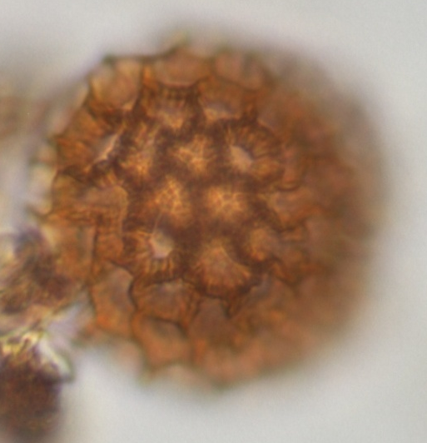
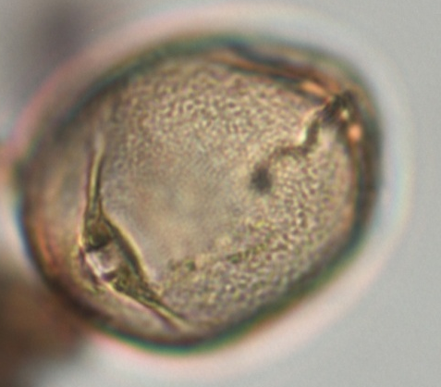
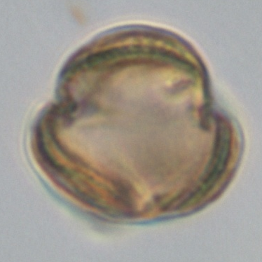
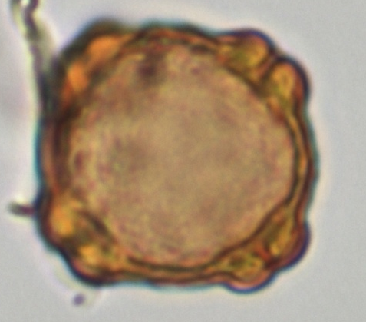
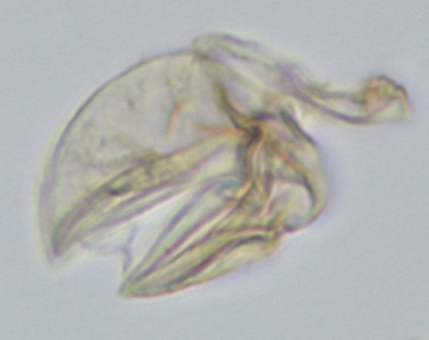
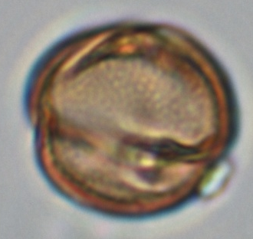
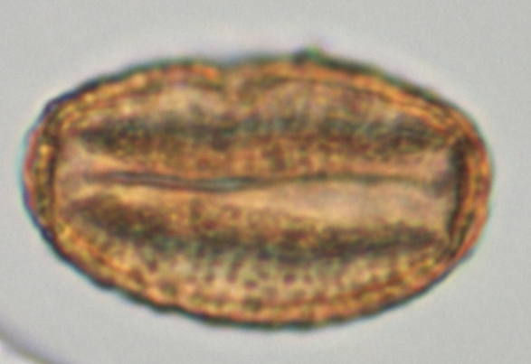
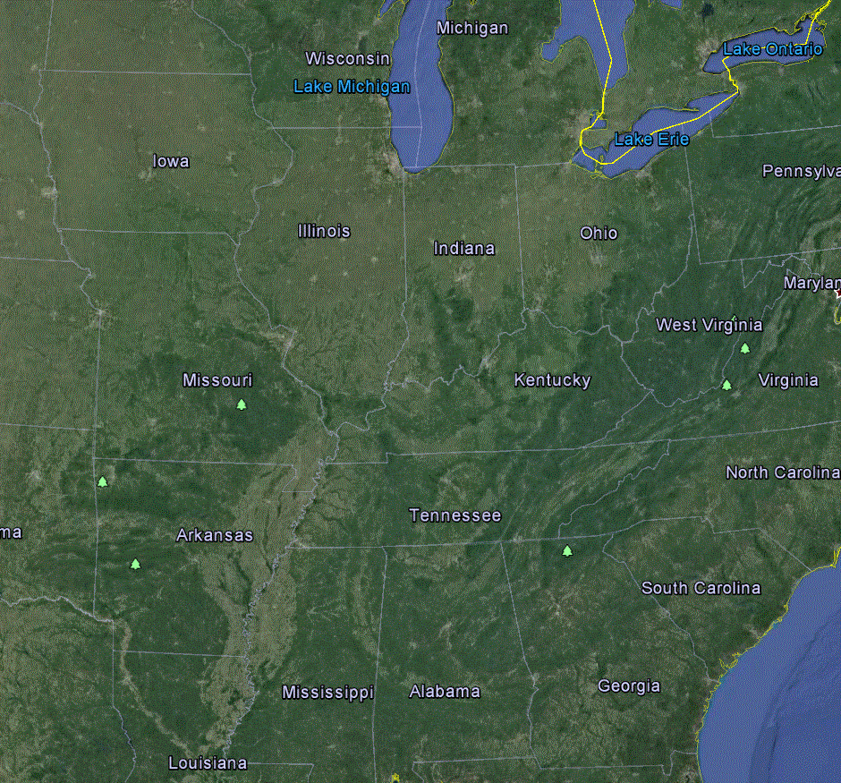
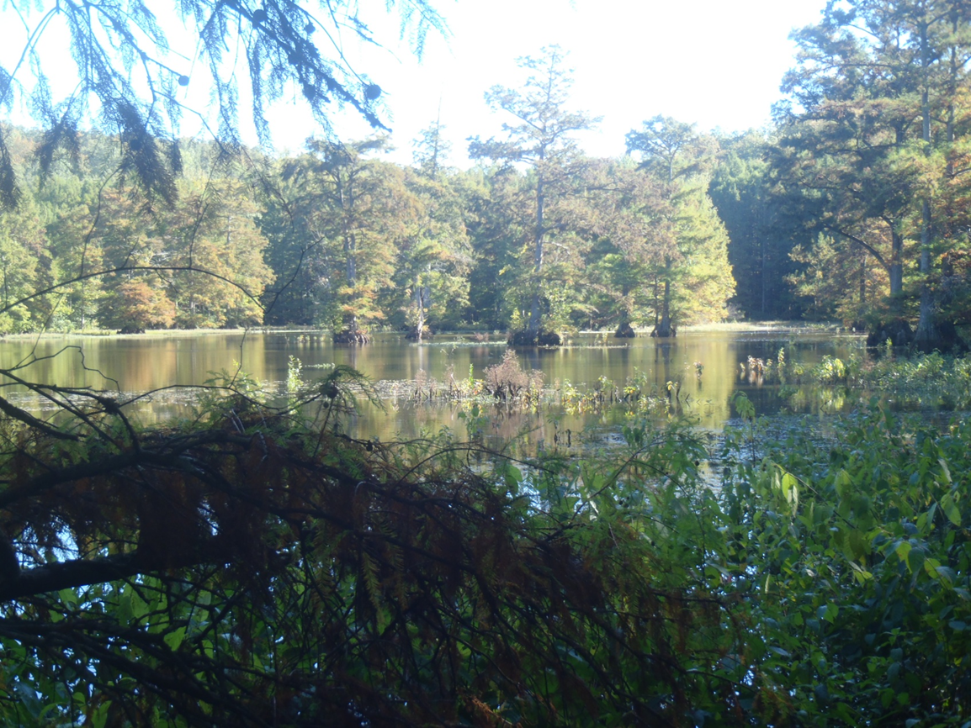
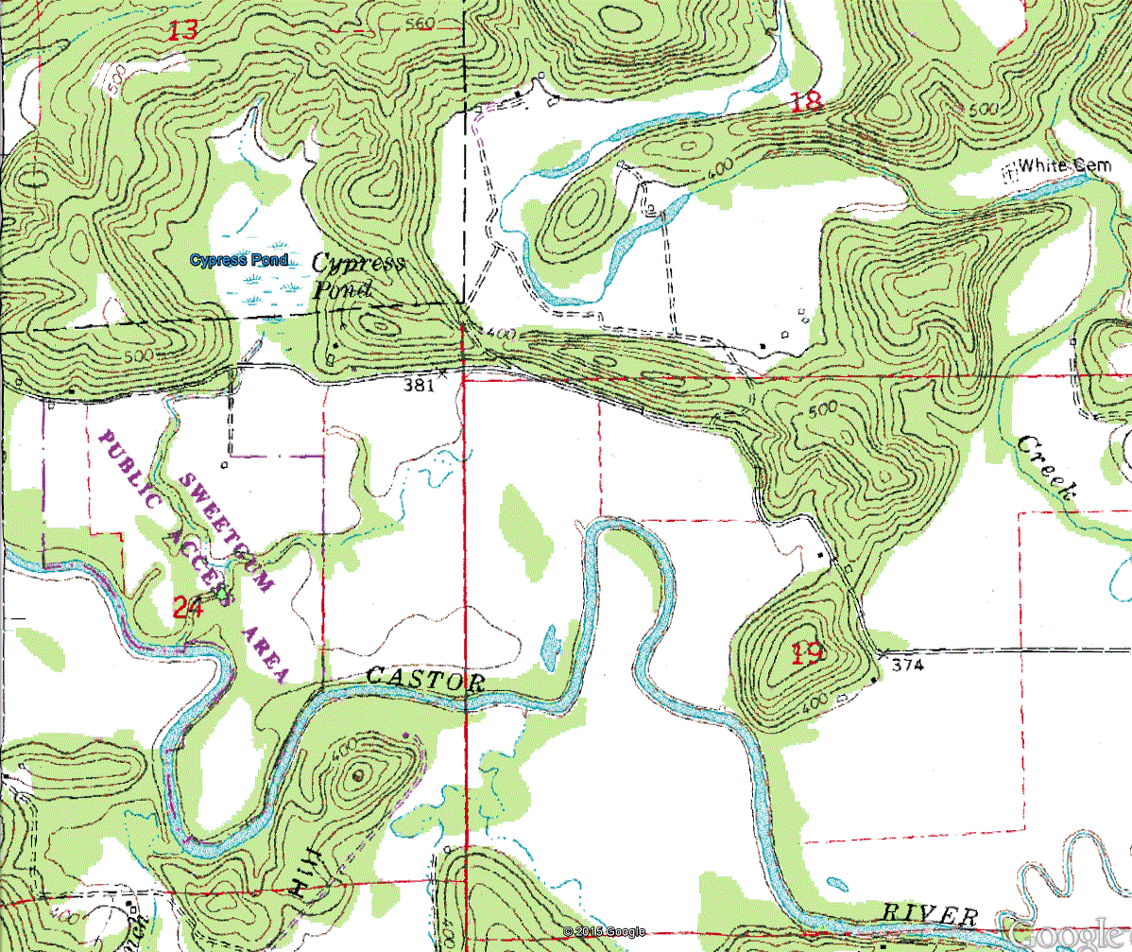
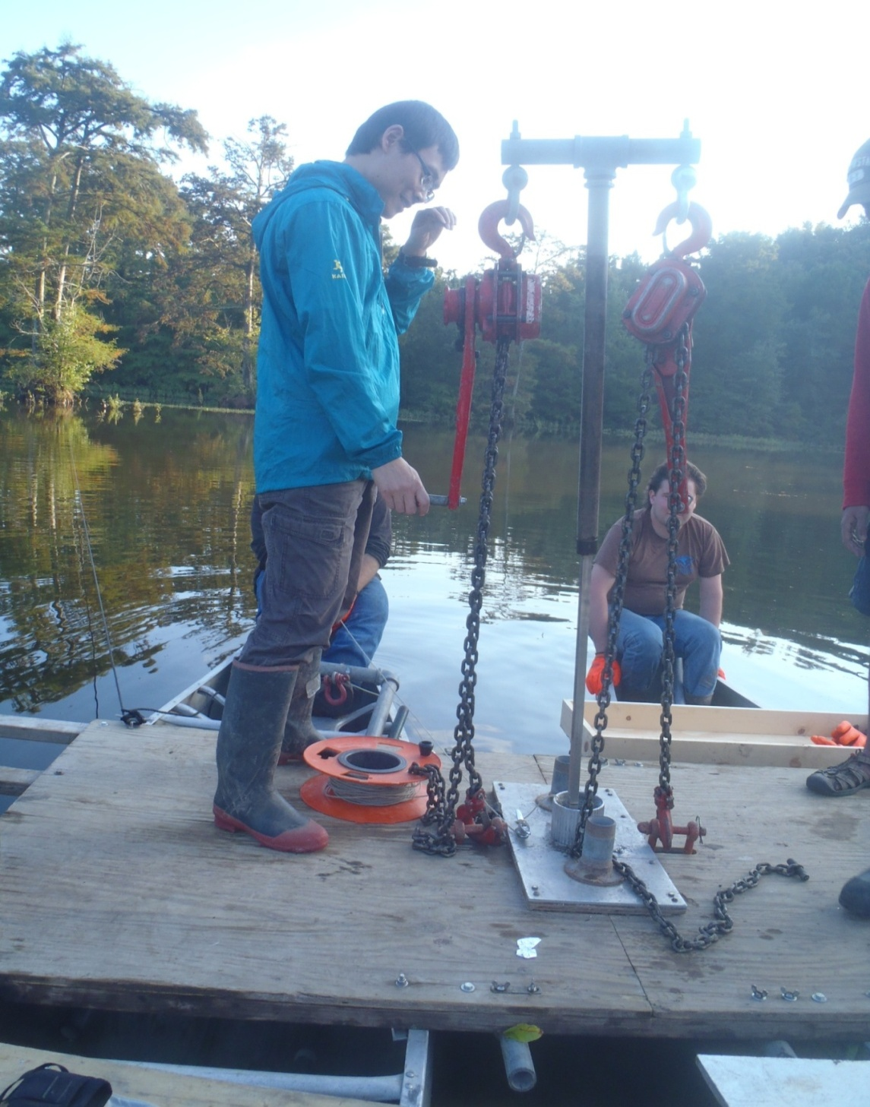
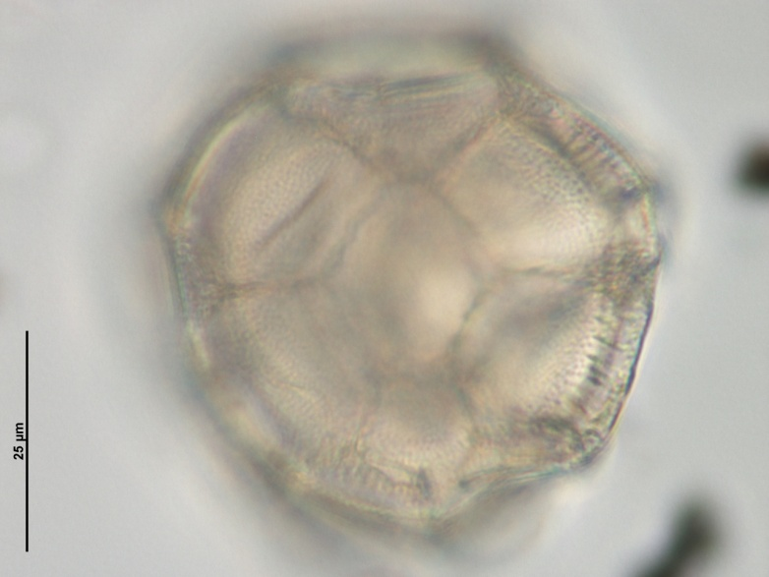
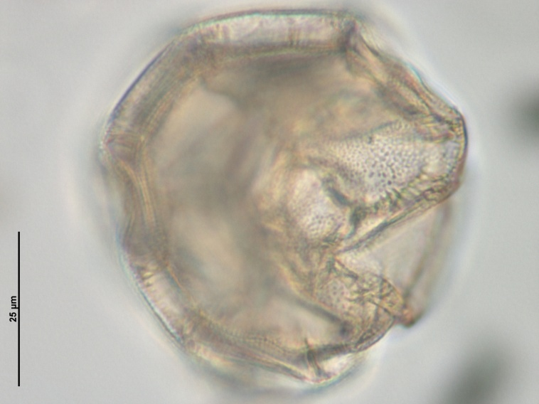
Preliminary Holocene Paleoclimatic Data from Palynology of Cypress Pond, South Central Missouri
Haselwander, R.D.*, Oboh-Ikuenobe, F.E.*, and Grimm, E.⁺
*Missouri University of Science and Technology, Geology and Geophysics Program, Department of Geosciences and Geological and Petroleum Engineering, ⁺Illinois State Museum
Abstract
Pollen and non-pollen palynomorphs in a staggered sediment core from Cypress Pond in Bollinger County, Missouri, sampled at low-resolution, were used to reconstruct paleovegetation and infer paleoclimatic information in the region. The core was taken in eleven successive drives using a Livingston piston corer for a total depth of 5.1 m. Age constraints were established using radiocarbon dating on wood macrofossils. A mixed pollen assemblage was recovered in the sediments. Temperate forest pollen taxa included Quercus (oak), Pinus, Alnus (alder), Ulmus (elm), Juglans (walnut), Liquidambar (sweetgum), Cornus (dogwood), and Nyssa (black/tupelo gum), along with more wetland-loving Carya (hickory), Betulaceae (birch),Populus (cottonwood), and Cupressaceae (cypress). Glade pollen belonging to Poaceae (grass), Asteraceae (sunflowers, including Ambrosia[ragweed]), Plantago (plantain), Chenopodiaceae (goosefoot), and Humulus (hop) and the aquatic genera Brasenia (water-shield), Nuphar (water-lilly) and Myriophyllum (watermillfoil) were also present. Preliminary results from this data indicate warming conditions in the mid-late Holocene, which allowed cypress to become an important part of more recent vegetation. Eutrophic water conditions appear to coincide with this warming period, which is shown by the appearance of Pediastrum boryanum var. cornutum in the same interval.
Sand in Clay
Magnetic Susceptibility
Uncommon
Very Rare
LOI-500
LOI-900
cm
Core
Rare
10
Artemisia (Sagebrush)
Myriophyllum (Watermillfoil)
Cupressaceae (Cypress)
Cephelanthus (Buttonbush)
Persicaria lapathifolia-type (Pale Smartweed)
Nyssa cf. aquatica
(Tupelo Gum)
Quercus
(Oak)
20
1
10 µm
30
2565 YBP ¹⁴C
A
Sediment Analysis
Cypress Pond sediments are broken into three lithofacies – A, B, and C
Facies A is a mottled, organic-rich mud
Facies B is a massive mud with indicators of reducing conditions (vivianite) and intermittent aridity (nodular hematite)
Facies C is a mottled mud with minor but notable sand and some pebbles, indicating more frequent flooding, and possible protracted aridity (~270-370 cm)
40
50
1290 YBP ¹⁴C
60
70
2
80
90
100
110
3
120
130
140
150
4
Pollen Analysis
160
B
Study Area
170
180
Pollen Zones
Cypress Pond (37.175589 N, 90.116853 E) is located
on the edge of the Ozark Plateau
190
200
5
1
210
2
220
230
3
240
250
6
260
270
4
280
290
7
300
310
320
Raw counts are presented above – taxa with no label have less than five individuals in a single sample
Zone 1 appears to indicate warmer winter temperatures, as seen by a rise in Cypress
Zone 2 could indicate higher effective precipitation than the present, indicated by a rise in Willow and Buttonbush
Zone 4 had poor recovery, however the bottom-most sample appears to indicate an Oak woodland, similar to the paleovegetation observed in the rest of the core
330
340
8
350
360
C
370
380
390
9
Future Work
Dates obtained from wood samples in the top ~50cm appear spurious, likely because the wood itself was very old when it was deposited in relatively recent sediments. Hence, charcoal picking is underway to obtain reliable radiocarbon dates
A surface core has been obtained to cover the time between the top of this study and the present (~30cm); pollen analysis of these final samples is on-going
Methods
400
410
Sediments cored in sections with Livingstone-style corer, 2013
Cores were extruded, wrapped,
and put in cold storage.
Core analysis, included whole core (e.g. Magnetic Susceptibility), descriptions and LOI performed at U. Minnesota LacCore facility
Pollen samples (31) prepared at Illinois State Museum using Mueller-Grimm method
Pollen counted on a Nikon E100 in silica oil mounted slides, up to 300 palynomorphs per sample
420
430
440
10
450
460
470
480
Do you recognize me?
490
11
500
510
Key:
Acknowledgements
We would like to thank the Missouri University of Science and Technology for funding this project; Xiaozhong Huang, Varun Paul, Adam Barron, and Justin Levy for their assistance with coring; Pietra Mueller for assistance with pollen processing; and the folks at LacCore for their support in preliminary core analysis.
Pebbles –
Vivianite –
Hematite –

