Slide 1
Science As Story: Communicating Geoscience
In Unexpected (And Effective) Ways
Terri Cook
Down To Earth Science
www.down2earthscience.com
Clear as Mud? Advancing Communication in the Geosciences
GSA Annual Meeting
Baltimore, November 4, 2015

Slide 2
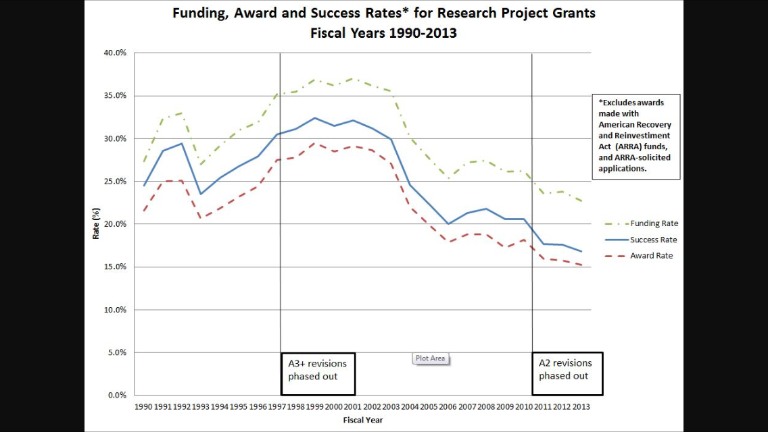
Science funding is decreasing, as is the rate of success for funding research project grants:
Nexus.od.nih.gov

Slide 3
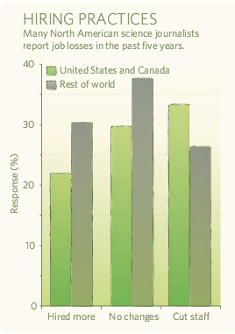
At the same time, traditional science journalism is in decline, particularly in North America.
“Independent science
coverage is not just
endangered, it’s dying.”
--- Robert Lee Hotz
Science Journalist
The Wall Street Journal
Nature, 2009

Slide 4
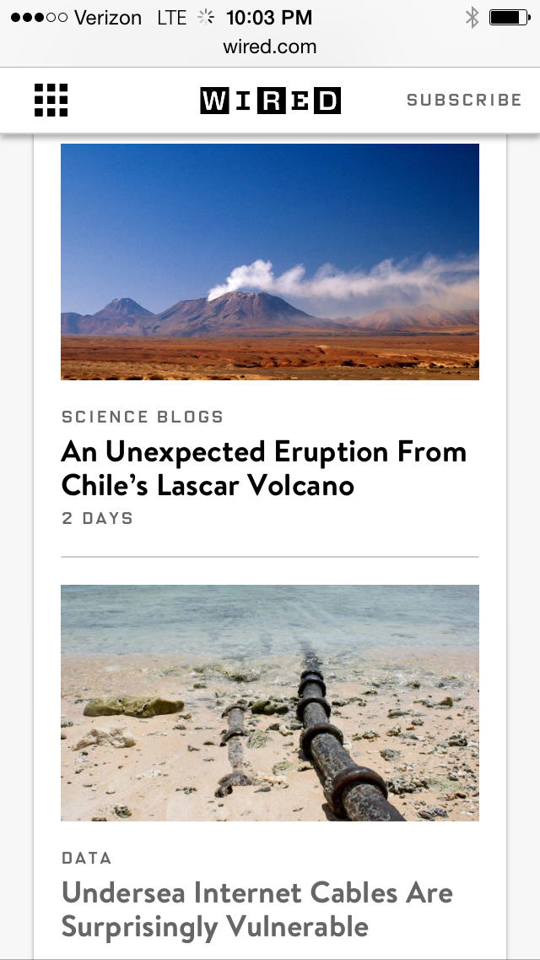
The amount of scientific material being made available to the public is on the rise, as are the number of blogs written by scientists.
Although blogs are an increasing resource for the public and many science journalists, they don’t have the same broad audience as mass media, and they don’t always critically evaluate the science.

Slide 5
Journalists can bring a wide variety of scientific topics to many audiences:
Policymakers, other scientists, and the public.
And…
Scientists’ research provides the material that science journalists present.

Slide 6
Yet the two groups do not always see eye-to-eye:
90% of scientists believe that not many members of the press understand the nature of science and technology.
And…
85% of reporters think that scientists are somewhat (or not at all) accessible.
--- UCAR.com

Slide 7
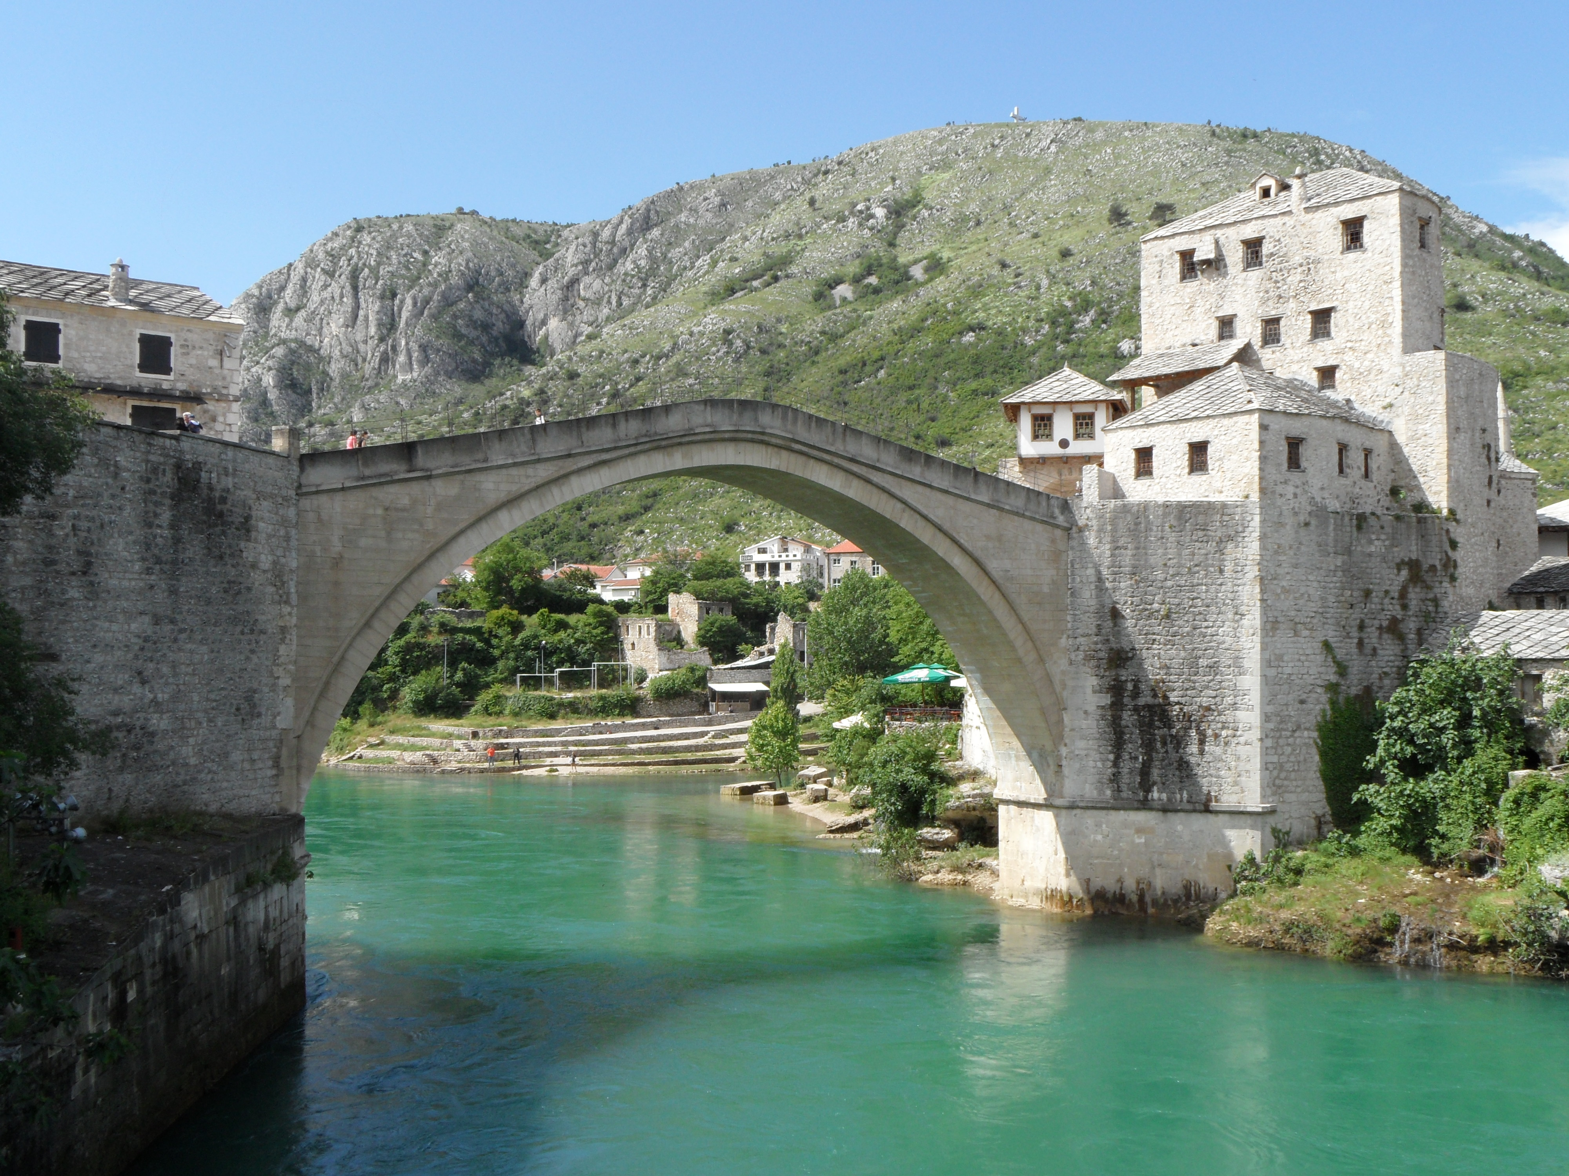
But it’s becoming increasingly important to bridge this gap and work together to benefit geoscientists, journalists, and most of all, the public.
How can scientists and science journalists better engage our audiences and expand our reach?

Slide 8
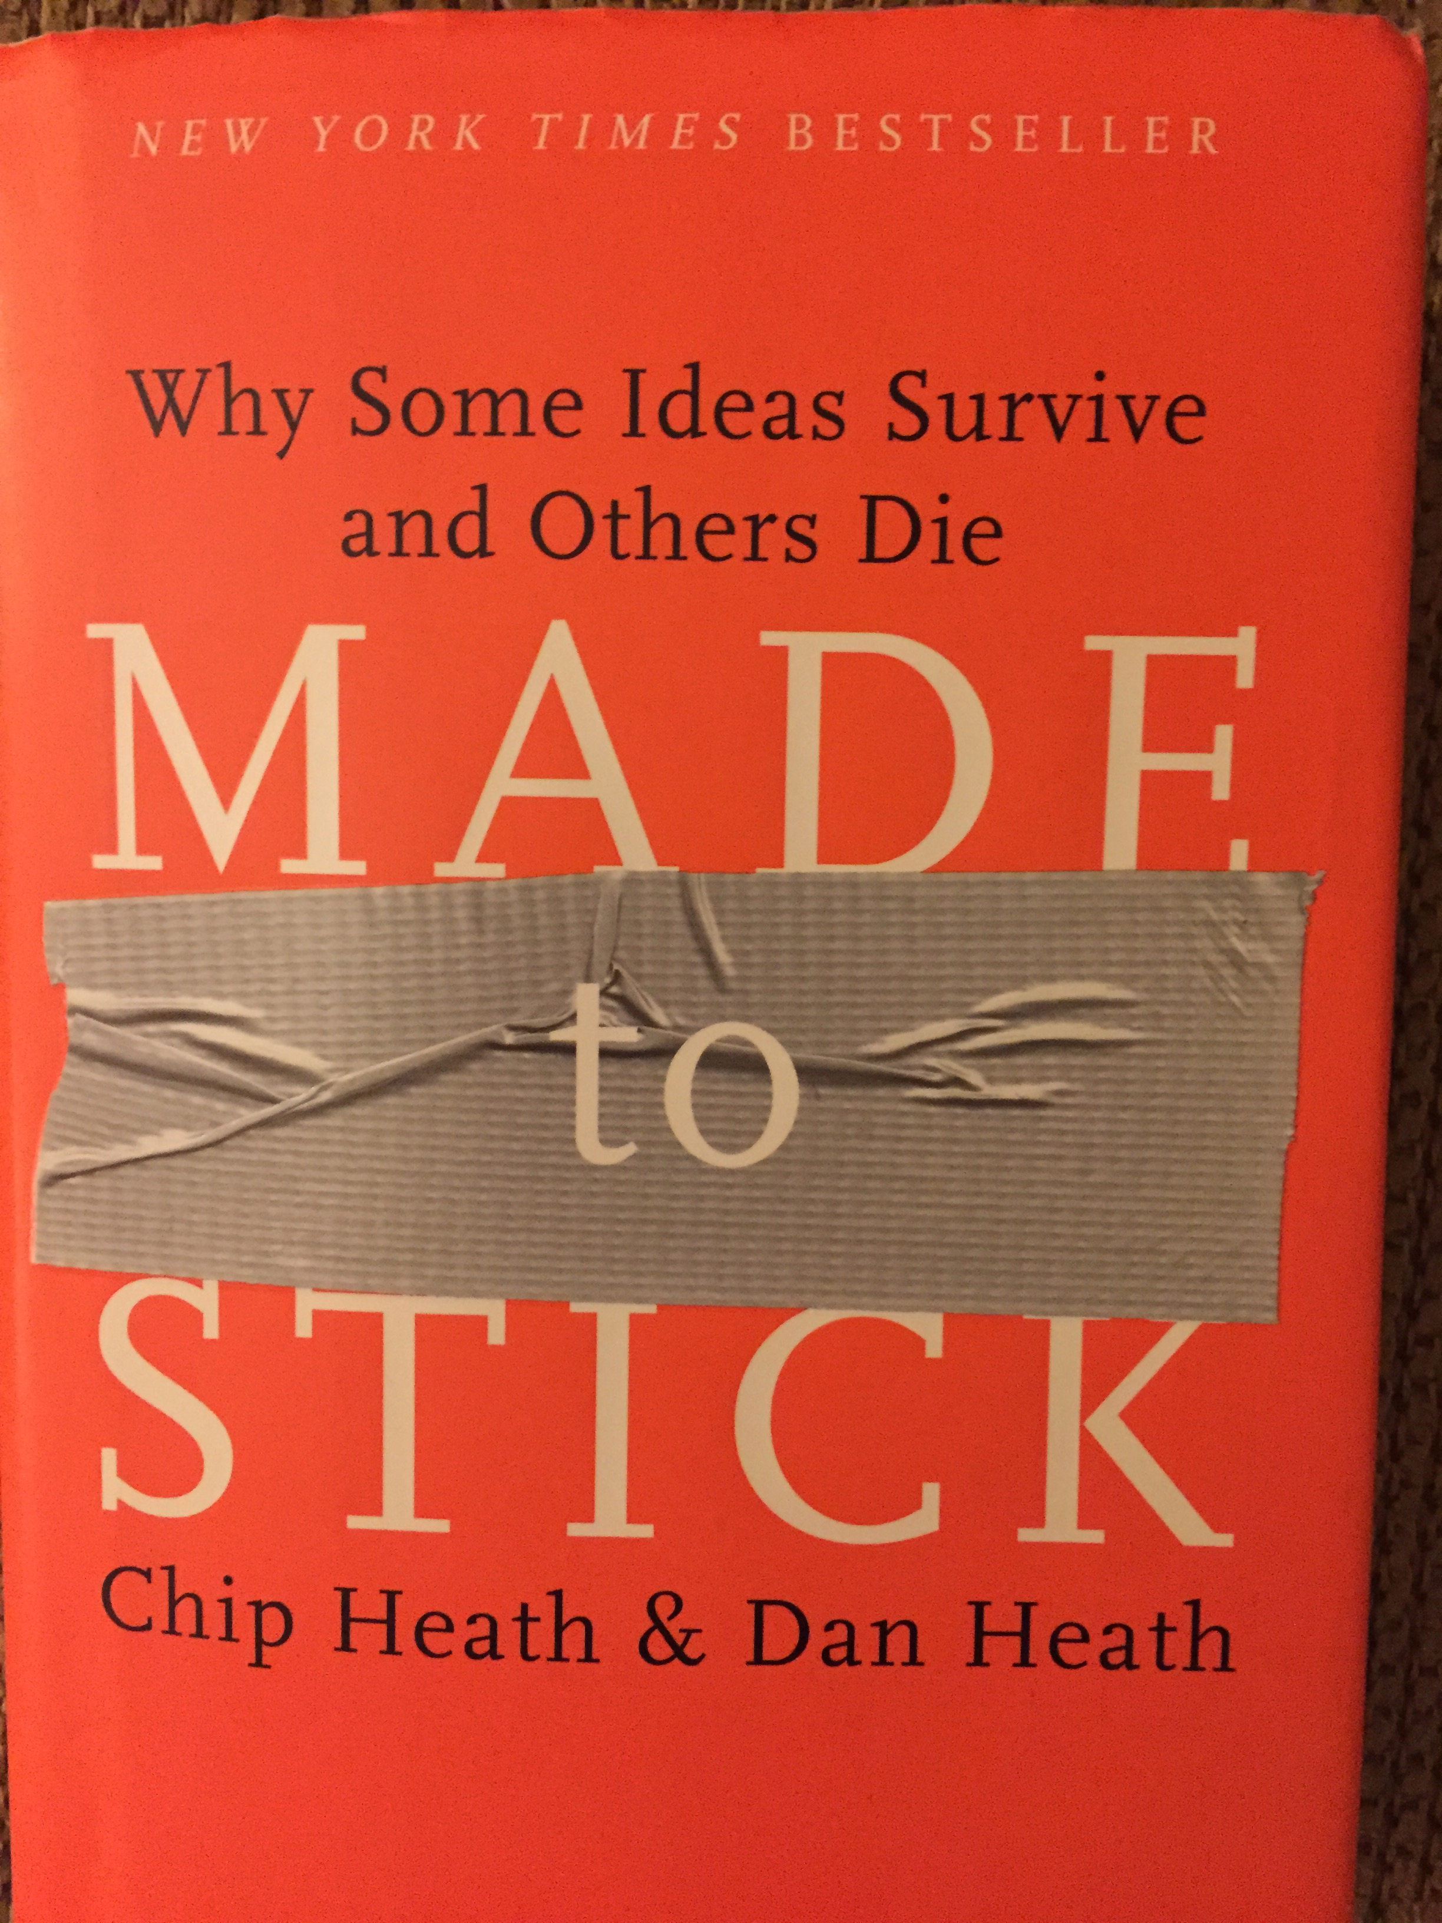
How to engage an audience?
Chip and Dan Heath:
Made To Stick
How do you design an idea that sticks?
Sticks = Your idea is understood and remembered, and has a lasting impact.

Slide 9
6 Principles of Sticky Ideas:
Simple
Unexpectedness
Concreteness
Credibility
Emotions
Stories
S

Slide 10
6 Principles of Sticky Ideas:
Simple
Unexpectedness
Concreteness
Credibility
Emotions
Stories
S
Simple ≠ Dumbed Down
To make ideas stick, we must find the core.
Ruthless prioritization
Journalism: the “Lead”

Slide 11
6 Principles of Sticky Ideas:
Simple
Unexpectedness
Concreteness
Credibility
Emotions
Stories
S
Both journalists and scientists can get lost in the details and fail to find the central story.
Journalists: Don’t bury the lead.

Slide 12
6 Principles of Sticky Ideas:
Simple
Unexpectedness
Concreteness
Credibility
Emotions
Stories
S
Surprise:
When a pattern is broken and our preconceived notions fail
Curiosity: Caused by creating a gap in knowledge – like an itch that needs scratching

Slide 13
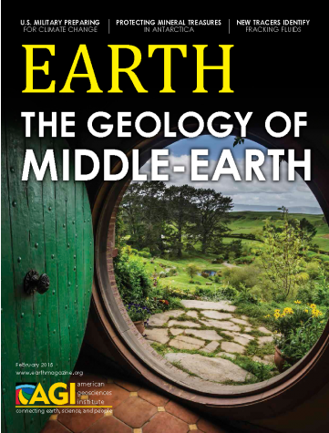
Unexpected!
Core: The geologic history of Middle Earth filming sites
Means of engaging a broader audience
To stick, the unexpected ideas should produce new insights

Slide 14
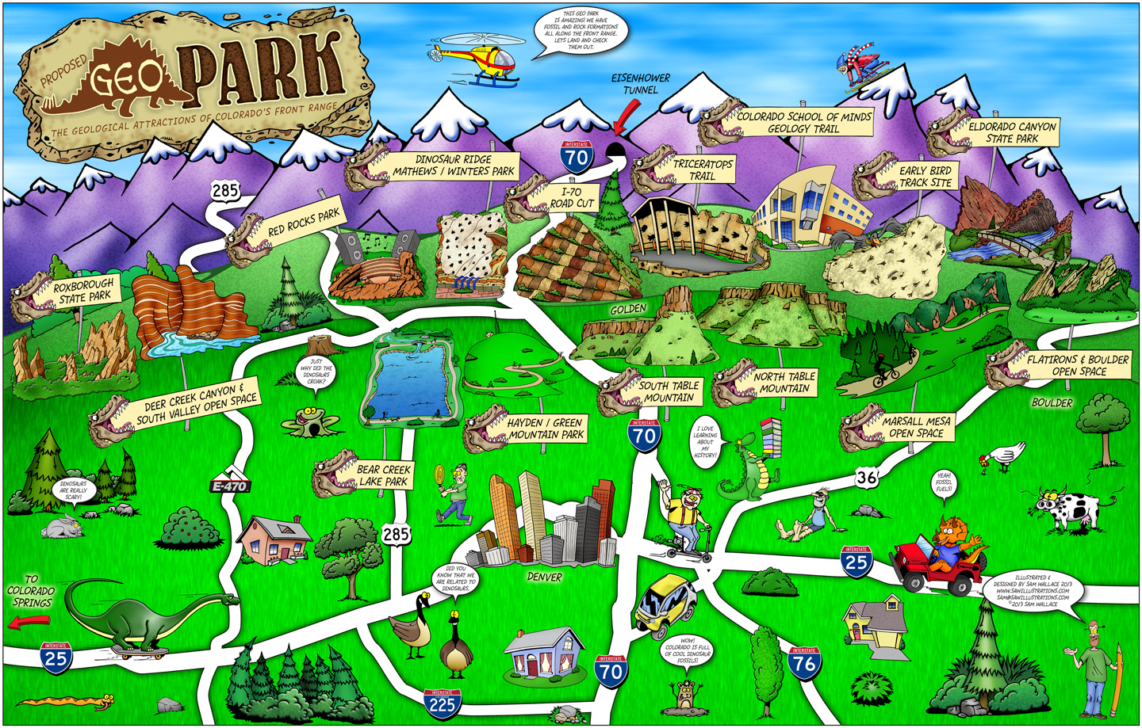
Unexpected! Communicating about a proposed Geopark along the Colorado Front Range
Bob Raynolds, Denver Museum of Nature and Science

Slide 15
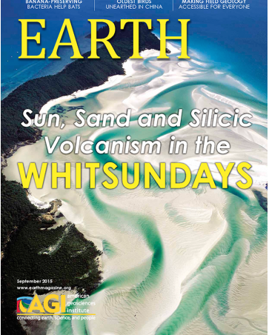
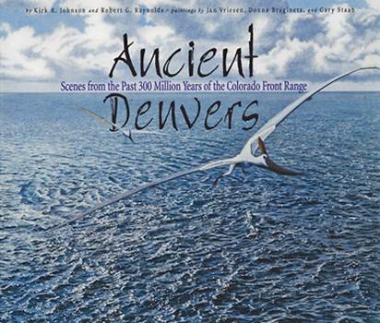
Metaphors and gripping visuals help grab attention and hold the audience’s interest.
Kirk Johnson and Bob Raynolds

Slide 16
6 Principles of Sticky Ideas:
Simple
Unexpectedness
Concreteness
Credibility
Emotions
Stories
S
Concrete details make the science more tangible and help people remember. “Show, not tell”
Credible: Convincing details, from a believable source.
Emotions: Make people care.
We’re wired to care about living organisms, not so much about rocks.

Slide 17
How does this work in practice?
Simple ✔
Unexpectedness ✔
Concreteness ✔
Credibility ✔
Emotions ✔
Stories ✔
S
JFK’s 1961 entreaty:
“I believe that this nation should commit itself to achieving the goal , before this decade is out, of landing a man on the moon and returning him safely to the earth…”

Slide 18
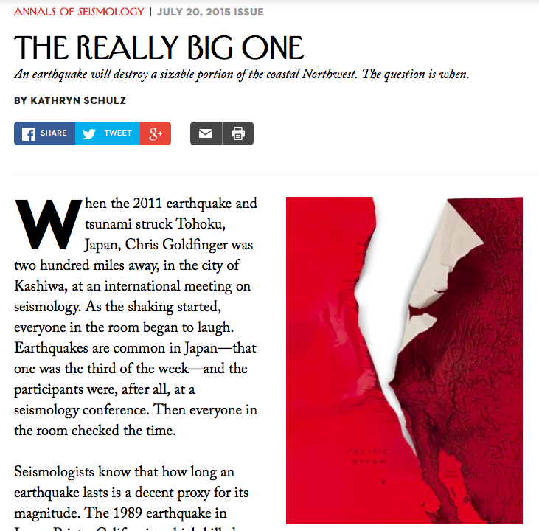
How does this work in practice?
Simple
Unexpectedness
Concreteness
Credibility
Emotions
Stories
S

Slide 19
6 Principles of Sticky Ideas:
Simple ✔
Unexpectedness
Concreteness
Credibility
Emotions
Stories ✔
S
The article starts with a story:
Seismologist Chris Goldfinger (OSU)at a 2011 conference in Japan when the ground starts shaking.
Time= proxy for magnitude
15 seconds: M=6.9 (1989 Loma Prieta)
30 seconds: ≈ M7.5
60 seconds: ≈ M7.9
2 minutes: ≈ low M8
3 minutes: ≈ high M8
4 minutes: ≈ M9

Slide 20
“For decades, seismologists had believed that Japan could not experience an earthquake stronger than magnitude 8.4 … in the end, the magnitude-9.0 Tohoku earthquake and subsequent tsunami killed more than 18,000 people, devastated northeast Japan, triggered the meltdown at the Fukushima power plant, and cost an estimated $220 billion.”

Slide 21
6 Principles of Sticky Ideas:
Simple
Unexpectedness ✔
Concreteness
Credibility
Emotions
Stories
S
But for Goldfinger, “the main quake was itself a kind of foreshock: a preview of another earthquake still to come.”
➔ Cascadia Subduction Zone

Slide 22
6 Principles of Sticky Ideas:
Simple
Unexpectedness
Concreteness ✔
Credibility ✔
Emotions ✔
Stories
S
Vivid details, credible sources:
Kenneth Murphy (FEMA): “Our operating assumption is that everything west of Interstate 5 will be toast.”
Goldfinger: “Let’s just say I would rather not be here.”

Slide 23
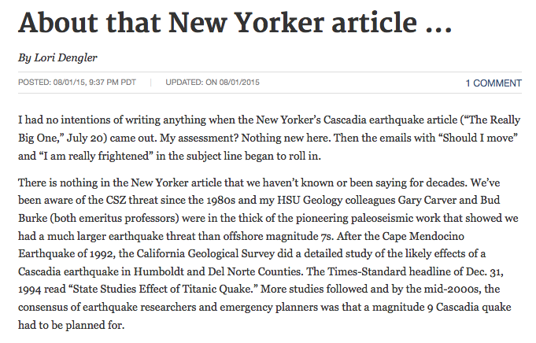
6 Principles of Sticky Ideas:
Simple✔
Unexpectedness ✔
Concreteness ✔
Credibility ✔
Emotions ✔
Stories ✔
S
The article definitely stuck!
The Times-Standard

Slide 24
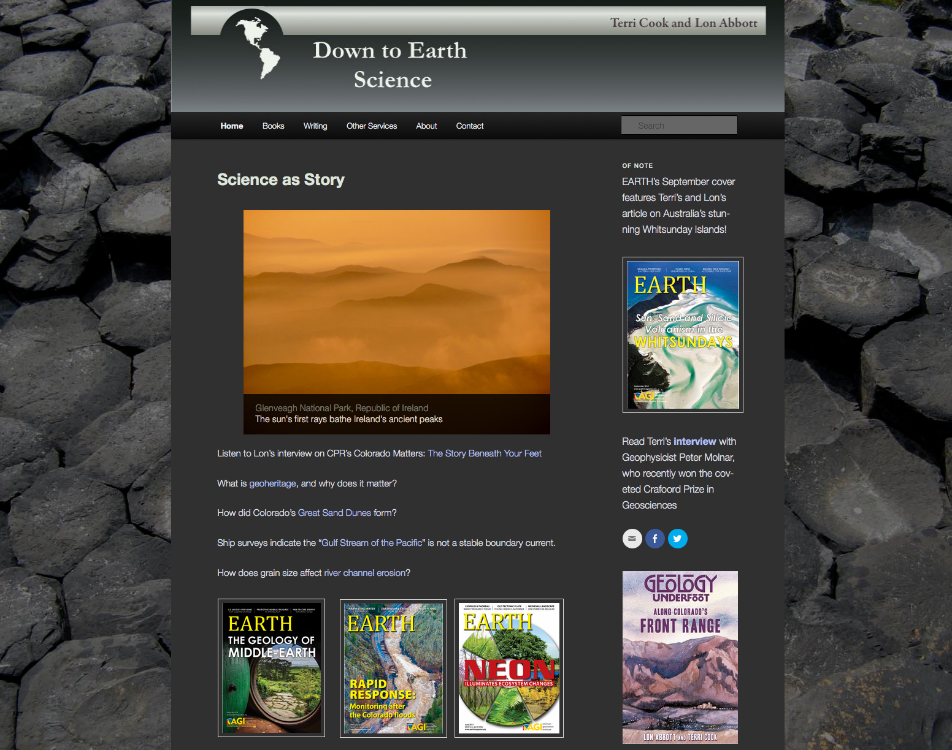
@GeoTravelTerri
Working together, using these principles, scientists & science journalists can make geological ideas stick.

