Slide 1

Landslide inventory management and usage in the Norwegian EWS
Søren BOJE, Graziella DEVOLI, Hervé COLLEUILLE
Norwegian Water Resources and Energy Directorate
Notes:
NGI Logo mangler,

Slide 2

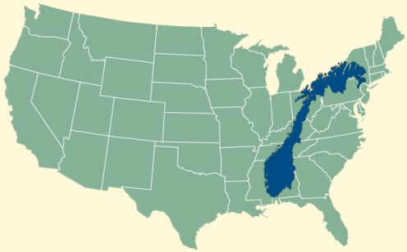
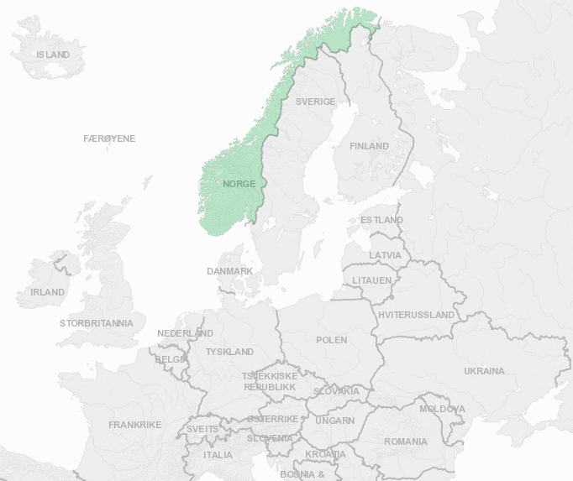
The EWS of landslides in Norway
Recently established (2013), emerged from the flood forecasting service (est. 1989), who observed several concurrences between floods in small catchments and landslides
The EWS is based on assumption that critical hydrometeorological conditions are able to indicate days with increased landslide hazard at a regional scale
Uses hydrological model simulations with a spatiotemporal resolution of 24 hr and 1 km² → derive i.e. soil moisture content and groundwater level; and threshold levels based on statistical studies of landslide inventories
Size of Norway:
~1000 mi N-S, 150.000 mi²
Notes:
Nevn gjerne det øvrige arbeidet som har blitt presentert i terskelrapporten

Slide 3
Landslide database management
- recent change in practise
In 2010 the NVE (a governmental institution) was given the responsibility to initiate a new EWS for landslides (a political decision), and inherited a database from the Norwegian Geological Survey (NGU)
Pre 2010 scope – ”passive” database management
  Main focus on susceptibility mapping at commune level aka. slope scale → focus on runout length and possible events affecting bouldings and important infrastructure. Less focus on the quality of recorded time of event and location of release area.
Post 2010 scope – more ”active” database management
  Usage for mapping susceptibility + landslide EW
  Spatio-temporal accuracy crusial for threshold studies -> focus on quality assesment of historic and future events

Slide 4
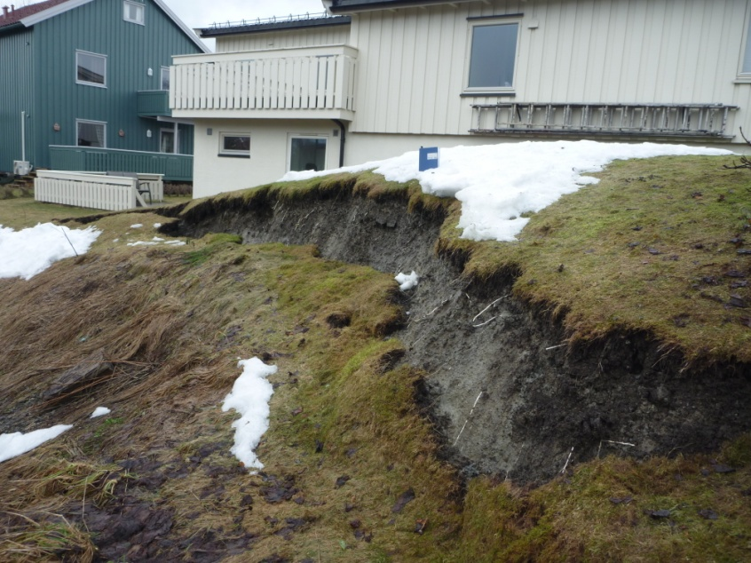
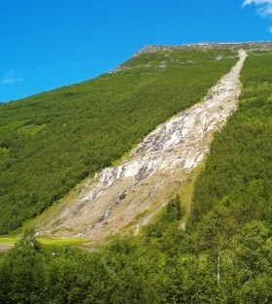
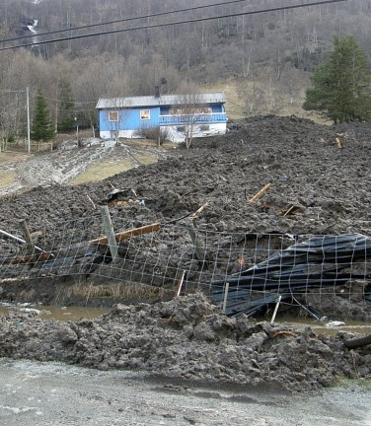
The Norwegian landslide database
Part of the larger mass movement database ~ 50.000 events (incl. rockfall, snow avalanches etc.)
Contains ~ 6200 rainfall induced mass movements
So far 1204 events have been quality assesed as landslides, which the EWS uses as a generic term for:
Shallow slides
Debris avalanches
Debris flows
Foto: T. Bargel
Foto: T. Bargel
Foto: N.O. Dalvik

Slide 5
Quality assesed landslides (pre 2010)
Part of Norway | Nr. of relevant landslides |  |  |  | Quality assesed for threshold studies
 | Total | No date | Pre 1960 | 1960-2010 | Project 1 | Project 2 | Project 3 | Project 4
East | 1129 | 24 | 557 | 551 | 129 |  | 39 | 424 | 592
West | 2694 | 236 | 605 | 1848 | 130 | 16 | 3 | 119 | 268
South | 700 | 9 | 354 | 337 | 2 |  |  | 11 | 13
North | 1672 | 1029 | 91 | 552 |  | 1 | 1 | 328 | 331
Total | 6195 | 1298 | 1604 | 3288 | 261 | 17 | 43 | 882 | 1204
Data post 2010
  Weekly assesment at group meetings
  Been used for continuously validation of thresholds

Slide 6
Problems with registrations pre 2010
Poor quality in location of release area
  Too flat terrain, to steep with no soil cover, where the event hit the infrastructure
Poor quality in timing of event
  Uncertainty of days or weeks
  Uncertainty not written, however an ”average” date is used (15th of xx month, 1th Jan. 1th Jul) → registrations on ”dry” days with no water supply
Poor quality on mass movement type (i.e. rock falls have often been described as debris avalanches or vice versa)
Sparse text descriptions and no photos

Slide 7
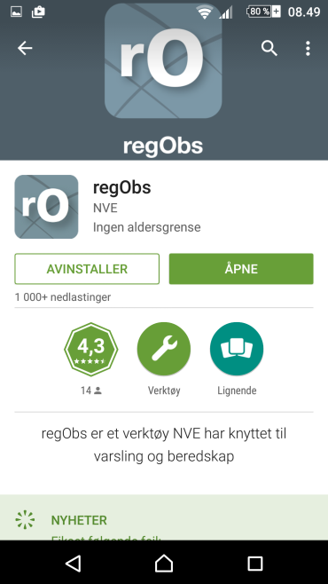
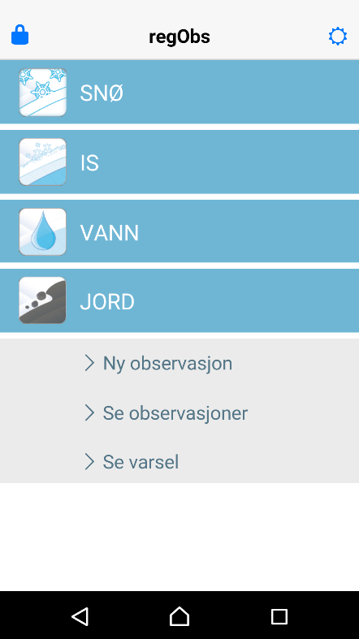
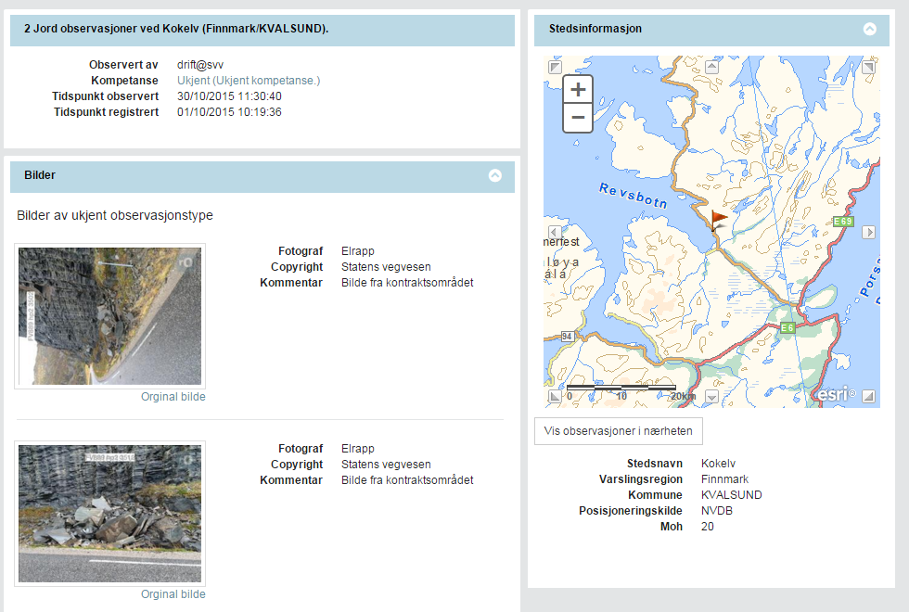
Rutines from 2010 by the NVE
(due to change of scope and less strained resources)
Daily media monitoring
Automatic registrations from the road and rail authorities (with photo documentation)
Crowdsourcing (regObs)
  Everyone interested can register observations
  Possible to assign experience to individual users
  Is it usefull? The story of dentist Astor Furseth – from the 1980’s untill today – has the most recordings of landslides, with high quality!
Notes:
Furseth: Largest contribution by a single person to the database

Slide 8

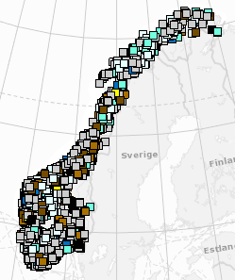
How we quality asses pre 2010 events
A detectives job looking at
Text descriptions
Topographic maps
Photos and aerial photos
Google street view
Hydrometeorological conditions to examine the timing and the release area to a scale of 1 km²

Slide 9
Example of areal photos
Topographic conditions
Before and after the event
Slide ID 33635
NGU, Astor Furseth,
Dato: 9.07.2007
Type: “løsmasserskred uspesifisert” men fra kommentarer “jordskred”
Etter kontroll: Flomskred

Slide 10
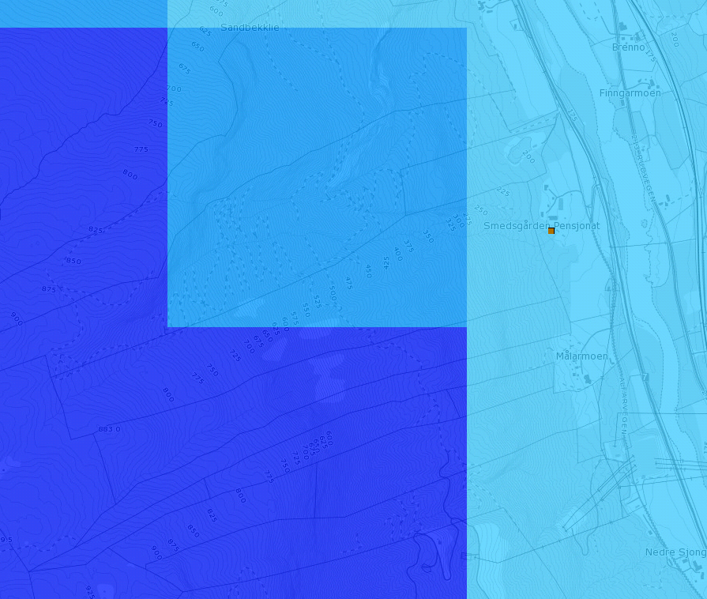

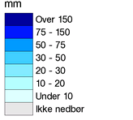
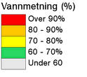
Same event, hydrometeorological conditons
Each grid represent 1 km² with a unique mean height above sea level → reflect different conditions
From xgeo.no
Preceipitation
Soil water saturation

Slide 11
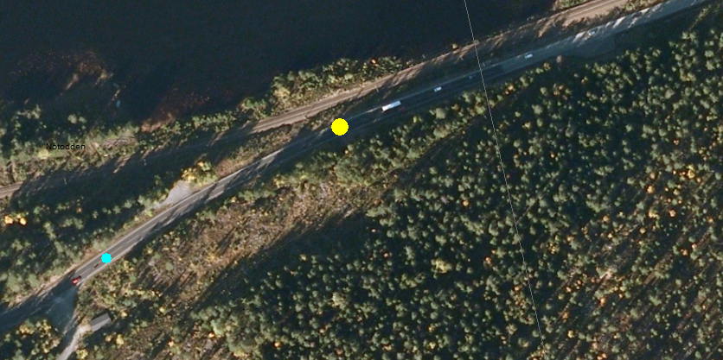
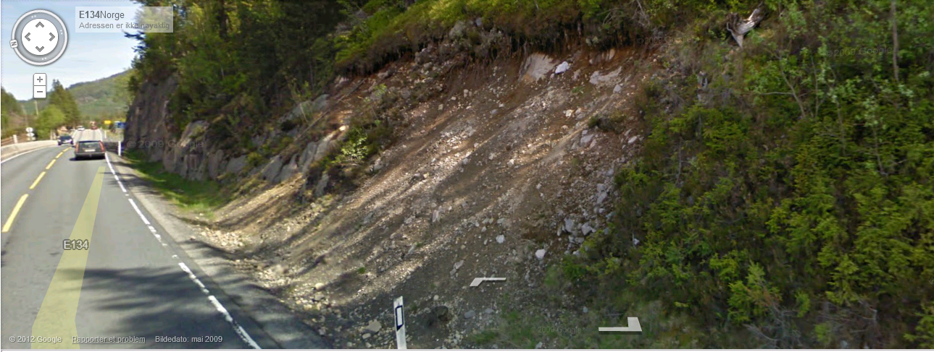
Example of usefullness of google street view (GSW)
No photos from observation
Poor aerial photo
”Lucky match” in GSW (photo taken relatively shortly after event)
Note: GSW is very usefull to confirm the exact impact location on roads for ”now-events”

Slide 12
Inventory usage - threshold studies with quality assesed events
Four projects from 2010-15
From nationwide to regional studies
Testing hydrometeorological variables with different classification techniques

Slide 13

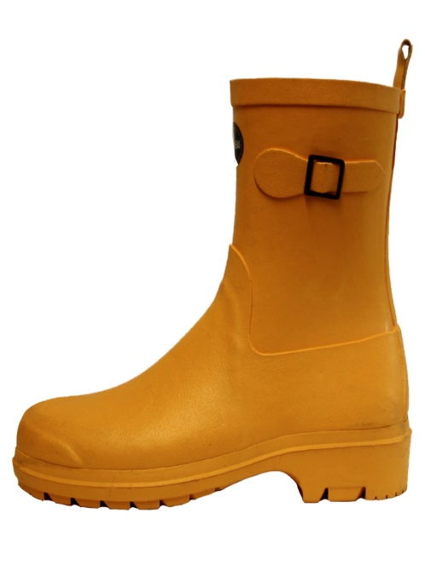
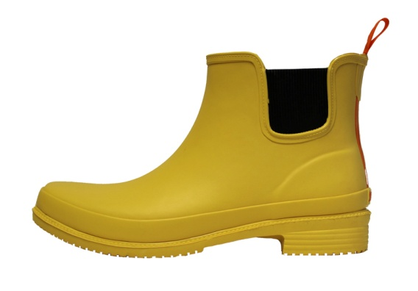

Methodology
Statistical analyses of combinations of hydrometeorological variables using various classification techniques:
  Tree-classification, discriminant analysis (linear and quadratic) and Naïve Bayes classification
For each event, a collection of 28 no-slide days were selected
For evaluating the results and decide the optimal model choice (optimal classification method and variables)
  (a) the area under ROC-curve and (b) the misclassification error rate
Final manual adjustment of suggested thresholds for three separate awareness levels - yellow, orange, red
  By evaluating the spatial distribution of the thresholds for days with and without landslides
Notes:
Kanskje figur med valg av extreme hendelser. Sjekk evt. terskelrapporten.

Slide 14
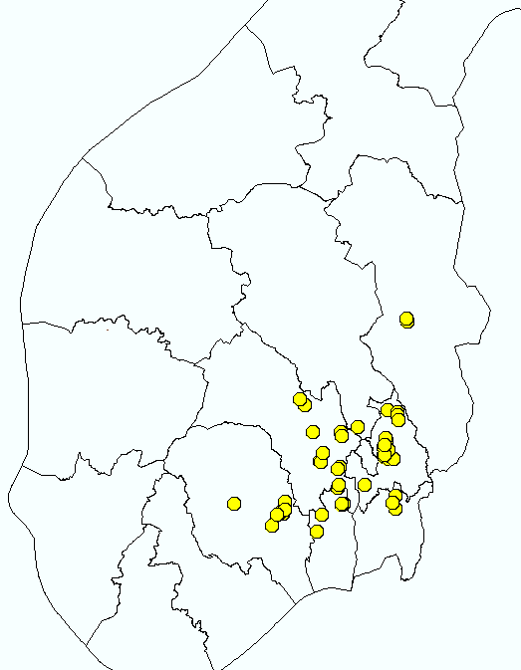
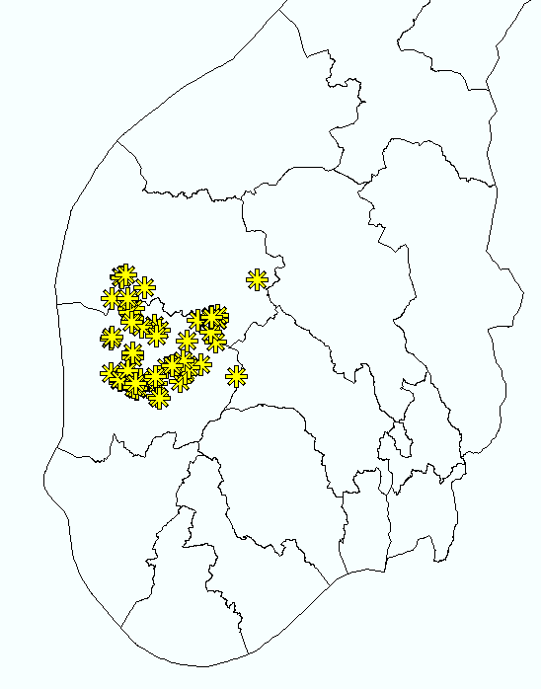
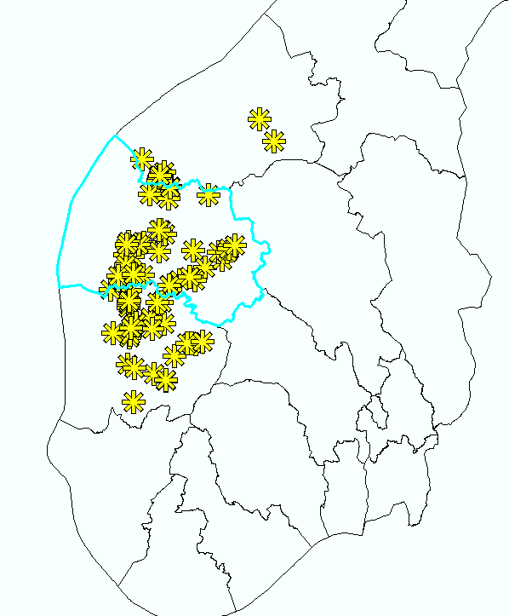
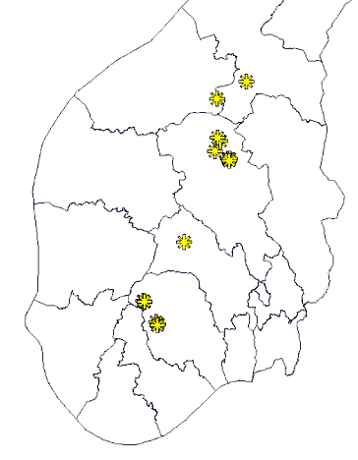
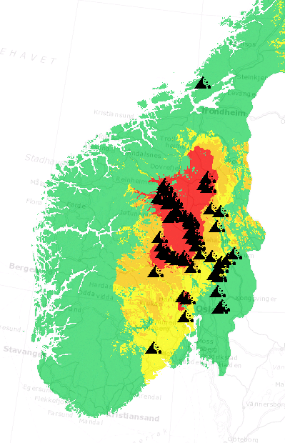
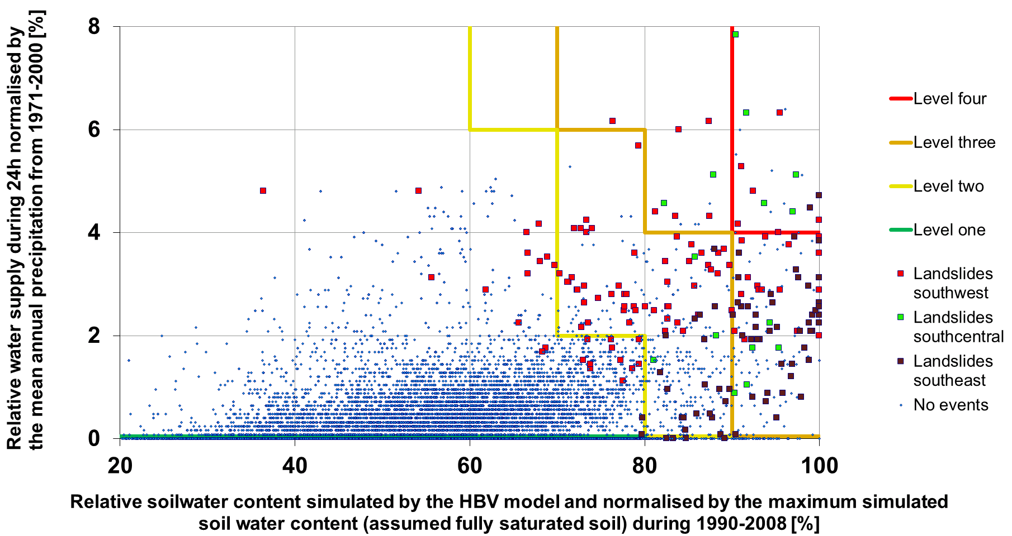
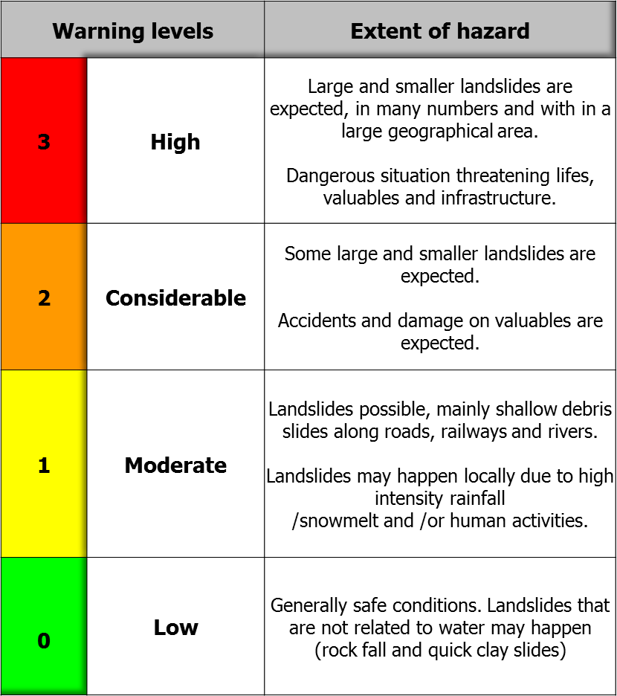
Example of a succesfull study
Project 1, 2010 ~ 206 events
  Inventory based on four ”extreme” weather situasjonens, each with many landslides
  Thresholds of water supply (rain+snowmelt) and soil water saturation were established using treclassification
May 22nd 2013

Slide 15
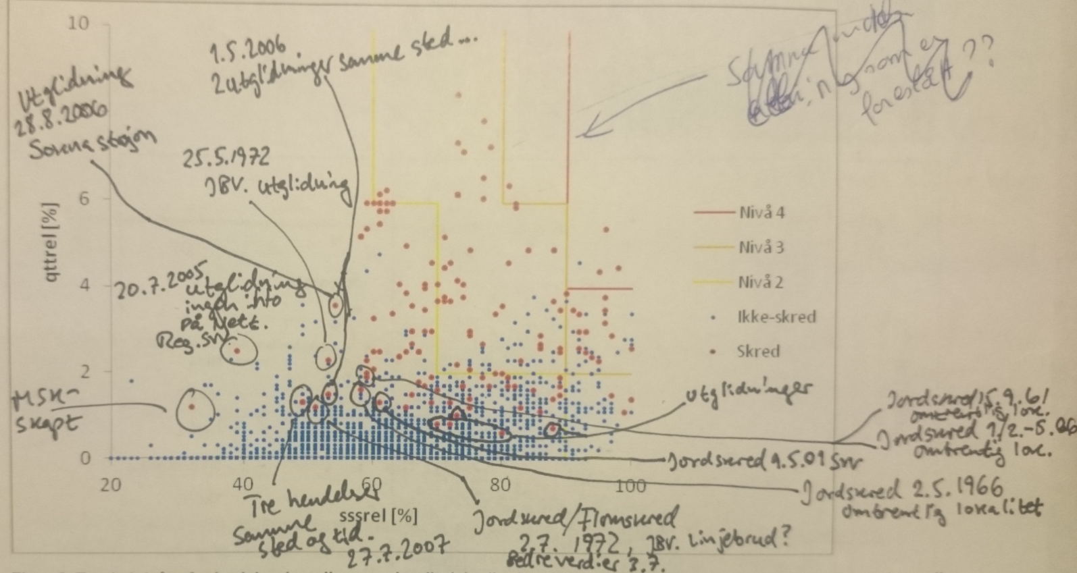
A less successfull study
- but learning experience
Project 4, 2013
  Regional studies in N and SE Norway, using many days with one or few landslides
Less good seperation of days with and without events, and too sensitive in space
Two major sources of errors
  Precipitation may have missed the weather station -> bad data for thresholds
  Something in the assesment was overlooked, or the information provided was lacking quality (e.i. human impacts)

Slide 16
Summary / conclusions
Currently 1204 quality assesed landslides in the database
Inventory management with good data is
  A difficult task with many time consuming considerations
  Depending on the focus (susceptibility and/or EW) -> Different needs of data quality (extent, timing, triggering location)
For regional threshold analyses
  Be carefull to use data from days with few events
  Rather use fewer days with many landslides
    ”Extreme” weather events with a large spatial coverage can give insigth into a larger range of triggering conditions -> Possible to estimate both yellow, orange and red levels of awareness

Slide 17
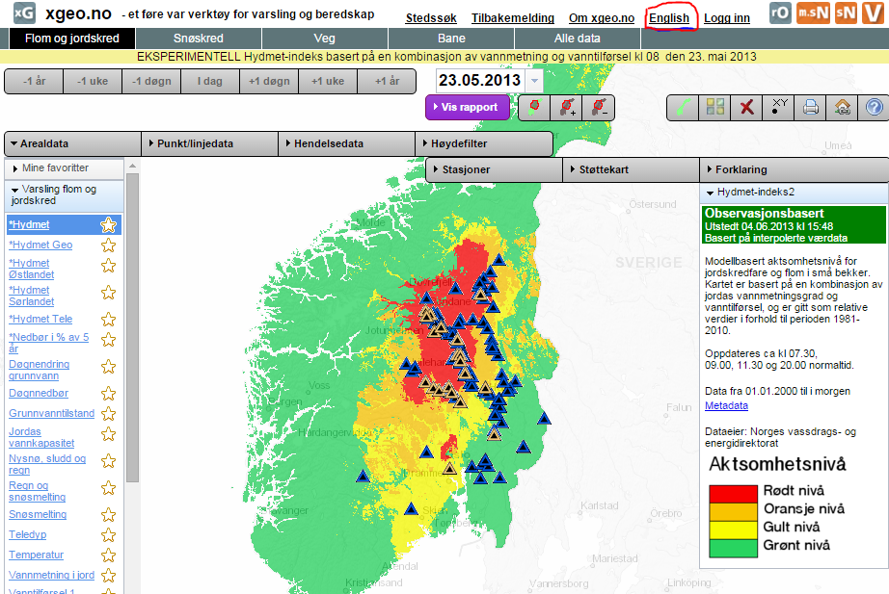
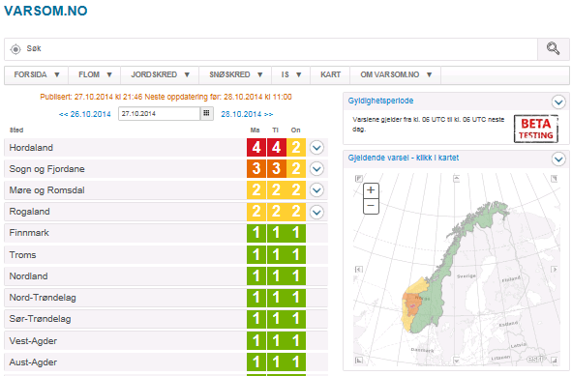
Please look at our management tools at xgeo.no, or visit varsom.no our warning portal, or make a landslide recording through regObs.no
Thank you for the attention
email snbo@nve.no

