Slide 1


THE USE OF GIS IN EVALUATING LONGITUDINAL
PROFILES OF KARST STREAMS
Kathryn Schroeder¹
Eric W. Peterson¹
Toby Dogwiler²
¹ Department of Geography-Geology
Illinois State University
² Geography, Geology and Planning Department
Missouri State University

Slide 2
Background
Longitudinal Stream Profile Generation
Gaps in data = Incomplete Profile
(Woodside et al., 2015)

Slide 3
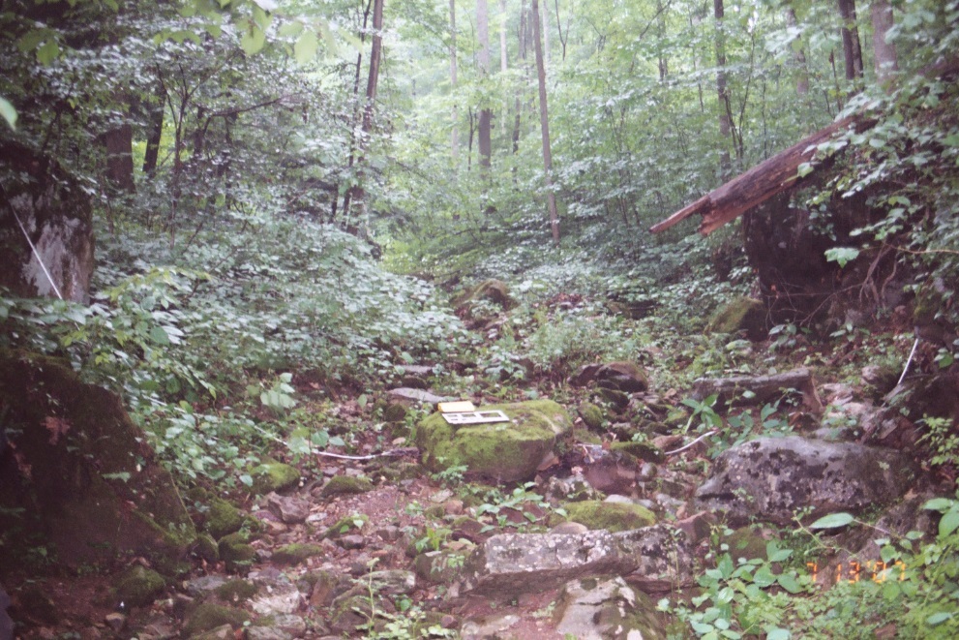
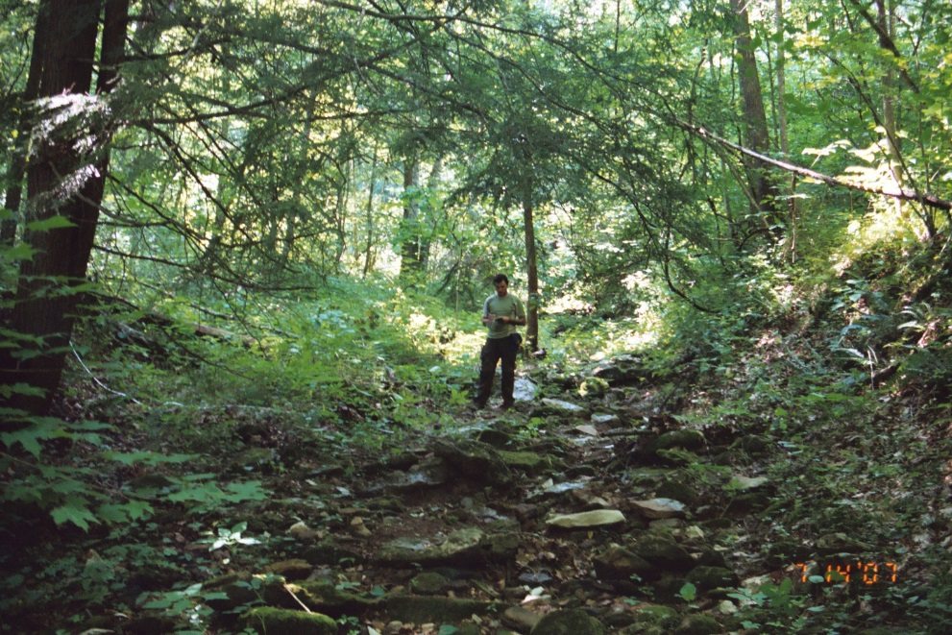
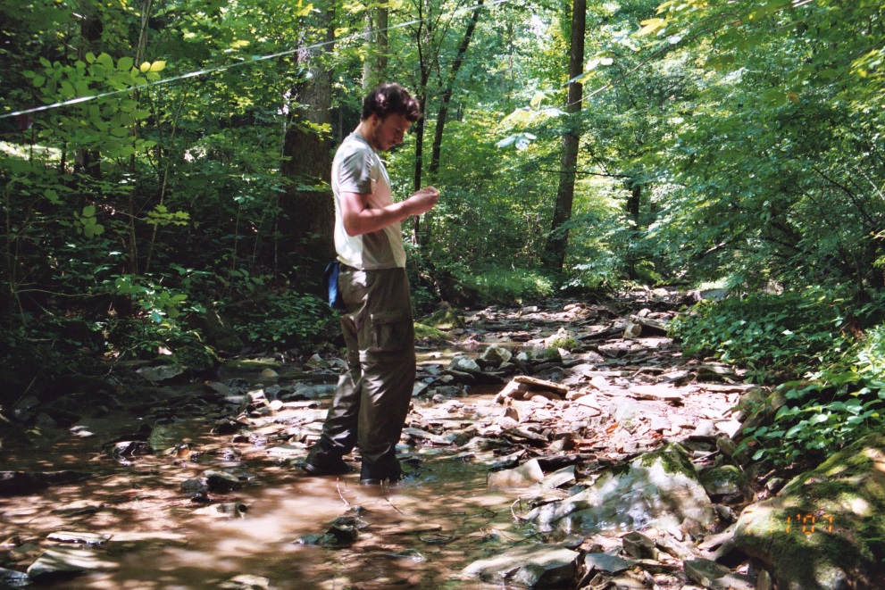
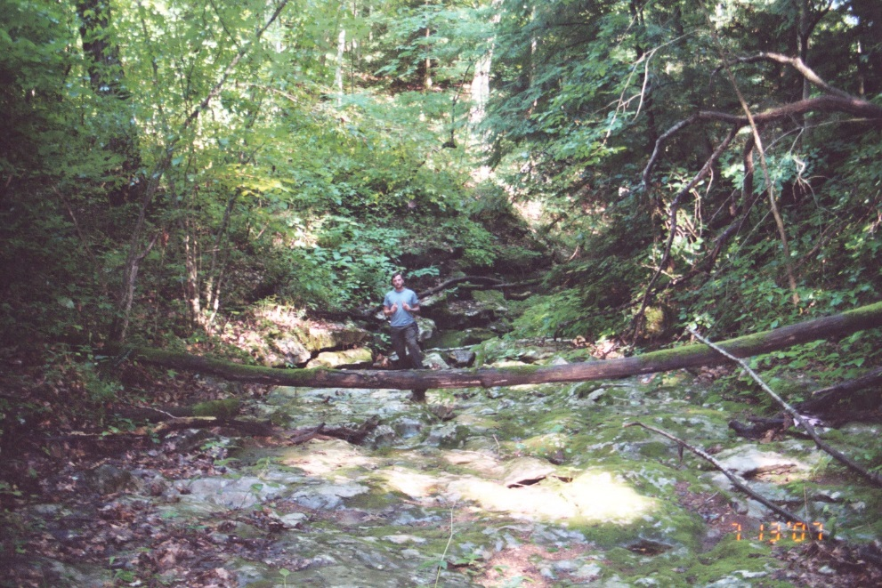
Issues
Surveying – Base Station
GPS – Canopy Cover
Time – Distance Covered

Slide 4
GIS – Model Cave Elevations
(Jacoby et al., 2013)

Slide 5
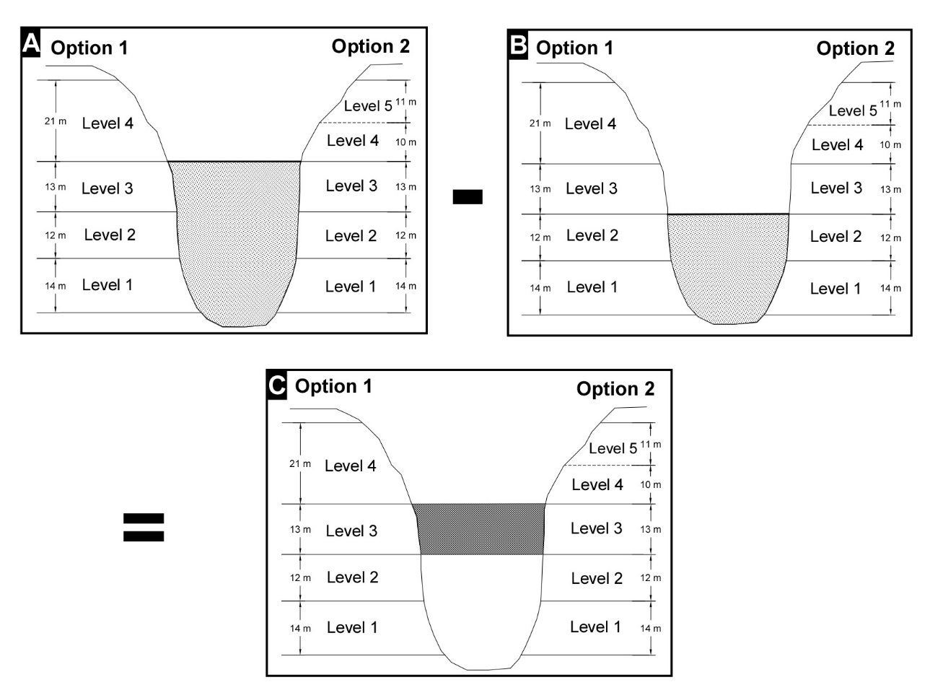
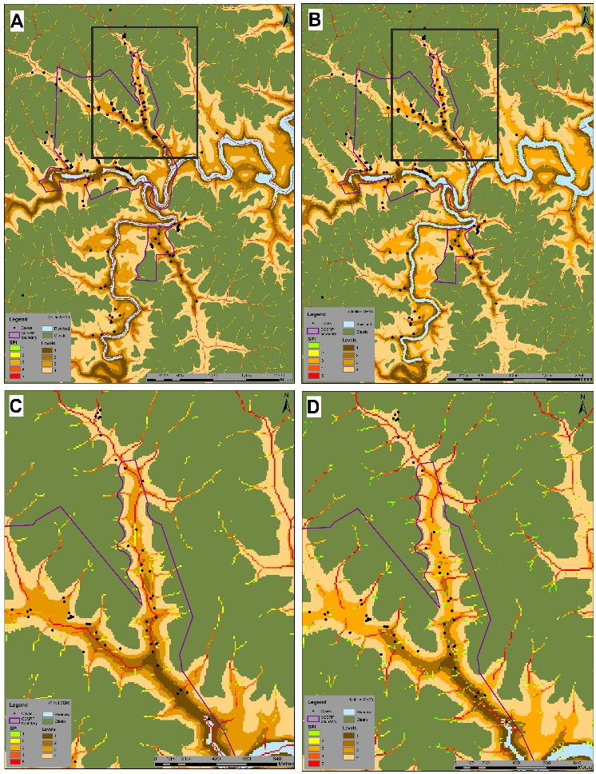
GIS – Erosion Potential
(Jacoby et al., 2011a)
(Jacoby et al., 2011b)

Slide 6
Question
Can DEM data and GIS be used to develop Longitudinal Stream Profiles?
Objectives - Needs
  Fill gaps in data
  Provide detailed-accurate information
  Expanded Coverage
(Woodside et al., 2015)

Slide 7
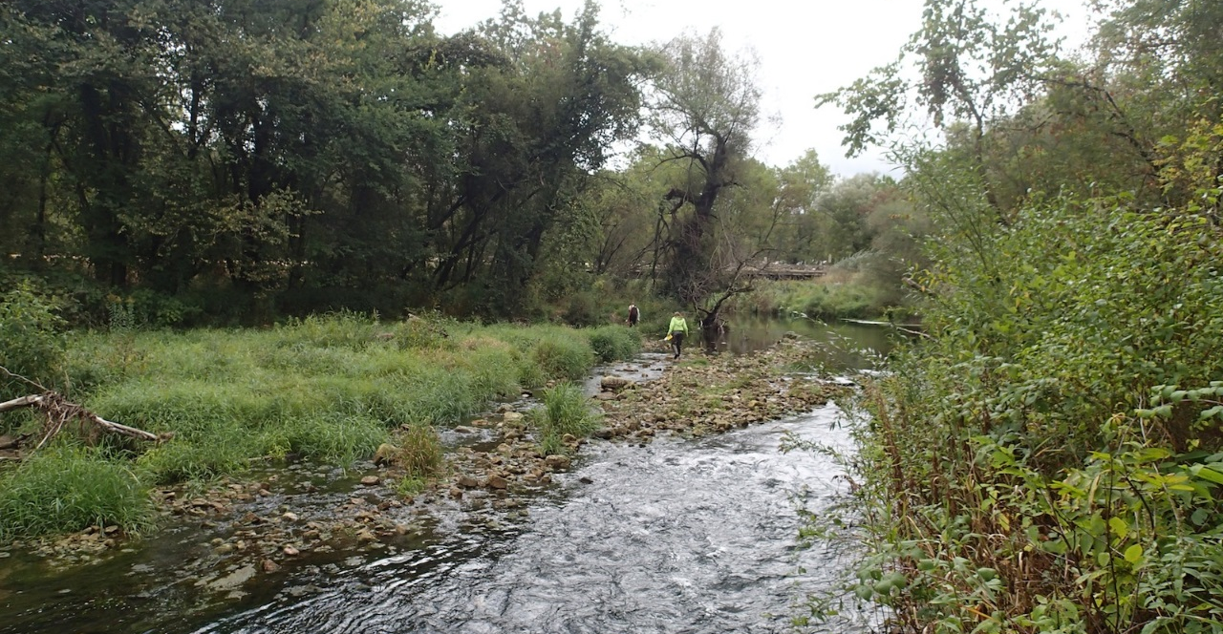
Setting
Driftless area of southeast Minnesota
Streams within three counties: Fillmore; Winona; and Houston; were examined.
Paleozoic Siliciclastic and Carbonate Rocks

Slide 8
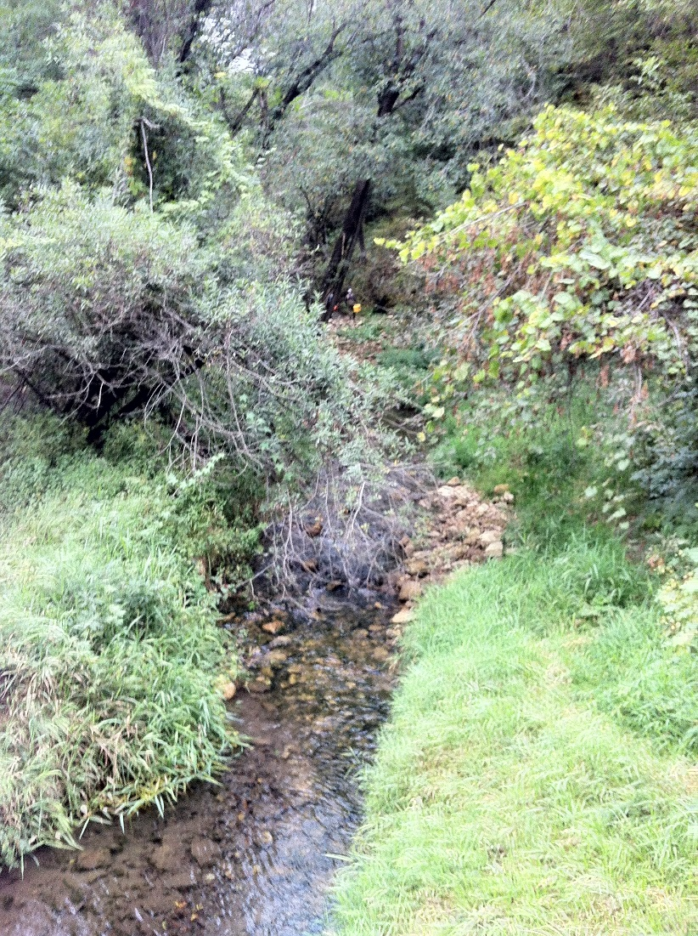
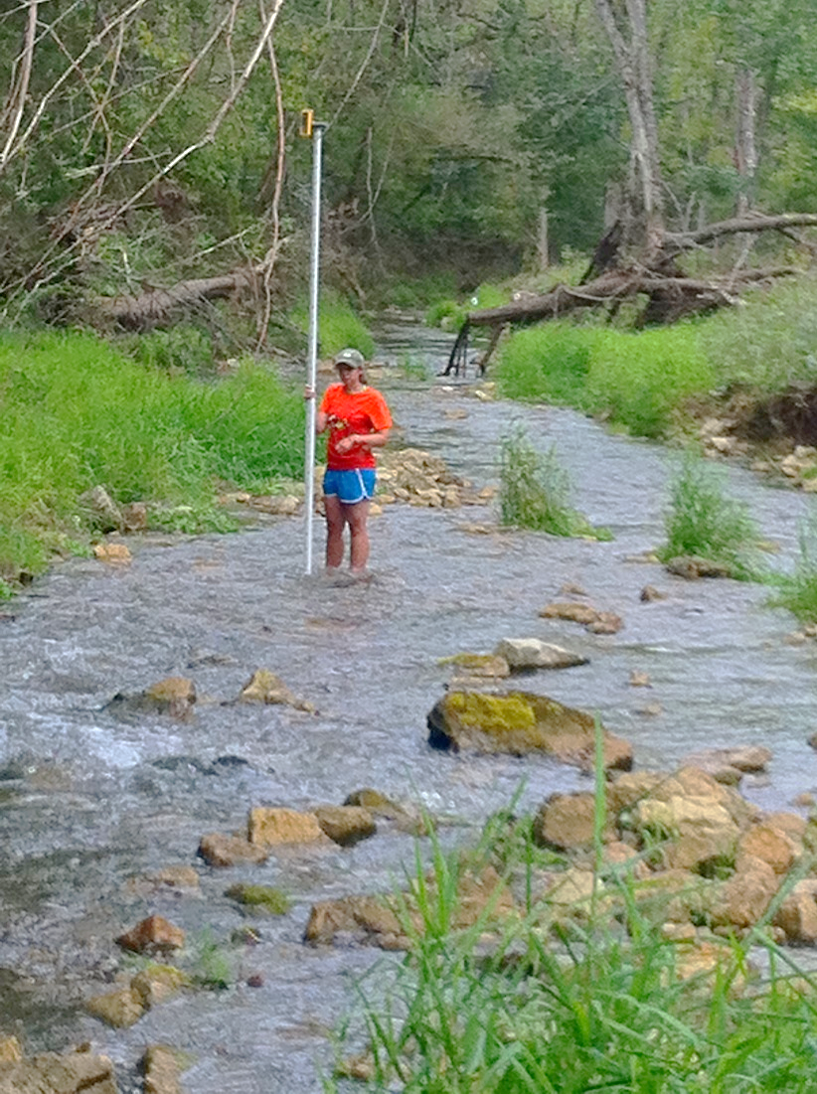
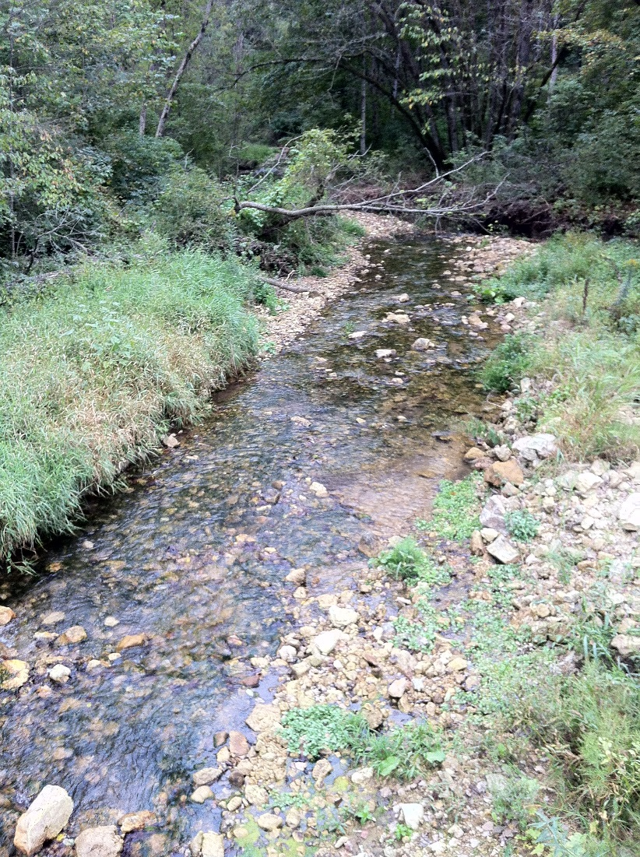
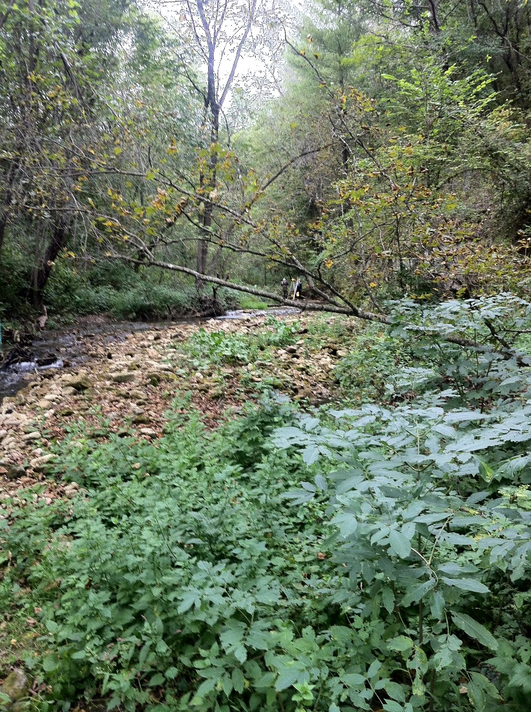

Slide 9
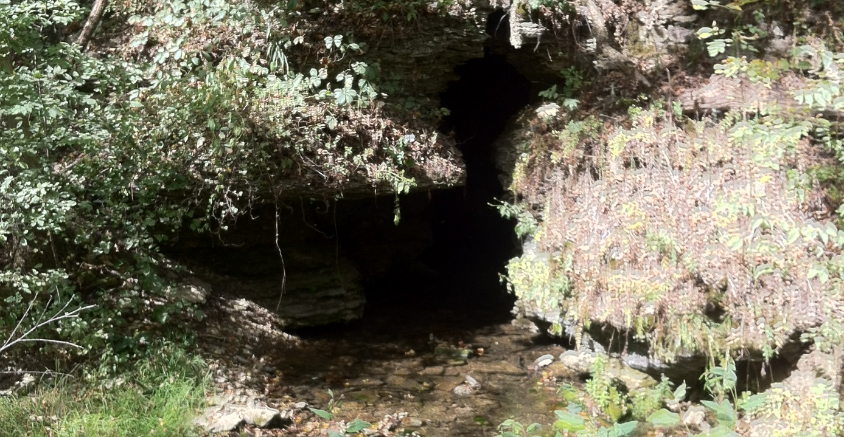
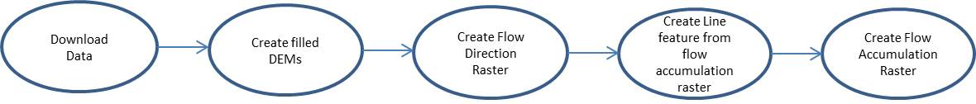
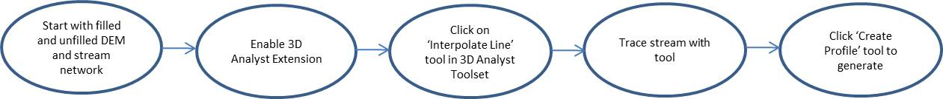
Longitudinal Profile Construction
ESRI’s ArcMAP™ 10.2.
DEMs of 1-meter (1-m) and 3-meter (3-m) resolutions were obtained from the Minnesota DNR (http://www.mngeo.state.mn.us/chouse/elevation/lidar.html).
Filled DEMs vs. unfilled DEMs.
Stream networks were created using ArcGIS’s Spatial Analyst Hydrology toolset.
Longitudinal profiles were developed using ArcGIS’s 3D-Analyst “Interpolate Line” tool by tracing a line along streams.

Slide 10
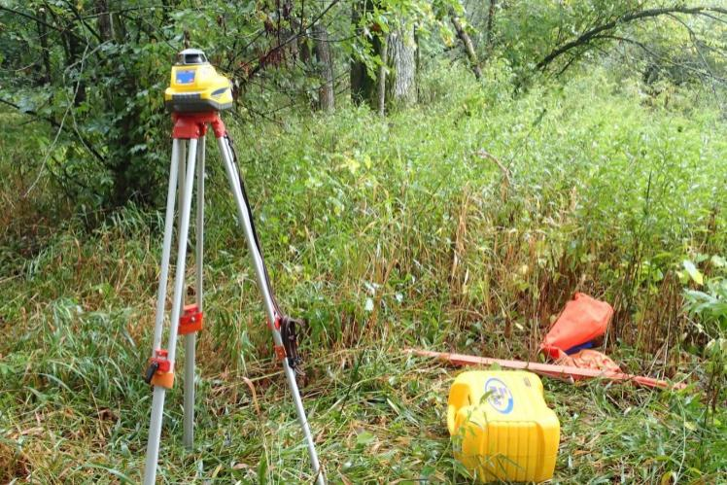
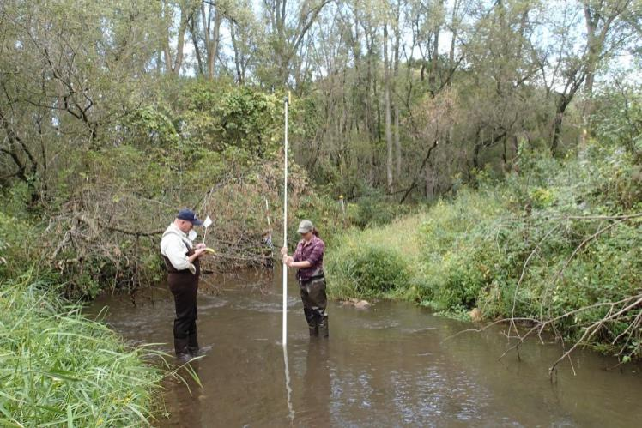
Field Survey
Spectra Precision GL422 Grade Laser
Trimble GeoExplorerXT (dGPS).
Rangefinder.

Slide 11
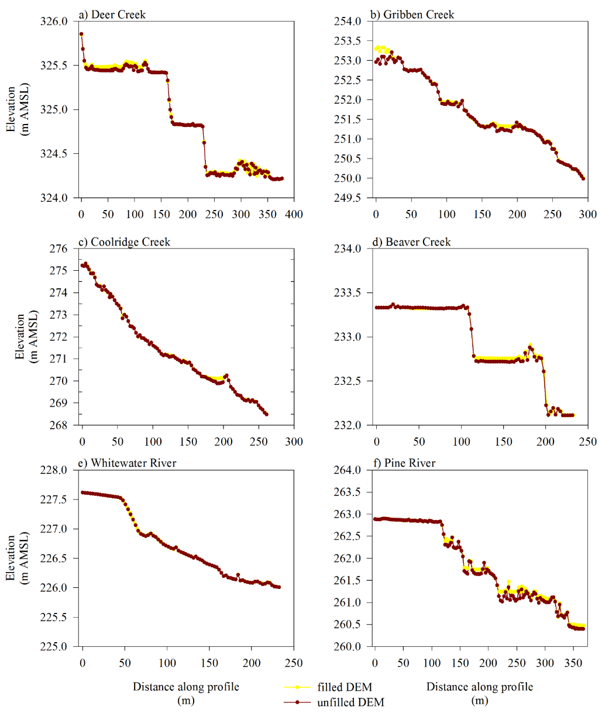
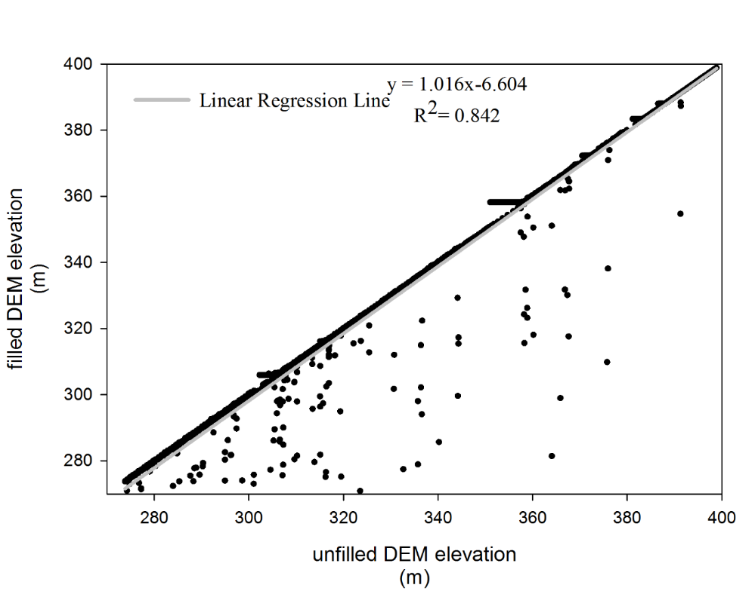
Filled DEM vs. Unfilled DEM
33 Longitudinal profiles - 6 field verified
3-m DEMs
The relationship between the two data sets is nearly 1:1 (R² = 0.84).
Filled DEM produced profiles that removed pools from the profile

Slide 12
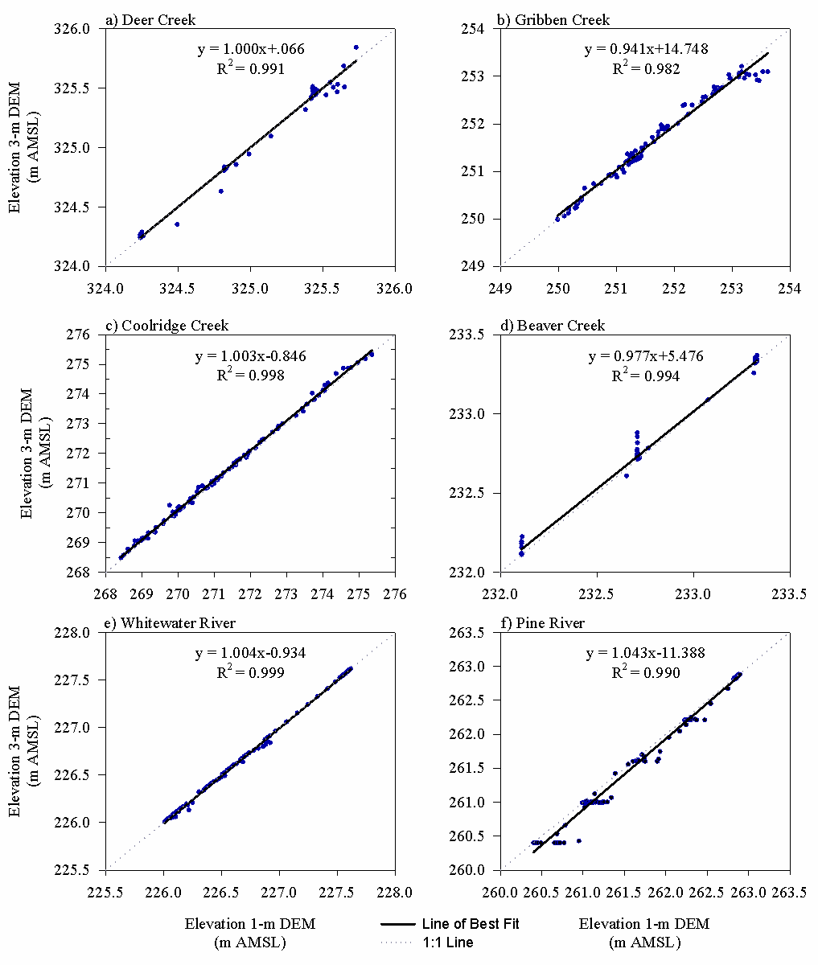
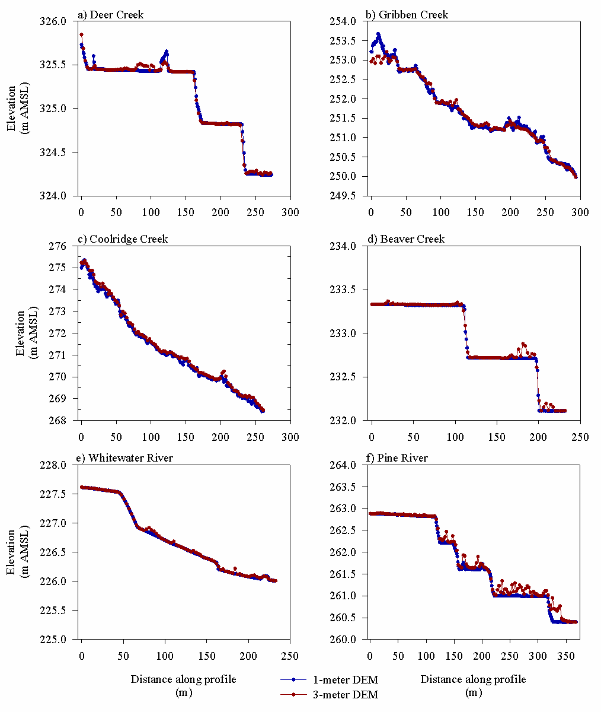
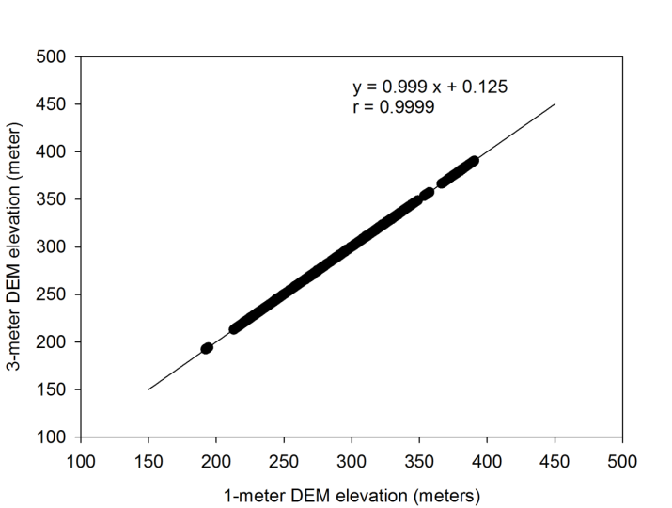
DEM Resolution
(1-meter DEM vs. 3-meter DEM)
Little variation between profiles generated from 1-m DEMs as compared to those generated from 3-m DEMs.
1-m DEMs profiles - greater continuity and smoothness
Features present in both profiles

Slide 13
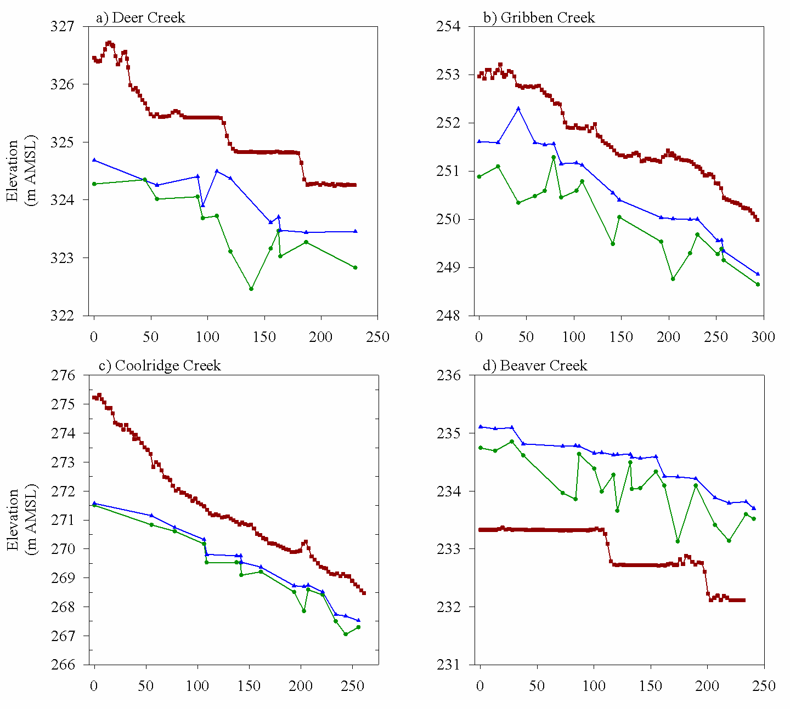
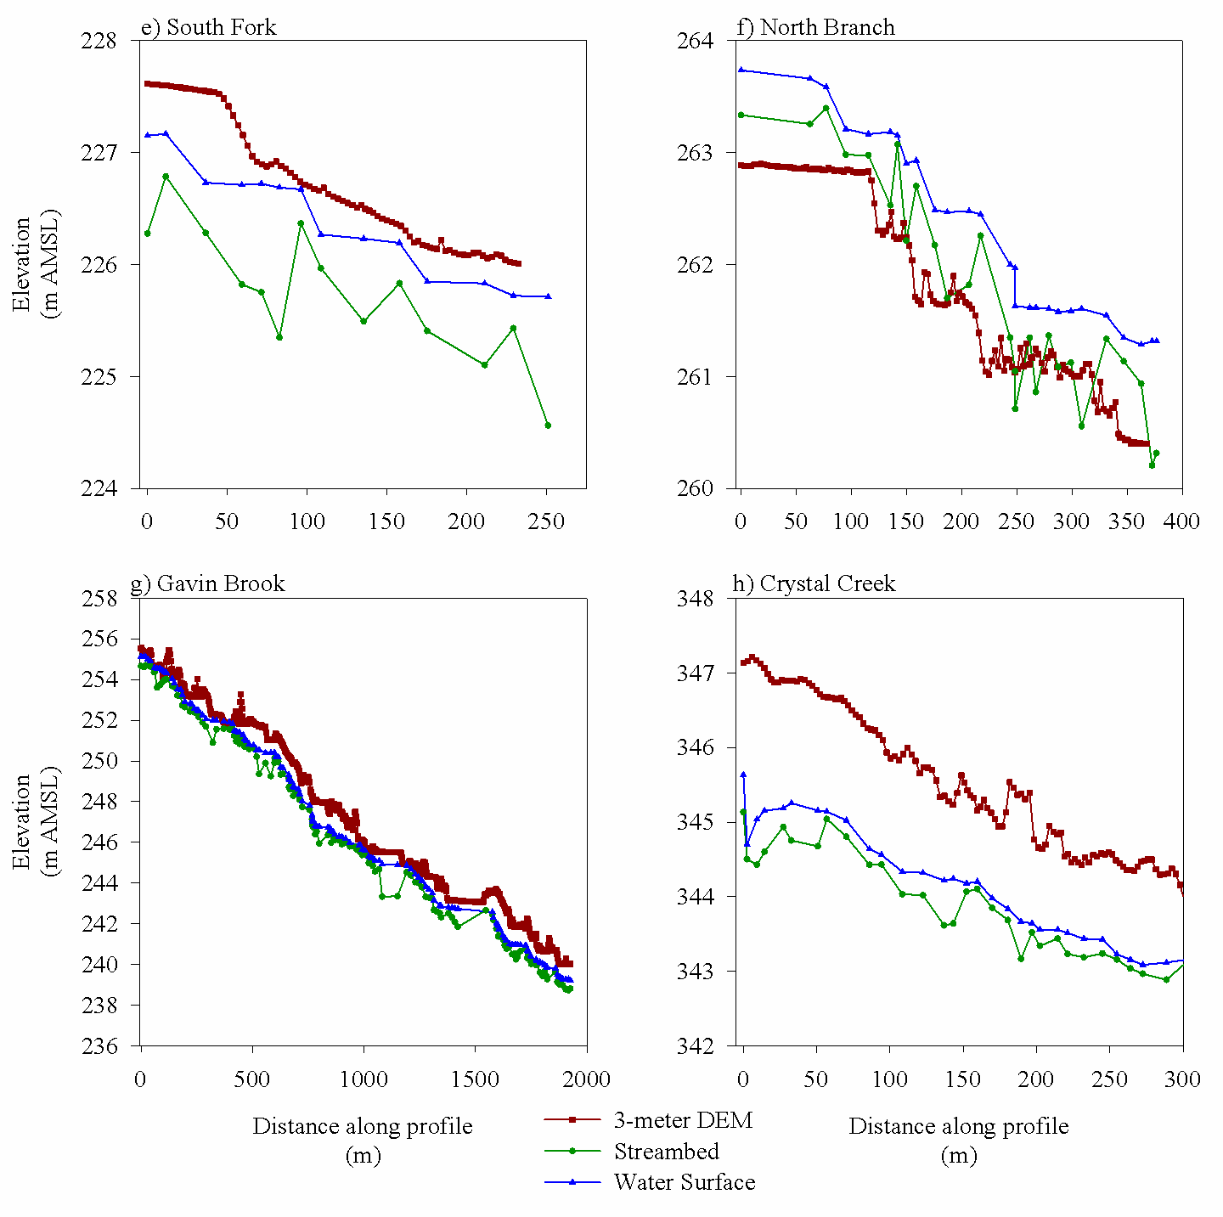
Field vs. ArcGIS-generated
The GIS profile tends to mimic the water surface rather than the streambed.
While present, pool and riffle sequences are more subdued in the GIS profiles
Differences between the DEM-derived elevations and the streambed elevations ranged from 1 meter to 3.5 meters.
LiDAR
Accuracy of GPS (Vertical error as great as 1.5 meters).

Slide 14
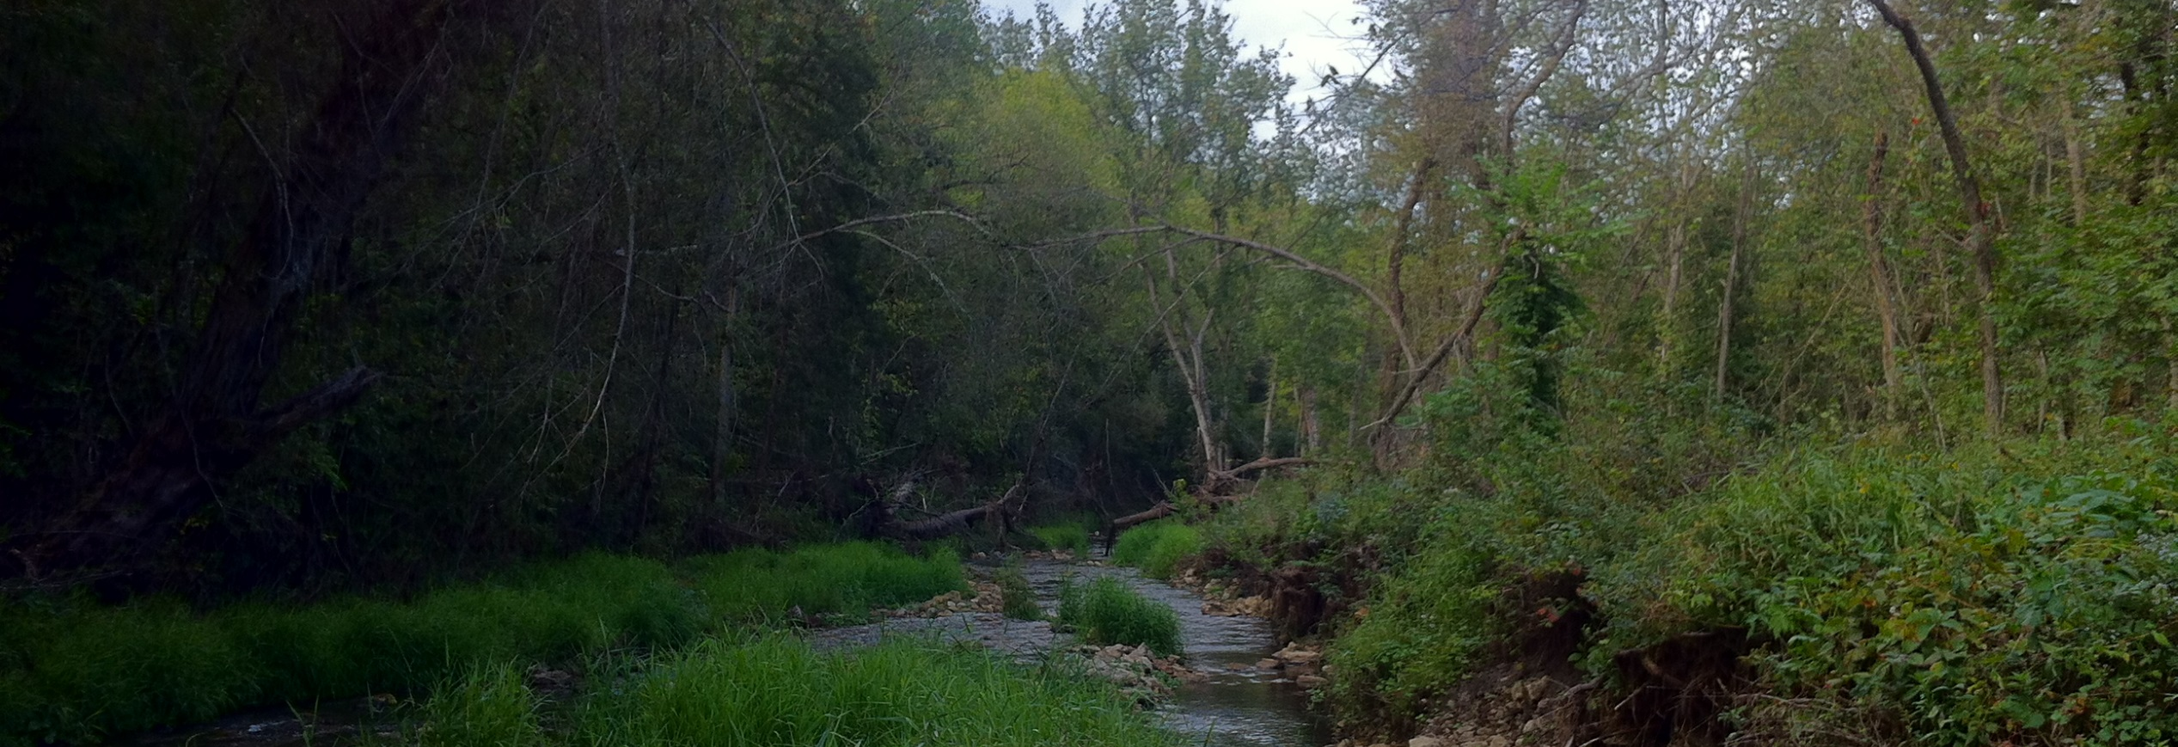
conclusion
GIS-generated profiles identify the locations and occurrences of pools and riffles but are not identical to field-surveyed profiles.
1-m and 3-m DEM-generated similar profiles
GIS is a cost-effective method to construct profiles and is useful when it supplement fieldwork.

