Slide 1
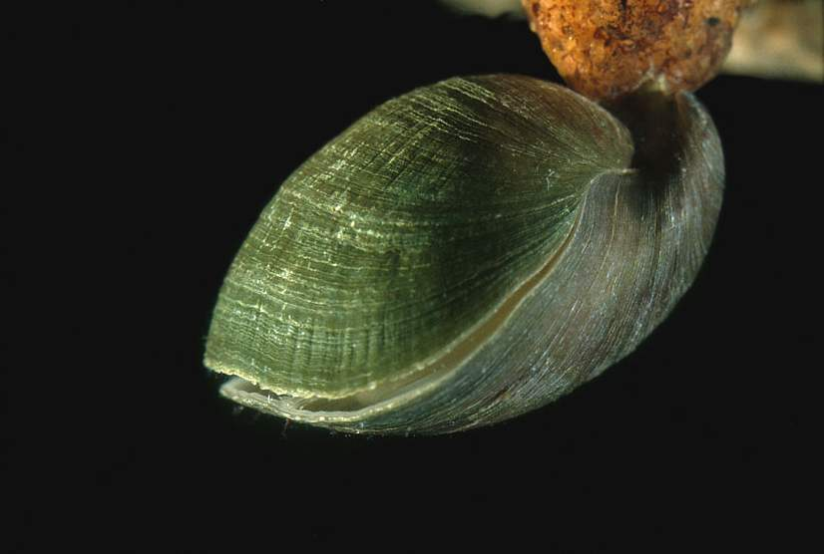
The Role of Substrate Preference in Mid-Mesozoic Brachiopod Decline
Marko Manojlovic
UC Santa Cruz

Slide 2
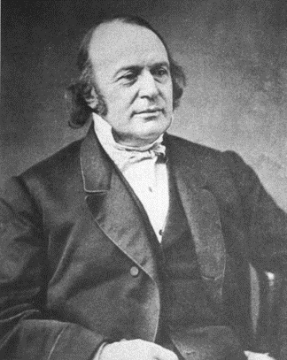

Brachiopods vs Bivalves
“Every zoologist acknowledges the inferiority of the Bryozoa and the Brachiopods when compared with the [Bivalves]….Now if any fact is well established in Paleontology, it is the earlier appearance and prevalence of the Bryozoa and Brachiopoda in the oldest geological formations, until [Bivalves] assume the ascendancy which they maintain to the fullest extent at present”
Louis Agassiz 1857
“Our knowledge of comparative physiology is still so elementary that we do not know, for instance, whether or not the cellular biochemical pathways of the mollusks give them superiority over the brachiopods, as one might suspect from a study of the geological record of these phyla.”
Ernst Mayr 1959

Slide 3
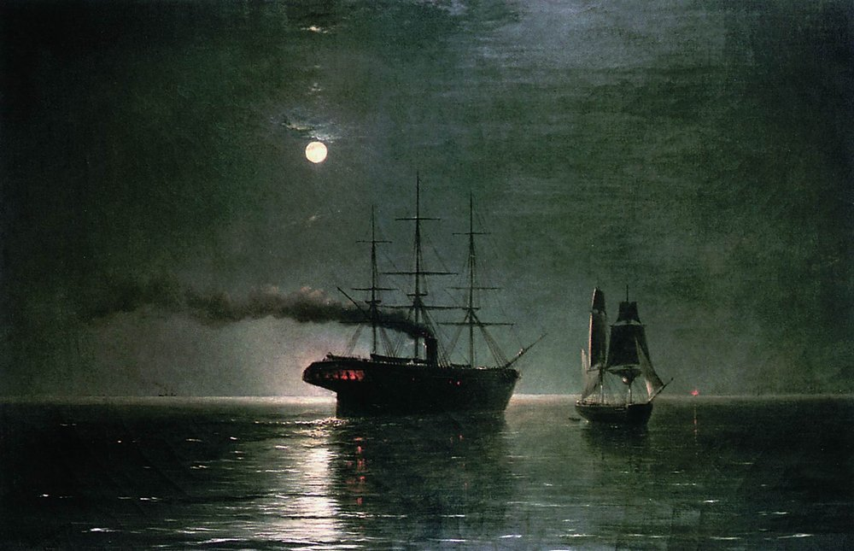
Brachiopods vs Bivalves
In 1980 Gould and Calloway argued that brachiopods did not decline due to competition with bivalves
Instead they point to the much larger effect of the Permian-Triassic extinction on the brachiopods compared to bivalves
“Ships passing in the night”
Recently it has been argued that bivalves were
always metabolically dominant and that their
superior metabolism helped them survive
the P-T extinction

Slide 4
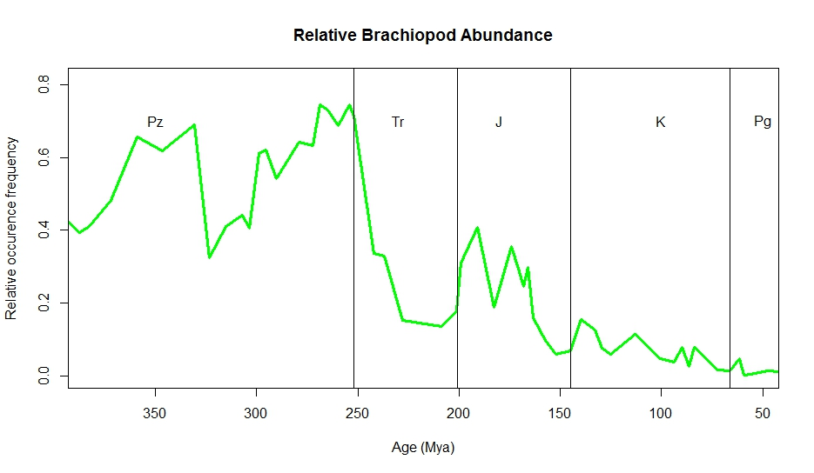
Brachiopods vs Bivalves
The Jurassic represents the last “golden age” of brachiopods as the group recovered from the P-T extinction

Slide 6
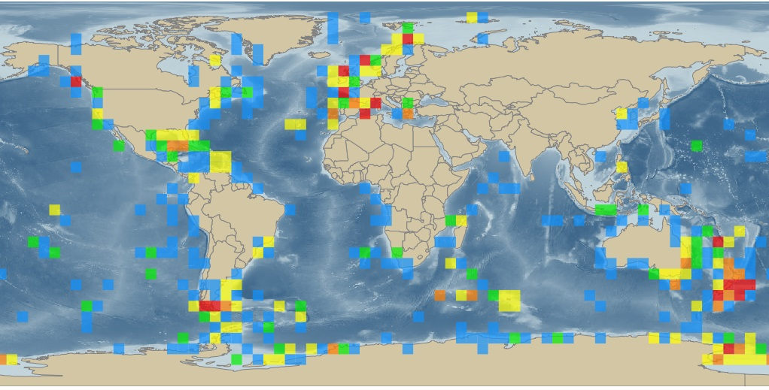

Modern Brachiopod Distribution
Restricted to hard substrates and deep, low nutrient environments
Strongly associated with carbonate substrates in studies of large living communities off Brazil and New Zealand
Number of records

Slide 7
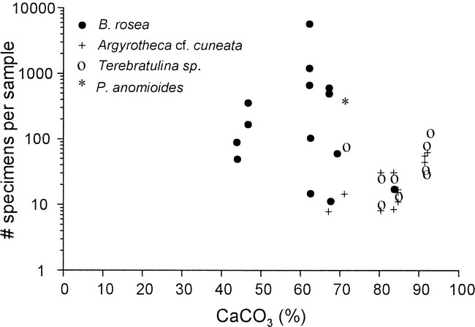
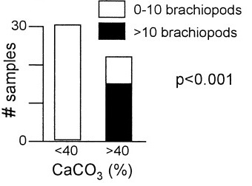
Brazil (Kowalewski et al. 2002)
Brachiopods only present in >40% CaCO³ samples, unlike mollusks
*
*Fisher’s Exact Test

Slide 8
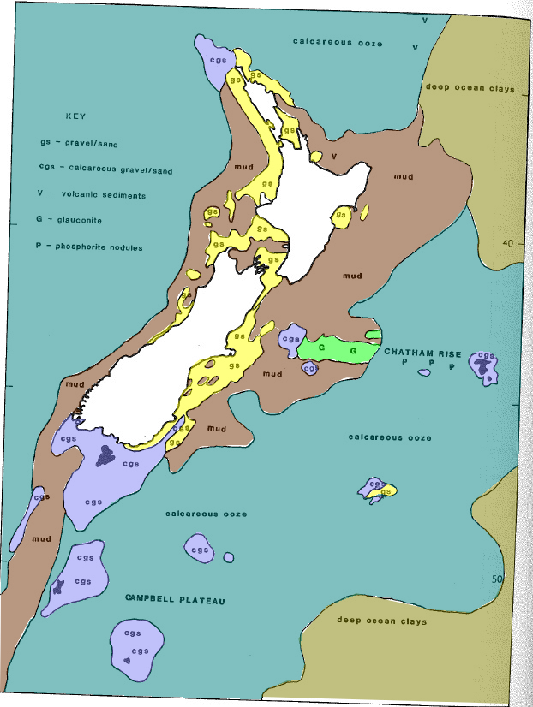
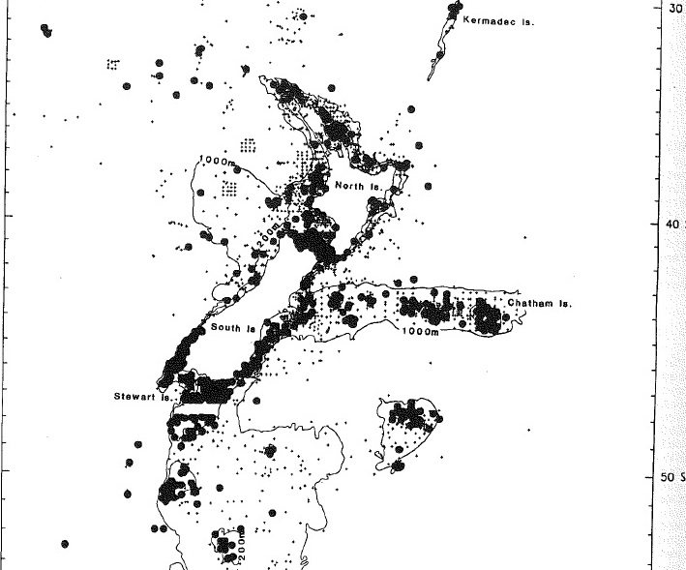
Adapted from Lee 1990

Slide 9
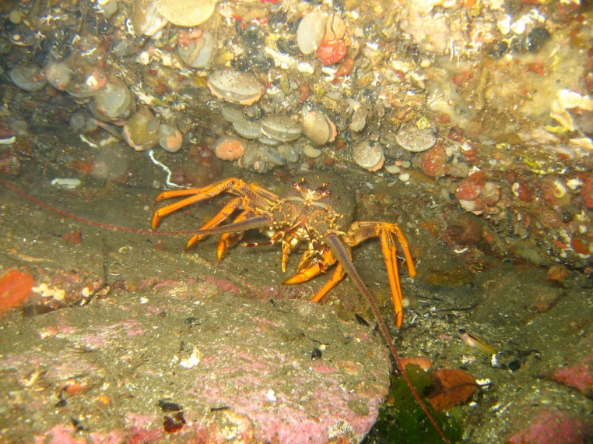
Substrate
Brachiopods much more reliant on hard substrate than bivalves
Can’t recover if buried by burrowers and almost never able to reattach if dislodged from substrate
Restricted to harder substrates and marginal environments by burrowing and grazing organisms

Slide 10
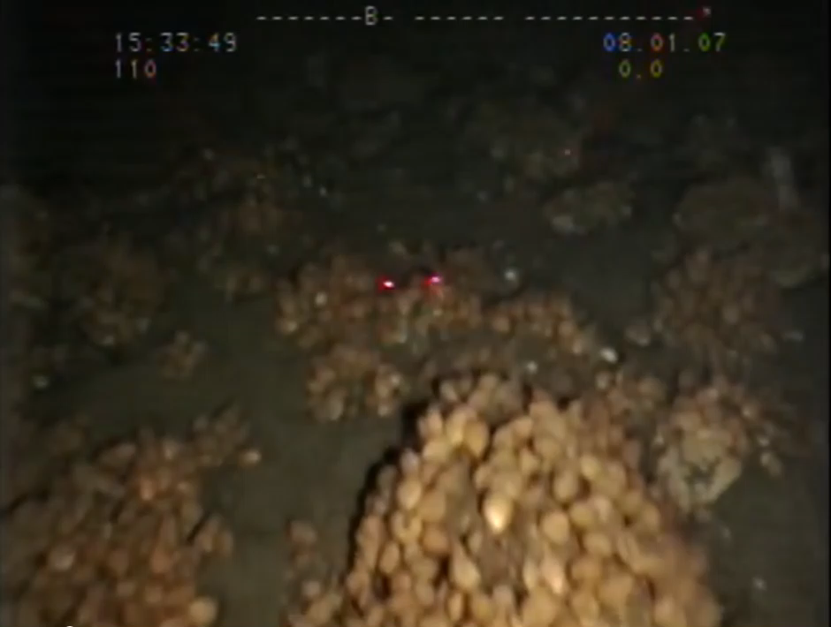

Slide 11
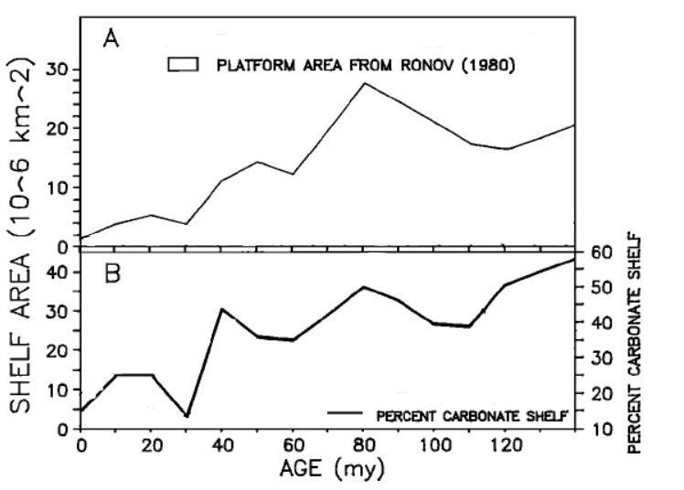
Carbonate Decline
Global decline in carbonate area since the Jurassic
Adapted from
Opdyke and Wilkinson 1988

Slide 12

Methods
Used the Paleobiology Database which stores global fossil age, location and lithology data
Entered over 1,000 collections of Jurassic and Cretaceous brachiopods from over 100 references

Slide 13
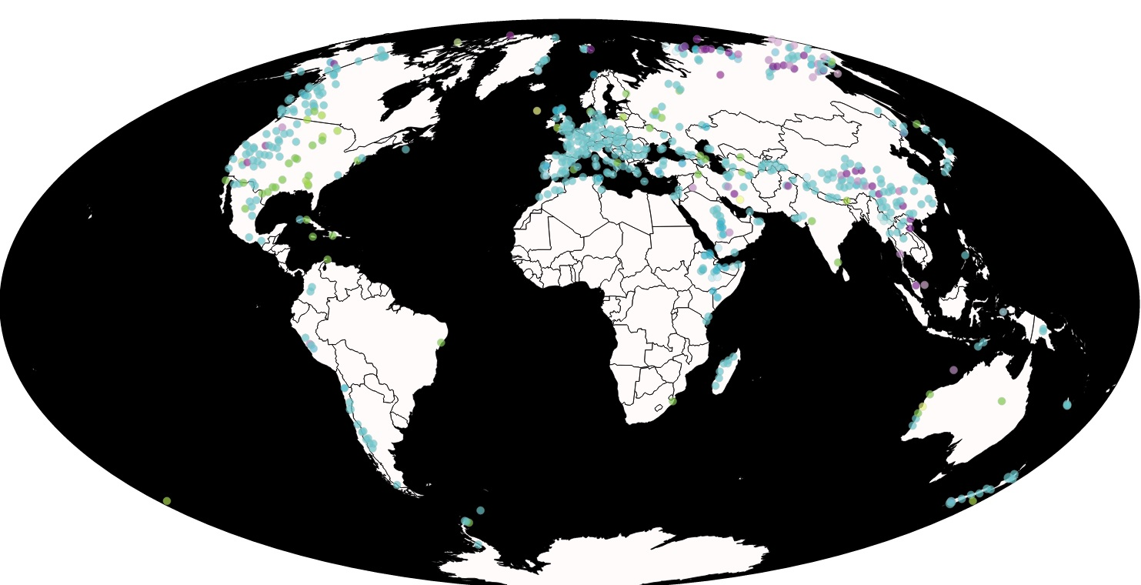
Time Periods
Triassic
Jurassic
Cretaceous

Slide 14
Methods
Examined brachiopod/bivalve substrate preference by lumping the lithology of fossil collections into two broad categories:
Carbonate: limestone (various subtypes), chalk, lime mudstone etc…
Siliciclastic: sandstone, mudstone etc…
Carbonate environments generally offer harder attachment surfaces and usually lithify more rapidly, offering new attachment opportunities
Siliciclastic environments represent primarily soft bottoms with few attachment opportunities and more intense burrowing activity

Slide 15
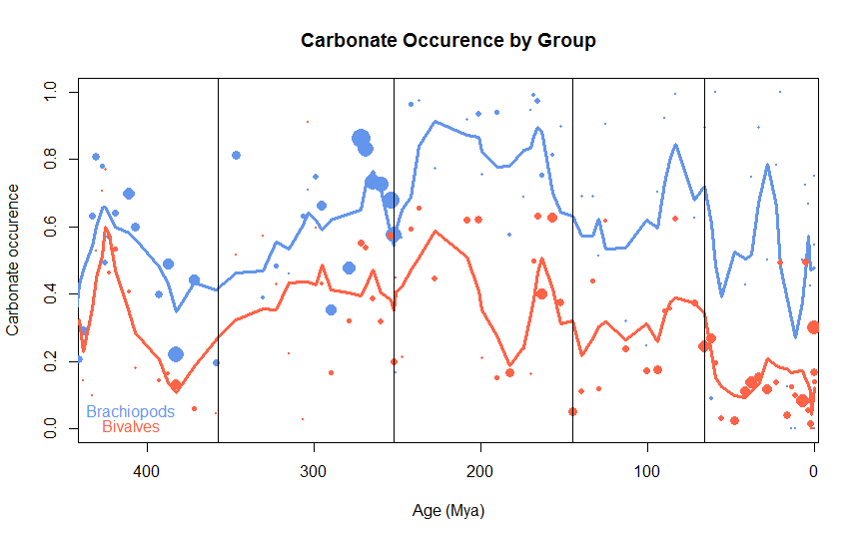
Brachiopod Carbonate Preference
Brachiopods show consistently stronger carbonate preference (increasing in Mesozoic)

Slide 16
Brachiopod Carbonate Preference
Brachiopods show consistently stronger carbonate preference (increasing in Mesozoic)

Slide 17
Brachiopod Carbonate Preference
Stronger carbonate preference maintained when normalized to other marine groups

Slide 18
PaleoDB Limitations
Literature dominated by European collections, poor coverage elsewhere
Europe hosted large carbonate platforms during the Mesozoic, especially Jurassic

Slide 19
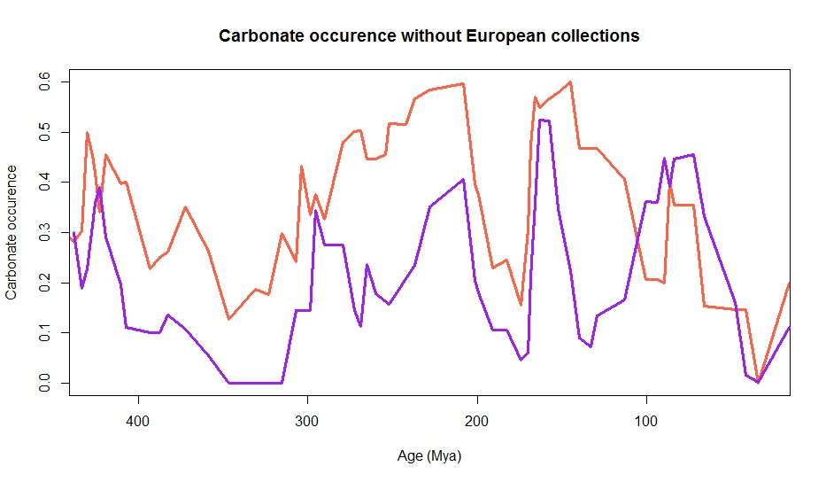

Slide 20
Conclusions
Modern brachiopods restricted to hard, often carbonate substrates compared to widespread bivalves
Literature data shows strong preference of brachiopods for carbonates compared to bivalves
The decline in carbonate area coupled with brachiopod preference for carbonate substrates could have contributed to brachiopod decline

Slide 21
Future Work
Further data collection from under-represented areas
Regional level analysis of preference data and paleolatitude analysis
Additional fieldwork focusing on the Early to Late Mesozoic

Slide 22


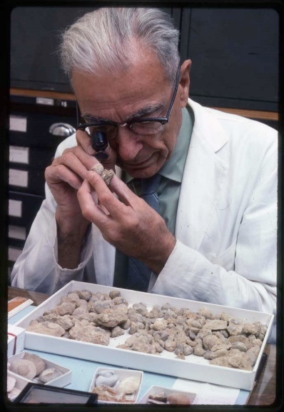
Acknowledgments
Matthew Clapham
The Paleobiology Database and all its contributors
Paleontological Society
G. Arthur Cooper Award

Slide 23
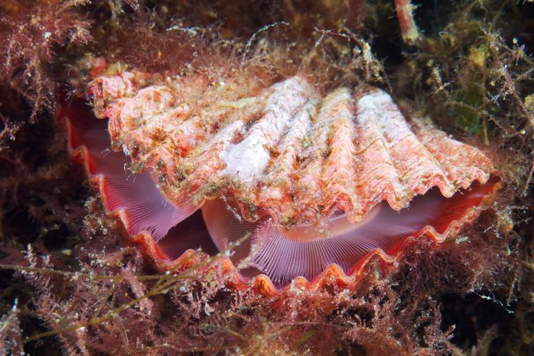
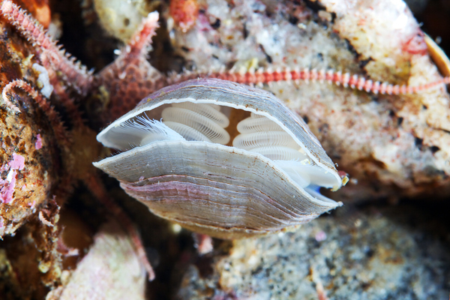
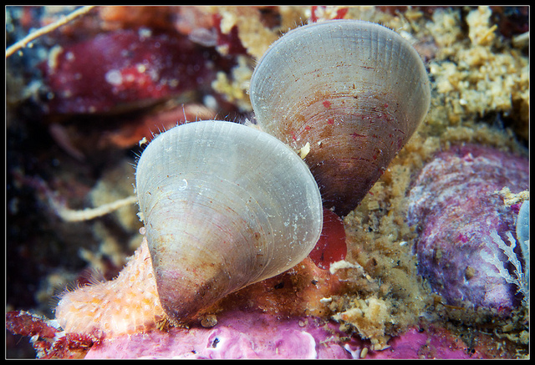
Questions?

