Slide 1
Seismic Hazard Mapping of the National Capital Region Using Random Field Models
C. Guney Olgun
Department of Civil and Environmental Engineering, Virginia Tech
Thomas A. Barham, Morgan A. Eddy, Mark Tilashalski,
Martin C. Chapman, Adrian Rodriguez-Marek
GSA 2015
Baltimore, Maryland
3 November 2015

Slide 2
2011 Mineral Virginia Earthquake
M5.8 Earthquake occurred August 23, 2011 at 1:51pm
Light to moderate damage in DC area, about 130 km away
Regional geological conditions contributed to significant soil amplification
PGA for DC area estimated 0.02-0.03g on rock and 0.06g at soil sites

Slide 3
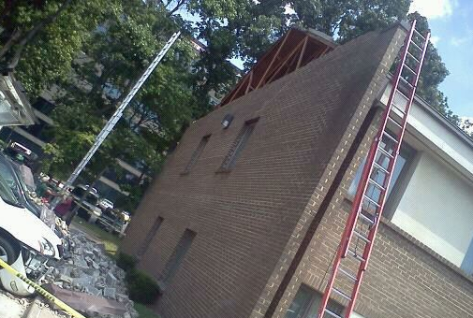
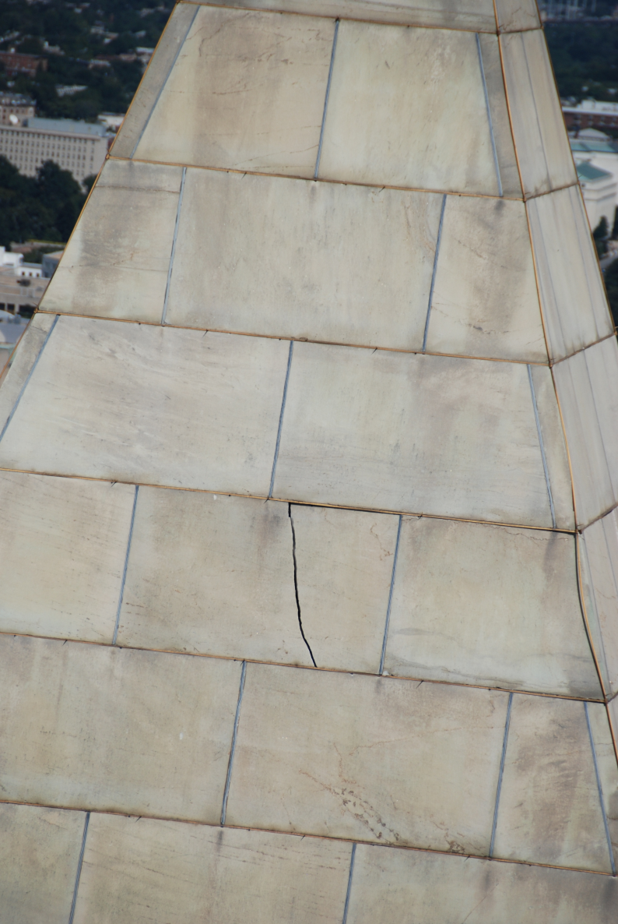
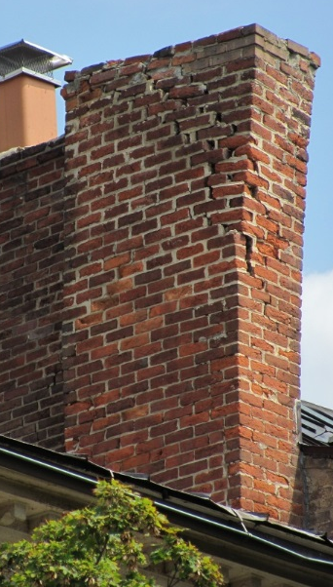
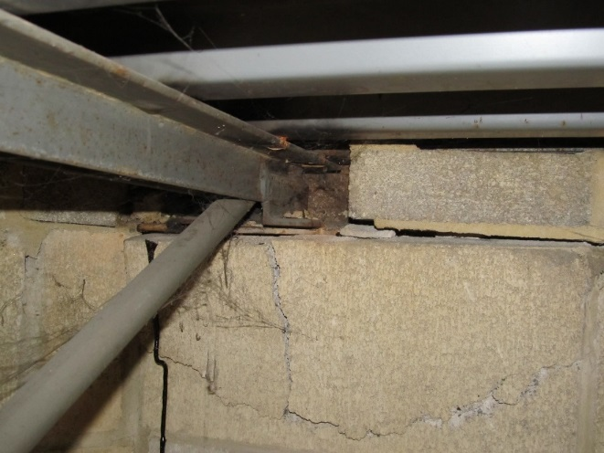
Structural Damage in the Area
M.A. Eddy
National Park Service

Slide 4
Atlantic Coastal Plain Geology
Regional geology along the Atlantic coastal plain area dominated by several physiographic provinces
Shallow soils over rock (Piedmont, Fall Line)
Deep tertiary and cretaceous marine deposits over rock (Coastal Plain)
Sharp impedance contrasts between different geologic units (residual, young alluvial, tertiary and cretaceous marine, rock)
(Ator et al. 2005)

Slide 5
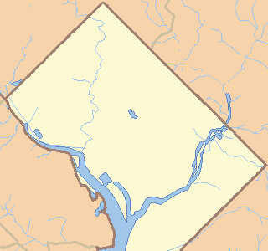
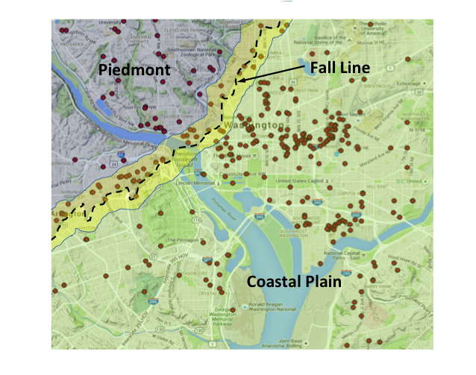
Washington D.C. Geology
2. Fall Line
1
2
1. Piedmont
Residual
Alluvial
Residual
Weathered
Rock
Weathered
Rock
3. Coastal Plain
3
Alluvial
Potomac Formation
Idealized Subsurface Cross-section for Washington, D.C.

Slide 6
Investigation of Subsurface Geology
39.00
Subsurface profiles from about 600 geotechnical investigations
Shear wave velocity profiles from 122 investigations
Artificial neural network (ANN) analysis of the geological profile in the area
38.96
Latitude
38.92
38.88
38.84
-77.13
-77.09
-77.05
-77.01
-76.97
Longitude

Slide 7
Geological Cross-Sections (W-E)
Ground Surface
Rock
Potomac
W
E

Slide 8
Geological Cross-Sections (W-E)
Ground Surface
Rock
Potomac
W
E

Slide 9
Geological Cross-Sections (W-E)
Ground Surface
Rock
Potomac
W
E

Slide 10
Geological Cross-Sections (S-N)
Ground Surface
Potomac
Rock
S
N

Slide 11
Geological Cross-Sections (S-N)
Ground Surface
Rock
S
N

Slide 12
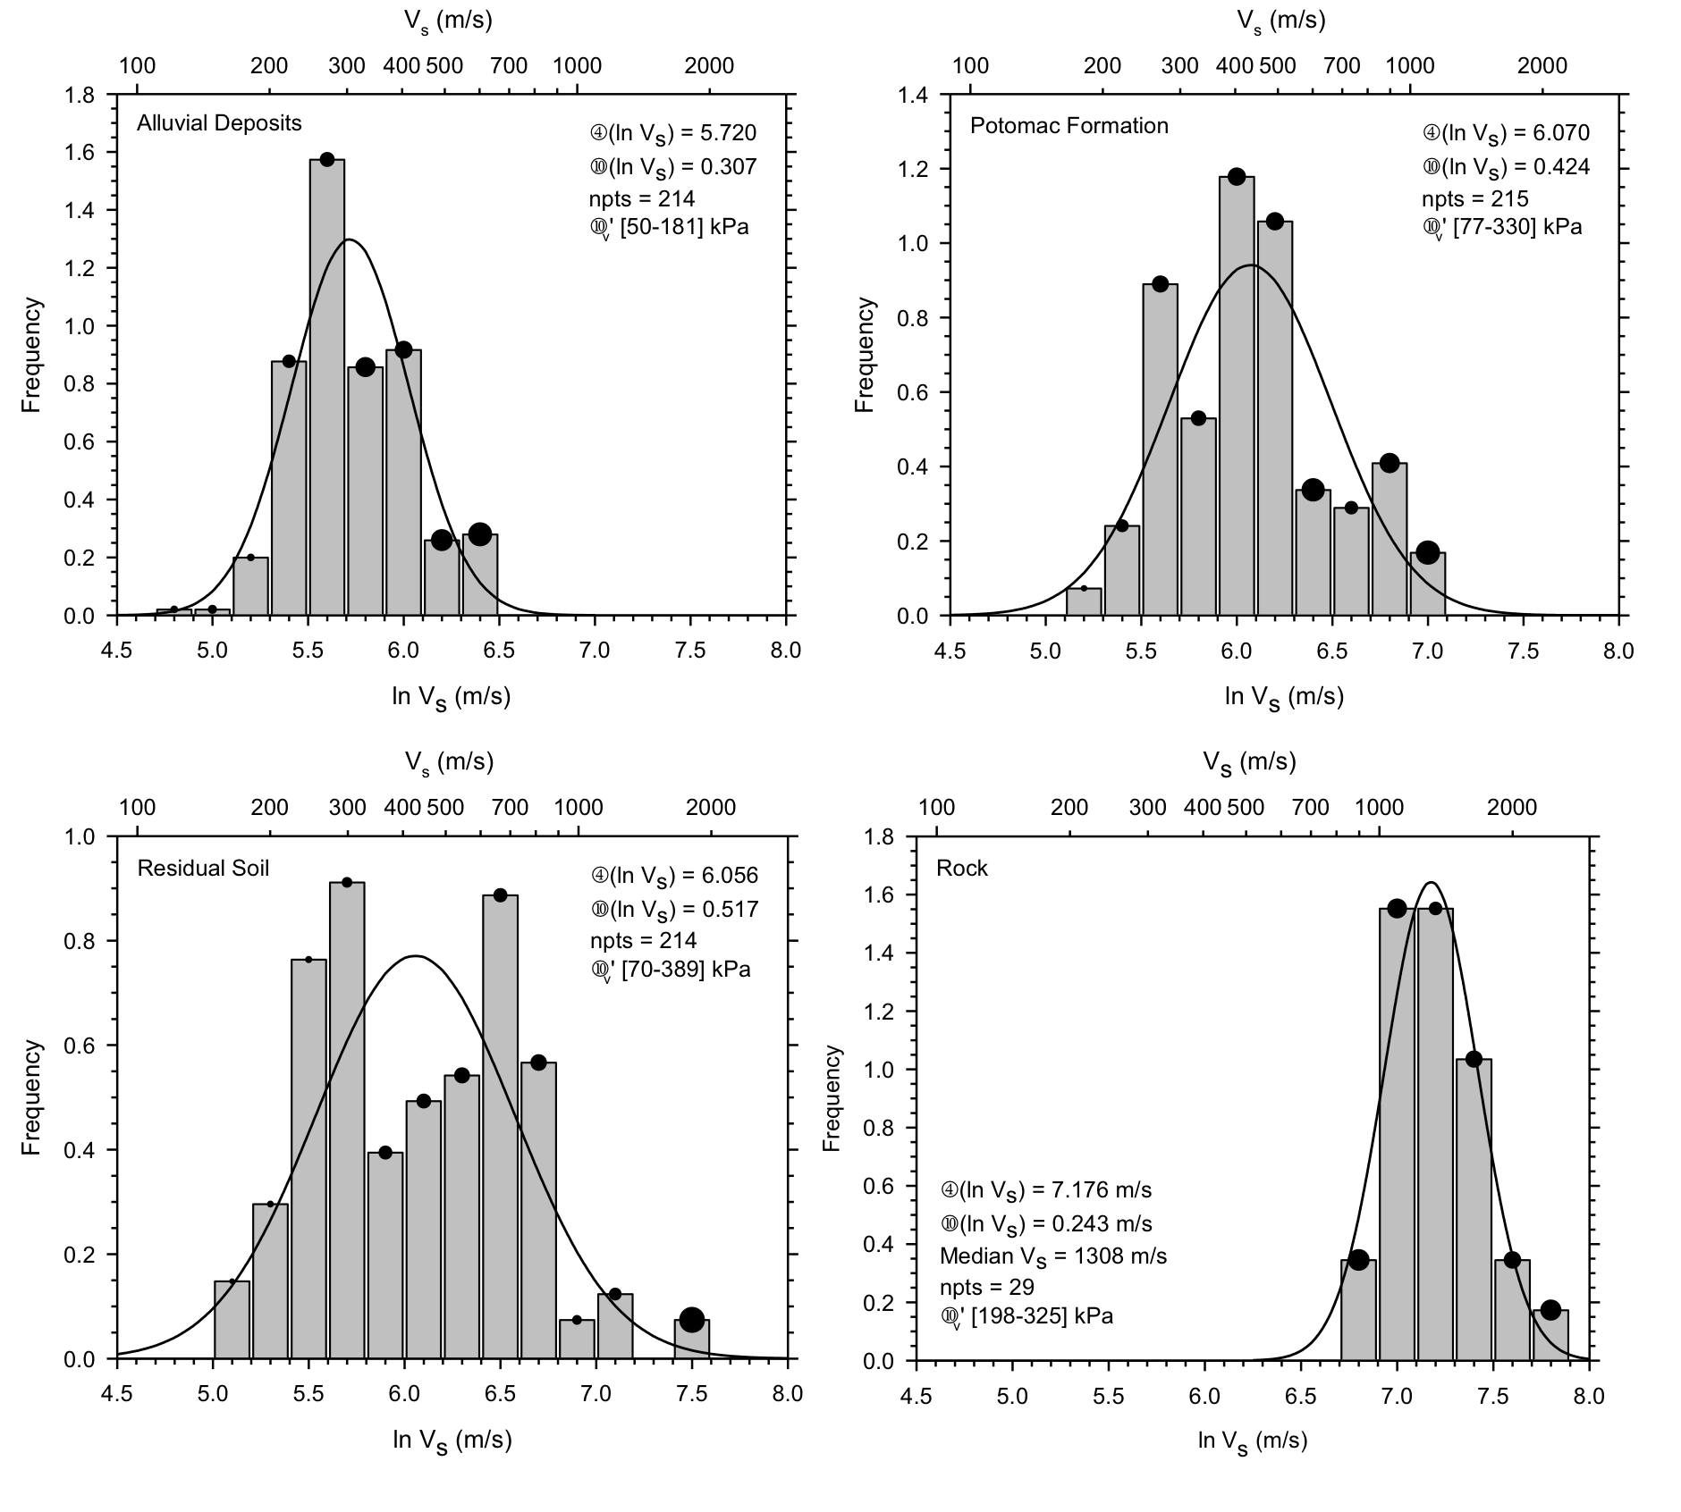
V_{s} Measurements of Geological Units

Slide 13
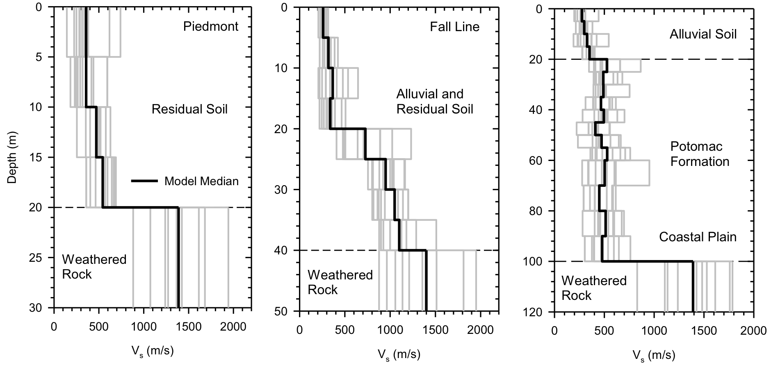
Random Field Modeling

Slide 14
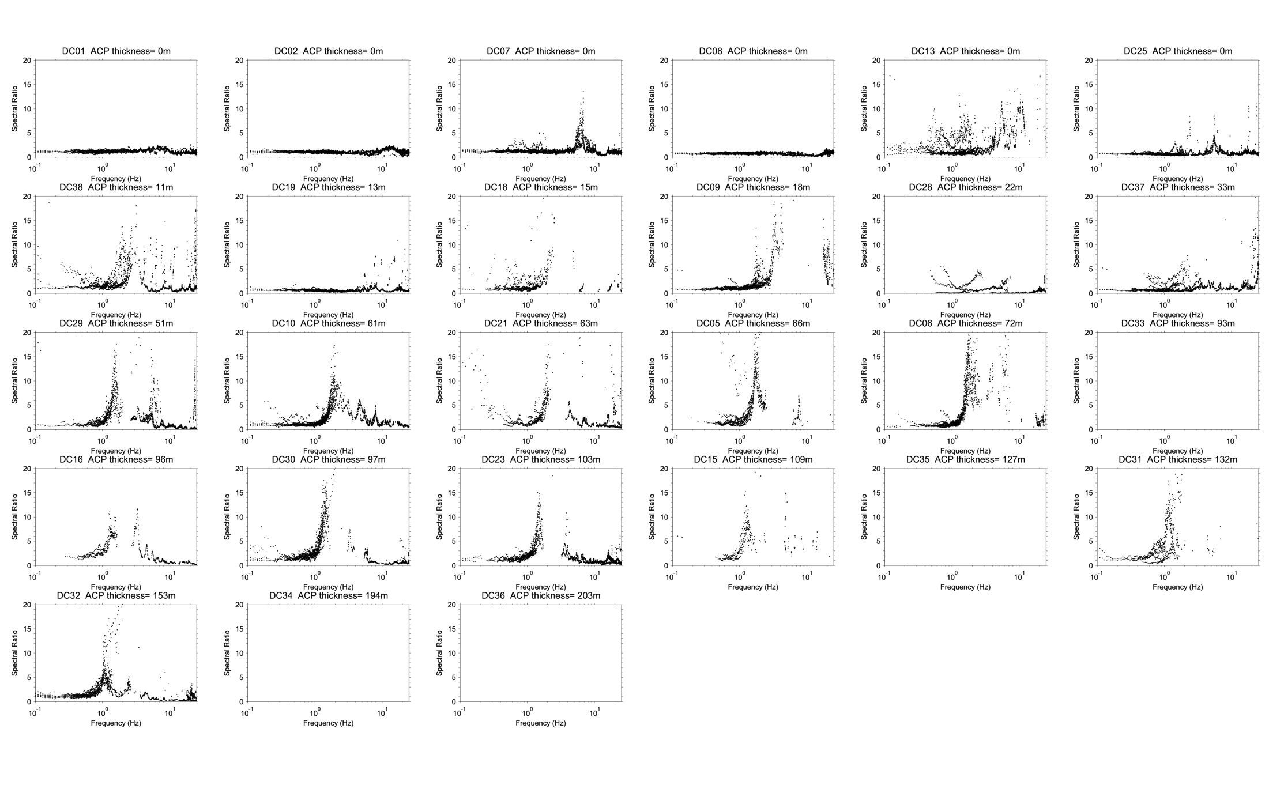
Piedmont Site : 2nd District Police Station
Spectral ratio (ground surface to rock)
Stiff shallow site
Residual soils (~15 m thick) underlain by rock
Fundamental frequency 4.5 Hz
Residual Soil
Weathered Rock
F_{a} =2.80
F_{v} =0.94
(courtesy T. Pratt and S. Hough)

Slide 15
Fall Line Site : 1328 14th St. NW
Spectral ratio (ground surface to rock)
Stiff site
Alluvial and residual soils (~19 m thick) underlain by rock
Fundamental frequency 5.0 Hz
Alluvial Soil
Weathered Rock
F_{a} =2.68
F_{a} =2.45
F_{v} =2.65
F_{v} =0.90
(courtesy T. Pratt and S. Hough)

Slide 16

Coastal Plain Site : Washington Monument
Spectral ratio (ground surface to rock)
Alluvial Soil and Potomac Formation
Deep alluvial and Potomac formation (~60 m thick) underlain by rock
Fundamental frequency 1.5 Hz
Weathered Rock
(courtesy R. Kayen)
F_{a} =2.68
F_{v} =2.65
(courtesy T. Pratt and S. Hough)

Slide 17
Summary and Conclusions
D.C. area geology exhibits sharp impedance contrasts that can significantly amplify ground motions
Subsurface profile mapped from extensive field data and ANN
Limited information on regional velocity structure and relevant properties (Q, κ) (Hashash et al. 2013)

Slide 18






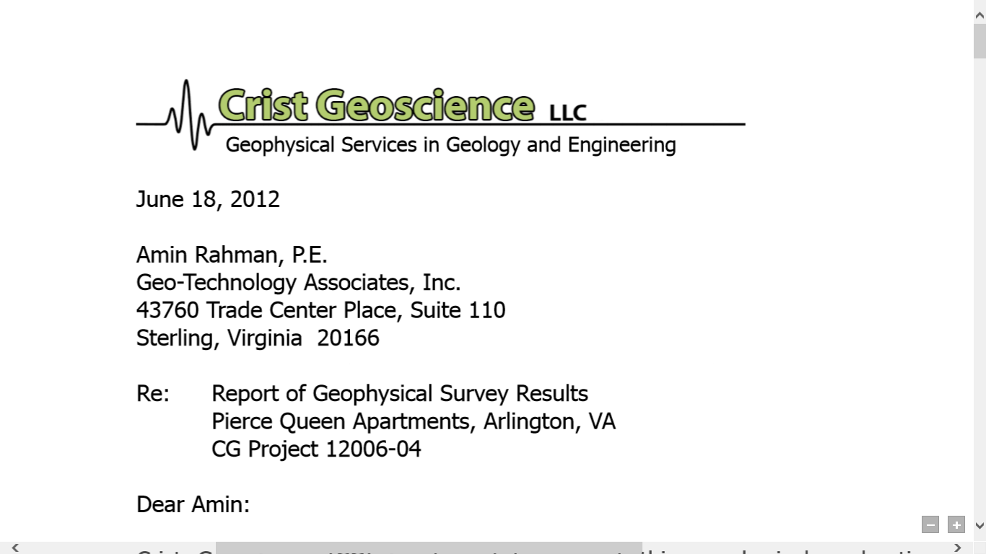

Acknowledgements
Washington D.C. area geotechnical and shear wave velocity data provided by
Piedmont
Geotechnical, Inc.
Seismometer measurements from D.C. area provided by Dr. Tom Pratt and Dr. Susan Hough (Poster Session 293, Exhibits Hall, 4 November 2015)
Washington Monument seismic profile provided by Dr. Robert Kayen, USGS
NEHRP Earthquake Hazards Program award numbers G10AP00035, G13AP00076, G15AP00047

