Slide 1
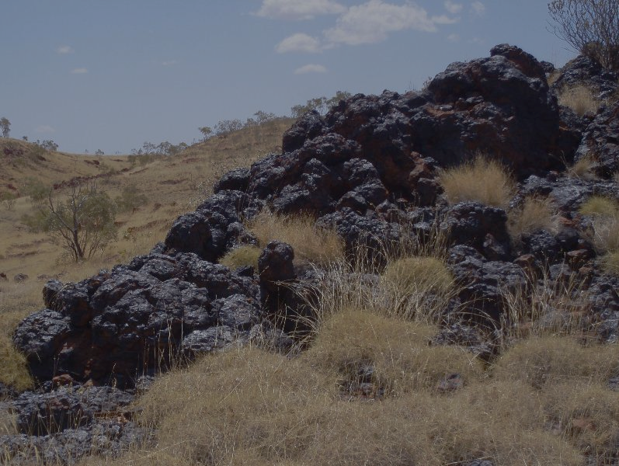
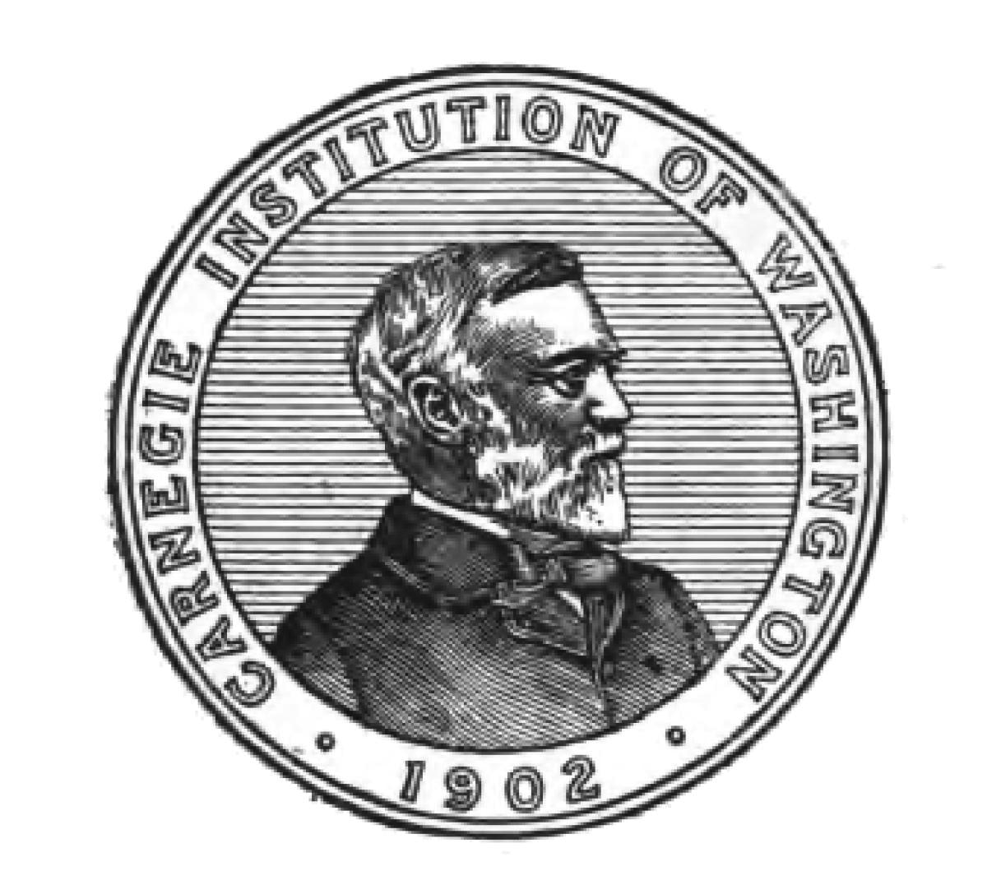






Mineral Ecology and Evolution of Manganese:
Using redox sensitive minerals to
probe Earth’s history
Daniel Hummer,¹ Robert Hazen,¹ Grethe Hystad,²
Joshua Golden,³ Robert Downs³
¹ Geophysical Laboratory, Carnegie Institution of Washington
² Department of Mathematics, Computer Science and Statistics, Purdue University Calumet
³ Department of Geosciences, University of Arizona
Notes:
Change grethe location
Put keck logo

Slide 2
Outline
1) ECOLOGY:
There are ~192 undiscovered Mn
minerals on Earth today
2) EVOLUTION:
Mn mineralization is episodic and correlates with supercontinent formation
3) REDOX HISTORY:
Mn mineral distributions over time recorded the oxygenation of Earth’s atmosphere
Notes:
1 – 150 missing Mn minerals
2 – episodic with supercontinents
3 – changes in Mn species reflect oxygenation of atmosphere
Use numbers

Slide 3
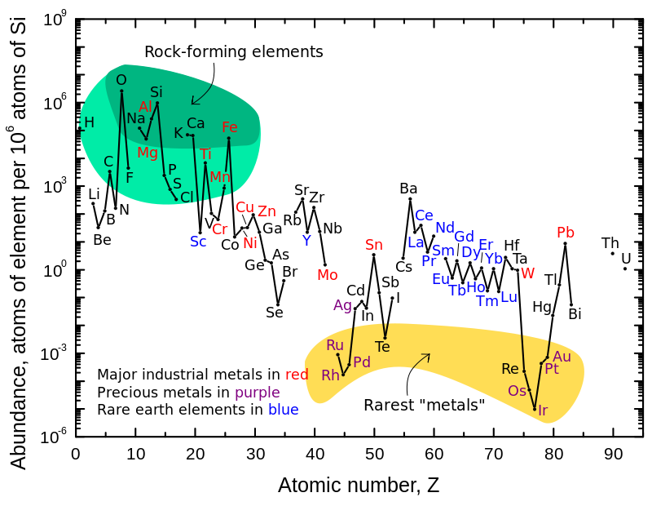
Mn is the 12th most abundant element in Earth’s crust
Haxel, Boore and Mayfield (USGS)

Slide 4
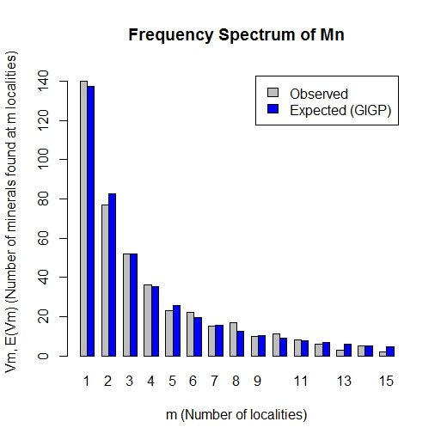
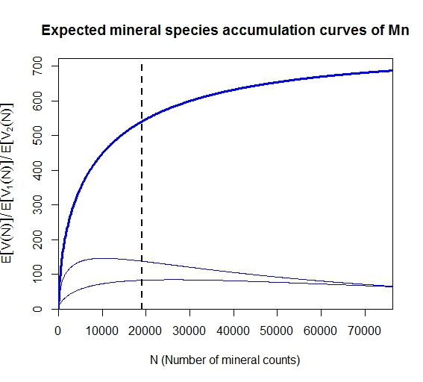
Mn Mineral Frequencies
(LNRE)
192 Mn minerals left to discover
Minerals found at m localities
Number of known minerals
544 known
Mn minerals right now
Number of localities (m)
Number of mineral counts
Mn minerals fit a Large Number of Rare Events distribution
Extrapolating to large counts reveals how many Mn minerals are unknown
Hazen et al. (2015a,b)
Hystad et al. (2015a,b)
Notes:
Change axes to be understandable
Simple!
Remove extraneous curves
Label undiscovered Mn minerals

Slide 5
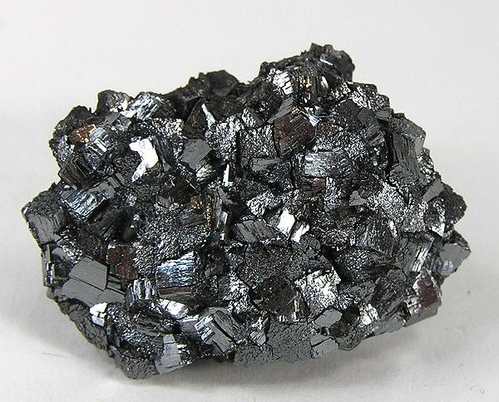
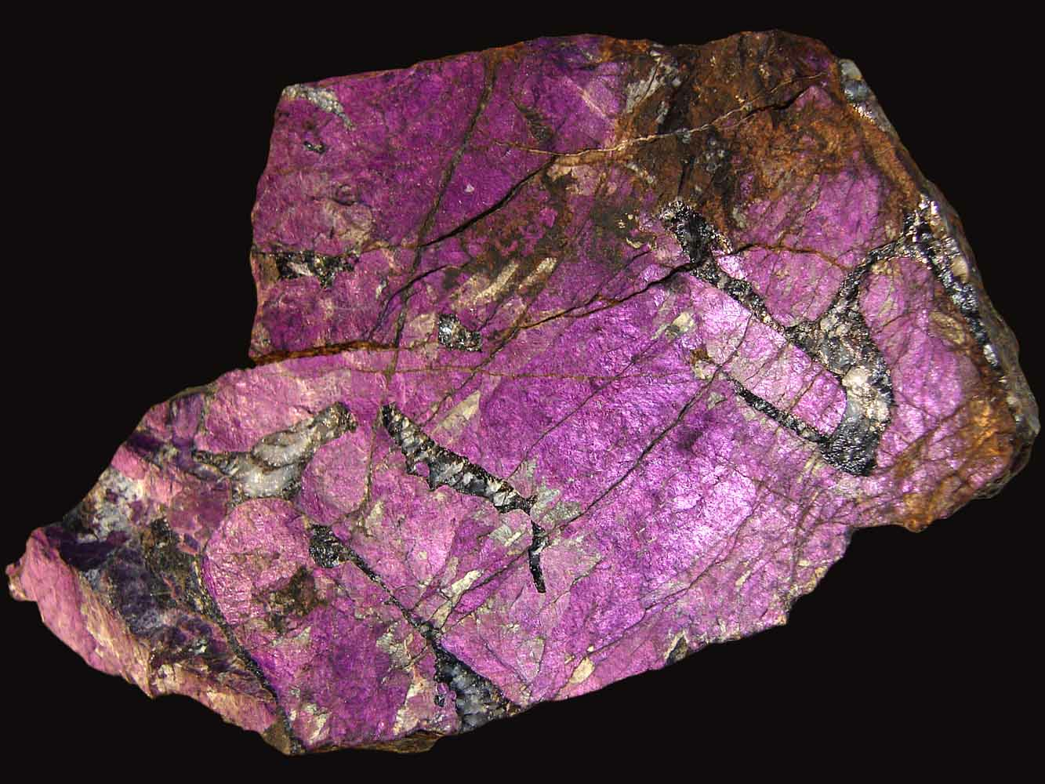
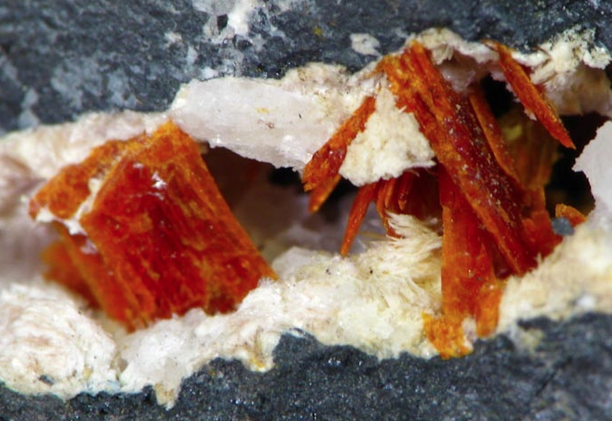
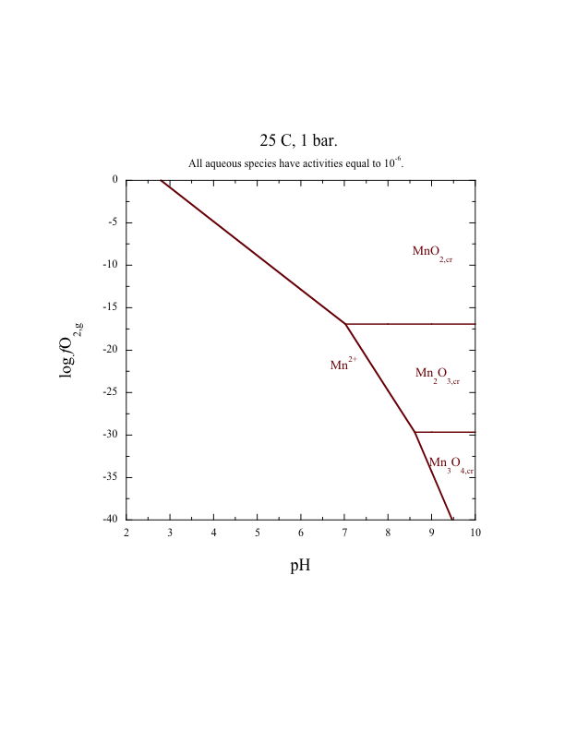
Mn Oxidation States
Mn⁴⁺
MnO₂
Ramsdellite
Mn³⁺
Mn₂O₃
Mn²⁺
Purpurite
Mn₃O₄
Mn²⁺, Mn³⁺
Courtesy of Jihua Hao
Saneroite
Notes:
Put photos here

Slide 6
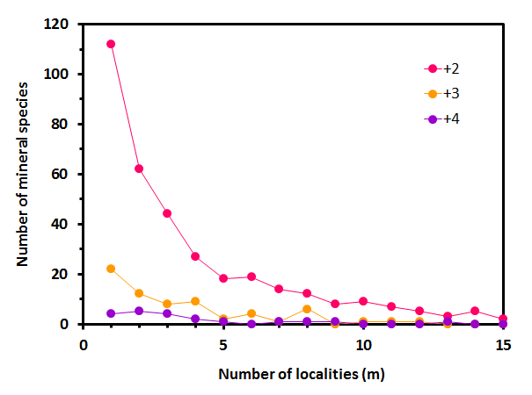
Mn Frequencies by oxidation state
What else can we learn from separating oxidation states?

Slide 7
Accumulation Curve of Mn Minerals
2+
3+
4+
GOE

Slide 8
Age Distribution of Mn Minerals
2+
3+
4+
Mn mineralization coincides with supercontinent formation

Slide 9
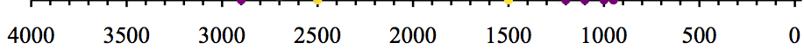
Average Oxidation State of Mn
2+
3+
4+
Notes:
Separate these graphs
Caveat on different environments
Many variables contribute to scatter of early record

Slide 10
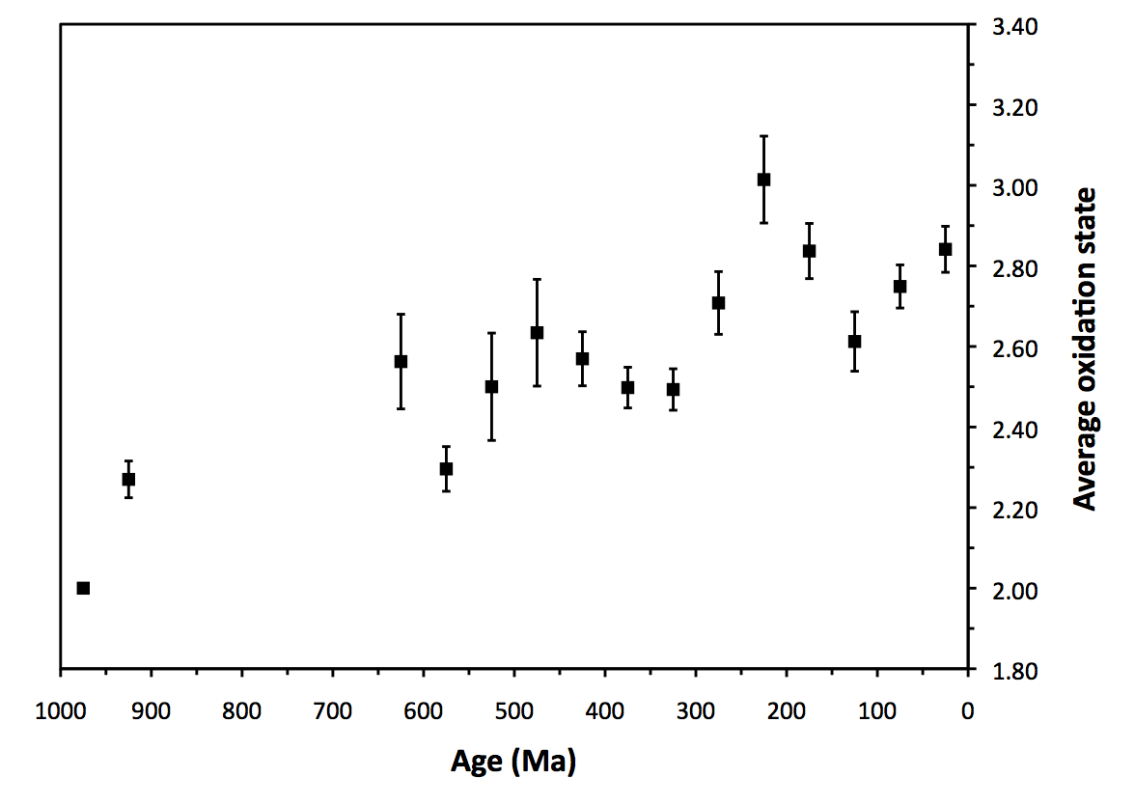
Average Oxidation State of Mn

Slide 11
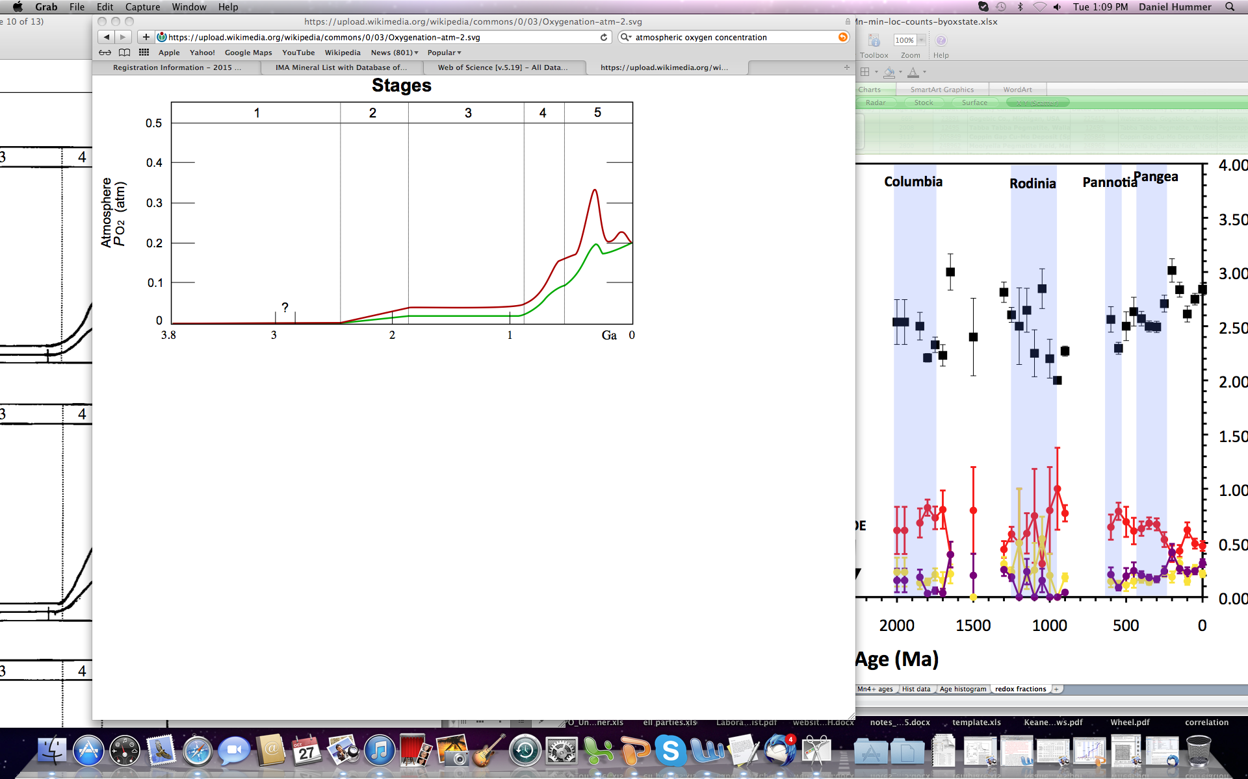
Rise of Atmospheric Oxygen
Age (Ga)
Holland (2006)

Slide 12
Mn Oxidation State / Atmospheric O₂
0.30
0.25
0.20
0.15
0.10
0.05
0
Hummer et al.
Holland (2006)
Holland (2006) + 100 Ma
P(O₂) (atm)
100 Ma lag

Slide 13
Conclusions
1) There are ~192 undiscovered Mn minerals on Earth today
2) Mn mineralization is episodic and correlates with supercontinent formation
3) Mn mineral distributions over time recorded the oxygenation of Earth’s atmosphere
Notes:
1 – 150 missing Mn minerals
2 – episodic with supercontinents
3 – changes in Mn species reflect oxygenation of atmosphere
Use numbers

