Slide 1


Lost in translation:
Tracing island-arc geologic records from modern activity to ancient accreted terranes
Amy E. East
Pacific Coastal & Marine Science Center
U.S. Geological Survey, Santa Cruz, CA
Peter D. Clift
Dept. of Geology & Geophysics
Louisiana State University, Baton Rouge, LA

Slide 2
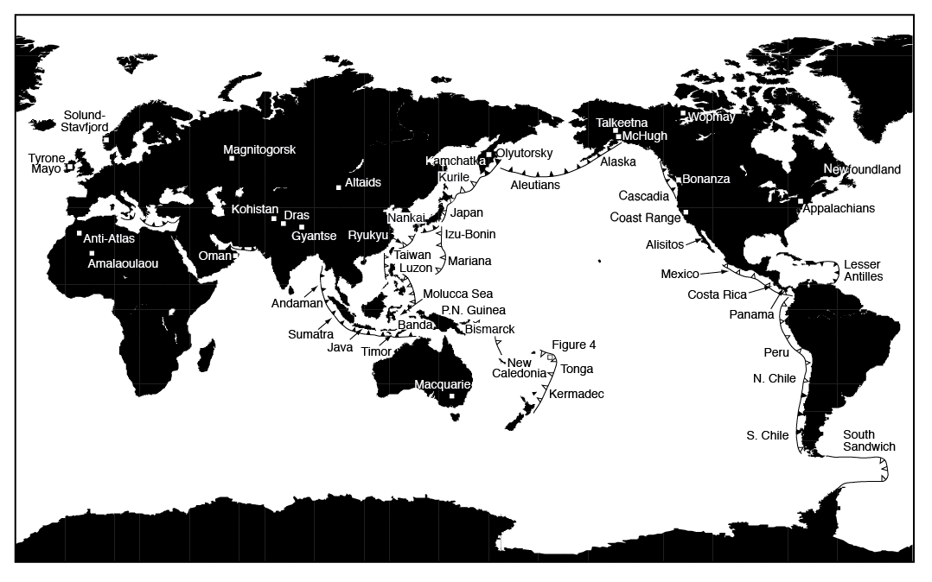
What is lost vs. preserved in transition from modern arcs to ancient record?
Notes:
In trying to understand how convergent margins evolve, including the tempo and processes of arc accretion, it’s informative to ask what is lost and what’s preserved in the transition from activity of that margin to inactivity and becoming part of the geologic record. There are quite a few examples, worldwide, of both modern, active arcs and accreted arc terranes. In this talk I’ll concentrate on processes of an oceanic arc accreting onto a continent.

Slide 3
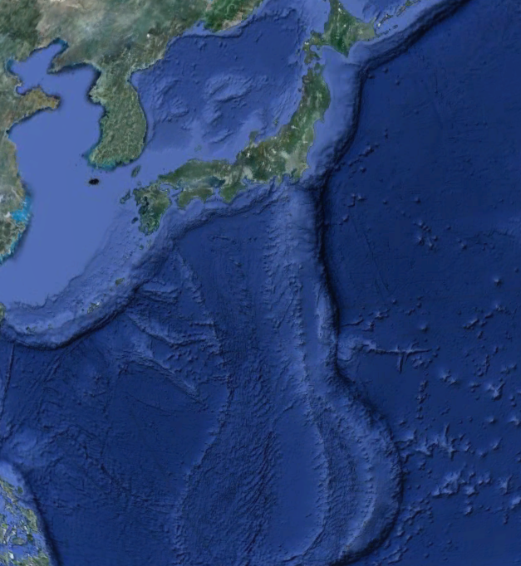
Why study arc emplacement and accretion?
Ancient, accreted oceanic arc terranes are used for
  Plate motion, tectonic, paleogeographic reconstructions
  Economic resource potential
  Understanding continental-crust formation
  Reconstruction of hazard recurrence?
Izu-Bonin-Mariana arc colliding with Honshu, Japan
Notes:
Why is this important?
Ancient, accreted arc terranes occur in orogenic belts on every continent. They can help us understand paleogeography, plate motion, and continent assembly. Accreted arcs are often economically important, containing gold and other commercially interesting resources. Accreted terranes have done much to inform a long-standing debate about origins of the continental crust. Will discuss that in more detail toward the end. Also if parts of an arc terrane are well enough preserved, they could help identify paleohazard occurrence, lg EQ & tsunamis, from things like MTDs, which might help us learn more about modern hazards at convergent margins. This last idea is a bit speculative right now, but I think it would be interesting to look at that down the road.

Slide 4
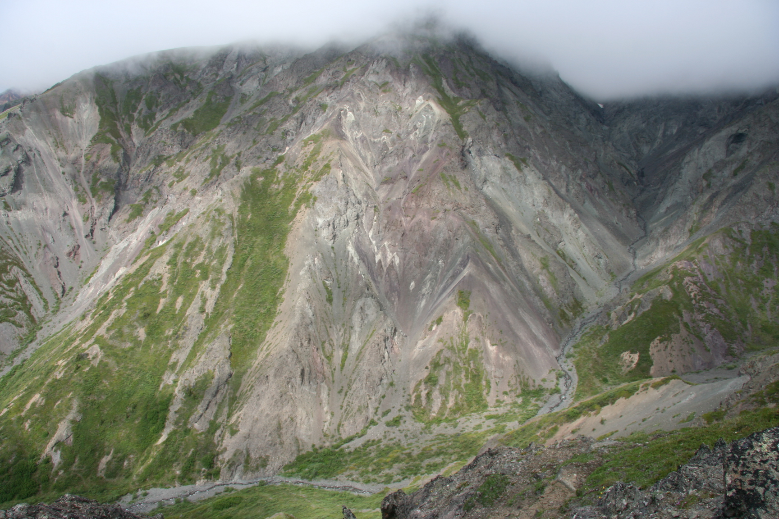
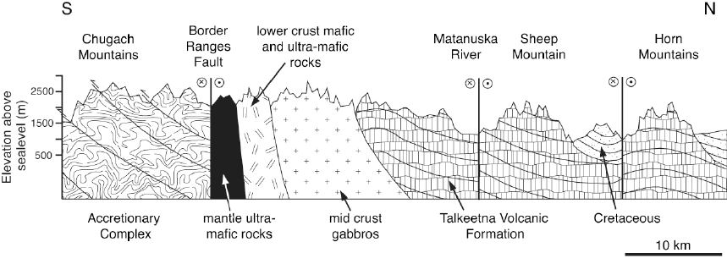
Geologic records of ancient oceanic arcs
Long-term preservation (and incorporation into continental crust) requires arc-continent collision
Accreted arc terranes on every continent
Provide valuable exposures difficult to access in modern, active arcs: deeper crustal levels, temporal/spatial scale
Talkeetna arc cross-section, Alaska
DeBari and Sleep, 1991; Clift et al., 2005; Greene et al., 2006; DeBari and Greene, 2011
Notes:
So, if an island arc is to be preserved long term, it must accrete onto a continent. Accreted arc terranes occur on every continent, and there are 8 or 10 that have been pretty intensively studied. These ancient arc terranes provide access to long, well preserved records of the chemical and magmatic evolution of an arc, at scales and depths that it’s much more difficult and expensive to access in modern arcs (either by drilling or geophysical investigations).

Slide 5
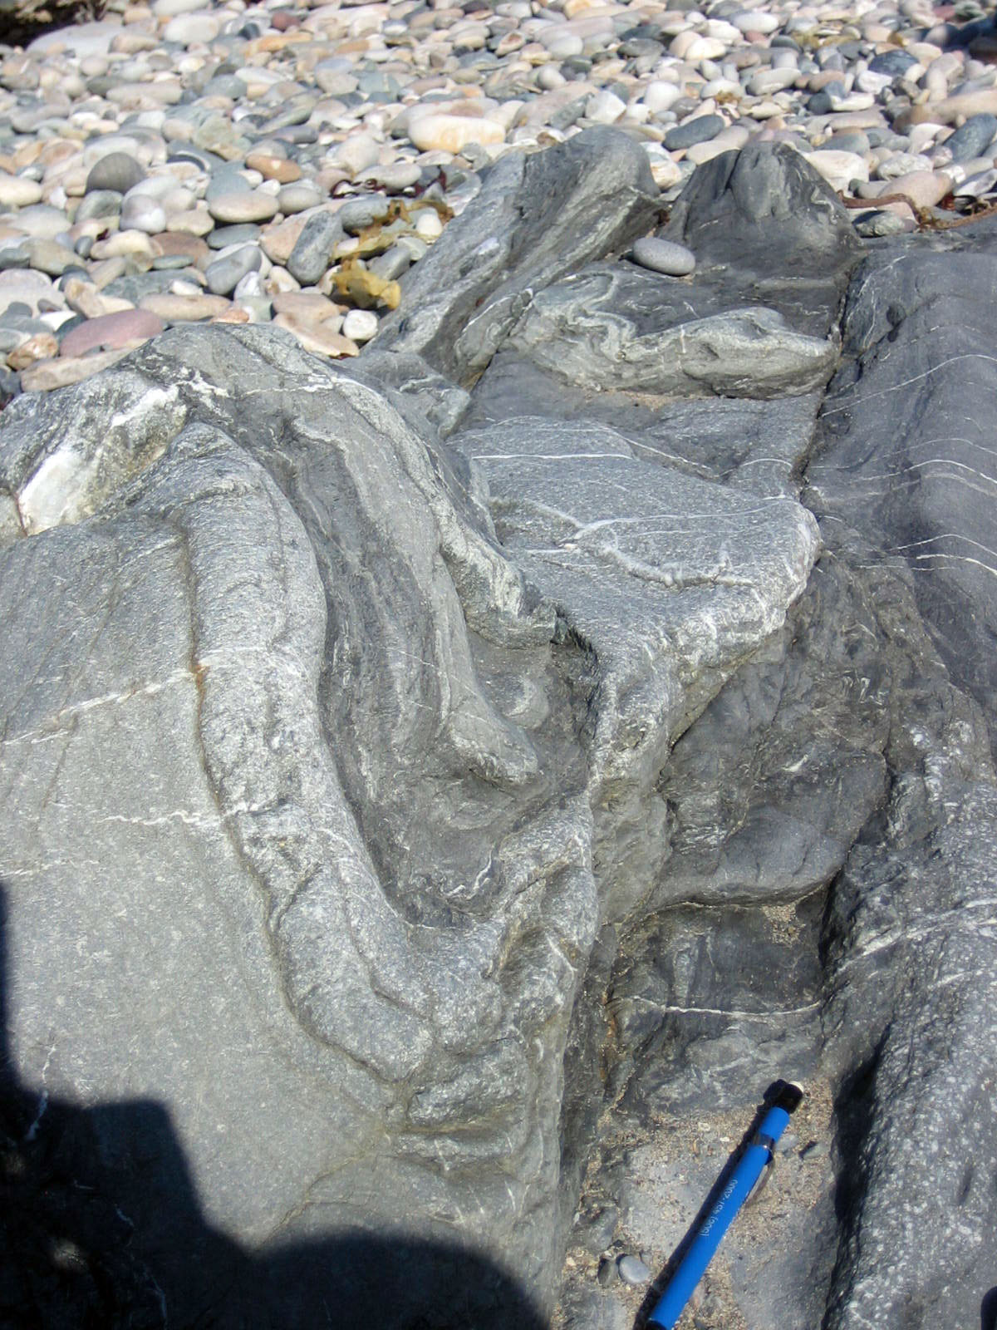
Translating from modern to ancient
Some arc tectonic and sedimentary processes are preferentially preserved in the rock record, others lost
Collision geometry drives crustal and terrane composition
Bias toward arcs in tectonic accretion for a long time
Temporal bias toward final stages of arc activity
Ordovician accretionary complex, Westport, Ireland
(syn-collisional)
Notes:
Of course, it is impossible to preserve all of an arc terrane intact (it’s a destructive plate boundary, after all). Some processes of an active arc are probably preferentially preserved, while others are lost. The state of the arc terrane after collision depends on the geometry of collision, how oblique it may have been and largely on whether the arc collided with a passive or an active margin. Preservation probably also is biased toward arcs that underwent tectonic accretion for a long time before collision, which is not that common in the modern oceans. Tectonic erosion is a more common state at island arcs now. And there is likely a temporal bias toward late stages of arc activity when the arc was most likely to be in a state of tectonic accretion.

Slide 6
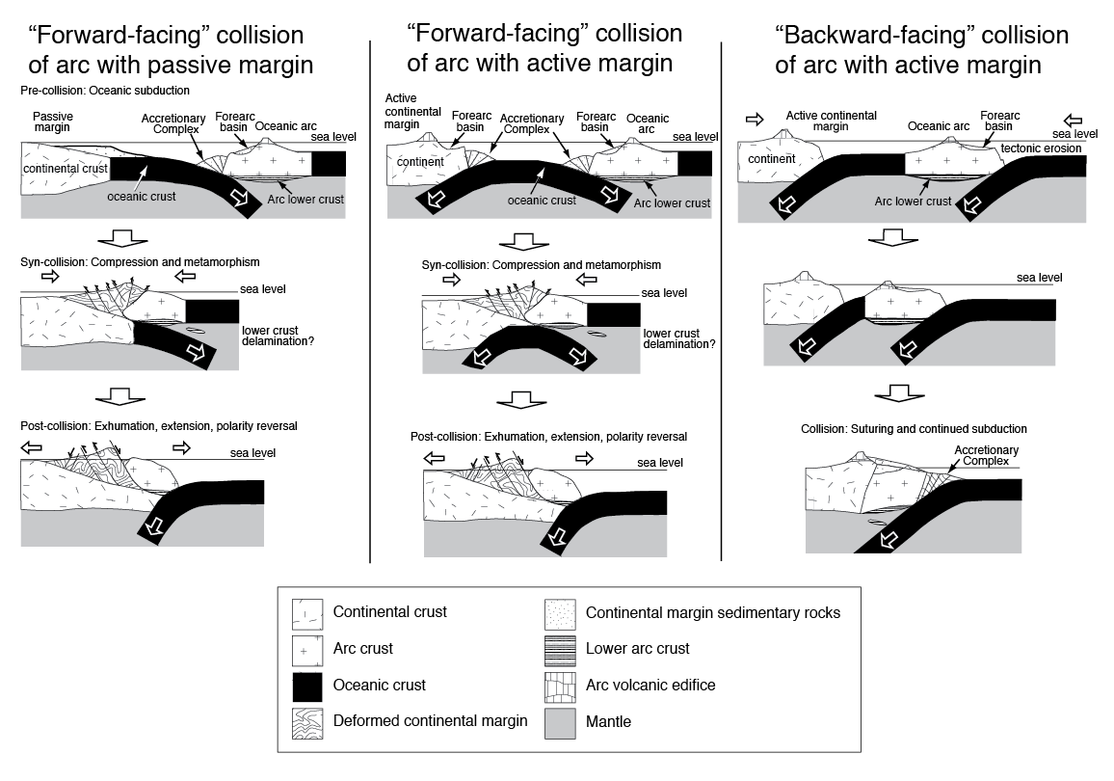
Collision geometry matters
Draut and Clift, 2013
Earth-Science Reviews
Notes:
Geometry: basic configurations are having the arc on the upper plate hit head-on into either a continental passive margin [left] or an active margin [center panel]. Or, what I call backward-facing, when an oceanic arc backs into an active margin, colliding backarc first - two trenches, two slabs dipping the same direction, and the subduction zone that created that arc can keep going after collision. Any of these configurations collide an arc with a continent, but what you end up with in the accreted terrane can be quite different in terms of parts of the arc likely to get preserved, and the chemical composition of syn-collisional or post-collisional magmatism. Let’s go through a few examples…
[Talkeetna REE chemistry: flat, mostly. Slightly more depleted than average CC, some places slightly enriched relative to chondrite, but generally pretty flat.]

Slide 7
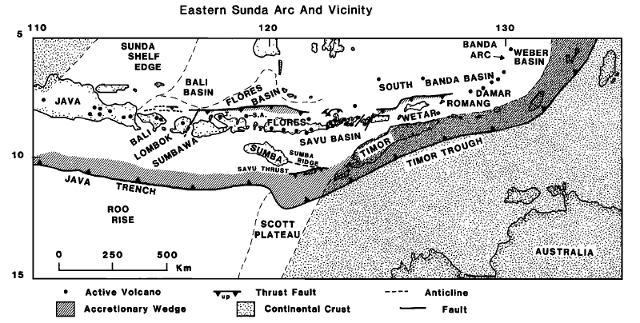
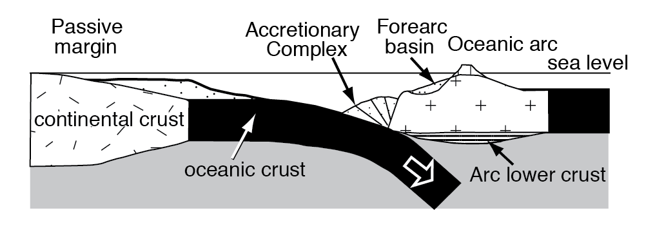
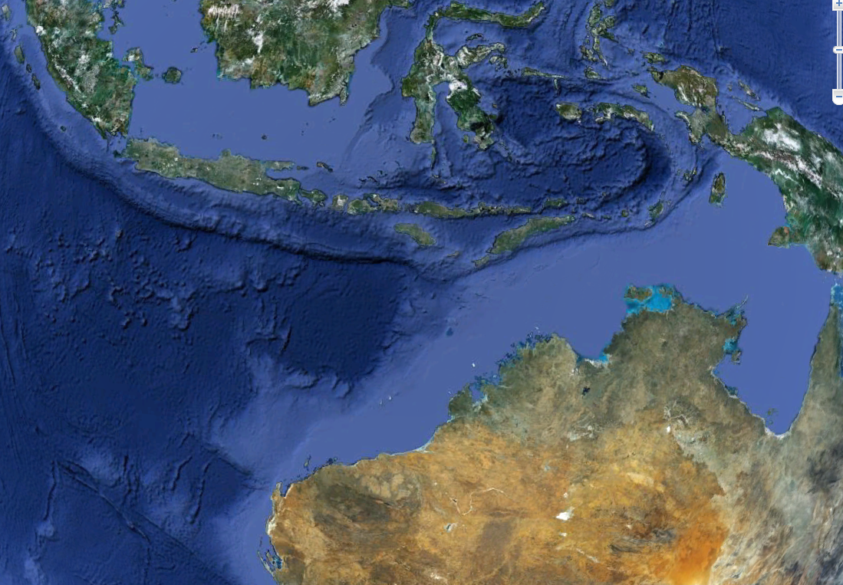
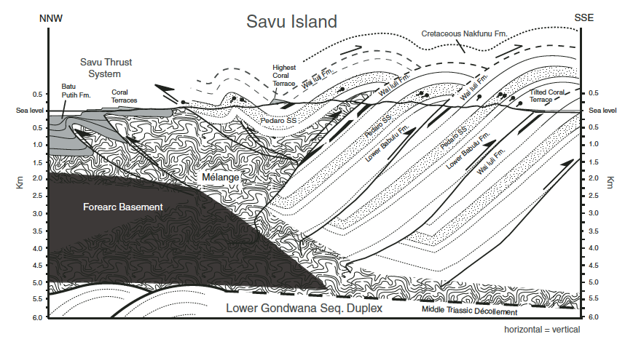
Forward-facing collision examples
(forearc collides first)
Silver et al., 1983
Taiwan, Luzon Arc/Eurasia collision
Banda Arc/Australia collision
Urals (Devonian)
Grampian/Taconic Orogeny (Ordovician)
New Caledonia (Eocene)
New England orogen, Australia (Ordovician)
Harris et al., 2009
Notes:
Example in modern ocean of arc on upper plate colliding with a passive margin: Banda arc/Australia collision. Another good one is Taiwan, where the arc collides with the passive margin offshore of China, collision migrating along the margin, and completes a polarity flip as it goes. Others in geologic record. Urals: Dennis Brown’s work, e.g. A much-studied example is Grampian/Taconic orogeny (British Isles & eastern North America, Ordovician, thought to have this geometry). There’s also New Caledonia in Eocene, and New England orogen, Australia.

Slide 8
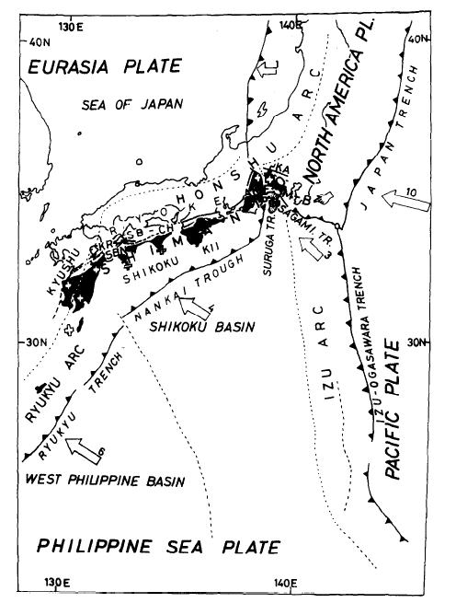
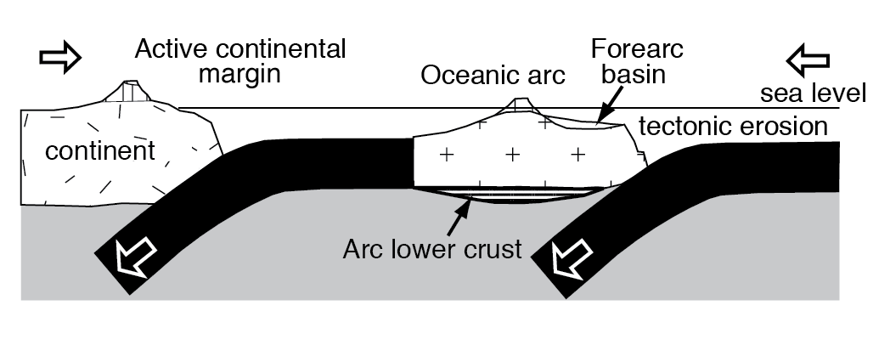
Backward-facing collision examples
(backarc collides first)
Izu-Bonin Arc collision at Honshu
(Ogawa et al., 1985)
Izu-Honshu collision
Talkeetna Arc, Alaska (Jurassic)
Dras-Kohistan Arc (Cretaceous)
Notes:
Example of a backarc colliding first is IBM arc colliding with Honshu, pretty oblique collision at TTT triple junction. The Talkeetna arc near here and the Dras-Kohistan arc also proposed to have collided that way. Also keep in mind that any collision of any geometry will be complicated by promontories and embayments in the continental margin if not also the arc, causing a diachronous collision and degrees of deformation in the arc terrane that are not necessarily consistent along strike.

Slide 9
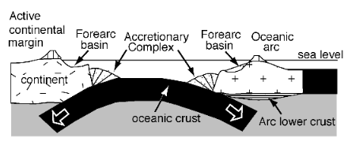
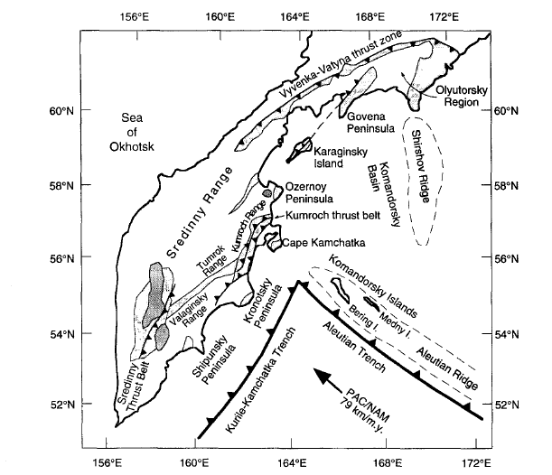
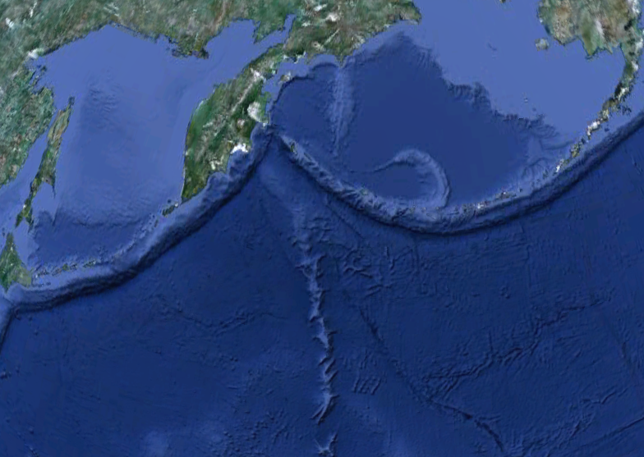
Western Aleutians / Kamchatka
High-angle forward-facing collision of forearc with active continental margin: arc can “splinter” against continent
Western Aleutian Arc collision at Kamchatka
(Geist et al., 1994; Scholl et al., 2007)
Notes:
The only sort-of example of a modern forward-facing collision of an arc with an active margin is the high-angle collision of the western Aleutians with Kamchatka. It’s almost a special case because it’s so high angle that it’s almost a transform margin at the collision point.

Slide 10
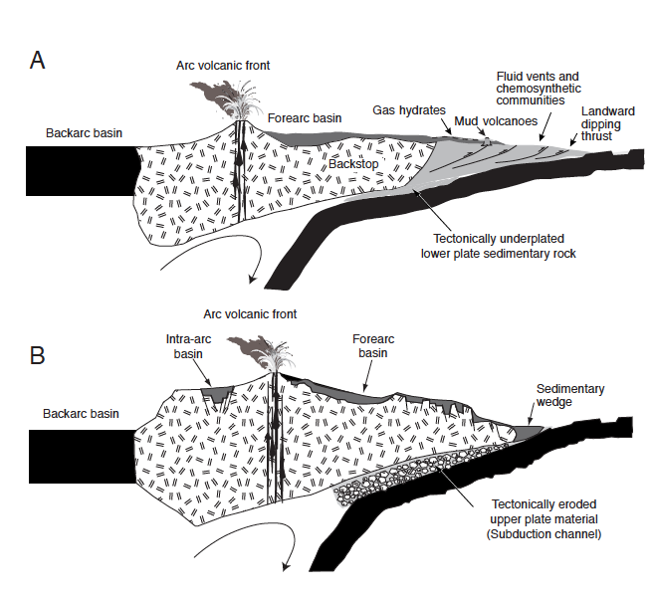
Tectonic erosion ruins great rocks
Tectonic accretion
Tectonic accretion (gain material at trench)
Tectonic erosion (arcward migration of trench, losing material from upper plate)
Tectonic
erosion
Notes:
Tectonic erosion is prevalent at about 2/3 of modern island arcs, as we know from papers by Scholl, von Huene, Peter Clift and others. Any material lost off the arc and upper plate in tectonic erosion is material that won’t be preserved in the arc terrane when it eventually becomes part of a continent, unless you manage to reattach it by underplating. But where tectonic accretion occurs, and you gain material either by underplating or frontal accretion, you are adding material that is more likely to be preserved after collision. So places undergoing tectonic accretion are conducive to preserving evidence of anything that happened during that margin’s activity.

Slide 11
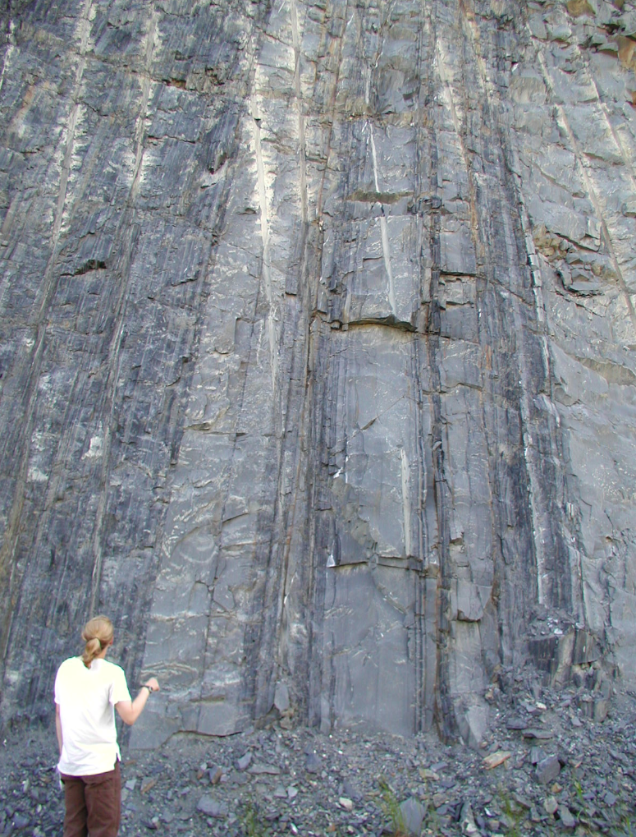
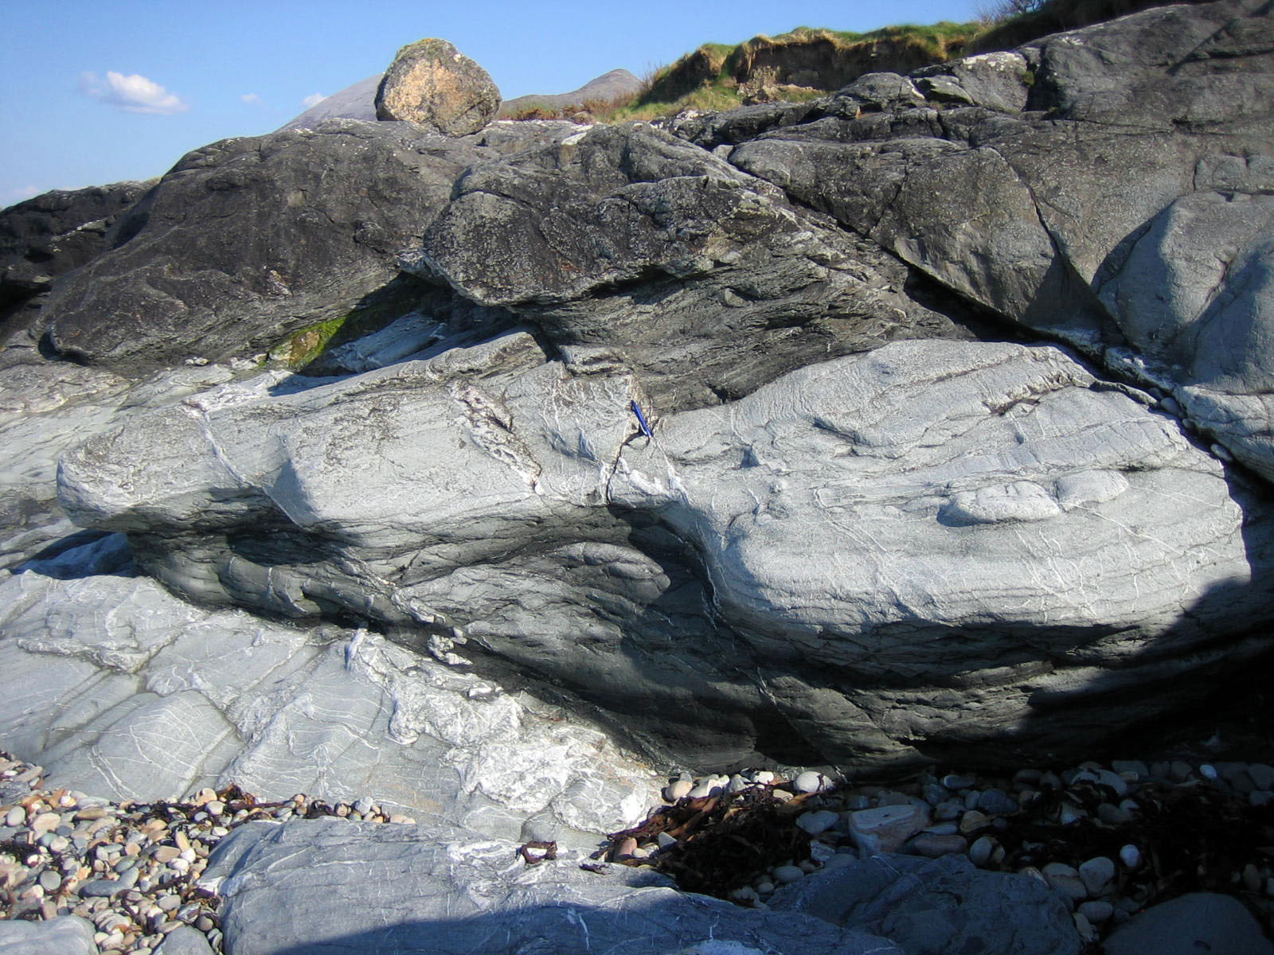
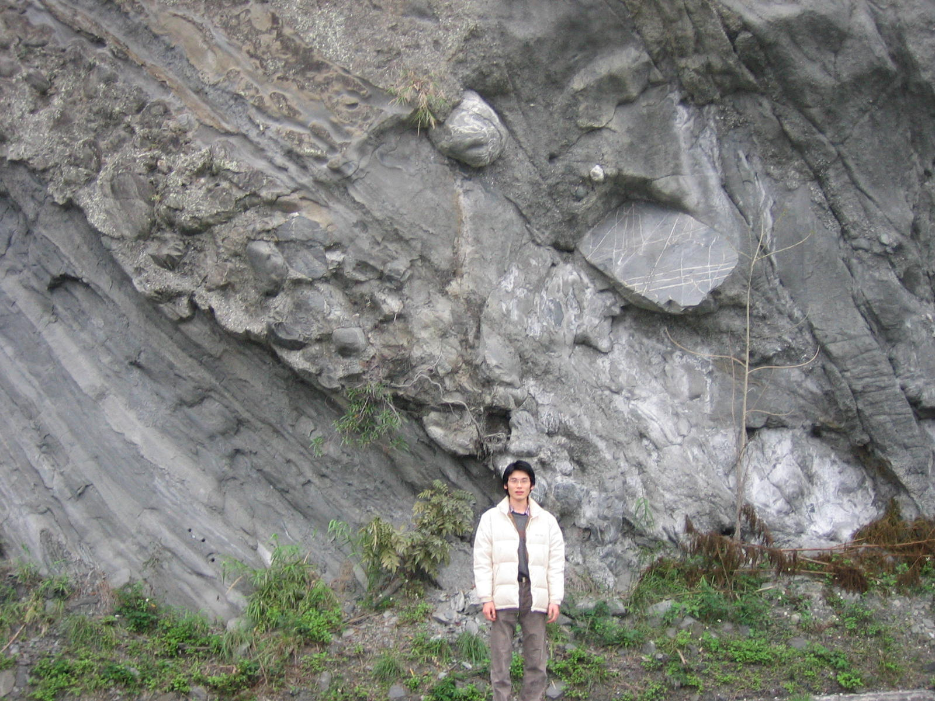
Accreted arc volume likely biased toward late-stage activity
Tectonic accretion prevails as arc nears continent, sediment flux to trench increases just before collision
Syn-collisional sediment deposits can be thick
Westport accretionary complex
(Ordovician), Ireland
McHugh Complex,
Cretaceous, Alaska
Syn-collisional Paliwan conglomerate, Taiwan
Notes:
Tectonic accretion is more likely to occur near the end of an arc’s activity, as it approaches collision; there’s likely to be more material going down the trench as you get close to a continent, and that can generate an accretionary complex. This can mean when you look at ancient arc terranes and see an accretionary prism, they are likely to be from late-stage activity or from during collision and mountain-building, not so much from the oceanic phase of arc activity before it got close to the continent. So we believe there’s a temporal bias in what gets preserved in an accreted arc terrane.

Slide 12
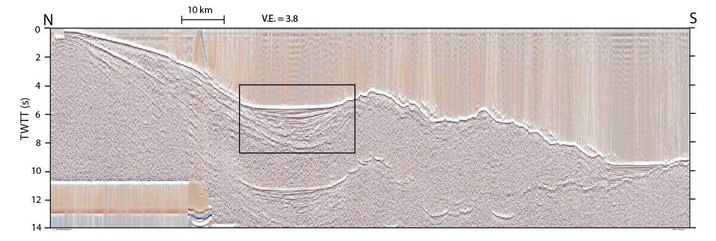
Collision preserves, alters, or destroys different regions of an arc
Forearc region has 4 possible fates after collision:
  Intact survival and continued sedimentation
  Burial beneath accretionary prism
  Being uplifted, inverted, eroded
  Being destroyed by subduction
Central Aleutian forearc basin, outer-arc high, and trench
Notes:
Let’s look briefly at what can happen to different parts of an arc as it collides with a continent.
The forearc is, in active arcs, often where the best deposition and accumulation occur; they’re not always basins, they can be forearc platforms, like Tonga and the Marianas have, but if there are basin deposits you can have a great record of arc activity if they’re preserved. It is possible for these basins to survive collision and even to continue accumulating sediment [Urals, Aktau Fm of Brown et al., 2006; South Mayo Trough]. Alternatively, the forearc can be overthrust by the accretionary prism.
Basins can also be uplifted and inverted during collision, which either destroys their deposits or at least greatly complicates their interpretation. Examples occur in Papua New Guinea, Indonesia (South Savu Basin) and East Timor, where (especially East Timor) there’s impressive uplift (>3000 m) and deformation. Even if they’re not too badly deformed, uplifting and inverting a forearc basin destroys its accommodation space so it doesn’t record what happens during collision.
And then last, basins can be partly or completely destroyed by going down the trench as collision proceeds. This appears to have happened as the Izu-Bonin arc collides with Honshu (Otsuki, 1990) and at Kamchatka (not clear how much goes down to great depth, probably not much – underplates?)

Slide 13
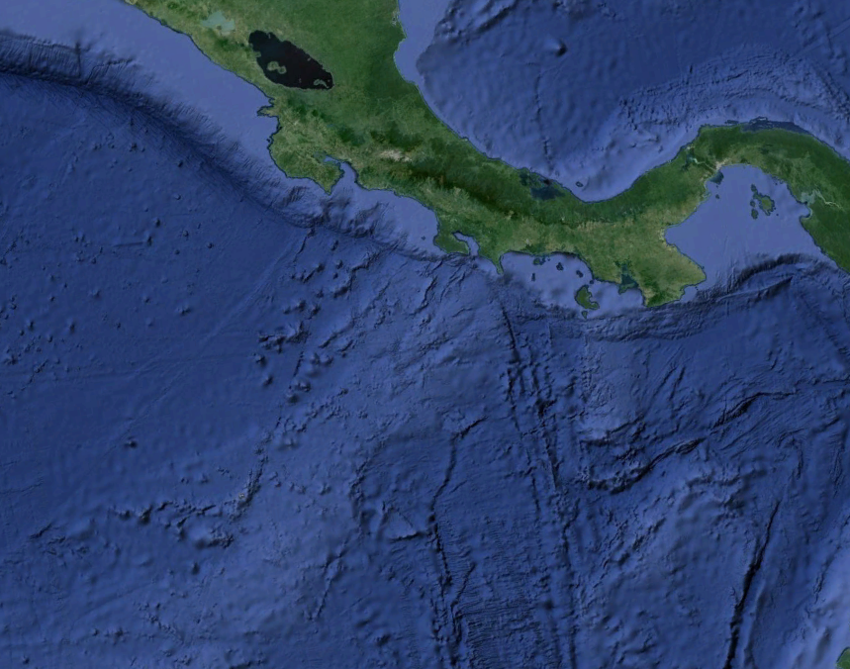
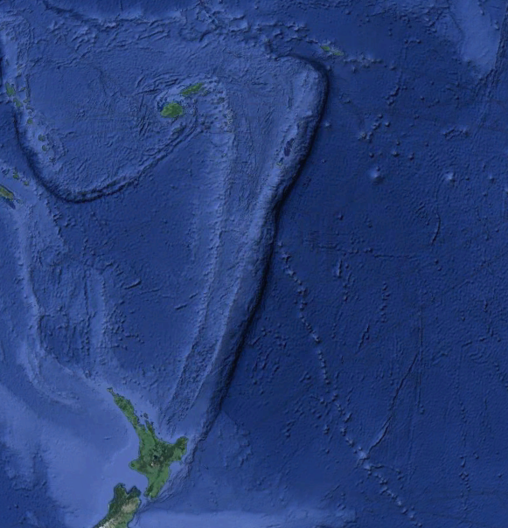
Arcs accommodating subduction of bathymetric highs: is evidence preserved?
Forearc region can be strongly affected
(McCann & Habermann 1989; Rosenbaum & Mo, 2011; Trehu et al., 2012)
Size, depth of subducting feature
Upper-plate strength
Amount of sediment present
Convergence velocity
Cocos Ridge
Can cause:
  Uplift then subsidence, tilting
  Forearc mass wasting
  More tectonic erosion
  Gap in arc volcanism
Louisville seamounts
Notes:
What happens to the forearc is especially interesting if we’re considering how a congested margin might behave, and whether the geologic record can preserve evidence of that congestion. When you subduct a bathymetric high, how much it damages the upper plate depends on a number of things [first set of bullets], but it can cause [2nd set bullets: uplift then subsidence, +/- tilting; mass wasting, increased tectonic erosion, gap or hiatus in arc magmatism].

Slide 14
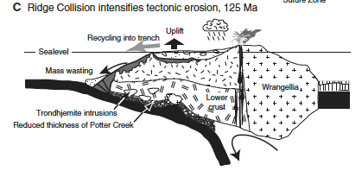
Detecting ancient subduction of bathymetric highs
Forearc region has 4 possible fates after collision:
  Intact survival and continued sedimentation
  Burial beneath accretionary prism
  Being uplifted, inverted, eroded
  Being destroyed by subduction
Best chance for preserving sedimentary record of bathymetric-high subduction!
e.g., Cretaceous Alaska;
Pavlis and Roeske, 2007;
Amato & Pavlis, 2010;
Amato et al., 2013
Amato et al., 2013
Notes:
Any of those effects can be hard to unequivocally attribute to trench congestion in the ancient record, especially if the thing that subducted is not preserved. But if preservation of the forearc and accretionary wedge are good enough, it’s possible. Your best bet for that is when the forearc region and accretionary wedge are not too badly damaged during collision. For example in the Chugach Terrane, near here, where Jeff Amato and his colleagues inferred bathymetric-high subduction (of a ridge) under the Cretaceous Alaskan margin based on forearc and accretionary complex records of uplift and depositional hiatus as the ridge went down. There are also examples of bathymetric-high subduction inferred in forward-facing collision zones, including in the Appalachians (Cees van Staal’s work).

Slide 15
Collision preserves, alters, or destroys different regions of an arc
Intra-arc basins, arc massif altered, metamorphosed
(e.g., Kamchatka; Hourigan et al., 2009)
Difficult to preserve backarc basin
  Might expect to find repetition of similar-age rocks (Calvert, 2011), but no.
  Chilas Complex, Kohistan, and Alisitos Arc, Baja
Forward-facing collision
Backward-facing collision
Notes:
Intra-arc basins and the arc massif, the backbone of the arc, have higher starting topography than either the forearc or backarc, and so are more likely to end up as part of the accreted terrane rather than being subducted. However, they can be badly deformed.
It’s difficult to preserve a backarc basin after a collision of any geometry. If the arc collides with a passive margin and convergence then continues, a new subduction zone will start up dipping the other way which means a new slab breaks through what was the backarc. In collision of an arc with an active margin, because the arc backed into the continent, the backarc basin would mostly be destroyed even before collision occurs. But there are a few examples of apparent backarcs in accreted terranes, including the Chilas Complex of the Kohistan arc, a small area in the Talkeetnas, and Cathy Busby’s examples from Baja California.

Slide 16
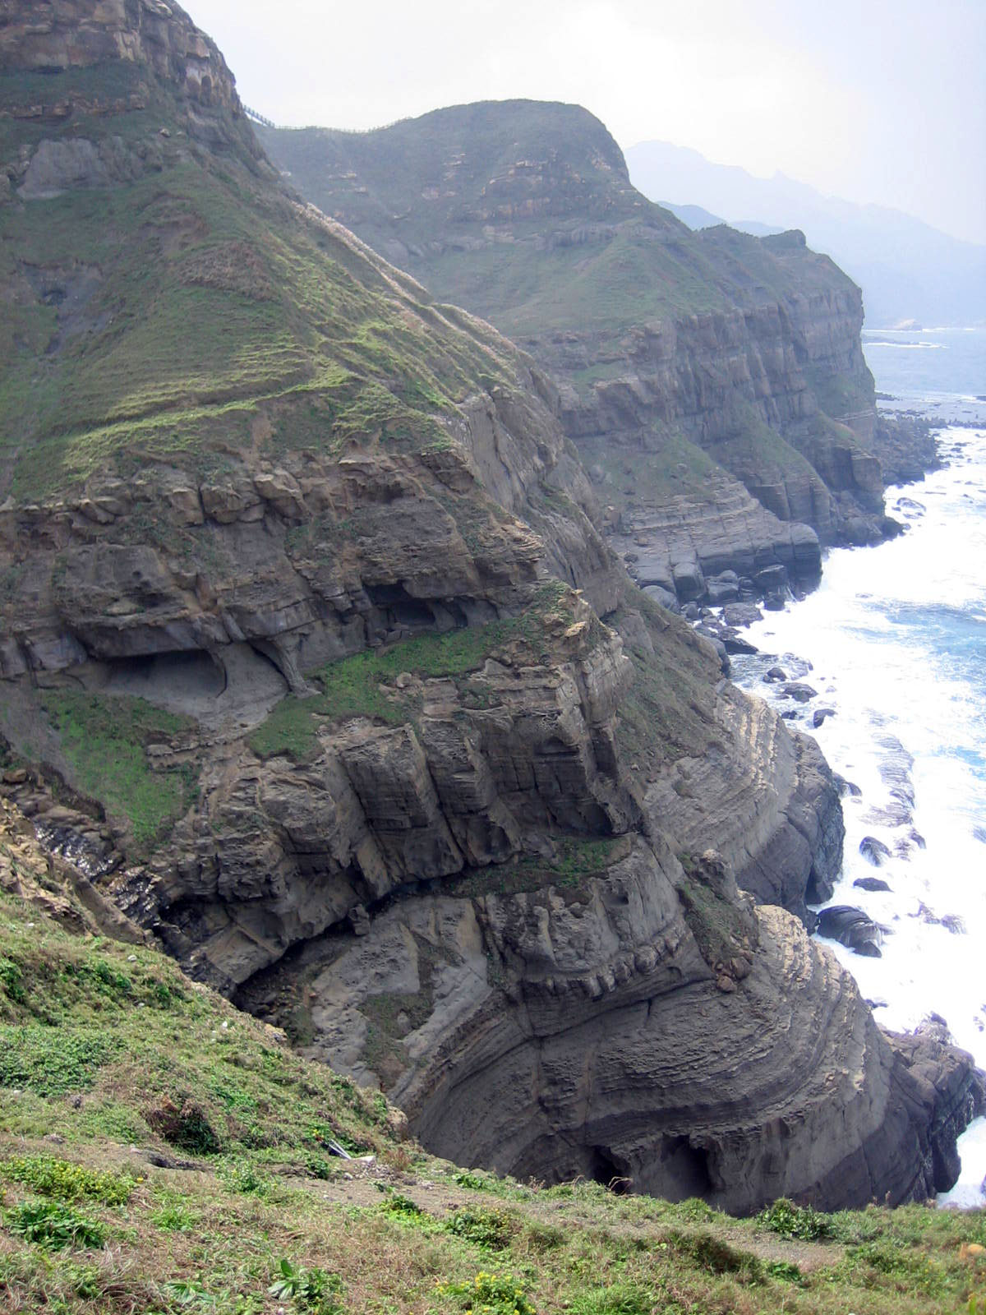
So… alteration of arcs by collision means what ultimately accretes onto (and forms) continents can be very different from active oceanic arcs
Pitou Point, Taiwan
Notes:
So, arc terranes can be substantially altered by collision and accretion, and what we go and walk around on on land long after the collision may not be much like the oceanic arc was while it was active. However, there are useful things to be learned from accreted arc terranes…

Slide 17
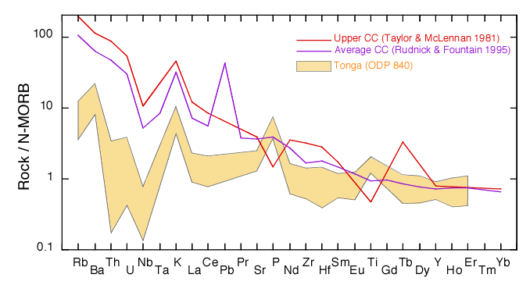
Formation of continental crust at arcs?
Oceanic arc volcanism has high field strength element (HFSE) depletion, similar to continental crust
But most mantle-derived melts too mafic, too depleted in light rare earth elements (LREE) to match bulk continental composition
Does arc-continent collision solve geochemical ‘problem’?
Continental crust vs. arc crust from Tonga (ODP 840)
Notes:
Want to close by briefly mentioning what we can learn from arcs about post-Archean continental crust production. Plot is arc chemistry compared to that of continental crust. Arcs and continental crust share some distinct trace element characteristics. But, most mantle-derived melts are basaltic, including at arcs, as far as we know. Bulk continental crust is andesitic to dacitic, and quite enriched in LREEs. So, how did continental crust form, and how were arcs or accreted arcs involved?
Kohistan arc crust contains tonalite, granite, and diorite in addition to its mafic/ amphibolite stuff, but even the evolved magmas have LREE-depleted trace element chemistry (Fig. 3 of Bosch et al., 2011).
Talkeetna REE plots are basically flat.

Slide 18
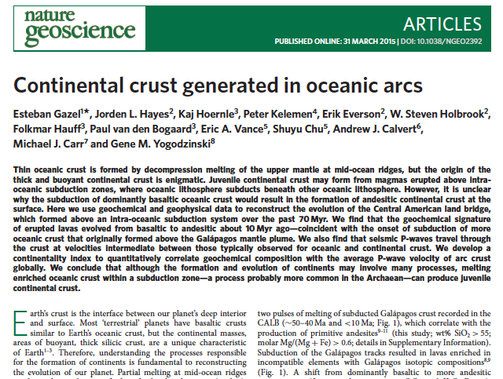
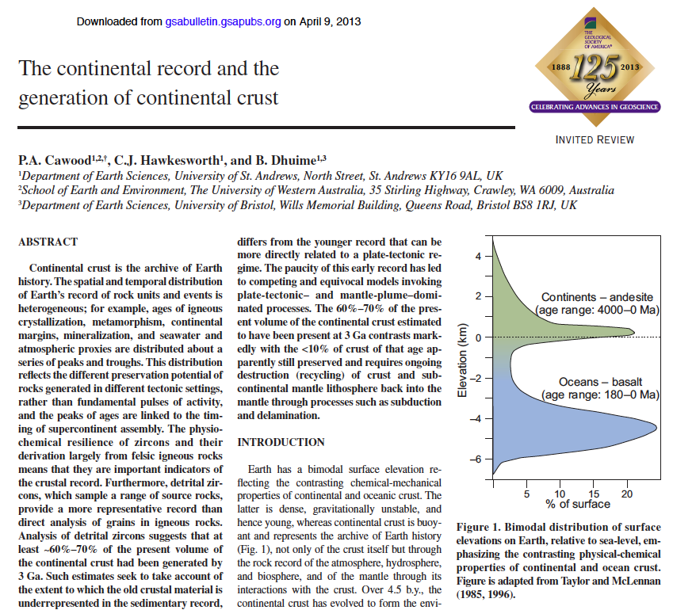
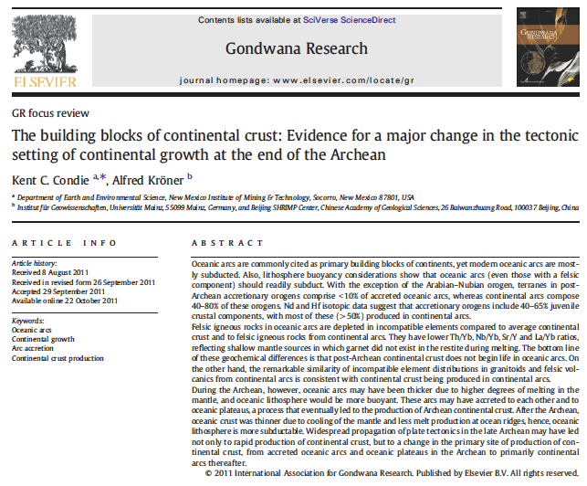
Possibilities for forming continental crust at arcs?
Arc/passive-margin collision (forward-facing) produces enriched melts (see Draut and Clift work), dense lower crust lost
Oceanic arcs eventually produce evolved melts even w/o collision – Central America land bridge (Gazel et al., 2015)
Continues to be topic of interest for accreted-arc studies
Notes:
Arcs tell us about a few ways continental crust may form. One is that as an arc collides with a passive margin (NOT apparently with an active margin, but a passive margin), highly evolved melts can fractionate and become part of the accreted terrane, helping drive the bulk terrane composition toward continental. Another idea, in Gazel et al.’s Nature paper last month, is that some arcs do evolve enough during their life to produce continental-type crust eventually, especially if the slab contains some enriched hot-spot crust, but most arcs haven’t done this, and IF they have, it’s hard for us to tell because we don’t know that much about the middle and lower crust of active arcs (the 2014 drilling of the IBM arc will probably help in this respect). Gazel developed a “continentality index” to gage how far each oceanic arc now has gotten down that road toward producing continental melts.
This continues to be a topic of great interest - how do arcs make different kinds of melts, and what role does arc accretion play in making continental crust.

Slide 19
Summary: preservation and loss of material from arc terranes
Collision geometry and preservation problems greatly affect accreted arc terranes
Geologic record biased toward tectonically accreting arcs, including late-stage of arc activity, when tectonic accretion likely > tectonic erosion
Best chance to study congested-margin evolution = best-preserved forearc basins
Arc accretion plays some role in forming continental crust, especially forward-facing collision
Notes:
To conclude, collision geometry and preservation problems greatly affect what is preserved in ancient arc terranes. Accreted terranes are likely biased toward tectonically accreting arcs, including late stages of activity as the arc neared a continent. The best chance of inferring the behavior of congested margins would be in accreted terranes with good forearc preservation; unfortunately that doesn’t always happen. And, collisional magmatism can produce continental-type melts, notably when an arc collides with a passive margin.

Slide 20
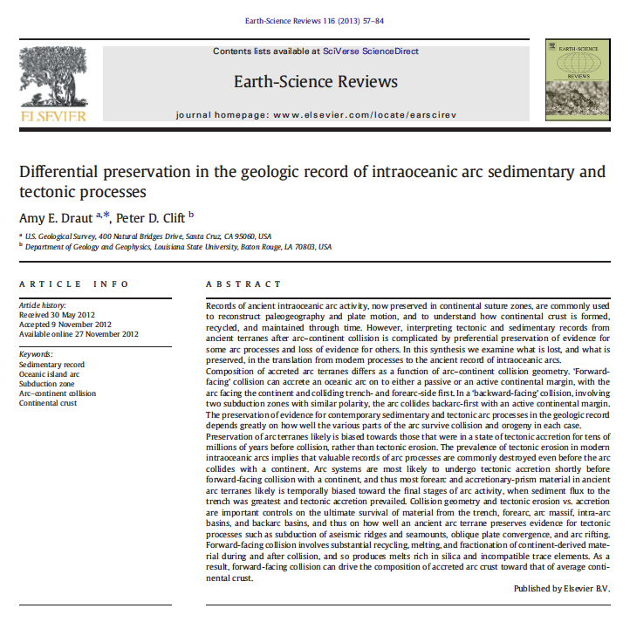
Questions?
2013 paper in Earth-Science Reviews, v. 116, 57-84

Slide 21
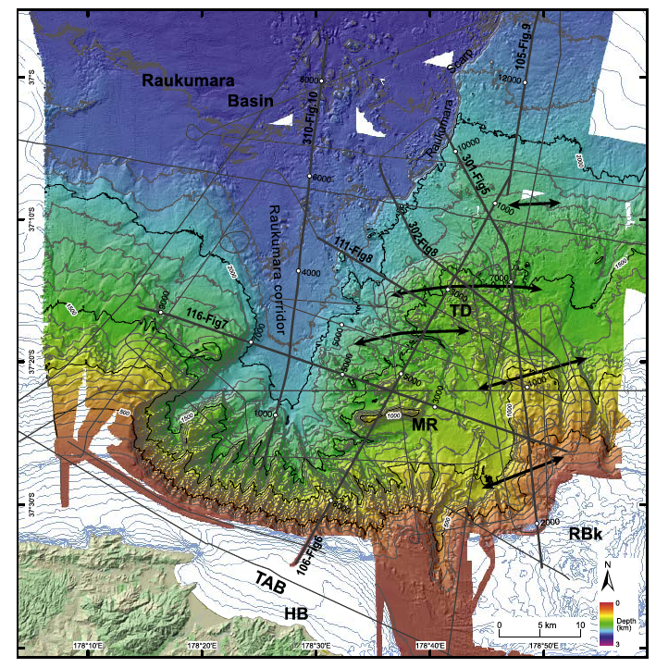
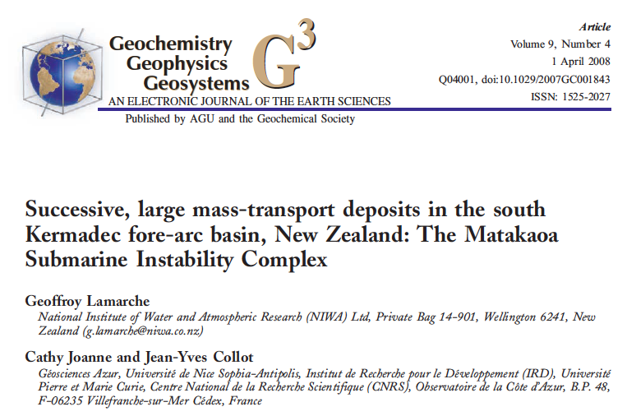
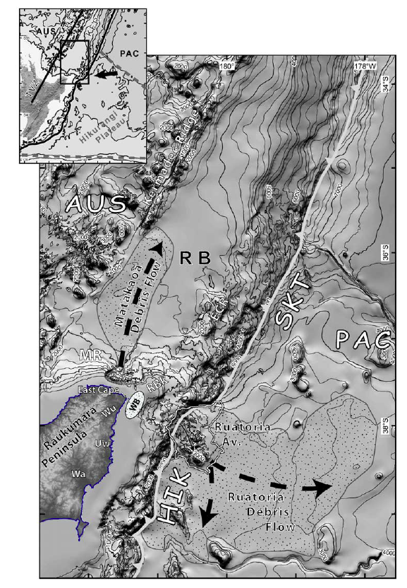
Can paleotectonic hazards be inferred from ancient, accreted arc terranes?
We know some big mass-transport deposits (MTDs) show up in forearc regions of modern, active arcs
Four >100 km³ MTDs in forearc basin offshore New Zealand

Slide 22
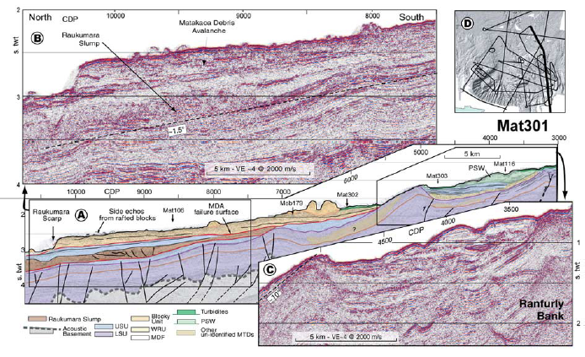
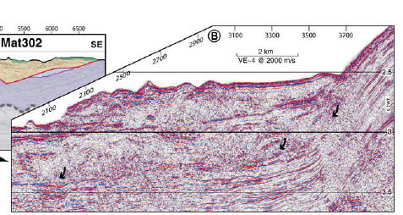
Can paleotectonic hazards be inferred from ancient, accreted arc terranes?
We know some big mass-transport deposits (MTDs) show up in forearc regions of modern, active arcs
Four >100 km³ MTDs in forearc basin offshore New Zealand (Lamarche et al., 2008)

Slide 23
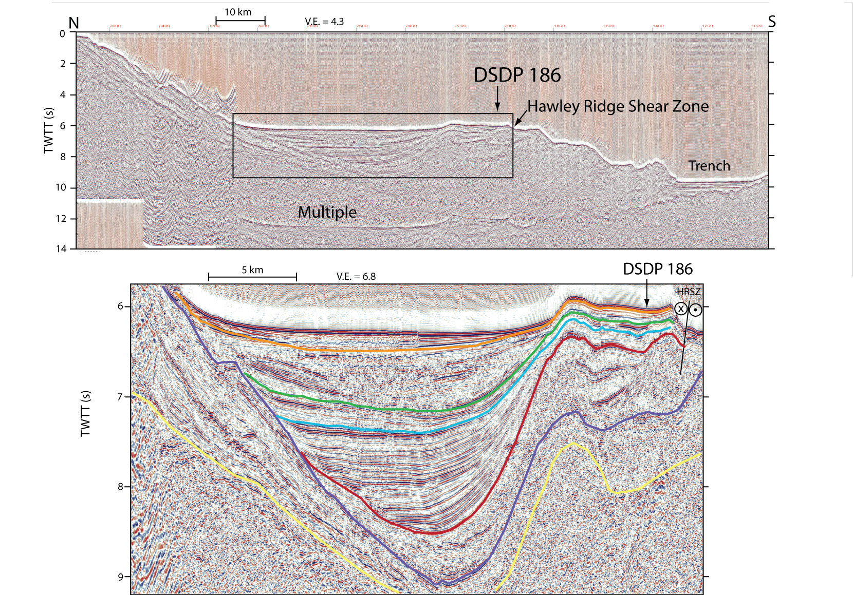
A >900 km³ MTD in forearc basin of central Aleutians (Ryan et al., 2012)

