Slide 1
Whiterockian (Middle Ordovician) Graptolites of the Lower Member of the Vinini Formation, Roberts Mountains,
Eureka County, Nevada
Erin Schuster
CSU Long Beach

Slide 2
Geologic Setting
Vinini Formation separated informally into Lower and Upper Members
Lower Member occurs in three locations
East and West side of Roberts Mountains
Isolated outcrop to North
Consists of:
Lower 140 m siliceous shale unit
Upper 1832 m sandstone unit
Nearly equal proportions of sandstone, siltstone, and shale
Shale sparse, 2-10 cm intervals

Slide 3
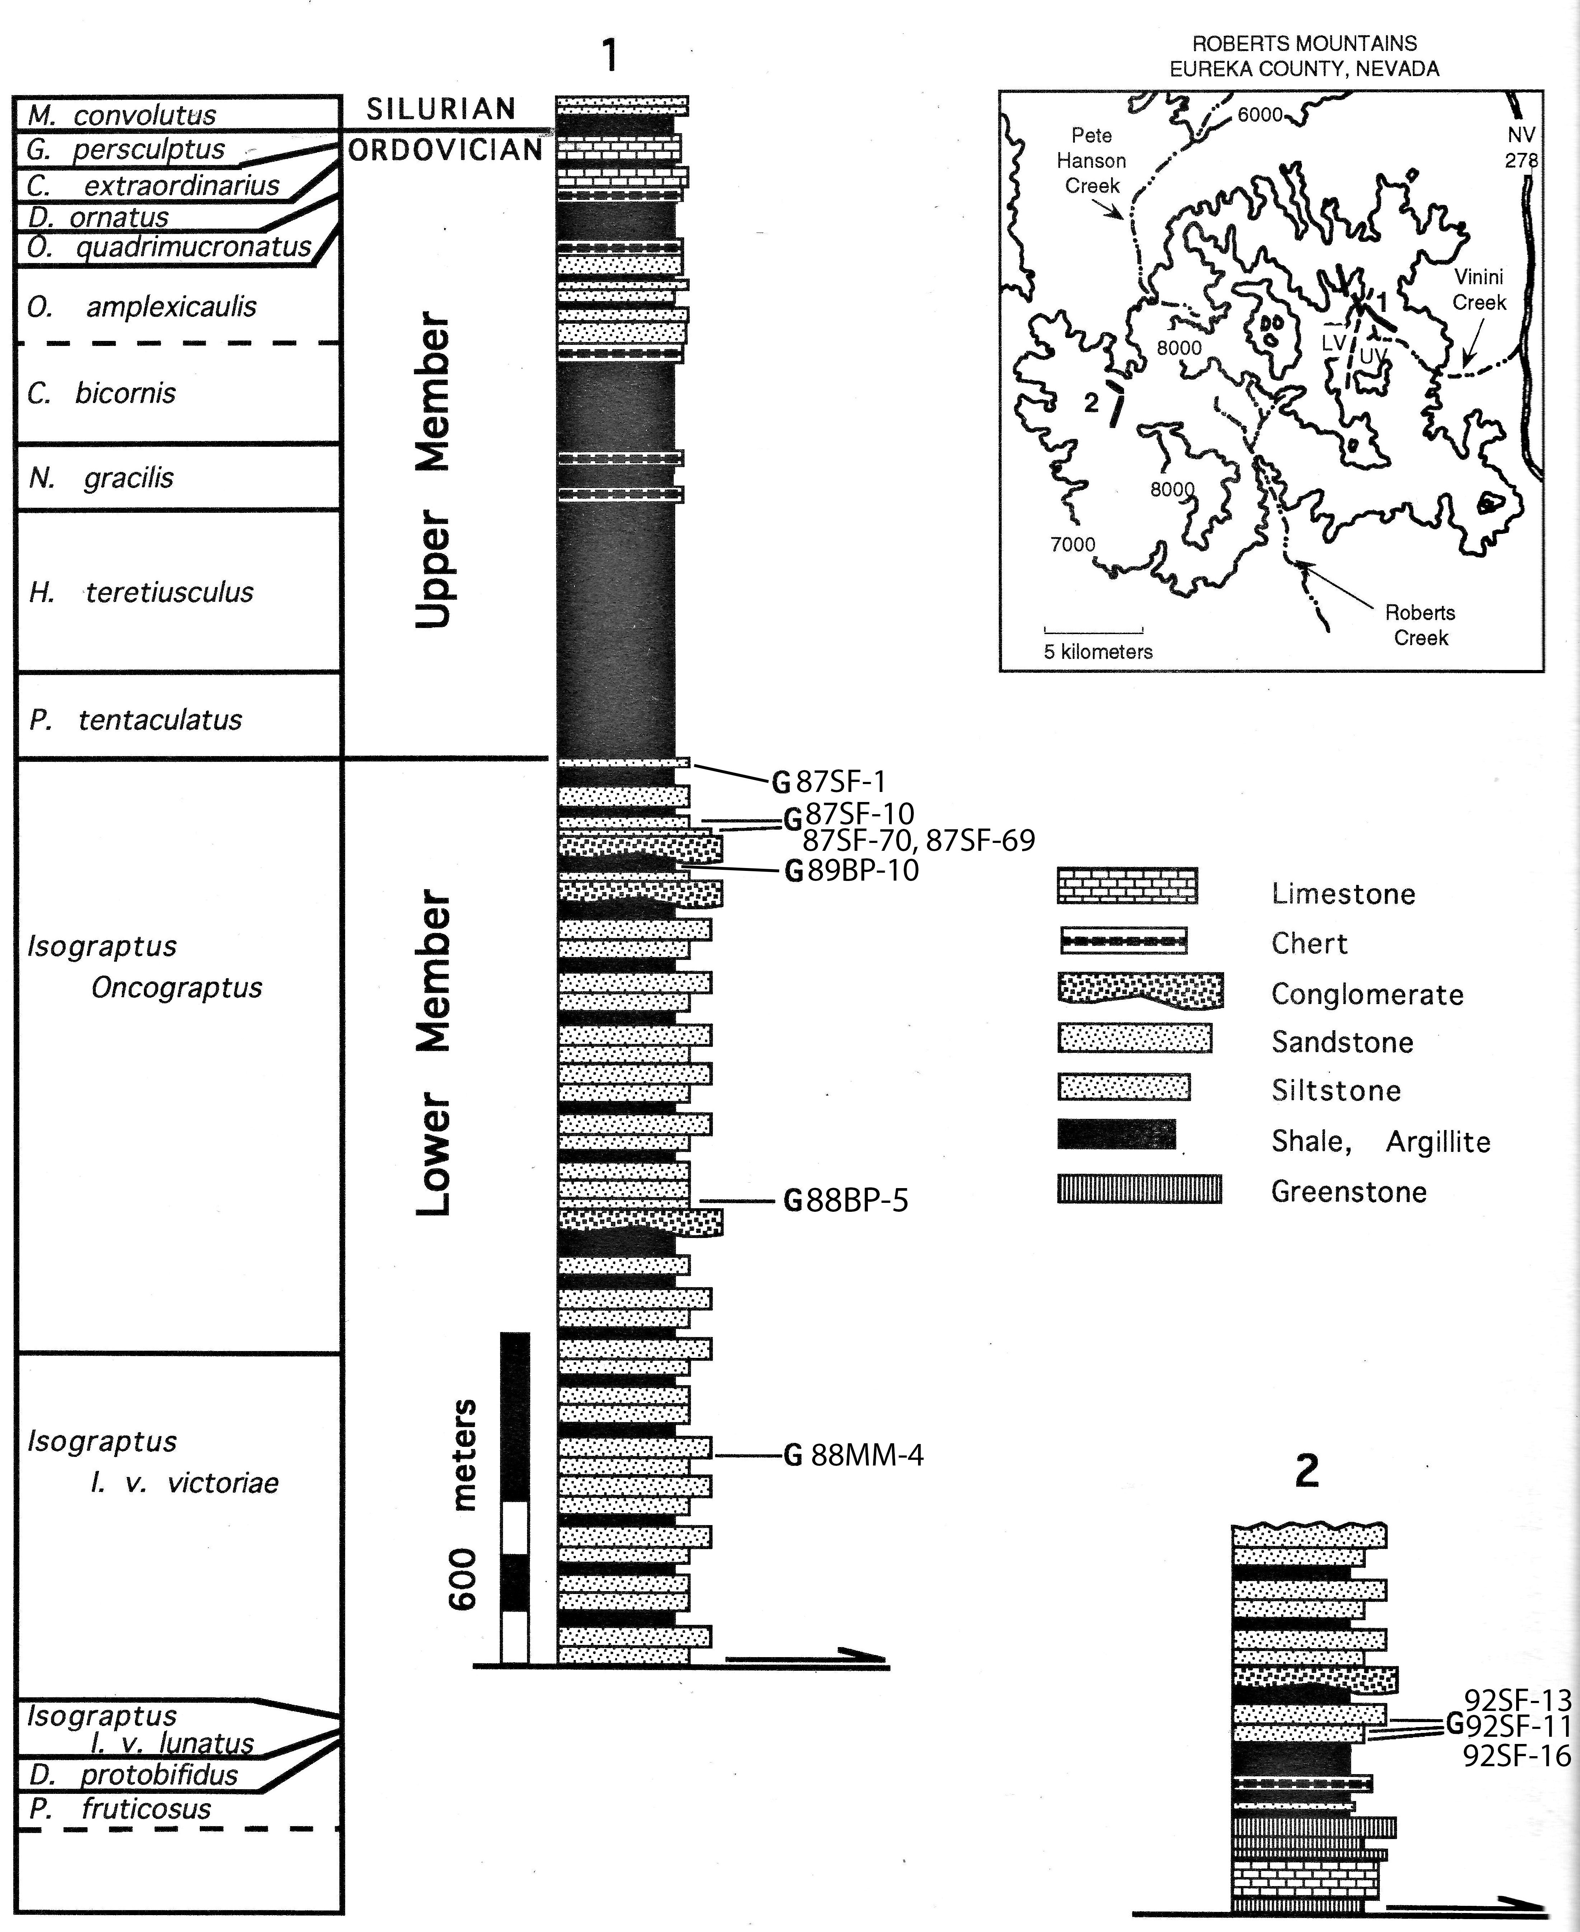
East (column 1) longest exposure
Bounded by thrust fault
Characteristic alternation of sandstone and siltstone
West (column 2)
Bounded by thrust fault
Overlain by channel of greenstone in sandstone
Flows, flow breccias and volcaniclastics
10 m deep by 20 m wide
Sandstone occurs as three roughly fining upward sequences with irregular bottoms
North
Collection 87SF-1 corresponds with 87SF-70

Slide 4
Sandstone beds episodic
Characteristic of partial to complete Bouma turbidites
Coarsen and thicken up section, interbedded with pelagic shale
Evidence of sea fan progradation
Above 900 m
Bed thickness decreases and traced laterally
Sandstone beds no longer pinch out

Slide 5
Upper most 75 m grades into Upper Member
Highest sandstone bed 100 m below top of Lower Member
Sandstone beds decrease in thickness and abundance
Siltstone and shale become dominate lithology
Base of Upper Member placed at top of highest siltstone bed
1832 m in measured section

Slide 6
Nature of the Collection
Graptolites collected in both sandstone and shale
Majority of specimens collected in sandstone
4 of 33 species collected in shale
Didymograptus extensus, Xiphograptus svalbardensis, Pseudisograptus gracilis, and Isograptus victoriae sp.
D. extensus and I. victoriae sp. only species occurring soley in shale

Slide 7
Specimens preserved in turbidites
Experienced transport before deposition
Dendroid specimens preserved only as fragments
Planktic species less fragmented
Due to:
Shorter distance of transport, or
More robust specimens

Slide 8
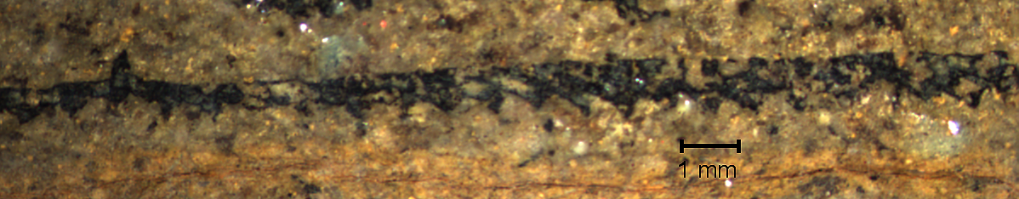
Xiphograptus svaldbardensis
Specimens occur in both sandstone and shale
Sandstone specimens have stipe lengths of 6.49-55.25 mm
Shale specimens have stipe lengths of 1.73-5.63 mm
Other species from the shale do not show this trend or do not occur in sandstone

Slide 9
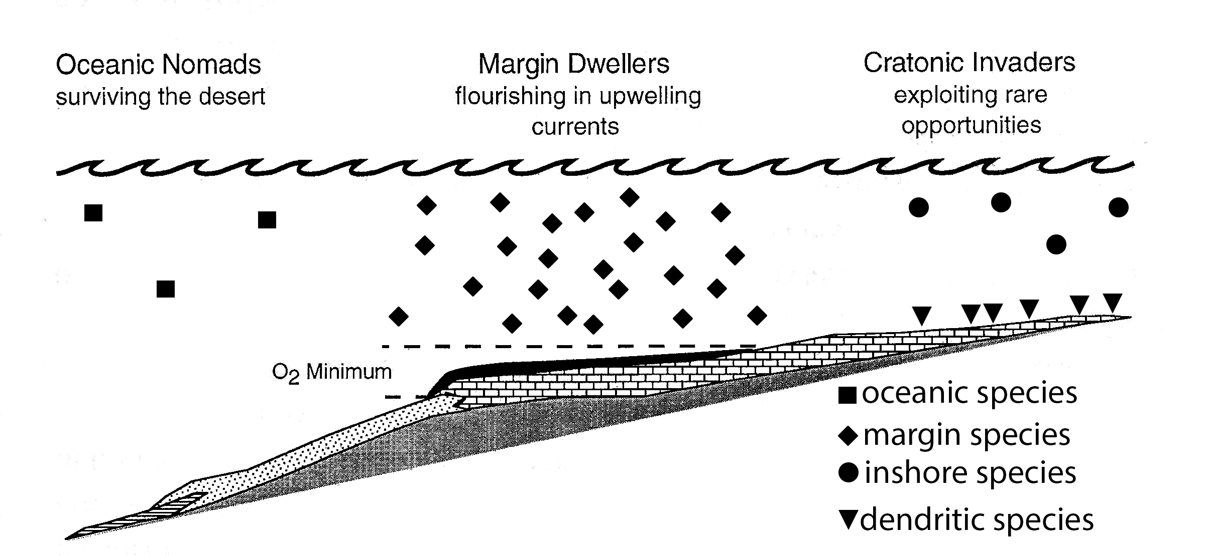
Model of Paleoecology
Mix of species
Restricted to shallow seas
Sessile, benthic dendroids
Few planktic graptoliods
Oceanic graptoloids
Isograptids
Concentrated in upwelling environments
Postmortem transport in turbidity currents

Slide 10
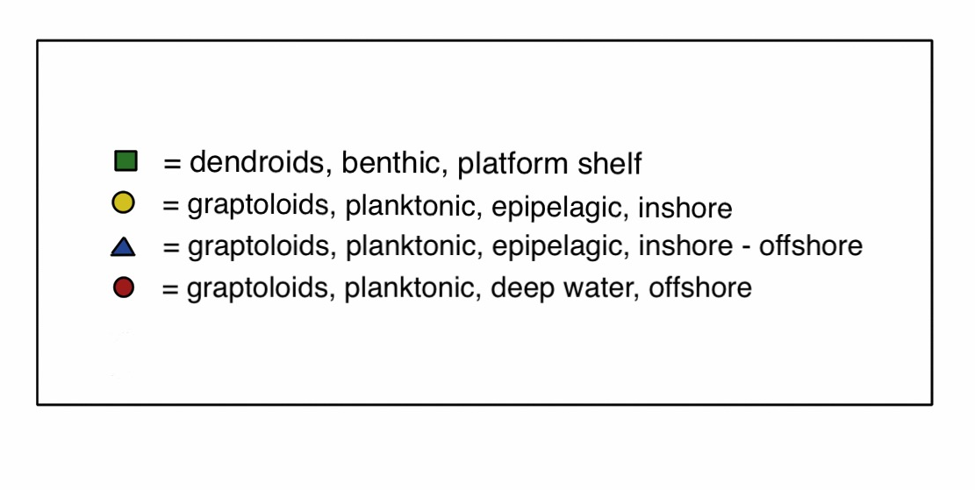
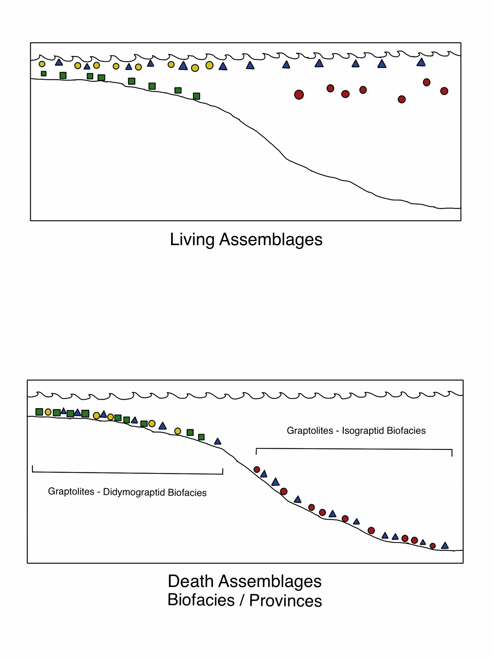

Slide 12
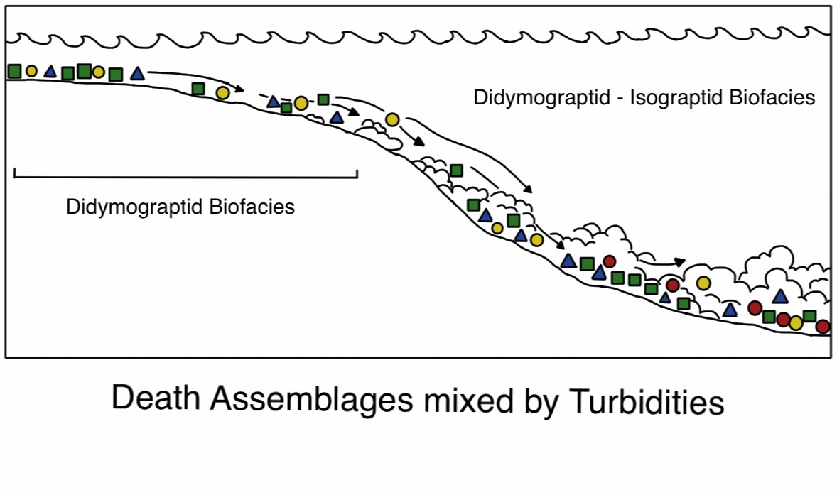

Slide 13
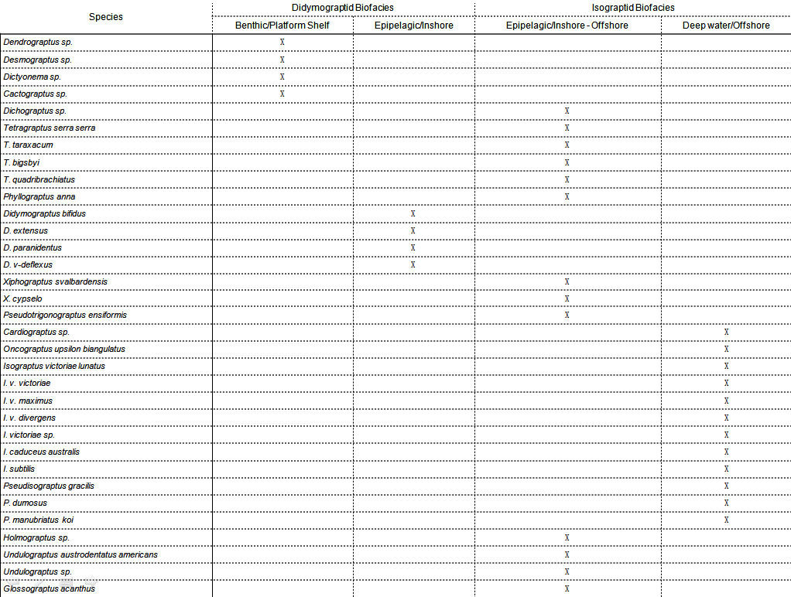

Slide 14
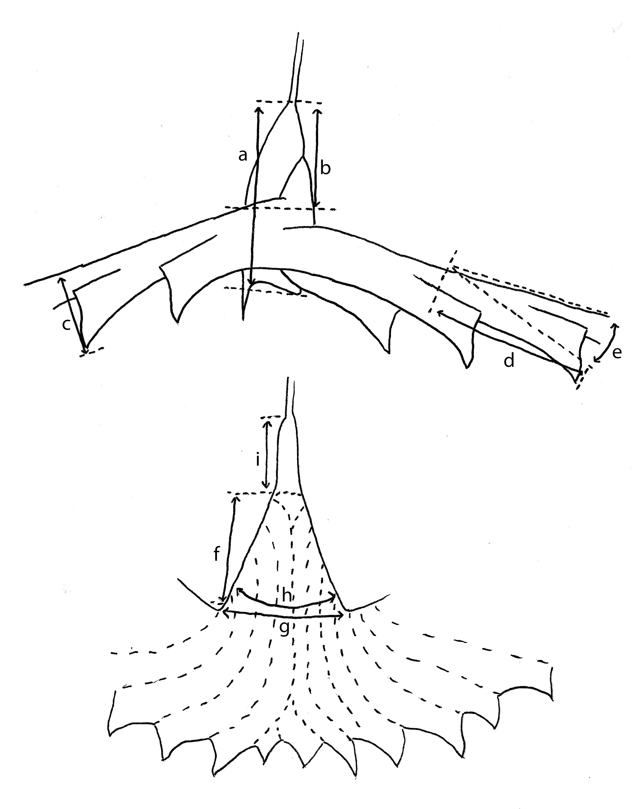
Morphometrics
a: Sicular length
b: Supradorsal sicular length
c: Stipe width
d: Thecal length
e: Thecal inclination
a
b
c
e
d

Slide 15
Morphometrics: Pseudisograptids
f: Manubrium length
g: Manubrium width
h: Manubrium angle
i: Free sicular length
i
f
h
g

Slide 16
Systematic Paleontology
33 taxa from 17 genera described
Species compared to other described specimens
Some Nevada species displayed smaller measurements
Due to preservational differences
Effected stipe and rhabdosome width most
No other effect on morphometrics

Slide 17
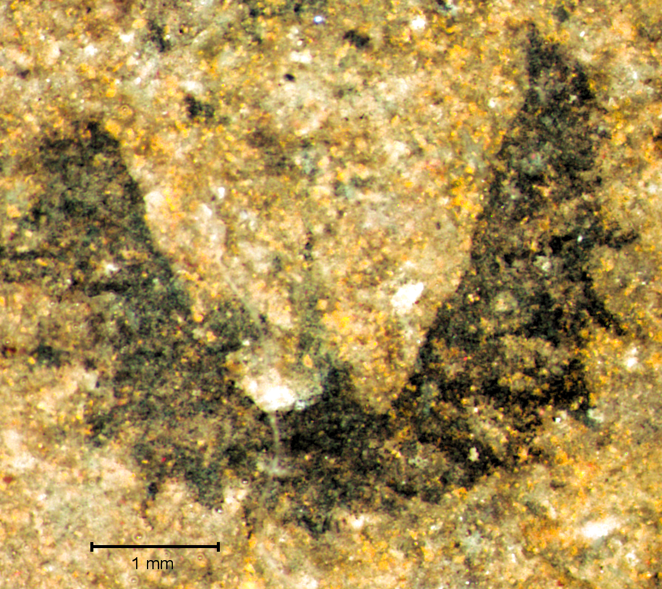
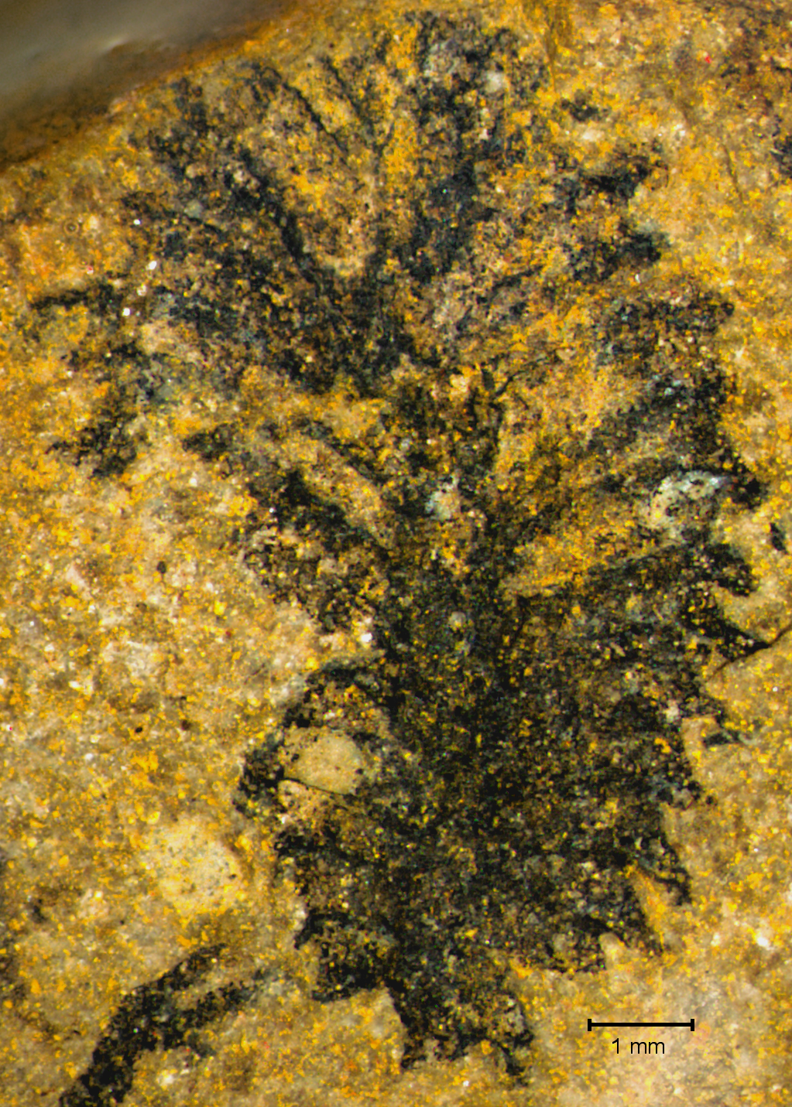
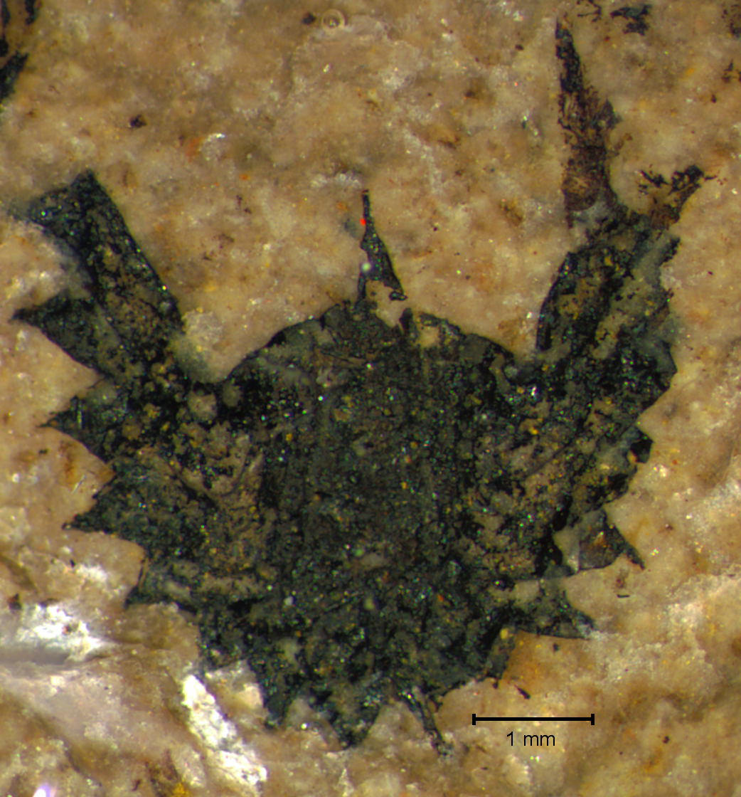
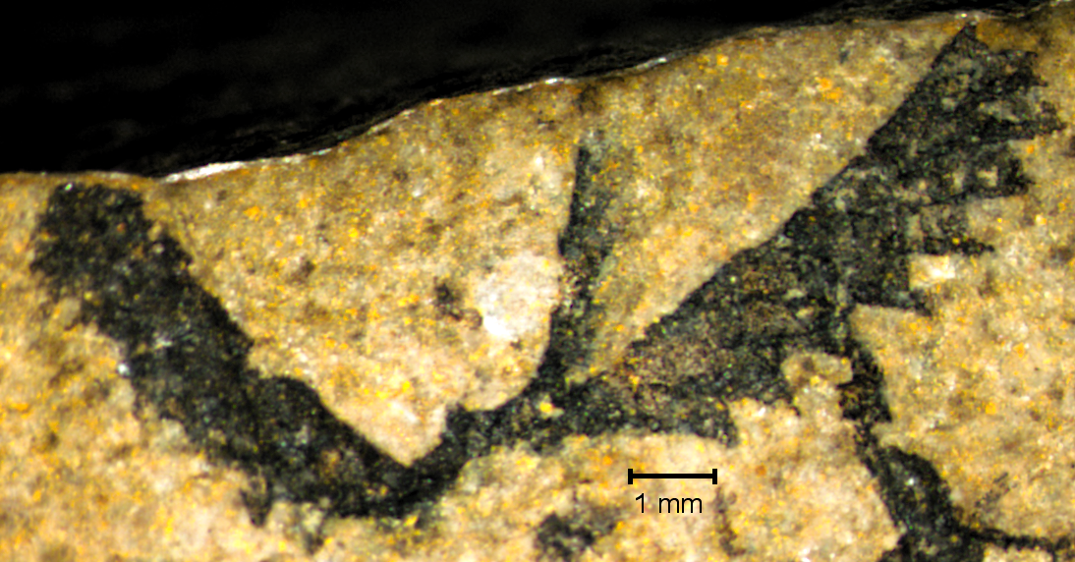
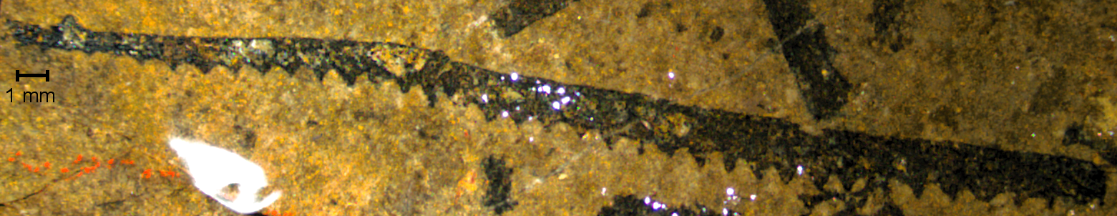
Isograptus victoriae lunatus
Pseudisograptus dumosus
Phyllograptus anna
Xiphograptus cypselo
Tetragraptus serra serra
Notes:
Exceptions: Isograptus victoriae lunatus - overall smaller: sicular length 2.09mm (2.5mm), stipe length 2.55mm (8mm), stipe width increasing from .91mm to 1.05mm (increasing from 1.3mm to 1.4mm)
Phyllograptus anna - Overall smaller: length 5.6mm (8mm), width 4.03mm (5mm)
Pseudisograptus dumosus - form A, but smaller supradorsal sicular length, manubrium length, and stipe width
Tetragraptus serra serra - shorter funicle 1.13mm (2.4-3.0mm Williams and Stevens)
Xiphograptus cypselo - larger than described: stipe width 1.09 to 1.46 in 10 mm (.7 to 1mm in 6mm), max 2.21mm (2.0mm)

