Slide 1
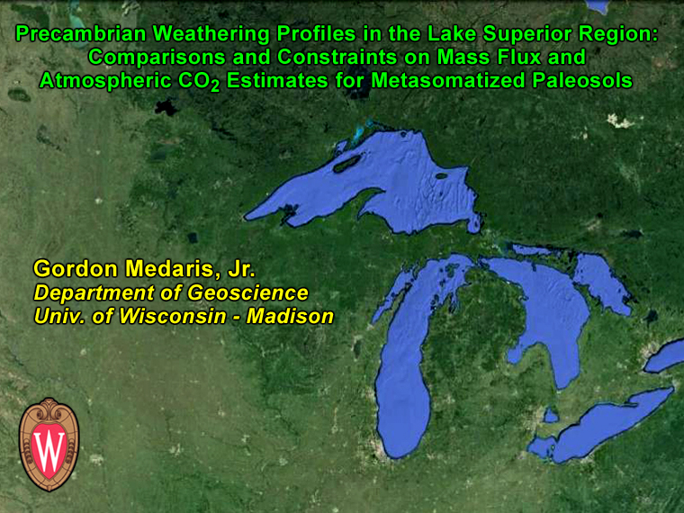

Slide 2
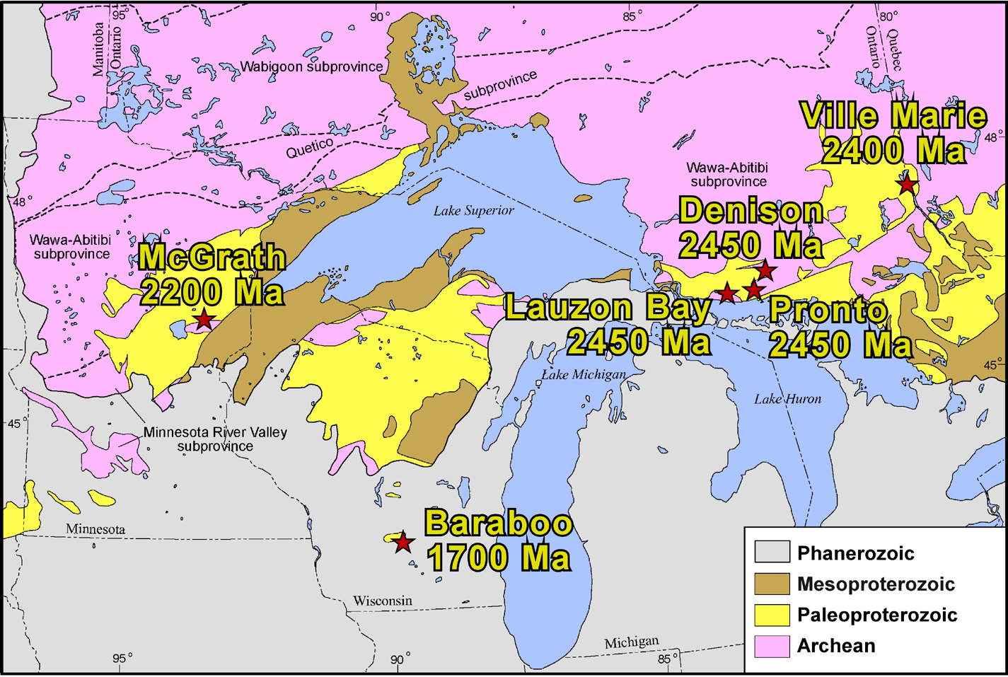
Localities and Ages of Paleoproterozoic Granitic Paleosols
In the Lake Superior Region
(map courtesy of Mark Jirsa)

Slide 3
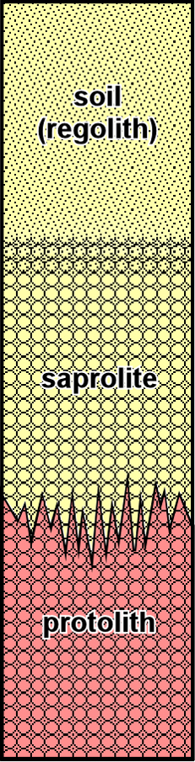
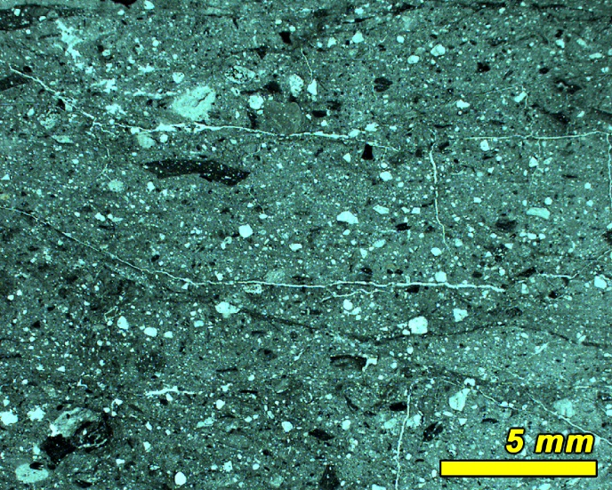
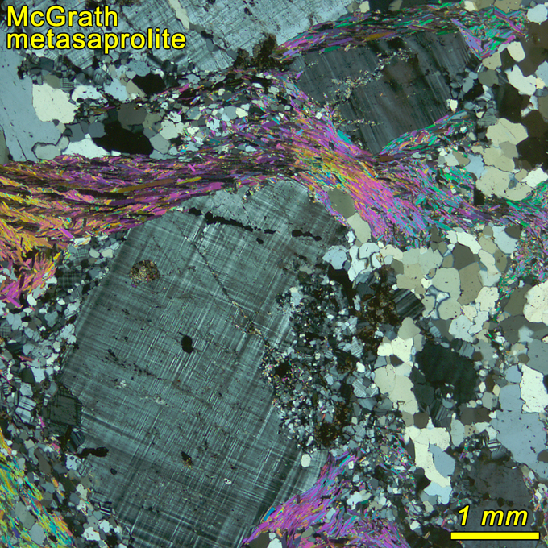
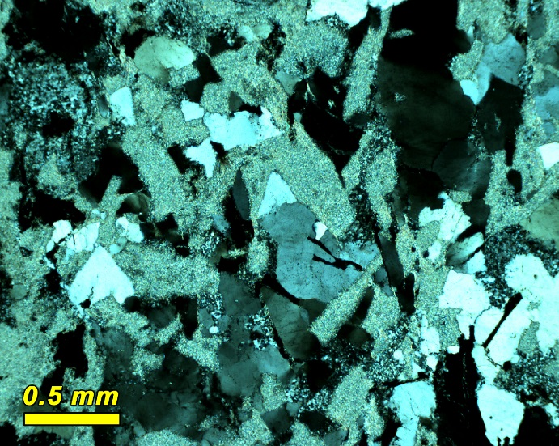
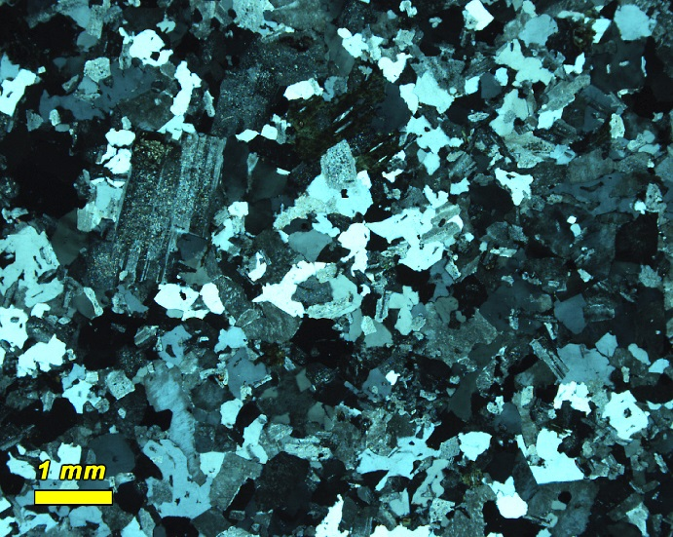
Schematic Paleoweathering Profile
regolith
saprolite
protolith

Slide 4
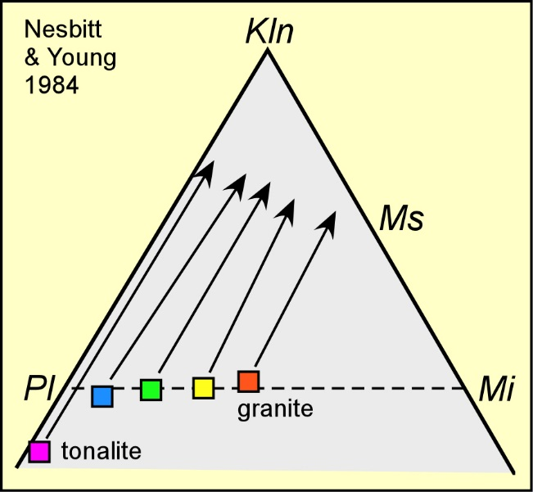
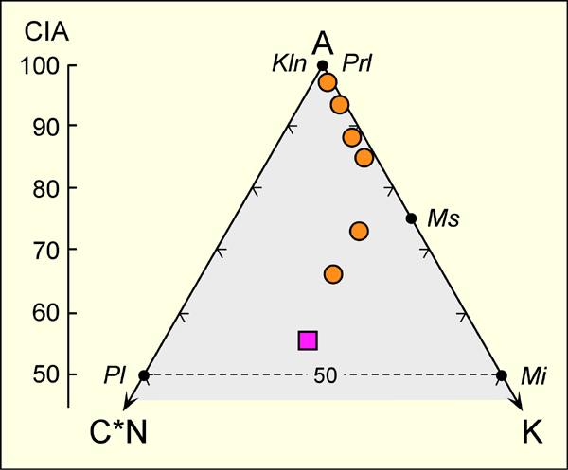
The A-C*N-K Plot (molar)
modern
tropical
weathering
profile
protolith
Chemical Index of Alteration (CIA)
CIA = 100 × molar Al₂O₃/(Al₂O₃+CaO*+Na₂O+K₂O)

Slide 5
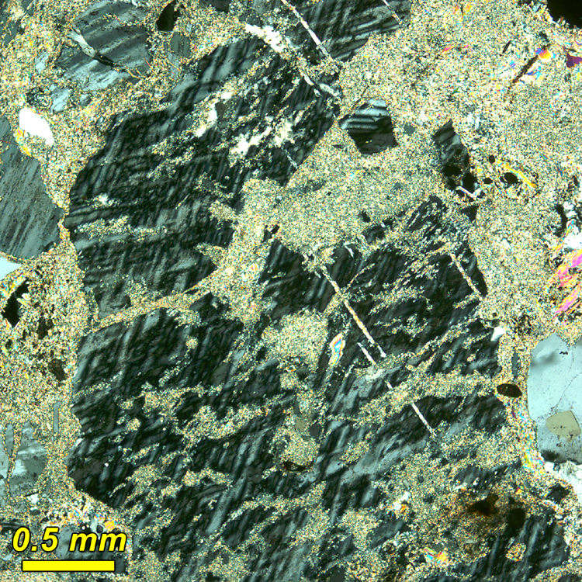
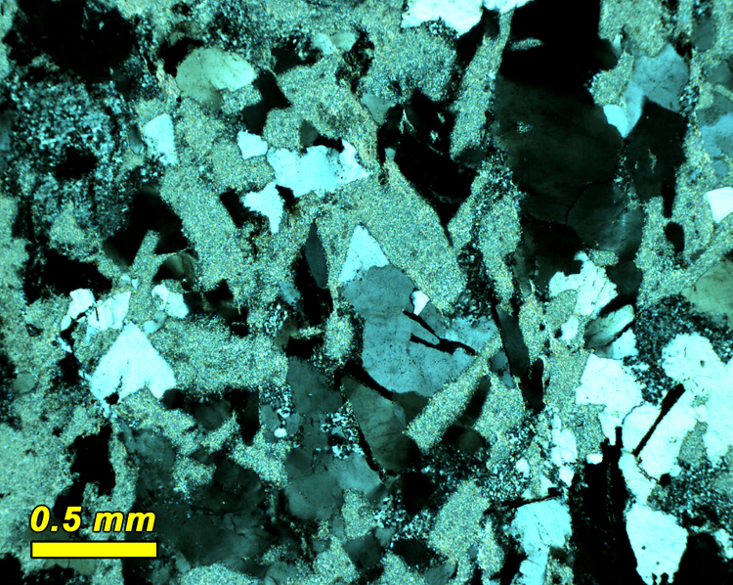
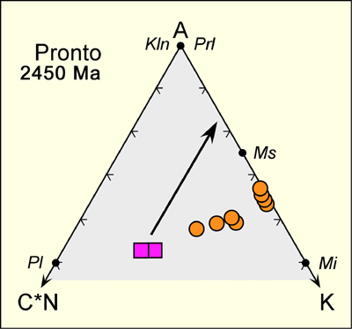
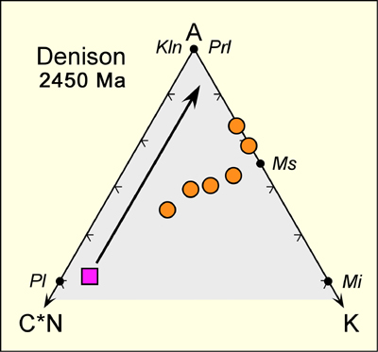
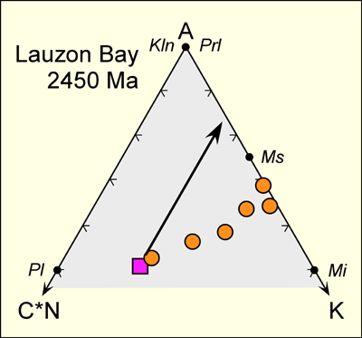
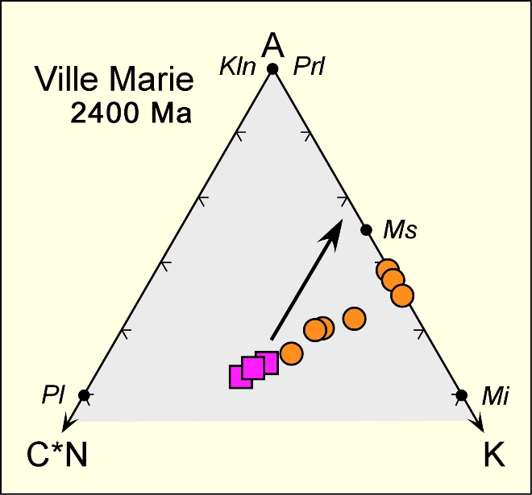
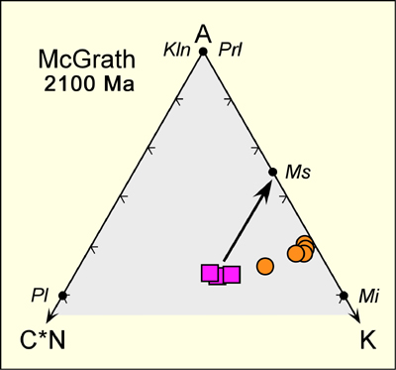
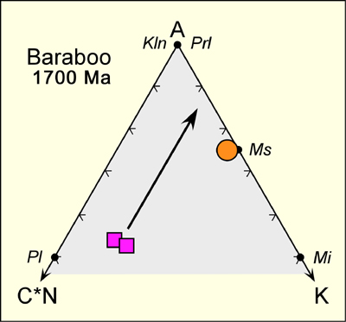
A-C*N-K Plots for Six Precambrian Paleosols
all saprolites are displaced from the weathering vectors
Potassium Metasomatism !!
1740 Ma
1460 Ma
(11)
l saprolite n protolith

Slide 6
Compositional Changes in Saprolite Relative to Protolith
% change in saprolite = 100 × [(c_{j,s}/c_{j,p})/(c_{i,s}/c_{i,p}) – 1]
where c_{j,s} = concentration of oxide j in saprolite
c_{j,p} = concentration of oxide j in protolith
c_{i,s} = concentration of immobile oxide in saprolite
c_{i,p} = concentration of immobile oxide in protolith
Immobile candidates are Al, Ti, and Zr
Al is chosen because it is a major constituent, and
it has the lowest variation among the three elements
!! A caveat: the protolith must be homogeneous !!

Slide 7
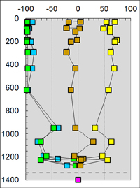
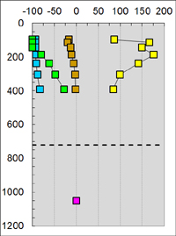
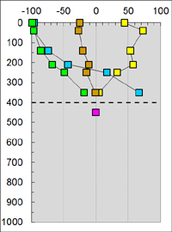
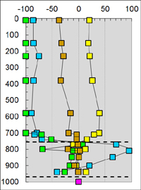
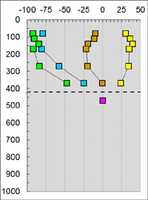
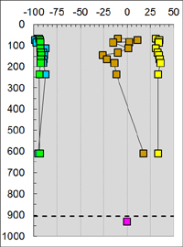
Compositional variation with depth
% change relative to Al₂O₃ in protolith
Pronto
Si n
Ca n
Na n
K n
protolith n
Depth, cm
Denison
Lauzon Bay
Ville
Marie
Depth, cm
McGrath
Baraboo

Slide 8
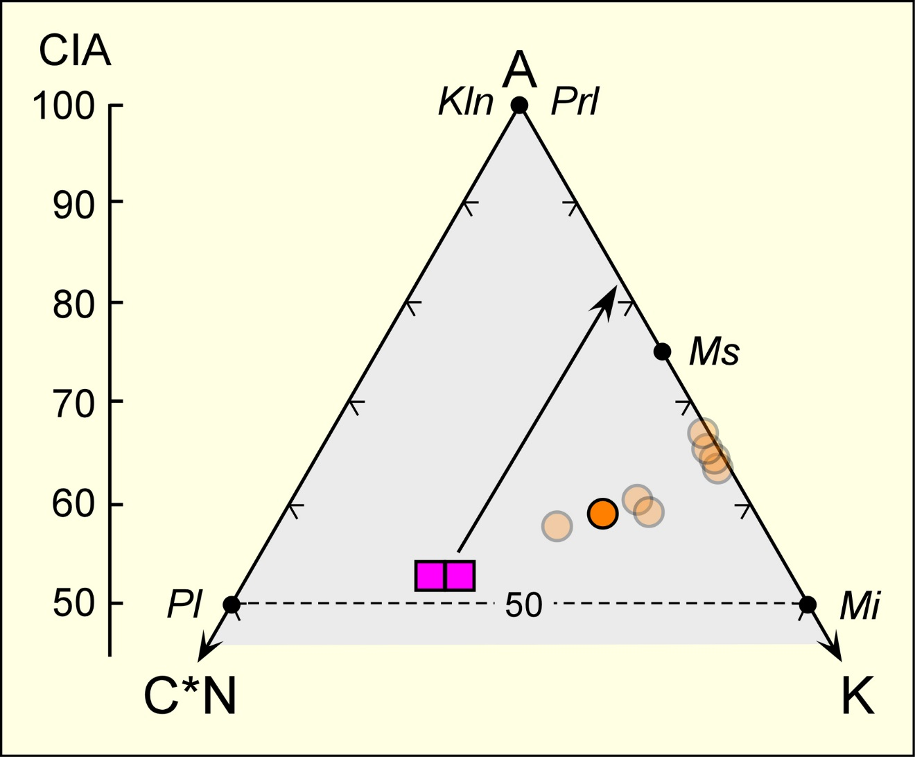
Reconstruction of CIA and K₂O in Metasomatized Samples
Pronto
K₂O:Al₂O₃
22:78
67.5
from
C*N
from
K

Slide 9
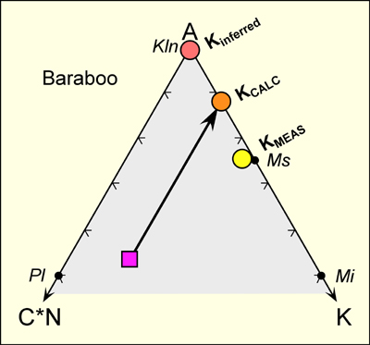
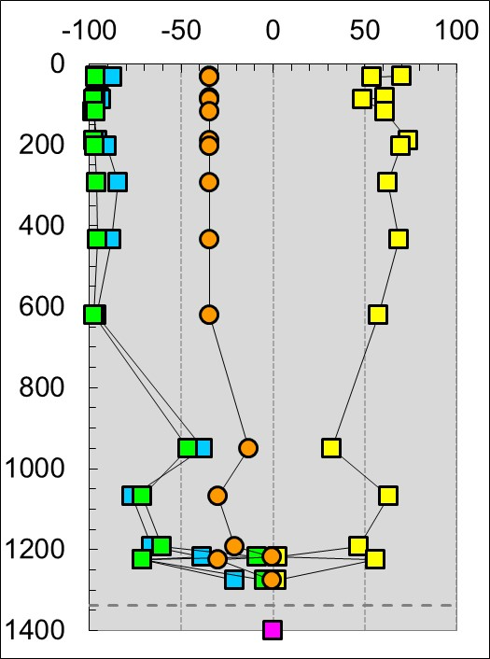
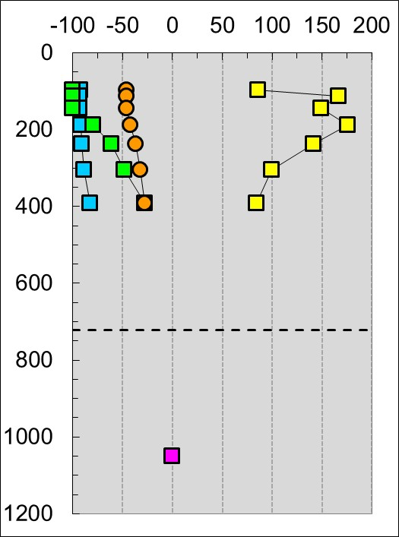
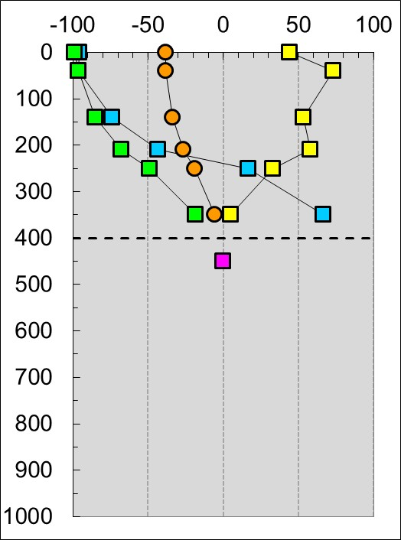
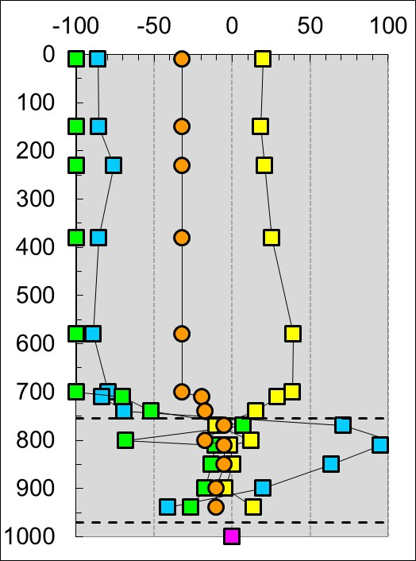
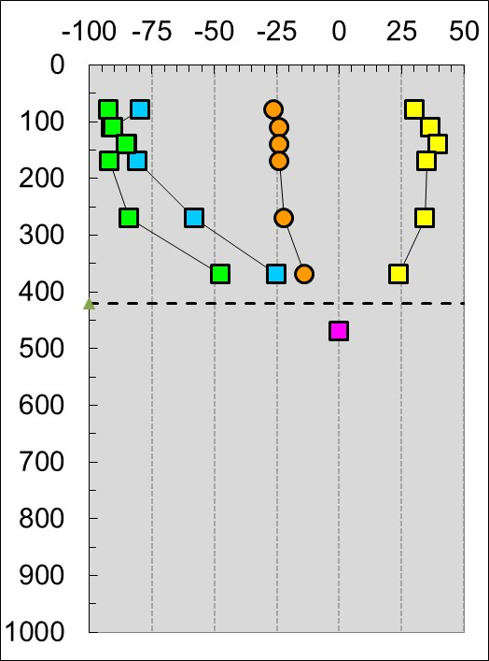
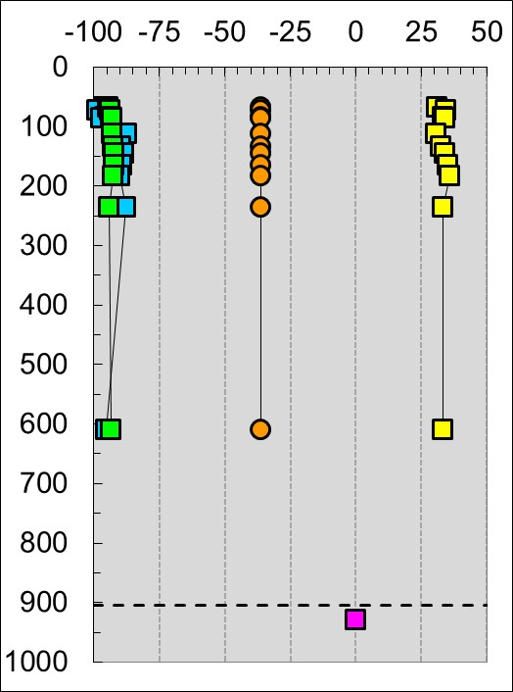
Compositional variation with depth – note K_{MEAS} & K_{CALC}
% change relative to Al₂O₃ in protolith
Pronto
Ca n
Na n
K_{MEAS} n
K_{CALC} l
protolith n
Depth, cm
Denison
Lauzon Bay
Ville
Marie
Depth, cm
McGrath
Baraboo

Slide 10
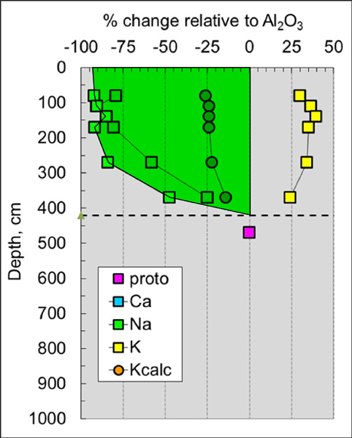
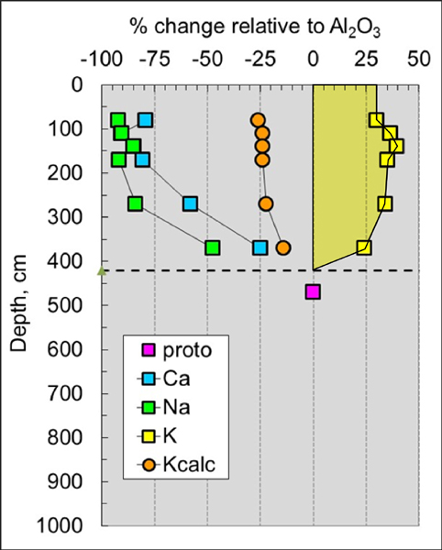
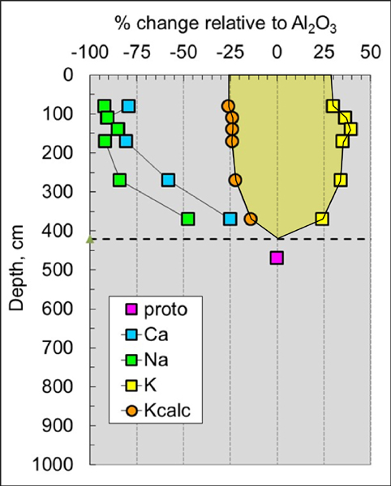
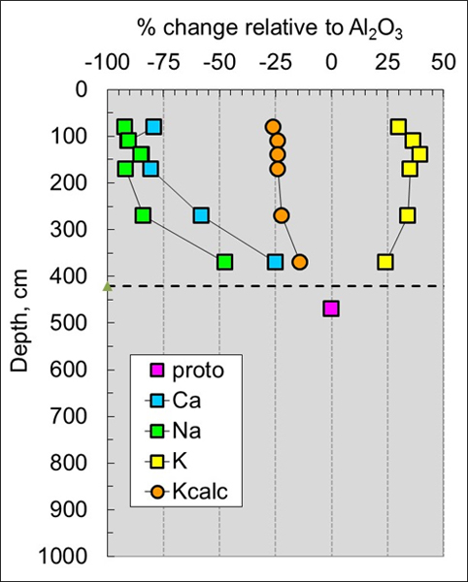
Mass Balance Equation
M_{j} = ρ_{p}c_{j,p} ∫ τ_{j,s}(z) dz
McGrath
where:
M = mass of oxide removed or added
ρ = density of protolith
c = concentration of oxide in protolith
τ = translocation of oxide in saaprolite
z = depth
Ca n
Na n
K_{MEAS} n
K_{CALC} l
protolith n

Slide 11
Depths of Weathering and Mass Fluxes (Removal & Addition)
Magnitude of Weathering = Total Mass Removed

Slide 12
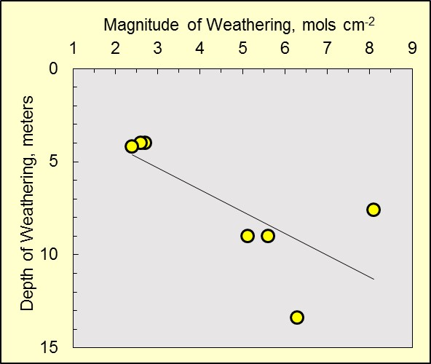
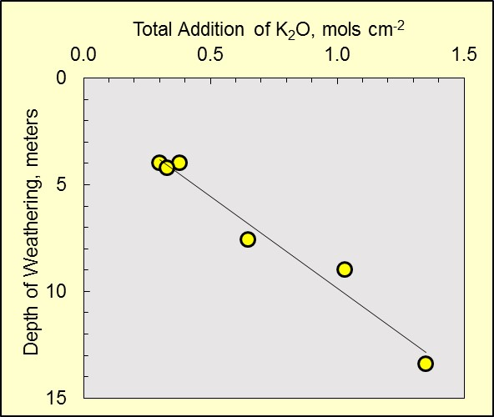
removal of:
SiO₂
CaO
Na₂O
K₂O_{CALC}
Ville
Marie
Baraboo
R² = 0.53
Pronto
MW and depth are a function of:
• rate of weathering
• rate of erosion
• duration of weathering
Ville
Marie
Baraboo
R² = 0.97
Pronto

Slide 13
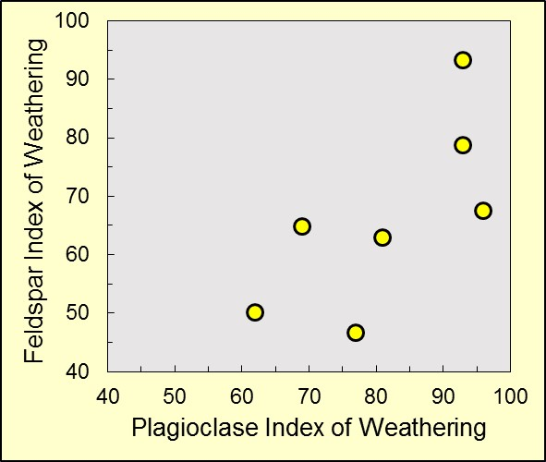
Magnitude of Weathering vs. Intensity of Weathering
B’boo inferred
Plagioclase Index of Weathering
PIW = 100 × CN_{CALC} / CN_{TOTAL}
where CN_{CALC} is calculated mass flux of CaO and Na₂O
CN_{TOTAL} is total removal of CaO and Na₂O
B’boo calculated
VM
Feldspar Index of Weathering
FIW = 100 × CNK_{CALC} / CNK_{TOTAL}
where CNK_{CALC} is calculated mass flux of CaO, Na₂O, and K₂O
CNK_{TOTAL} is total removal of CaO, Na₂O, and K₂O

Slide 14
Calculation of Atmospheric CO₂ (Sheldon 2006)
XO + 2CO₂ + H₂O = X²⁺ + 2HCO₃⁻
M/t ≈ p_{CO2} [(K_{CO2}r)/10³ + (κD_{CO2}α)/L]
M/t (mol_{CO2}/cm² year): time-averaged flux of CO₂ required
for observed weathering
pCO₂ : partial pressure of atmospheric CO₂
K_{CO2} : Henry’s Law constant for CO₂
r : rainfall rate
κ : a constant involving time and gas volume
D_{CO2} : diffusion constant for CO₂ in air
α : diffusion constant CO₂ (soil)/diffusion constant CO₂ (air)
L : depth to the water table

Slide 15
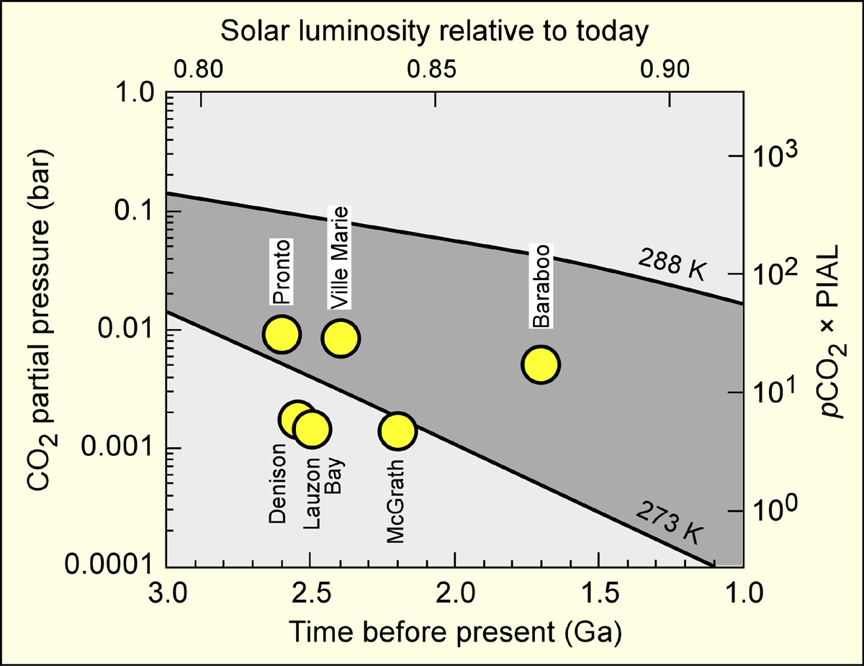
Calculated pCO₂ Relative to
Pre-Industrial Atmospheric Level (280 ppm)
for a weathering duration of 100,000 years

Slide 16
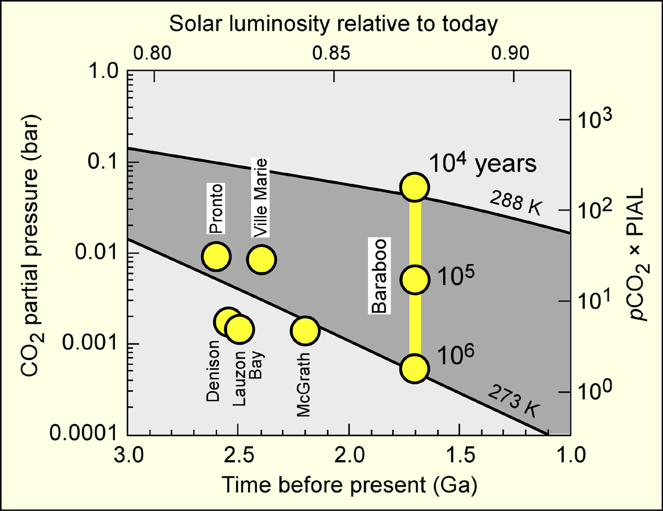
Calculated pCO₂ Relative to
Pre-Industrial Atmospheric Level (280 ppm)
the effect of weathering duration

Slide 17
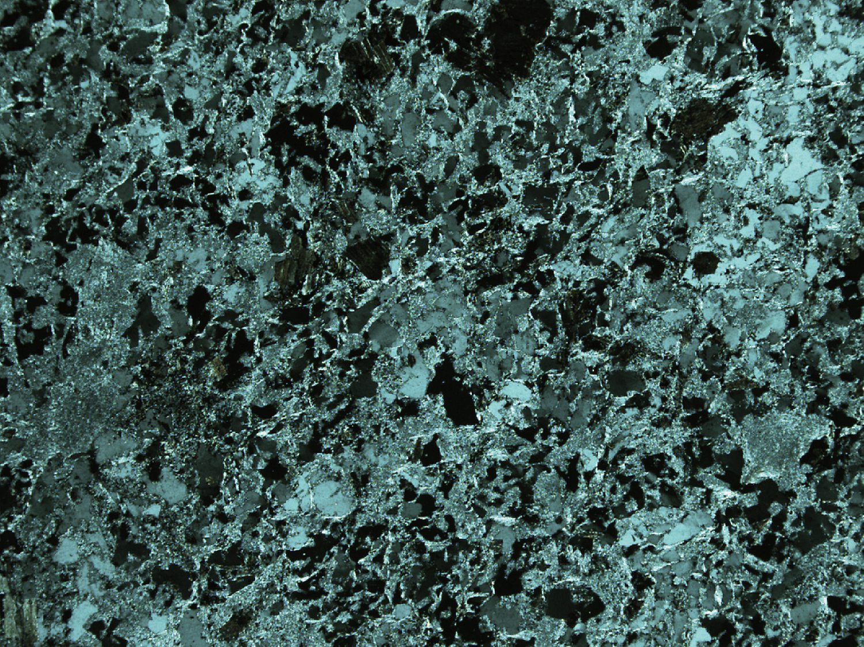
Conclusions
• K-metasomatism is a common phenomenon in Precambrian paleosols
• Despite such metasomatism, application of the A-C*N-K plot
allows for calculation of minimum values of mass flux in
paleoweathering profiles and minimum estimates of
atmospheric pCO₂
• The Feldspar Index of Weathering (FIW) is an effective parameter
for evaluating the proportion of total feldspar removed from an
entire weathering profile, i.e. the intensity of weathering, and
is useful in comparing the intensity of weathering among paleosols
• Among the investigated localities, the highest FIW value is found
in the Baraboo paleosol, from which all feldspar was removed by
weathering, accounting for the absence of feldspar in the
overlying supermature Baraboo Quartzite

