Slide 1
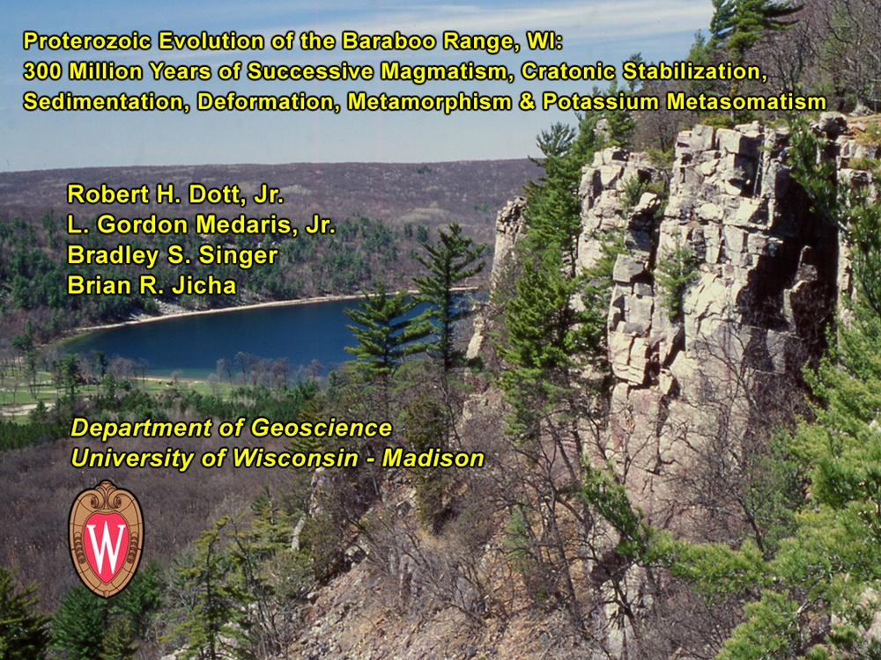

Slide 2
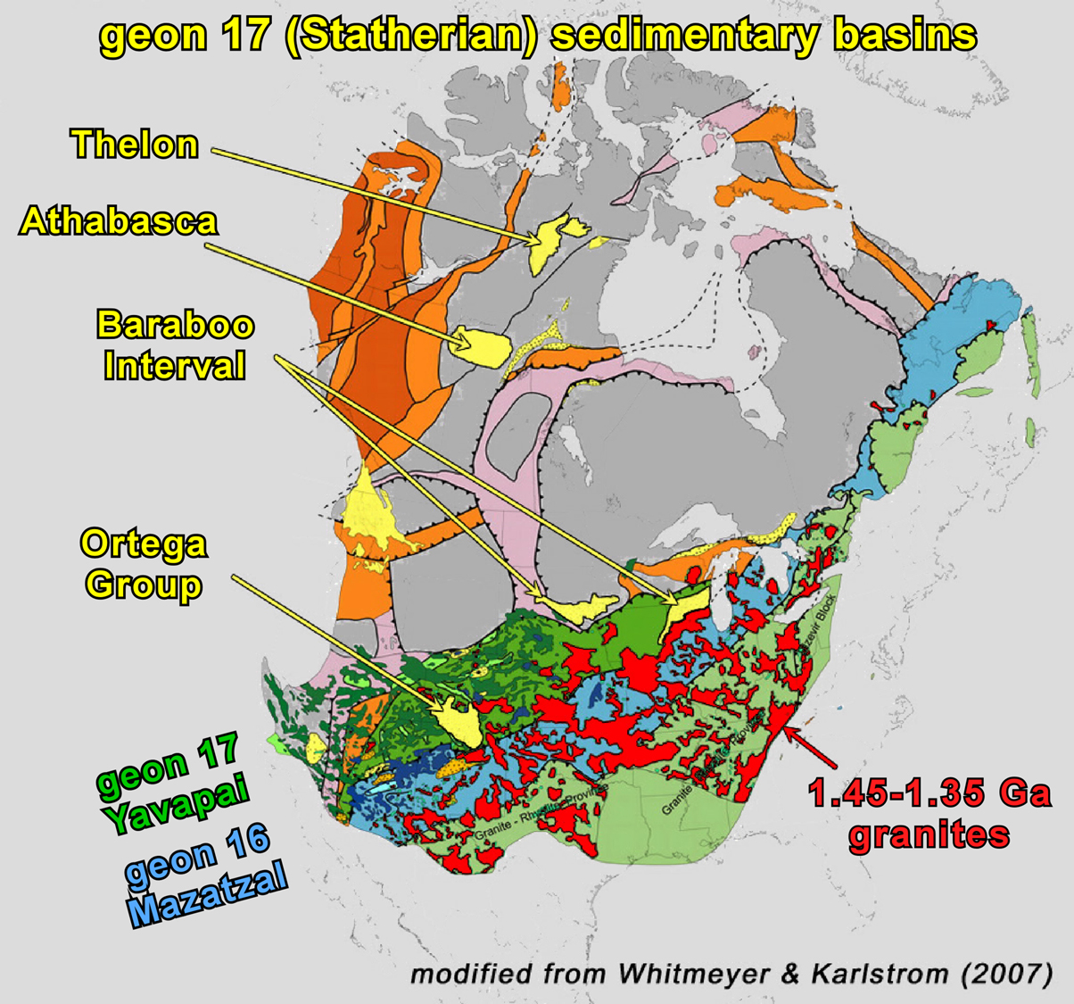
Notes:
One of geon 17 continent-wide sedimentary basins characterized by supermature quartzite
Strategically located to record Yavapai, Mazatzal, and geon 14 granitic events

Slide 3
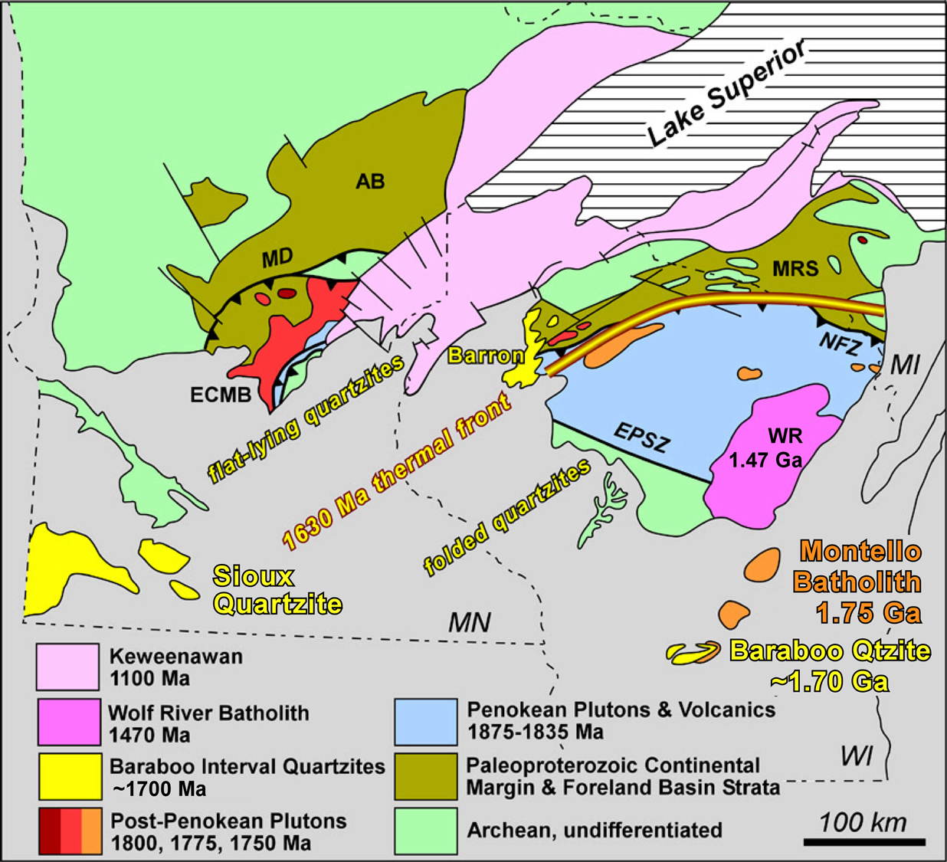
Simplified Geological Map of the Southern Lake Superior Region
Penokean ⁴⁰Ar/³⁹Ar cooling ages
geon 16 ⁴⁰Ar/³⁹Ar cooling ages
Notes:
Basement of Montello Batholith – post-Penokean, 1750 Ma

Slide 4
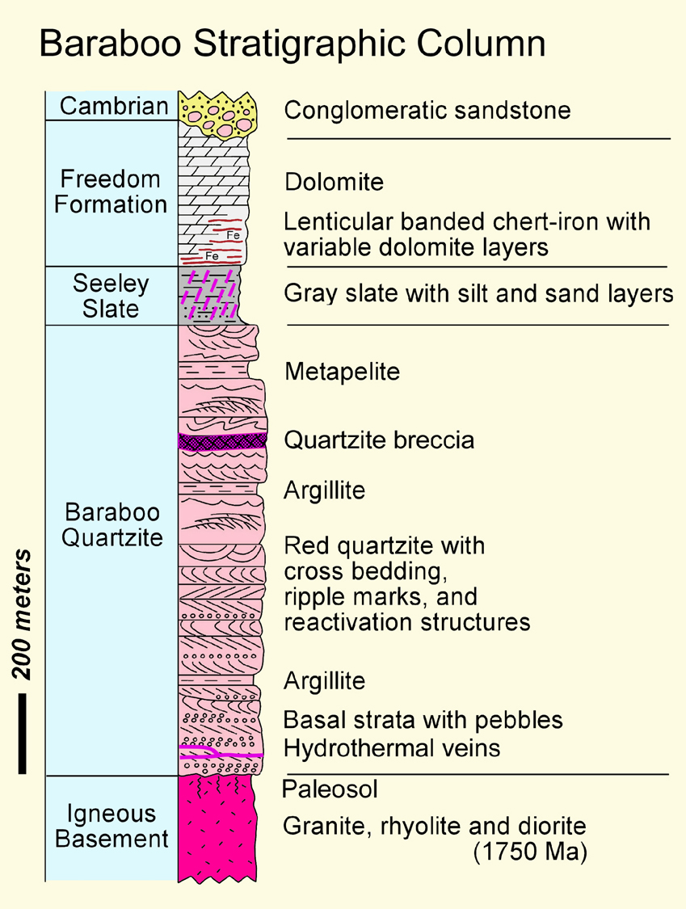

Slide 5
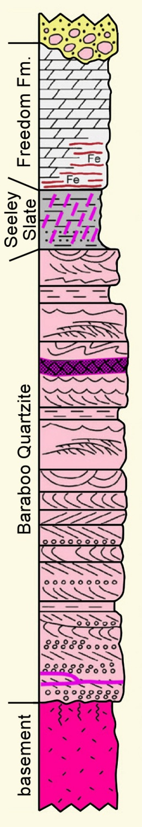
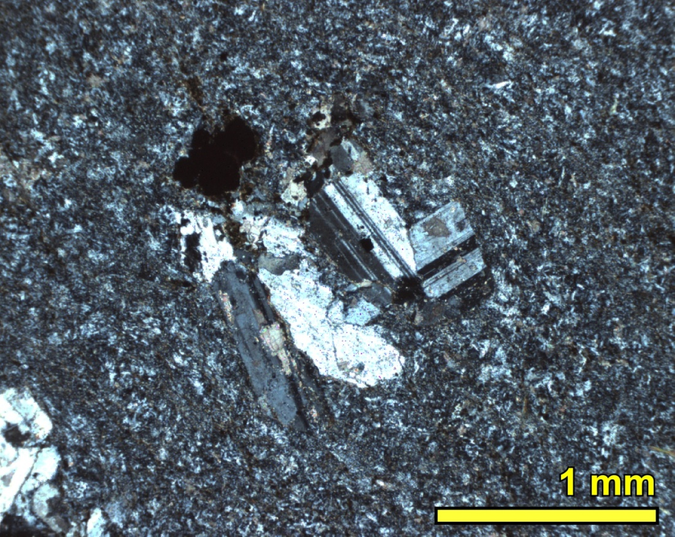
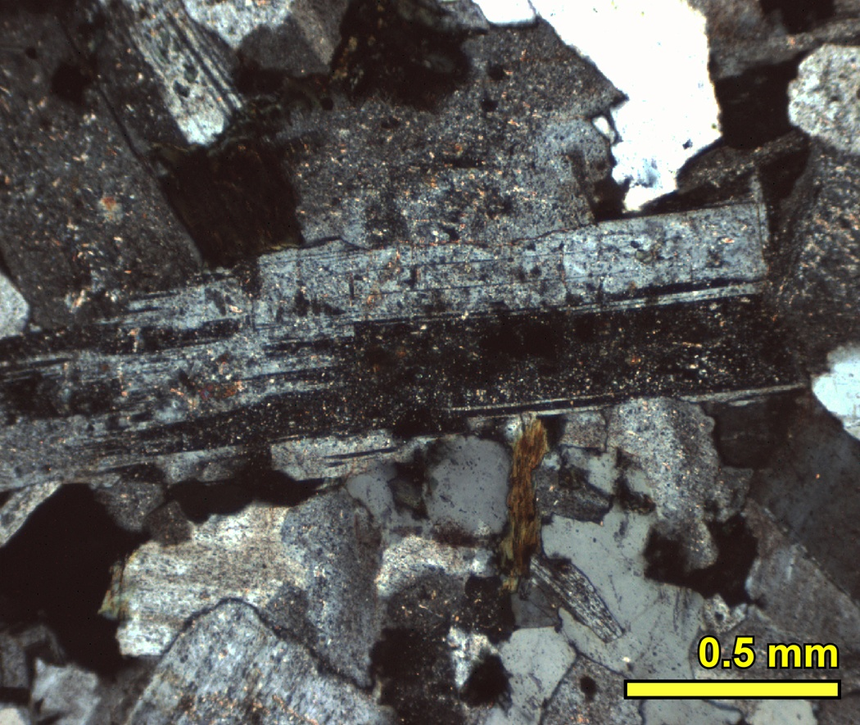
1750 Ma Igneous Basement
relict igneous textures, but greenschist mineral assemblages
Rhyolite:
plagioclase phenocrysts
replaced by albite
Granite:
plagioclase replaced by albite & fine-grained epidote;
biotite replaced by chlorite
Notes:
U-Pb zircon age of both rhyolite and granite in basement is 1750 Ma
Igneous textures are preserved, but igneous minerals have been replaced by greenschist facies minerals: albite, epidote, chlorite

Slide 6
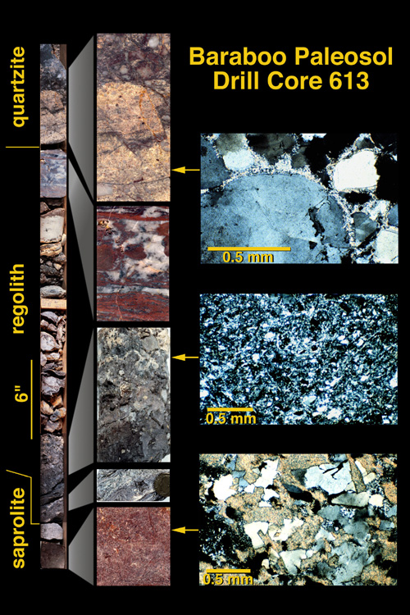
30 foot-thick paleosol in granite beneath quartzite
Notes:
25 foot-thick paleoweathering profile: ~3 feet of regolith & 22 feet of saprolite
Supermature weathering: complete removal of plagioclase and K-feldspar; note “complete” removal of CaO and Na2O and significant removal of SiO2. Note substantial addition of K2O – K-metasomatism! Return to this point later.
Minimum estimate of pCO2 – consistent with that predicted by the faint sun model.

Slide 7
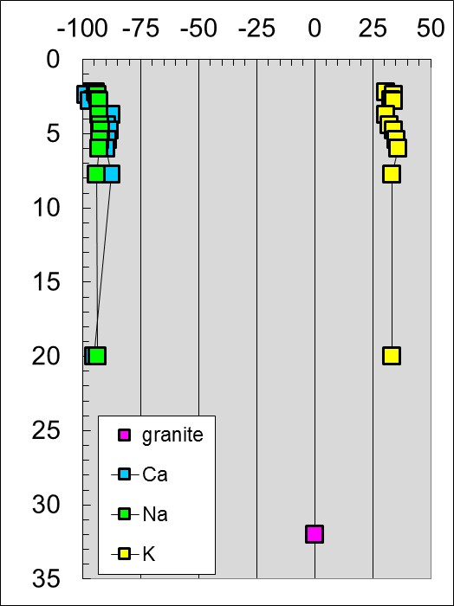
30 foot-thick paleosol in granite beneath quartzite
% change relative to Al in granite
depth, feet
saprolite
granite
atmospheric pCO₂ = 19 × PIAL (10⁵ years of weathering)

Slide 8
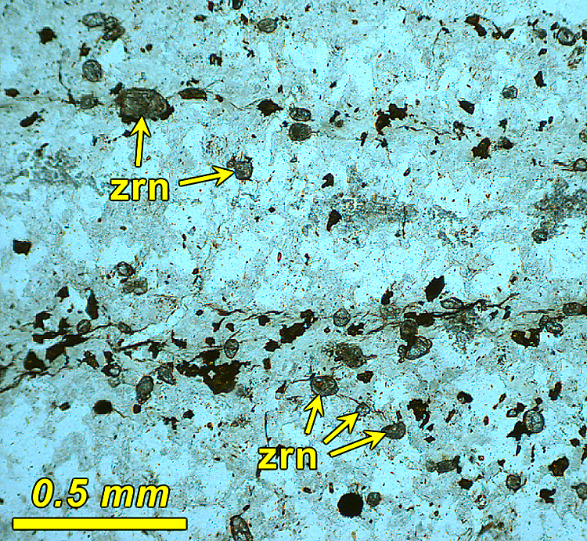
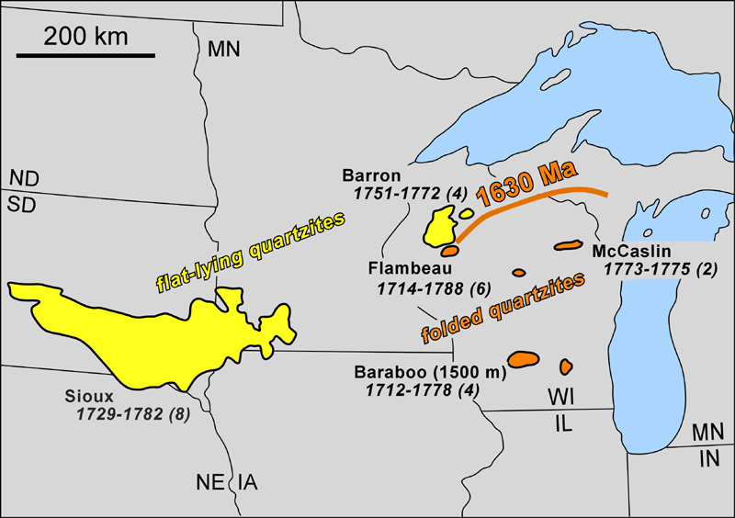
Baraboo Quartzite: ²⁰⁷Pb/²⁰⁶Pb ages of detrital zircons
geon 17 detrital zircon ages in Baraboo Interval quartzites
base of the Baraboo Quartzite: 1778 ± 3 Ma
1761 ± 3
1741 ± 6
1712 ± 4
Notes:
Presence of geon 17 detrital zircons confirms post 1750 Ma deposition of quartzite/

Slide 9
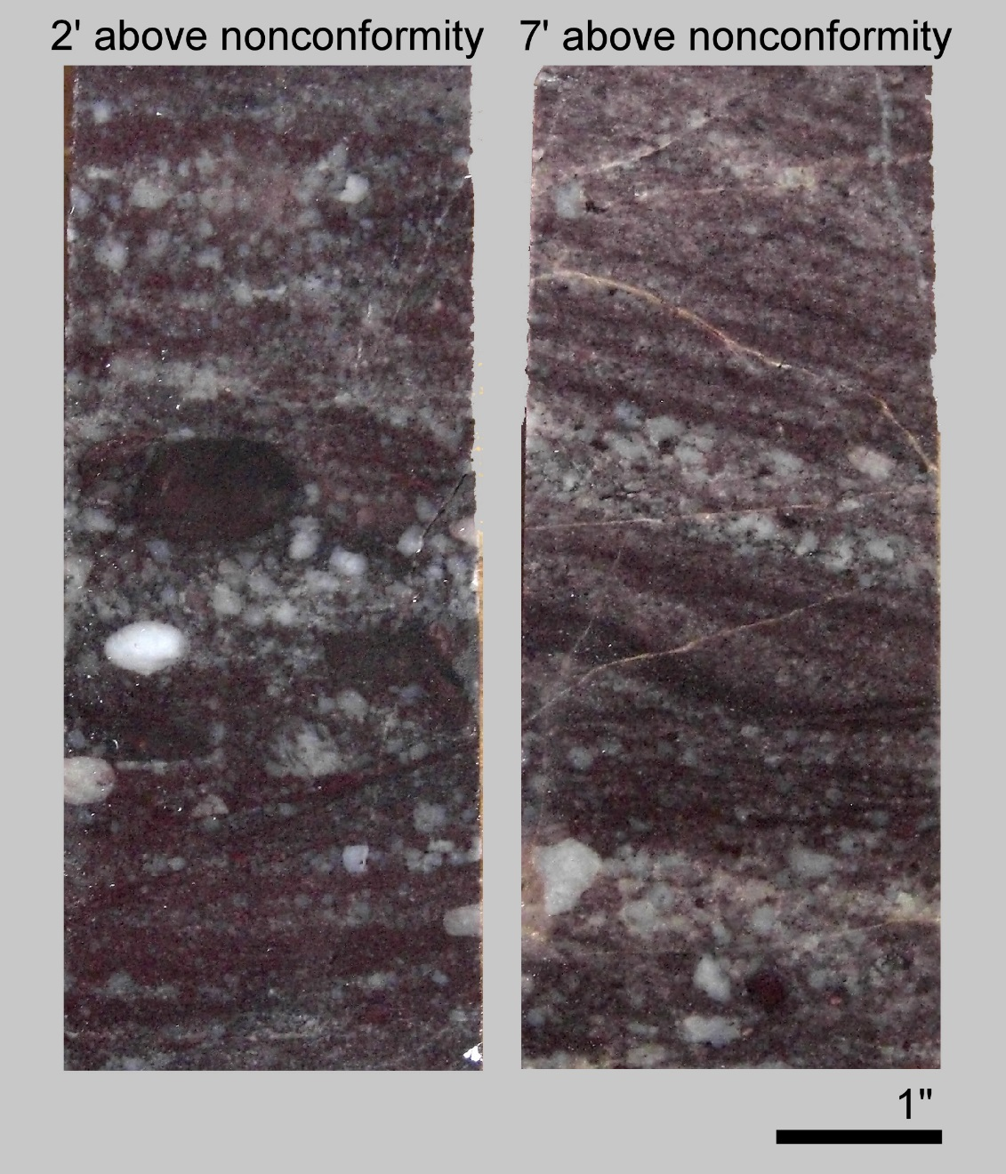
Baraboo Quartzite: depositional environments
shallow
marine
tidal
fluvial
fluvial

Slide 10
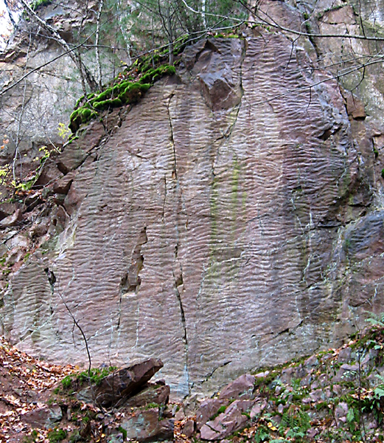
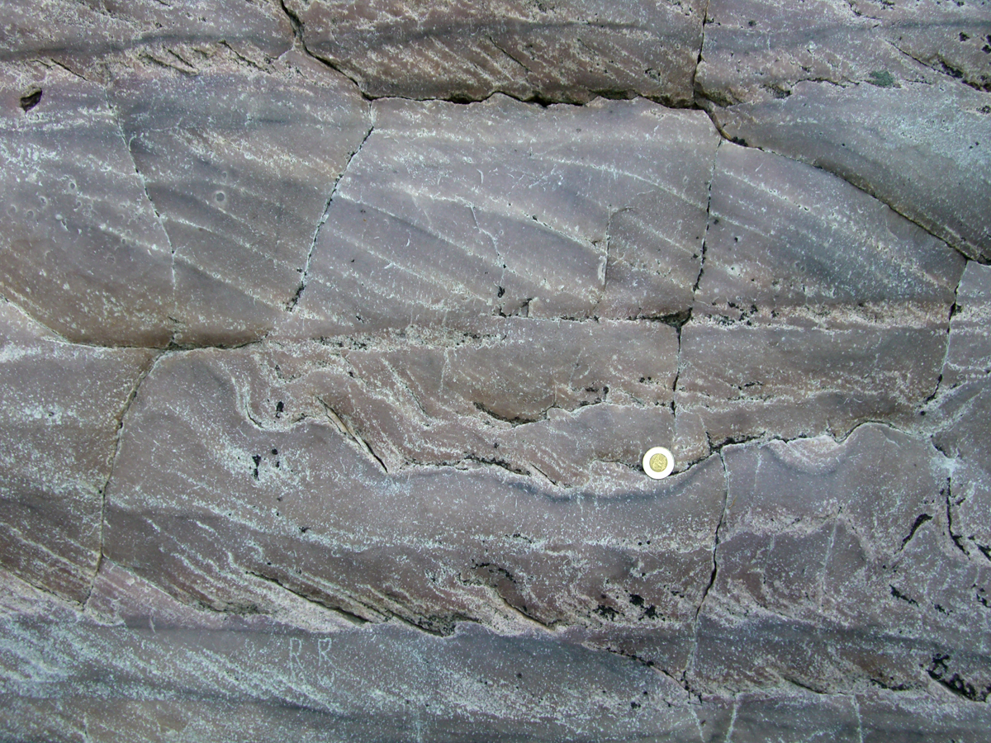
Baraboo Quartzite: depositional environments
shallow marine
tidal
shallow
marine
tidal
fluvial

Slide 11
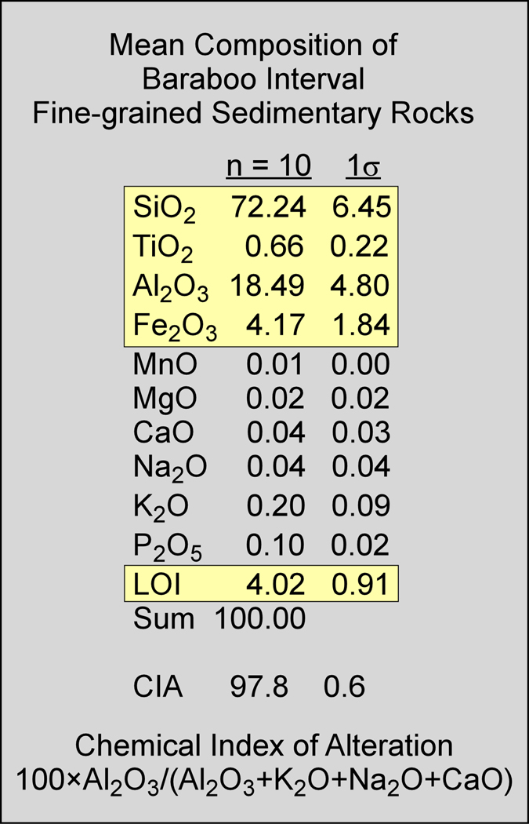
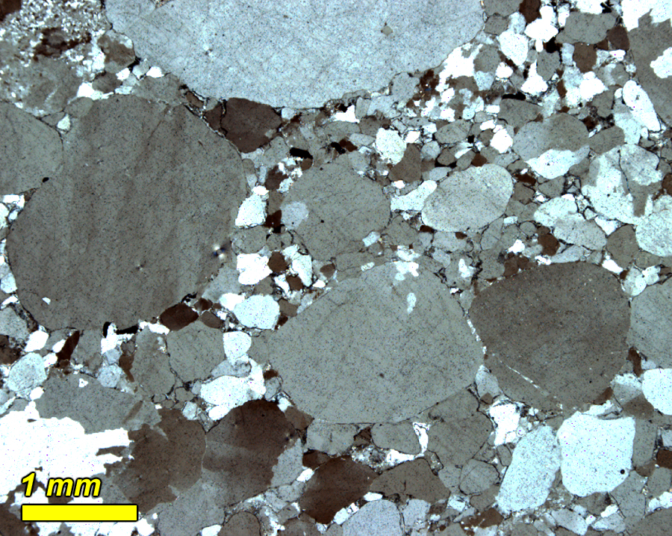
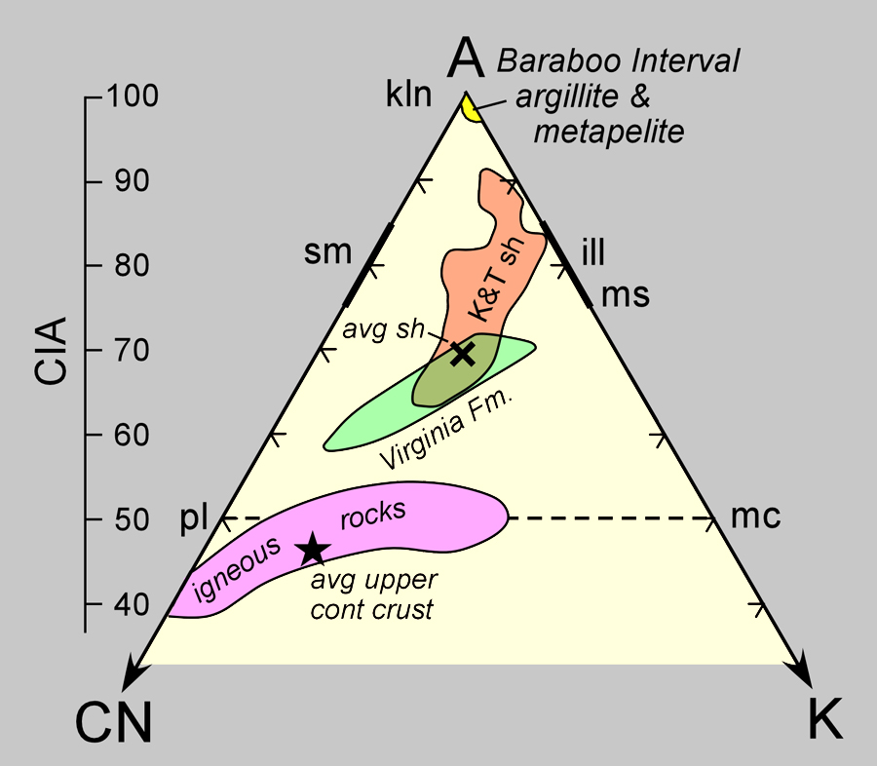
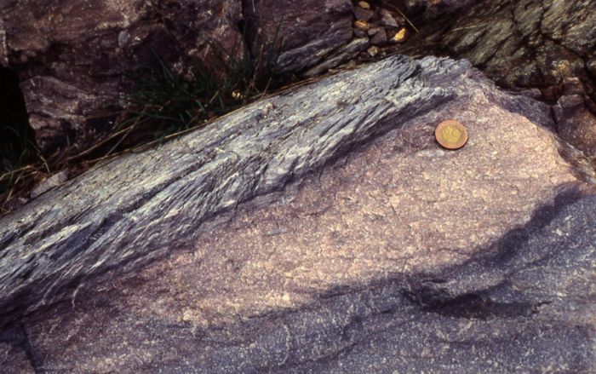
Supermature composition of quartzite, phyllite, and metapelite
quartzite
phyllite
Notes:
Quartzite is ~100% SiO2, so not too informative.
Fine-grained metasediments consist almost entirely of Si, Ti, Al, Fe, and water. CIA = 98.
Note supermature composition in A-CN-K ddiagram. Compare to fine-grained sediments in Virginia Fm. and Cordilleran Cretaceous and Tertiary shales.

Slide 12
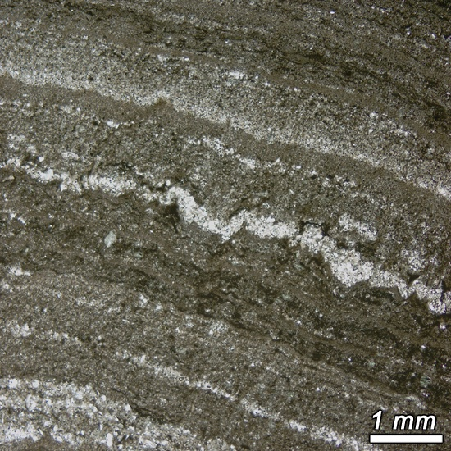
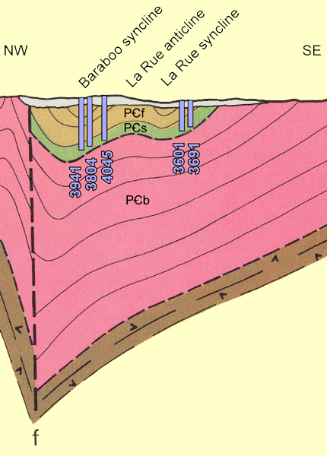
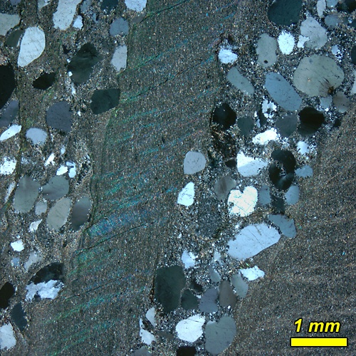
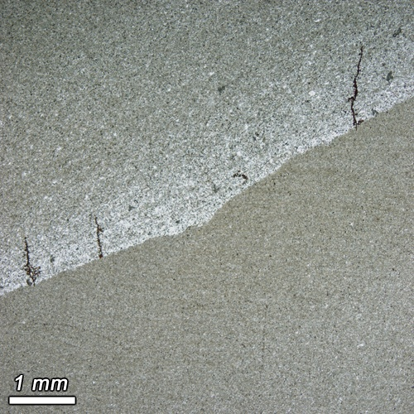
Seeley Slate (known from mines & drill cores)
quartz
muscovite
chlorite
rutile
pyrite
tourmaline
±siderite
Notes:
Thinly laminated silt and mud, with intermittent thin carbonate layers and sandy lenses.
Local graded bedding.

Slide 13
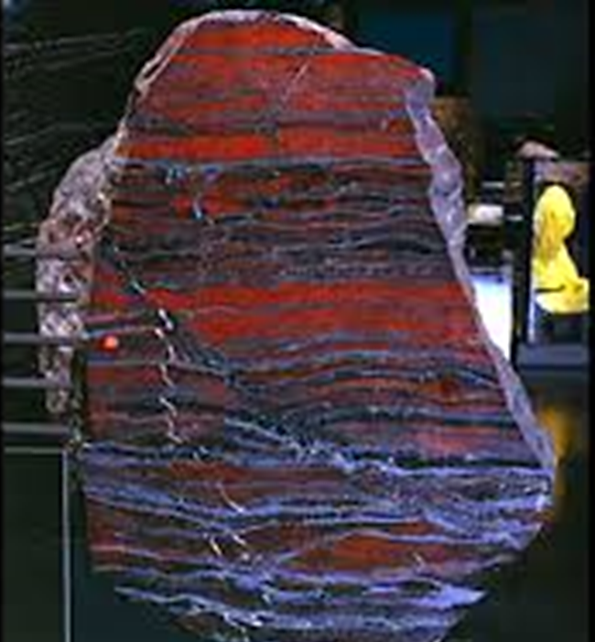
Freedom Formation (known from mines & drill cores)
Dolomite and
Banded Fe-formation

Slide 14
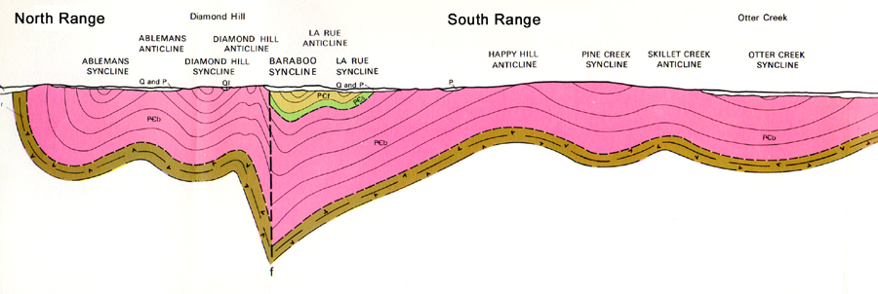
The Baraboo Syncline (Mazatzal ~1630 Ma)
Cross-section of the Baraboo Range (Dalziel & Dott, 1970)
Notes:
Time of folding is uncertain, but thought to be related to geon 16 Mazatzal orogeny, based on geon 16 Ar cooling ages for biotite and hornblende in geon 18 Penokean basement.
Note prominent S1 cleavage in Seeley slate, and locally, subhorizontal S2 cleavage crenulation.

Slide 15
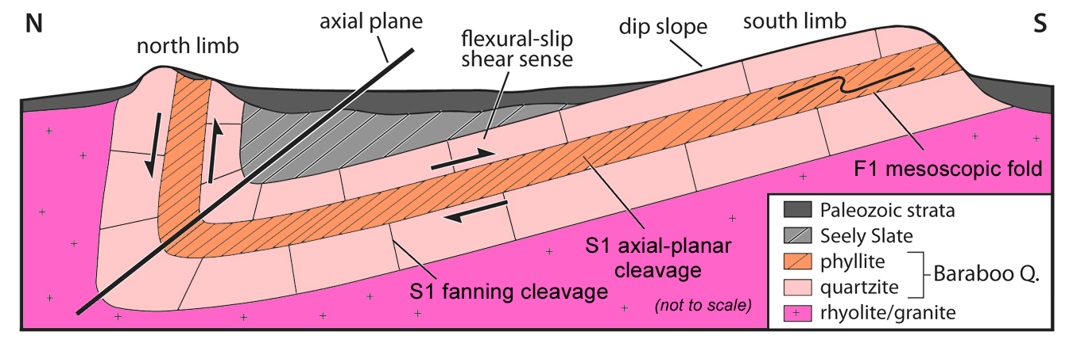
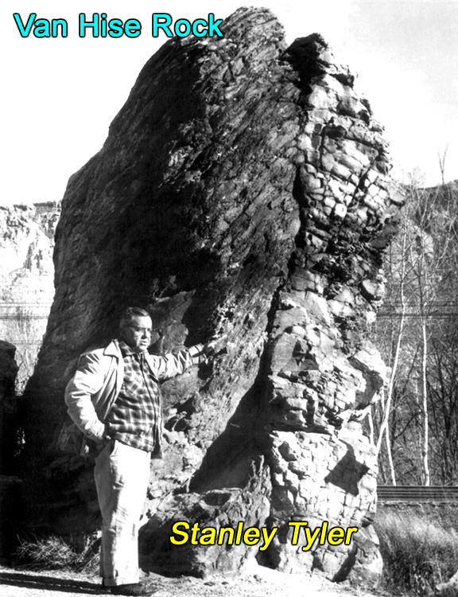
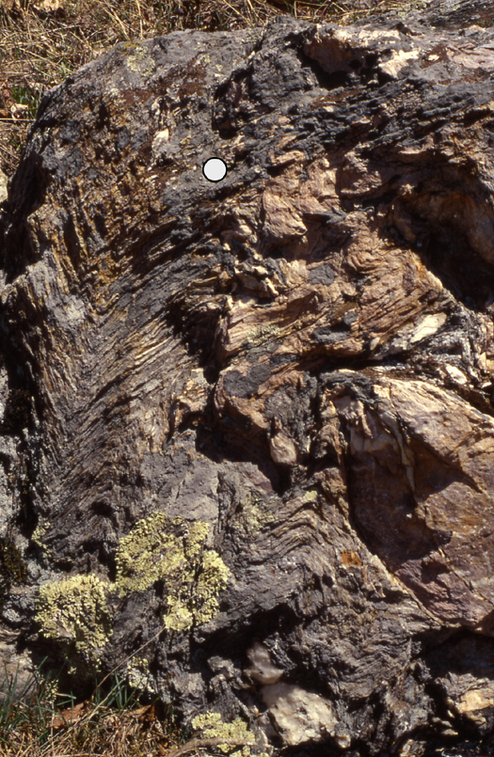
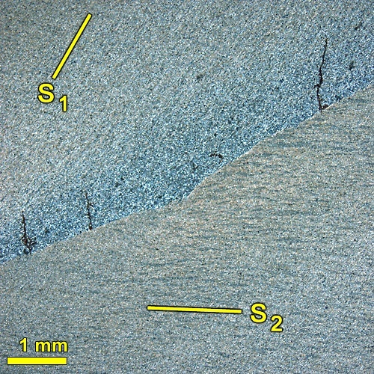
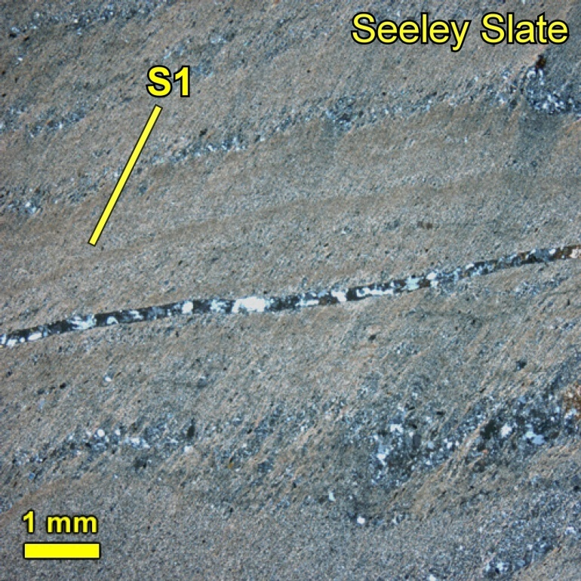
Simplified Cross-section of the Baraboo Range (from Steve Marshak)
F1 fold in phyllite
Seeley Slate

Slide 16
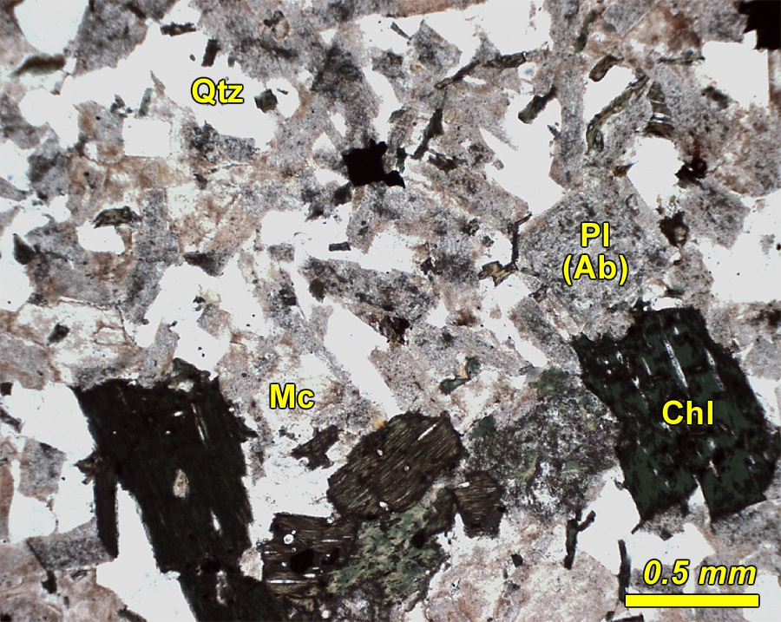
Metamorphism in the Baraboo Range
diorite, granite, and rhyolite
quartz+microcline+albite+chlorite+epidote+hematite
Baxter Hollow Granite
Notes:
Greenschist facies assemblage in basement – geon 16?

Slide 17
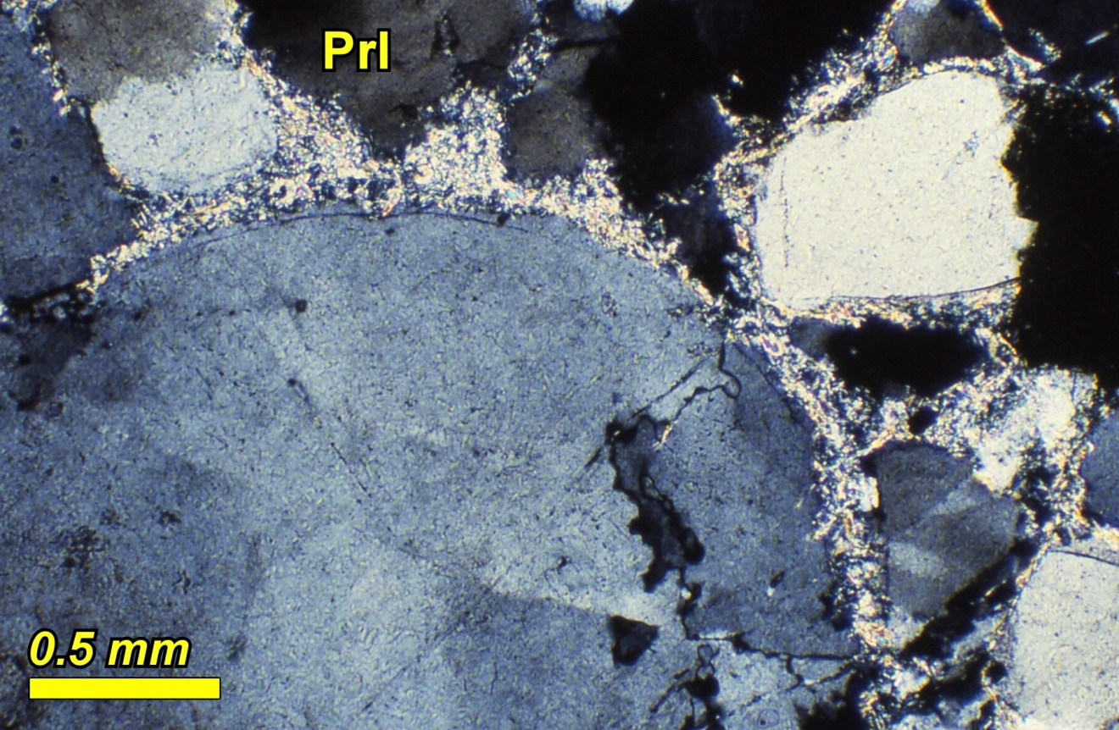
Metamorphism in the Baraboo Range
quartzite, phyllite, and metapelite
SiO₂-Al₂O₃-Fe₂O₃-H₂O
quartz + pyrophyllite + hematite
quartzite
Notes:
Pyrophyllite (formerly kaolinite) in quartzite

Slide 18
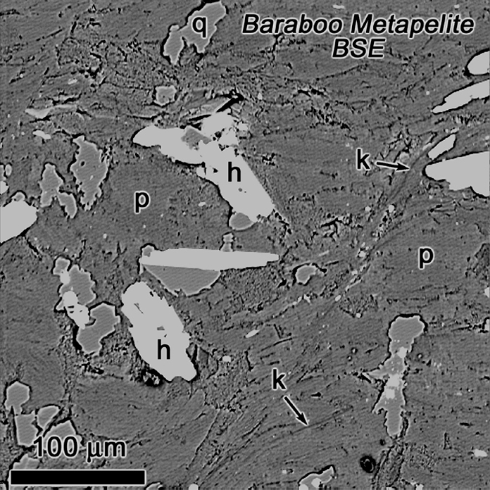
Metamorphism in the Baraboo Range
quartzite, phyllite, and metapelite
SiO₂-Al₂O₃-Fe₂O₃-H₂O
metapelite
Qtz
Prl
Hem
Kln + Qtz = Prl + H₂O
Notes:
Back-scattered electron (BSE) image of metapelite at Point of Rocks – mostly pyrophyllite (p) with prominent hematite (h) grains.
Note “eroded” appearance of quartz, due to reaction, Kln + Qtz = Prl + H20

Slide 19
Muscovite and Potassium Metasomatism
muscovite is restricted to four positions
in the Baraboo statigraphic column
Seeley Slate
quartzite breccia
hydrothermal veins
paleosol
Notes:
Muscovite is abundant in Seeley Slate, but rare elsewhere in the Baraboo Range,
occurring only in quartzite breccia, hydrothermal veins, and paleosol.

Slide 20
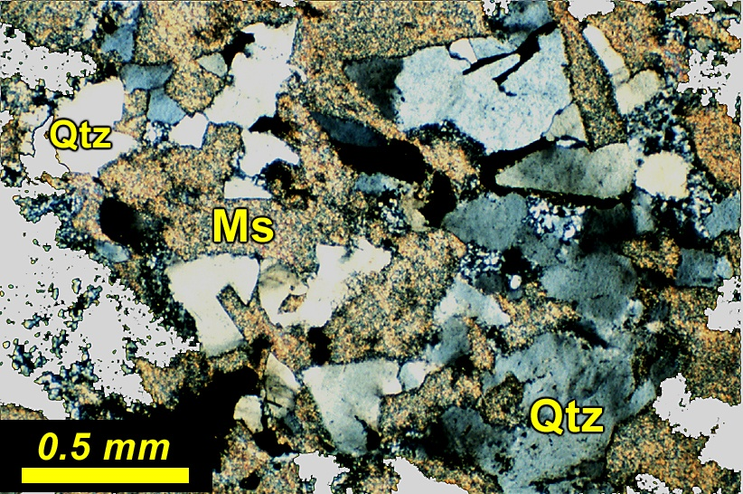
Muscovite and Potassium Metasomatism
muscovite + quartz
saprolite
Notes:
Saprolite: muscovite relaces weathered feldspar (formerly kaolinite)

Slide 21
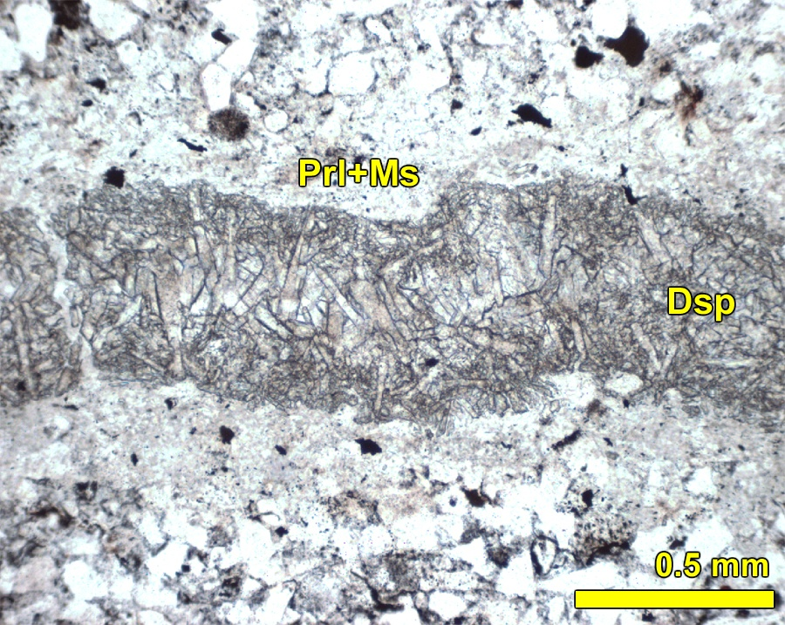
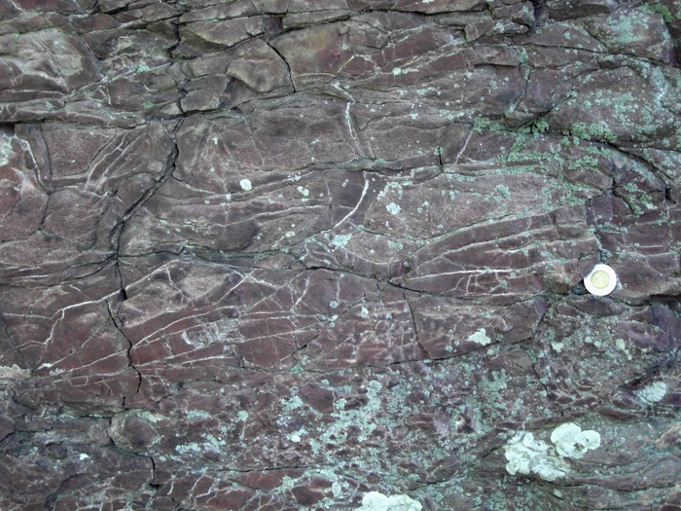
Muscovite and Potassium Metasomatism
muscovite + pyrophyllite + diaspore [AlO(OH)]
hydrothermal veins
Notes:
Diaspore is incompatible with quartz – note that Dsp and Qtz are separated by pyrophyllite and muscovite

Slide 22
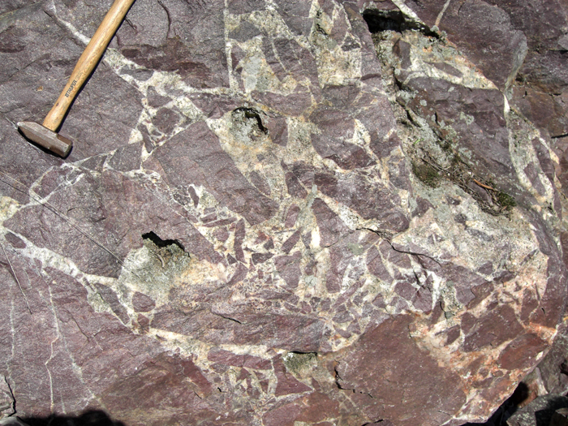
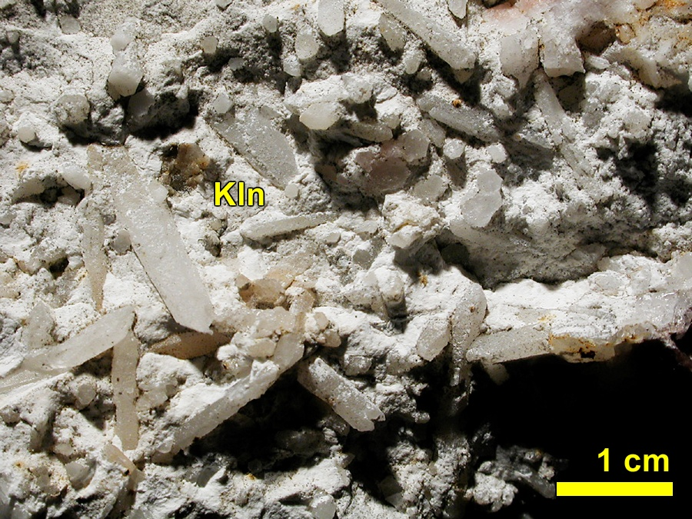
Muscovite and Potassium Metasomatism
quartz + kaolinite ± muscovite
vug in quartzite breccia
quartzite breccia
Notes:
Muscovite is rare, but occurs locally, in quartzite breccia.
Note that the aluminum silicate here is kaolinite, rather than pyrophylite.

Slide 23
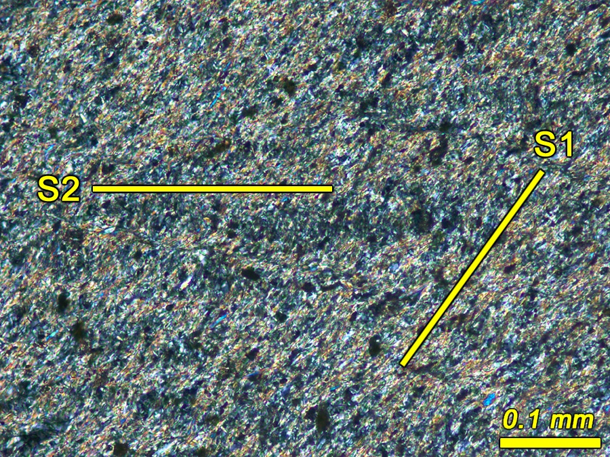
Muscovite and Potassium Metasomatism
Seeley Slate
Ms
Chl
Qtz
Rt
Py
Tur
±Sid
Notes:
Muscovite is abundant in Seeley slate, where it is aligned parallel to S1.
Note subhorizontal cleavage crenulation.

Slide 24
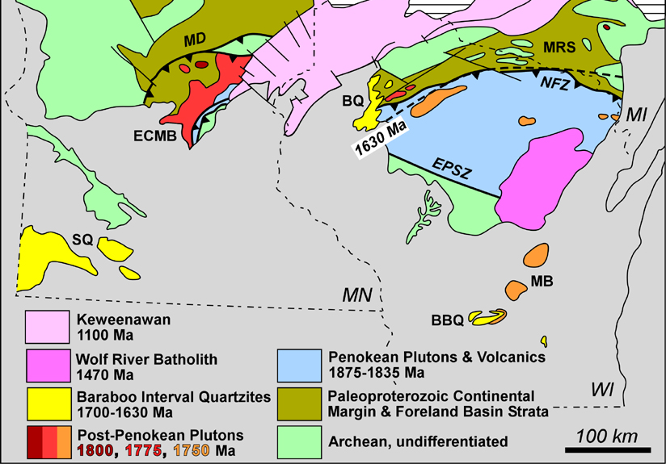
Muscovite and Potassium Metasomatism
Folding is thought to be a Mazatzal Event (1630 Ma)
⁴⁰Ar/³⁹Ar ages of muscovite – 1630 Ma??
1456 – 1484 Ma (not geon 16!!)
1460, 1470, 1481,
1484 ± 3 Ma
Seeley Slate
quartzite breccia
1459 ± 3 Ma
WR
Wolf River Batholith
1468 – 1484 Ma
hydrothermal veins
1467 ± 11 Ma
paleosol
1456 ± 11 Ma
Notes:
40Ar/39Ar ages were obtained for muscovite from the four settings, expecting to find geon 16 ages.
However, all ages are geon 14, and the same age as the Wolf River batholith.
Significant K metasomatism by geon 14 fluid migration along permeable channelways in the crust.

Slide 25
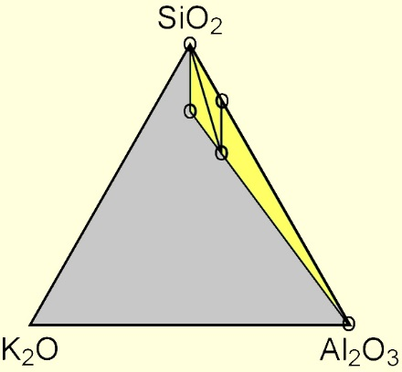
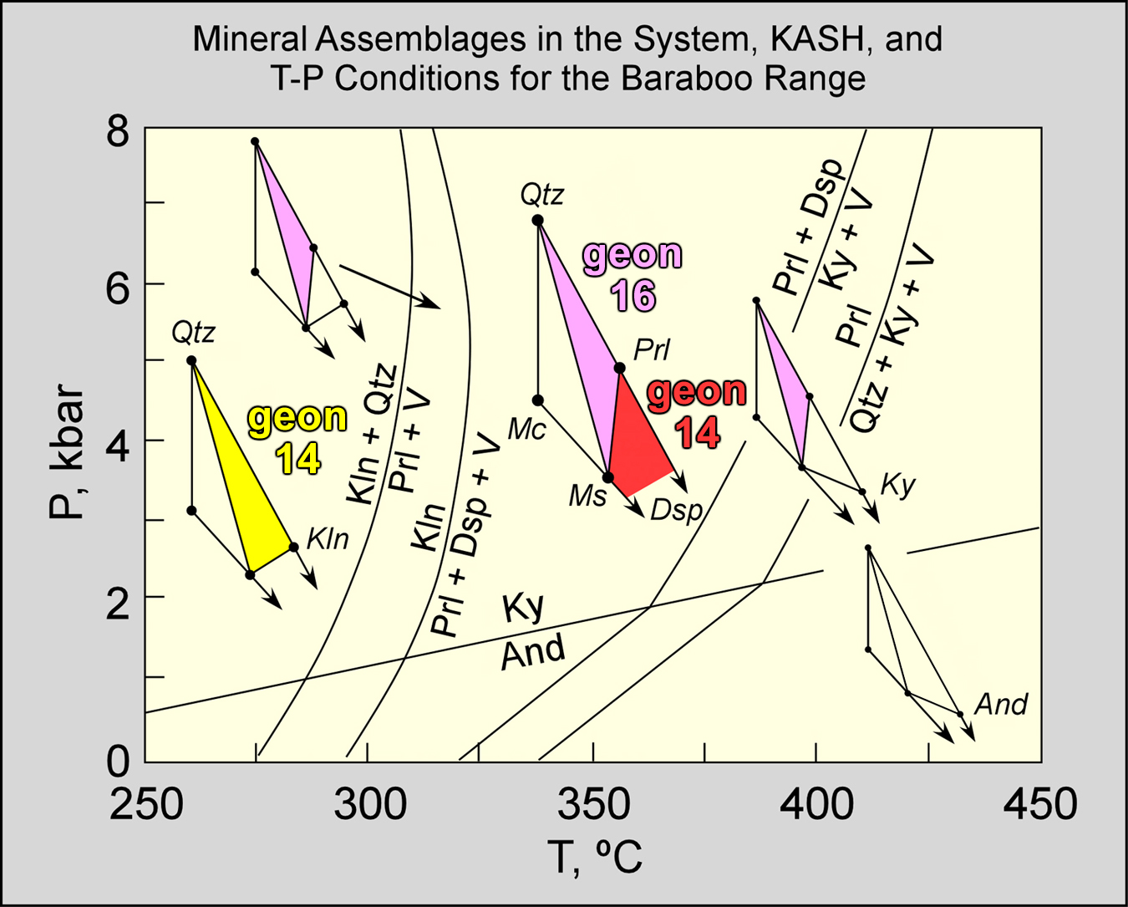
Metamorphic Conditions
Notes:
The Prl-Qtz assemblage in the quartzite section is presumed to be geon 16 and associated with folding of the B’boo syncline.
The Prl-Dsp-Ms (hydrothermal veins) and Kln+Qtz±Ms (quartzite breccia) assemblages are geon 14.
Note that the temperatures of geon 16 and geon 14 metamorphism are below the closure temperature for Ar in muscovite, so the Ar muscovite ages are the ages of crystallization.

Slide 26
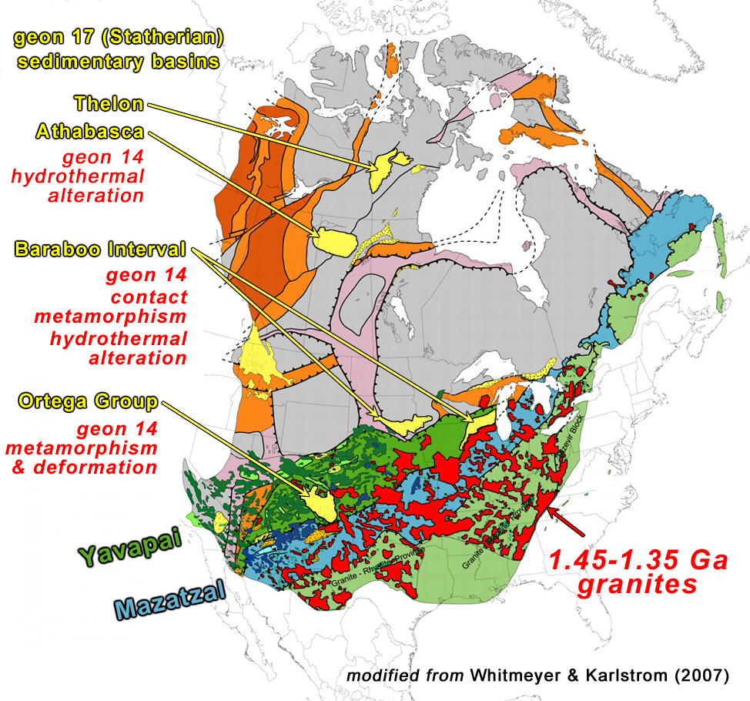
geon 14 magmatism, fluid flow and K-metasomatism
Summary of Major Proterozoic Events
Recorded In the Baraboo Range
-------------------------
• 1750 Ma (Yavapai) igneous basement
• ~1700 Ma mature paleosol
• ~1700 Ma deposition of supermature
sandstone, siltstone, and mudstone
• ~1630 Ma (Mazatzal) folding and
low-grade metamorphism
• ~1470 Ma hydrothermal activity and
K-metasomatism
Notes:
Effects of geon 14 magmatism on the geon 17 basins.

