Slide 1


Site-Specific Critical Acid Load Estimates for Forest Soils in the Osborne Creek Watershed, Michigan
Trevor C. Hobbs- Soil Scientist
Huron-Manistee National Forests

Slide 2

Intro/Background: Watershed Condition Framework
Soil Contamination
Good (1) Functioning Properly | No substantial areas of soil contamination in the watershed exist. When atmospheric deposition is a source of contamination, sulfur and/or nitrogen deposition is more than 10 percent below the terrestrial critical load.
Fair (2) Functioning at Risk | Limited areas of soil contamination may be present, but they do not have a substantial effect on overall soil quality. When atmospheric deposition is a source of contamination, sulfur and/or nitrogen deposition is 0-10 percent below the terrestrial critical load.
Poor (3) Impaired Function | Extensive areas of soil contamination may be present. When atmospheric deposition is a source of contamination, sulfur and/or nitrogen deposition is above the terrestrial critical load.
Notes:
The US Forest Service has a nation-wide program called the Watershed Condition Framework, which was designed to assess the health of all watersheds on Forest Service land. Basically, each watershed is given an overall score, according to a combination of environmental attributes, such as water quality, ozone levels, riparian vegetation, etc. One of those attributes- soil contamination- is an assessment of how much impact acid rain has had on soils in a given watershed.

Slide 3
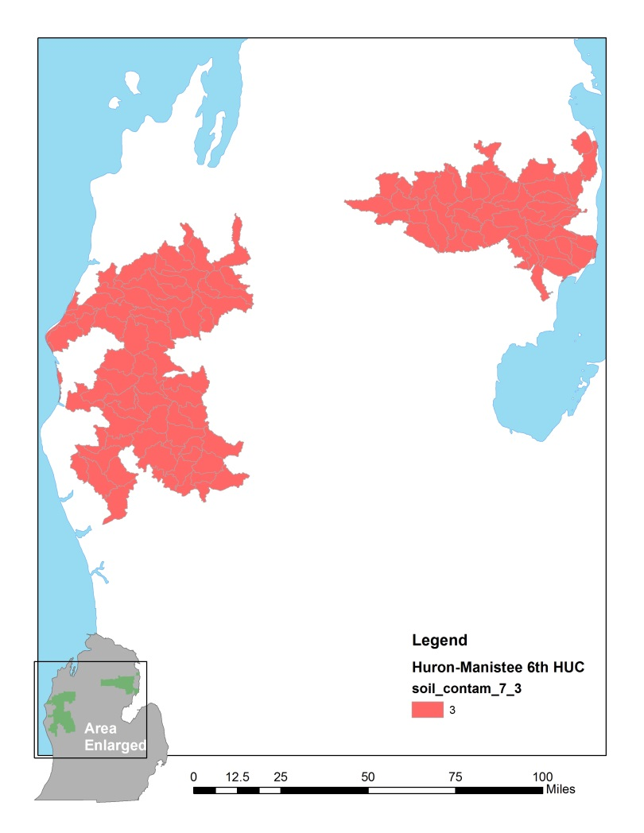
Intro/Background: Watershed Condition Framework
Soil Contamination
Good (1) Functioning Properly | No substantial areas of soil contamination in the watershed exist. When atmospheric deposition is a source of contamination, sulfur and/or nitrogen deposition is more than 10 percent below the terrestrial critical load.
Fair (2) Functioning at Risk | Limited areas of soil contamination may be present, but they do not have a substantial effect on overall soil quality. When atmospheric deposition is a source of contamination, sulfur and/or nitrogen deposition is 0-10 percent below the terrestrial critical load.
Poor (3) Impaired Function | Extensive areas of soil contamination may be present. When atmospheric deposition is a source of contamination, sulfur and/or nitrogen deposition is above the terrestrial critical load.
Notes:
ALL of the watersheds on the Huron-Manistee NF were assigned the lowest score of “3-Impaired Function”, because the deposition of sulfur and nitrogen- which are the primary pollutants that affect soil acidification- is above the terrestrial critical load.

Slide 4
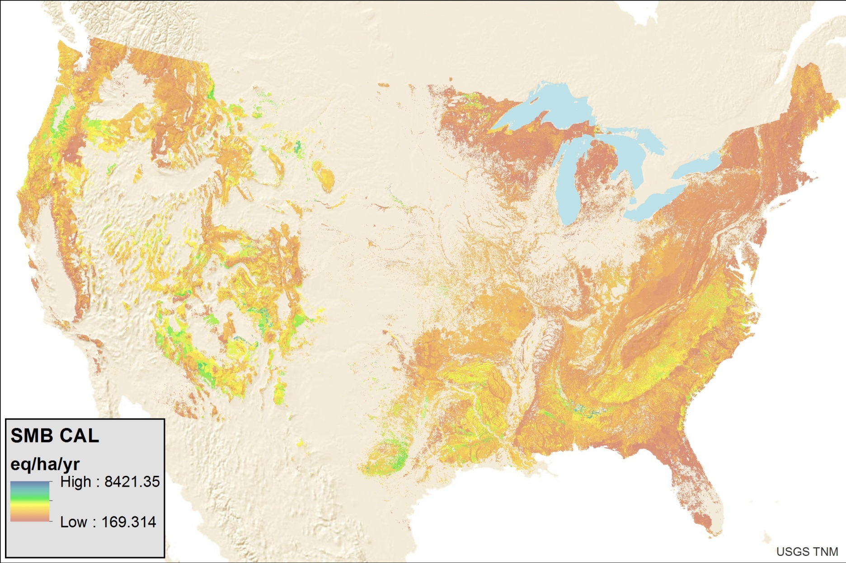
Background: National Scale Critical Acid Load (CAL) Estimates
Data source: (McNulty and Boggs, 2010)
As applied to soils, the critical load of acidity is defined as “the highest depositional load that will not cause chemical changes in soil leading to long-term harmful effects on ecosystem structure and function” (Nilsson and Grennfelt 1988)
Notes:
So- what is a critical load? As applied to soils, the critical load of acidity is defined as “the highest depositional load that will not cause chemical changes in soil leading to long-term harmful effects on ecosystem structure and function. To date, the only data that provides a critical load assessment that forest managers in Michigan can use is a series of publications by a research group out of the Southern Research Station headed by Steve McNulty and his colleagues, which is shown here. Which I’m going to refer to from now on as “National Scale Study”. So, when the critical load threshold is crossed…

Slide 5
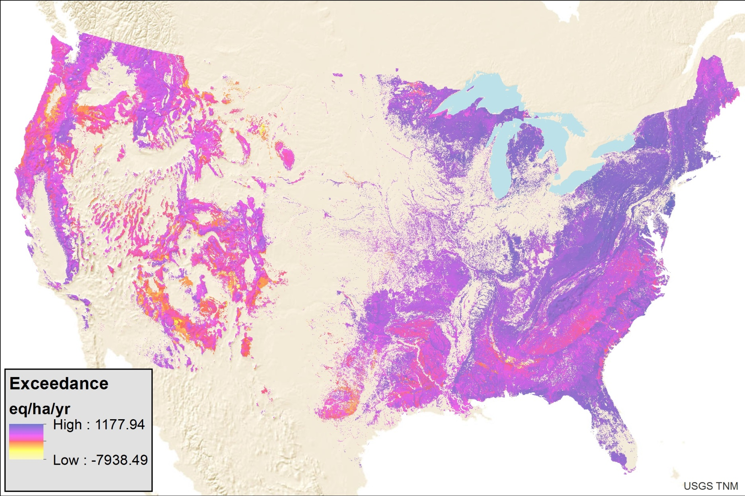
Background: National Scale Critical Acid Load (CAL) Estimates
Data source: (McNulty and Boggs, 2010)
Data source: (McNulty and Boggs, 2010)
As applied to soils, the critical load of acidity is defined as “the highest depositional load that will not cause chemical changes in soil leading to long-term harmful effects on ecosystem structure and function” (Nilsson and Grennfelt 1988)
Notes:
The soil is said to be in “exceedance”. As you can see, in Michigan we have some of the highest modeled critical load exceedances in the country, primarily because we have such slowly weatherable sandy soils.

Slide 6
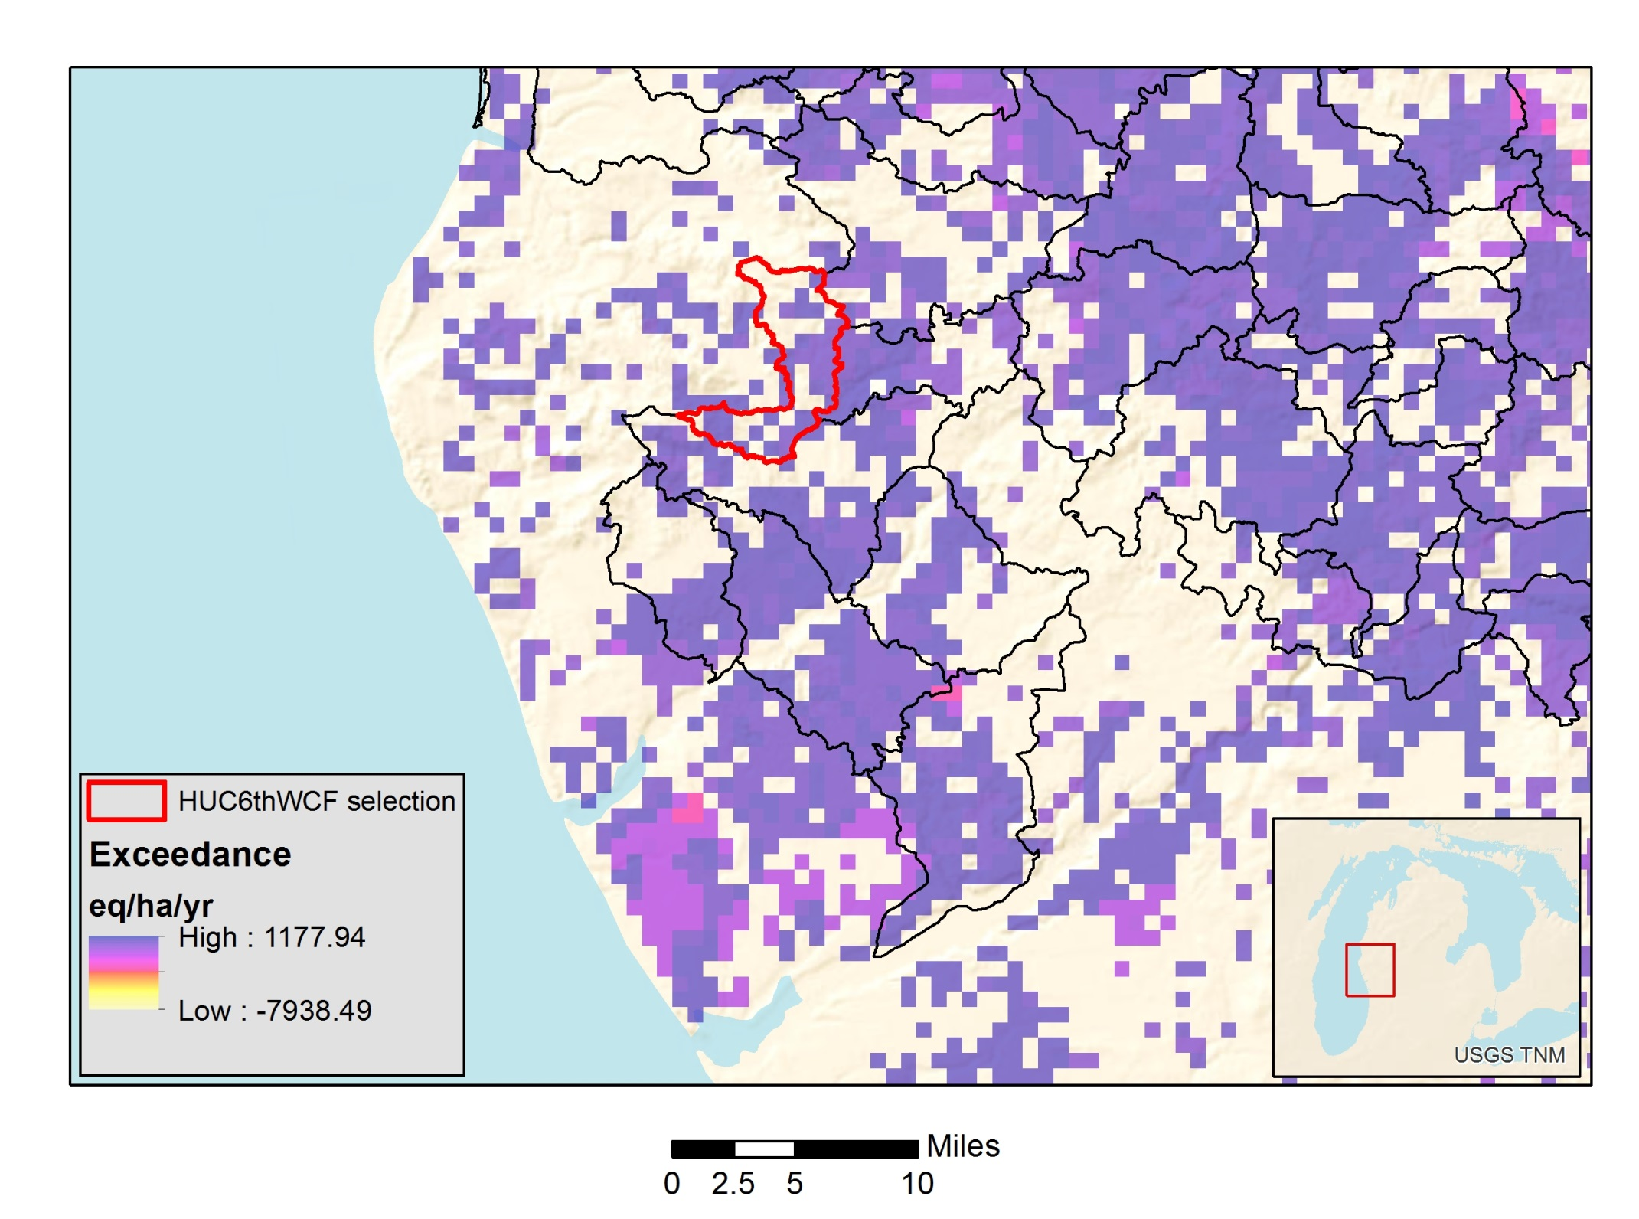
Notes:
But when you take a closer look at how the national scale assessment lines up with the scale of our watersheds, it becomes apparent that the input data may not accurately represent actual conditions on the ground…

Slide 7
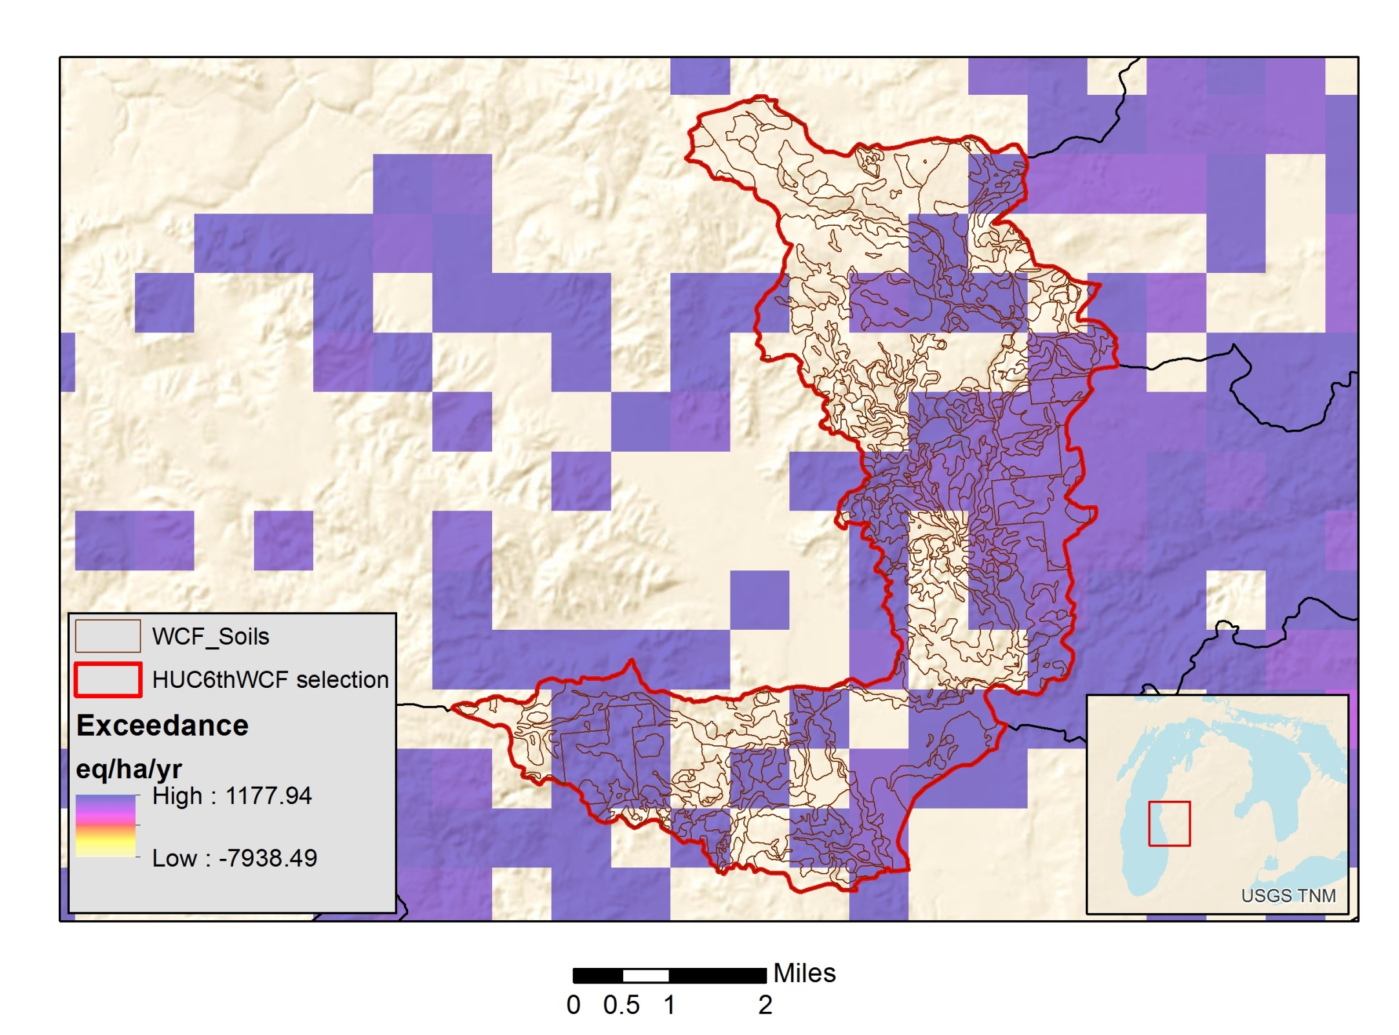
Notes:
You can see here how the soils data for this watershed overlap with the 1km resolution raster data of national scale CAL estimates used. So, what I wanted to do was look in depth at one of our watersheds as a case study- which is shown here, the Osborne creek watershed- to examine whether or not the coarse-resolution data provides an accurate estimate of soil acidification by selecting a range of sites to do detailed, site-specific analysis, using the same modelling approach, and comparing results.

Slide 8
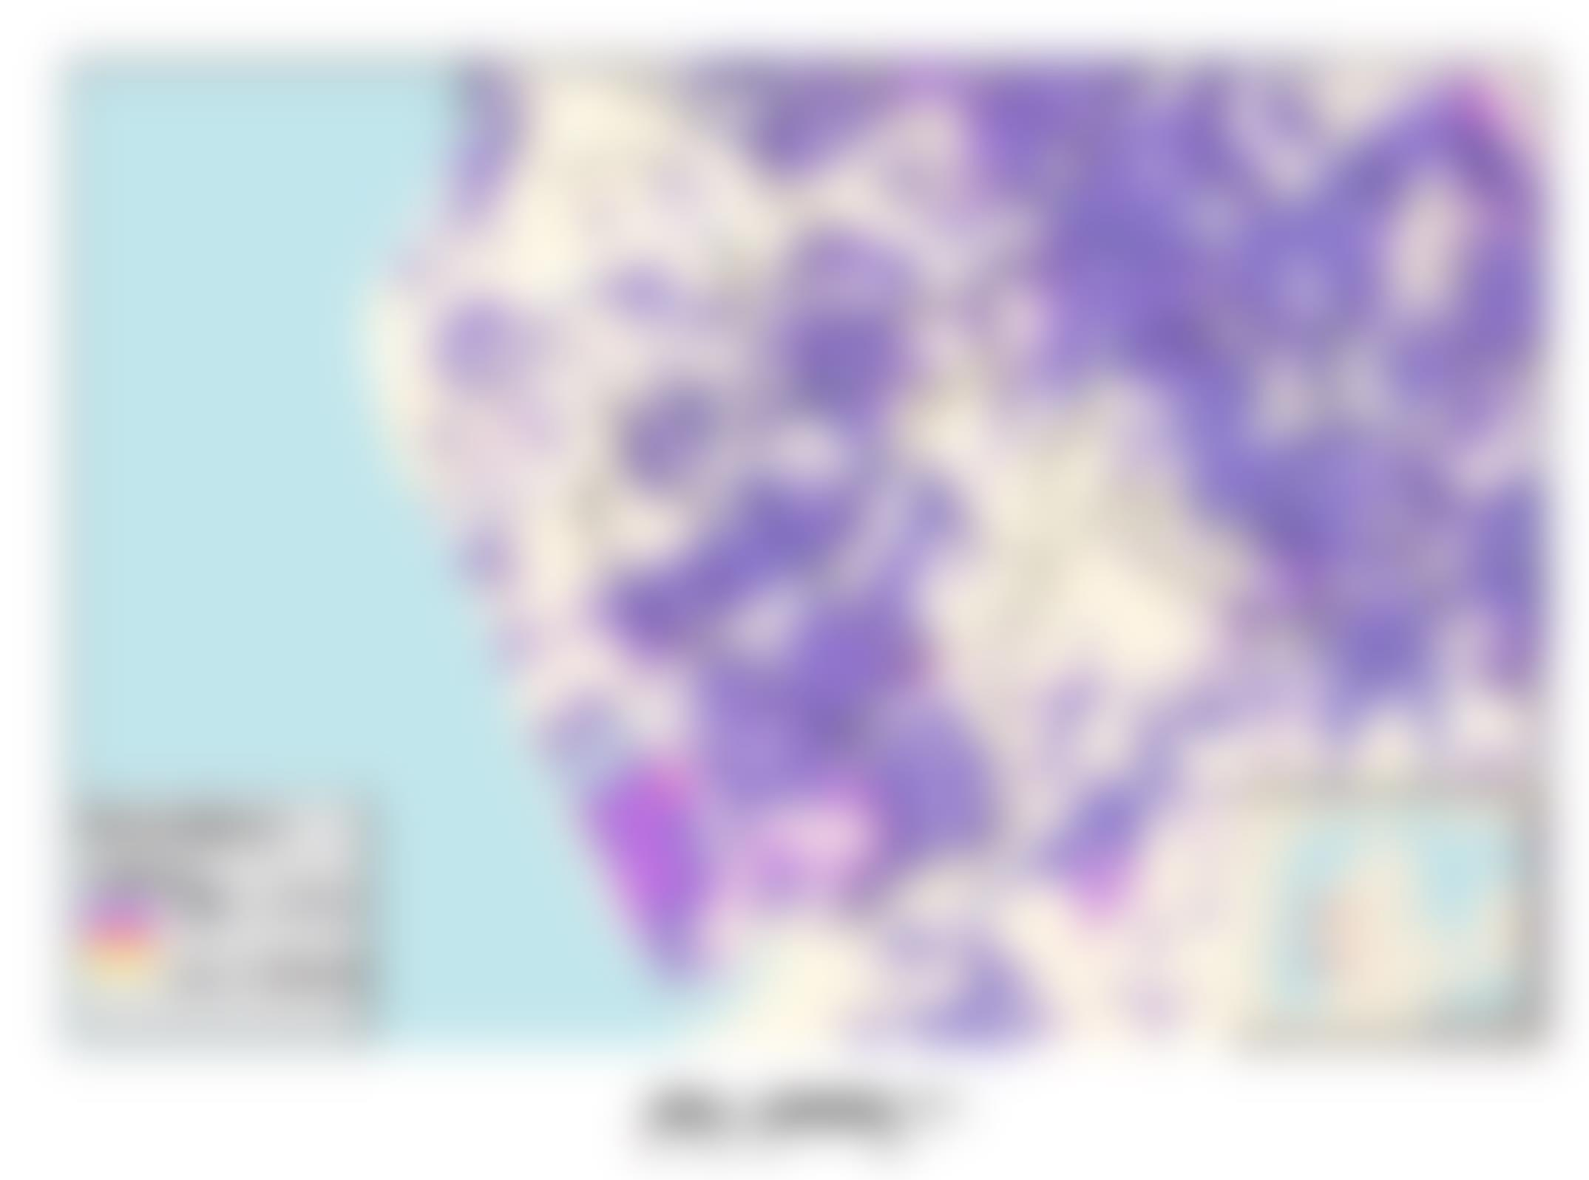
RESEARCH QUESTIONS
What is the critical load of acidity for forest soils in the Osborne Creek watershed according to site-specific (empirical) data analysis?
Has the critical load of acidity actually been exceeded? If so, by how much?
Is the Watershed Condition Framework rating of “3-impaired function” appropriate for the Huron-Manistee National Forests?

Slide 9

Background: Modeling Soil Acidification with the Simple Mass Balance (SMB) Model
CAL(S+N) = BC_{dep} – Cl_{dep} + BC_{w} – BC_{u} + N_{i} + N_{u} + N_{de} – ANC_{le,crit}
Notes:
So, there are many ways to model critical acid loads. The most commonly applied method is the simple mass balance method, which summarizes all of the cycling processes involved in contributing to or neutralizing acidity between trees and soils. So, in the following illustration, processes that contribute toward lowering soil acidity are highlighted red, and those that buffer soil acidity are highlighted blue. The critical load for sulfur and nitrogen, represented by the left side of the equation is the summation of…

Slide 10
Background: Modeling Soil Acidification with the Simple Mass Balance (SMB) Model
CAL(S+N) = BC_{dep} – Cl_{dep} + BC_{w} – BC_{u} + N_{i} + N_{u} + N_{de} – ANC_{le,crit}
S_{dep}
N_{dep}

Slide 11
Background: Modeling Soil Acidification with the Simple Mass Balance (SMB) Model
CAL(S+N) = BC_{dep} – Cl_{dep} + BC_{w} – BC_{u} + N_{i} + N_{u} + N_{de} – ANC_{le,crit}
S_{dep}
N_{dep}
Cl_{dep}
BC_{dep}

Slide 12
Background: Modeling Soil Acidification with the Simple Mass Balance (SMB) Model
CAL(S+N) = BC_{dep} – Cl_{dep} + BC_{w} – BC_{u} + N_{i} + N_{u} + N_{de} – ANC_{le,crit}
S_{dep}
N_{dep}
Cl_{dep}
BC_{dep}
BC_{w}

Slide 13
Background: Modeling Soil Acidification with the Simple Mass Balance (SMB) Model
CAL(S+N) = BC_{dep} – Cl_{dep} + BC_{w} – BC_{u} + N_{i} + N_{u} + N_{de} – ANC_{le,crit}
S_{dep}
N_{dep}
Cl_{dep}
BC_{dep}
BC_{u}
BC_{w}

Slide 14
Background: Modeling Soil Acidification with the Simple Mass Balance (SMB) Model
CAL(S+N) = BC_{dep} – Cl_{dep} + BC_{w} – BC_{u} + N_{i} + N_{u} + N_{de} – ANC_{le,crit}
S_{dep}
N_{dep}
Cl_{dep}
BC_{dep}
BC_{u}
N_{i}
BC_{w}

Slide 15
Background: Modeling Soil Acidification with the Simple Mass Balance (SMB) Model
CAL(S+N) = BC_{dep} – Cl_{dep} + BC_{w} – BC_{u} + N_{i} + N_{u} + N_{de} – ANC_{le,crit}
S_{dep}
N_{dep}
Cl_{dep}
BC_{dep}
N_{u}
BC_{u}
N_{i}
BC_{w}

Slide 16
Background: Modeling Soil Acidification with the Simple Mass Balance (SMB) Model
CAL(S+N) = BC_{dep} – Cl_{dep} + BC_{w} – BC_{u} + N_{i} + N_{u} + N_{de} – ANC_{le,crit}
S_{dep}
N_{dep}
Cl_{dep}
BC_{dep}
N_{de}
N_{u}
BC_{u}
N_{i}
BC_{w}

Slide 17
Background: Modeling Soil Acidification with the Simple Mass Balance (SMB) Model
CAL(S+N) = BC_{dep} – Cl_{dep} + BC_{w} – BC_{u} + N_{i} + N_{u} + N_{de} – ANC_{le,crit}
S_{dep}
N_{dep}
Cl_{dep}
BC_{dep}
N_{de}
N_{u}
BC_{u}
N_{i}
BC_{w}
ANC_{le,crit}

Slide 18
Background: Modeling Soil Acidification with the Simple Mass Balance (SMB) Model
CAL(S+N) = BC_{dep} – Cl_{dep} + BC_{w} – BC_{u} + N_{i} + N_{u} + N_{de} – ANC_{le,crit}
S_{dep}
N_{dep}
Cl_{dep}
BC_{dep}
N_{de}
N_{u}
BC_{u}
N_{i}
BC_{w}
ANC_{le,crit}

Slide 19
Background: Modeling Soil Acidification with the Simple Mass Balance (SMB) Model
Critical Acid Load Exceedance, Ex(S+N_{dep}) = S+N_{dep} – CAL(S+N)
Exceedance of CAL
Base Cation Exports:
Harvesting
Leaching Loss
Base Cation Imports:
Mineral Weathering
Base Cation Deposition (atmosphere)
Soil BC Exports
Soil BC Imports
Charge Balance (equivalent weight)
“Soil Compartment”
Notes:
Exceedance is then the difference between what the final critical acid load value is and the actual deposition of sulfur and nitrogen compounds from the atmosphere. It can essentially be thought of as the charge balance between base cation imports and exports from the soil compartment. In forest ecosystems, the main base cation exports from the soil are from harvesting, which essentially removes nutrients from the site that were originally derived from the soil, as well as natural and anthropogenic leaching losses. In contrast, the primary base cation imports are the slow release of base cations from primary minerals via weathering, and base cation deposition from the atmosphere.

Slide 20

Modeling Approach
Use SMB model, but insert as much site-specific (field collected) data as possible, compare to results from national scale estimates.
Empirical Data
  Stand Characteristics (Tree growth volume)
  Tree tissue nutrient concentrations (tree N and BC uptake)
  Soil mineralogy (mineral weathering rate)
Modeled Data
  Atmospheric Deposition of base cations Ca, Mg, K, Na (NADP data, 2000-2012) and Sulfur and Nitrogen (CMAQ data, 2000-2012)
  Discharge/soil infiltration (from nearest weather station)
  Acceptable leaching rate (ANC_{le,crit}) (NCSS data for Typic Udipsamments in MLRA 94a)
Assumed Data
  Critical BC:Al ratio is soil solution (acceptable leaching rate)
  Nitrogen dynamics (fate of N in soil)
Develop a range of CAL estimates- “best” and “worst” case scenarios
Notes:
It’s almost never practical to achieve a complete picture of all the parameters in the Simple Mass Balance Model, so some data will inevitably need to be assumed or modeled. In this study, the empirical data I collected included stand growth characteristics, tree tissue nutrient concentration data, and soil mineralogy (to calculate weathering), which are not only some of the most important (and sensitive) parameters in the SMB model, they also happen to be relatively inexpensive data to collect. Other data that needed to be modeled included the deposition of ions from the atmosphere, which is publicly available data from the National Atmospheric Deposition Program- I used the years 2000-2012, as well as sulfur and nitrogen deposition data from the Community Multi-scale Air Quality dataset (using the same years). Discharge (soil infiltration) was gathered from the nearest Michigan agricultural experiment station. And I modeled an acceptable leaching rate by deriving a localized relationship between Al and H in soil solution from lab data from the NCSS soil characterization database for typic udipsamments in MLRA 94a. Finally, the assumed parameters of the model included choosing the appropriate BC:Al ration in soil solution, which is generally set to 1o for deciduous trees and 1 for coniferous trees. And then also, because of the inherent difficulties in modeling the fate of N in forest soils, I developed a range of final CAL estimates which describe the best and worst case scenarios for soil acidification, where the best case scenario is that all N deposited that is not taken up by vegetation is continually cycled in the soil and not leached to groundwater, and the worst case scenario is that all N deposited not taken up by vegetation is leached.

Slide 21
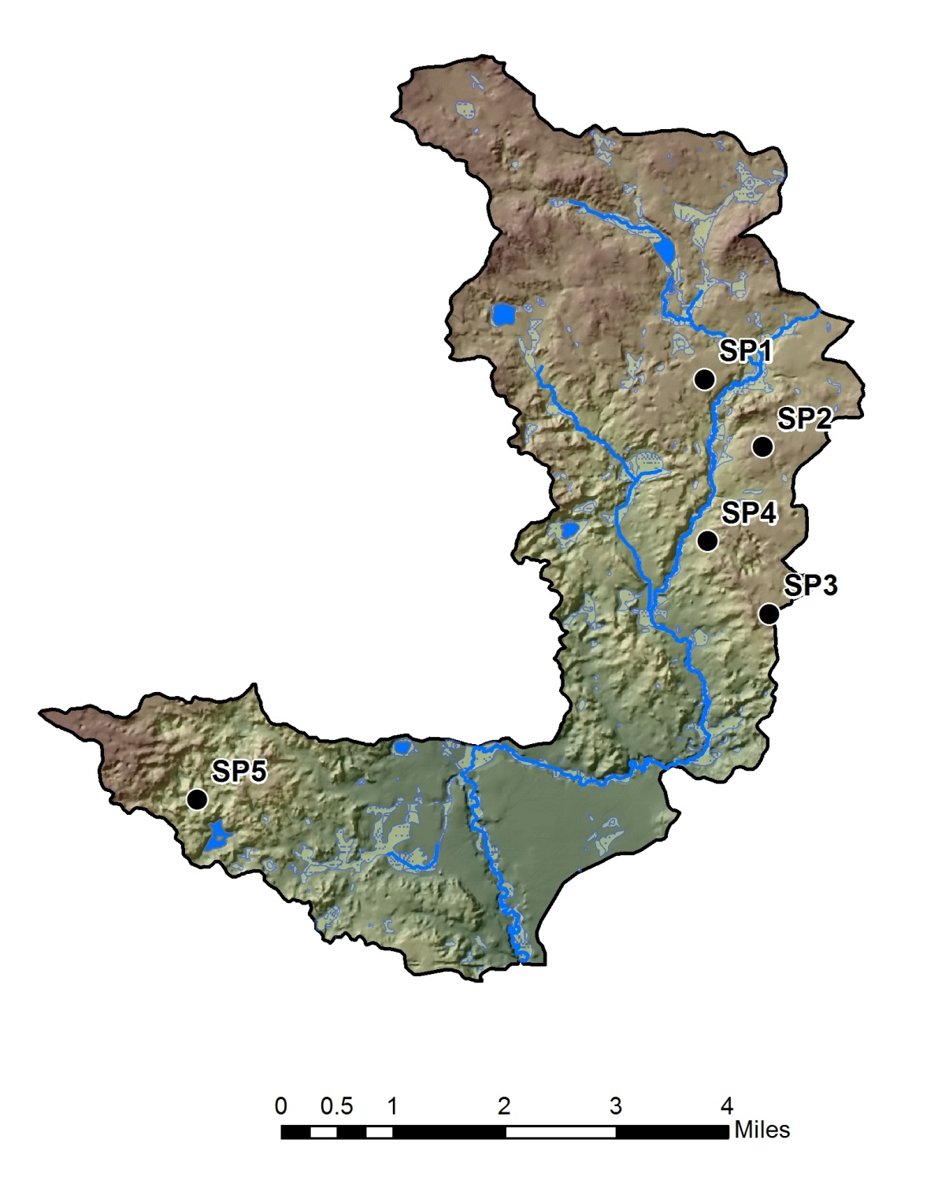
Osborne Creek Watershed
Five sites for detailed soil and tree sampling
  Site 1- red pine
  Site 2- sugar maple
  Site 3- white oak
  Site 4- red pine
  Site 5- northern red oak
Notes:
Here’s a DEM of the Osborne Creek watershed, with the sample sites indicated. The objective was to capture a range of samples across different forest types that also were part of national scale estimates for the same location.

Slide 22
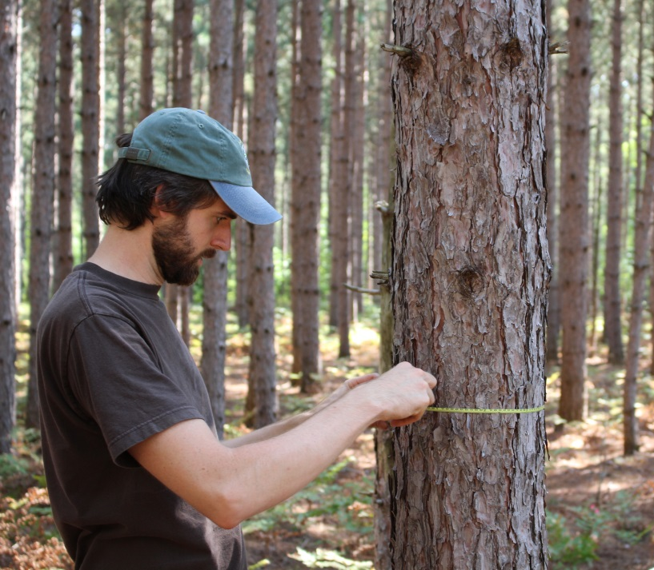

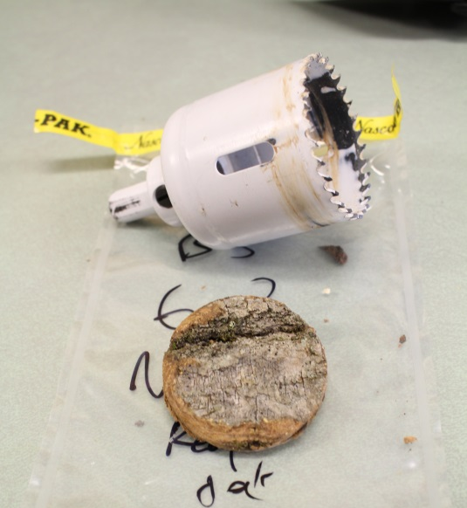
Methods: Tree Sampling (Nutrient Uptake: N_{u} and Bc_{u})
Trees > 5 in. DBH counted in 20x20 m site plot
Bark and Bole samples taken from 5 trees/site
Same 5 trees measured for DBH, bole height, and total height to calculate tree volume
Tree age (rings) counted and average nutrient uptake/tree/year for the 5 trees were extrapolated to frequency of trees in 20x20 m plot
N_{u} and BC_{u}= AVI x SG x nutrient concentrations of N, Ca, Mg, and K (derived from ICP-AES after HF-HNO₃ digest) for bark and bole calculated separately and added together.
Converted to eq/ha/yr
** Species-specific volumetric equations assume stem-only harvest (leaves and branches < 4-inch diameter left on site
Notes:
At each site, a 20x20 m plot was laid out, and trees were counted within the plot. 5 trees were randomly selected within the plot for tissue sampling (bole wood was gathered with a ¼ increment borer, and bark wood was sampled with a two-inch hole saw, and those same 5 trees were measured for diameter at breast height, bole height, and total height (including crown)- all to try to achieve an accurate estimate of tree volume. The tissue samples were subjected to ICP-AES after complete acid digestion. Then, the age of the trees (determined by counting rings), the specific gravity, the tree growth characteristics, and the nutrient contents derived from ICP-AES were used to determine Nitrogen and Base Cation uptake for the entire site by taking the average nutrient contents from the 5 sampled trees and extrapolating them to the number of trees in the stand, and converted to equivalents/ha/yr. Important note, tree uptake values are only representative of the amount of nutrients that are removed from a site via harvesting of the trees… in this study, I used species specific volumetric equations that assume a stem-only harvest where leaves- and branches < 4 inch diameter- are left on site.

Slide 23
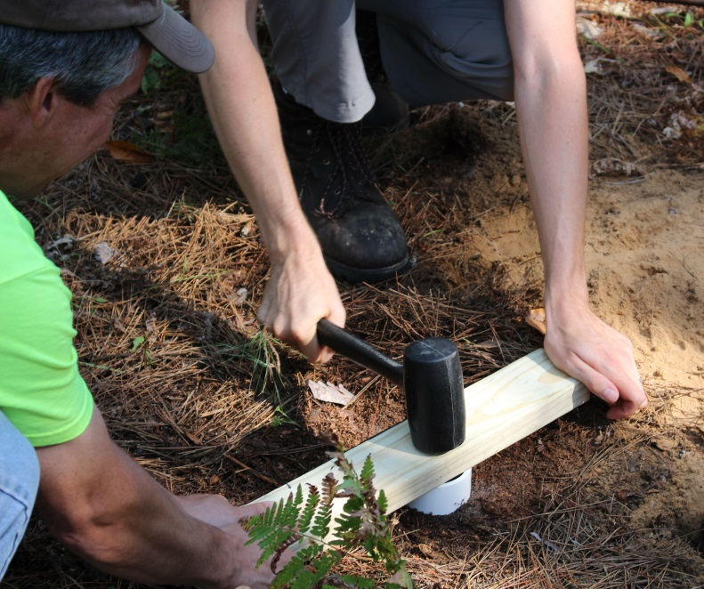
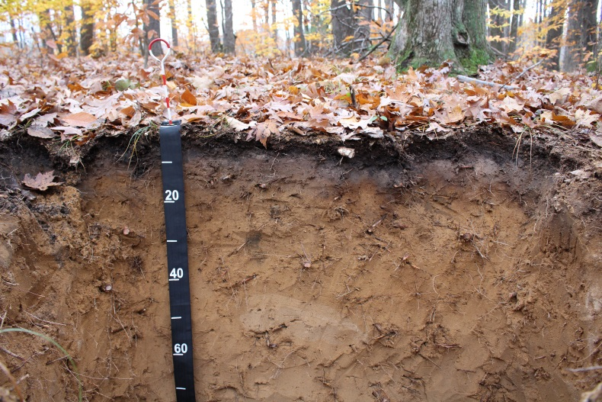

Methods: Soil Sampling (Base Cation Weathering: BC_{w} )
Lab methods (selective extractants)
Exchangeable bases (Ca, Mg, and K) at field pH (NH₄Cl) subtracted from…
Bases obtained via complete acid digestion (HF-HNO₃) to derive estimate of “remaining” (non-exchangeable/solid phase) quantities in each horizon
ICP-AES
Weathering Rate
Ti-depletion pedological mass balance (Elgi and Fitze, 2000) calculated as:
Bulk density sampling
$m_{j,flux}\left(z_{w}\right)=\sum_{a=1}^{n}{C_{j,p}ρ_{p}} \left(\frac{1}{ε_{i,w}+1}\right)τ_{j,w }∆z_{w}$
$ε_{i,w}= \left(\frac{ρ_{p}C_{i,p}}{ρ_{w}C_{i,w}}\right)−1$
$τ_{j,w }= \left(\frac{C_{j,w}C_{i,p}}{C_{j,p}C_{i,w}}\right)−1$
Horizon sampling
Notes:
Then, to model soil mineral weathering, pits were dug at the center of each 20x20 m plot, bulk density samples collected from the surface, and 3 more at different depths from the pit face down into the C horizon. Horizons were described and sampled according to NRCS standards. Then each of the horizon samples was subjected to two selective extractants in the lab- the first; exchangeable bases at field pH using NH4Cl, and the second; complete acid digestion followed by ICP-AES for both. This data was then used to estimate mineral weathering for each horizon using Ti-depletion PMB method, which essentially compares the relative concentrations of weatherable minerals (such as major base cations) and non-weatherable minerals in surface horizons vs. underlying parent materials.. The purpose of the two different extractants was to eliminate the base cations adsorbed to OM prior to calculating weathering losses, essentially to restrict the mass flux calculations to remaining (non-exchangeable/solid) mineral phases. Failing to make this adjustment could result in a significant underestimation of mineral weathering from surface horizons due to the preferential uptake and release back to the soil of base cations adsorbed to OM…. This becomes more important later.

Slide 24
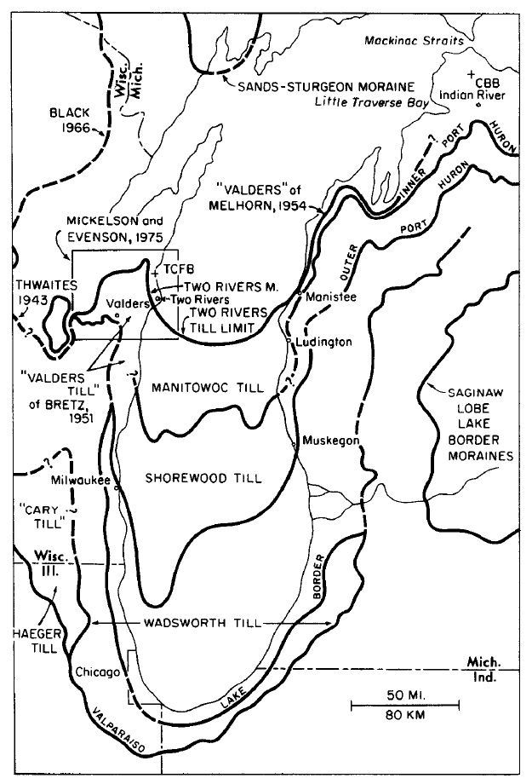
Methods: Soil Sampling (Base Cation Weathering: BC_{w} )
Weathering Rate
Results of Ti-depletion are then divided by absolute age of landscape…
Study area falls between Inner and Outer Port Huron Moraines (red dot at left)
Minimum limiting age of Inner port Huron = 12,960 (±350) radiocarbon years BP (Blewett et al., 1993)
Value of 15,100 Calendar years BP was used
Map from Evenson et al. (1976)
Notes:
Then after total weathering losses from each horizon are summed throughout the profile, the results are converted to equivalents and divided by the age of the landscape. Now, the age of the landscape surrounding the study area hasn’t been well constrained by absolute dates, however, the osborne creek watershed (represented by the red dot here) falls between the inner and outer Port-Huron Moraines, which Blewett et al dated the Inner Port Huron Moraine to approximately to 12,960 radio carbon years BP, which converts to around 15,100 calendar years, which was considered a conservative (over estimation) of the age of the soils in the study area.

Slide 25
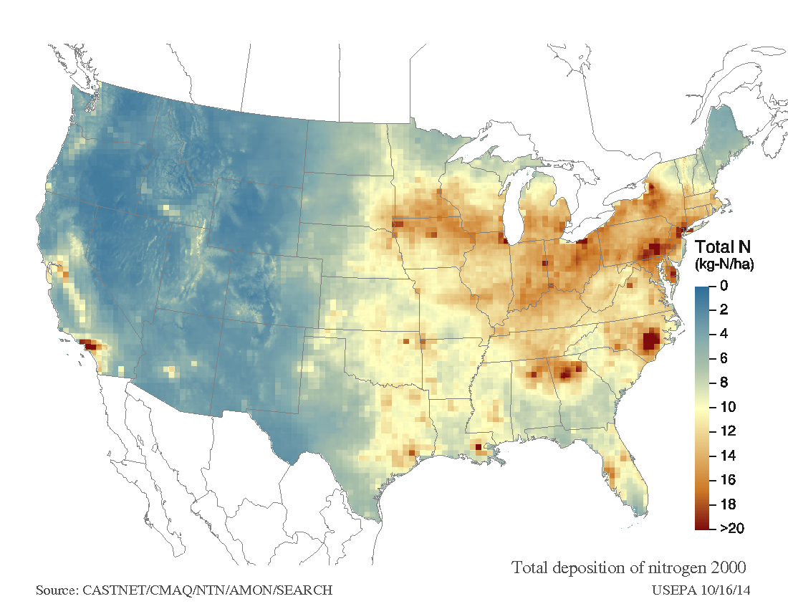
Results: Atmospheric Deposition (S_{dep} + N_{dep} )

Slide 26
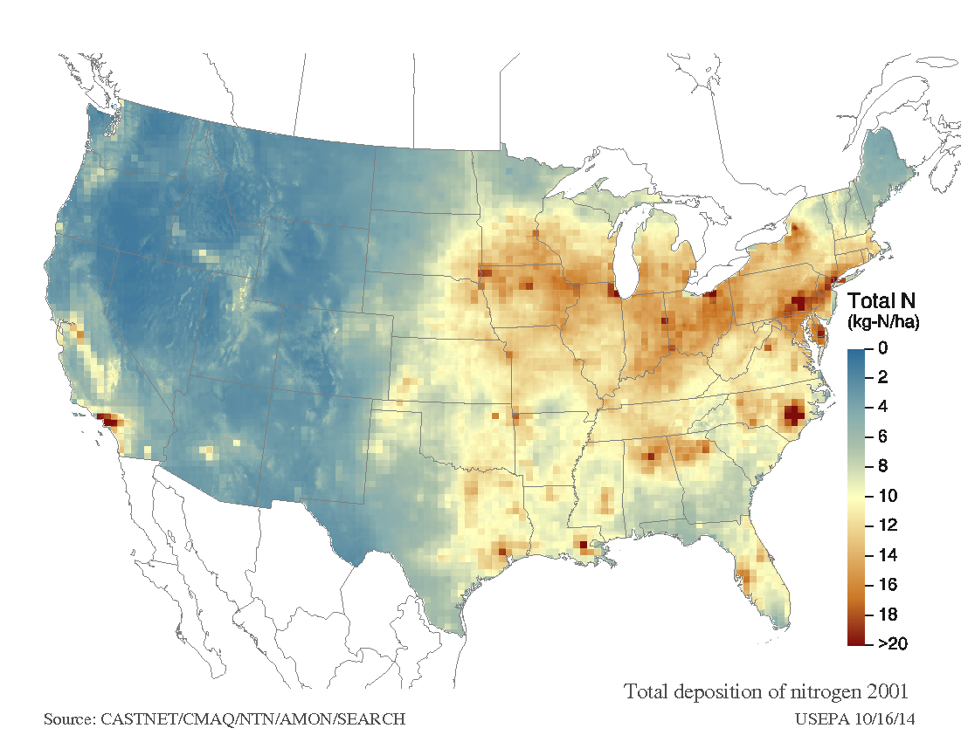
Results: Atmospheric Deposition (S_{dep} + N_{dep} )

Slide 27
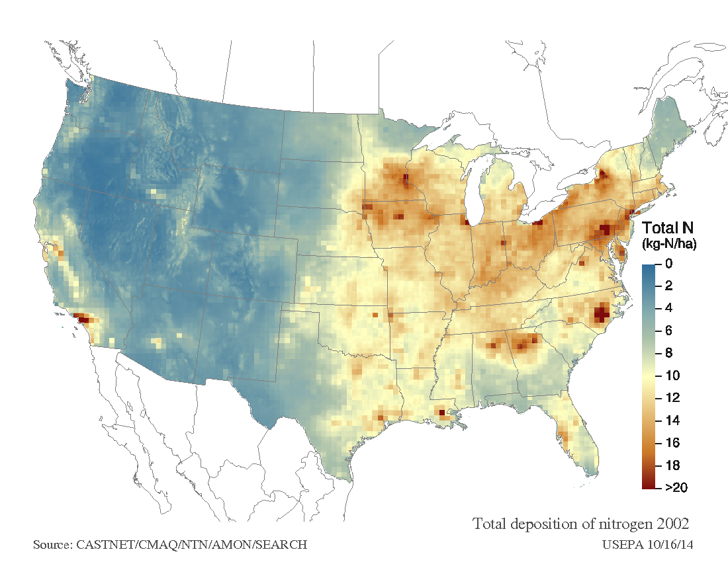
Results: Atmospheric Deposition (S_{dep} + N_{dep} )

Slide 28
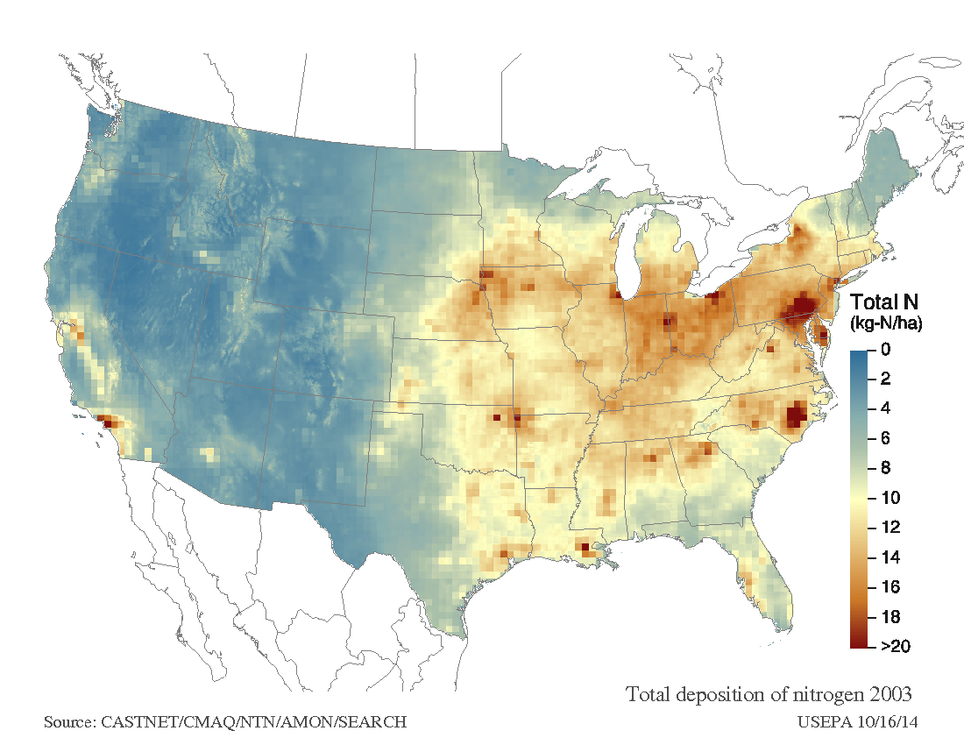
Results: Atmospheric Deposition (S_{dep} + N_{dep} )

Slide 29
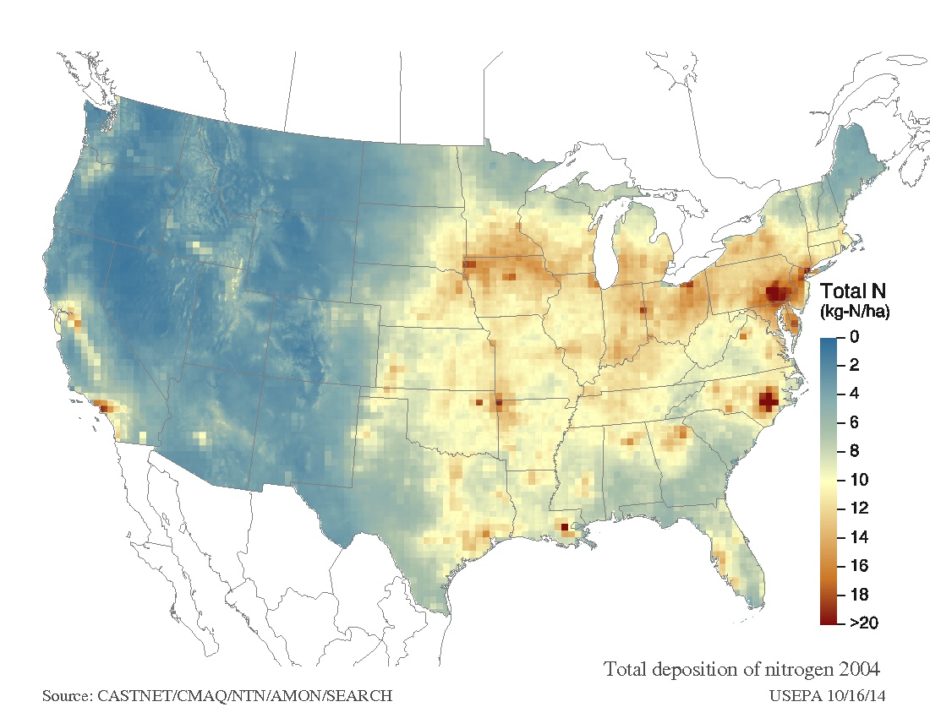
Results: Atmospheric Deposition (S_{dep} + N_{dep} )

Slide 30
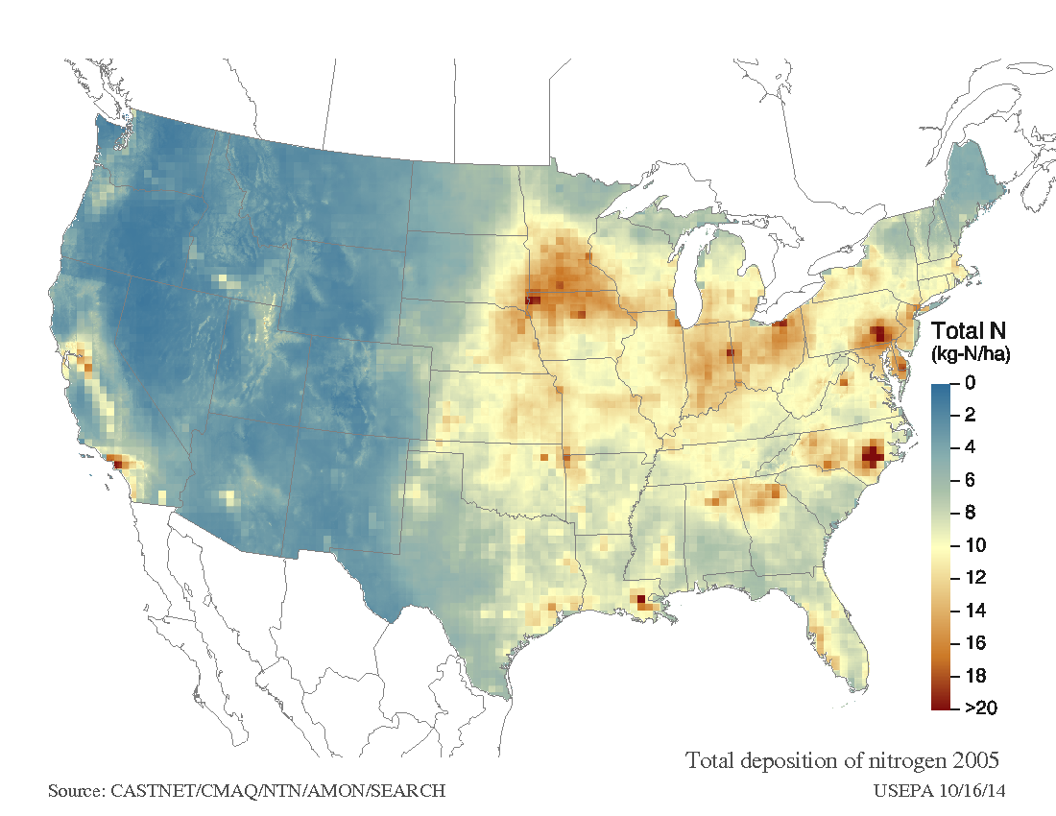
Results: Atmospheric Deposition (S_{dep} + N_{dep} )

Slide 31
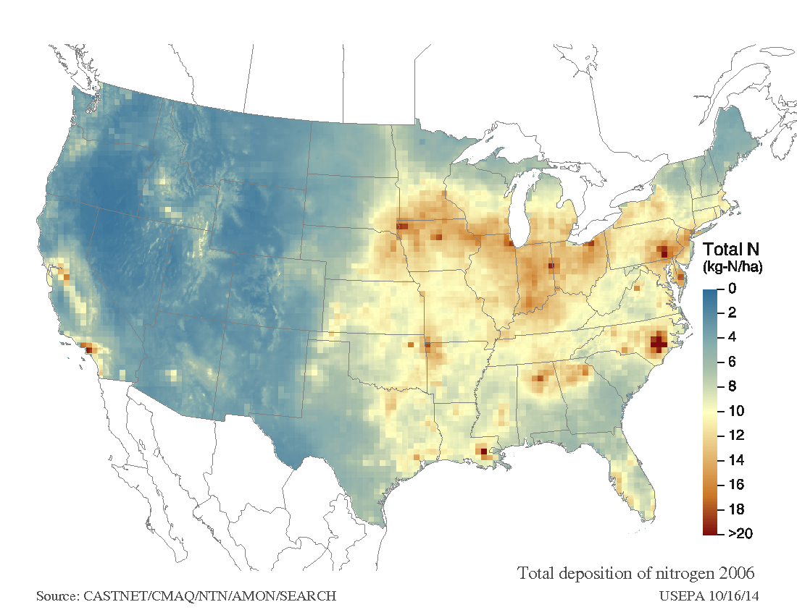
Results: Atmospheric Deposition (S_{dep} + N_{dep} )

Slide 32
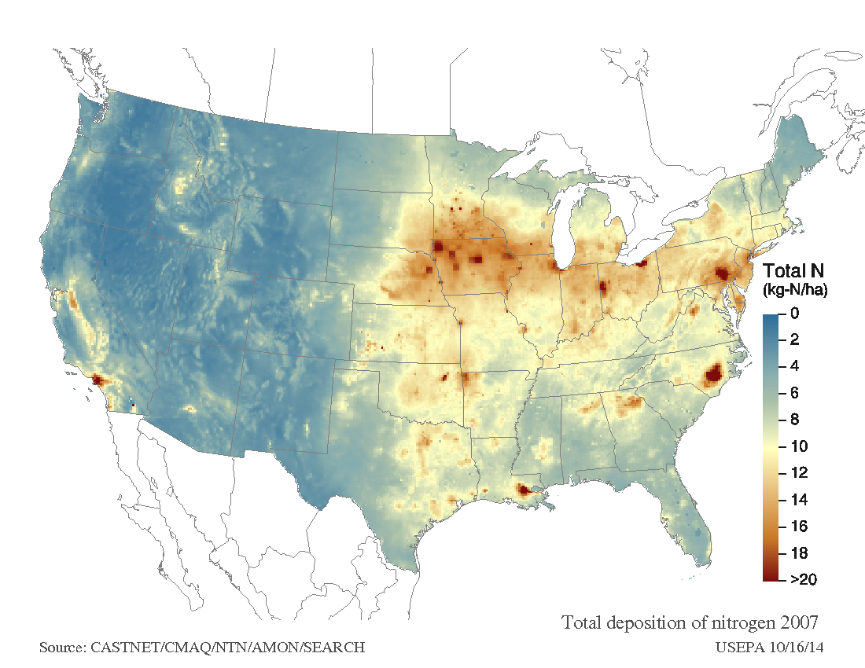
Results: Atmospheric Deposition (S_{dep} + N_{dep} )

Slide 33
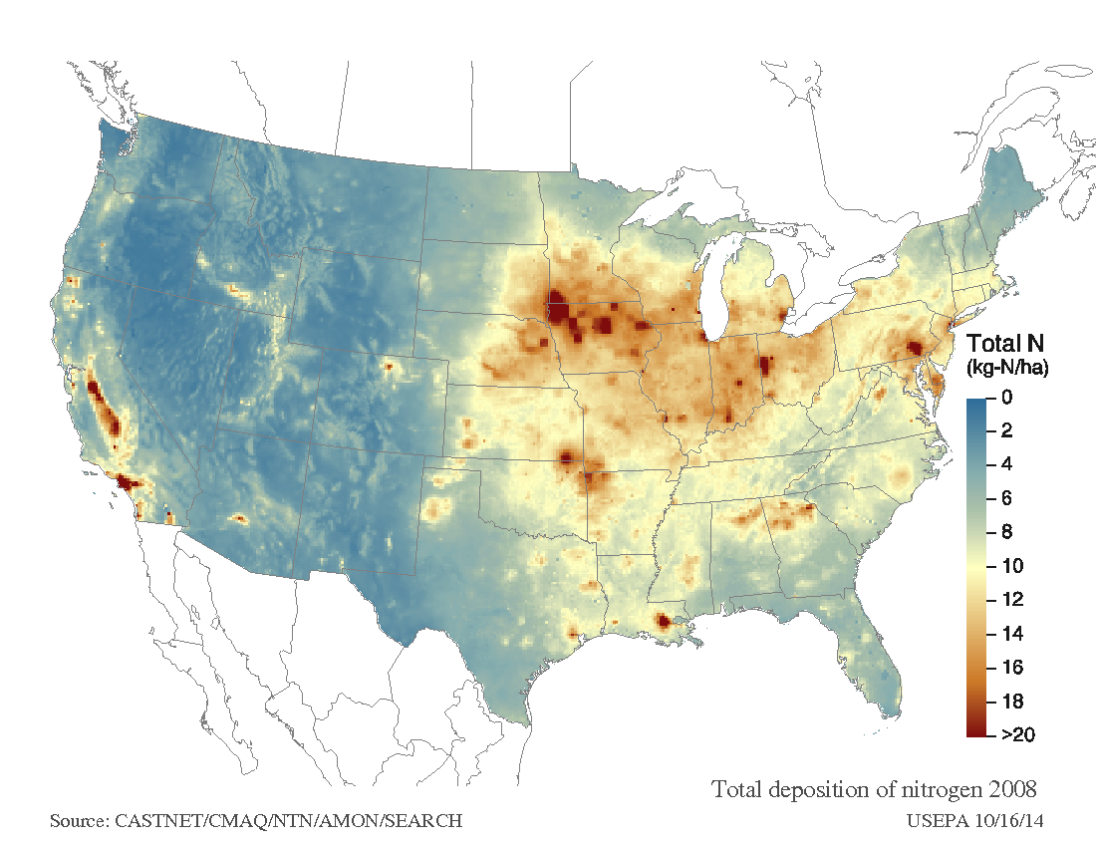
Results: Atmospheric Deposition (S_{dep} + N_{dep} )

Slide 34
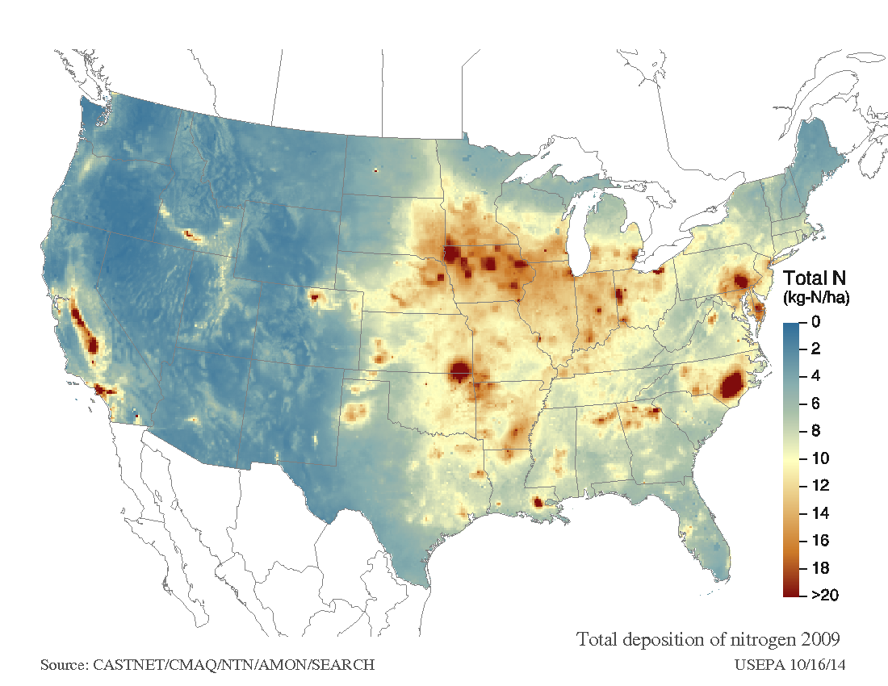
Results: Atmospheric Deposition (S_{dep} + N_{dep} )

Slide 35
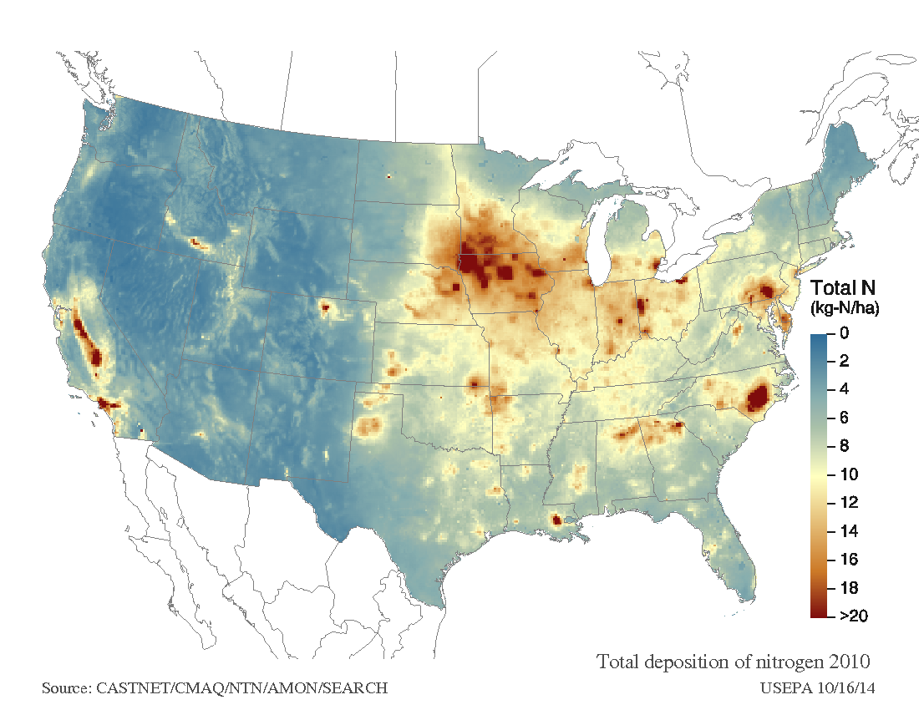
Results: Atmospheric Deposition (S_{dep} + N_{dep} )

Slide 36

Results: Atmospheric Deposition (S_{dep} + N_{dep} )

Slide 37

Results: Atmospheric Deposition (S_{dep} + N_{dep} )

Slide 38
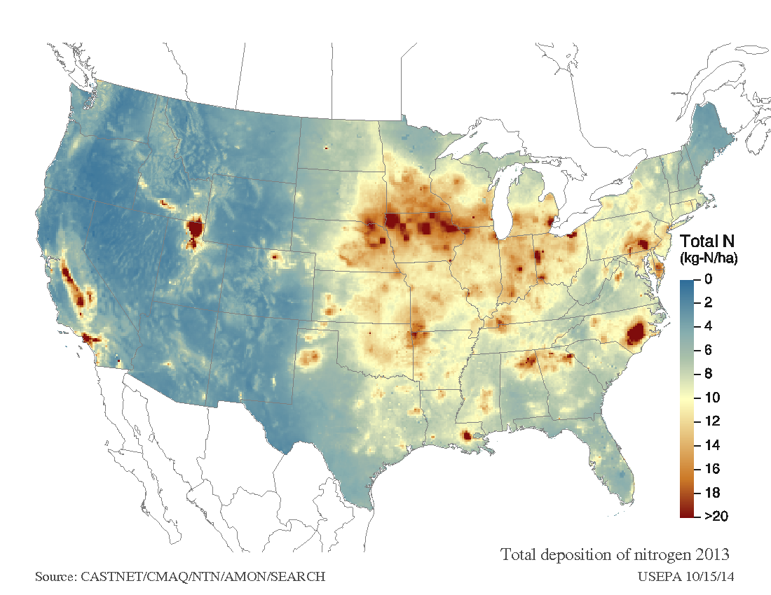
Results: Atmospheric Deposition (S_{dep} + N_{dep} )

Slide 39
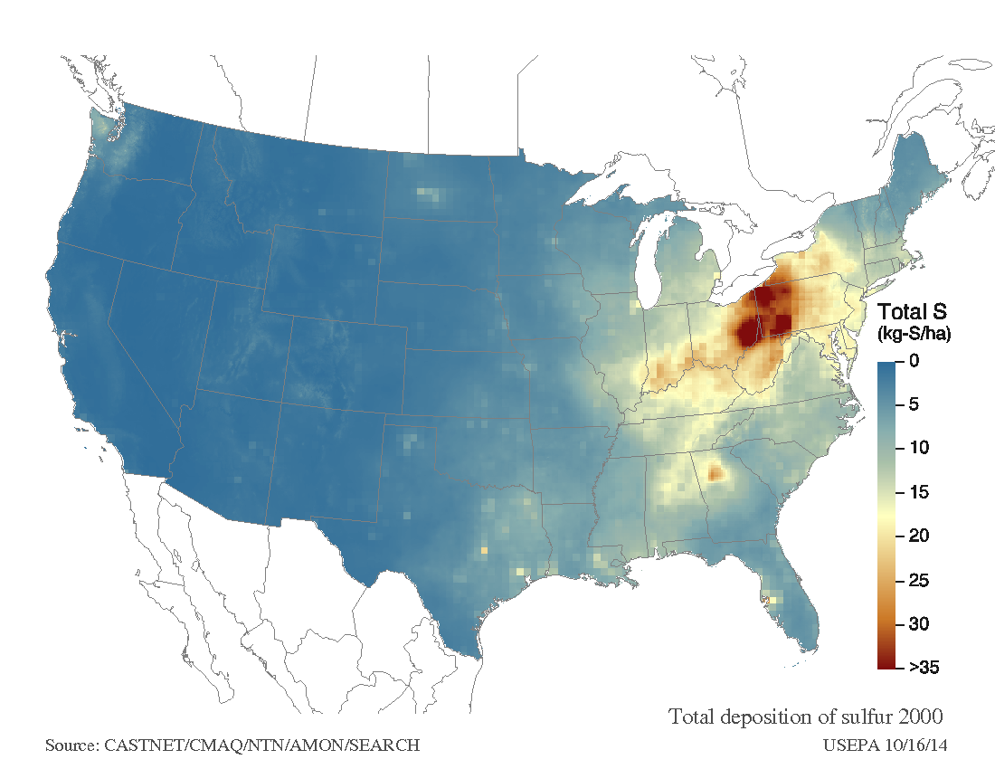
Results: Atmospheric Deposition (S_{dep} + N_{dep} )

Slide 40

Results: Atmospheric Deposition (S_{dep} + N_{dep} )

Slide 41

Results: Atmospheric Deposition (S_{dep} + N_{dep} )

Slide 42

Results: Atmospheric Deposition (S_{dep} + N_{dep} )

Slide 43

Results: Atmospheric Deposition (S_{dep} + N_{dep} )

Slide 44
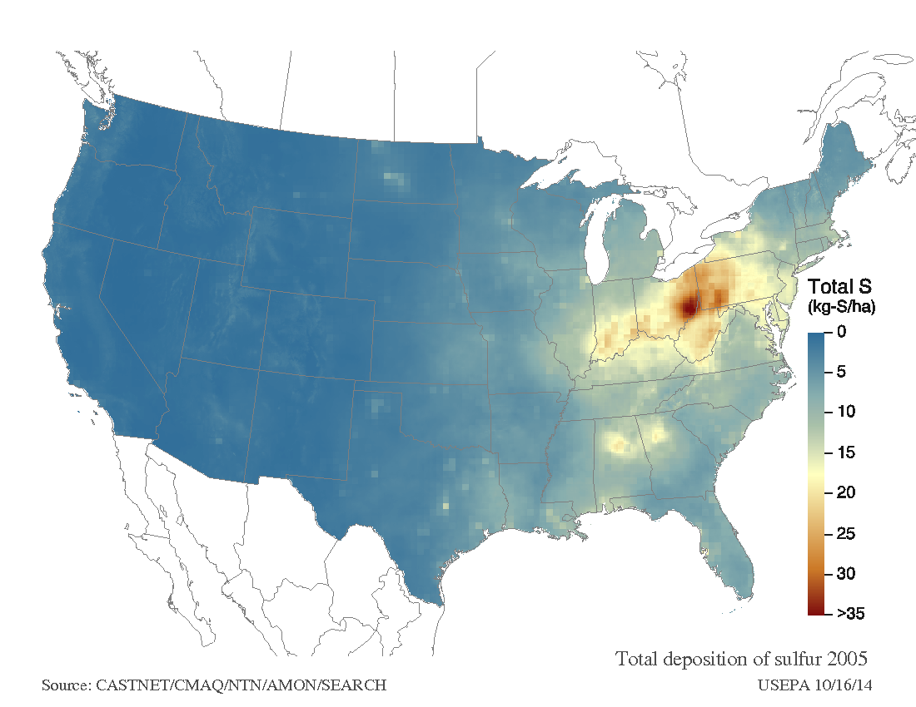
Results: Atmospheric Deposition (S_{dep} + N_{dep} )

Slide 45

Results: Atmospheric Deposition (S_{dep} + N_{dep} )

Slide 46

Results: Atmospheric Deposition (S_{dep} + N_{dep} )

Slide 47

Results: Atmospheric Deposition (S_{dep} + N_{dep} )

Slide 48
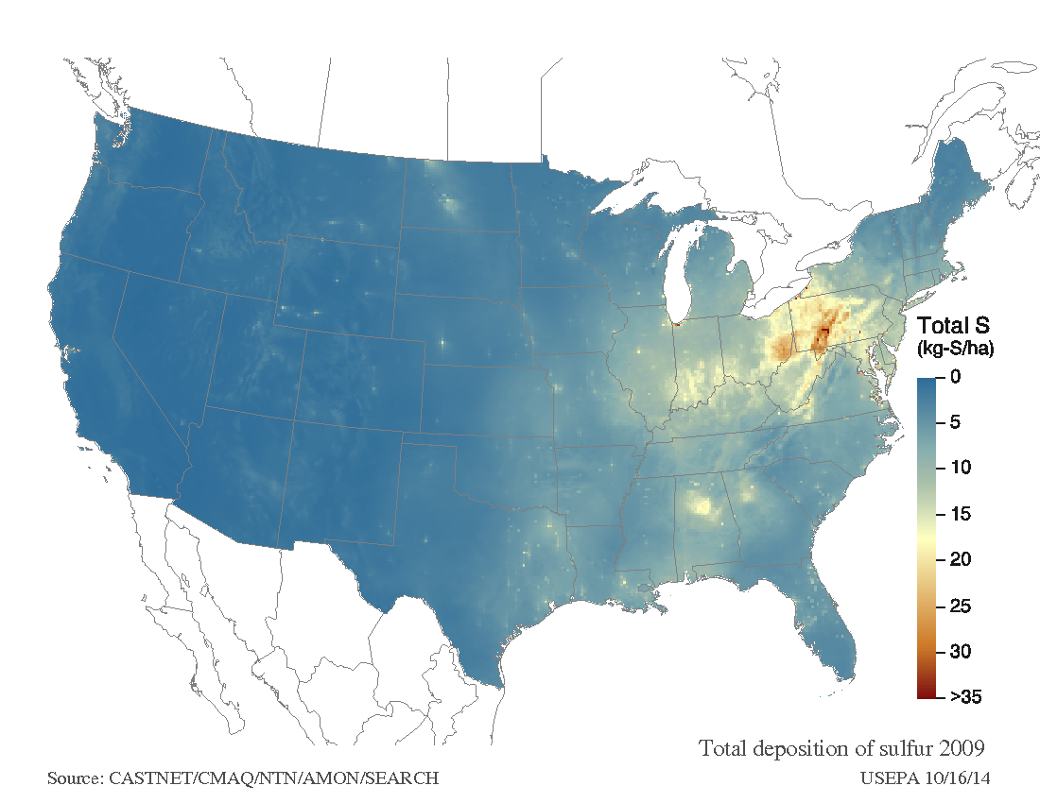
Results: Atmospheric Deposition (S_{dep} + N_{dep} )

Slide 49

Results: Atmospheric Deposition (S_{dep} + N_{dep} )

Slide 50
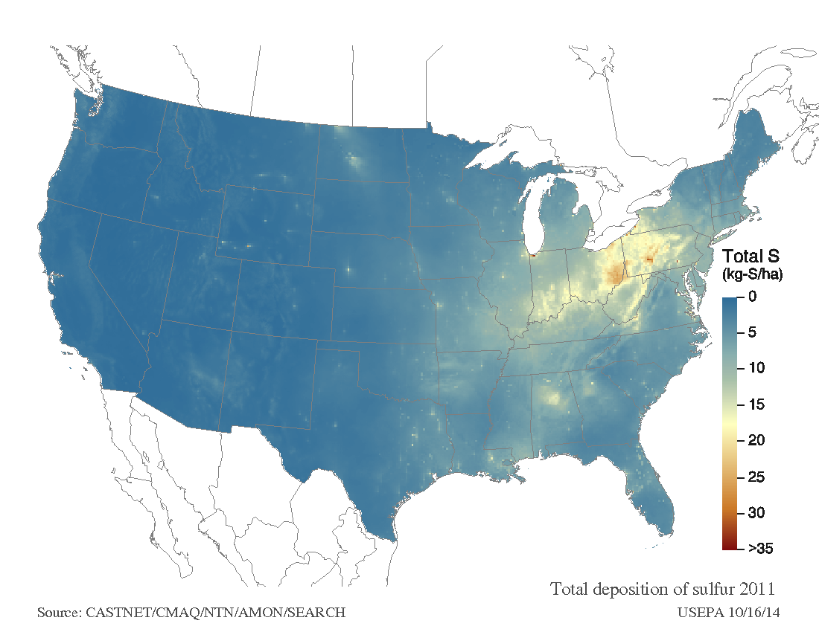
Results: Atmospheric Deposition (S_{dep} + N_{dep} )

Slide 51
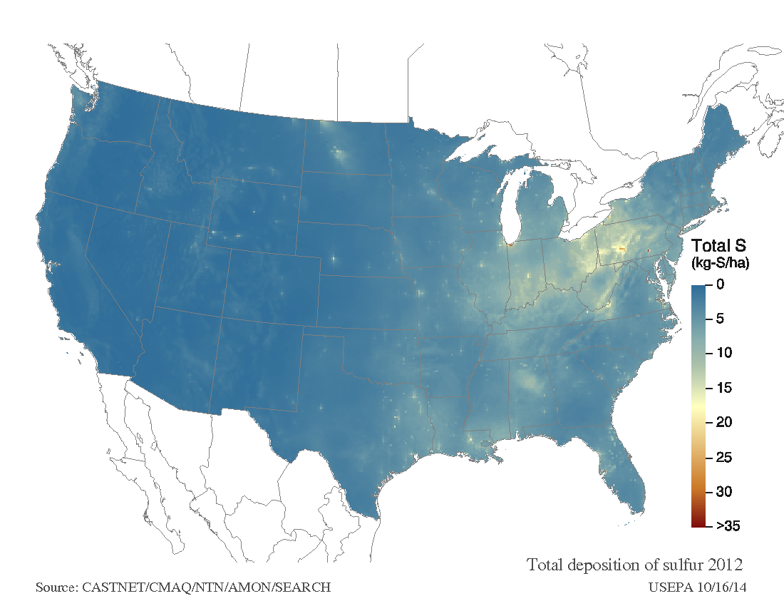
Results: Atmospheric Deposition (S_{dep} + N_{dep} )

Slide 52
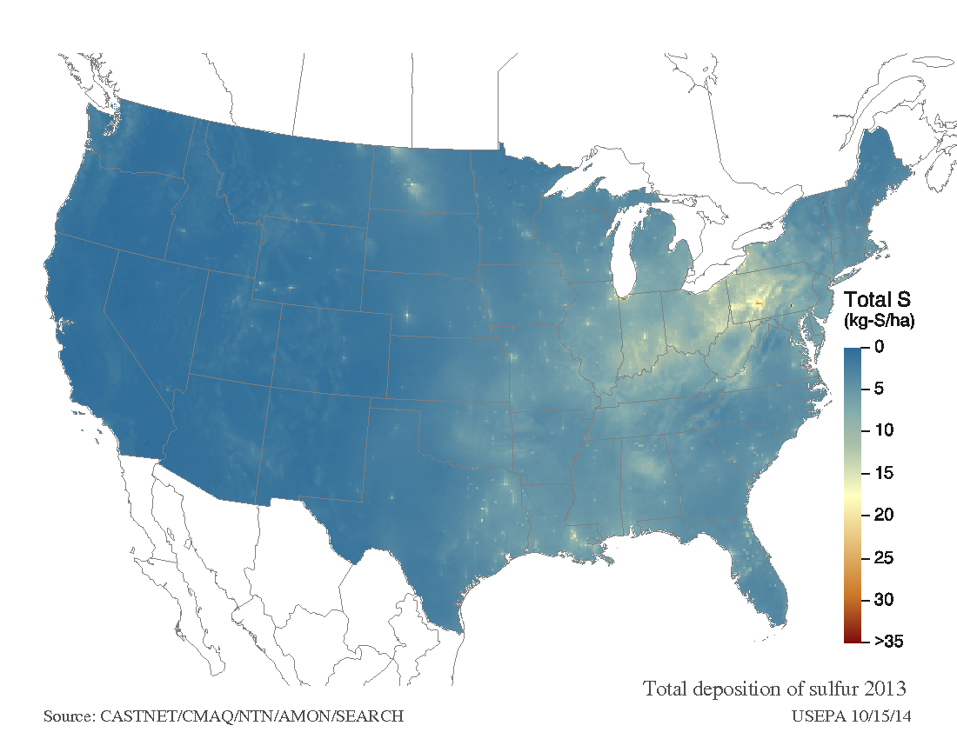
Results: Atmospheric Deposition (S_{dep} + N_{dep} )

Slide 53
Results: BC_{u} (base cation uptake- comparison of studies)
S1 - red pine
S2 – sugar maple
S3 – white oak
S4 – red pine
S5 – northern red oak
Notes:
Here are some results of base cation uptake from this study, and from the same species used in the national scale study by McNulty et al. The values used as input data in the national scale study are derived from the Tree Chemistry Database, which is essentially an amalgamation of published values from all over North America. Some species have a lot of data, and the averages are therefore more meaningful, whereas others (such as white oak) only have four published values. Three observations here- all of the sites in this study have greater uptake values, 2) the hardwood sites, particularly white oak and sugar maple are more than twice as high as what was used in national scale estimates, and 3) even the two red pine sites in this study exhibit considerable differences. So, the method used in this study to estimate nutrient uptake assumes that tissue concentrations in sampled trees adequately represent the entire population of trees across the stand (i.e., average data from sampled trees were extrapolated to un-sampled trees). This assumption is based on the premise that nutrients and water in the soil are consistent across the site and not limiting, and therefore, tissue concentrations are largely controlled by genetics (Alban 1988).

Slide 54
Results: N_{u} (Nitrogen uptake- comparison of studies)
S1 - red pine
S2 – sugar maple
S3 – white oak
S4 – red pine
S5 – northern red oak
Notes:
So, the method used in this study to estimate nutrient uptake assumes that tissue concentrations in sampled trees adequately represent the entire population of trees across the stand (i.e., average data from sampled trees were extrapolated to un-sampled trees). This assumption is based on the premise that nutrients and water in the soil are consistent across the site and not limiting, and therefore, tissue concentrations are largely controlled by genetics (Alban 1988).

Slide 55
Results (Tree bole BC concentrations)
S1 - red pine
S2 – sugar maple
S3 – white oak
S4 – red pine
S5 – northern red oak
Notes:
But if you look at the actual nutrient concentration data (this here from bole wood samples), you’ll see there is considerable variation among species groups. What’s interesting to me is that you have the same relative concentrations of Mg/K/Ca within a species group, but the actual contents vary considerably, particularly among the hardwood species.

Slide 56
Results (Tree bark BC concentrations)
S1 - red pine
S2 – sugar maple
S3 – white oak
S4 – red pine
S5 – northern red oak
Notes:
Here’s the same kind of data for the tree bark samples, notice the scale here is ten-fold bigger, as bark growth tends to demand more nutrients than bole wood. But, the same basic observations apply- that hardwoods have more variation than the conifer sites, and therefore it is much more difficult to model nutrient uptake for hardwoods than for softwoods… and that the final critical load for these sites should be interpreted with this uncertainty in mind.

Slide 57
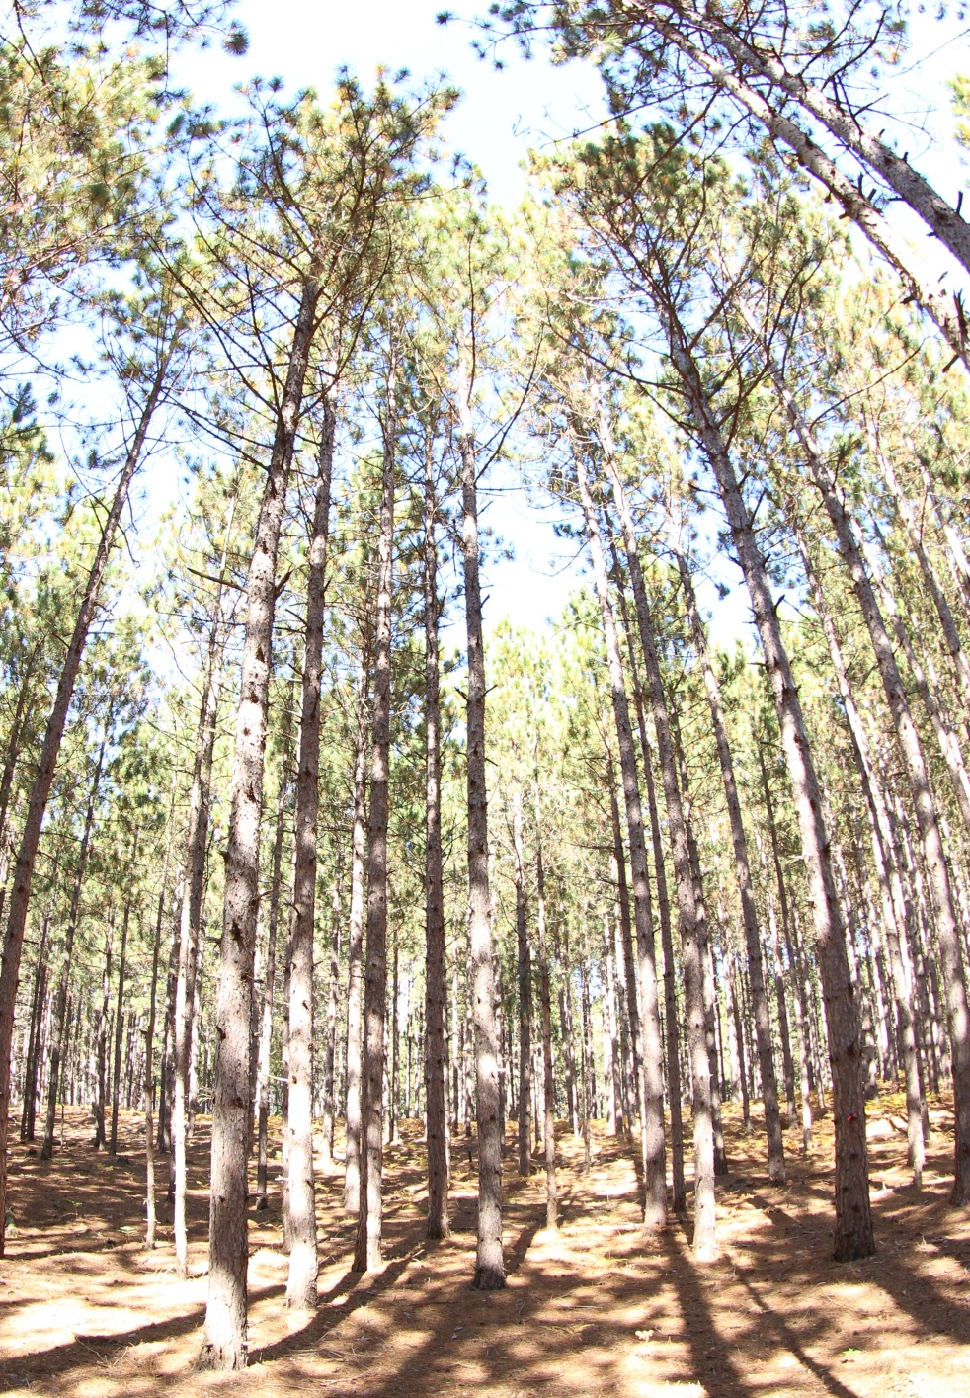
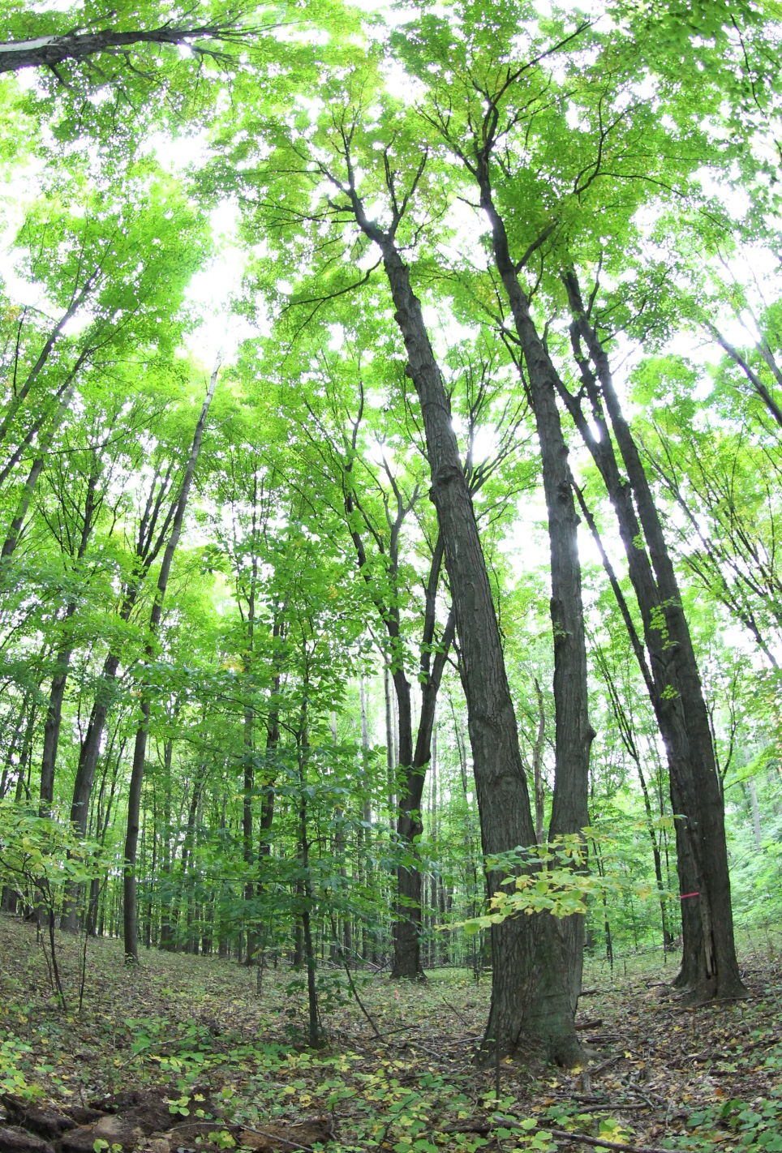
Does stand heterogeneity influence nutrient uptake?
Diverse Structure
Even-Aged/Monoculture
S2 – sugar maple
S4 – red pine
Notes:
But, what I’d like to suggest as well, is that perhaps nutrient uptake is more influenced by stand structure than by genetics alone…. So, that stands with more heterogeneous structure, such as the sugar maple site on the left here have much greater variability in nutrient uptake because light and growing space is more mixed, as opposed to your classic red pine plantation on the right here, which are all even aged and planted in rows, and therefore, light and space is consistently limited across the stand…

Slide 58
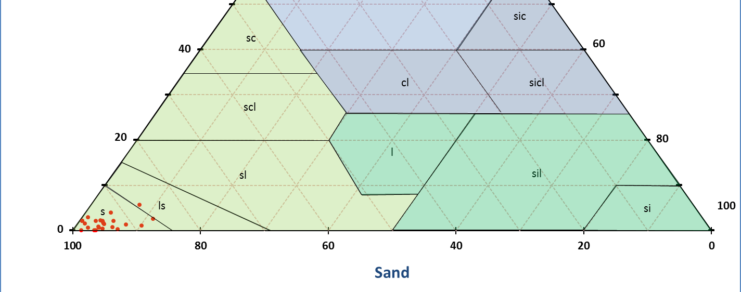
Results: soil physiochemical characteristics
Clay
Silt
Average characteristics of all horizons (n= 24)
Clay contents = 1.6%
Effective Cation Exchange Capacity = 0.45 cmol/kg
Loss On Ignition = 2.83%
Notes:
So, lets shift focus a bit and look at some of the soils data. All of the sampled horizons are incredibly sandy… average clay contents are around 1.6% for all horizons, eCEC is around .45 cmol/kg, and LOI is a meager 2.83%... These soils are so sandy and nutrient poor, I had to double check with the lab that the numbers were right!

Slide 59
Results: Soil horizon pH
pH
Very strongly acid
Strongly acid
Ultra acid
Extremely acid
Notes:
Here’s a depth plot of pH for the 5 soil pits. All sites exhibit lowest pH in surface horizons, which receive the bulk of atmospheric deposition. All increase with depth. Some of the surface horizons have pH in the realm of ultra acid, between 3-3.5 pH… incredibly acidic.

Slide 60
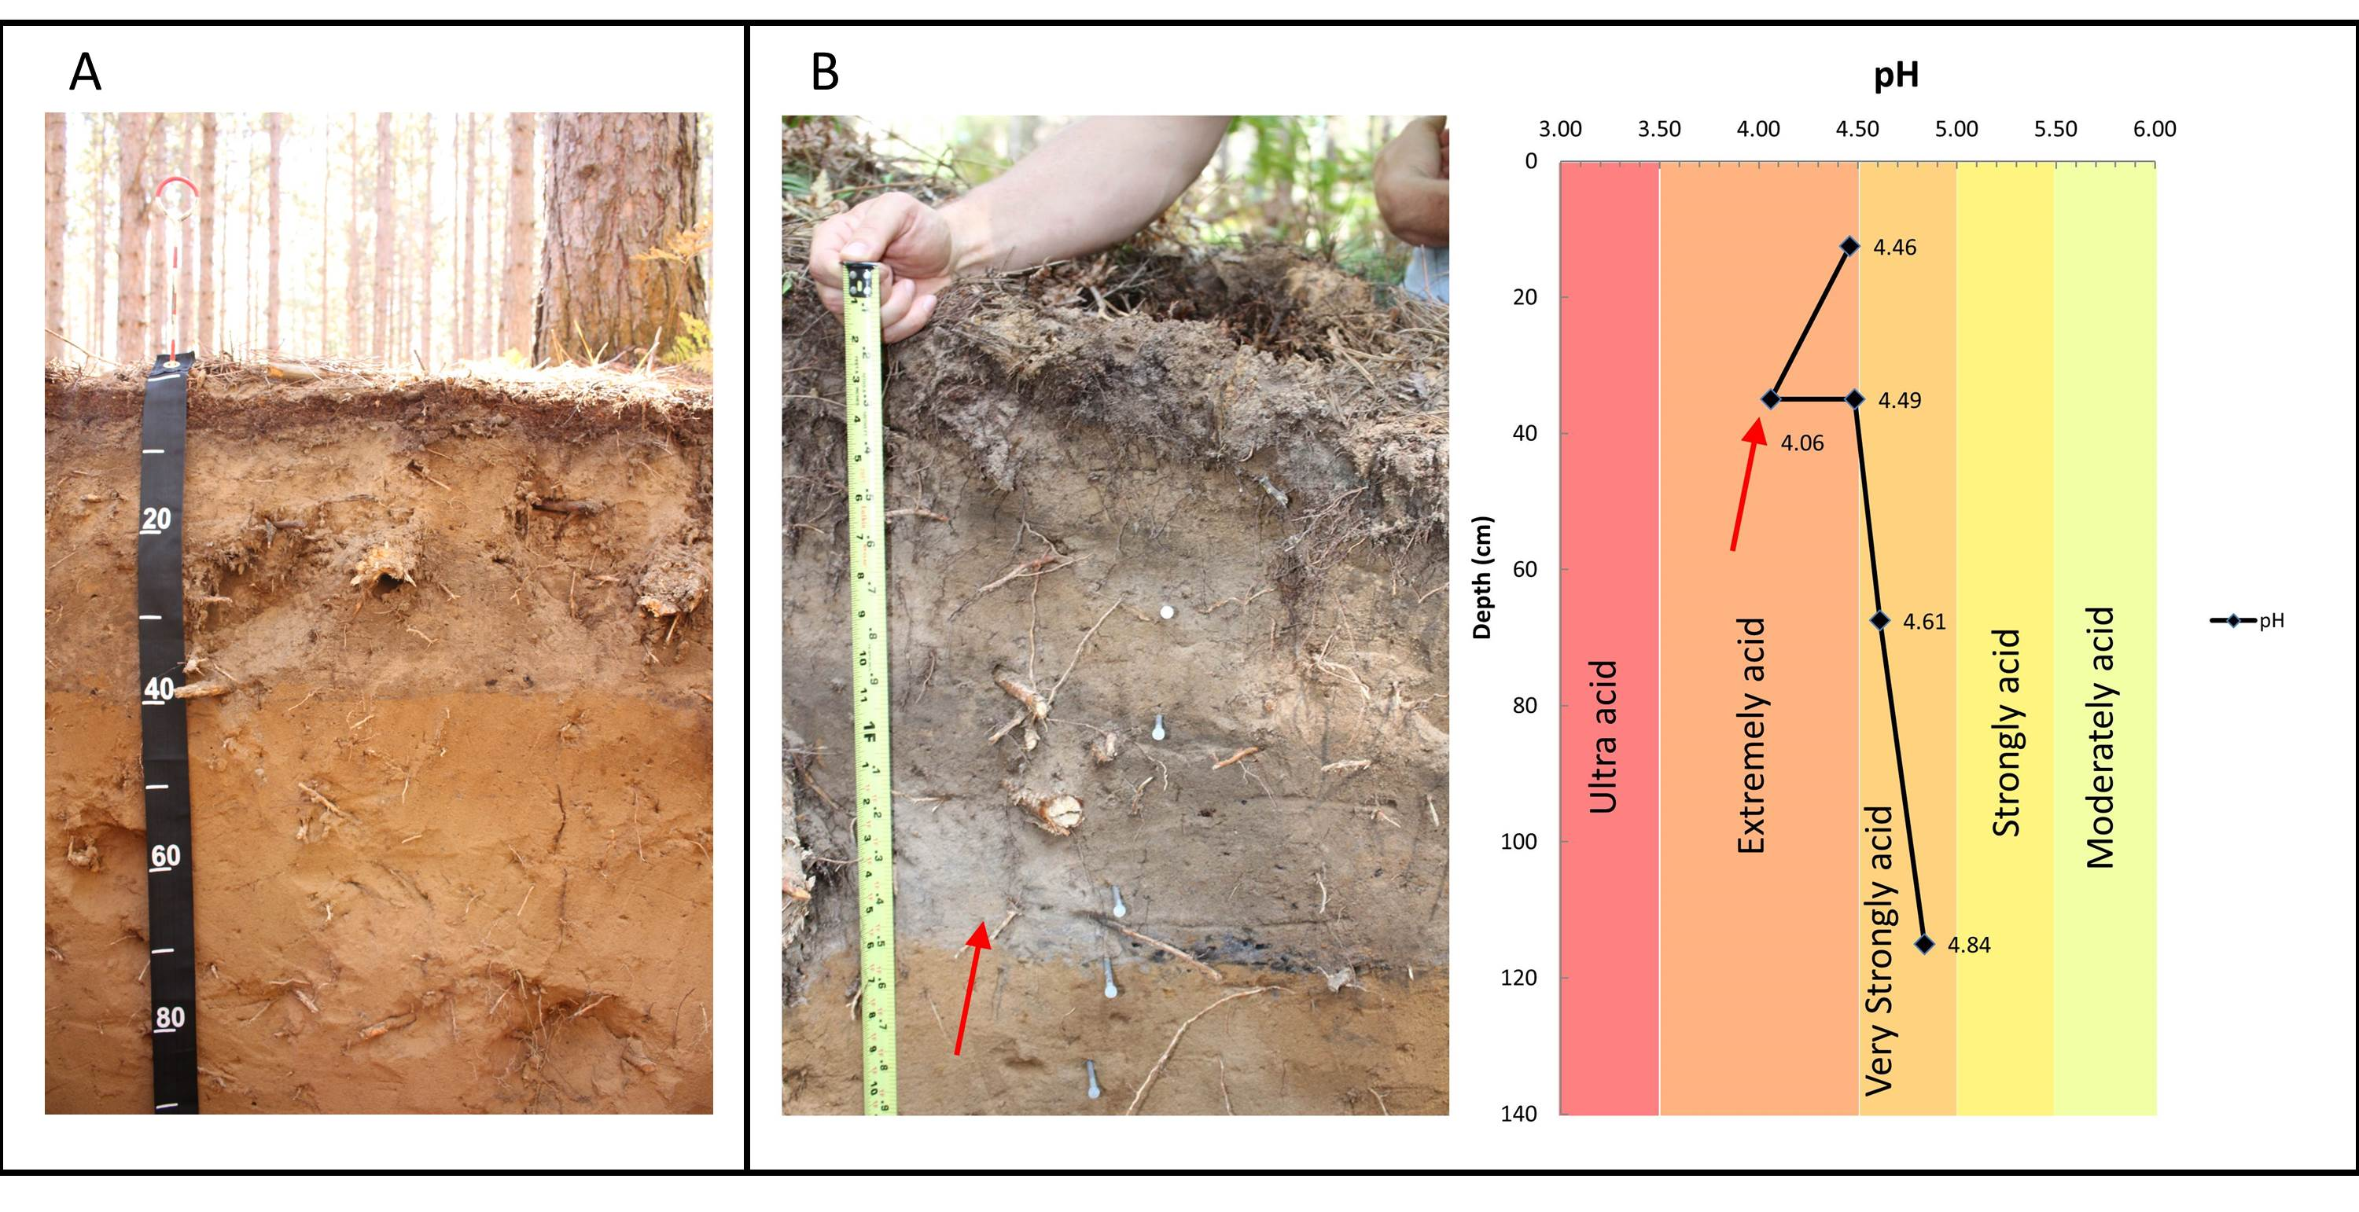
Results: soils under red pine- some evidence of acidification
Apb horizons slightly lighter than overlying A horizons (10YR 5/2 vs. 10YR 2/2)
Lighter color/lower pH around large root (site 1)
Low Molecular Weight organic acids/nutrient mining?
Site 4
Site 1
A
E
A/E
Apb
E
Btw
Apb
C
BC
Notes:
The red pine sites in particular exhibit some actual physical signs of acidification. These sites were failed agricultural fields back at the turn of the last century, prior to the land being turned over to the forest service- so what you see is a classic buried Apb horizon, which was then subsequently buried during site preparation for planting red pine in the 1960s. It’s difficult to tell in the picture, but the buried Apb horizons are slightly lighter in color than their overlying more recent A horizons, suggesting that acidic conditions in the subsoil have facilitated the translocation of humus out of these horizons in a relatively short time span (about 50 years). I actually took a second pH sample from the Apb horizon at site 1 (on the right side here) just under this root where it appeared leaching was accelerated relative to the rest of the horizon, and indeed that sample came out at 4.06 vs. 4.5 in the rest of the horizon. Red pine in particular is so sucessful on these nutrient poor sites because it has been shown to release low molecular weight organic acids that break down primary minerals in order to obtain more nutrition from the soil… I think that is what is going on here…

Slide 61
Results: Soil base saturation
Base saturation
Increased risk of aluminum toxicity (<20%)
Normal range
Super-saturated
Notes:
But, despite very low pH, base saturation remains moderate to excessively high at all sites. None of the sites exhibit base saturation below 20% which is the commonly accepted standard threshold for fine root damage. You might expect base saturation to be high in surface horizons here because the CEC is so low, and the breakdown of leaf litter at the surface would release a lot of these nutrients, but that soils are so dry, particularly in the summer months, that these bases get hung up in the surface horizons. But, even in the deeper horizons, particularly at sites 2 and 3, base saturation is in the realm of 2-300 %

Slide 62
Results: Soil BC weathering (mass flux $m_{j,flux}$)- Site 1
Collapse
Dilation
Notes:
Here are some results from the weathering calculations. So, the graph on the left is a depth plot showing the “strain” of Ti, which essentially showing the ratio of Titanium to weatherable minerals, such that negative values indicate horizon collapse or mass loss due to weathering, whereas positive values indicate dialation, or expansion of that horizon. Now dialation can be attributeable to decreases in bulk density because of bioturbation, or heterogeneity of the original parent materials throughout the profile, or both. The graph on the right then incorprates that strain data to calculate mass loss of the weatherable minerals throughout the profile.

Slide 63
Results: Soil BC weathering (mass flux $m_{j,flux}$)- Site 3
Weathering Losses
BC Gains
Collapse
Dilation
Notes:
Contrast that to site 2, and you have absolutely NO weathering collapse, but instead, huge dialation values, and essentially resulting in large base cation gains, particularly in the sub soil. What’s interesting is that the magnitude of the gains, particularly for Mg, is not consistent with the amount of Dilation- you have huge dialation here in the upper profile, but not much base cation gains, and relatively subdued dialation in the sub soil, but huge base cation influxes. This- to me- indicates that there is some “external source” of base cations being supplied to these soils that is not attributable to weathering.

Slide 64
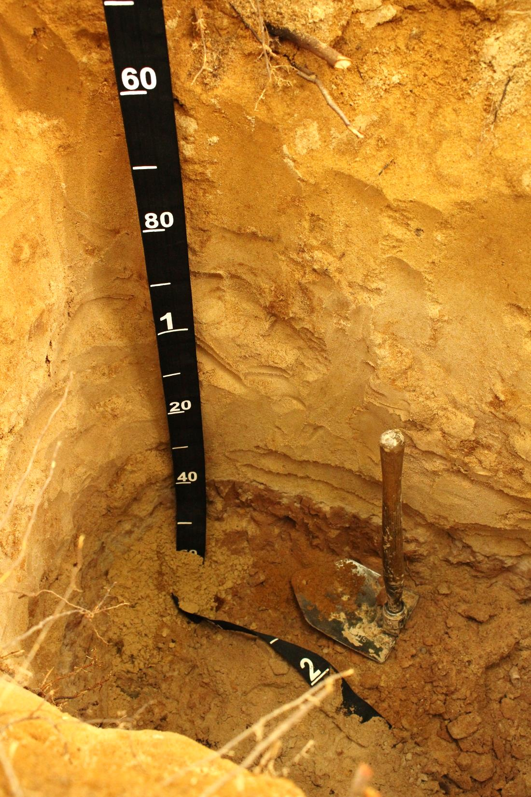

Lithologic Discontinuity- Sandy outwash over loamy calcareous Till
Dolomitized or high Mg limestone nodules incorporated into glacial till from underlying Paleozoic carbonates (i.e., Michigan Formation)?
Periodic perching of Ca-Mg rich groundwater?
Other “external” BC sources?
Notes:
Indeed, what I found at site 2 is that these soils overly a loamy till at depth that contains chalky nodules, which I think are highly weathered dolomite or high Mg limestone that was derived from the underlying Michigan formation as the ice advanced from the west. Perhaps also, you might have periodic influxes of shallow groundwater that spend a lot of time in contact with the till, then periodically inundate the sandy outwash above, and therefore supplying waters supersaturated in Ca and Mg.

Slide 65
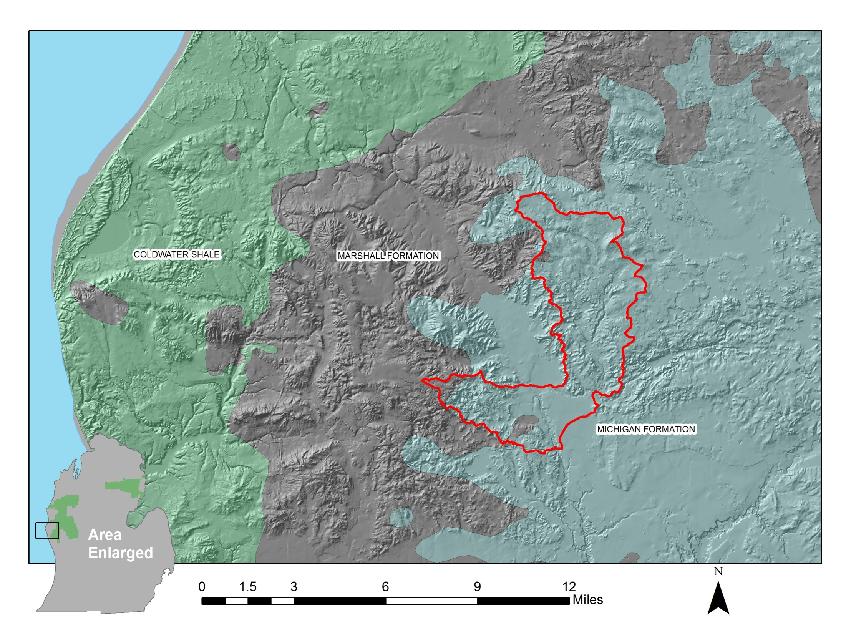

Slide 66
Results: Soil BC weathering rates
Final Weathering Rate Calculations:
S1 - red pine
S2 – sugar maple
S3 – white oak
S4 – red pine
S5 – northern
red oak
Net gains of base cations (i.e., “negative weathering rate”) suggest external source of base cations at these sites, possibly from…
Notes:
So as far as weathering rates go, this totally complicated the results… the sites that overly till, have “Negative weathering rates” or essentially, net base cation gains relative to their parent materials. The other two sites, had more reasonable results, and are indeed more slowly weatherable than what was estimated for the same locations in the national scale study.

Slide 67
Deeply rooted trees/cycling nutrients from below C-horizon
Lithologic discontinuity
v
v
v

Slide 68
Results: Empirical Critical Acid Loads and Exceedances
Site | McNulty et al (2010). | CAL 1 | CAL 2 | Exc. 1 | Exc. 2
Site 1 (red pine) | 0 | 32.05 | 670.76 | 1177.62 | --
Site 2 (sugar maple) | 764.92 | -164.37 | 139.80 | 1374.04 | 328.14
Site 3 (white oak) | 768.00 | -171.84 | 104.87 | 1345.12 | 363.07
Site 4 (red pine) | 770.48 | -171.84 | 349.51 | 1381.51 | 118.42
Site 5 (northern red oak) | 424.86 | -276.65 | 261.98 | 1411.88 | 205.27
Incorporating the uncertainty in the fate of N cycling in forest ecosystems: best and worst case scenarios…
CAL 1 = critical acid load scenario where all N is leached
CAL 2 = critical acid load scenario where all N not taken up by vegetation is retained in soil
Empirical data suggest CALs are lower (and exceedances higher) than national scale estimates for same locations.
Negative CALs = suggest soil is driving toward acidification regardless of anthropogenic activities (S+N Deposition and/or tree harvesting).
Notes:
Now, I hate to show a table in a presentation, but there might not be a better way to explain this… The first column is the final CAL derived from the coarse resolution modeling effort, and the second two columns are the critical acid loads according to site specific data analysis. Because of the difficulty in modeling the fate of N in forest ecosystems, what I did was develop a range of critical acid loads that represent the best and worst case scenarios with CAL 1 being a scenario where all the N deposited that is not taken up by vegetation is leached from the soil, and CAL 2 where all N not taken up by vegetation is retained in the soil. Then exceedances 1 and 2 correspond to CALs 1 and 2. A few points to make here- under scenario 1, 4 of the sites resulted in negative CAL estimates, which essentially means, regardless of harvesting or acid rain, these soils are driving toward acidification giving the high nutrient uptake and very slowly weatherable soils. Second, that under all scenarios, these sites likely experience CAL exceedance

Slide 69
Conclusions
For the Osborne Creek Watershed, Site-Specific empirical evidence suggests…
Tree nutrient uptake rates in this study are higher than what is used to model uptake for same species at national scale.

Slide 70
Conclusions
For the Osborne Creek Watershed, Site-Specific empirical evidence suggests…
Tree nutrient uptake rates in this study are higher than what is used to model uptake for same species at national scale.
Tree nutrient uptake rates vary widely among hardwoods on similar sites/soils.

Slide 71
Conclusions
For the Osborne Creek Watershed, Site-Specific empirical evidence suggests…
Tree nutrient uptake rates in this study are higher than what is used to model uptake for same species at national scale.
Tree nutrient uptake rates vary widely among hardwoods on similar sites/soils.
Weathering rates are extremely slow, and much less than what is used to model weathering for same soils at national scale.

Slide 72
Conclusions
For the Osborne Creek Watershed, Site-Specific empirical evidence suggests…
Tree nutrient uptake rates in this study are higher than what is used to model uptake for same species at national scale.
Tree nutrient uptake rates vary widely among hardwoods on similar sites/soils.
Weathering rates are extremely slow, and much less than what is used to model weathering for same soils at national scale.
Positive net base cation gains (i.e., negative weathering rates) suggest significant “external” source of base cations→ soils/trees receive more nutritional support from external sources than weathering alone.

Slide 73
Conclusions
For the Osborne Creek Watershed, Site-Specific empirical evidence suggests…
Tree nutrient uptake rates in this study are higher than what is used to model uptake for same species at national scale.
Tree nutrient uptake rates vary widely among hardwoods on similar sites/soils.
Weathering rates are extremely slow, and much less than what is used to model weathering for same soils at national scale.
Positive net base cation gains (i.e., negative weathering rates) suggest significant “external” source of base cations→ soils/trees receive more nutritional support from external sources than weathering alone.
Soils in the Osborne creek watershed likely experience CAL exceedance under best and worst case scenarios.

Slide 74
Conclusions/Implications
Despite high likelihood of CAL exceedance, soil base saturation remains excessively high at all sites in the watershed.

Slide 75
Conclusions/Implications
Despite high likelihood of CAL exceedance, soil base saturation remains excessively high at all sites in the watershed.
No visible signs of biological impacts/tree decline- a score of “2-Funtioning at Risk” is probably more appropriate for watershed condition framework rating.

Slide 76
Conclusions/Implications
Despite high likelihood of CAL exceedance, soil base saturation remains excessively high at all sites in the watershed.
No visible signs of biological impacts/tree decline- a score of “2-Funtioning at Risk” is probably more appropriate for watershed condition framework rating.
High variability of results makes extrapolation to other watersheds difficult to justify.

Slide 77
Conclusions/Implications
Despite high likelihood of CAL exceedance, soil base saturation remains excessively high at all sites in the watershed.
No visible signs of biological impacts/tree decline- a score of “2-Funtioning at Risk” is probably more appropriate for watershed condition framework rating.
High variability of results makes extrapolation to other watersheds difficult to justify.
The SMB model may not fully capture the nuances of nutrient cycling in forest soils with siliceous soils over calcareous substrata.

Slide 78
Conclusions/Implications
Despite high likelihood of CAL exceedance, soil base saturation remains excessively high at all sites in the watershed.
No visible signs of biological impacts/tree decline- a score of “2-Funtioning at Risk” is probably more appropriate for watershed condition framework rating.
High variability of results makes extrapolation to other watersheds difficult to justify.
The SMB model may not fully capture the nuances of nutrient cycling in forest soils with siliceous soils over calcareous substrata.
More detailed/widespread examination of soil nutrient status across forest, esp. on short-rotation stands is highly recommended.

Slide 79
QUESTIONS?
Acknowledgments
Thanks to Geological Society of America GeoCorps Guest Scientist Program, Huron-Manistee National Forests, Rich Corner, Jonathon Meeks, Terry Saarela, Carol Young, Danielle Roush, Russ Sutton, Trent Wickman, Mary Beth Adams, Vince Archer, Steve McNulty, Erika Cohen (all USFS), Cornell Nutrient Analysis Lab, Jennifer Phelan (RTI International), Dave Smith (USGS), and Julian Aherne (Trent University).
Presentation References :
McNulty, Steven G, and Johnny L Boggs. 2010. “A Conceptual Framework: Redefining Forest Soil’s Critical Acid Loads under a Changing Climate.” Environmental Pollution (Barking, Essex : 1987) 158 (6). Elsevier Ltd: 2053–58. doi:10.1016/j.envpol.2009.11.028.
McNulty, Steven G., Erika C. Cohen, Jennifer A. Moore Myers, Timothy J. Sullivan, and Harbin Li. 2007. “Estimates of Critical Acid Loads and Exceedances for Forest Soils across the Conterminous United States.” Environmental Pollution 149 (3): 281–92. doi:http://dx.doi.org/10.1016/j.envpol.2007.05.025.
Nilsson, J., and P. Grennfelt, eds. 1988. Critical Loads for Sulphur and Nitrogen. Copenhagen, Denmark: NORD 1988.
Potyondy, J.P., and T.W. Geier. 2011. Watershed Condition Classification Technical Guide: USDA, Forest Service, FS-978.
USEPA. 2014. “Total Deposition Project” v. 2014.01. ftp://ftp/epa/gov/castnet/tdep.

Slide 80
(Extra Slides)

Slide 81
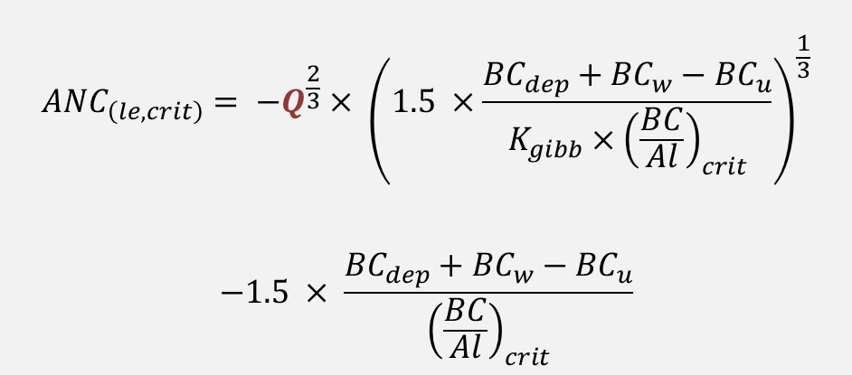
Methods: Critical Acid Neutralizing Capacity Leaching (ANC_{le,crit} )
$${ANC}_{\left(le,crit\right)}= −Q^{\frac{2}{3}}× {\left(1.5 ×\frac{{BC}_{dep}+{BC}_{w}−{BC}_{u}}{K_{gibb}×{\left(\frac{BC}{Al}\right)}_{crit}}\right)}^{\frac{1}{3}}$$
$$−1.5 × \frac{{BC}_{dep}+{BC}_{w}−{BC}_{u}}{{\left(\frac{BC}{Al}\right)}_{crit}}$$
P>PET
P>PET
Data from nearest weather station Hart, MI
PET>P
P = Precipitation PET = Reference Potential Evapotranspiration

Slide 82

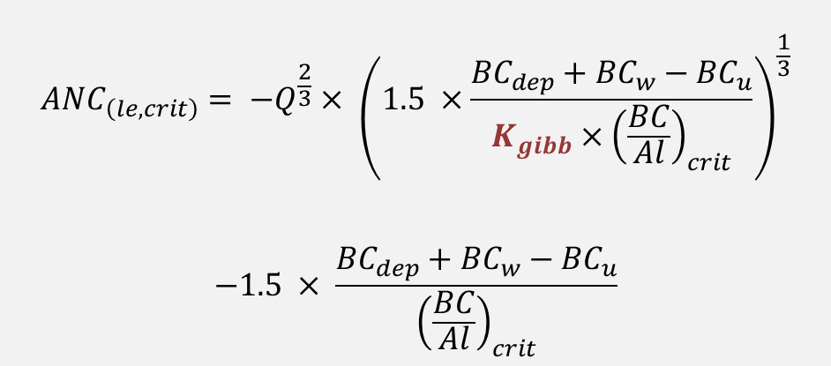
Methods: Critical Acid Neutralizing Capacity Leaching (ANC_{le,crit} )
$${ANC}_{\left(le,crit\right)}= −Q^{\frac{2}{3}}× {\left(1.5 ×\frac{{BC}_{dep}+{BC}_{w}−{BC}_{u}}{K_{gibb}×{\left(\frac{BC}{Al}\right)}_{crit}}\right)}^{\frac{1}{3}}$$
$$−1.5 × \frac{{BC}_{dep}+{BC}_{w}−{BC}_{u}}{{\left(\frac{BC}{Al}\right)}_{crit}}$$
$K_{gibb}$ = gibbsite equilibrium constant describing the relationship between Al and H⁺ in soil solution
Soil Type | Organic Matter (%) | Kgibb (m⁶ /eq²)
Mineral Soils; C Layer Soils with low organic | <5 | 950-9500
Soils with low organic matter; B/C layers | 5-15 | 300-3000
Soils with some organic matter; A/E layers | 15-30 | 100
Peaty and organic soils; organic layers | >70 | 9.5
Default values from UBA Mapping Manual (UBA, 2004)

Slide 83
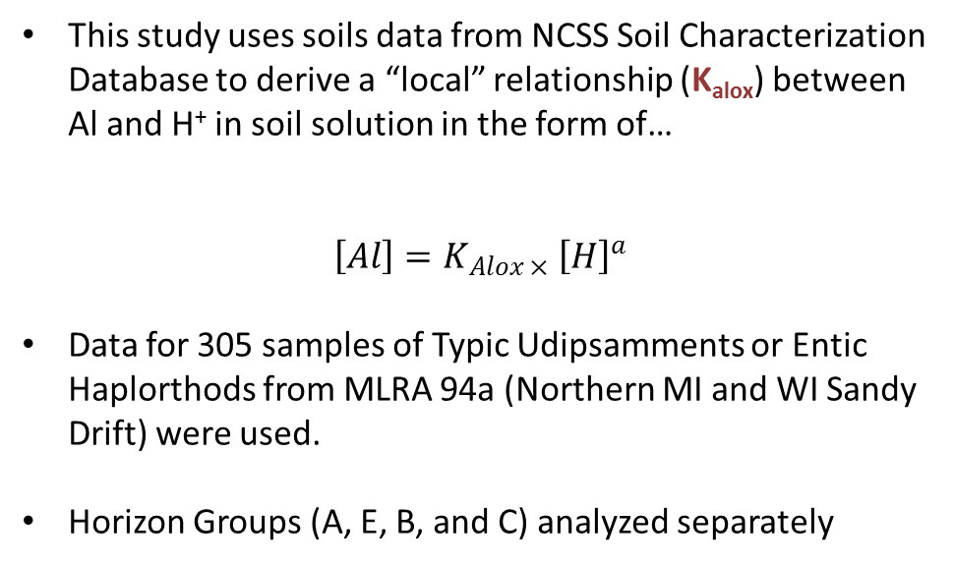
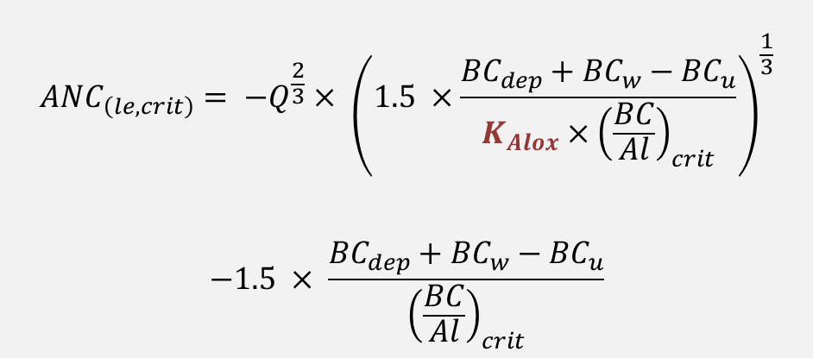
Methods: Critical Acid Neutralizing Capacity Leaching (ANC_{le,crit} )
$${ANC}_{\left(le,crit\right)}= −Q^{\frac{2}{3}}× {\left(1.5 ×\frac{{BC}_{dep}+{BC}_{w}−{BC}_{u}}{K_{Alox}×{\left(\frac{BC}{Al}\right)}_{crit}}\right)}^{\frac{1}{3}}$$
$$−1.5 × \frac{{BC}_{dep}+{BC}_{w}−{BC}_{u}}{{\left(\frac{BC}{Al}\right)}_{crit}}$$
This study uses soils data from NCSS Soil Characterization Database to derive a “local” relationship (K_{alox}) between Al and H⁺ in soil solution in the form of…
$$\left[Al\right]=K_{Alox ×} {\left[H\right]}^{a}$$
Data for 305 samples of Typic Udipsamments or Entic Haplorthods from MLRA 94a (Northern MI and WI Sandy Drift) were used.
Horizon Groups (A, E, B, and C) analyzed separately

Slide 84
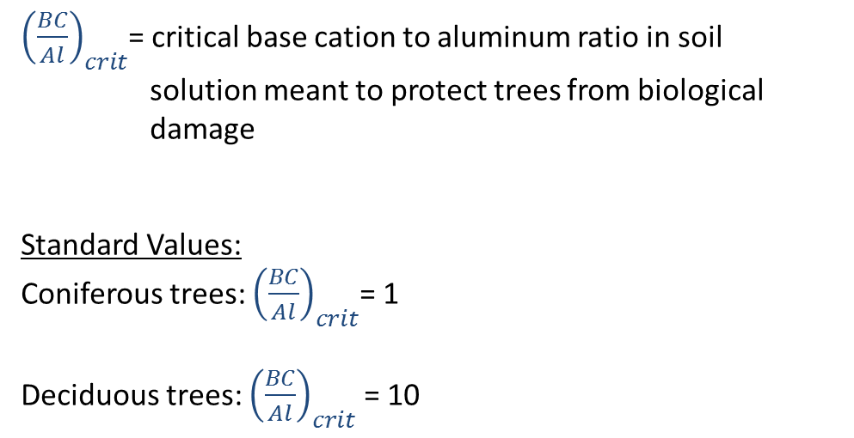
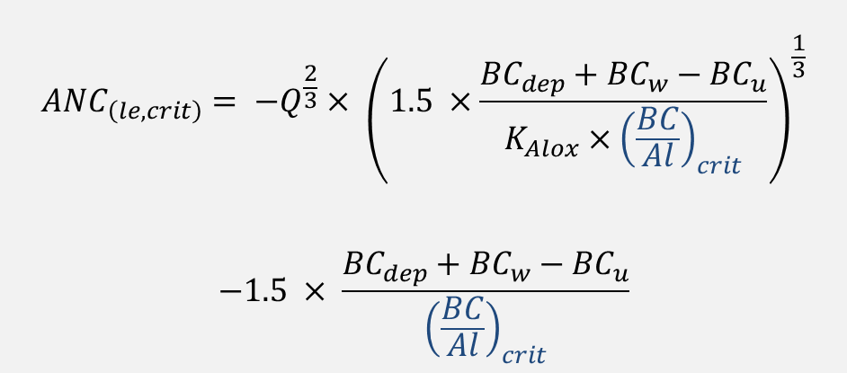
Methods: Critical Acid Neutralizing Capacity Leaching (ANC_{le,crit} )
$${ANC}_{\left(le,crit\right)}= −Q^{\frac{2}{3}}× {\left(1.5 ×\frac{{BC}_{dep}+{BC}_{w}−{BC}_{u}}{K_{Alox}×{\left(\frac{BC}{Al}\right)}_{crit}}\right)}^{\frac{1}{3}}$$
$$−1.5 × \frac{{BC}_{dep}+{BC}_{w}−{BC}_{u}}{{\left(\frac{BC}{Al}\right)}_{crit}}$$
${\left(\frac{BC}{Al}\right)}_{crit}$= critical base cation to aluminum ratio in soil solution meant to protect trees from biological damage
Standard Values:
Coniferous trees: ${\left(\frac{BC}{Al}\right)}_{crit}$= 1
Deciduous trees: ${\left(\frac{BC}{Al}\right)}_{crit}$ = 10

Slide 85
Results: Soil BC weathering (strain ϵ(Ti),w)
Collapse
Dilation

Slide 86
Results: Soil BC weathering (strain ϵ(Ti),w)
Ti contents exhibit a weak relationship to bulk density- therefore, large strain values likely indicate parent material heterogeneity (bioturbation, plow mixing, or depositional stratification)

