Slide 1
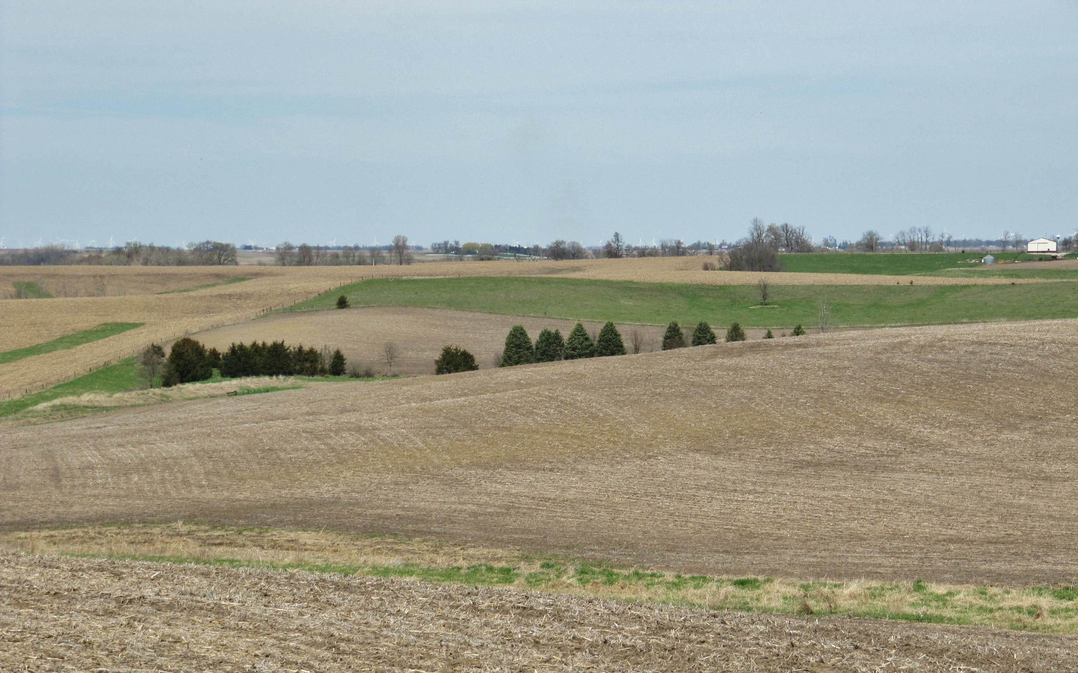
Pleistocene Paleosols
and the
Clarinda Soil Series
in
Adams County, SW Iowa
Kathleen Woida & Richard Lensch
USDA – Natural Resources Conservation Service

Slide 2
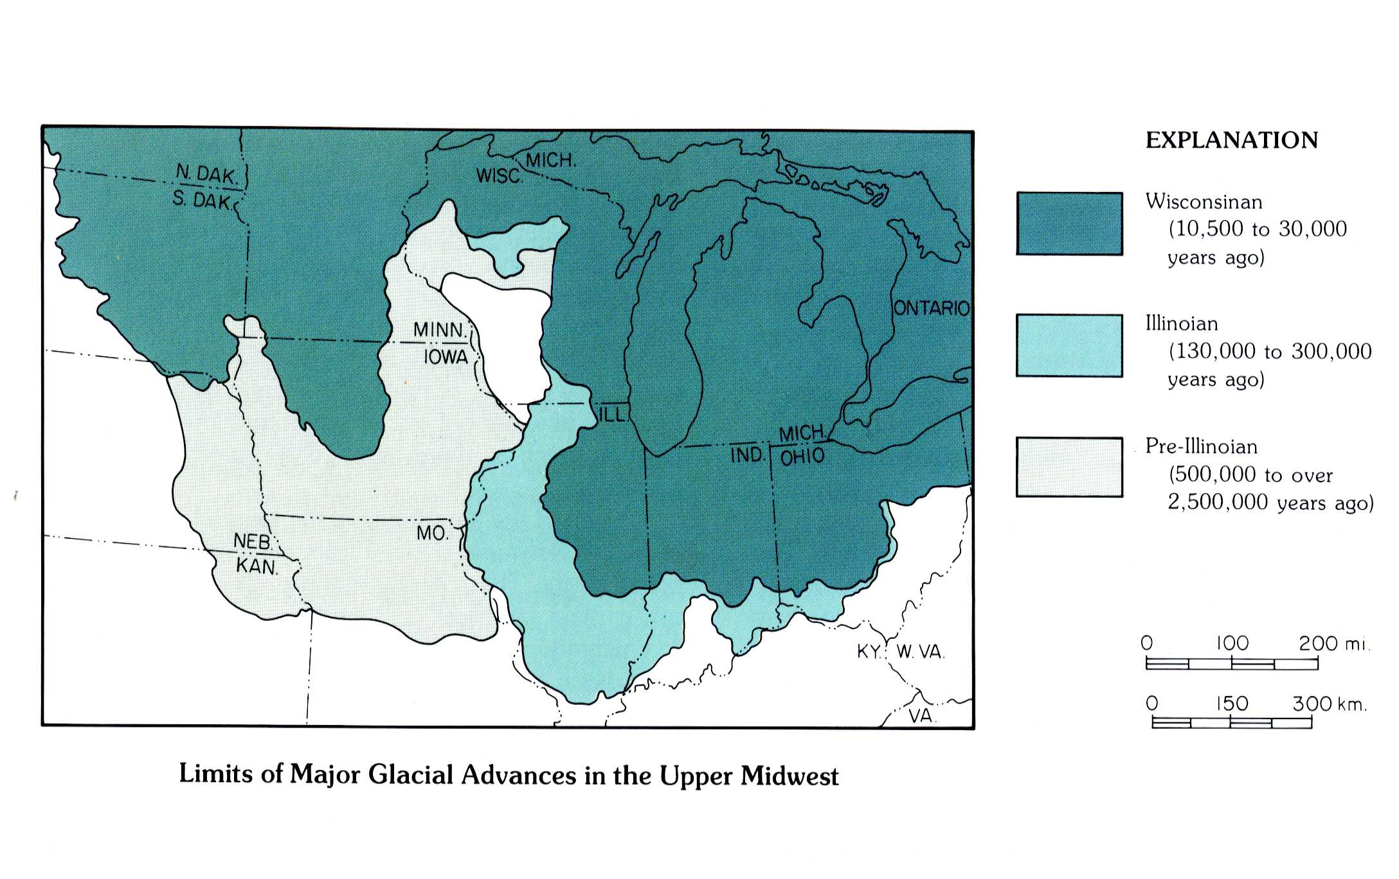
Limits of Major Glacial Advances in Upper Midwest
(Iowa Geological Survey, 2000)

Slide 3
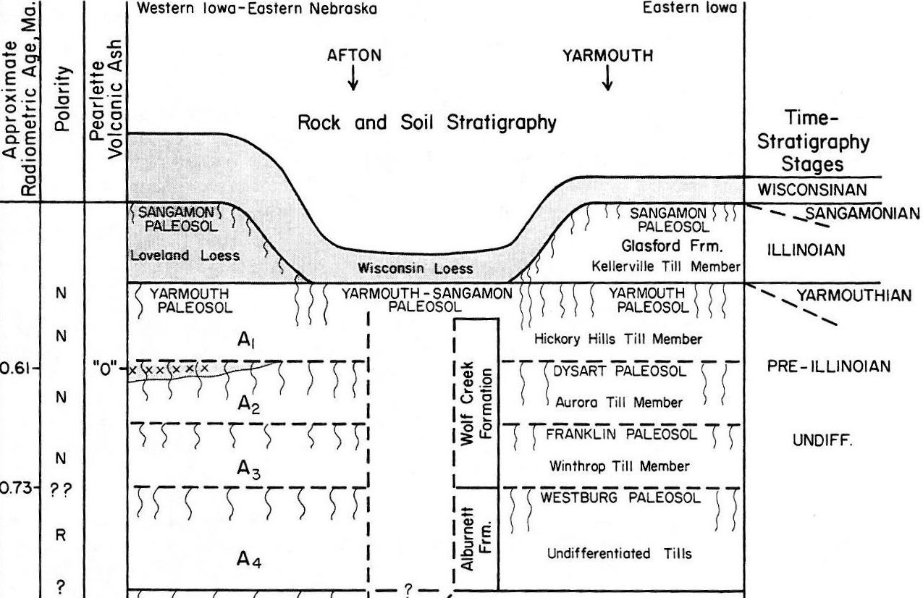
Quaternary stratigraphy across Iowa
(mod. from Iowa Geol. Survey, 1992)
A₁ till
PIP-1
A₂ till
PIP-2
A₃ till
(=B₁)

Slide 4
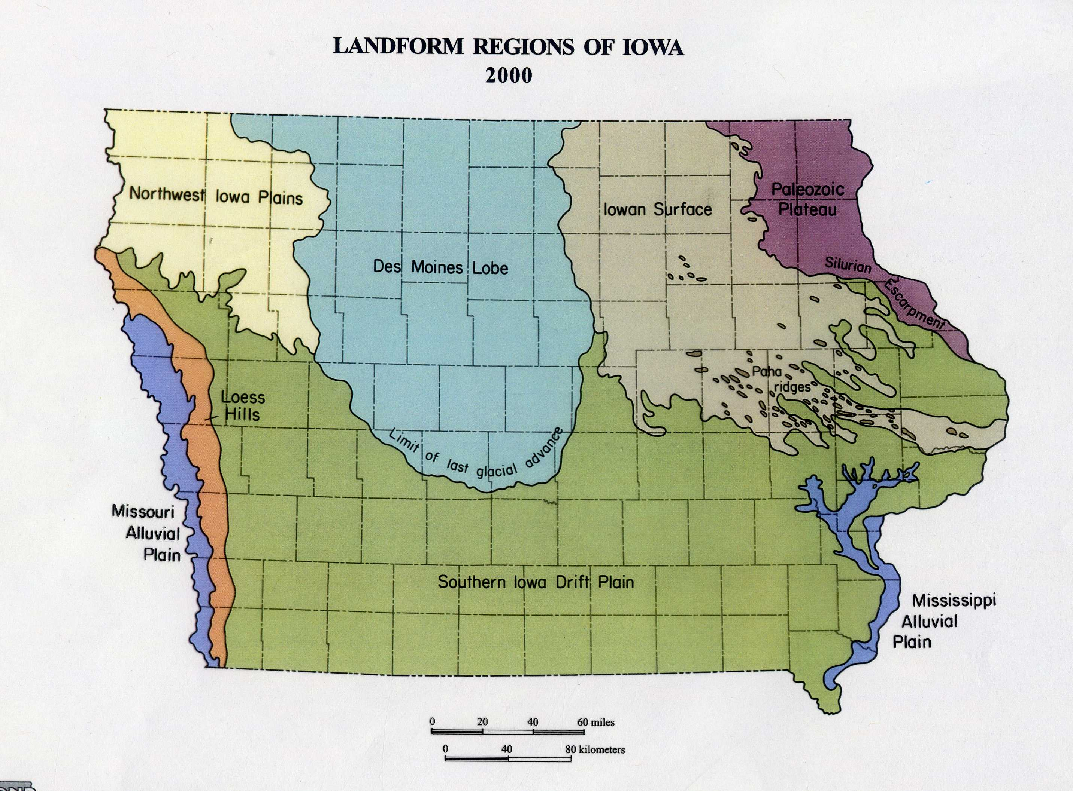
Greenfield Quadrangle
Adams Co.
Afton
(Jean Prior, Landforms of Iowa, 1991)

Slide 5
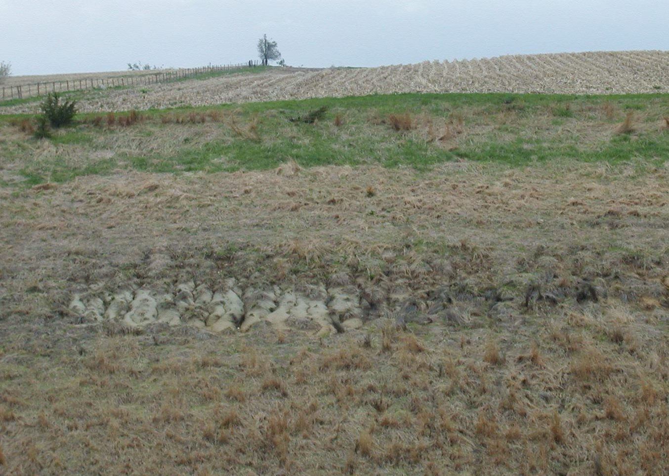
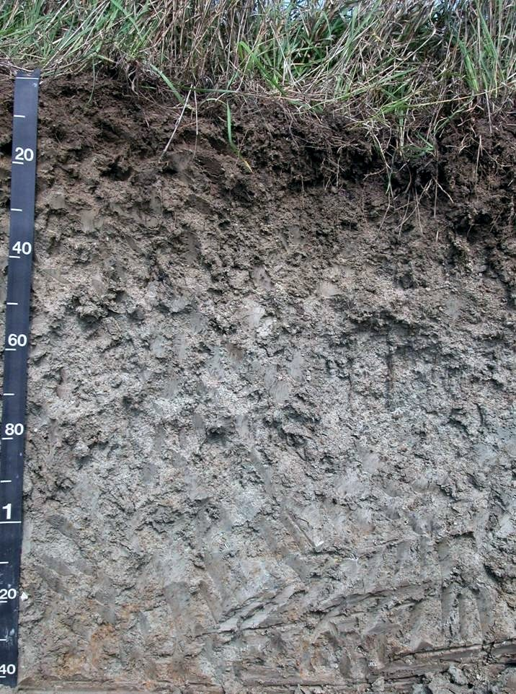
Clarinda silty clay loam / silty clay
“Fine, smectitic, mesic, Vertic Argiaquoll”

Slide 6
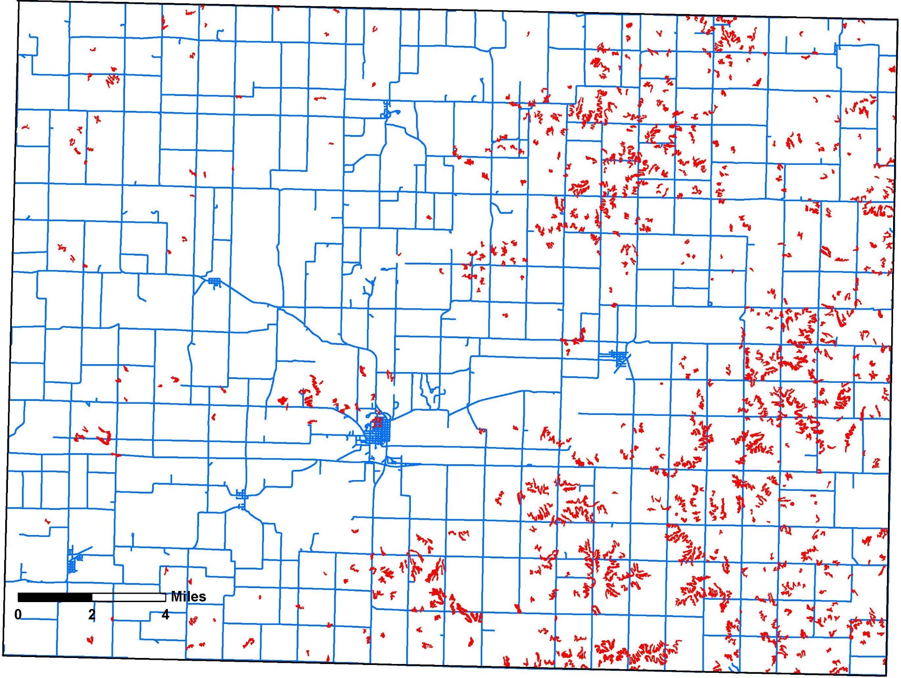
Clarinda Soil Series in Adams County, IA
(from Adams Co. Soil
Survey, 2008)
Corning

Slide 7
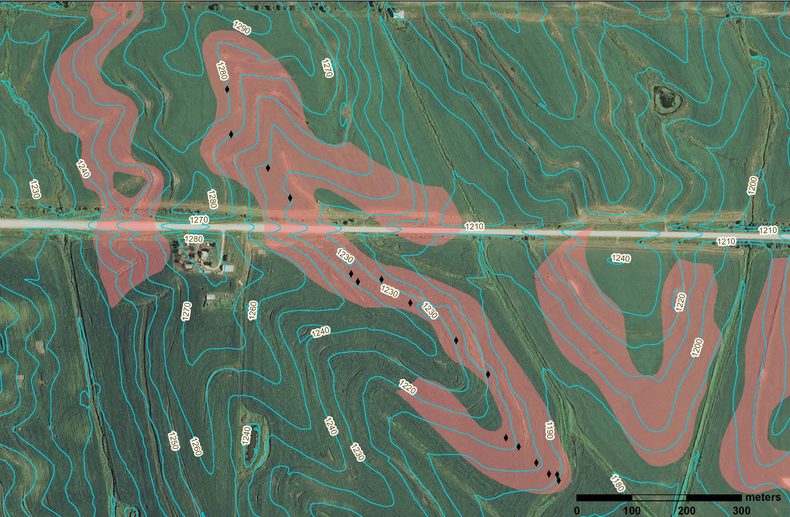
Clarinda map unit with elevation range of >100 ft
Hand probe hole
YSP
A1 till
PIP-1
PIP-1
A2 till

Slide 8
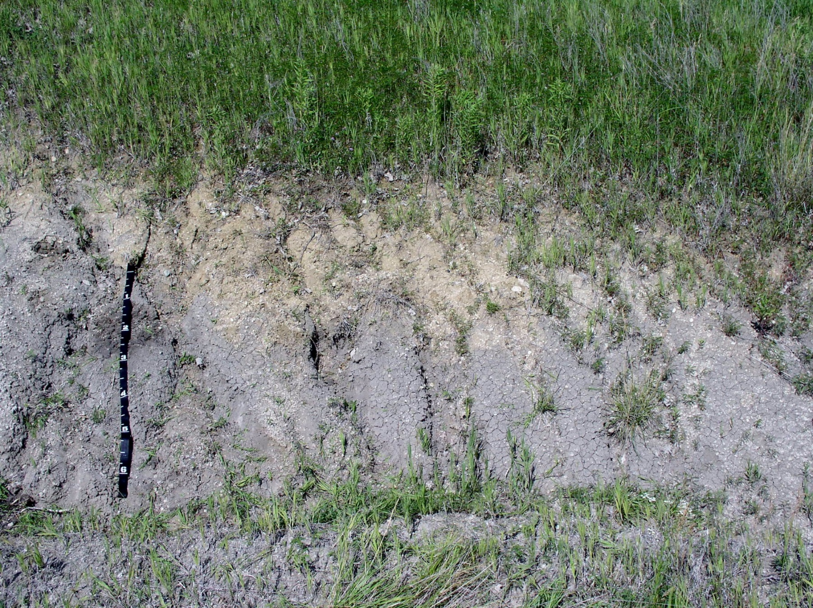
Pre-Illinoian paleosol exposed near Corning
Till (clay loam)
Gray paleosol (silty clay)

Slide 9
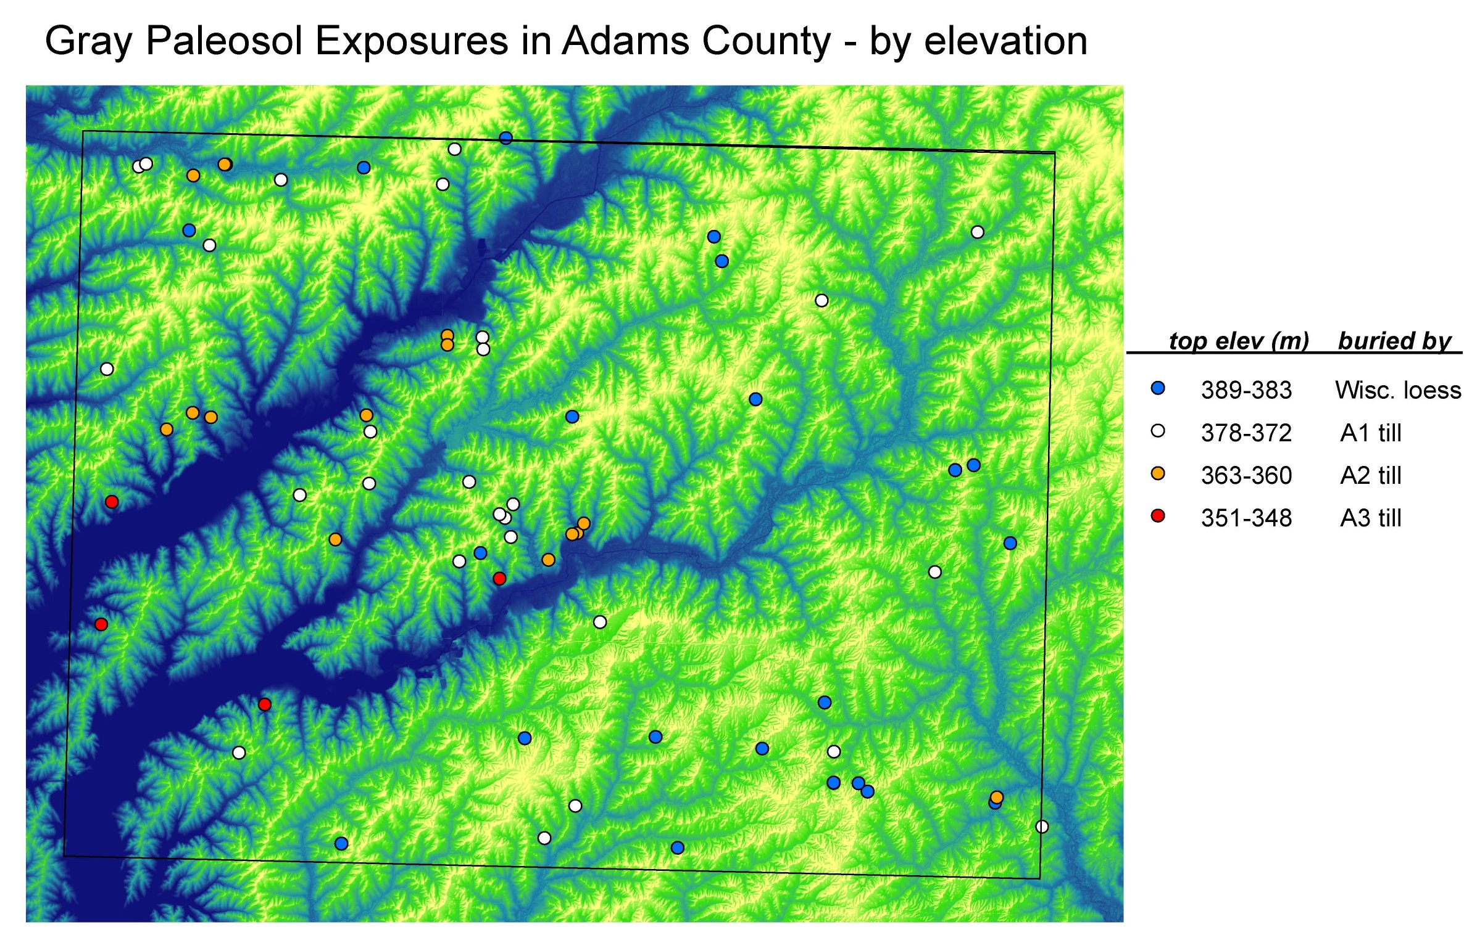
Base Map:
LiDAR DEM

Slide 10


Slide 11
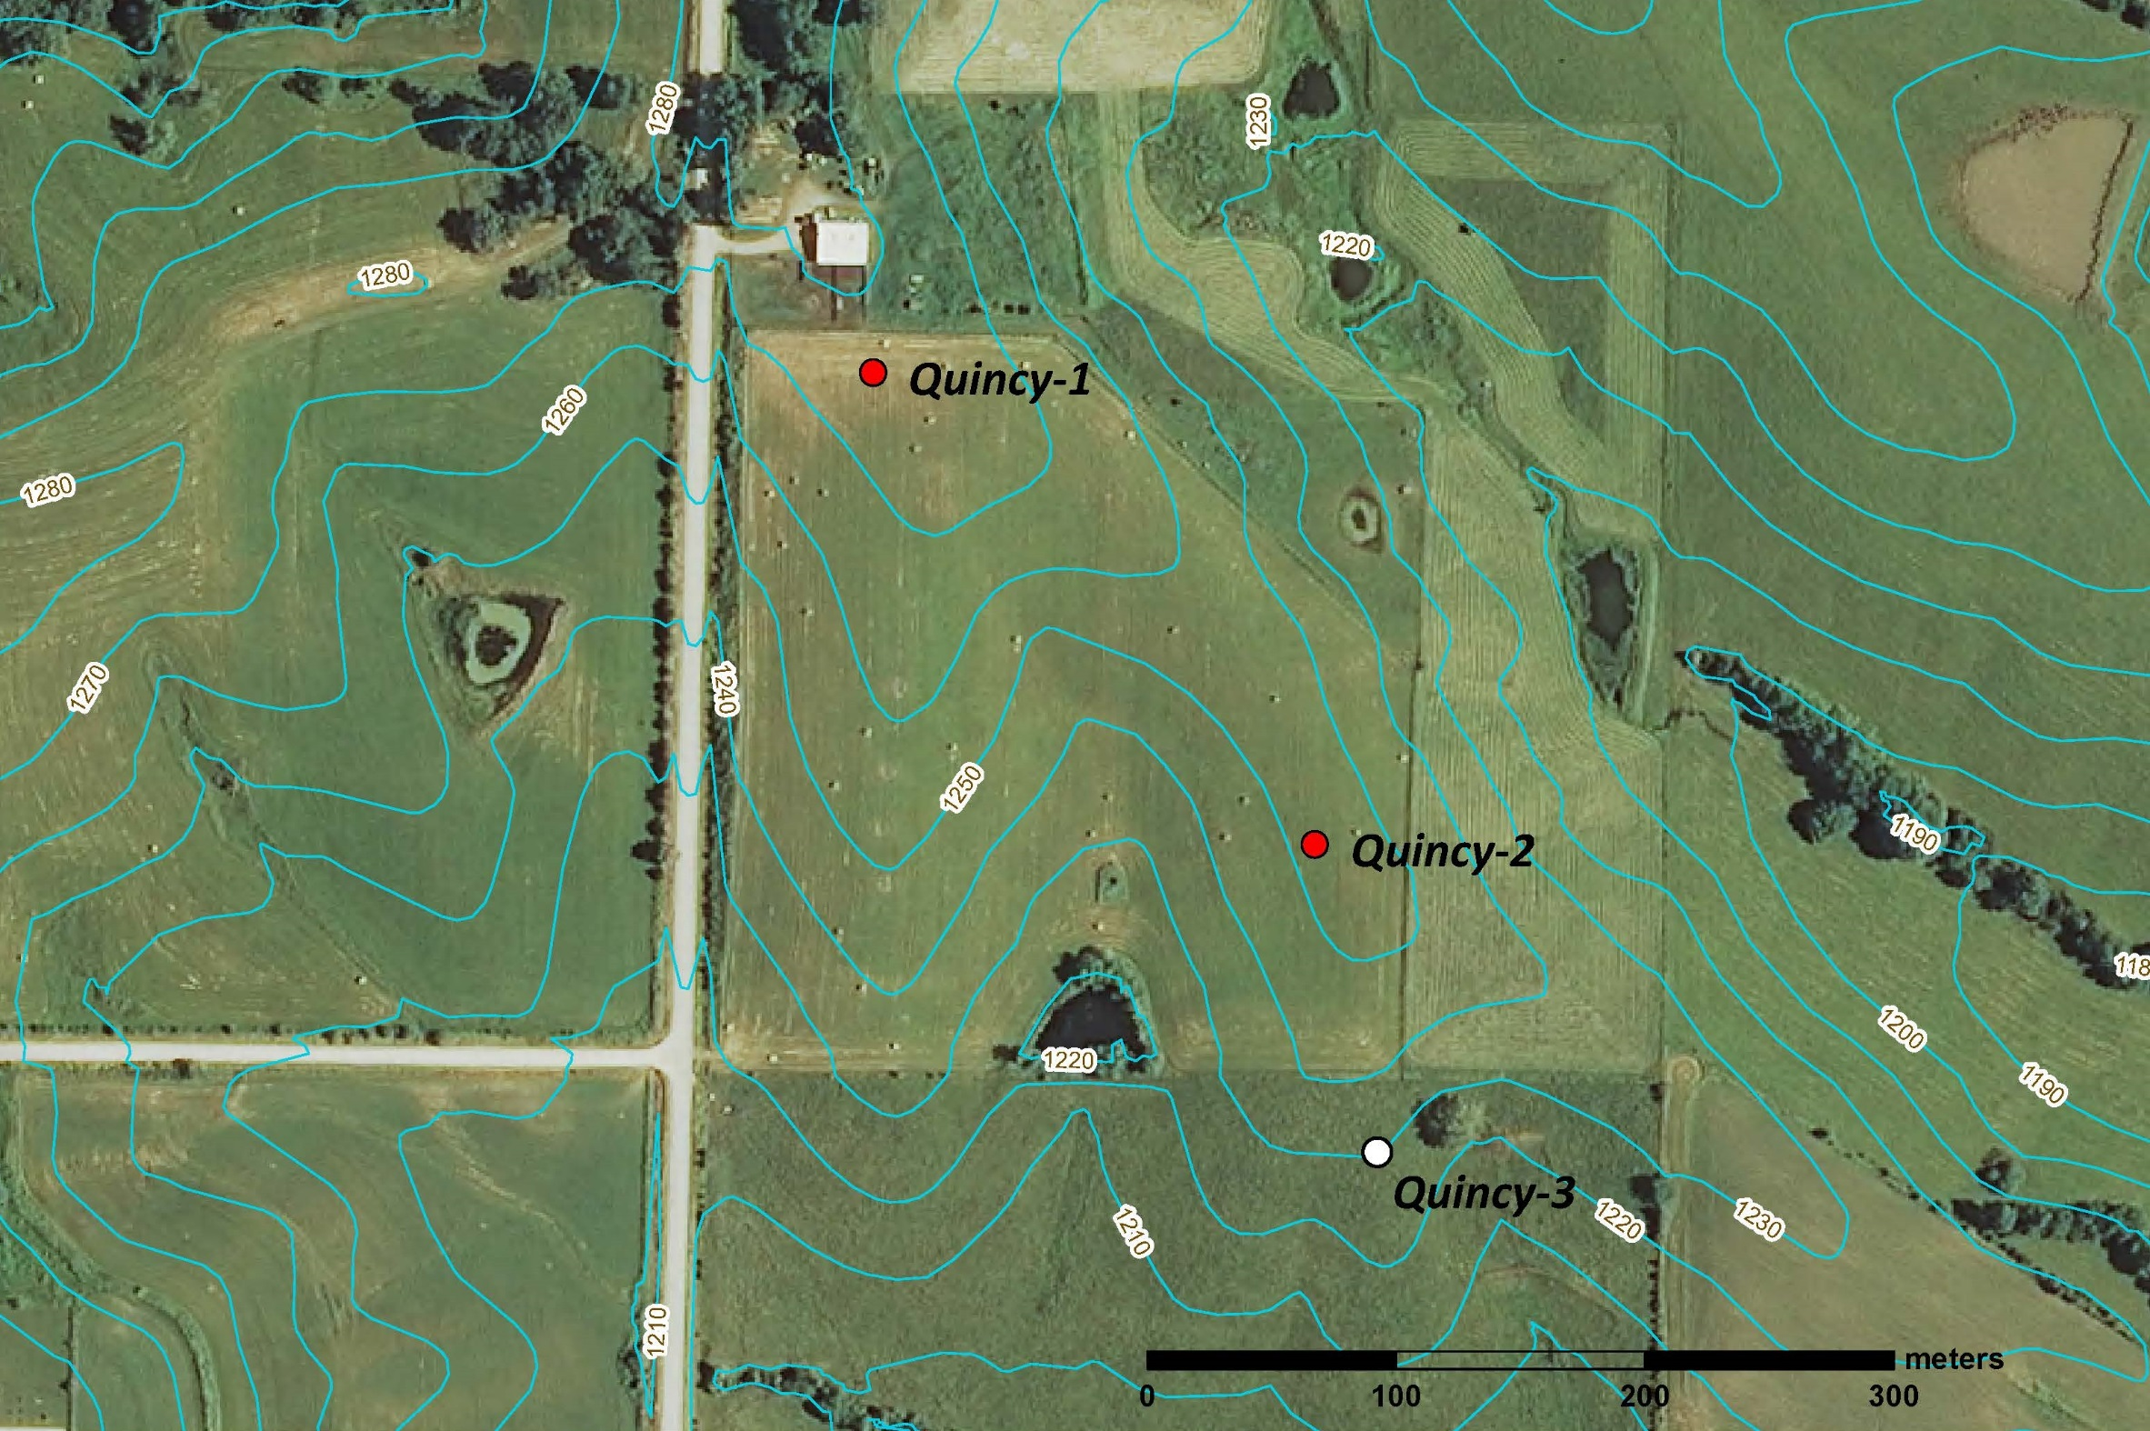

Slide 12
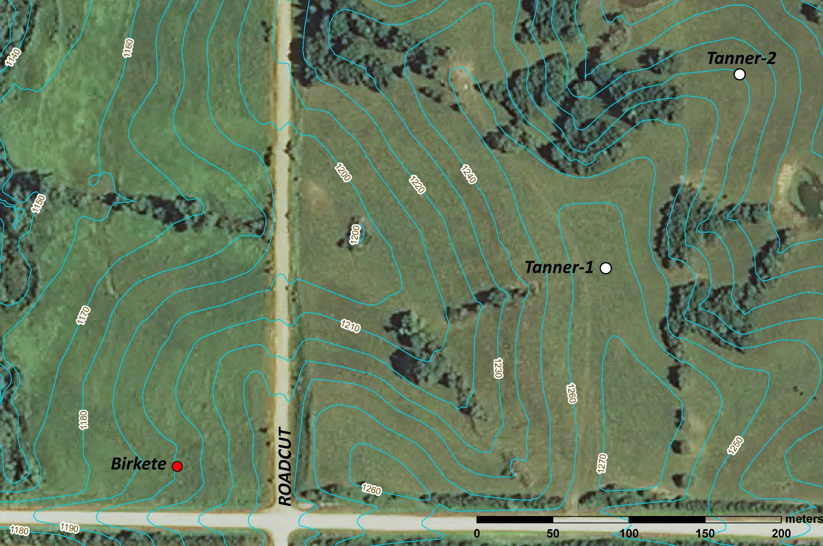

Slide 13
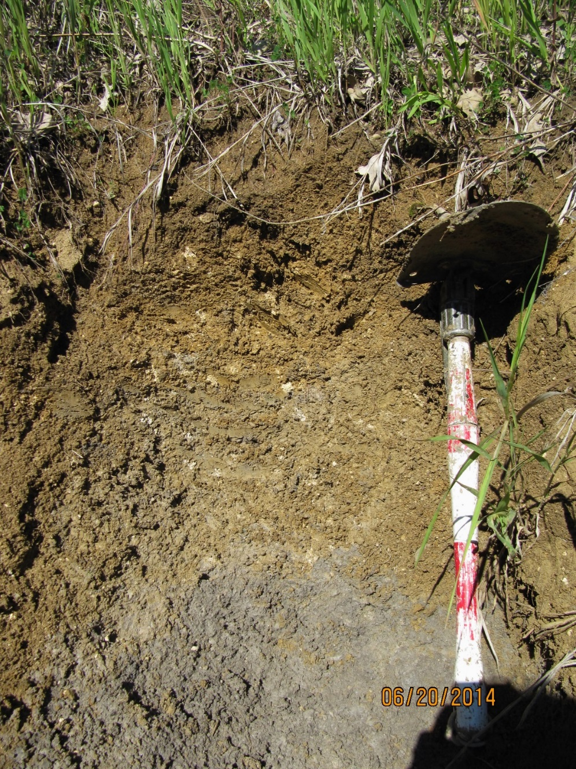

Slide 14
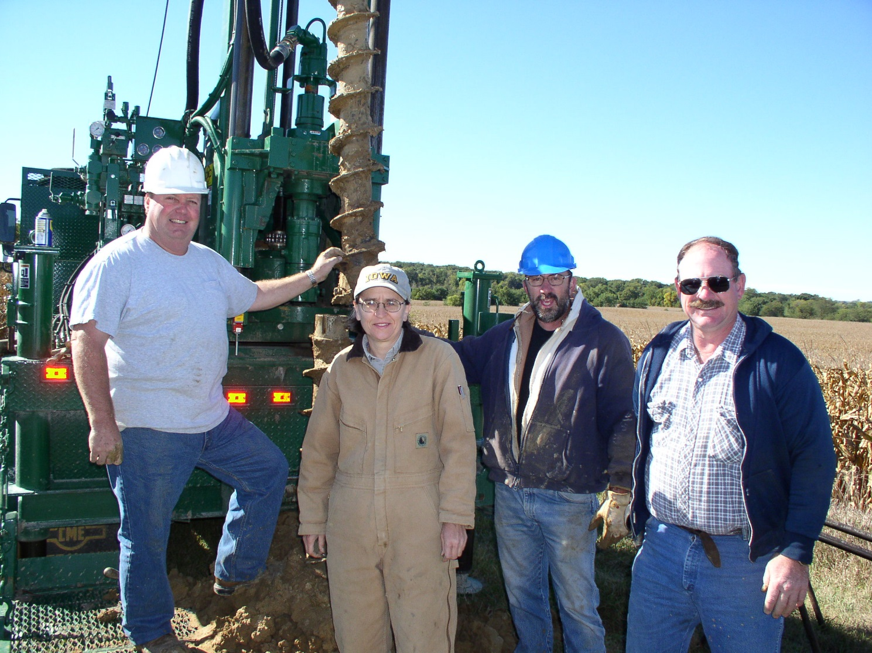

Slide 15
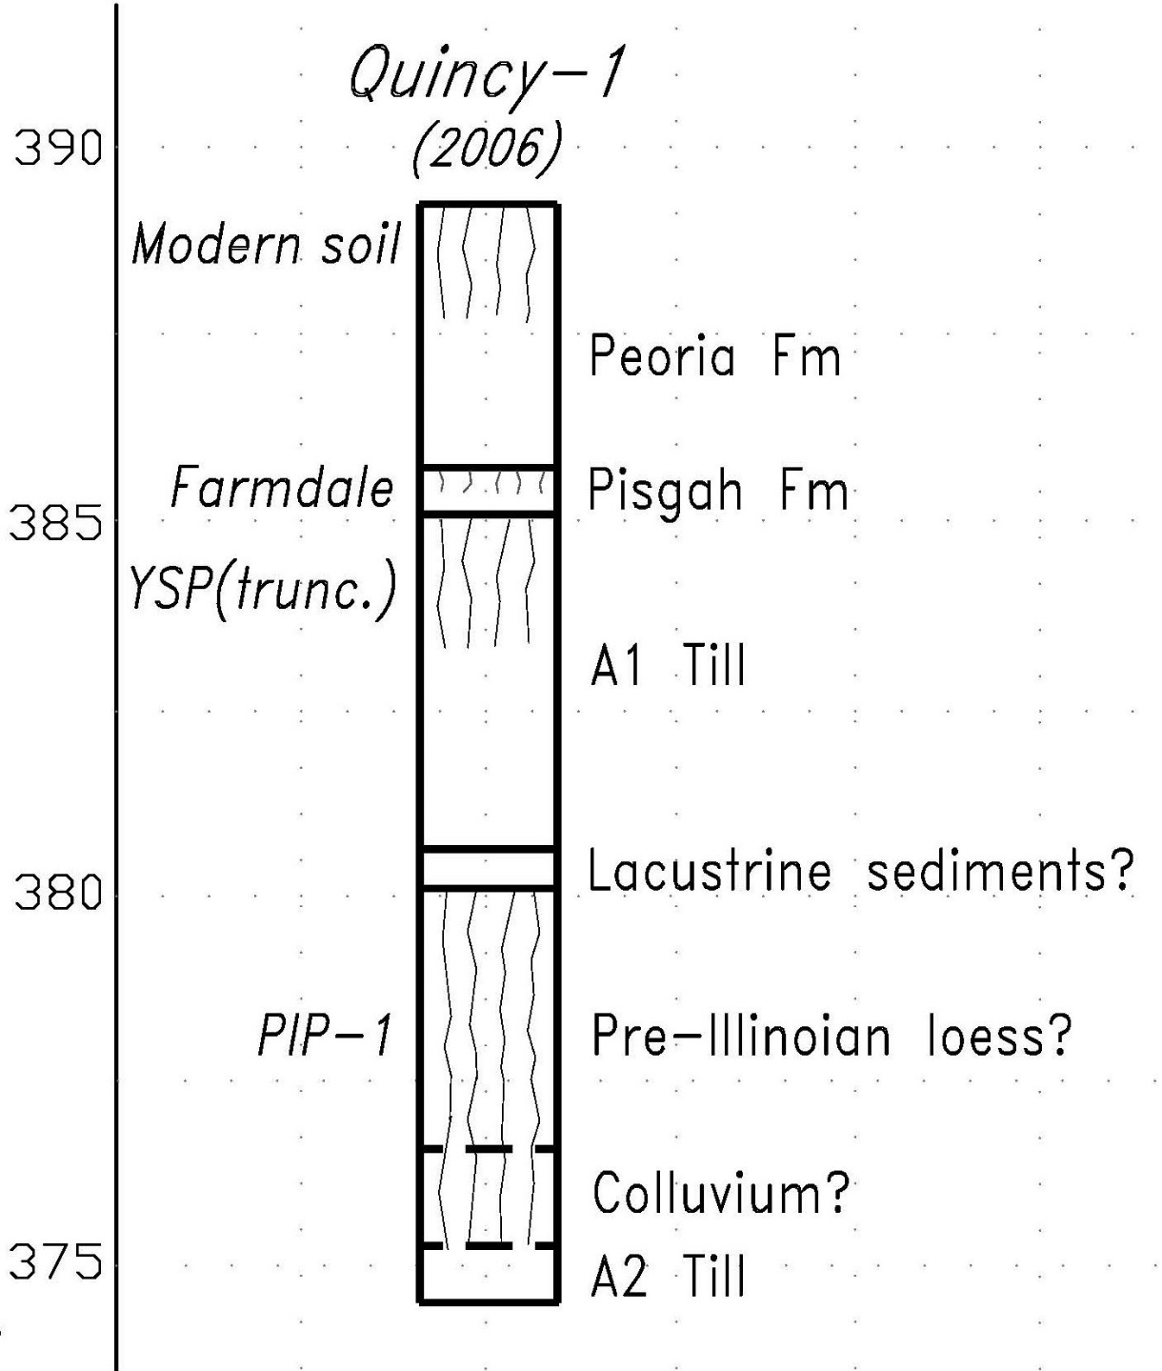
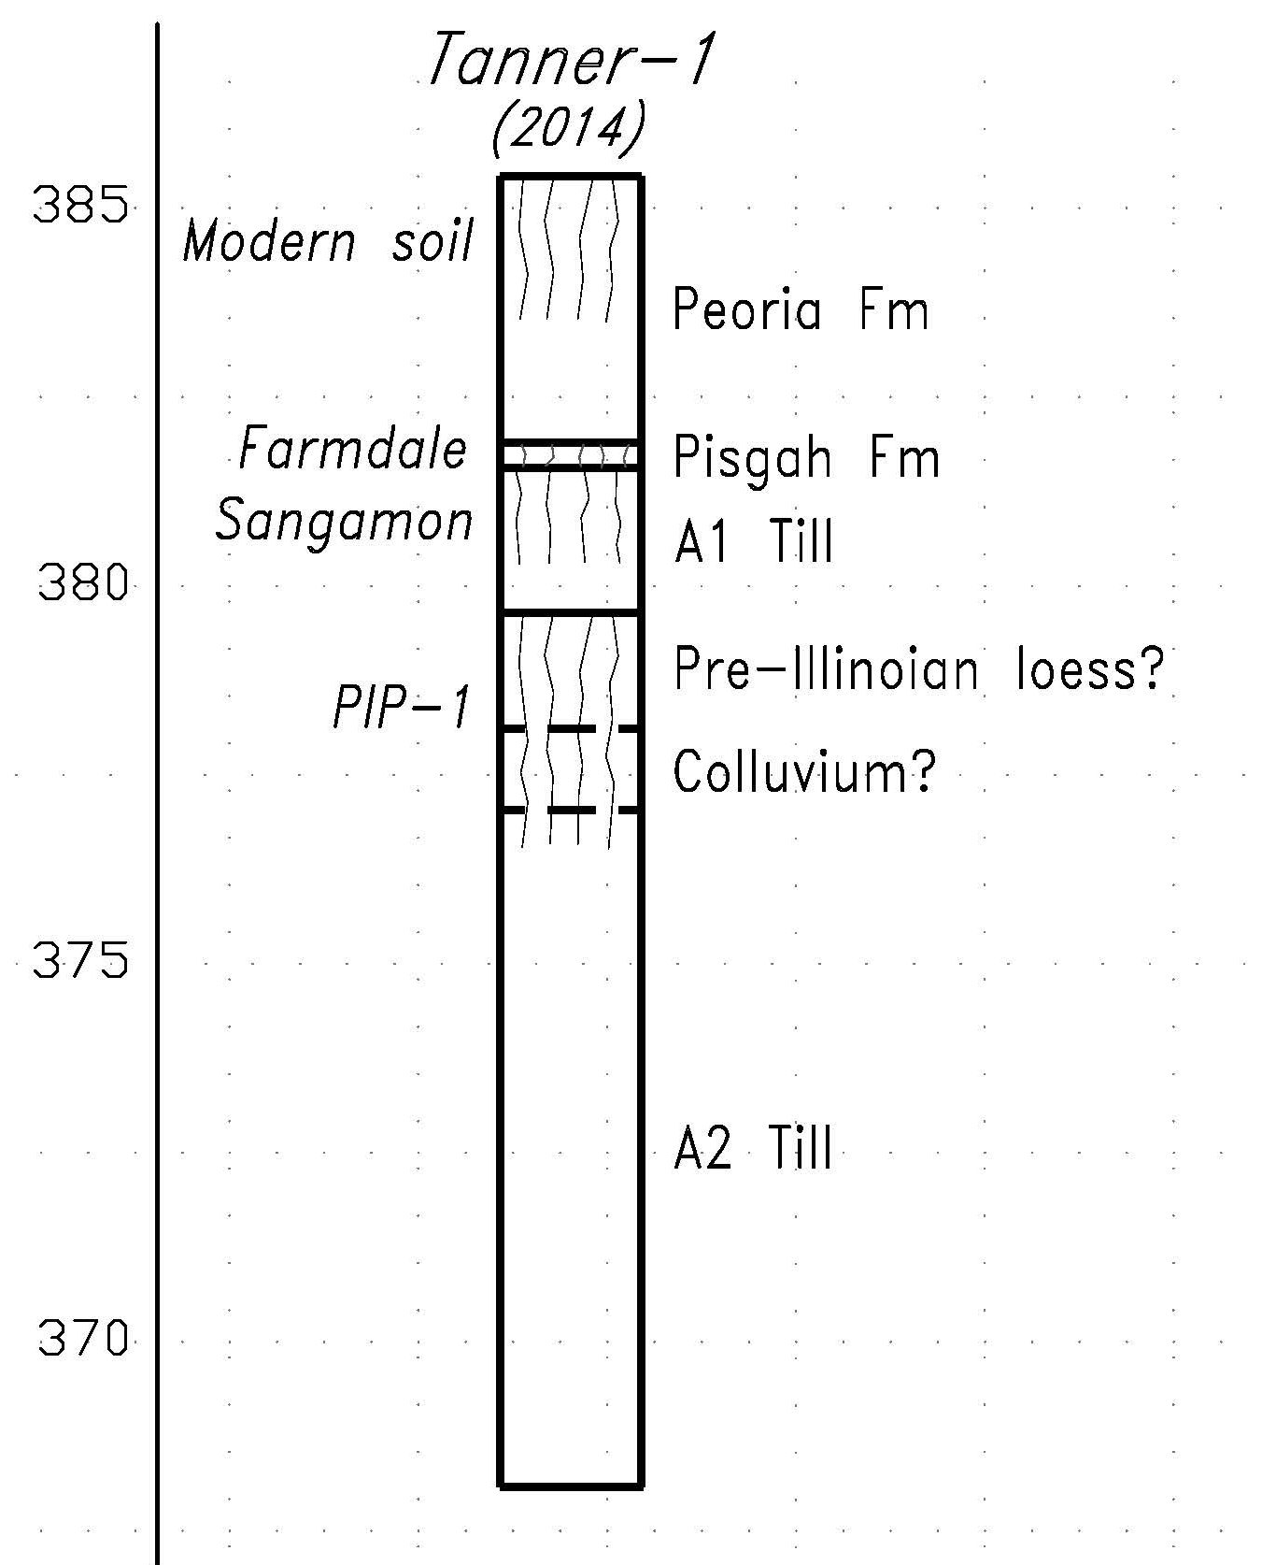
L.
Alluvium?

Slide 16
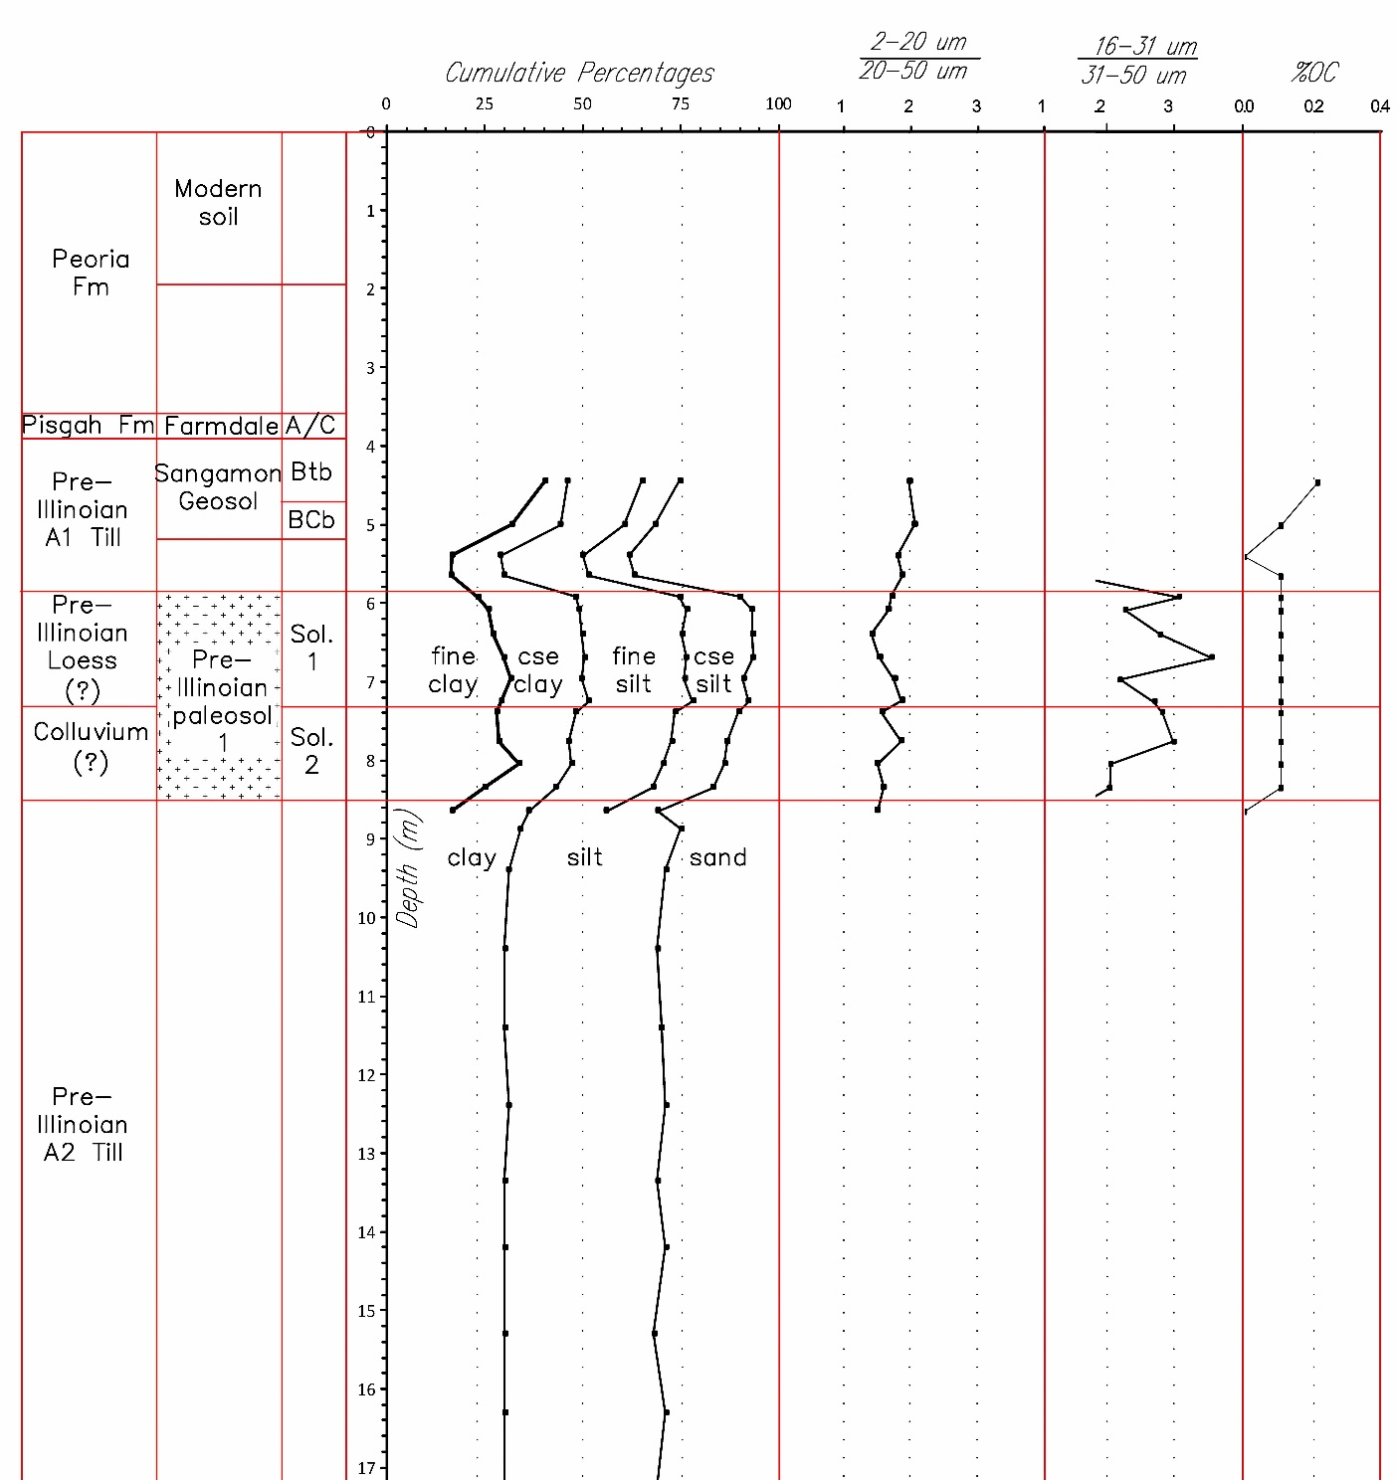
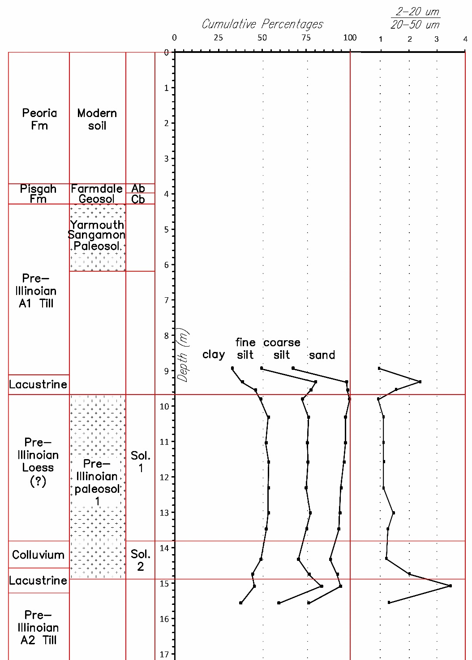
PSA of PIP-1 (Quincy)
PSA of PIP-1 (Tanner)
Sol.
2
Alluvium
Leached
Leached

Slide 17
PSA of PIP-1 (Quincy)
PSA of PIP-1 (Tanner)
clay
Sol.
clay loam
2
Alluvium
silty clay
clay loam
silty clay loam
Leached
clay loam
silty clay
Leached
clay loam

Slide 18
PSA of PIP-1 (Quincy)
PSA of PIP-1 (Tanner)
Sol.
2
Alluvium
t
t
Leached
t
Leached
t

Slide 19
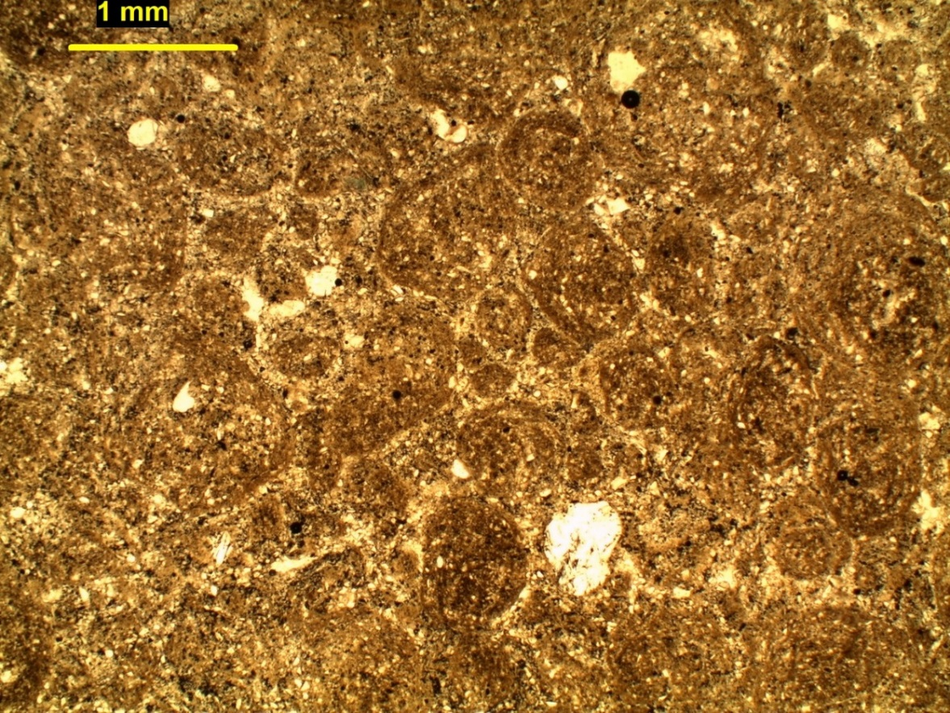
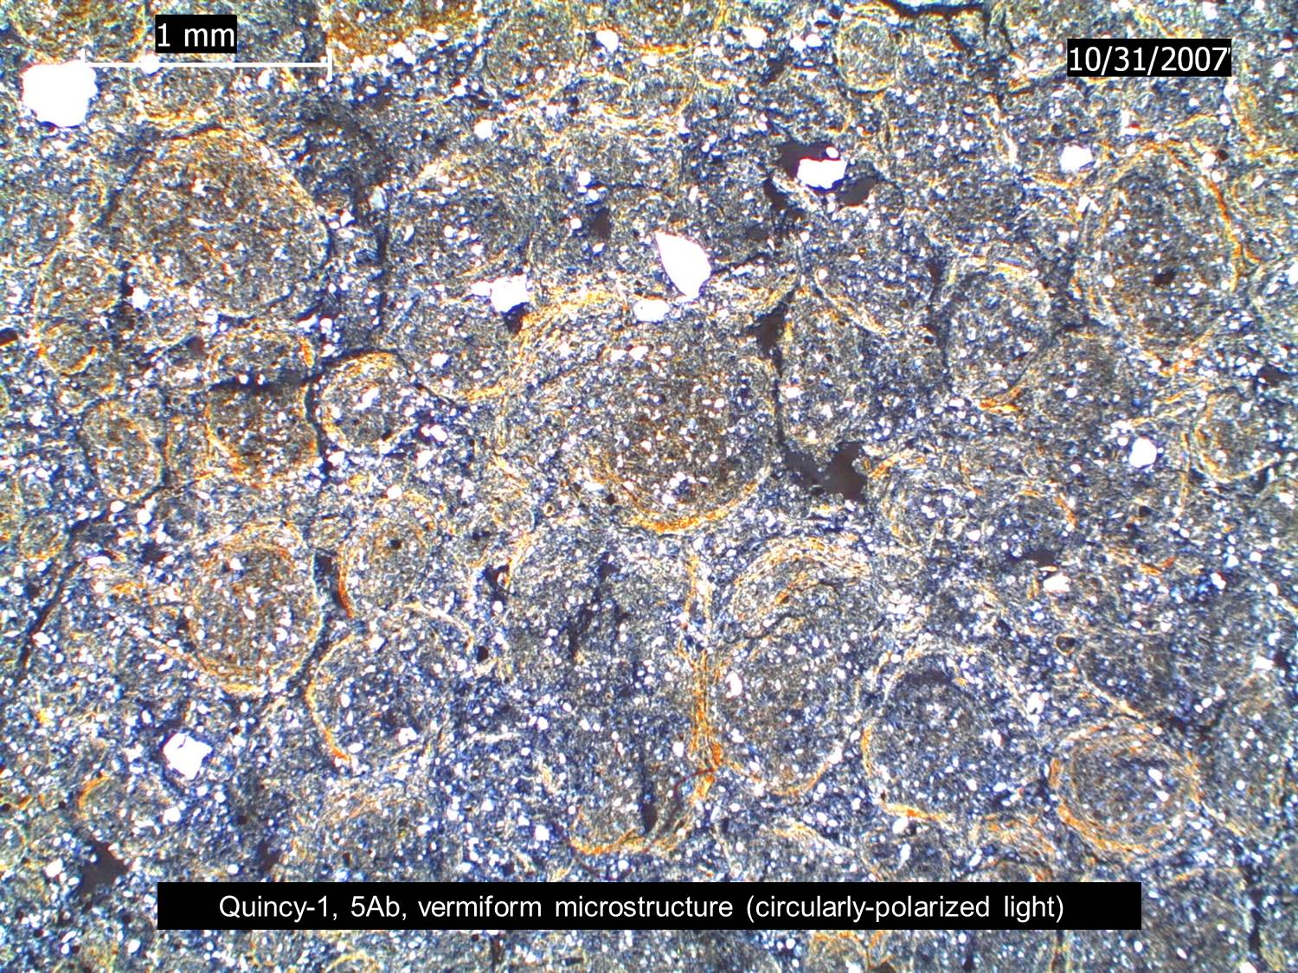
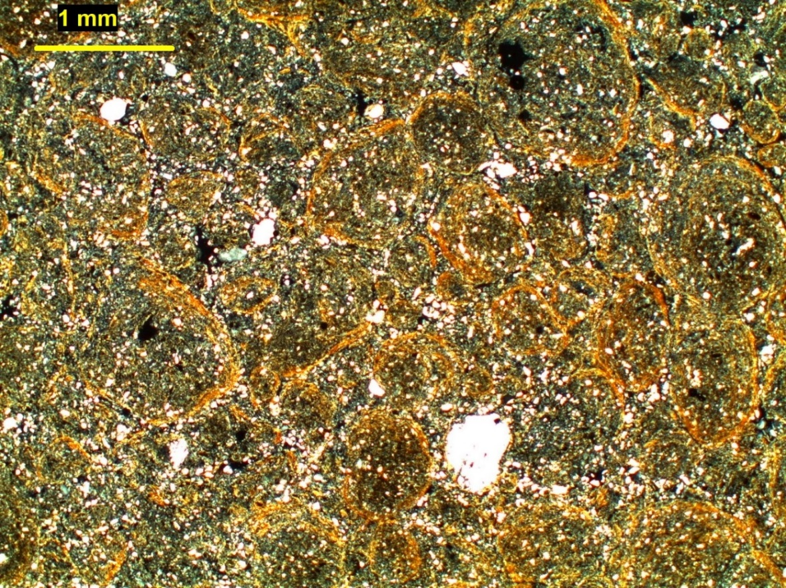
Granular structure
(circularly striated
birefringence fabric)
PIP-1 Ab horizon
E horizon later on?
(clay depletion)
Quincy 1 – 20 cm (25X-PPL)
Quincy 1 – 17 cm (25X-CPL)
Quincy 1 – 20 cm (25X-CPL)

Slide 20

Pedogenic barite in PIP-1 (suggests low pH at some stage)
Alluvium?
barite
barite

Slide 21
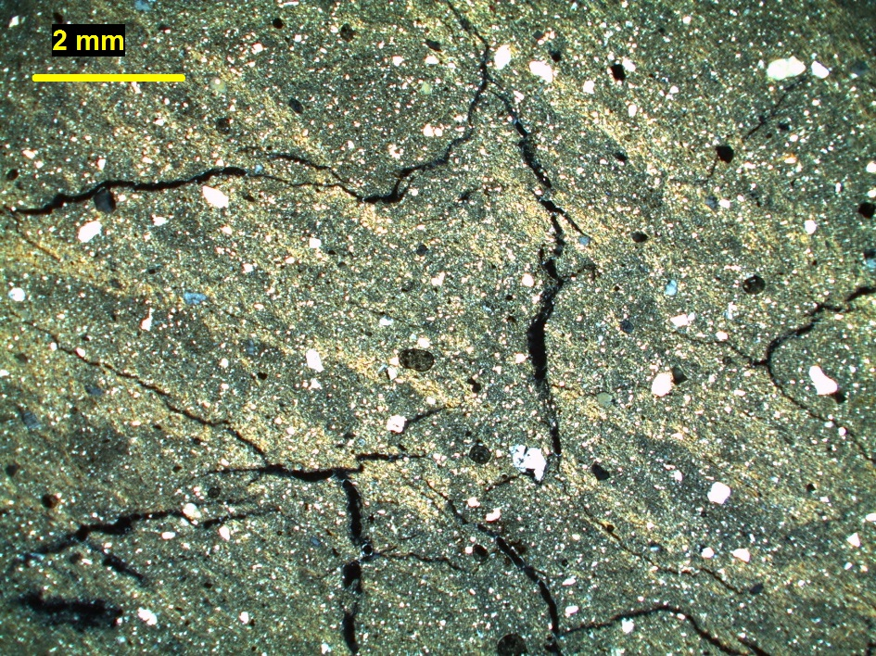
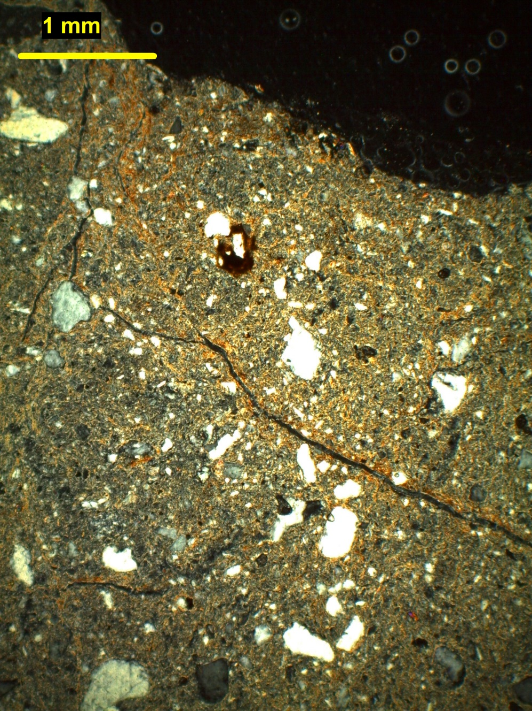
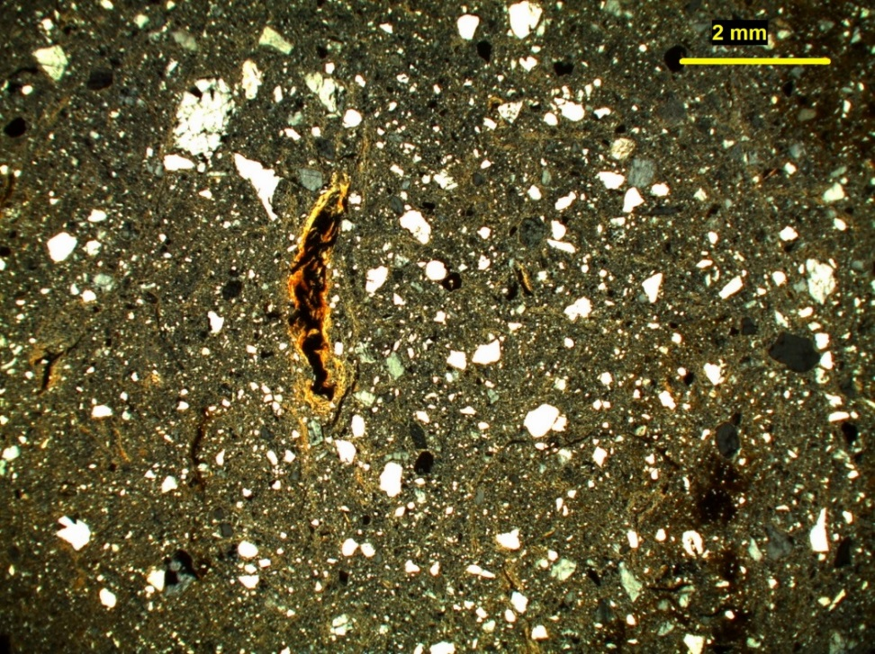
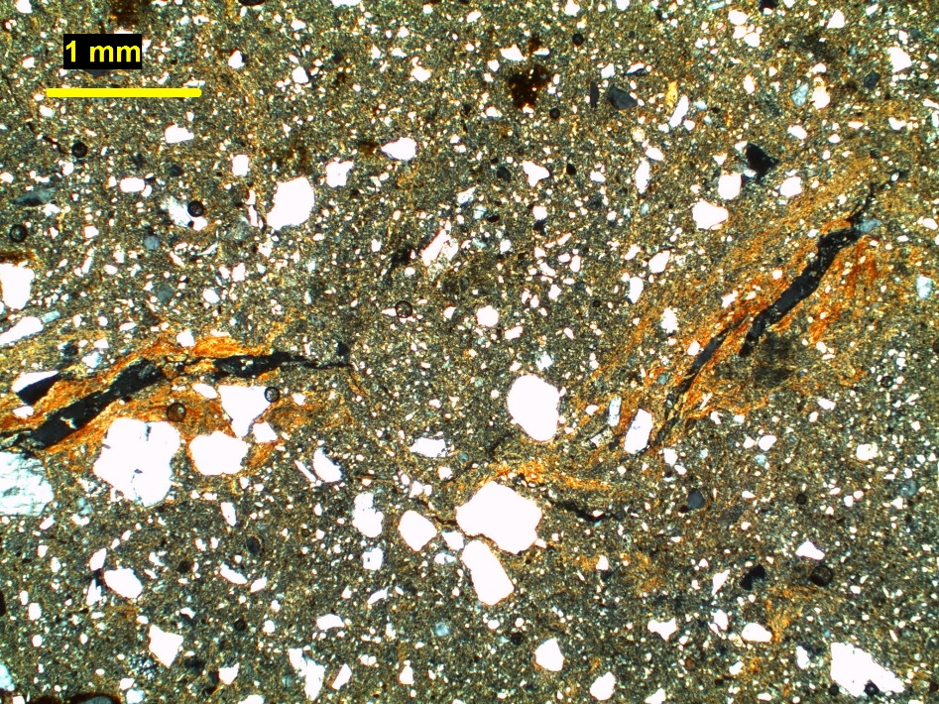
Tanner 1 – 193 cm (40X-CPL)
Sress-oriented clay -
upper solum B-horizon
Tanner 1 – 100 cm (12X-XPL)
Quincy 2 – 450 cm (12X-CPL)
Translocated clay
- lower solum
Tanner 1 – 243cm (25X-CPL)

Slide 22
Quincy
Pedogenic carbonates in PIP-1
Tanner
Sol.
2
Alluvium
Leached
Leached
2 CaCo₃
2 CaCo₃
t

Slide 23
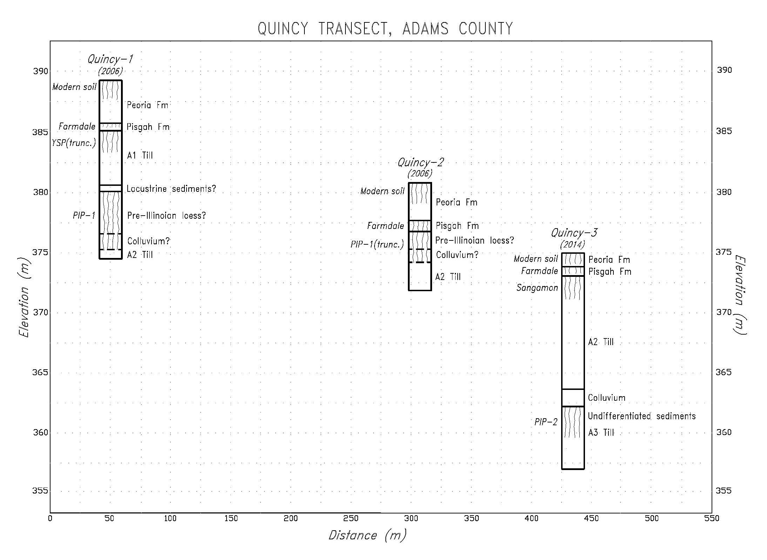
L.

Slide 24
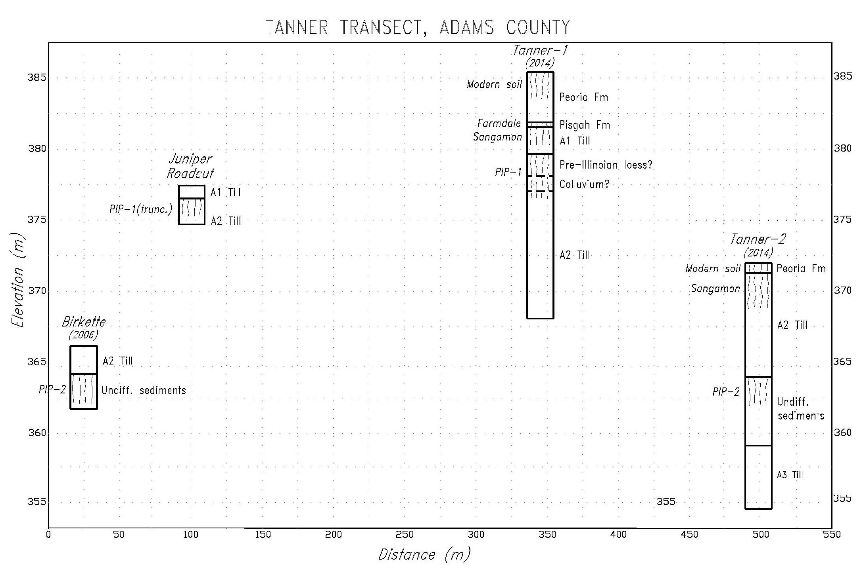
L.
Alluvium?
L.
Pond seds.

Slide 25
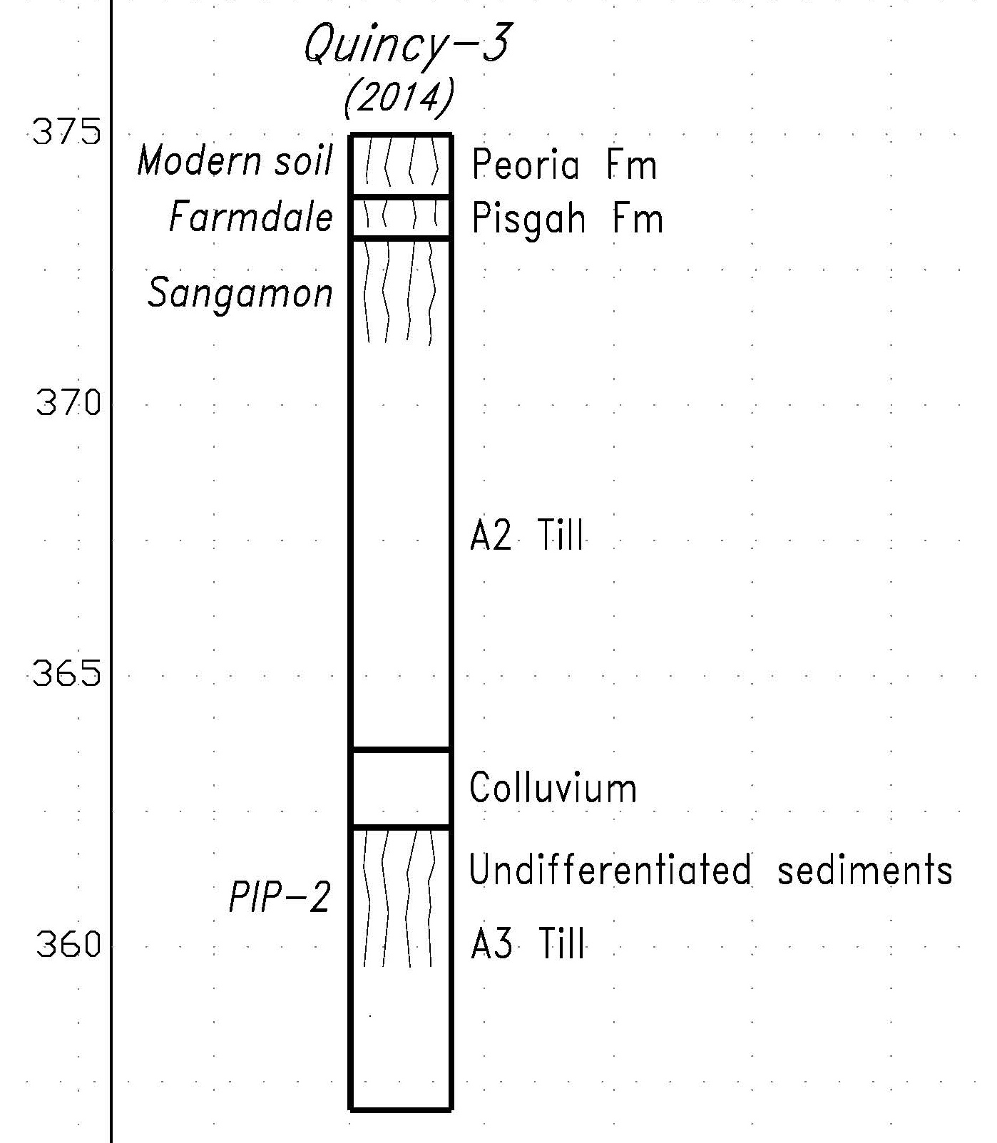
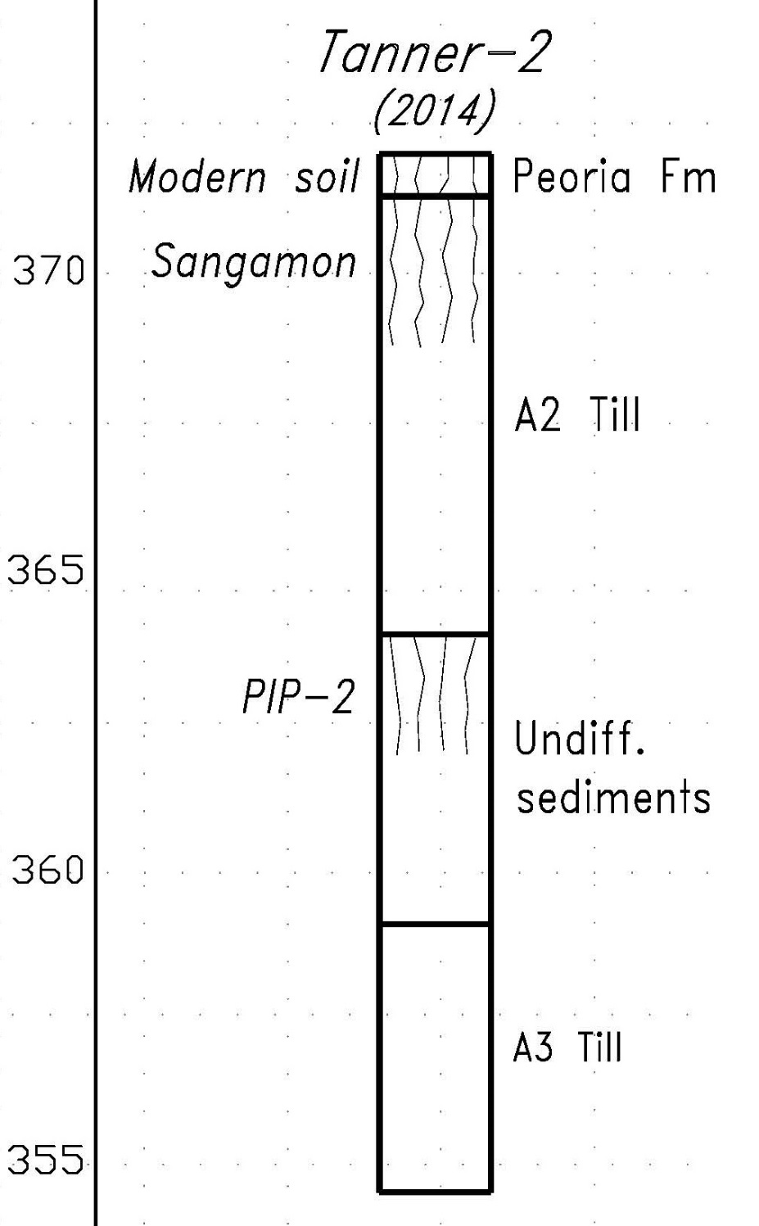
L.
L.
Longer period of weathering?
Pond seds.

Slide 26
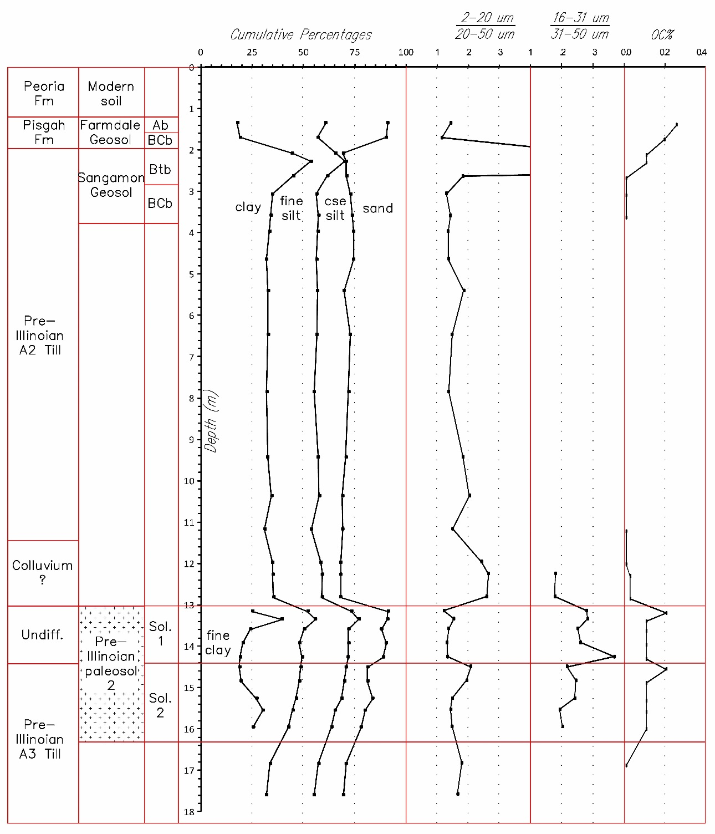
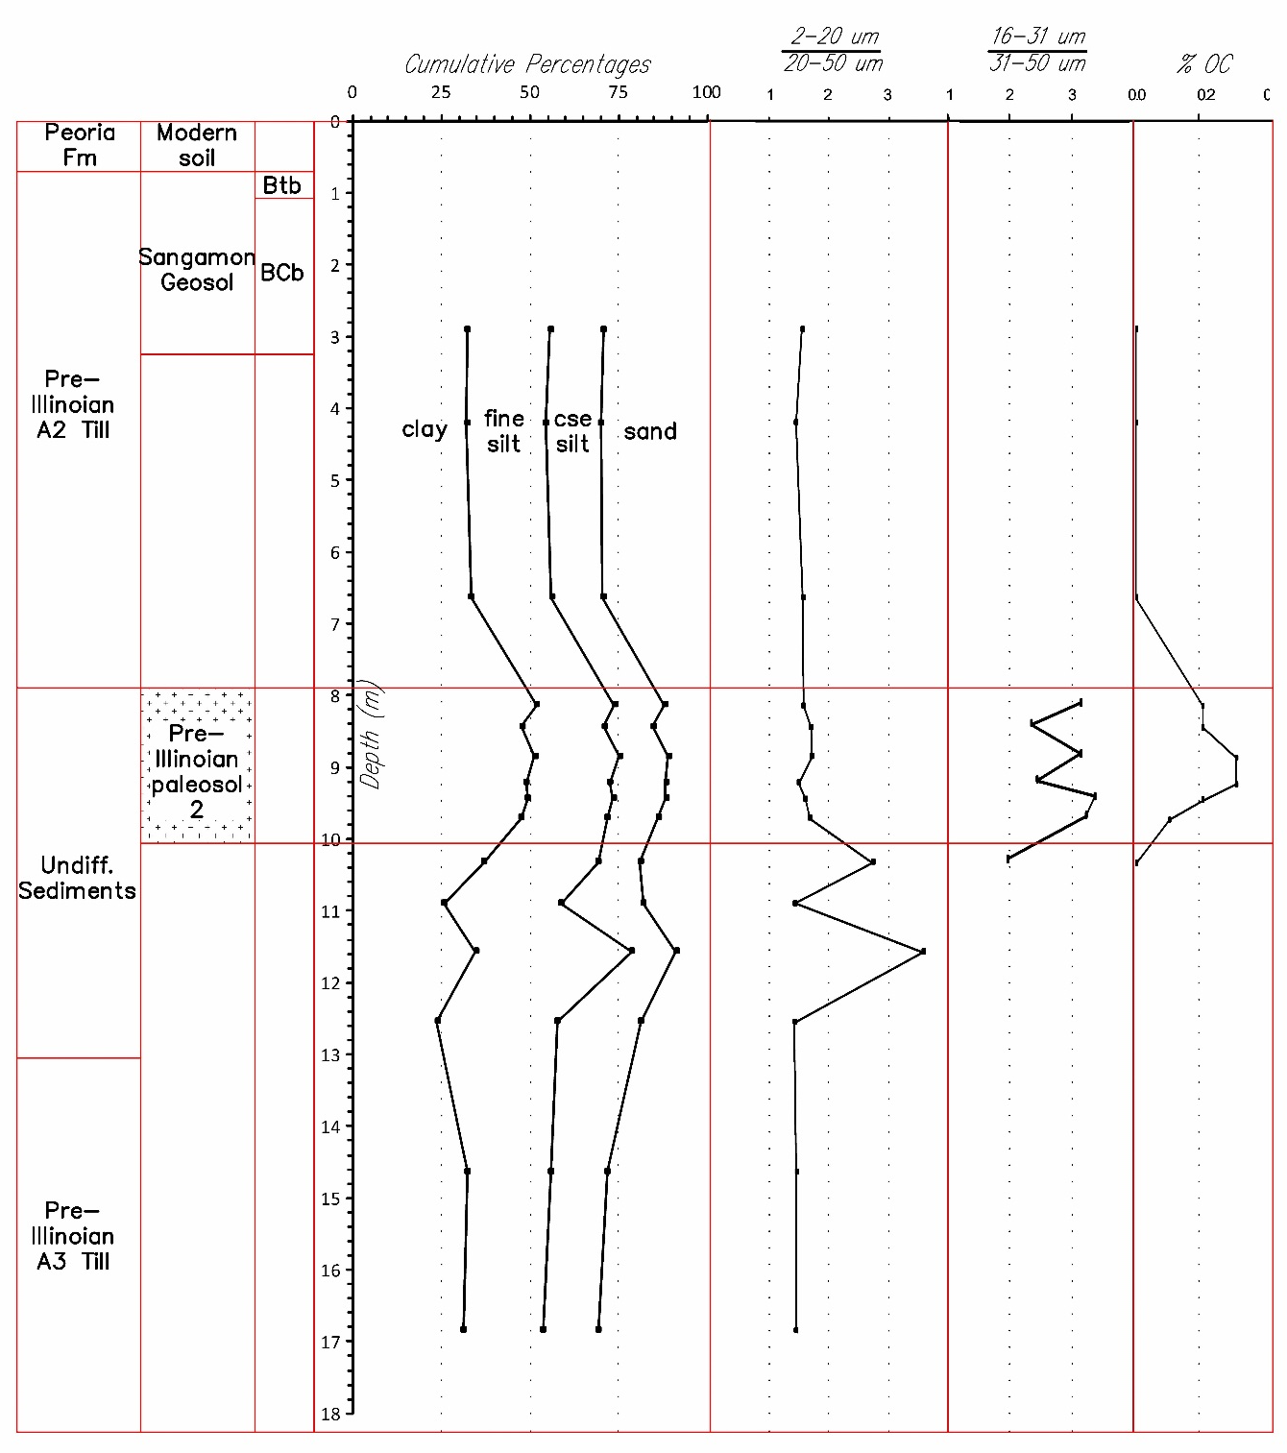
PSA of PIP-2 (Quincy)
PSA of PIP-2 (Tanner)
Pond
Leached
Leached

Slide 27
PSA of PIP-2 (Quincy)
PSA of PIP-2 (Tanner)
clay loam
clay loam
Pond
clay
Leached
silty clay loam
& silt loam
clay
clay loam
Leached
clay loam

Slide 28
PSA of PIP-2 (Quincy)
PSA of PIP-2 (Tanner)
Pond
Leached
t
t
Leached

Slide 29
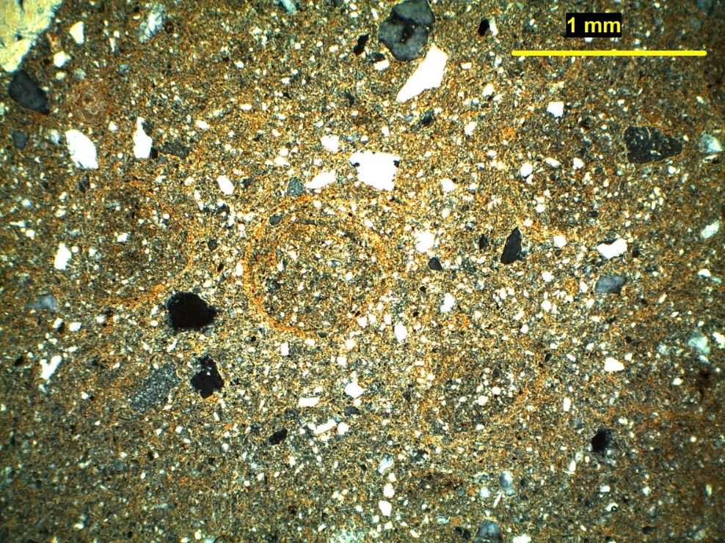
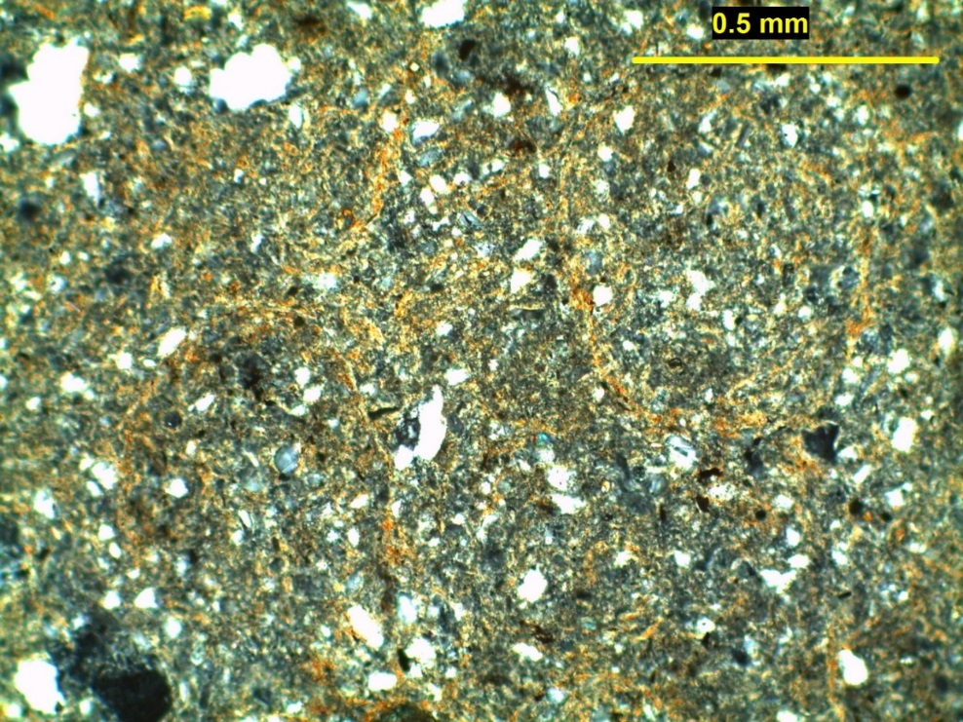
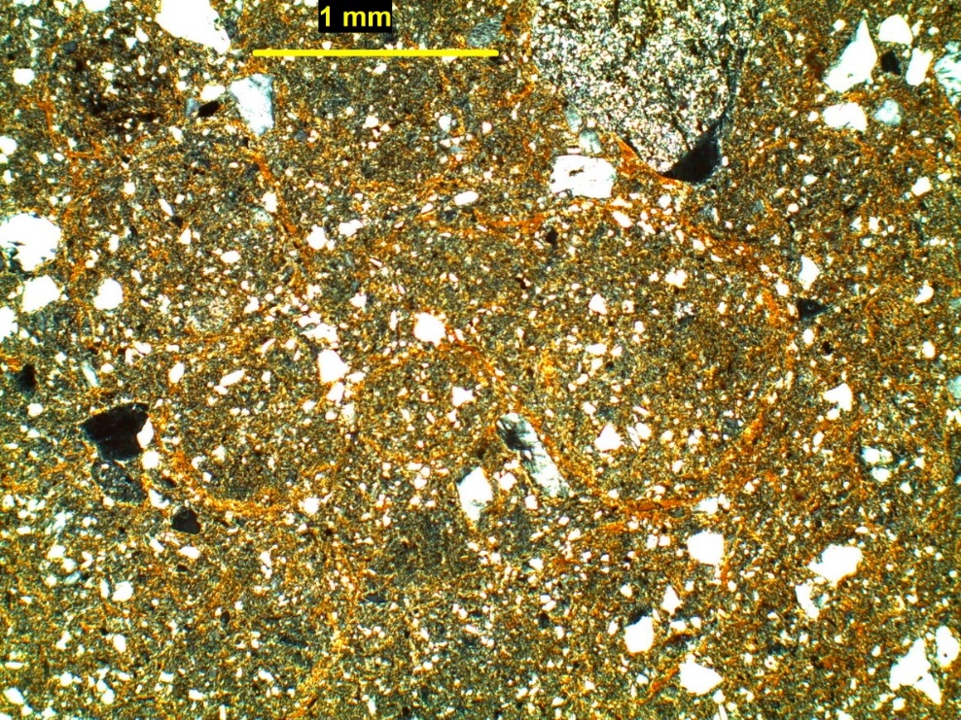
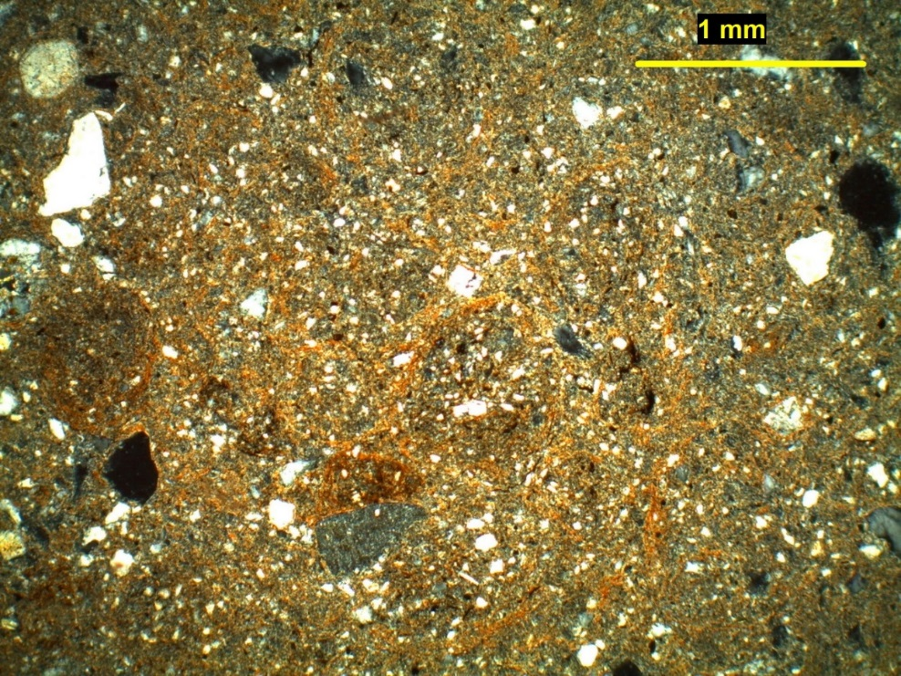
Circular-striated
b-fabric
PIP-2 – upper solum
Quincy 3 – 71 cm (40X-CPL)
Quincy 3 – 145 cm (100X-CPL)
Quincy 3 – 97 cm (40X-CPL)
Quincy 3 – 130 cm (40X-CPL)

Slide 30
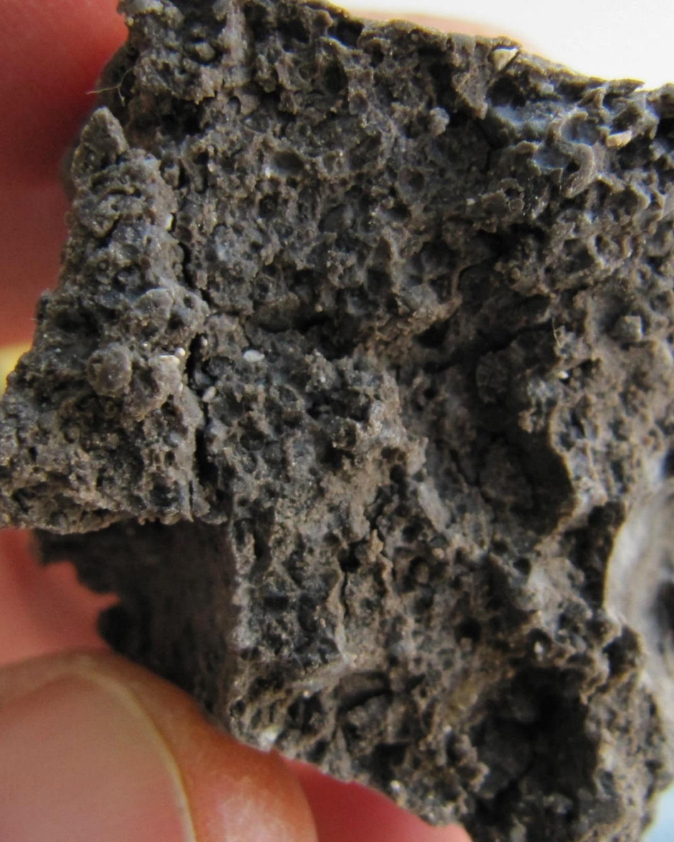
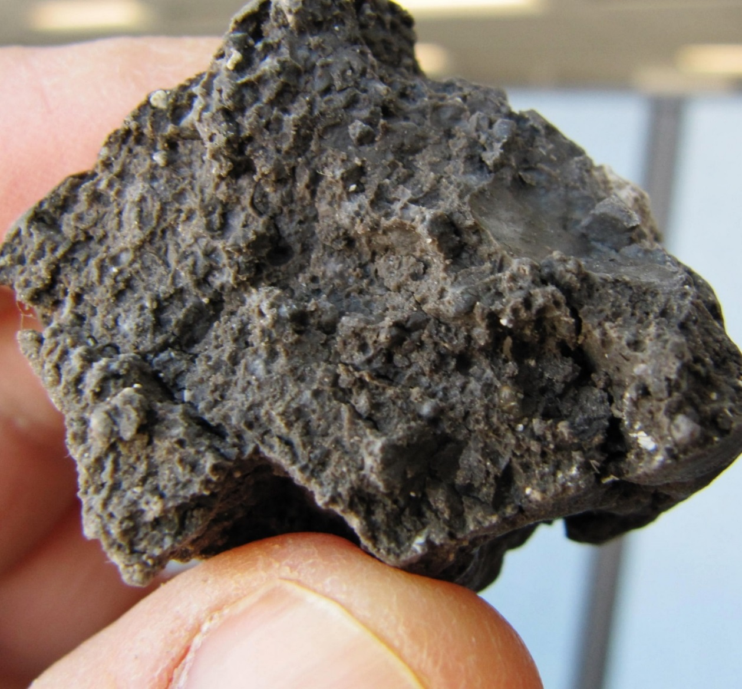
“Fused” granular structure
PIP-2 upper solum (Quincy site)
Mollic horizon?

Slide 31
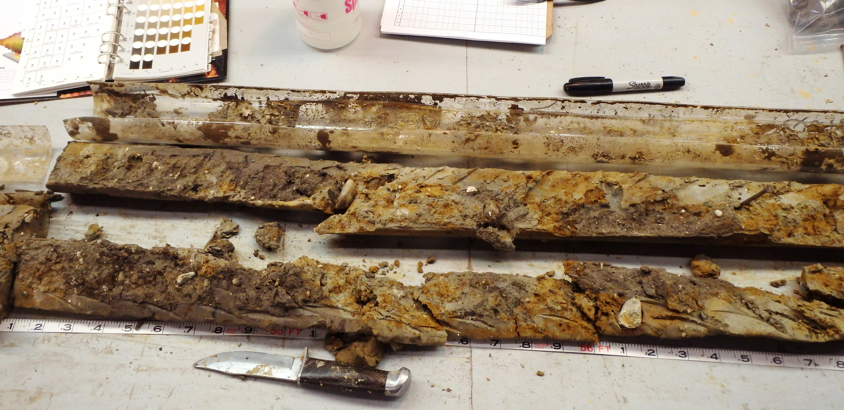
Krotovina in A3 till - lower solum of PIP-2 (Quincy site)
TOP to left

Slide 32
PSA of PIP-2 (Quincy)
PSA of PIP-2 (Tanner)
Lacustrine
t
Leached
t
Leached

Slide 33
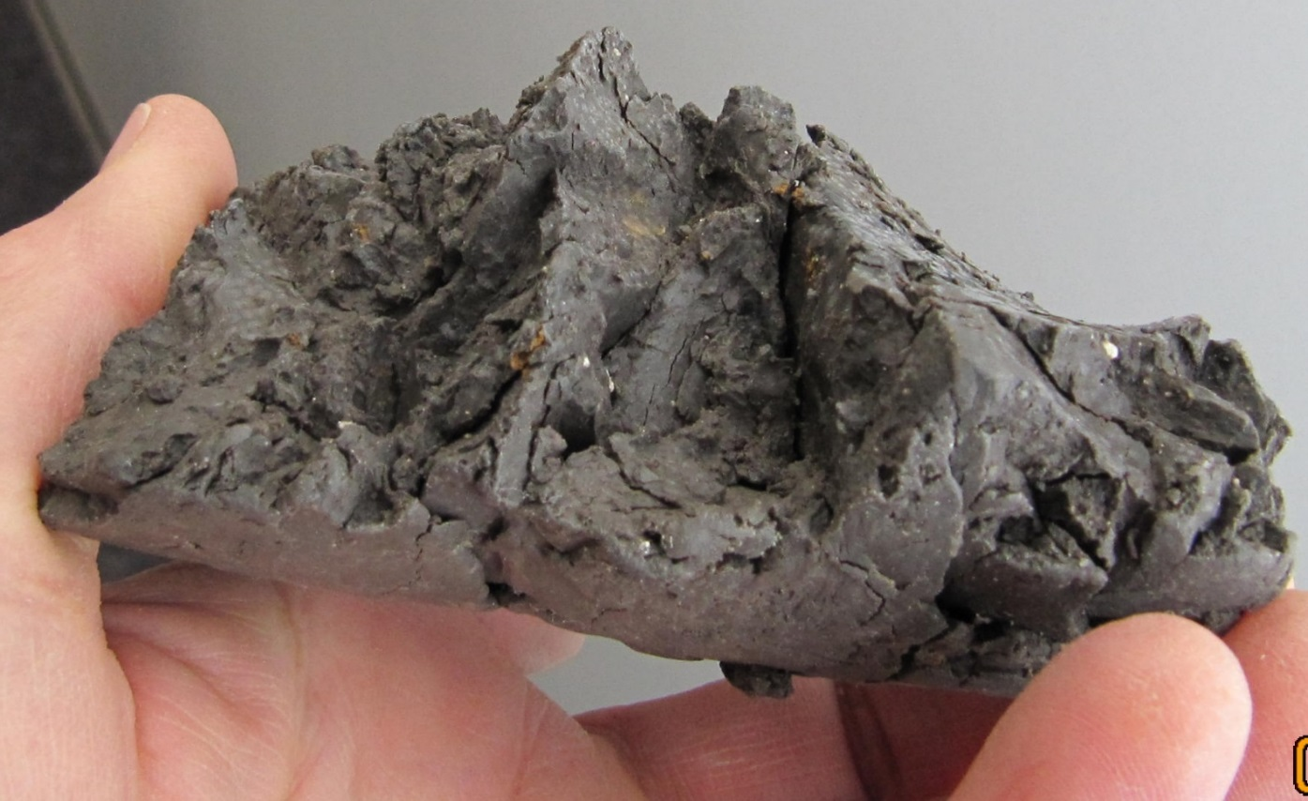
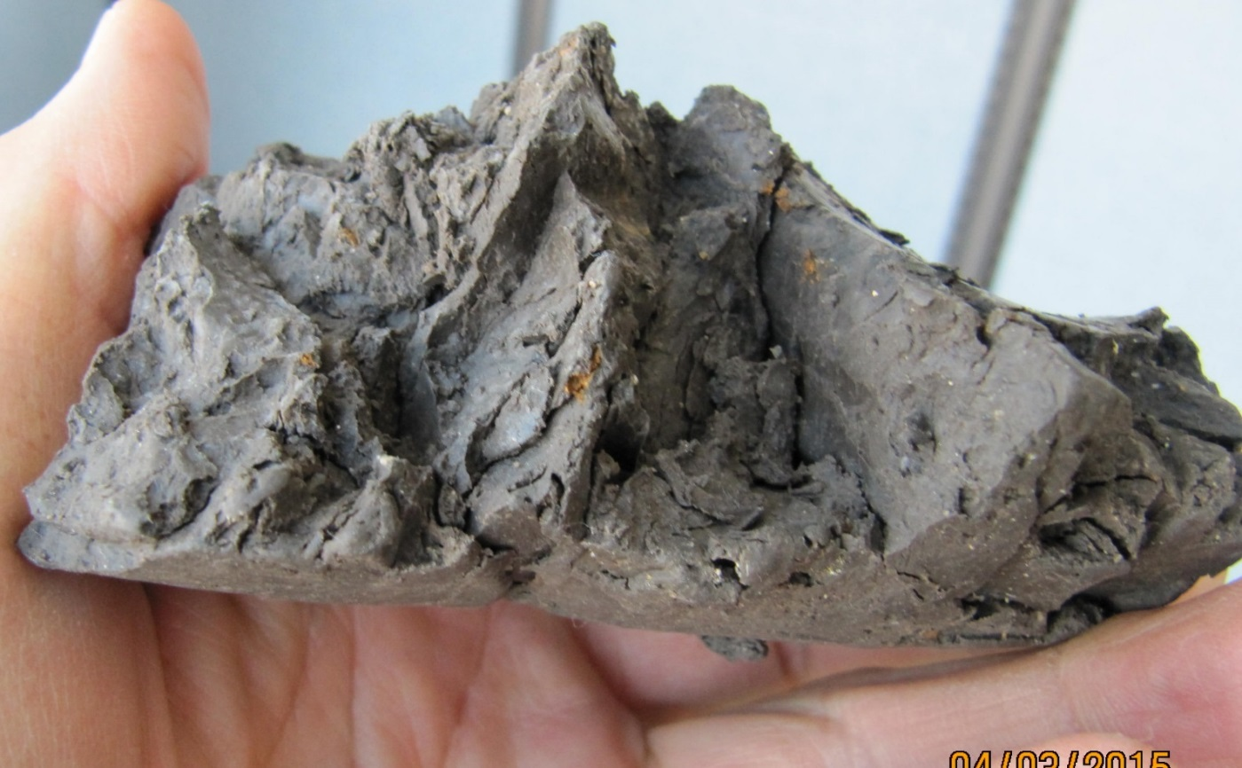
Wedge structure from shrink-swell
- middle of PIP-2 (Tanner site)

Slide 34
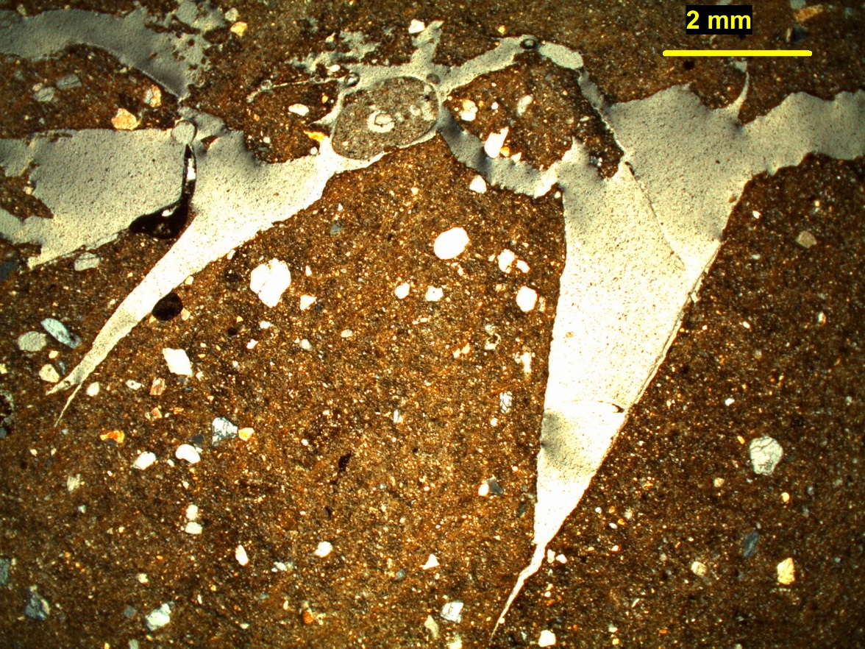
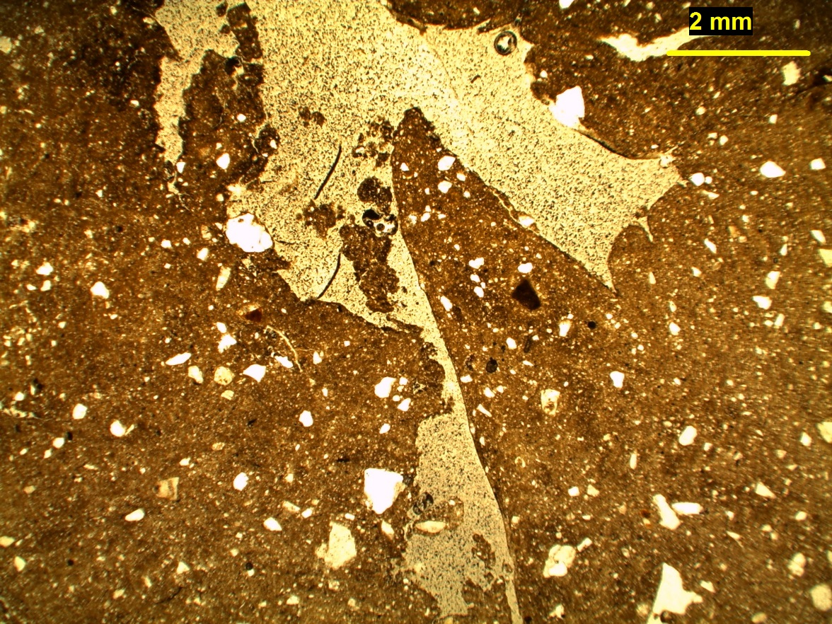
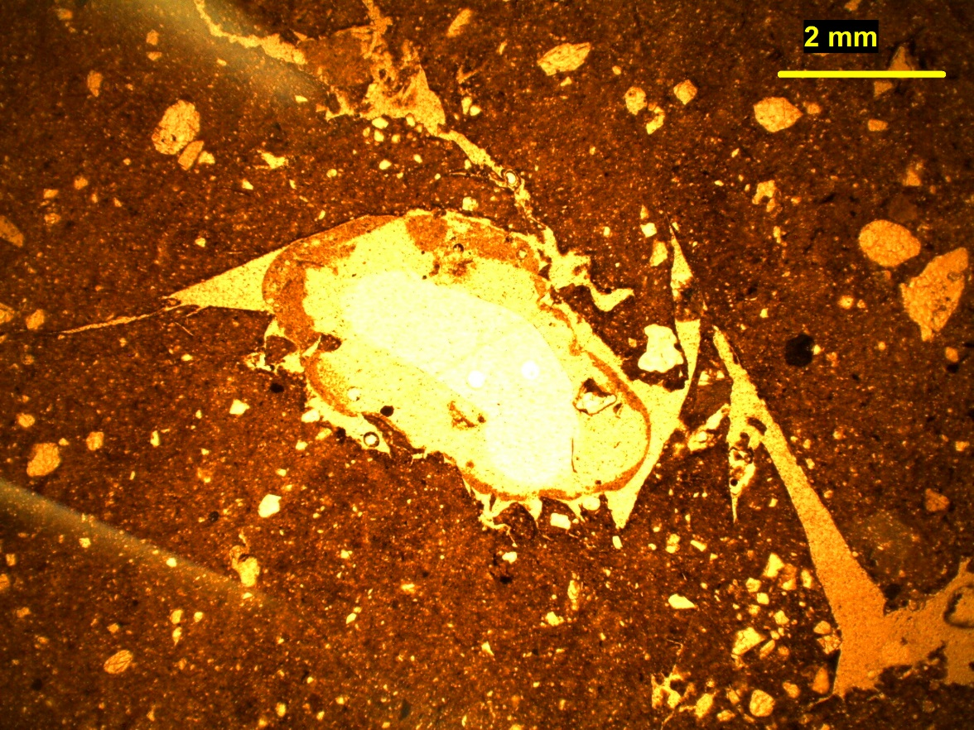
Wedge structure from shrink-swell processes
- middle of PIP-2 (Tanner site)
Tanner 2 – 75 cm (12X-PPL)
Tanner 2 – 110 cm (12X-PPL)
Tanner 2 – 80 cm (12X-PPL)

Slide 35
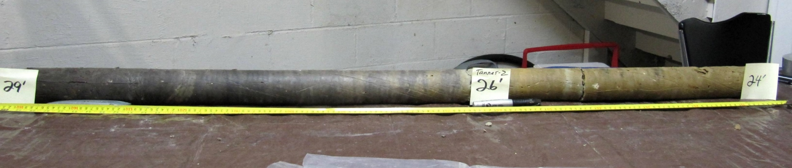
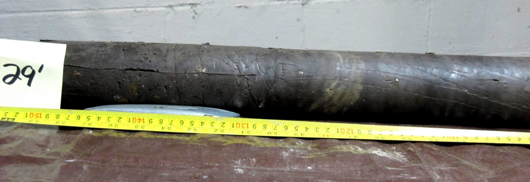
Upper half of PIP-2 core (Tanner site)
TOP of paleosol
low landscape
position
TOP to right

Slide 36
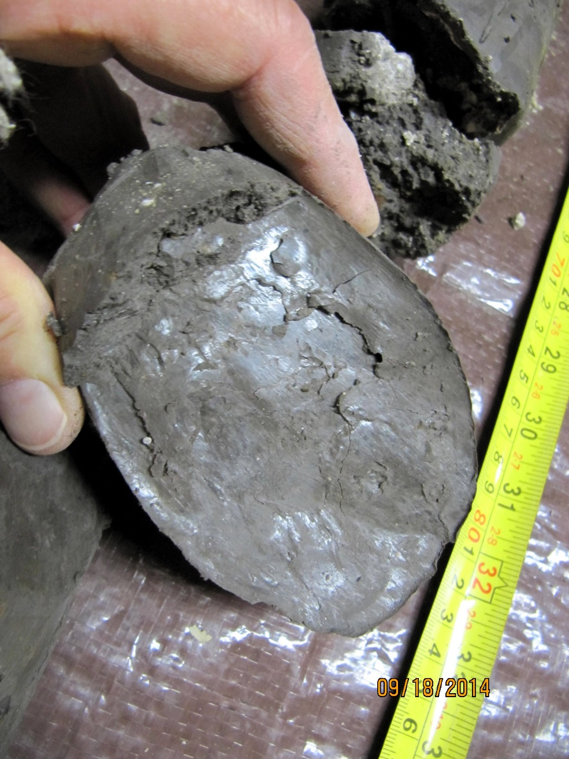
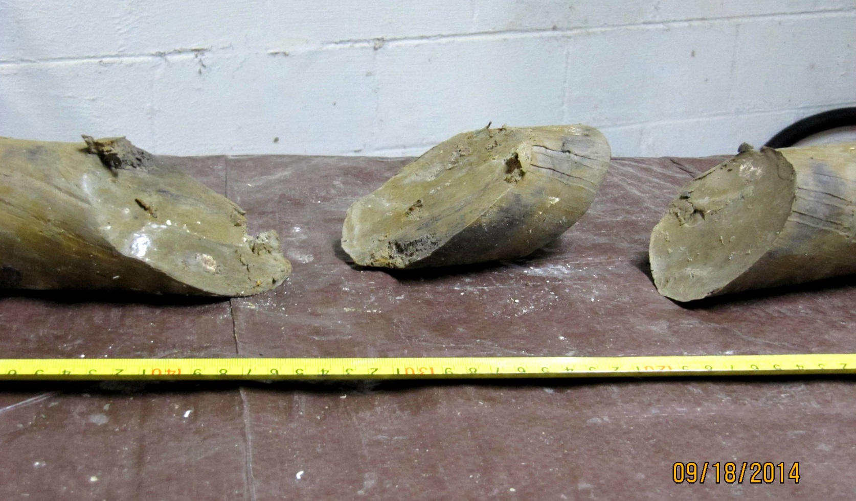
Prominent slickensides & stress cutans
- middle of PIP-2 (Tanner site)
absent at Quincy site

Slide 37
Quincy
Pedogenic carbonates in PIP-2
Tanner
Leached
2 CaCo₃
2 CaCo₃
Leached

Slide 38
Summary
The Clarinda is mapped on 4 different paleosols in Adams Co.,
over an elevation range of 70 meters. The paleosols get
older from east to west as the landscape lowers
3 of the 4 Pre-Illinoian paleosol examples in this study were
developed almost completely in non-till deposits
3 of the 4 paleosols appear to consist of more than one solum
At the Quincy site, both PIP-1 and PIP-2 appear to have an
A-horizon at least partially preserved
Morphologic differences between sites are likely due to different
paleo-landscape positions

