Slide 1
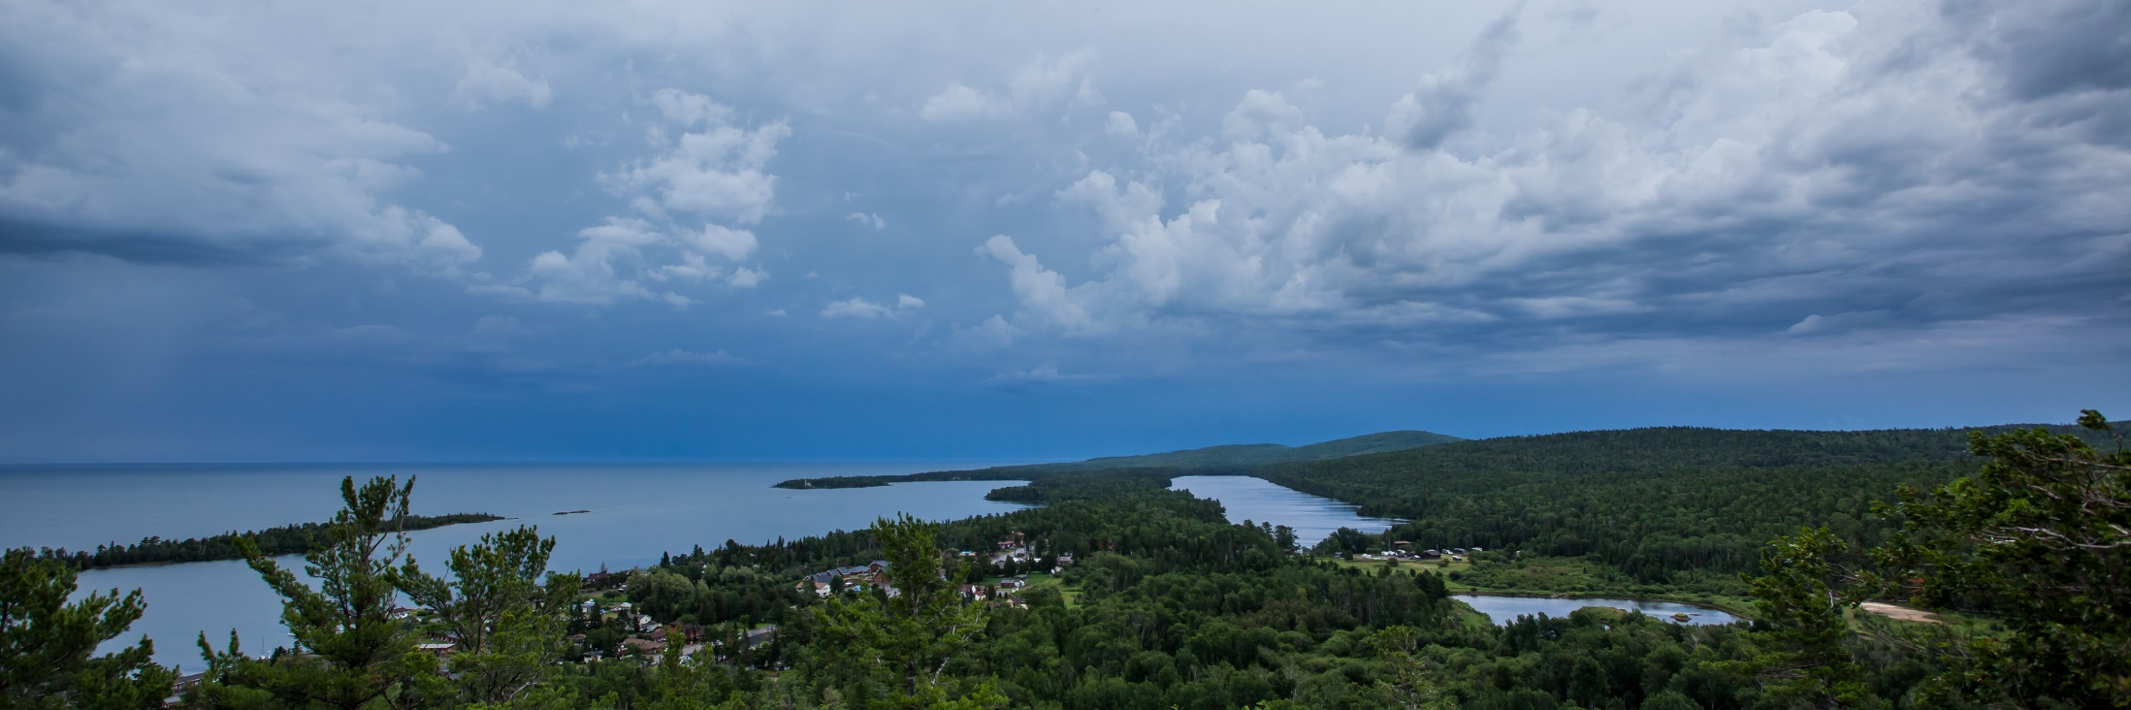
Geoheritage - A Positive Influence on Public Perception of Earth Science
Erika VYE and William ROSE
Geological Engineering & Sciences
Michigan Technological University
ecvye@mtu.edu
GSA North-Central Meeting, May 19-20th

Slide 2
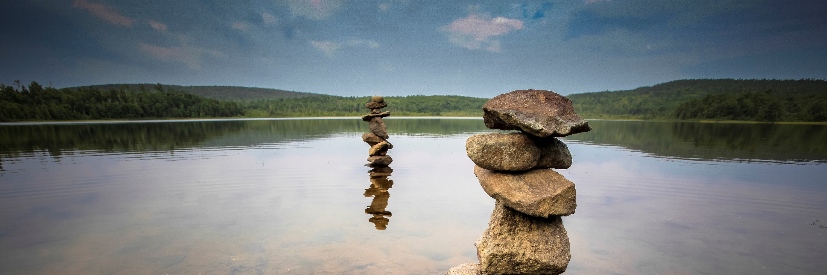
Outline
Benefits of geoheritage
Geoheritage, geodiversity and geoconservation
Global Geopark Network
Advancing geoheritage

Slide 3
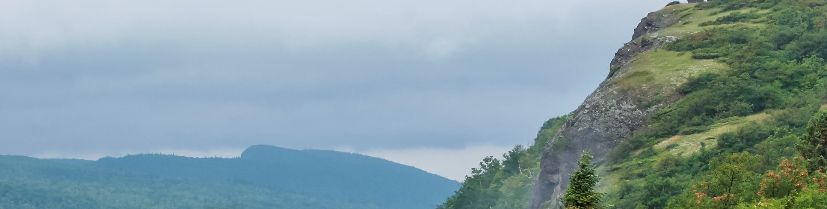
What is Geoheritage?
“Geoheritage encompasses significant geologic features, landforms, and landscapes which are conserved in consideration of the full range of values that society places on them, including scientific, aesthetic, cultural, educational, recreational, commercial/tourism, and other values, so that their lessons and beauty will remain as a legacy for future generations.”

Slide 4



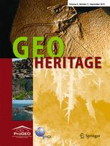
Benefits of geoheritage
Improved scientific literacy
Improved health and well-being
Improved economic benefit
Conservation and preservation of geosites and collections
Participation in growing movement worldwide

Slide 5
Why does it matter?
Natural resource
Non renewable
Social
Education
Geotourism
Economic
Geoheritage
Nature Conservation
Land Use Planning
Science
Environmental
Brihla (2013)

Slide 6
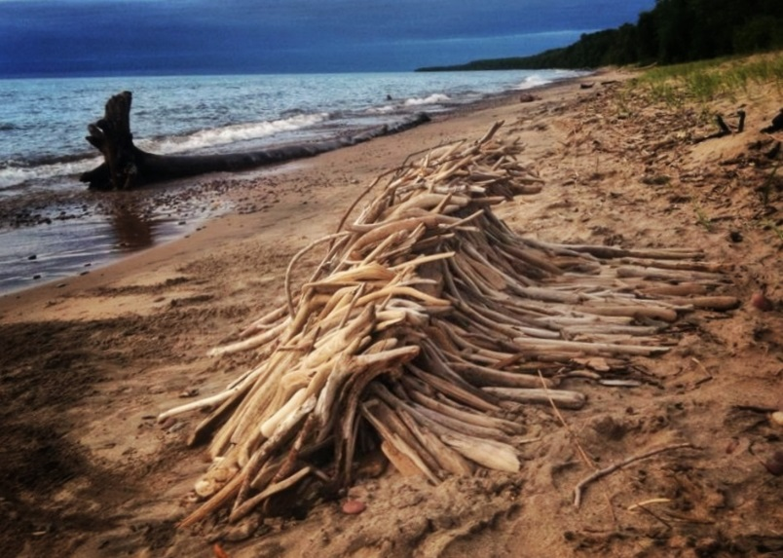
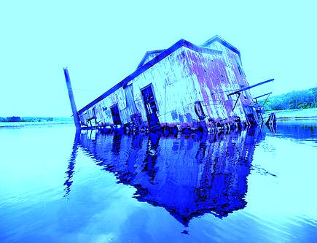
Geoheritage defines us

Slide 7
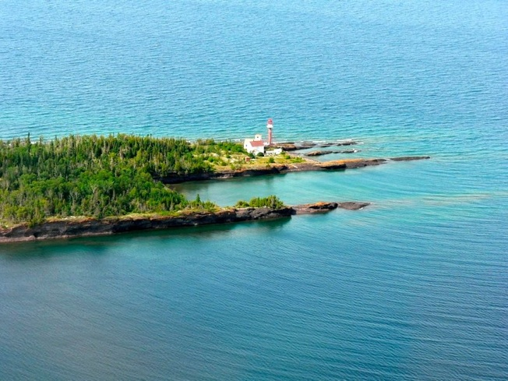
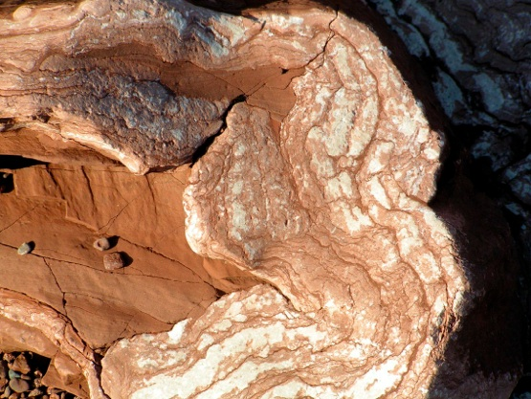
Geodiversity
“Geodiversity is the variety of rocks, minerals, fossils, landforms, sediments and soils, together with the natural processes which form and alter them. “
Murray Gray (2004)

Slide 8
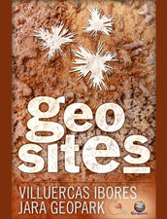
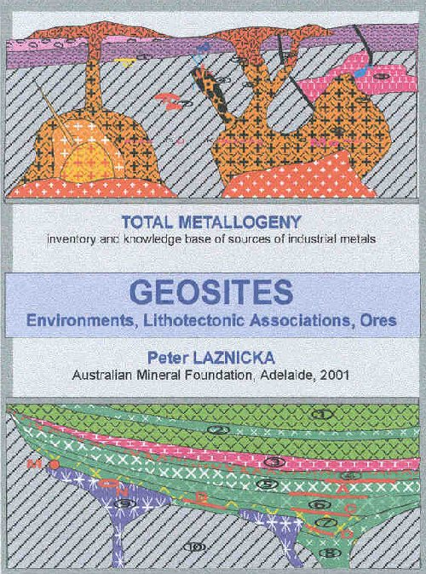
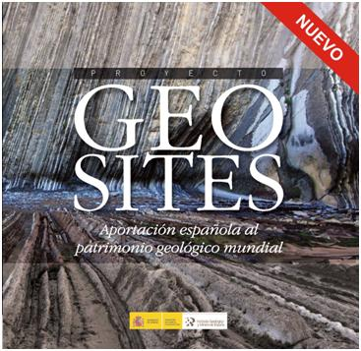
Geoheritage and geodiversity sites
Places of geologic significance (in situ or ex situ)
Inventorying, recognizing sites of value
Characterization and assessment based on topic, value, scale and use

Slide 9
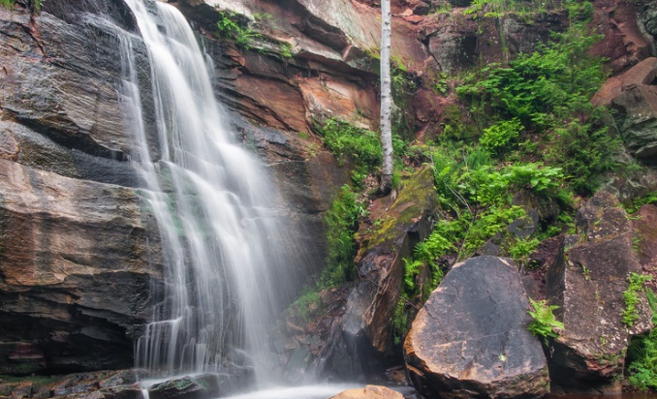
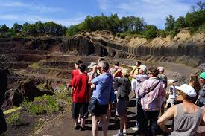
In situ outcrops
Man made and natural
Natural
Anthropogenic

Slide 10
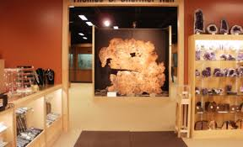
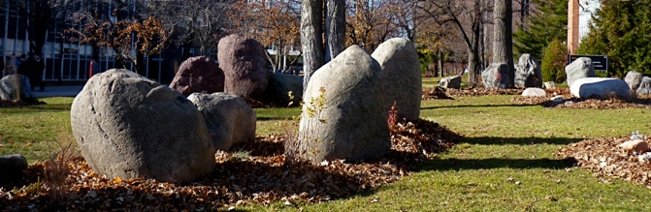
Ex situ sites

Slide 11
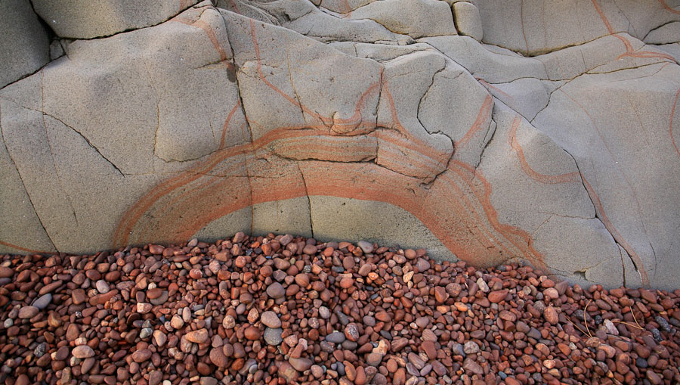
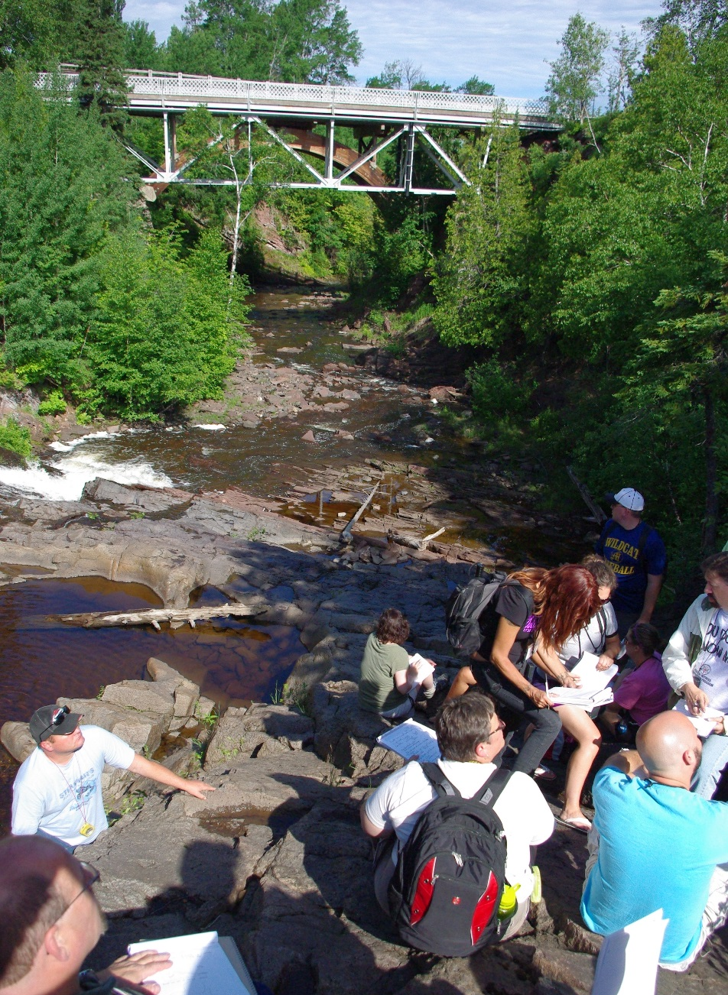
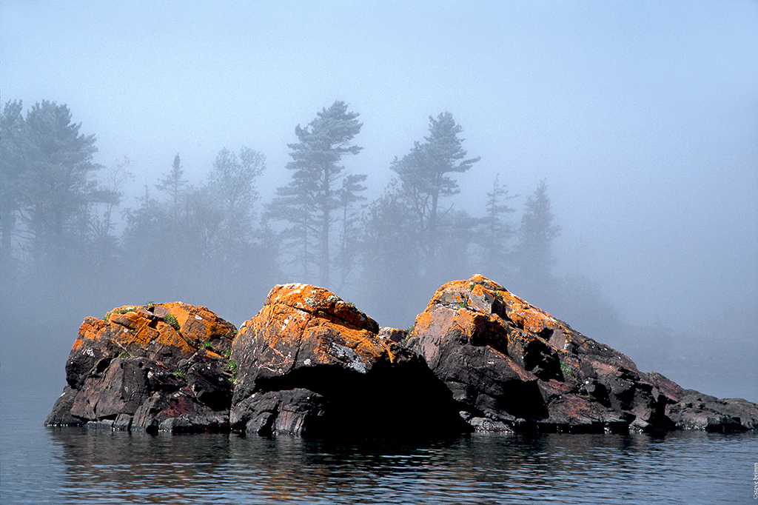
Different Values: Scientific - Educational - Touristic

Slide 12
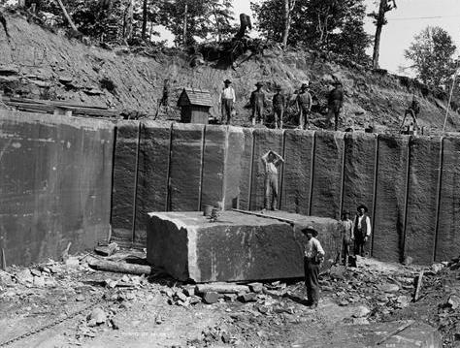
Geoconservation
Identification, protection and management of valuable elements of geodiversity
Recognizing the value of abiotic nature
Emerging geoscience discipline
Masters degrees offered in European universities

Slide 13
Recognition for geoheritage
UNESCO World Heritage
UNESCO Geoparks
National Parks
State parks
Municipal parks
Protected areas (by legislation or community stewardship)
Scientifically recognized areas
Privately managed geotourism sites
Interpreted vantage points

Slide 14
Recognition for geoheritage
UNESCO World Heritage
UNESCO Geoparks
National Parks
State parks
Municipal parks
Protected areas (by legislation or community stewardship)
Scientifically recognized areas
Privately managed geotourism sites
Interpreted vantage points

Slide 15

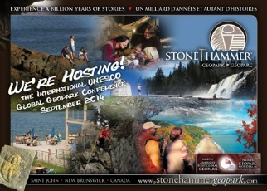
Geoparks
Nationally, or globally, significant geologic area.
Geoparks are defined by the geology of the landscape and transcend the boundaries of parks and other protected areas.
A Geopark operates as a partnership of people and land managers working to promote Earth heritage through education and sustainable tourism.

Slide 16
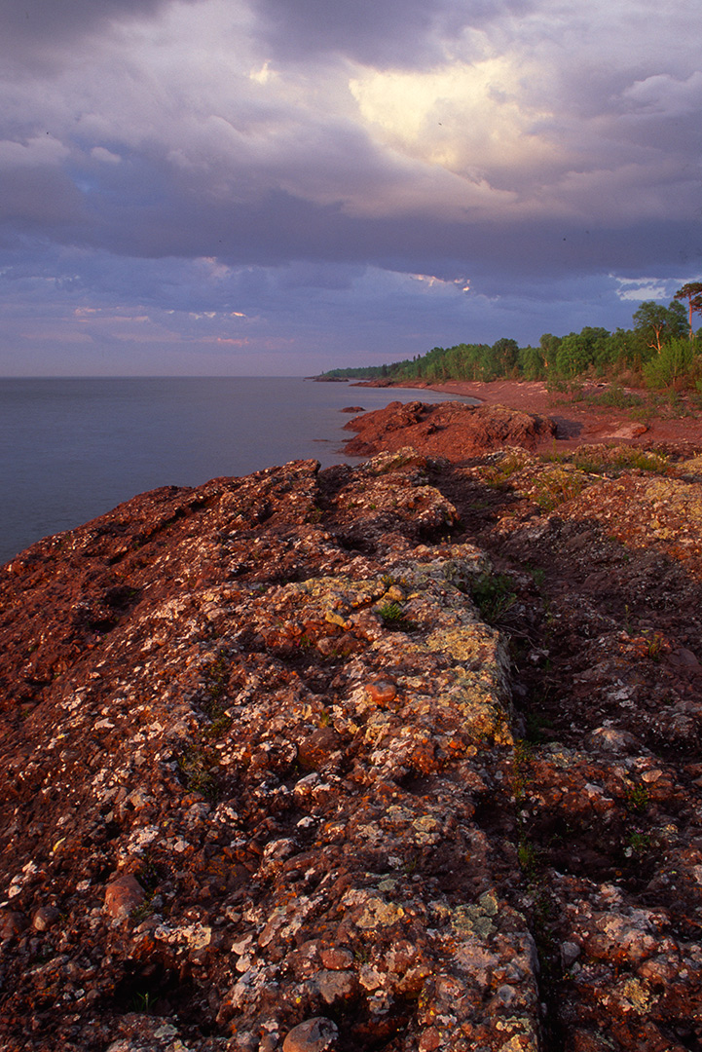
Benefits of Geoparks
Wider recognition and a higher profile of the site.
Public education on geoscience topics: volcanoes, earthquakes, tectonics, erosion, minerals, caves, paleontology, historical mining.
Promotion of the site’s geological heritage and its role in the history of the local area.
Promote local economic development.

Slide 17
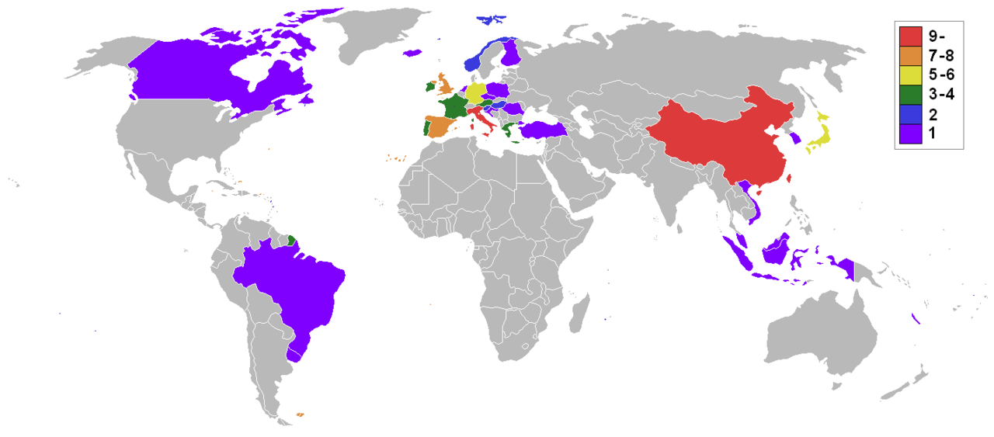
Global Distribution of Geoparks

Slide 18

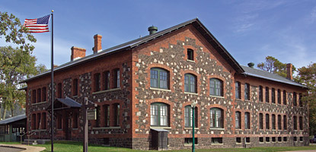
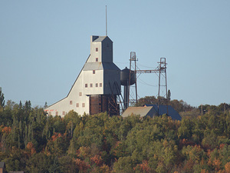
Grassroots efforts in the Keweenaw
Geoheritage
Partnerships
Education

Slide 19
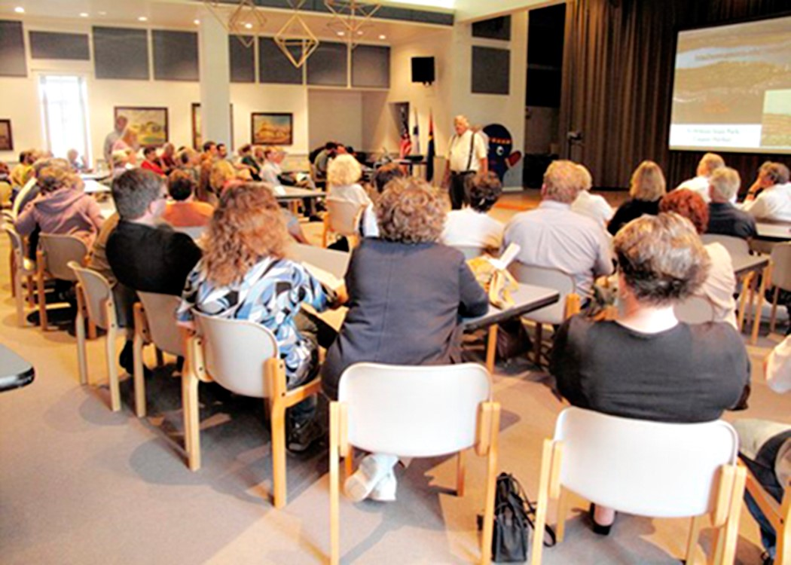
Keweenaw Geopark discussion
March 18th , 2011
"Experiences with the Bohemia Geopark initiative in Europe and the European perspective of Geoparks," led Dr Benjamin Van Wyk deVries, Professor, Universite Blaise Pascal, Clermont Ferrand, France
March 18th , 2012
Community meeting on Geopark proposal with guest speaker Bob Lillie
March 26th , 2013
Geopark discussion with
Dr Benjamin Van Wyk deVries

Slide 20

“Grassroots Year of Geoheritage!”
build constructive geo-interpretation for the public
constructive partnership of geoheritage partners
have “something for everyone”
make it a celebration!

Slide 21
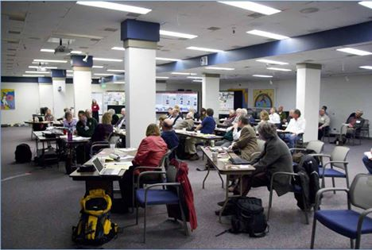
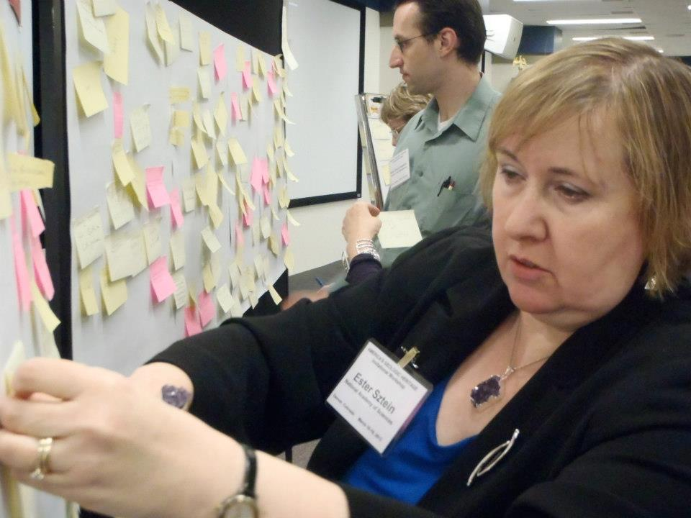
Recent Geoheritage efforts in the US
First ever meeting on Geoheritage in the US, March 2013 in Denver, CO.
Responding to the 15 year surge in other parts of the world
GSA position statement on geoheritage

Slide 22
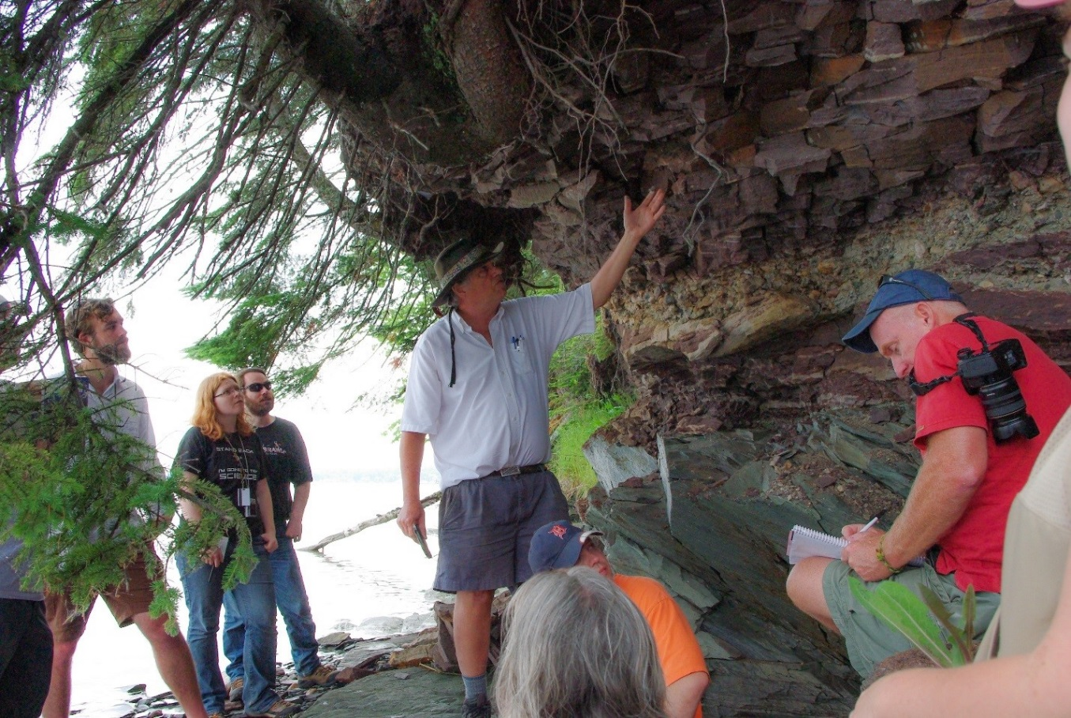
Advancing geoheritage
Communicate the value of geoheritage sites to decision makers and the public
Build partnerships to identify, designate and manage geoheritage sites
Develop educational materials about geoheritage

Slide 23
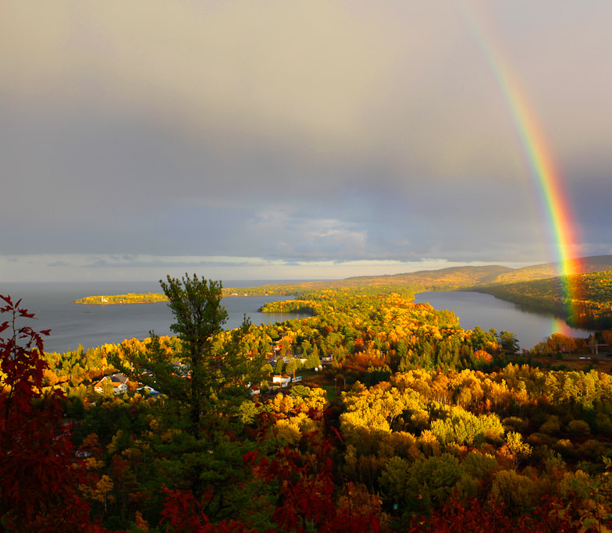
Advancing Geoheritage
Build a regional and national geoheritage network
Formation of the US committee for Geoparks
Support participation in Global Geopark Network
Geosite inventory, assessment and characterization

Slide 24
Geoheritage and public perception of Earth science
The Three E’s
Engagement
Economic development
Education
Calder, 2013

Slide 25
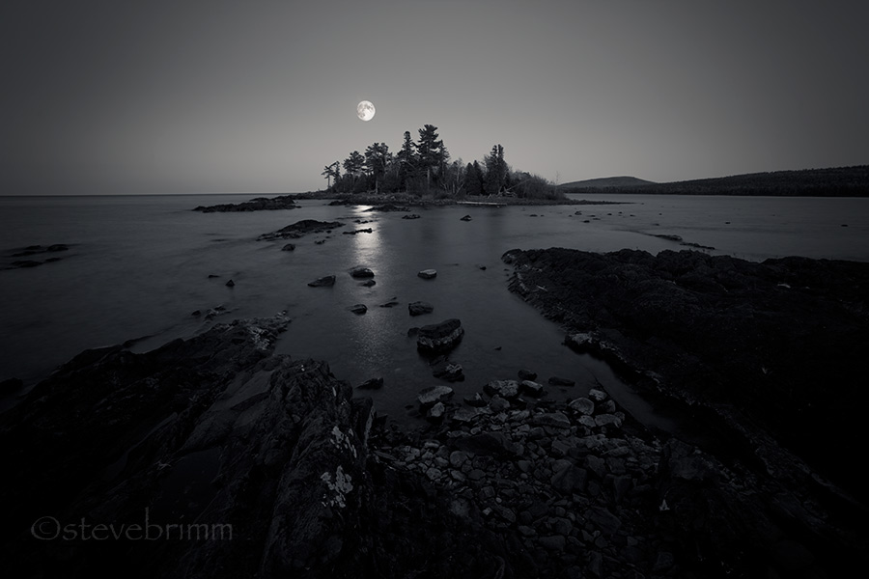
Thank you!
T53: Geoheritage Matters – GSA, Baltimore, November 1-4.

