Slide 1
Reaching Out to Communities to Identify and Address Local Concerns
Mike Phillips
Illinois Valley Community College
Oglesby, IL
Notes:
Good Morning!
I’m Mike Phillips, and this morning I will discuss several of the important roles through which we can serve our communities: that of professional consultant, concerned citizen, and by working on or with a community advisory group. I will discuss the benefits and limitations of participation in both roles and provide examples of each.
I will also discuss what we can do to help ensure that geoscientists are included in the decision-making process more often.

Slide 2
Community Concerns with a geoscience aspect
Natural hazards
Human-induced hazards
Natural resources
Land-use planning
Notes:
Communities face many concerns with a geoscience aspect.
How many times have you read an article in the local newspaper or heard a report on the radio and said to yourself and your colleagues: What on earth were they thinking when they did that? Do they no nothing about geology? How could they be so ignorant about how the earth works?
Decisions on how to address these issues are made by a wide variety of people serving in a wide variety of roles.

Slide 3
Who Decides?
Elected officials
Government employees
Paid consultants
Effected property owners/residents
Community advisory groups
Notes:
<click>
We choose our elected officials to make decisions for us and organize government at all levels to address the needs of our society. Elected officials often rely on <click> government employees with specific expertise and <click> paid consultants to address specific issues. When there is conflicting information or interests, the elected officials may be called on to make a final decision between competing choices.
In addition to this formal structure, there are less formal groups of people who may have input based on personal interest or expertise. <click>
Property owners that are directly impacted by a hazard (or perceived hazard) will often insist on being included in the decision-making process. <click>
Community advisory groups are typically composed of local residents who have expressed interest in an issue. These groups may be legally mandated or formed in response to a specific concern.
None of these roles are guaranteed to include a geologist.

Slide 4
The Process
Legal structure
Notices
Professional reports
Formal approval
Hearings
Comment submission
Informal structure
Notes:
Decisions often follow a legally-mandated <click> process such as the designation of flood-plains; siting of mines, landfills, and other facilities; and development of “zoning” in cities or counties. The legal requirements are developed by elected officials and will set out the roles and rights of various interested parties.
Requirements may include <click>posting of a notification; <click> the participation of a licensed professional, such as a geologist or engineer; <click>agency or legislative approval; and <click>public hearings or <click>other opportunities for input by effected persons or organizations. The requirements may also minimize or exclude certain types of input.
It is very important to understand the legal rules so that the impact of your input is maximized.
There may also be an informal structure. For example, neighbors may agree to take a certain course of action such as where to put a community garden or compost pile. Business owners often select a site based on an internal process.
These informal systems are also important to understand because many important decisions can be made before any external input is contributed.

Slide 5
The Geologist’s Roles
Professional consultant (may be compensated)
Appalled outsider
Involved community member
Notes:
<click>Often, geoscientists become involved only when someone brings them in as consultants. Unfortunately, many decision-makers do not know that they should consult a geologist in the first place.
So, we learn the results of an uninformed decision midway through the process or, worse yet, after the fact <click> and are left to wonder why a geologist was not consulted.
It is my opinion, based on experience, that by <click> becoming more involved in our communities as geologists, we can help to ensure our place at the table when decisions that should include a geoscience perspective are being made. In some cases, a paid professional will be hired, but in many cases, we may donate our expertise or use the opportunities for research.

Slide 6
Professional Consultant
Private Consulting Geologist
fee-based
individual or part of a firm
may be licensed
may also be an academic
Academic Geologist
grant or contract-funded or community service
may be part of a research project
may include students
may act as a resource contact
Notes:
For most of us, the preferred role is probably that of a professional consultant. It is certainly nice to have one’s expertise recognized and requested.
This role may be filled by someone working in the “consulting” field or by someone in their role as an academic or possibly both.
In this role, the geoscientist is acting as an “expert.” There may be field work and/or lab work. The end product might be a written report, a research document, a letter, or testimony as an expert witness.
The academic might include students in the research in order to provide them with real world experience in both geoscience research and communication. This type of research also offers the opportunity to discuss ethics and objectivity with students as they contemplate their future role as a professional scientist.
In some cases the professional geoscientist might simply act as a resource, helping government officials or impacted residents understand what the key issues are and translating technical documents.

Slide 7
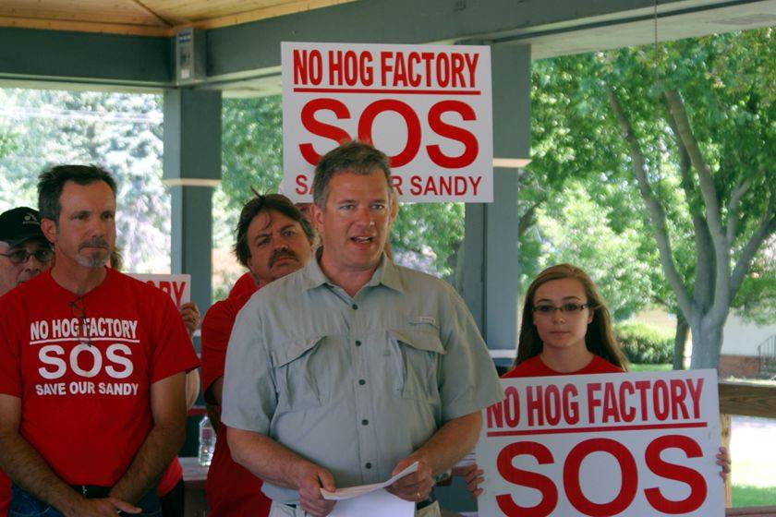
Community Member
Concerned citizen
Activist
Impacted resident
Notes:
As a community member, you might find yourself in one of several possible roles.
We are all concerned about what happens in our communities. In some cases, you might have a specific issue or set of issues that you feel passionate about. And in some cases, you might be directly impacted.
An official role you can take on as a community member is participation in a Community advisory group.

Slide 8
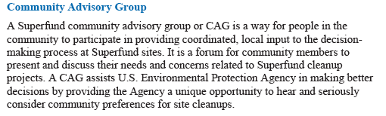
Community Advisory Group
Formed to address a specific need
Authority
Broad membership
Hybrid of two roles
Professional Geologist
Concerned Citizen
Notes:
A Community advisory group is a formally organized group of local residents assembled to address a specific concern.
The group may be organized by local government or by a state or federal agency. For example, the U.S. EPA has a specific process for organizing such groups to provide input when planning environmental remediation. A Community advisory group will have membership that reflects the community. When the issue has a geoscience component, it can be a great benefit to have a geologist included. <click>
As a community member, you understand the needs of your neighbors and the other members of the group will trust a local resident. As a professional, you will be able to help translate technical documents, ask relevant questions, and provide guidance for the group. This can be a very important and rewarding role and you can help to ensure that the geoscience aspects of an issue are not only included but understood and respected.

Slide 9
Considerations
Getting a geologist included
Objective scientist
Activist
Honest broker
Notes:
I think the most important role might be recognizing a concern that would benefit from the input of a geologist and working to ensure that input is sought and included.
To accomplish this, you need to be aware of relevant issues facing your community AND you need to take the initiative to contact the appropriate authorities, such as the mayor, county board chair, business owner, or state representative, and ask them if they have consulted a geologist. If you learn that an informational meeting is being held regarding such an issue, you should attend, listen, and introduce yourself. You then need to be prepared to volunteer yourself or recommend a colleague who can look into the issue and provide an initial assessment. Even if the issue is not within your specialty, as a geologist you will have insight and understand much of the technical terminology.
Most people want to avoid making a poor decision and will welcome input from a knowledgeable person. However, you should not be discouraged if your input is turned away by someone who might want to avoid potentially bad news.
In all of these roles, it is important to maintain objectivity with respect to the science. It is important to let others know what the science indicates and how strong the evidence is. While you will occasionally disappoint some people who want the evidence to direct things along a preferred course, in the long run you will gain trust and credibility.

Slide 10
Examples
Notes:
I’ll now discuss a few examples.
In a given situation, you might find yourself in one role or in several.
My primary goal is to ensure that the geoscience perspective is provided and considered.

Slide 11
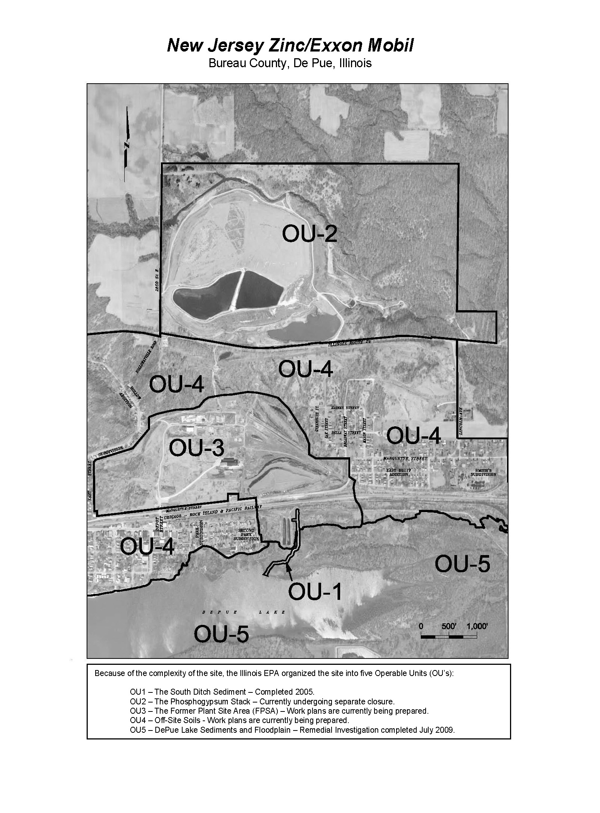
DePue
Notes:
The site is very complex and has been divided into five operating units. Site investigation work has been going on for over 20 years and there are stacks of reports to review. I was asked to assist the local community advisory group. The community advisory group is also receiving assistance from law school students at Northwestern University and I act as a consultant to both groups and provide them with feedback when new reports are produced by consultants investigating the site.
A side issue that has arisen has been maintaining the water level in Lake DePue to allow the continuation of an annual boat race that is very important to the town both socially and economically.

Slide 12
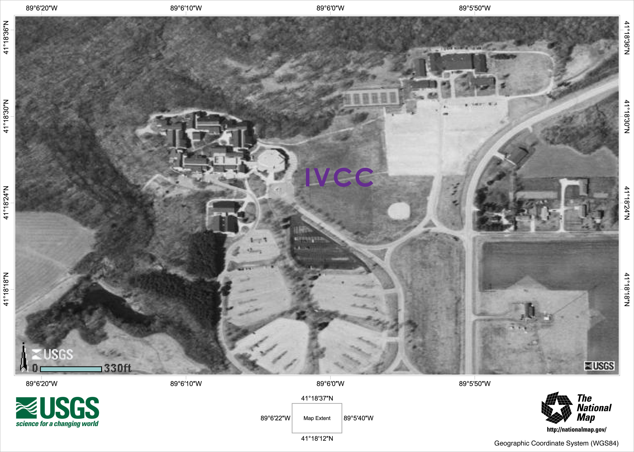
College Construction
Notes:
Sometimes the need is close to home. My college recently undertook a major expansion project. After speaking with the college president and board chair, I performed an environmental assessment and submitted a report to the college as part of the planning process. I have always found it odd when colleges and universities do not utilize the expertise that is present on campus. These are some of the easiest and most obvious opportunities for us and we need to take advantage of them. I also directed the college’s attention to a slope issue near our main building and walked the slope with the board chair. The slope issue was addressed before there was damage to the building, and I use the slope as an instructional device in my environmental geology course.

Slide 13
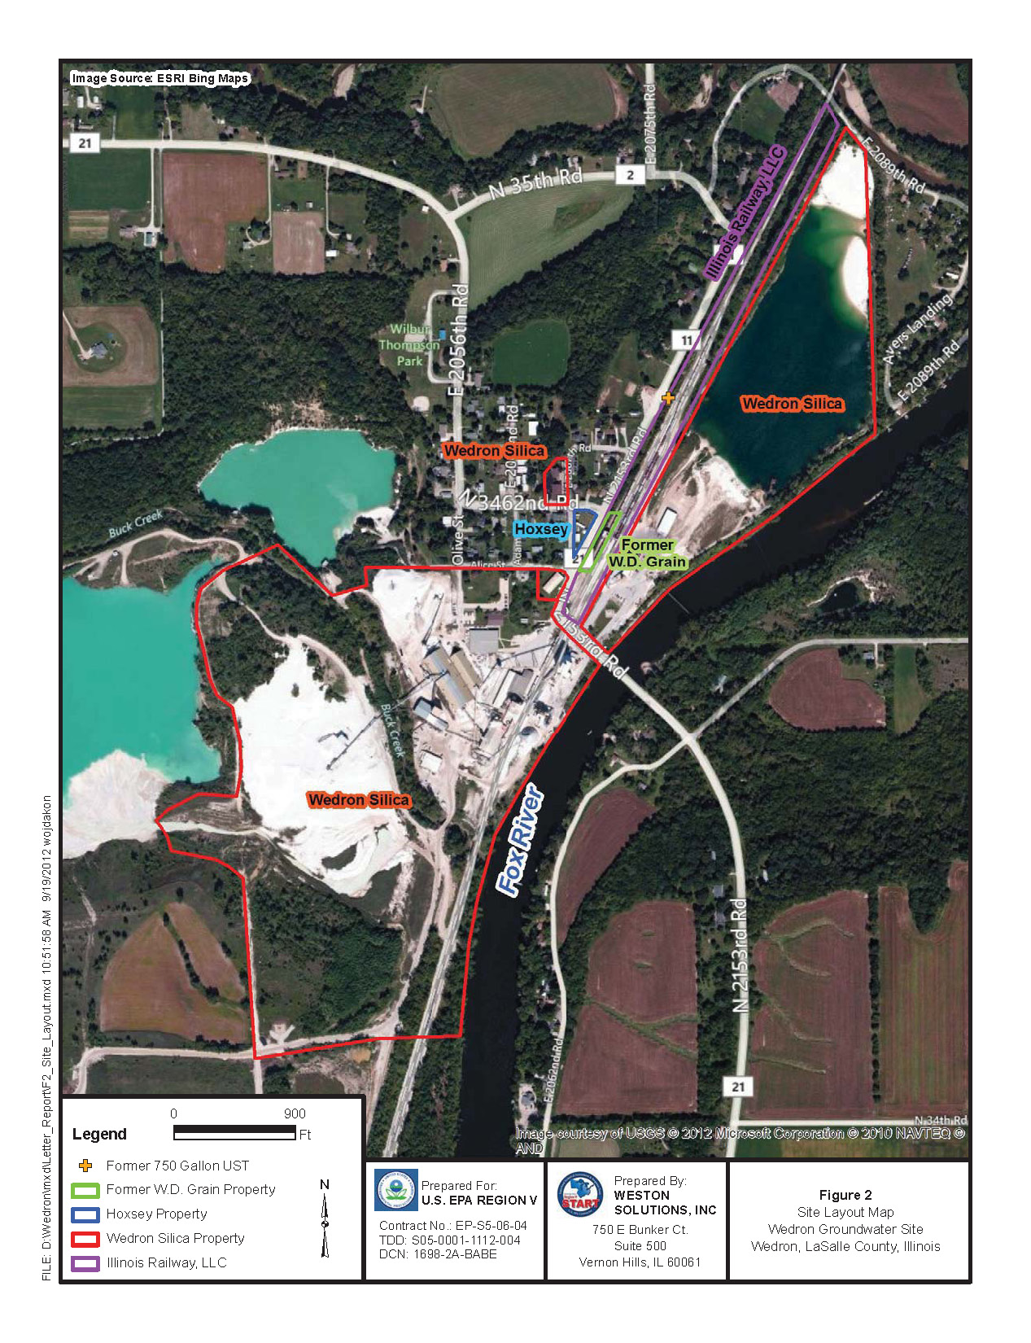
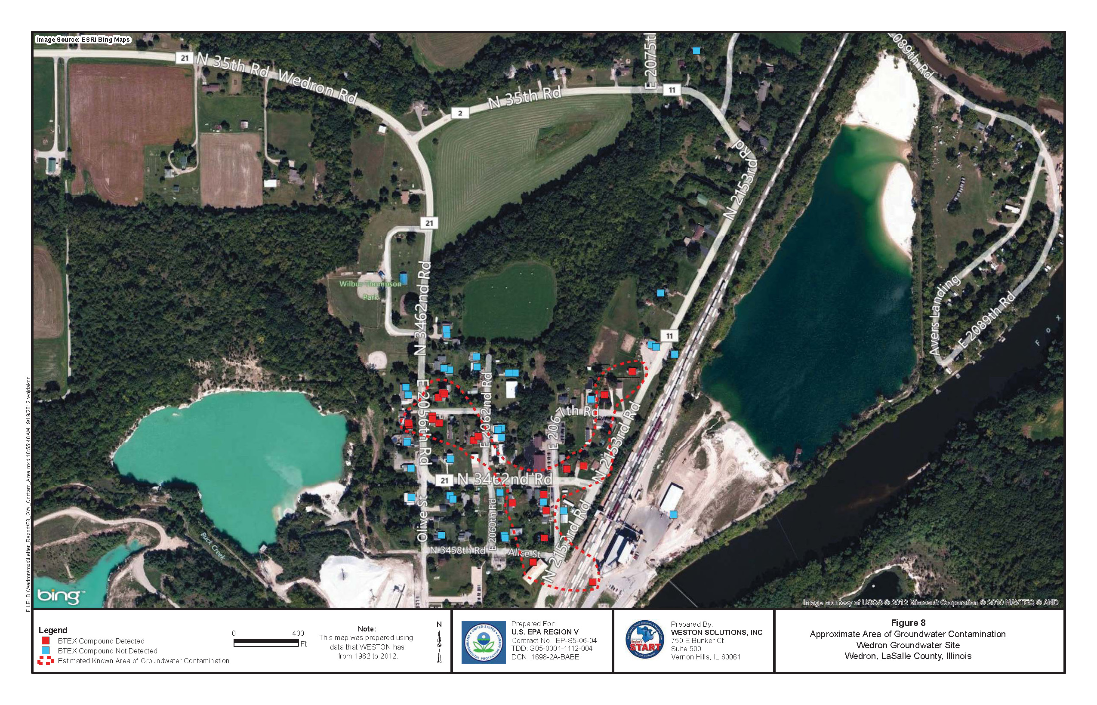
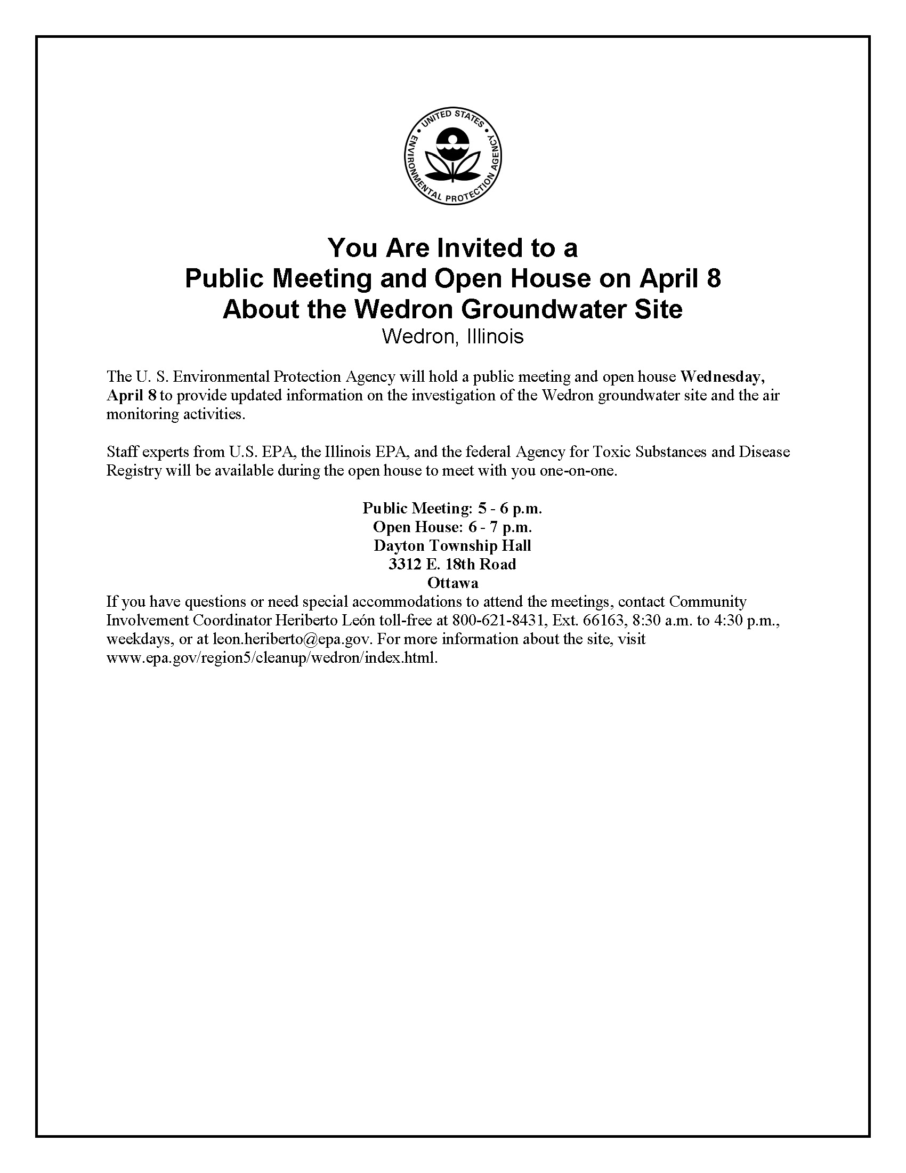
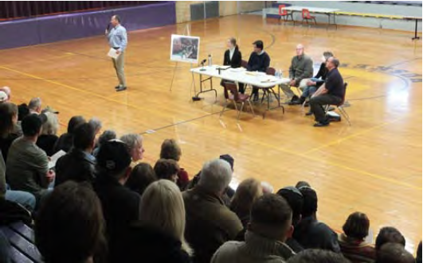
Wedron
Notes:
I first learned of the groundwater contamination problems in Wedron from a colleague who showed me an article in the local news paper. I attended the next public hearing and introduced myself to the EPA project manager and some of the local residents. I am currently acting as the contact person for our local state representative, and I attend most of the public meetings and keep him informed of the results. I have also been working with the EPA and local residents as they continue to investigate the site and explore remediation options.

Slide 14
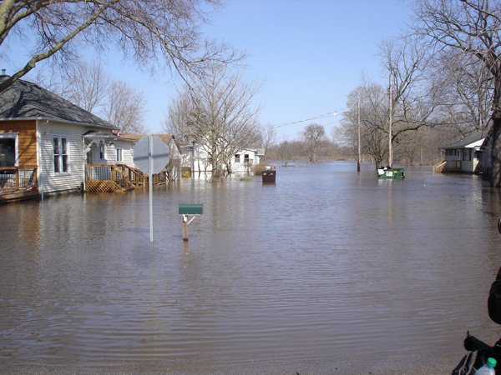
Flood
Notes:
In 2013, there was record flooding along the Illinois River. I accompanied the local state representative as he toured the area and spoke with the governor, local mayors, and affected residents. Flooding is a frequent hazard in our area and a particular interest of mine. I have been able to provide advice to local officials on different ways to address the hazard.

Slide 15
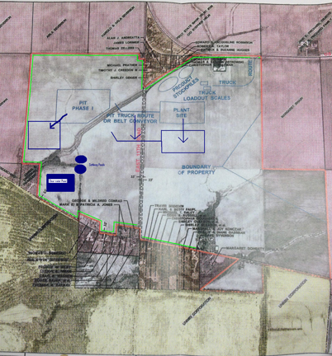
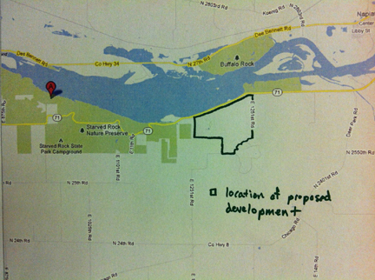
Proposed sand mines
Notes:
As a result of the fracking boom, a number of sand mines have recently been proposed for LaSalle County where my college is located. The first mine submitted a very detailed proposal, and I was provided a copy by a colleague who serves on the zoning board of appeals. I made comments at the public hearing of the zoning board and submitted written comments to the county board chair and several county board members.
For a second mine proposal, I was asked by local residents to testify on their behalf at an annexation hearing. After reviewing the information available, I was able to comment on several environmental concerns that the mine’s plan needed to address including the presence of a high sulfur coal seam in the overburden.
For several other proposed mines one of my students worked with a group of local residents to identify and articulate their concerns. I assisted her in her efforts by providing resources and contacts.

Slide 16
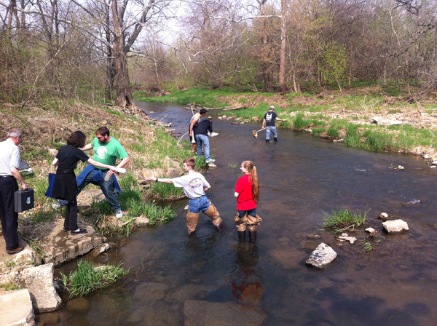
Proposed Hog Confinement Facility
Notes:
I have been acting as both an impacted resident and consultant after a large hog confinement facility was proposed a mile from my home. I joined with a group of neighbors to look into the proposal. We requested a hearing and were able to ask questions of the proponents. We the used the Freedom of Information Act to obtain documents they submitted to the Department of Agriculture including boring logs and construction diagrams. We developed a detailed document addressing our concerns with respect to the Department’s siting criteria; I took responsibility for the sections that had a significant geoscience component. Although not all of our concerns were addressed, the project is moving forward.
My college has a long-standing program where we take students out to test the water quality in local rivers. At the suggestion of my colleague, who oversees the program, we recently took the students out to perform baseline testing of a small river that may be impacted by the hog facility.

Slide 17
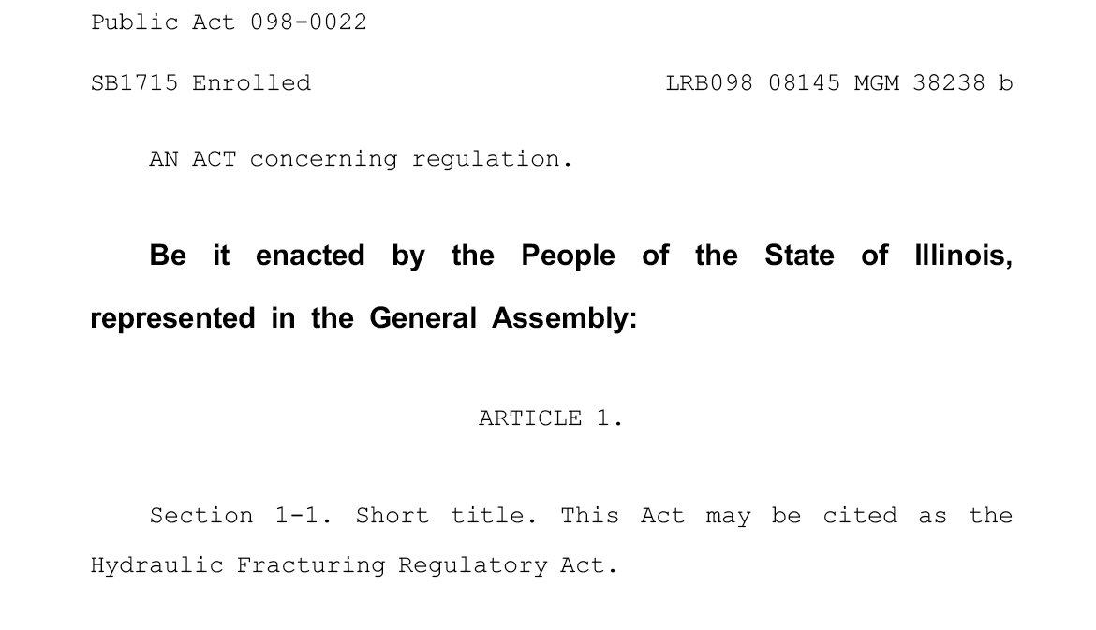
Fracking Bill

Slide 18
Benefits
Community members & leaders
Informed decisions
Increased understanding and appreciation of geosciences
Resource person
Geologist
Increased understanding and appreciation of community needs
Increased understanding and appreciation of how geoscience information is received and used

Slide 19
Thank you!
Mike Phillips
Illinois Valley Community College

