Slide 1


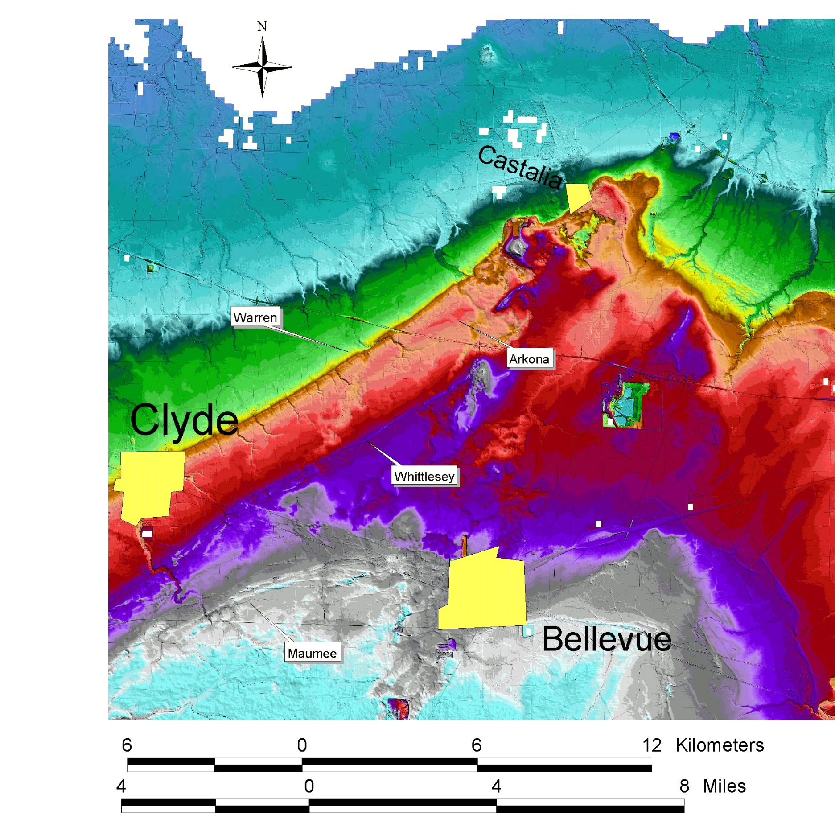
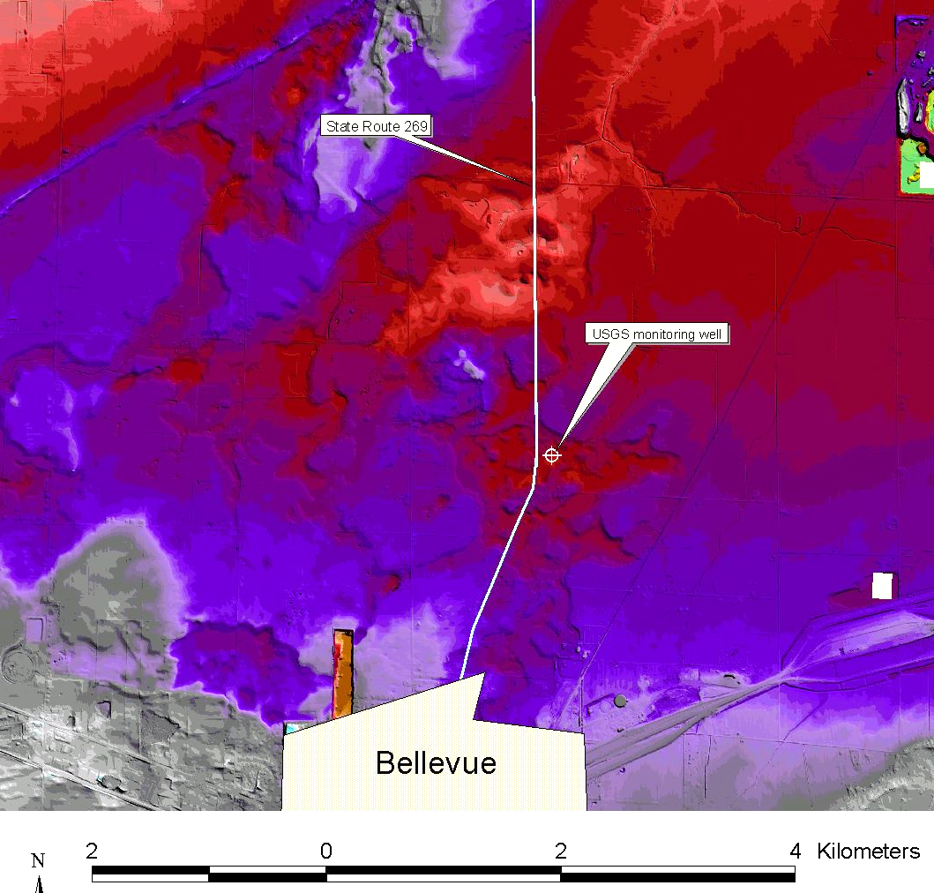
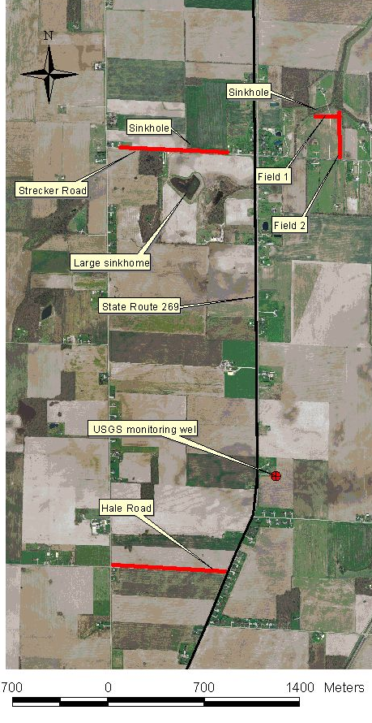
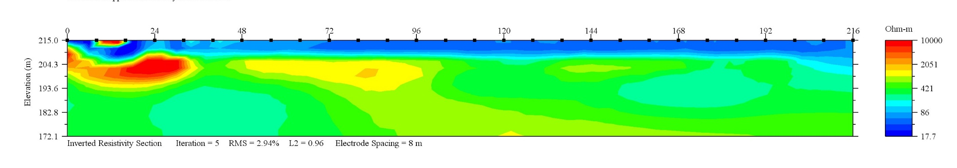
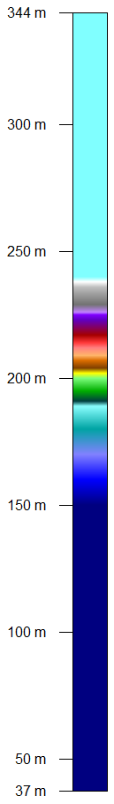
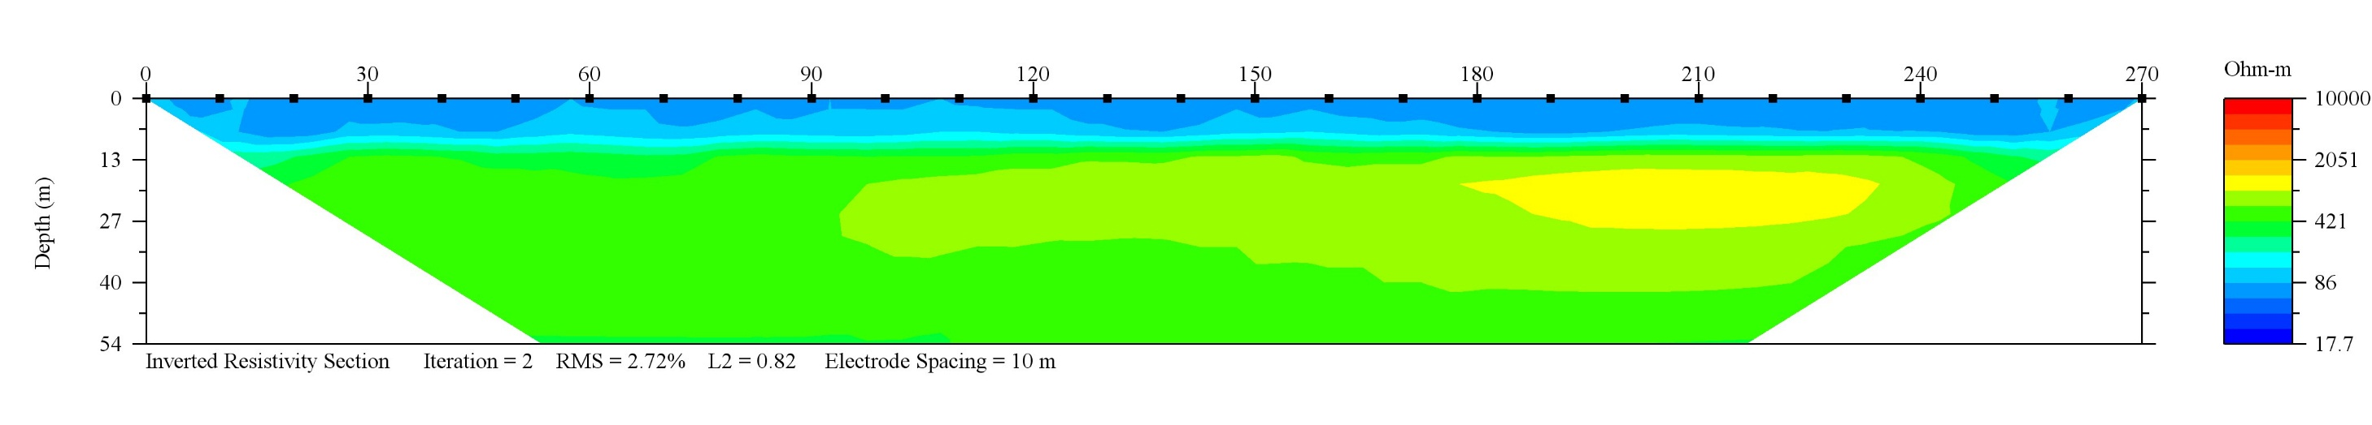
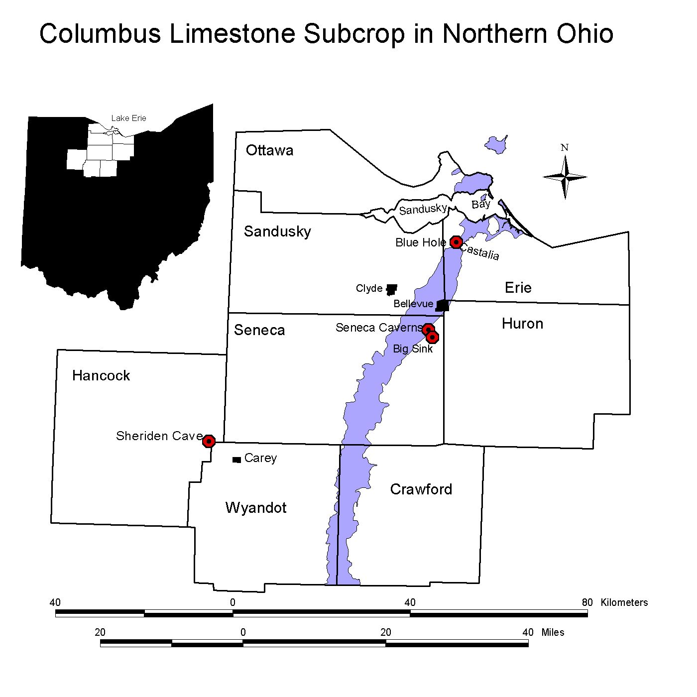
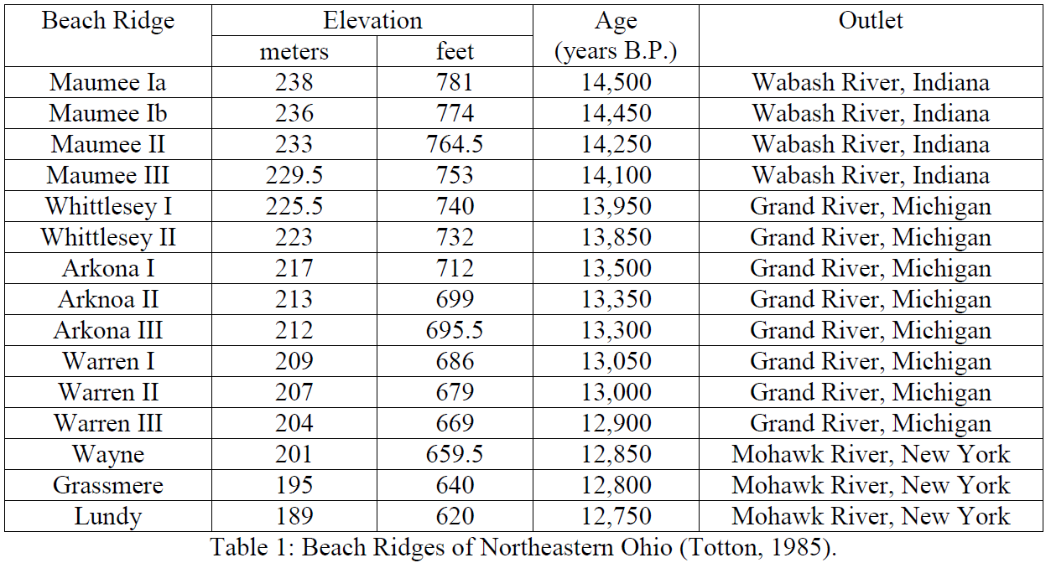
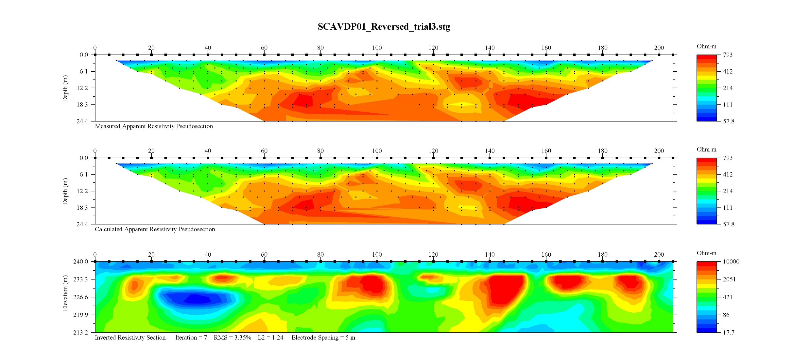
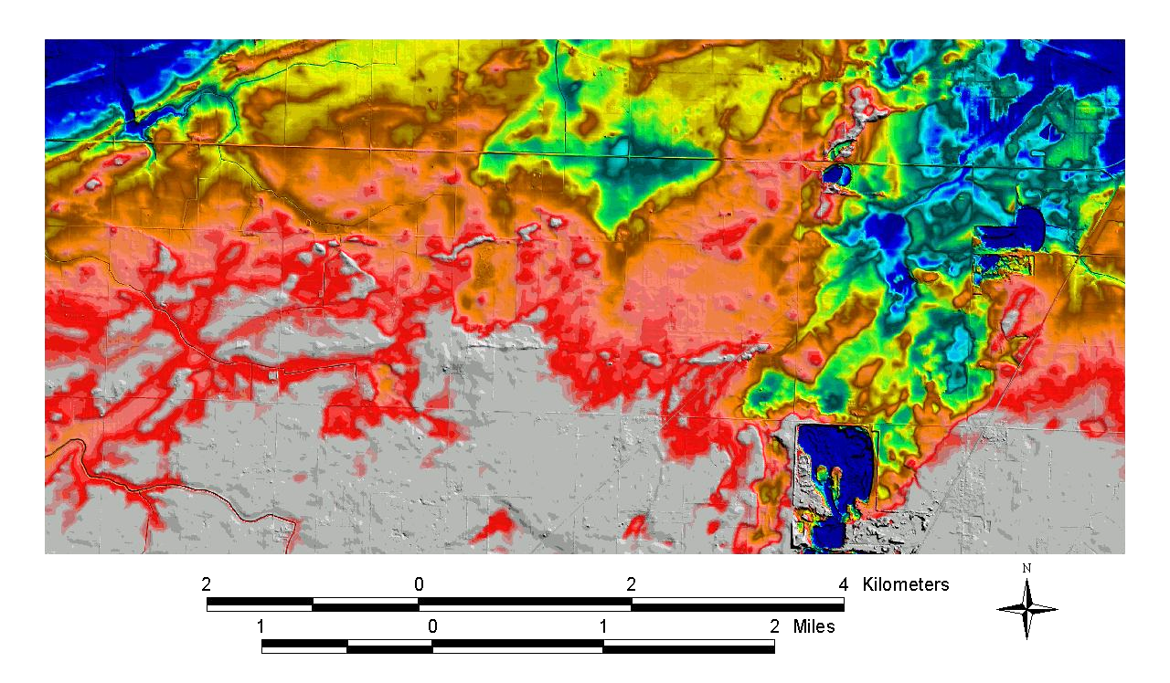
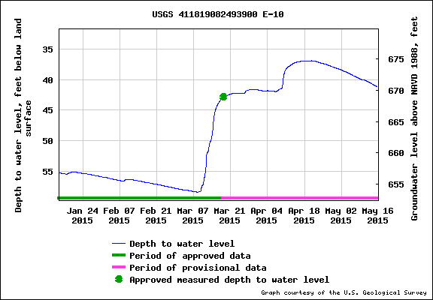
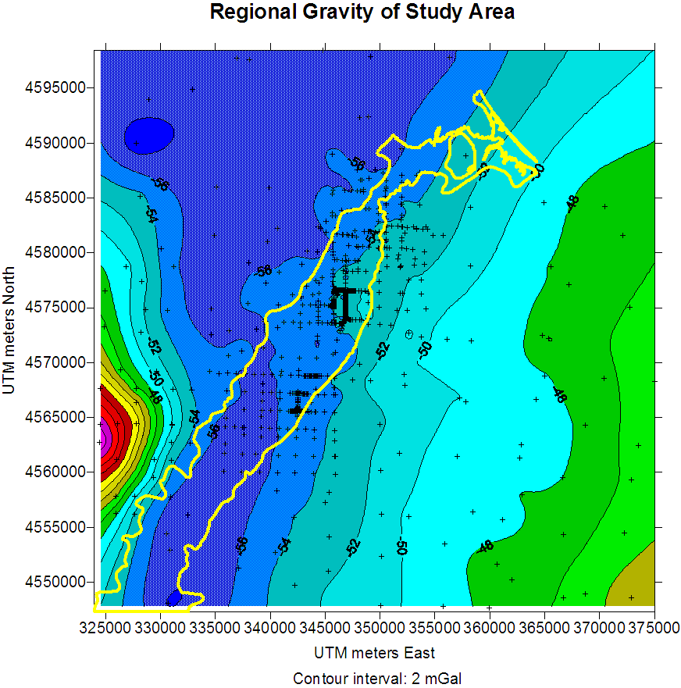
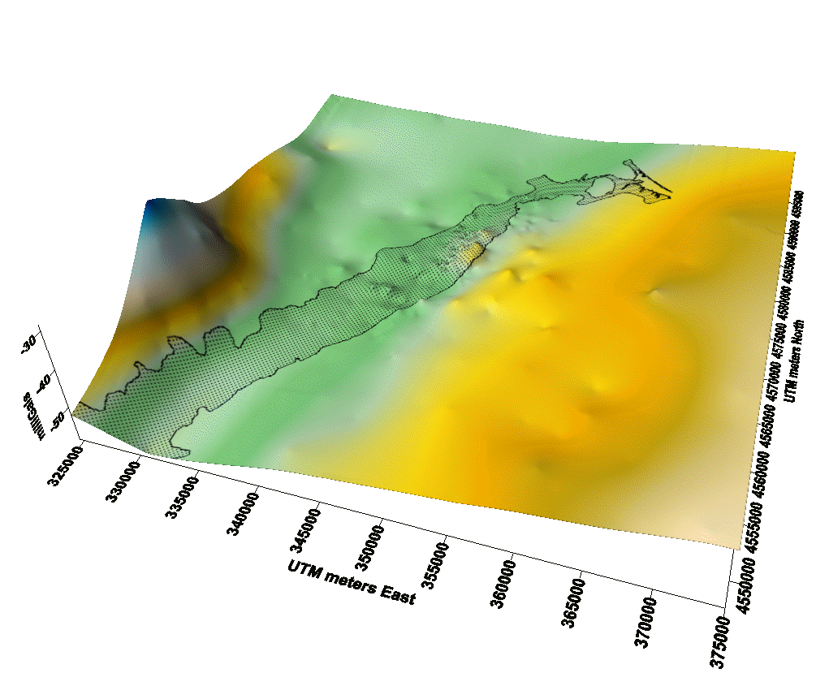
GEOPHYSICAL SEARCH FOR CONCEALED KARST NORTH OF BELLEVUE, OHIO Donald J. Stierman, Biniam Haileab Estifanos, Peter Bordovalos and Lawrence A. Drane III Department of Environmental Sciences, University of Toledo, Toledo, OH
ABSTRACT
Streams are sparse near Bellevue, Ohio because karst in the Columbus Limestone drains the area to feed springs in Castalia and Sandusky Bay. However, on rare occasions, sinkholes north of Bellevue have acted as springs following episodes of heavy precipitation. We used micro-gravity and electrical resistivity in an attempt to map subsurface voids in the area where flooding in 2008 was most severe. Gravity was also measured at more widely spaced stations surrounding the study area. Although a dipole-dipole profile over Seneca Caverns (south of Bellevue) shows both air-filled and water-filled voids in the limestone, we discovered no similar geophysical evidence of voids along either of two long (690 m and 830 m) east-west resistivity profiles along roads north and south of the most striking sinkhole complex in the area. Resistivity lows are instead interpreted as sediment-filled karst. Except for sinkholes only a few meters across and broad but shallow circular depressions in many agricultural fields, most of the surface is characterized by glacial and shoreline features over 10,000 years old. These broad depressions might be ancient karst filled with glacial-age sediments rather than zones of developing karst.
West
East
Figure 9: Subsurface resistivity model for profile Field 1 (see Figure 7). There is a small open sinkhole 15 meters north of the first electrode.
South
North
Figure 10: Resistivity model for profile Field 2. A large, shallow depression east of the 230 – 260 profile segment appears to have no influence.
Figure 6: A DEM shows the greatest topographic disturbance of the glacial terrain due to karst development near Bellevue. State Route 269 has flooded several times when these sinkholes changed from drains to springs (Raab et al., 2009). Perhaps the large quantity of water entering the karst via these sinkholes has accelerated their development.
West
East
Figure 3: Digital elevation model (DEM) constructed from USGS 1/9 arc-second data (http://nationalmap.gov/viewer.html). Elevation ranges were selected to highlight multiple stages of ancestral Lake Erie. Most of the area underlain by the Columbus Limestone is characterized by surface features shaped by glacial or post-glacial- lake processes. We have yet to discover a shoreline severely deformed by karst development.
Figure 7: Orthophoto showing electrical resistivity profile locations (red lines) north of Bellevue.
West
East
Figure 5: Drainage patterns in the Bellevue area (U.S. Census Bureau, 2011).
Figure 11: Dipole-dipole inversion results at Strecker road: (a) measurement in October 2012 when the static water level at USGS monitoring well was at 9.5m below the surface, (b) Repeat measurement in August 2013 when the water table was at 5.5m below the surface, and (c) interpretation of the dipole-dipole result along lithologic stratigraphy.
Figure 8: Dipole-dipole electrical resistivity profile across Seneca Caverns (Figure 1). Air-filled voids cannot conduct electricity while water-filled voids conduct electricity better than limestone. The thin layer of surficial till is rich in clay, an excellent electrical conductor when moist. The top pseudosection shows data points and observed apparent resistivities. The bottom cross section shows the electrical resistivity model generated by the inversion routine, EarthImager2D. The center pseudosection is a forward calculation of the electrical resistivity model.
Figure 1: Index map with selected karst and geographical features.
(a)
Figure 4: DEM of an area directly west of Bellevue. Numerous enclosed topographic lows are homes to ponded water during spring thaw and following heavy rains.
Figure 12: Dipole-dipole resistivity at Hale road taken in Jun 2012. The static water level at the nearby USGS monitoring well was at 9.7 m below the surface.
Some comments on hydrology: aquifer response to precipitation events or sudden thaw is rapid (above), suggesting that, at least north of Bellevue, recharge via sinkholes is significant. In August of 2013, we observed that ponded water in fields (right) persisted for many days, while a nearby sinkhole was dry (far right). This leads some of us to the conclusion that shallow depressions might represent paleokarst filled with drift.
Discussion: We were surprised that electrical resistivity failed to detect air-filled or water-filled voids north or south of the large sinkhole complex south of Strecker Road. Future investigations will be based on the hypothesis that sediments fill much of the karst, as at Sheriden Cave. It will be interesting to obtain an electrical resistivity image of what lies under the broad, shallow depressions west of Bellevue (Figure 4).
(b)
Gravity was measured using LaCoste and Romberg meter G-1109. Electrical resistivity measurements were made using the SuperSting R1/IP (Advanced Geosciences, Inc.) with a 28-channel Swift automatic switching system. This work was supported by the Department of Environmental Sciences, The University of Toledo.
References cited
Raab, James, B. Haiker, W. Jones, M. Angle, R. Pavey, M. Swinford and D. Powers, Ground Water Induced Flooding in the Bellevue Ohio Area, Spring and Summer 2008; ODNR Division of Water Technical Report of Investigation 2009-1, Ohio Department of Natural Resources, Columbus, Ohio, 19 pp.
Totten, Stanley M., Chronology and nature of the Pleistocene beaches and wave-cut cliffs and terraces, northeastern Ohio; in Quaternary Evolution of the Great Lakes, Geological Association of Canada Special Paper 30 (Karrow and Calkid, eds.), pp. 171 – 184.
Figure 2 (a & b): Regional simple Bouguer anomaly. Line shows Columbus Limestone subcrop.

