Slide 1
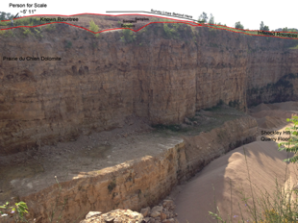
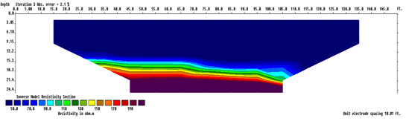

Fast and Affordable Depths to Bedrock Using Geophysics
Dave Hart and Carolyn Streiff
North Central Geological Society of America Meeting - 2015

Slide 2
Depth to Bedrock
Basic data for lots of land use planning and decisions
a search on depth and bedrock in WDNR’s code gave 650 hits
How to determine best geophysical method to apply (criteria)
Fast (< 2 hours to collect data)
Relatively inexpensive (< $15K)
Doesn’t require too much training (technical person)
Reliable results (within 20 % of actual depth)
Detects depths of interest (0 – 50 feet depth)
Non invasive (no holes or disturbing crops)
Portable (1 to 2 persons can carry)
Electrical Resistivity Imaging (ERI)
Passive Seismic (Horizontal Vertical Spectral Ratio method)

Slide 3
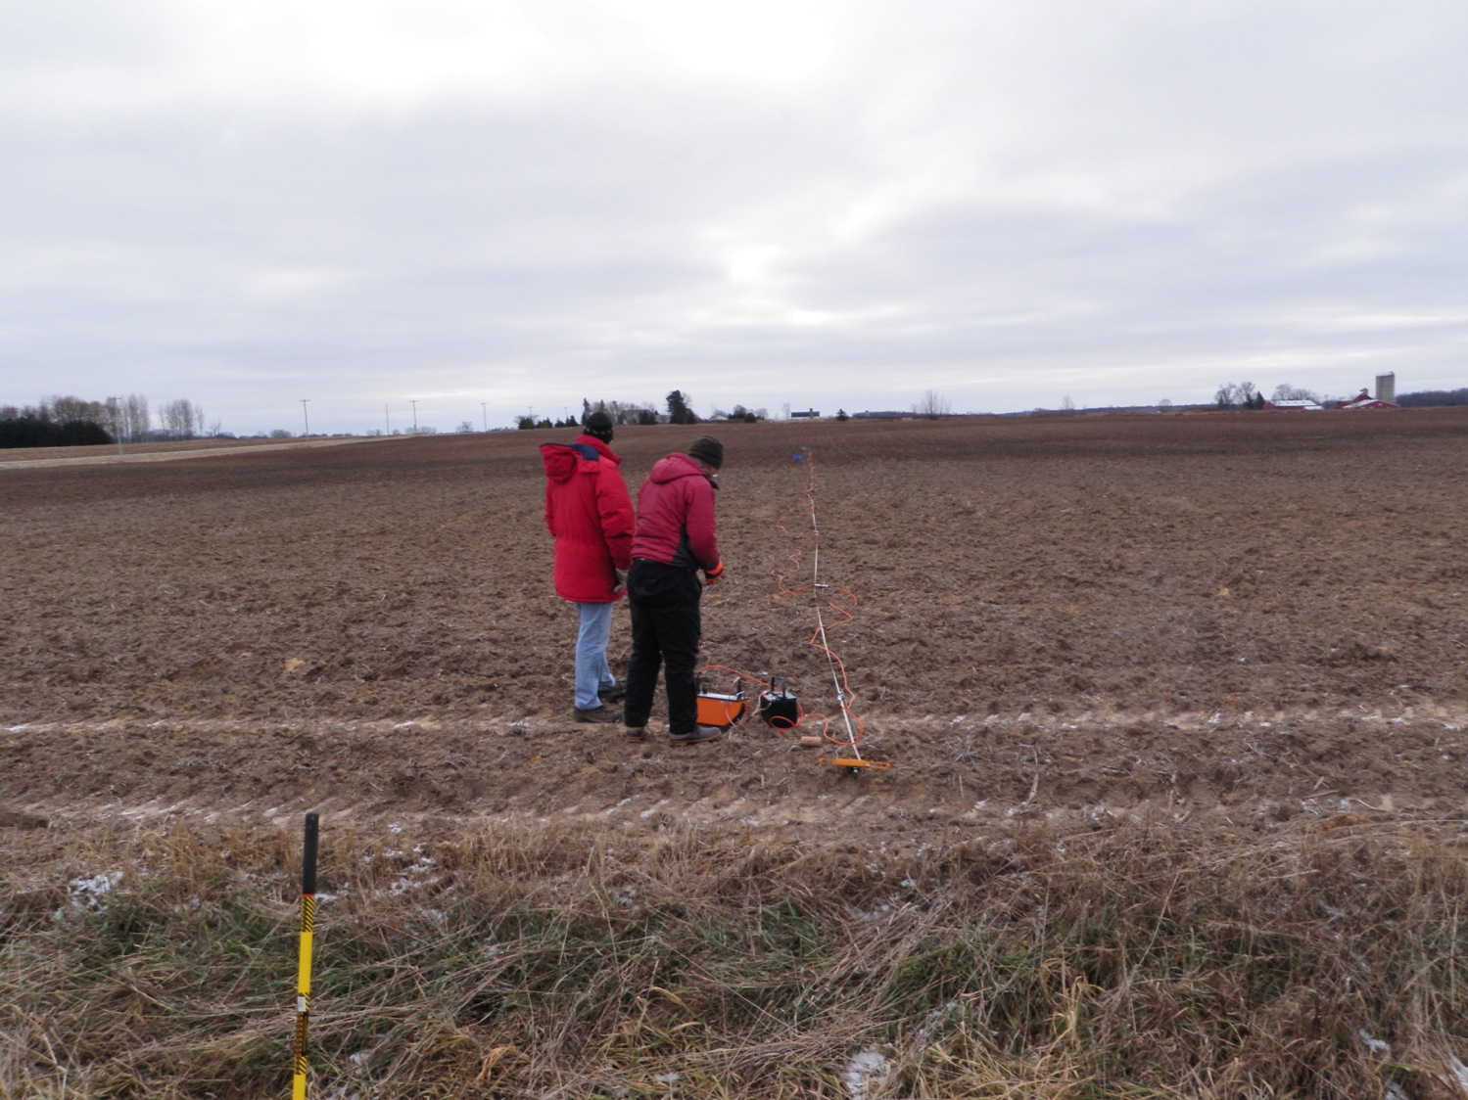

Slide 4
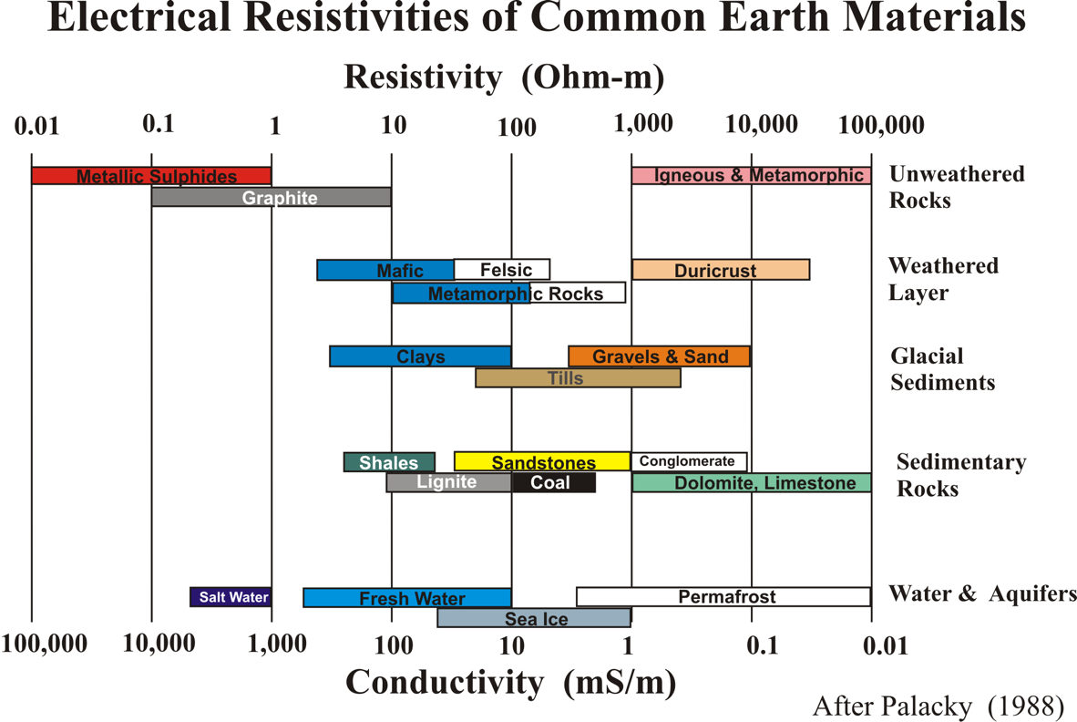
Electrical Resistivity
Often overburden conducts electricity better than bedrock.
Need to be in general area where this is true. (note example locations)

Slide 5
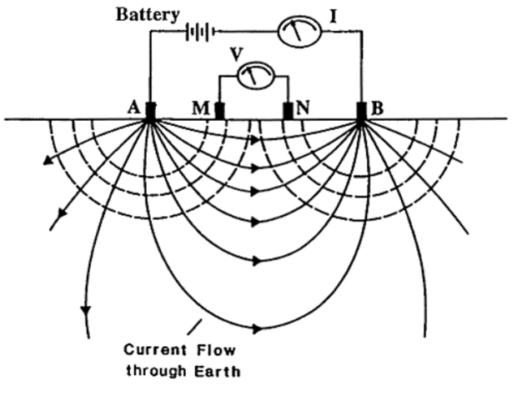
Electrical Resistivity Imaging
Analogous to groundwater flow
Current electrodes like injection and pumping wells
Voltage electrodes like piezometers
Variations in materials cause flow lines to warp that can be seen in the voltages.
Multiple sets of electrodes allow image or tomography of subsurface.

Slide 6
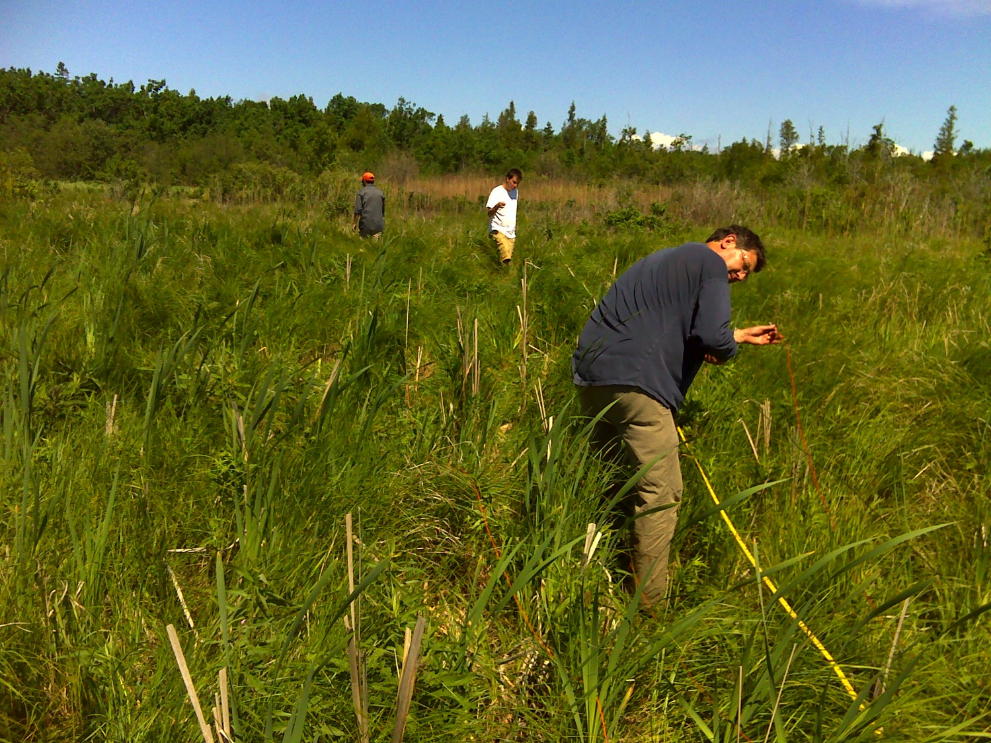
We can move the connectors by hand to get the different electrode combinations to see the bedrock at depth…

Slide 7
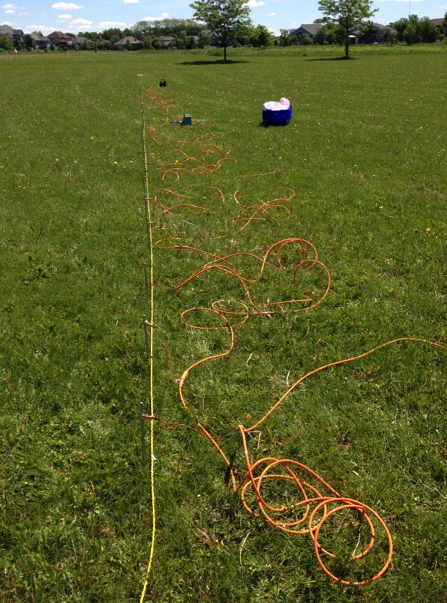
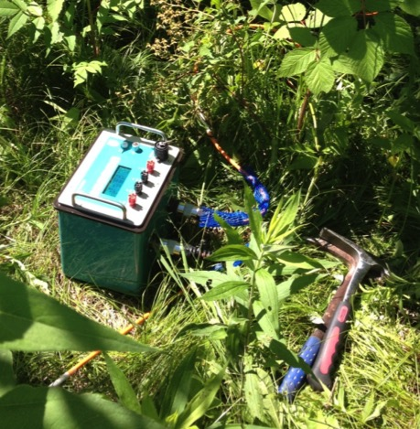
Or we can let the box with a built-in computer and switches do it
Current Electrodes: Send and receive an input current into the ground
Potential Electrodes: Measure the difference in the input current
Moving these electrodes provides resistivity measurements at different depths and distances along the survey line.
Box can do either dipole-dipole or Wenner electrode combinations
Box
Electrodes

Slide 8
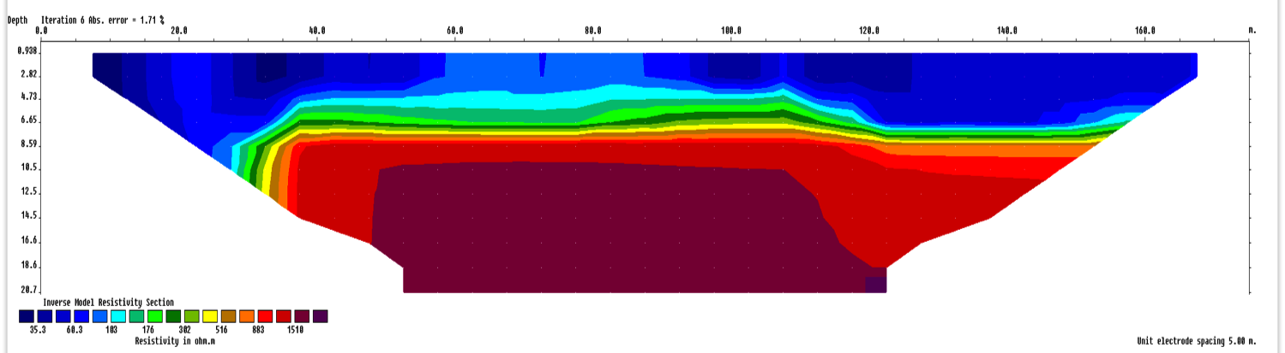
Data Analyzed Software automatically matches resistivities w/data
0 m
160 m
< 100 ohm m
> 1000 ohm m
Sharp transition form blue to red (low to high) indicates quick change in geology from sediment to bedrock.
Seen at around 5 meters depth (16 feet)
Depth to bedrock around 15 to 20 feet here.

Slide 9
Some Examples from around Wisconsin
Rountree sediment – Southwest Wisconsin
Homeowner Sinkhole – Iowa County
Mink River Wetland – Door County
Till – Calumet County
Les Voigt Fish Hatchery - Bayfield County

Slide 10
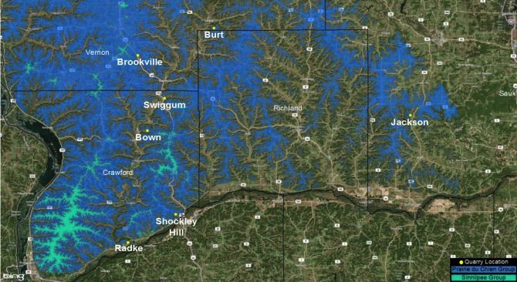
Depth to bedrock in Southwest Wisconsin
Rountree formation caps many of the dolomite hills.
Mostly clay with varying thickness
Completed a study of dolomite quarries and Rountree

Slide 11
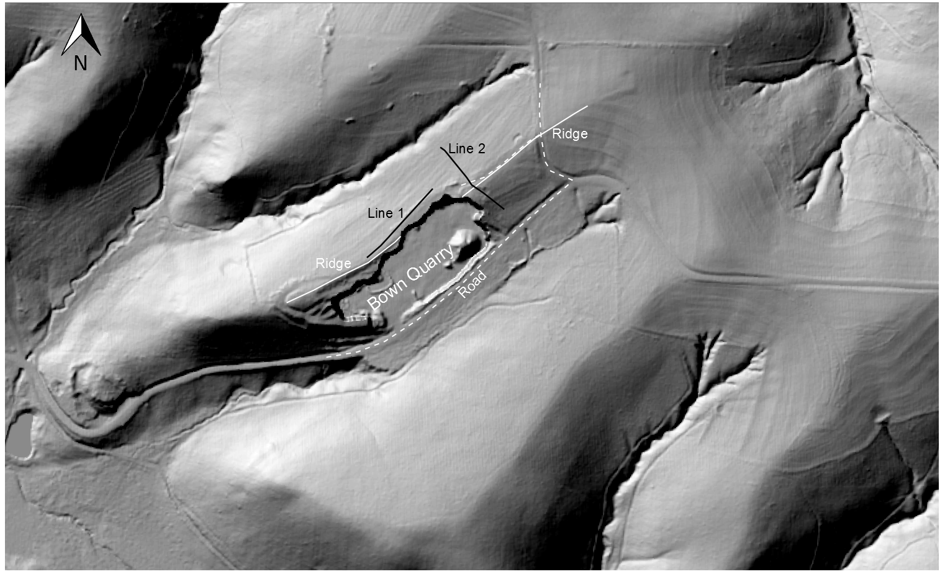
Bown Quarry

Slide 12
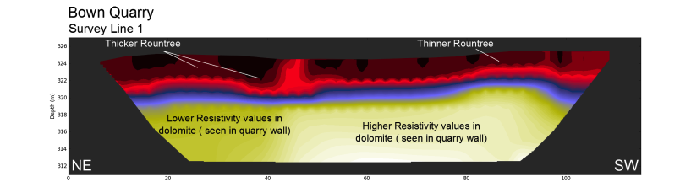
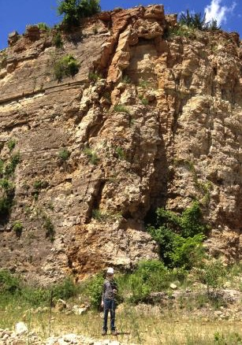
Line 1 – Parallel to Ridge
Sharp contact
Depth varies from 6 to 12 feet (2 – 4 meters)
Can also variation in bedrock
SW
NE

Slide 13
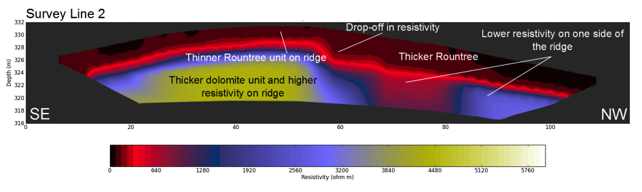
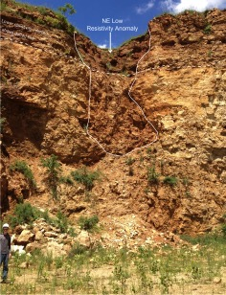
Line 2 – Perpendicular to Ridge
Rountree can sometimes follow fractures
By filling and/or altering dolomite and enlarging the fractures.

Slide 14
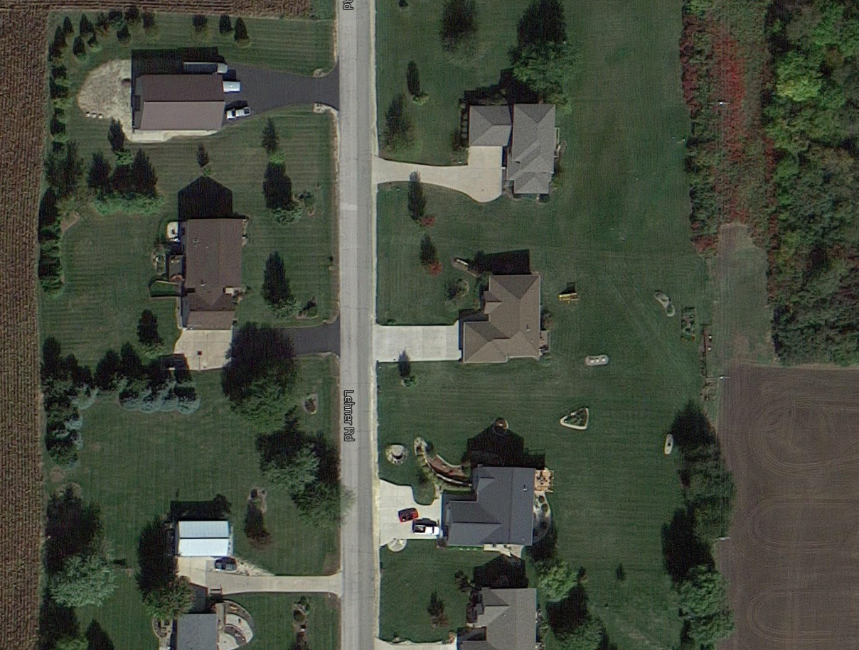
Sinkhole Investigation
Spring 2015
Spring 2014

Slide 15
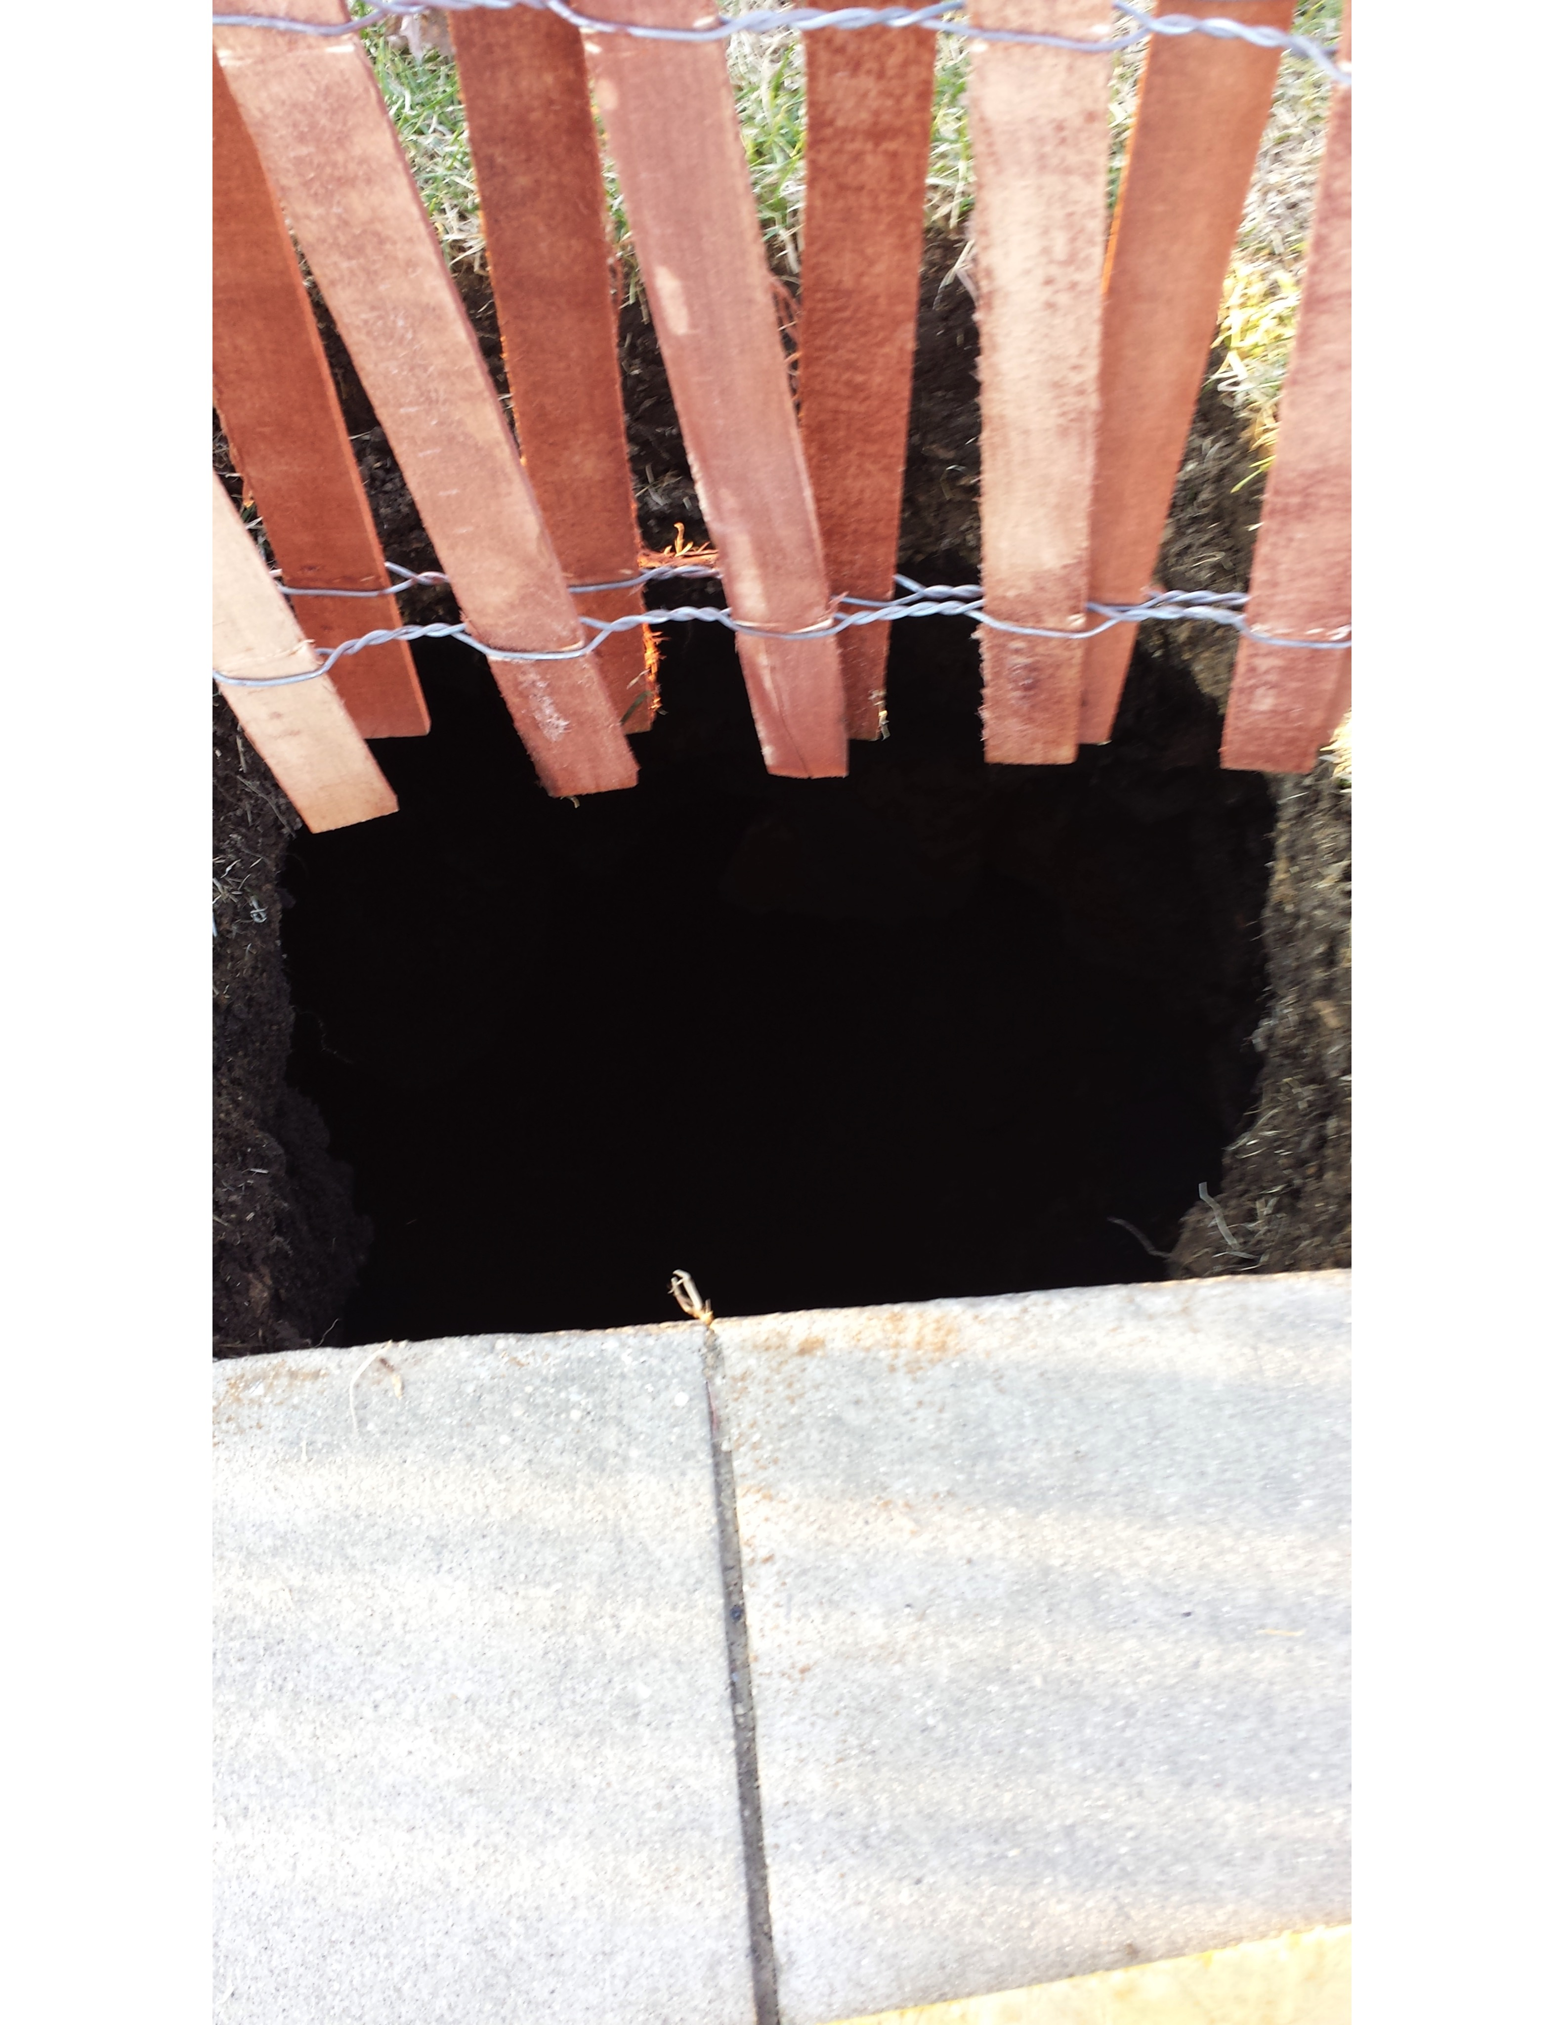
Initial appearance
Spring 2014

Slide 16
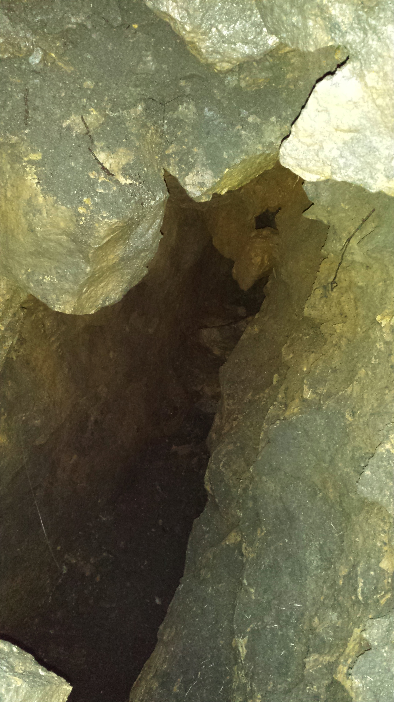
Opened up
Spring 2014
2-3 feet width
20 foot depth (laser distance)
40 foot length (laser distance)
Repaired
backhoe compaction
Native fill
5 yards of concrete

Slide 17
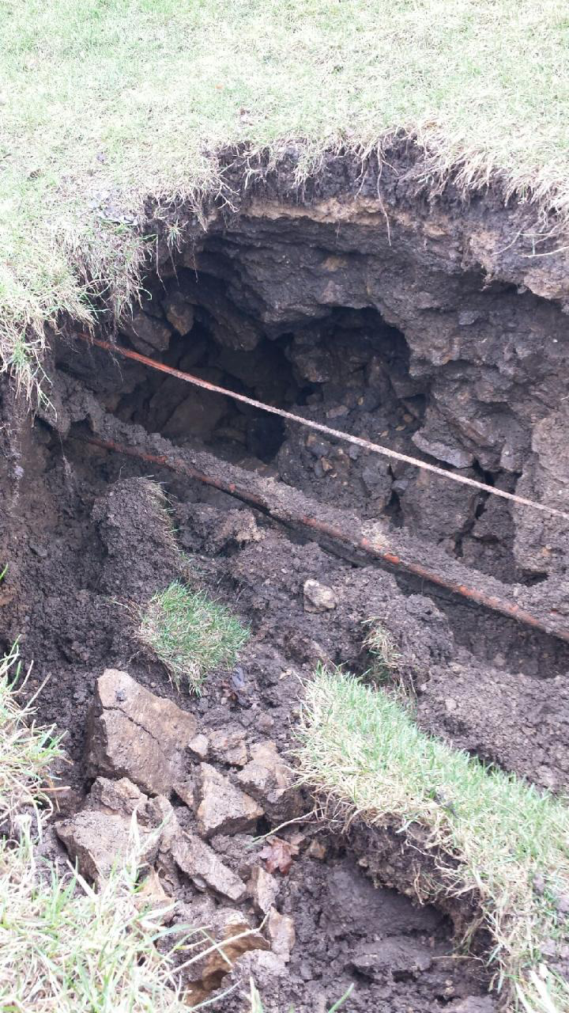
Second Sinkhole
Spring 2015
Near road ~20 feet from previous
Typical for Wisconsin
Repaired with similar technique

Slide 18
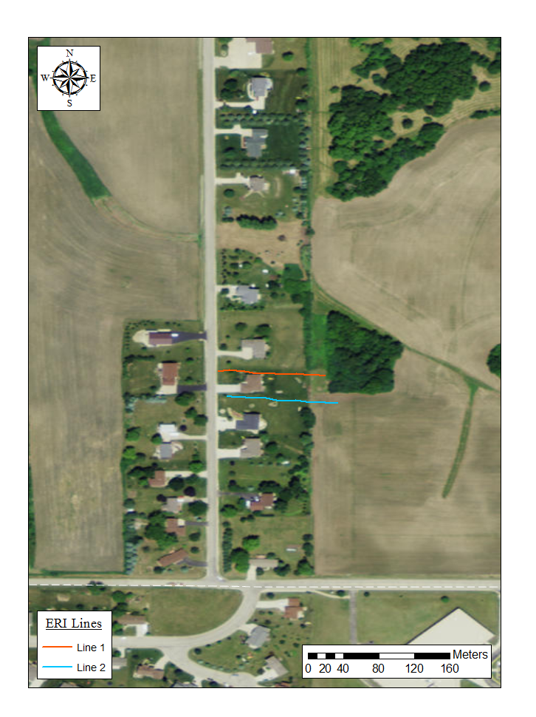
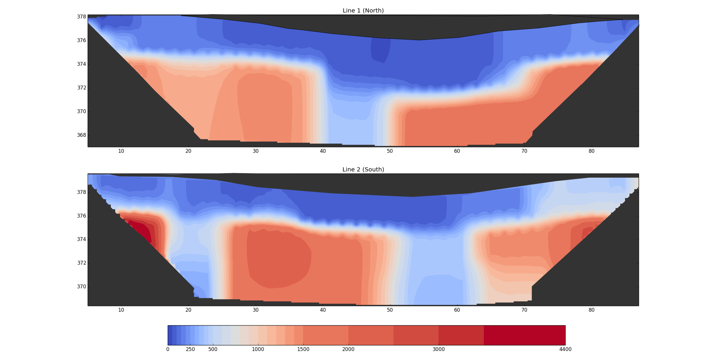
Elevation (m) Line 1 (North)
378
374
Blue<250 ohm m
370
Red>1000 ohm m
10 20 30 40 50 60 70 80
Distance (m)
Elevation (m) Line 2 (South)
378
Sediment
374
Dolomite
Bedrock
370
10 20 30 40 50 60 70 80
Distance (m)

Slide 19
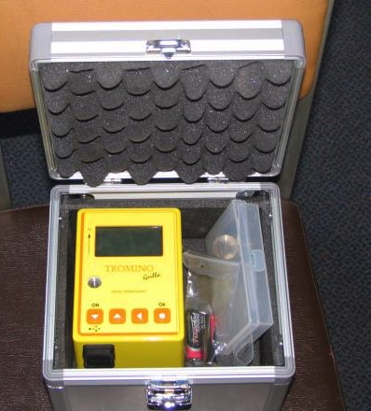

HVSR Passive Seismic
Records ambient noise or vibrations from wind, vehicles, other low frequency sources
Records all Frequencies between 0.1 cycles/second to 20 cycles/second
Fast data collection (20 minutes)
Some expertise to recognize good/bad data.

Slide 20
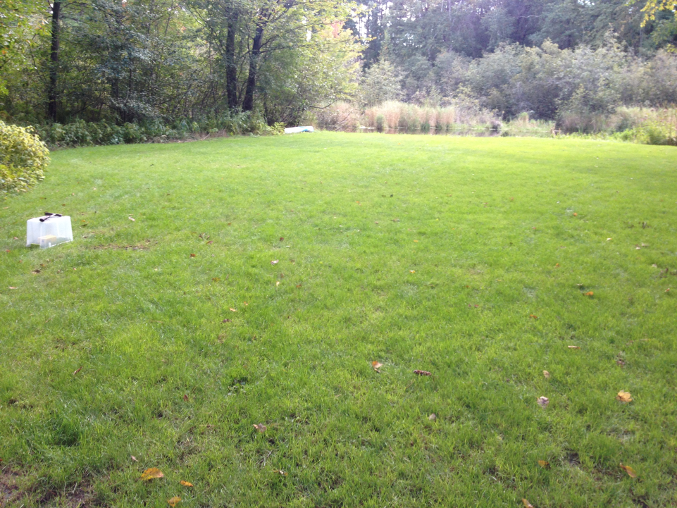
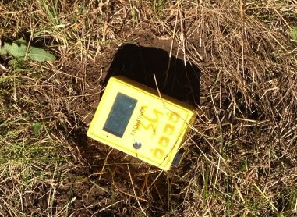
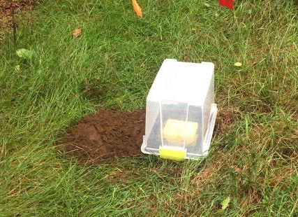

Slide 21
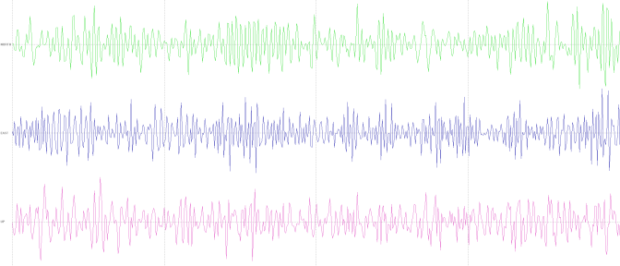
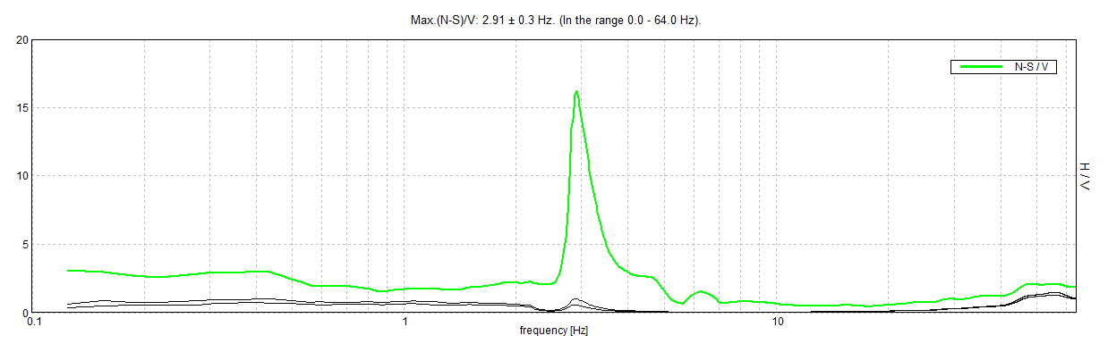
Vibration Data
8 seconds shown, Total is 20 minutes
N-S
E-W
Vertical
Peak Ratio –
2.91cycles/second
73 feet depth

Slide 22
Some Examples from around Wisconsin
Wisconsin River Valley
Tunnel Channel – Central Wisconsin
Little Plover River Basin – Central Wisconsin
Les Voigt Fish Hatchery - Bayfield County

Slide 23
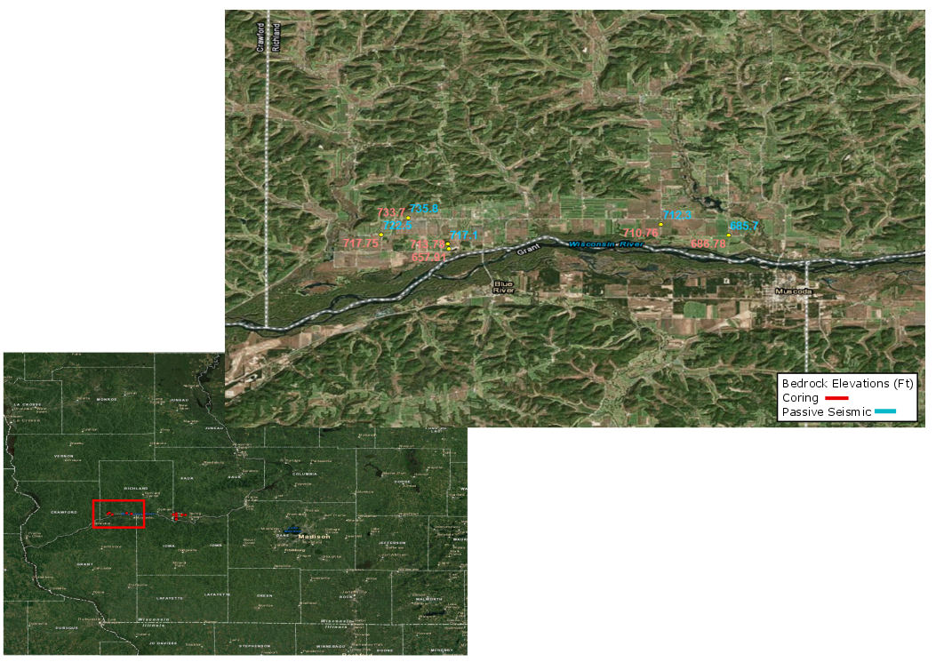
Wisconsin River
Valley
Using Minnesota’s
a and b constants, matching to sediments.
(Chandler and Lively, 2014)
733.70
735.8
710.76
686.78
717.75
712.3
713.78
685.7
722.5
717.1
Elevations shown here
Depths to bedrock are generally less than 100 ft.
Decent agreement between coring w/geoprobe and passive seismic

Slide 24
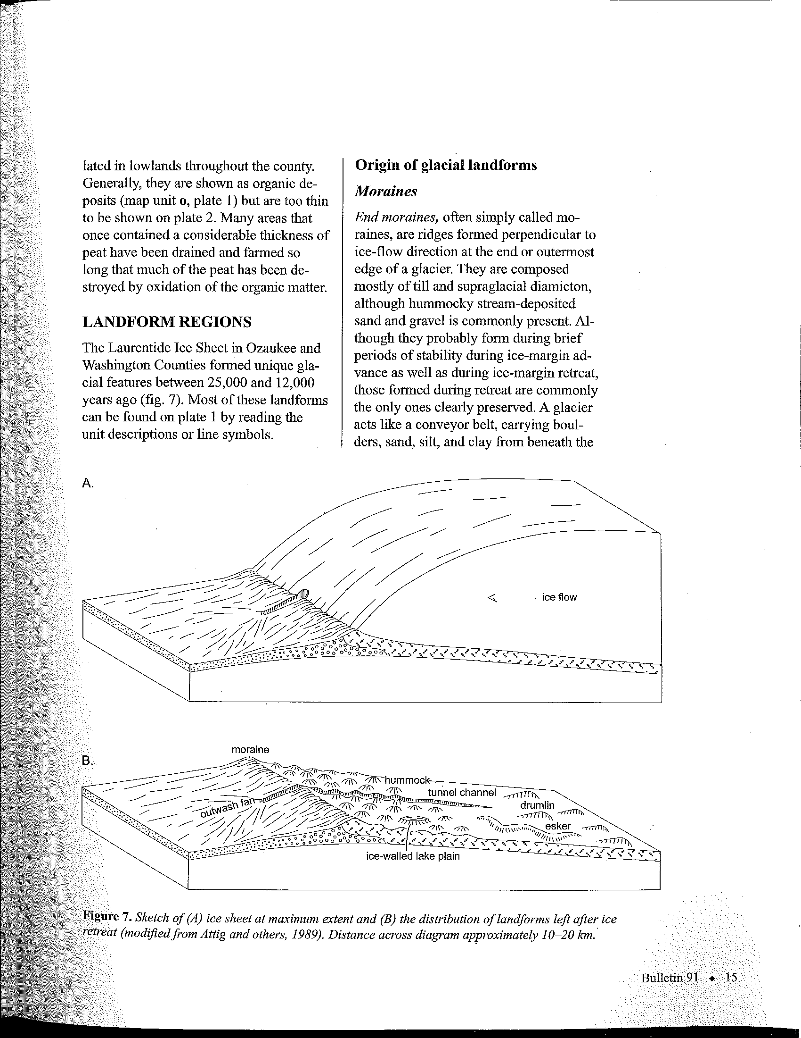
Tunnel Channels
Mickelson and Syverson, 1997

Slide 25
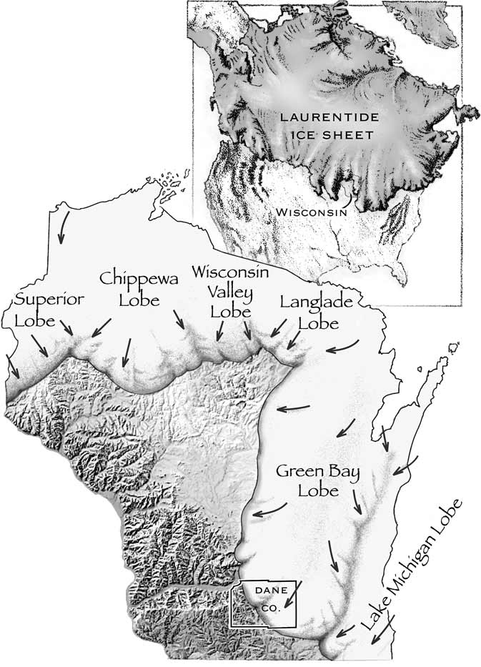
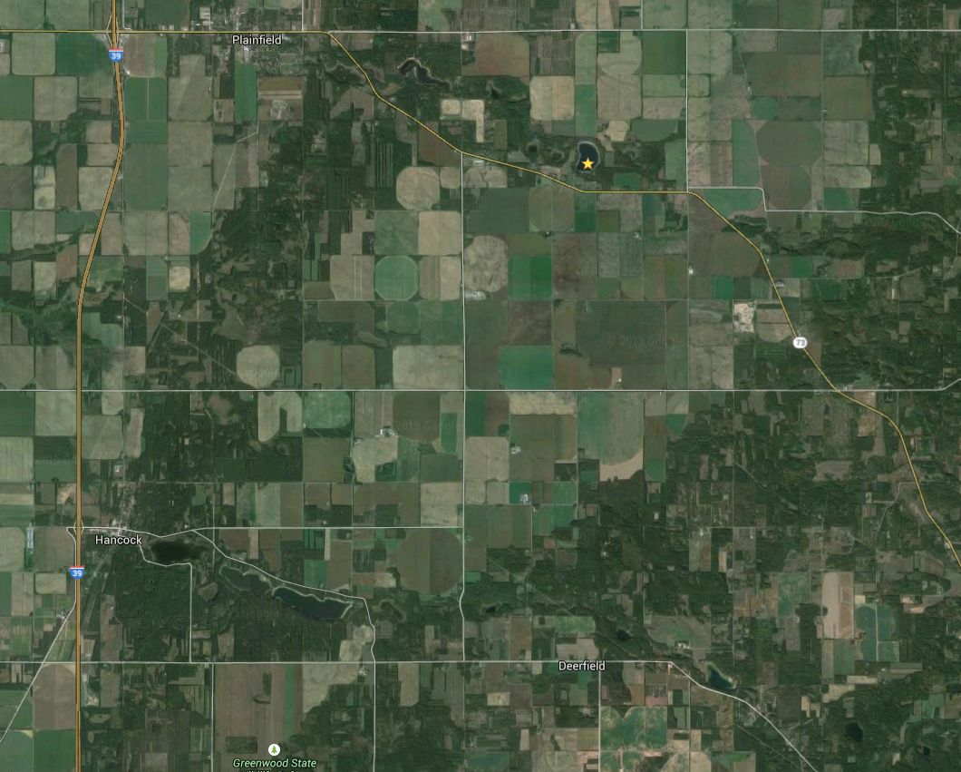
Tunnel Channels

Slide 26
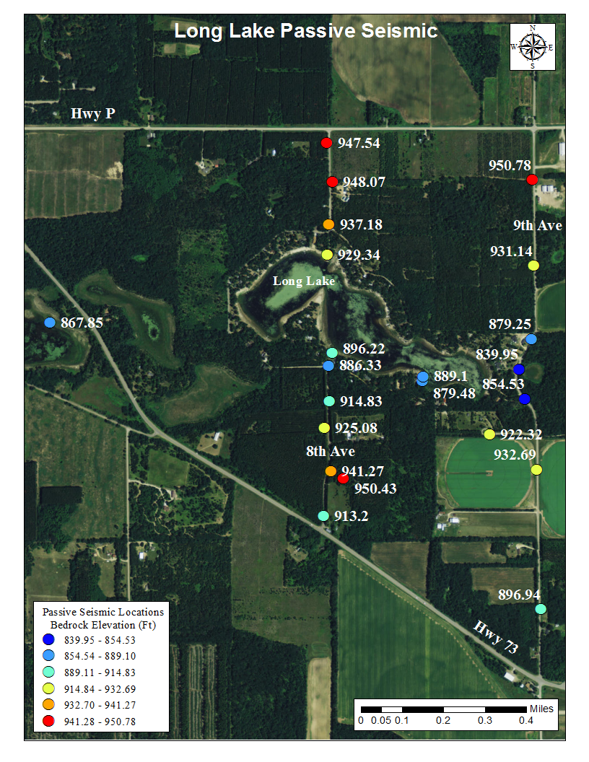
Tunnel Channels
Depths to bedrock are around 100 ft.
Bedrock Elevation is plotted to eliminated topography.
See lower elevations in the tunnel channel
Pre-glacial drainage or eroded while glacier was present?

Slide 27
Questions?

