Slide 1


Sedimentology of two Lower Pennsylvanian fluvio-tidal reservoir sandstones in the Illinois Basin
Nathan D. Webb

Slide 2
Outline
Background
Pennsylvanian oil production
Stratigraphy & geologic setting
Study area
Methods
Geophysical log correlation & facies analysis
Results
Comparing the Griggs and Robins sandstones
Implications
Outline Background Methods Results Summary
Notes:
Part 1 – Broad overview of the geologic setting of the ILB during the Pennsylvanian
Part 2 – Summary of a few selected unresolved issues with hints as to how they may be addressed

Slide 3
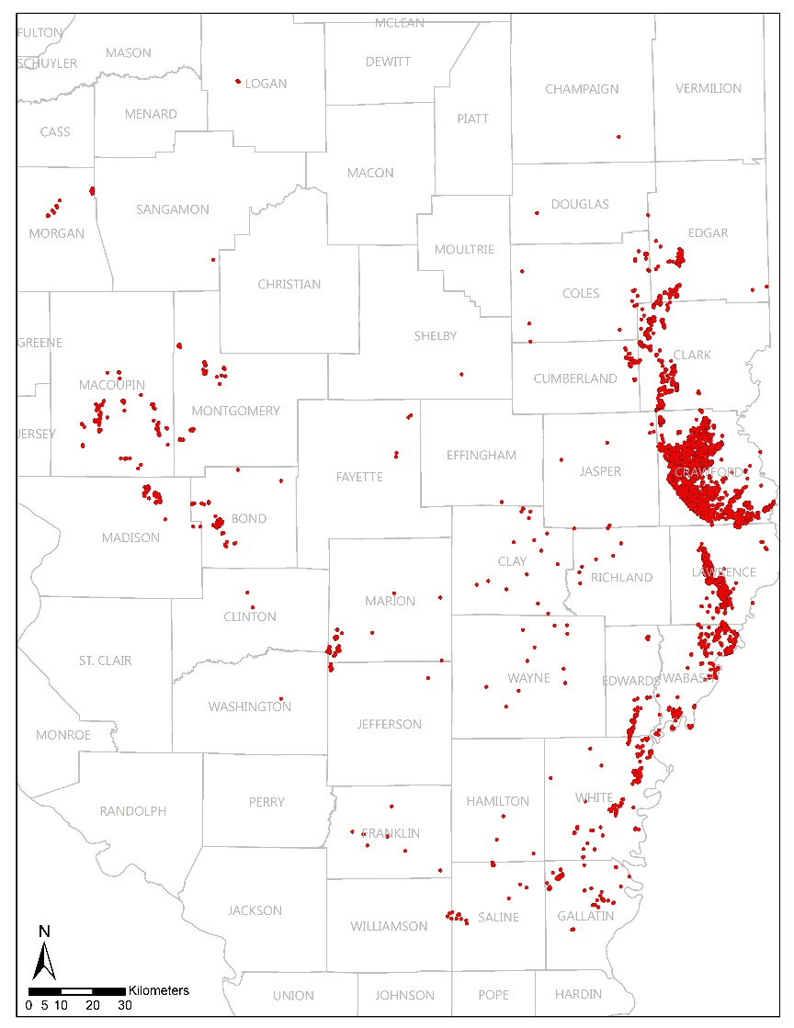
Pennsylvanian oil production
Southeastern Illinois
Early development
Continued production
Good potential EOR target
Abundant data
Well logs
Core
Pennsylvanian Production in Illinois
Outline Background Methods Results Summary

Slide 4
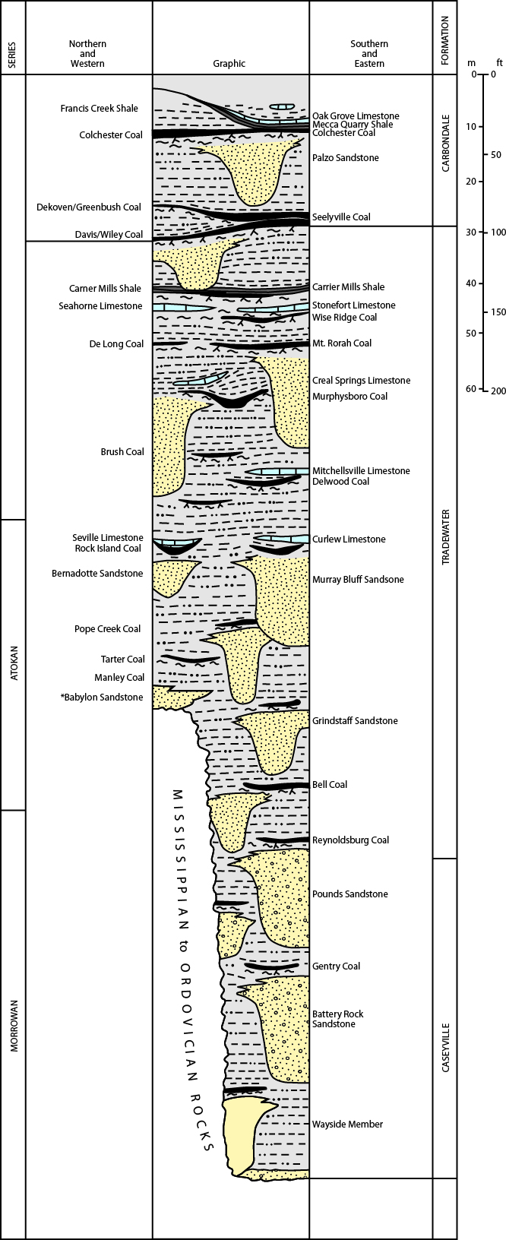
Stratigraphy
Lower Pennsylvanian
Caseyville Fm.
Tradewater Fm.
Largely sandstones and shales
Few regional marker beds
Sub-Pennsylvanian unconformity
From Nelson et al., 2011
Outline Background Methods Results Summary
Notes:
Everywhere in the Illinois basin, rocks of Pennsylvanian age overlie older rocks along an unconformable contact.
Pennsylvanian overlie rocks as old as Ordovician to Silurian in certain parts of that basin, but more generally overlie Mississippian age strata
Most Penn rocks overlie Chesterian strata, containing cyclical deposits of sandstone (clastic) and limestone.

Slide 5
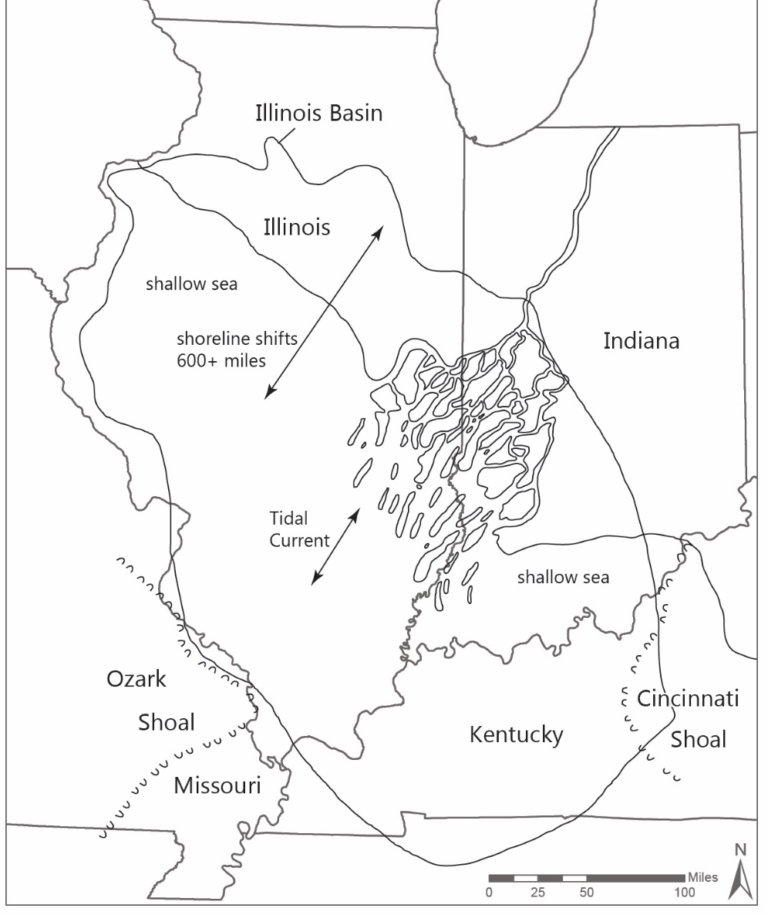
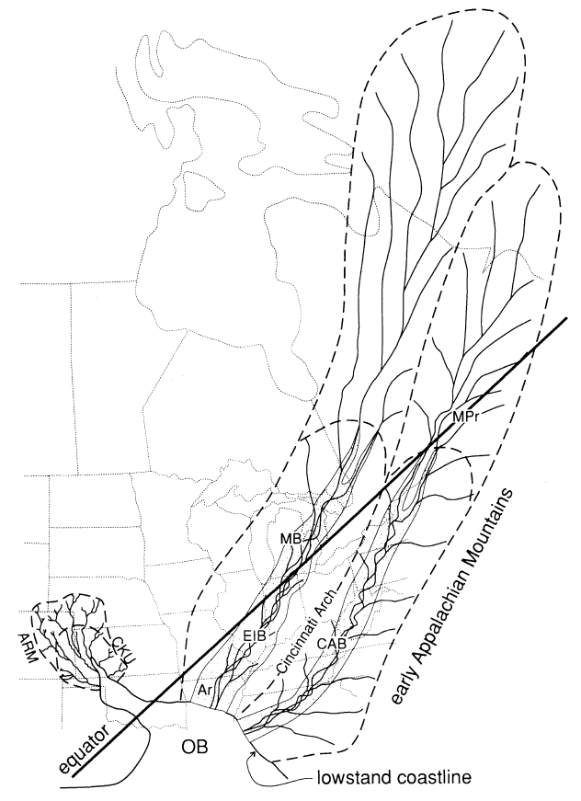
Geologic setting
Modified from Jacobson 2000
From Archer and Greb 1995
Outline Background Methods Results Summary
Notes:
Two maps showing the ILB at different periods during the Penn
Sediment was introduced into the basin by an Amazon scale drainage system that fed the basin from the NE
Map on the left shows ILB during a high stand sea level condition with delta prograding into the basin
Map on the right shows probable extent of drainage system and sea level low stand – sediment would have been bypassing ILB to reach Arkansas and Oklahoma

Slide 6
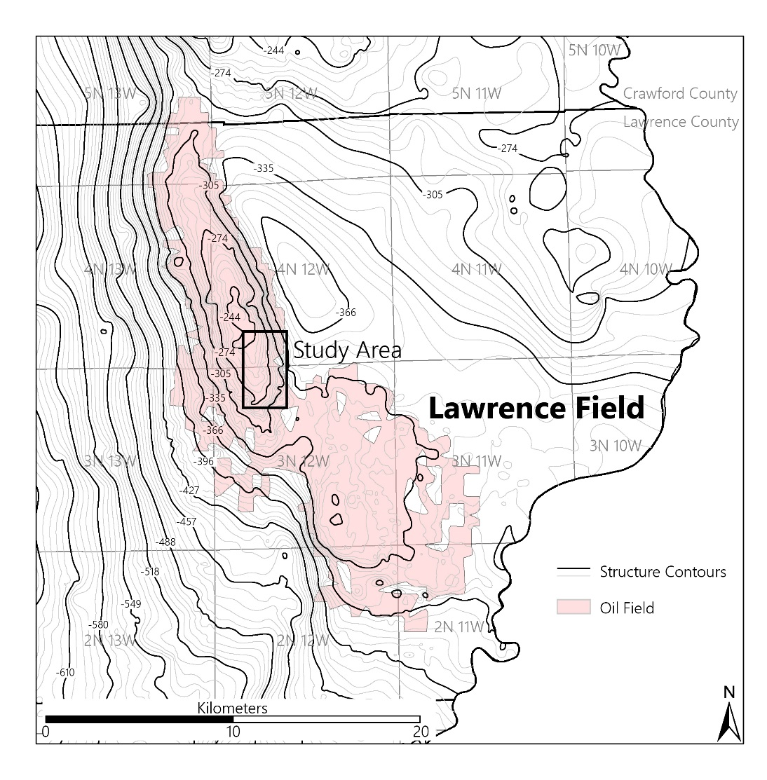
Study area
Lawrence Oil Field
Area with dense log and core control
Numerous Pennsylvanian sandstone reservoirs
EOR targets
Outline Background Methods Results Summary
Notes:
Partlow = Mt. Vernon-Ste. Marie paleovalley; Hardinsville = near Benton-Fairfield paleovalley; Robins = not associated with unconformity

Slide 7
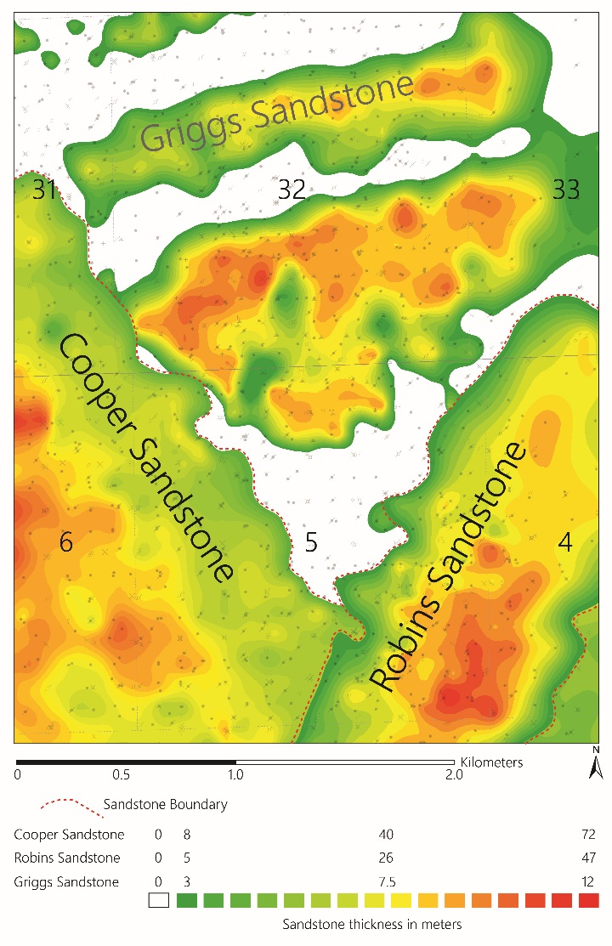
Pennsylvanian sandstone reservoirs in Lawrence Field
Griggs sandstone
E-W trend
Narrow, elongated parallel sandstone bodies
Up to 12 m thick
Robins sandstone
NE-SW trend
Narrow, elongate single sandstone body
Up to 47 m thick
Outline Background Methods Results Summary

Slide 8
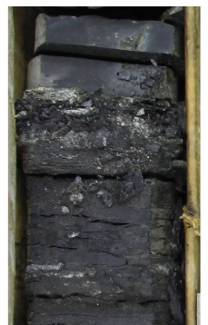
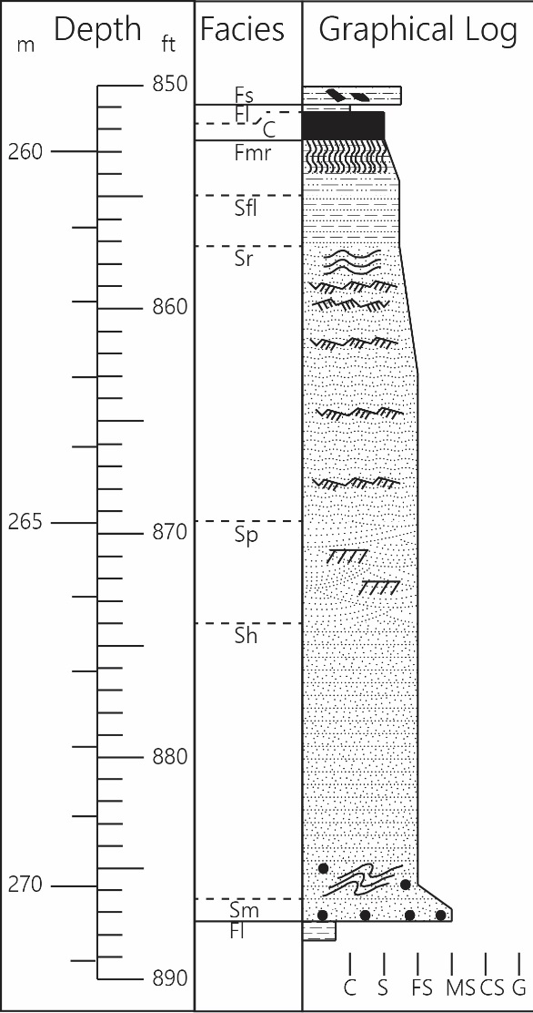
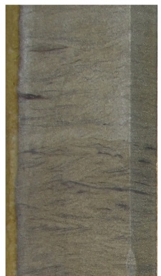
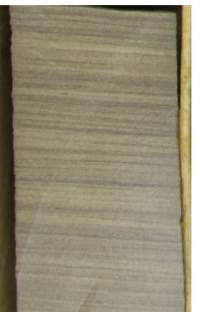
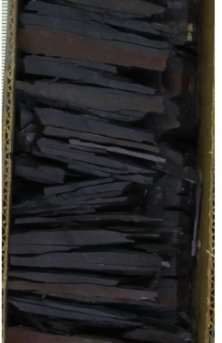
Griggs sandstone - facies
Facies (Code) | Description | Bed form/Process Classification | Environmental Interpretation
Coal and carbonaceous shale (C) | Black bright to dull coal and dull carbonaceous shale | Accumulated plant debris and mud deposited from suspension | Swamp deposits
Laminated shale (Fl) | Dark grey shale, interstratified with rare laminae of light grey siltstone or very fine sandstone, contains bands of siderite that form layer up to a few centimetres thick with some larger concretions | Clay deposited from suspension settling interrupted by rare solitary ripples | Prodelta muds
Massive siltstone to mudstone (Fmr) | Light to medium grey, massive to vaguely bedded siltstone to mudstone, contains irregular siderite concretions, fine carbonized rootlet traces, some slickensides, and carbonaceous plant fragments | Silt and mud deposited from suspension settling homogenized and disturbed by pedoturbation | Poorly developed rooted paleosols
Fine to very fine-grained ripple-bedded sandstone (Sr) | Commonly exhibits carbonaceous material on bedding surfaces, can contain shale beds a few millimeters thick | Lower flow regime ripples | Ripple deposits from multiple environments
Fine- to medium-grained planar bedded sandstone (Sh) | Light brown, oil stained, fine- to medium-grained sandstone, planar to subhorizontal bedding, can contain laminations of shale up to a few millimeters thick | Suspension settling in hypopycnal flows or high energy tractional currents in hyperpycnal flows | Delta deposits
Fine to Medium grained planar cross bedded sandstone (Sp) | Fine to medium grained sandstone with planar crossbeds; | Lower flow regime 2D to 3D dunes | Deltaic dune deposits
Outline Background Methods Results Summary

Slide 9
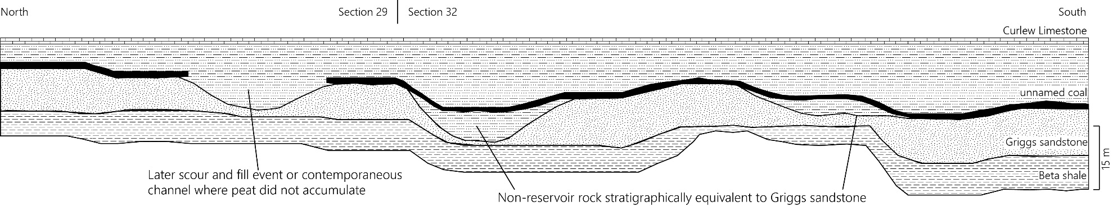
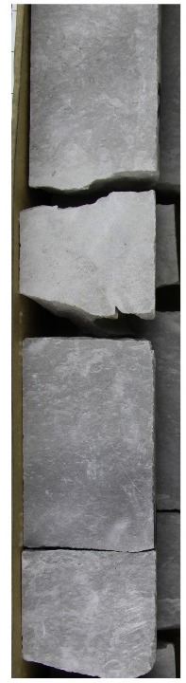
Griggs sandstone – Lateral relationships
Coal overlies Griggs sandstone and non-reservoir sandy siltstone lateral equivalent
Evidence for lateral facies changes and later erosion
Outline Background Methods Results Summary

Slide 10
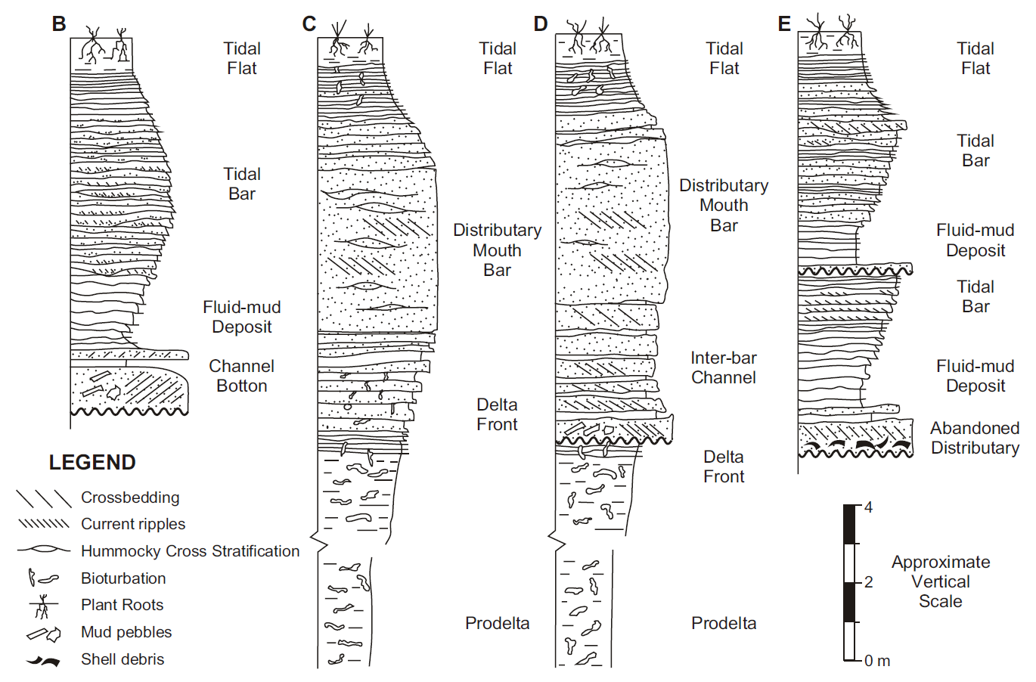
Griggs sandstone - model
Fluvial dominated but tidally influenced delta
Lateral facies changes internal to environment
Modified from Jacobson 2000
Dalrymple et al 2003
Outline Background Methods Results Summary

Slide 11
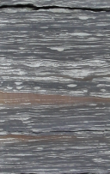
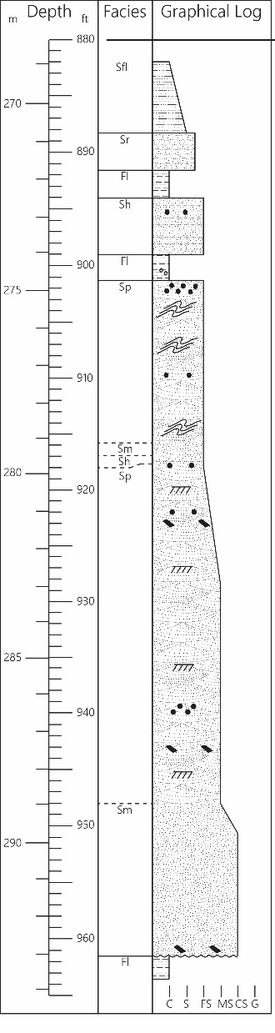
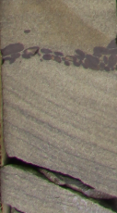
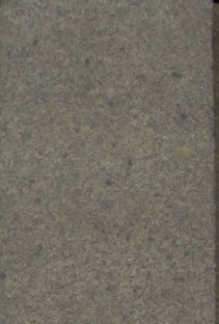
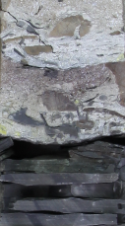
Robins channel - facies
Facies (Code) | Description | Bed form/Process Classification | Environmental Interpretation
Laminated shale (Fl) | Dark grey shale, interstratified with rare laminae of light grey siltstone or very fine sandstone, contains bands of siderite that form layer up to a few centimetres thick with some larger concretions | Clay deposited from suspension settling interrupted by rare solitary ripples | Prodelta muds
Massive sandy siltstone (Fs) | Light grey and mottled sandy siltstone. | Rapid deposition from suspension | Abandoned channel deposits
Lenticular bedded sandstone (SFl) | Interbedded dark grey shale and light grey very fine sandstone, can have rhythmic bedding with alternatively more sand and more shale every 15 cm, rare zones of wavy bedding | Alternations between mud deposited from suspension settling and sand ripples | Sediment starved, mud dominated tidal deposits
Fine to very fine-grained ripple-bedded sandstone (Sr) | Commonly exhibits carbonaceous material on bedding surfaces, can contain shale beds a few millimeters thick | Lower flow regime ripples | Ripple deposits from multiple environments
Medium to coarse Grained massive sandstone (Sm) | Medium grained sandstone with massive bedding | Subaqueous gravity flow deposits | Braided river deposits
Fine to coarse grained planar cross bedded sandstone (Sp) | Fine to coarse grained sandstone with planar crossbeds; common soft sediment deformation; siderite clasts along bed set surfaces | Lower flow regime 2D to 3D dunes | Braided river/deltaic dune deposits
Crudely bedded gravel (Gm) | Crudely bedded gravel or gravelly sandstone; contains coal, shale, siderite, and lithic clasts; siderite or calcite cemented matrix | Traction transported bed load gravel | Basal lag deposits
Outline Background Methods Results Summary
Notes:
Multiple grain size fluctuations suggest possibility of multiple episodes of deposition

Slide 12
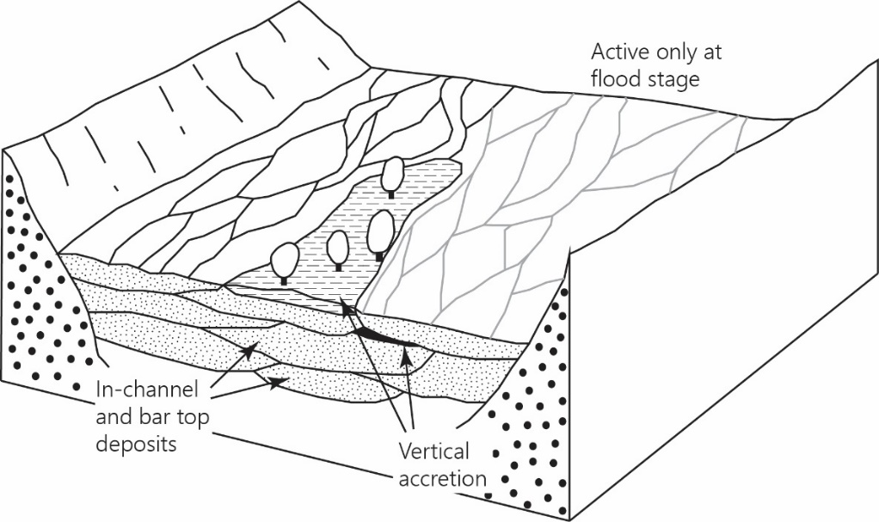
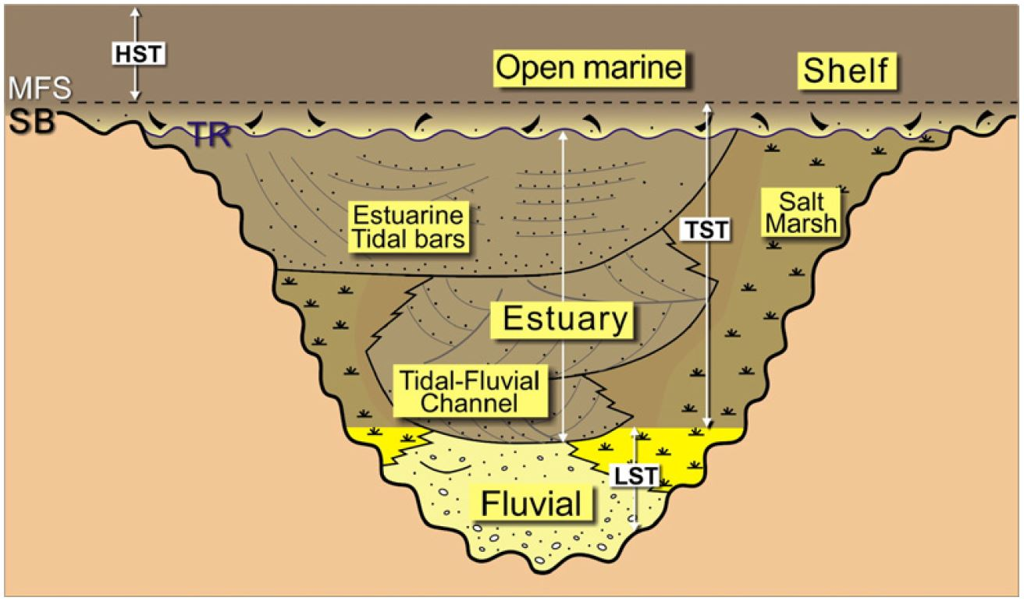
Robins sandstone - model
Braided river deposits in incised valley
Increasing tidal influence upward
Fluvial to estuarine transition
Walker and Cant 1984
Dalrymple and Choi 2007
Outline Background Methods Results Summary

Slide 13
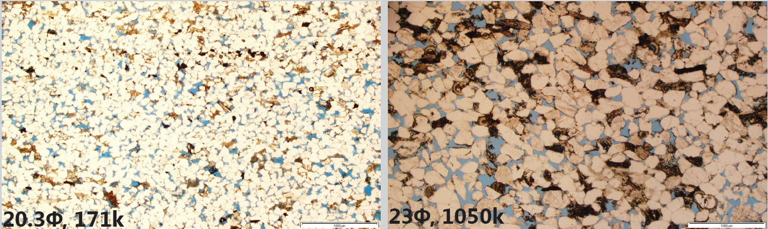
Diagenetic differences
Griggs sandstone
Robins sandstone
Compaction & quartz cementation has occluded some Φ and k in Griggs sandstone
Siderite has replaced organics & spores but only minor compaction means preserved reservoir quality in the Robins sandstone
Outline Background Methods Results Summary

Slide 14
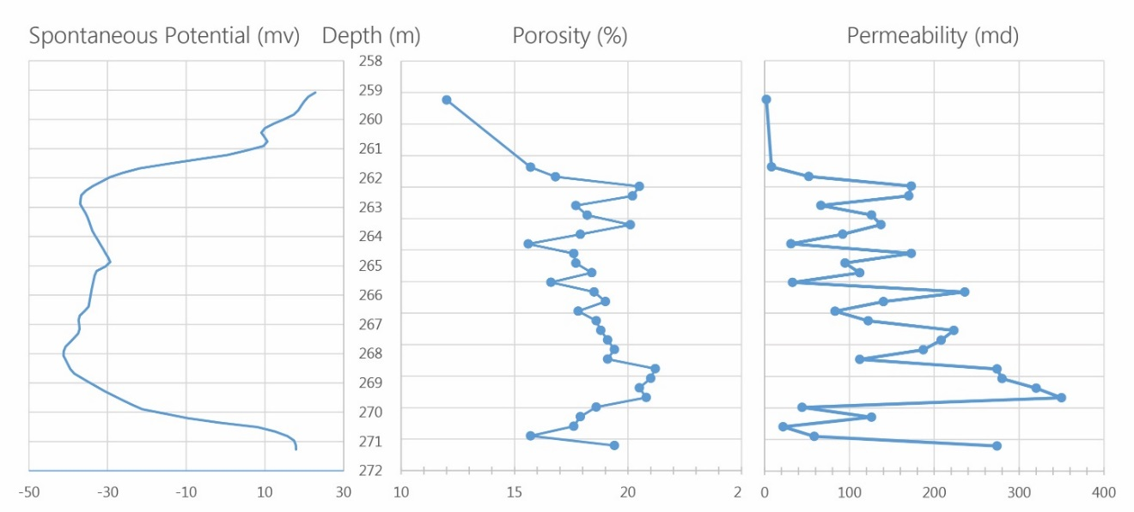
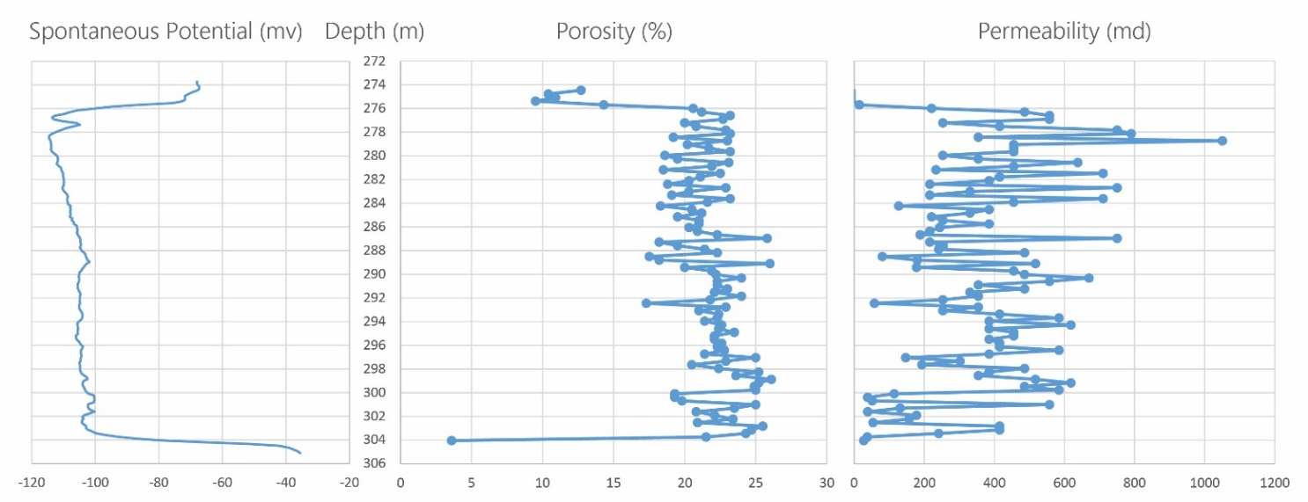
Reservoir quality differences
Griggs sandstone
Lower Φ and k
More heterogeneous
Robins sandstone
Higher Φ and k
More homogeneous
Outline Background Methods Results Summary

Slide 15
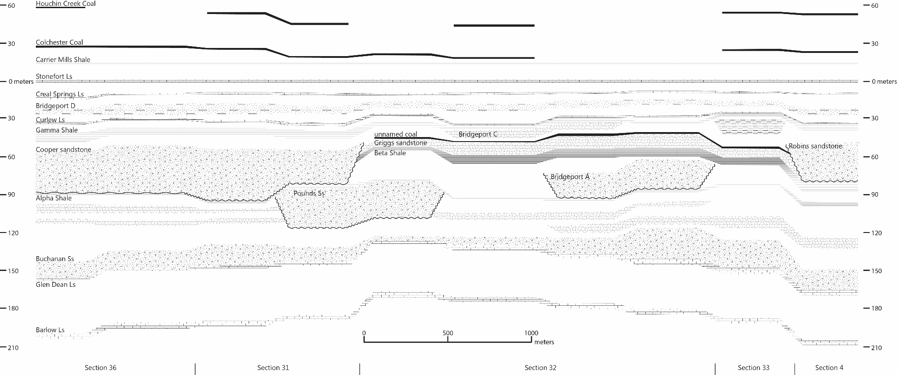
Stratigraphic relationships
Geophysical log correlation indicates incisement of older Griggs deltaic sandstone prior to deposition of the Robins fluvial sandstone
Outline Background Methods Results Summary

Slide 16
Implications
Low accommodation setting means common incisement and valley fill
Juxtaposition of depositional environments
Reservoirs occupy same relative stratigraphic position but are not connected and have different properties
Especially important for enhanced oil recovery
Outline Background Methods Results Summary

Slide 17
Summary
Griggs and Robins sandstones represent two very different Pennsylvanian sandstone reservoirs…
Seemingly stratigraphic equivalents
Different ages and depositional environments
Different reservoir characteristics
Implications for potential EOR operations
Outline Background Methods Results Summary

Slide 18
Sedimentology of two Lower Pennsylvanian fluvio-tidal reservoir sandstones in the Illinois Basin
Nathan D. Webb

