Slide 1
Human, Animal, or Infrastructure? Identifying Sources of of Urban-Derived Bacteria to Aquatic Environments
Jenny C. Fisher, Deborah K. Dila, Sandra L. McLellan
University of Wisconsin-Milwaukee
May 19, 2015

Slide 2
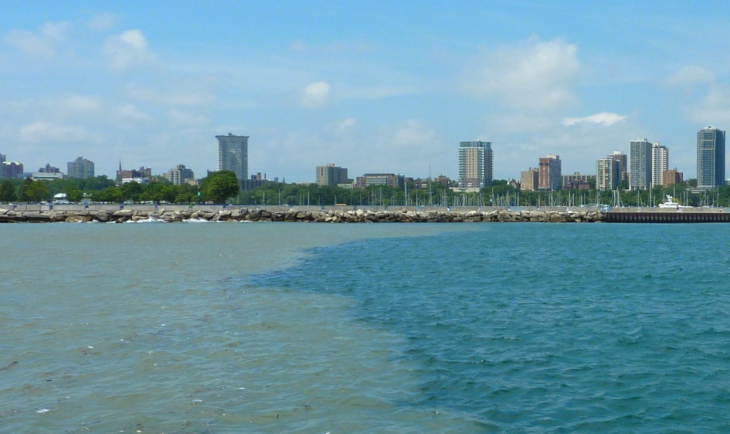
Identifying Sources of Fecal Pollution
Notes:
Metro Milwaukee area – SW issues are a concern b/c of direct effects on Lake Michigan, and recreational uses of waterways and beaches
Fecal sources in stormwater have been investigated for >10 yrs. with traditional methods and some molecular,
How we use use NGS and some new computational methods
WE can ascertain what proportion of different stormwater sources are human fecal, animal fecal, or associated with urban infrastructure

Slide 3
Identifying Sources of Fecal Pollution
Notes:
Metro Milwaukee area – SW issues are a concern b/c of direct effects on Lake Michigan, and recreational uses of waterways and beaches
Fecal sources in stormwater have been investigated for >10 yrs. with traditional methods and some molecular,
How we use use NGS and some new computational methods
WE can ascertain what proportion of different stormwater sources are human fecal, animal fecal, or associated with urban infrastructure

Slide 4
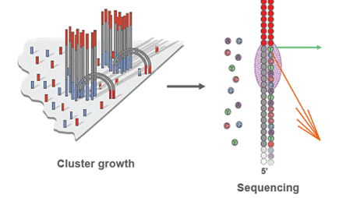
Identifying Sources of Fecal Pollution
Notes:
Metro Milwaukee area – SW issues are a concern b/c of direct effects on Lake Michigan, and recreational uses of waterways and beaches
Fecal sources in stormwater have been investigated for >10 yrs. with traditional methods and some molecular,
How we use use NGS and some new computational methods
WE can ascertain what proportion of different stormwater sources are human fecal, animal fecal, or associated with urban infrastructure

Slide 5
Identifying Sources of Fecal Pollution
HUMAN
PIPE
ANIMAL
Notes:
Metro Milwaukee area – SW issues are a concern b/c of direct effects on Lake Michigan, and recreational uses of waterways and beaches
Fecal sources in stormwater have been investigated for >10 yrs. with traditional methods and some molecular,
How we use use NGS and some new computational methods
WE can ascertain what proportion of different stormwater sources are human fecal, animal fecal, or associated with urban infrastructure

Slide 6

Water Quality Monitoring
Goal: human health risk reduction
FIB: easy to monitor but low correlation with pathogens
qPCR: targets one or more known sources
Cannot resolve complex sources
Notes:
Goal of monitoring water quality is human health risk reduction
Ecoli /FC used for standards/monitoring/TMDLS; but don’t reveal source SO risk is unclear
ID sewage/lateral/other human is key BUT
Understanding relative impacts of other sources (knowing % contributions) is needed for management, remediation, even weighing trading issues

Slide 7
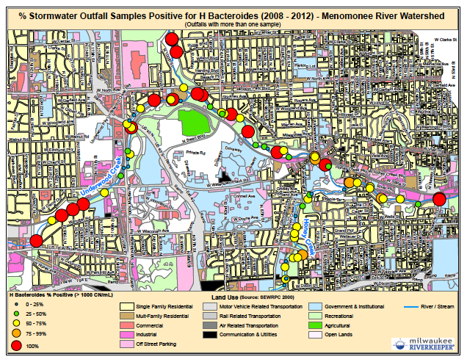
Outfall Monitoring Project
Notes:
Long term sampling revealed widespread chronic and intermittent fecal contamination (FC/ECOLI)
High % were sometimes + for human using one or more HIB assays

Slide 8
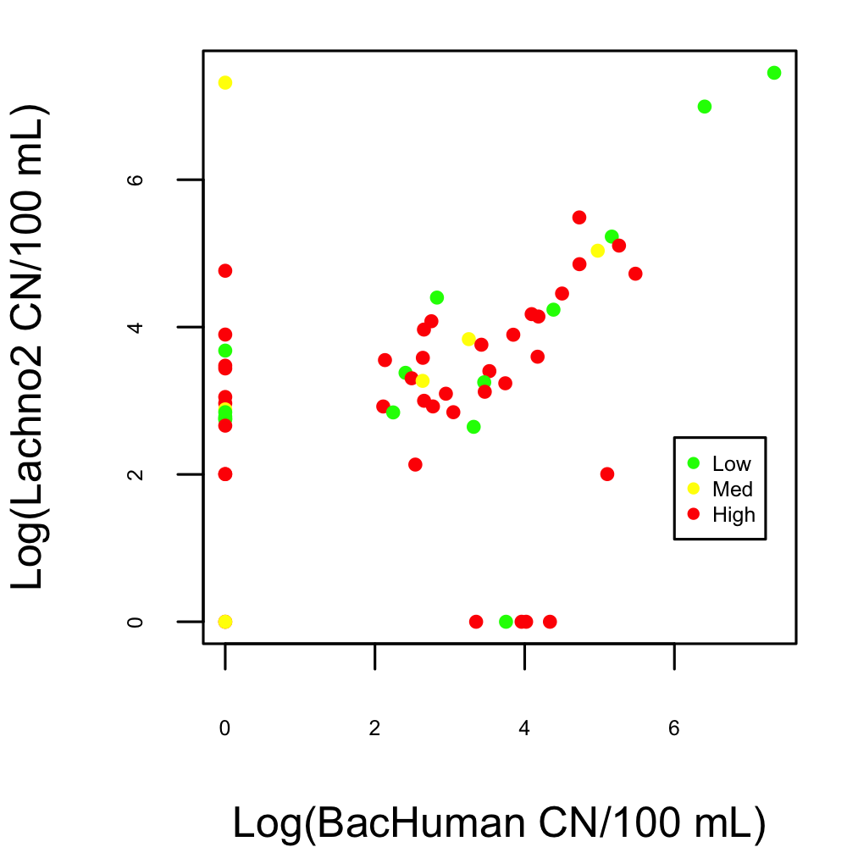
Additional Pollution Sources

Slide 9
Resolving Fecal Sources
Confirm human fecal
Identify known animal sources
Determine presence of “urban wildlife”
Calculate contributions
Image source: sourcemolecular.com
Source Molecular
graphic: M. Larenas, Source Molecular
Notes:
We use sequencing to

Slide 10
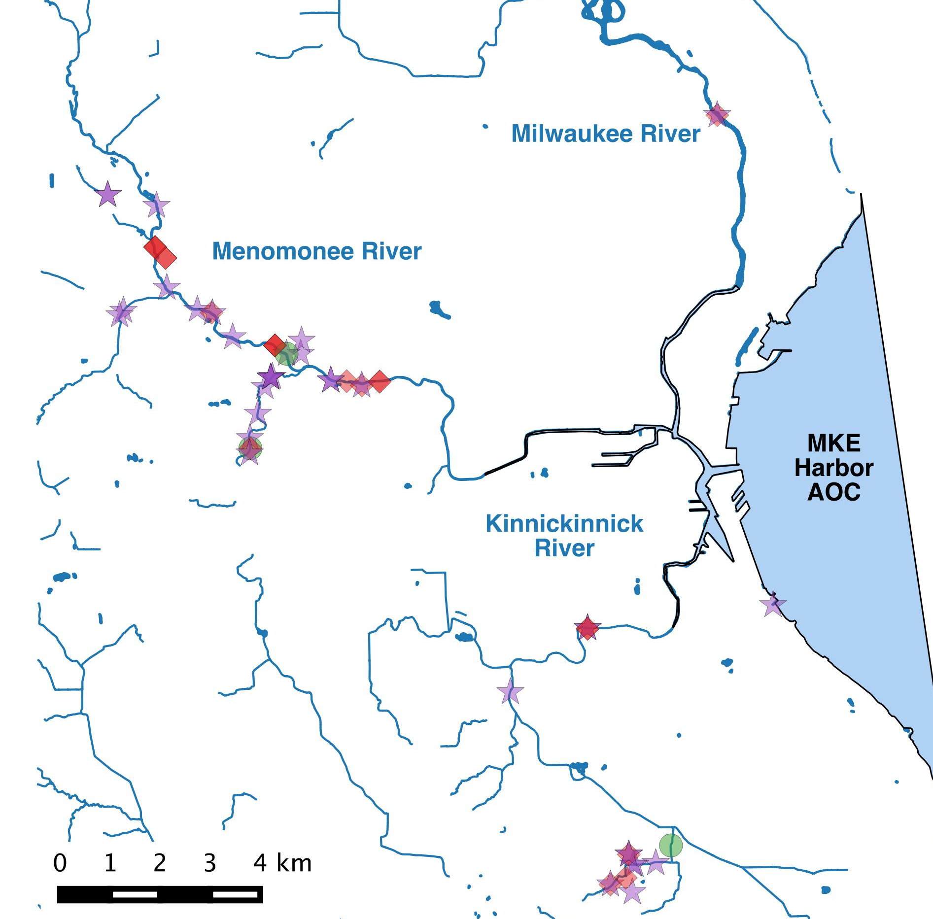
Sequence Sites
Clean
Human/Sewage
Unknown
Notes:
Green = clean; Red = presumed human, purple= ????
A range of sites from clean (low FIB ) to high FIB/HIB and mixed were chosen for community sequencing
Clean = background SW composition; human = confirm sewage, ??? Figure out what is contributing

Slide 11
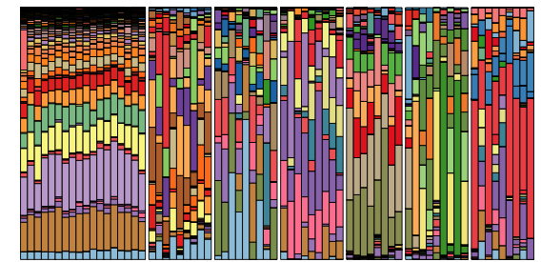
Microbial Fingerprints of Fecal Communities
SEWAGE
ANIMALS
JC Fisher et al. (in review) AEM
Notes:
Source tracking with NGSeq – we chose Illumina HiSeq – 1000000 seq per sample, for the V6 region of 16S rRNA gene,
My previous work with animals and sewage showed that sequences from multiple taxa are specific to hosts

Slide 12
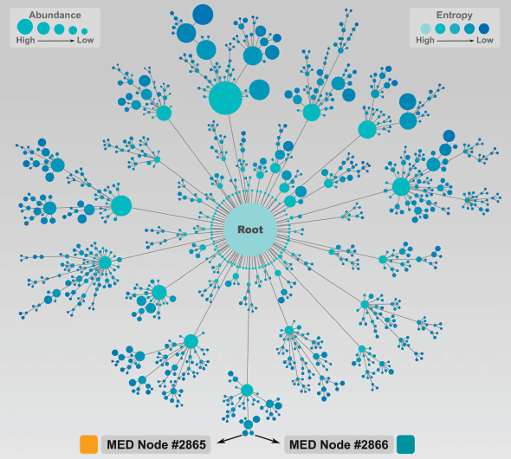
Minimum Entropy Decomposition
Clustering method for NGS amplicon sequences
Produces taxonomically homogeneous OTUs
Resolves ecotypes with ≥1 nt sequence difference
AM Eren et al. (2014) ISME
Notes:
Sequences were clustered using Min Ent Decomp analysis, dev. By collaborator Murat Eren @ MBL
Groups sequences into Op. Tax. Units based on high entropy nucleotide positions along sequence alignment.
Basically – an organic way of grouping sequences based on evolutionary or neutral variation that occurs in distinct populations
Rather than a strict % similarity cutoff
Can be used on a total community or taxonomic group

Slide 13
Community Analysis
Lachnospiraceae
Notes:
I did MED analysis on the family Lachnospiraceae, important group of fecal bacteria
Ordination multidimensional scaling

Slide 14
Determining Sources
SEWAGE | STORM WATER | KNOWN ANIMAL | SOURCE
++ | ++ | - - | Infrastructure
++ | + | - - | Human
- - | + | +/ - | Known animal(s)
- - | + | - - | “Urban wildlife”
+/- | +/- | +/- | Non-specific
Notes:
I determined the sources in stormwater based on the MED nodes found in other sources
*Nodes present in all sewage and majority of stormwater but absent from animals = infra
*Present in all sewage and some stormwater samples = sewage/human either cross connections, exfiltration, laterals
*Absent from sewage, present in some SW, observed in one of the previously seq’d animal groups = animal
*Apparent animal, but not matching known = candidate for our “urban wildlife” group, which might include Raccoons, squirrels, rodents, birds, etc.

Slide 15
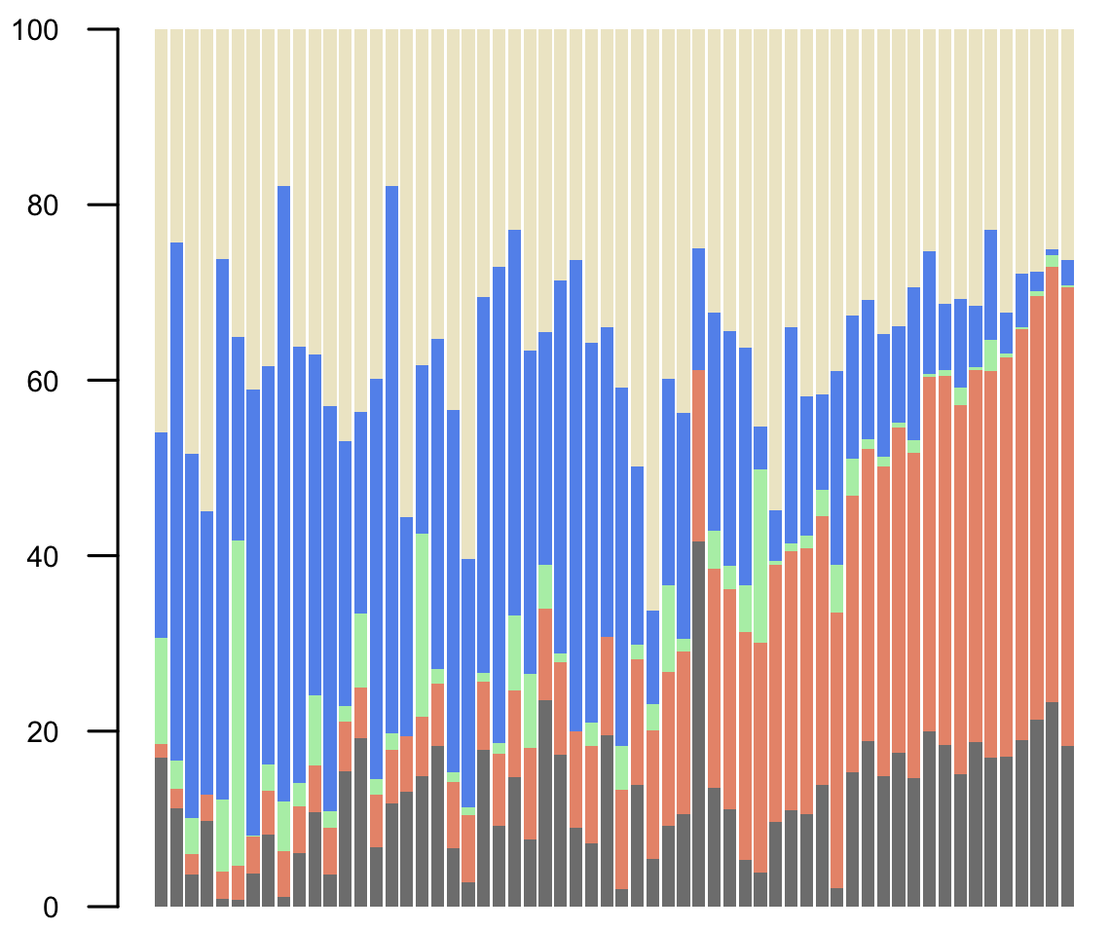
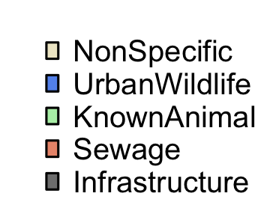
Source Distribution

Slide 16
Source Distributions
“Urban Wildlife” consistently found
Dominant source of animal pollution
Chronic sewage contamination from trace to high levels
Large fraction cannot be determined
Further resolution with other fecal groups needed

Slide 17
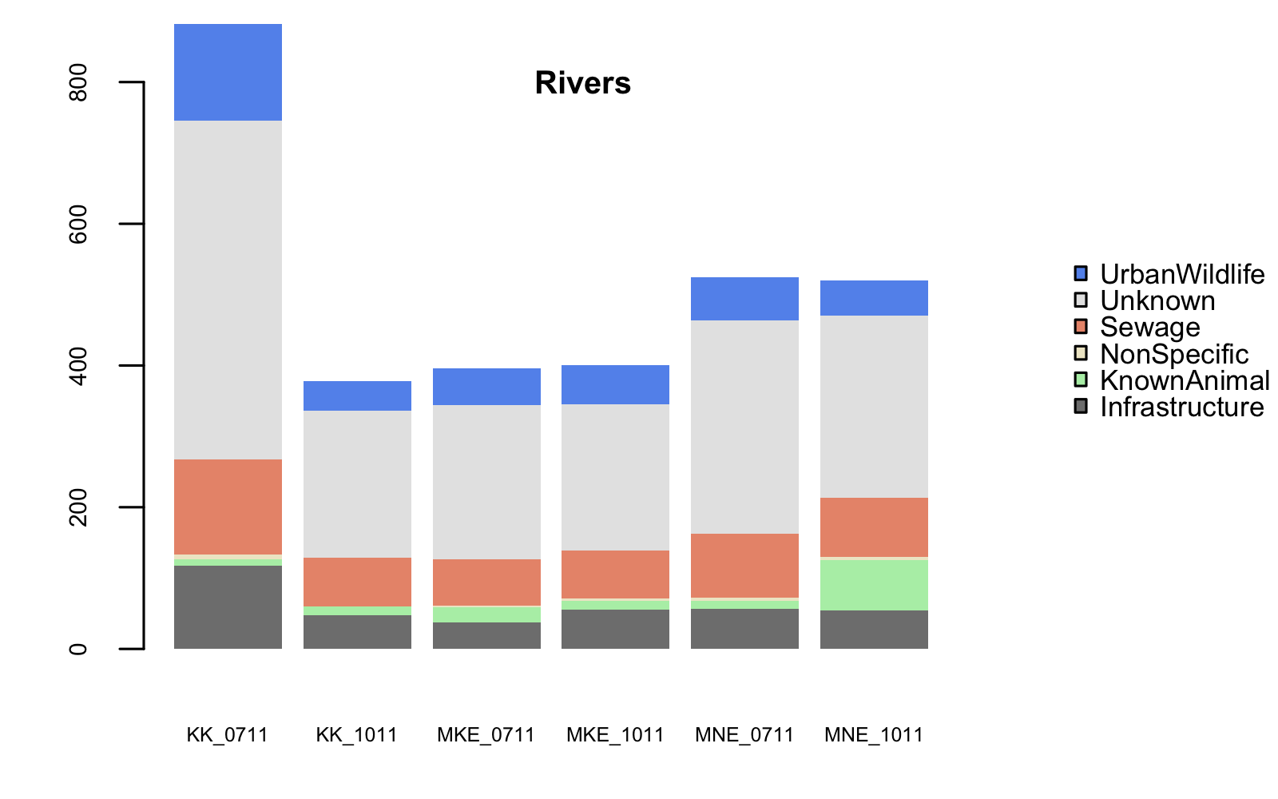
Presence in Rivers
Kinnickinnic
Milwaukee
Menomonee

Slide 18
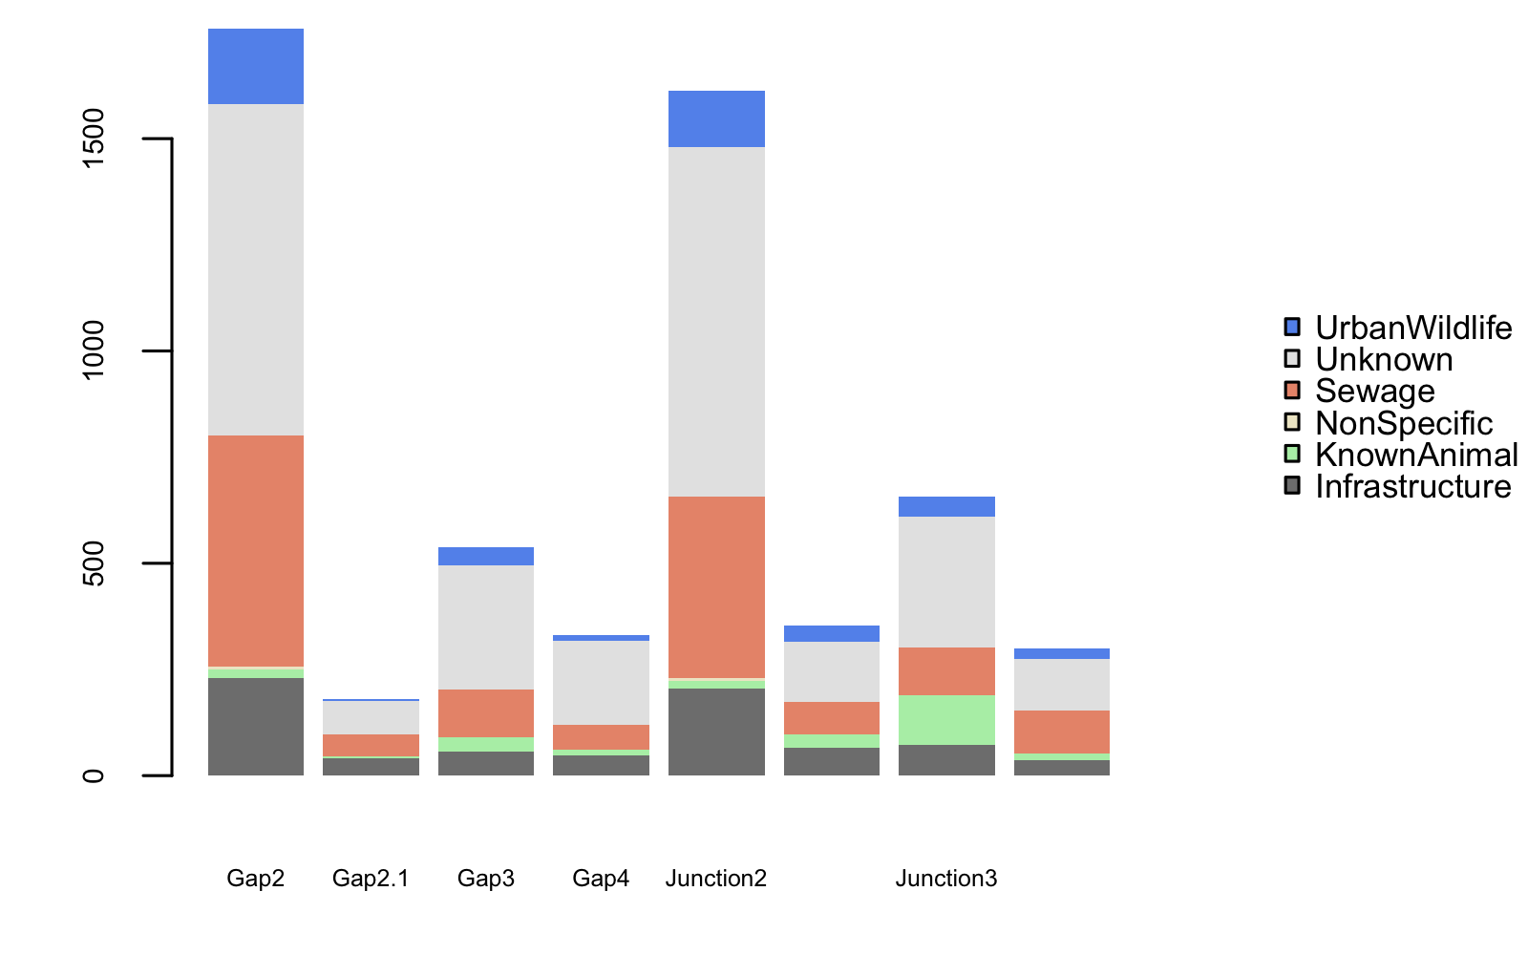
Presence in MKE Harbor
GAP
JUNCTION

Slide 19
Presence in MKE Harbor
CSO
GAP
JUNCTION

Slide 20
Conclusions
Sequencing improves identification of complex fecal pollution sources
Urban wildlife is a major source of fecal pollution in Milwaukee stormwater, rivers, and harbor
Significant human sources should be prioritized for remediation
Future work will correlate source contributions to FIB to better determine human health risk

Slide 21
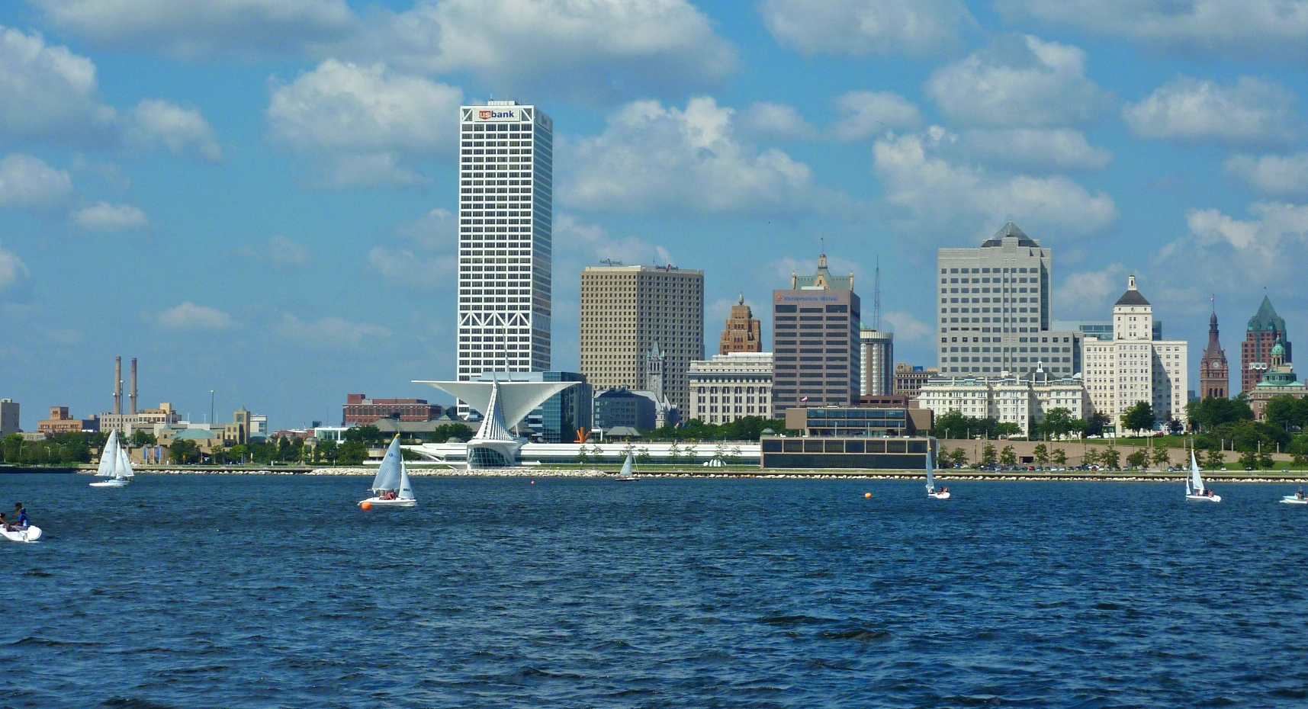
Acknowledgments
FUNDING:
National Institutes of Health
Milwaukee Metropolitan Sewerage District
COLLABORATORS:
Melinda Bootsma, Danielle Cloutier, Hayley Templar, Chelsea Corson, Shuchen Feng, Ryan Bartleme, Katie Halmo (UWM)
Milwaukee Riverkeeper & MMSD
Murat Eren, Hilary Morrison, Mitch Sogin (MBL)

Slide 22
Acknowledgments
FUNDING:
National Institutes of Health
Milwaukee Metropolitan Sewerage District
COLLABORATORS:
Melinda Bootsma, Danielle Cloutier, Hayley Templar, Chelsea Corson, Shuchen Feng, Ryan Bartleme, Katie Halmo (UWM)
Milwaukee Riverkeeper & MMSD
Murat Eren, Hilary Morrison, Mitch Sogin (MBL)

