Slide 1
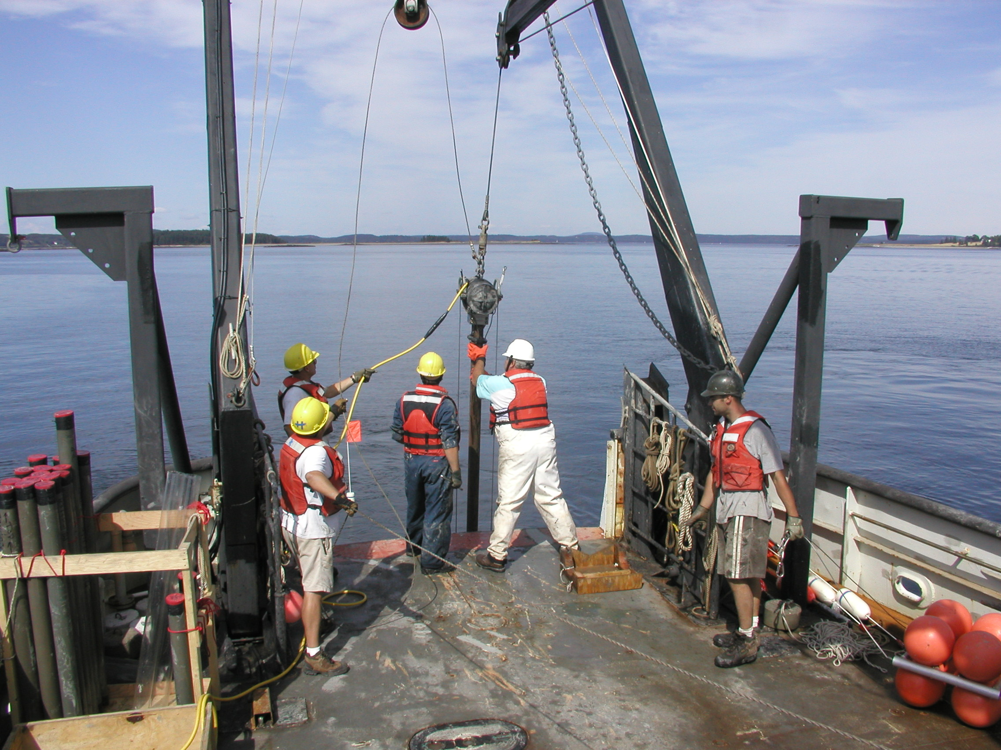
Manifestation of Bluff Erosion in the Transgressive
Stratigraphy of Maine Estuaries
Daniel F. Belknap and Joseph T. Kelley
School of Earth and Climate Sciences
University of Maine
Vibracoring,
R/V Argo Maine,
08/20/02

Slide 2
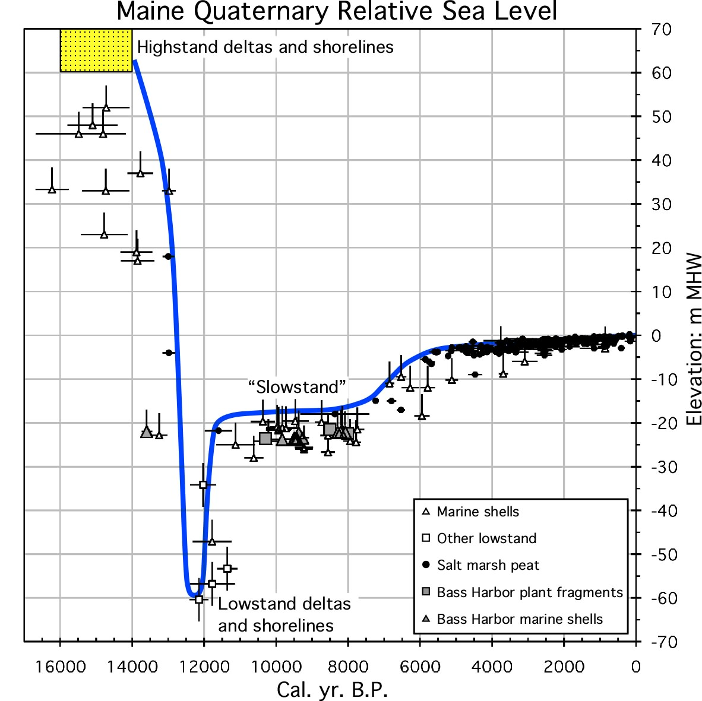
Belknap et al., 1987; Barnhardt et al., 1995; Kelley et al. 2013

Slide 3
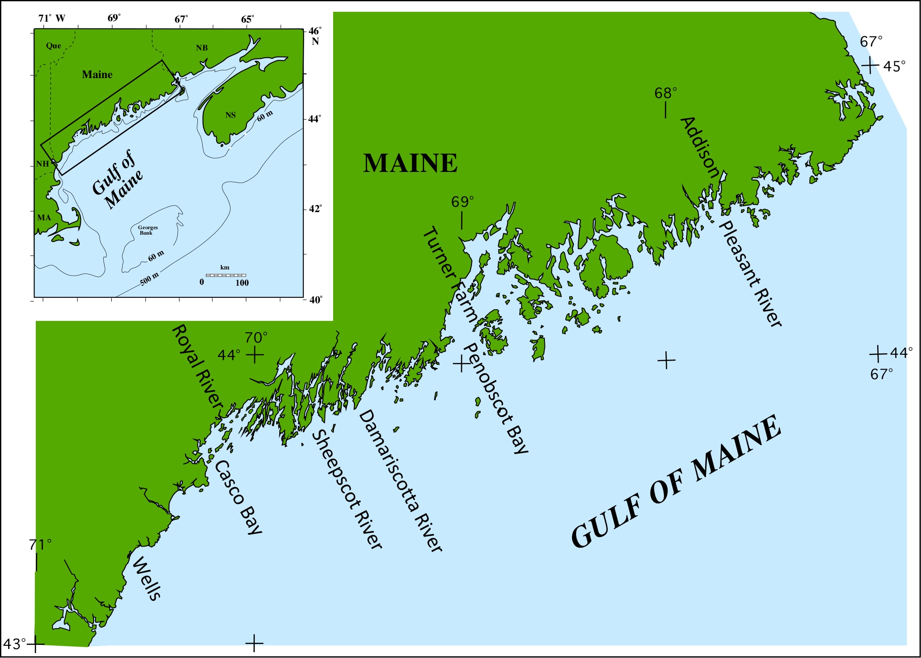

Slide 4
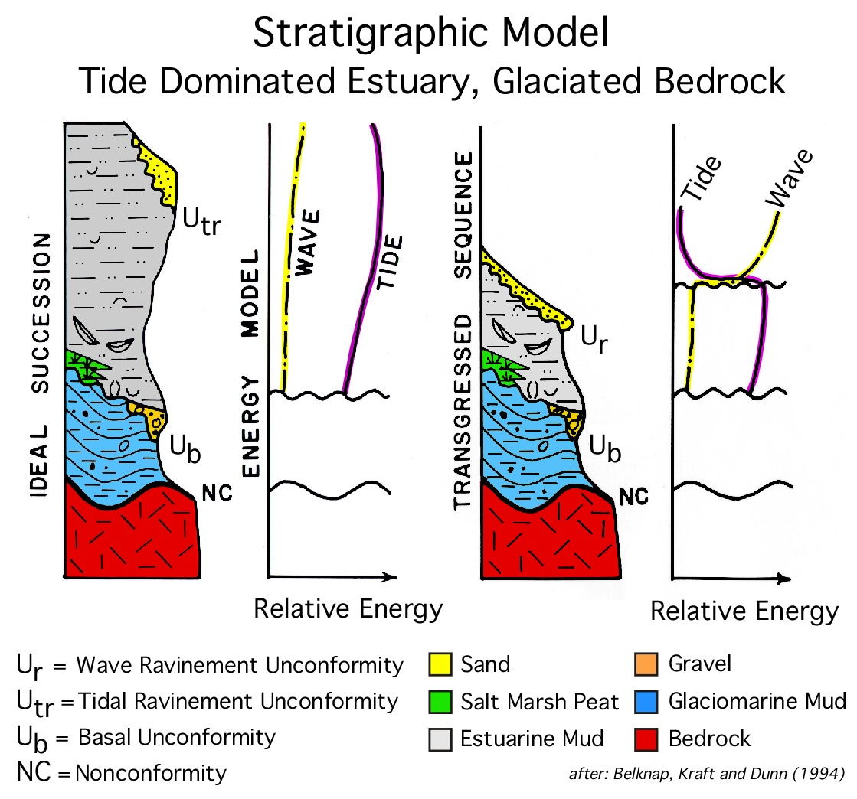

Slide 5
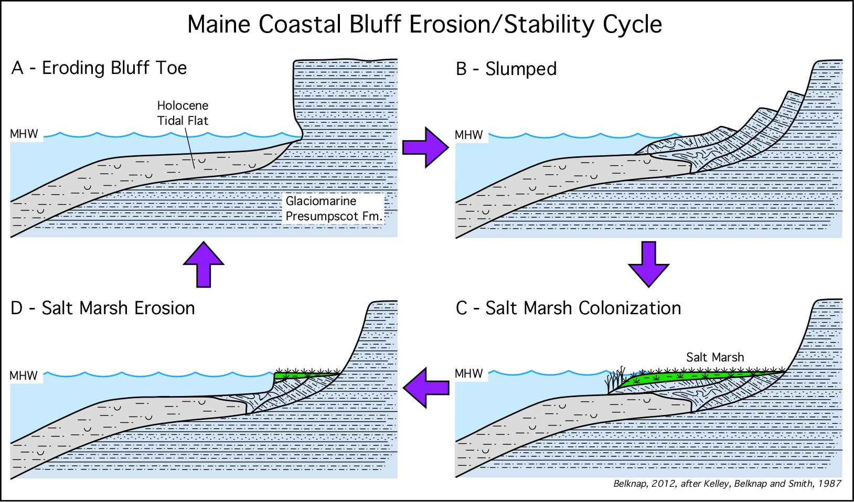

Slide 6
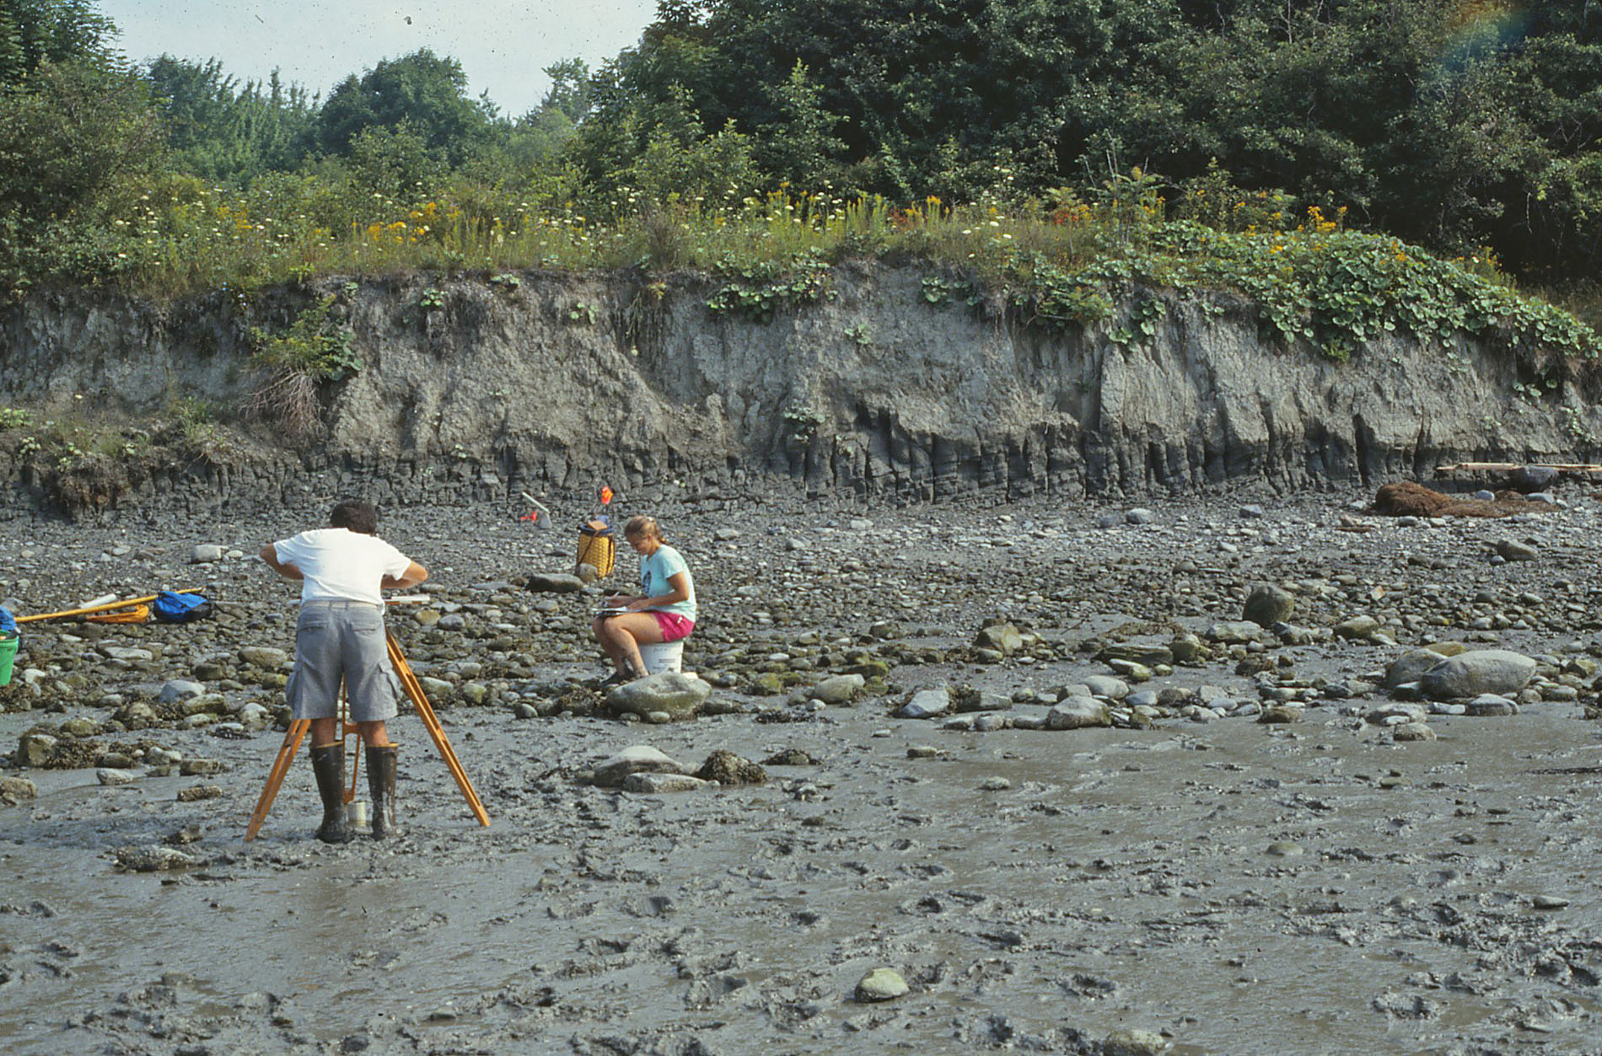
Erosing scarp into Rockland 1973 slump toe
Rockland 1973 slump toe, 08/03/88
D.F. Belknap

Slide 7
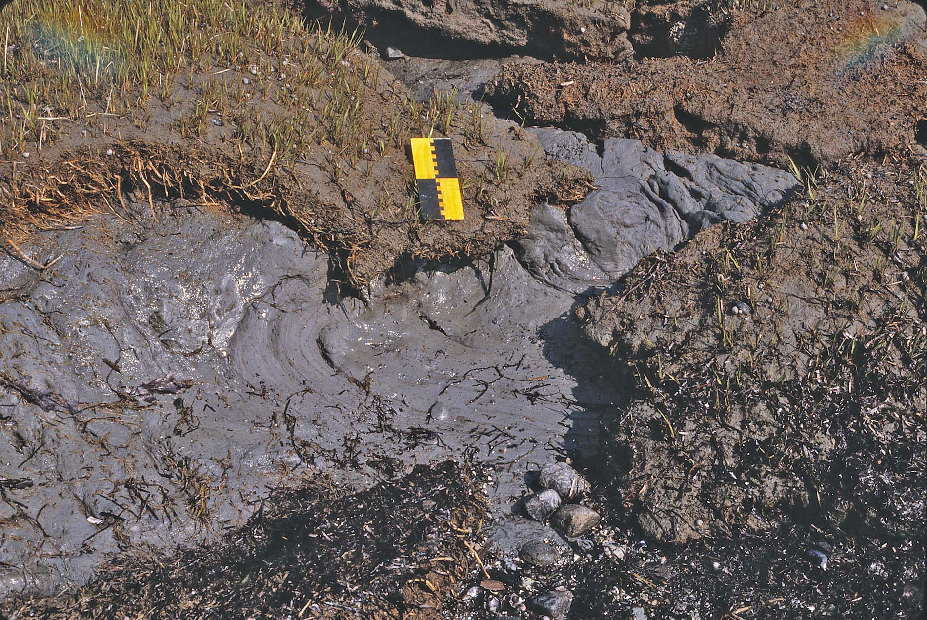
Deformed Presumpscot Fm. at former slump toe, marsh colonization
Little Flying Point, Freeport, Casco Bay, ME, 05/20/85
D.F. Belknap

Slide 8
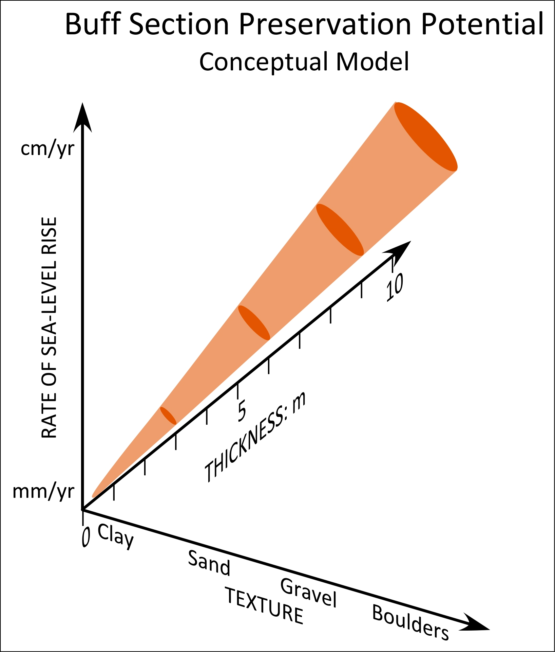

Slide 9
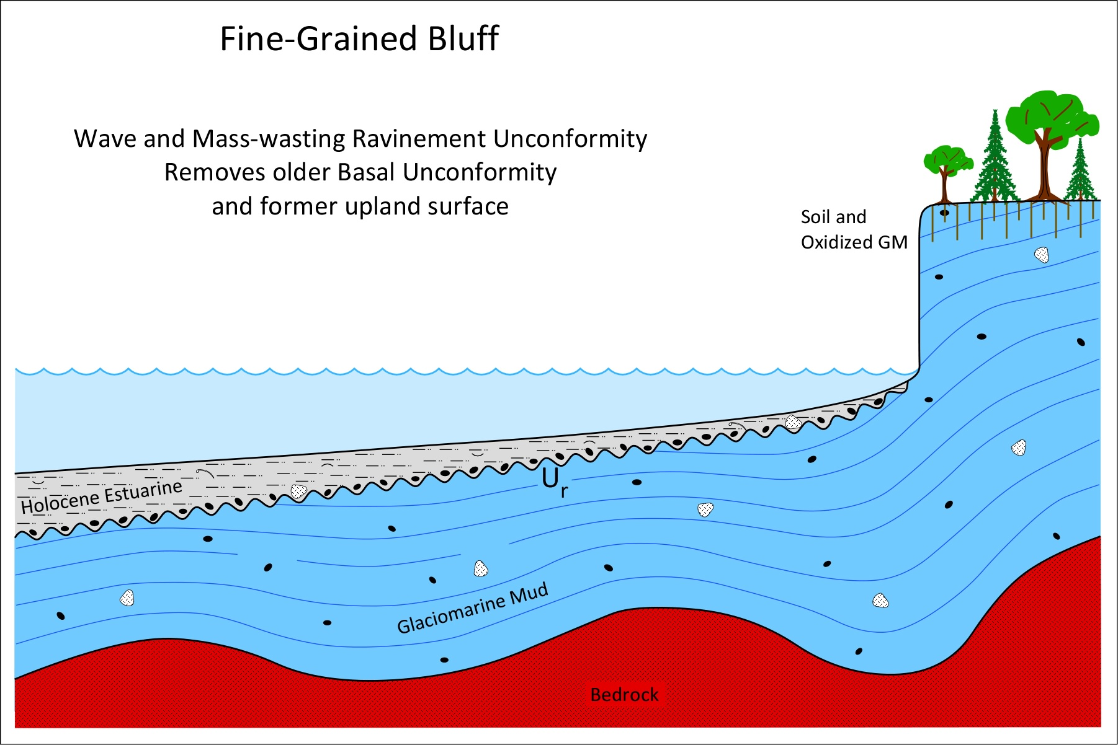

Slide 10
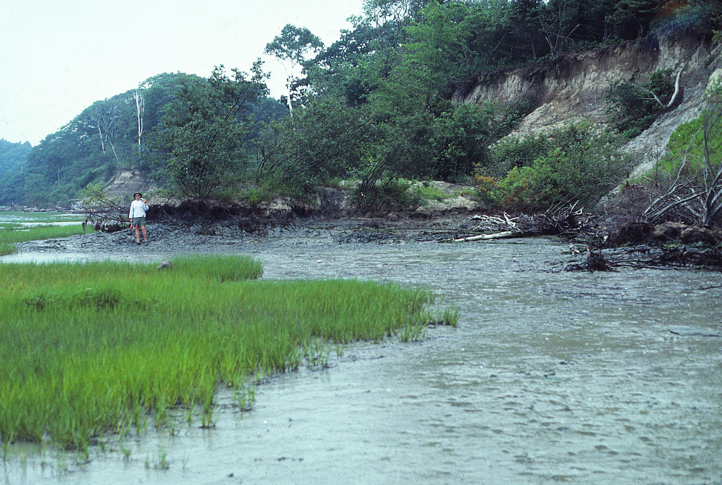
Fine-grained bluff erosion – Presumpscot Fm., waves and slumps
Bunganuc Bluff, Maquoit Bay, N. Casco Bay, Freeport, ME, 06/22/87
D.F. Belknap

Slide 11
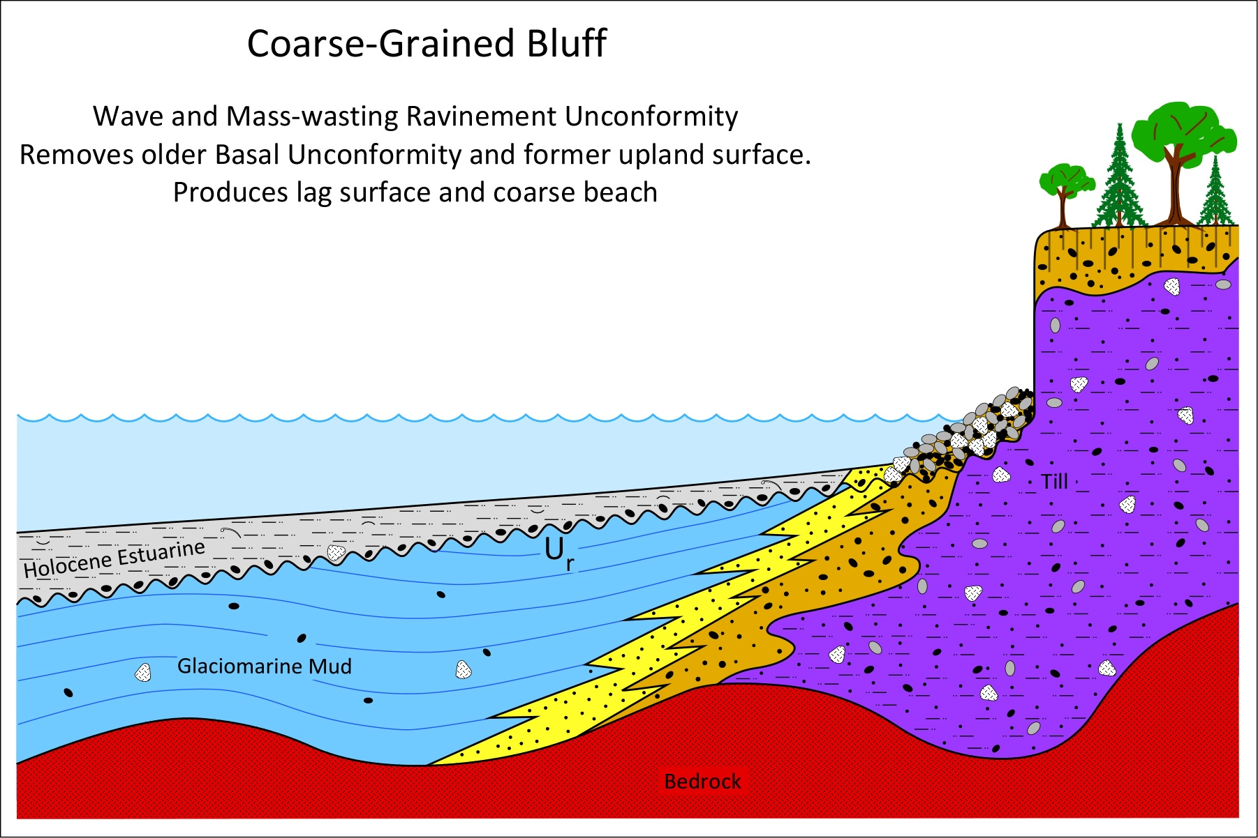

Slide 12
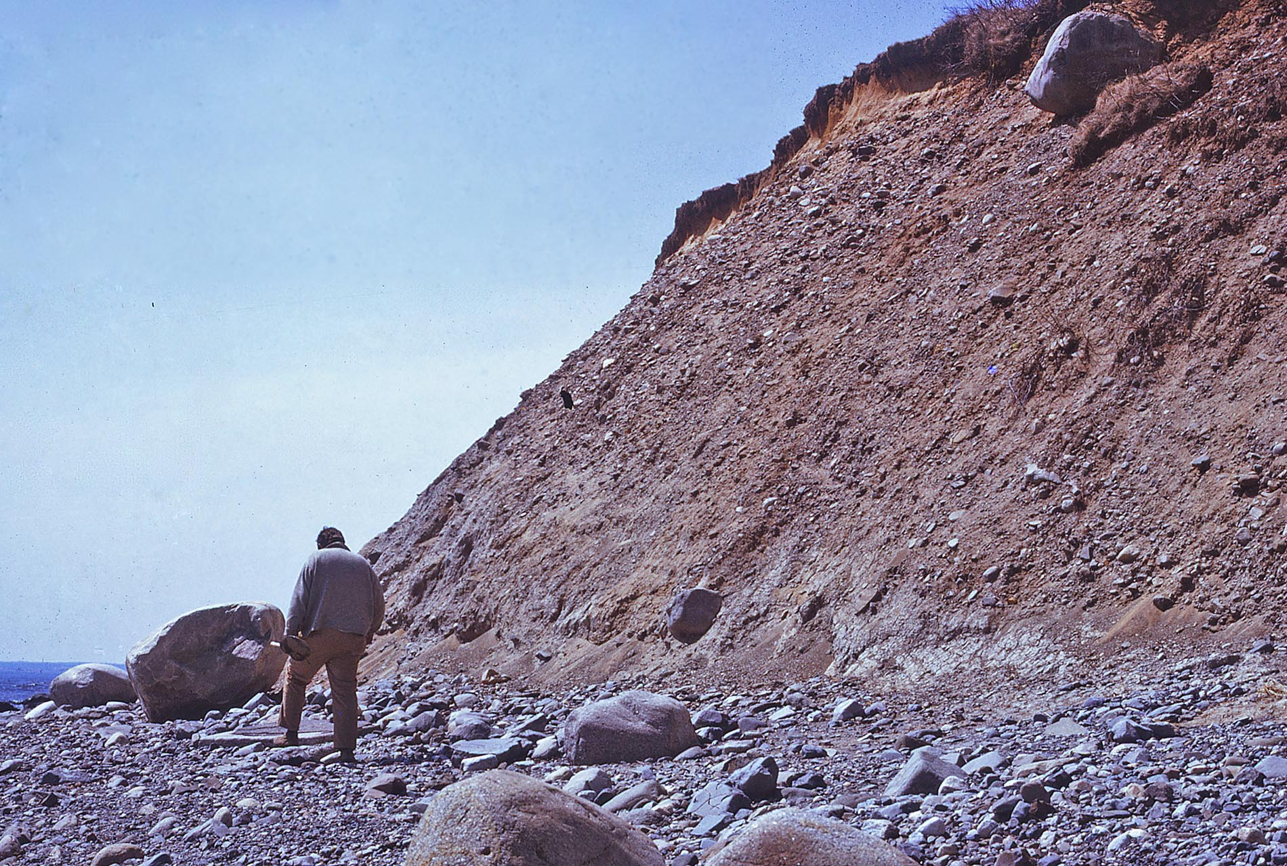
Drumlinoid till – coarse bluff erosion
Great Hill, Kennebunk Beach, ME, 04/16/73
D.F. Belknap

Slide 13
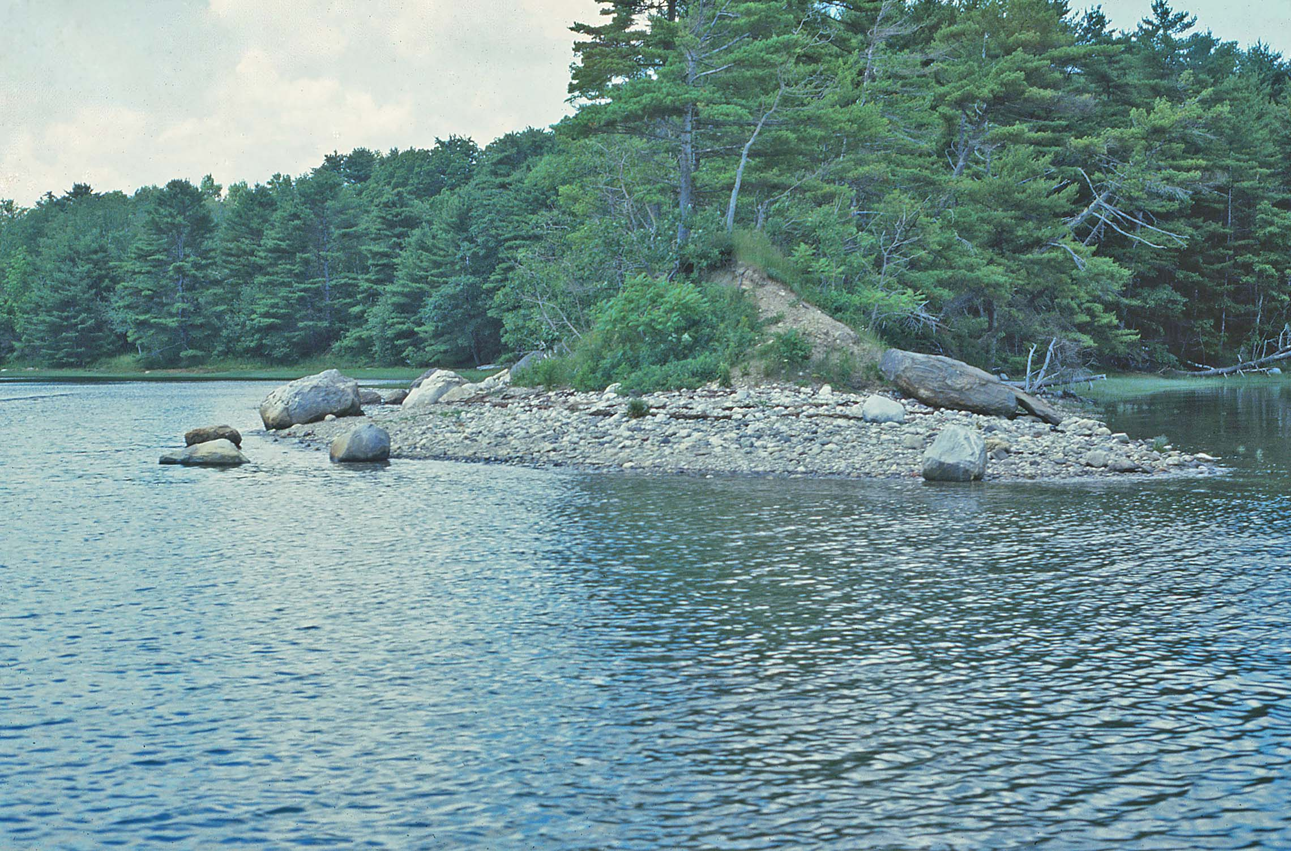
Minor moraine – coarse bluff erosion
Dodge Upper Cover, Damariscotta River estuary, 07/13/84
D.F. Belknap

Slide 14
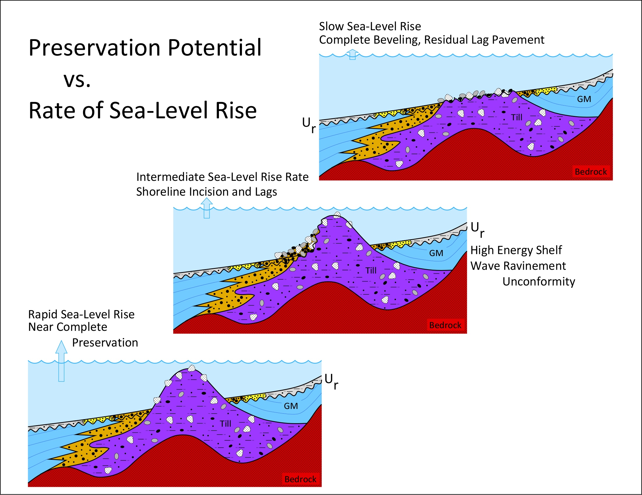

Slide 15
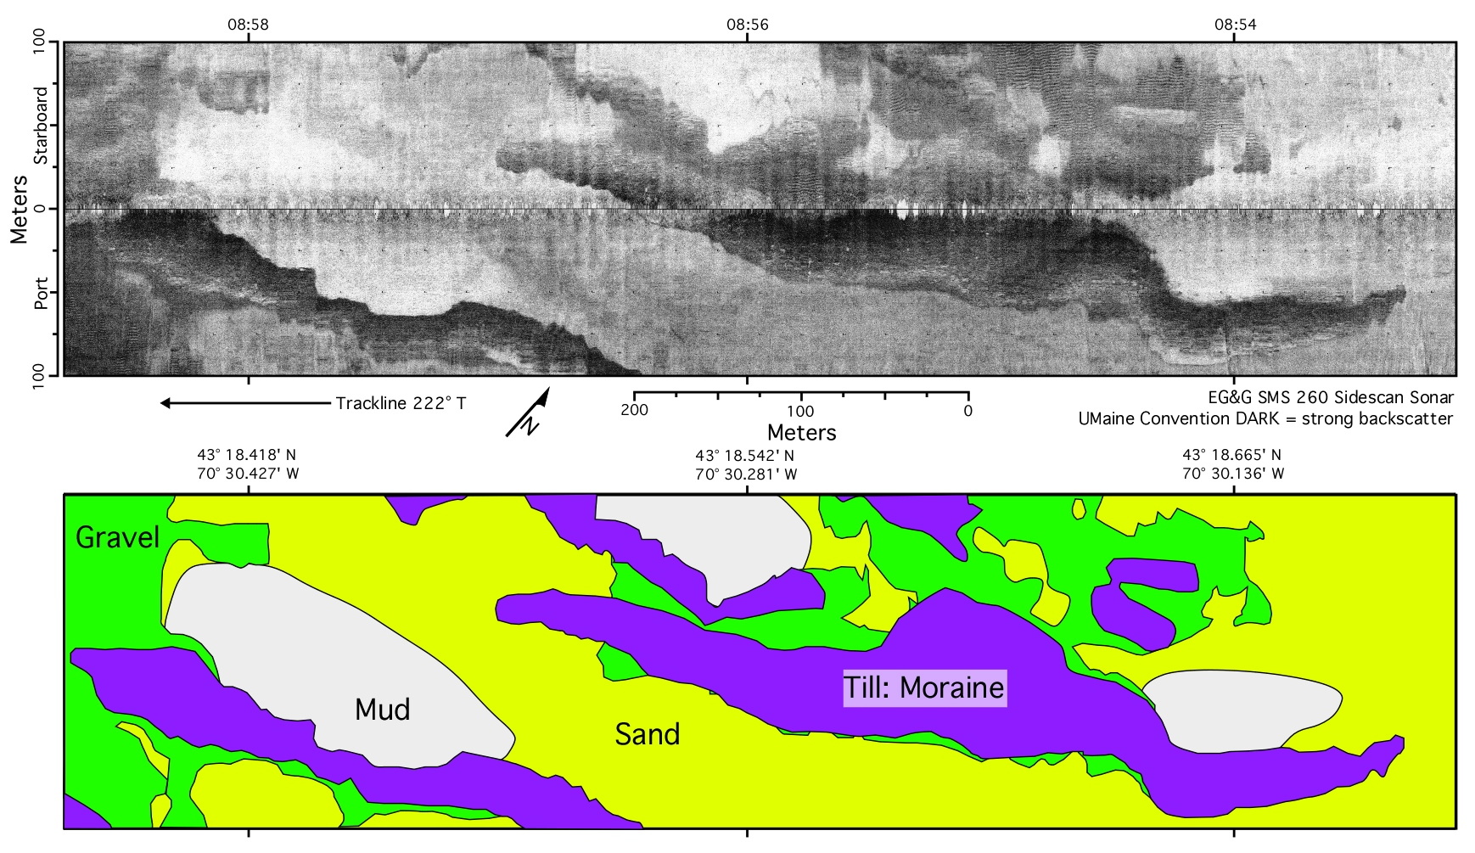

Slide 16
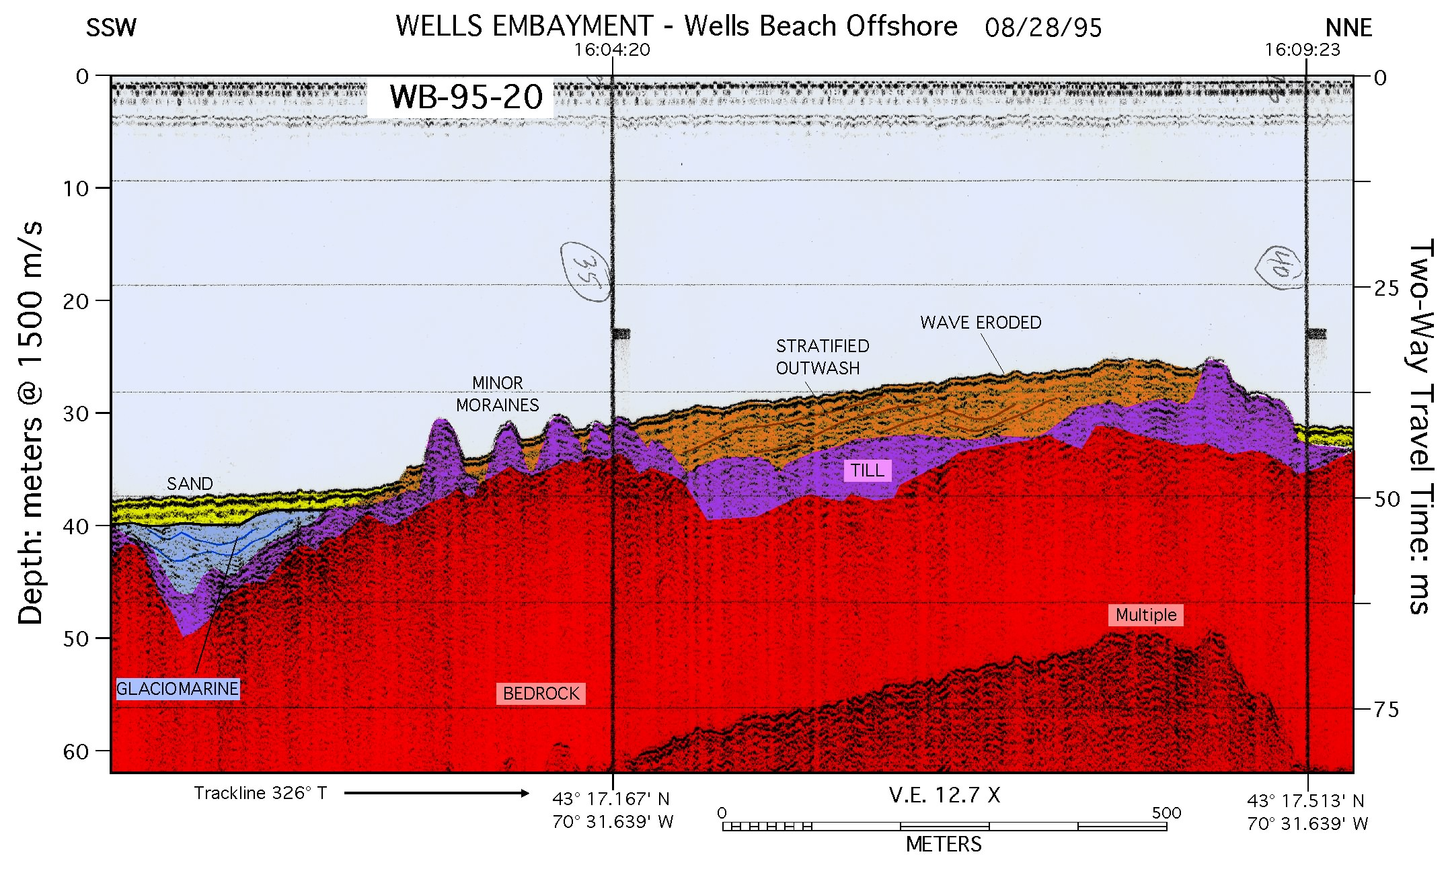

Slide 17
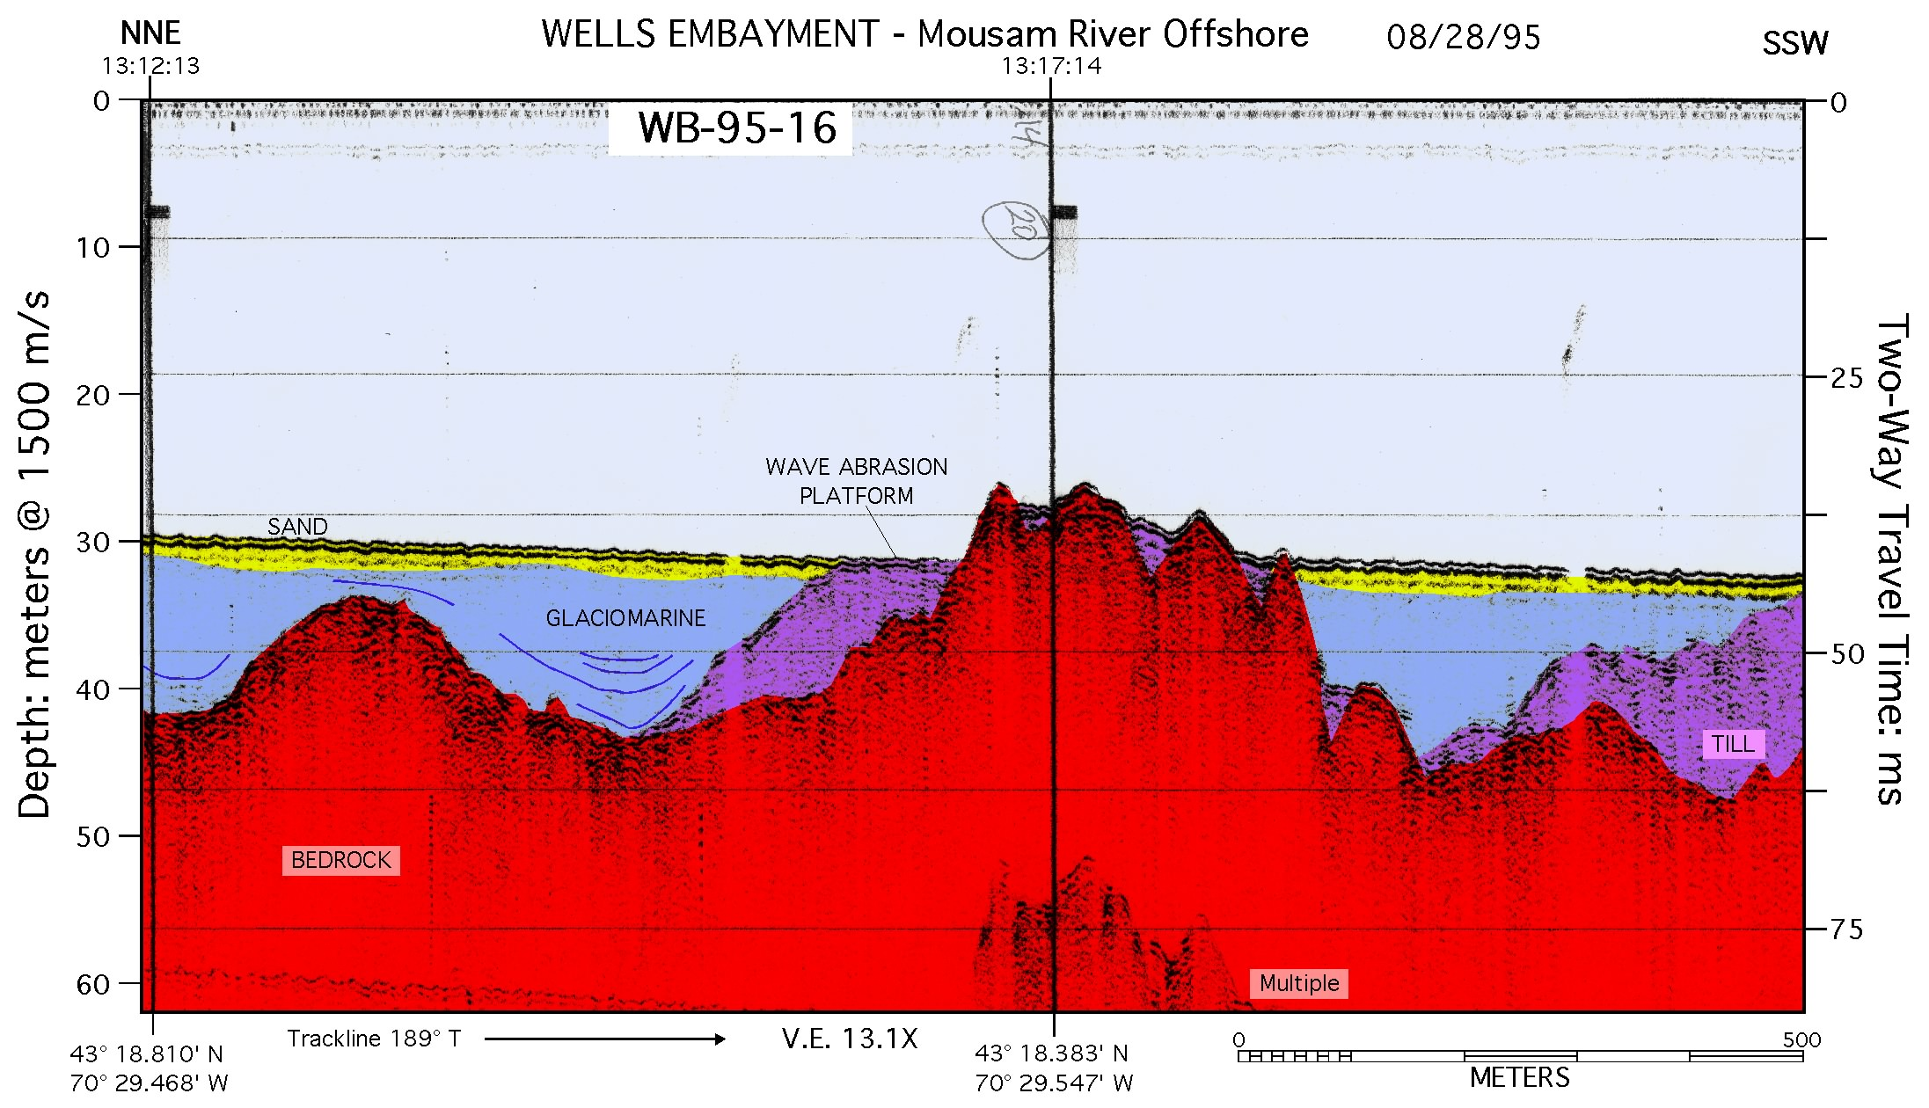

Slide 18
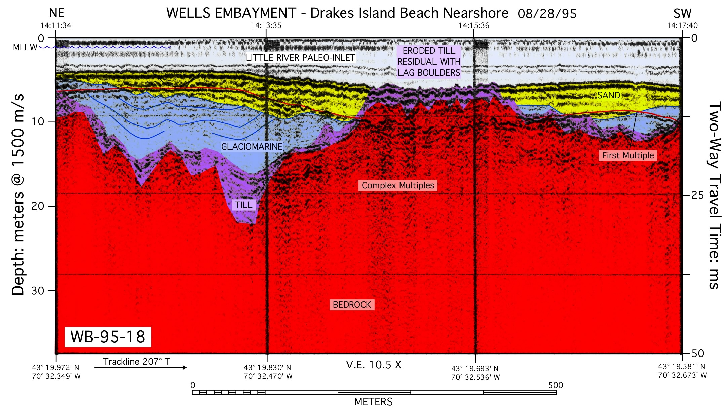

Slide 19
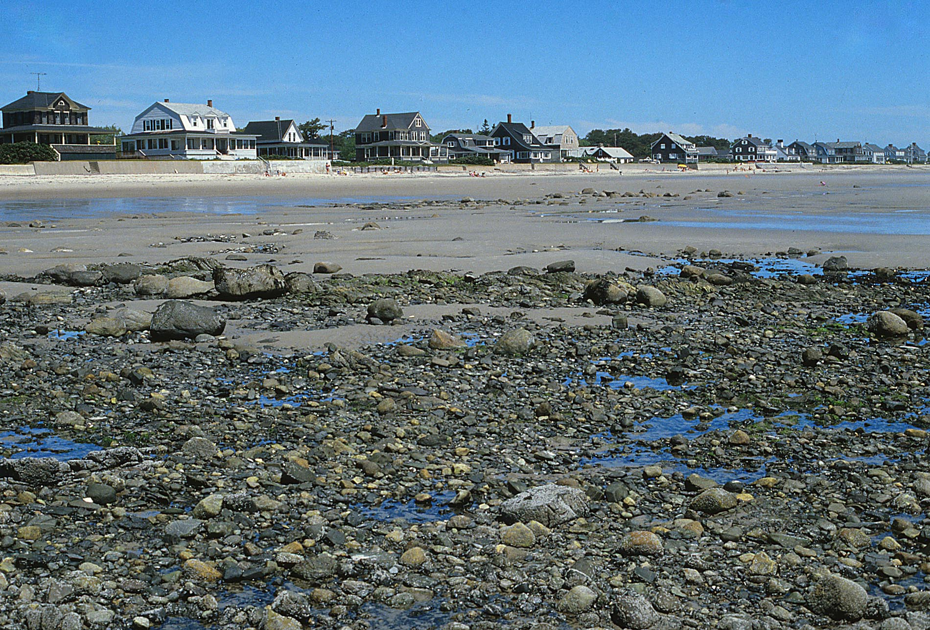
Boulder gravel lag, erosion of drumlinoid till
Drakes Island Beach low tide terrace, 06/20/84
D.F. Belknap

Slide 20
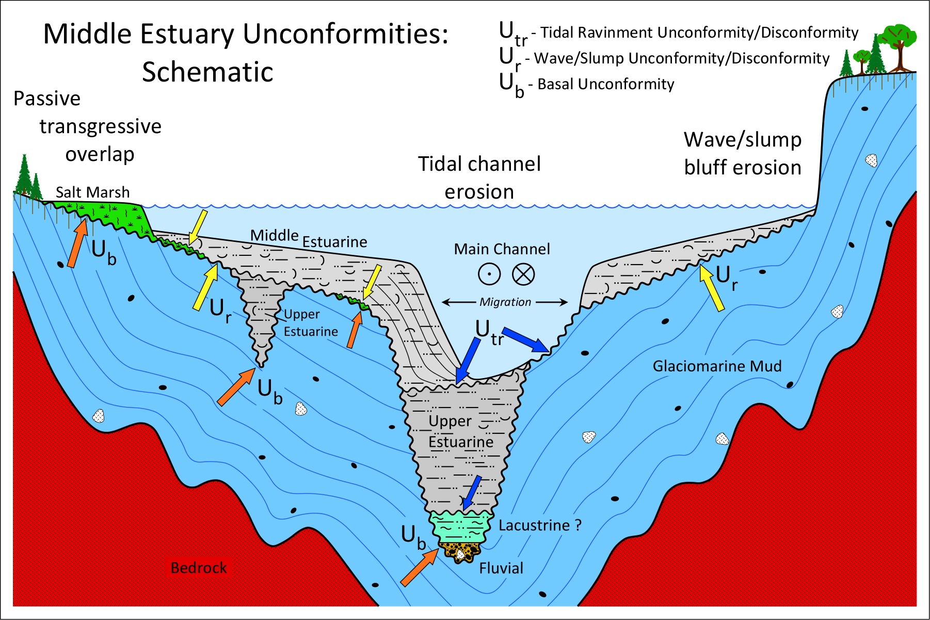

Slide 21
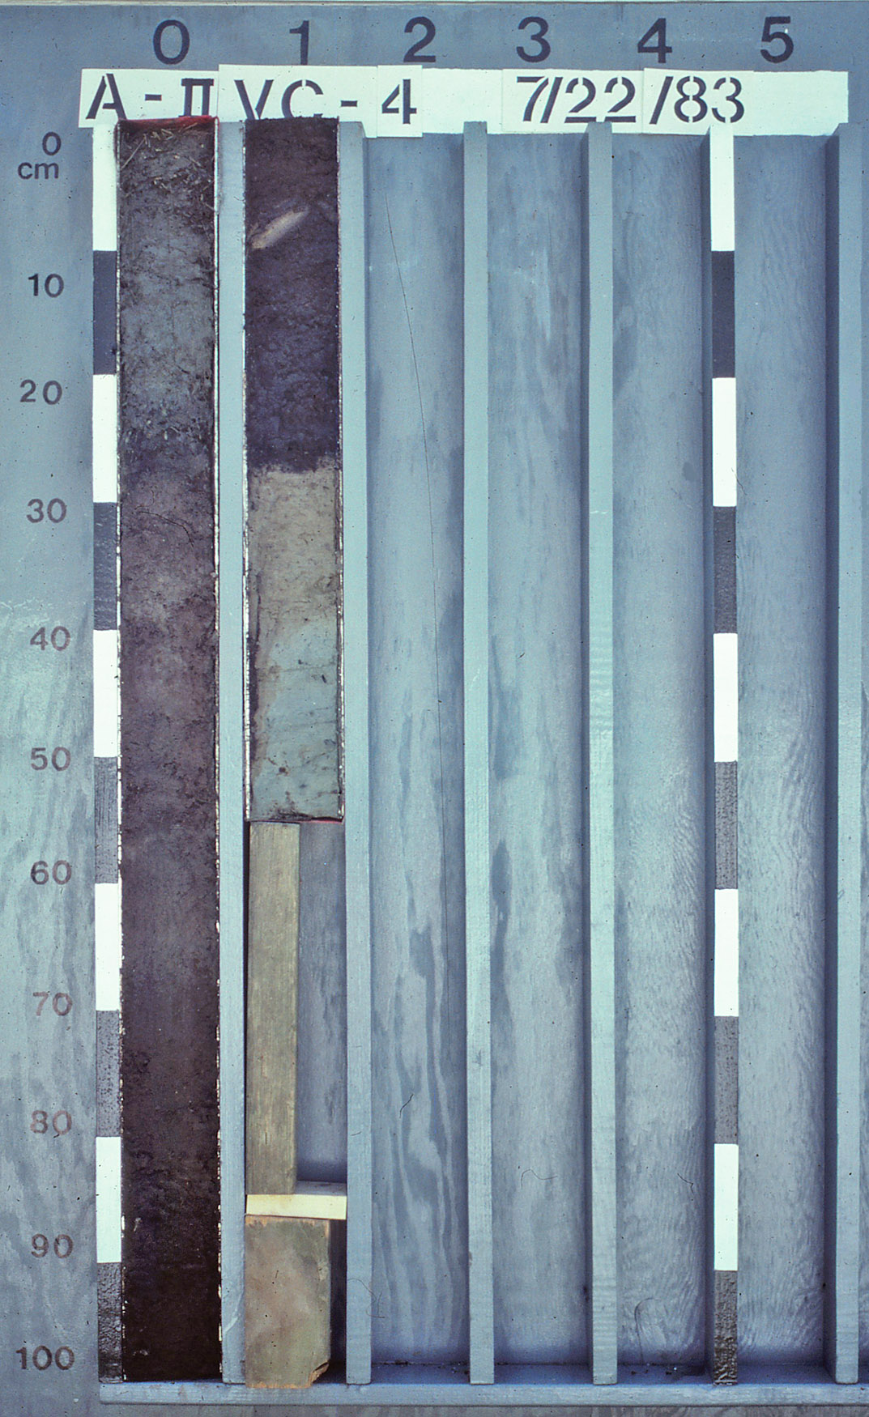
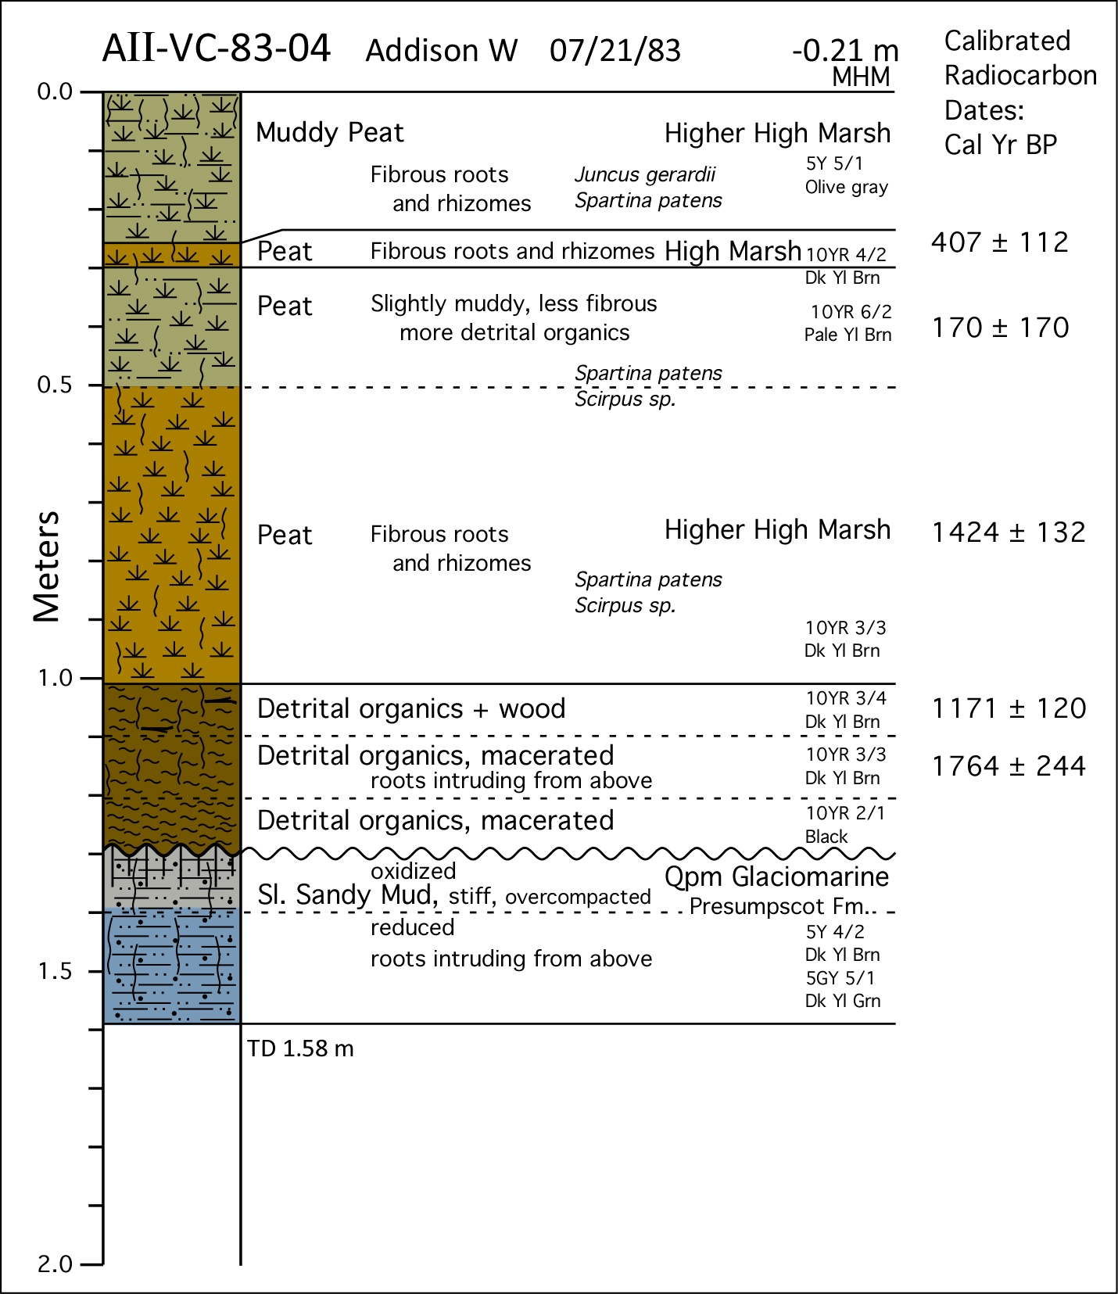

Slide 22
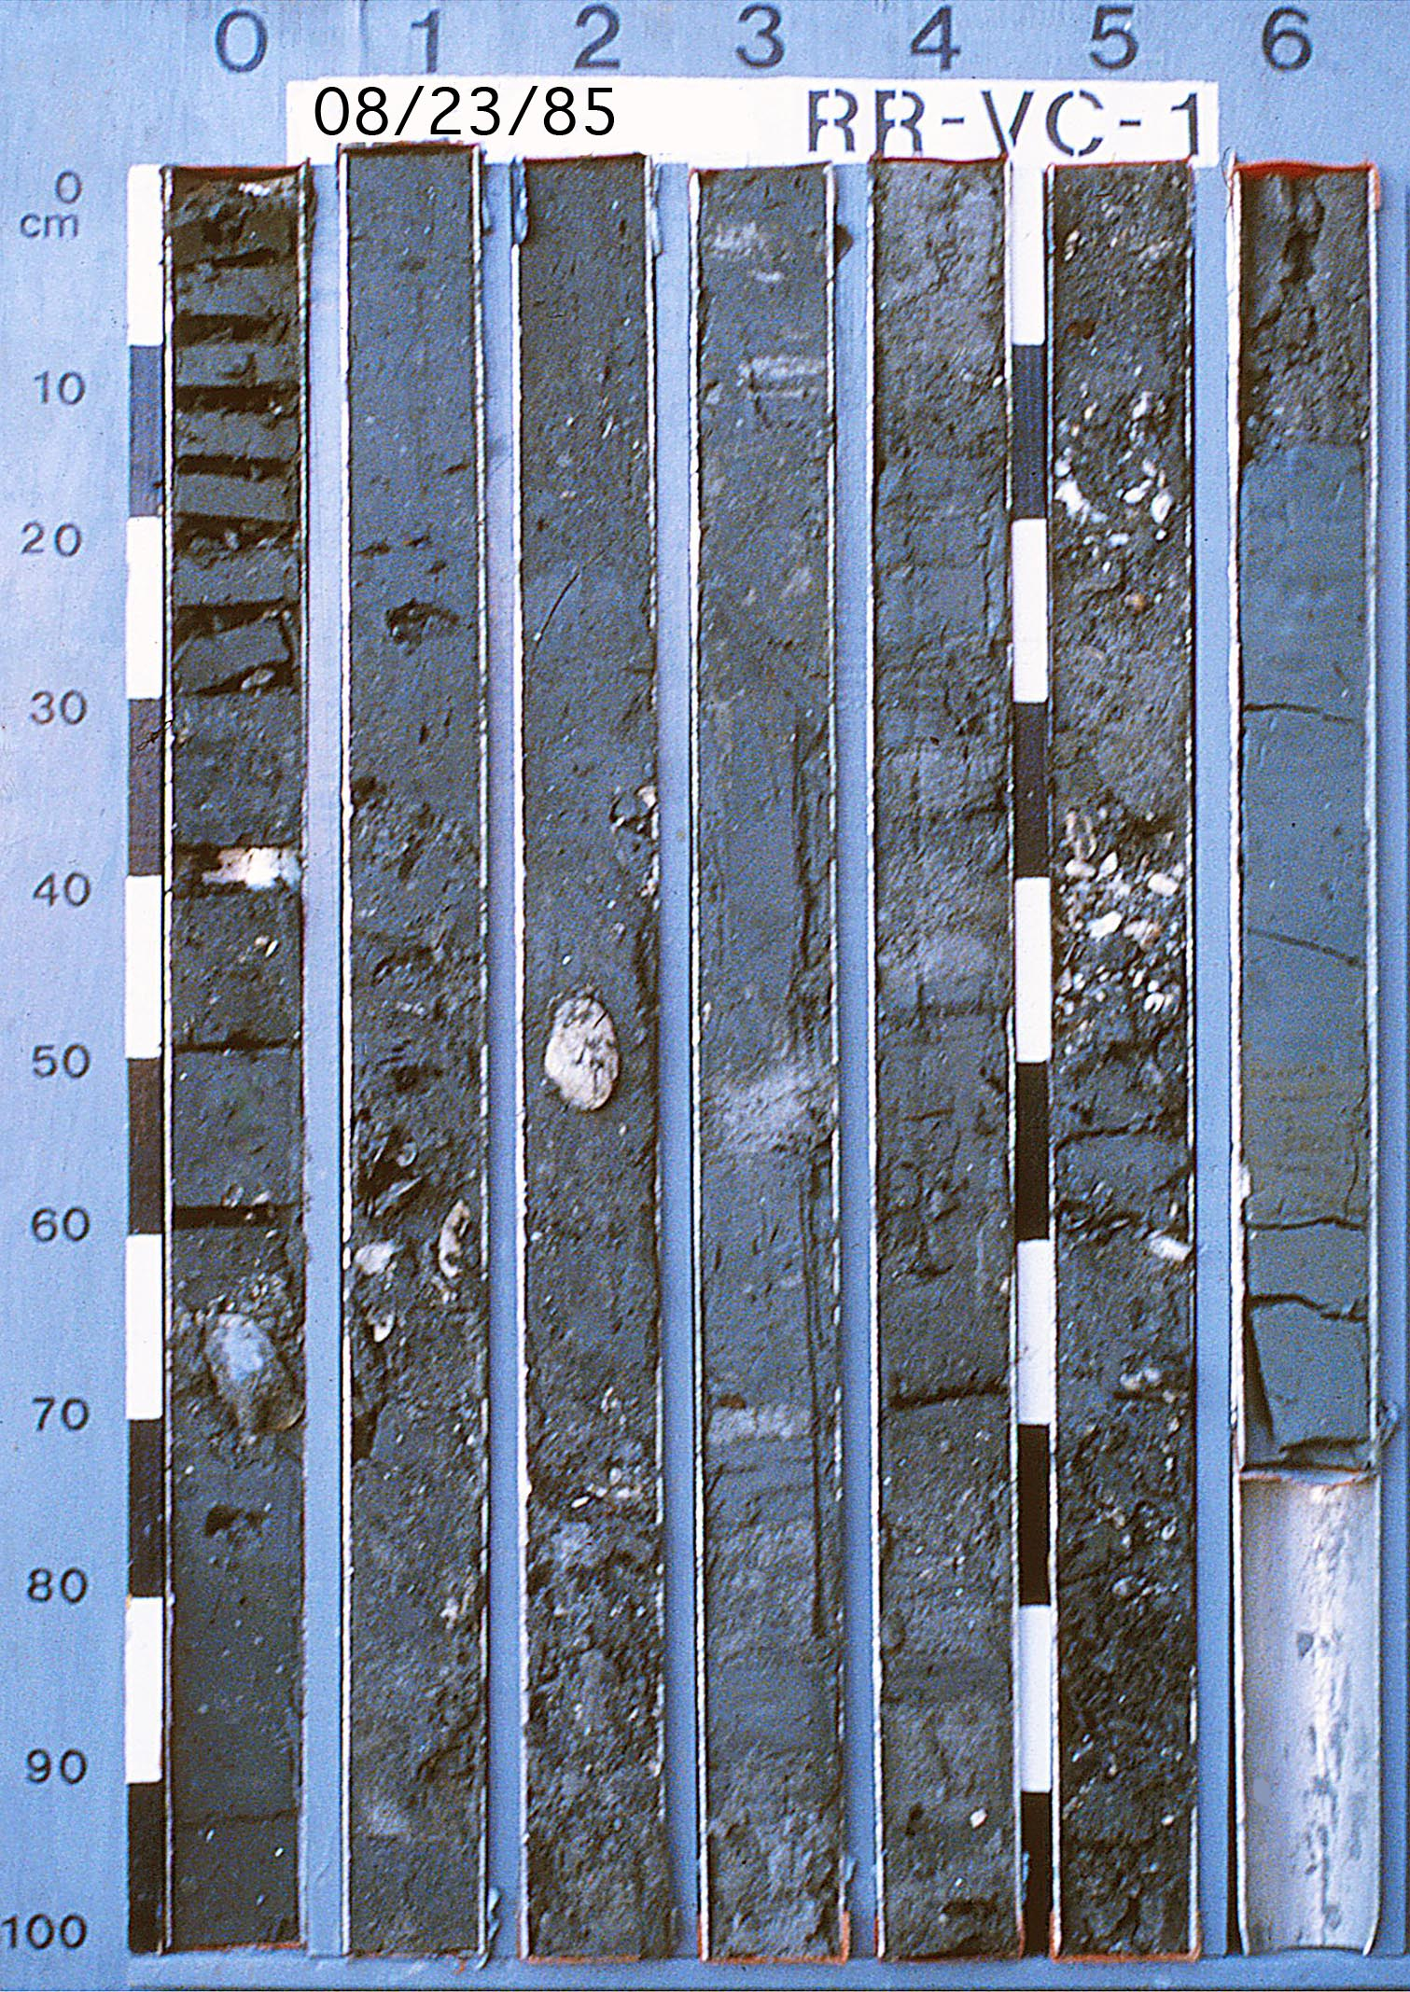
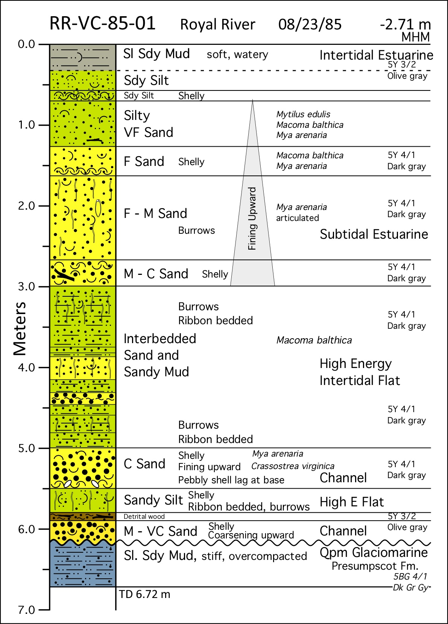

Slide 23
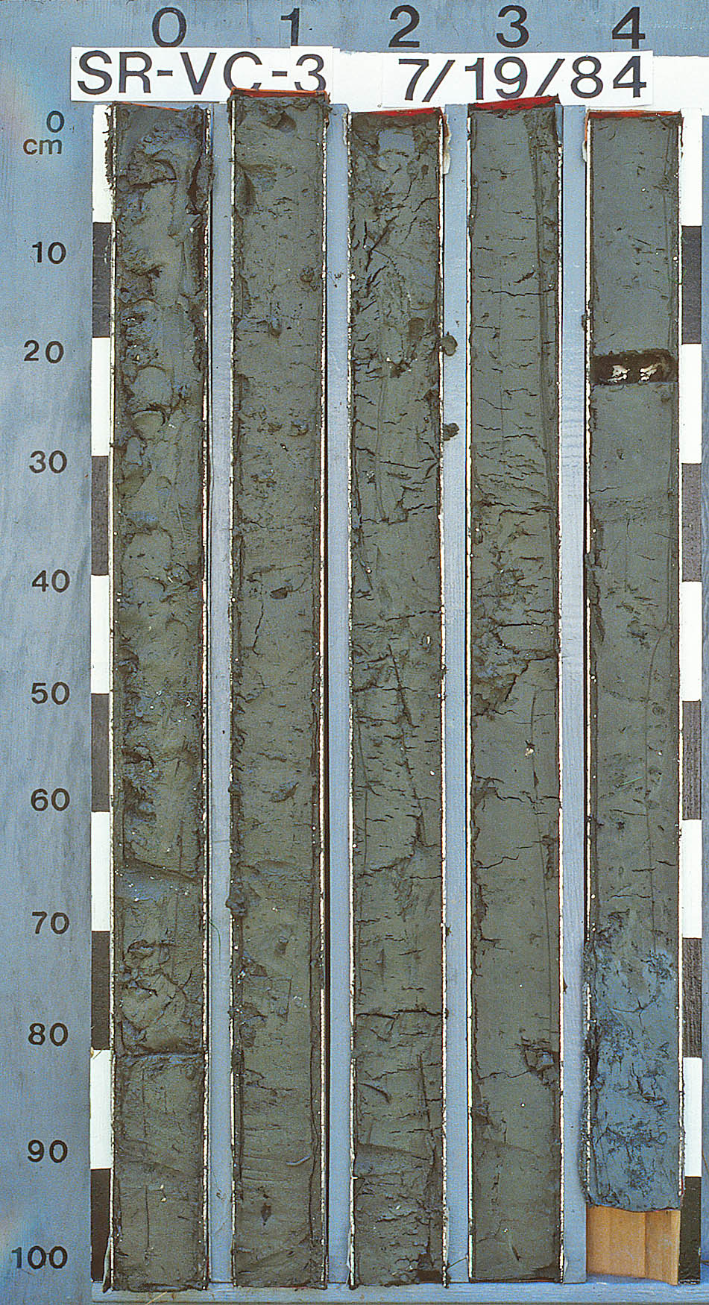
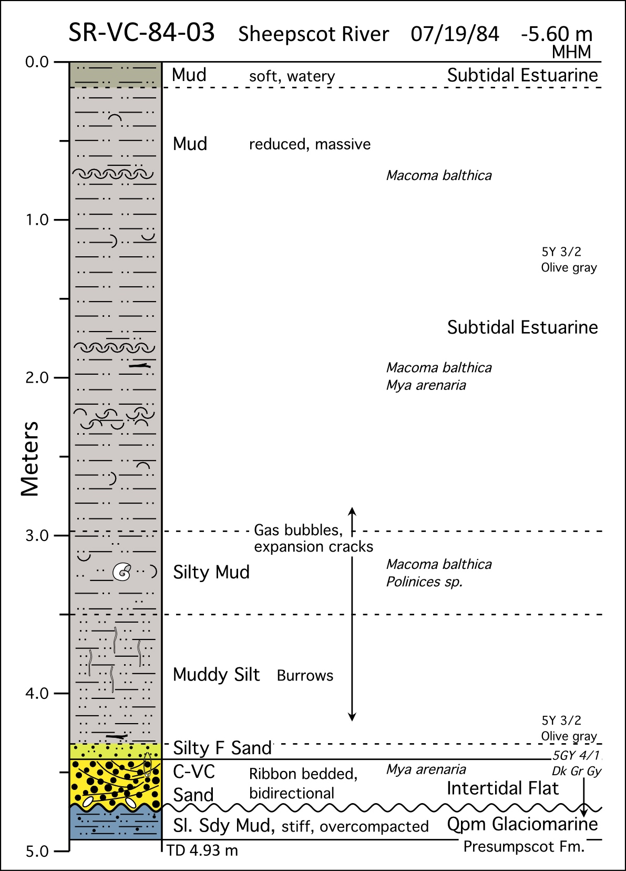

Slide 24
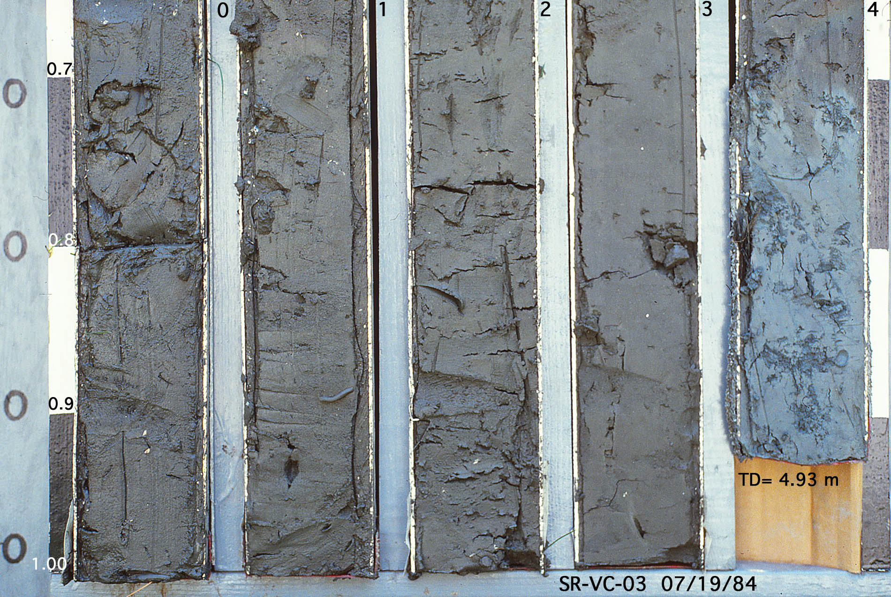
SR-VC-84-03 Sheepscot River Estuary
Burrow at unconformity
U_{b}

Slide 25
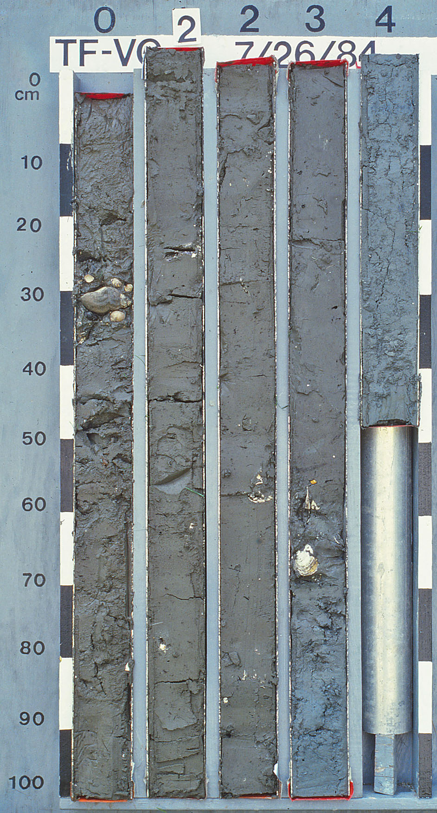
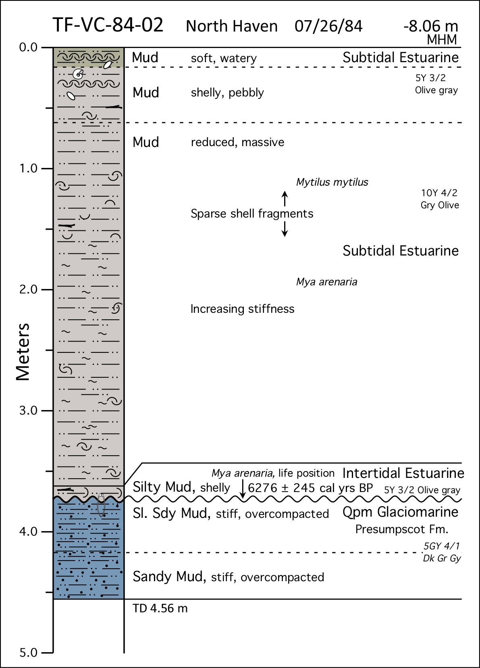

Slide 26
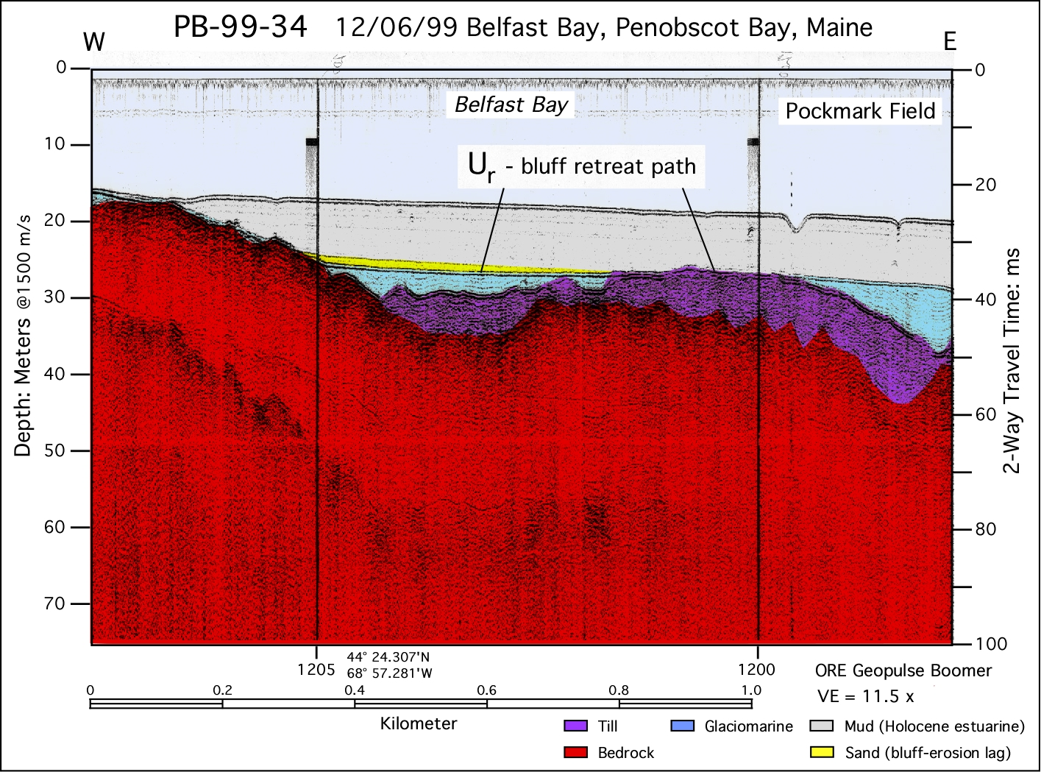

Slide 27
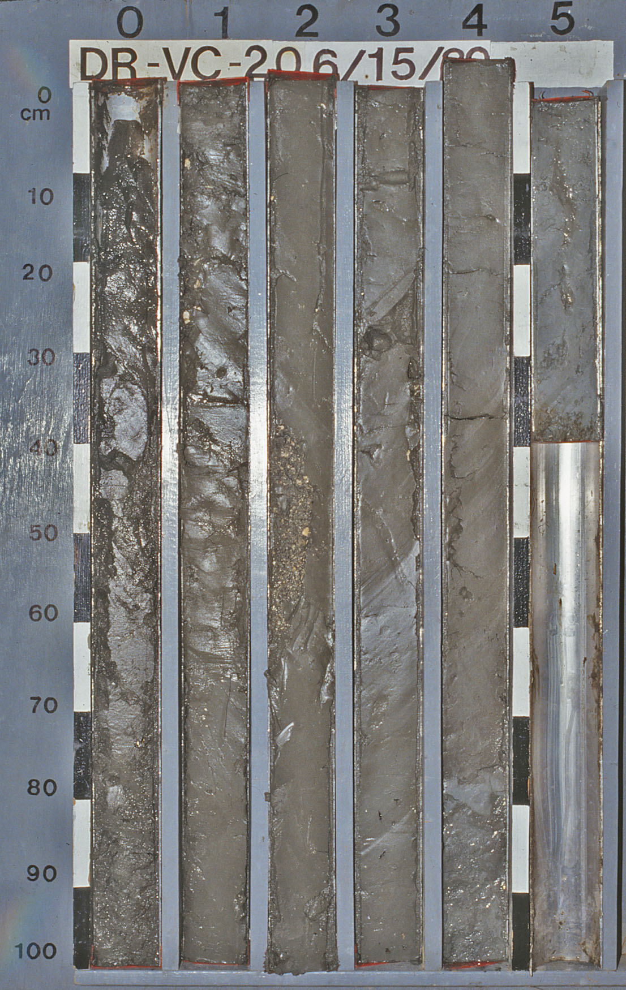
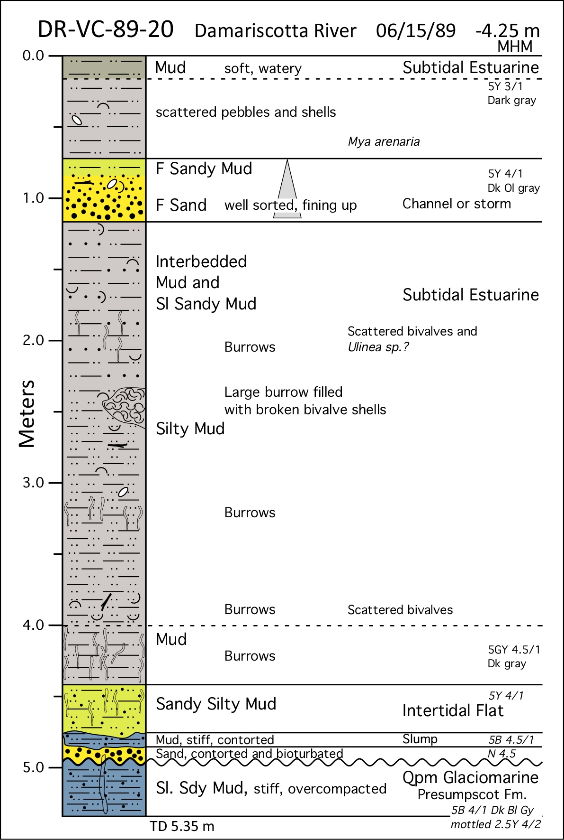

Slide 28
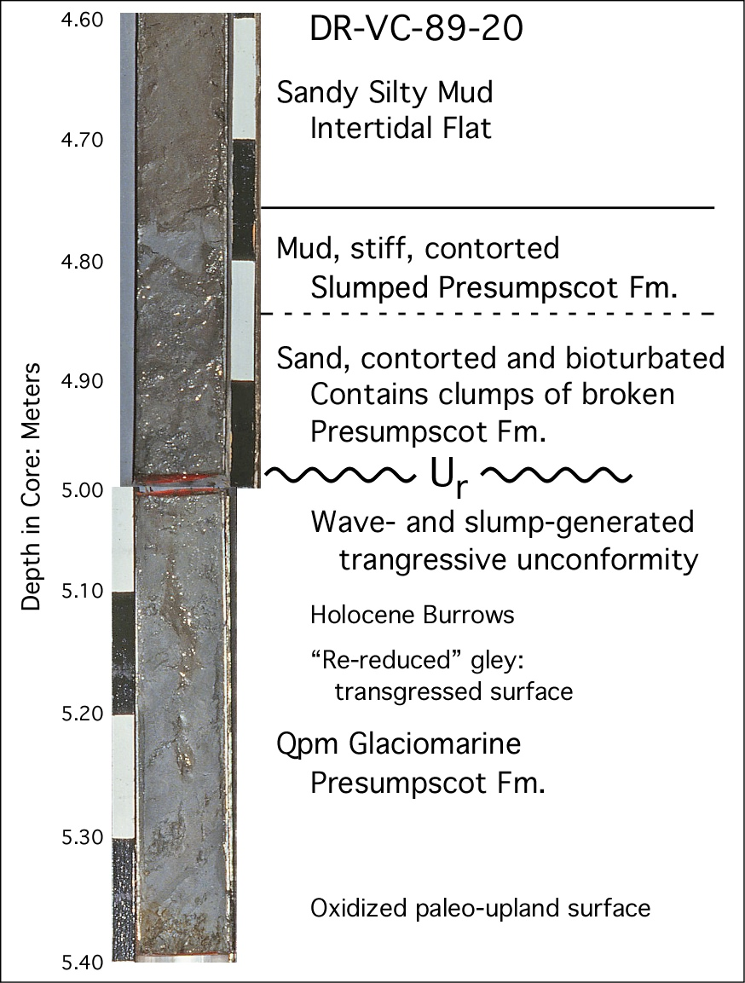

Slide 29
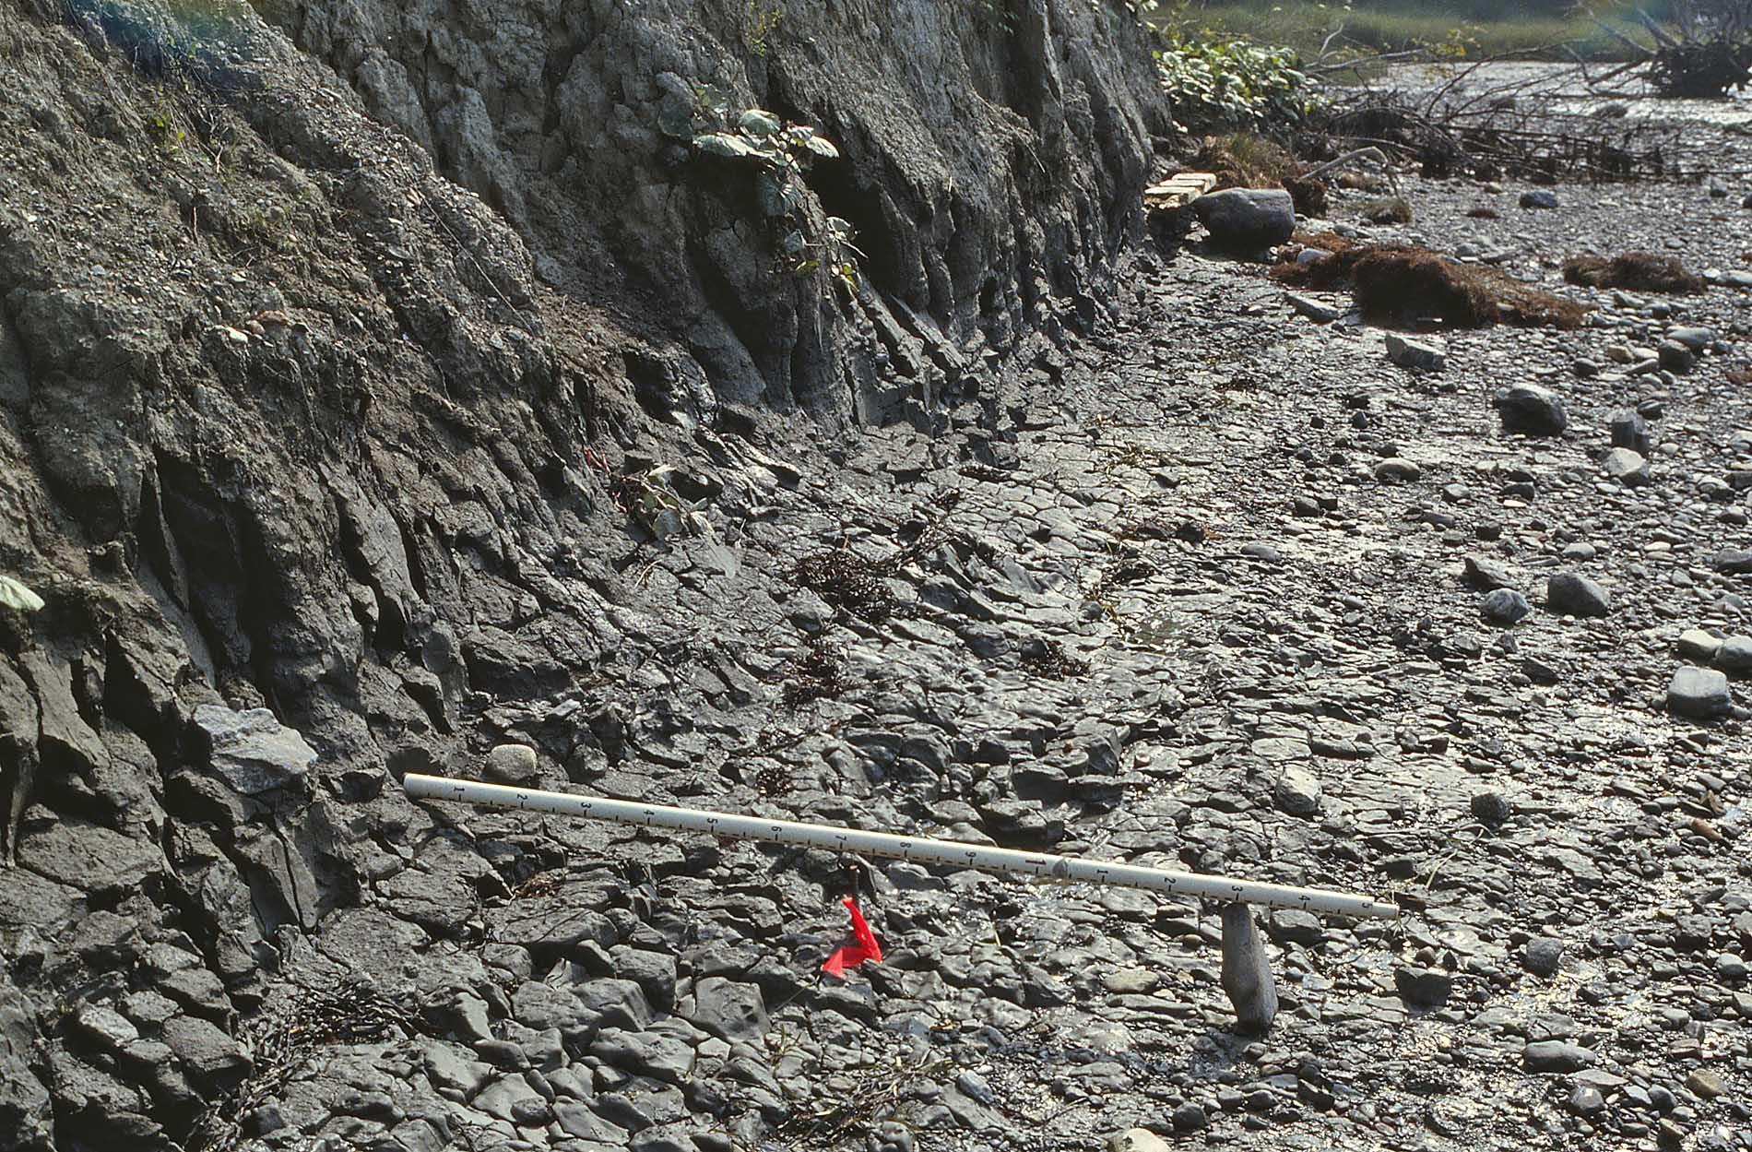
Scarp and blocky eroded fragments, Rockland 1973 slump toe
Rockland 1973 slump toe, 08/03/88
D.F. Belknap

Slide 30
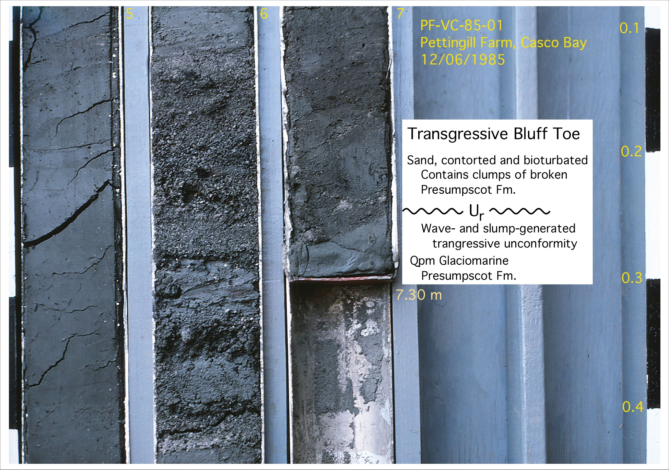

Slide 31
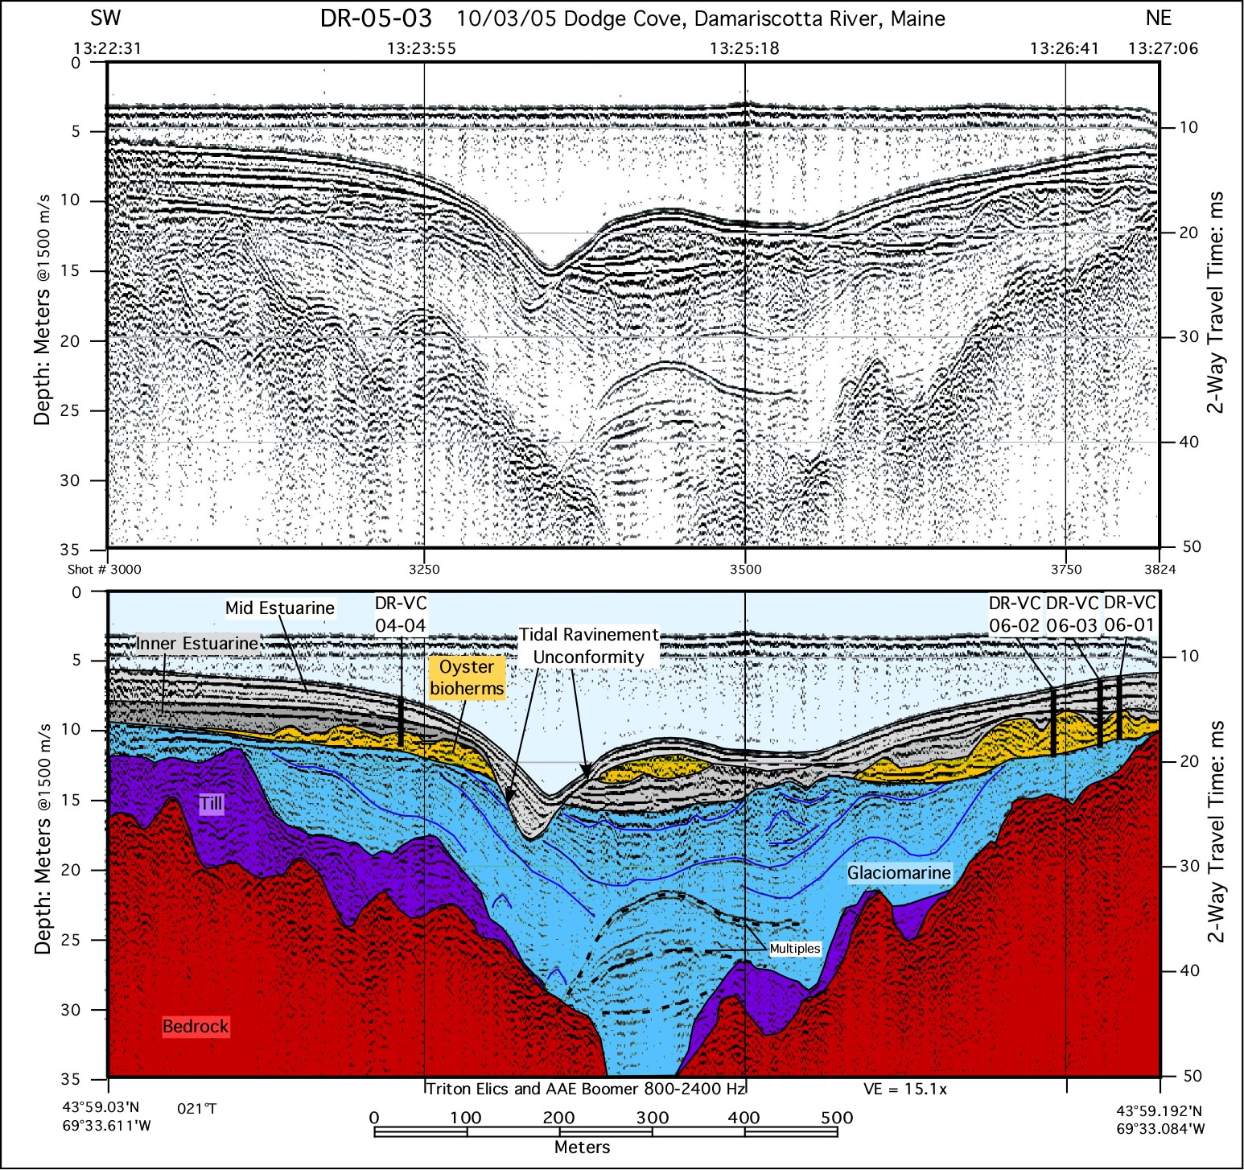

Slide 32
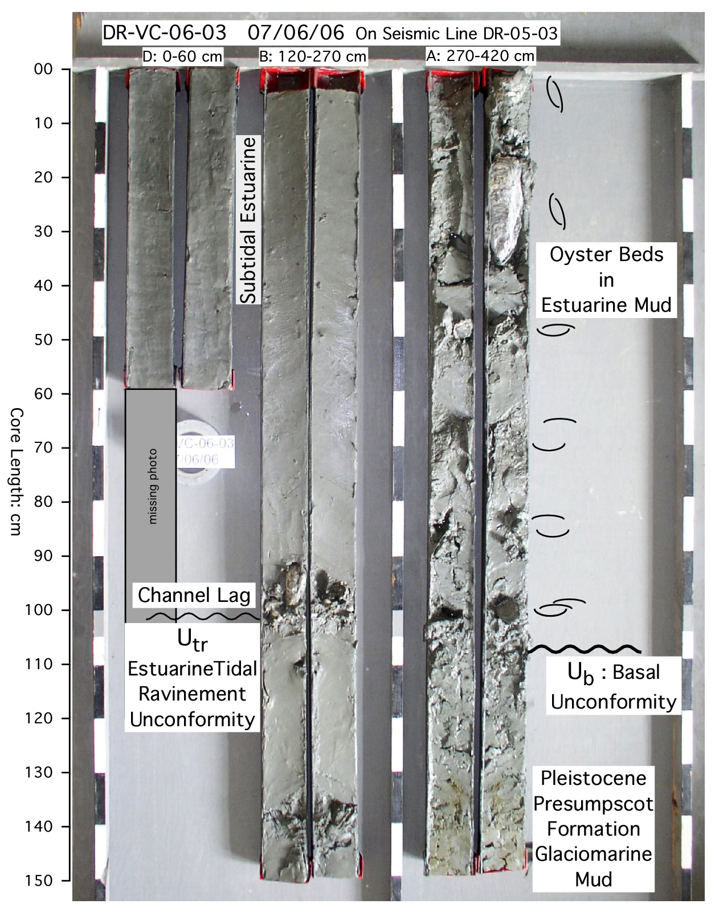
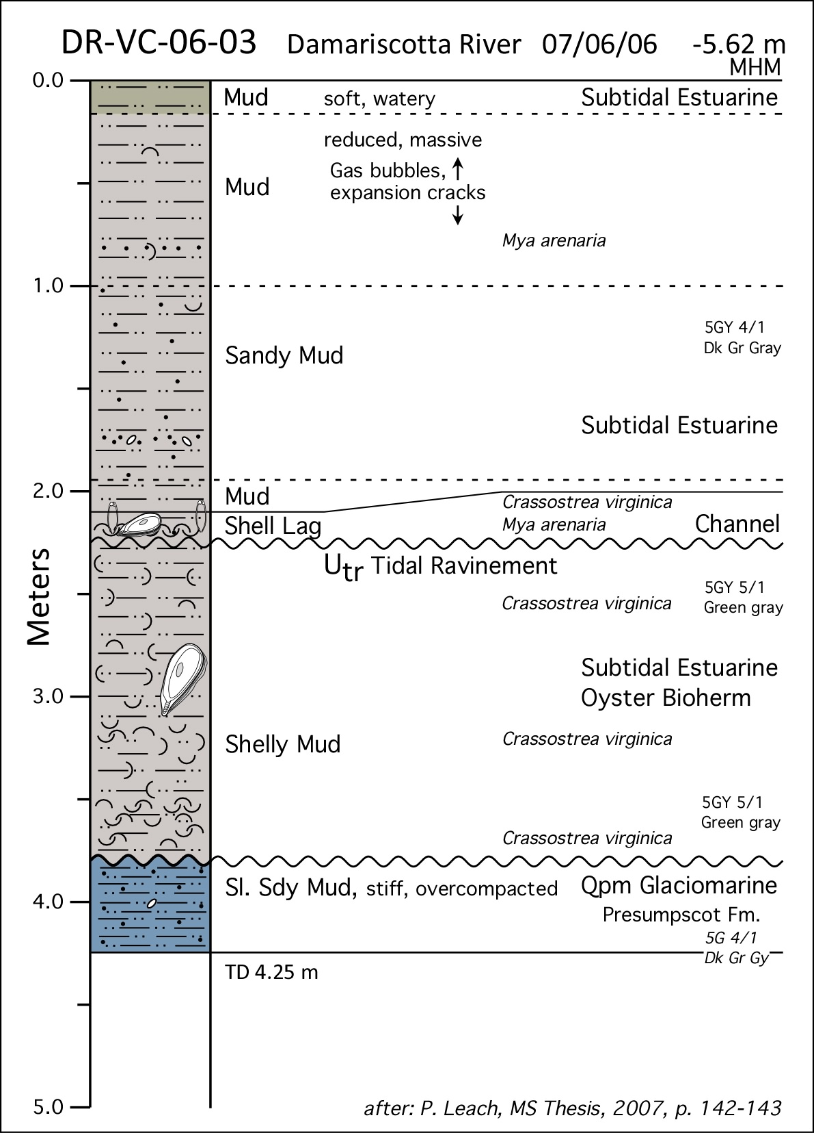

Slide 34
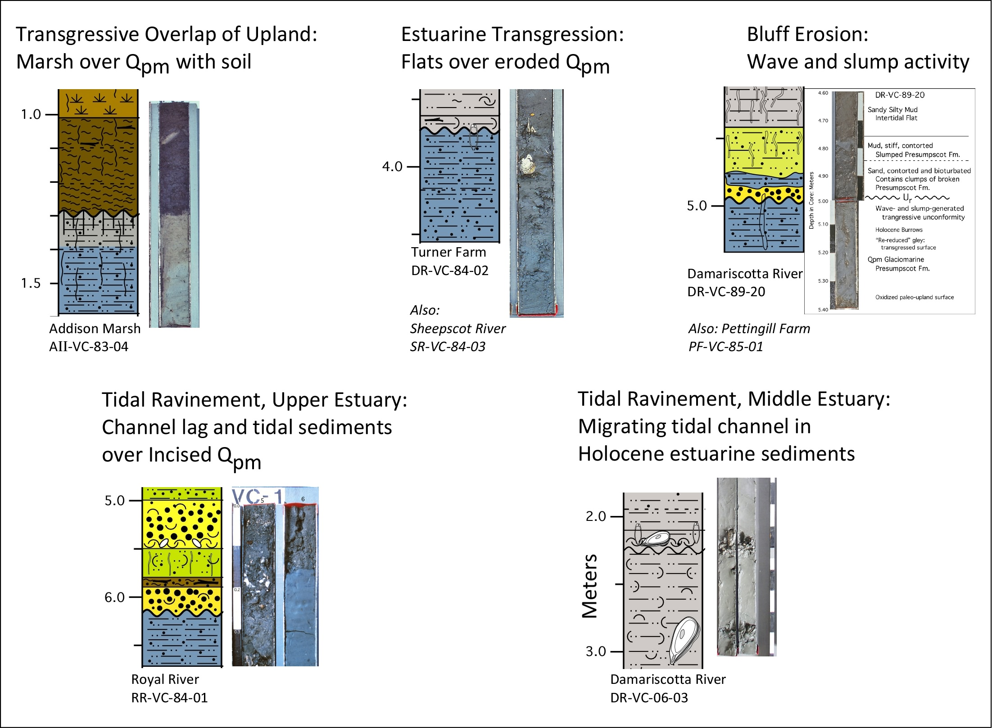

Slide 35
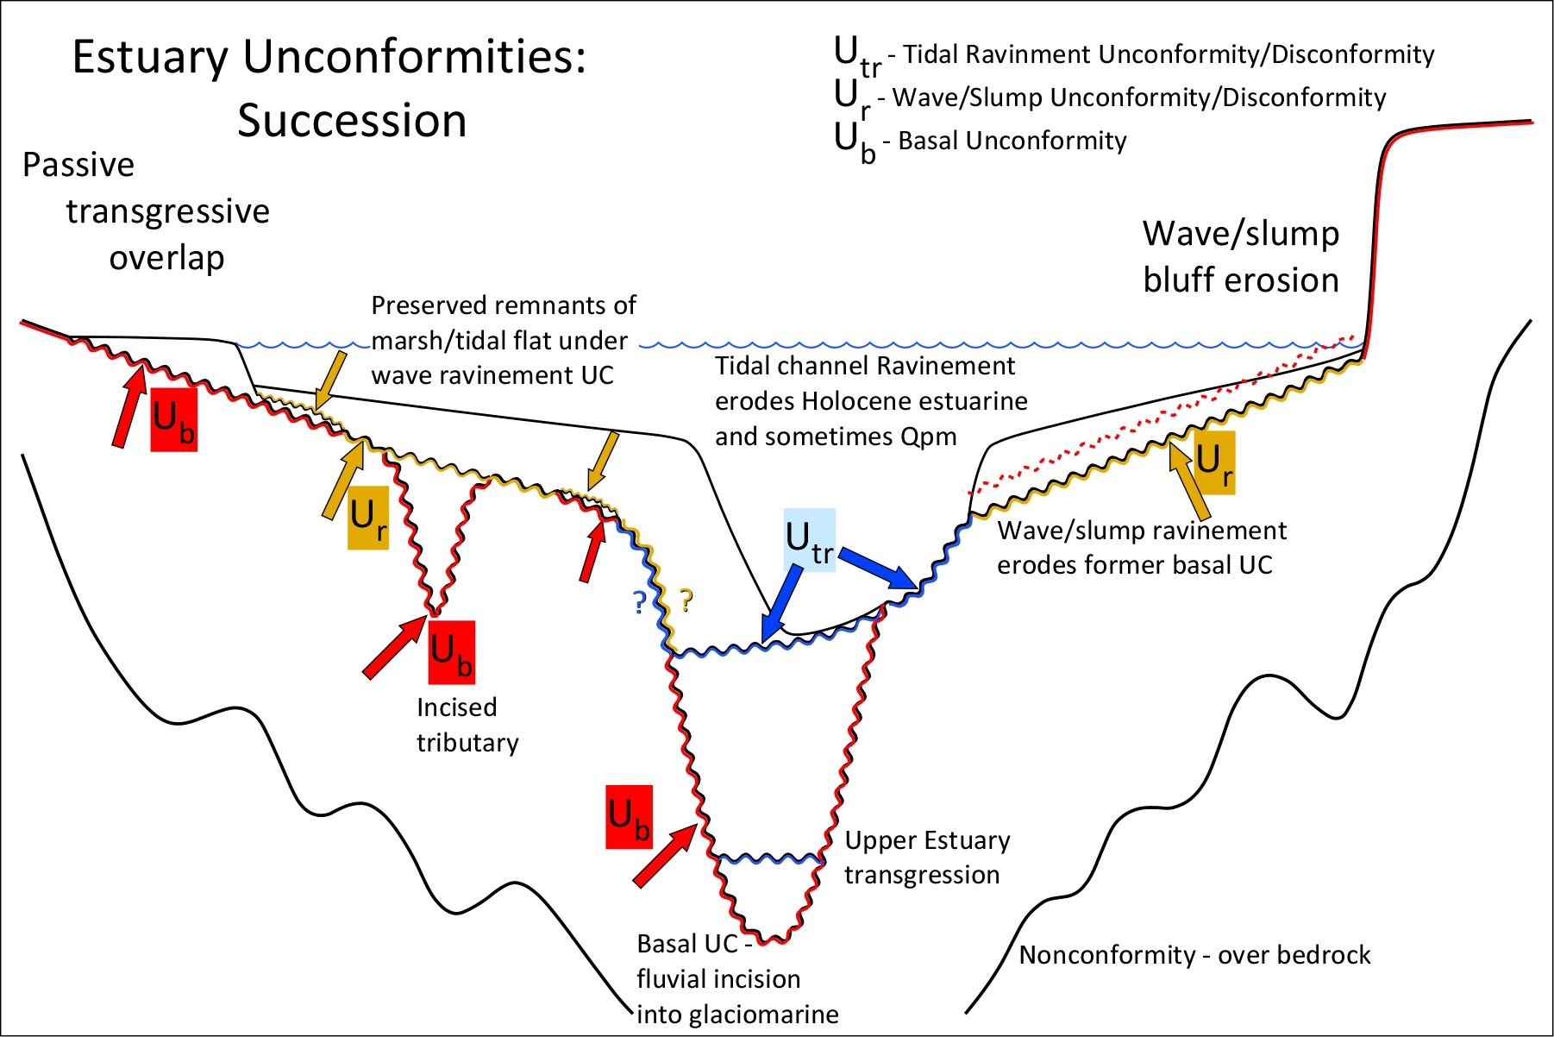

Slide 36
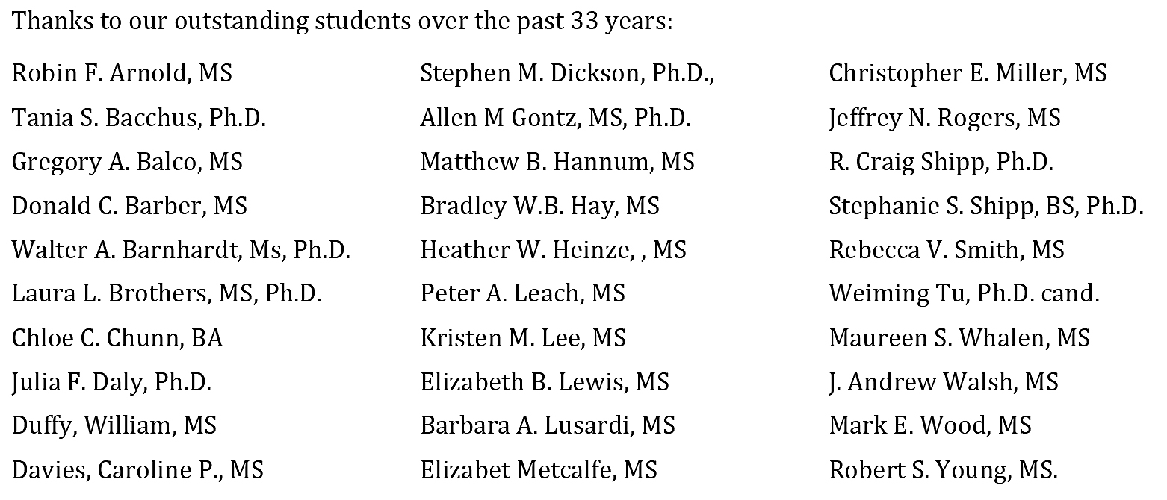



Acknowledgments

