Slide 1
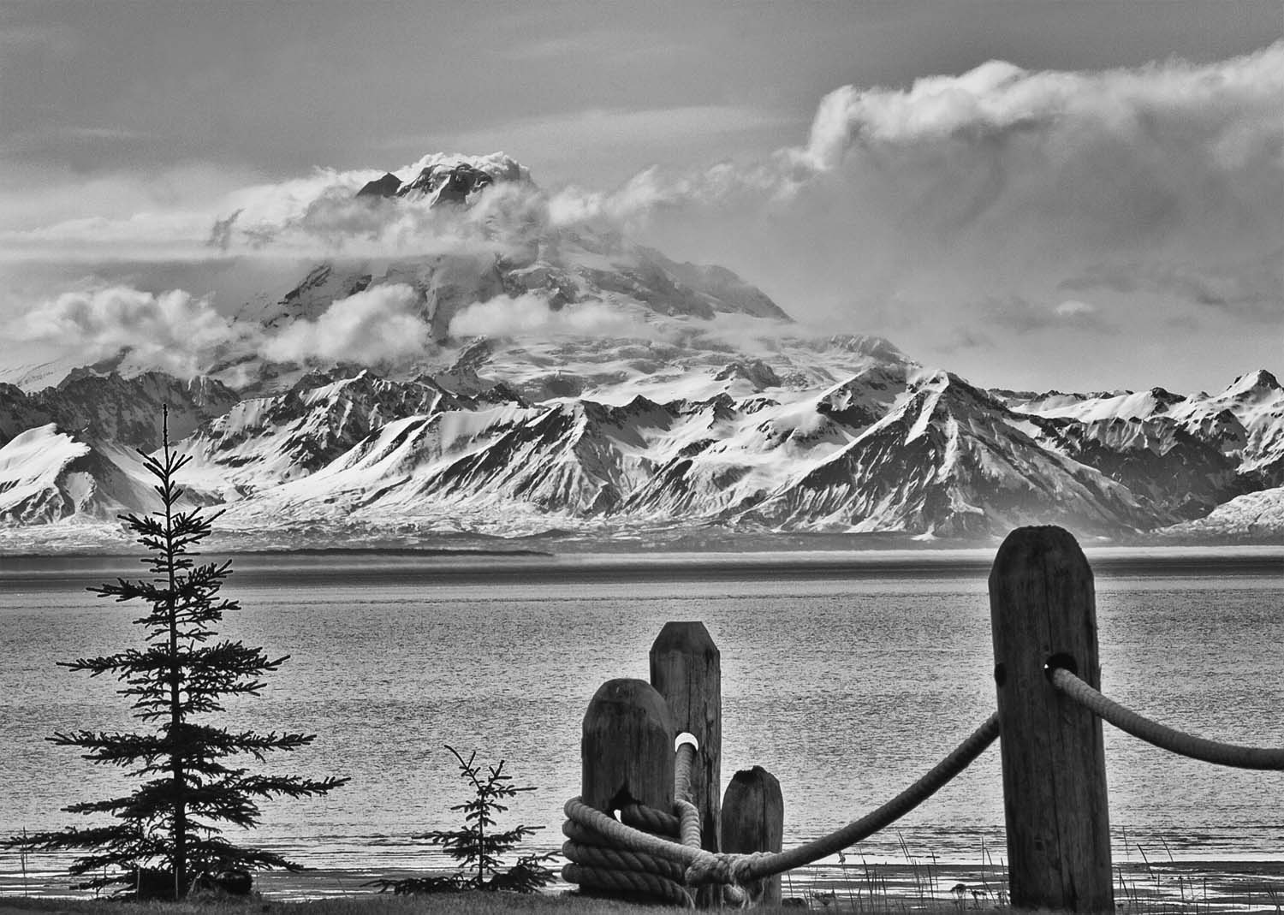


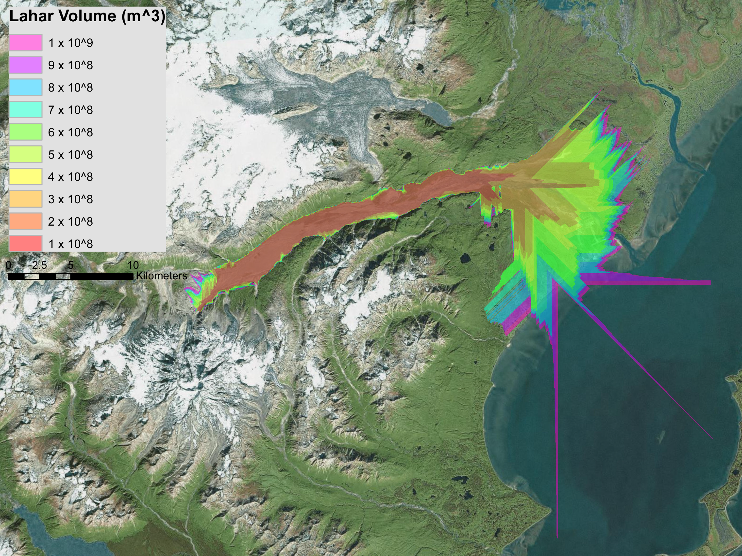
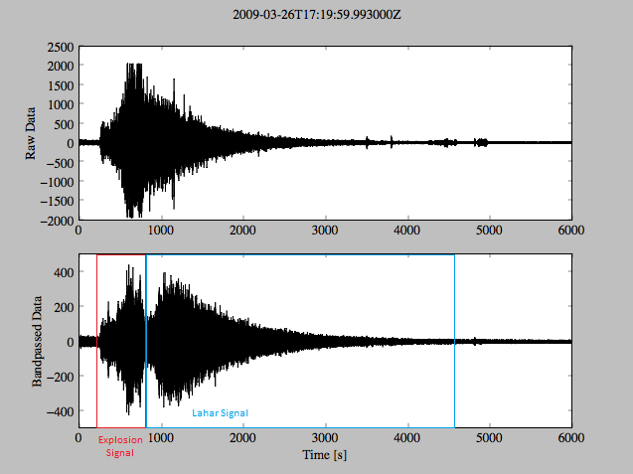
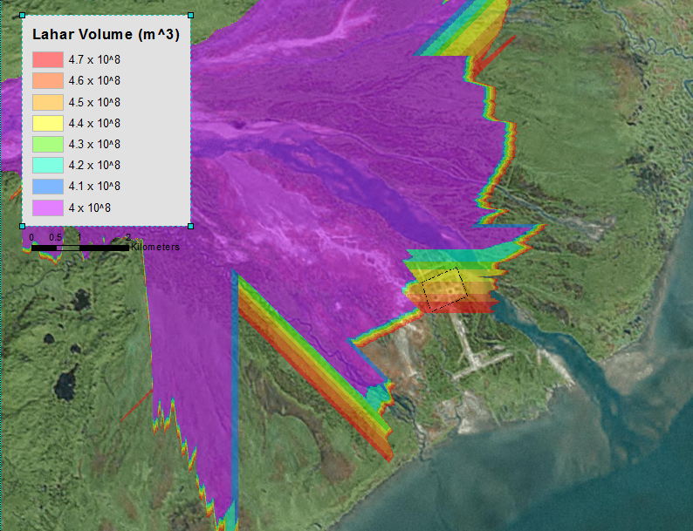
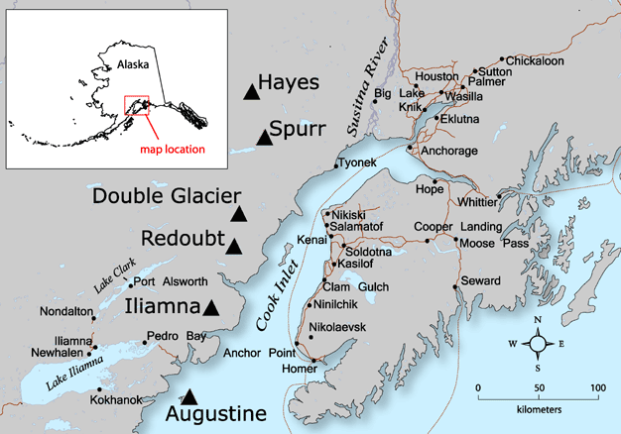
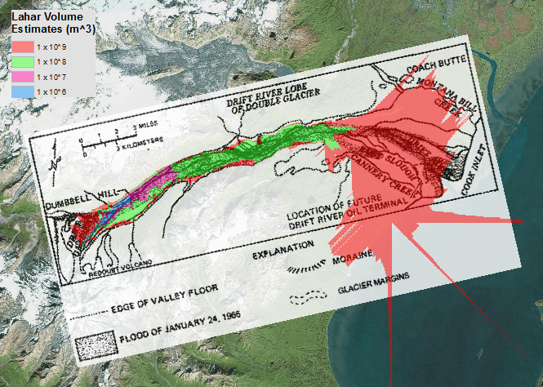
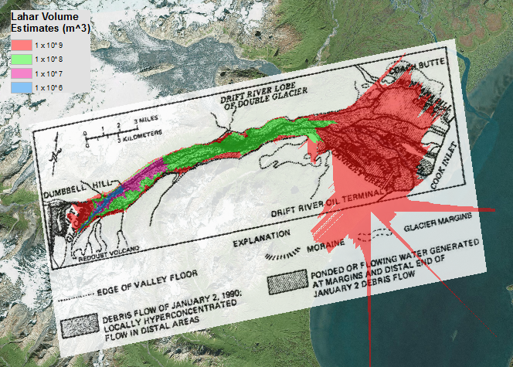
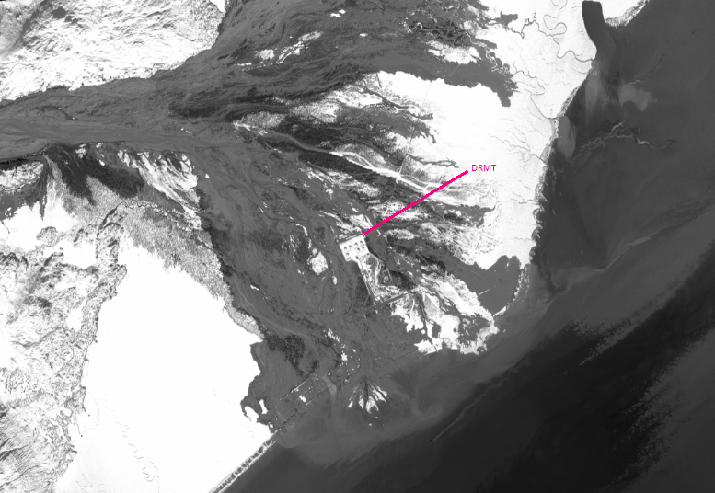
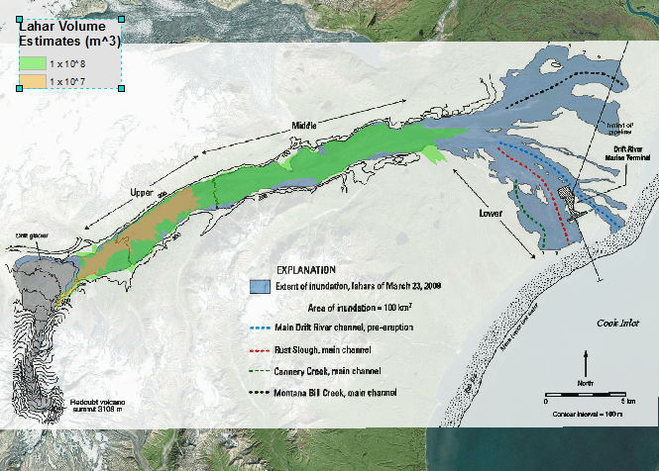
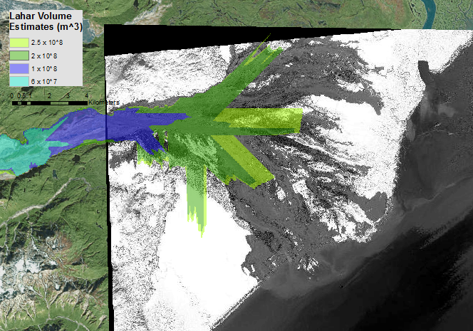
Modeling Lahar Inundation With the Aid of Seismic Data at Redoubt Volcano, Alaska
Alex Iezzi, Douglas Thompson, and Beverly Chomiak
Connecticut College Department of Physics, Astrophysics, and Geophysics, New London, CT 06320
Abstract
Redoubt Volcano is a 3108 m tall stratocone located in Cook Inlet, Alaska that explosively erupts roughly every 20 years. The five eruptions since 1900 all share the common characteristic of being accompanied by multiple large to very large lahars, as well as many that are smaller in magnitude. About 35 km from the crater of Redoubt Volcano lies the Drift River Marine Terminal, that if inundated, has the potential to cause a spill comparable to the Exxon Valdez spill of 1989. Lahars are non-Newtonian flows that evolve as they move downstream as a result of their bulking and debulking processes. The aim of this project is to model the three largest lahars from both the most recent 2009 and 1989-90 eruptions of Redoubt to predict their area of inundation for future eruptions.
Summary of Inundation
Lahar Date | Best Estimate for Volume | Comparison with Laharz Simulations and Volume Estimate
January 24, 1966 | Mapped by Dorava and Meyer (1994) | Laharz estimates low 10⁸ m³ due to only slight flows outside the Drift River channel
December 21, 1989 | Mapped by Dorava and Meyer (1994) | Laharz estimates low 10⁸ m³ due to only slight flows outside the Drift River channel
January 2, 1990 | Mapped by Dorava and Meyer (1994); Volume estimates of 10⁷-10⁸ m³ | Volume estimates appear to be consistent at higher 10⁸ m³ simulations
February 15, 1990 | Mapped by Dorava and Meyer (1994) | Laharz estimates low 10⁸ m³ due to only slight flows outside the Drift River channel
March 23, 2009 | Mapped by Waythomas et al (2013); Volume estimates of 10⁷-10⁸ m³ | Volume estimates appear to be consistent at higher 10⁸ m³ simulations
March 26, 2009 | Mapped by Waythomas et al (2013) | Laharz estimates low to mid 10⁸ m³ due to flows outside the Drift River channel and reaching the DRMT
April 4, 2009 | Satellite Image; Volume estimates of 6-25 x 10⁷ m³ | Volume estimates appear a little low compared to simulations
Explosion and lahar signal seen seismically on March 26, 2009
Lahar Inundation Modeling
Using GIS and the lahar simulation program Laharz_py, inundation models were created and cross-correlated with the known mapped area of inundation done by USGS post-eruption for the three largest 2009 lahars as well as those of the 1989-90 eruption. The semi-empirical program Laharz_py is based upon 26 lahars by Iverson (1998):
A = 0.05 V ^{2/3}
B = 200 V ^{2/3}
Simulation To Determine the Volume Required to Reach DRMT
Simulation Comparisons With Mapped Inundation Areas
Redoubt Volcano Location
January 24, 1966
January 2, 1990
Simulation with Proposed Increase in Berm Height to 22 Feet
Conclusions
Simulations confirm the larger order of magnitude approximations by Waythomas et al (2013) and Dorava and Meyer (1994)
Laharz does not do a good job at accurately modeling the more channelized nature of flows that are characteristic of the Drift River delta where topography is less steep
Adding a berm 22 feet high as the DRMT stated they were going to do after the 2009 eruption does not appear to have an effect on the flow patterns of the lahar simulations
These modeling techniques can be used for future eruptions of Redoubt in order to aid in the prediction of the lahar inundation.
March 23, 2009
April 4, 2009
References
· Iverson, R. M., Schilling, S. P., & Vallance, J. W. (1998). Objective delineation of lahar-inundation hazard zones. Geological Society of America Bulletin, 110(8), 972-984.
· Schilling, S.P. (2014). Laharz_py—GIS tools for automated mapping of lahar inundation hazard zones: U.S. Geological Survey Open-File Report 2014-1073, 78 p.,
·Waythomas, C. F., Pierson, T. C., Major, J. J., & Scott, W. E. (2013). Voluminous ice-rich and water-rich lahars generated during the 2009 eruption of Redoubt Volcano, Alaska. Journal of Volcanology and Geothermal Research, 259, 389-413.
Acknowledgements
Alaska Volcano Observatory Staff and Resources
USGS, Kleinman Grant, and CELS for funding
Photo Credit: Laurie Johnson
Satellite Imagery of the April 4, 2009 Eruption of Redoubt Volcano

