Slide 1
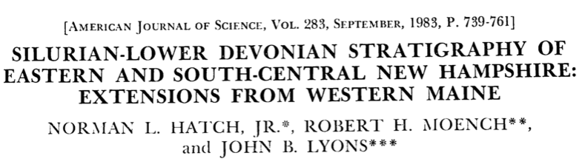
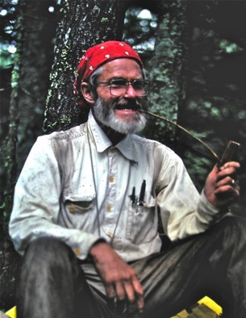
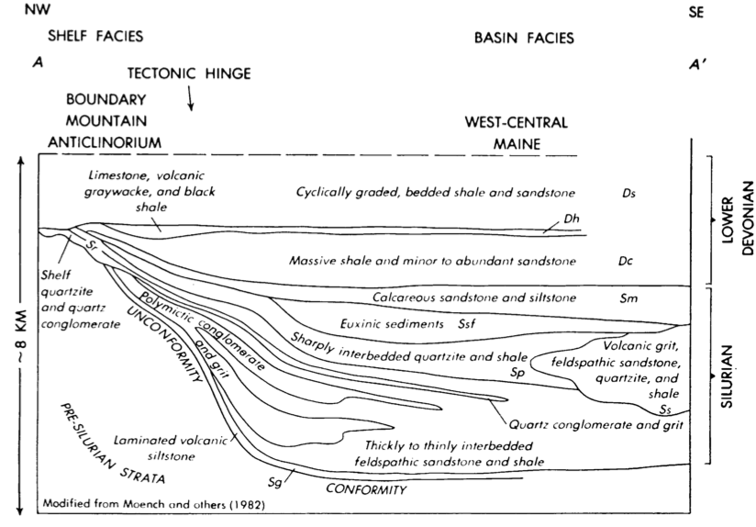


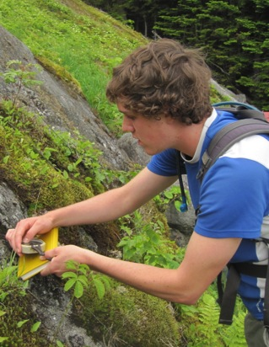
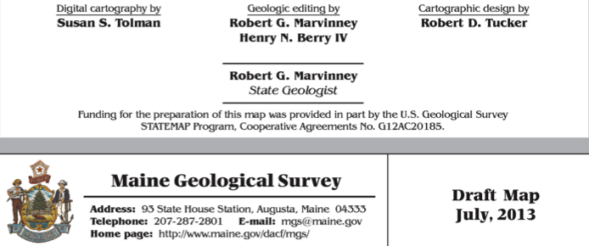
SILURIAN STRATIGRAPHY REVISITED: EXTENSIONS FROM NEW HAMPSHIRE!
J. Dykstra Eusden
Assisted by Sula Watermulder, Saebs Choe,
and Riley Eusden

Slide 2
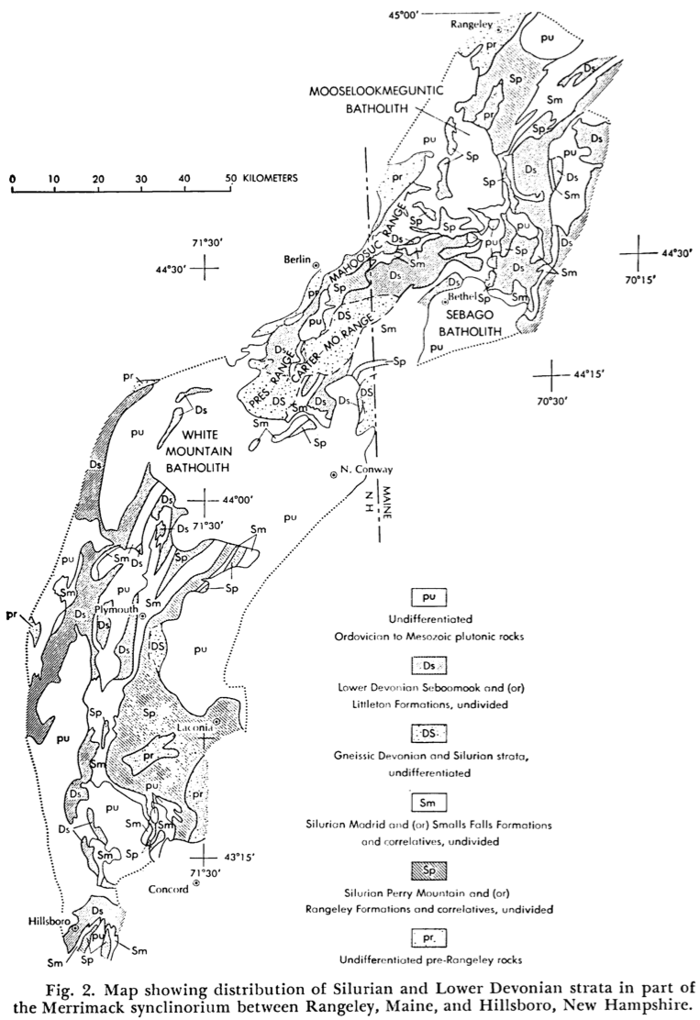
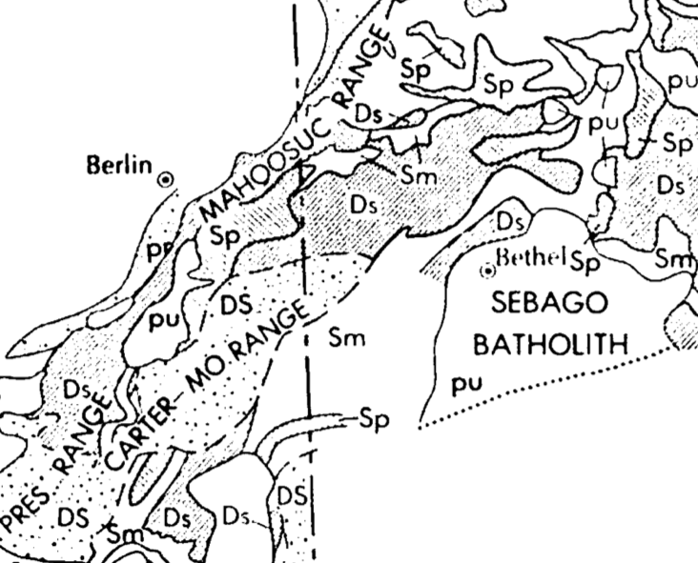
Hatch, Moench, and Lyons 1983
Region in red box is mostly Ds/Dl and Sm.
Devonian Seboomook and Littleton Fms and Silurian Madrid Fm
No Rangeley or Perry Mtn Formations

Slide 3
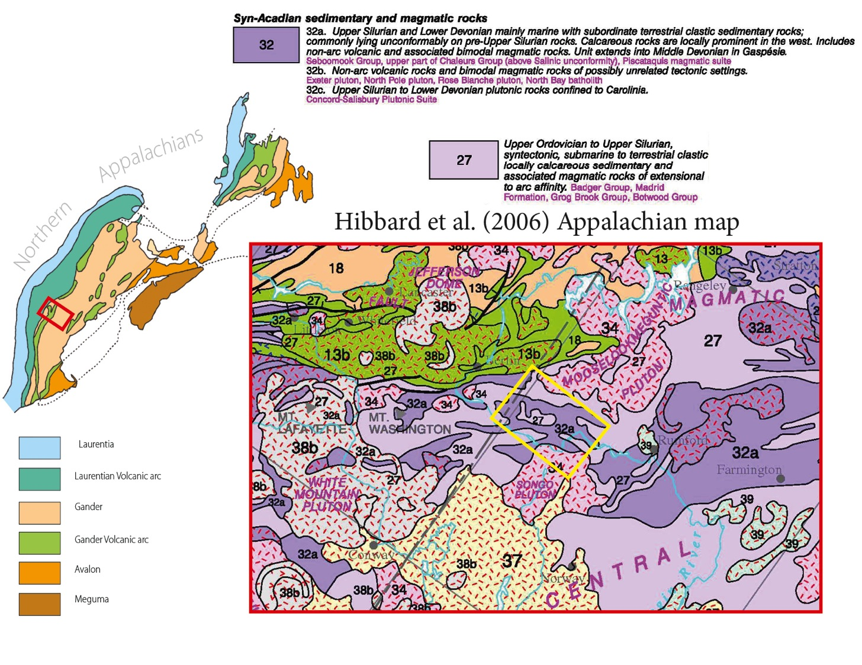

Slide 4
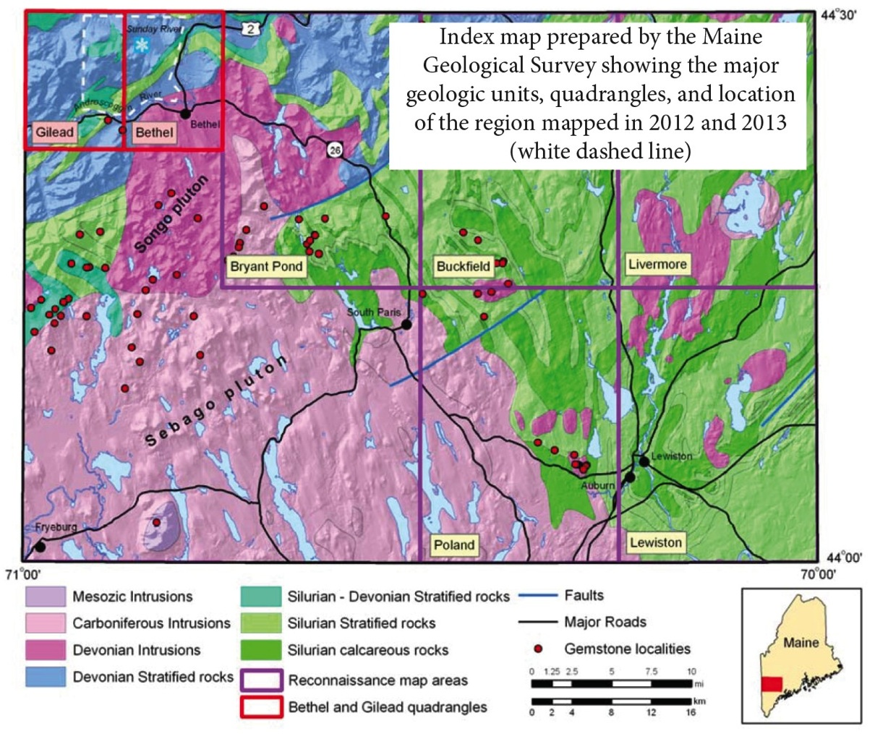

Slide 5
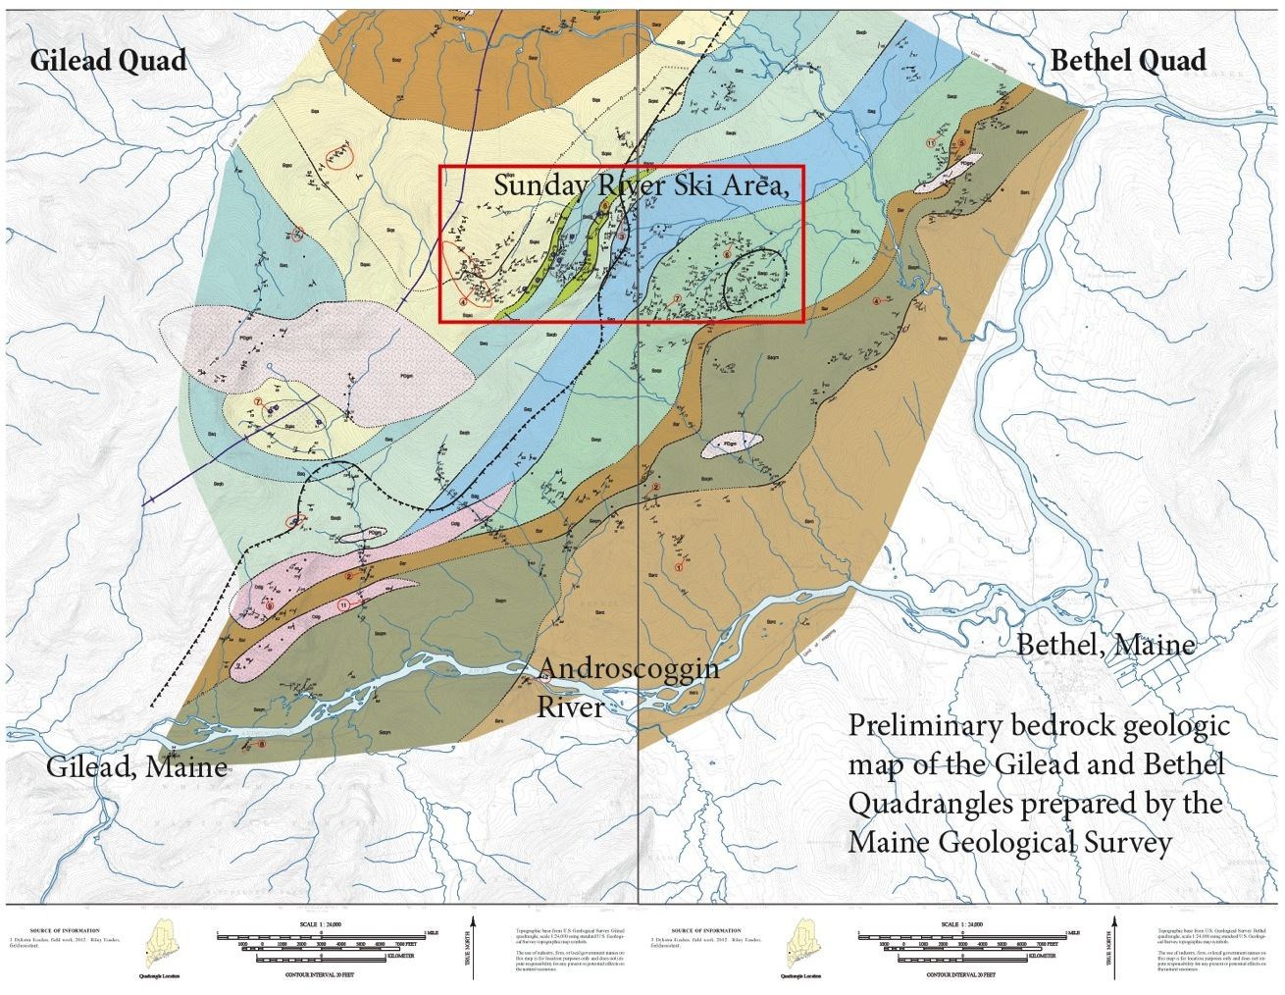

Slide 6
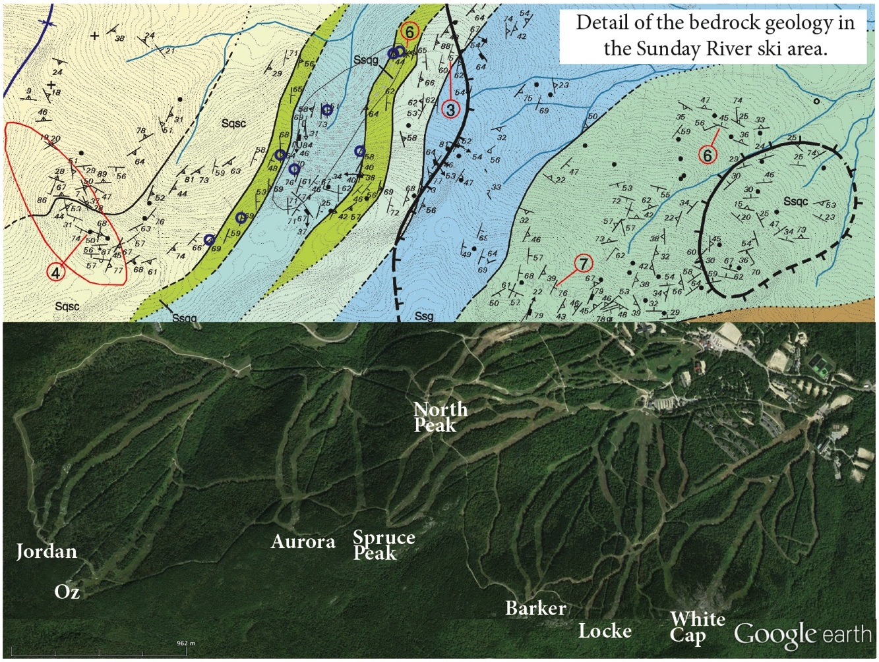

Slide 7
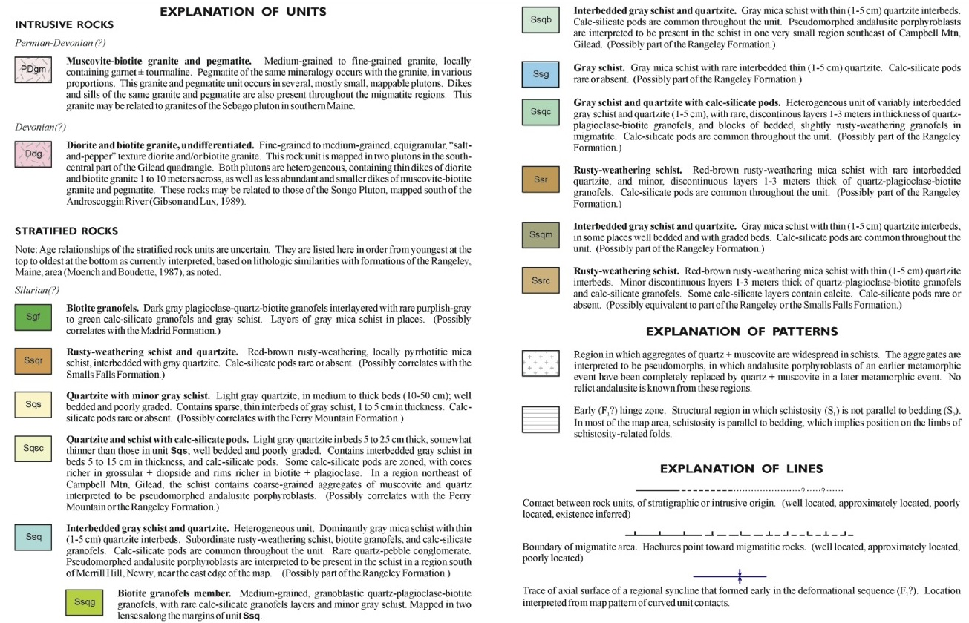

Slide 8
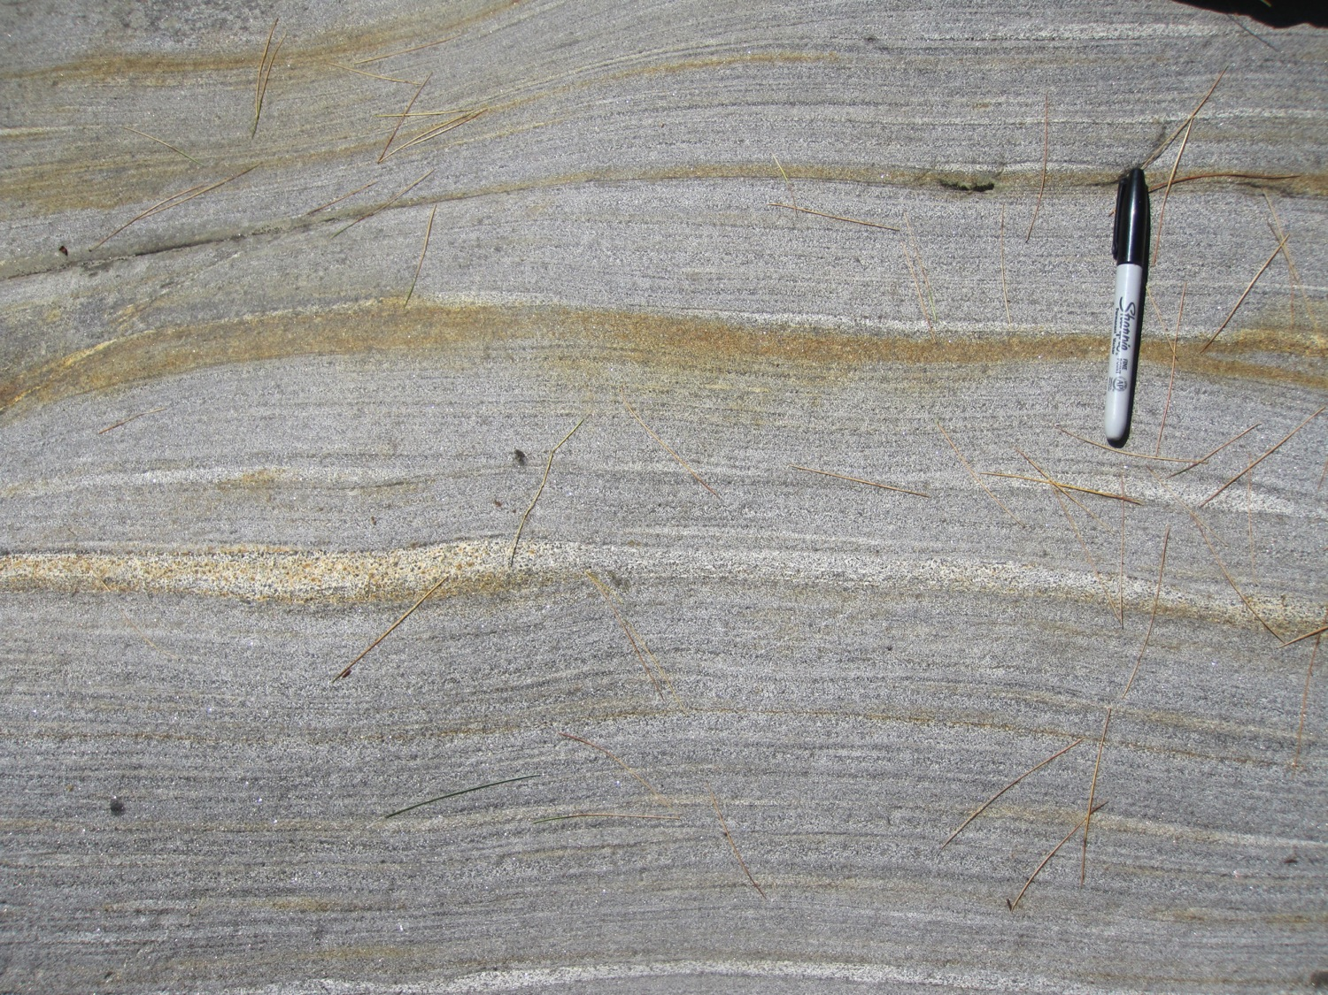
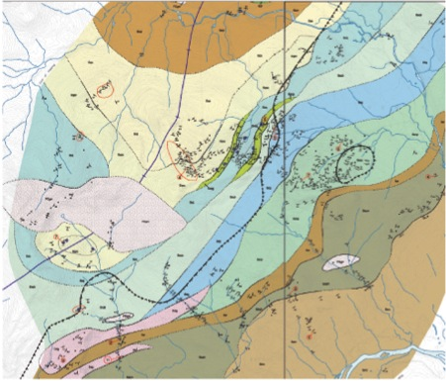
Biotite granofels – Silurian Madrid Fm?

Slide 9
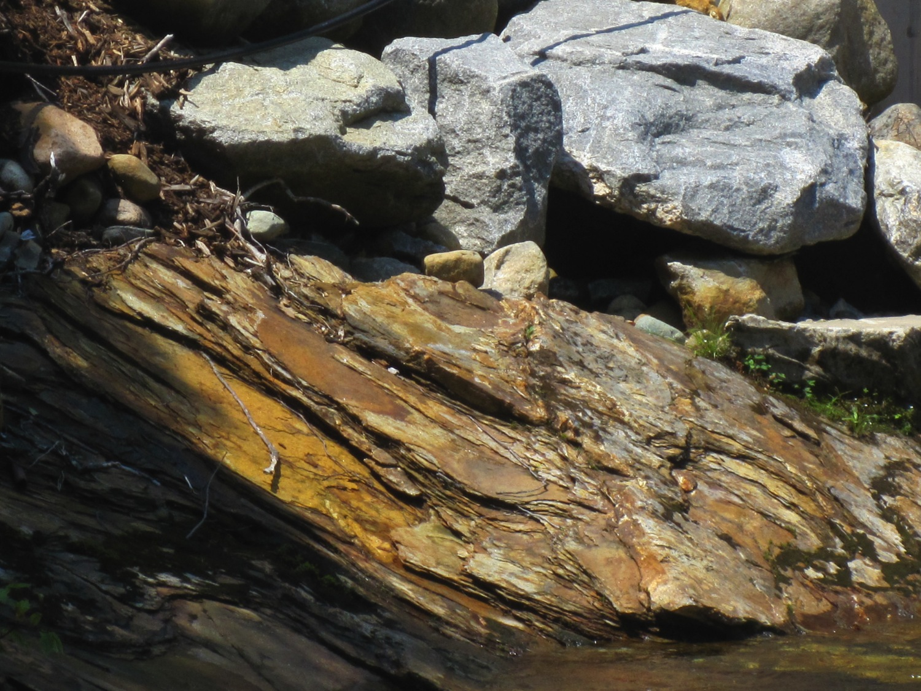
Rusty schist & quartzite– Silurian Smalls Falls Fm?

Slide 10
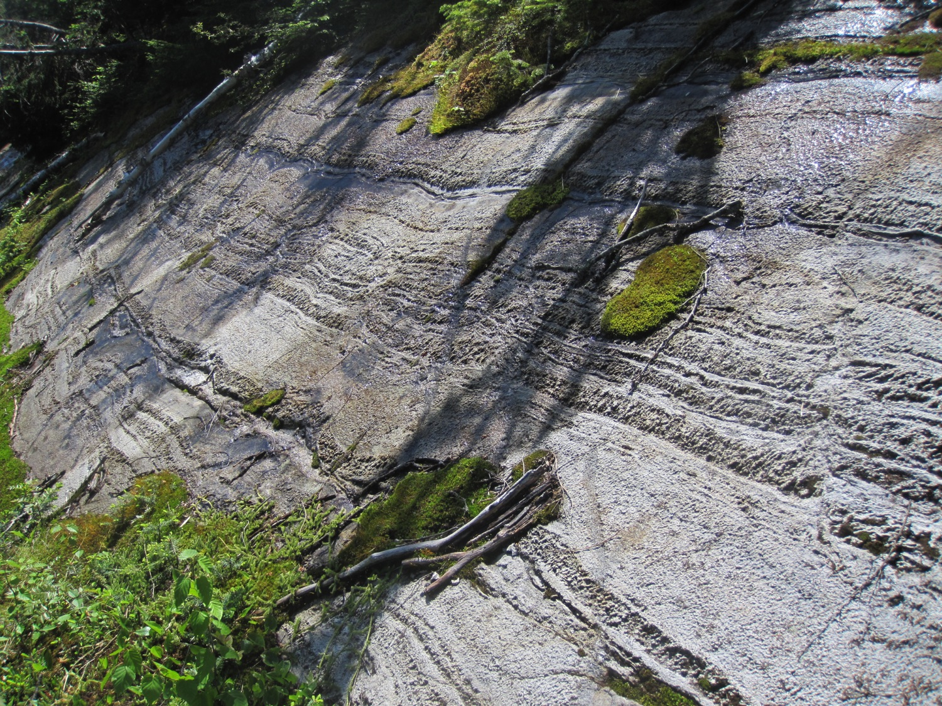
Gray schist & clean quartzite– Silurian Perry Mtn Fm?

Slide 11
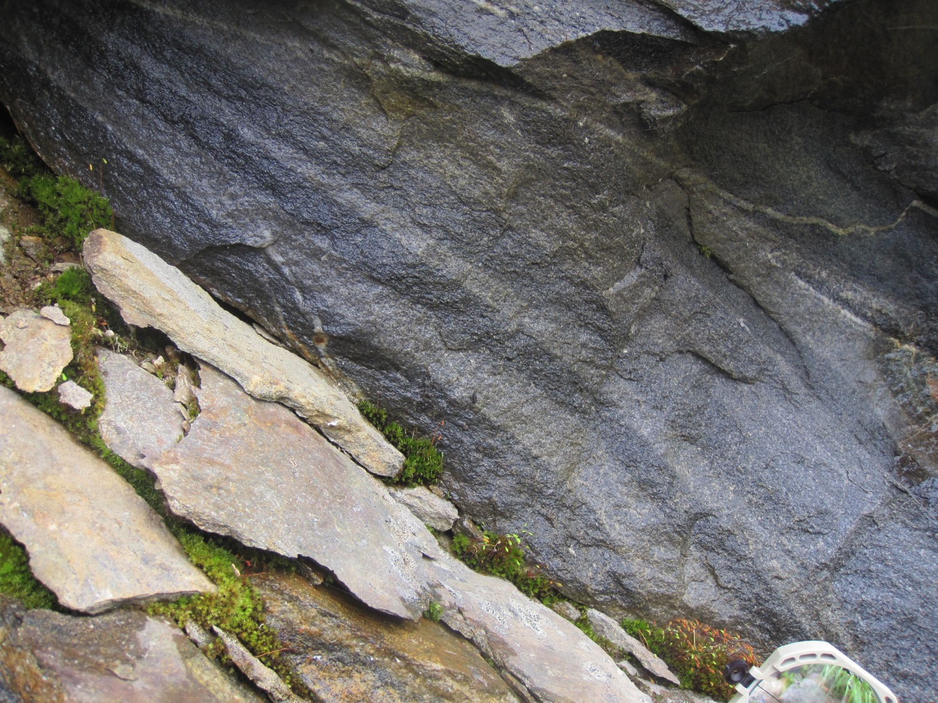
Biotite and calc-silicate granofels member
– Silurian Rangeley Fm?

Slide 12
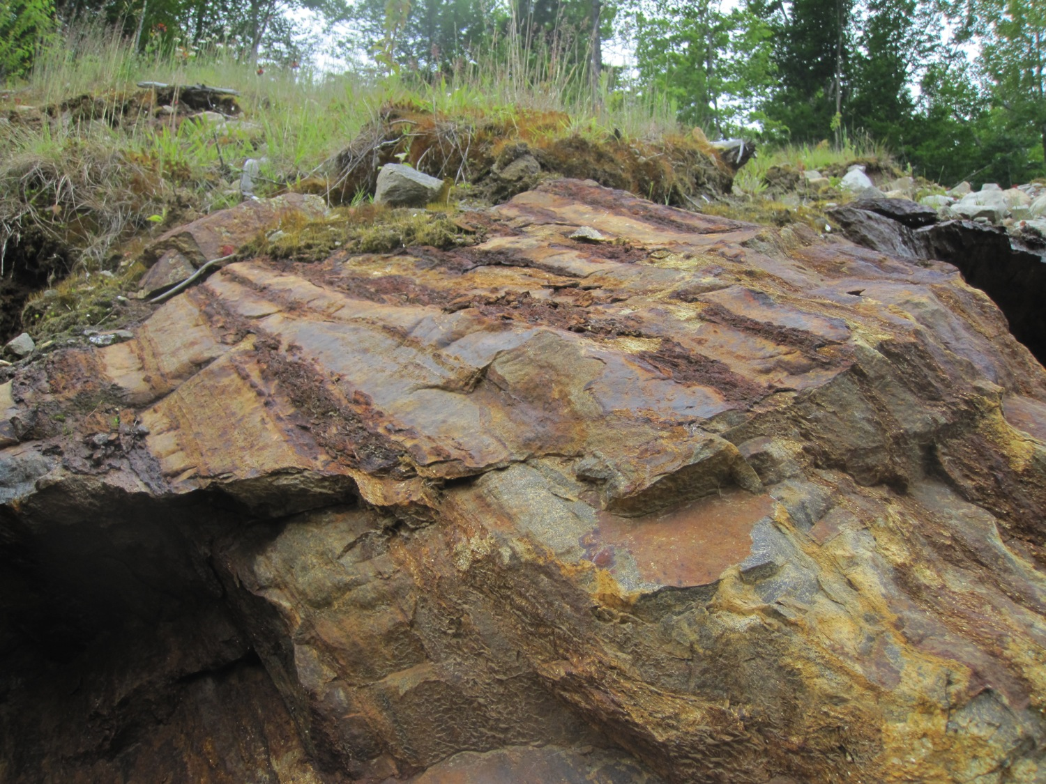
Rusty schist & quartzite member
– Silurian Rangeley Fm?

Slide 13
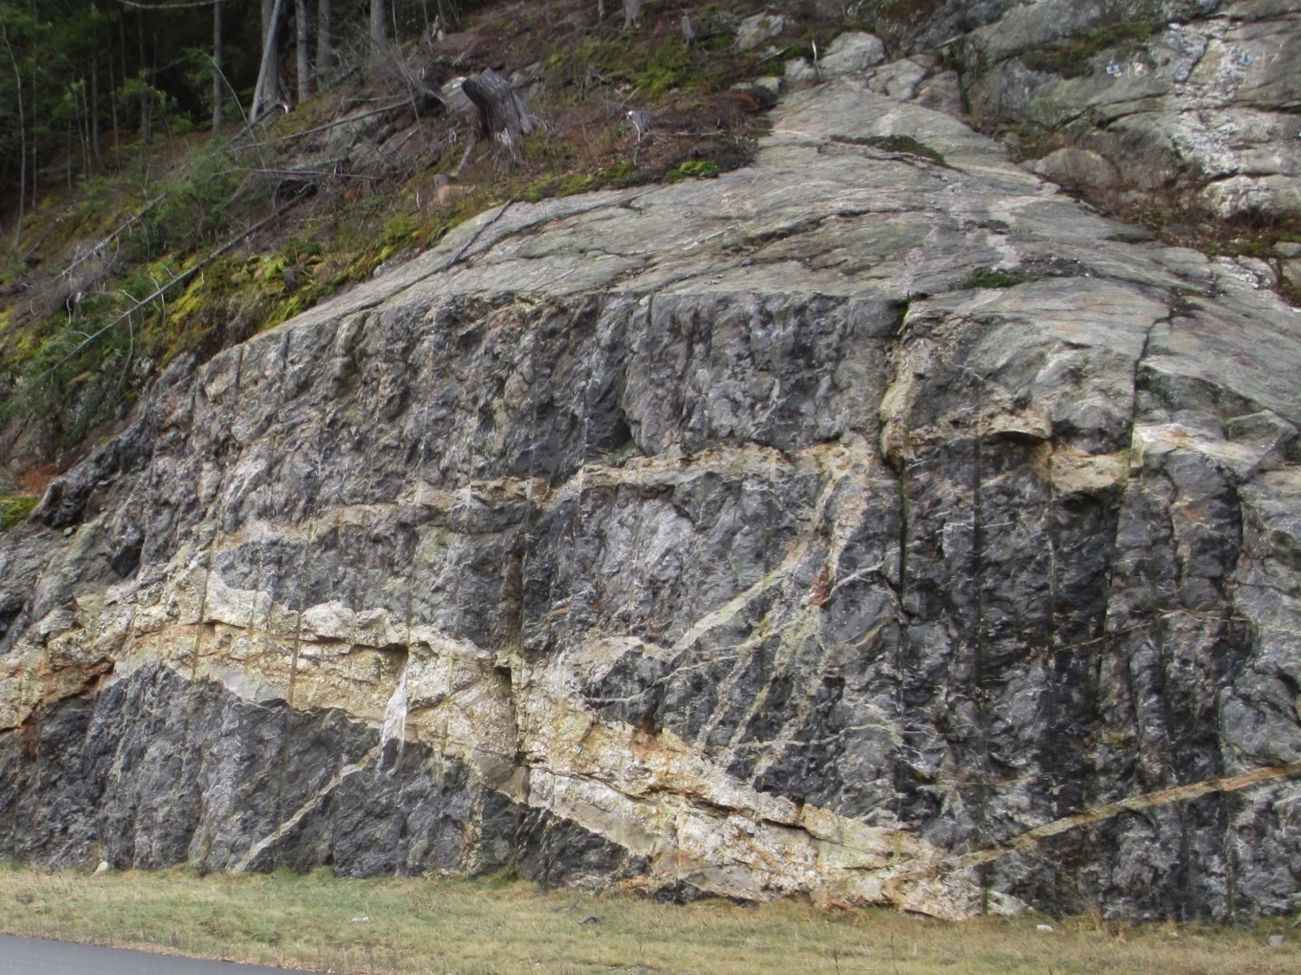
Gray migmatite and pegmatite – Silurian Rangeley Fm?

Slide 14
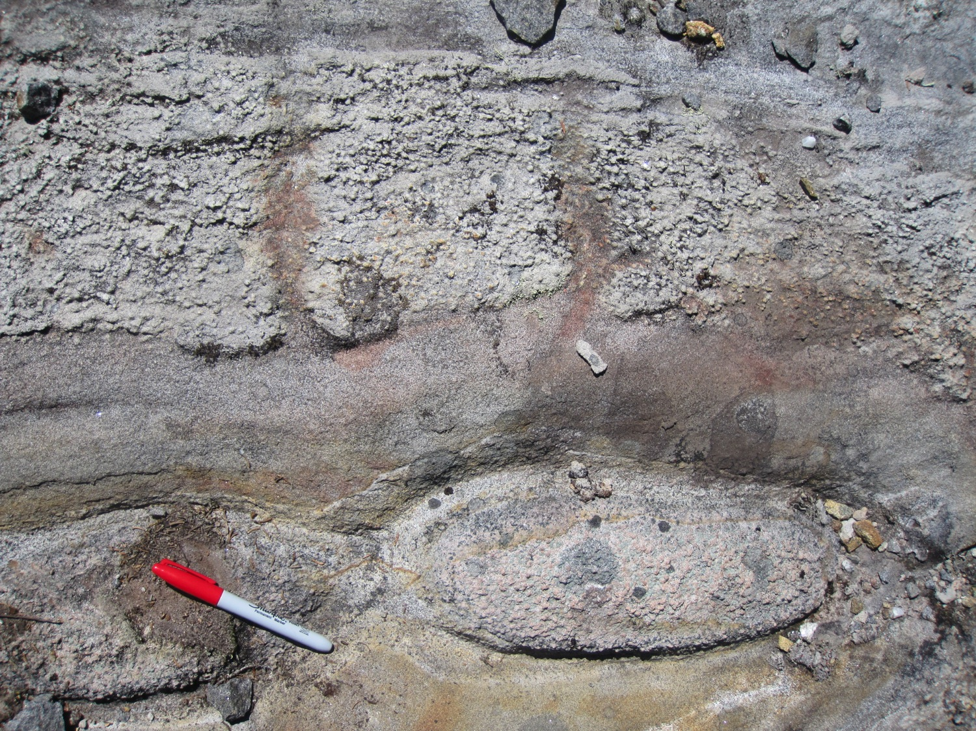
Well bedded schist & quartzite with concentrically zoned, boudined calc-silicate pods – Silurian Rangeley Fm?

Slide 15
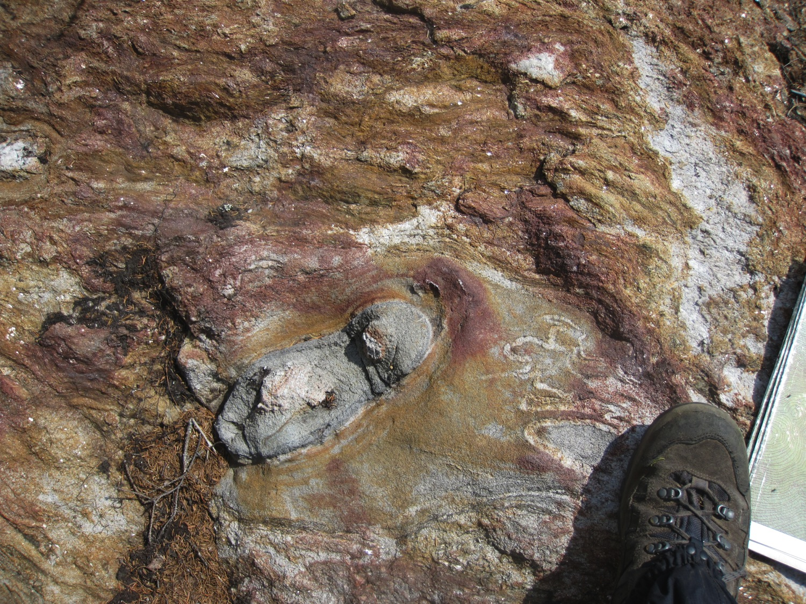
Rusty schist and migmatite with calc-silicate pods and granofels
– Silurian Rangeley Fm?

Slide 16
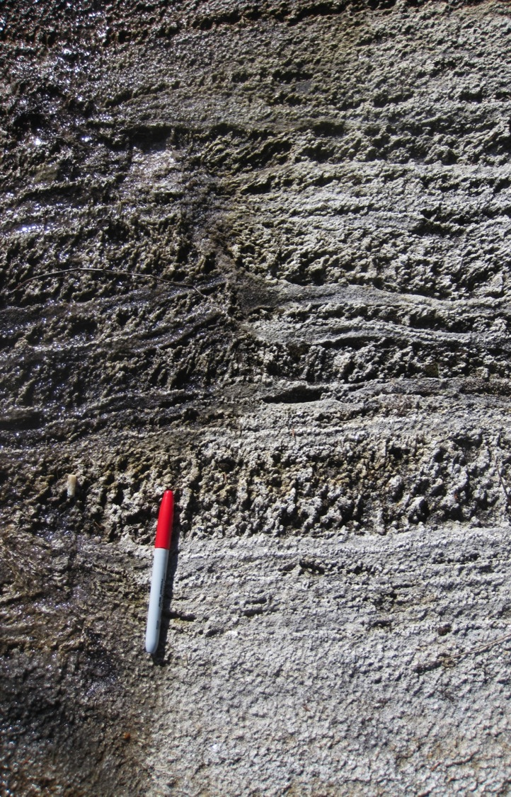
Hinge zone of F1 nappe
Foliation, S1
Bedding, So

Slide 17
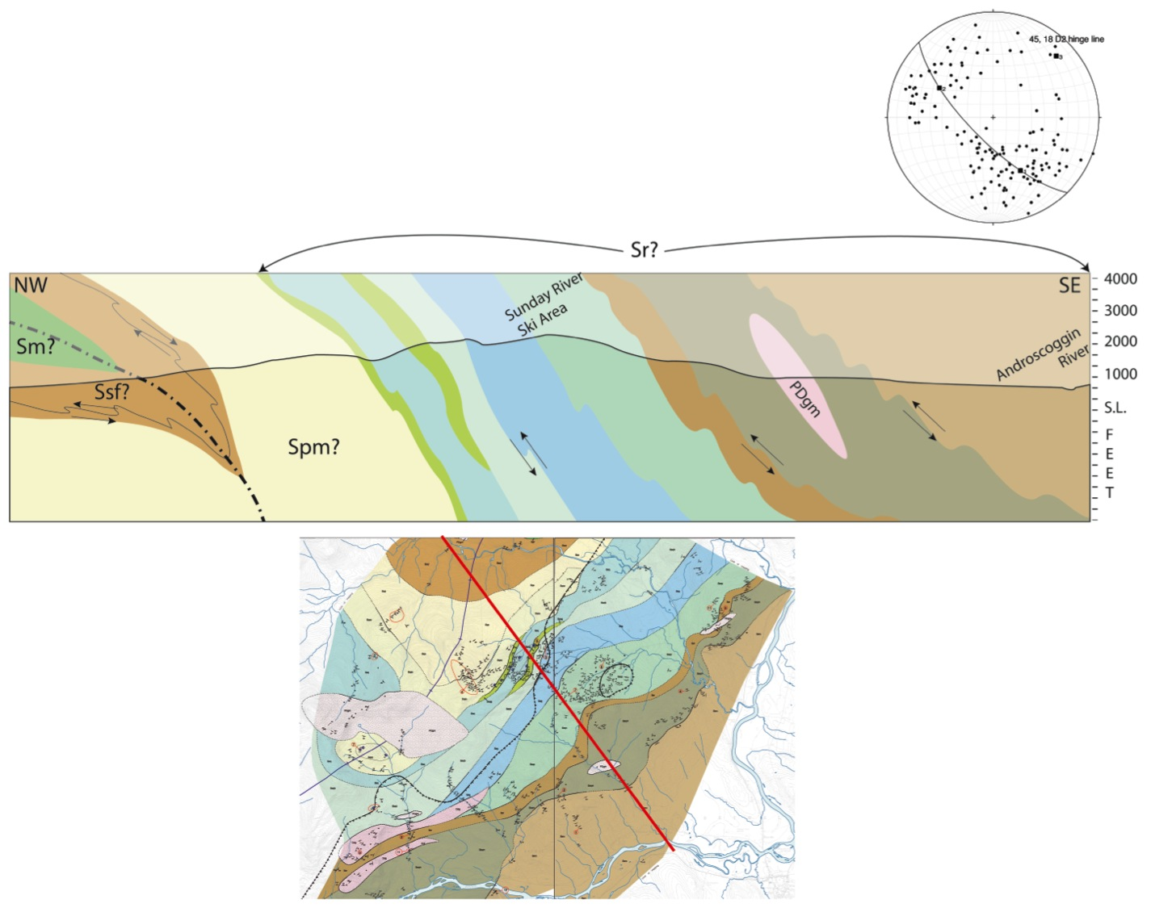
D2 folding of an Inverted stratigraphy? D1 west vergent?
Possible early Acadian D1 nappe stage fold hinge
Later Acadian D2 refolding NE trending hinge line

Slide 18
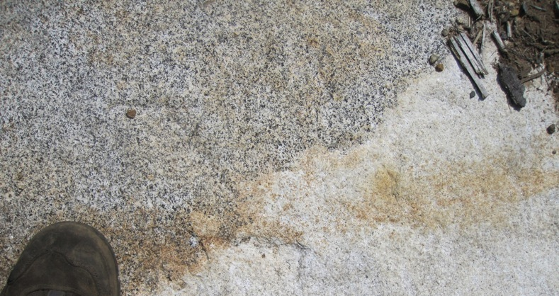
Newly discovered diorites
Part of Piscataquis Volcanic Arc
Dorais, 2003

Slide 19
Bradley and Tucker’s model for the
Piscataquis Volcanic Arc

Slide 20
Murphy (really van Staal’s) model for the Salinic orogeny
Reusch’s model for the Salinic orogeny

Slide 21
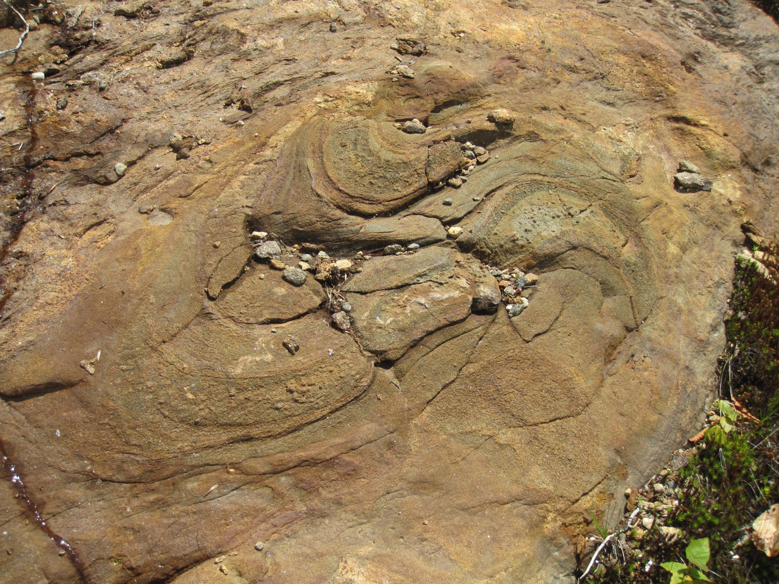
Rusty granofels with bedded, folded calc-silicate layers – Silurian Rangeley Fm?

Slide 22
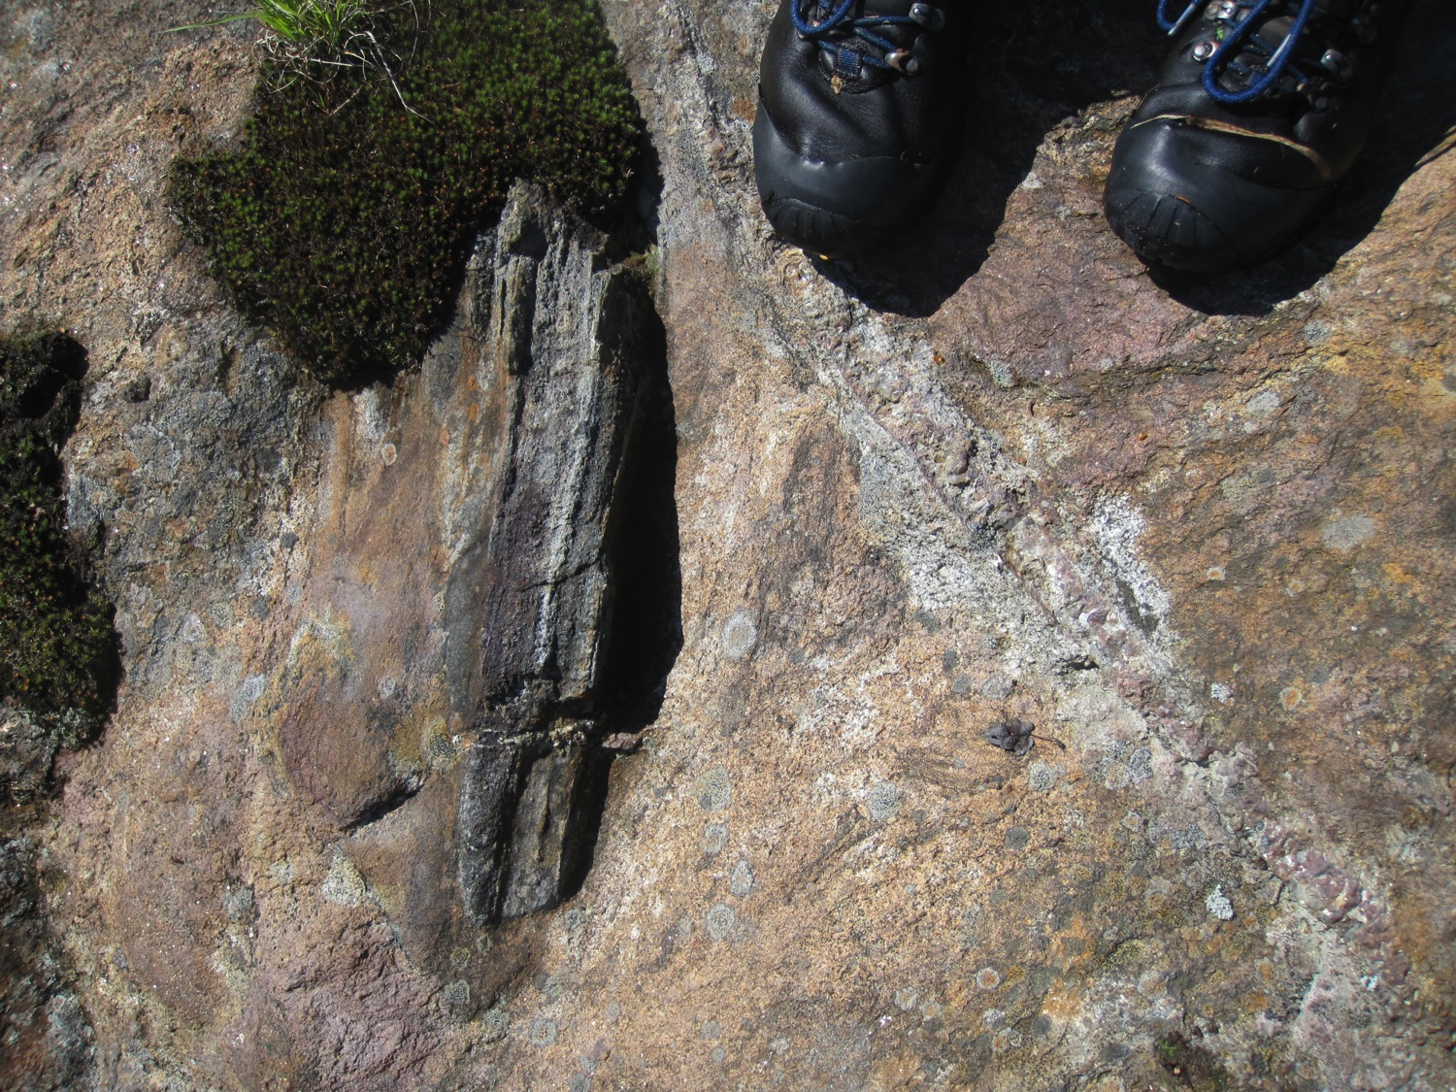
Rusty schist and migmatite with broken, bedded fragment of calc-silicate – Silurian Rangeley Fm?

Slide 23
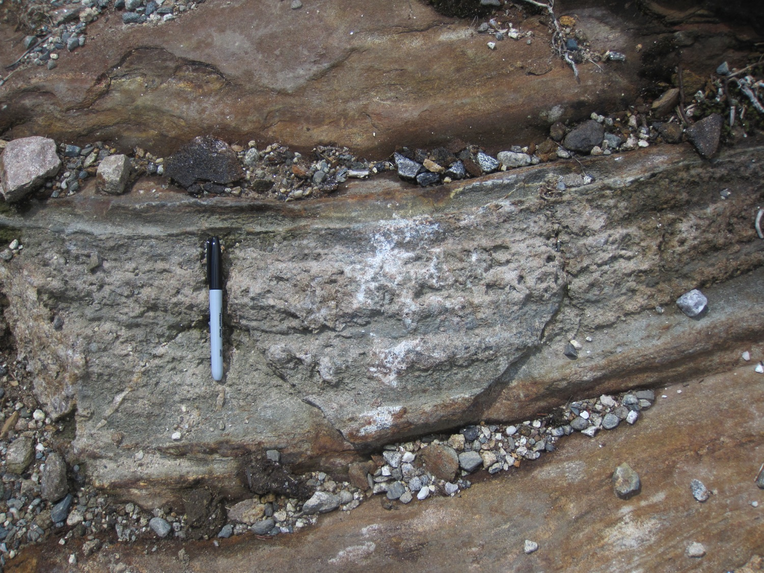
Rusty granofels with broken, bedded fragment of coarse
calc-silicate – Silurian Rangeley Fm?

Slide 24
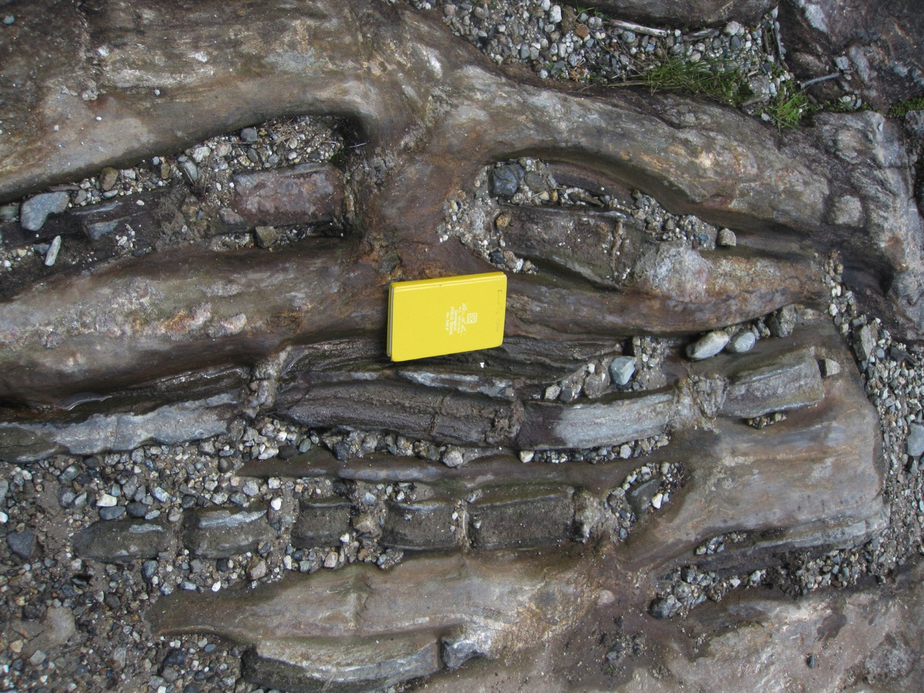
Rusty granofels with broken, bedded fragments of coarse
calc-silicate – Silurian Rangeley Fm?

Slide 25
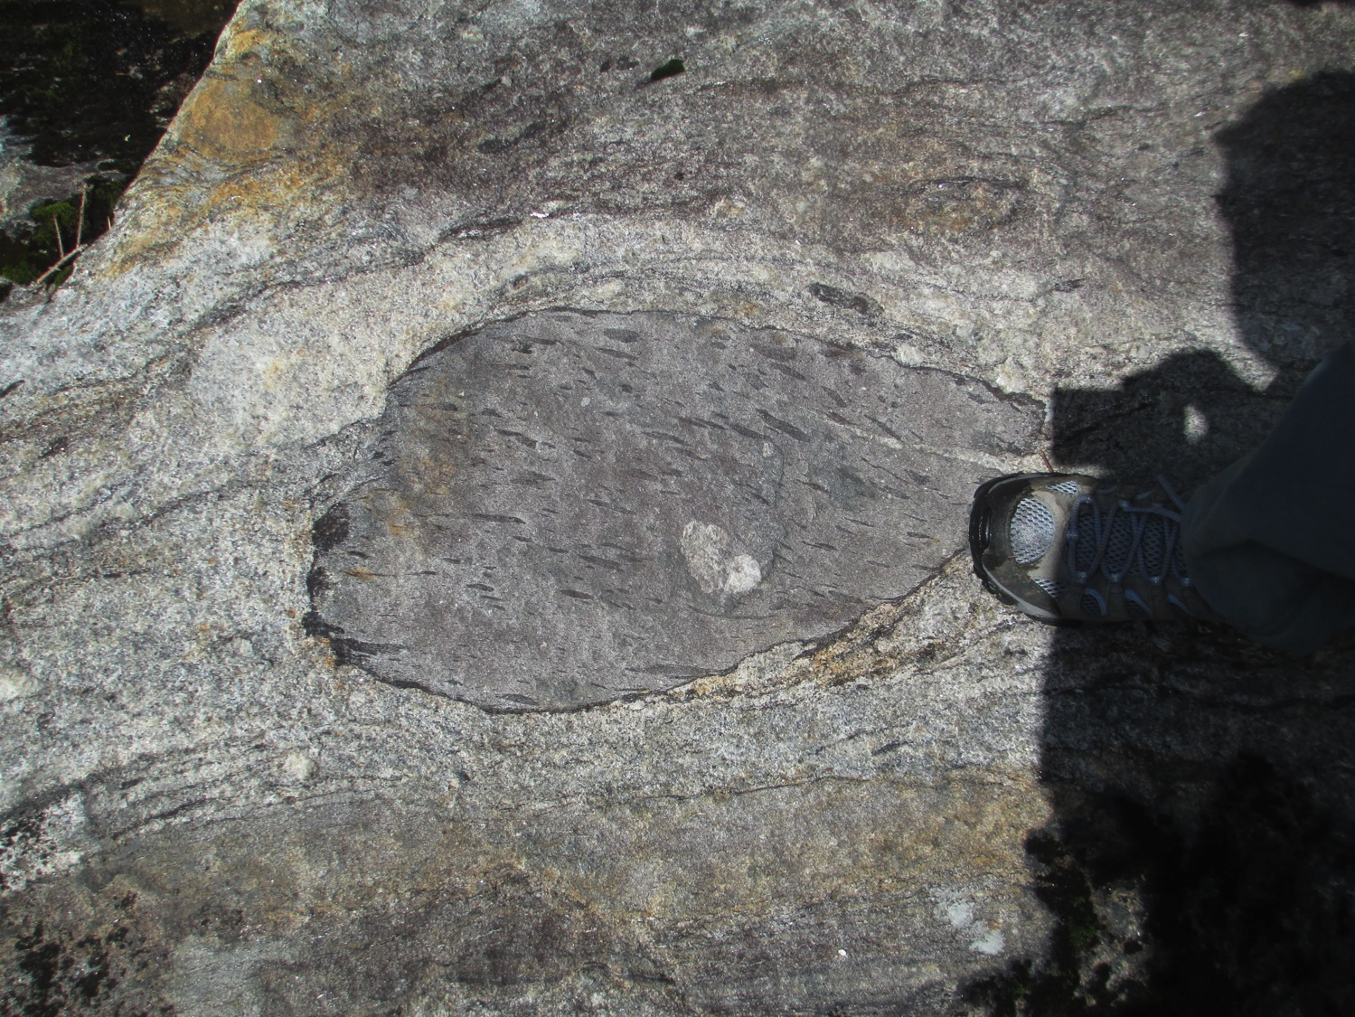
Gray migmatite with broken, mafic clast, a meta-basalt fragmental tuff – Silurian Rangeley Fm?

Slide 26
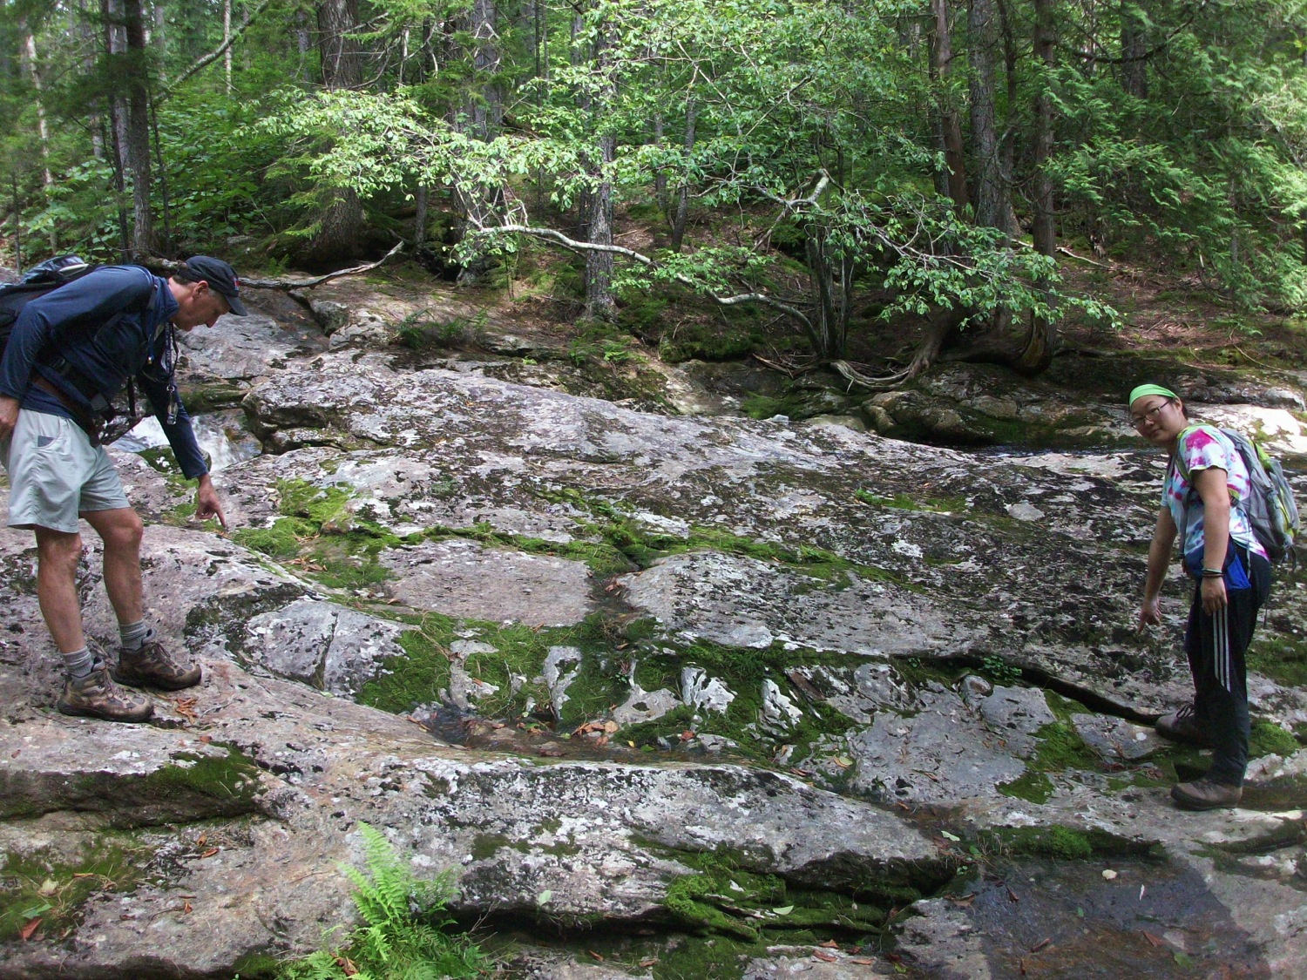
Mother of all pods…….
Silurian Rangeley Fm?

Slide 27
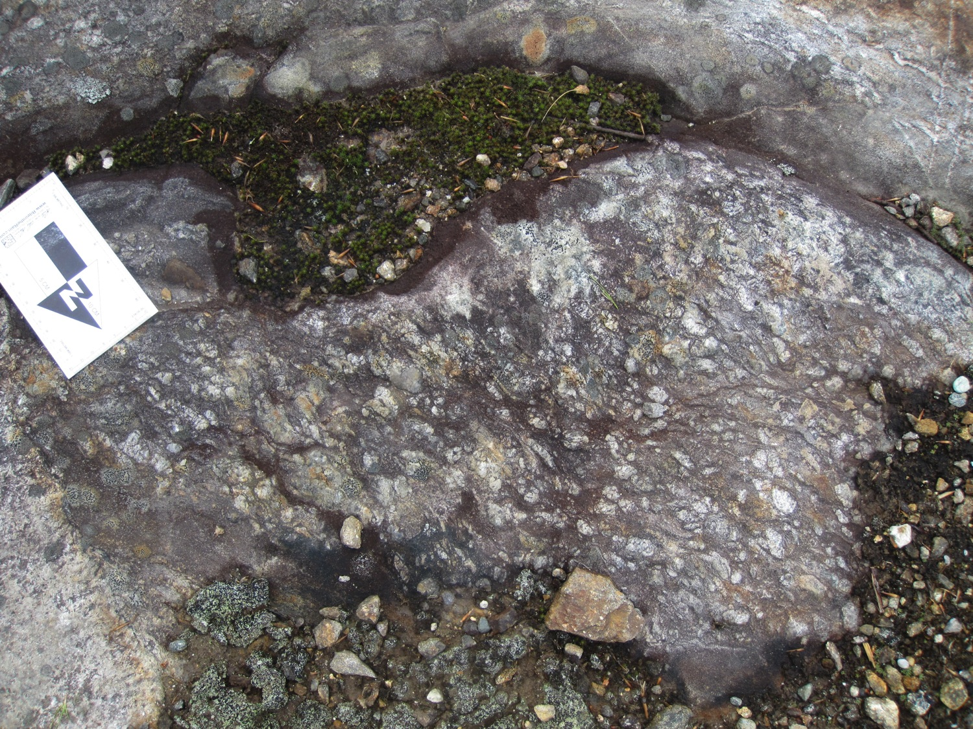
Quartz pebble conglomerate– Silurian Rangeley Fm?

Slide 28
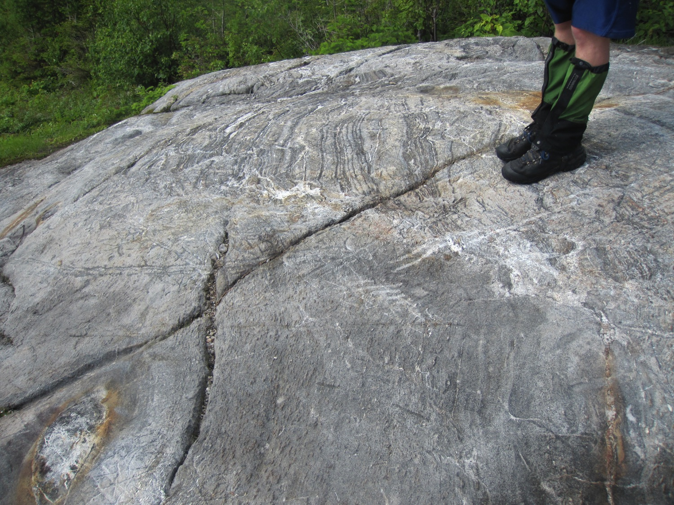

Slide 29
Pre-metamorphic fault

Slide 30

Model for the disruption of the Rangeley Fm.
Silurian Olistostromes and pre-metamorphic faults may record the Salinic disturbance?
Modified from Eusden and Lyons, 1996

Slide 31
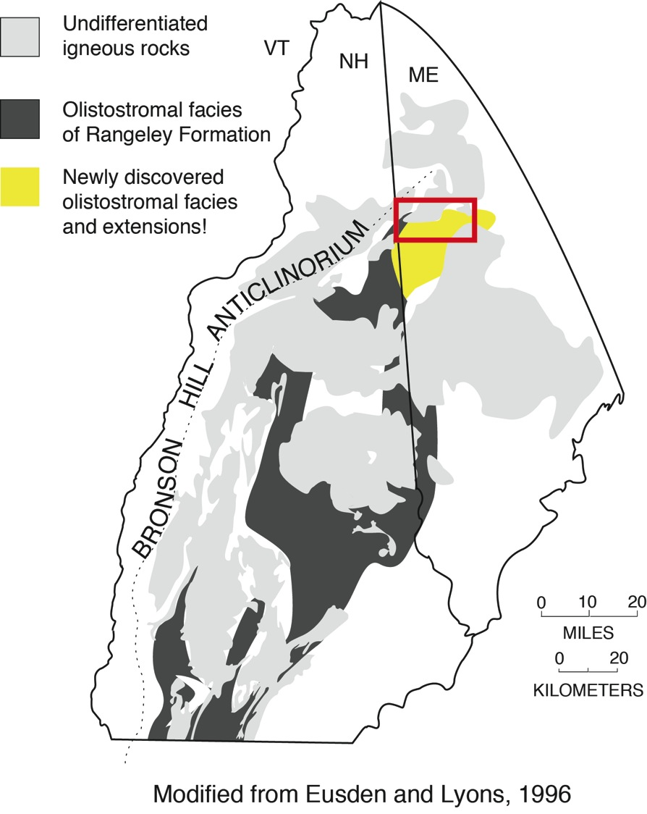
Extent of Silurian Olistostromes
in NH and Maine
Modified from Eusden and Lyons, 1996

Slide 32
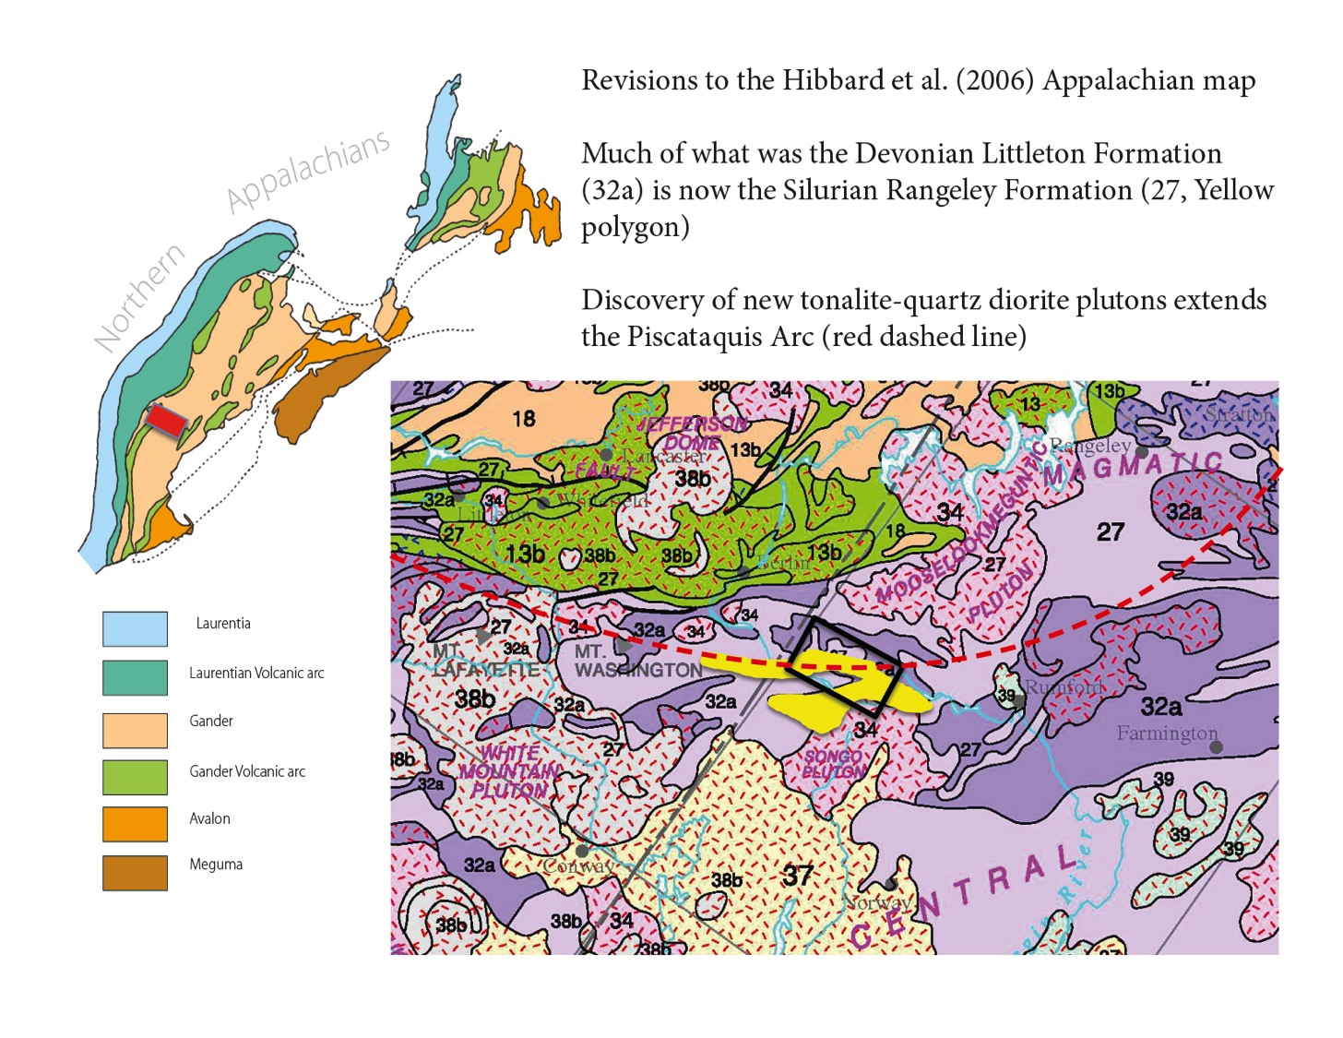

Slide 33

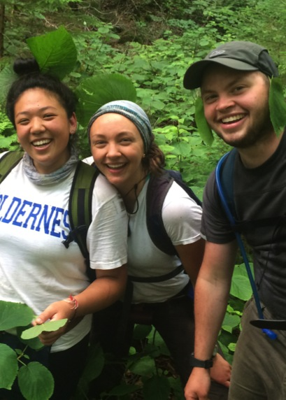
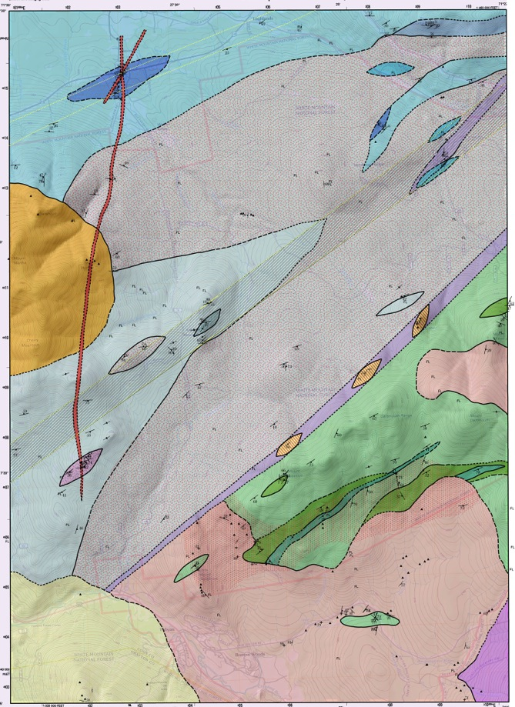
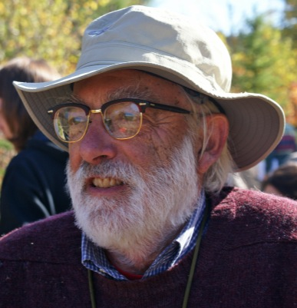
Bob and Doug
would be happy that their legacy of mapping continues!
Sarah Xiao, Michelle Devoe, and Graham Oxman and their new map of the Mt. Dartmouth quad. Tuesday POSTERS!
NEGSA ‘15

