Slide 1
NYSGA Guidebooks and Geospatial
Index Now Available
Otto H. Muller
Geology Department
Alfred University
fmuller@alfred.edu
David Valentino
Department of Atmospheric and Geological Sciences
SUNY at Oswego
Executive Secretary of NYSGA
Notes:
In this talk we describe our progress to date in putting the Guidebooks from the New York State Geological Association (NYSGA) field conferences into computer accessible format. We chose to produce kml files, easily used in Google Earth and other free or inexpensive applications, rather than ArcGIS files as our intention is to provide wide access to as many users as possible.

Slide 2
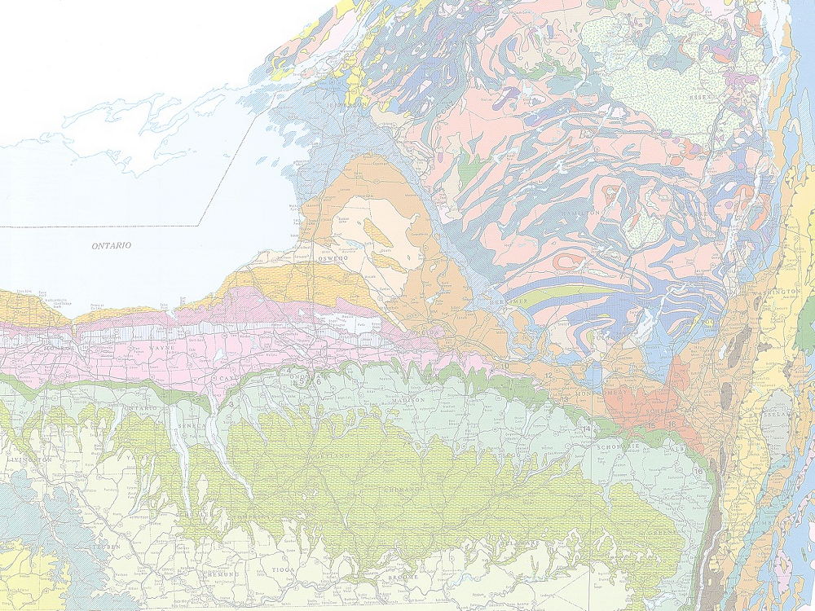
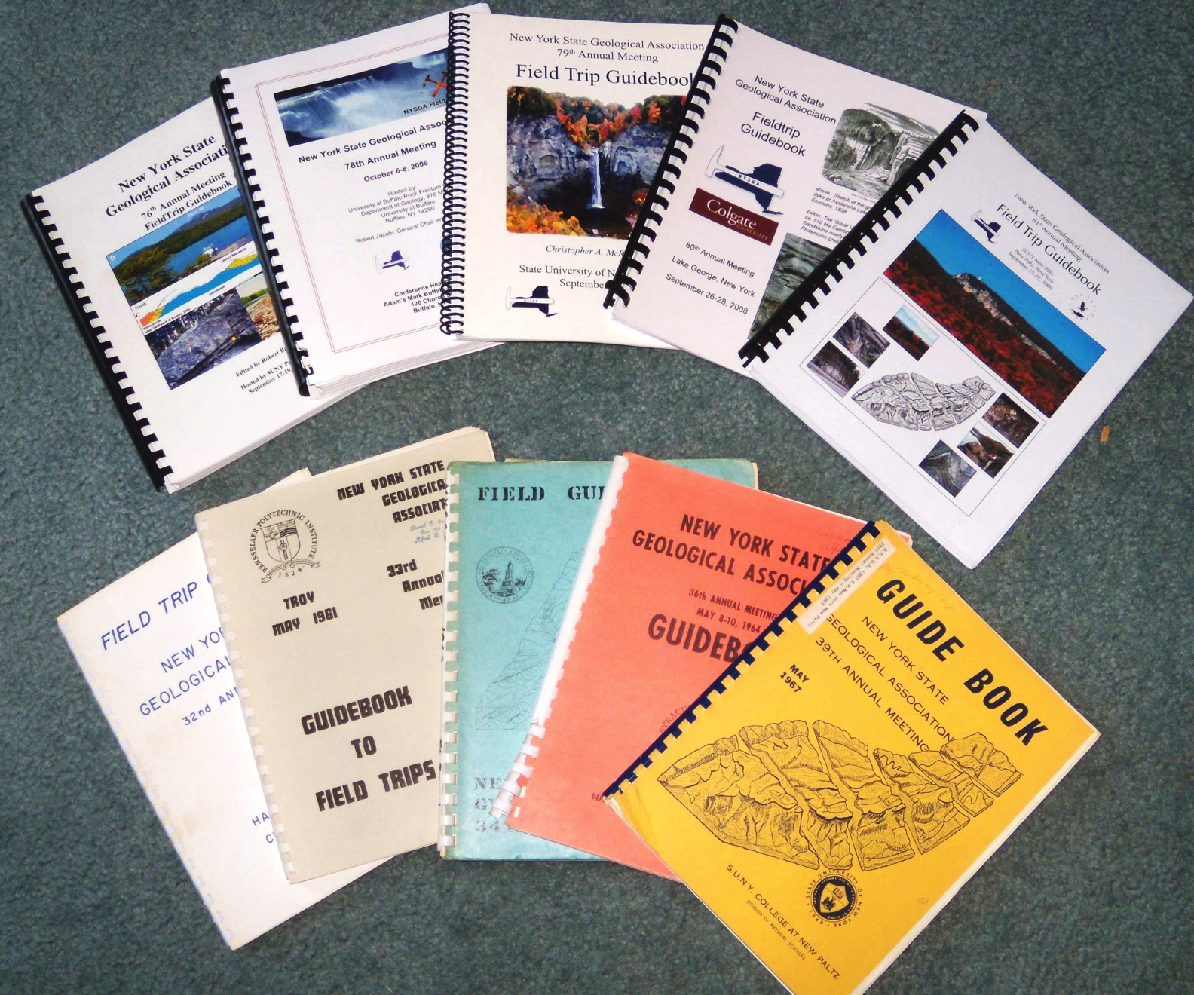

56 years of evolving thoughts
...about the same rocks
Notes:
These Guidebooks represent an invaluable resource, known to many in New York and surrounding states, but not widely available in distant libraries. One missing resource, however, is an accessible index. Folks have been known to browse through a collection of guidegooks trying to find the trip they are looking for. As Field Conference Guidebooks, they have variable reliability. Often the authors are experienced experts, reporting on decades of work, but sometimes an author may be a graduate student presenting somewhat speculative results. Some peer review has occurred, but is unlikely to have been thorough or rigorous.

Slide 3
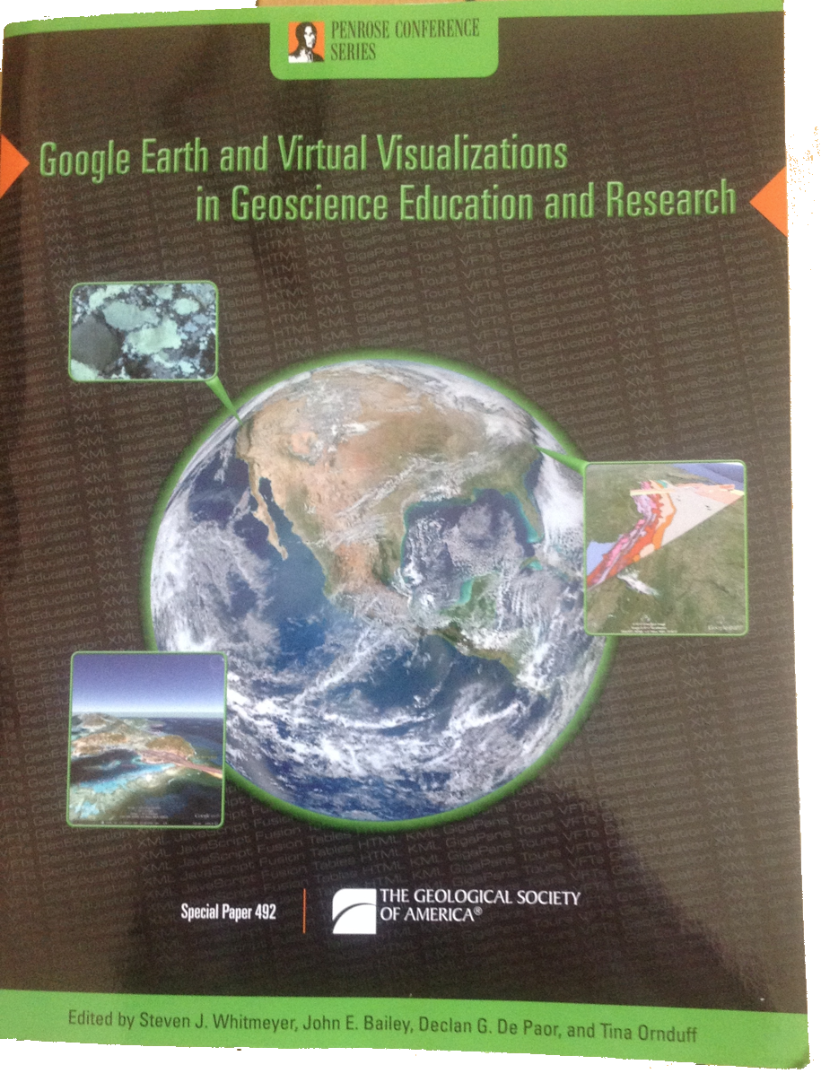
Complete instructions, useful for other Field Trip Guidebooks, can be found in GSA Special Paper 492:
Google Earth and Virtual Visualizations in Geoscience Education and Research
Whitmeyer, Bailey, DePaor and Ornduff, eds.
2012
Notes:
We have taken the Road Logs from the field trips and put them into kml files, locating each stop as accurately as we could on Google Earth. The techniques we used are described in detail in GSA Special Paper 492, Google Earth and Virtual Visualizations in Geoscience Education and Research, Whitmeyer, Bailey, DePaor and Ornduff, eds., 2012. Here we provide only a brief summary:

Slide 4
    The Process
      Scan Roadlogs from Guidebook or obtain PDF
      Do Optical Character Recognition (OCR)
      Plot route on Google Earth
      Put Placemarks on route with results from OCR
      Adjust content, styles, etc., of kml file
      Clean up in Filemaker
      Upload kml file to Web and to Fusion Tables
Notes:
All of the guidebooks are now available as pdf files, but when we began this project many were only available in hard copy. If so, we scanned the Introductions and Road Logs. Text was obtained from the pdf or scanned images using Adobe Acrobat OCR software. After cleaning up the many OCR errors, the text was put into Placemarks on Google Earth. These were output as kml files, spelling was corrected and styles assigned before adding them to the Filemaker database and uploading them to the Web and to Google Fusion Tables.

Slide 5
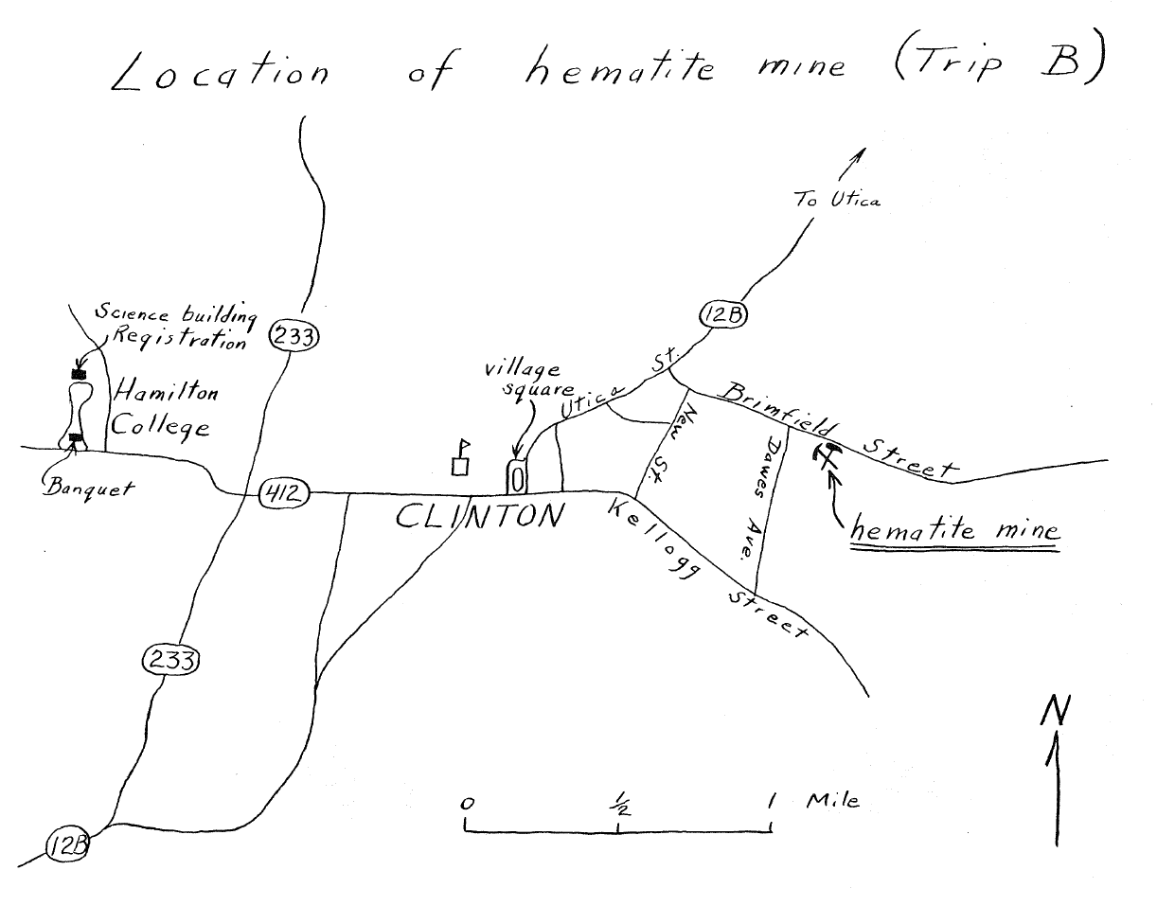
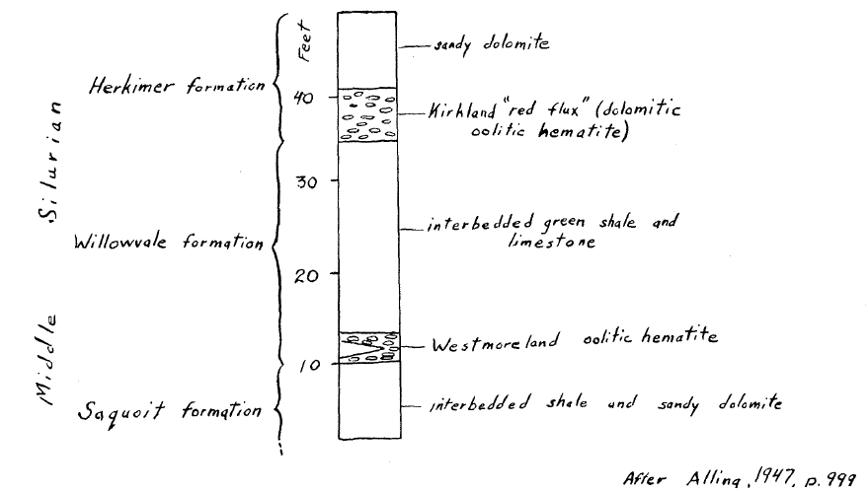
1960 Trip B went underground in the Clinton Metallic Paint Co. mine. The mine closed in 1963.
Notes:
The guidebooks have evolved considerably since 1956. Here is an example from a trip in 1960. The map and columnar section are hand drawn and hand lettered. Remarkably, the participants on this trip were permitted down into the mine, and there were no requirements for hard hats, insurance, or statements indemnifying the land holder from any potential lawsuits.

Slide 6
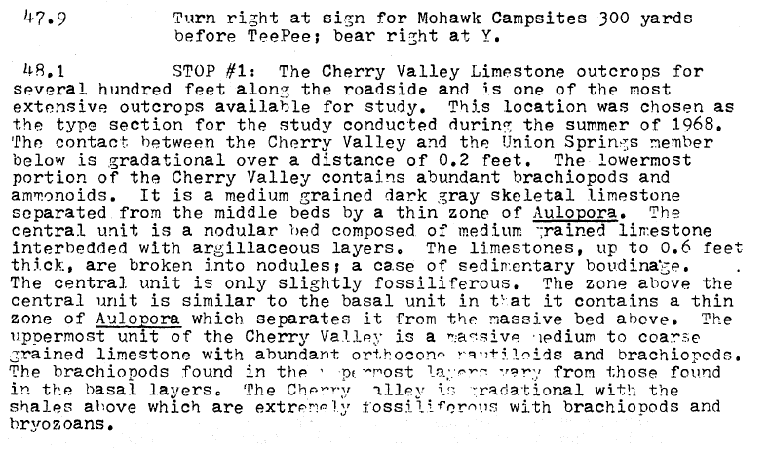
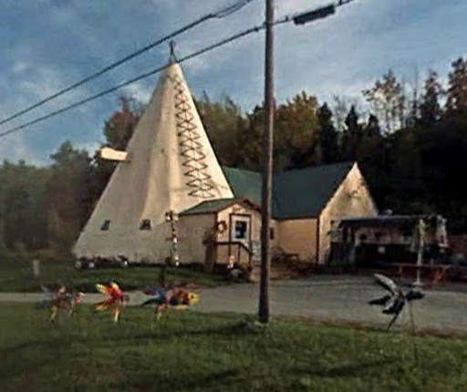
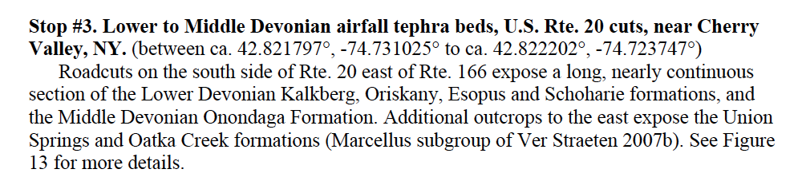
John Cottrell
1972 Trip G
Charles VerStraeten
Gordon Baird
Paul Karabinos
Scott Samson
Carlton E. Brett
2012 Trip A7
Notes:
Typography and the way location data is indicated have changed, also. In 1972, much of the typescript is barely legible, and we are told “Turn right at sign for Mohawk Campsites 300 yards before TeePee; bear right at Y.” Fortunately with StreetView it is not difficult to find the TeePee...
By 2012, type is very clear and we are told “(between ca. 42.821797°, -74.731025° to ca. 42.822202°, -74.723747°).”

Slide 7
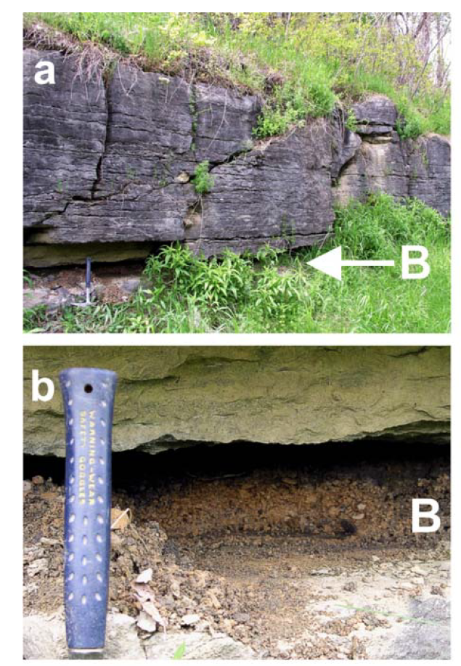
a) Seneca Member of Onondaga Limestone at Stop 4 of this trip. Prominent crevice of Tioga B Tephra visible at
base. Hammer for scale in lower left, at base of outcrop.
b) Close-up view of Tioga B at Stop 4, showing 12 cm thick
K-bentonite clay bed. Deep recession due to bioerosion (decades of geologists collecting samples).
2012 Trip A7
Notes:
In addition to GPS coordinates, recent Guidebooks contain full color photographs, detailed maps and superb columnar sections, etc. Repeated field trips to the same localities have, however, taken a toll. The owners of many exceptional localities now prohibit access, probably because of too many visits by geologists. Outcrops have suffered, too. Here the process is termed “bioerosion” and the outcrop modification is obvious.

Slide 8
      Progress to date:
        36 Guidebooks
        333 Trips
        6,121 Placemarks
            2,184 Stops
            3,632 Views
            (145,784 lines of code and data)
Notes:
This project began in 2009 at the urging of Bill Kelly, who has since retired from the New York State Geological Survey. The starting date of 1956 was chosen because we felt that earlier trips would not be of much value to today’s geologists.
“Stops” are places where the field trips stopped to examine features. “Views” are places mentioned in the Road Log, but where the field trip did not actually pull off the road.

Slide 9
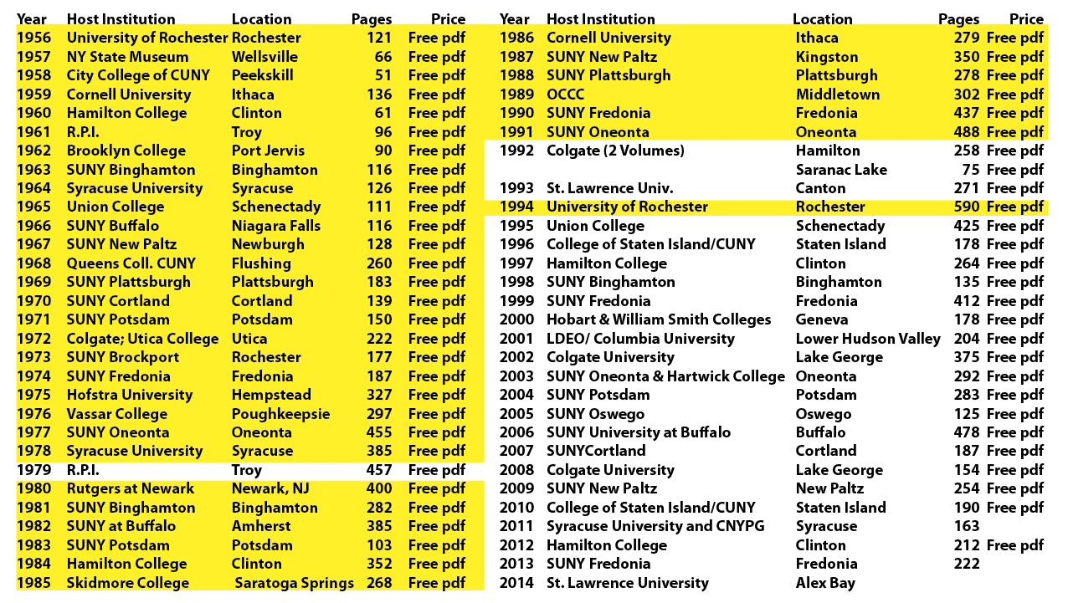
Notes:
As this presentation was being prepared (February, 2015) all of the guidebooks between 1956 and 1994 have been entered into the database except for three. We plan on completing those three shortly.

Slide 10
    The Products
      Kml / kmz files for Google Earth, etc.
      Fusion Table Interface
      FileMaker Go Database for IOS devices
      Stand-alone FileMaker Database for Macs
Notes:
The original plan was simply to convert stops into Google Earth placemarks, and let the user reconfigure these into custom field trips. When Google Fusion Tables came out, the option to have users add their own photos presented itself. Pitching this at meetings, etc., produced plenty of enthusiastic support, but no photos. We also tried a blog, with similar results.
FileMaker came up with a free app for IOS devices, which permits any user to access already created FileMaker databases. With this, a convenient way to search and display data became available, and we put considerable effort into producing templates for that app and a useful database of NYSGA guidebooks.
As some users may want to explore the database more thoroughly on their desktop Macs, we are also providing a stand-alone FileMaker database which they can use without access to the FileMaker application.

Slide 11
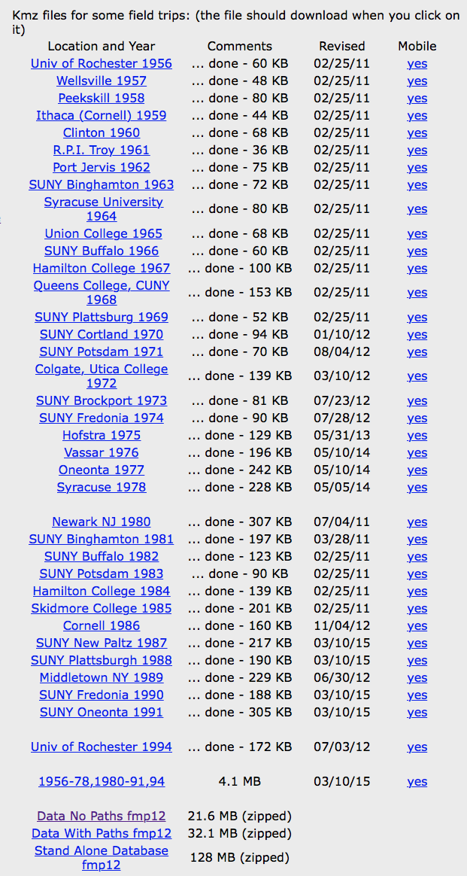
Currently, all files from this project are located at:
http://ottohmuller.com/nysga2ge/Files.html
Soon, these will be moved to the NYSGA site:
http://nysga-online.net/
Notes:
Eventually we will migrate all of these files to the NYSGA site, but at the moment they are available as shown.

Slide 12
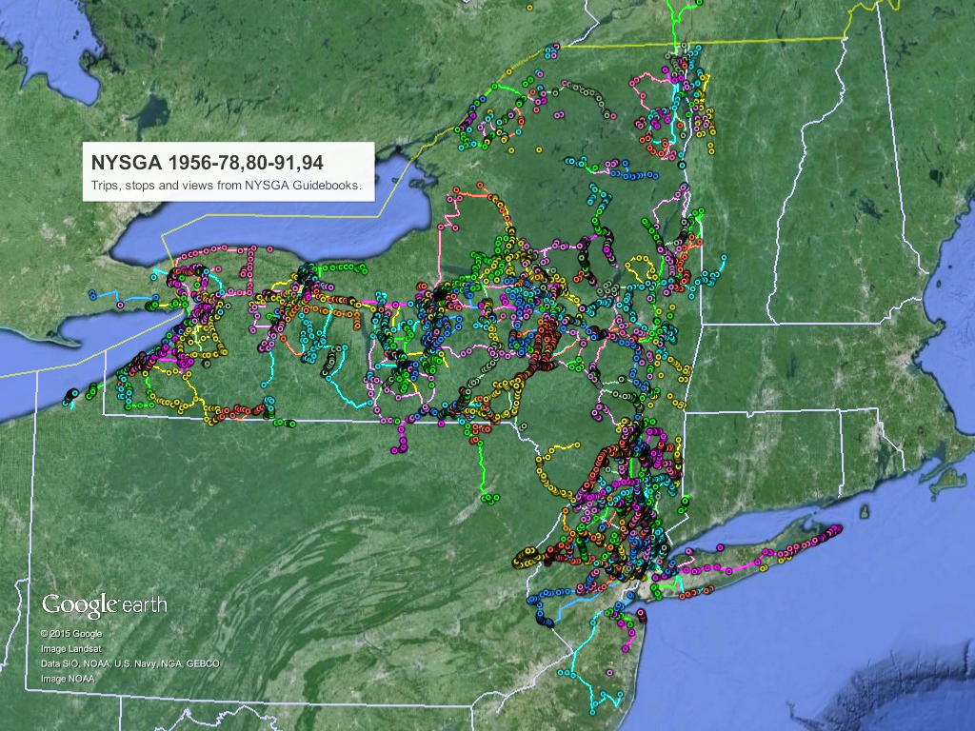
Notes:
This slide shows the current coverage. Trip routes are shown as lines, stops and views as circles. Zooming in would show many more circles, as they stack up on top of each other at this scale. Colors were chosen to differentiate the various trips offered in a particular guidebook.
Not surprisingly, those areas with colleges having active Geology programs are the areas with the most action.

Slide 13
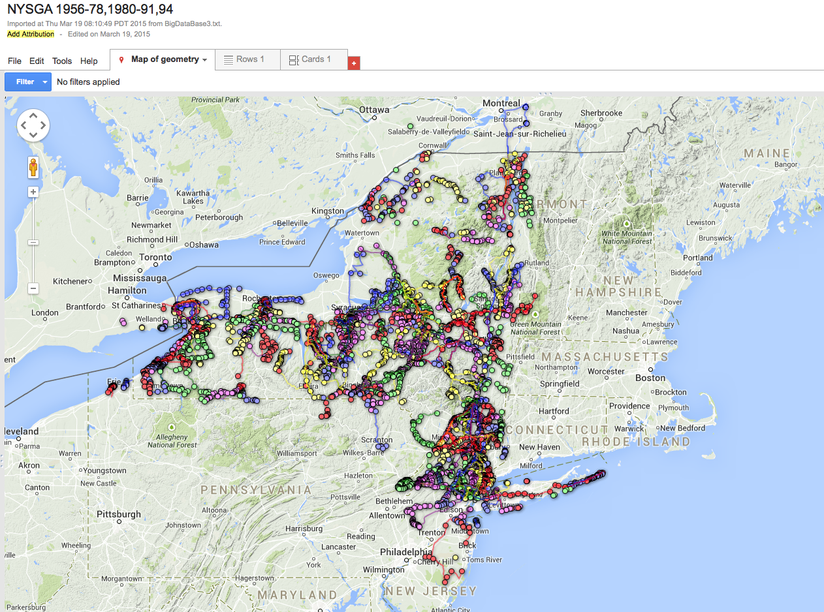
Notes:
The same data set, but shown as a Fusion Table. Here filters can be applied to limit what is displayed, and resulting maps can be downloaded as kml files, or even embedded in users' websites.
The filters are equivalent to logical "AND" searches, however, preventing the kinds of elaborate searching permitted in FileMaker.

Slide 14
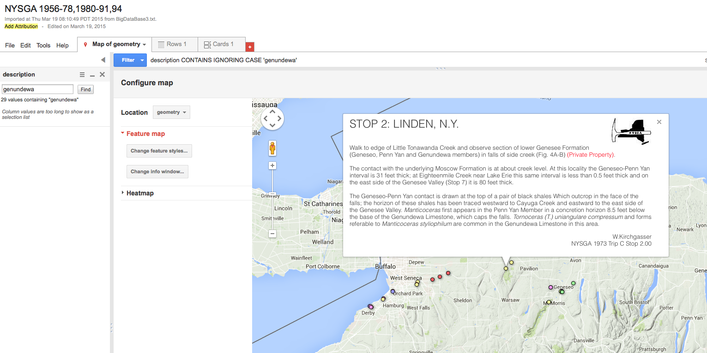
Results of search for "Genundewa," a member of the Devonian Genesee Formation.
Found 27 Stops and 2 views.
https://www.google.com/fusiontables/DataSource?docid=1xzvRq1NlbCCr9zOIoPeWq0Bgzy2ryB6vdXtIYtjx
Notes:
This slide illustrates an example of a Google Fusion Tables search. Searching for the term "Genundewa" in the Description field found 27 stops and 2 views. The locations of these are shown on the map, as is the Fusion Tables Placemark display for one of them.
In addition the URL for the Fusion Table is shown in blue.
All of the data can be downloaded from the Fusion Table as a csv or kml file, or as a network link.

Slide 15
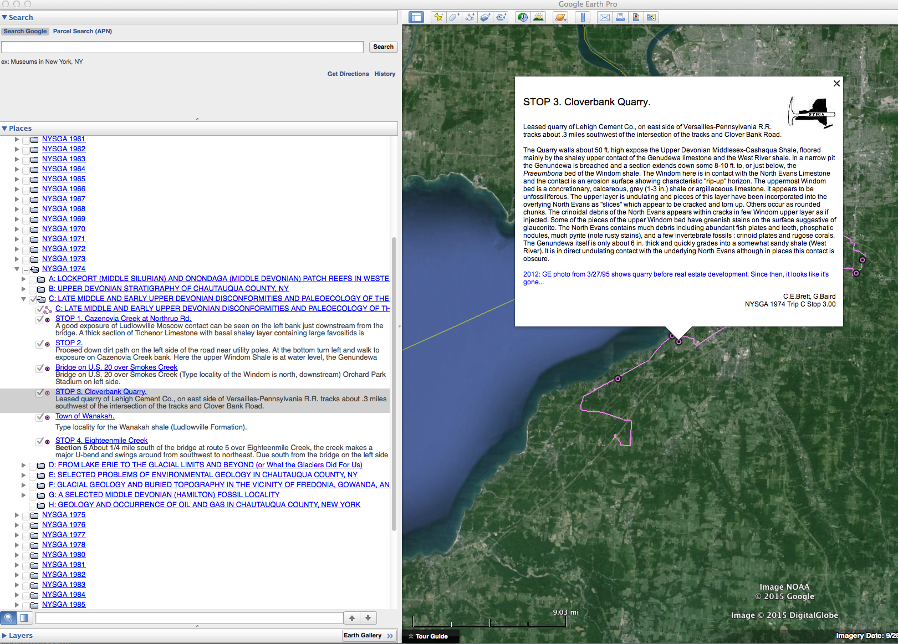
1994 Trip C Stop 3 C.E.Brett and G.Baird
Notes:
When viewed in Google Earth, this data is organized by year, then by trip, then by stop and view in the order followed by the trip. Users can save any parts as kml or kmz files.
This slide shows the files displayed hierarchically on the left. Only Trip C from the 1974 Guidebook is displayed on the map, and the placemark for STOP 3 is shown. Blue text indicates comments added as we transformed the guidebook data into Google Earth data.

Slide 16
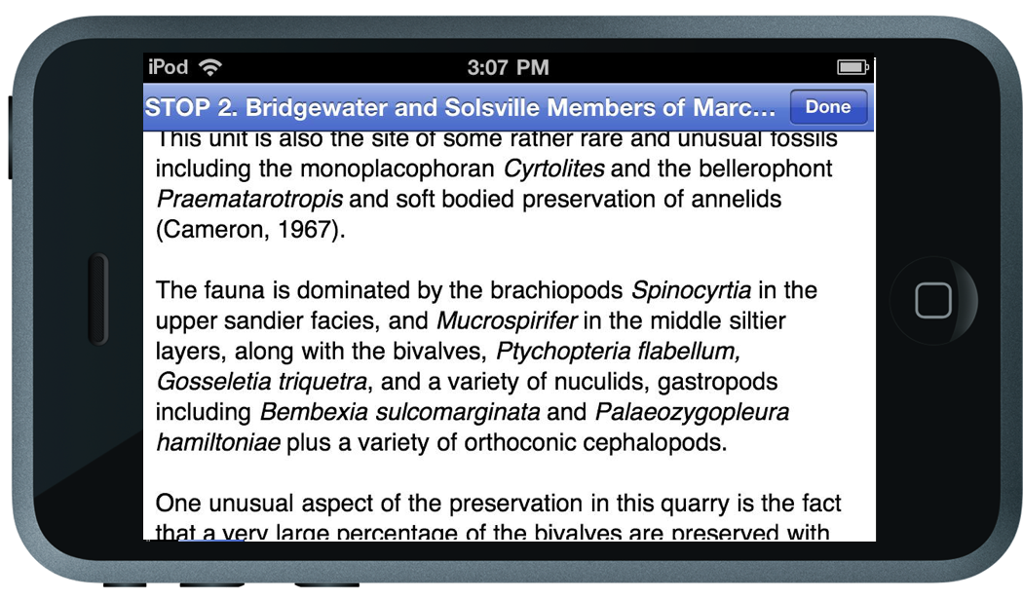
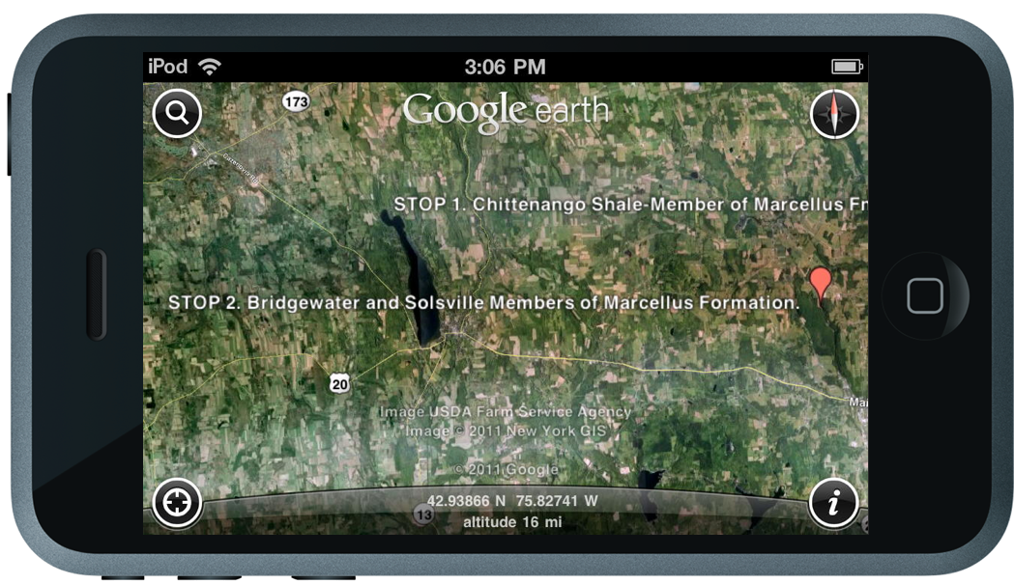
As seen on Google Earth Mobile…
Notes:
Here we see how things look on a small screen. Descriptions are still formatted correctly, and are generally legible. Users without a data plan will need to access Google Earth while on a WiFi network, and cache their results before heading into the field.

Slide 17
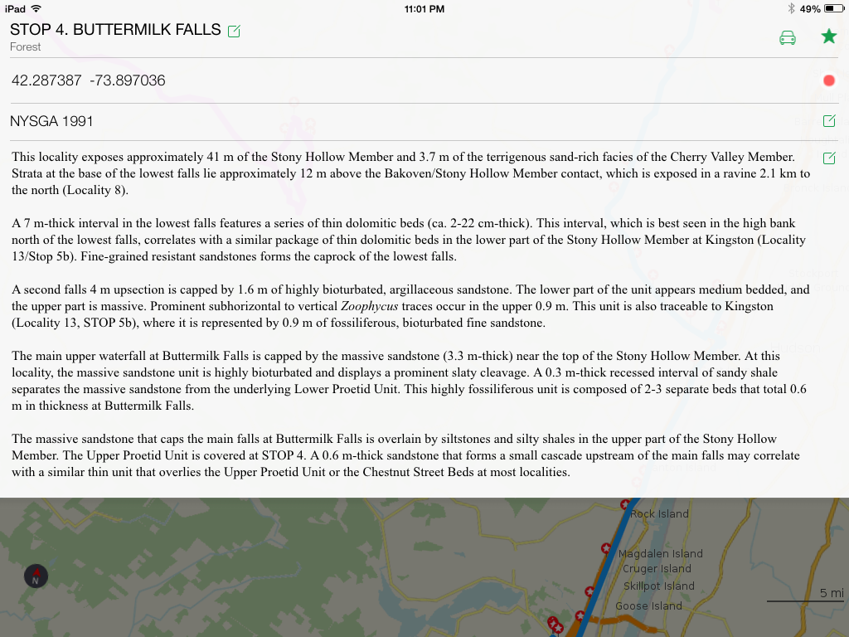
As seen on Maps.me on an iPad
Notes:
Many apps are able to display kml data. Here is one on an iPad called Maps.me. It does a good job of formatting the description field.

Slide 18
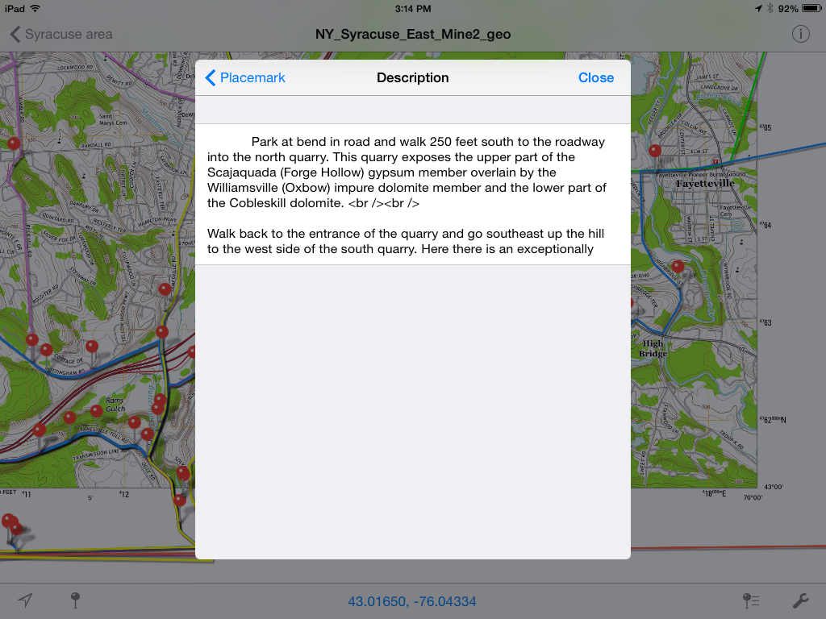
As seen on PDF Maps on an iPad
Notes:
PDF Maps permits users to import their own maps. In the background on this slide is a current USGS topographic map, with vector based graphics, as imported into PDF Maps. The placemarks show up well, but the html formatting is shown, rather than implemented. Because surficial and geologic maps are likely to be important to many users, and because PDF Maps has an import limit of 200 placemarks, the FileMaker Go database outputs large kml files as a several sequentially numbered files of this size.

Slide 19
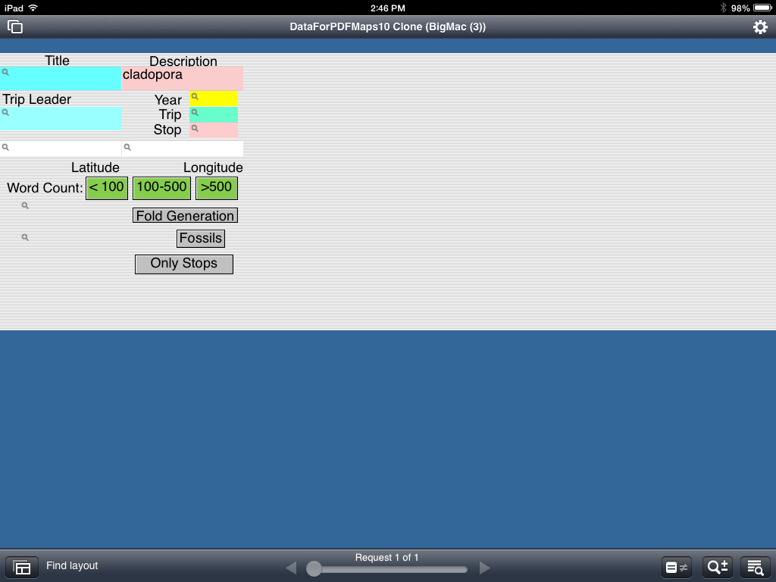
FileMaker Go Database on an iPad
Notes:
Here is how the FileMaker Go app search window looks on an iPad. Although many of the buttons are self explanatory, some many need explanation: Word Count permits users to select those placemarks ithe extensive descriptions, or short ones. Before the pdfs for all of the guidebooks became available, this let users select those placemarks with extensive road log descriptions. Fold Generation selects those placemarks containing an "f" with a subscript. And Fossils selects placemarks with Italics. If a description had the specific name of a fossil in Italics, then that formatting was kept.
In the example shown in this slide, the search was foe "cladopora" within the Description field.

Slide 20
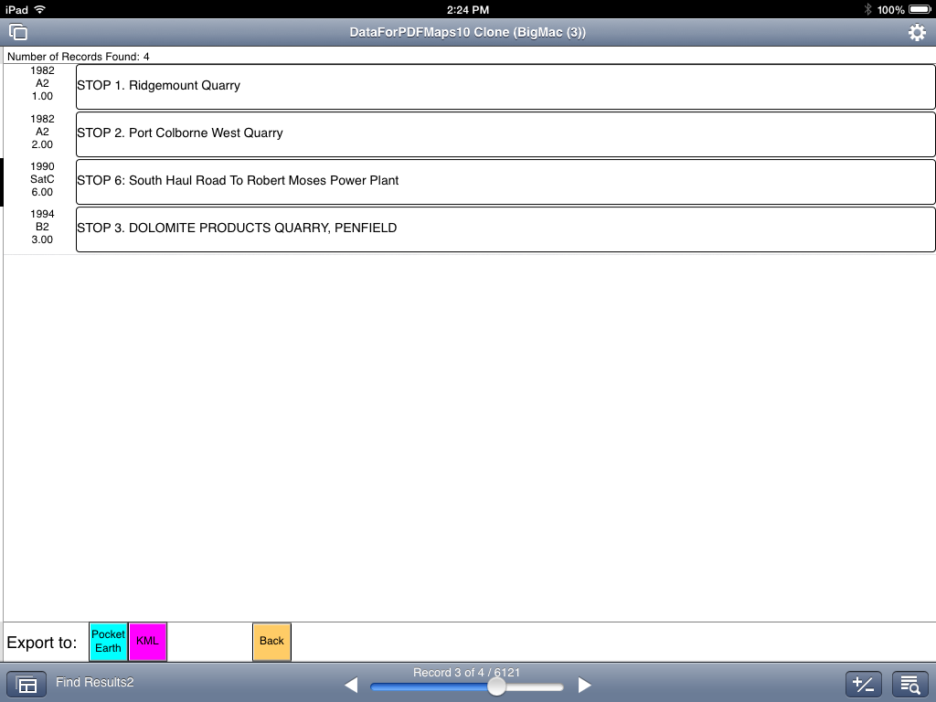
FileMaker Go Database on an iPad
Notes:
Search results show four places within the database where the word "cladopora" occurs within the description field. Clicking on any of the buttons to the right will bring up that stop, as shown in the next slide.

Slide 21
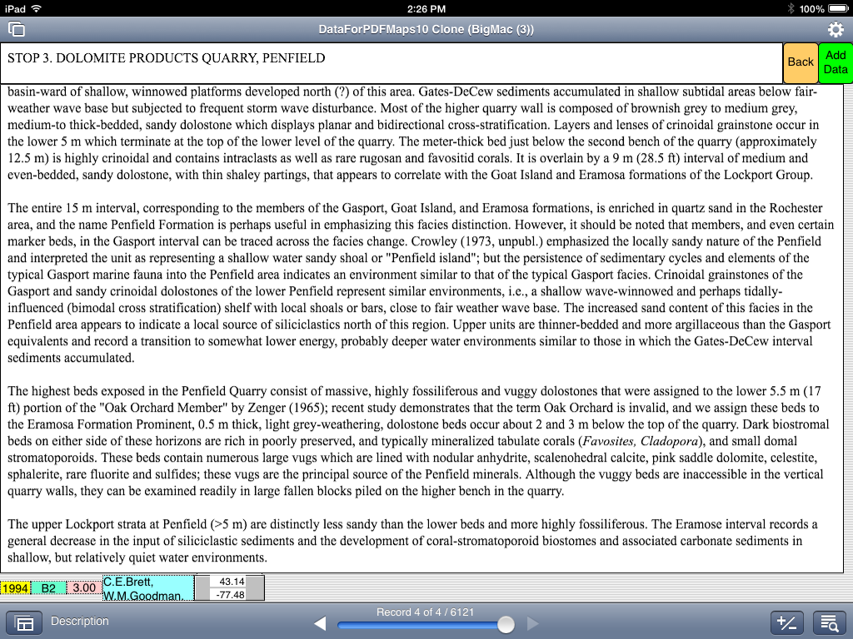
FileMaker Go Database on an iPad
Notes:
The iPad view in FileMaker Go is large, scrollable, and has relevant stop and trip information at the bottom left. Two buttons at the upper right return you to the Found screen or let you add additional data to the field.

Slide 22
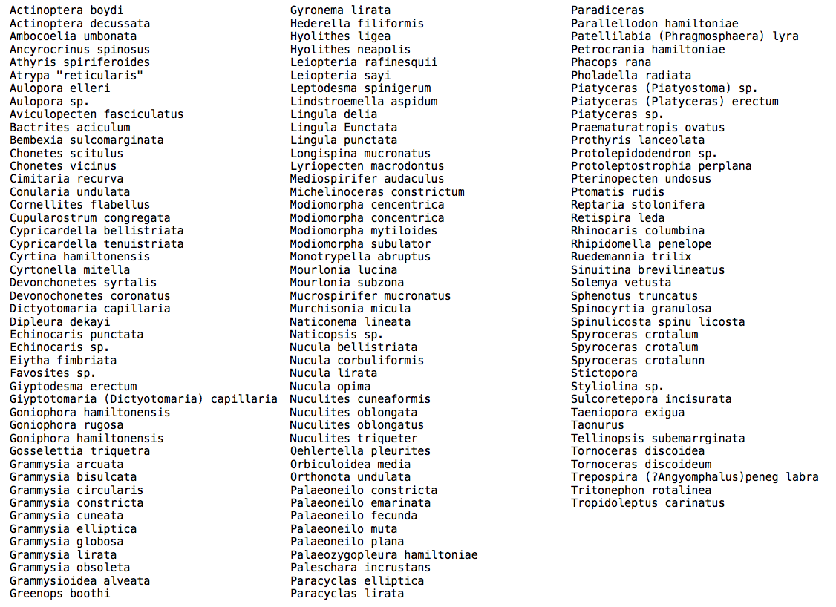
List of Fossils
From Index
Notes:
FileMaker on a desktop device permits access to an index file, useful if the user wishes to see whether or not a term exists in the database. FileMaker Go does not have this function. Using a desktop version, we generated this list of fossils which some users may find useful.

Slide 23
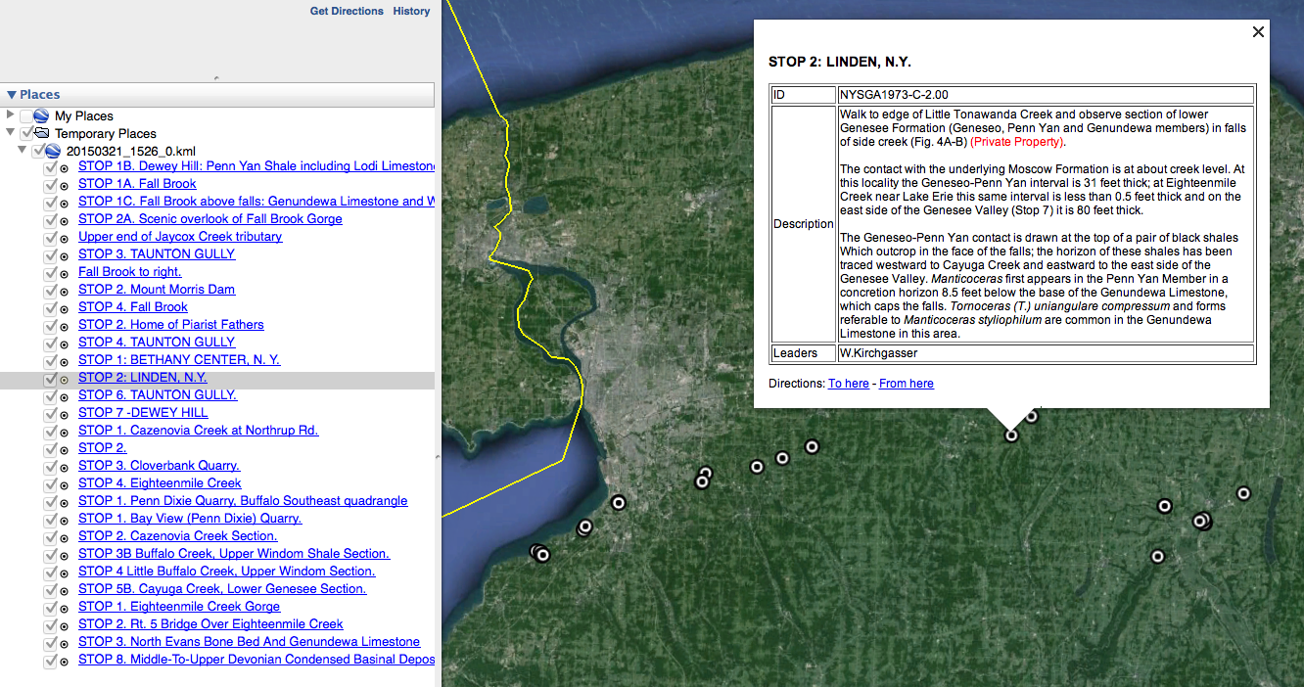
Results of search for "Genundewa," a member of the Devonian Genesee Formation.
Found 27 Stops and 2 views.
Notes:
The FileMaker Go database exports Found Sets as kml files, with a name generated from the date and time. These kml files can be imported into a desktop version of Google Earth, as shown here. Although the HTML formatting is intact, the NYSGA logo and custom balloon formatting are not exported.

Slide 24
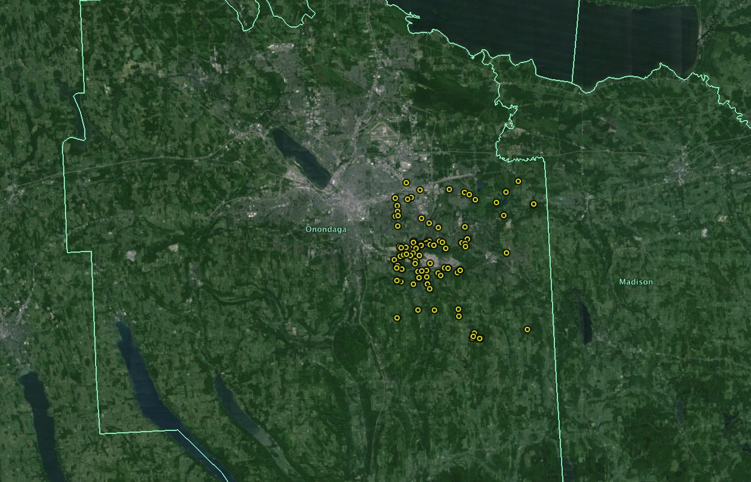
A geographically constrained set
of 111 placemarks
Notes:
There may be times when a user wishes to filter placemarks geographically. The FileMaker Go file now has that capability, as shown here.

Slide 25

Relevant URLs:
NYSGA Guidebooks (free PDF’s):
http://nysga-online.net/index.php/repository/browse-download-repository-items
NYSGA2GE Fusion Tables:
https://www.google.com/fusiontables/DataSource?docid=1xzvRq1NlbCCr9zOIoPeWq0Bgzy2ryB6vdXtIYtjx
This talk, kmz files, additional information:
http://ottohmuller.com/nysga2ge/Files.html

