Slide 1

Soil water sources for non-native species Japanese knotweed, phragmites and multiflora rose
Mariya Guzner¹, Joshua C. Galster¹, Dirk W. Vanderklein²
¹Department of Earth and Environmental Studies, ²Department of Biology, Montclair State University

Slide 2
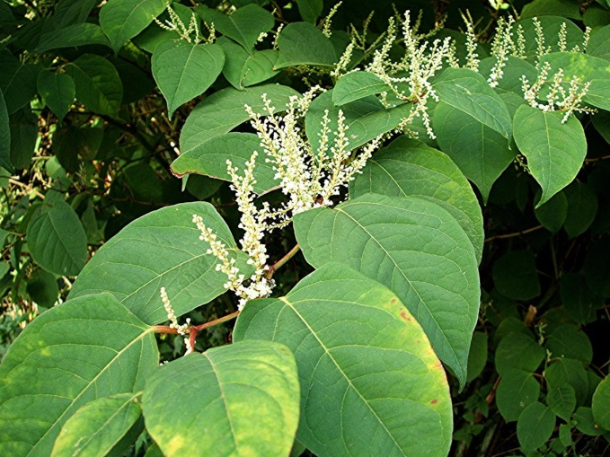
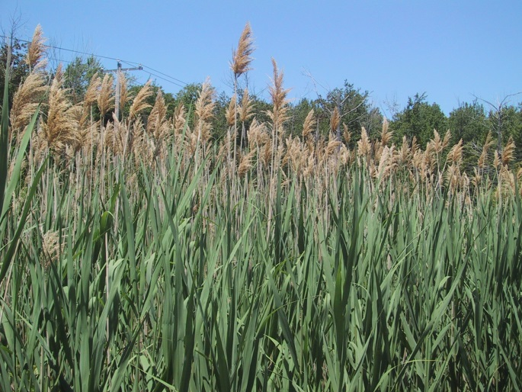
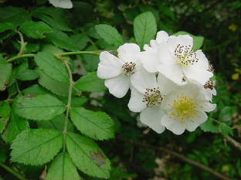
Invasive Plants
Not indigenous to an area
No natural consumers
Successfully out-compete native plants
Alter their environment
Japanese Knotweed
Phragmites
Multiflora Rose
Notes:
Grow together in riparian corridor
Non-native species are termed invasive because they are not indigenous to an area and do not have natural predators in their new environment, allowing them to successfully compete with native plants and alter their habitat (Enright 2000).

Slide 3

Invasive Plants
Understanding their water use is important for:
Water resource management
Predicting changes in biodiversity and plant community structure
Especially important for riparian species!
(Nature Conservancy)
Notes:
Take significant amounts of water from streams through transpiration
May be directly or indirectly competing for water resources with other species and therefore changing community
Understanding and assessing how these species affect the freshwater system would have economic and societal benefits and help in developing drought prevention and management strategies (Charles and Dukes 2007).
Studying the ways in which these non-native species uptake water can also provide valuable insight into the means by which they compete with and out-compete other species. Invasive species may have negative consequences on native biodiversity and can alter community structure through interference competition (Charles and Dukes 2007).

Slide 4
What We Found
Invasive riparian plant species are not all alike in terms of water use!
  Respond differently to soil moisture
  Have different transpiration rates
  Access different soil sources for water
Notes:
Invasive riparian plants do not have the same impact on water sources or responses/behavior!
Cannot be treated the same for removal projects, in estimating water use and in predicting changes to community structure

Slide 5
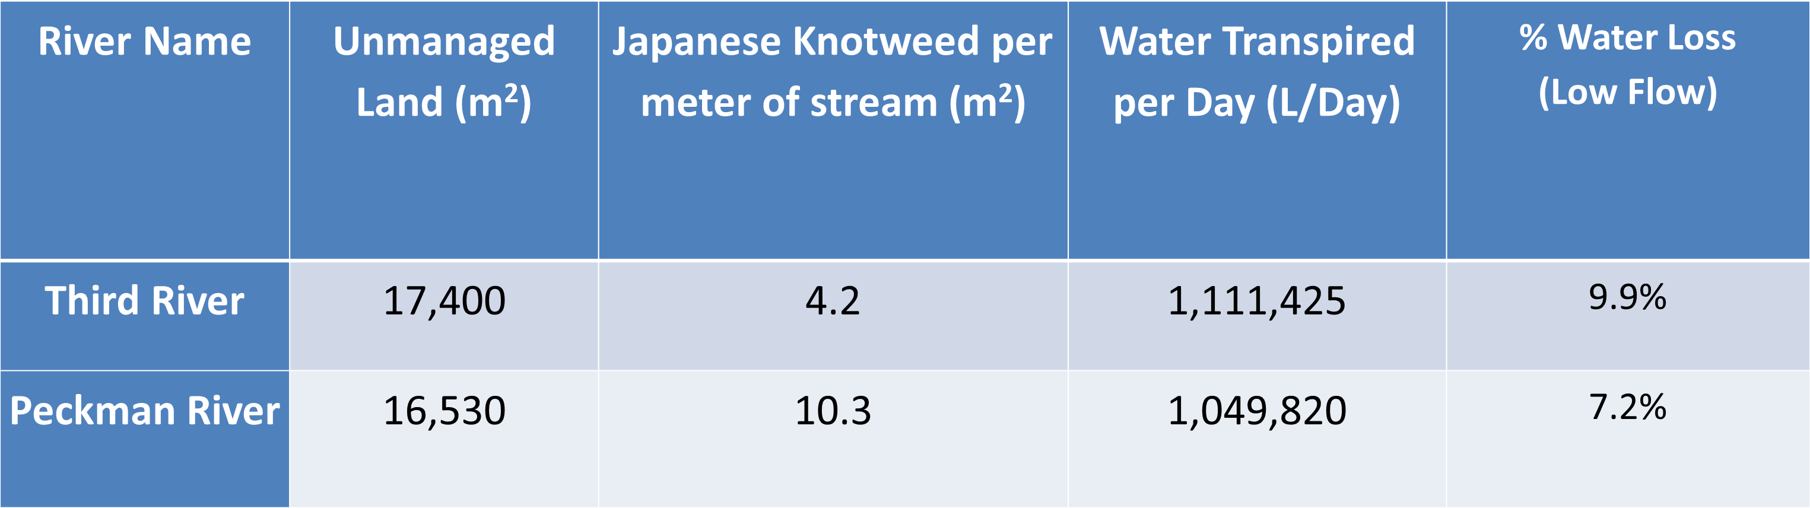
Previous Work
Japanese knotweed depletes up to 10% of total stream water during low-flow, summer months on two small streams in New Jersey.
Notes:
Research conducted in the past two years indicates that Japanese knotweed, a non-native plant species that grows abundantly in New Jersey, depletes up to 10% of the total water from streams during low-flow, summer months (Vanderklein et. all 2013)
Results show that Japanese Knotweed may be responsible for depleting up to 1.1 million liters of water/day from the Third River and 1.06 million liter/day from the Peckman River. This plant species has the potential to remove up to 9.9% of daily water flow from the Third River and 7.2% of daily water flow at the Peckman River during low flow (summer months). These water loss figures should be taken into account when estimating freshwater availability in New Jersey.

Slide 6
Research Questions
How do these three invasive species use water and respond to changes in soil moisture conditions?
Sampled soil and plant material in early, middle and late summer.
Measured transpiration rates.
Isotopic analyses of soil and plant material.

Slide 7
Background on Stable Isotopes
Given that:
Isotopic ratios for ¹⁸O and ²H vary throughout the soil column.
Plants don’t fractionate ¹⁸O and ²H.
We can:
Compare isotopic ratios between plant sap and soil to find the source of water transpired.
Notes:
Because the isotope ratios for hydrogen and oxygen vary throughout the soil column and water uptake by vegetation does not fractionate ¹⁸O and ²H, comparing isotope ratios between the water within plants with those in the soil can indicate the source of the water transpired (Orellana et. all 2012).

Slide 8
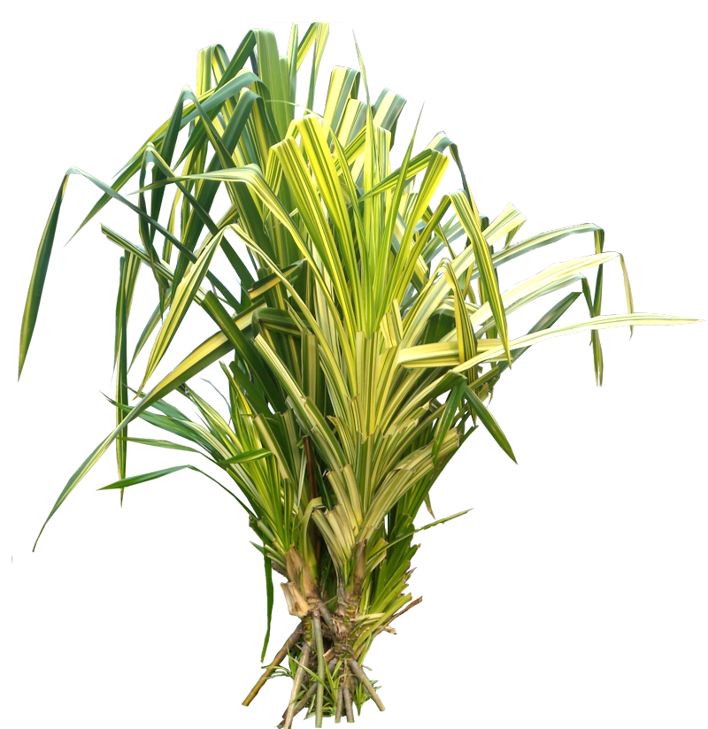
1
2
3
4
Notes:
A picture because this is so cool.

Slide 9
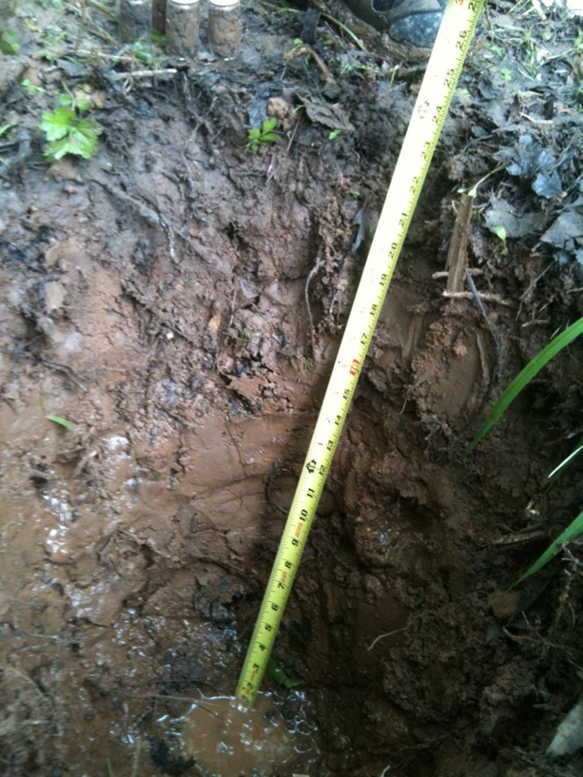
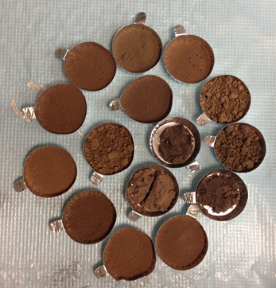
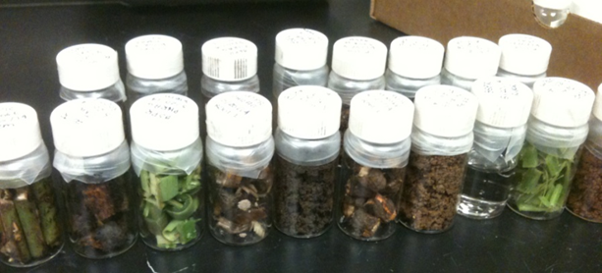
Methods: Sample Collection
Soil
Stem
Root
River
Notes:
Analyzing Isotopes
δ²H and δ¹⁸ O vs. VSMOW
Analyzed using a Thermo Delta V isotope ration mass spectrometer (IRMS) interfaced to a Gas Bench II.

Slide 10
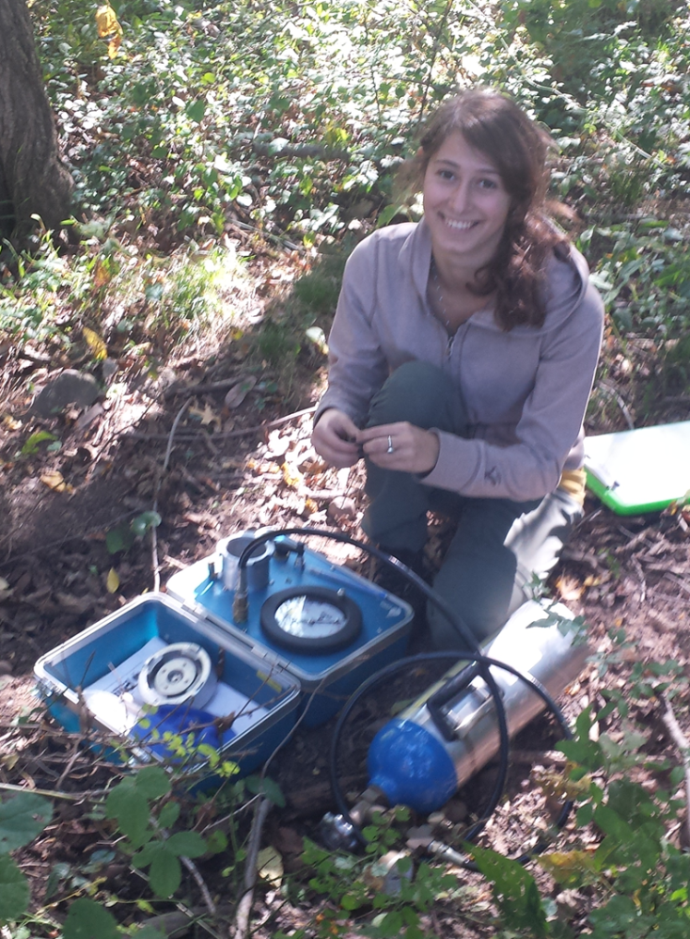
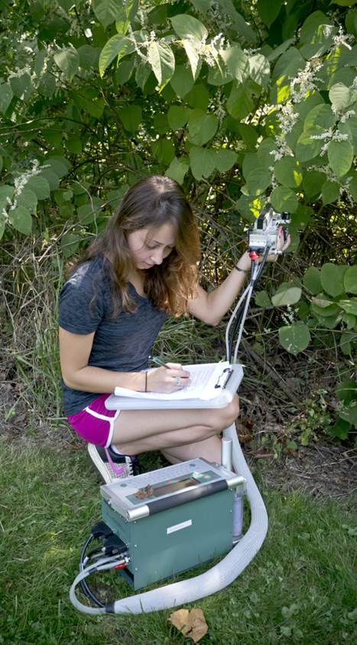
Methods: Physiology
Transpiration
Hydraulic conductivity
Leaf water potential
Notes:
Physiological Measurements
Transpiration, hydraulic conductivity and a suite of
related data using IRGA
Leaf water potential using PMS Model 600 Pressure Chamber

Slide 11
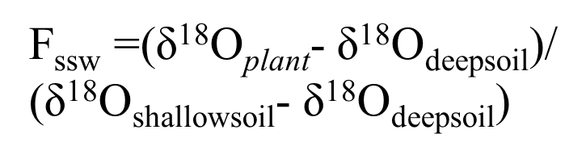
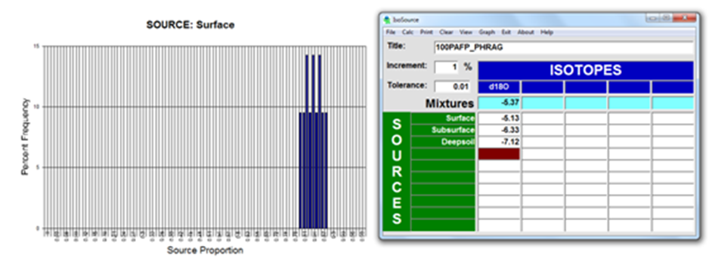
Methods: Mixing Models
Fraction of Shallow Soil Water equation (Darrouzet-Nardi et al. 2006)
IsoSource Software (EPA)

Slide 12
Results: Isotopes by Depth
²H and ¹⁸O are correlated.
Shallow soil is isotopically enriched.
Deeper soil is increasingly depleted.
Saturated soil isotopic ratios show no clear change with depth.
δ²H , δ¹⁸O
Notes:
Shallow soil is often more isotope enriched (less negative) than deep soil due to the fractionating effect of transpiration (Allison et al. 1983). The δ²H_{VSMOW} and δ¹⁸O_{VSMOW} values of the soils sampled beneath multiflora rose and phragmites supported this trend.
Phragmites often grew in saturated soils in which the water moved freely through the vertical soil profile. The δ²H_{VSMOW} and δ¹⁸O_{VSMOW} values in this soil therefore did not display the gradient expected in non-saturated soils. In most instances, isotopic values in this soil showed no clear change with depth.

Slide 13
Results: Water Sources
Japanese knotweed and Multiflora Rose
Used shallow water in the early summer
Sourced deeper water later in the season
Phragmites
Uses nearly 100% shallow water
Exceptions are dry periods when it is unavailable
Notes:
Water Sources
The δ²H_{VSMOW} and δ¹⁸O_{VSMOW} values for Japanese knotweed and multiflora were closest to the isotope signature of shallow soil layer (<10 cm) in the early summer 2014.
Results using the Fssw mixing model proposed by Darrouzet-Nardi et al. support that these two species used primarily shallow water early in the season and increasingly accessed deeper sources in the late summer/early autumn 2014.
Phragmites δ²H_{VSMOW} and δ¹⁸O_{VSMOW} values indicate that the species sourced primarily shallow water except during dry periods when it was less available.

Slide 14
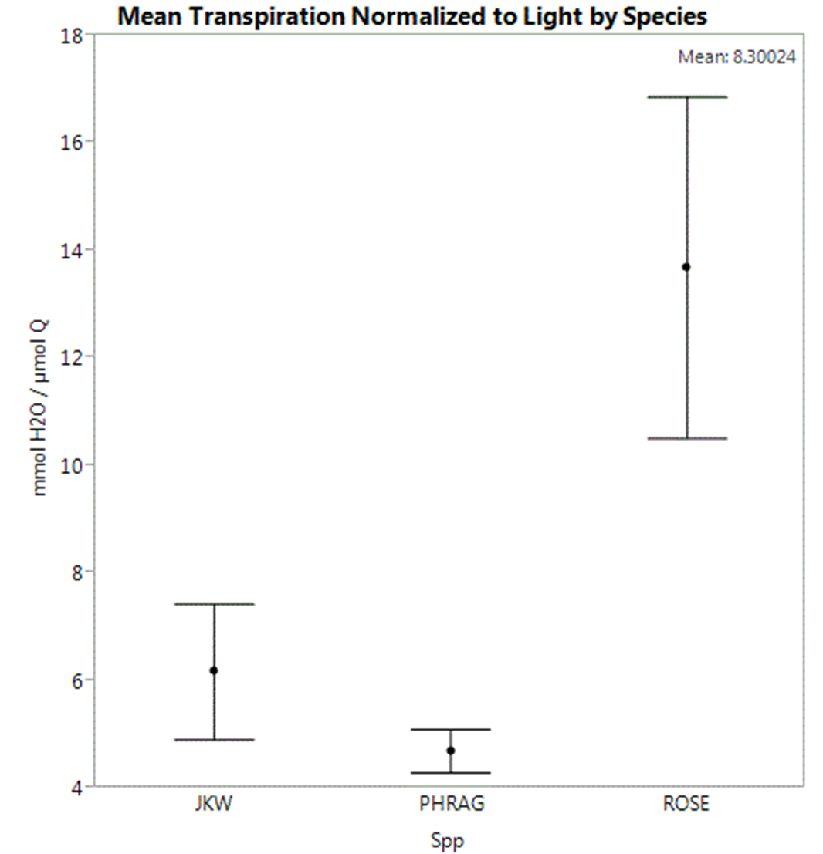
Results: Transpiration Rate
Transpiration Rate
Species
Notes:
Soil Moisture and Transpiration
Multiflora rose had consistently higher transpiration rates on average than phragmites or Japanese knotweed. One reason may be that multiflora rose typically grows in soil that is relatively dry compared with Japanese knotweed and phragmites, and water stressed species are often more water efficient.
Phragmites, the species typically found in inundated soil, correspondingly had the lowest average transpiration rates.

Slide 15
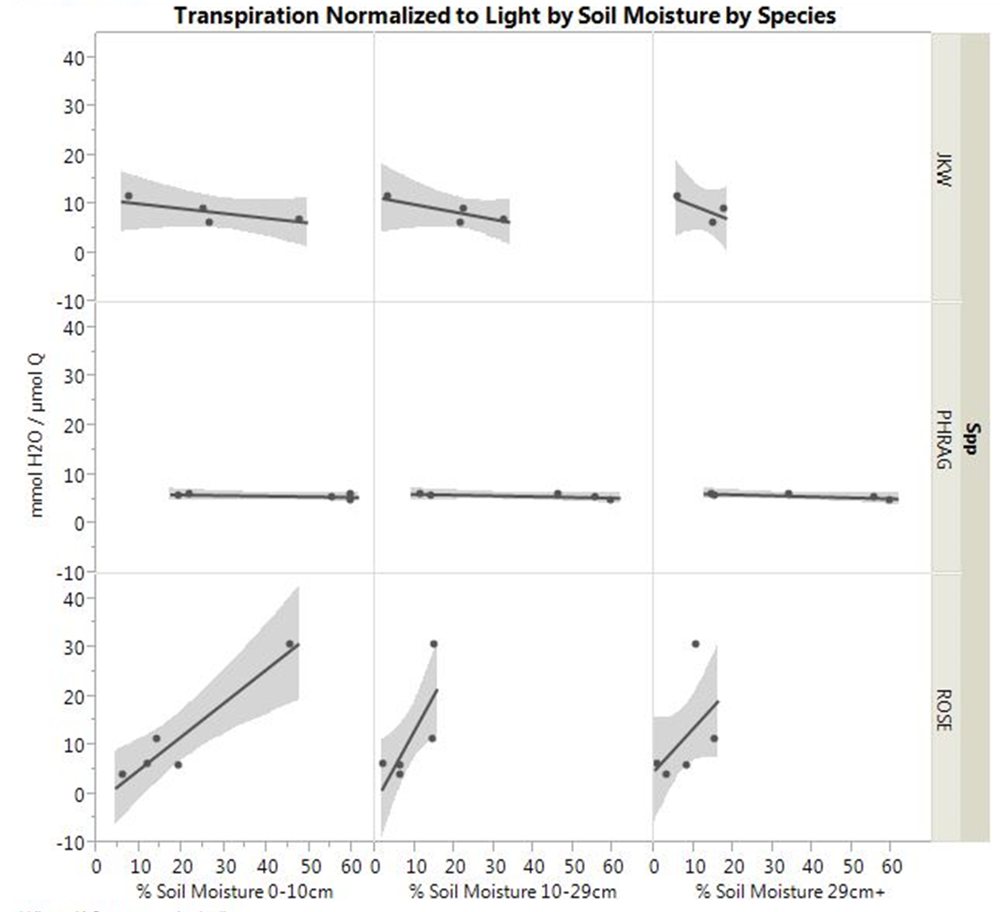
Results: Response to Soil Moisture
Multiflora rose responds to soil moisture – it transpires at a higher rate when there is more water available.
Transpiration Rate
Transpiration Rate
Transpiration Rate
% Moisture
% Moisture
% Moisture
Multiflora Rose
Phragmites
Japanese Knotweed
Notes:
Multiflora rose was also the only species of the three that responded to high and low soil moisture with increased and decreased transpiration, respectively.

Slide 16
Conclusions
Isotope ratios by depth
δ²H and δ¹⁸O are high in shallow soil
  Become depleted (more negative) in deeper soil
Water sources
Japanese knotweed and Multiflora rose use increasingly deeper water sources over the course of the season
Phragmites uses shallow water except during dry periods
Transpiration Rates
Multiflora rose has the highest transpiration rate
Phragmites has the lowest transpiration rate
Multiflora rose is the only species that responds to changes in soil moisture

Slide 17
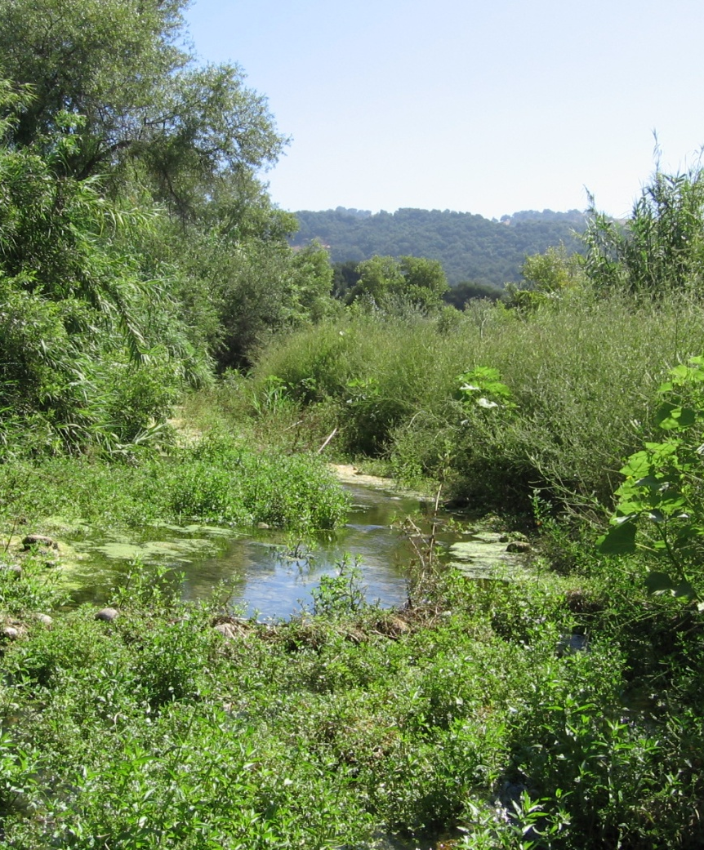
Why It Matters
Quantifying riparian vegetation affects on water resources, especially Japanese Knotweed and multiflora Rose.
Invasive species removal projects.
Predicting future plant community structure.

Slide 18
Future Work
Extend study to more non-native and native riparian species.
Monitor water sources and transpiration across more field seasons.
Quantify total water transpired by each species.
Notes:
Extend this study to more non-native and native species to make a complete set of baseline data on riparian species water use.
Monitor riparian plant water sources across more field seasons for a fuller understanding of water sourcing and use under a suite of hydrologic regimes.
Quantify the total water transpired by each species to compare their impacts on water availability.
Investigate the ways in which soil type affects isotope ratio changes with depth.

Slide 19



Acknowledgements
This undergraduate research project was supported by grants awarded to the Montclair State University Science Honors Innovation Program (SHIP) by the Merck Foundation and the Roche Foundation.
Thank you to the Cornell Isotope Lab (COIL) for isotopic analyses!
And to Stephen for his help in the field and lab.

Slide 20
References
Allison G B, Barnes C J and Hughes M W. 1983. The distribution of deuterium and ¹⁸O in dry soil. Exp. J. Hydrol. 64, 377-397.
Charles, H., and Dukes, J.S. Impacts of Invasive Species on Ecosystem Services. Ecological Studies, Vol.
193. W. Nentwig (Ed.). Biological Invasions. Springer-Verlag Berlin Heidelberg 2007. 217-237p.
Darrouzet-Nardi A, D’Antonio C M, Dawson T E. 2006. Depth of water acquisition by invading shrubs and resident herbs in a Sierra Nevada meadow. Plant and Soil. 285, 31-43.
Enright, W. D. The Effect of Terrestrial Invasive Alien Plants on Water Scarcity in South Africa. 2000. Phys. Chem. Earth (B), Vol 25, No. 3, pp 237-242
New Jersey Highlands Council. 2008. Water Resources Volume 2: Water use and availability. Technical Report. 235 p.
Orellana F., Verma P., Loheide II, S. P., and Daly E. 2012. Monitoring and Modeling Water-Vegetation
Interactions in Groundwater-Dependent Ecosystems. Reviews of Geophysics, 50, RG3003.
Vanderklein, D., Galster, J., Guzner M., Segura, M. 2013. The Impact of Japanese Knotweed on Stream
Water Content of the Peckman and Third Rivers, NJ. Montclair State University. MAESA Conference 2013.
Images:
http://sbc.lternet.edu/~leydecke/Al%27s_stuff/Ventura%20Nutrient%20TMDL/TMDL%20algal%20survey%20photos/2008_08_11.Diana%27s%20Expedition.VR06.3%20to%20VR11/03_Aug%2011,%202008_Kristie%27s%2007%20reach_aquatic%20plants%20and%20riparian%20willows%20now%20dominate%20what%20was%20bare%20cobbles.JPG
http://www.naturespot.org.uk/species/japanese-knotweed
http://www.greatswamp.org/MultifloraRose.htm
http://stewardsofwater.com/blog/phragmites-threatens-wetlands-in-guelph-ontario/
Thank you! ☺

Slide 21
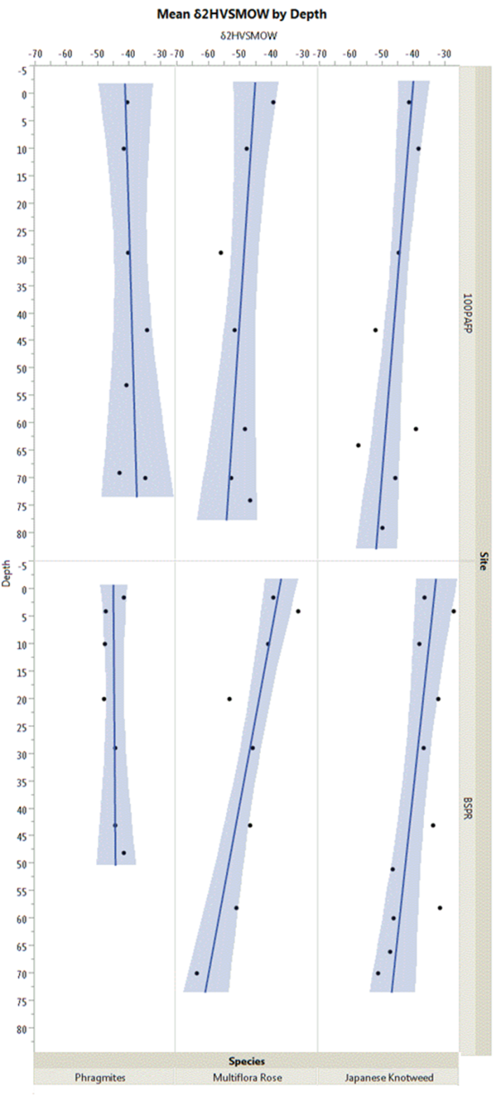
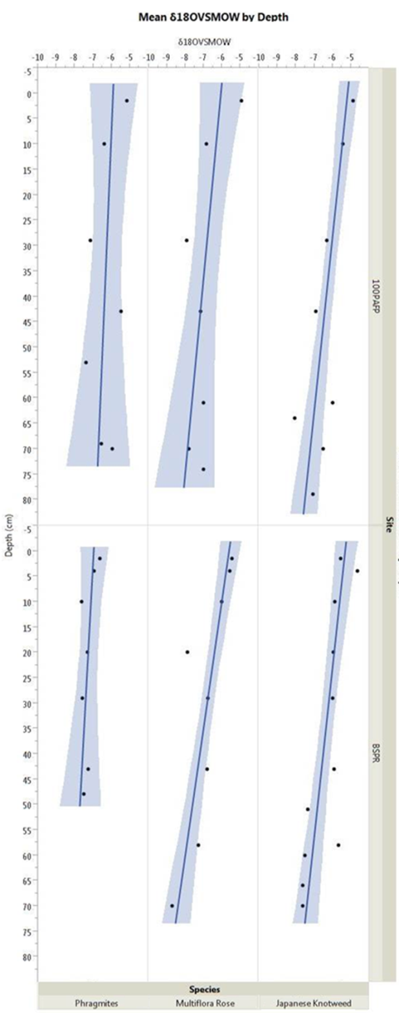

Slide 22
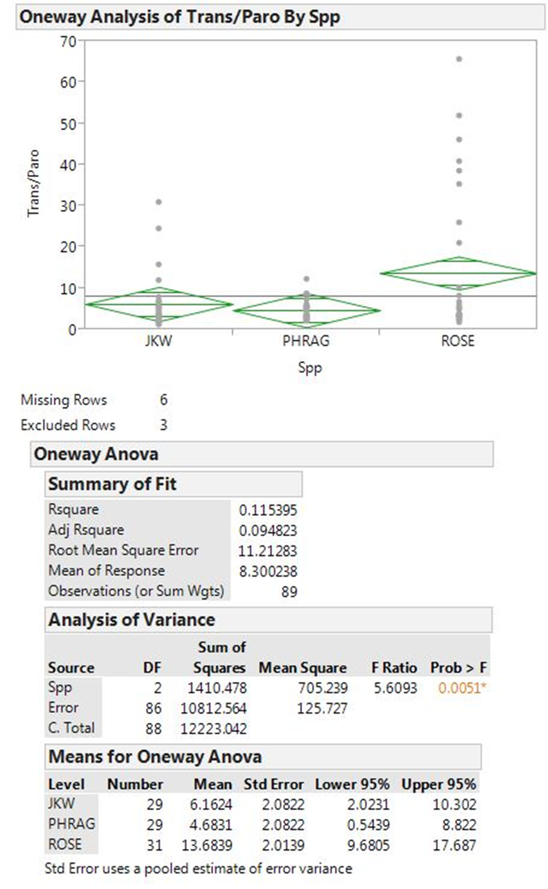

Slide 23


