Slide 1
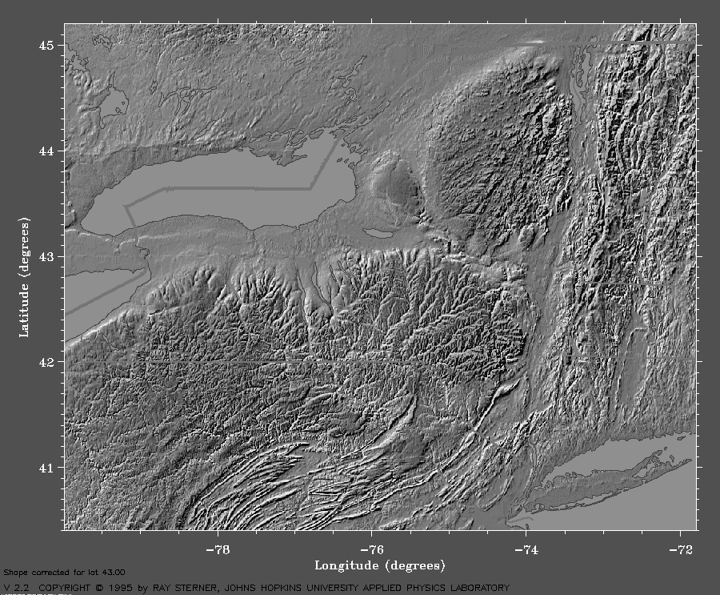
The Glacial Geology of the Hudson River Gorge based on Bridge Crossings between Albany Coveville and Newburgh, NY
By
ROBERT DINEEN
Lamb Cottage
Geigertown, PA
ERIC HANSON
Hanson-Van Vleet
Clifton Park, NY
Notes:
The title of this paper is: The Glacial Geology of the Hudson River Gorge based on Bridge Crossings between (Albany) Coveville and Newburgh, NY.
Note the slight increase in scope.
This is a report on the surficial geology sampled by test borings for bridge crossings of the Hudson River between Coveville and Newburgh, NY.
The bridge crossing data is supplemented by water well and boring logs compiled for a study of the bedrock topography initiated by Jim Davis and me during the late-60s.
We’ve also incorporated seismic refraction data from the bedrock study.
Numerous seismic lines were run on the Hudson’s floodplain from Coveville to the Rip Van Winkle Bridge crossing.
The bedrock study was discussed in Davis, 1968; Davis and Dineen, 1969; and Dineen, Hanson, and Waller, 1983.
Davis, J.F., 1968. Relationship of the preglacial Mohawk River to the Hudson River near their confluences (abstract): Geological Society of America, Northeast Meeting, Abstracts with Program, p. 35
Davis, J.F. and Dineen, R.J., 1969. A subsurface investigation of the bedrock configuration of the Hudson Valley and its tributaries between Albany and Catskill New York (abstract): Geological Society of America, Northeast Meeting, Abstracts with Program, p. 12
Dineen, R. J., Hanson, E. L, and Waller, R., 1983. Bedrock Topography and Glacial Deposits of the Colonie Channel between Saratoga Lake and Coeymans, New York: New York State Museum Map and Chart Series No. 37, 55 p.

Slide 2
St. Lawrence
Lowlands
Champlain
Lowlands
Adirondack
Mountains
Ontario Lowlands
Mohawk
Lowlands
Erie
Lowlands
New England Uplands
COVEVILLE
Connecticut Lowlands
ALBANY
Hudson Lowlands
Allegheny Plateau
NEWBURGH
PHYSIOGRAPHIC PROVINCES
Notes:
The study area is in the Hudson Lowlands of eastern New York State.
The lowlands were a major conduit for glacial ice during glacial advances. They channeled meltwater from the Hudson, Ontario, Champlain, and St. Lawrence lowlands during glacial retreat.
The advances and retreats of the glaciers resulted in multiple episodes of bedrock scour and deposition and erosion of glacial sediments.
Whereas complex sequences of glacial sediments are preserved on the Mohawk Lowlands and on Long Island, the Hudson Lowlands appear to record only the last retreat of the ice.
We examined test boring logs from bridge crossings of the Hudson River to refine the glacial stratigraphy in the Lowlands.
Fenneman, N.M., 1938. Physiography of the Eastern United States: McGraw-Hill Book Publishers, N.Y., 714 p.

Slide 3
COVEVILLE
Study Area
NEWBURGH
Notes:
The study area extends from Coveville to Newburgh.

Slide 4
LATE PLEISTOCENE STRATIGRAPHY
EASTERN NYS STRATIGRAPHY
Lake Stages
YOUNGER
DRYAS
STADE
HUDSON RIVER
Champlain Sea
10.5k
Outflow from Lake Vermont
“LAKE” FORT ANN
11,000
Catastrophic floods through
Champlain Lowlands (2X+)
LAKE COVEVILLE
10.9k
LAKE QUAKER SPRINGS
TWO CREEKS
INTERSTADE
11.8k
12,000
Catastrophic floods through
Mohawk Valley (3X)
LAKE ALBANY II
Tide waters in lower Hudson Valley
13,000
LAKE ALBANY I
AGE IN C-14 YEARS
PORT HURON
STADE
MOHAWK TILL:
MIDDLEBURGH-ROSENDALE
READVANCE
13.2?k
14,000
MACKINAW
INTERSTADE
?LITTLE FALLS GRAVEL?
PORT BRUCE
STADE
LAKE HUDSON
?HELL HOLLOW TILL?
15,000
ERIE
INTERSTADE
LITTLE FALLS GRAVEL
16,000
NISSOURI
STADE
HELL HOLLOW TILL
GLACIAL STRATIGRAPHY
Notes:
This slide shows the relationship between the glacial chronology and events in eastern New York.
The left-hand column shows the radiocarbon ages of the various glacial stages.
The events in the second column are divided into “stades” (glacial advances or cold periods) and “interstades” (glacial retreats or warm periods).
The ages of the events are approximate; there are few dates for the stages older than the Two Creeks Interstade.
The central column is the glacial stratigraphy of eastern New York.
It lists the major events that occurred in the Hudson-Champlain Lowlands.
The earliest event was the deposition of the Hell Hollow till by an Early Wisconsinan readvance.
The glacier retreated during the Erie Interstade and opened up the Mohawk Lowlands to eastward drainage from Central NYS.
The Little Falls Gravel was deposited during the Erie Interstade.
The ice returned during the Middleburgh-Rosendale readvance, resulting in the deposition of the Mohawk till
It advanced to the vicinity of Poughkeepsie, NY
Lake Hudson occupied the Hudson Valley south of Newburgh, NY
Lake Hudson was dammed by the Terminal Moraine.
As the M-R ice retreated from the Kingston area, Lake Albany formed between it and a dam in the Hudson Highlands.
The dam was probably the Shenandoah moraine.
The Middleburgh-Rosendale ice was retreating by 13,200 C-14 yrs ago
Lake Albany expanded as the ice retreated.
Tide water flooded the Hudson Gorge through the Hudson Highlands by 12,000 C-14 yrs ago.
The Lake Albany sequence is shown in the right-hand column.
The lake deposits decrease in age from south to north.
Falling lake level stages coincided with catastrophic floods emanating from the Mohawk and Champlain lowlands.
The glacial drainage was cut off when the Champlain Sea invaded the Champlain and western St. Lawrence Lowlands.
The Middleburgh-Rosendale readvance probably occurred during the Port Huron Stade, and most of the Lake Albany sediments were deposited during the Two Creeks Interstade.
Averill, S.P., Pardi, R.R., Newman, W.S., and Dineen, R.J., 1980. Late Wisconsin-Holocene History of the Lower Hudson Region: New Evidence from the Hackensack and Hudson River Valleys: in Manspeizer, W. (editor), Field Studies of New Jersey Geology and Guide to Field Trips: 52nd Annual Meeting, New York State Geological Association, pp. 160-190.
Chapman, D.H., 1942. Late-glacial and post-glacial history of the Champlain Valley: 23rd Annual Report, VT Geological Survey, pp. 48-
Clark, P.U. and Karrow, P.F., 1984. Late Pleistocene water bodies in the St. Lawrence Lowland, New York, and regional correlations: Geological Society of America Bulletin, v. 95, pp. 809-813*
Connally, G.G. and Cadwell, D.H., 2002. Glacial Lake Albany in the Champlain Valley: in McLelland, J. and Karabinos, P. (editors) Guidebook to Fieldtrips in New York and Vermont: New England Intercollegiate Geological Conference, 94th annual meeting and New York State Geological Association, 74th annual meeting, Lake George, NY, pp. B8-1 to B-26
Connally, G. G. and Sirkin, L. A., 1986. Woodfordian ice margins, recessional events, and pollen stratigraphy of the Mid-Hudson Valley: in Cadwell, D. H. (editor). The Wisconsinan Stage of the First Geological District, Eastern New York: New York State Museum Bulletin 455, pp. 50-72
Connally, G.G. and Sirkin, L.A., 1973. Wisconsinan history of the Hudson-Champlain lobe: in Black, R.F., Goldthwait, R.P., and Willman, H.B. (editors) The Wisconsinan Stage: Geological Society of America Memoir 136, pp. 47-70
DeSimone, D.J., 1992. Hudson Lowland lake levels: in Dineen, R.J., DeSimone, D.J., Hanson, E.L., LaFleur, R.G., 1992. The Late Glaciation of Eastern New York State: Glacial Tongues and Bergy Bits: 55th Annual Reunion, Friends of the Pleistocene, Clifton Park, NY
DeSimone, D.J., Wall, G.R., Miller, N.G., Rayburn, J.A., Kozlowski, A.L., 2008. Glacial geology of the northern Hudson through southern Champlain Lowlands: Guidebook to Field Trips for the 71st Annual Reunion Northeastern Friends of the Pleistocene, 58p.
DeSimone, D.J. and LaFleur, R.G., 1986. Glaciolacustrine phases in the northern Hudson Lowland and correlatives in western Vermont: Northeastern Geology, v. 8, no. 4, pp. 218-229
DeSimone, D.J. and LaFleur, R.G., 1985. Glacial geology and history of the northern Hudson Basin, New York and Vermont: New York State Geological Association Guidebook, 57th Annual Meeting, Trip A-10, pp. 82-116
Dineen, R.J., 2010. Whither readvances in the Hudson and Mohawk Lowlands?: Hudson-Mohawk Professional Geologists Association, Cadwell Lecture
Dineen, R.J., DeSimone, D.J., Hanson, E.L., LaFleur, R.G., 1992. The Late Glaciation of Eastern New York State: Glacial Tongues and Bergy Bits: 55th Annual Reunion, Friends of the Pleistocene, Clifton Park, NY, 60 p.
Dineen, R.J., DeSimone, D.J., and Hanson, E.L., 1988. Glacial Lake Albany and Its Successors in the Hudson Lowlands: in Brigham-Grette, J. (editor), Field Trip Guidebook, AMQUA 1988: Contribution No. 63, Department of Geology and Geography, University of Massachusetts, Amherst, MA, pp. 1-60
Dineen and others, 1983
Dineen, R.J. and Rogers, W.B., 1979. Sedimentary environments in Glacial Lake Albany in the Albany section of the Hudson-Champlain lowlands: in Friedman, G.M. (editor) Guidebook: Joint Annual Meeting, New York State Geological Association- Intercollegiate Geological Conference, try, N.Y., pp. 87-119
Donnelly, J.P., Driscoll, N.W., Uchupi, E., Keigwin, L.D., Schwab, W.C., Theiler, E.R., Swift, S.A., 2005. Catastrophic meltwater discharge down the Hudson Valley: a potential trigger for the Intra-Allerod cold period: Geology, v. 33, no. 2, pp. 89-92
Karrow, P.F., 1984. Quaternary stratigraphy and history, Great Lakes-St. Lawrence region: in Fulton, R.J. (editor) Quaternary Stratigraphy of Canada- a Canadian Contribution to IGCP Project: Geological Society of Canada, Paper 84-10, pp. 137-153
LaFleur, R.G., 1983. Mohawk Valley episodic discharges- the geomorphic and glacial sedimentary record: in Friedman, G.M. (editor). Annual Spring Meeting, April 29-May 1, 1983, Guidebook: National Association of Geology Teachers, Eastern Section, pp 45-68
LaFleur, R.L., 1979. Deglacial events in the eastern Mohawk-northern Hudson region: New York State Geological Association, Guidebook, 51st Annual Meeting, Trip B-6, pp. 326-350
LaFleur, R.L., 1965a. Glacial lake sequences in the eastern Mohawk-northern Hudson region: Guidebook to Field Trips, New York State Geological Association, pp. C1-C23
LaFleur, R.L., 1965b. Glacial geology of the Troy, New York quadrangle: N.Y.S. Museum and Science Service, Map and Chart 7, 22 p.
LaSalle, P., 1988. Quaternary stratigraphy of Quebec, a review: in Gadd, N.R., (editor) The Late Quaternary Stratigraphy of the Champlain Basin: Geological Association of Canada Special Paper 35, pp. 155-171
Miller, N.G., and Nestor, P.L., 2006.Paleoecology of a late Pleistocene wetland and associated Mastodon remains in the Hudson Valley, southeastern New York State: in Greb, F.S. and DiMichele, W.A. (editors) Wetlands Through Time: Geological Society of America Special Paper 399, pp. 299-304
Miller, N.G., (in press) Contemporary and prior environments of the Hyde Park, New York, Mastodon on the basis of associated plant fossils: Bulletin of American Paleobotany, v. 62
Pair, D. and Rodrigues, C. G., 1993. Late Quaternary deglaciation of the southwestern St. Lawrence Lowlands, Ontario and New York: Geological Society of America Bulletin, v. 105, pp. 1151-1164
Pair, D., Karrow, P.F., and Clark, P.U., 1988. History of the Champlain Sea in the central St. Lawrence Lowland, New York, and its relationship to water levels in the lake Ontario Basin in Gadd, N.R. (editor) The Late Quaternary Development of the Champlain Sea Basin: Geological Association of Canada, Special Paper 35, pp. 107-123
Parent, M. and Occhietti, S. 1999. Late Wisconsin deglaciation and glacial lake development in the Appalachians of southeastern Quebec: Geographie physique et Quaternaire, v. 53, pp. 117-135
Rayburn, J.A., Franzi, D.A., Knuepfer, P.K. 2002. A large late glacial breakout flood through the Champlain and Hudson lowlands, New York: (abstract) Geological Society of America Annual Meeting, Denver, CO
Richard, P.J.H and Occhietti, S., 2005. ¹⁴C chronology for ice retreat and inception of Champlain Sea in the St. Lawrence Lowlands, Canada: Quaternary Research, v. 63, pp. 353-358
Ridge, J.C., Canwell, B.A., Kelly, M.A., and Zelley, S.Z., 2001. Atmospheric ¹⁴C chronology for late Wisconsinan deglaciation and sea-level change in eastern New England using varve and paleomagnetic records: in Weddle, T.K. and Retelle, M.J. (editors) Deglacial History and Relative Sea Level Changes, Northern New England and adjacent Canada: Geological Society of America Special Paper 351, pp. 171-189
Ridge, J.C. 1991. Late Wisconsinan glaciation of the western Mohawk Valley and west Canada Valley of Central New York: Field Trip Guidebook: Northeastern Friends of the Pleistocene, 54th Annual Reunion, Herkimer, New York
Ridge, J.C., 1997. Shed Brook Discontinuity and Little Falls Gravel: evidence for the Erie Interstade in central New York: Geological Society of America Bulletin, v. 109, pp. 652-665
Ridge, J.C., 2003. The last deglaciation of the northeastern United States: a combined varve, paleomagnetic, and calibrated ¹⁴C chronology: in Cremeens, D.L. and Hart, J.P. (editors), Geoarcheology of Landscapes in the Glaciated Northeast: New York State Museum Bulletin 497, pp. 15- 45
Ridge, J.C., 2004. The Quaternary glaciation of western New England with correlations to surrounding areas: in Ehler, J.G. and Gibbons, P.L. (editors) Quaternary Glaciations Extent and Chronology, Part II, North America: Developments in Quaternary Science 2. Elsevier, New York, pp. 169-199
Ridge, J.C. and Larsen, F.D., 1990. Re-evaluation of Antevs’ New England varve chronology and new radiocarbon dates of sediments from Glacial Lake Hitchcock: Geological Society of America Bulletin, v. 102, pp. 889-899
Ridge, J.C., Besonen, M.R., Brochu, M., Brown, S.L., Callahan, J.W., Cook, G.J., Nicholson, R.S., and Toll, N.J. 1999. Varve, paleomagnetic, and 14C chronologies for Late Pleistocene events in New Hampshire and Vermont, U.S.A.: Geographie physique et Quaternaire, v. 53, No. 1, pp. 79-106
Stoller, J.H., 1911. Glacial geology of the Schenectady Quadrangle: New York State Museum Bulletin 154, 44 p.
Stoller, J.H., 1916. Glacial geology of the Saratoga Quadrangle: New York State Museum Bulletin 183, 50 p.
Stoller, J.H., 1920. Glacial geology of the Cohoes Quadrangle: New York State Museum Bulletin 215-216, 49 p.
Wall, G.R. and LaFleur, R.G., 1995. The paleofluvial record of Glacial Lake Iroquois in the eastern Mohawk Valley, New York: in Garver, J.I. and Smith, J.A. (editors) Guidebook to Field Trips: 67th Meeting, New York State Geological Association, Union College, Schenectady, NY, pp. 173-203

Slide 5
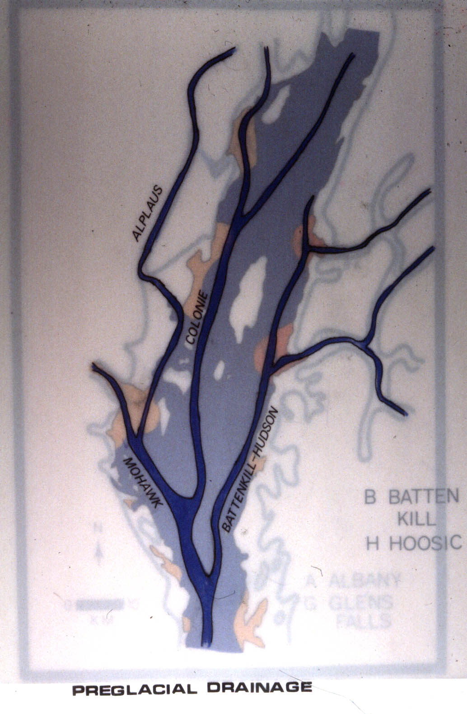
FORT ANN
PREGLACIAL DRAINAGE
GLENS FALLS
BATTEN KILL
THREE MAJOR PREGLACIAL
CHANNELS
COLONIE
COVEVILLE
Mohawk
Colonie
Batten Kill-Hudson
SARATOGA
SPRINGS
HOOSIC
THREE TRIBUTARIES
MOHAWK
ALBANY
Alplaus
Batten Kill
Hoosic
BATTEN KILL-HUDSON
0
10
RAVENA
KM
Notes:
This map shows the northern portion of the Study Area.
The Hudson Lowlands north of Ravena were drained by a trellis drainage system during pre- and inter-glacial times.
Three major streams drained the area:
The Mohawk drained the Mohawk Lowlands, southern Adirondacks, and northern Allegheny Plateau.
The Colonie was the primary stream and drained the eastern Adirondacks through its tributary, the Alplaus.
This map shows the northern portion of the Study Area.
The Hudson Lowlands north of Ravena were drained by a trellis drainage system during pre- and inter-glacial times.
Three major streams drained the area:
The Mohawk drained the Mohawk Lowlands, southern Adirondacks, and northern Allegheny Plateau.
The Colonie was the primary stream and drained the eastern Adirondacks through its tributary, the Alplaus.
And the Batten Kill-Hudson drained the New England Uplands via its tributaries, the Batten Kill and Hoosic rivers.
The Mohawk and Colonie channels are buried by thick glacial deposits.
The Lowlands were flooded by Glacial Lake Albany (in blue) during late glacial time.
The preglacial channels provided space for the deposition of large volumes of glacial sediments.
And the Batten Kill-Hudson drained the New England Uplands via its tributaries, the Batten Kill and Hoosic rivers.
The lower Mohawk and Colonie river channels are buried by thick glacial deposits.
The Lowlands were flooded by Glacial Lake Albany (in blue) during late glacial time.
The preglacial channels provided space for large volumes of glacial deposits.
The present Hudson River occupies the Batten Kill-Hudson channel from Coveville to Ravena.
Davis, J.F., 1968
Davis, J.F. and Dineen, R.J., 1969
Dineen and Rogers, 1979
Dineen, Hanson, and Waller, 1983
Simpson, E.S., 1949. Buried preglacial groundwater channels in the Albany-Schenectady area in New York: Economic Geology, v. 44, pp. 713-720

Slide 6
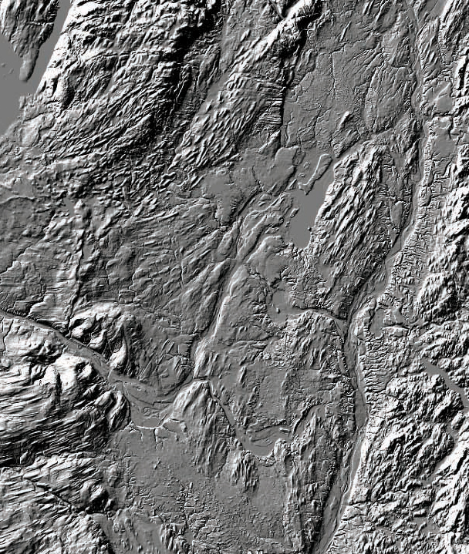
FORT ANN
GLENS FALLS
COVEVILLE
SARATOGA
SPRINGS
SARATOGA
LAKE
ALPLAUS CHANNEL
COLONIE CHANNEL
MOHAWK RIVER
MOHAWK RIVER
SCHENECTADY
HUDSON RIVER
TROY
MOHAWK CHANNEL
ALBANY
NORTHERN REACH
Notes:
This is a Digital Elevation Model of the northern Hudson Lowlands.
It was generated by the NYSGS.
It shows the major physiographic features of the northern Hudson Lowlands and the location of the Northern Cross Sections.
Note the multiple troughs in the landscape.
The preglacial Mohawk, Colonie, and lower Alplaus channels are buried by glacial lake deposits.
The Northern Cross Sections are within the red oval.

Slide 7
FORT ANN
BATTEN KILL
DELTA
COVEVILLE
SARATOGA
SPRINGS
IRO-MOHAWK
HOOSIC
DELTA
SCHENECTADY
SCHENECTADY
DELTA
TROY
HUDSON RIVER
ALBANY
NORTHERN REACH
Notes:
The deposits sampled by the Northern Cross Sections were emplaced, in part, by catastrophic flood waters from the Mohawk Lowlands.
The flood waters were the outflow of Glacial lake Iroquois in the Ontario Lowlands.
They were the Iro-Mohawk drainage.
The Iro-Mohawk floods were deflected north-northeast, into the Alplaus channel, when Lake Albany dropped from the Albany I level to the Albany II level.
The Hudson River flows in a deep trench carved by catastrophic floods from the Mohawk and Champlain valleys.
The Iro-Mohawk flowed from the Mohawk Valley.
They included the Quaker Springs and Coveville floods.
The Iro-Mohawk overflow spilled through channels cut into the eastern wall of the Alplaus Channel.
The northernmost, or Fish Creek channel entered the Batten Kill-Hudson channel at Coveville.
Some of the Coveville and all of the Fort Ann floods came from the Champlain Valley.
The catastrophic flood channel and the course of the present Hudson River was deflected by the glacial Batten Kill and Hoosic River deltas.
The yellow dot is the location of the radiocarbon-dated Lake Quaker Springs deposit that Norton Miller and I reported on in 2006.
It was dated a 11,900 C-14 yr BP.
Brigham, A.P., 1929. Glacial Geology and Geographic Conditions of the Lower Mohawk Valley: New York State Museum Bulletin 280, 233 p.
Dineen, R.J. and Miller, N.G., 2006. Age and paleoecology of plant fossils associated with the Quaker Springs stage of Lake Albany and a chronology of events in the Hudson-Champlain lowlands New York (abstract): Geology Society of America, Abstract with Programs 38, Northeast Meeting, p. 8*
Dineen, R.J. and Hanson, E.L., 2011. Glacial lake chronology in the Hudson Lowlands, New York. Geological Society of America, Northeastern Section, 47th Annual Meeting, Abstracts with Programs
Dineen, R.J. and Hanson, E.L. 1995. Glacial Deposits in the Mohawk and Sacandaga Valleys, or a Tale of Two Tongues Redux: in Garver , J.I. and Smith, J.A. (editors), Field Trip Guide for the 67th Annual Meeting of the New York State Geological Association: New York State Geological Association, 67th Annual Meeting, Union College, Schenectady, NY, pp. 39-55
Dineen, R.J. and Hanson, E.L., 1985. Deglaciation of the Middle Mohawk and Sacandaga Valleys, or a Tale of Two Tongues: in Lindemann, R. (editor), Field Trip Guide Book: New York State Geological Association, 57th Annual Meeting, pp. 250-268.
Hanson, E.L., 1977. Late Woodfordian drainage history of the lower Mohawk Valley: Rensselaer Polytechnic Institute, Masters Thesis, 62 p.
LaFleur, 1965, 1979, 1983
Stoller, 1911, 1916, 1920
Wall and LaFleur, 1995

Slide 8
FORT ANN
COVEVILLE
K
K’
S
S’
Preglacial
Batten Kill-
Hudson
C
C’
W
W’
Cross-
Section
ALBANY
NORTHERN REACH
Notes:
This shows the locations of the Northern Cross Sections.
They are, from north to south:
The Kroma Kill Section,
The Stillwater Section,
The Campbell Island Section,
and the Waterford Section.
The Kroma Kill Section is only a few miles south of the Iro-Mohawk- scoured area around Coveville.
The Stillwater Section is at the confluence between the Hoosic and Hudson rivers.
The Campbell Island and Waterford sections lie at the south end of this reach.
The Campbell Island Section is where the retreating ice front was when the Lake Albany levels fell from Albany I to Albany II.
DeSimone and LaFleur, 1986
Dineen and others, 1992
DeSimone and others, 2005
The Waterford section is just upstream from the confluence of the Mohawk and Hudson rivers.

Slide 9
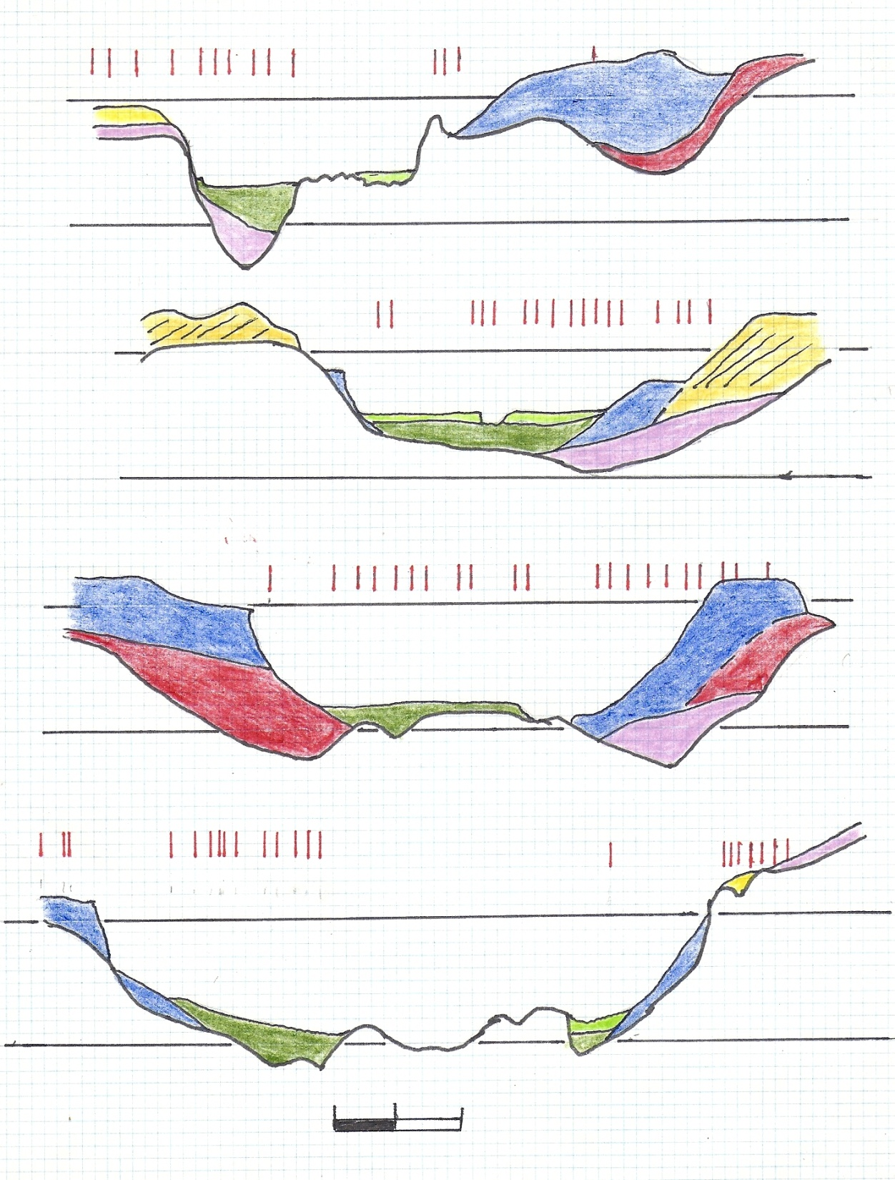
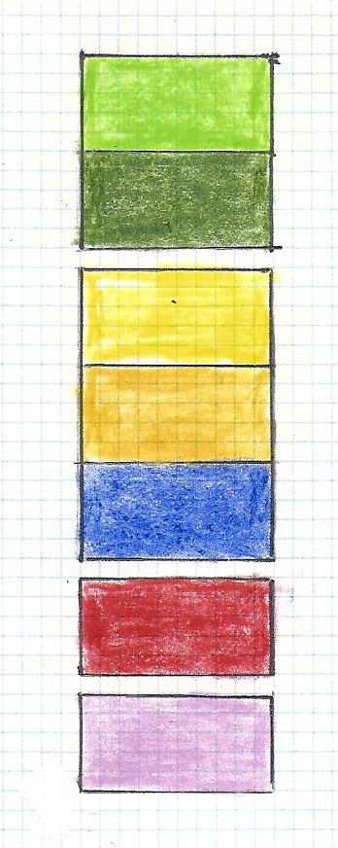
KROMA KILL
K
K’
NORTHERN REACH
200 ft
200 ft
LITHOLOGY
SL
SL
STILLWATER
S
S’
200 ft
200 ft
LEGEND
HOLOCENE ALLUVIUM
FORT ANN
SL
SL
LAKE ALBANY SAND
C
CAMPBELL ISLAND
C’
LAKE ALBANY DELTAICS
200 ft
200 ft
LAKE ALBANY CLAY and SILT
ICE-CONTACT STRATIFIED DRIFT
TILL
SL
SL
WATERFORD
W
W’
200 ft
200 ft
View from the South
(Upstream)
SL
SL
0
2,000
10X Vertical Exaggeration
FEET
Notes:
The deposits in Cross Sections in the Northern Reach are described here.
Elevations are in feet, referred to sea level.
Data points used in the cross sections are the red dashes above the sections.
The data points include wells or borings and seismic refraction lines, plus field observations.
The units are (from top to bottom):
Holocene alluvium, consisting of silty sand and gravel, with gravel predominating towards the base.
Fort Ann III flood deposits, consisting of gravelly sand.
Coveville flood deposits near Stillwater, consisting of boulder gravel.
An erosional disconformity, traceable from the Kroma Kill to the Newburgh-Beacon Bridge.
Lake Albany Sand, consisting of Albany II, Quaker Springs, and Coveville fine to medium sand.
Lake Albany deltaics, consisting of Albany II, Quaker Springs, and Coveville sand and gravel.
Lake Albany II varved clay and silt.
Ice-Contact Stratified Drift, consisting of sand and gravel.
Till, consisting of bouldery, silty, clay diamicton.
Dahl
DeSimone and others, 2005
Hanson, 1977

Slide 10
200 ft
LA II
200 ft
KROMA KILL
Preglacial
Tributary
SL
Preglacial
Batten Kill-
Hudson
SL
Hoosic
Delta
200 ft
200 ft
STILLWATER
LA II
Preglacial
Batten Kill-
Hudson
SL
SL
Coveville
gravel
200 ft
200 ft
LA II
CAMPBELL ISLAND
LA II
SL
Preglacial
Batten Kill-
Hudson
SL
200 ft
200 ft
WATERFORD
SL
SL
0
NORTHERN REACH
2,000
STRATIGRAPHY
FEET
Notes:
The interpretation of the deposits identified in the cross sections is as follows:
The Kroma Kill Section is notable for the thick wedge of Albany II silt and clay burying a tributary valley east of the Hudson;
Till lines the preglacial Batten Kill-Hudson channel;
Quaker Springs sand lies west of the Hudson, it was distributed by Iro-Mohawk flow from the Coveville channel;
a deep gorge is cut into the older deposits;
it is 230 ft deep;
and a thick section of Fort Ann III sediments lies in the preglacial Batten Kill-Hudson channel.
The Stillwater Cross Section shows:
Till lines the Batten Kill-Hudson channel;
Quaker Springs stage deltaics were deposited by the Hoosic River;
and Coveville-Fort Ann flood deposits occupy the gorge cut into the older deposits by the Coveville floods.
The gorge is 180 ft deep.
Campbell Island Cross Section is the “Bergy Bits” locality of DeSimone, described in Dineen and others, 1992; DeSimone and others, 2005.
Till lines the preglacial Batten Kill-Hudson channel;
ICSD overlies the Till.
The ICSD is a common unit at the base of the Lake Albany deposits.
In this case, the thickness of the ICSD suggests an ice marginal position, as noted by DeSimone, 1992.
Here, Lake Albany fell from the Albany I level to the Albany II level.
The Coveville-Fort Ann beds are relatively thin at this location;
And lie at the base of a 180 ft- deep gorge.
The Waterford Cross Section shows evidence of extensive scour to a depth of 250 ft, with relatively thin Coveville-Fort Ann deposits over the bedrock.
DeSimone and LaFleur, 1986
DeSimone, 1992
DeSimone, and others, 2005
Dineen and Rogers, 1979
Dineen and others, 1983, 1992
Dineen and Hanson, 2011

Slide 11
200 ft
200 ft
KROMA KILL
230 ft
SL
SL
200 ft
200 ft
180 ft
STILLWATER
SL
SL
200 ft
200 ft
CAMPBELL ISLAND
210 ft
SL
SL
200 ft
200 ft
WATERFORD
250 ft
SL
SL
0
2,000
NORTHERN REACH
DEPTH of SCOUR
FEET

Slide 12
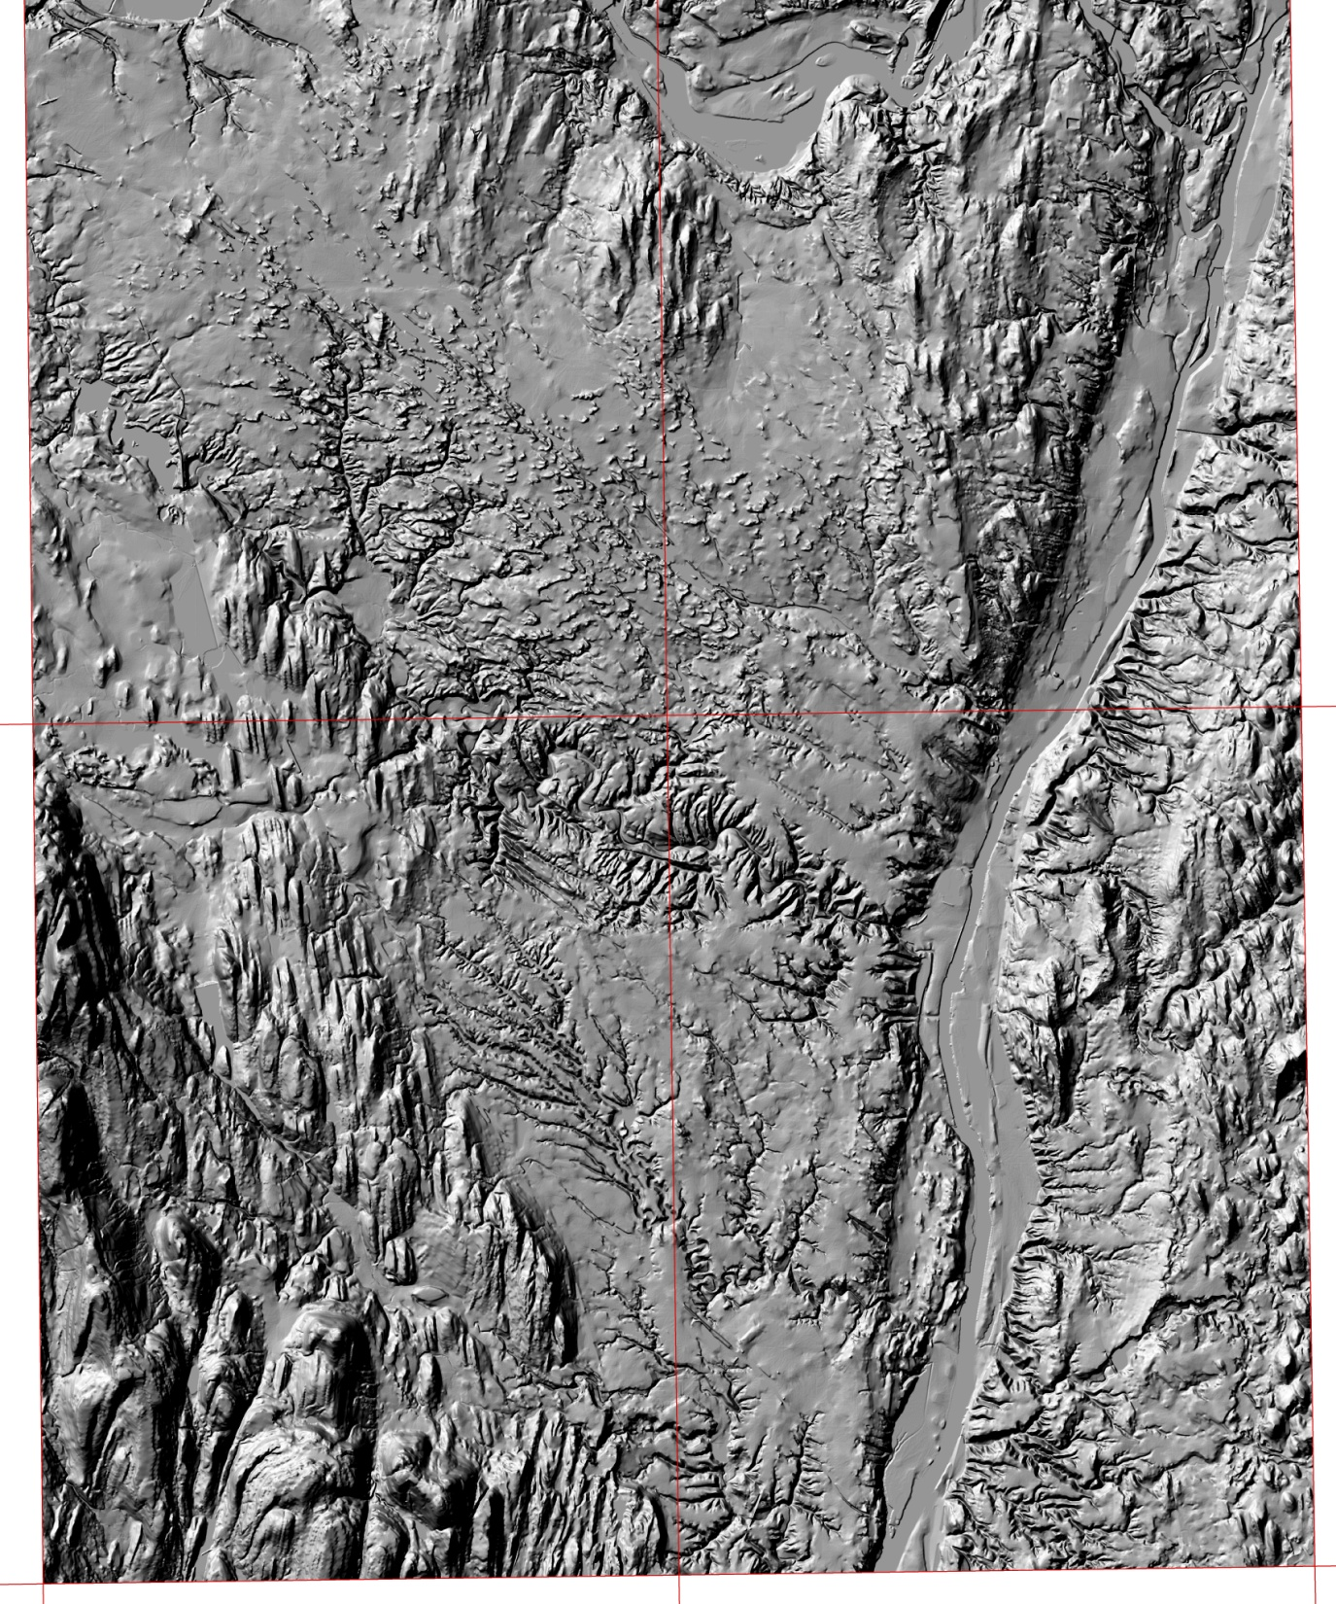
SCHENECTADY
COHOES
Colonie Channel
Alplaus Channel
Mohawk Channel
Hudson-Batten Kill Channel
T
T’
ALBANY
I
I’
Colonie Channel
A
RENSSELAER
A’
Preglacial
Batten Kill-
Hudson
G
G’
Cross-
Section
Hudson-Batten Kill Channel
Cohoes
C-14 Site
Corning Connection
Colonie Channel
ALBANY REACH
Notes:
The Albany Area Sections are downstream from the confluence of the Mohawk and Hudson rivers.
The Hudson follows the Batten Kill-Hudson channel.
The Colonie and Mohawk channels are buried under thick glacial sediments.
The Yellow dot marks the location of Norton Miller’s fossil wood bed at Cohoes,
the bed dated at approximately 10,500 C-14 years, BP
and was at an elevation of approximately +120 ft.
The cross sections include:
The Troy-Menands Cross Section;
The crossing of Interstate I-90;
The Albany-Rensselaer Cross Section;
and the Glenmont Cross Section.
Davis, 1968
Davis and Dineen, 1969
DeSimone and others, 2005
Dineen and others, 1983
LaFleur, 1965a
Miller, N.G. and Griggs, L.B., 2004. Younger Dryas peat and wood from near the Cohoes Mastodon site, Albany County, New York: Poster
Schrock, R.N., 1963. Geology of the Pleistocene sediments, Troy North quadrangle: Rensselaer Polytechnic Institute, Masters Thesis, 82 p.

Slide 13
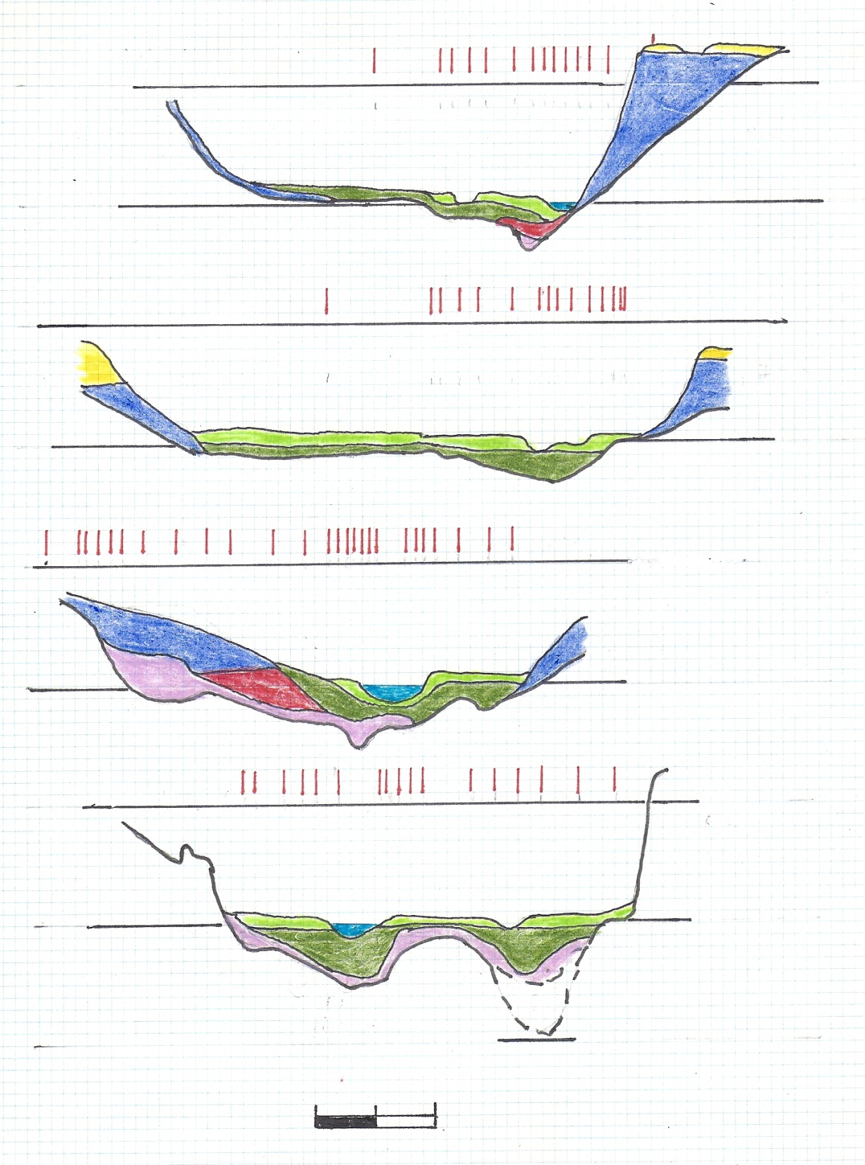
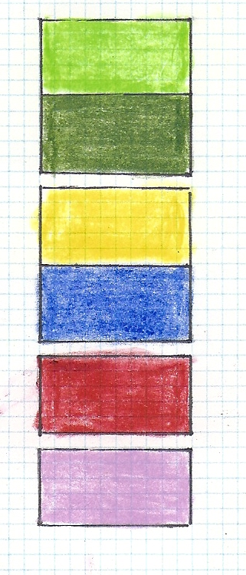
T
T’
ALBANY REACH
200 ft
TROY-MENANDS
200 ft
LITHOLOGY
SL
SL
I
I’
200 ft
200 ft
LEGEND
INTERSTATE I-90
HOLOCENE ALLUVIUM
SL
FORT ANN
SL
LAKE ALBANY SAND
A
A’
200 ft
200 ft
LAKE ALBANY CLAY and SILT
ALBANY-RENSSELEAR
ICE-CONTACT STRATIFIED DRIFT
SL
SL
TILL
G
G’
200 ft
GLENMONT
200 ft
SL
SL
View from the South
(Upstream)
SEISMIC
?
0
2,000
10X Vertical Exaggeration
FEET
Notes:
The units are (from top to bottom):
Holocene alluvium, consisting of silty sand and gravel, with gravel predominating towards the base.
Fort Ann flood deposits, consisting of gravelly sand.
A disconformity.
Lake Albany Sand, consisting of Albany II and Quaker Springs fine to medium sand.
Lake Albany I and II varved clay and silt.
Ice-Contact Stratified Drift, consisting of sand and gravel.
Till, consisting of bouldery, silty, clay diamicton.
LaFleur, 1965b

Slide 14
200 ft
LA I & II
200 ft
TROY-MENANDS
SL
Preglacial
Batten Kill-
Hudson
SL
200 ft
200 ft
INTERSTATE I-90
SL
SL
200 ft
200 ft
ALBANY-RENSSELEAR
LA I & II
SL
SL
Preglacial
Batten Kill-
Hudson
Loudonville
Esker
Complex
200 ft
200 ft
GLENMONT
SL
SL
Flood-Scoured
Bedrock
Preglacial
Batten Kill-
Hudson?
SEISMIC
0
2,000
STRATIGRAPHY
ALBANY REACH
FEET
Notes:
All of the cross sections contain relatively thin Late Glacial and Holocene sediments, and all were deposited in the deeply scoured Coveville-early Fort Ann gorge.
The Troy-Menands Cross Section is floored by a small inner gorge containing Till,
representing the Batten Kill-Hudson channel.
The thick clay and silt sequence to the east is Albany I deep-water deposits.
The Coveville-Fort Ann deposits are thin here and are at the base of a 270-ft gorge.
The Interstate I-90 Section is incised into Lake Albany I silt and clay and Quaker Springs sand.
Till was not sampled at this location.
The thin Holocene and Ft. Ann deposits lie in a 240-ft gorge.
The Albany-Rennselaer Cross Section is more complex:
The base contains Till over the Batten Kill-Hudson channel.
A thick sequence of ICSD overlies the Till,
it is an extension of the Loudonville Esker Complex.
Albany I silt and clay overlies the esker complex.
A thick wedge of Fort Ann flood deposits overlies the older deposits.
They lie at the base of a 270-ft gorge.
The Glenmont Cross Section also shows signs of scour,
including a thin remnant of till overlying the older bedrock topography
and exposures of flood-scoured bedrock to +150 ft on the west side of the section.
The Coveville-early Ft. Ann gorge is 270 ft deep.
The bedrock gorge shown on the eastern side of the section is based on a projection of seismic data to the north and south.
LaFleur, 1965b

Slide 15
200 ft
200 ft
TROY-MENANDS
270 ft
SL
SL
200 ft
200 ft
INTERSTATE I-90
240 ft
SL
SL
200 ft
200 ft
ALBANY-RENSSELEAR
270 ft
SL
SL
200 ft
200 ft
GLENMONT
270 ft
SL
SL
SEISMIC
0
2,000
ALBANY REACH
DEPTH of SCOUR
FEET

Slide 16
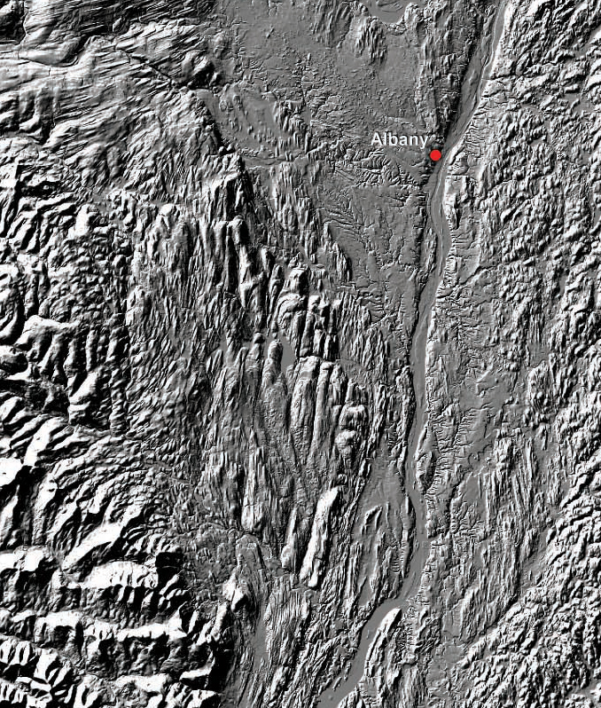
SCHENECTADY
Mohawk Channel
Batten Kill-Hudson Channel
Colonie Channel
B
B’
C
C’
RAVENA
N
N’
S
S’
HUDSON
CATSKILL
CONFLUENCE REACH
Notes:
The Confluence Reach includes the confluence of the Colonie and Batten Kill-Hudson channels.
The cross sections include the:
The Berkshire Spur of the NYS Thruway, upstream from the confluence;
The Coeymans Cross Section, at the confluence;
The New Baltimore Cross Section, downstream of the confluence;
And the Stockport Cross Section north of Hudson, NY.
The three southernmost cross sections are based primarily on seismic lines.
Davis, 1968
Davis and Dineen, 1969
Dineen and others, 1983

Slide 17
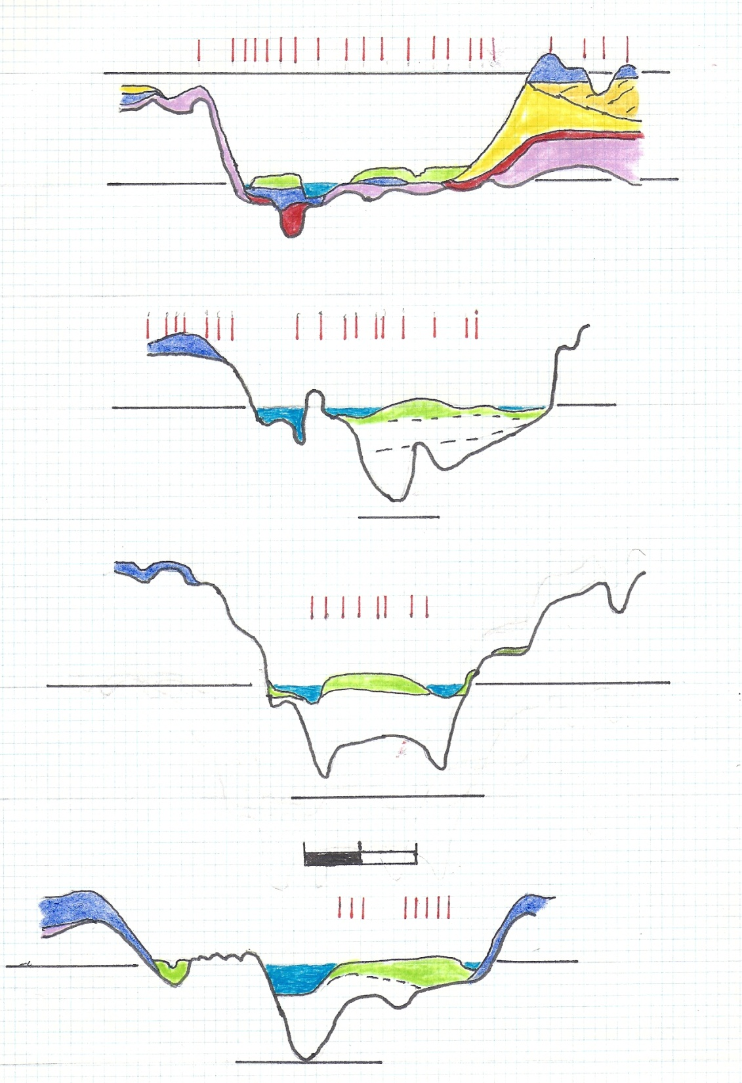
B
B’
200 ft
200 ft
CONFLUENCE REACH
BERKSHIRE SPUR
LITHOLOGY
SL
SL
LEGEND
C
C’
HOLOCENE ALLUVIUM
COEYMANS
FORT ANN
SL
SL
SEISMIC
LAKE ALBANY SAND
N
-200 ft
-200 ft
N’
LAKE ALBANY DELTAICS
NEW BALTIMORE
LAKE ALBANY CLAY and SILT
SL
SL
SEISMIC
ICE-CONTACT STRATIFIED DRIFT
-200 ft
-200 ft
0
2,000
TILL
S
S’
STOCKPORT
View from the South
(Upstream)
SL
SL
SEISMIC
-200 ft
-200 ft
10X Vertical Exaggeration
Notes:
The units are (from top to bottom):
Holocene alluvium, consisting of silty sand and gravel, with a layer of gravel at the base.
Coveville and Fort Ann flood deposits, consisting of slightly gravelly sand.
Lake Albany Sand, consisting of Albany I, Albany II, and Quaker Springs fine to medium sand.
Disconformity.
Lake Albany deltaics, consisting of Albany I sand and gravel.
Lake Albany varved clay and silt of Albany I and Albany II.
Ice-Contact Stratified Drift, consisting of sand and gravel.
Till, consisting of bouldery, silty, clay diamicton.
Davis, 1968
Davis and Dineen, 1969
Dineen and others, 1983

Slide 18
200 ft
200 ft
BERKSHIRE SPUR
LA I & II
SL
SL
Preglacial
Batten Kill-
Hudson
Above the Batten Kill-
Hudson/Colonie Confluence
Flood-Scoured
Bedrock
COEYMANS
SL
SL
SEISMIC
At the Batten Kill-
Hudson/Colonie Confluence
-200 ft
-200 ft
NEW BALTIMORE
Flood-Scoured
Bedrock
Flood-Scoured
Bedrock
SL
SL
SEISMIC
STRATIGRAPHY
CONFLUENCE REACH
-200 ft
-200 ft
0
2,000
STOCKPORT
SL
SL
Flood-Scoured
Bedrock
SEISMIC
-200 ft
-200 ft
Notes:
The interpretation of the deposits identified in the cross sections is as follows:
The Berkshire Spur crossing of the Hudson River is above the confluence of the Batten Kill- Hudson/Colonie:
The Holocene Alluvium and Coveville-Fort Ann catastrophic flood deposits are thin in this cross section, there is a gravel layer at the base;
The Coveville-Fort Ann gorge is 260 ft deep.
Lake Albany I silt and clay overlies deltaic deposits prograding from the east;
ICSD underlies the lake deposits, they fill a trough cut through the underlying till and into the floor of the Batten Kill-Hudson channel;
The trough appears to be graded to the drop-off at the confluence to the south.
The Coeymans Cross Section is at the Confluence.
It is based on multiple seismic refraction lines run on Schodack Island, in the Hudson River.
The bedrock surface was the only feature made clear by the seismic lines,
although higher seismic velocities (5,000-6,000 ft/sec vs. 4,000 ft/sec) suggest that till overlies the bedrock.
The Quaternary fill lies above a deep bedrock surface.
Bedrock surfaces above the river are flood-scoured to elevations of +120 ft.
The Coveville though Fort Ann scour was approximately 260 ft deep.
The New Baltimore and Stockport cross sections are also based on seismic refraction lines on islands in the River.
They also show flood-scoured rock surfaces above the river level.

Slide 19
200 ft
200 ft
260 ft
BERKSHIRE SPUR
SL
SL
COEYMANS
260 ft
SL
SL
SEISMIC
-200 ft
-200 ft
NEW BALTIMORE
>260 ft
SL
SL
SEISMIC
-200 ft
-200 ft
0
2,000
STOCKPORT
SL
SL
SEISMIC
>260 ft
-200 ft
-200 ft
CONFLUENCE REACH
DEPTH of SCOUR
Notes:
The ambiguity of the seismic velocity interpretation prevents from the estimating the depth of late glacial scour on the New Baltimore and Stockport cross sections.

Slide 20
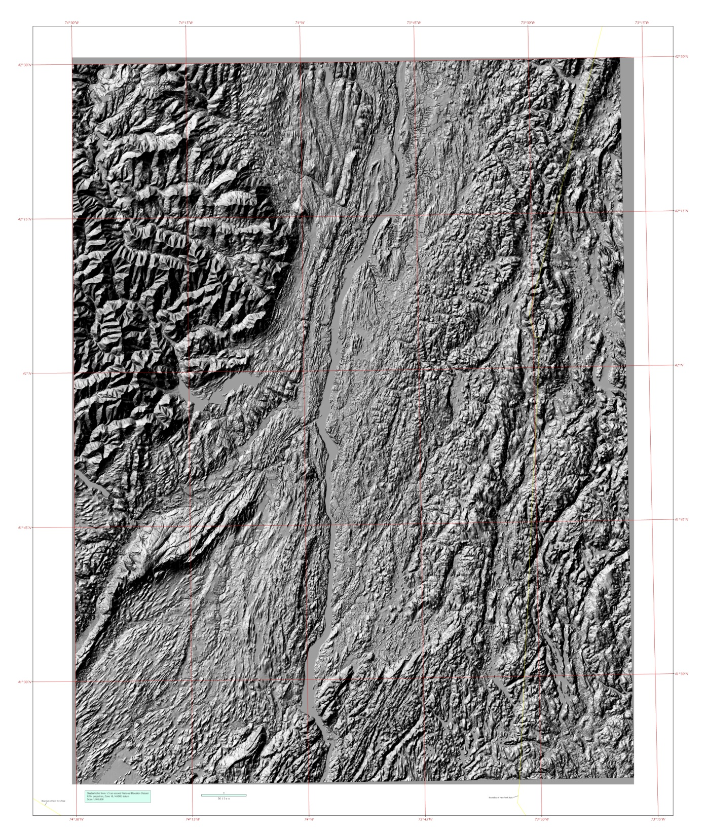
RVW
HUDSON
RVW’
KR
KR’
KINGSTON
MHP
POUGHKEEPSIE
MHP’
NB
NB’
NeEWBURGH
SOUTHERN REACH
Notes:
The Southern Reach extends from the Rip Van Winkle Bridge, near Hudson, to the Newburgh-Beacon Bridge Crossing at the threshold to the Hudson Highlands.
It contains
the Rip Van Winkle,
Kingston-Rhinecliff,
Mid-Hudson-Poughkeepsie,
and Newburgh-Beacon bridge crossings.

Slide 21
Schenectady
Mohawk Channel
Batten Kill-Hudson Channel
Colonie Channel
Ravena
Hudson
Catskill
RVW
RVW’
SOUTHERN REACH
Notes:
The Southern Section begins immediately south of Catskill and Hudson, at the Rip Van Winkle Bridge Crossing.
The Stockport Cross Section, the last cross section of the Confluence Section, lies a short distance to the north.

Slide 22
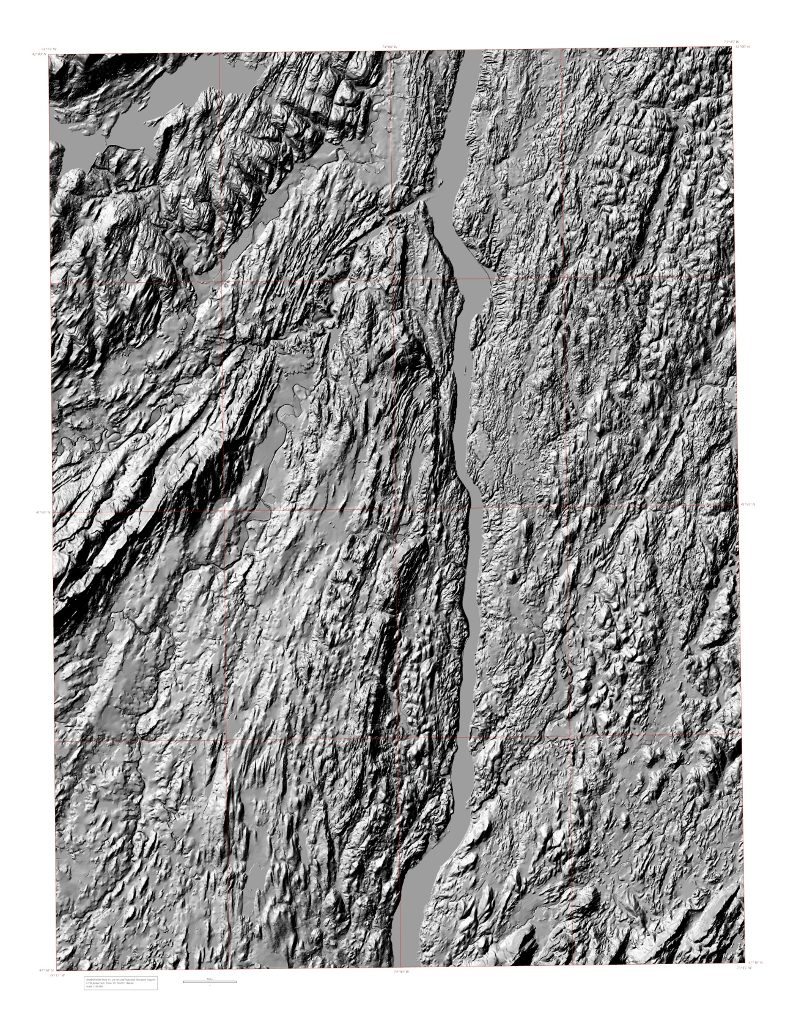
KR
KR’
Kingston
Poughkeepsie
MHP
MHP’
Newburgh
NB
NB’
SOUTHERN REACH
Notes:
The Southern Section extends downriver to the gateway to the Hudson Highlands at the Newburgh-Beacon Cross Section.
The Kingston-Rhinecliff Cross section lies a short distance south of the RVW.
The Mid-Hudson-Poughkeepsie crossing is at a narrow passage of the Hudson River through a gorge constricted by the Marlboro Mountains in the west and dolostone to the east.
Poughkeepsie is built on the dolostone block.

Slide 23
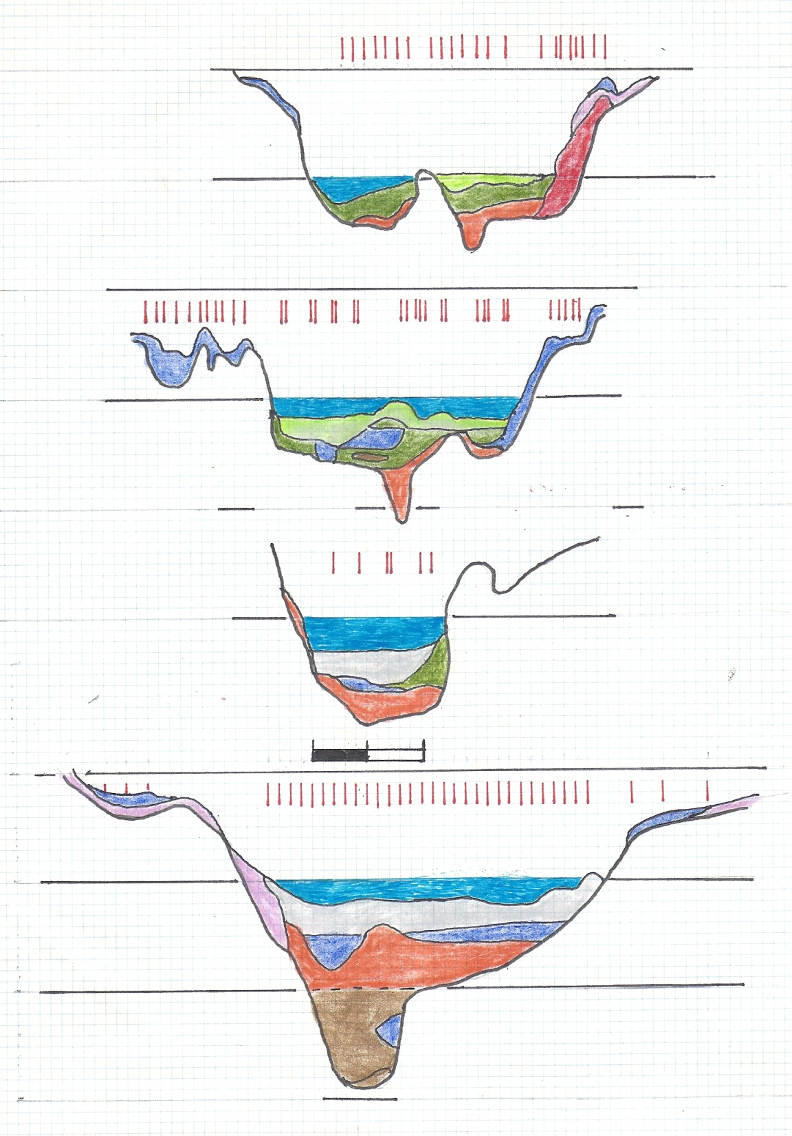
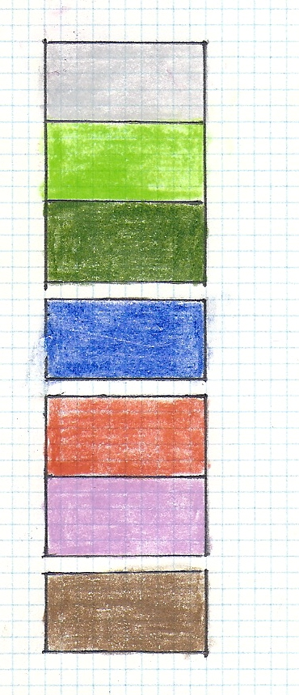
RPW
RPW’
200 ft
200 ft
SOUTHERN REACH
RIP VAN WINKLE
LITHOLOGY
SL
SL
LEGEND
KR
KR’
200 ft
200 ft
HOLOCENE TIDAL MUDS
KINGSTON-RHINECLIFF
HOLOCENE ALLUVIUM
SL
SL
QUAKER SPRINGS-
COVEVILLE-FORT ANN
-200 ft
-200 ft
MHP
MHP’
LAKE ALBANY CLAY and SILT
SL
SL
MIDDLEBURGH-ROSENDALE
OUTWASH
MID-HUDSON - POUGHKEEPSIE
NB
0
2,000
NB’
TILL
200 ft
200 ft
NEWBURGH-BEACON
LITTLE FALLS GRAVEL(?)
SL
SL
View from the South
(Upstream)
-200 ft
-200 ft
10X Vertical Exaggeration
Notes:
The Rip Van Winkle Bridge’s test boring logs were supplemented by extensive seismic refraction lines on Rogers Island, in the middle of the River.
The Holocene deposits grade from alluvial to deltaic sand at the Rip Van Winkle Cross Section.
This is the Modern Tidal delta of the Hudson River.
The Coveville-Fort Ann flood deposits thicken again
And grade to organic silt at the Kingston-Rhinecliff Bridge section.
Disconformity.
The Coveville-Fort Ann deposits are underlain by the M-R outwash.
The Quaker Springs through Fort Ann gorge is 250 ft deep.
ICSD underlies M-R Till under the drumlins on the east side of the RVW crossing.
The Till is overlain by Albany I clay and silt.
The Kingston-Rhinecliff Cross Section lies further south.
The Holocene deltaic sands at RVW grade into sandy organic silt at the Kingston-Rhinecliff Cross Section.
The Coveville-Fort Ann gravelly sands are thicker and might include Quaker Springs fluvial deposits.
The QS-CV-FA gorge is 310 ft deep.
Thin Lake Albany silt and clay are draped over the adjacent rock terrace.
M-R outwash overlies the bedrock surface.
Mid-Hudson-Poughkeepsie Cross Section
The Holocene organic silt is thicker.
The Quaker Springs-Coveville-Fort Ann sand and gravel deposit is thinner.
It lies in a 290-ft deep gorge.
The M-R outwash is bouldery gravel
And fills the deeper valley.
Lake Albany I clay and silt overlies Till on the adjacent terraces.
Till was NOT sampled under the Bridge.
The Newburgh-Beacon Cross Section is the southernmost cross section before the Hudson Highlands.
The Holocene Organic Silt is quite thick.
Lake clay (the submarine phase of the QS-CV-FA catastrophic flood sequence) overlies an irregular surface on MR plus Shenandoah outwash.
The Late glacial erosional gorge is 315 ft deep.
Material is compact below -200 ft
Boulder gravel and a few clay lenses were sampled below -200 ft.
Connally and Sirkin, 1986
Newman, W.S., Thurber, D.H., Zeiss, H.S., Rokach, A, and Musich, L. 1969. Late Quaternary geology of the Hudson Estuary: a preliminary report: New York Academy of Sciences Transactions ser. 11, v. 31, pp. 548-570
Newman, W.S., Cinquemani, L.J., Sperling, J.A., Marcus, L.F., Pardi, R.R., 1987. Holocene Tectonics and the Ramapo Fault Zone sea-level anomaly: a study of varying marine transgression rates in the Hudson Estuary, New York and New Jersey: in Nummedal, D., Pilkey, O.H., and Howard, J.D.(editors). Sea-Level Fluctuation and Coastal Evolution: Society of Economic Paleontologists and Mineralogists, Special Publication No. 41, pp. 97-111
Stanford, S.D., 2010. Glacial geology and geomorphology of the Passaic, Hackensack, and lower Hudson valleys: in Benimoff, A.I. (editor) Field Trip Guidebook, 82nd Annual meeting, New York State Geological Association, College of Staten Island/CUNY, pp. 47-84
Stanford, S.D., 2009.Onshore record of Hudson River drainage to the continental shelf from the Late Miocene to Late Wisconsinan glaciation, USA: synthesis and revision: Boreas, 17 p.

Slide 24
200 ft
200 ft
RIP VAN WINKLE
Till over ICSD
SL
SL
Holocene
Tidal Delta
200 ft
200 ft
SL
SL
KINGSTON-RHINECLIFF
Transition to
Organic Silt
-200 ft
-200 ft
Flood-Scoured
Bedrock
SL
SL
MID-HUDSON - POUGHKEEPSIE
Boulder Gravel:
Head-of-Outwash
0
2,000
200 ft
200 ft
NEWBURGH-BEACON
SL
SL
QS-CV-FA
Marine Sediment
-200 ft
-200 ft
Boulder Gravel
Little
Falls
Gravel
Compact below
-200 feet
SOUTHERN REACH
STRATIGRAPHY
Notes:
The Holocene deposits grade from alluvial and deltaic sand at the Rip Van Winkle Cross Section to the “ubiquitous organic silt” of Walt Newman (1969) at the Kingston-Rhinecliff Cross Section.
The organic silt persists through the Hudson Highlands to the Tappan Zee Bridge (Newman and others, 1969).
The Quaker Springs-Coveville-Fort Ann flood deposits thicken and grade into clay at N-B.
They are underlain by the M-R outwash.
ICSD underlies M-R Till under the drumlins on the east side of the RVW crossing.
The Till is overlain by Albany I clay and silt.
M-R outwash extends to N-B,
M-R outwash is coarsest (most bouldery) at MHP
The compact, boulder sand and gravel below -200 ft at the Newburgh-Beacon cross section is the Little Falls Gravel.
Flood-scoured bedrock surfaces are well developed from Hyde Park to Poughkeepsie.
Connally and Sirkin, 1986
Newman, W.S., Thurber, D.H., Zeiss, H.S., Rokach, A, and Musich, L. 1969. Late Quaternary geology of the Hudson Estuary: a preliminary report: New York Academy of Sciences Transactions ser. 11, v. 31, pp. 548-570
Newman, W.S., Cinquemani, L.J., Sperling, J.A., Marcus, L.F., Pardi, R.R., 1987. Holocene Tectonics and the Ramapo Fault Zone sea-level anomaly: a study of varying marine transgression rates in the Hudson Estuary, New York and New Jersey: in Nummedal, D., Pilkey, O.H., and Howard, J.D.(editors). Sea-Level Fluctuation and Coastal Evolution: Society of Economic Paleontologists and Mineralogists, Special Publication No. 41, pp. 97-111
Stanford, S.D., 2010. Glacial geology and geomorphology of the Passaic, Hackensack, and lower Hudson valleys: in Benimoff, A.I. (editor) Field Trip Guidebook, 82nd Annual meeting, New York State Geological Association, College of Staten Island/CUNY, pp. 47-84
Stanford, S.D., 2009.Onshore record of Hudson River drainage to the continental shelf from the Late Miocene to Late Wisconsinan glaciation, USA: synthesis and revision: Boreas, 17 p.

Slide 25
200 ft
200 ft
RIP VAN WINKLE
250 ft
SL
SL
200 ft
200 ft
310 ft
SL
SL
KINGSTON-RHINECLIFF
-200 ft
-200 ft
SL
290 ft
SL
MID-HUDSON - POUGHKEEPSIE
0
2,000
200 ft
200 ft
NEWBURGH-BEACON
SL
315 ft
SL
-200 ft
-200 ft
SOUTHERN REACH
DEPTH of SCOUR
Notes:
Scour depth increases to approximately 300 feet south of the RVW.

Slide 26
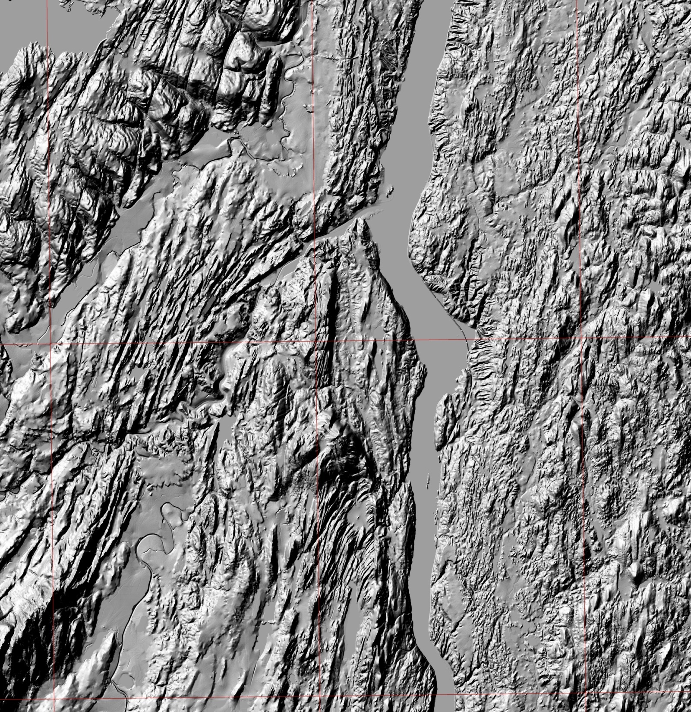
K-R
Red Hook Moraine
C&S 1986
Striae
C&S
exposure
Dineen
exposure
HOW
Well w/ Till
over ICSD
R
HOW
Head-
Of-Outwash
DEM
By
Janet Manchester
NYSGS
ML
HOW
ROSENDALE READVANCE REVISITED
Notes:
As noted in 2011, the key features pointing to a readvance into the Wall Kill Lowlands include:
the Mohonk Lake and Rosendale gravel pit of Connally and Sirkin’s (orange hexagrams);
Exposures e (red hexagrams);
cross sections for the Kingston-Rhinecliff and Mid-Hudson Poughkeepsie bridges (red bars);
Heads of Outwash (HOW);
wells recording till over clay, sand, and/or gravel (red triangles);
and the Red Hook Moraine of Connally and Sirkin, 1986.
Examination of Connally’s “type locality”, the Rosendale pit, did not reveal any till in the early 1980’s, when Pricilla Duskin and I examined it.
Apparently, the till deposit noted by Connally was of limited extent.
Similarly, the “double tundra-spruce peaks” noted by Connally and Sirkin was not detected in pollen cores reported by Guy Robinson, Kirsten Menking, and Dorothy Peteet at the 2009 NYSGA meeting.
Several exposures contained till-over-stratified drift with thrust planes between the units.
Striae directions are in light blue.
The sediments sampled under the MHP Bridge included a sequence of boulder gravel above the rock floor.
This suggests that the M-R readvance’s Head of Outwash was nearby.
Even though Connally and Sirkin’s “type localities” have problems, the evidence points to the existence of the Rosendale Readvance.

Slide 27
SUMMARY and CONCLUSIONS I
The Modern Hudson River’s floodplain deposits grade from alluvial sand
and gravel at the Kroma Kill section to sand with gravel at the Albany-Troy
section, to tidal delta sand at the Rip Van Winkle section. They grade into
Organic-matter rich tidal silts from the Kingston Rhinecliff to the
Newburgh-Beacon cross sections.
The trough eroded through the Lake Albany deposits is 230 ft deep at the
Kroma Kill cross section, deepening to 315 ft deep at the Newburgh-Beacon
Cross section.
Depth of Scour
X-SECT | KROMA KILL | STILL | CAMP | WATER | TROY | I-90 | ALBANY | GLEN
DEPTH in FEET | 230 | 180 | 210 | 250 | 280 | 240 | 220 | 220
X-SECT | BERK | COEY | NEW BALT | STOCK | RVW | K-R | MHP | N-B
DEPTH in FEET | 260 | ? | ? | ? | 260 | 310 | 290 | 315
Notes:
The Modern floodplain deposits grade from alluvial sand and gravel at the
Kroma Kill section to sand with gravel at the Albany-Troy section, to tidal
Delta sand at the Rip Van Winkle section.
Theygrade into organic-matter rich tidal silts from the Kingston Rhinecliff to the Newburgh-Beacon sections.
The Fort Ann and Coveville catastrophic flood deposits can be traced from
the Kroma Kill to the Kingston-Rhinecliff sections.
The Lake Albany deposits north of the Stillwater section were deposited
in Lake Albany II and Lake Quaker Springs.
The Lake Albany deposits from Newburgh-Beacon to the Stillwater section
Were deposited in Lake Albany I.
The Head-of-Outwash for the Middleburgh-Rosendale readvance is a short distance north of the Mid-Hudson-Poughkeepsie section.
The Coarse sands and gravels at the base of the Rip Van Winkle and Kingston-Rhinecliff sections are outwash from the retreating M-R readvance.
The compact, bouldery sand and gravel at the base of the Newburgh-Beacon section is the Little Falls Gravel.

Slide 28
SUMMARY and CONCLUSIONS II
The Fort Ann catastrophic flood deposits can be traced from the Kroma Kill to the Kingston-Rhinecliff cross sections.
The Coveville and Quaker Springs catastrophic flood deposits can be traced from the Coeymans to the Kingston-Rhinecliff cross sections.
The Head-of-Outwash for the Middleburgh-Rosendale Readvance is a short distance north of the Mid-Hudson-Poughkeepsie section.
The coarse sands and gravels at the base of the Rip Van Winkle and the Kingston-Rhinecliff cross sections are outwash from the retreating Middleburgh-Rosendale readvance.
The compact, bouldery sand and gravel at the base of the Newburgh-Beacon cross section is the Little Falls Gravel.

