Slide 1


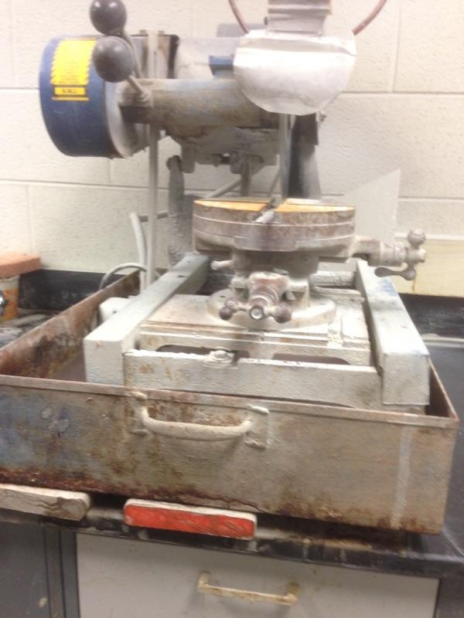
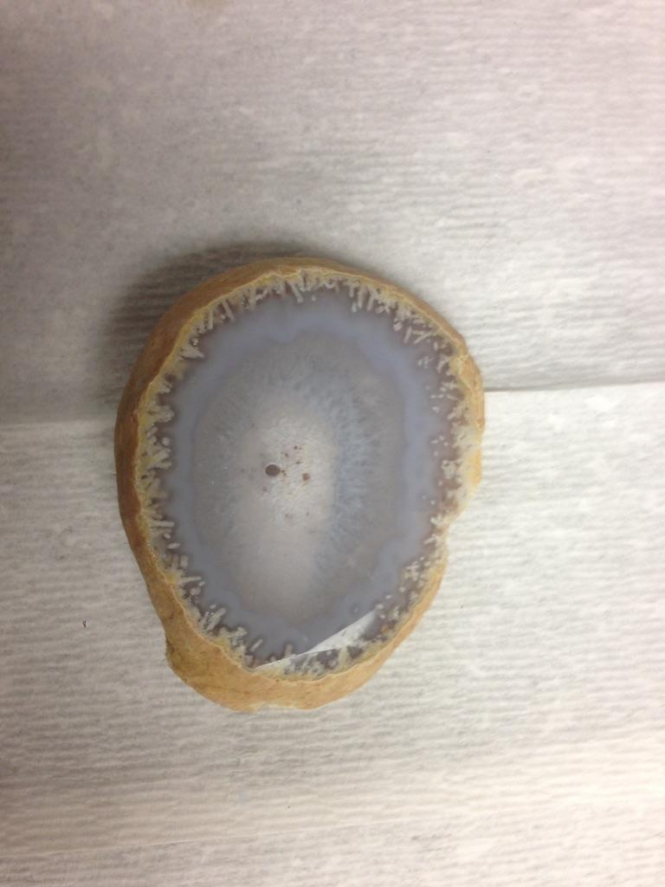
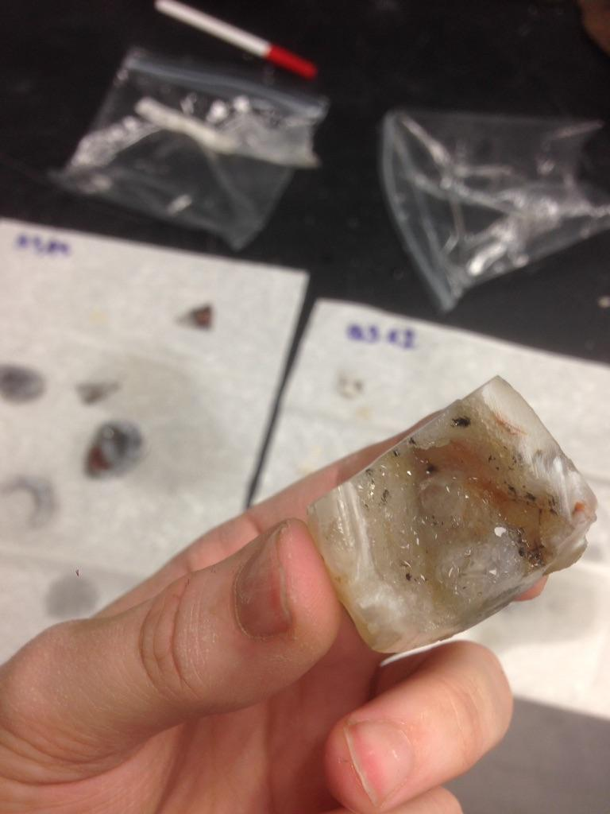
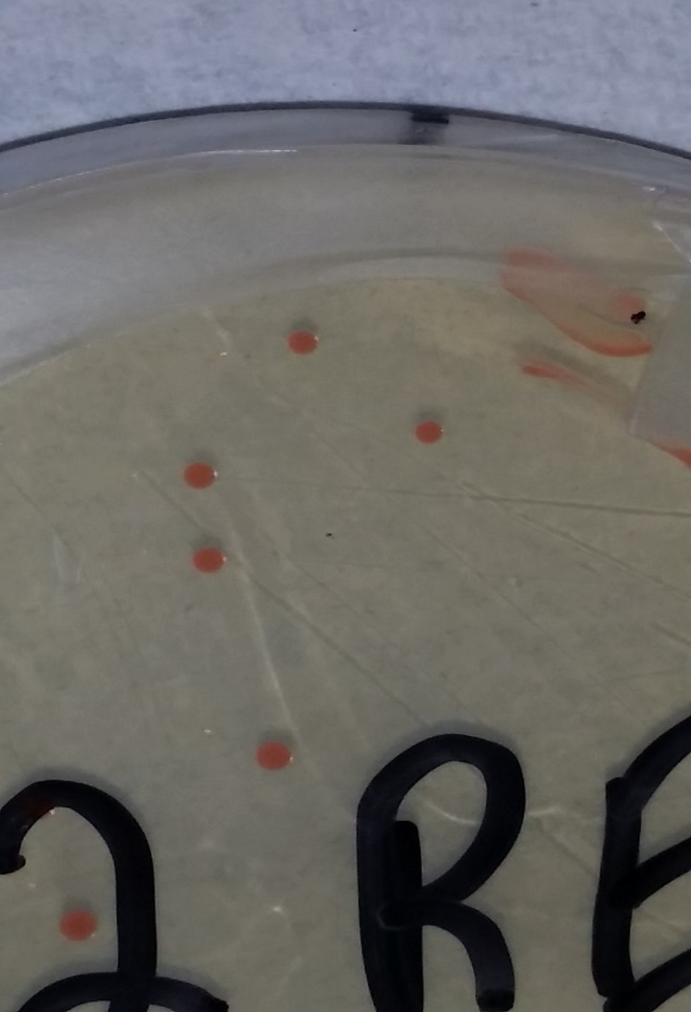
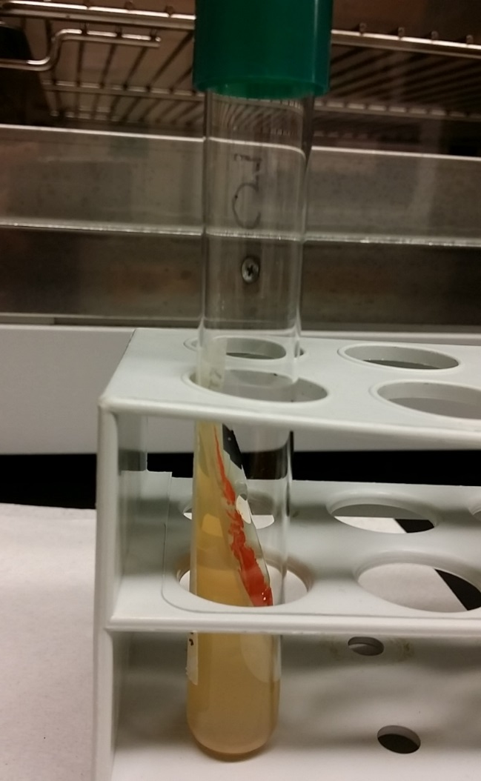
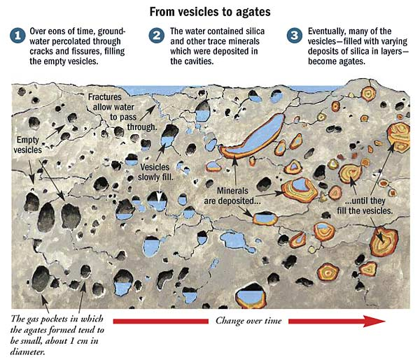
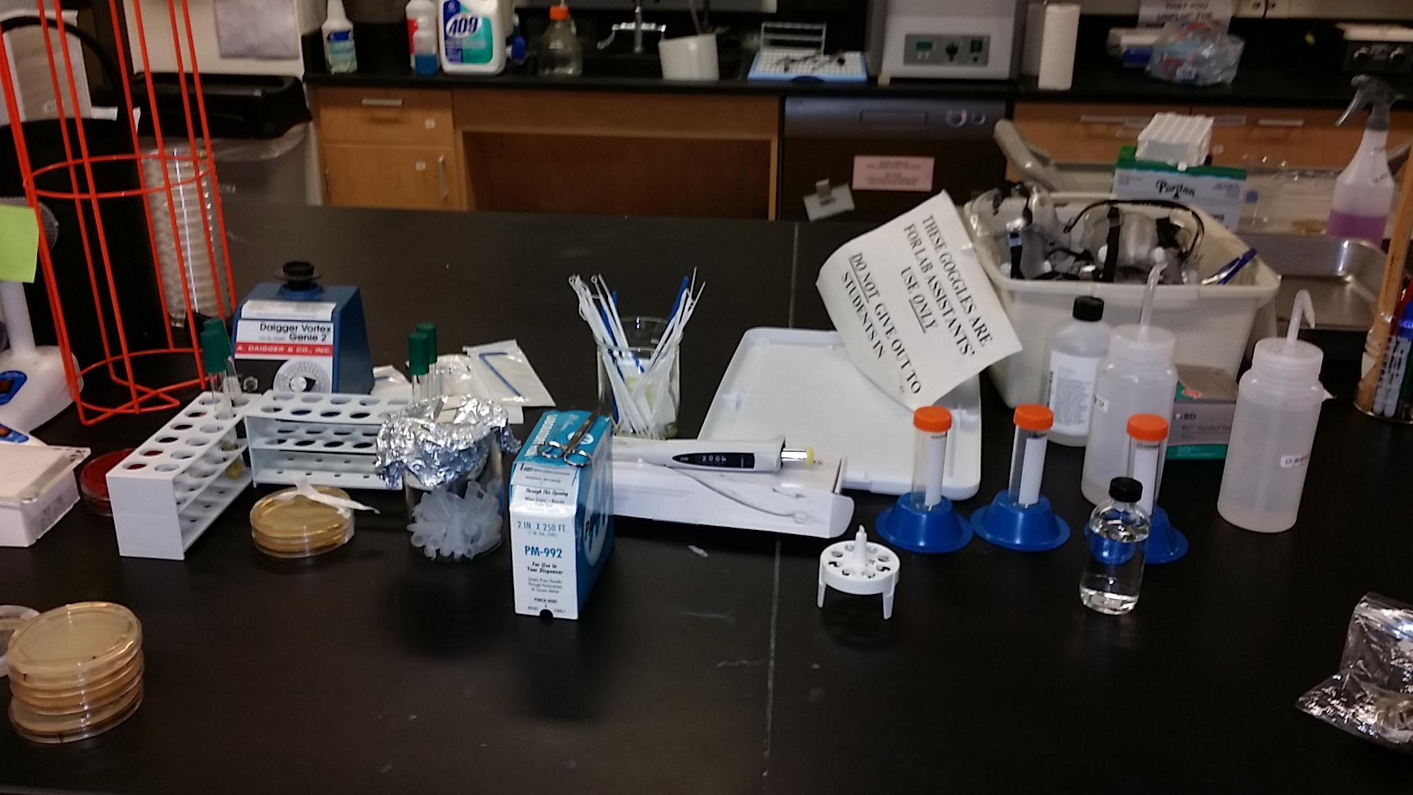
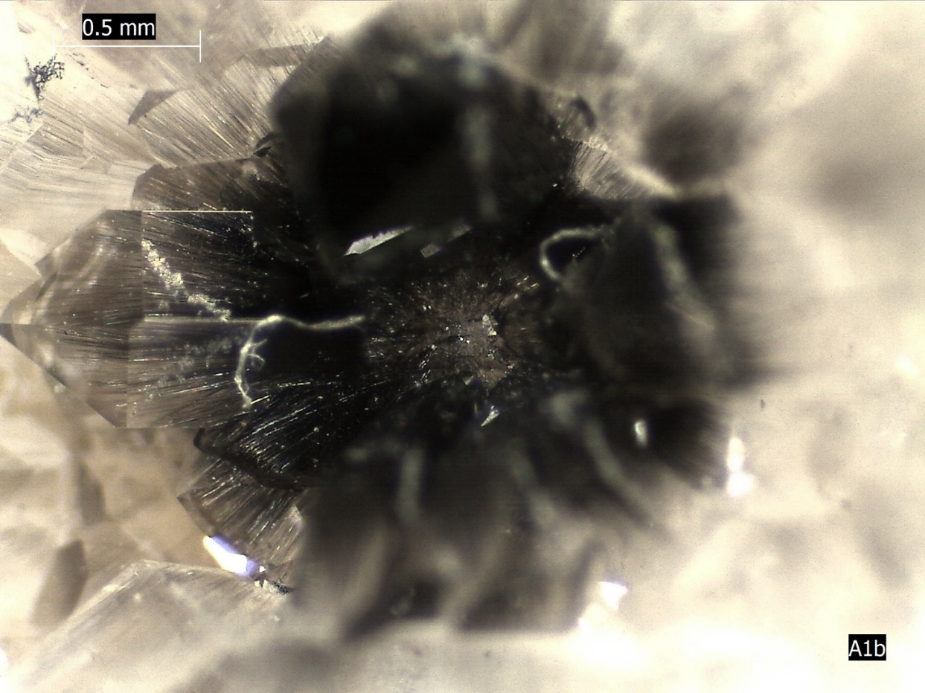
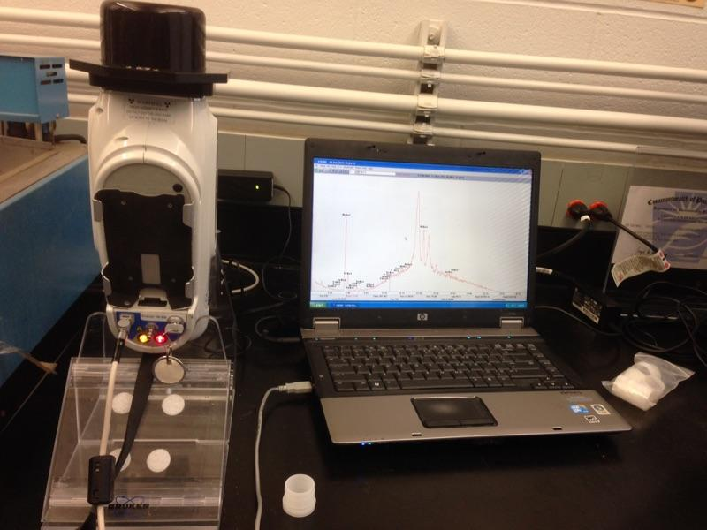
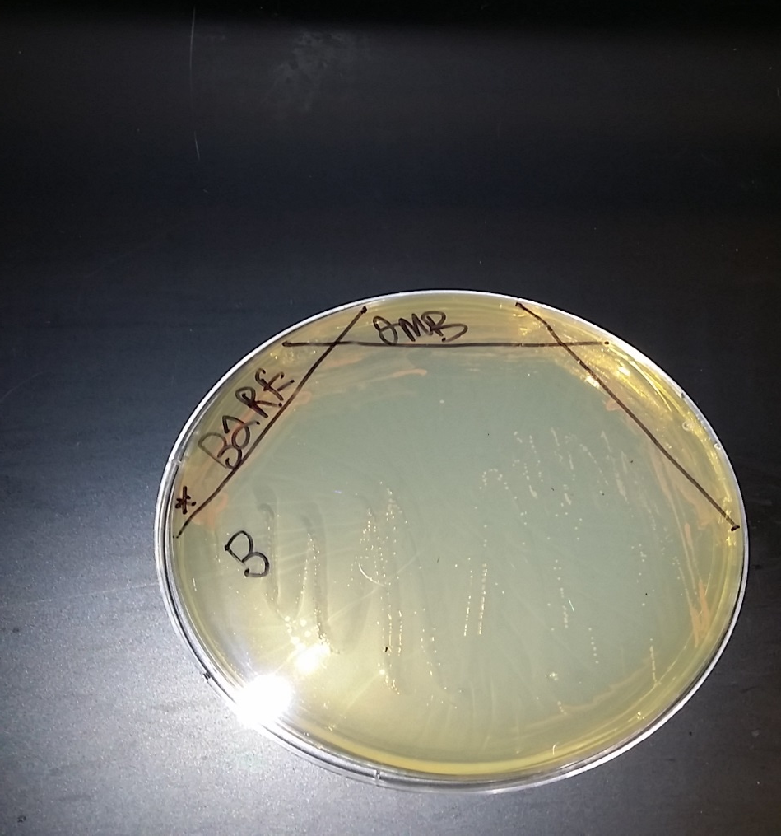
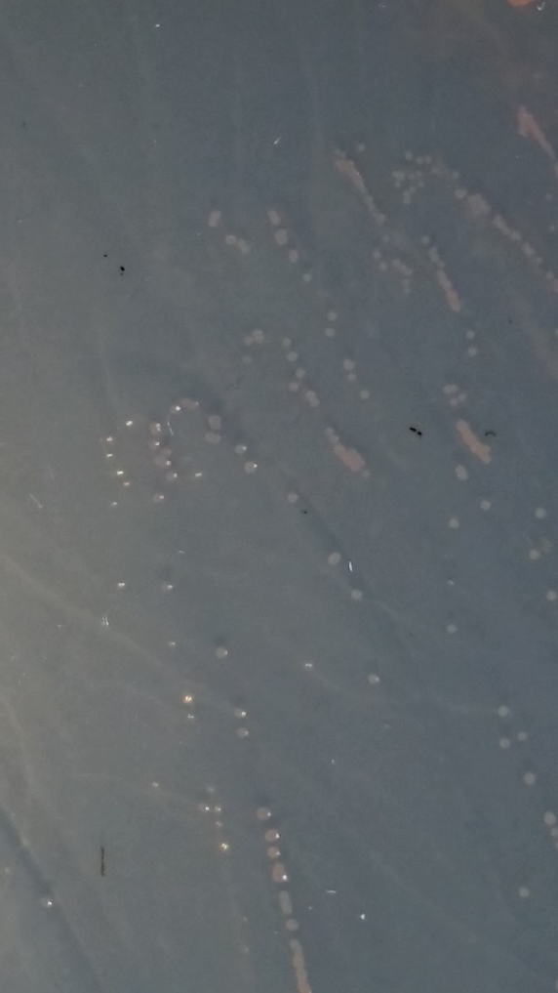
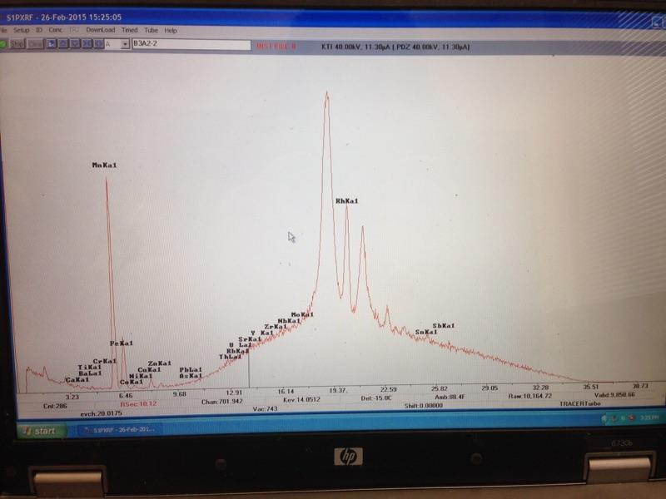
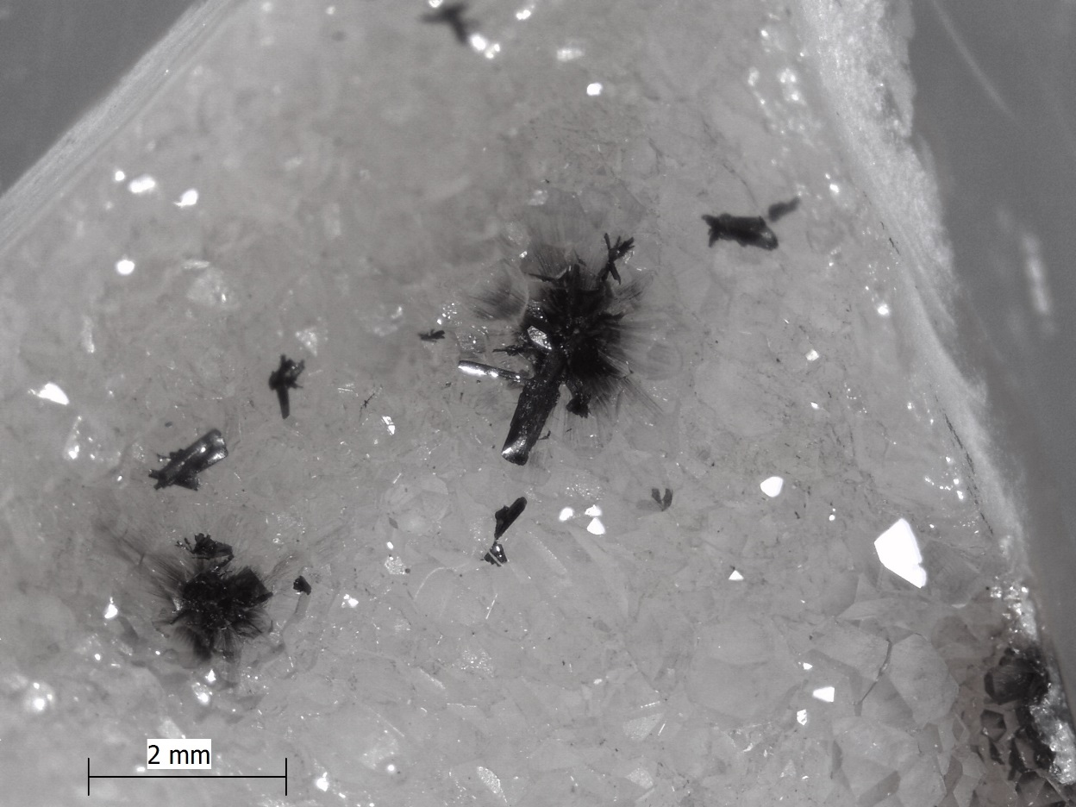
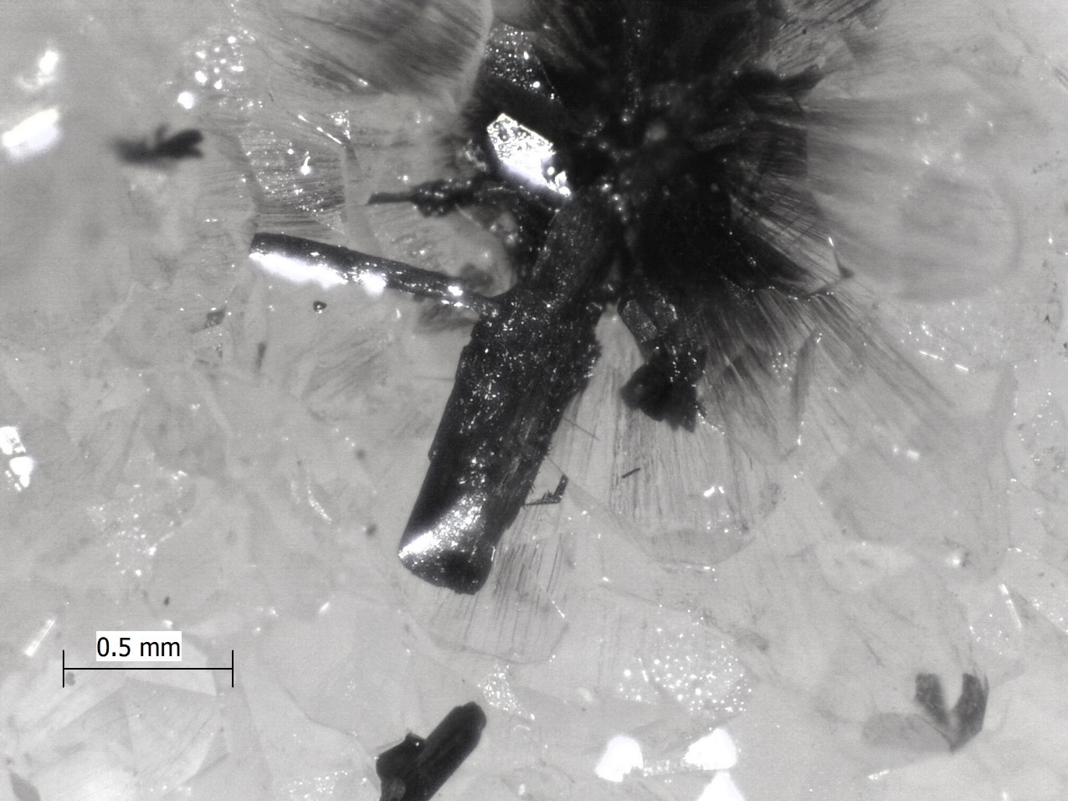
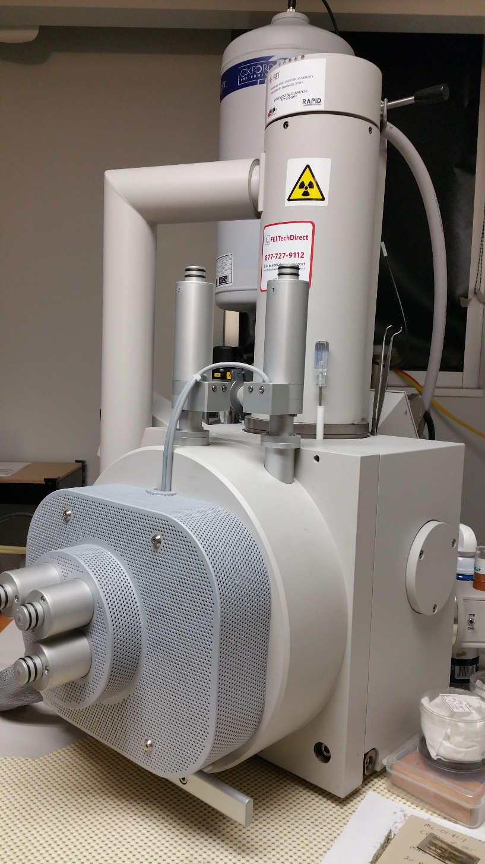
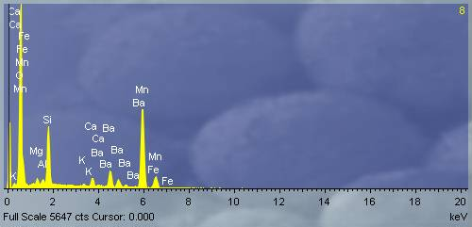
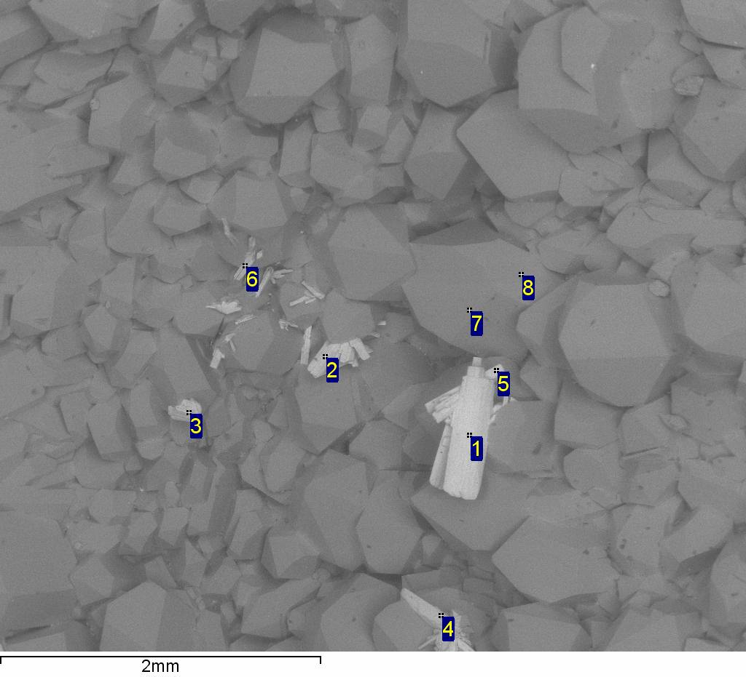

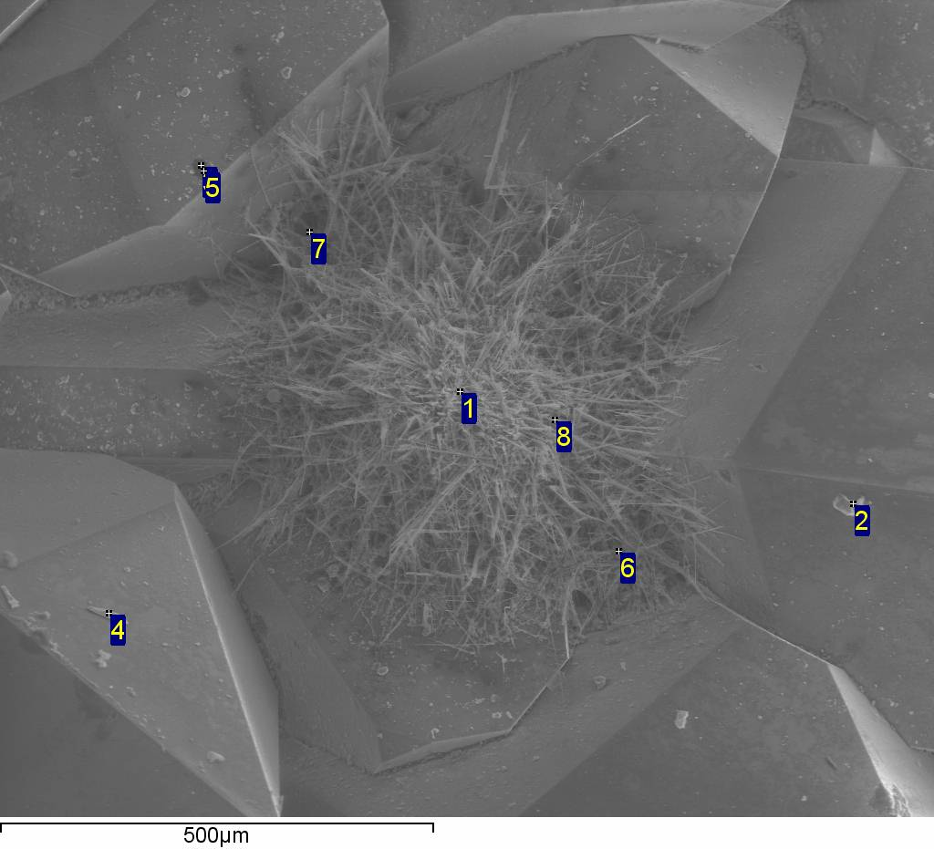
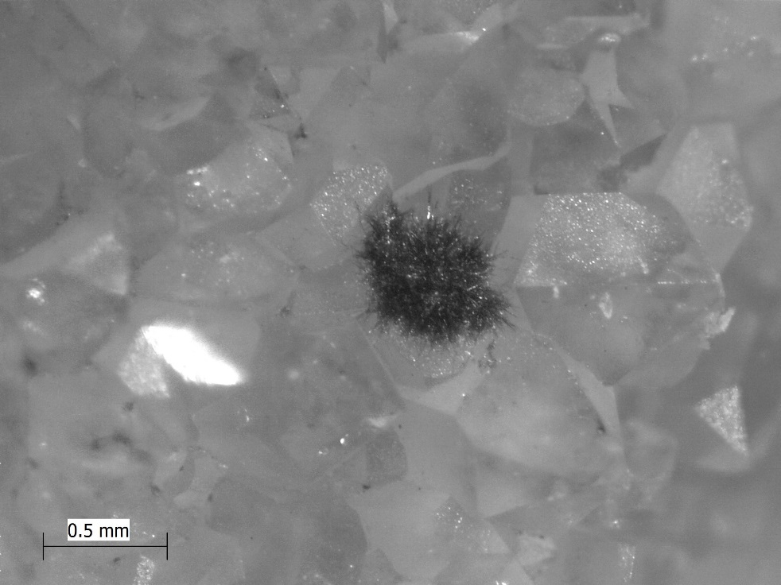
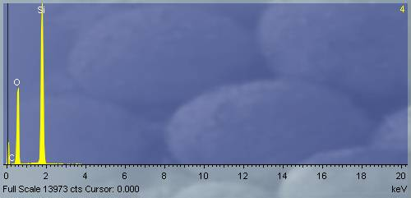
A GEOLOGICAL, MICROBIOLOGICAL AND GEOCHEMICAL STUDY OF AGATES FOUND TO HAVE FLUID INCLUSIONS WITHIN THEIR INTERNAL CAVITIES
MAFFEI, Matthew, HUTCHINSON, Karen, BAKLENHOL, Jessica, KERN, Tricia, WOOD, Adam, CHILDERS, Daniel P., and ETHERINGTON, Christopher
Department of Math/Science, Delaware County Community College, 901 S. Media Line Rd, Media, PA 19063
abstract
GEOLOGY
MICROBIOLOGICAL
As part of the Physical Geology course at Delaware County Community College the students can choose an honors option project. This allows the students to gain a deeper understanding of geology though the practice of doing an undergraduate research project. Learning geology by doing geology. This year a group of students choose to combine the sciences of geology, microbiology and geochemistry to investigate the fluids inclusion in Agates. Agates are rock formations created within cavities which are formed when gases trapped within cooling lava leave behind vesicles. Over time, the vesicles fill with silica-rich groundwater which deposits the dissolved silica in layered quartz deposits. These cavities seal themselves with the silica deposits and can potentially permanently trap some water within the vesicle. The samples obtained for this study came from various regions in Brazil. In tapping this trapped water we can test for microorganisms that may thrive along with investigating into the actual chemical makeup of the fluid. By drilling into the internal cavity of the agate within a sterile environment samples of the trapped water were extracted. In order to detect microorganisms the samples were then cultured onto a growth medium along with a corresponding control sample of pure distilled and sterilized water. Individual colonies were picked and sub-cultured on nutrient agar slants for farther identification. Geochemical analysis of the fluids were done to determine the fluid composition and identify any accessory minerals in the agates.
As of yet unidentified growth cultured from sample
GEOCHEMISTRY
Close up of accessory mineral captured within silica deposit
Some of the equipment used to collect fluid from samples
Image acquired from Kollathdesign.com
Close up of iso-smear of unidentified growth
Bruker Handheld X-Ray Fluorescence (XRF) scanner
with laptop display
Scanning Electron Microscope (SEM)
with X-Ray Diffraction (XRD)
results
XRF results graph with spikes of Manganese and Iron
Microscopic images of accessory minerals
Spectrum | In stats. | C | Mg | Si | K | Ca | Mn | Fe | Ba | Dy | O | Total
1 | Yes |  |  | 4.23 | 0.36 |  | 61.52 | 8.61 |  |  | 25.28 | 100.00
2 | Yes | 2.10 |  | 7.02 |  |  | 57.93 | 1.94 |  |  | 31.02 | 100.00
3 | Yes |  | 0.27 | 12.71 |  | 0.28 | 52.68 | 3.07 |  |  | 30.99 | 100.00
4 | Yes |  |  | 11.27 |  |  | 51.42 | 7.38 |  |  | 29.93 | 100.00
5 | Yes |  |  | 4.51 | 1.53 |  | 64.30 | 3.38 | 1.01 |  | 25.26 | 100.00
6 | Yes |  |  | 23.07 |  |  | 34.27 | 2.28 |  | 3.01 | 37.37 | 100.00
7 | Yes |  |  | 40.90 |  |  | 9.69 |  |  |  | 49.42 | 100.00
8 | Yes |  |  | 46.59 |  |  | 0.26 |  |  |  | 53.15 | 100.00
Max. |  | 2.10 | 0.27 | 46.59 | 1.53 | 0.28 | 64.30 | 8.61 | 1.01 | 3.01 | 53.15
Min. |  | 2.10 | 0.27 | 4.23 | 0.36 | 0.28 | 0.26 | 1.94 | 1.01 | 3.01 | 25.26
Geological – Successfully extracted fluid from agate samples.
MicroBiological – Cultured unidentified growth from fluid of the
agate samples. Further evaluation pending.
Geochemical – Used XRF and SEM/XRD scans to determine chemical
composition of accessory minerals discovered within
silica deposits.
SEM XRD Scan with analysis output.
Special Thanks
SEM image and XRD analysis of accessory minerals contained within quartz crystals. Accessory elements found to be mainly Manganese and Iron.
Thomas Furmanak – Dept of Biology, Delaware County Community College
The West Chester University Dept of Geology and Astronomy
Dr. Cynthia Hall – XRF Dr. LeeAnn Srogi Dr. Frederick Monson
Microscopic image of area scanned by during SEM session

