Slide 1


Mineralogical diversity of abyssal pegmatites of the southern Adirondacks,
New York
David G. Bailey, Hamilton College
Marian Lupulescu, New York State Museum
Abigail R. Seadler, AGI

Slide 2
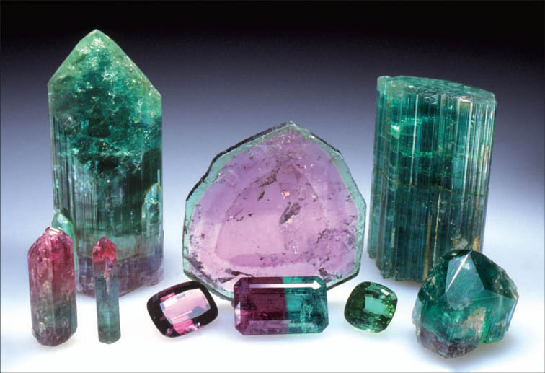
(Source: White, J.S., 2010, Rocks & Minerals)

Slide 3
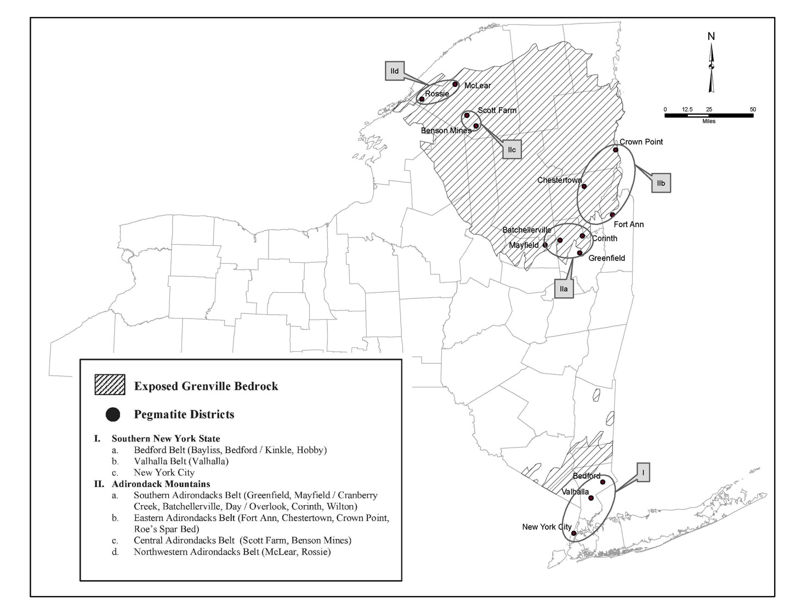
Pegmatites of NY
Notes:
The Batchellerville pegmatite on the Adelbert Gordon Farm (Saratoga County, Town of Edinburg) was opened in 1906 by Clapska Mining Company from Trenton, New Jersey (Newland 1916); worked until 1921.
The Cranberry Creek pegmatite from the Richard Tyrell Farm was exploited at about the same time as at Batchellerville by the Clapska Mining Company who later transferred it to the United States Feldspar Corporation; closed ~ 1915.
Overlook worked until 1920.

Slide 4
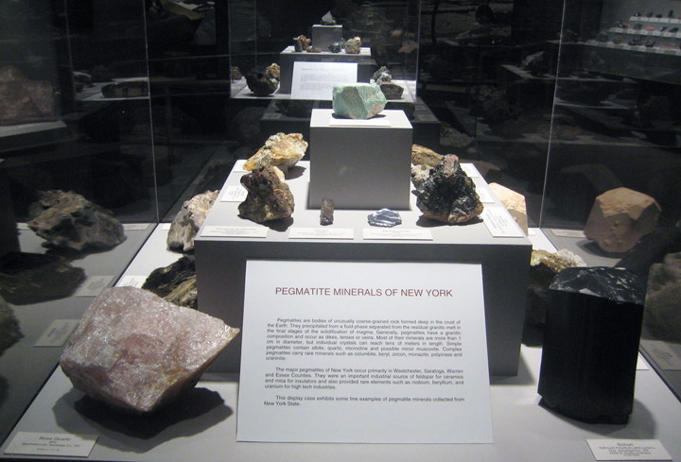

Slide 5
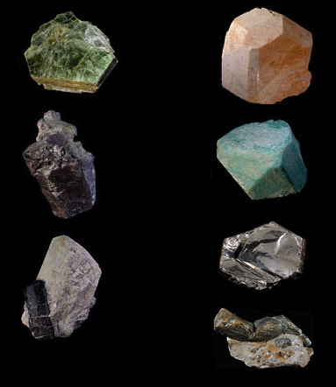
Talk Outline:
Field Characteristics
Mineralogy
Implications
(http://www.nysam.org/pegmatite/)

Slide 8
Adirondack Orogenies
Pegmatite
Zircon Ages
1000
Rigolet
Mayfield
1009 +/- 22 Ma
Ottawan
Batchellerville
1090 +/- 28 Ma
1100
Age (Ma)
Shawinigan
1200
Elzevirian
1300

Slide 9
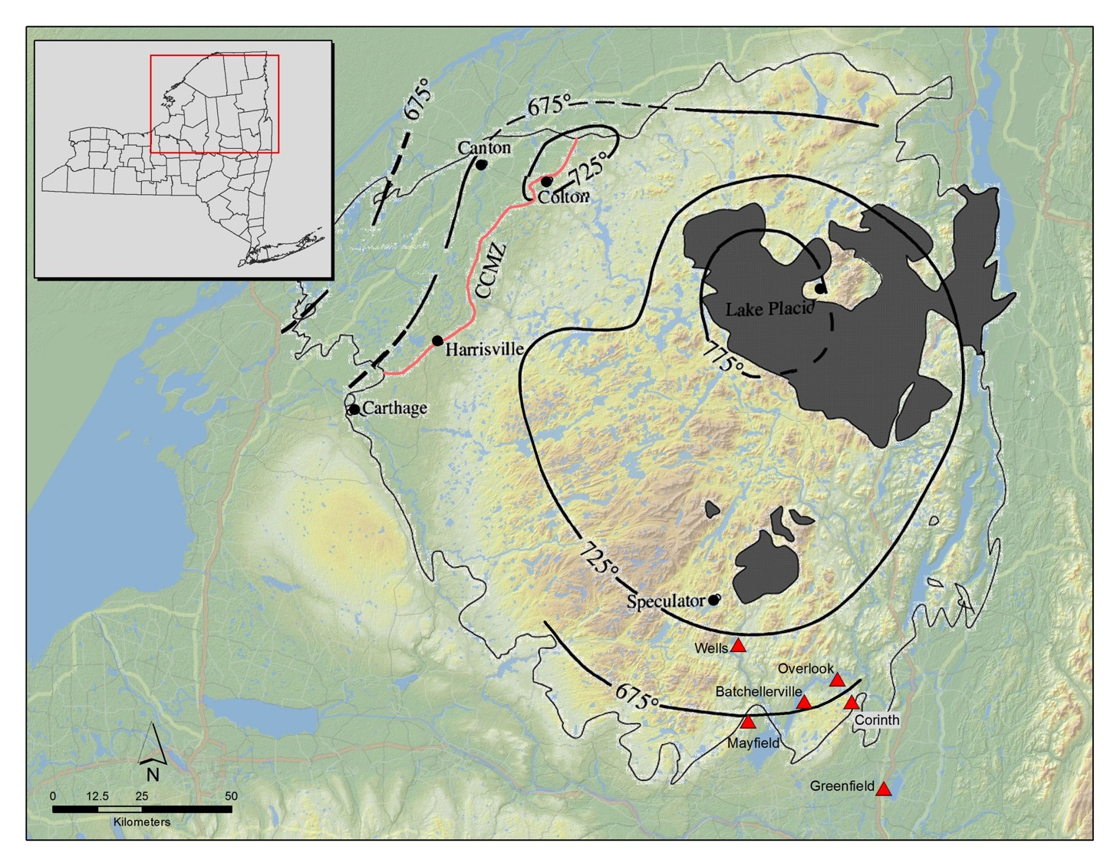

Slide 10
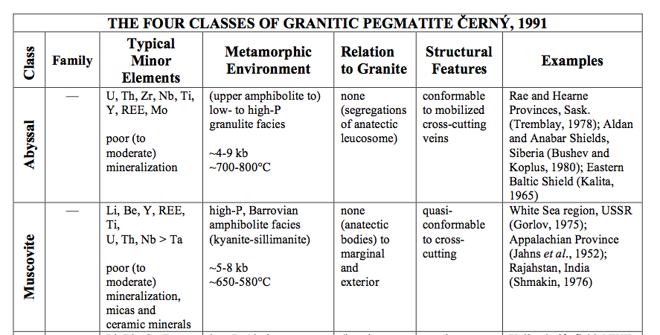
Abyssal / Muscovite Pegmatites
(Source: Simmons, www.minsocam.org/msa/special/pig/)

Slide 11
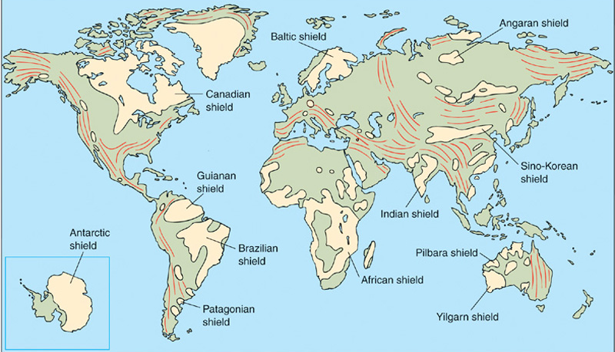
Abyssal Pegmatite Occurrences
(Base map from Levin, 2005)

Slide 12
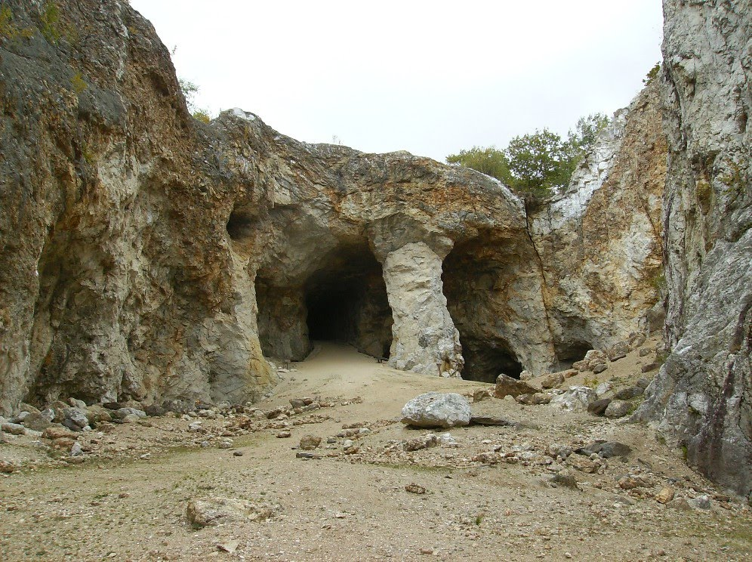
Ruggles Mine, NH

Slide 13
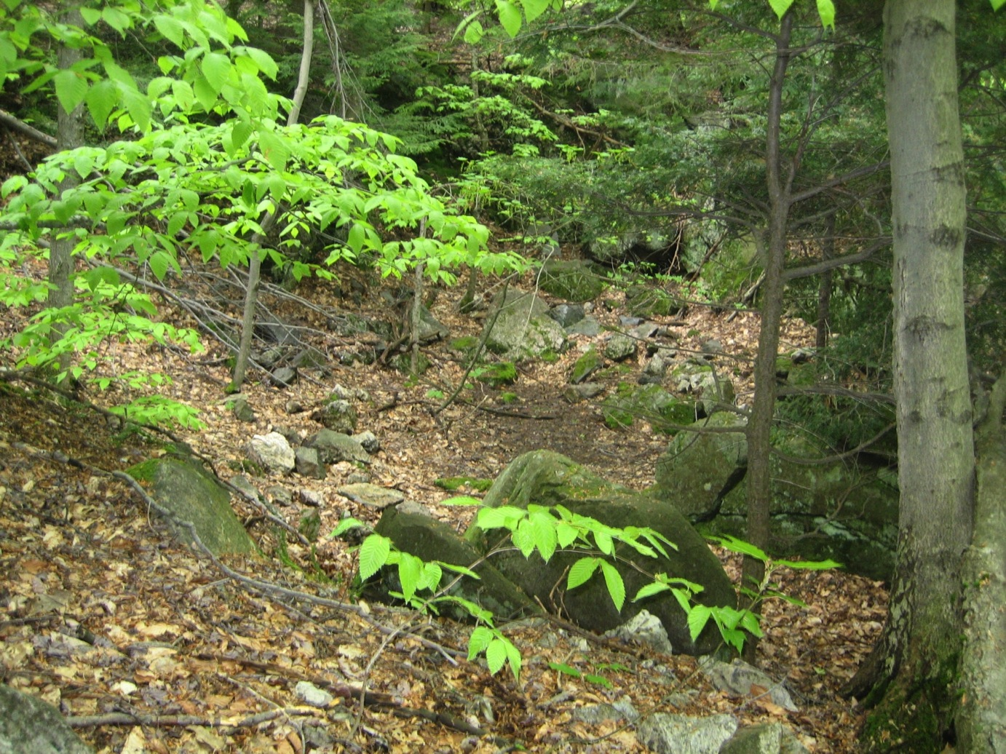
Mayfield Pegmatite
June 2013

Slide 14
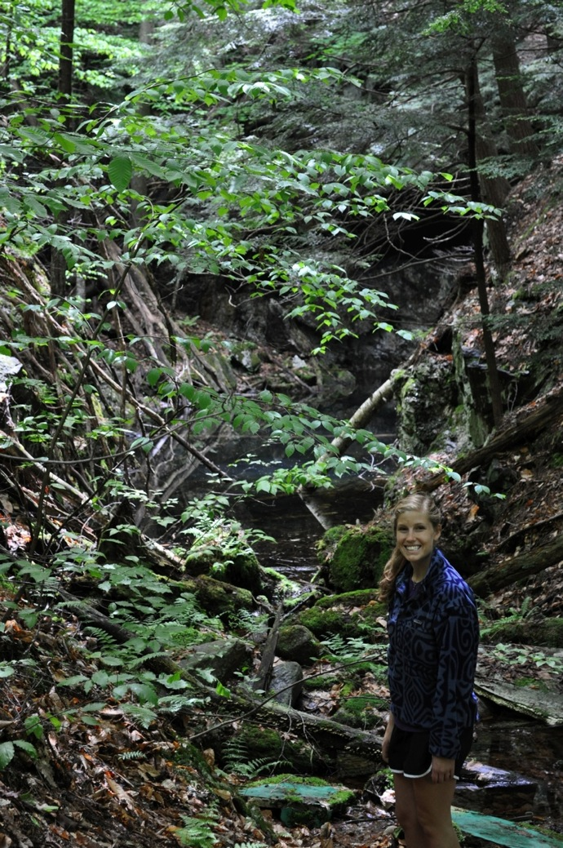
Batchellerville Pegmatite
Sep 2010

Slide 15
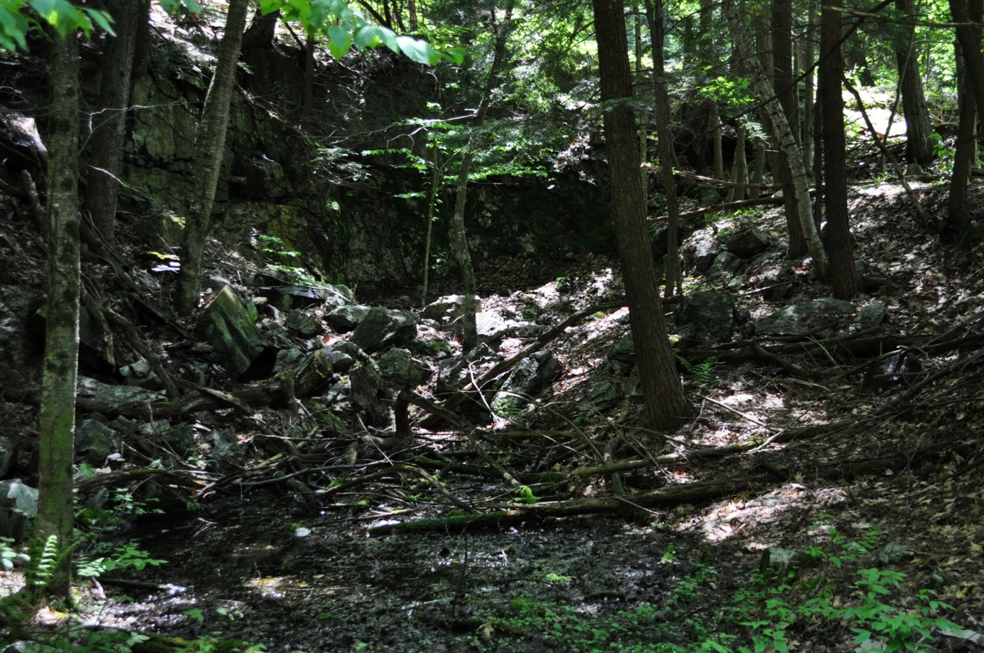
Batchellerville Pegmatite
Sep 2010

Slide 16
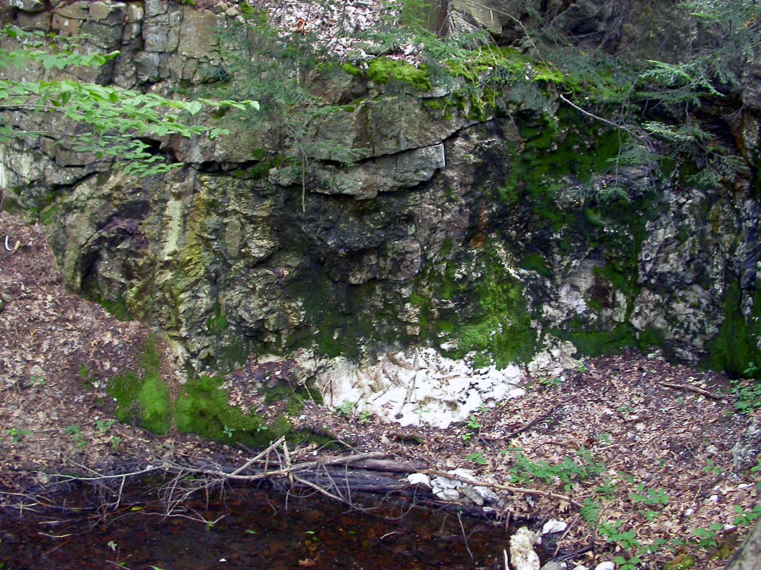
Batchellerville Pegmatite
Sep 2010

Slide 17
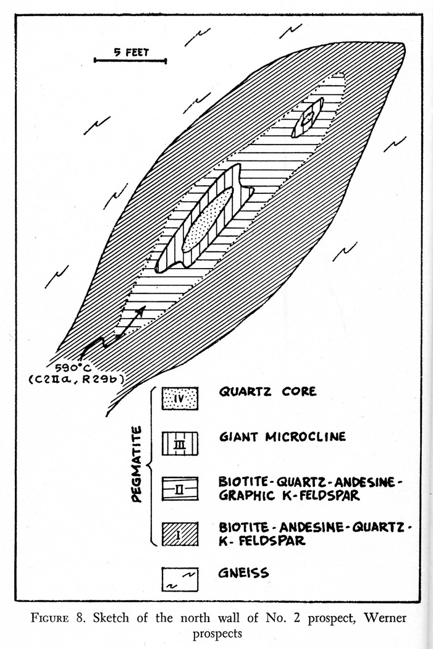
Mayfield Pegmatite
Werner #2 Pit
Tan (1966)

Slide 18
Summary of Field Characteristics:
1. No associated granites
2. Small bodies (typically 5-10 m wide; 10-40 m long)
3. Intrude biotite (hornblende) gneisses
(upper amphibolite / lower granulite facies)
4. Generally conformable with regional foliation
5. Unzoned to crudely zoned with quartz core

Slide 19
"Simple" Mineralogy.........

Slide 20
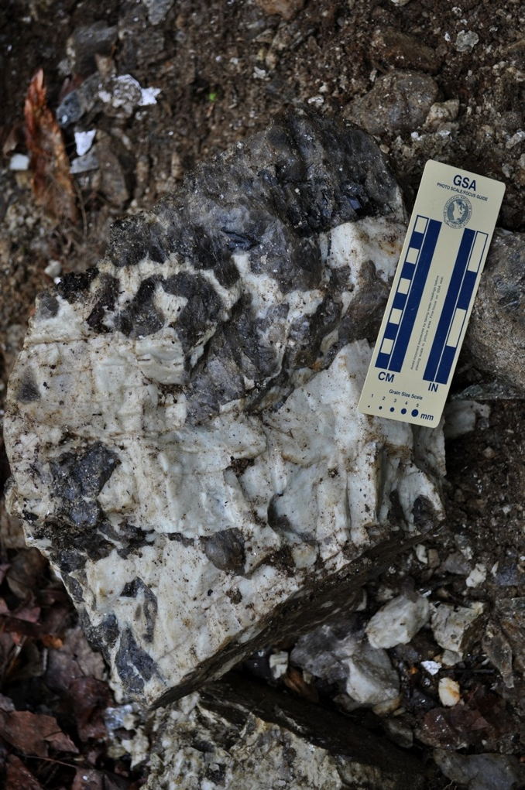
Microcline &
Smoky Quartz
Batchellerville

Slide 21
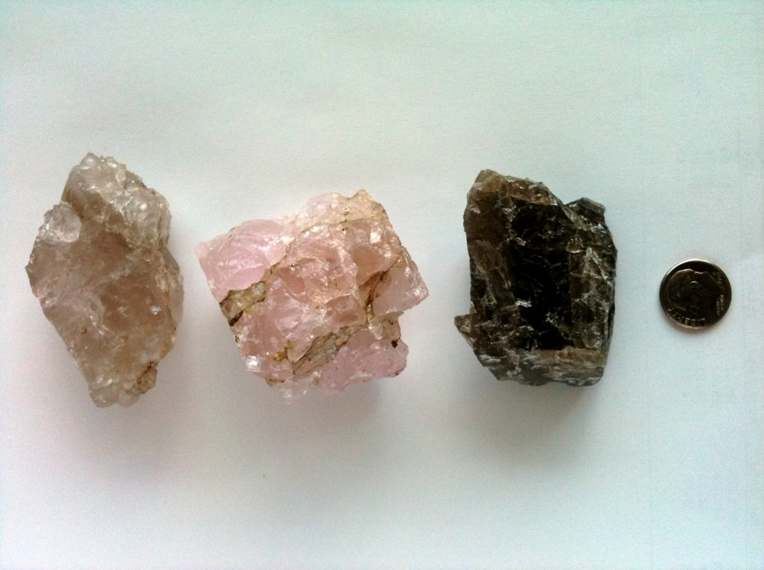
Quartz
Batchellerville

Slide 22
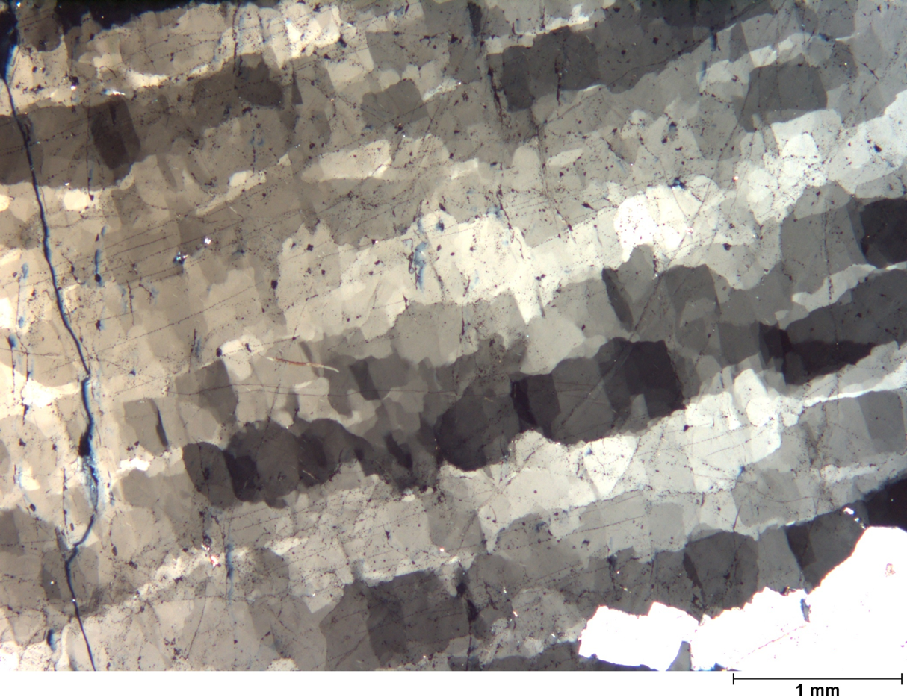
Quartz with mosaic sub-grain texture
Batchellerville

Slide 23
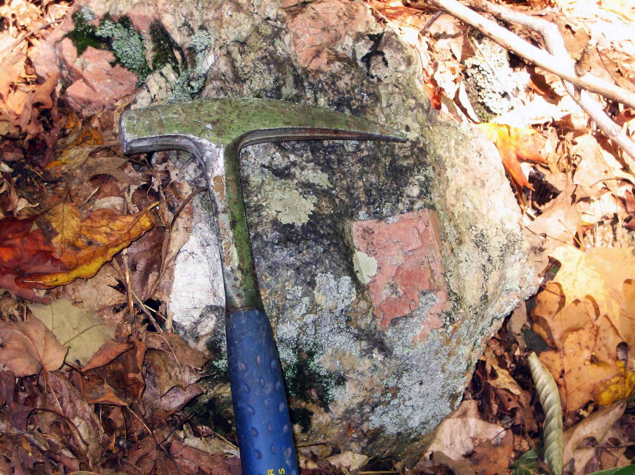
Microcline and Albite
Mayfield Pegmatite

Slide 24
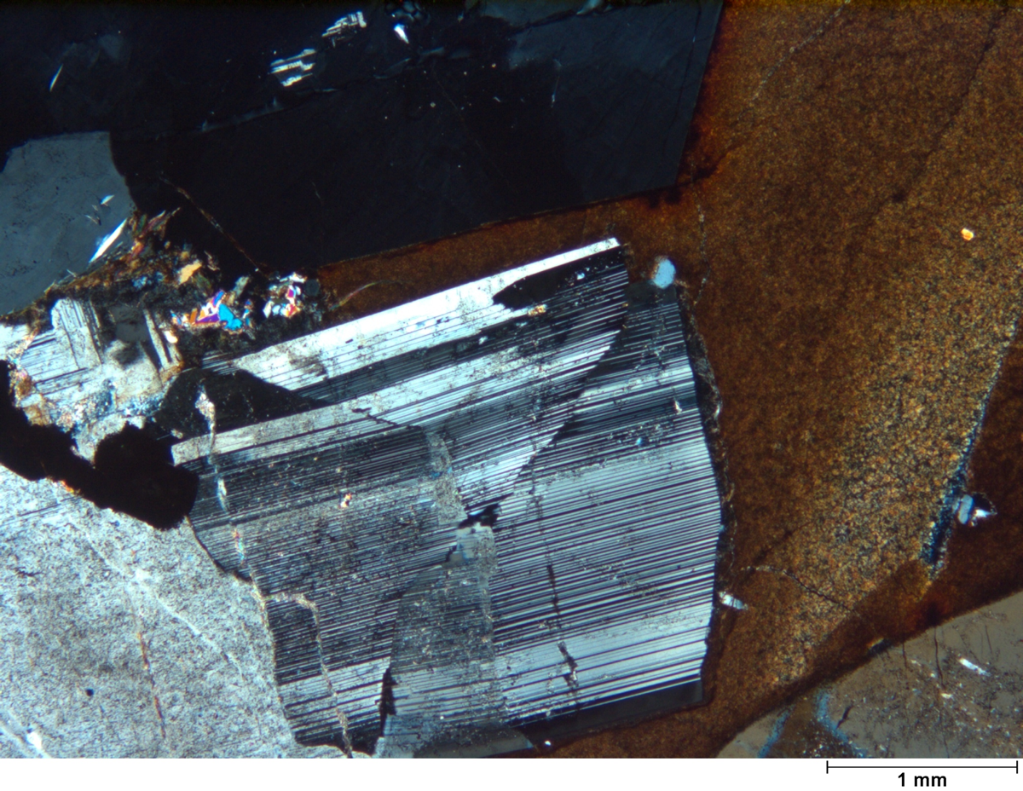
Albite w/ Biotite
Batchellerville

Slide 25
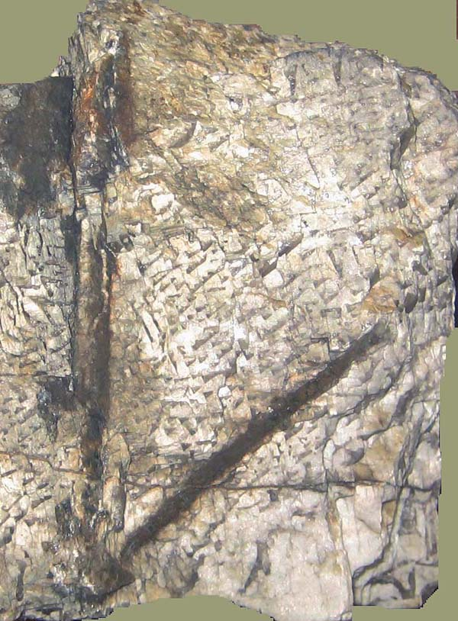
Graphic Granite
w/ Biotite
Batchellerville
(10 cm long plates)

Slide 26
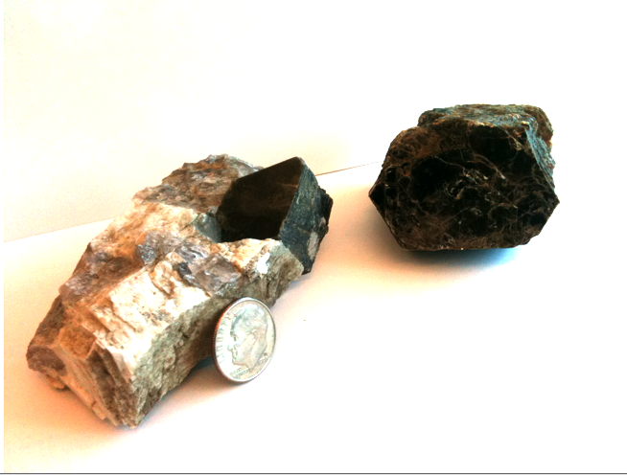
Biotite w/ Quartz and Microcline
Batchellerville

Slide 27
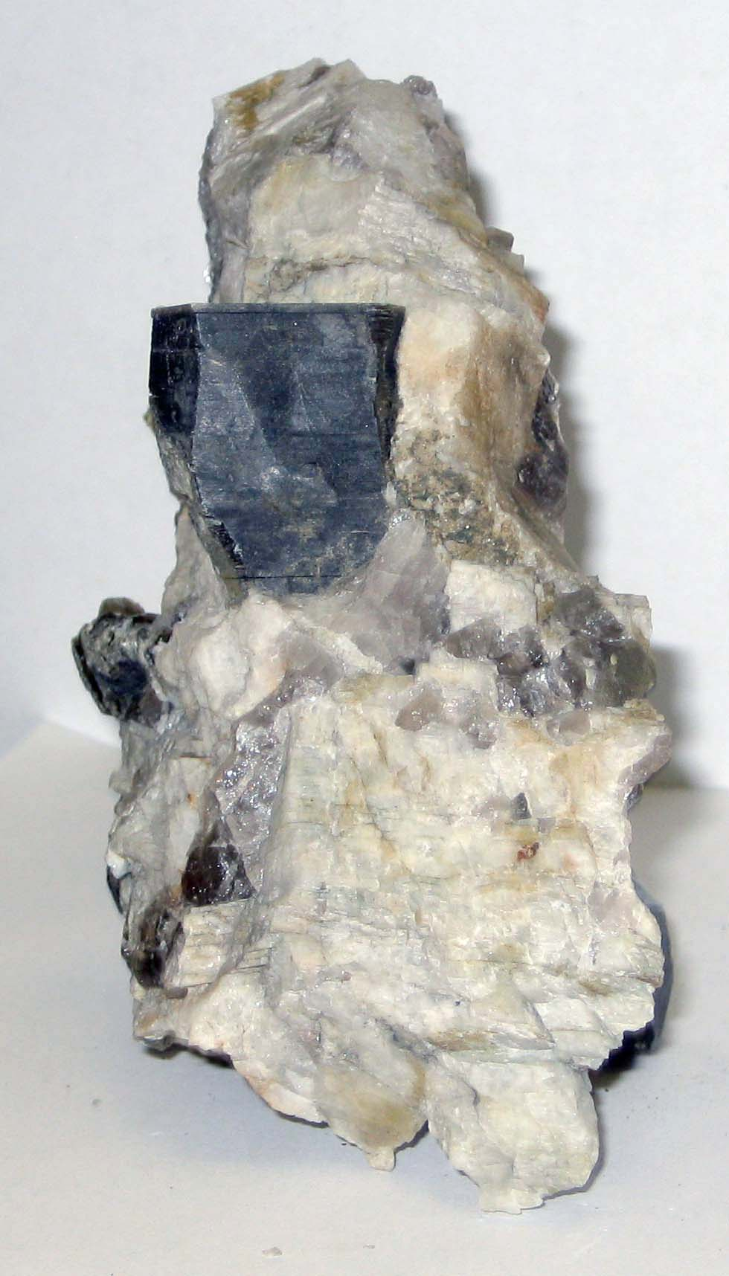
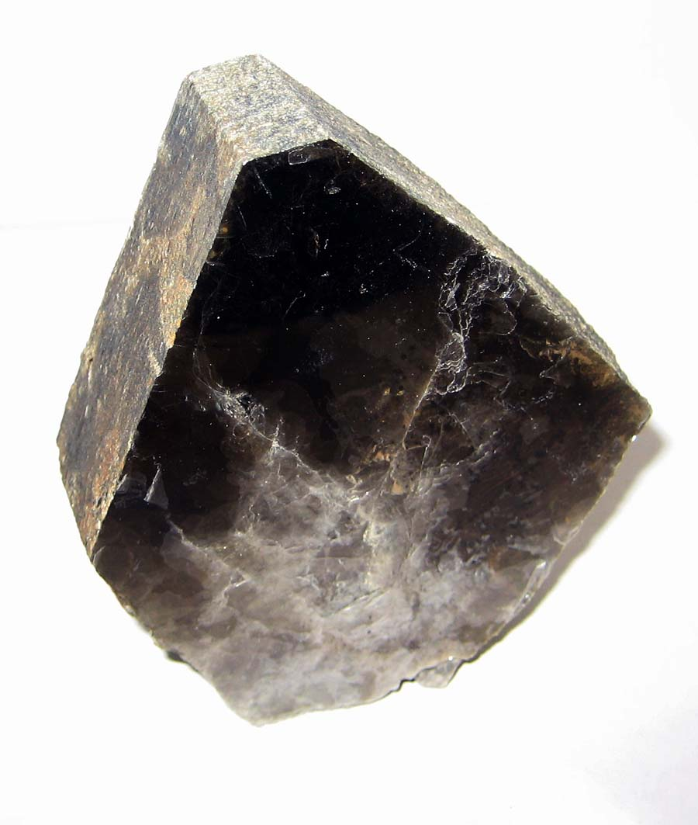
Muscovite
Batchellerville
NYSM 10734
NYSM 458.20

Slide 28
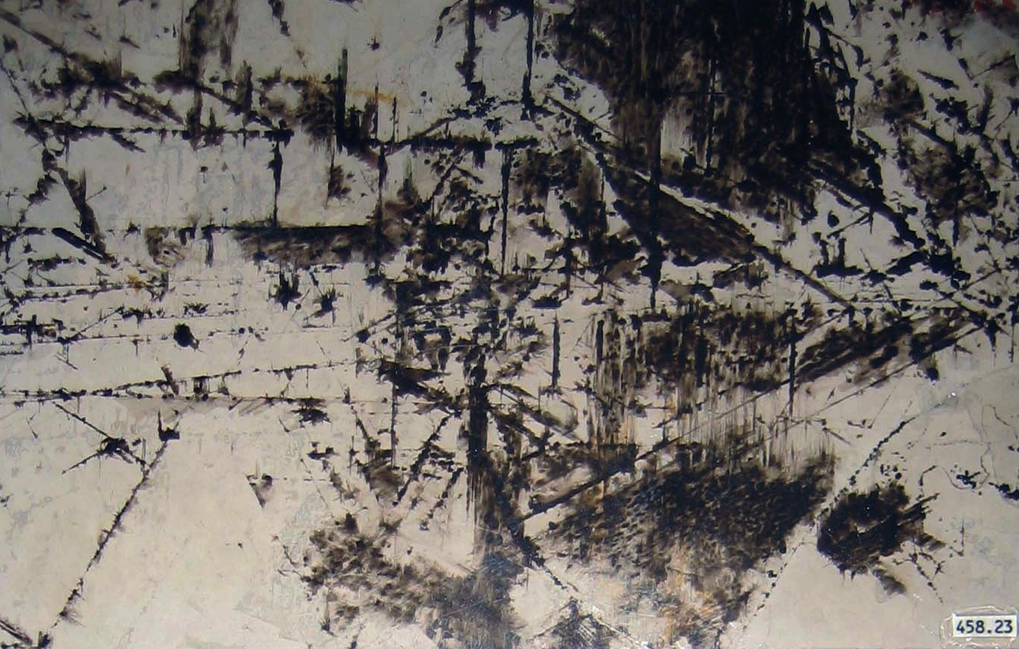
Muscovite w/ oxide inclusions
Batchellerville
(10 cm wide)
NYSM 458.23

Slide 29
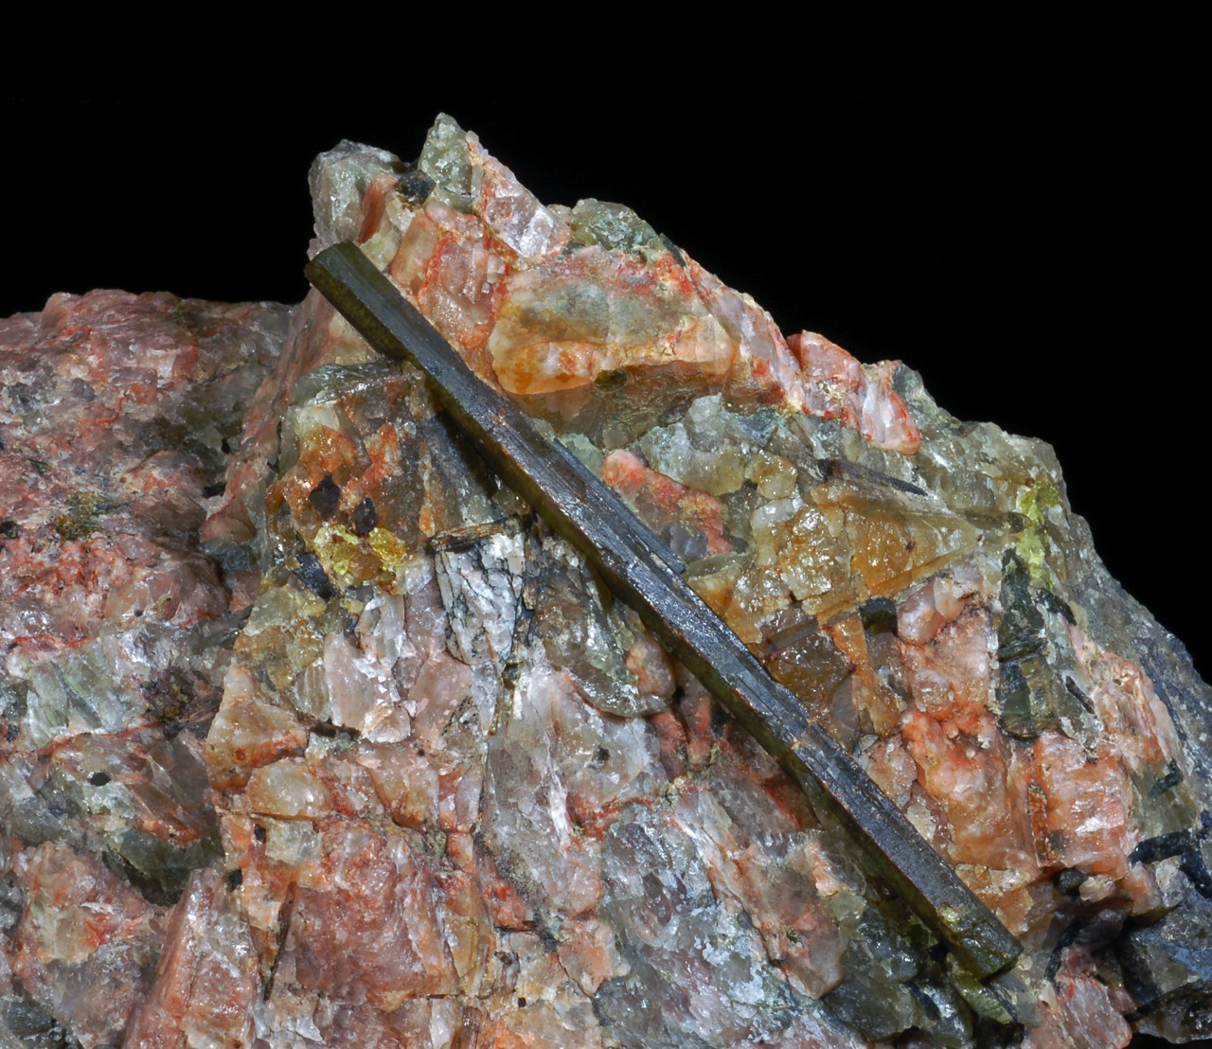
Sillimanite
w/ Quartz & Microcline
Benson Mines
(10 cm long XTL)

Slide 30
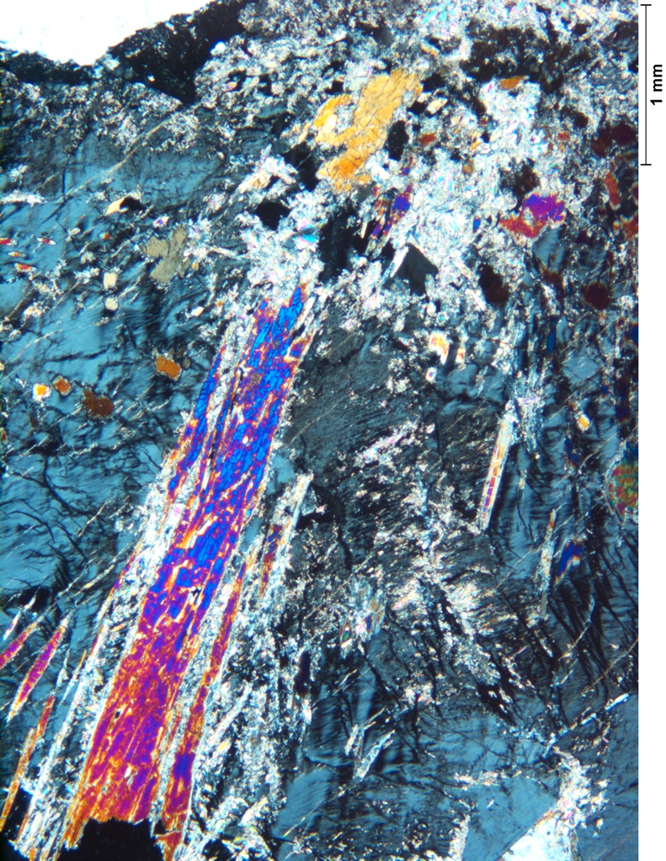
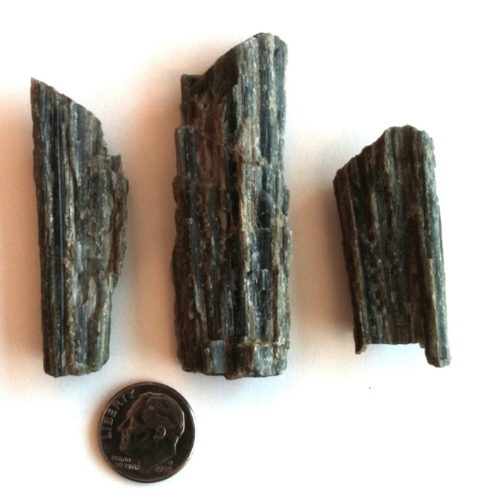
Sillimanite
Batchellerville

Slide 31
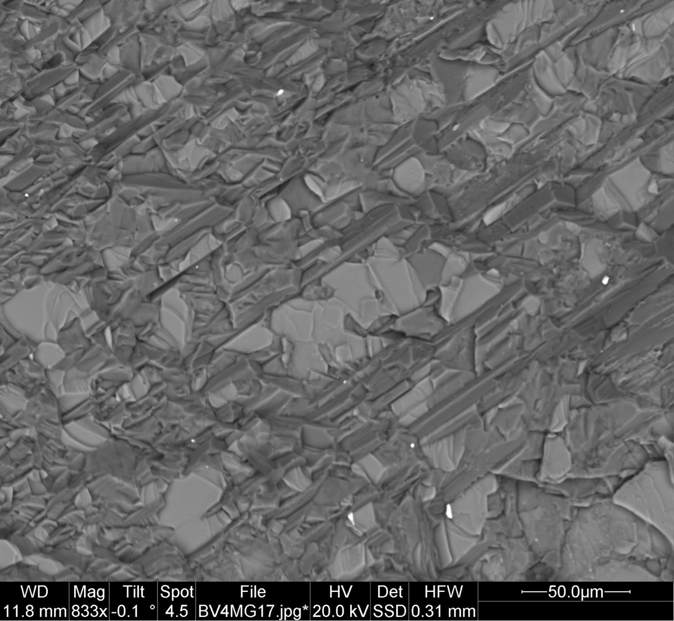
Sillimanite (S), Biotite (B) & Microcline (M)
Batchellerville
M
S
B
M
S
B
B
S
B
M

Slide 32
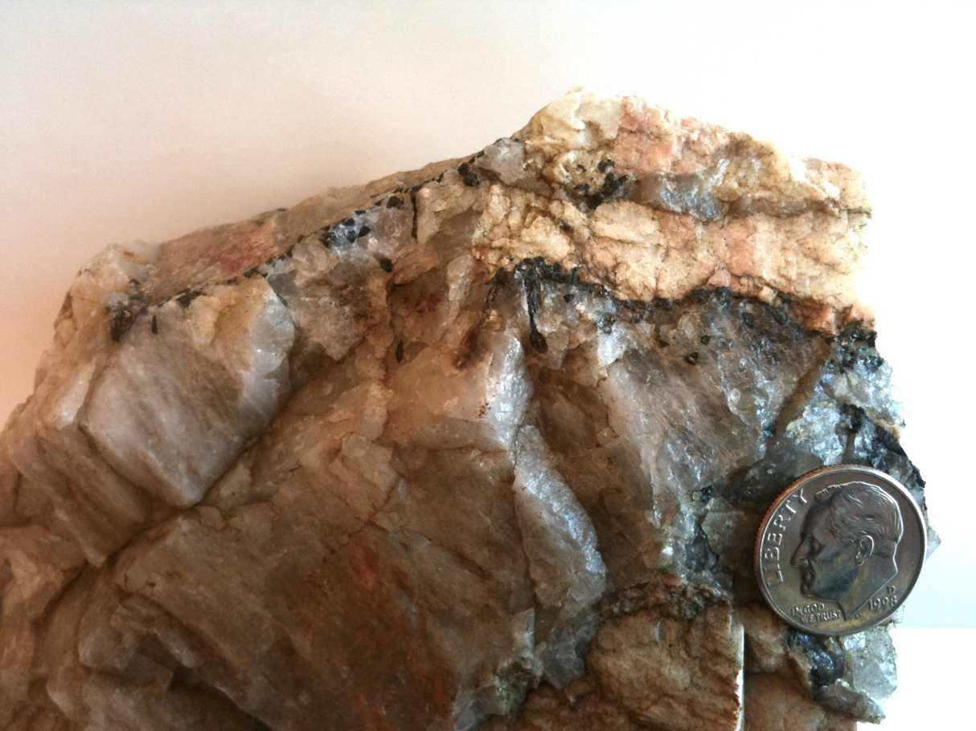
Tourmaline
at interface between Quartz & Microcline
Batchellerville

Slide 33
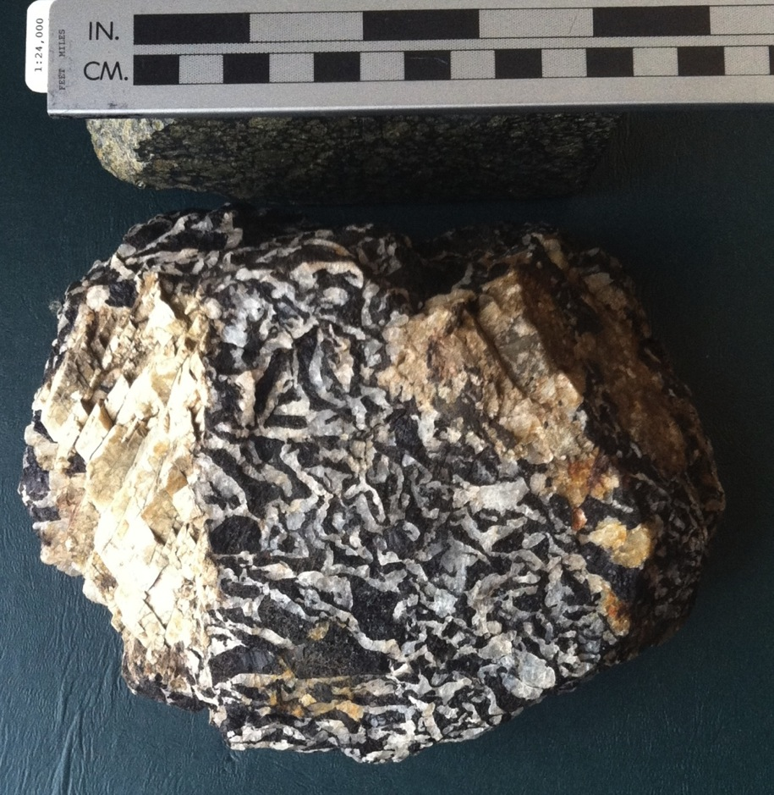
Tourmaline & Quartz
Overlook Quarry

Slide 34
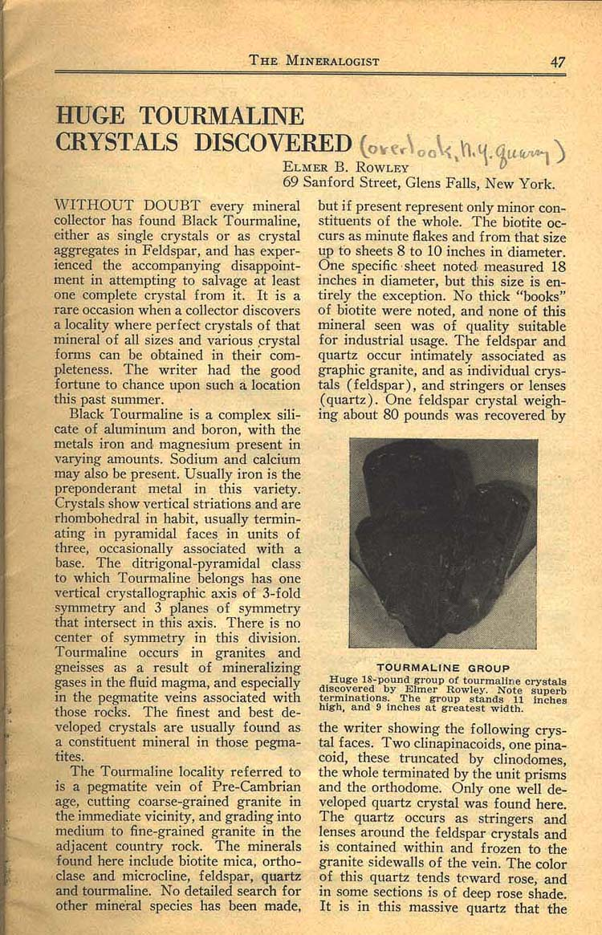
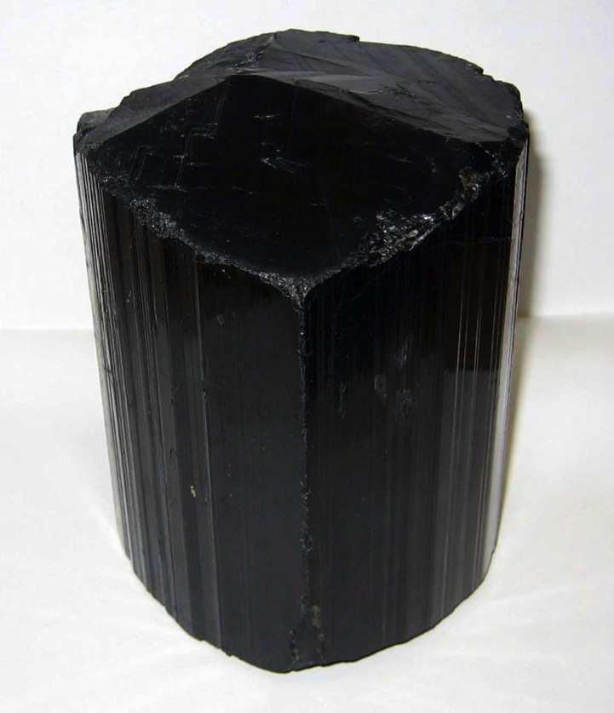
Tourmaline
Overlook Quarry
(25 cm tall)
NYSM 12944

Slide 35
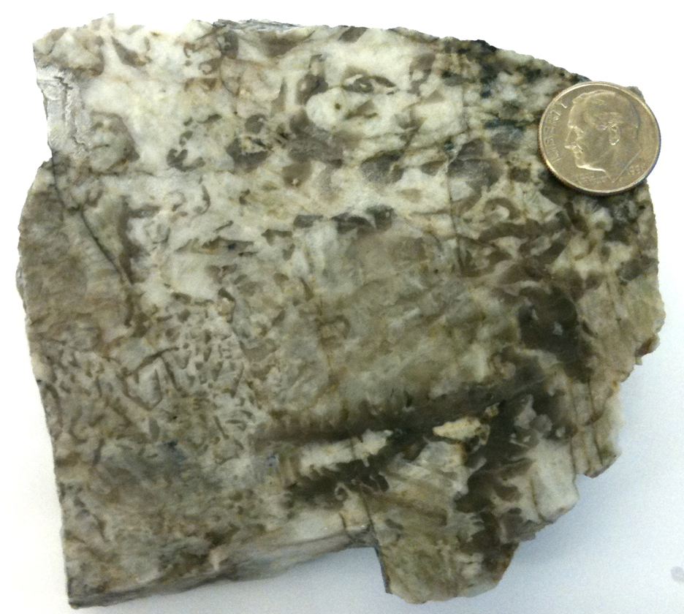
Dumortierite in Graphic Granite
Batchellerville

Slide 36
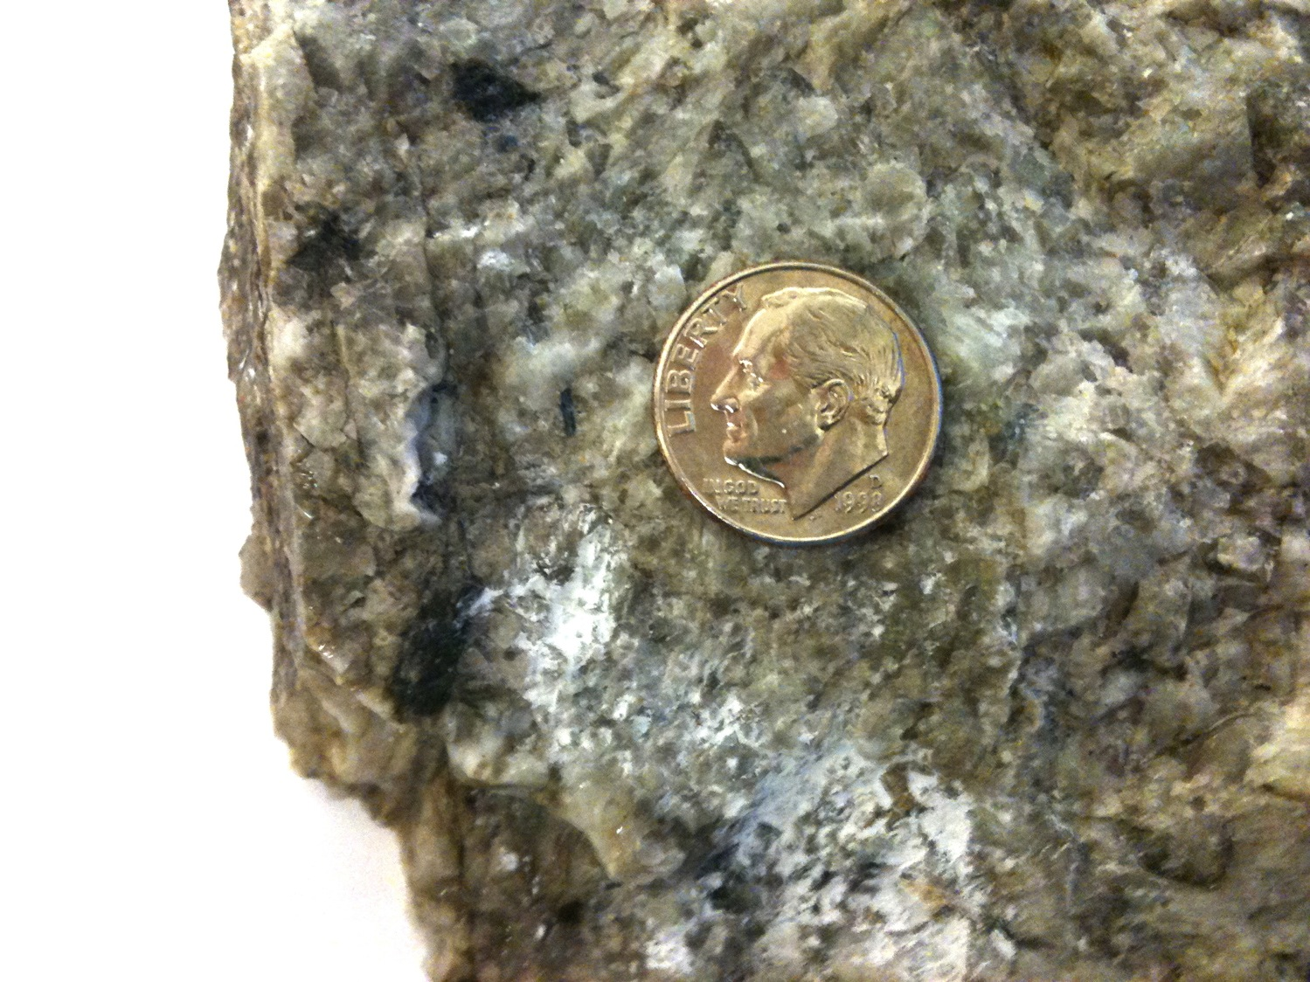
Dumortierite
Batchellerville

Slide 37
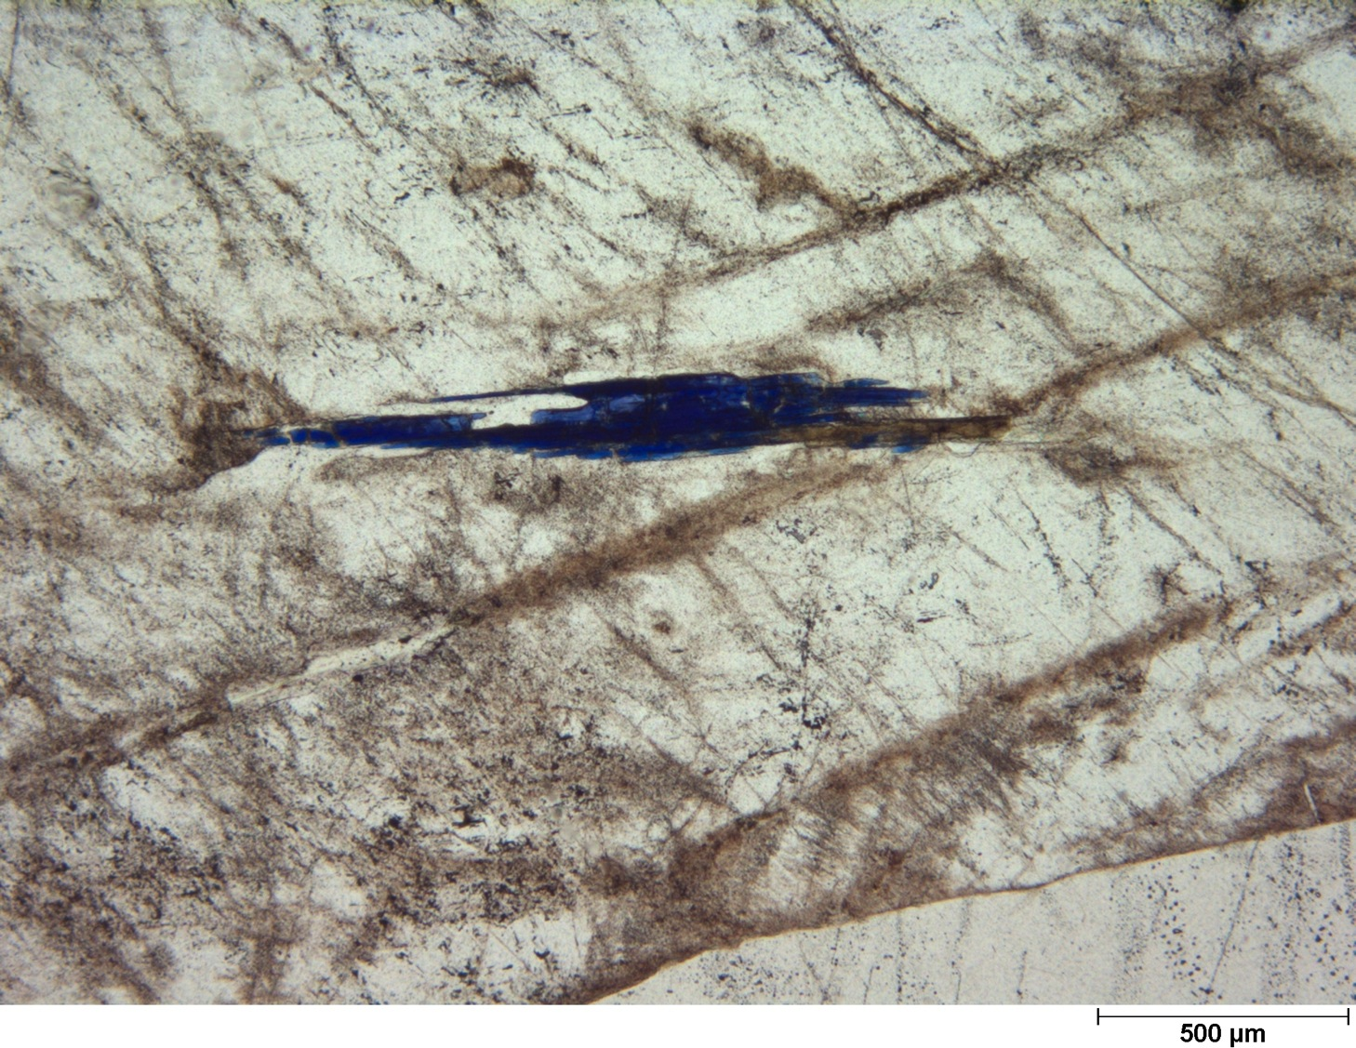
Dumortierite in Quartz
Batchellerville

Slide 38
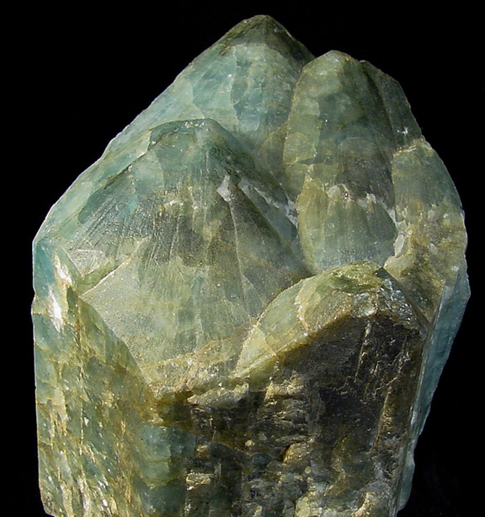
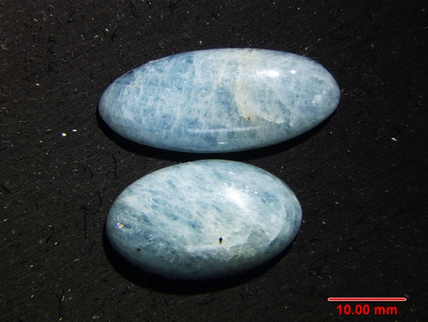
NYSM 10147
Beryl
Batchellerville
(16 cm tall)
(Photo credit: B. Gearhardt)

Slide 39
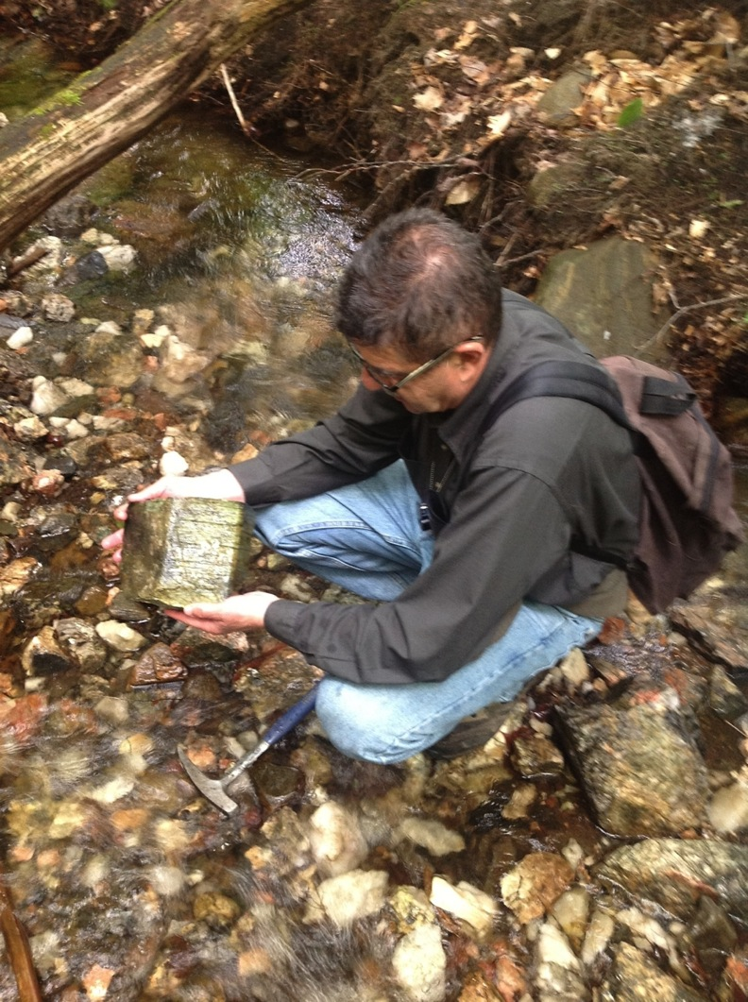
Beryl
Batchellerville
2011

Slide 40
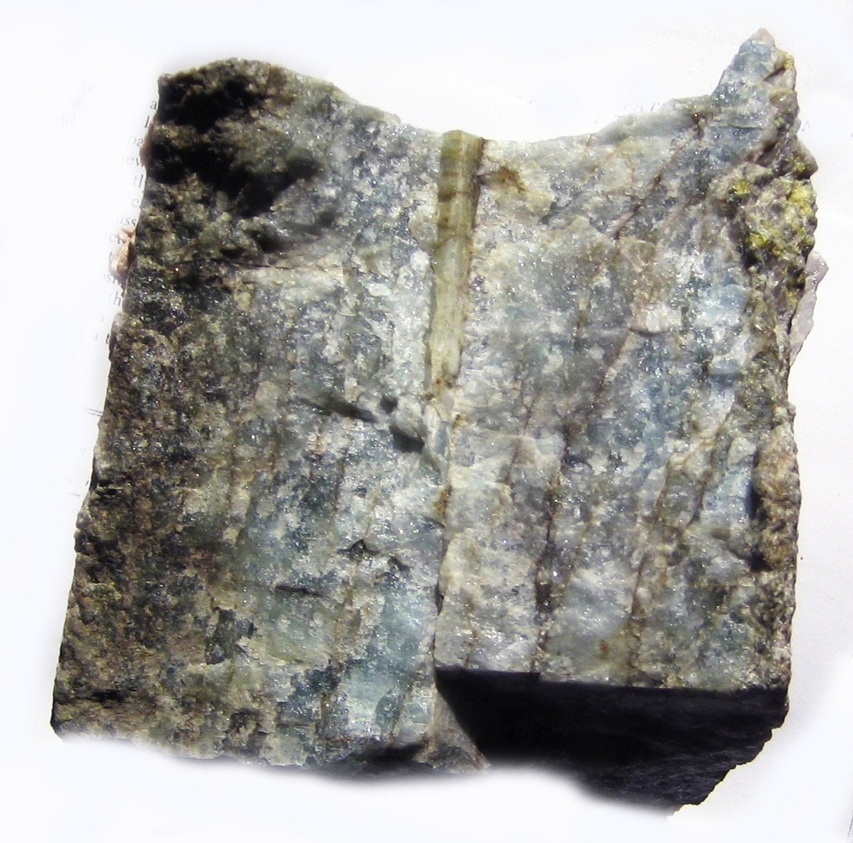
Beryl &
Chrysoberyl
Batchellerville
(4 cm long xtl)
NYSM 24595

Slide 41
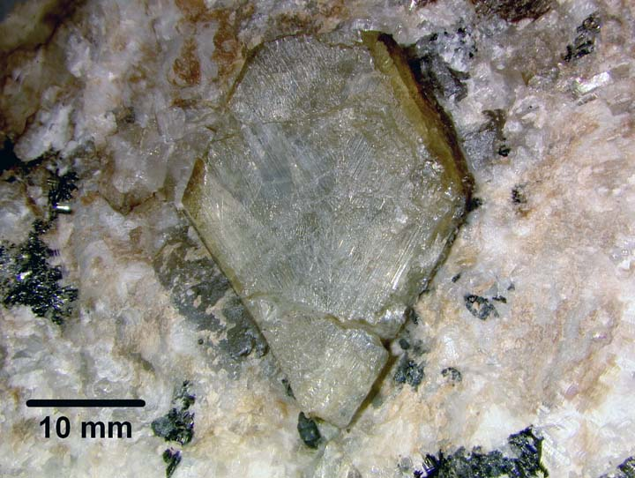
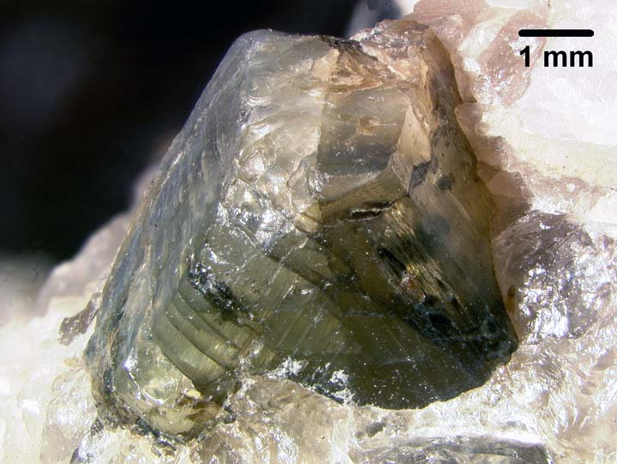
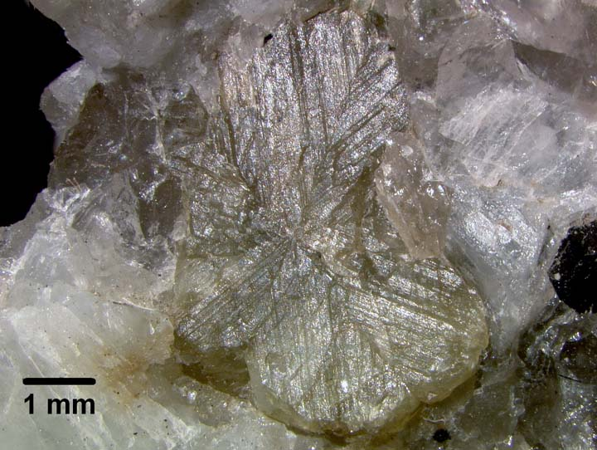
Chrysoberyl
Greenfield

Slide 42
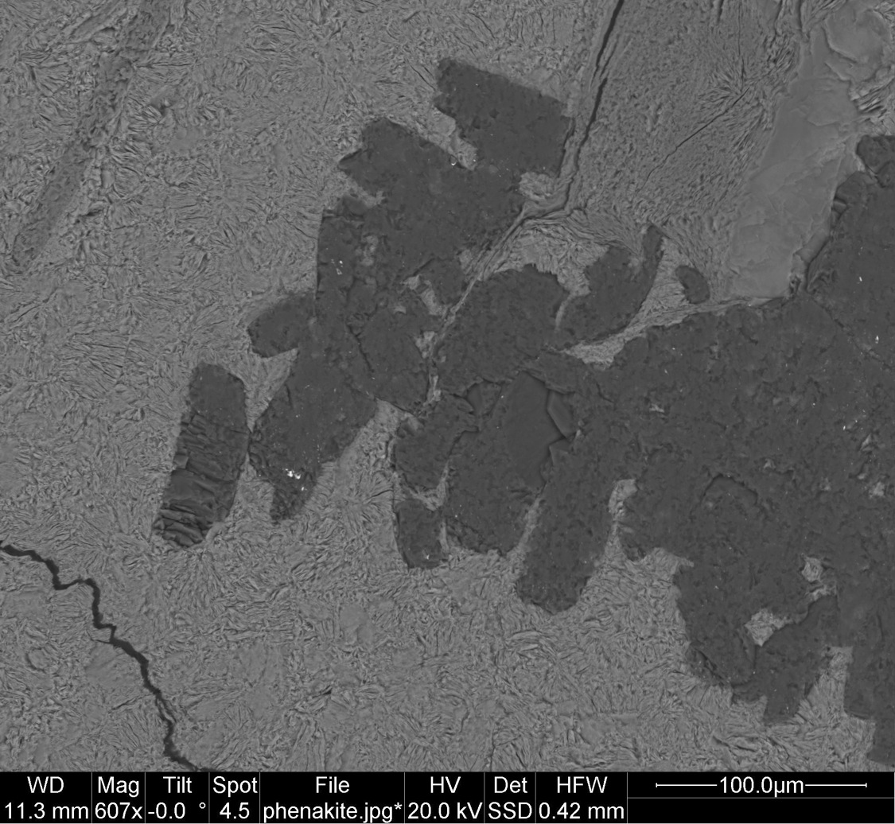
Quartz
Phenakite
Batchellerville
Phenakite

Slide 43
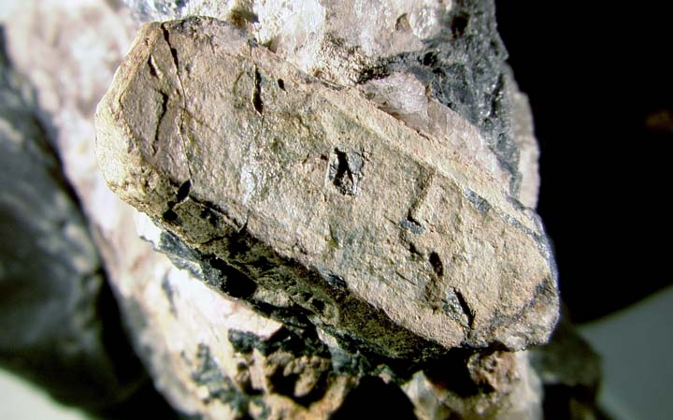
Polycrase-(U)
Overlook Quarry
(2.5 cm long XTL)
NYSM 8065

Slide 44
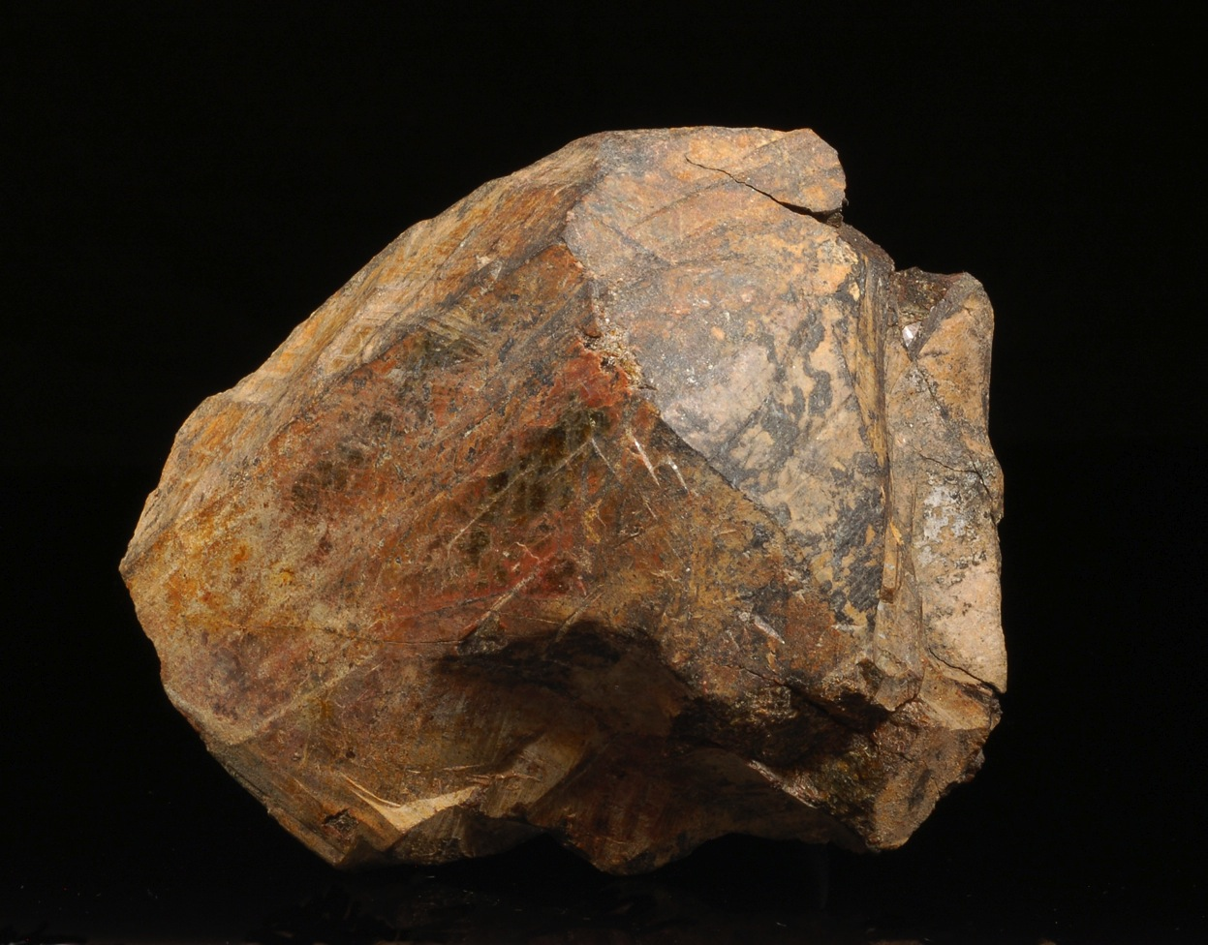
Monazite-Ce
Overlook Quarry
(10 cm long)
NYSM 24136

Slide 45
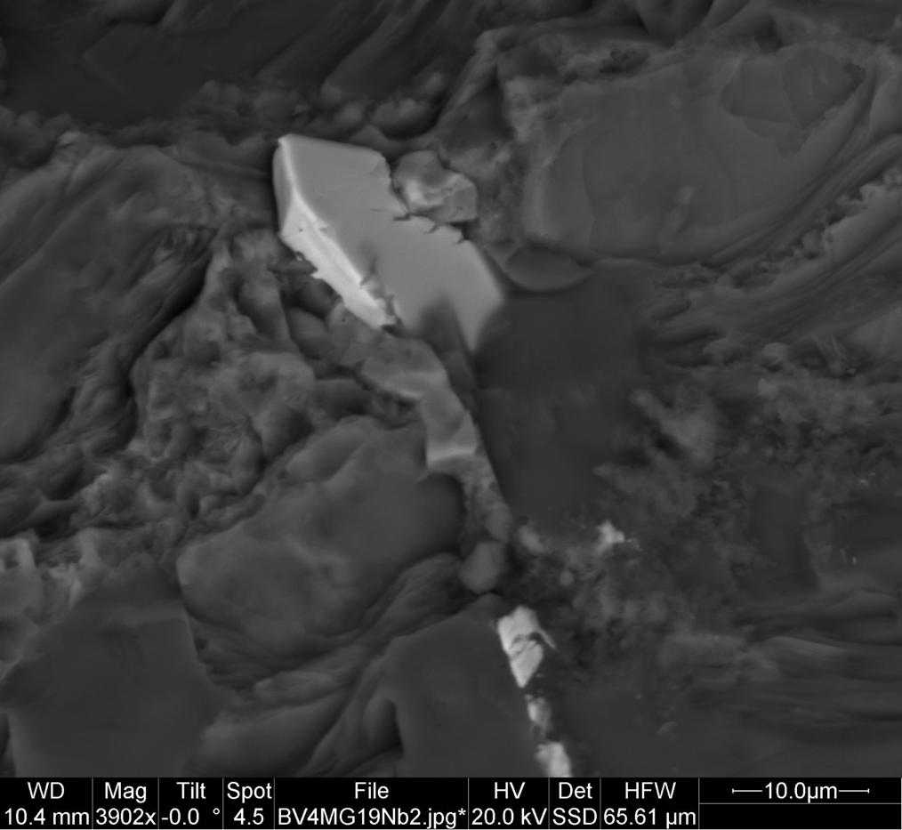
Columbite-Fe
Batchellerville
(in Quartz)

Slide 46
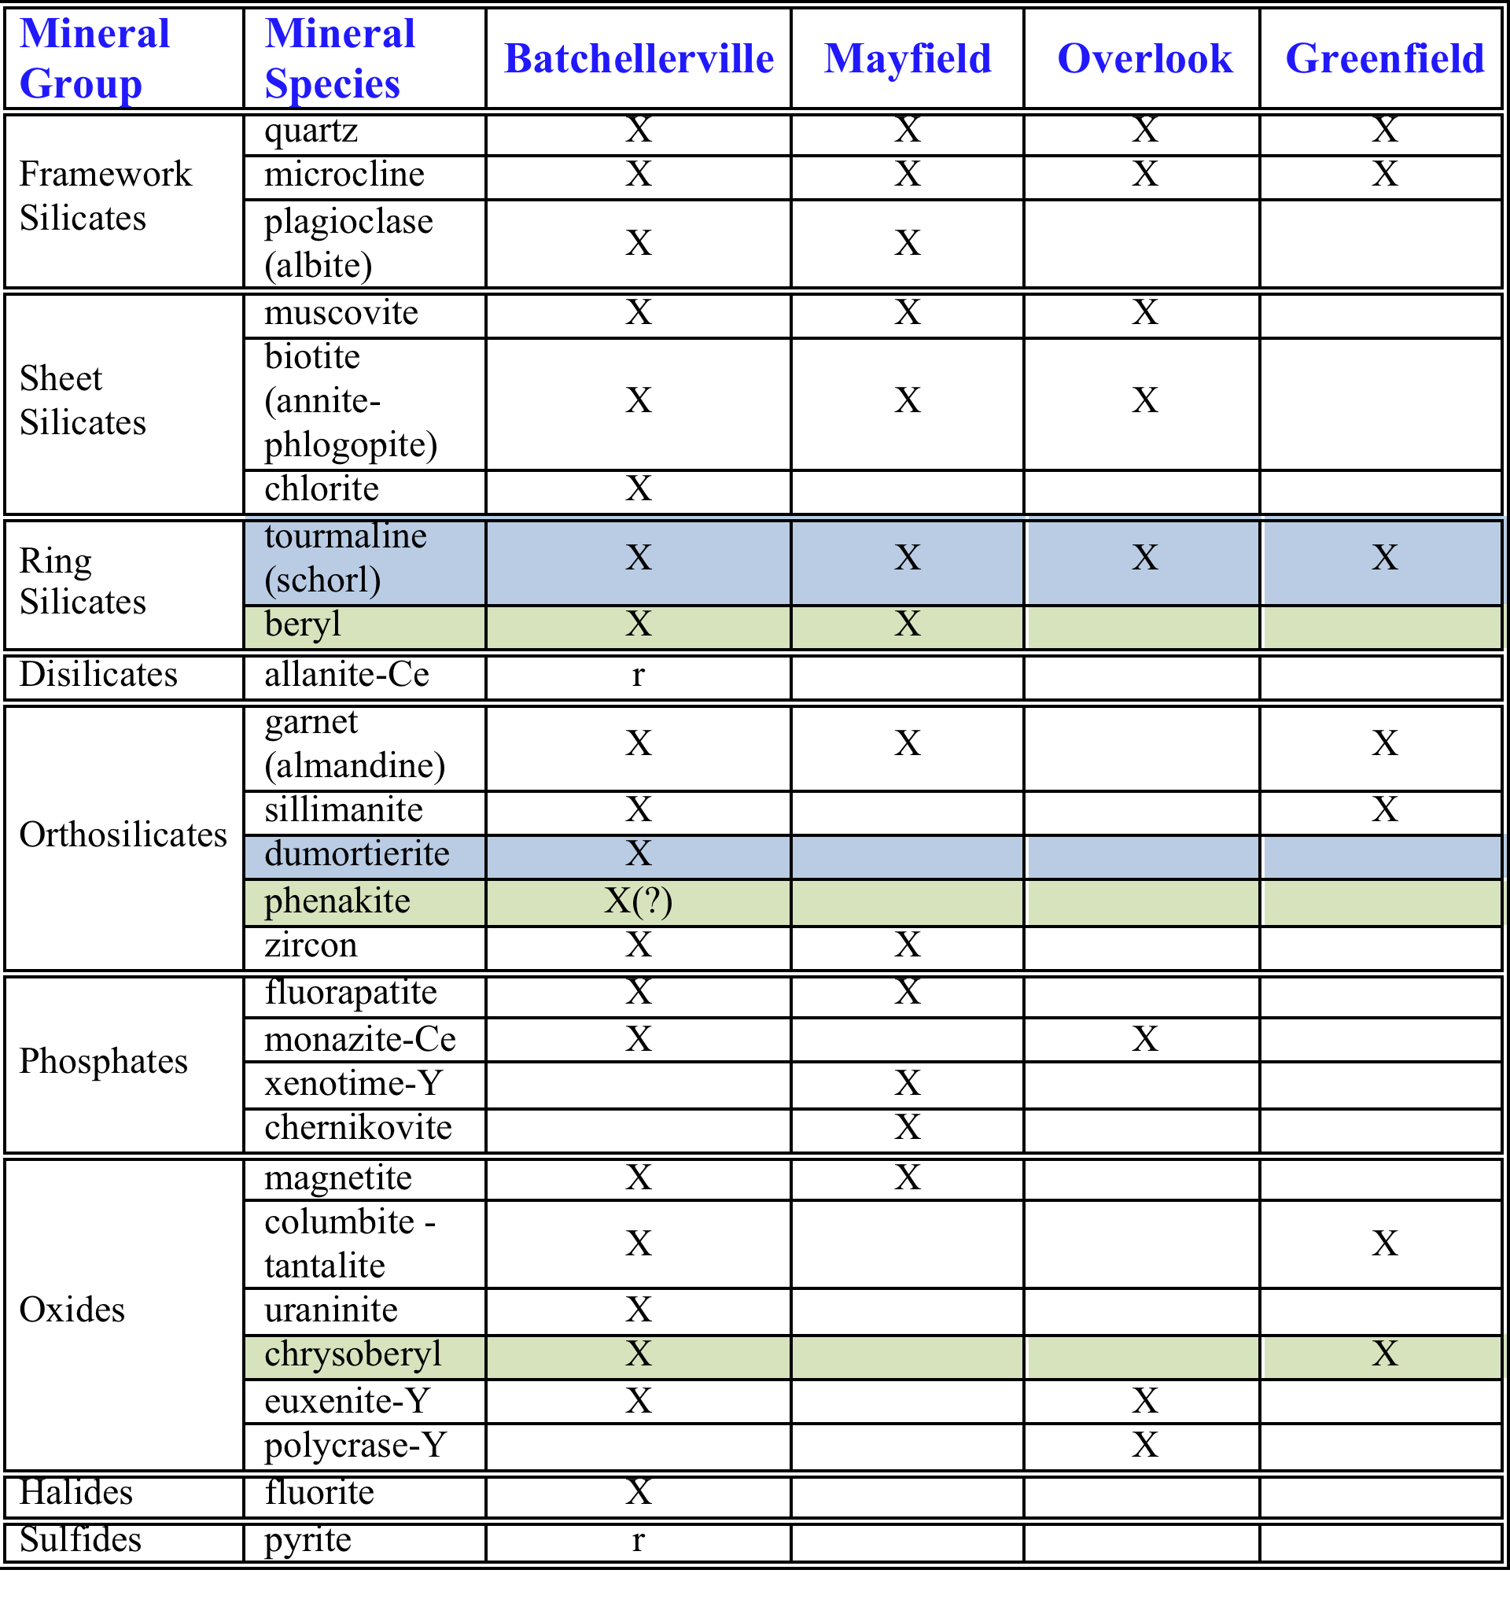

Slide 47
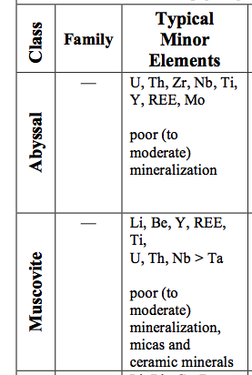
Minor Element Mineralization
Batchellerville | Mayfield | Overlook | Greenfield
B, Be | B, Be | B | B, Be
REE, Y, Zr | Y, Zr | REE, Y
U, Th | U | U, Th
Ta, Nb |  | Ta, Nb, Ti | Ta, Nb

Slide 48
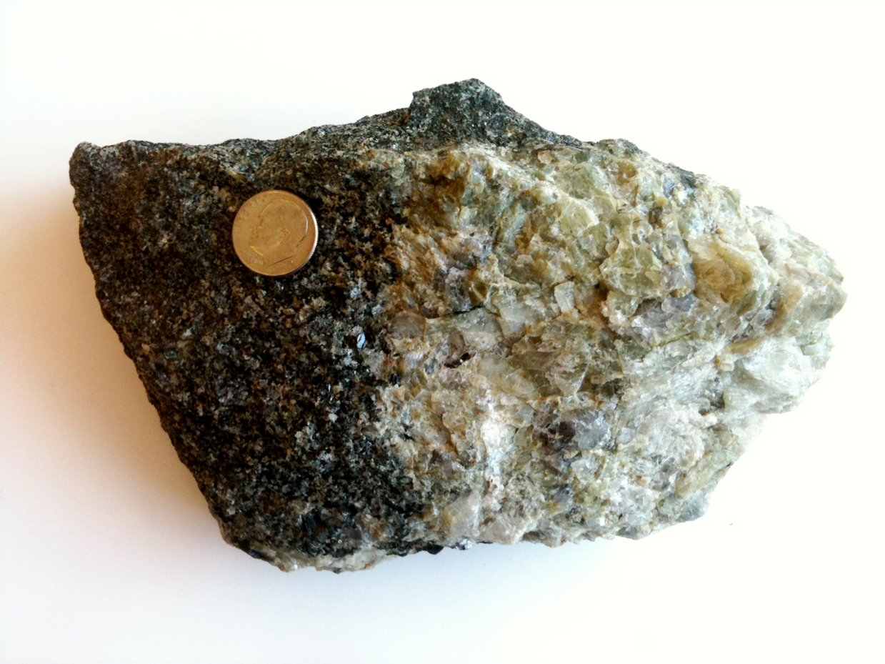
Host Rock Mineralogy & Chemistry....?
Biotite Garnet Gneiss
Pegmatite

Slide 49
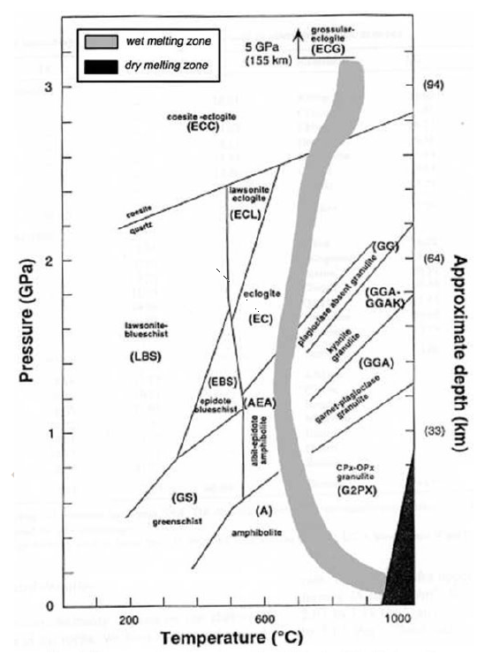
Conditions of Crustal Melting
(from Bonin, 2009; after Bousquet et al., 1997)

Slide 50
4
1. Qtz+Pl+Kfs+Ms+H₂O=Melt
1
3
2. Ms_{ss}+Pl_{ss}+Qtz+H₂O=Als+Melt
2
13%
3. Ms+Pl+Qtz=Kfs+Sil+Bt+Melt
4. Bt+Pl+Sil+Qtz=Grt+Melt
Ky
7%
5%
3% H₂O
Granitic melts produced by wet melting of pelitic gneisses
And
Sil

Slide 52
Summary:
Southern Adirondack Pegmatites
1. Grenville-age (1050 +/- 50 Ma), but post-deformation.
2. Formation Conditions: T ~ 650-700º, P~5-7 kb
"Abyssal / Muscovite Class" Pegmatites
3. Many small bodies; each with unique mineralogy
4. Mineralogy not complex, but exquisite and unusual mineral specimens have been found

Slide 53
Summary:
Southern Adirondack Pegmatites
1. Grenville-age (1050 +/- 50 Ma), but post-deformation.
2. Formation Conditions: T ~ 650-700º, P~5-7 kb
"Abyssal / Muscovite Class" Pegmatites
3. Many small bodies; each with unique mineralogy
4. Mineralogy not complex, but exquisite and unusual mineral specimens have been found
5. Origin: Localized H₂O-rich (but not saturated) partial melts of biotite gneiss
6. Detailed studies of pegmatite and host rock mineralogy and chemistry would reveal a great deal about the poorly understood process of anatexis in the mid to lower crust.

Slide 54
