Slide 1
Linking Individual and Collective Perspectives
on Resource Dependency:
Students as Sources of Data
Tim Lutz
Dept. of Geology & Astronomy
West Chester University
tlutz@wcupa.edu

Slide 2
The challenge of our time is that we are forced to confront two contradictory but coexisting worldviews.
Our society emphasizes individual freedom and success.
Our scientific data tell us that our collective effect on earth systems is devastating.

Slide 3
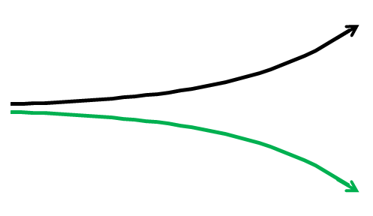
Two co-existing but conflicting realities
Economic success
Social progress
Promise of technology
Consumer choice and freedom
Human systems seem to be thriving
Earth systems are in decline
Soil
Fresh water
Fossil fuels
Bioproductivity
Biodiversity
CO₂ increase

Slide 4
The divergent trends have evolved through time so that ordinary (linear) analytical and problem-solving approaches cannot reconcile them.
Management scientist Russel Ackoff’s alternative is “to dissolve the problem… Dissolvers idealize rather than optimize, because the objective is to produce long-lasting satisfaction or at least get them back on track to attain their vision.” A course is taken that “changes the context (that is, the underlying system creating the problem) such that the problem disappears… To distinguish the approach that must be taken for this path, Ackoff calls it design. I add the emphasis because I believe it is the only one that can take on the challenge of producing sustainability.”
John R. Ehrenfeld, 2008, Sustainability by Design: A Subversive Strategy for Transforming Our Consumer Culture, Yale University Press. Italic emphasis added.

Slide 5
Gregory Bateson called this type of divergent situation a double-bind, and used it to model the origin of schizophrenia. According to Bateson, a double-bind occurs when we are exposed to:
A primary injunction or command
A secondary injunction in conflict with the first and at a more abstract level
Repeated exposure to the conflict
A prohibition against escaping the conflict
Gregory Bateson, 1972, Steps to an Ecology of Mind, Chicago University Press.
The double-bind is a problem that arises in systems when conflicting commands cannot be resolved; to dissolve the problem the entire system has to be engaged.

Slide 6
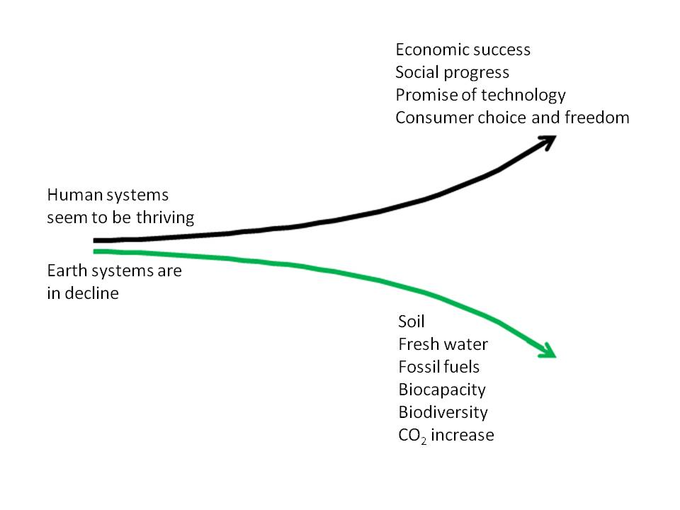
These two conflicting trends, experienced simultaneously, form a double-bind consisting of two conflicting commands…
1. Life is wonderful as it is; enjoy yourself and don’t rock the boat!
2. Our planetary support systems are failing; do something fast!

Slide 7
These two conflicting trends, experienced simultaneously, form a double-bind consisting of two conflicting commands, delivered at different levels of abstraction…
1. Everyday experience; economic reality; cultural reinforcement
2. Abstract data from distant and unfamiliar places with which we lack real connection

Slide 8
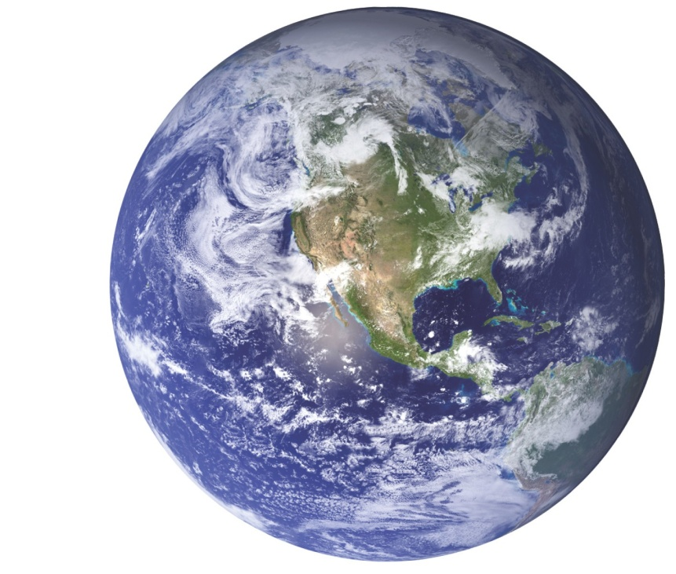
These two conflicting trends, experienced simultaneously, form a double-bind consisting of two conflicting commands, delivered at different levels of abstraction, and from which we cannot escape.
Our planet

Slide 9
This self-induced delusion of separate places on one planet has led to social schizophrenia and divisiveness. We want more and more stuff from Over There, while we try to throw more and more stuff Away. But that pesky junk keeps showing up Here. Unwanted stuff and pesky junk from Over There is coming Here, too, instead of staying Away where it's supposed to…
In our madness, we've failed to see that Here, Over There, and Away are simply one place with interchangeable names. Intellectually we know that the consequences of how we treat the atmosphere, the land, each other, and other species are inescapable; those consequences are all Here, it's all connected, and it's making us crazy.
Gloria Flora, 2010, Remapping Relationships: Humans in Nature: in The Post Carbon Reader: Managing the 21st Century’s Sustainability Crises, Watershed Media and the Post Carbon Institute. Emphases added.

Slide 10
A breakthrough, a leap to a new level of consciousness and a new type of creative learning, is needed to escape double-bind. Bateson suggested an analogy to the relationship between a Zen master and student.
“A similar event occurs in the relationship between Zen master and student, in which the master poses an impossible problem, a double bind known as a “koan.” Bateson cites the one in which the master holds a stick over the pupil and cries,
“If you say this stick is real, I’ll hit you.
If you say it isn’t real, I’ll hit you.
If you keep quiet, I’ll hit you.”
-- a classic double bind.”
Morris Berman, 1981, The Re-enchantment of the World, Cornell University Press.
The Zen master is aiming for enlightenment, not psychopathology!

Slide 11
A double-bind is a type of state in a system. To be disruptive to the double-bind pathology, a technology has to work with both of the diverging paths, not just one of them.

Slide 12
Models develop the habit in their users and developers of seeking patterns of correlation and locating systemic constraints that over time lead to more desirable results…
Good models are potentially powerful democratic tools putting expertise at the service of people with less knowledge; they externalize “privately” held knowledge, making the assumptions and selective construction of the “real” visible and its implications readily available for selective manipulation by the user with little further intervention by the expert.
John St. Julien, 2005, Complexity: Developing a more useful analytic for education: in Chaos, Complexity, Curriculum and Culture: a Conversation, W.C. Doll et al., eds., Peter Lang Publishing.
Models shift the focus from learning facts about ‘the world’ to learning about our personal dependence on, and participation in, the systems that make it up.

Slide 13
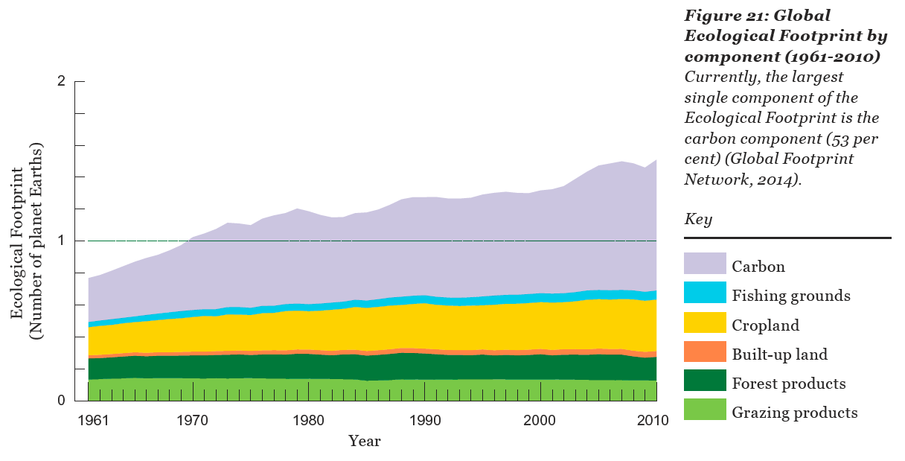
The Ecological Footprint: our dependence on bioproductivity at the global scale
WWF, 2014, Living Planet Report 2014: Species and spaces, people and places

Slide 14
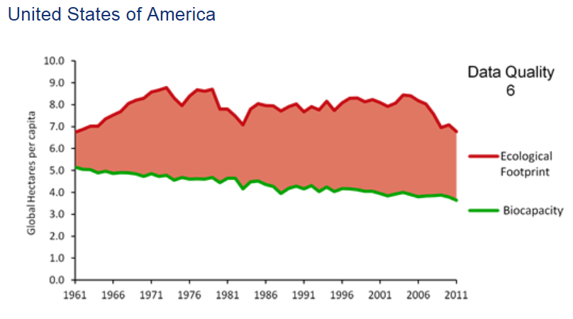
National accounting results: can we find the individual?
The Global Footprint Network: Advancing the Science of Sustainability
www.footprintnetwork.org

Slide 15
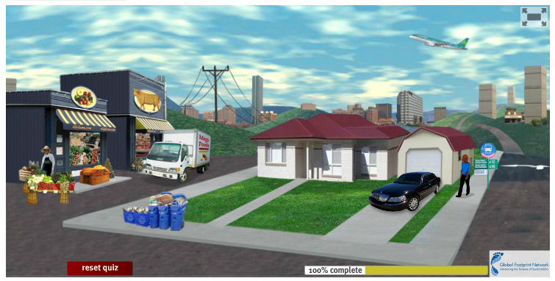
Example of the user interface screen for the personal ecologic footprint calculator
The Global Footprint Network: Advancing the Science of Sustainability
www.footprintnetwork.org

Slide 16
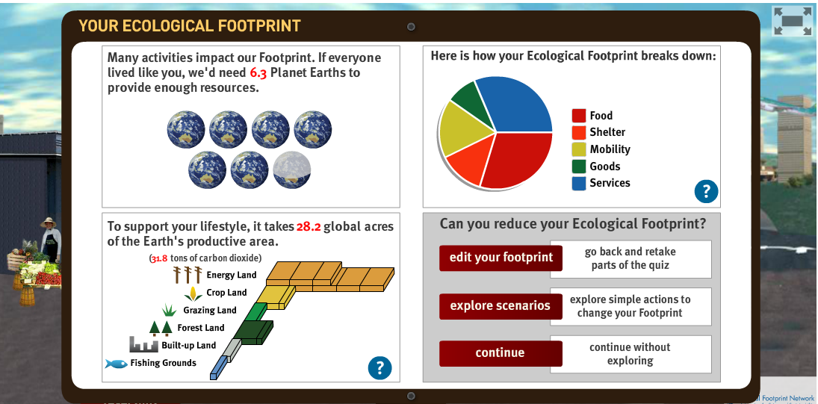
The user output screen for the personal ecologic footprint calculator
The Global Footprint Network: Advancing the Science of Sustainability
www.footprintnetwork.org

Slide 17
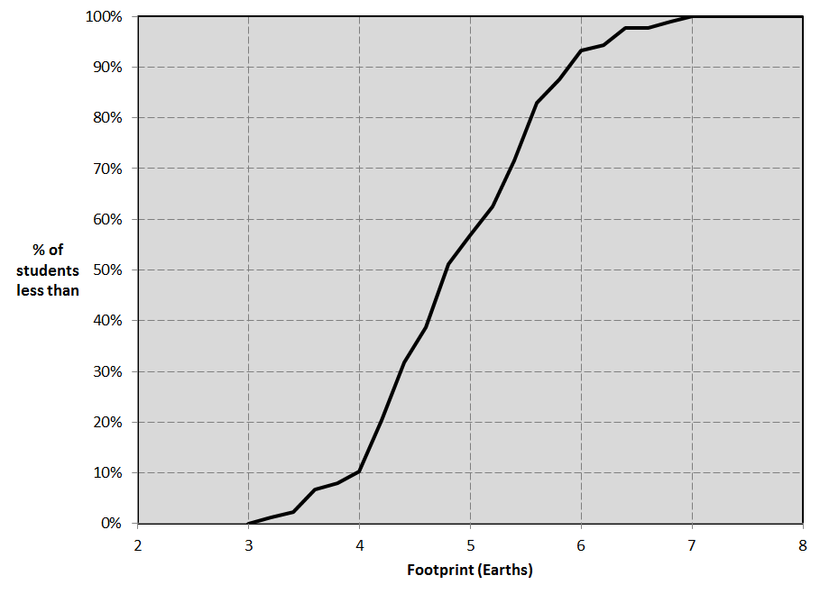
Cumulative distribution based on data from individual students
ESS 102, Spring 2015, n= 88

Slide 18
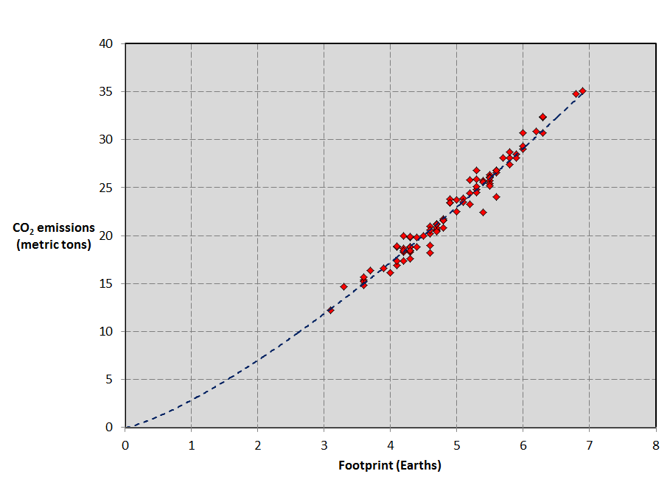
Chart relating footprint to carbon emissions: symbols represent individual students
ESS 102, Spring 2015, n= 88
The largest component of each student’s footprint was for energy land.

Slide 19
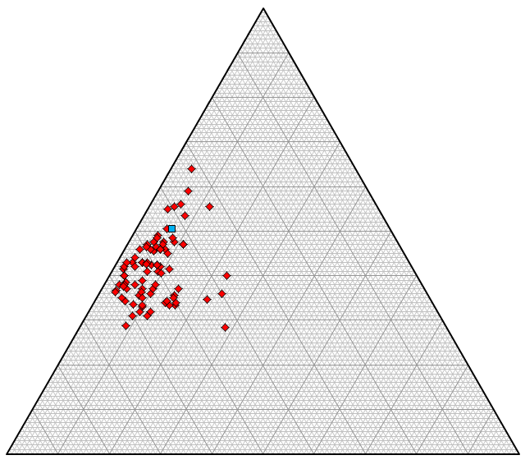
ESS 102, Spring 2015, n= 88
Services
Food +
Shelter +
Goods
Mobility

Slide 20
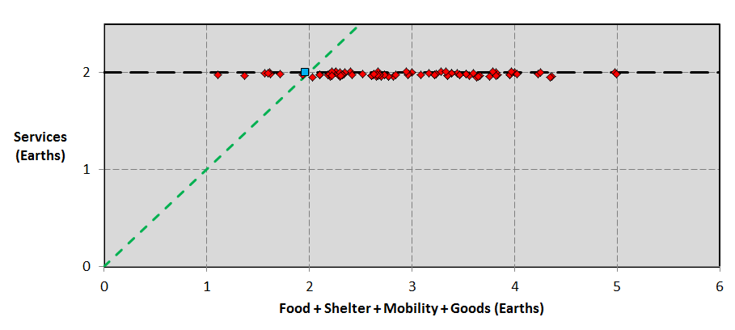
Services are those things in our lives that we don’t consume individually but that we all use: electric grid, highway system, education system, etc.
In any system, change starts with difference. The ability to visualize variability gives students a sense of who they are (in footprint terms), and who they could be.
System
dominant
Individual
preference
dominant
ESS 102, Spring 2015, n= 88

Slide 21
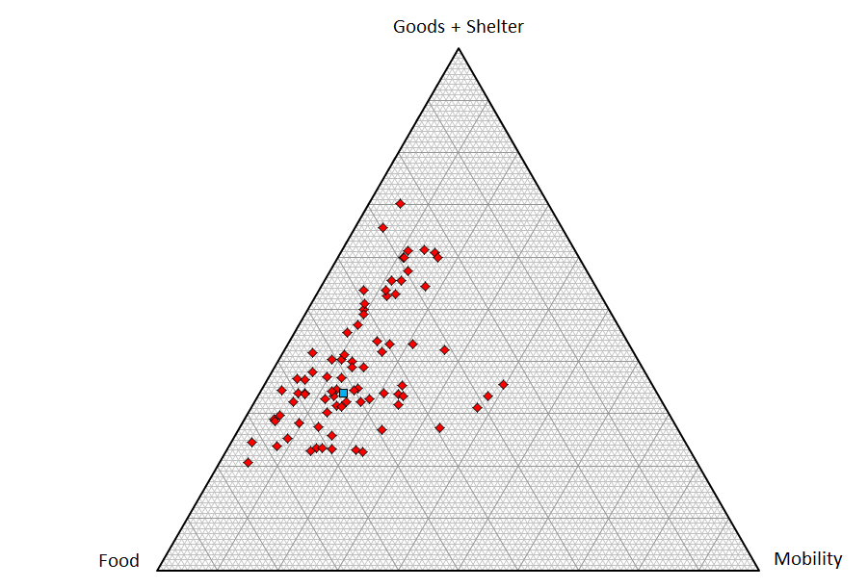
ESS 102, Spring 2015, n= 88
Components of individual preference and circumstance

Slide 22
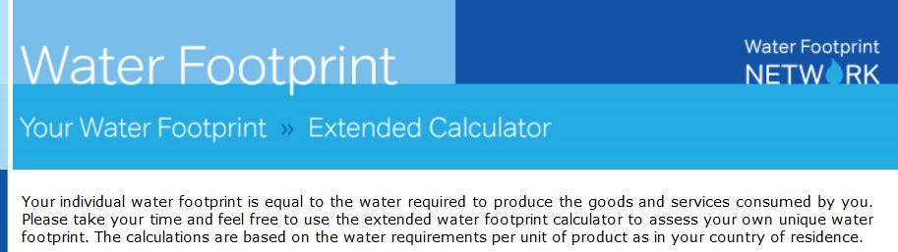
Water Footprint Network
http://www.waterfootprint.org/

Slide 23
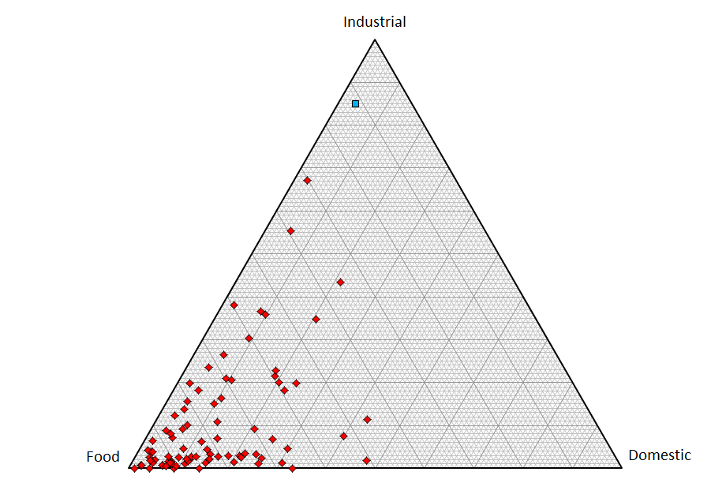
ESS 102, Spring 2015, n= 88
Water consumption components
Water is embedded in everything; for young people, food is typically the greatest water dependency

Slide 24
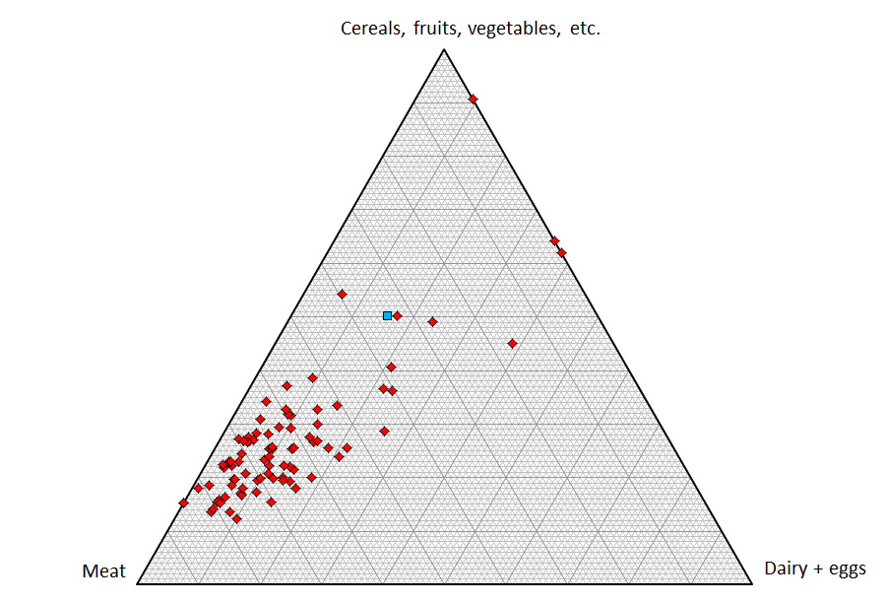
ESS 102, Spring 2015, n= 88
‘Vegan corner’
Water consumption components for food
What you choose to eat has a lot to do with your water dependency.
‘Vegetarian side’

Slide 25
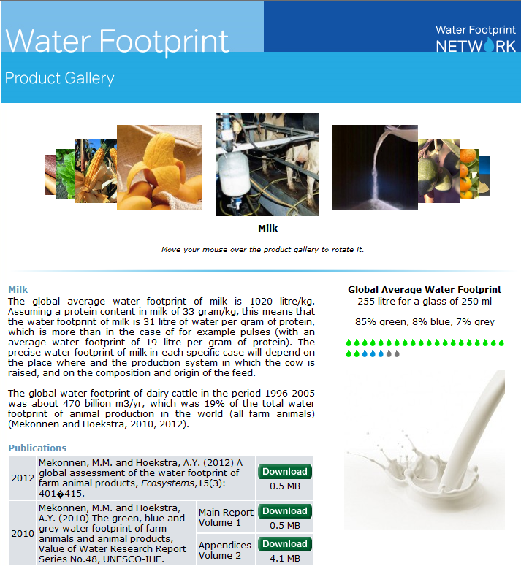
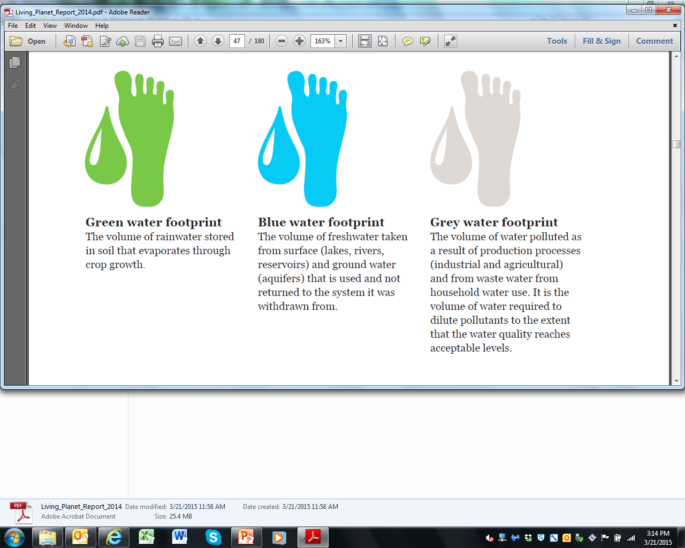

Slide 26
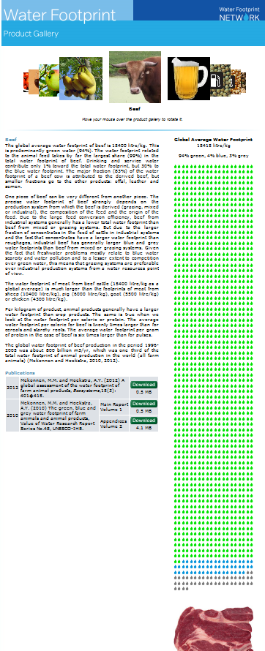
Water footprint for beef!
Shows the importance of fractional change

Slide 27
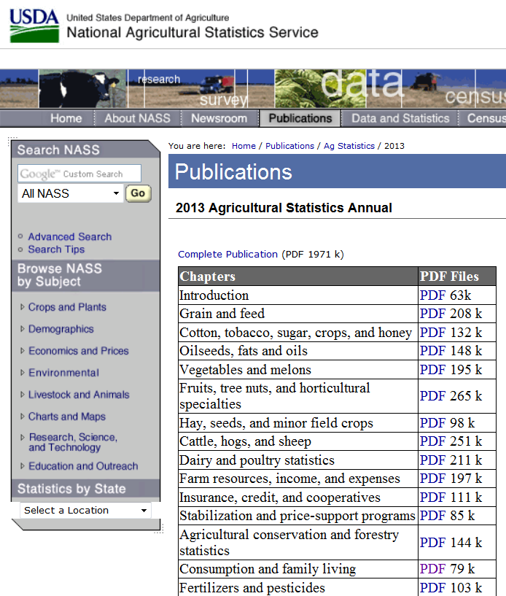
Giving water footprint results (e.g., Liter/kg) a watershed connection via data on crop yields (e.g., kg/acre), puts water dependence into watershed terms (Liter/acre).
National Agricultural Statistics Service publications http://www.nass.usda.gov/Publications/Ag_Statistics/index.asp

Slide 28
Linking Individual and Collective Perspectives
on Resource Dependency:
Students as Sources of Data
Why link? An approach that tries to address the entire system of individual choice and collective outcomes.
How to link? Footprint-type models transform the outcomes of individual choices into visual results that link the individual to the collective.
Does linking work? Assessment results suggest that utilizing data that reflect students’ lives is effective in promoting critical thinking and encouraging systems thinking about sustainability issues.

