Slide 1
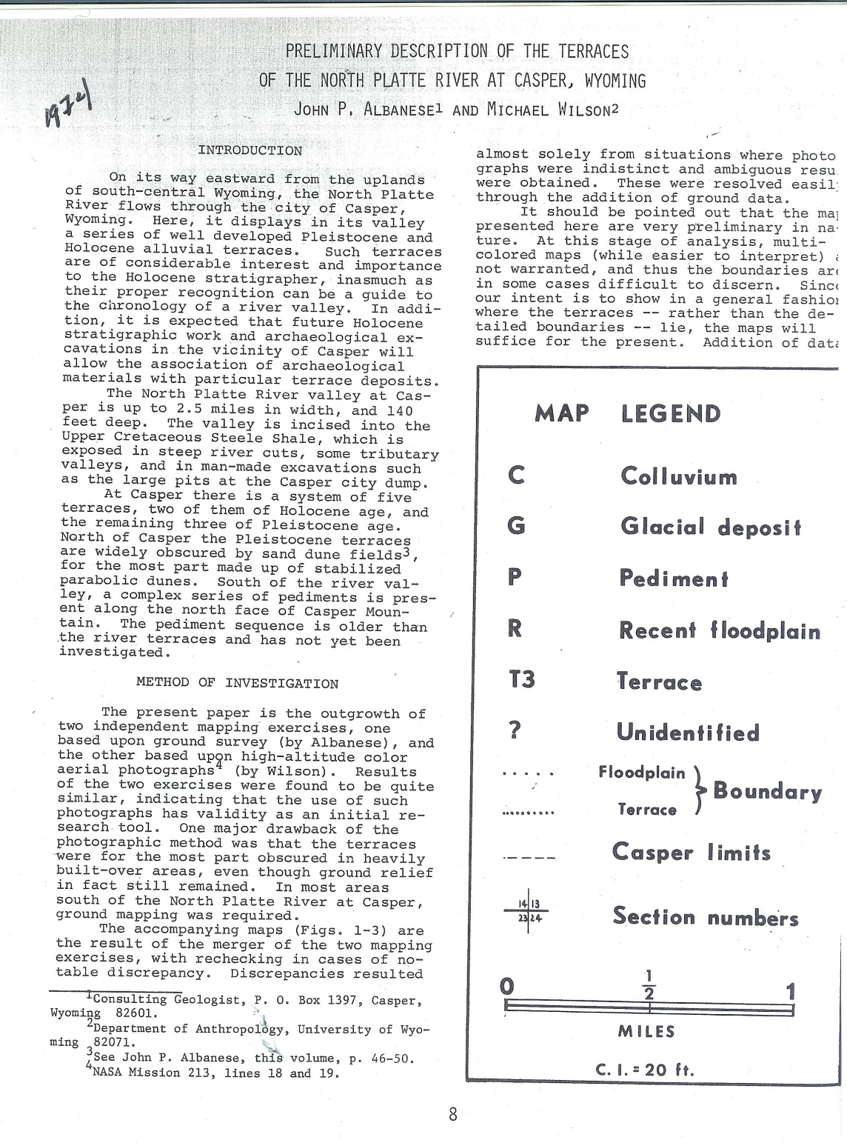
Well basically…….

Slide 2
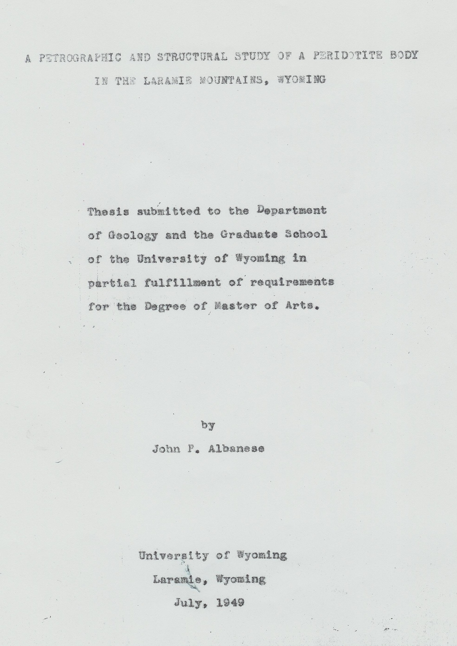
Well basically ……. (2)

Slide 3
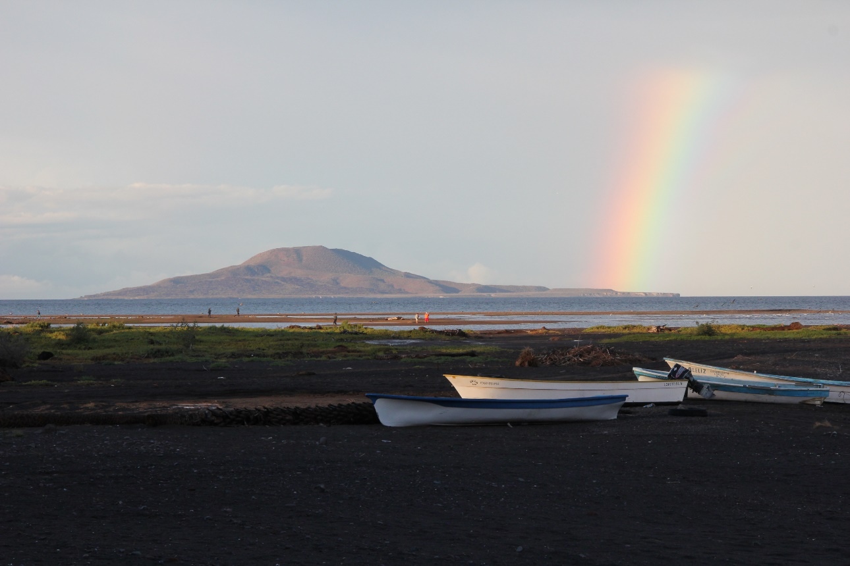
Geoarchaeological Evaluations Geomorphic Surfaces Loreto, Baja California Sur, Mexico: A Progress Report
Isla Coronado 160 ka

Slide 4
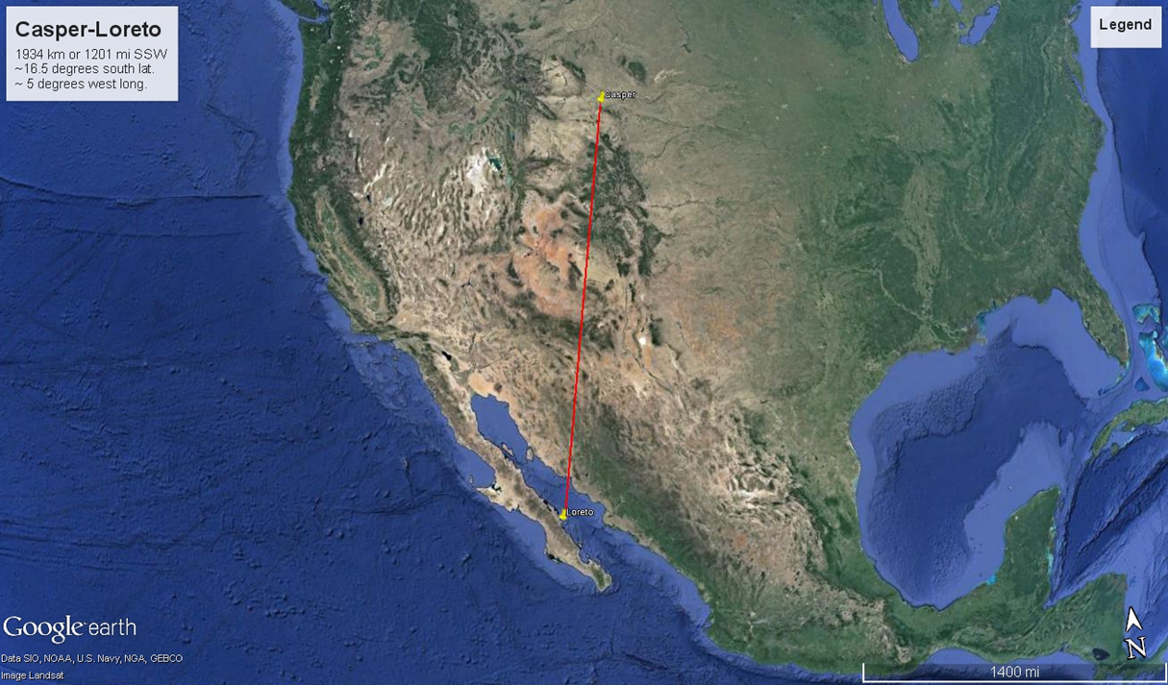

Slide 5
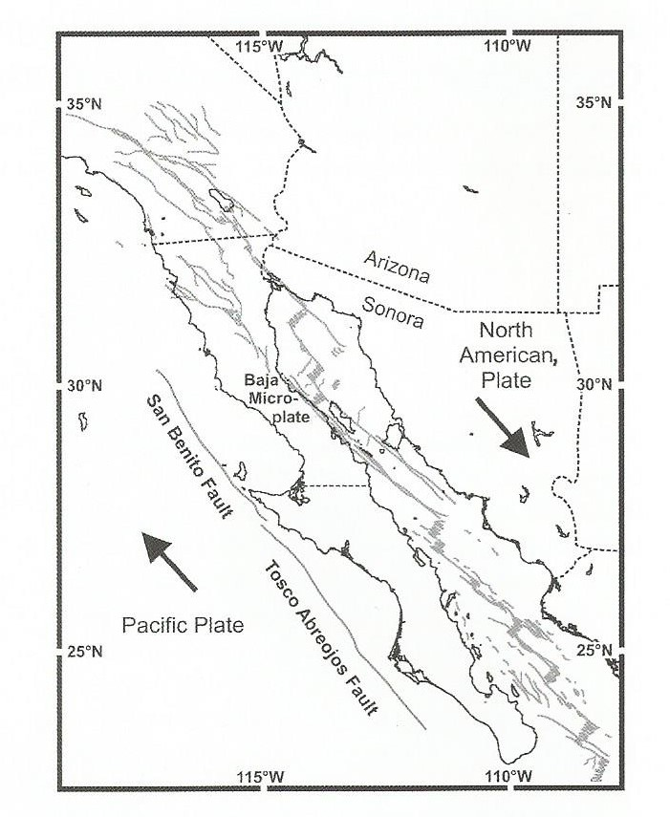
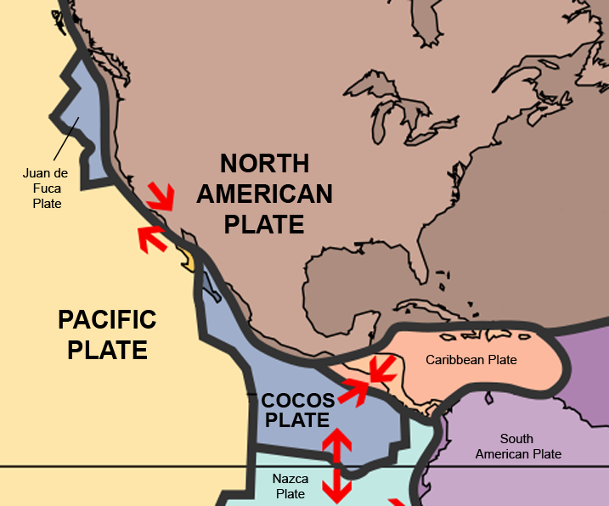
Tectonically active area
[Johnson & Ledesma-Vasquez 2009]

Slide 6
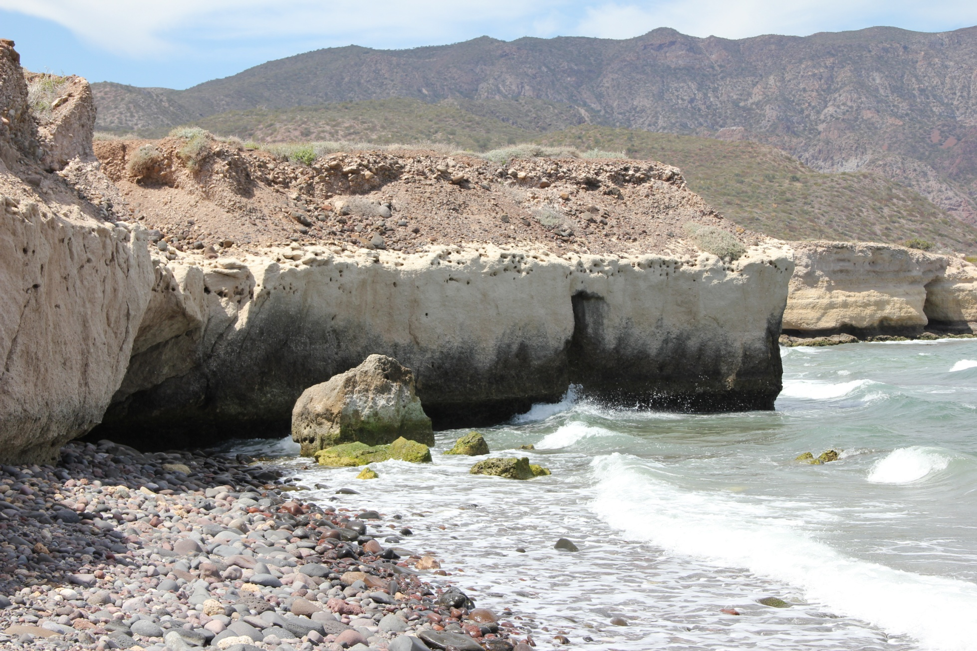
Tectonic Activity Punta El Bajo (Doctors Point) coral above deep sea fossils thought to date 105 to 80 ka (Johnson et al. 2009: 87)

Slide 7
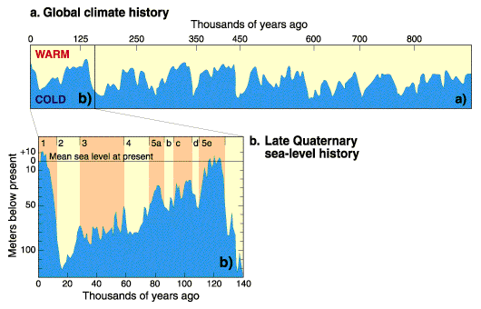
Tectonics and Quaternary sea levels

Slide 8
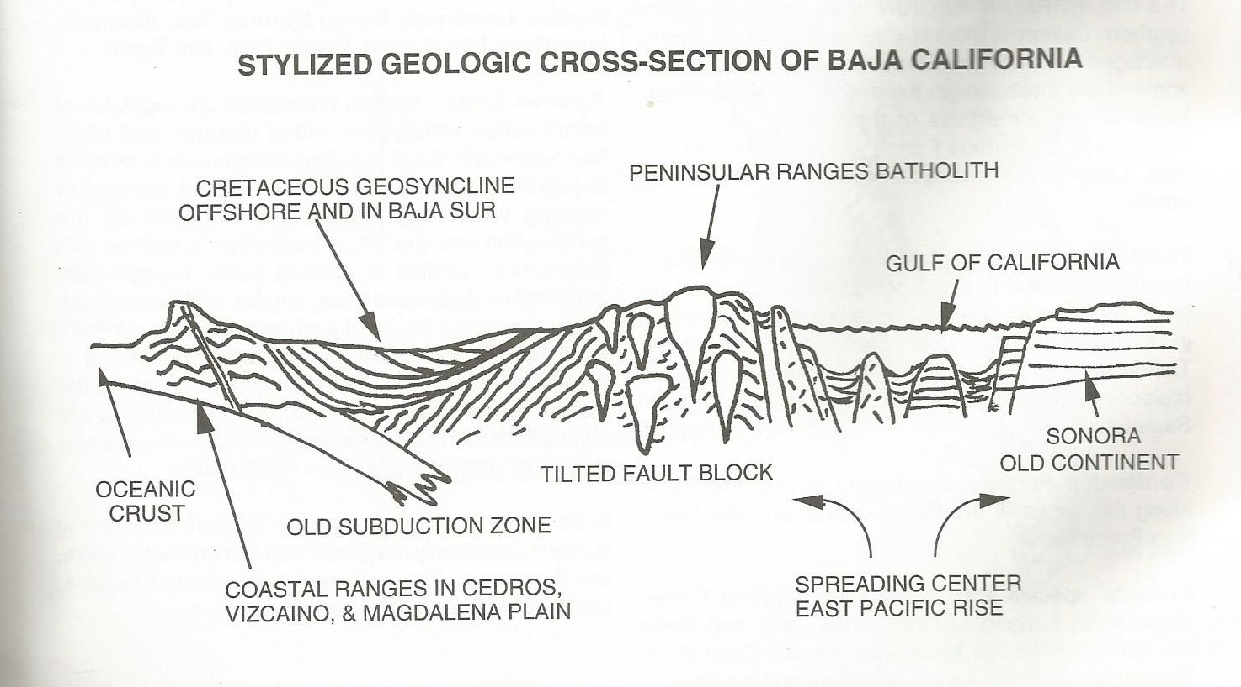
General geology Johnson [2014], Johnson and Ledesma-Vasquez [2009], Minch et al. [1998]
Phases of development
Subduction regime 29-12 ma
Crustal extension and opening of proto gulf 13-3.5 ma (extension of Basin and Range)
Transitional regime 3.5 ma to present (modern tectonic configuration)

Slide 9
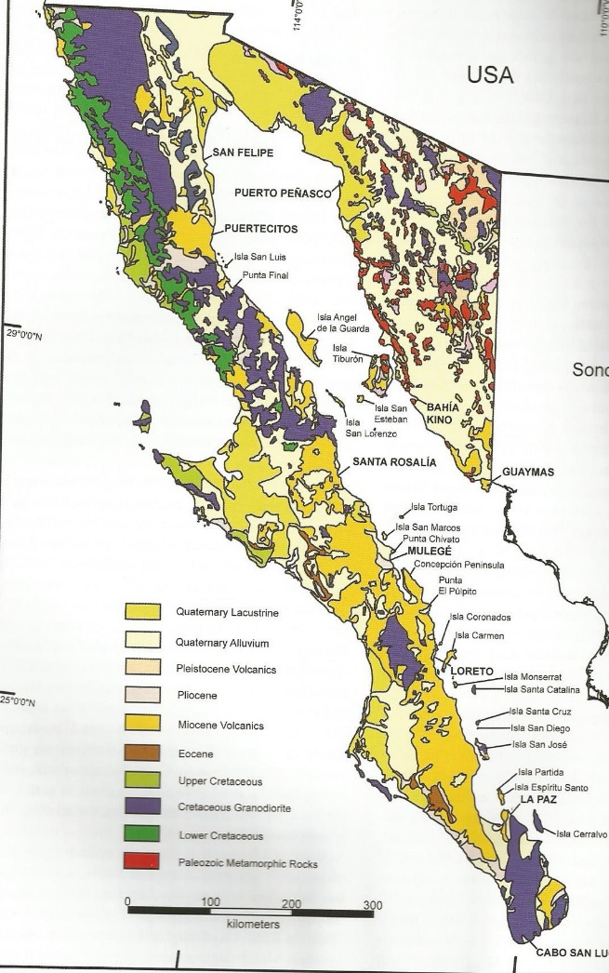
Quaternary (west) Miocene (east) [Johnson & Ledesma-Vasquez 2009]

Slide 10
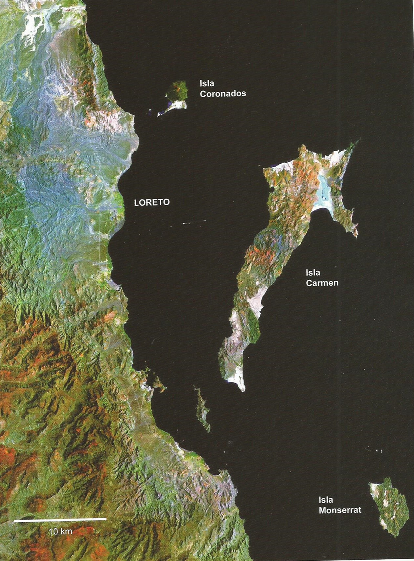
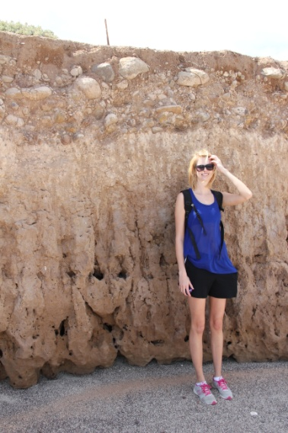
LANDSTAT (in Johnson and Ledesma-Vasquez 2009:13) Isla Carmen 5 geomorphic surfaces 170 m (557’) 68 m (223’) 400 ka 58 m (190’) 37 m (121’) 12 m (39’) Isla Coronando 2 surfaces 12 m (39’) 121 ka Punta El Bajo 80 ka?
Note scale and width
of Loreto study area

Slide 11
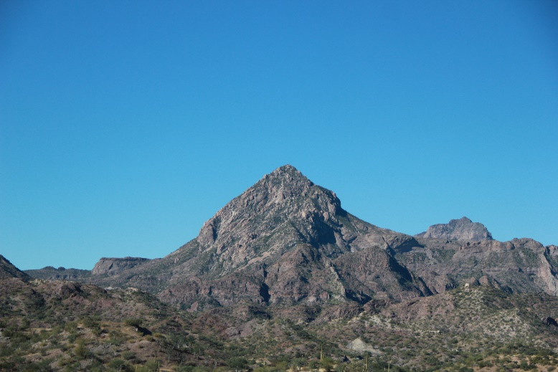
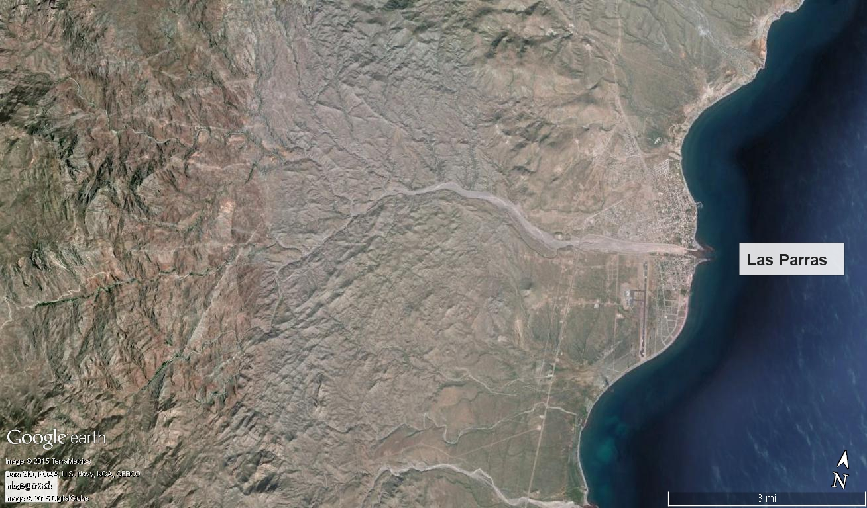
Arroyo Las Parras study area ephemeral wash, west to east trending Head in Sierra La Gianta at ~ 500 m elevation ~ 15 km long
Pilon de las Parras
Sierra La Gianta
head of Arroyo Las Parras

Slide 12
Well basically ……. (3 and 4) 3: a Plains Meeting Bunch of us young, know it all better then you grad students and recent grads….. 4: Suffering fools field trip ….

Slide 13
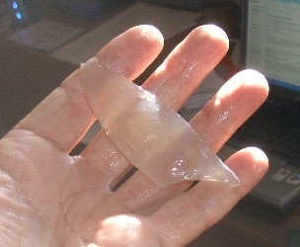
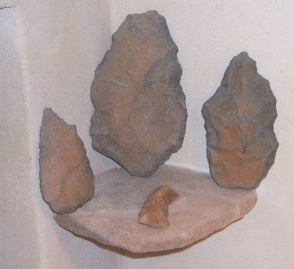
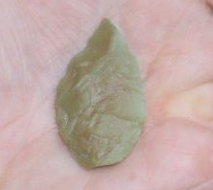
Interest sparked by: climatic reconstructions Sierra San Francisco, Baja California Sur, Mexico, to ca. 10,200 ¹⁴C yr B.P., California juniper (Juniperus californica) BCS coniferous woodland and chaparral vegetation, mild Mediterranean-type climate at least 5°–6°C cooler with at least twice the winter precipitation David Rhode (2002 QR) regional geoarchaeological investigations Pluvial Lake Chapala, large (ca. 66 km²) lake > 9070 yr B.P., desiccated by 7.45 ka yr B.P. Loren Davis (2003 Geoarch) Snorian Desert Clovis site dating 13,390 years (gomphotheres) Vance Holliday (oral communication) amateur collections

Slide 14
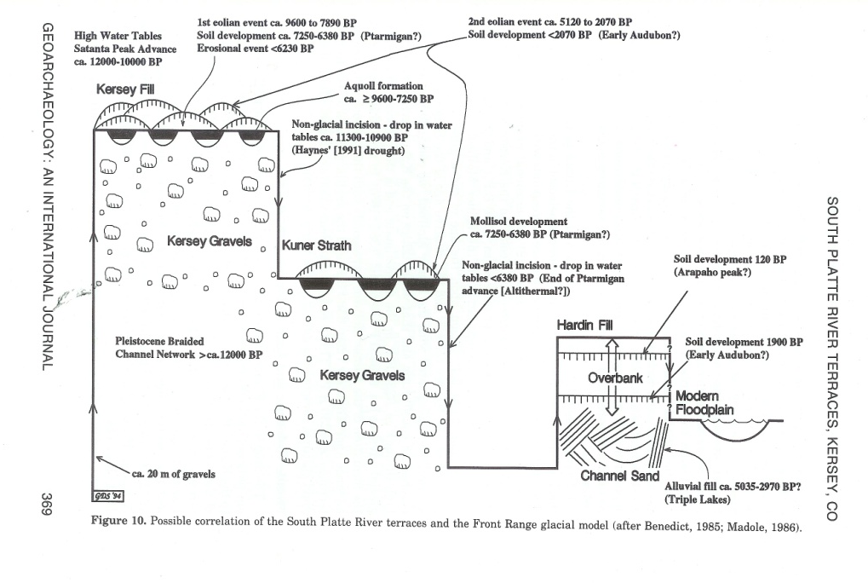
Goals: Identify and assess potential of terrains to yield buried cultural materials Approach: High Plains-Rocky Mountain Geoarchaeology Initial Task: Defining surfaces

Slide 15

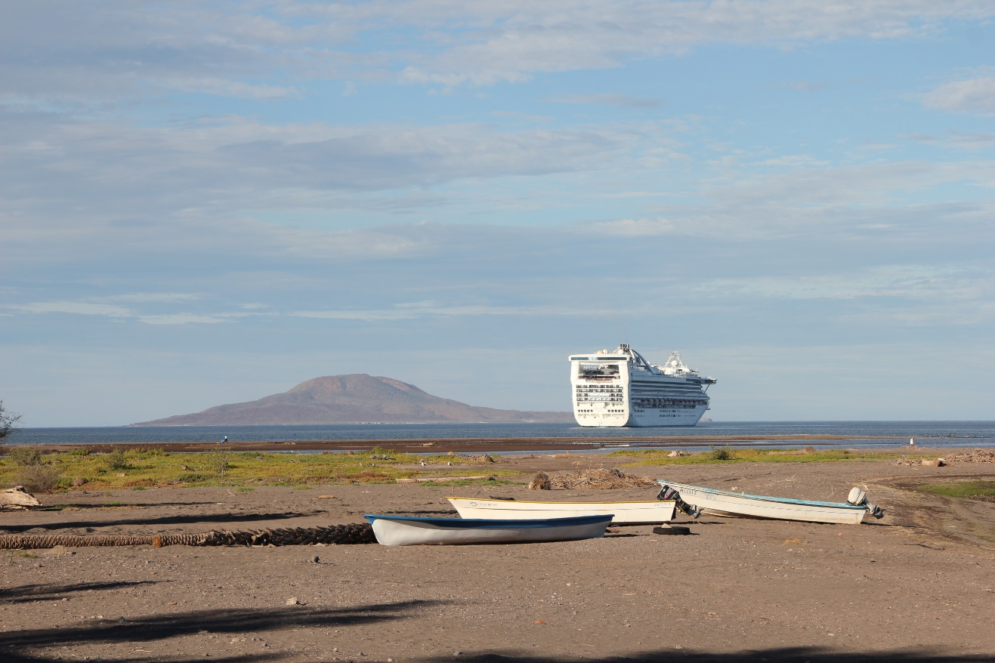
Paradigm Shift

Slide 16
Initial results elevations in feet above modern arroyo floor

Slide 17
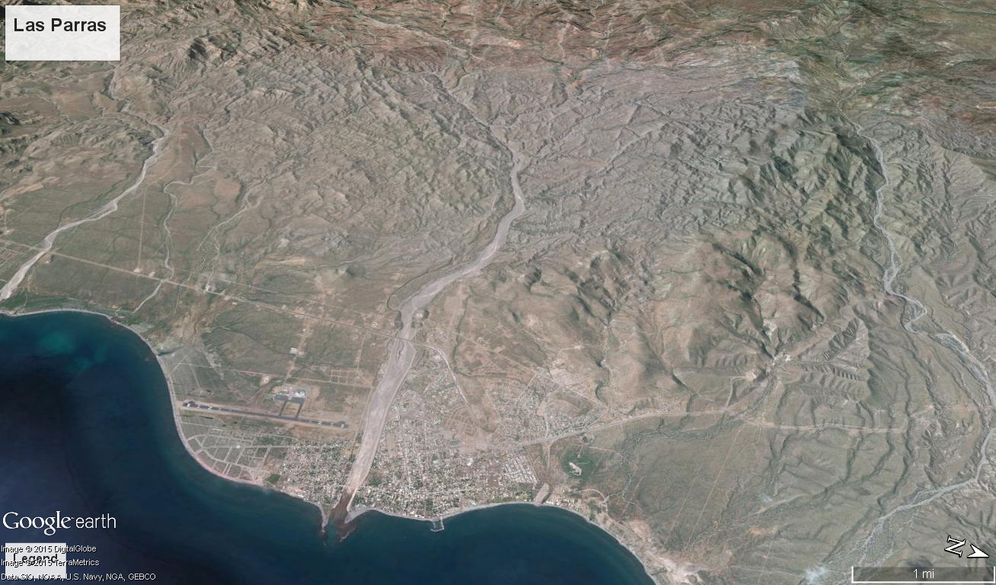

Slide 18
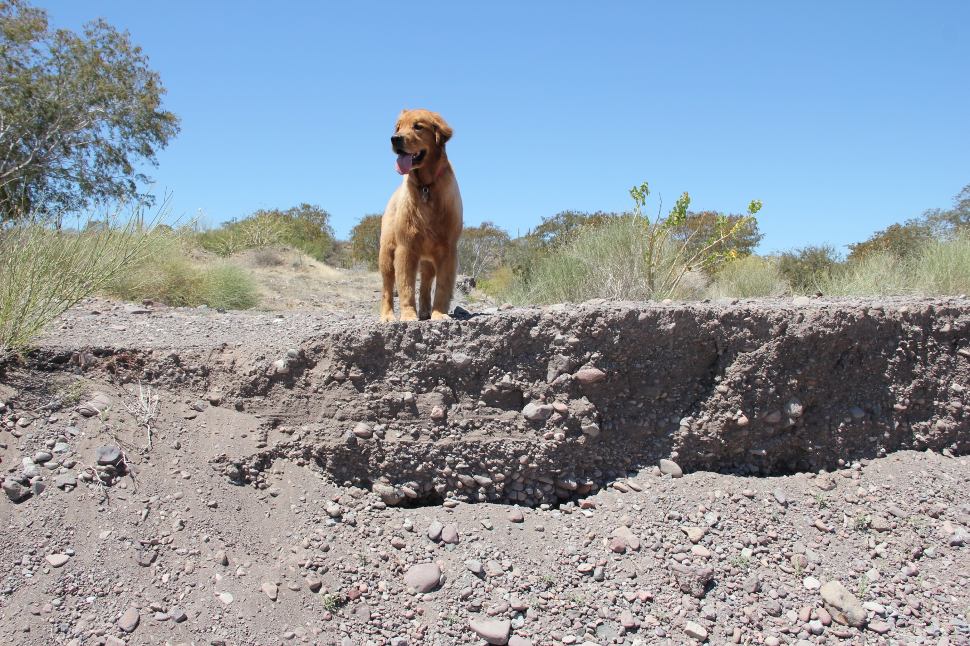
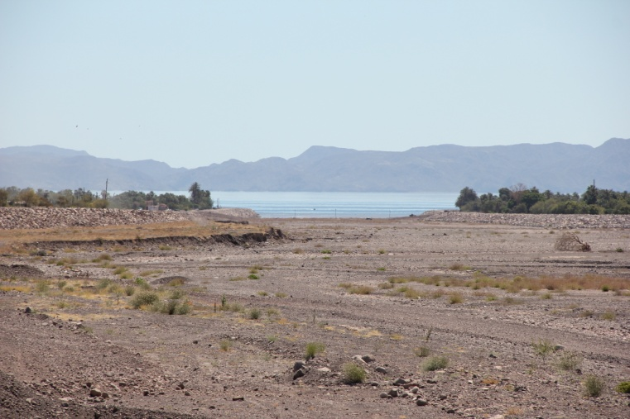
Las Parras

Slide 19
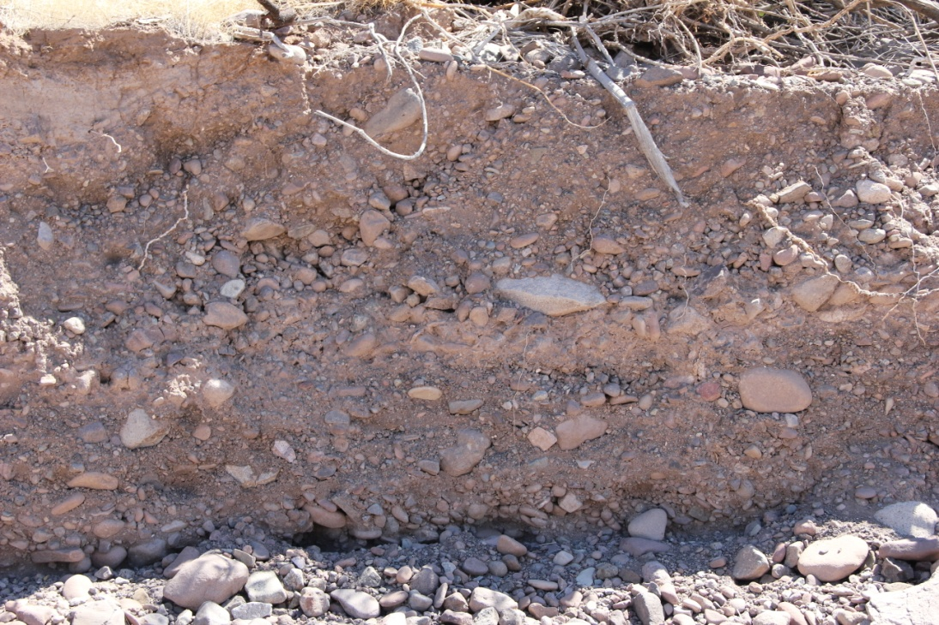
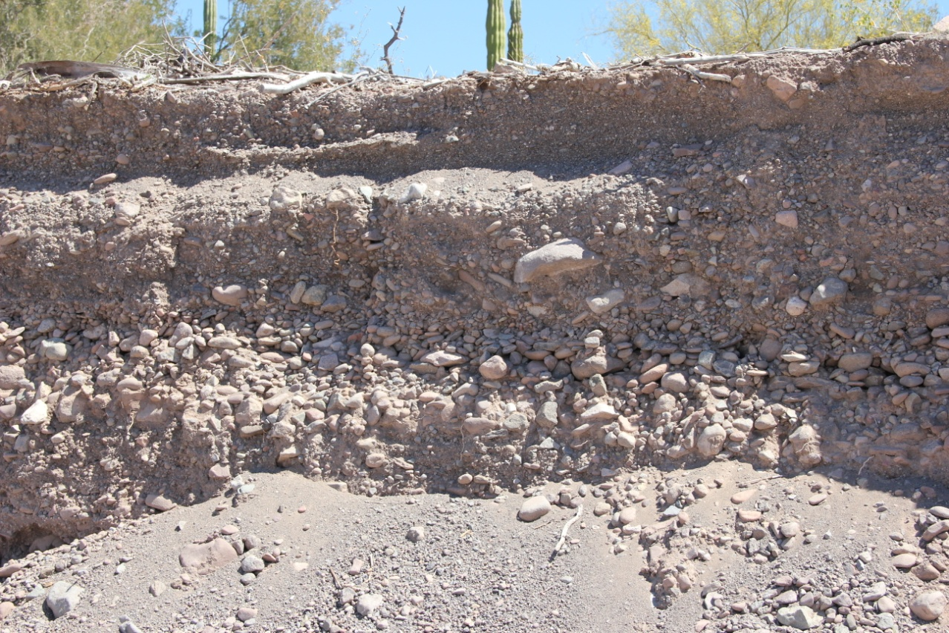
Aeropuerto

Slide 20
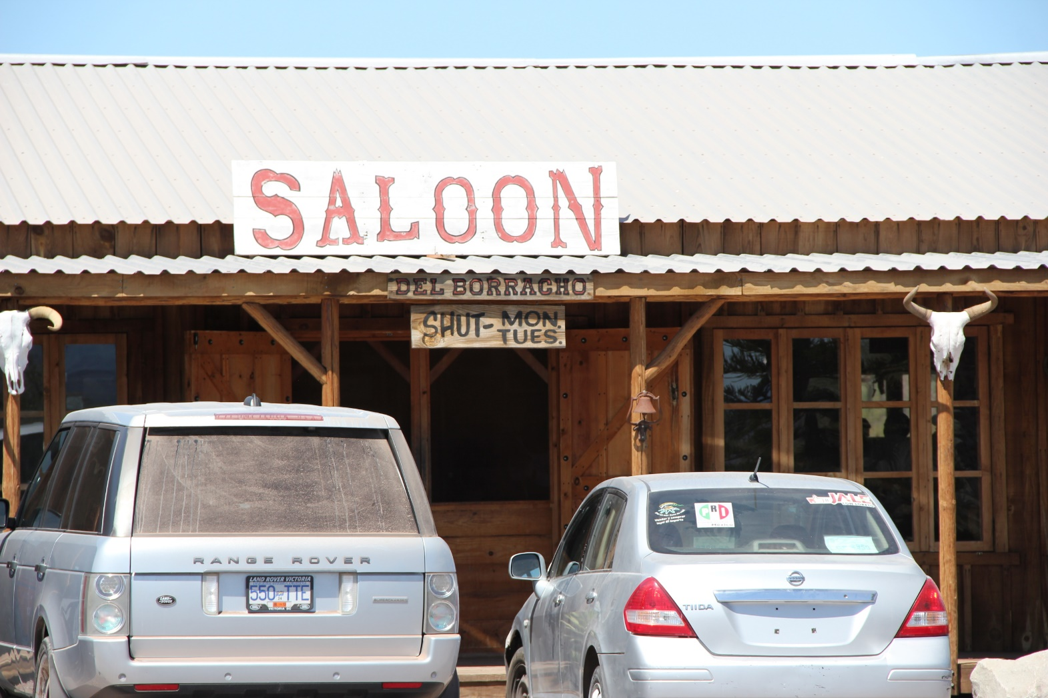
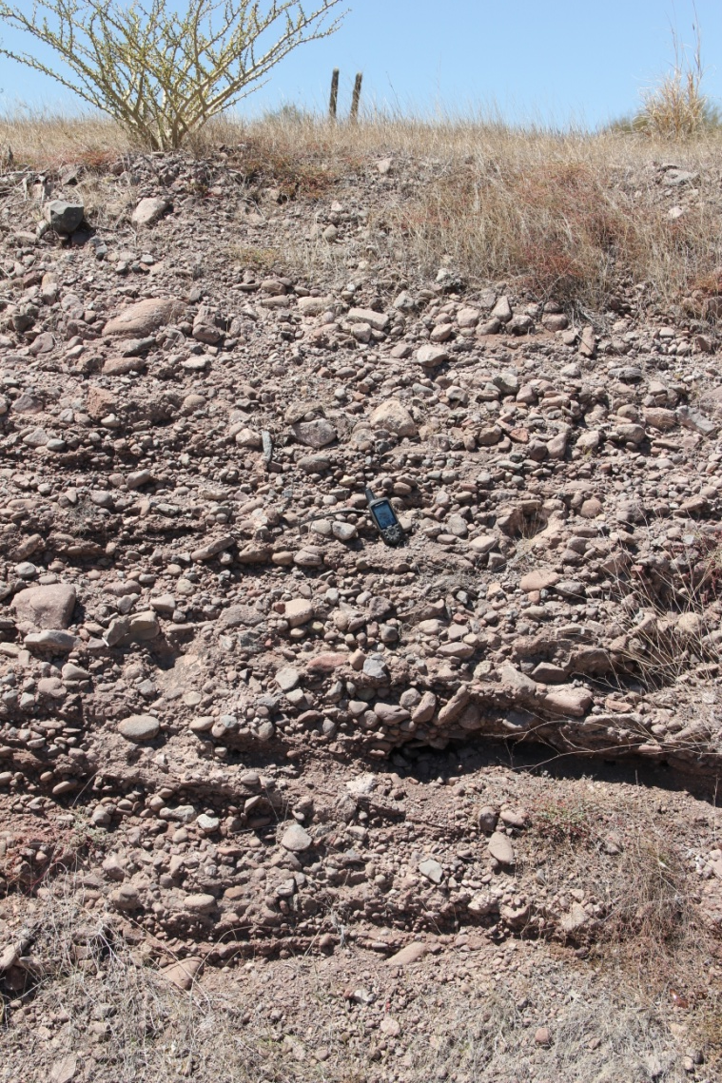
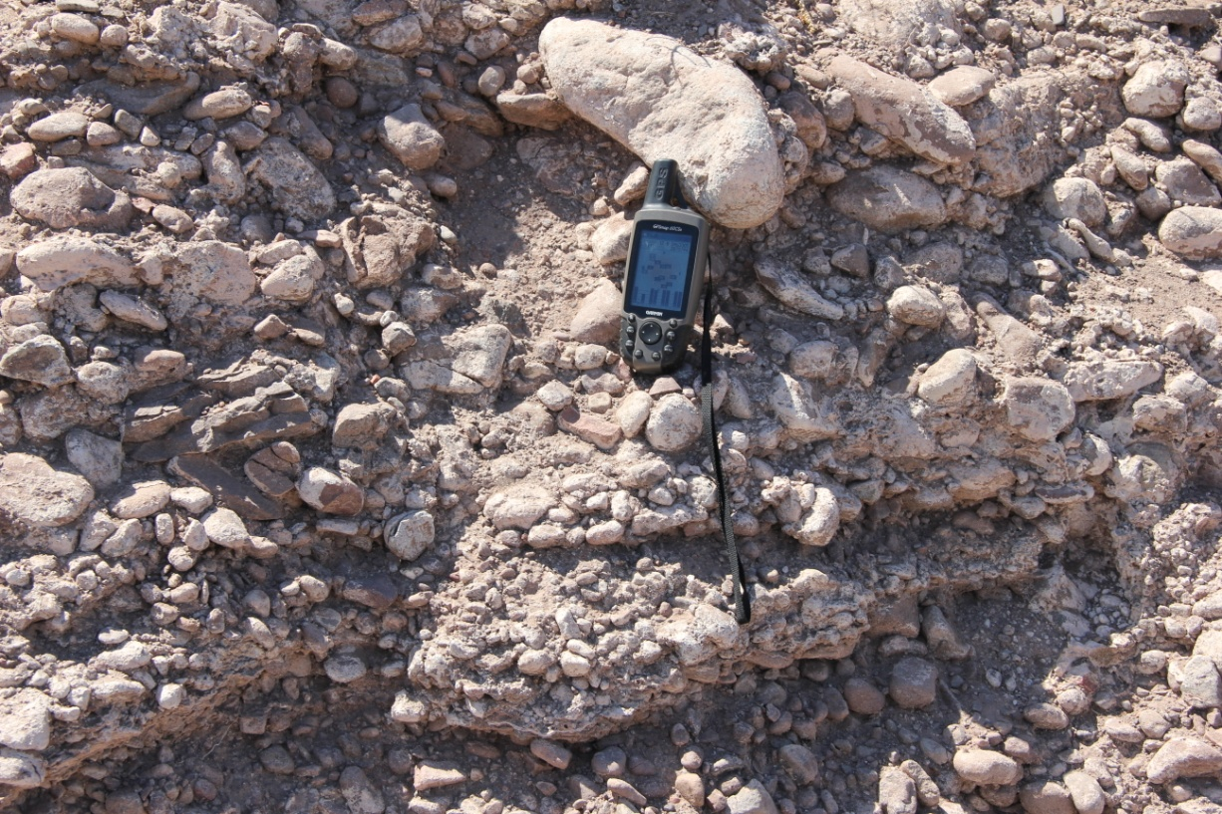
Del Borracho

Slide 21
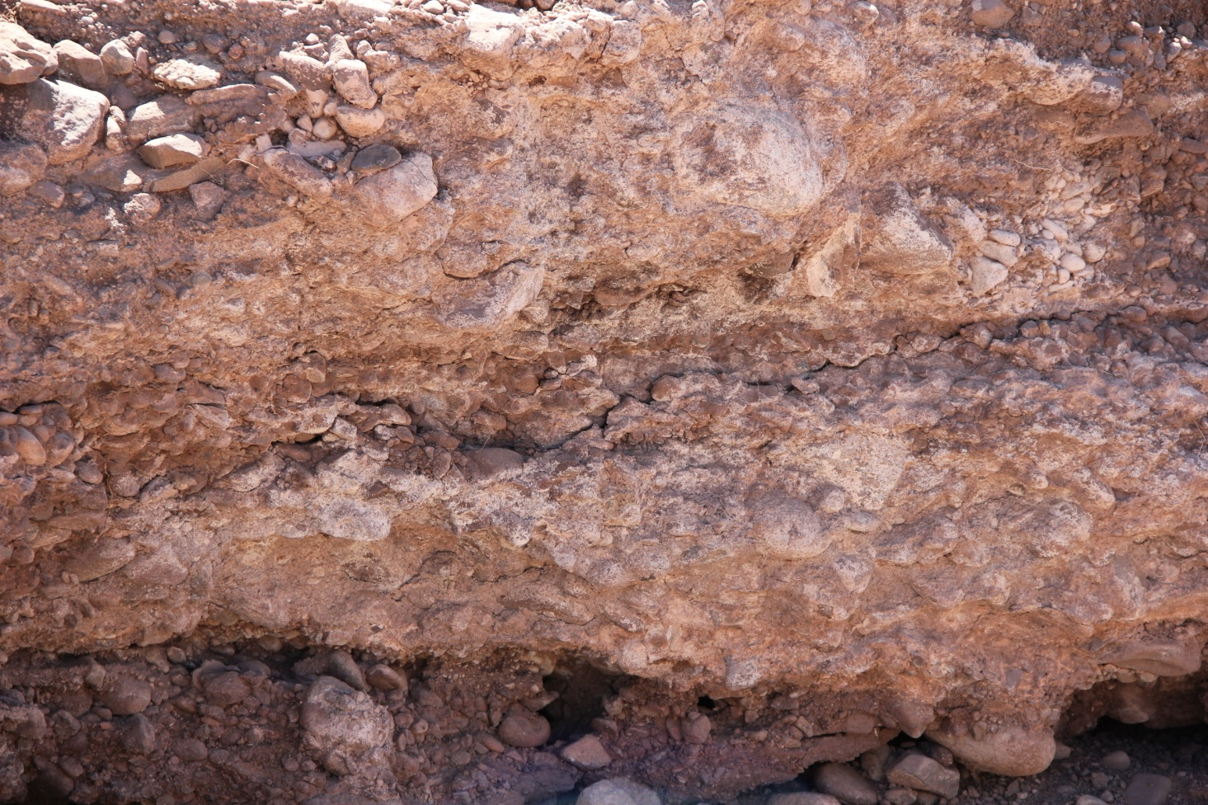
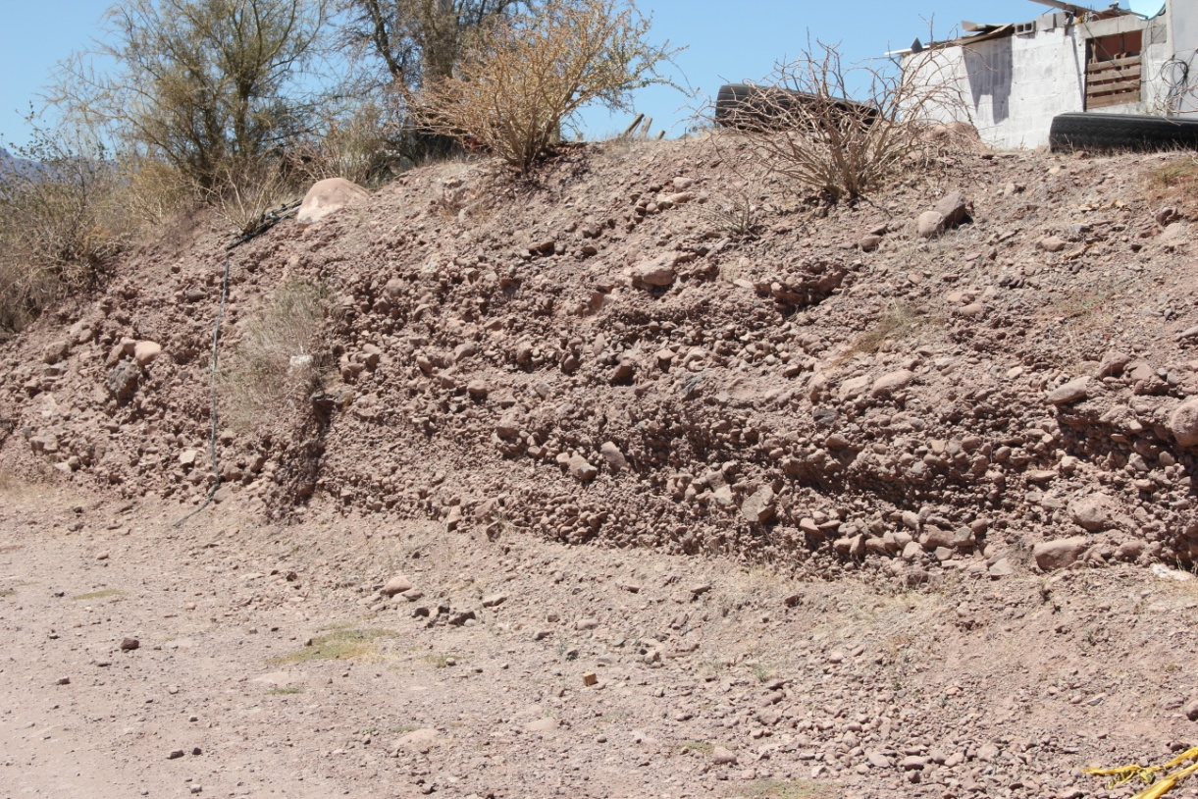
High Terrace

Slide 22
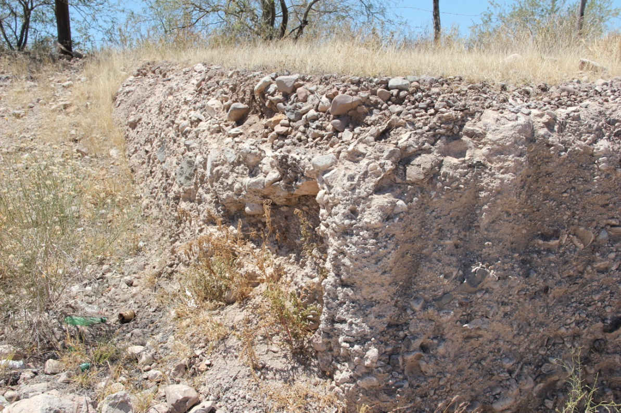
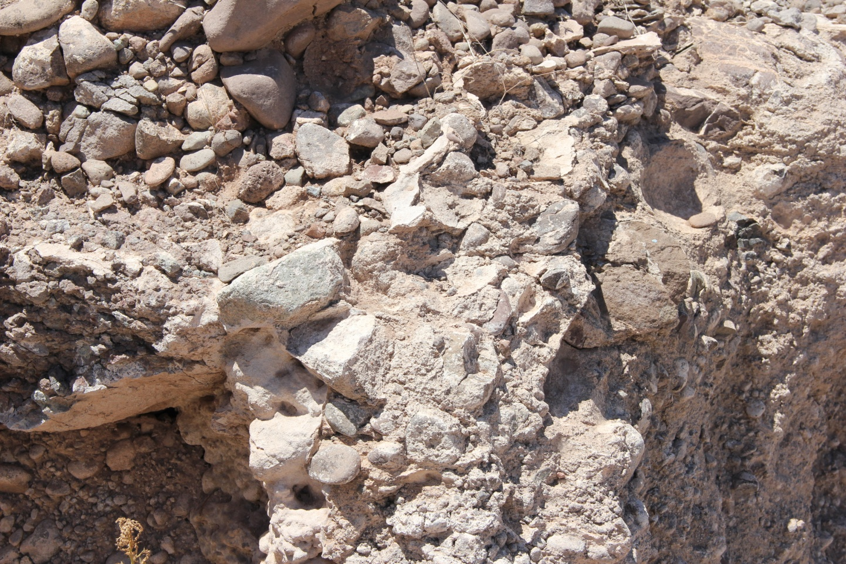
Sea View

Slide 23
Geoarchaeological Potential: Thoughts, Preliminary Rankings and Future
Abundance of pebbles (8-64 mm diameters) lowers potential for in situ preservation of smaller sites. Extreme energy associated with the depositional events
Latest Holocene records (>1697) show linkage between Loreto area and potable water.
Rankings
Las Parras: Limited to (late to latest Holocene)
Aeropuerto: Limited (mid Holocene [higher sea levels])
Del Borracho: Latest Pleistocene-early Holocene
High Terrace: Limited Pleistocene
Sea View: Limited Pleistocene
Future:
1) Refine elevations and extents
2) Detailed soil sediment descriptions
3) Dates
4) Refine time/tectonic/landform relationships

Slide 24
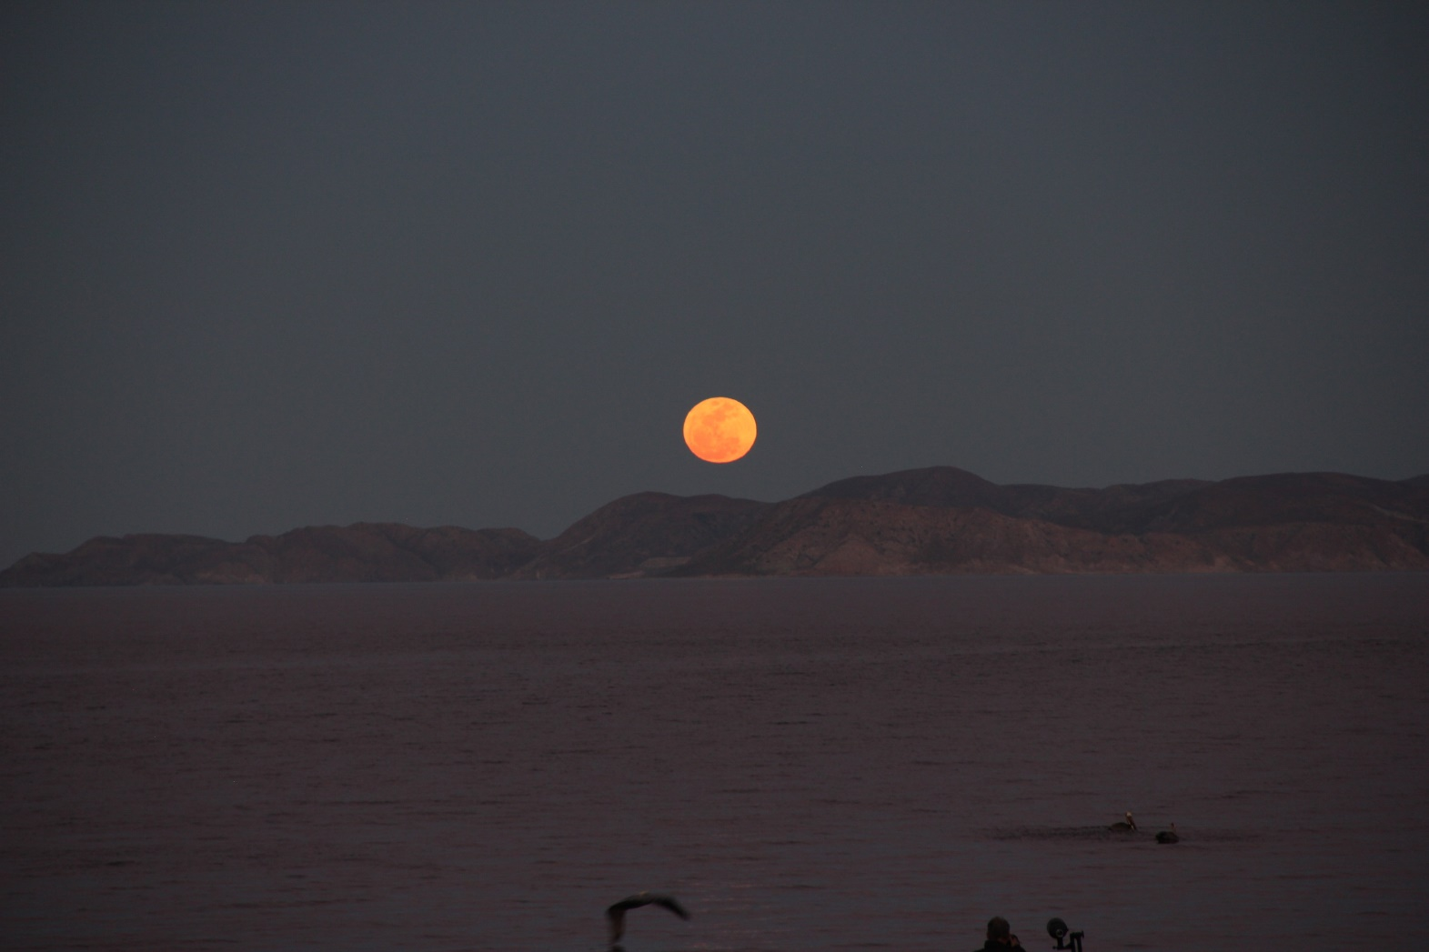
Moon rise February 2015

