Slide 1
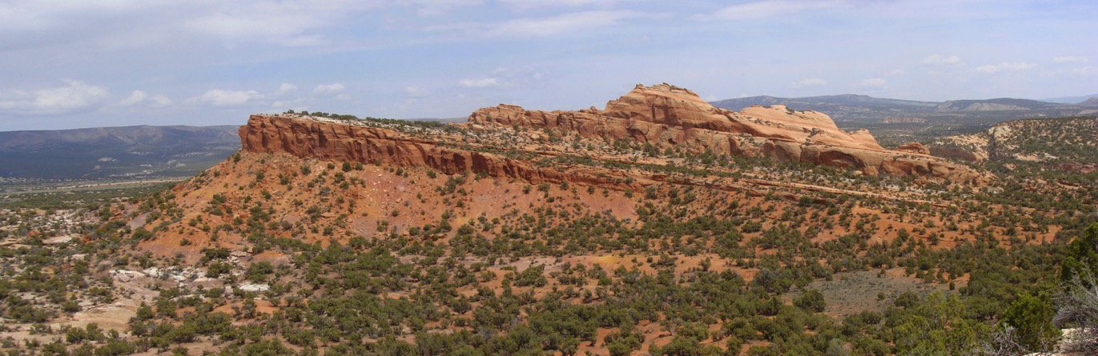
Why Do We Need Another Triassic Formation in the Uintas?
Bart Kowallis, Skyler May, Douglas Sprinkel, Paul Jensen, Thomas Morris, Brooks Britt

Slide 2
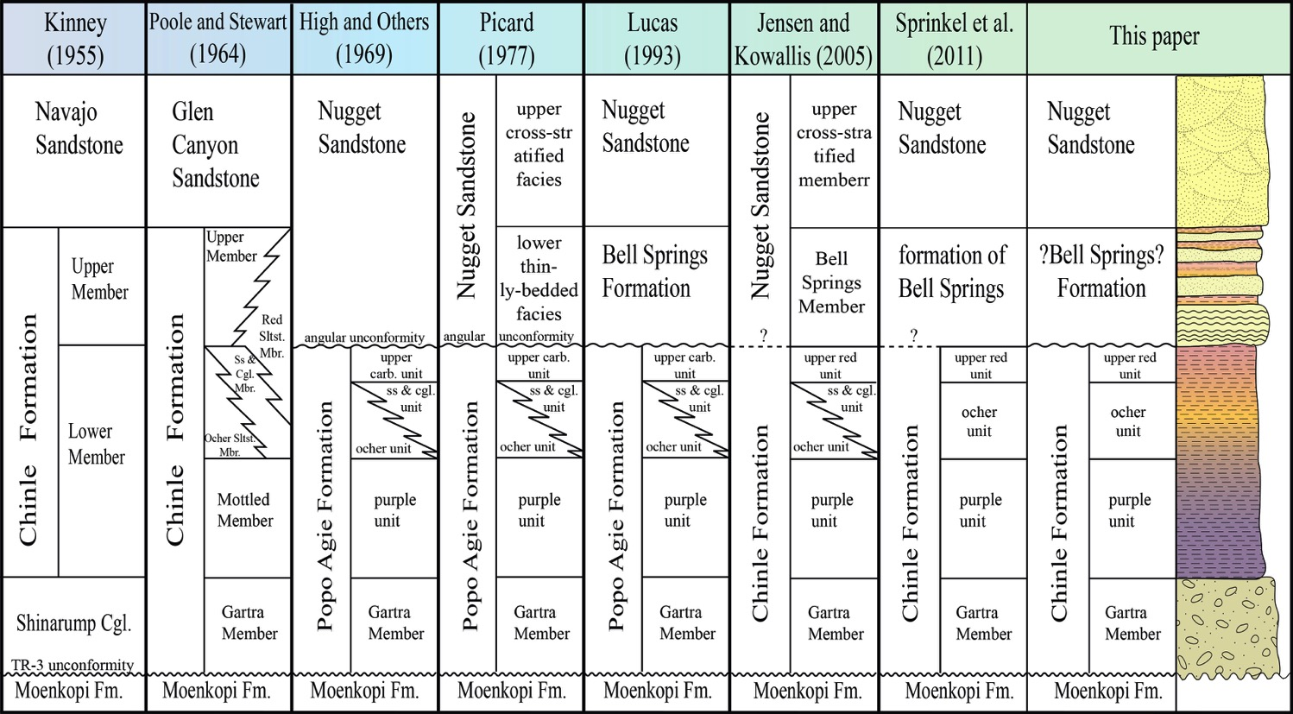
Previous published work
Notes:
Briefly discuss the nomenclature differences over time in the NE part of Utah. Indicate that we are not stuck on the name Bell Springs, but use it because it is already in the literature.

Slide 3
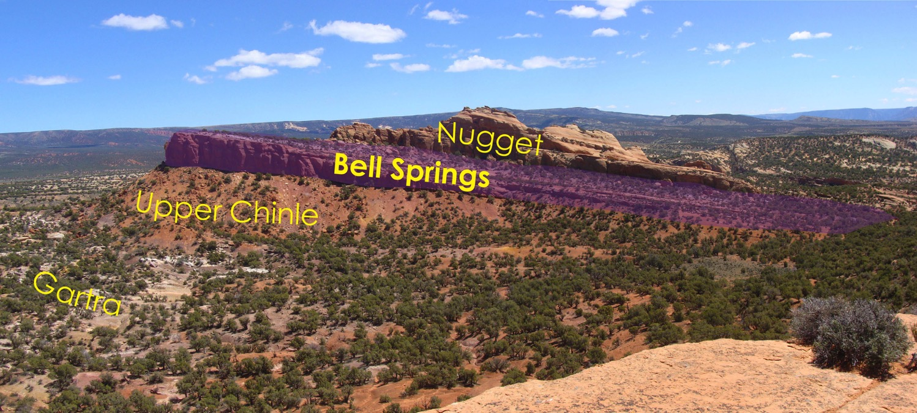
A new formation?
Does it make sense?
Does it satisfy the criteria for a formation?

Slide 4
Criteria for a Formation
Formations are the primary unit of lithostratigraphy
They are defined based upon LITHOLOGY
Lithologic contrast required varies, depending on:
  Complexity of geology in an area
  Detail needed for GEOLOGIC MAPPING
  Detail needed to work out geologic history of area
No formation is justified if it cannot be MAPPED at the typical scale of mapping in an area
[North American Stratigraphic Code, Article 24 & Chapter 5, Section C.2, International Stratigraphic Code]

Slide 5
Can It Be Mapped?

Slide 6
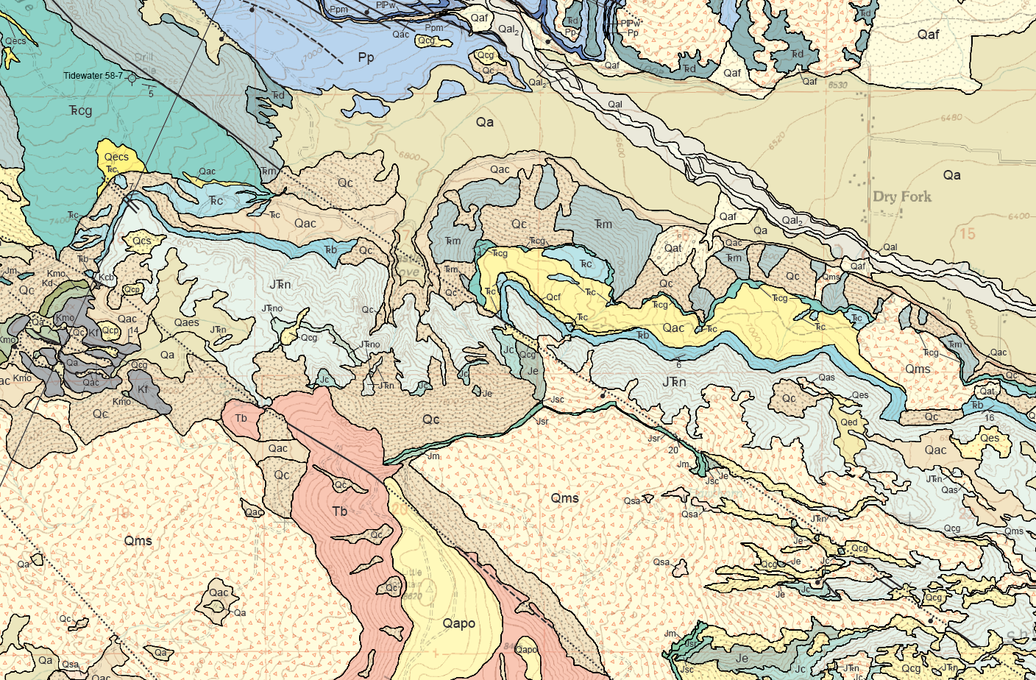
Part of Dry Fork 7.5” quadrangle by Haddox, Kowallis, & Sprinkel, 2010
Notes:
Point out the mapped Trb on this quad

Slide 7
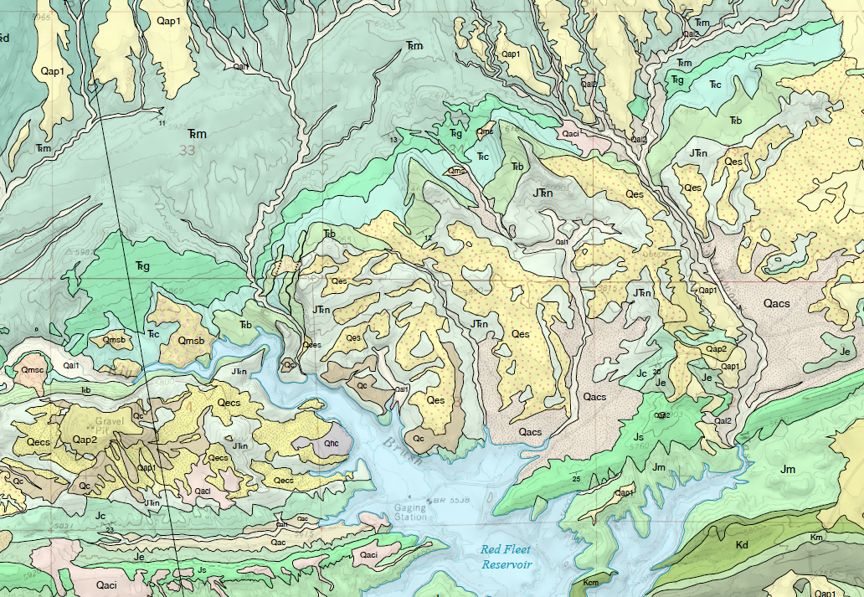
Part of Donkey Flat 7.5” quadrangle by Jensen, Sprinkel, & Kowallis, 2015

Slide 8
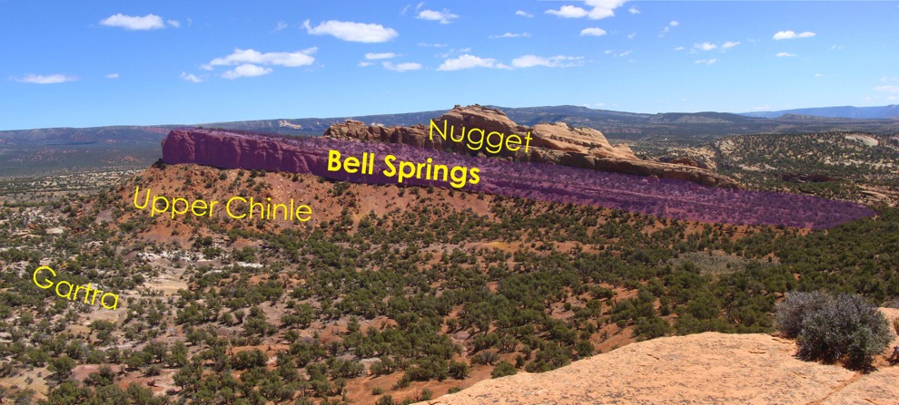
Is It Lithologically Distinctive?
Chinle Formation (underlying)
  Basal conglomerate/sandstone (Gartra Mbr) – fluvial
  Upper purple, ochre, and red mudstones (upper unnamed mbr) – lacustrine and soils
Nugget Sandstone (overlying)
  Large scale cross-bedding – eolian
  Some minor carbonates – interdune, oasis
Notes:
Discuss the lithologic character of the underlying and overlying units.

Slide 9
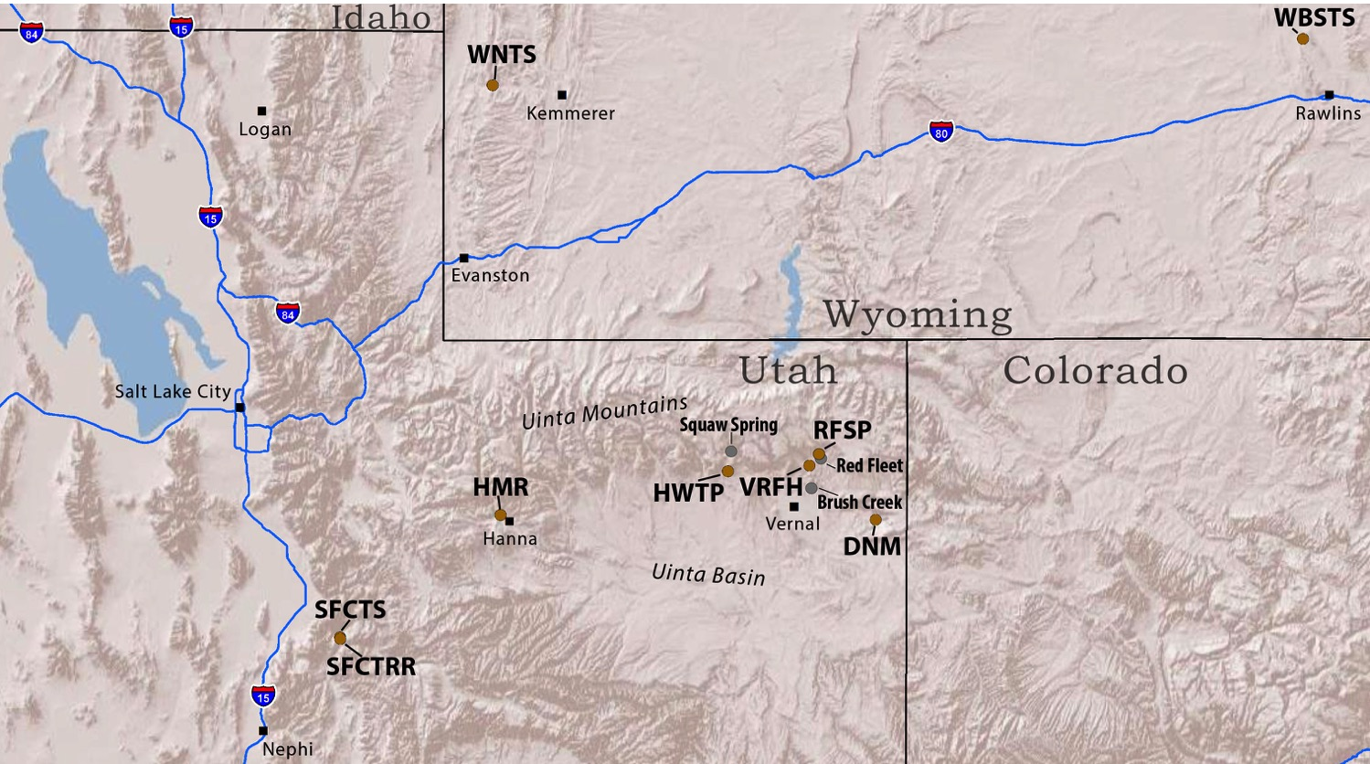
What about the Bell Springs?
Notes:
Tour of a few sections of the formation, with more detail from the Red Fleet section than any of the others.

Slide 10
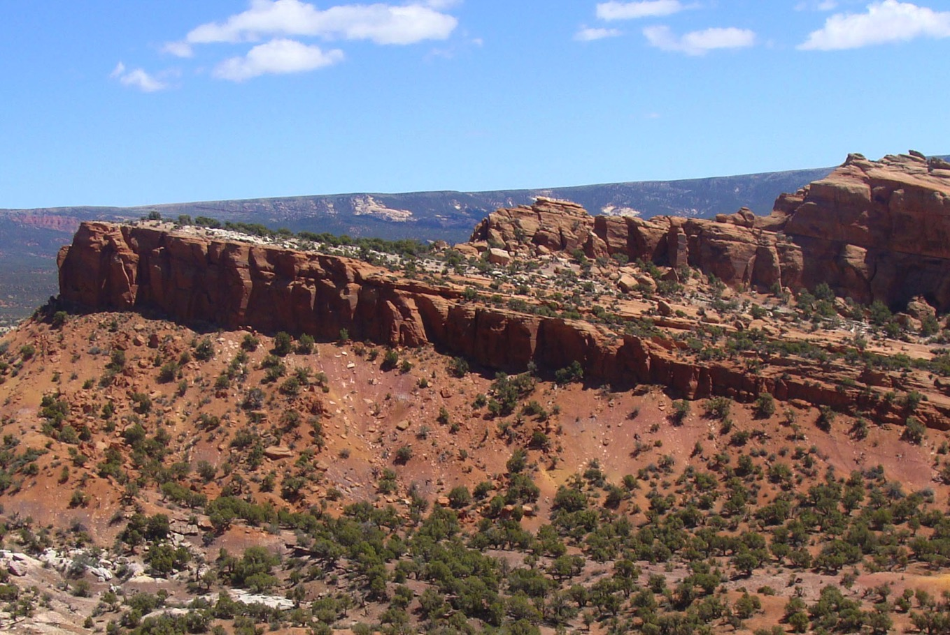
Red Fleet Section (RFSP) — Lower Contact
Chinle-Bells Springs contact
Notes:
What is the basal contact like?

Slide 11
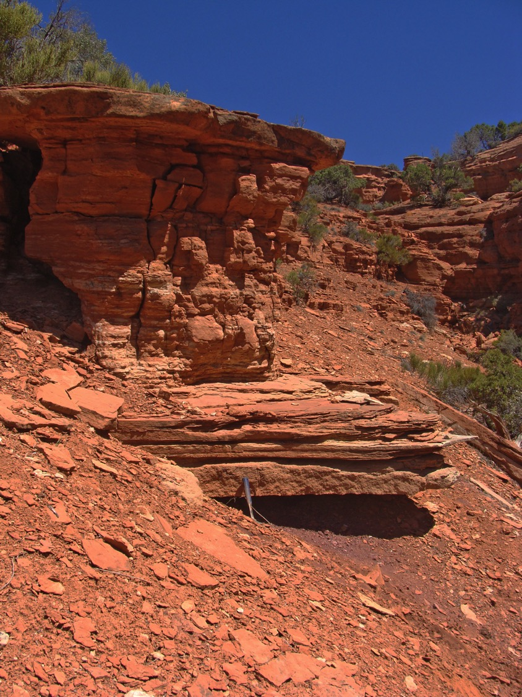
In the few places where the contact can be seen, it is a sharp contact, not gradational.
Bell Springs
Upper Member of Chinle

Slide 12
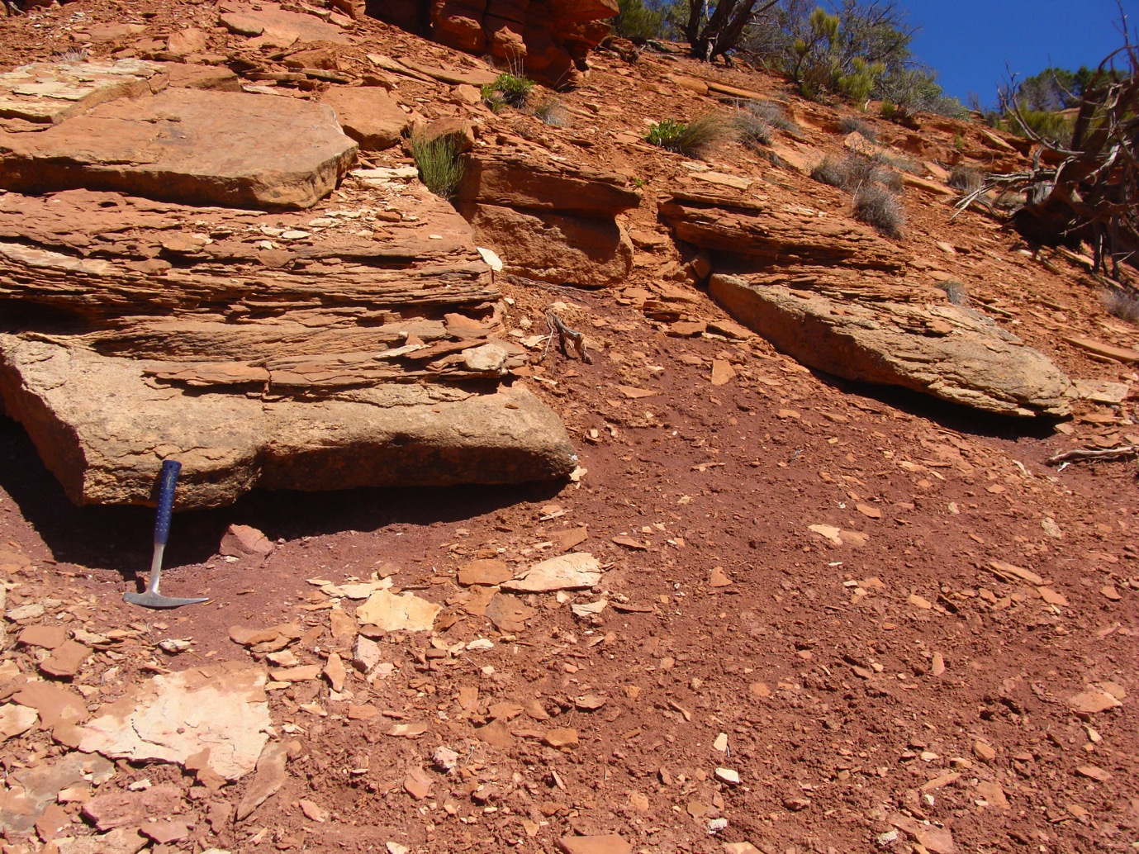
Notes:
Mostly the basal units are broken up and found as float on the soft underlying mudstones.

Slide 13
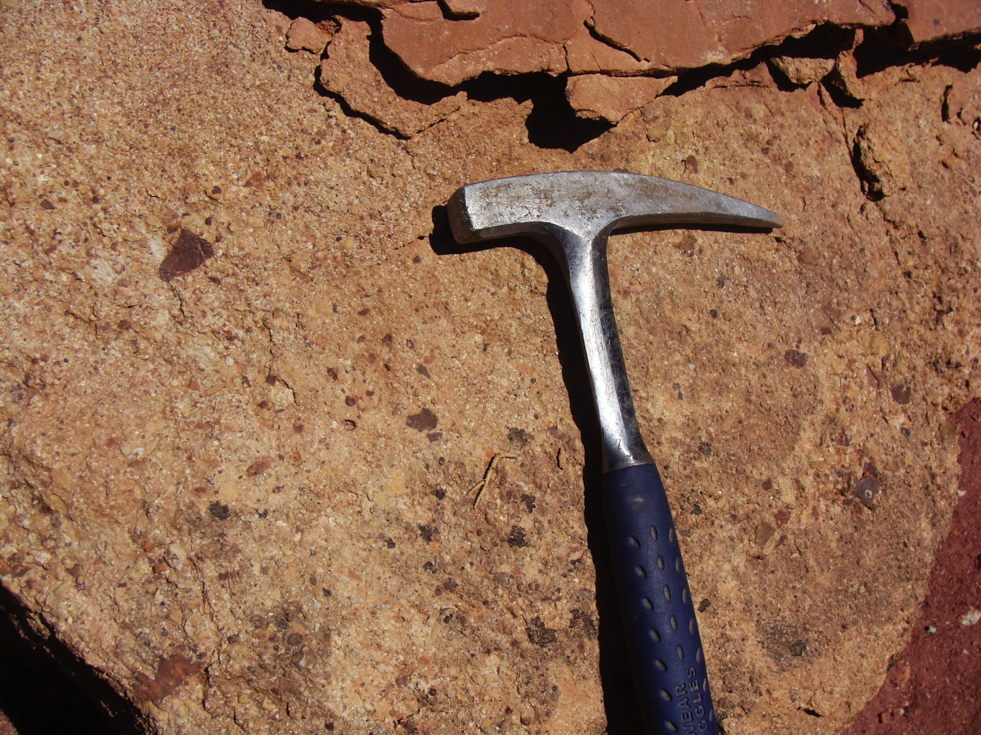
Basal pebble/
granule conglomerate
Notes:
The basal unit around the Red Fleet area is a pebble/granule conglomerate. It may represent a flood deposit. Most of the clasts appear to be ripped up pieces of the Chinle, including pieces of chert. Clasts are subrounded to rounded and cemented mostly by mud.

Slide 14
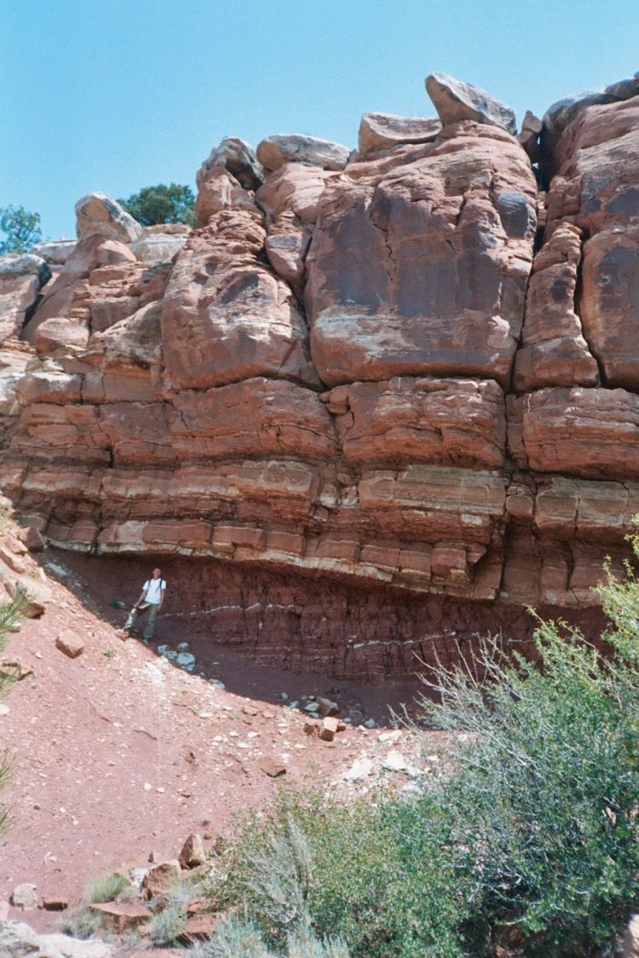
Sharp contact, with angular discordance in some places.
Notes:
In a few places there appears to be an angular discordance between the upper red mudstones of the Chinle and the overlying sandstones of the Bell Springs.

Slide 15
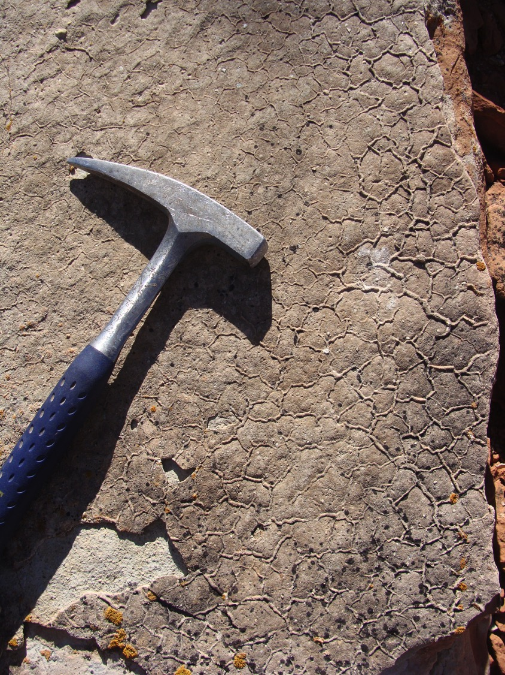
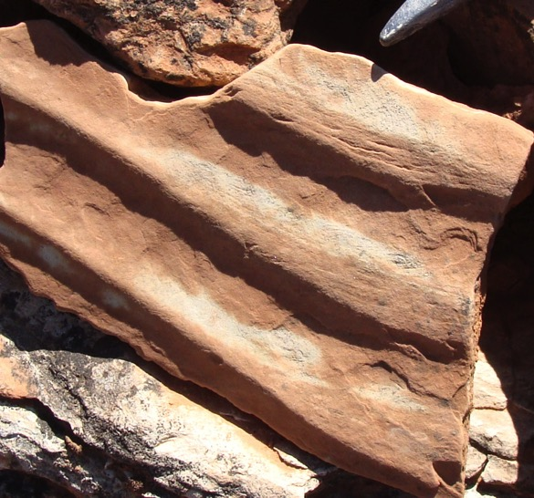
The lower flaggy interval contain ripples and evaporation-produced features
Notes:
The lower flaggy units of the Bell Springs, below the main cliff forming sandstone, contain by mud cracks, ripples, and evaporite casts, suggesting an environment that is only intermittently wet.

Slide 16
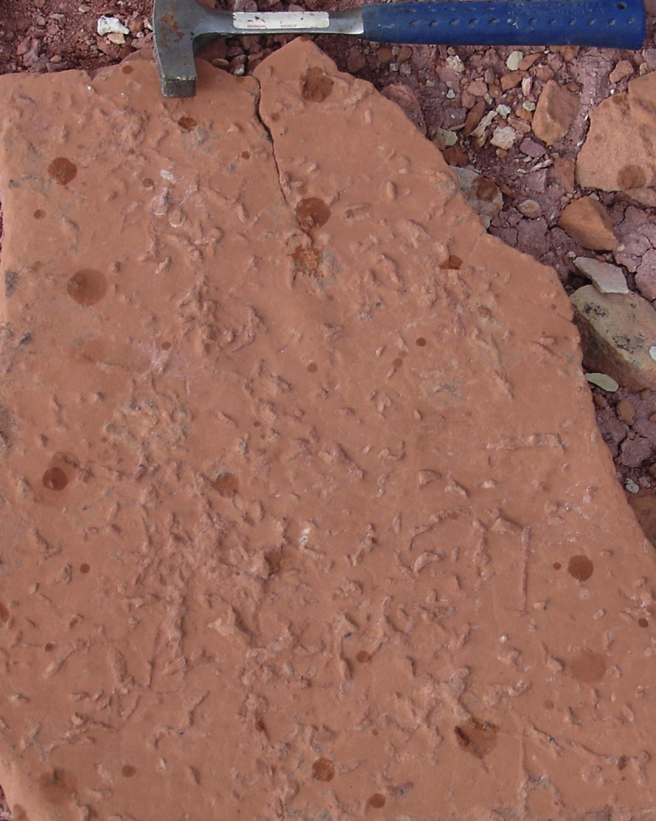
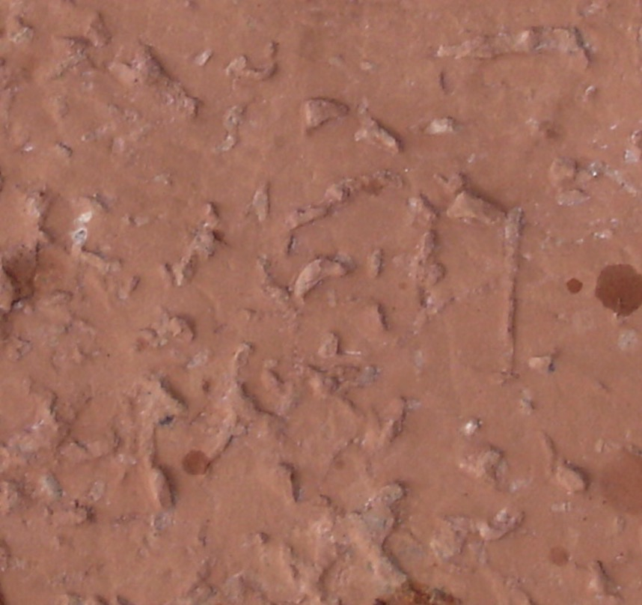
Evaporite casts

Slide 17
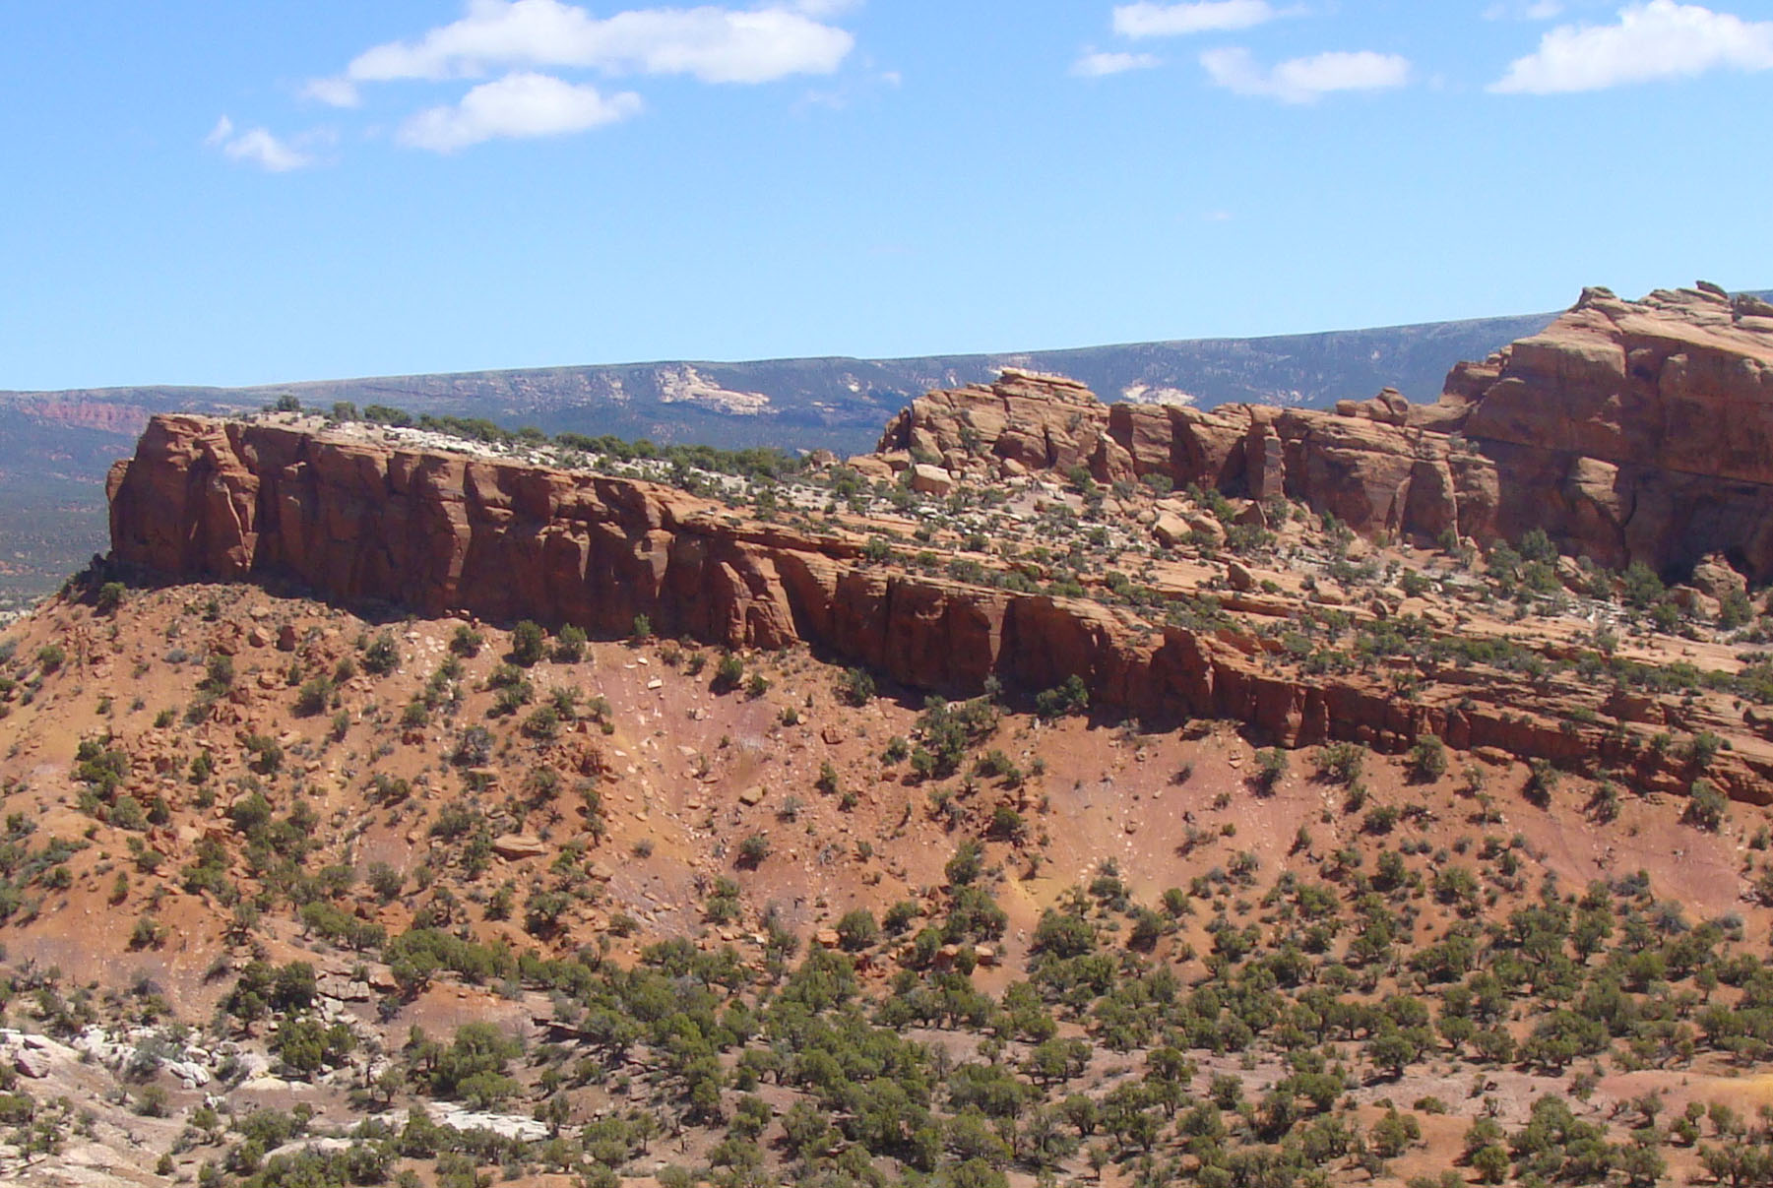
Notes:
Above the lower flaggy units we find a massive sandstone.

Slide 18
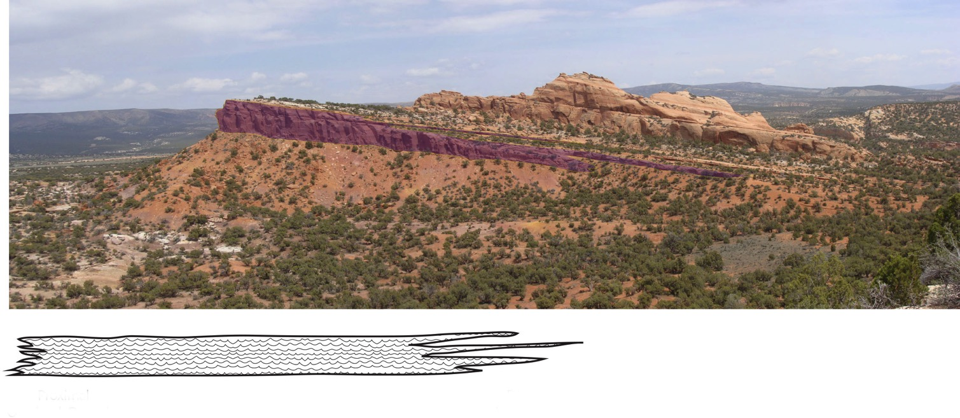
Above the first couple of meters of the formation we find the massive sandstone beds that make up the bows of the ships of the Red Fleet.
They are ripple laminated throughout.
Inland delta deposits, similar to the Okavango in Botswana?
Notes:
The ripples and grain size are suggestive of a moderately energetic environment, with water spreading out over a fairly broad area when present, followed by periods of evaporation. The shape and character of the deposit is suggestive of an inland delta, perhaps something like the modern Okavango in Botswana.

Slide 19

Ripple laminated sandstone
Notes:
Typical ripple laminations in the massive sandstone

Slide 20
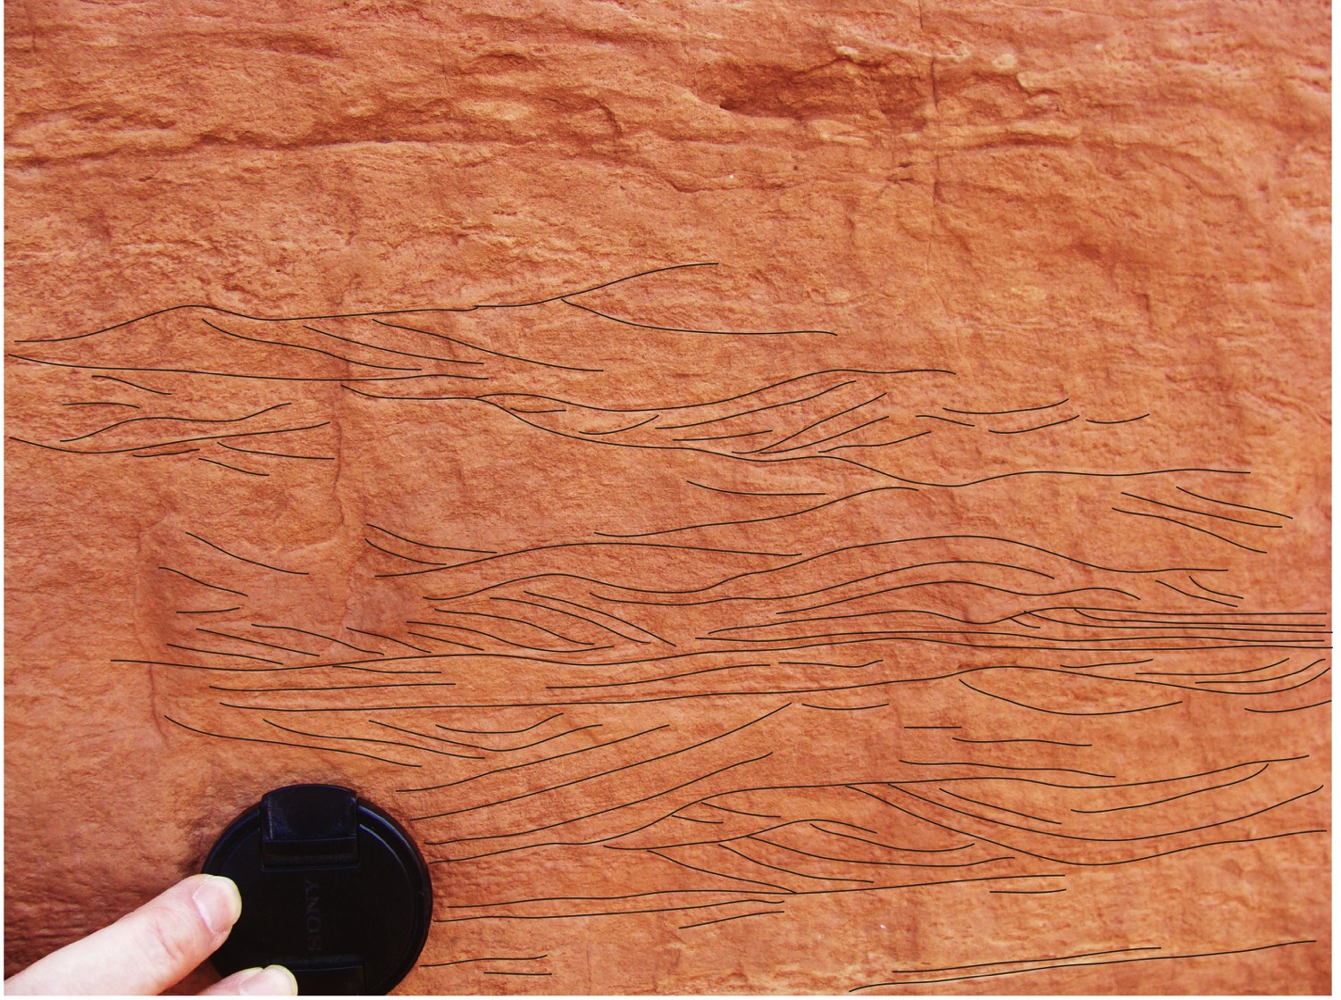
Notes:
Interpretive drawing to better show ripples.

Slide 21
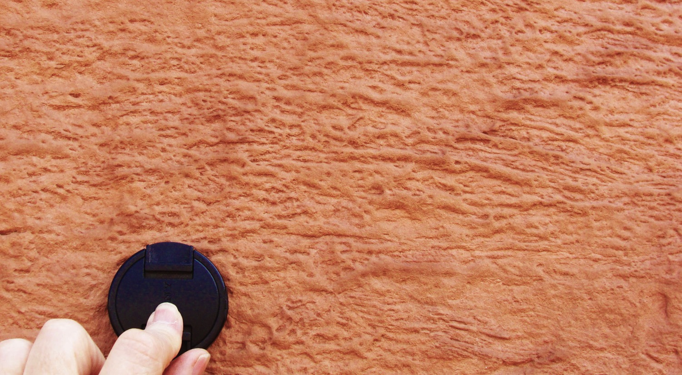
Bioturbation or evaporite disruption of ripple laminations
Notes:
In places the ripples almost disappear due to either bioturbation or growth of evaporites in the sand.

Slide 22
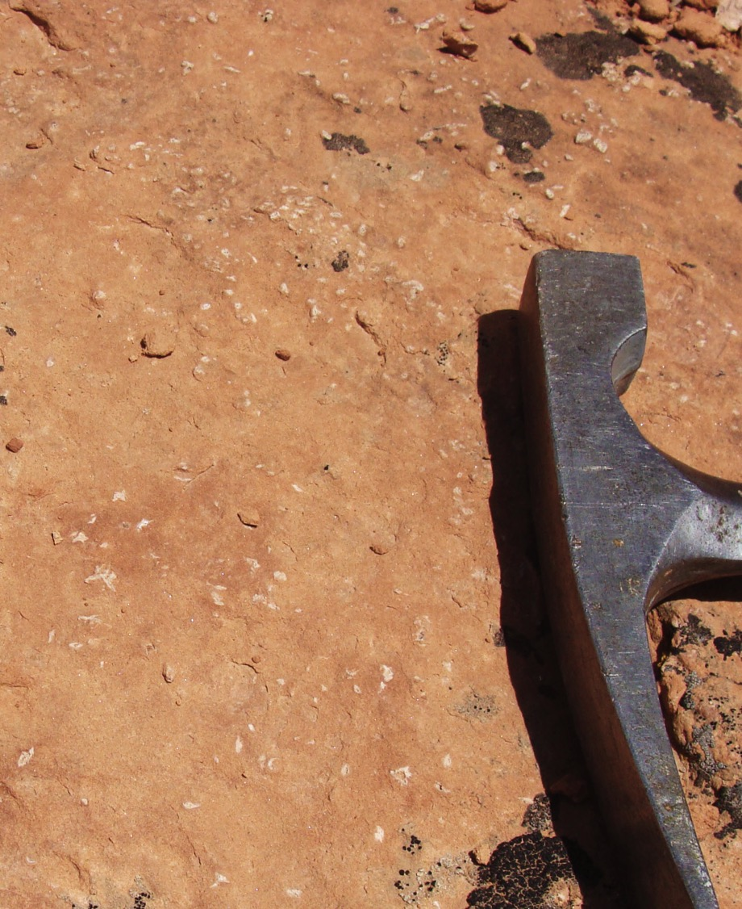
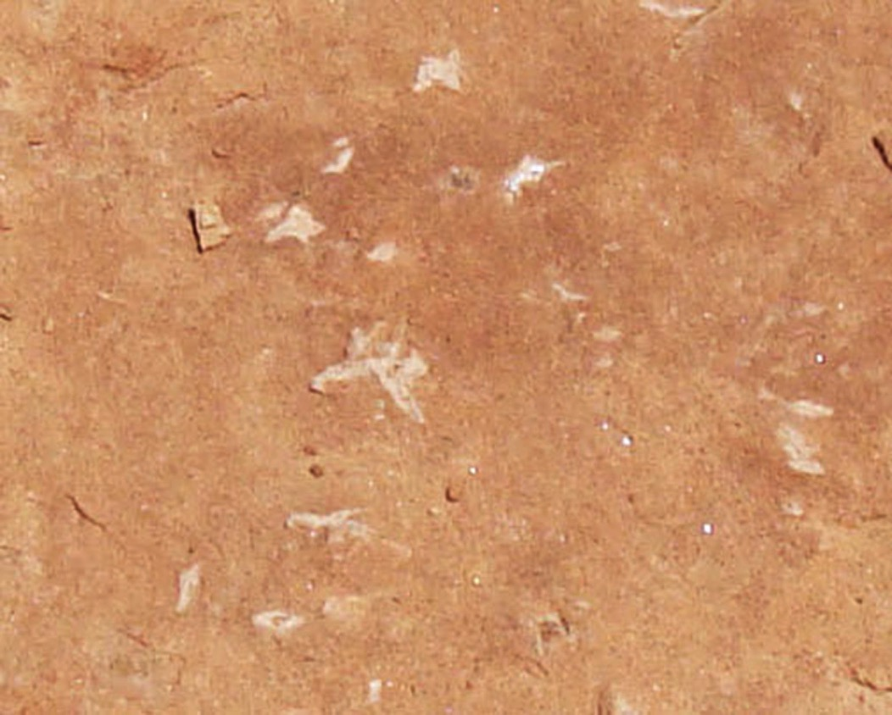
More evaporite casts
Notes:
On some layers we clearly see the casts of evaporite, probably gypsum, crystals.

Slide 23
Notes:
At the top of the massive sandstone the character of the formation returns to alternating finer and coarser layers producing more of a ledge and slope topography.

Slide 24
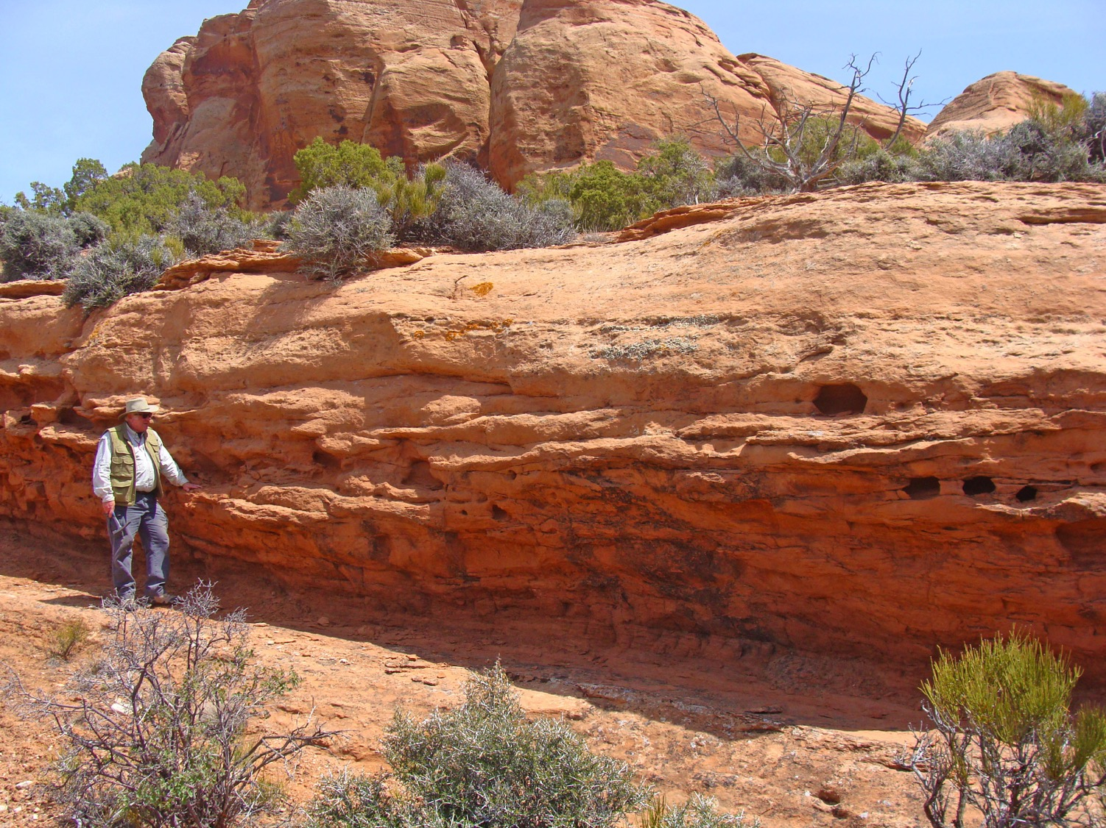
Shingling, small point bars
Notes:
Some of the ledges appear to show shingling, suggesting small point bars.

Slide 25
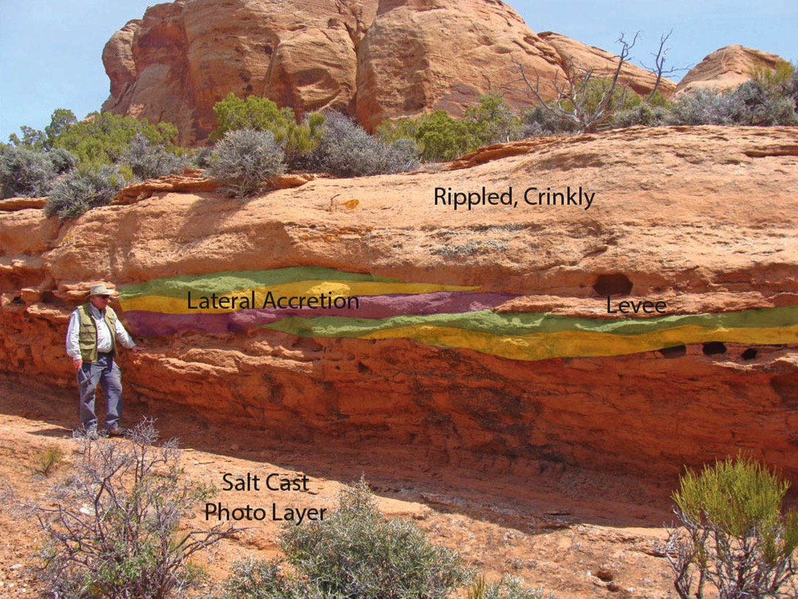
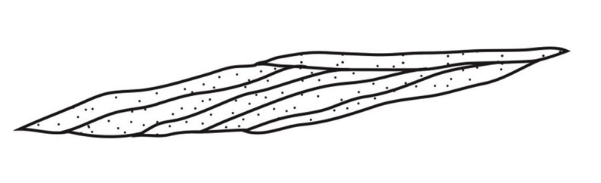

Slide 26
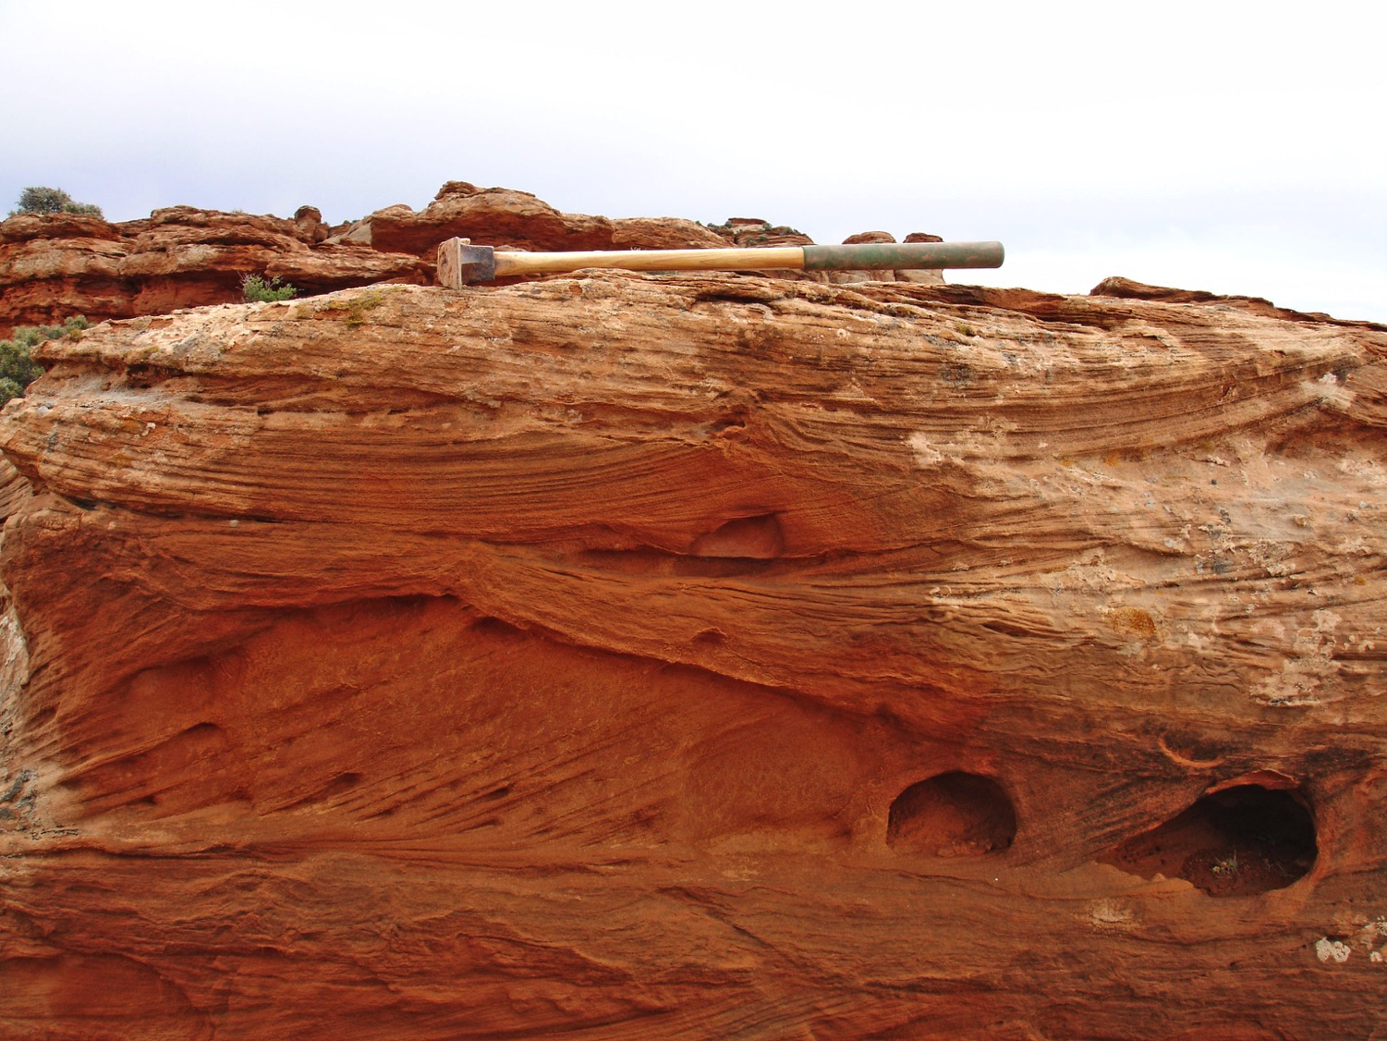
Small scale cross-bedding
Notes:
In other sand layers we find well developed small cross-bed sets with what appear to be fluid escape tepees and crinkly beds.

Slide 27
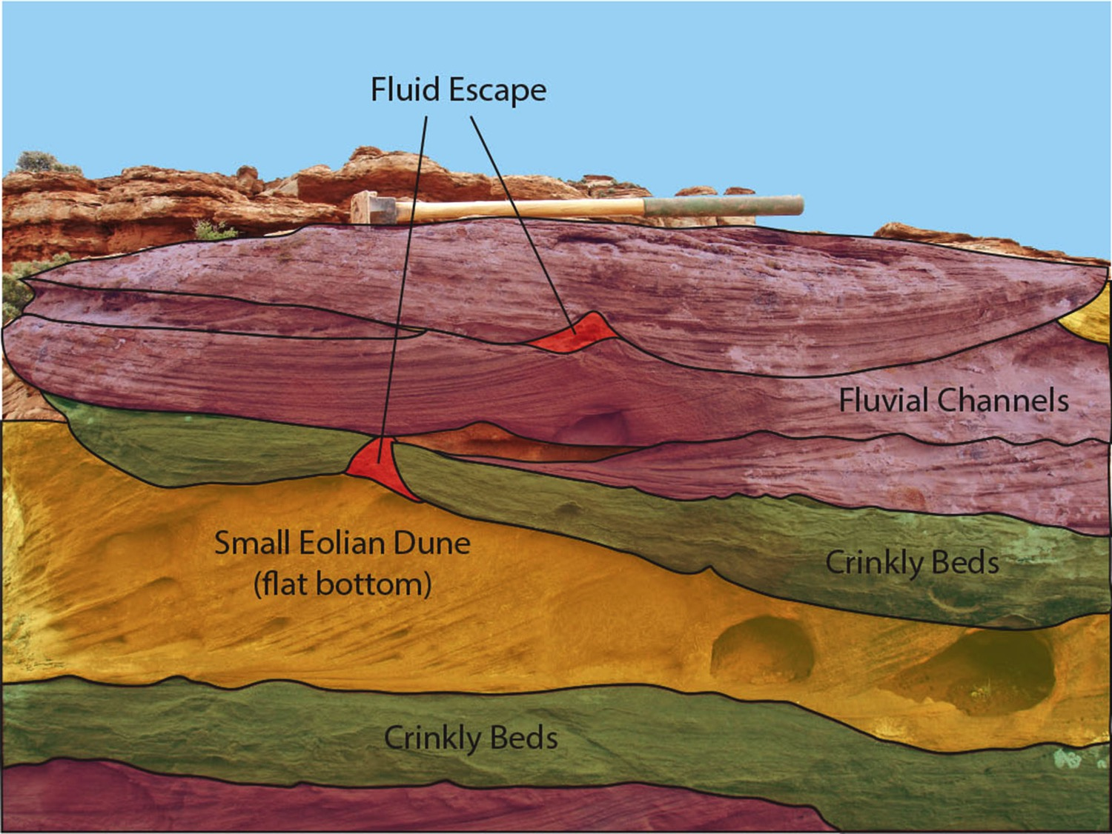
Notes:
This is an interpretive diagram of the previous photo

Slide 28
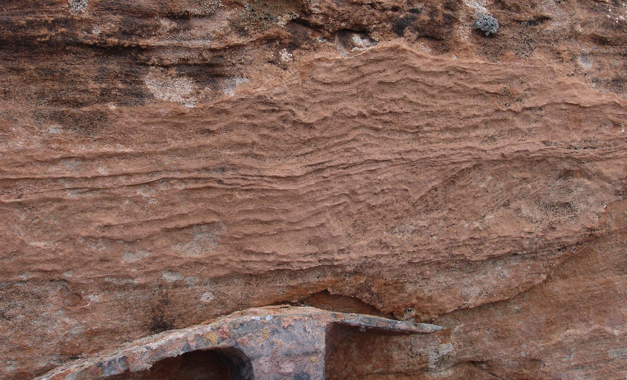
Crinkly beds
Evaporite disruption? or Algal growth?
Notes:
The crinkly beds may be due to either algal growth during wetter periods or growth of evaporites in the sand layers.

Slide 29
Notes:
Another sand body near the top of the formation.

Slide 30
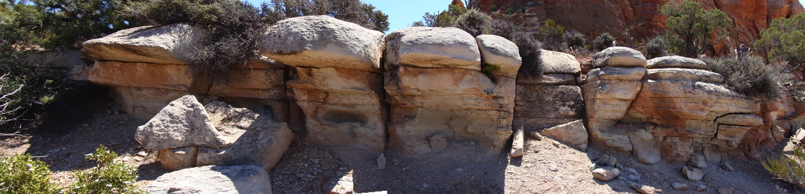
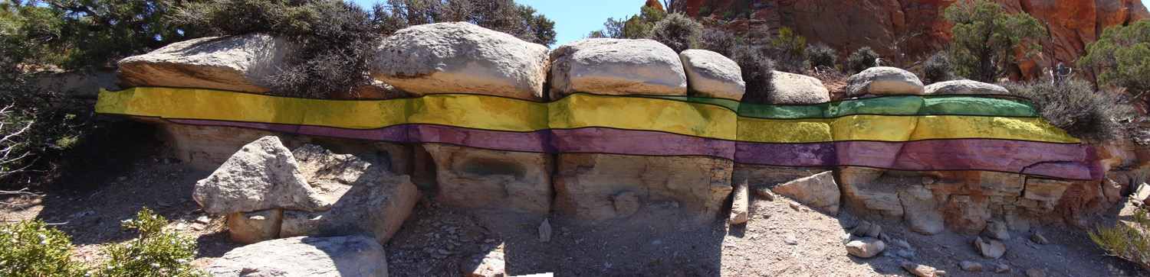
Point Bar and Levee Deposits
Notes:
This one appears to be a point bar deposit with perhaps a levee deposit (flat bottomed) on top.

Slide 31
Bell Springs-Nugget contact
Notes:
What does the upper contact look like?

Slide 32
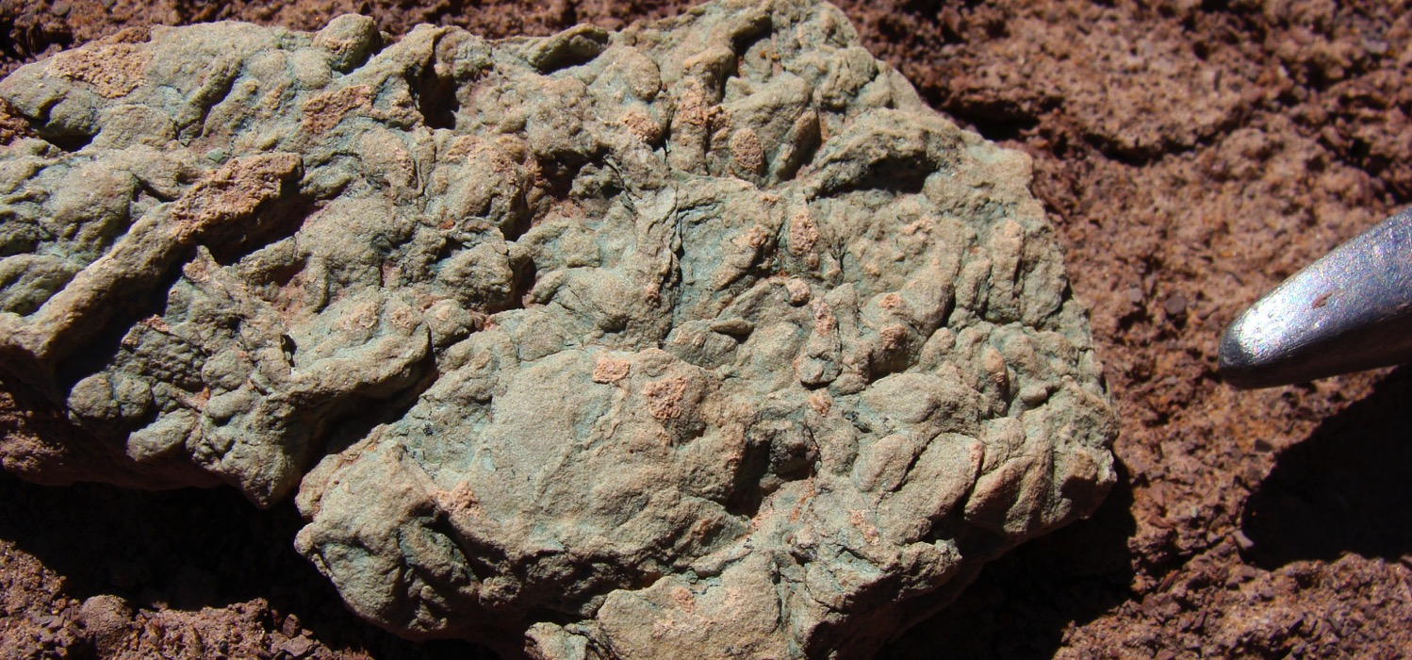
Pond deposit?
Thin green limy mudstone, in places intensely bioturbated
Notes:
Near the upper contact, we find one thin green mudstone with bioturbation, probably a pond deposit.

Slide 33
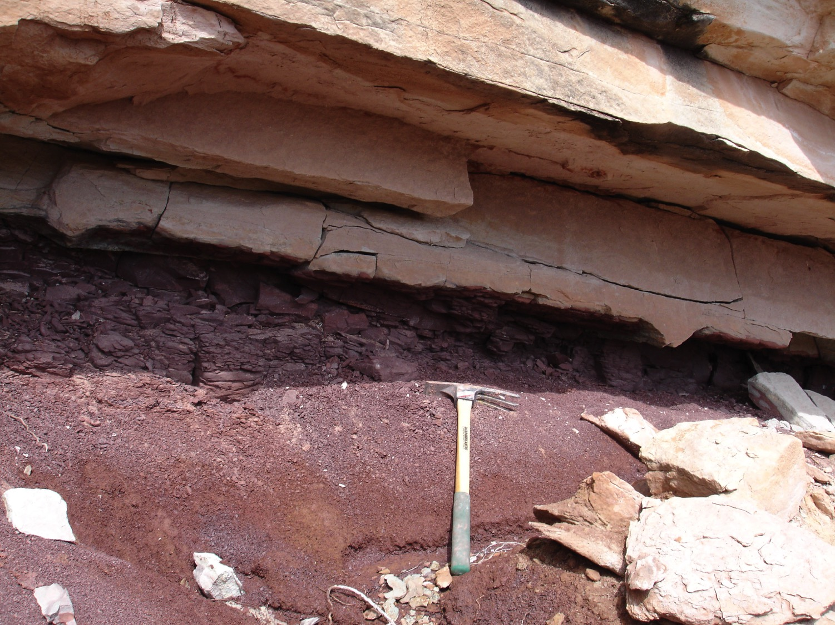
Upper contact
Possible load structures
Notes:
The overlying Nugget seems to have been deposited on a soft mud surface.

Slide 34
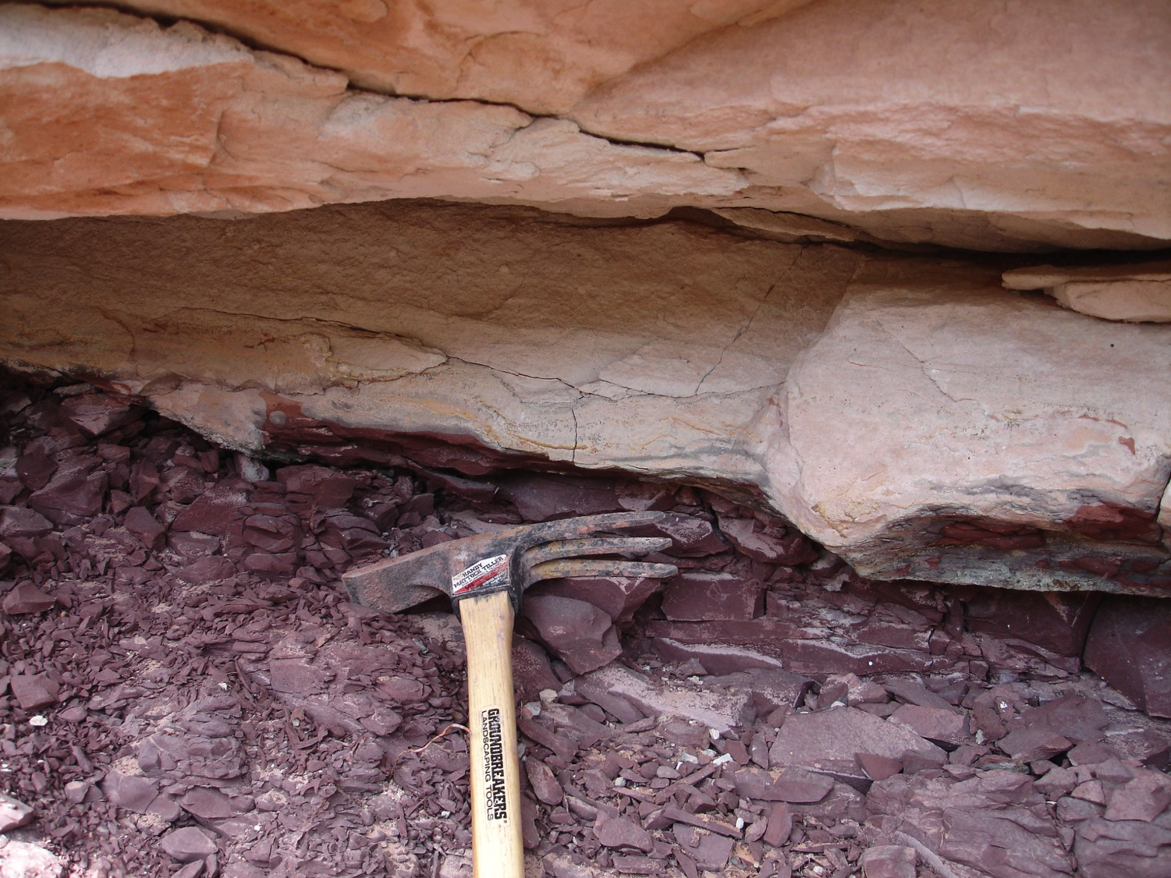
Notes:
Zoom in

Slide 35
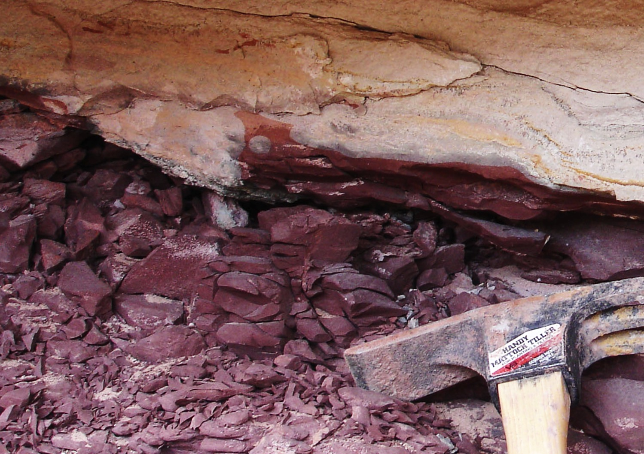
Notes:
Zoom in further to see the mud squeezed up into the sand.

Slide 36
Notes:
Next let’s look at the section near Dinosaur National Monument.

Slide 37
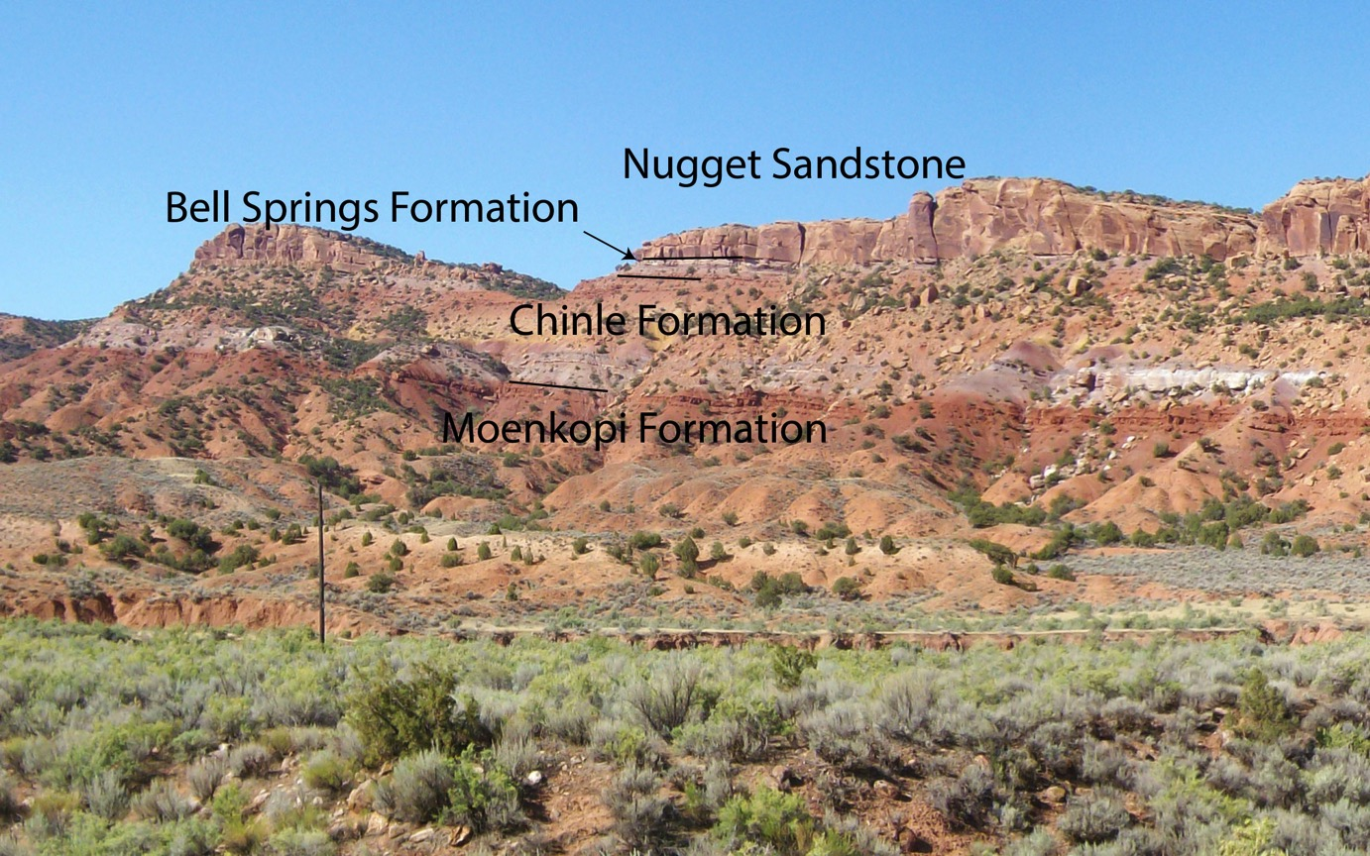
Upper Triassic near Dinosaur National Monument (DNM section)
Notes:
Here the Bell Springs is not as thick, but it is still present as a sandy interval between the Chinle and the Nugget.

Slide 38
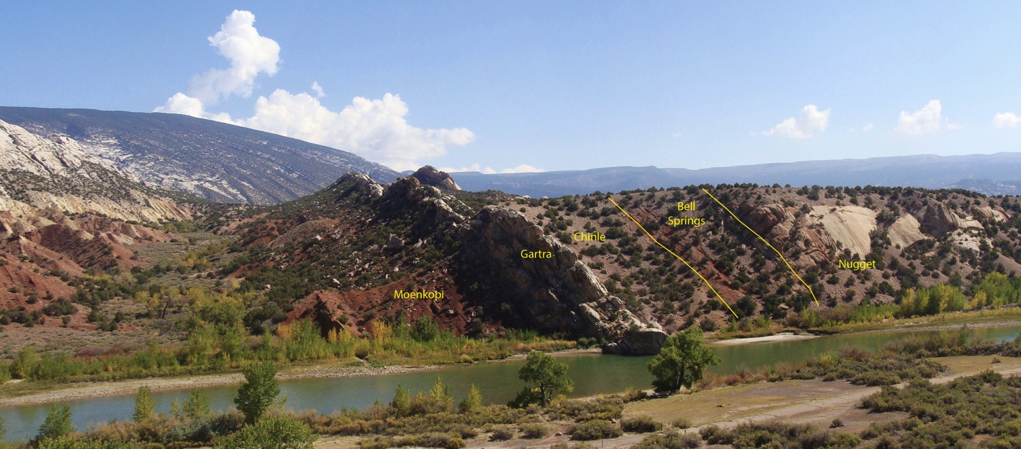
Dinosaur National Monument Section (DNM)
Along Green River at Split Mountain
Area of next slide

Slide 39
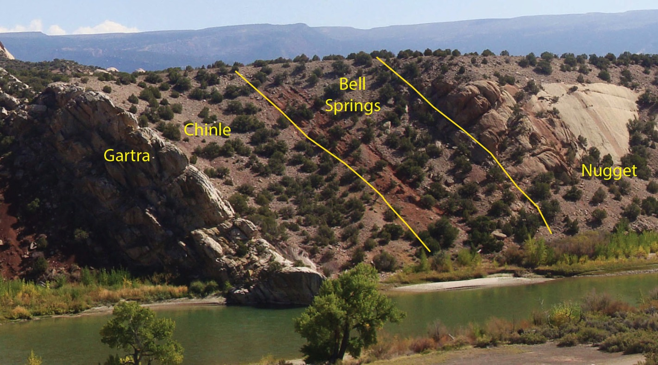
Closer View of Dinosaur National Monument Section (DNM)
Along Green River at Split Mountain

Slide 40
Notes:
Half-way to Paradise section in Lake Mountain quadrangle.

Slide 41
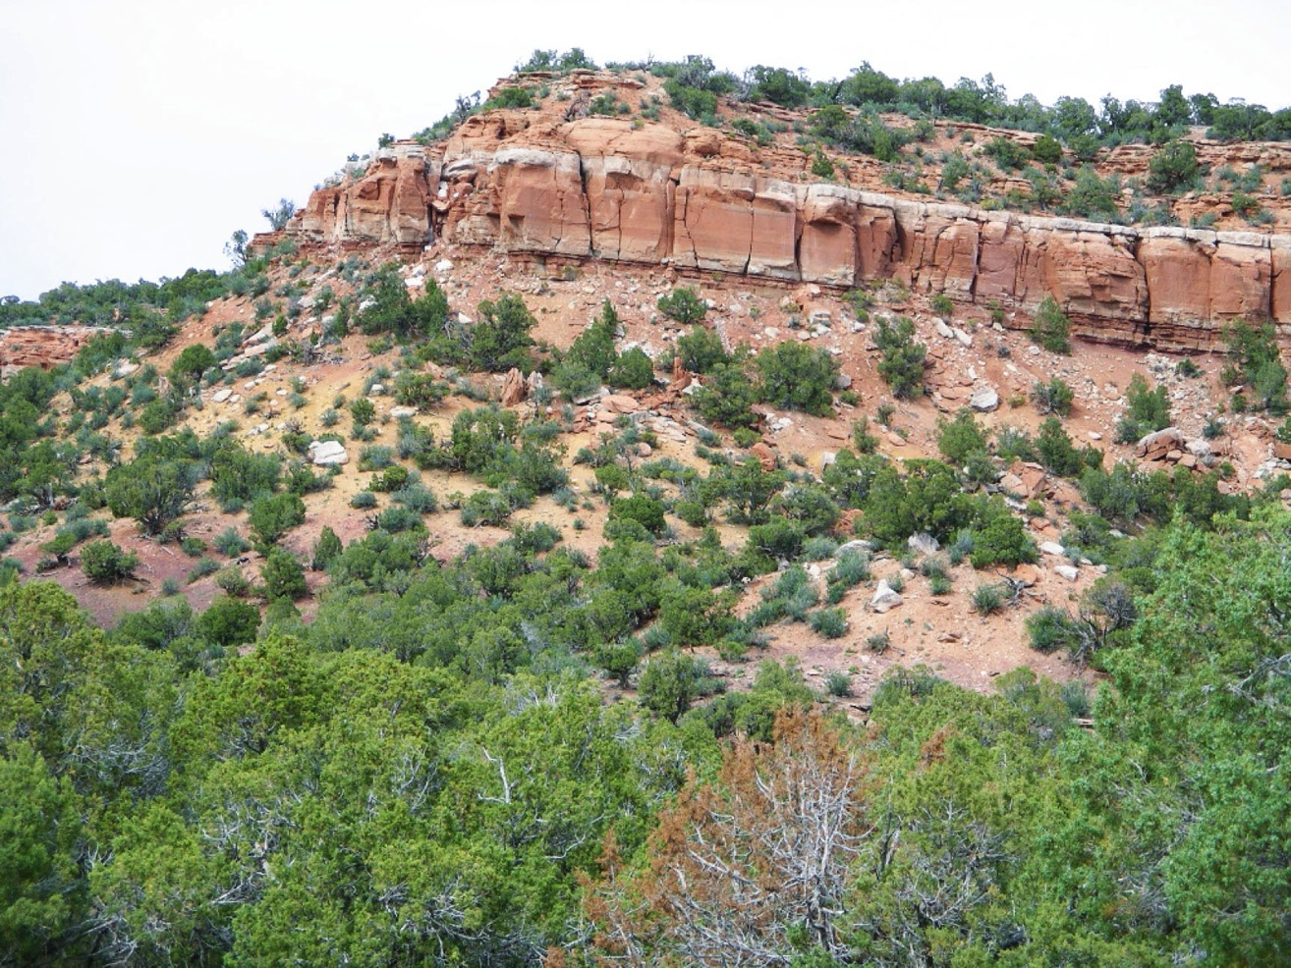
Upper Triassic Section in Lake Mountain Quadrangle (HWTP section)
Bell Springs
Chinle
Notes:
Point out mudstones of Chinle, the contact with the Bell Springs, and the similarity to the Red Fleet section.

Slide 42
Notes:
Although we are not suggesting that this formation should be extended to the Wasatch, we find a similar pattern there in the Ankareh Formation.

Slide 43
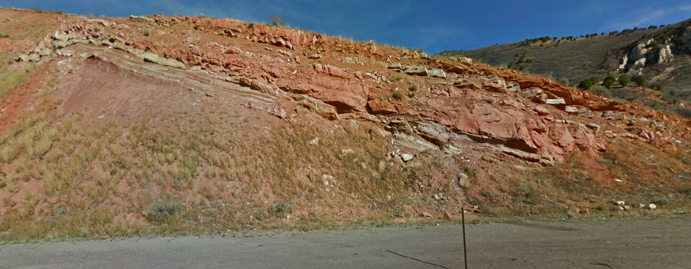
Ankareh Formation in Spanish Fork Canyon
Bell Springs
equivalent
Chinle
equivalent
SFCTS section
Notes:
Point out the swelling clay mudstones of the “Chinle” part of the Ankareh and the overlying sandy interval equivalent to the Bell Springs, including the lower flaggy interval with the more massive sandstone on above. Red arrow points to the location of the next photo.

Slide 44
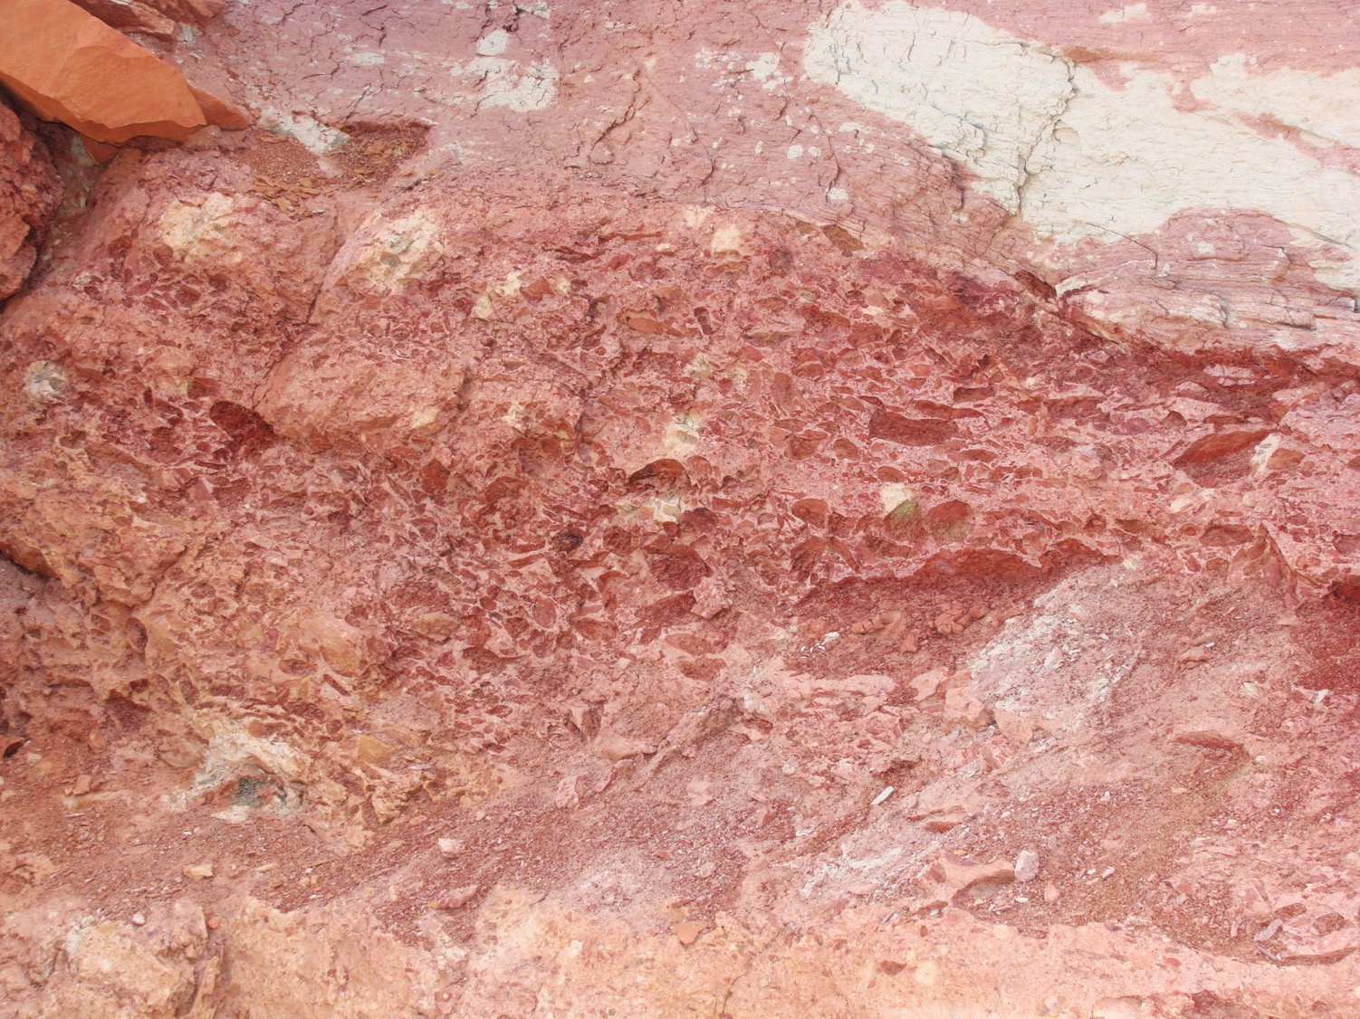
Rip-up clast conglomerate
Notes:
This and the next slide show sedimentary features in the upper Ankareh Formation that are similar to the sections along the south flank of the Uintas. At the base of the sandy section is a flood deposited, rip-up clast conglomerate similar to what we find at Red Fleet.

Slide 45
Ankareh Formation in Spanish Fork Canyon
Bell Springs
equivalent
Chinle
equivalent
SFCTS section
Notes:
Point out the more massive sandy interval. The red arrow points to the location of the next photo.

Slide 46
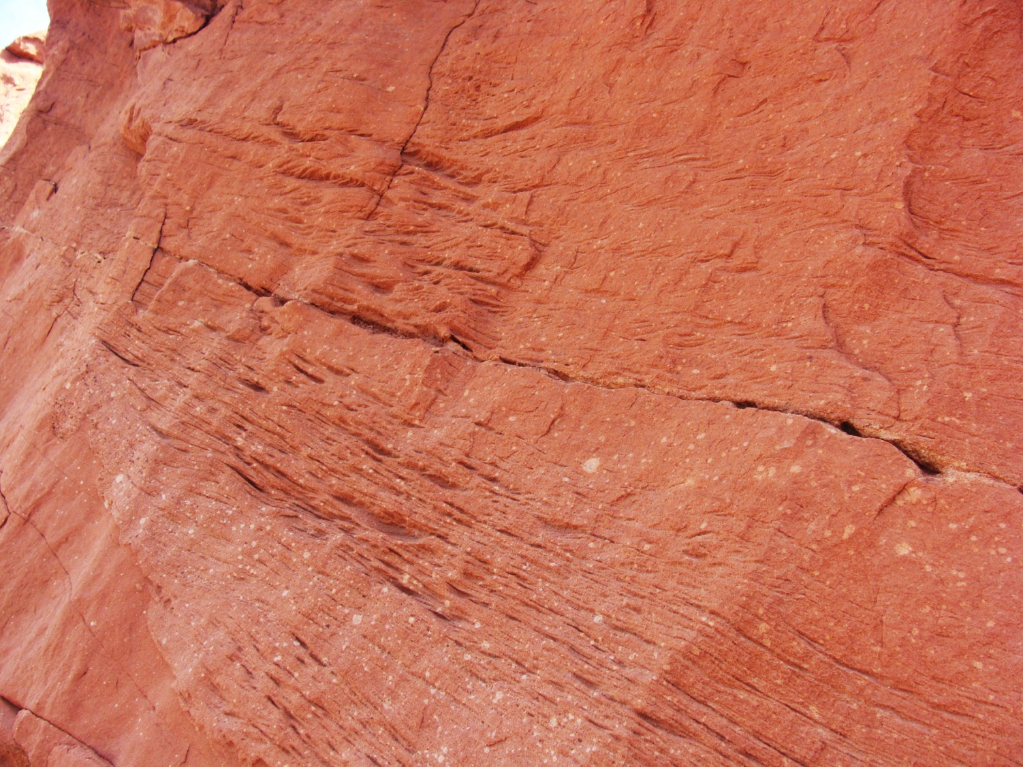
Ripple lamintated sandstone
Notes:
Ripple laminated sandstones are again a common theme.

Slide 47
Notes:
What about the type section of the Nugget in Wyoming?

Slide 48
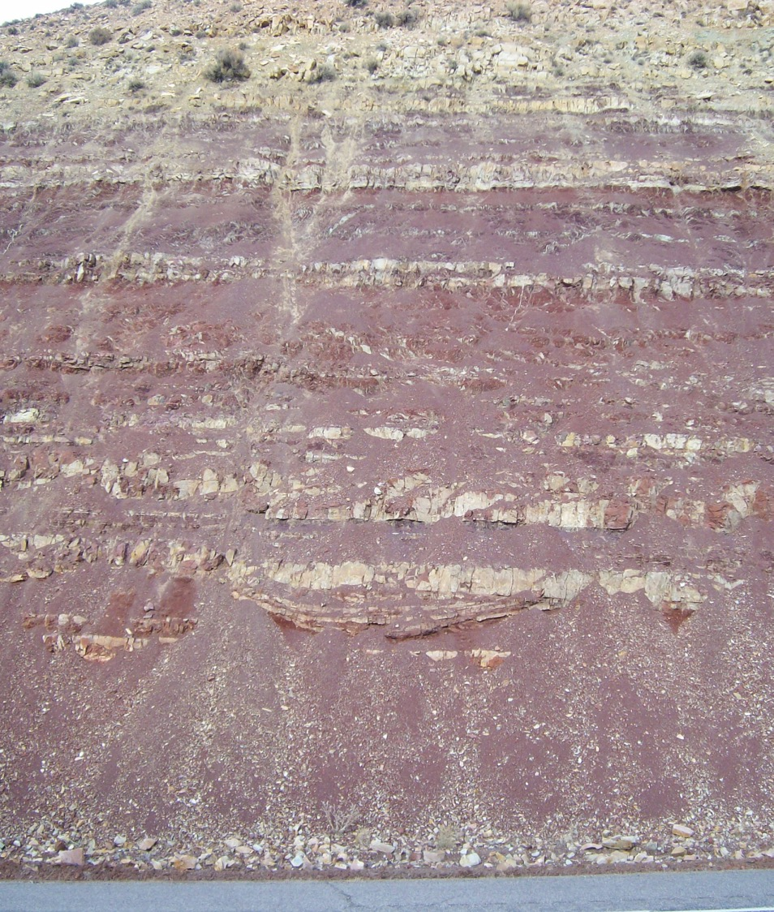
Nugget Sandstone
Nugget Sandstone Type Section (WNTS) at Nugget Station in Wyoming
Upper Popo Agie Formation
(Bell Springs?)
Notes:
Here there is less sand and more siltstone above the Popo Agie mudstones.

Slide 49
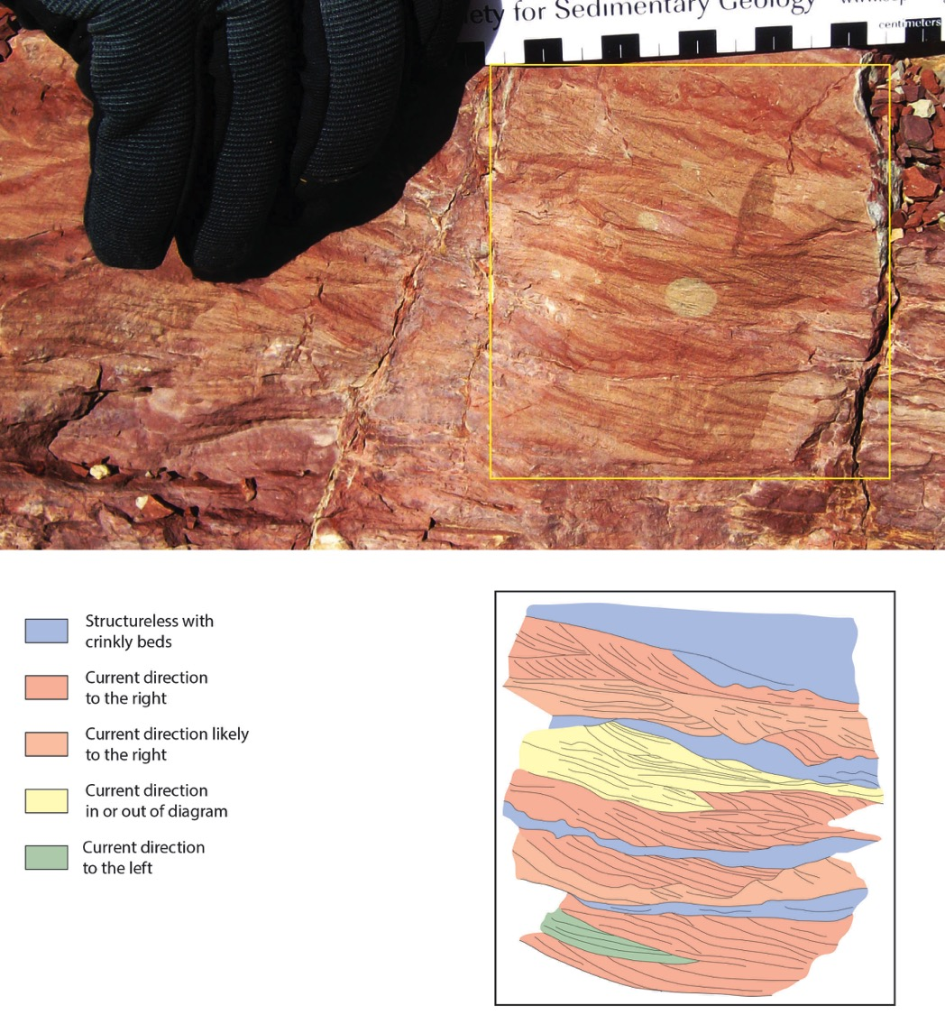
Notes:
The siltstones, however, are ripple laminated as can be seen in this close up of part of the section.

Slide 50
So, should we give these rocks a formation name?
Have we met the Criteria?
The rocks are mappable across a broad area along the south flank of the Uintas
There are well defined upper and lower contacts
  Basal pebble/granule bed
  Upper contact with evidence of soft sediment deformation
The rocks have a lithology that is distinctive from rocks above and below
The rocks provide additional insights into the geologic history of the area
Notes:
We believe that we have demonstrated that this is a useful map unit along the southern Uinta Mountains and that it should be given formation status.

Slide 51
What should we call the Formation?
Bell Springs Formation?
  Already in the literature, as used by Lucas (1993)
  Seem to be stratigraphically in the same position as the Bell Springs Member in Wyoming
Red Fleet Formation?
  Use something new?
Member of the Chinle Formation or Nugget Sandstone (Red Fleet Member)?
Formation of Chinle Group?
Notes:
We are not stuck on using Bell Springs, but do feel there is some justification for doing so. If not Bell Springs, then perhaps Red Fleet formation with a type section in the Red Fleet area.

Slide 52
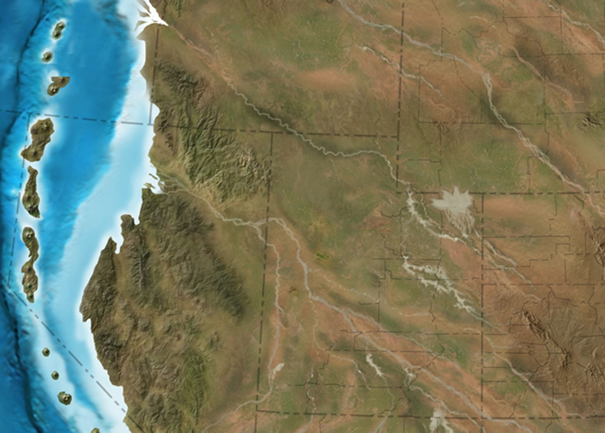
Inland
delta
Notes:
Here on a part of one of Ron Blakey’s paleogeographic maps, we show the possible location of the inland delta. We would envision this new formation being used in NE Utah.

Slide 53
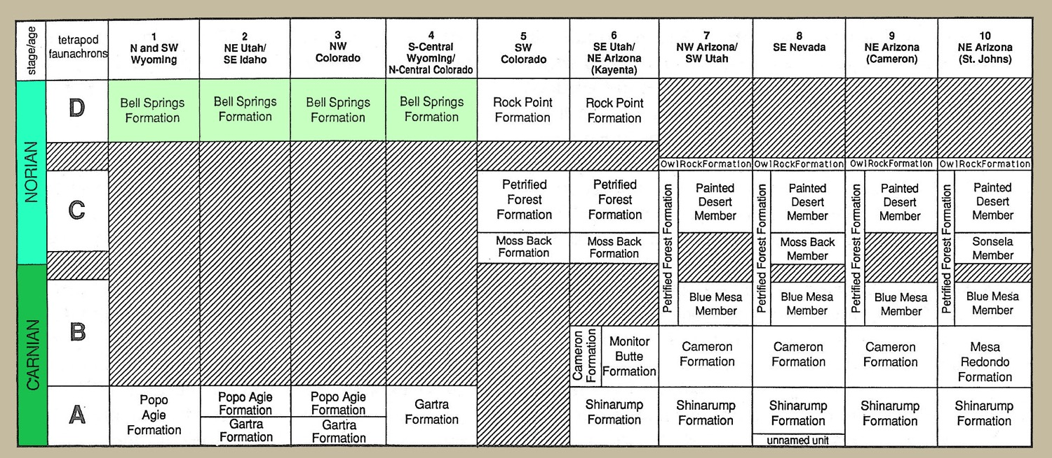
Lucas, 1993, Museum of Northern Arizona Bulletin, v. 59, p. 27-50.

Slide 54
Respecting Prior Publication
“Priority in publication is to be respected, but priority alone does not justify displacing a well-established name by one neither well-known nor commonly used; nor should an inadequately established name be preserved merely on the basis of priority.”
NASC – Article 7, remark C
Notes:
Lucas (1993) did propose the term Bell Springs Formation for these rocks. We are not certain, however, that the term “Bell Springs Formation” is adequately established in that publication, and would welcome your input on what you think these rocks should be called.

