Slide 1
PRELIMINARY RESULTS OF PALYNOLOGICAL STUDIES OF
THE CHUGWATER GROUP (TRIASSIC), WYOMING
Margaret M. Habib¹, Soo Hyun Kim²,
David Lovelace¹ and Sara C. Hotchkiss²
1 Department of Geoscience, University of Wisconsin-Madison,
2 Department of Botany & Center for Climatic Research, University of Wisconsin-Madison
Notes:
I’ll be continuing our research group’s theme on the Chugwater Group, specifically its palynology, or the study of pollen and spores.
I would like to thank my collaborators - Dave Lovelace for collecting the rock samples and proposing the project, Soo Kim for preparing the slides and helping with identification of pollen, and Sara Hotchkiss also for helping with identification.

Slide 2
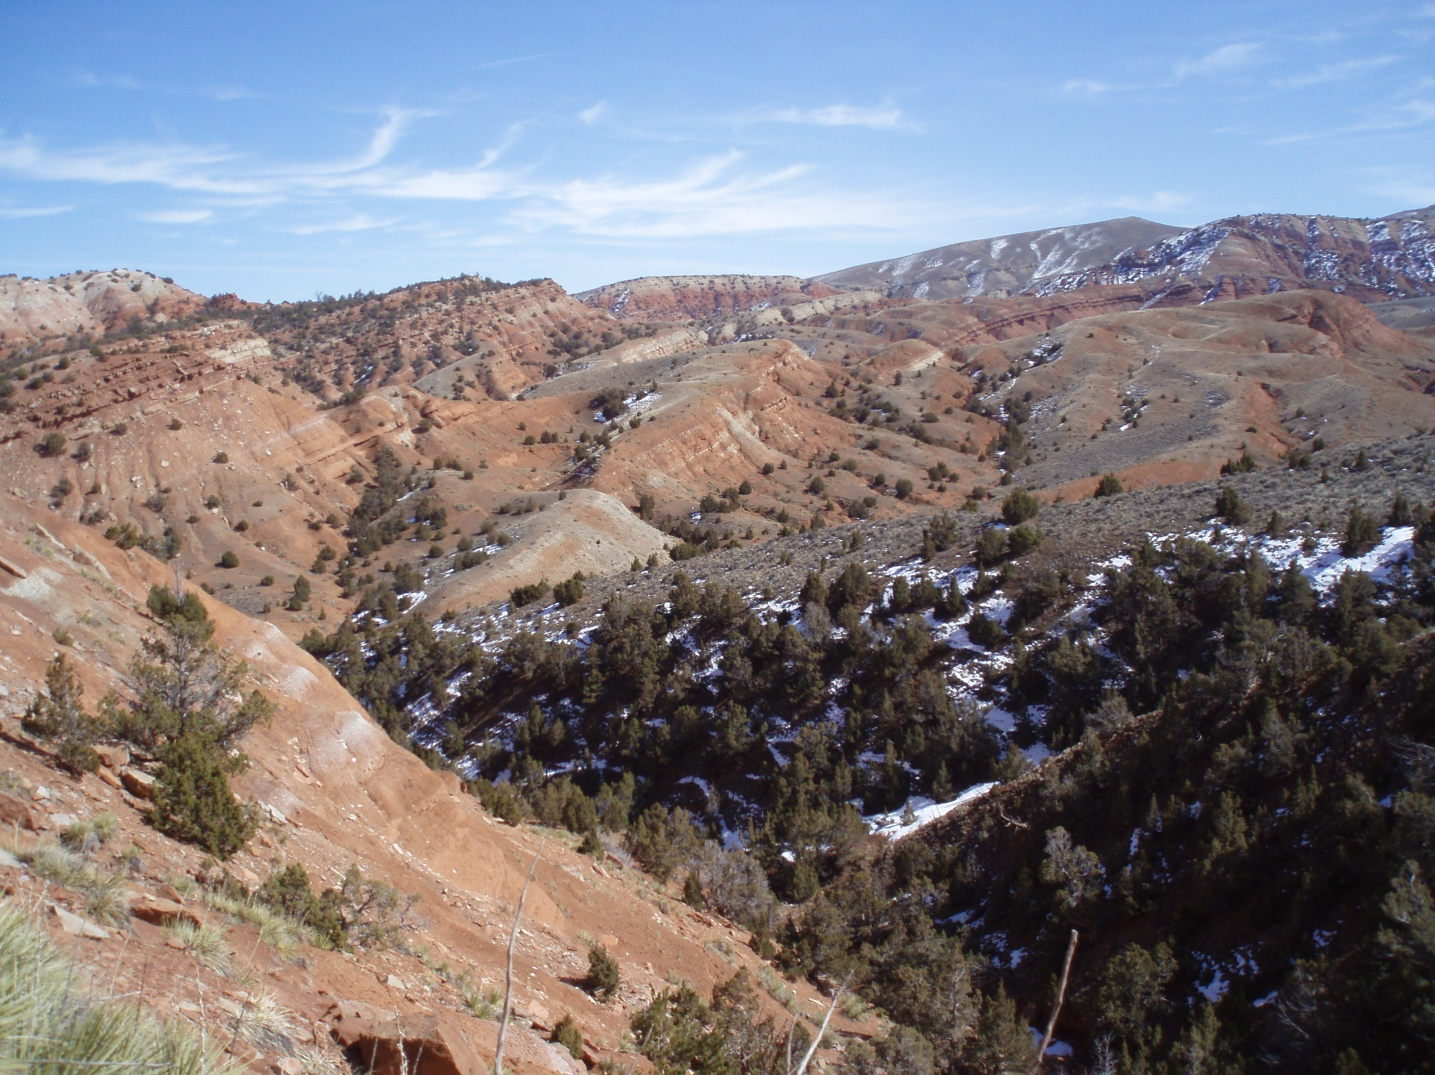
The Chugwater
Notes:
The Chugwater Group is a geologic set of formations located in Wyoming, Colorado, and Montana. While the body and trace fossil record of the Chugwater has been improving steadily over the last few years, work done on this formation is still scarce. Most fossils found from this strata are trace fossils, and no one has thought to look for pollen in red rocks. In fact, no new paleobotanical work has been presented in nearly a century. This study reports the very first paleopalynological findings from the Triassic Chugwater Group in Wyoming. This data will help strengthen paleoecological interpretations and provide the first glimpse of the flora from the Middle Triassic strata of Wyoming.

Slide 3
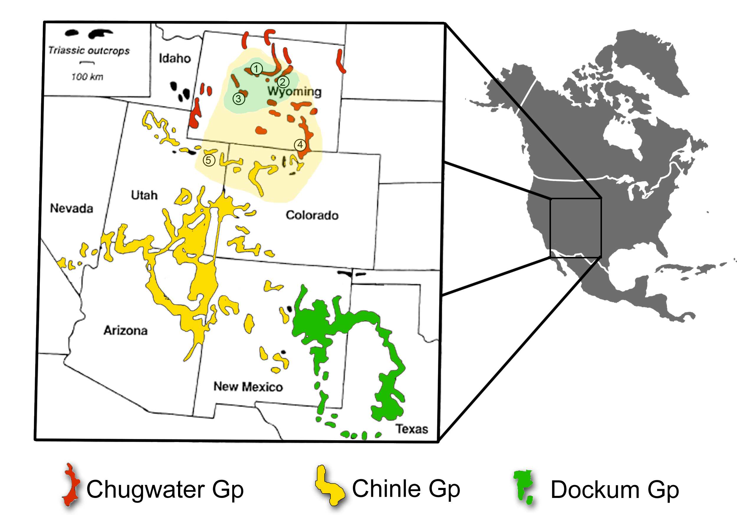
Continental Late Triassic deposits in western NA
Entirely Triassic in age and largely continental in origin; scarce paleobotanical work
Chinle was deposited on the Colorado Plateau; and over 50 plant taxa found
Dockum outcrops in western Texas and eastern New Mexico; equivalent to Chinle and biotas are very similar. Over 70 plant taxa have been reported
Notes:
The Chugwater is entirely triassic in age, and although previously thought to be predominantly marine, has been demonstrated to be more continental than previously thought. The only paleobotanical study from the Chugwater Group was done by Edward Berry in 1924, almost a century ago, in which six tentative plant taxa were identified.
The Chinle Formation, a comparable formation, was deposited on the Colorado Plateau on a low relief floodplain, and spans the last 30 million years of the Triassic. Over 50 plant taxa are found in this formation, including lycopods, horsetails, ferns, seed-ferns, cycads, ginkgos, and conifers.
The Upper Triassic Dockum Group, also similar to the Chinle, outcrops in Western Texas and in eastern New Mexico. The Dockum is the lateral equivalent of the Chinle and and their biotas are very similar - the Dockum flora correlates with that of the Chinle Group at the specific level.
The uppermost unit of the Chugwater, the Popo Agie Formation, is largely believed to be equivalent to the lowermost Dockum and Chinle. Although the paleoflora has been poorly studied to date, the Popo Agie has the potential to test environmental hypotheses proposed for this unit.

Slide 4
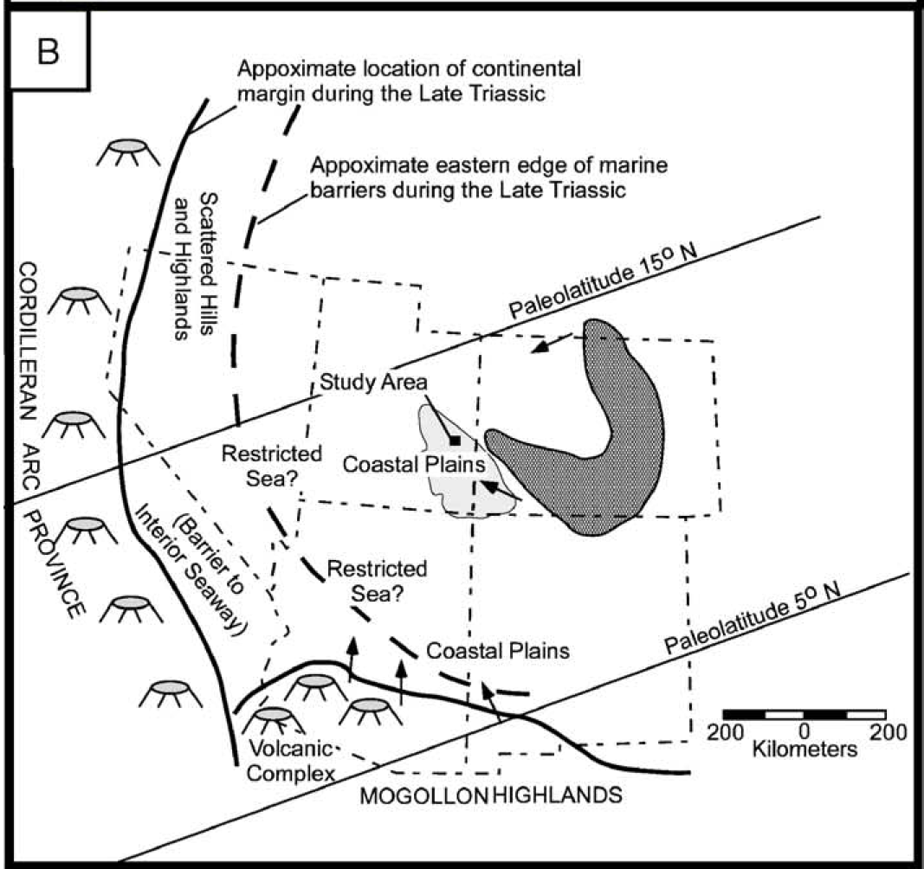
Prochnow et al., 2006
Notes:
Our data allows us to test potential latitudinal gradients given that the deposit we studied are close to 10 degrees further north than the Chinle and Dockum.

Slide 5
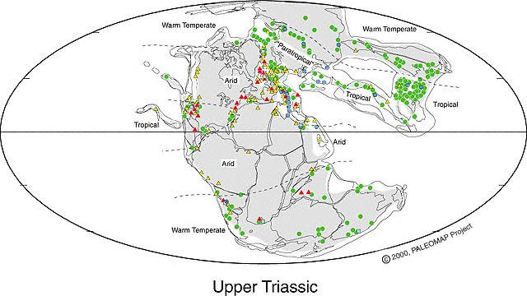
Western North America during the Late Triassic
Calcrete: Arid & Warm
Evaporite: Arid & Warm
Coal: Wet & Warm
© 2000, PALEOMAP Project
Paleolatitude: Close to the Equator
Paleoclimate: Monsoon? (Parish 1993)
Notes:
The plant remains found in the Dockum Group, particularly the presence of ferns, suggest that the climate was moist and warm when the unit was deposited. Most likely these plants’ closest relatives now live in tropical to subtropical parts of the world. The morphology of the Chinle plants also suggest that the climate was warm and moist when the Chinle was being deposited, and was probably fairly similar in adjacent areas where the Dockum was being deposited.

Slide 6
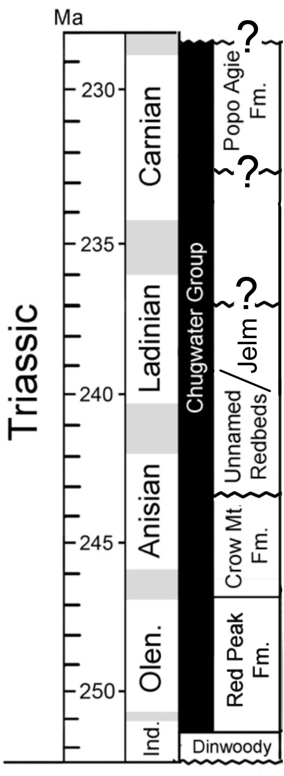
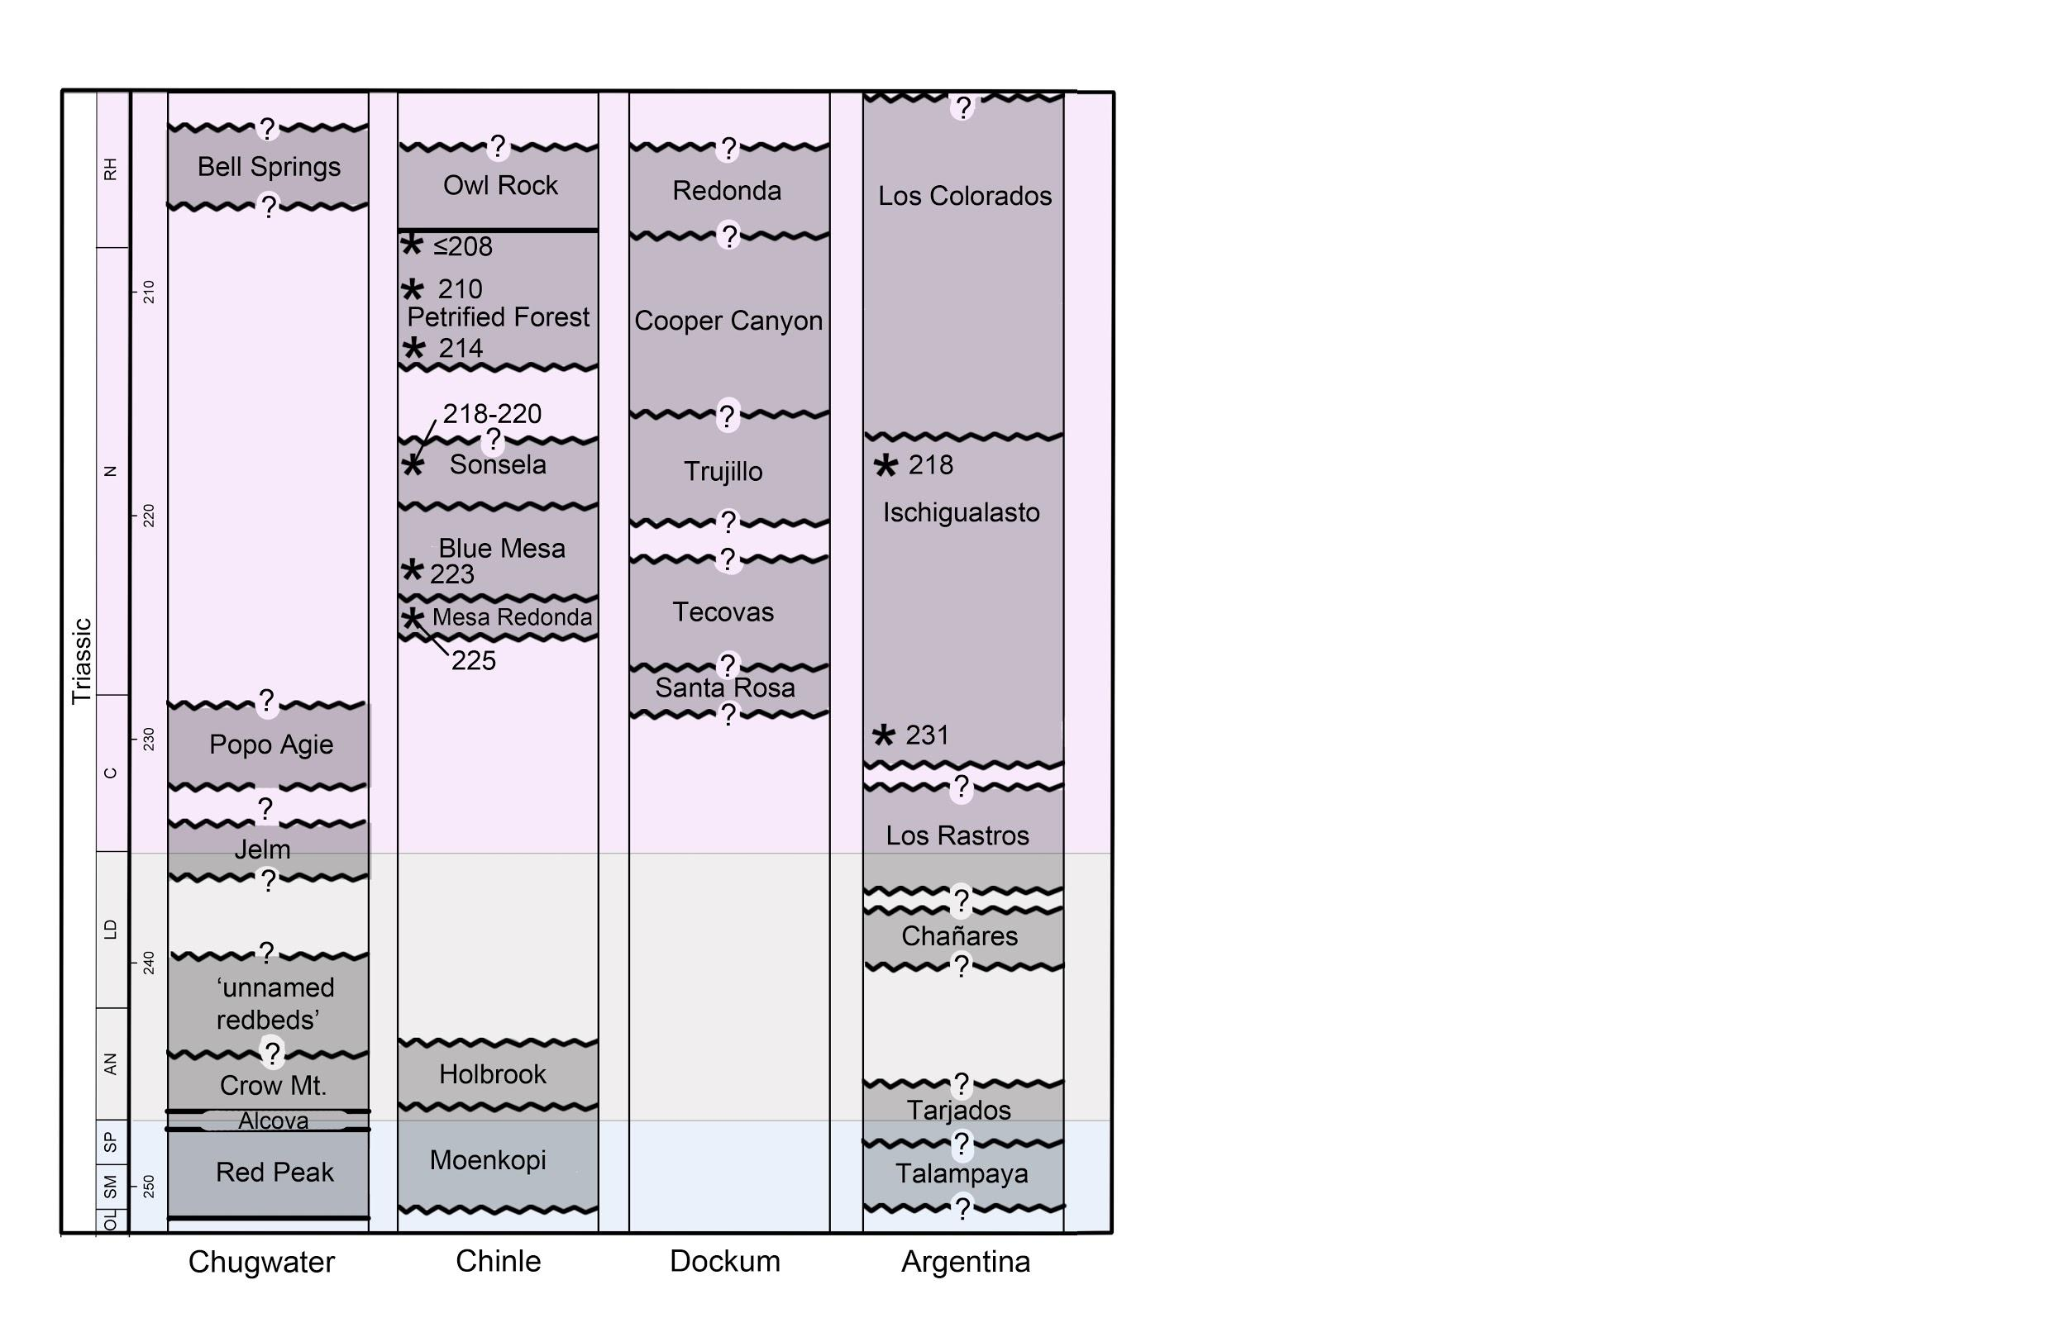
Stratigraphic Relationships
Notes:
The ages of the upper Chugwater strata are poorly constrained, but as Dave mentioned, this is our group’s hypothesized stratigraphic relationships.

Slide 7
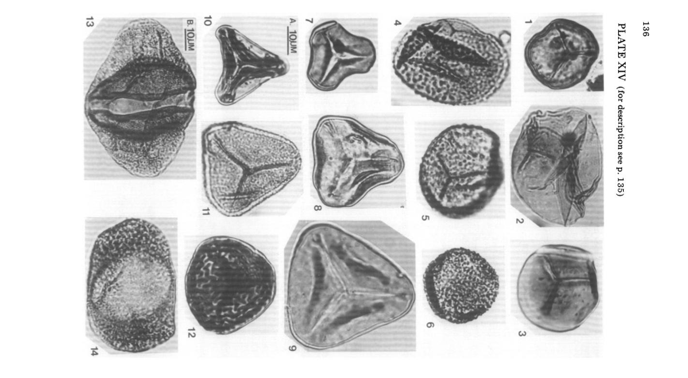
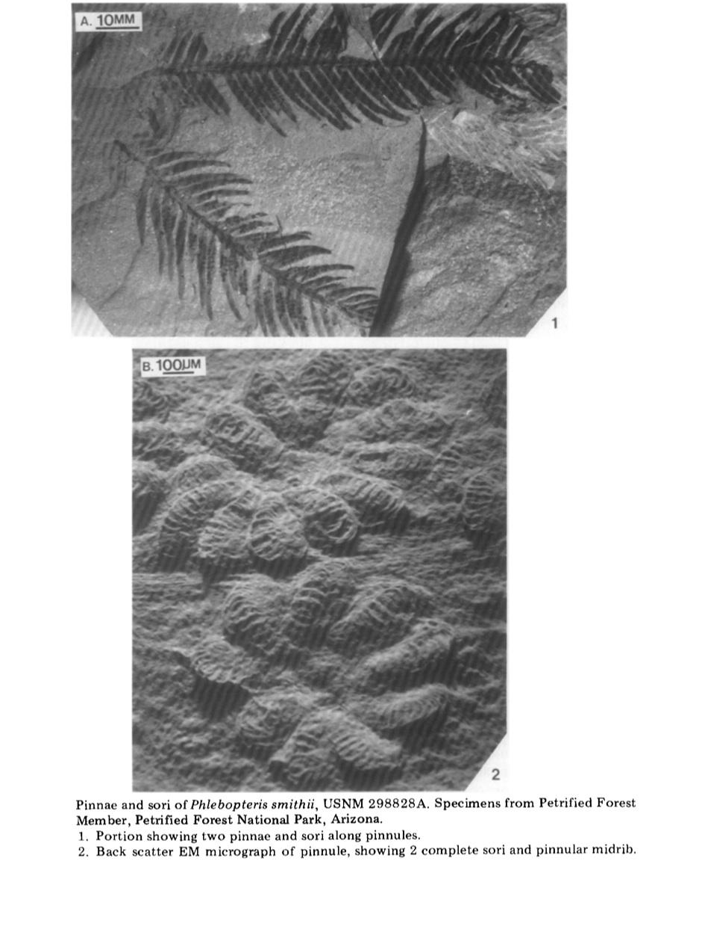
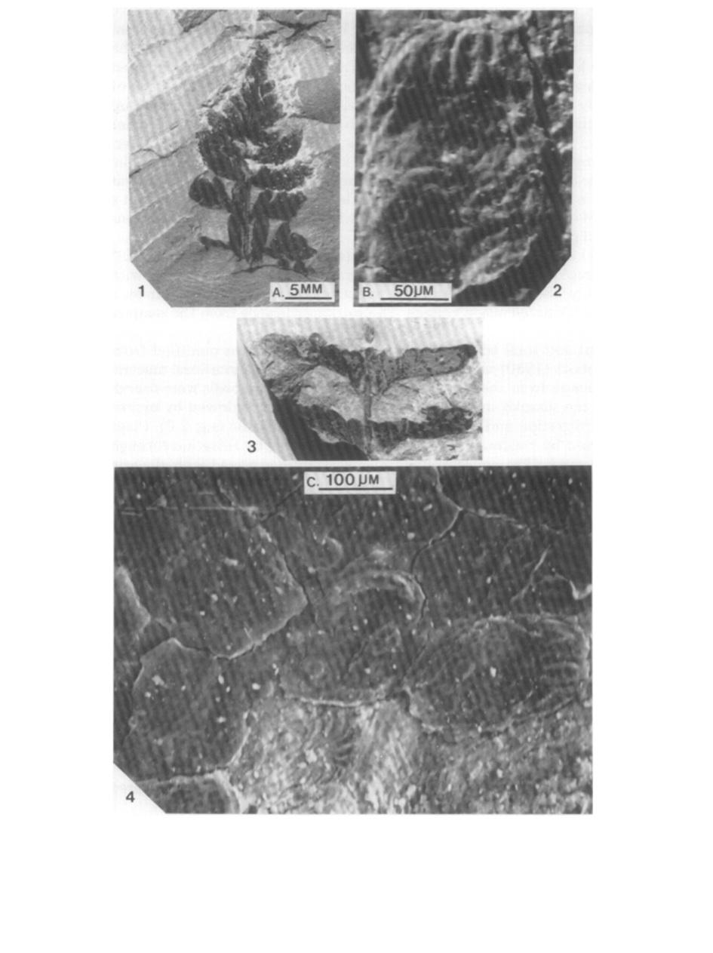
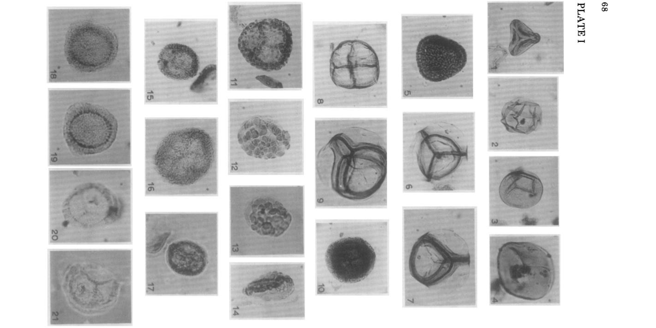
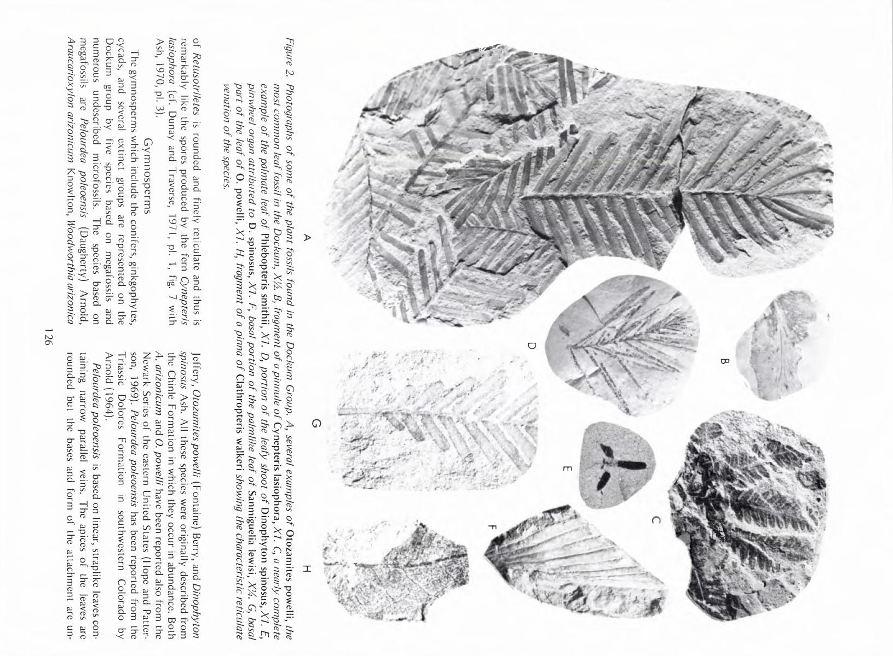
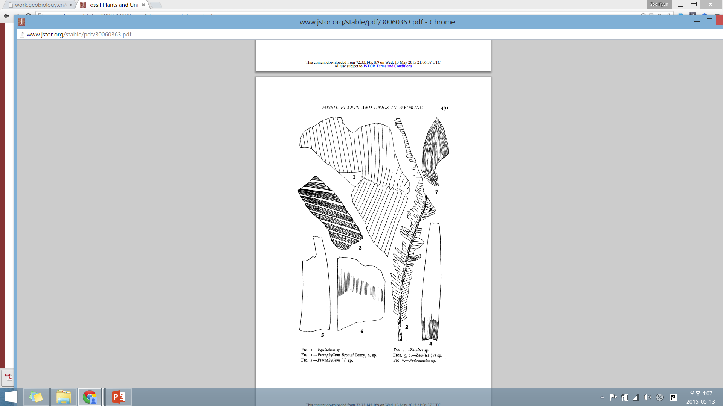
Previous paleobotanical studies
Deposits
Macrofossil
Microfossil
1) Chinle
Genera = 50
Litwin, 1985
Litwin, 1985
2) Dockum
Dunay and
Fisher, 1979
Genera = 70
Ash, 1972
3) Chugwater
Unknown
Genera = 6
Berry 1924
Notes:
The Popo Agie Formation possesses a unique vertebrate fauna, but as I mentioned earlier, only limited paleobotanical work on poorly preserved impressions has been done so far. The plant remains present in the Popo Agie are mostly fragmentary and thoroughly oxidized. These are just a few examples of the macrofossils that have been found.

Slide 8
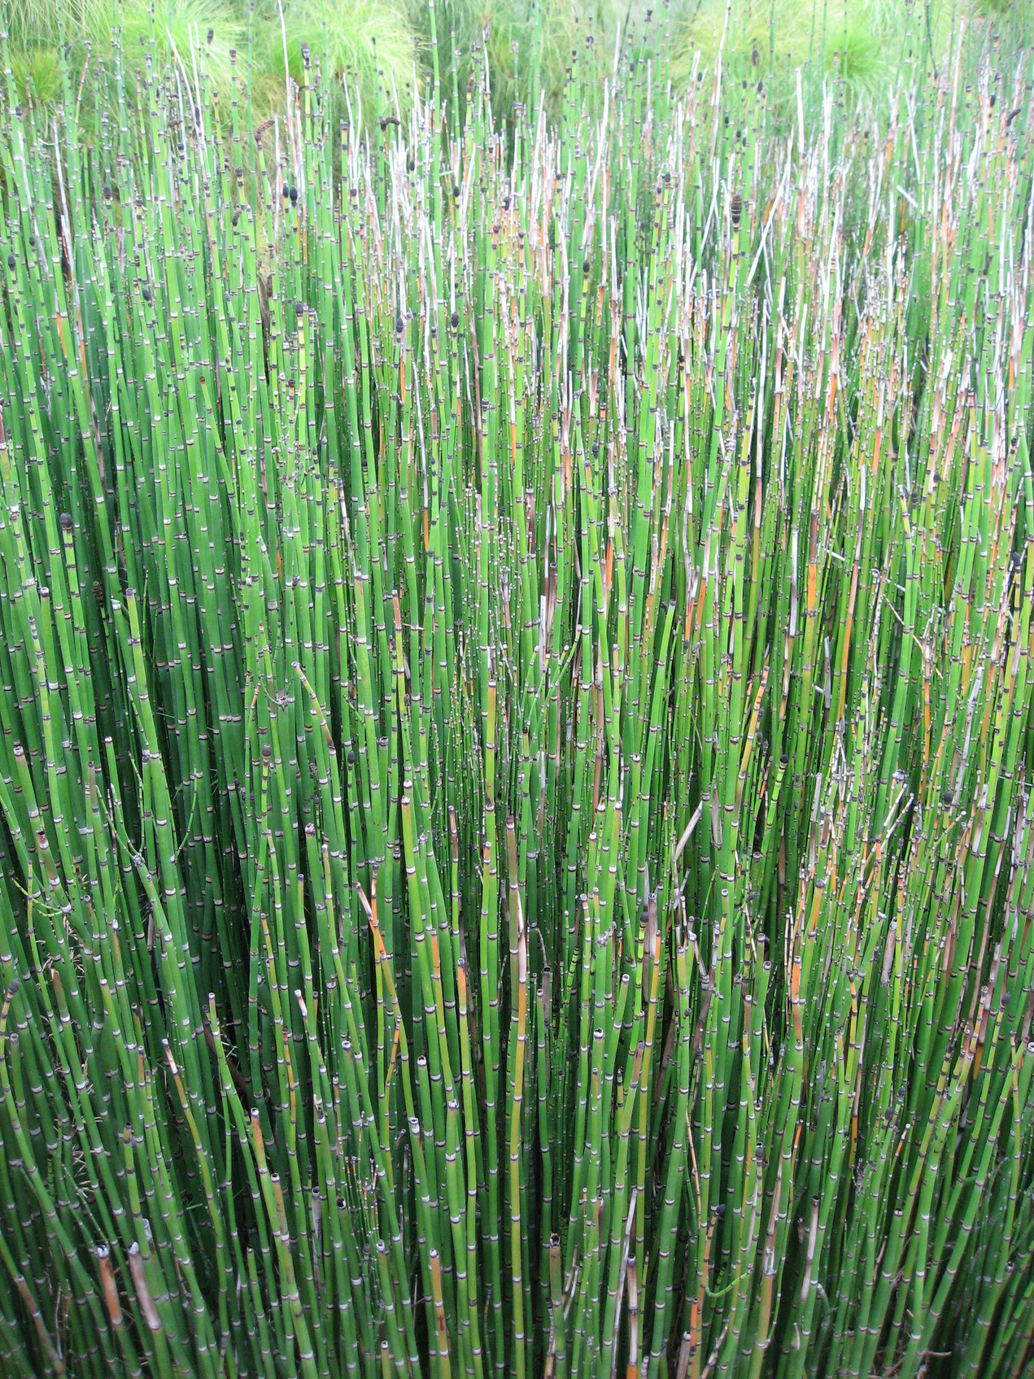
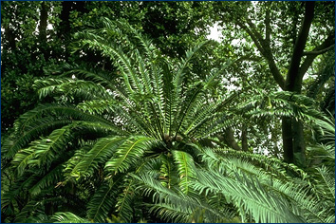
Impressions yielded from the Popo Agie
Equisetum (horesetails)
Equisetum sp.
Cycads
Pterophyllum browni Berry
Pterophyllum?
Zamites sp.
Eoginkgoites?
Podozamites?
Berry 1924
Notes:
Six species of plant remains have been described from the Popo Agie by Edward Berry in 1924 - Five cycadophytes and one Equisetum.

Slide 9
Study sites
LO1
Two deposits from which our microfossils were yielded:
DMB from ‘unnamed redbeds’ near Arminto, WY
L01 from the upper purple beds of the Popo Agie at the Sinks Canyon Center
DMB
Notes:
Two localities from the Chugwater Group have yielded our plant microfossil samples. The first locality, DMB, is from the ‘unnamed redbeds’, presumed to be Middle Triassic, which are located along the Redwall near Arminto, WY. These may well be the oldest palynomorphs reported from the Triassic of the Rocky Mountain west.
The term “Red Beds” is generally applied to successions of dominantly red strata. Even though most red beds are thought to have been deposited in continental environments, plant fossils rarely ever occur in them. When they do, they are usually found in the non-red strata in the successions. But they do occasionally occur in the red-colored strata themselves, as is the case with our samples.
The second deposit, L01, is from the upper purple beds of the Popo Agie Formation, which is Late Triassic, at the Sinks Canyon Center, Lander, WY. These samples are comparable to assemblages from the Chinle and Dockum.

Slide 10
Methods
Preparation of palynomorphs for microscopy using HF Acetolysis Treatment
1) Rinse an outcrop sample (about 20 g) with dH2O
2) Crush the samples to pea-sized pieces
3) Add 20% HCl (decalcification) + neutralization
4) Add 42% HF for 48 hours (demineralization) + neutralization
5) Add 10% KOH (remove organic residue) + neutralization
6) Acetolysis (remove cellulose) + neutralization
7) Mount slide
Notes:
Four original slides were prepared by National Petrographic. Once these slides confirmed that there was indeed pollen in our rock samples, we prepared several of our own slides. Our fossil playnomorph slides were prepared with a standard HF-Acetolysis treatment. Slides were observed and photographed using an Olympus light microscope at 400x magnification with a color Olympus DP70 digital camera.

Slide 11
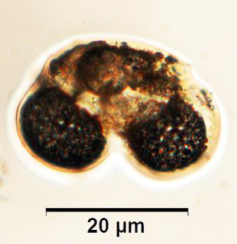
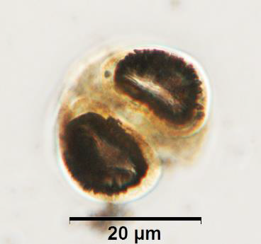
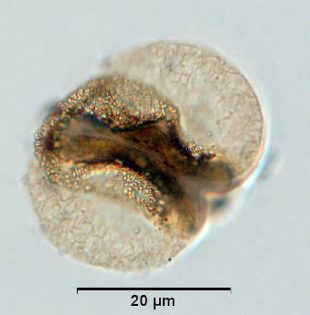
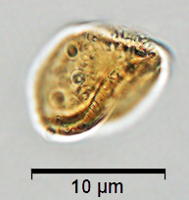
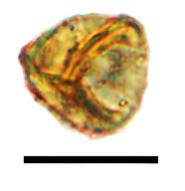
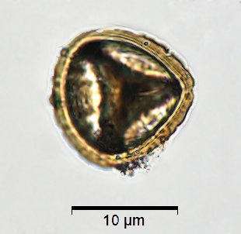
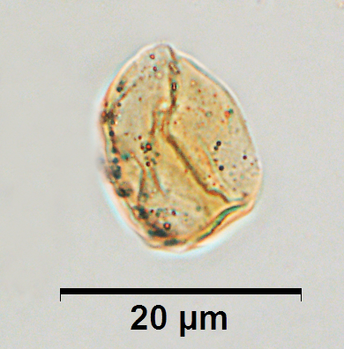
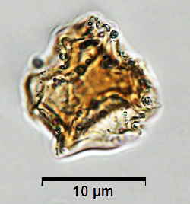
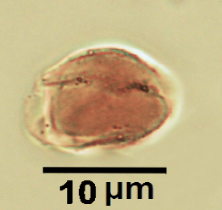
Results- DMB (Middle Triassic)
Notes:
We investigated our palynological samples with reference to the Chinle and Dockum palynofloras. Like these two paleofloras, both of our Chugwater palynoassemblages are dominated by bisaccate pollen grains and trilete spores.

Slide 12
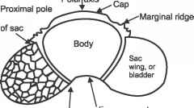
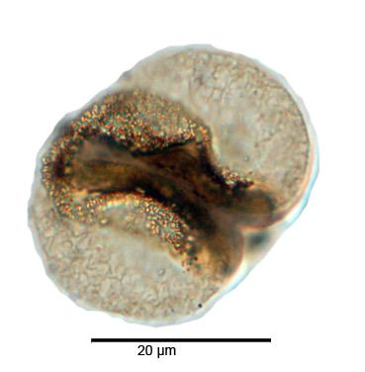
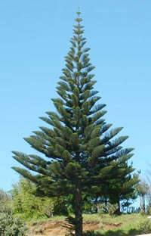
Bisaccate Pollen
Pityosporites sp.
Alisporites sp.
Notes:
Pollen grains first appeared about 300 million years ago, and are utilized by seed plants so they don’t have to depend on standing water for fertilization. They are produced in the male organ of the flower and are transferred by either wind or animals to the female organ of the flower (pollination).
Bisaccate pollen specifically consists of a body with two laterally-placed air-filled bladders, called sacci. Since they are wind-pollinated plants, the sacci are thought to help orient the pollen grain and increase dispersal distance. Bisaccate pollen is produced by coniferous trees such as pine and spruce.
As such, without body fossils we cannot determine the proximity of pollen producers to the deposit, although they were clearly present regionally. However,...

Slide 13
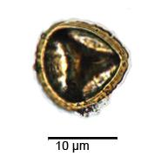
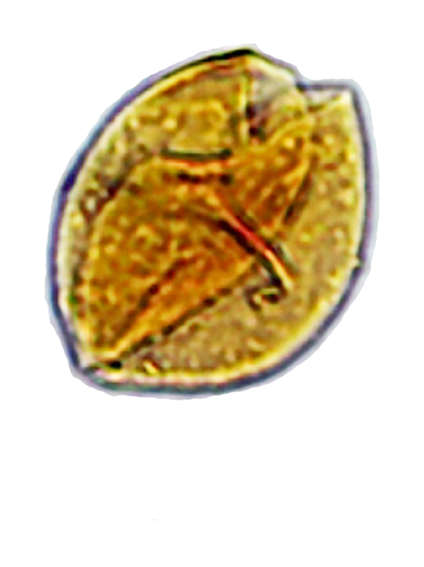
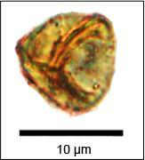
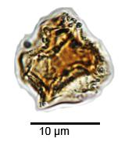
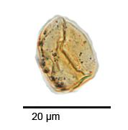
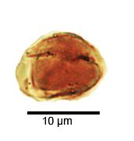
Spores
Notes:
Unlike pollen, spores are single celled propagules that require standing water for fertilization and reproduce asexually. Particularly trilete spores, many of which were found in the Middle Triassic DMB locality.

Slide 14
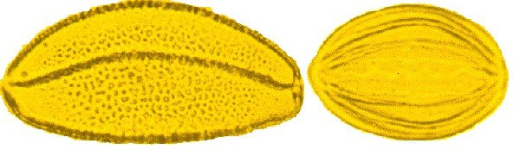
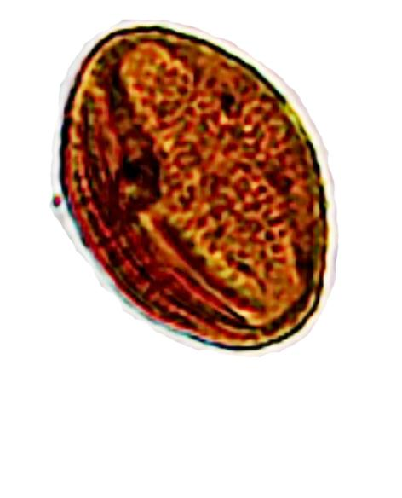
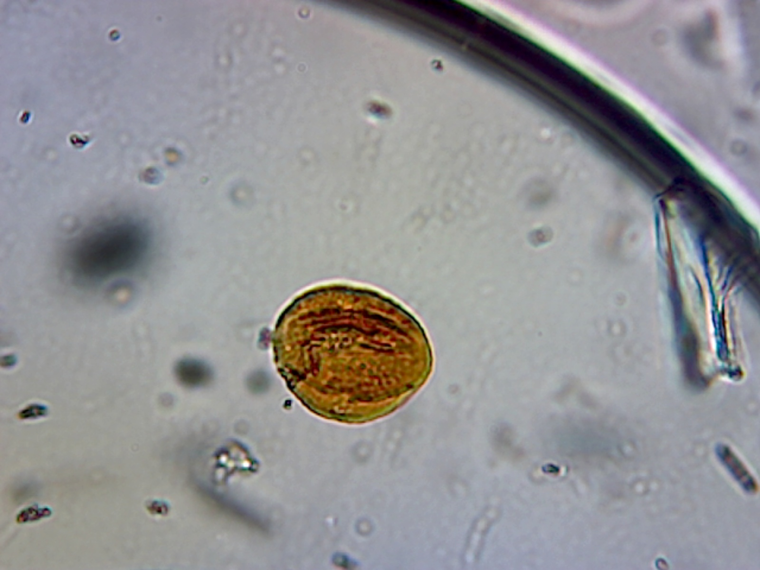
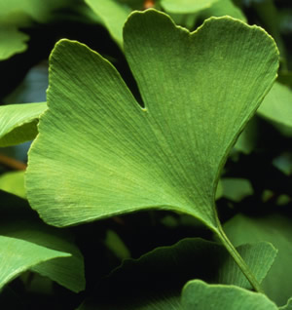
Cycad or Ginkgo
Proximal side view
Notes:
Monocolpate pollen grains, produced by cycads or gingko, have an elongated aperture called a “colpus”. Monocolpate grains are occasionally encountered in the Paleozoic, but are common beginning in the Triassic and range to Recent in the fossil record.

Slide 15
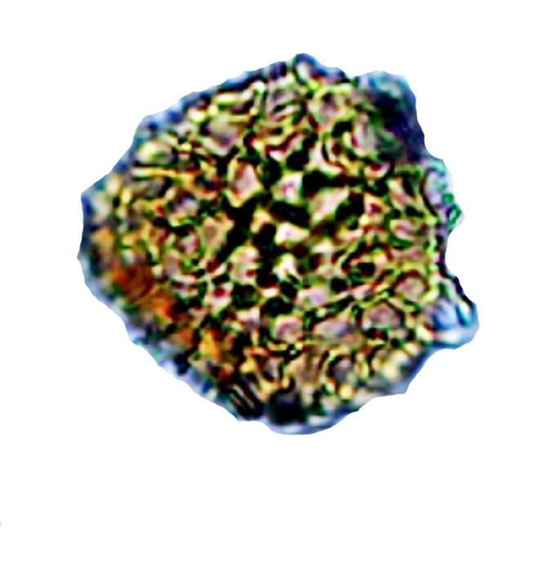
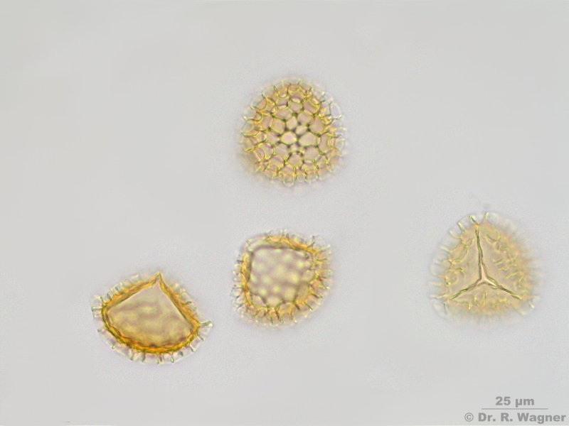
Stellatopollis sp.
extant Lycopodium spore
Notes:
As you can see, this palynomorph looks very similar to a modern-day lycopodium spore. Lycopodium is a genus of clubmosses.

Slide 16
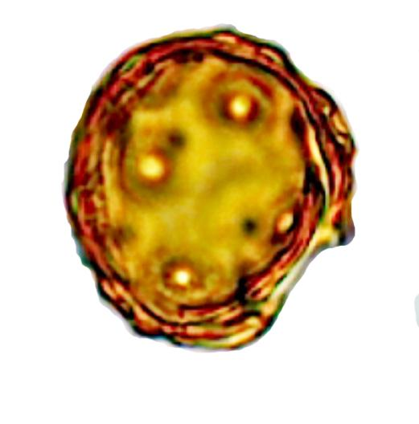
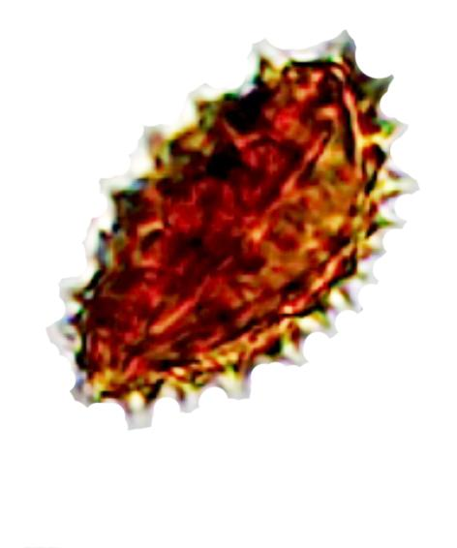
Unknown
10µm
10µm

Slide 17
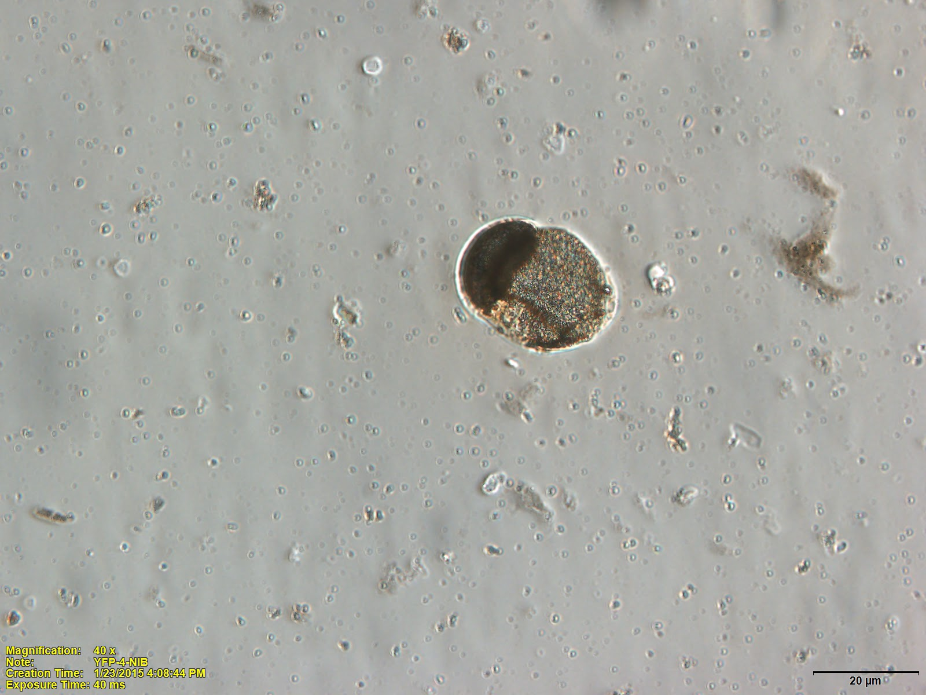
Results - L01
Notes:
palynological findings from the L01 site exhibited a much lower taxonomic diversity. Although there were numerous bisaccate grains, we were unable to identify the specimens to the genus level.

Slide 18
Palynomorphs from each Chugwater deposit
DMB L01 2013
Bisaccates
Alisporites
Pityosporites
Triletes
Dictyophillidites
Calamospora
Kyrtomisporis
Others
Duplicisporites
Bisaccate

Slide 19
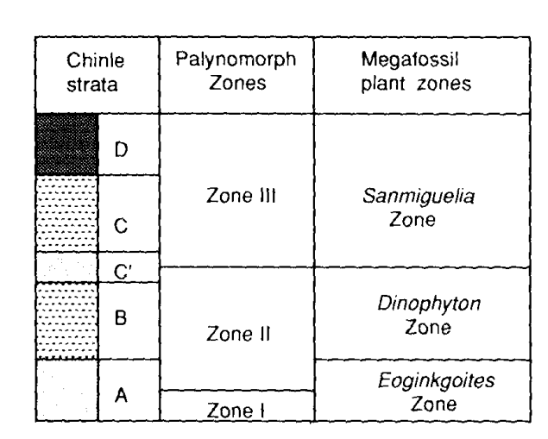
Discussion
Ash (1980, 1987)
Notes:
Ronald Litwin, Alfred Traverse, and Sidney Ash (1991) segregated palynomorph assemblages from the Temple Mountain, Shinarump, Moss Bak, Monitor Butte, and Petrified Forest Members into three biozones. These zones range from late Carnian to early Norain in age.
The oldest biozone, zone 1, is located at the base of the Chinle Formation in the Temple Mountain Member. It is characterized by the occurrence of bisaccate taxa and the lack of other key taxa characteristically found in stratigraphically higher members of the Chinle. All higher members bear palynofloras that are much more similar to each other than to the Temple Mountain assemblages.
Based on current identification, we can suggest that our LO1 observations are consistent with zone 1 as it is characterized primarily by bisaccates.
The Eoginkoites zone also characterizes the basal beds of the Chinle and may occur in the Popo Agie. Plant megafossils especially characteristic of this zone are ferns, cycads, and cycadoids.
The DMB locality yielded the oldest palynomorphs from the Chugwater group, and possibly the Triassic of the Rocky Mountain west. These samples demonstrate both autochthonous specimens such as the spores, while the bisaccate pollens have the potential to travel long distances from their place of origin and may represent an allochthonous portion of the assemblage.

Slide 20
Conclusions
The DMB locality yielded the oldest palynomorphs from the Chugwater group, and possibly the Triassic of the Rocky Mountain west.
These samples demonstrate both autochthonous specimens such as the spores, while the bisaccate pollens have the potential to travel long distances from their place of origin and may represent an allochthonous portion of the assemblage.
The LO1 site contained only bisaccate pollen; however Berry reported Eoginkoides (along with ferns, cycads and horsetail) macrofossils from sites within 1 km of the LO1 locality.
The LO1 locality matches well with the Zone 1 biozone from Temple Mountain, low in the Chinle section.

Slide 21
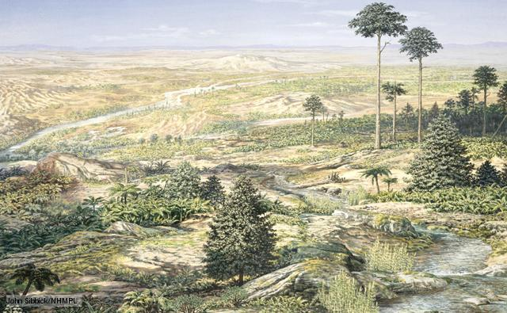
Future Directions
Notes:
These are only preliminary results. We have too little data to make conclusions about the overall floral ecology to test hypotheses of latitudinal gradients. However, these samples clearly demonstrate the presence of palynomorphs in the middle and upper chugwater strata and require further investigation.

Slide 22
Acknowledgements
Sarah Swanson, Director, UW-Madison Newcomb Imaging Center
National Petrographic Service, Inc.
Sinks Canyon Center, Lander, WY
James Nassif, Steve and Mary Lovelace, and the 2014 UW-Madison Geology Museum field crew
Notes:
In addition to my collaborators I would like to thank Sarah Swanson, director of UW Madison Botany Department’s Newcomb Imaging Center, who let us use her facility and trained us on microscopy and imaging. I would also like to thank National Petrographic for creating our first set of slides.

Slide 23
References
Ash, SR. 1972 Upper Triassic Dockum Flora of Eastern New Mexico and Texas.
Ash, SR (1987). The Upper Triassic Red Bed Flora of the Colorado Plateau, Western US. Pp. 95-105.
Berry, EW. 1924. Fossil Plants and Unios in the Red Beds of Wyoming. P. 488-497.
Kapp, Ronald O. How to Know Pollen and Spores. W.C. Brown Co., 1969. 249 p.
Litwin, RJ (1985) Fertile Organs and In Situ Spores of Ferns from the Late Triassic Chinle Formation of Arizona. Review of Paleobotany and Palynology, pp. 101-146.
Nudds, J. and Selden, P. (2008), Fossil Ecosystems of North America. The University of Chicago Press, Chigaco, IL, 288p.

Slide 24
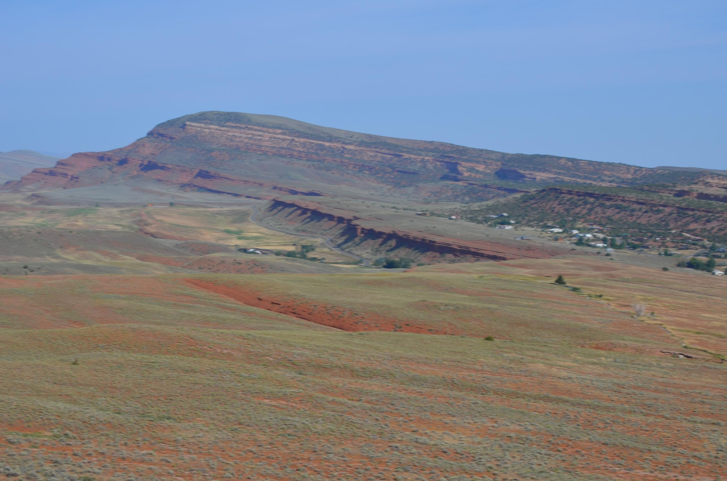
Thank You

