Slide 1
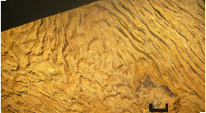
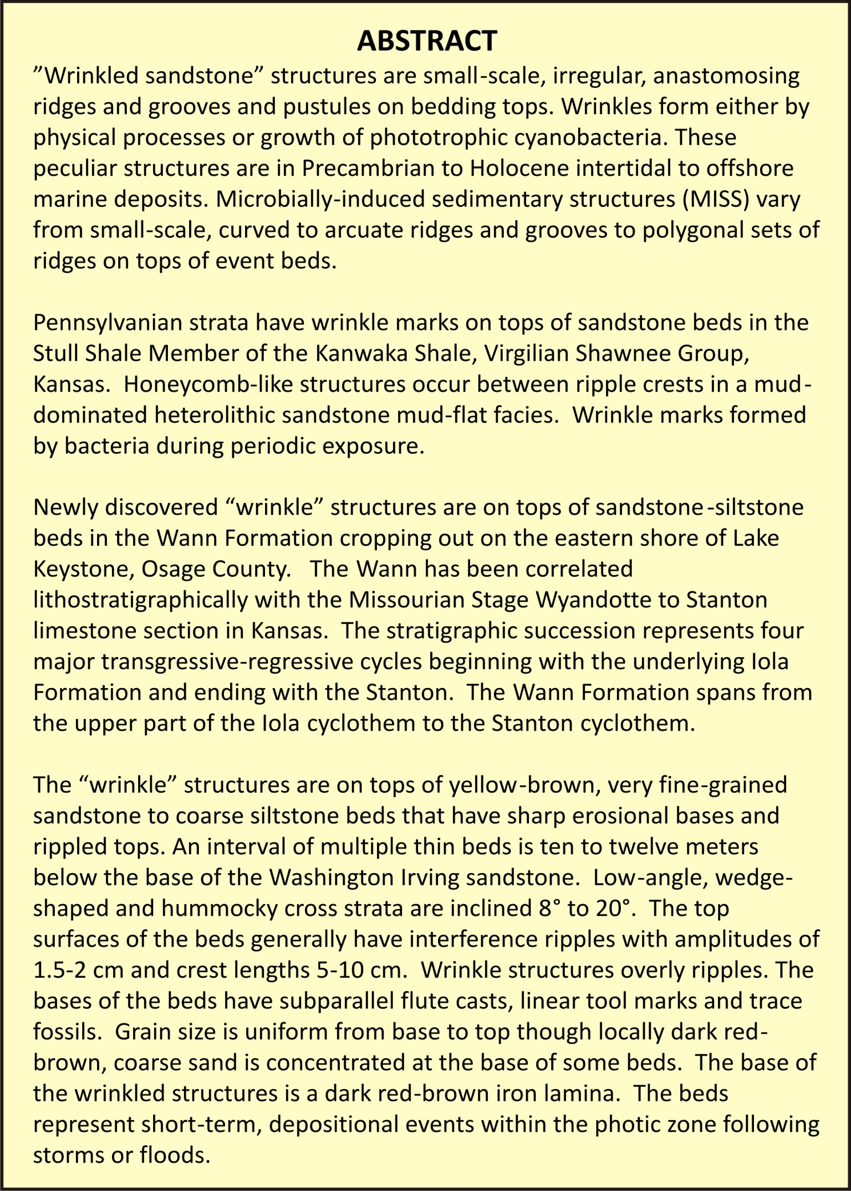
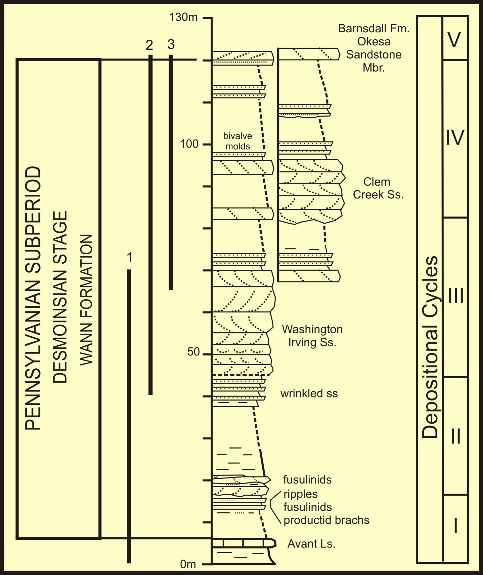
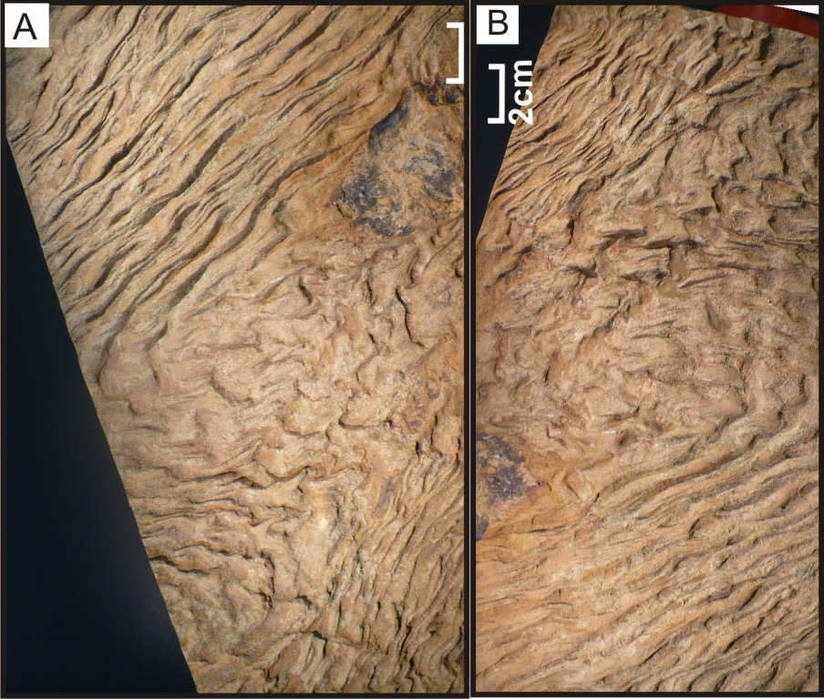
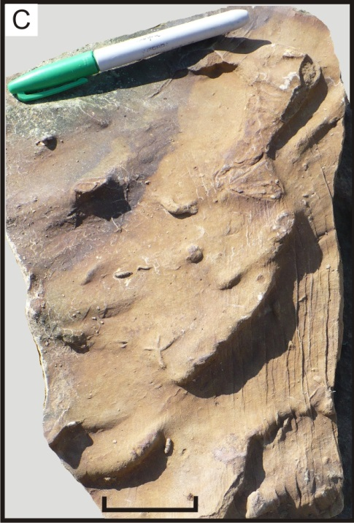
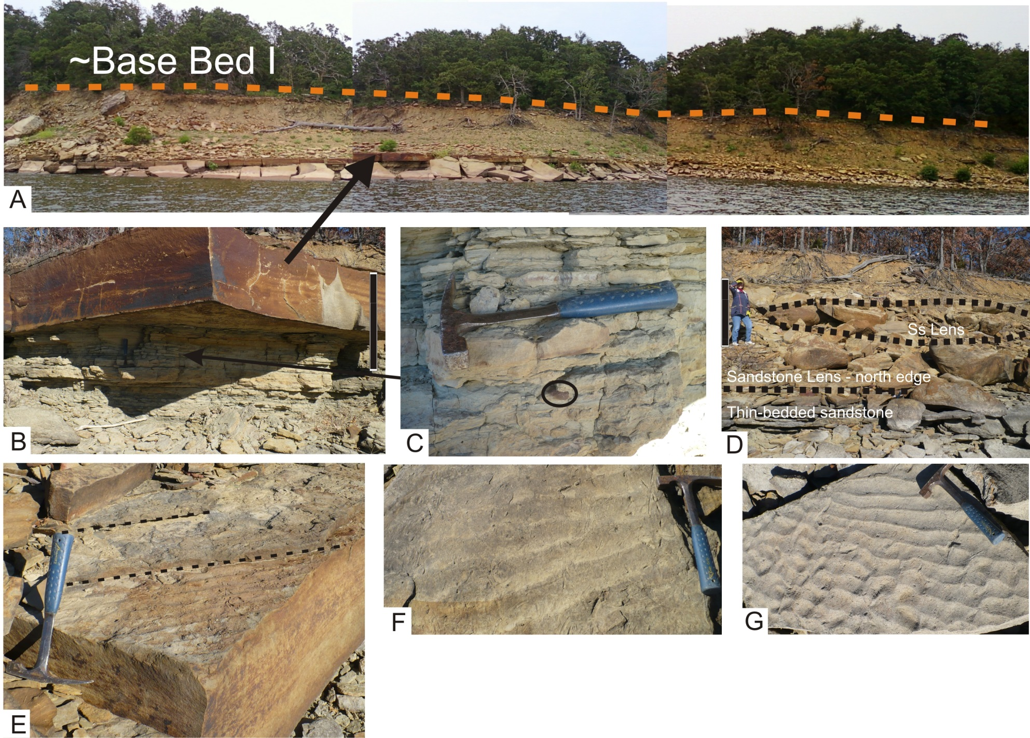

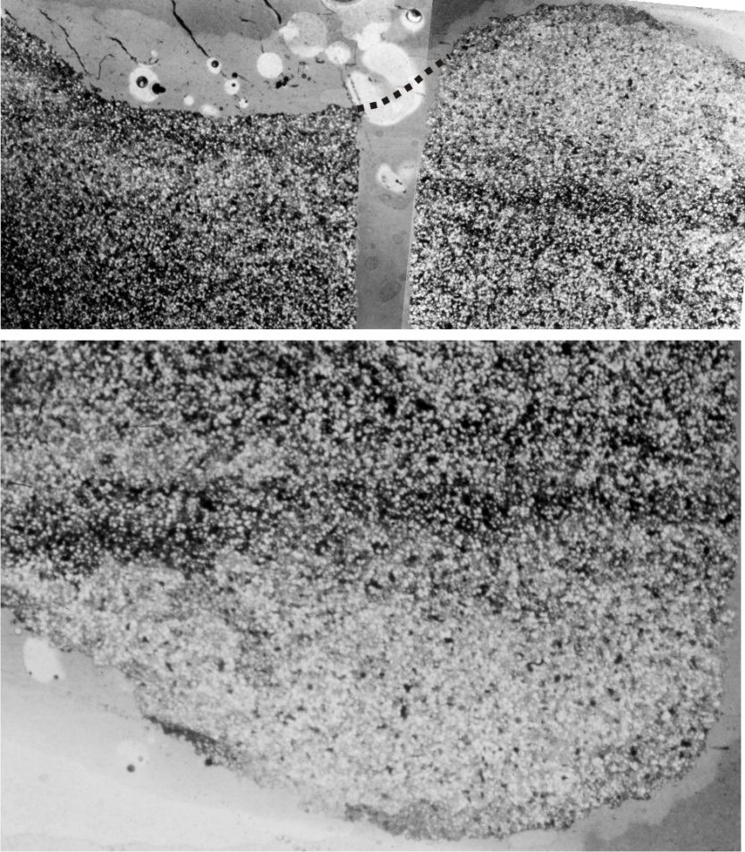
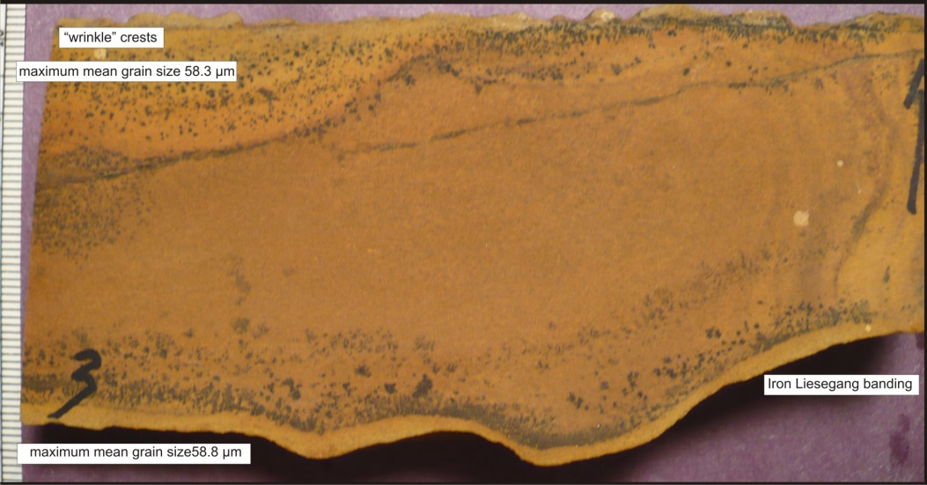
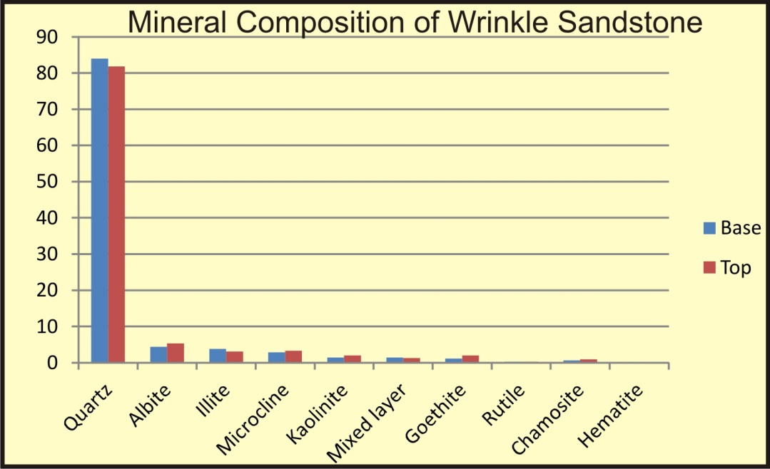
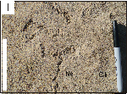
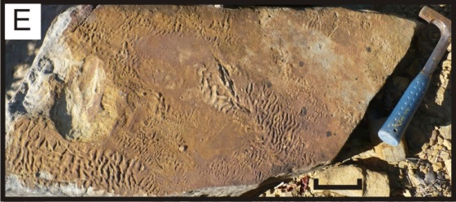
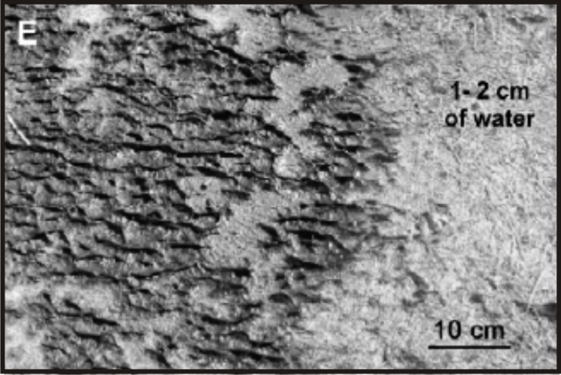
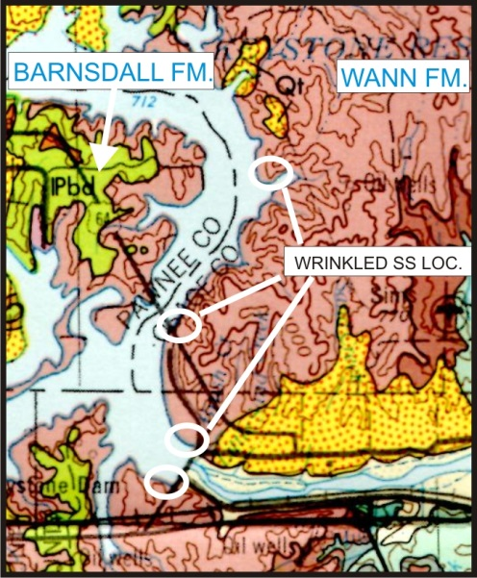
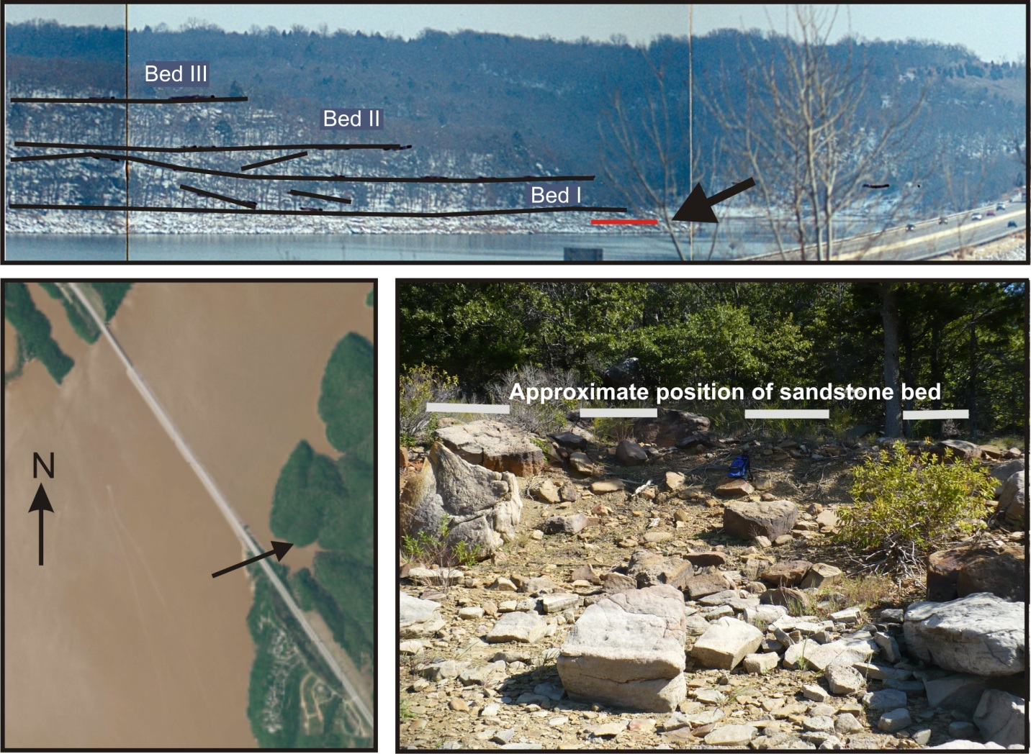
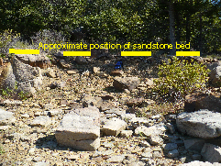
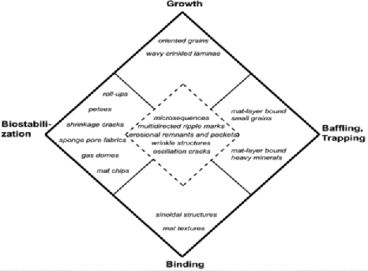
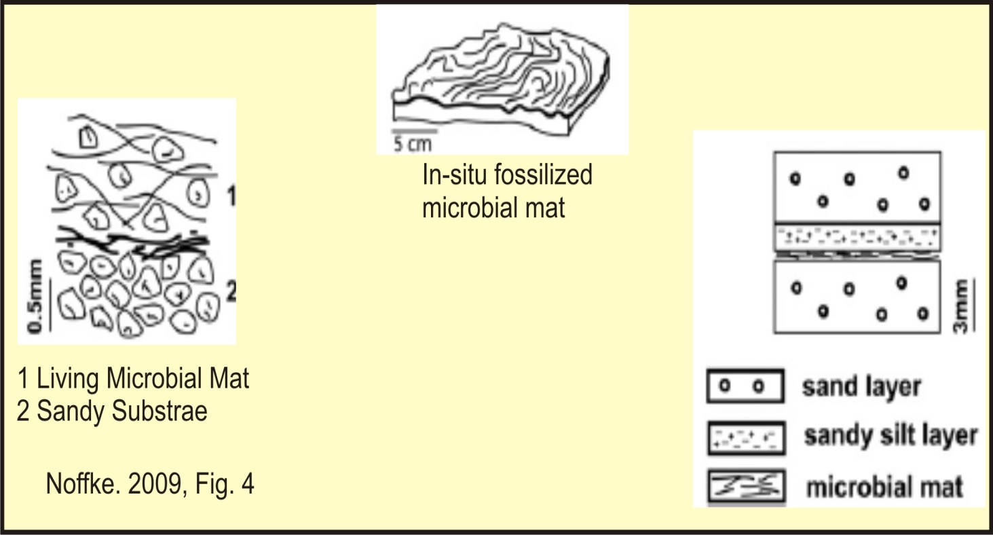
Wrinkled Sandstone: Missourian Wann Formation, Lake Keystone, Oklahoma
R.W. Scott & W. Cornell, Geosciences Department, University of Tulsa
A., B. Two views of top Wrinkled Sandstone Bed. C. Base of same bed
Max mean grain size 58.8 μm
Graphic log of Wann Fm.,
east end of Lake Keystone: criteria 1 & 2
MICROBIALLY INDUCED SEDIMENTARY STRUCTURES (MISS):
benthic prokaryotes encrusting sand laminae
Recognition Criteria (Nofke 2009)
1. No deeper burial than low grade metamorphism
2. In transgressive-regressive environments
3. “Microbial mat facies”: fine grained quartz sand
4. Reflects average hydraulic energy: Tidal, lagoon, shallow shelf environments
5. Geometry & dimensions similar to modern mats
6. Microtextures: wavy crinkled laminae with iron-hydroxide filaments or tufts
Max mean grain size 58.8 μm
G. H., Cross sections showing flute casts and
current bedding: criteria 3 & 4
Closeups of sandstone facies at Windy Crest Sailing Club.
A. Sandstone lens in upper part of Wann Fm. Sequence II at Windy Crest.
B. Base of sandstone lens. C. Burrowed sandstone beds underlying lens with brachiopod circled. D. Sandstone facies succession below convex lens.
E. Rippled top of lens with trace fossils. F. Top of lens G. Top of lens with deformed ripples.
Thin sections of wrinkle & flute: criteria 5 & 6
A
Mature Provenance Mineralogy By XRD
I. Bed top: Nerinites & Chondrites
B
C
Discontinuous Wrinkle sets: Wann Fm.
Modern intertidal mat;
Porada &Bouougri, 2007
SELECTED REFERENCES
Hagadorn, J.W., and Bottjer, D.J., 1999, Wrinkle structures: Microbially mediated sedimentary structures common in subtidal siliciclastic settings at the Proterozoic-Phanerozoic transition: v. 25, 11, p. 1047-1050.
LaFlamme, M., Schiffbauer, J.D., Narbonne, G.M., and Briggs, D.E.G., 2011, Microbial biofilms and the preservation of the Ediacara biota: Lethaia, v. 44, p. 203-213.
Mángano, M.G., Buatois, L.A., West, R.R., Maples, C.G., 2002, Ichnology of a Pennsylvanian equatorial tidal flat—The Stull Shale Member at Waverly, Eastern Kansas: Kansas Geological Survey Bulletin 245, 133 p.
Noffke, N., 1998, Multidirected ripple marks arising from bacterial stabilization counteracting physical rework in modern sandy deposits (Mellum Island, southern North Sea). Geology, 26, 10, 879-882
Noffke, N., 2009, "The criteria for the biogenicity of microbially induced sedimentary structures (MISS) in Archean and younger, sandy deposits". Earth-Science Reviews 96 (3): 173–180.
Noffke, N. 2010, Microbial Mats in Sandy Deposits from the Archean Era to Today: Springer Verlag, Heidelberg, 193 p.
Noffke, N., Beukes, N., Gutzmer, J., and Hazen, R., 2006, Spatial and temporal distribution of microbially induced sedimentary structures: A case study from siliciclastic storm deposits of the 2.9 Ga Witwatersrand Supergroup, South Africa: Precambrian Research, v. 146, p. 35-44.
Porada, H. and Bouougri, E., 2007, Wrinkle structures — a critical review: Earth Science Reviews 81:199-215.
East shore Lake Keystone; Wann Fm.; wrinkled SS directly below bed I.
B. East end Lake Keystone at US 412 bridge; arrow points to site of wrinkled sandstone bed.
C. Position of wrinkled sandstone bed.
Enid Geologic Map HA-7 USGS
Bingham & Bergman 1980;
Ok. Geol. Survey
Formation of MISS
Mat traps, baffles, binds fine clear quartz sand, minimal reworking, buried by sediment layer
Mechanisms forming MISS (Nofke, 2009, Fig. 3)

