Slide 1


Influence of late diagenetic fluids on Mississippian carbonate rock properties in the Southern Midcontinent
Sahar Mohammadi Dehcheshmehi
Doctoral Student in Geology
Jay M. Gregg
Oklahoma State University
Kevin L. Shelton
and
Martin Appold
University of Missouri

Slide 2
Outline
Introduction
Study Area
Methods
Result

Slide 3
Introduction
Problem:
The Mississippian carbonate resource play on the southern Midcontinent has a very complex diagenetic history.
Hypothesis:
Mississippian carbonates of the southern Midcontinent were significantly affected by regionally pervasive basinal fluids that affected their reservoir properties.
Impact
This study also increases understanding of the evolution of petroleum reservoirs in the Mississippian section of the southern Midcontinent.

Slide 4
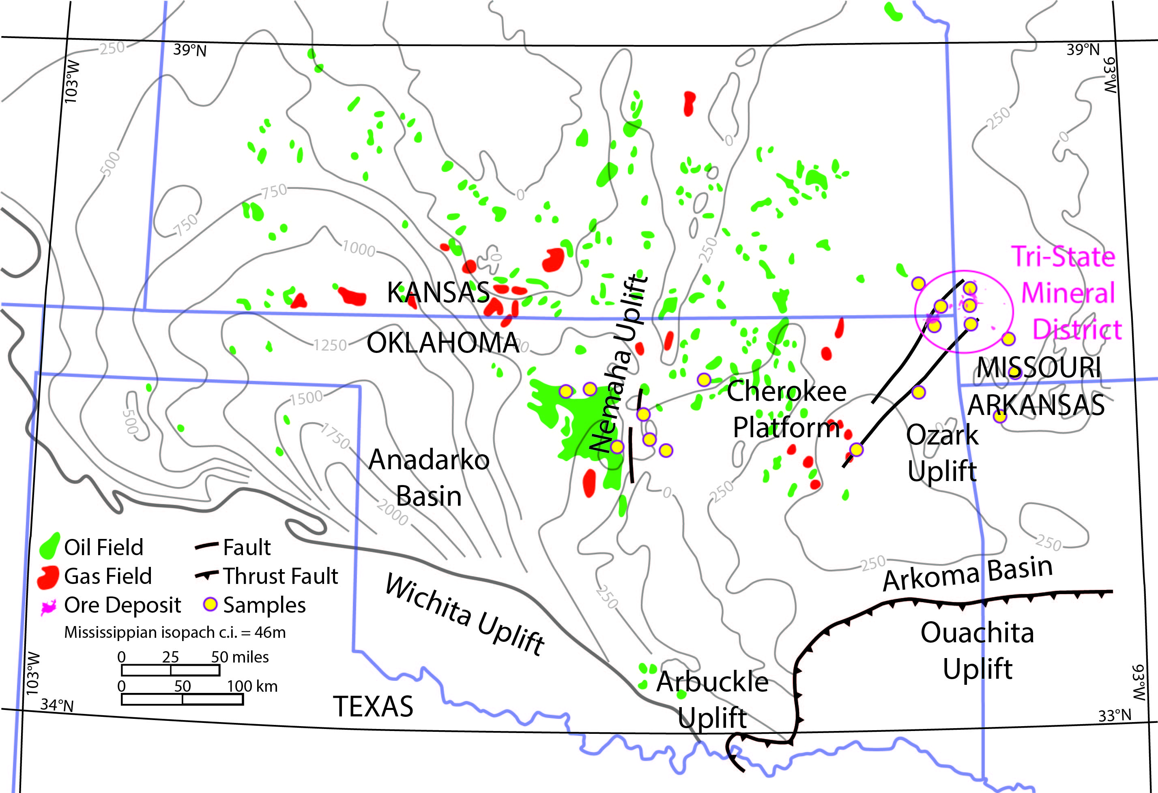
Study Area

Slide 5
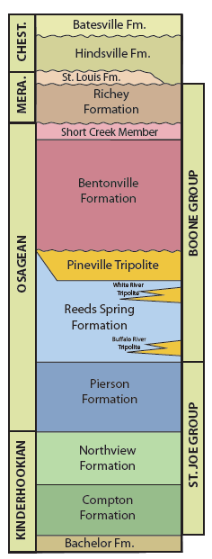
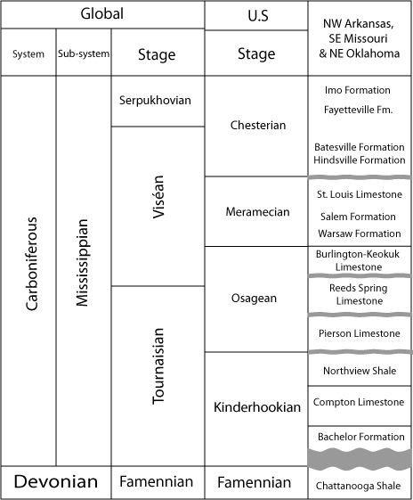
Modified from Thompson, 1986
Modified from Mazzullo et al., 2013

Slide 6
Methods
Petrography and cathodoluminescence (CL):
Olympus-BX51 microscopes and a CITL mk5 cold cathode CL system
Stable carbon and oxygen isotope ratios:
Delta Plus XL isotope ratio mass spectrometer
Fluid inclusion microthermometric analysis:
Linkam THMSG 600 heating and cooling stage mounted on an Olympus BX41 microscope

Slide 7
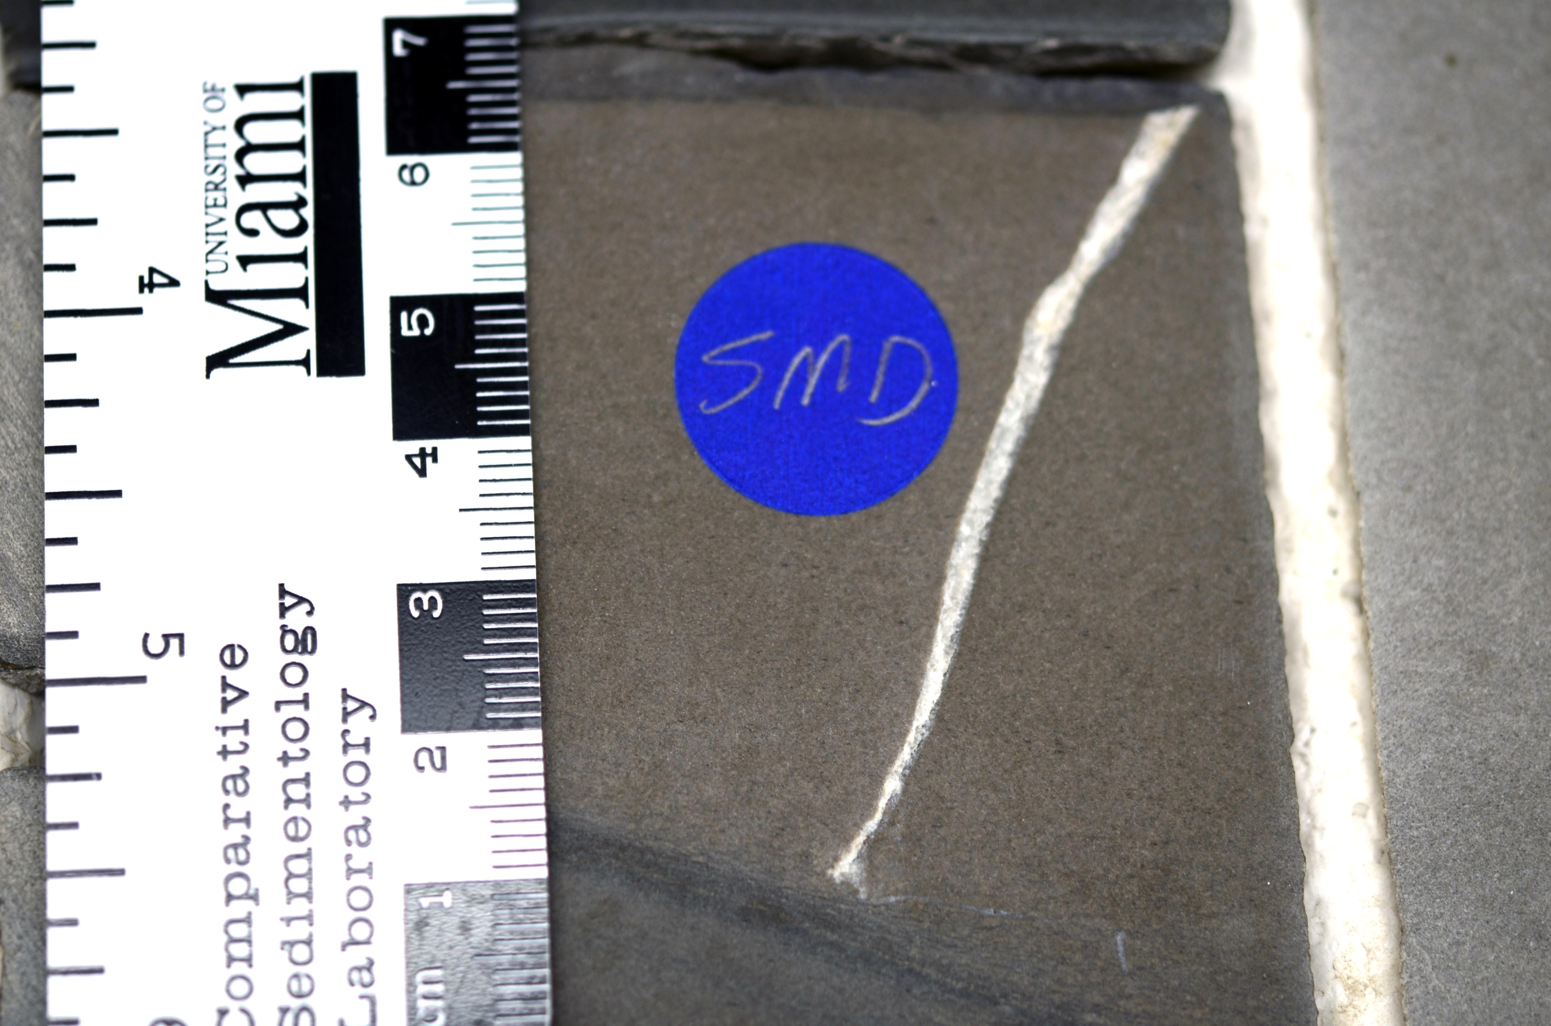
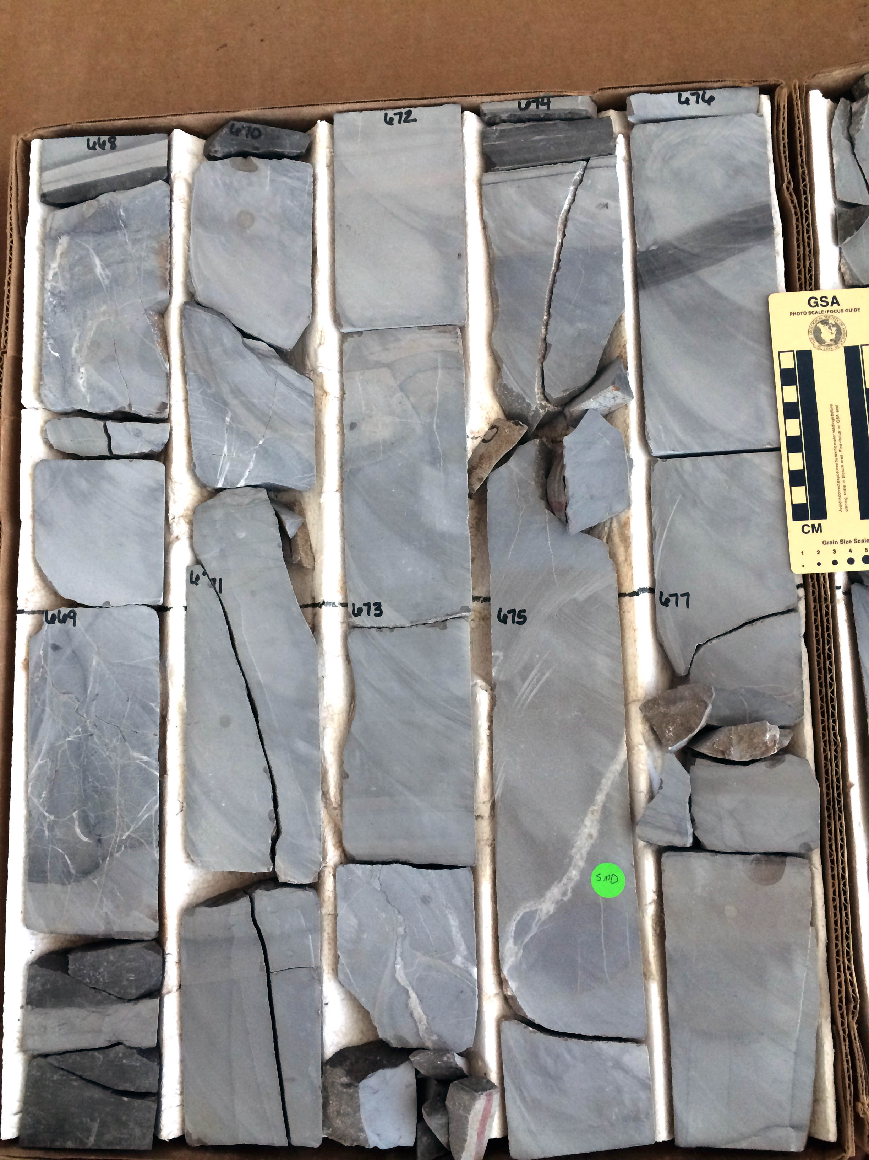
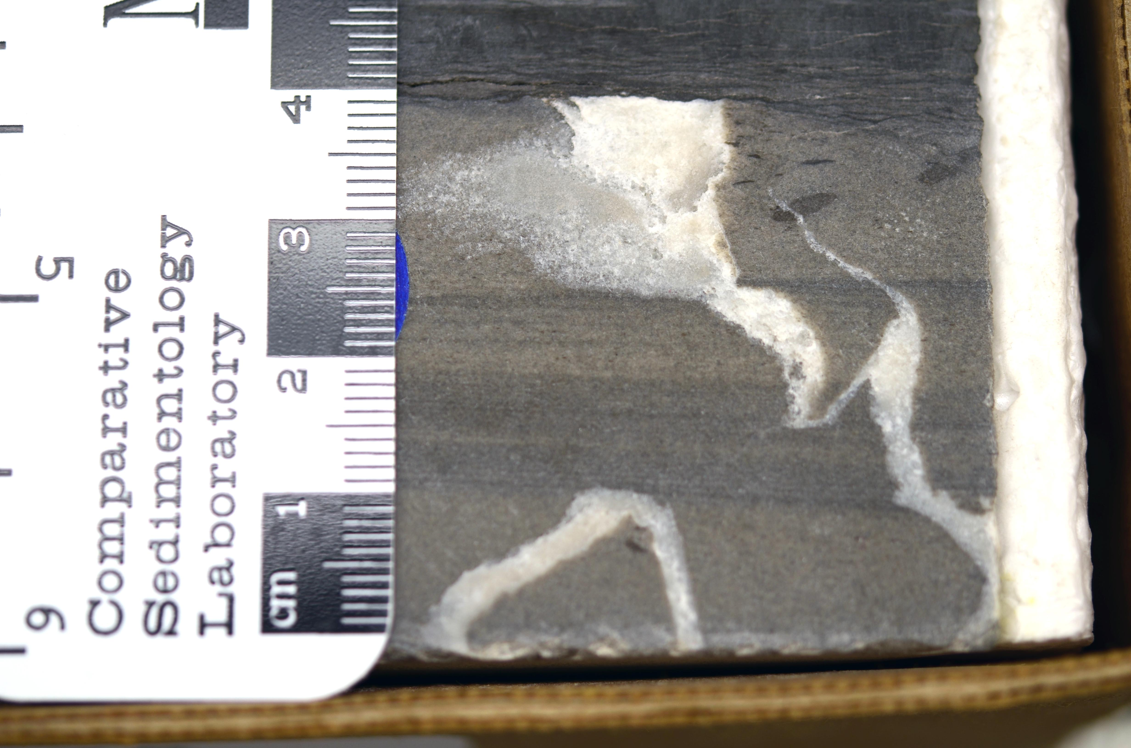
Wagoner, OK
Payne Co, OK

Slide 8
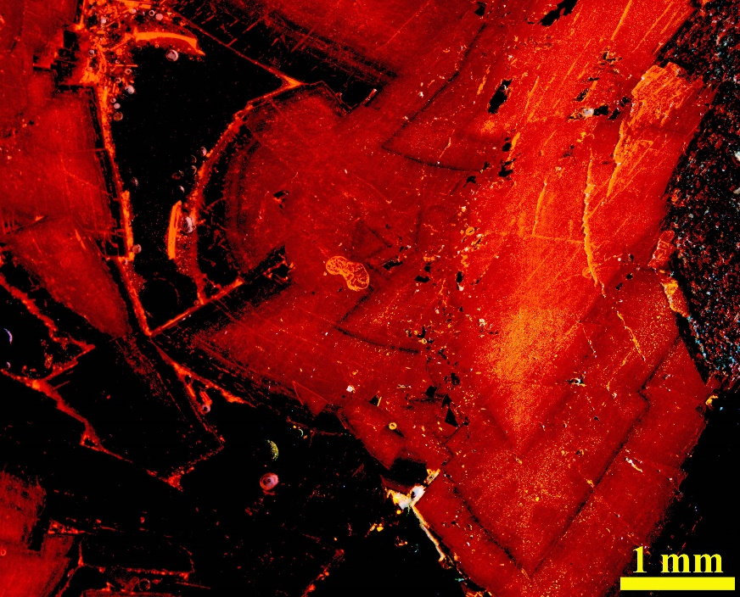
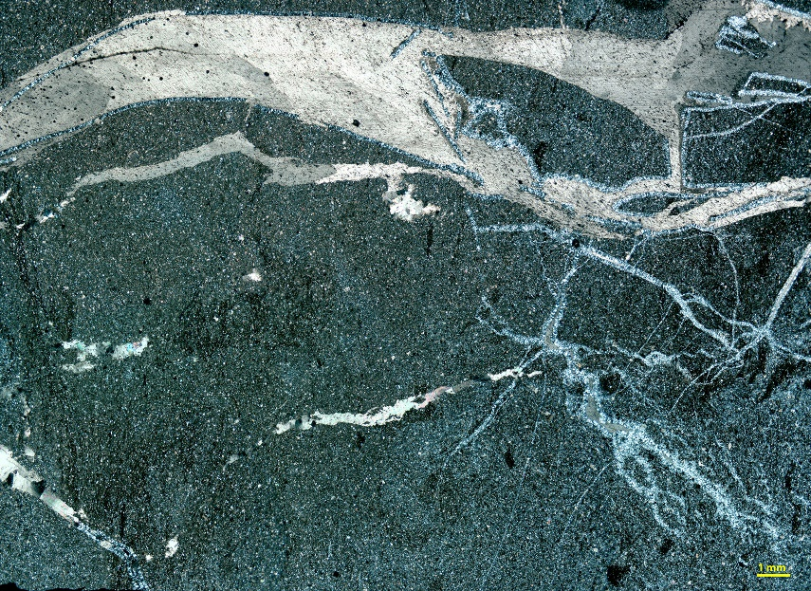
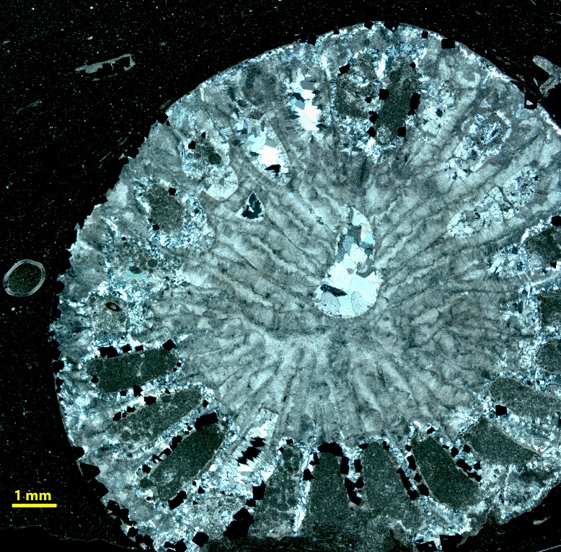
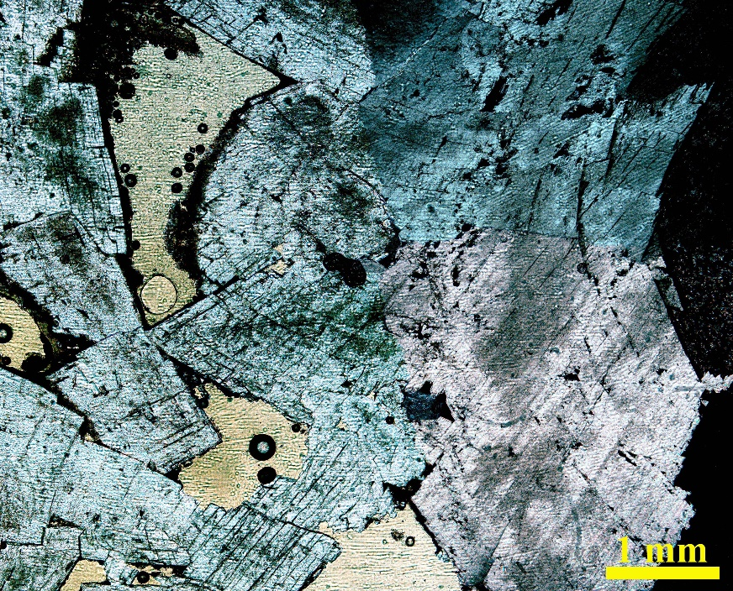
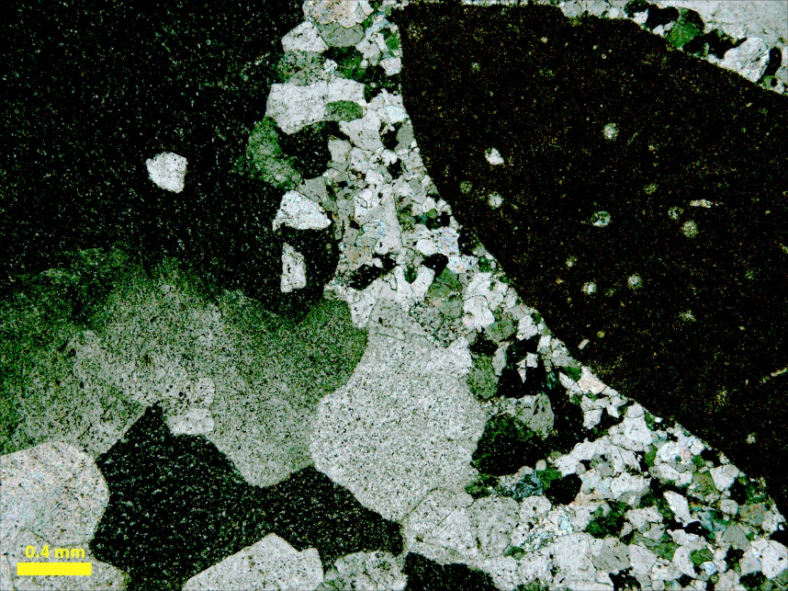
Petrography:
2 mm
North-central, Osage County, OK
1 mm
North-central, Osage County, OK
0.4 mm
Tri-State , Picher Field, OK
Pryor, Oklahoma

Slide 9
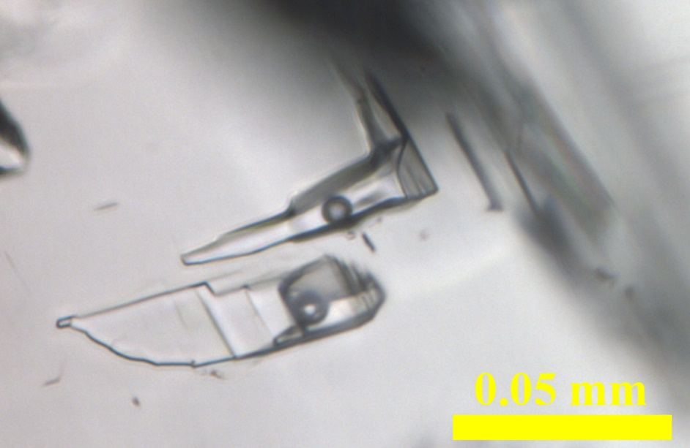
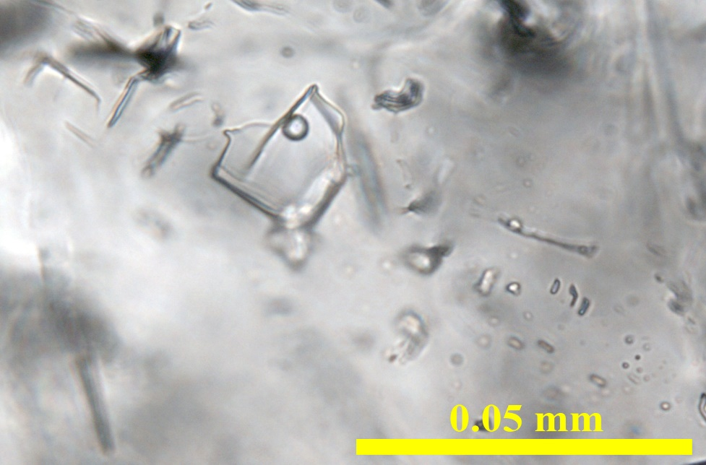
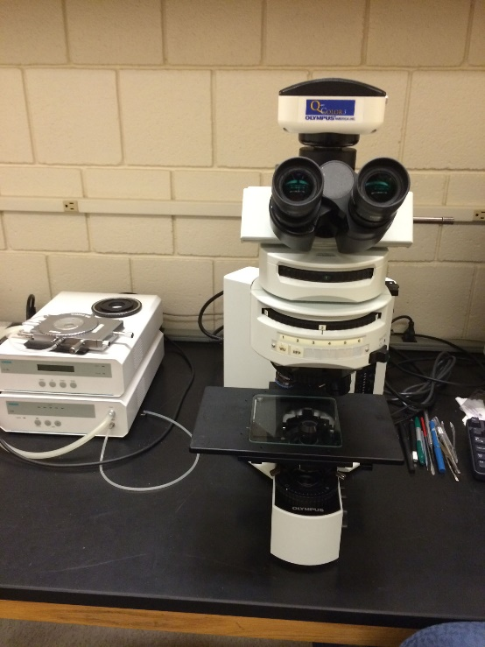
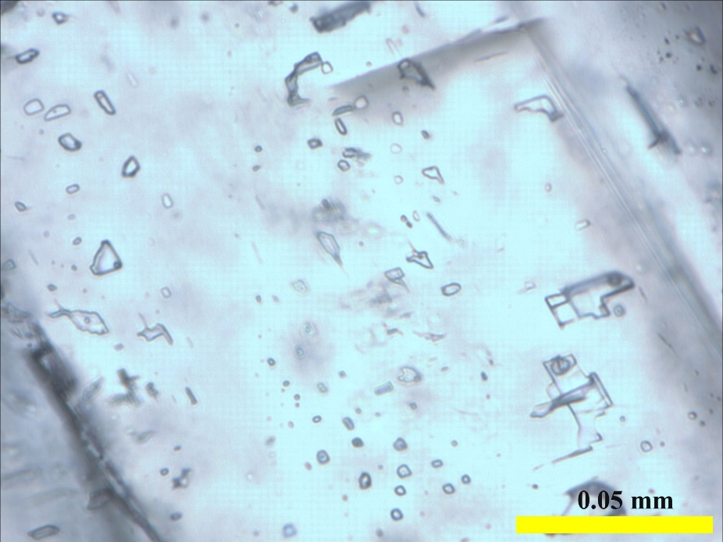
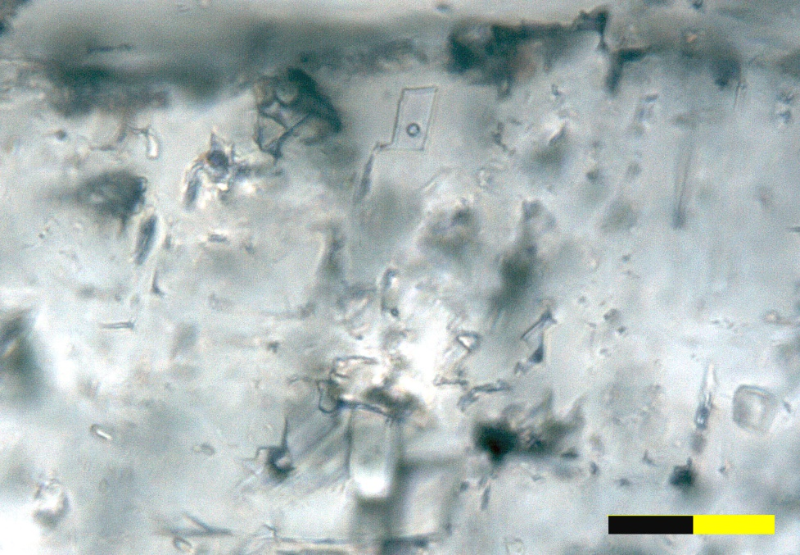
Primary
Fluid Inclusions:
Primary
Calcite cement, Neck City, Missouri
Calcite cement, Pryor, Oklahoma
Secondary
Primary
0.05 mm
0.05 mm
Calcite cement, Pryor, Oklahoma
Dolomite cement, Pryor, Oklahoma

Slide 10
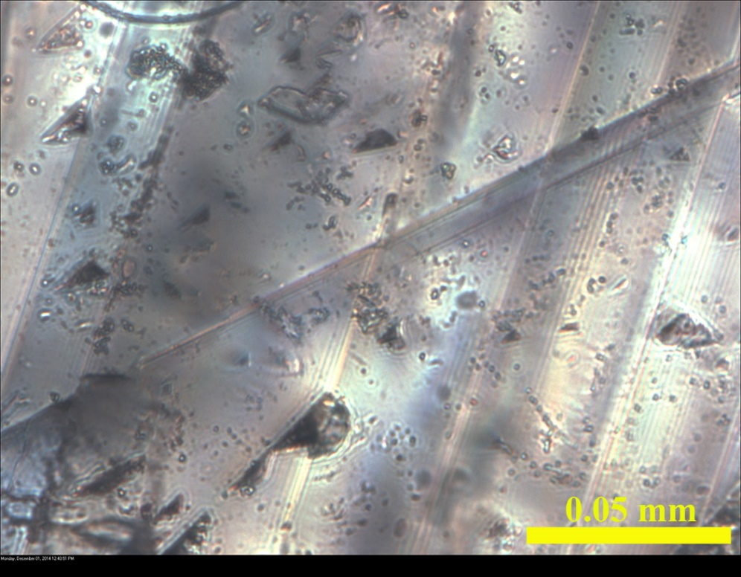
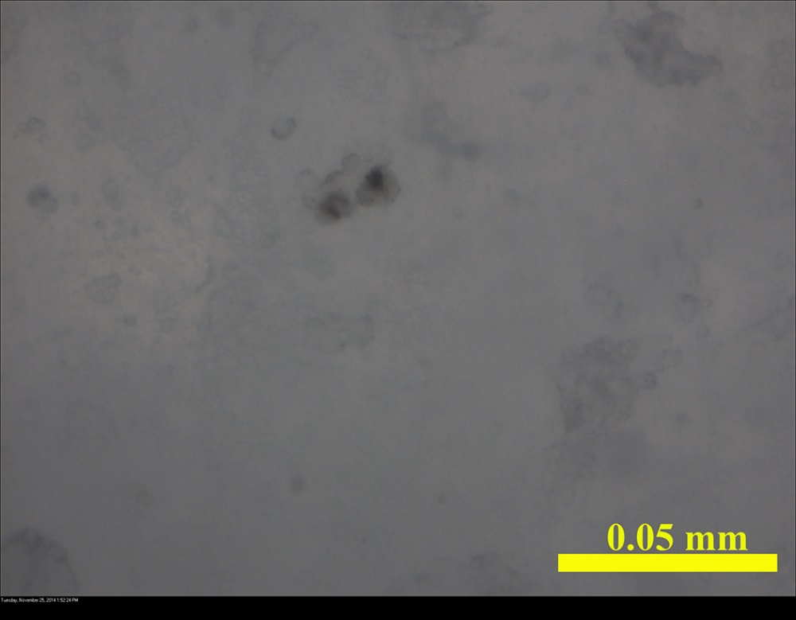
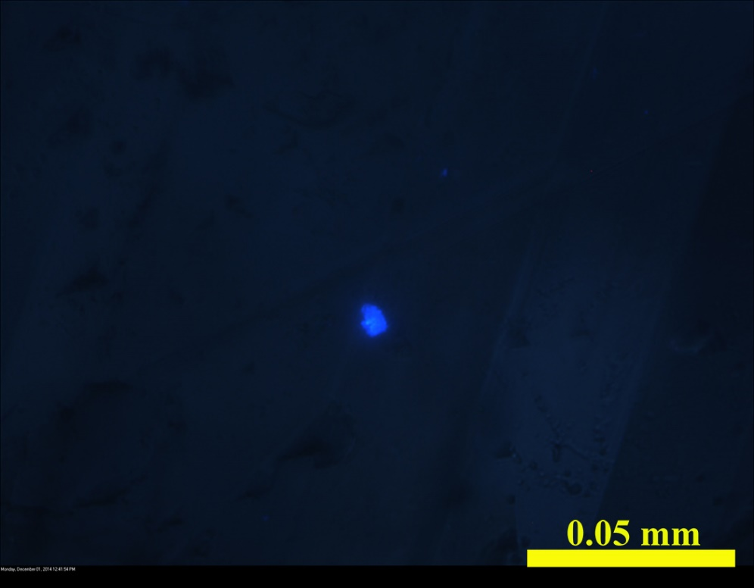
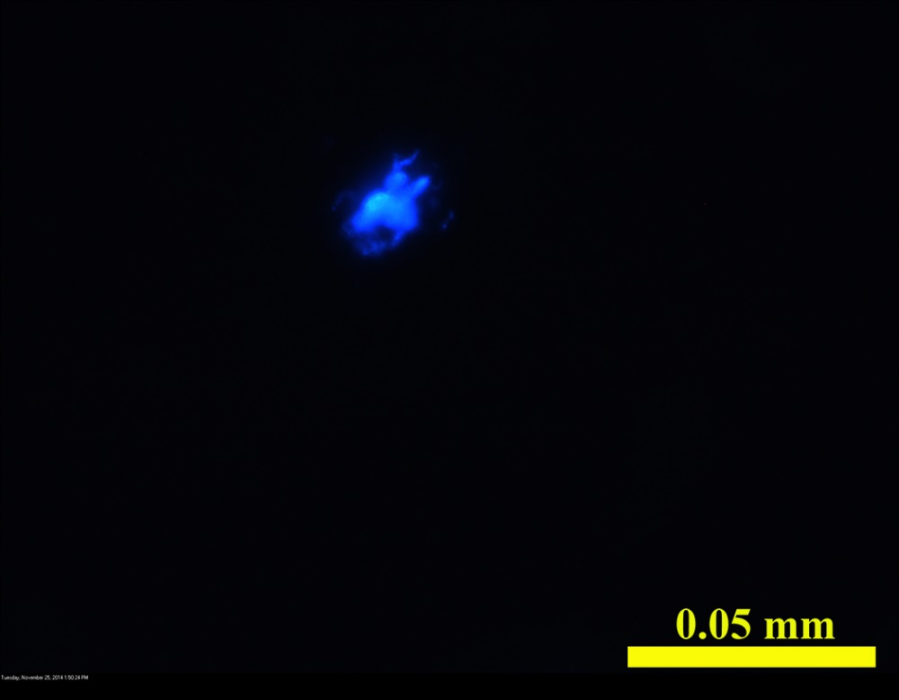
Wagoner, OK, Calcite
Tri-State Picher Field, Dolomite

Slide 11
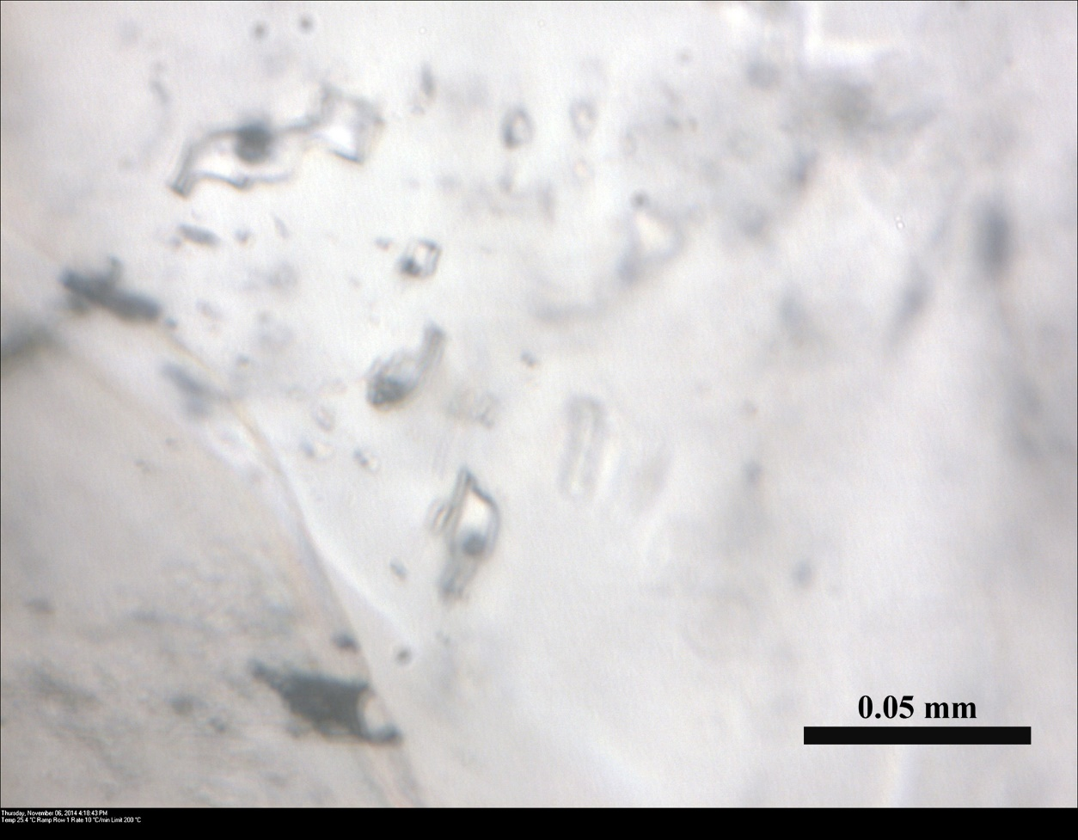
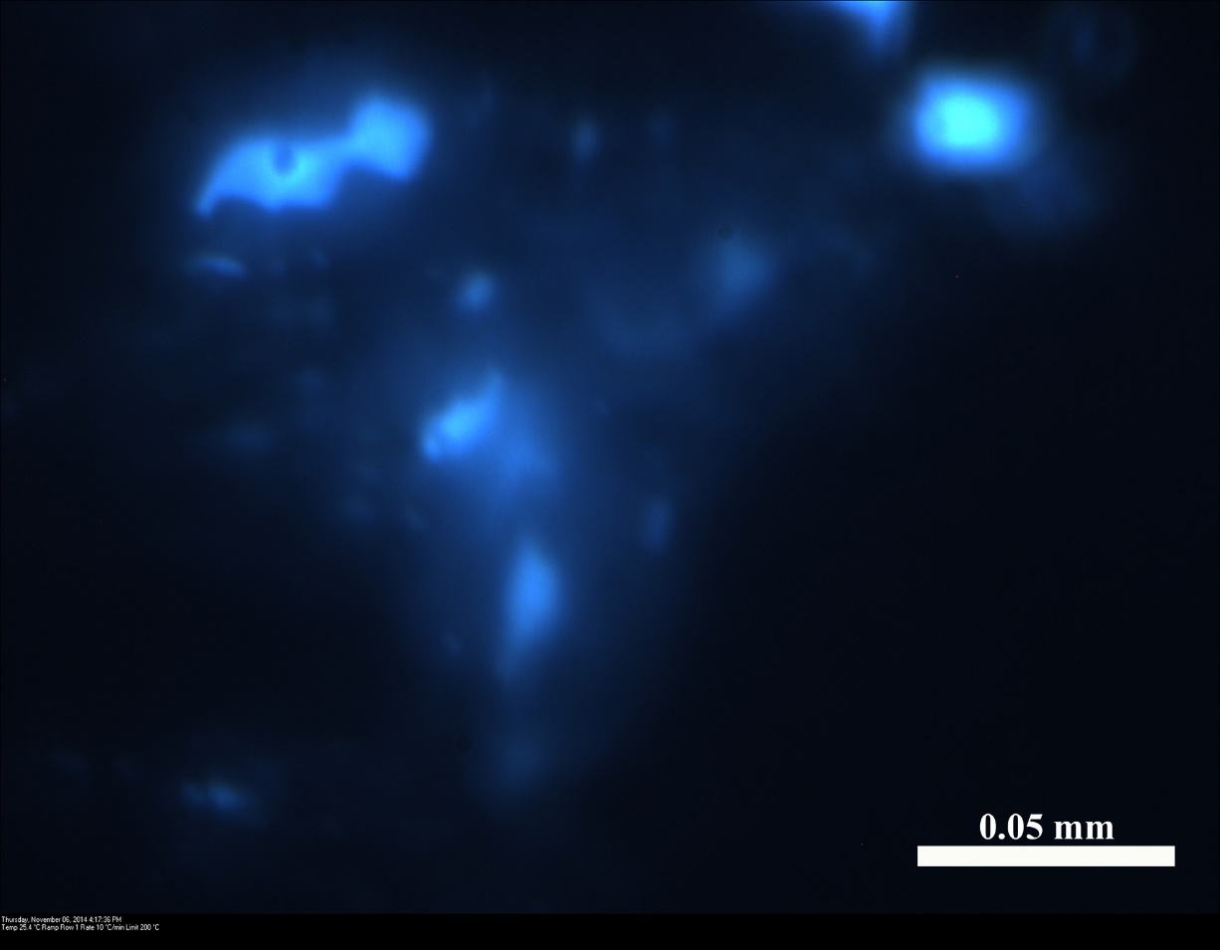
Inclusions with low-density petroleum
Plane polarized light
Wagoner, OK, Calcite
Fluorescent light

Slide 12
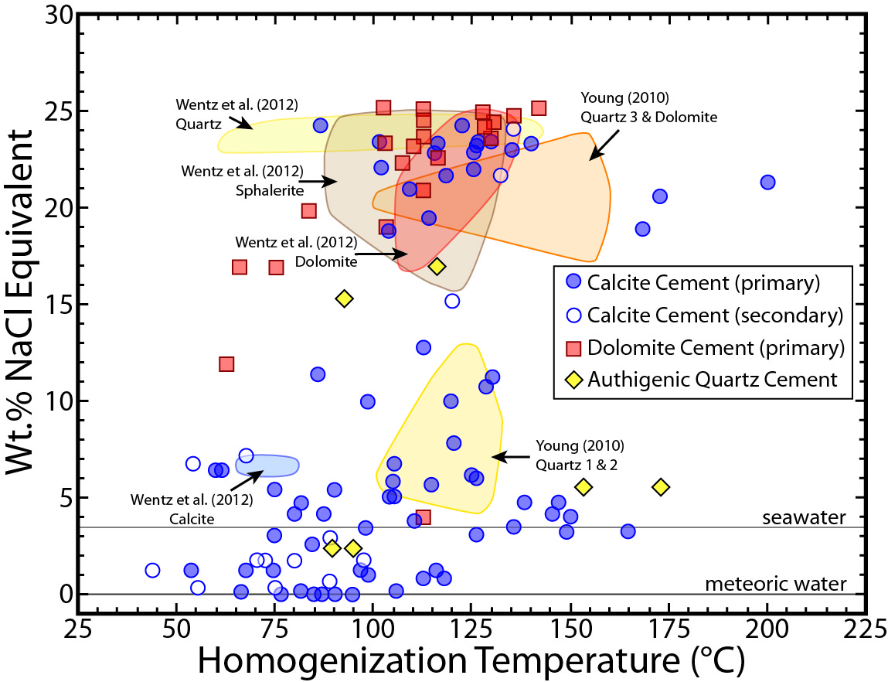
Fluid inclusion data

Slide 13
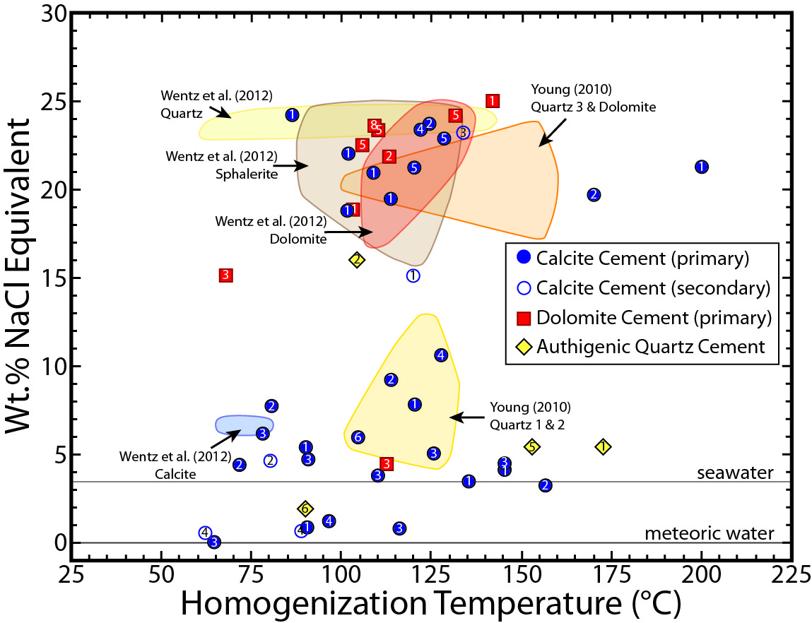
Fluid inclusion data

Slide 14
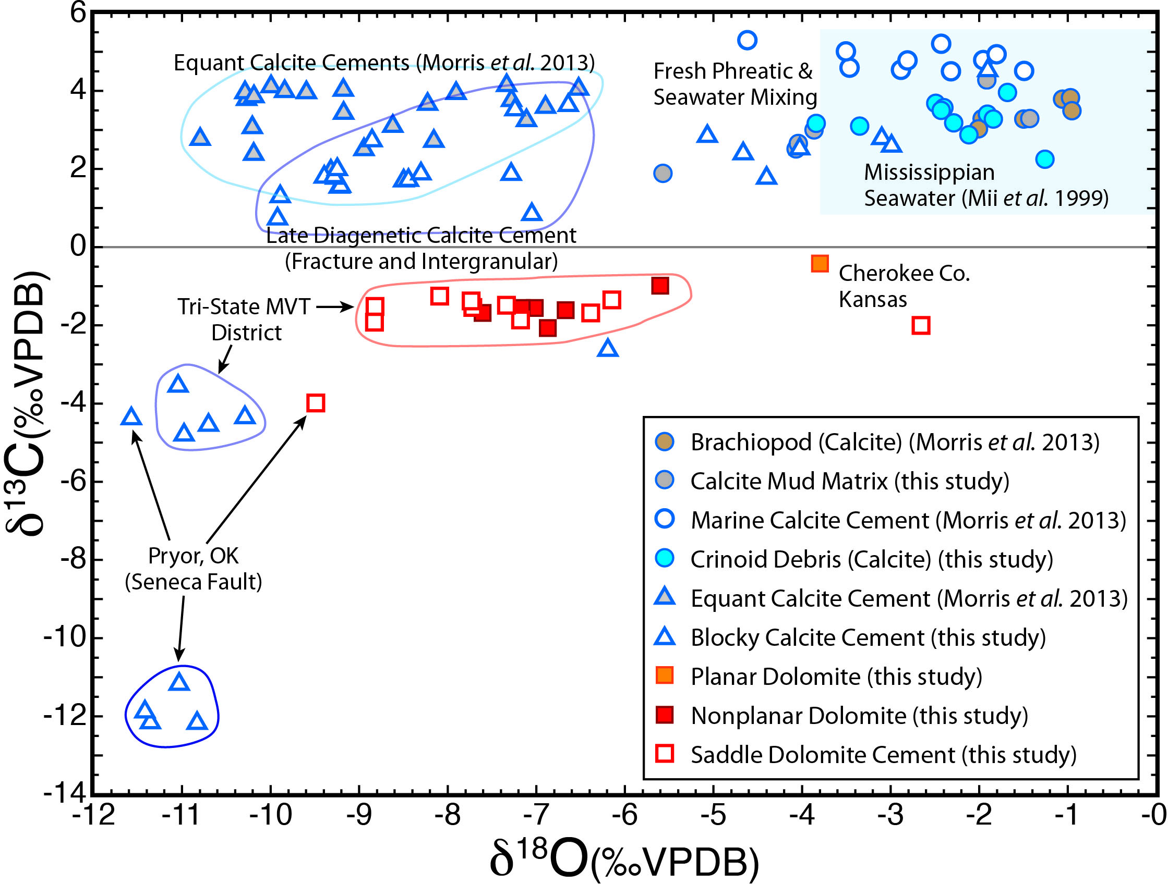
Mixed Meteoric
& Seawater
Basinal water
C & O isotope data
Seawater
Petroleum
cracking

Slide 15
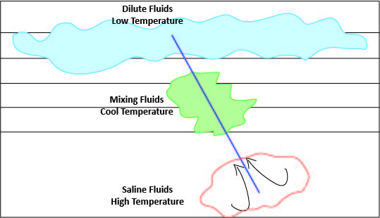
Conceptual model

Slide 16
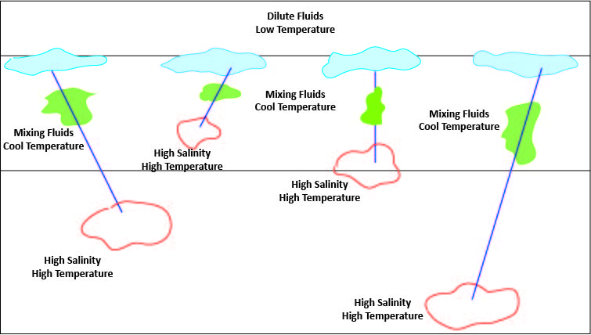
Realistic model

Slide 17
Study Area

Slide 18
Calculated δ¹⁸O_{water} values
δ¹⁸O_{water} values were calculated to determine if the cement depositing waters are in isotopic equilibrium with host rock carbonate or instead, reflect non-resident fluids that retain their source-derived oxygen isotope compositions, or if they represent both.
The results show that cement-depositing waters approached equilibrium with the host rock in Osage, OK#1, and reached equilibrium with the host rock in Osage, OK#2, Arkansas, Wagoner#1 and 2, Pryor#1 and 3, Treece, KS, Tri-State Anne Beaver Mine, and Tri-State Picher Field, but did not approach equilibrium or have a large ranges in Neck City and Pryor#2, but retained their previous source-derived isotope signature.

Slide 19
Results
Extensive carbonate cementation filling intra- and inter-grain porosity, vugs, and fractures began during early diagenesis and continued after burial and into the period of petroleum migration.
Much of the cement is late diagenetic, not early diagenetic. This means that the Mississippian carbonates retained much of their porosity until late in their diagenetic history.
Calcite and (saddle) dolomite cements were observed to contain two phase (liquid and vapor) fluid inclusions with homogenization temperatures ranging from 50° to 175°C and salinities ranging from 0 to 25 equivalent wt % NaCl.
Fluid inclusions for calcite and dolomite cements represent both dilute and saline basinal waters.
Carbon and oxygen isotope values for water, calculated from data obtained from calcite cements, are consistent with three of diagenetic waters: a) Meteoric water, b) seawater modified by meteoric water, c) basinal water.

Slide 20
Continued research
Strontium isotope analysis to better determine the source of the fluids.
Similar studies will be conducted on samples from the Nemaha ridge area in central Oklahoma and compare them with Tri-State area.

Slide 21
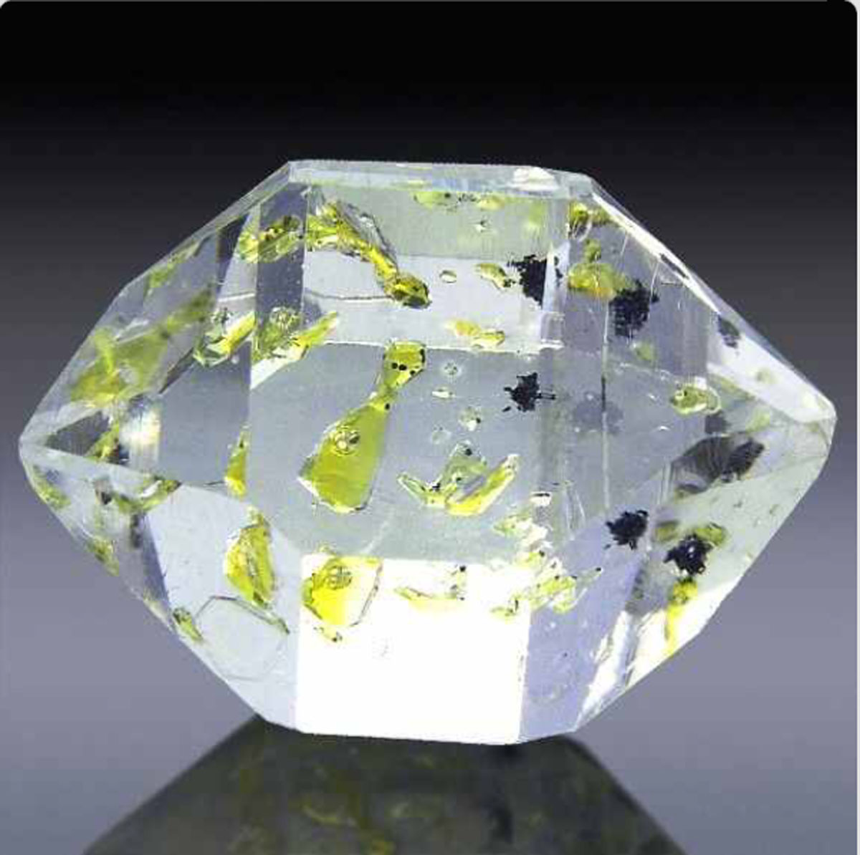

Thank you for your attention

