Slide 1
THOUGHTS ON THE RELATIONSHIP OF STRUCTURES OF THE NORTHERN MARGIN OF THE GULF OF MEXICO BASIN TO EARLY RIFTING OF THE BASIN
Gary L. Kinsland, Geology Department, School of Geosciences, University of Louisiana at Lafayette

Slide 2
Raphael Gottardi and I originally proposed a special session at this meeting to deal with structural questions related to the Northern Gulf of Mexico Basin (NGMB). Our purpose was to get those people who do research in, have hypotheses about or who simply think about the structural evolution of the NGMB together to discuss the topic and to enhance continued communication amongst the group. The session did not “make”; however, our goal is still the same.
In this presentation I will throw out some ideas and I invite comments…now, right after the talk, over beer/wine/dinner or on into the future.
Below is a hierarchy of geology think. I invite you to consider the value of each of these levels. I realize my ideas are near the bottom of this scale…that’s I why I invite the input of others.
GEOFACT (if such exists in science)
GEOPARADIGM
GEOTHEORY
GEOHYPOTHESIS
GEOIDEA
GEOPHANTASY (as in geophysics)
GEOBULLS__T

Slide 3
THE ABSTRACT HIGHLIGHTED AS PRESENTATION PLAN
Lineaments and structures indicate that the basement of the North American Continent east of the Rocky Mountains is fundamentally fractured in orthogonal directions, NW and NE. This set of weaknesses has controlled structures developed during break-ups and collisions since at least the Neoproterozoic Iapetian rifting of Laurentia. Major portions of the northeastern and northwestern margins of the Gulf of Mexico basin (GOMB) are bounded by rifts and transforms from this rifting event. Subsequent Paleozoic Appalachian-Ouachita collision occurred against this Precambrian margin resulting in collapse or overriding of promontories and filling of embayments, including the Ouachita embayment within which the GOMB formed. The NW – NE pervasive fractures also exist within the Ouachita embayment filling basement and controlled Mesozoic rifting of the GOMB. Some structures of the northern margin of the GOMB; e.g., LaSalle Arch, Angelina-Caldwell Flexure and southern portion of the North Louisiana Salt Basin; appear, by their orientations, to have been influenced by these fractures. Others; e.g., Sabine Uplift, Monroe Uplift and the Arkansas-Louisiana portion of the North Louisiana Salt Basin; appear not to be so directly related to these fractures.
Interpretations of maps of gravity, crustal thickness and heat flow and cross-sections of the northern GOMB lead to the hypothesis that the initial opening of the GOMB was by broad extension (from the NW to the SE) similar to the broad extension which in western North America resulted in Metamorphic Core Complexes. However, subsequent deposition has prevented exposure of the GOMB complexes resulting in “Incipient Metamorphic Core Complexes (IMCC),” e.g. Sabine and Monroe Uplifts. These IMCCs have a long history of rising and probably are continuing to rise today.

Slide 4
These are photo lineaments/lineations which
Fisk found when creating the report for the
development of the Mississippi River control
system. Similar NW – NE patterns have been
found over most of the lower 48 states. Many
studies have related these surface features to
basement fractures and faults. One example
is below from Kinsland et al. (2003) in which
a subset of the Fisk lineations is shown above
and superimposed upon magnetic data from
western central Louisiana. The magnetic data
correspond to basement topographic horsts
and grabens separated by basement faults
whose influence is presently indicated at the
surface as the mapped lineations. These
pervasive weaknesses control development of
crustal structural features.

Slide 5
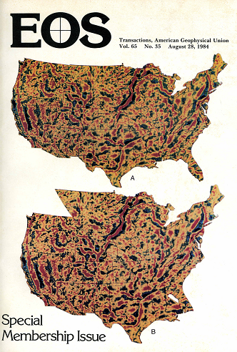
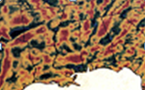
Kinsland (1984)
This curve is a small circle centered at Jason Morgan’s pole of rotation for the central Atlantic. It is therefore part of the set which determined the reentrants and promontories of the East Coast Passive Margin. Note that there is no evidence in these filtered gravity data for a similar match along a curve from Florida to southern Oklahoma.

Slide 6
Note extinct ridges, fracture zones, oceanic crust and continental ocean boundaries (COB)
New global marine gravity model from CryoSat-2 and Jason-1 reveals buried tectonic structure
Sandwell et al. Science 2014 346 (6205), p. 65

Slide 7
PP
Mickus et al. (2009) Potential field evidence for a volcanic rifted margin along the Texas Gulf Coast
BLACK LINE IS THEIR PROFILE…NOT MINE

Slide 8
From: Preliminary Precambrian Basement Structure Map of Continental United States – An interpretation of geologic and aeromagnetic data P.K. Sims, R.W. Saltus and E.D. Anderson, 2005

Slide 9
My fault interpretations
TREND OF “FIVE ISLANDS SALT DOMES”
From: Preliminary Precambrian Basement Structure Map of Continental United States – An interpretation of geologic and aeromagnetic data P.K. Sims, R.W. Saltus and E.D. Anderson, 2005

Slide 10
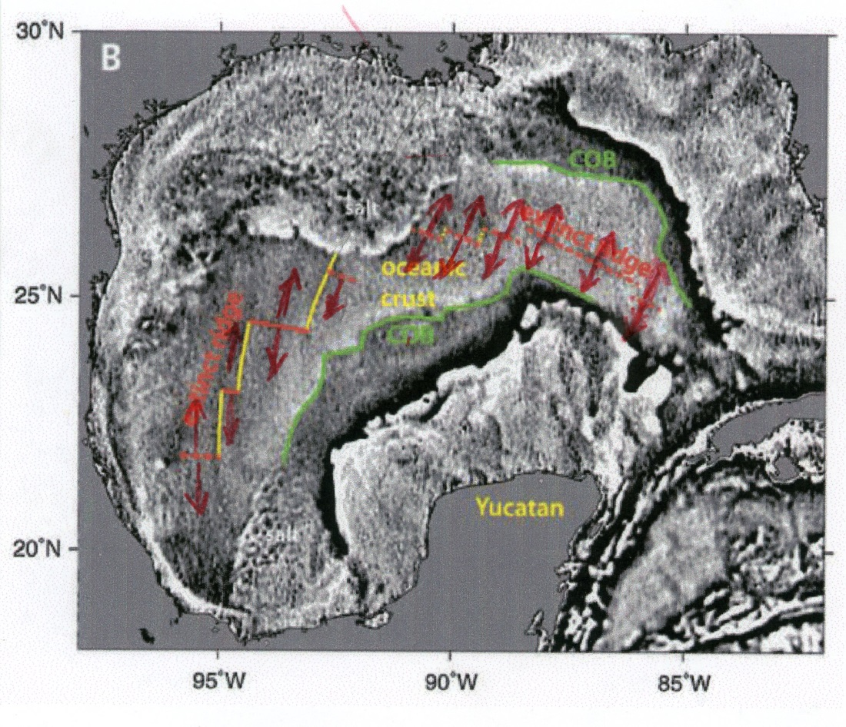
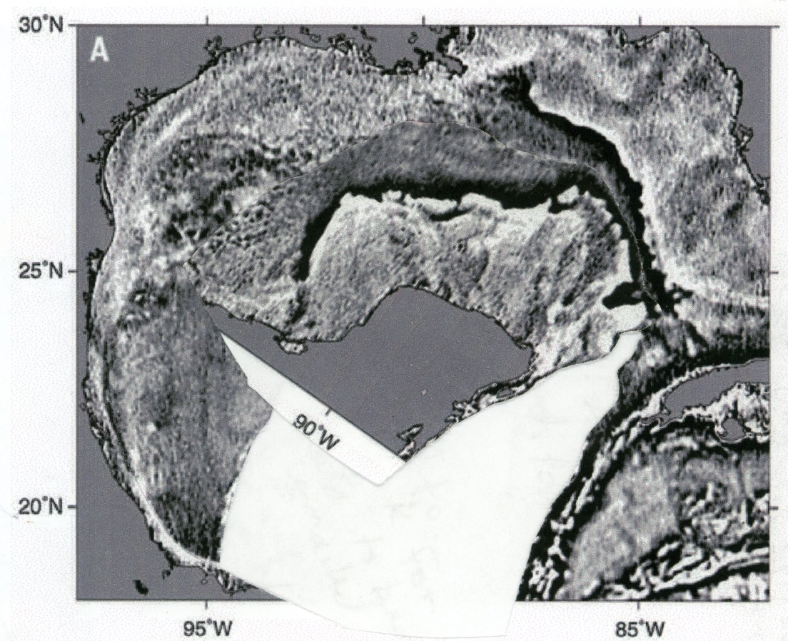
My highlights of spreading directions.
My reconstruction following the spreading directions, lengths and COBs.

Slide 11
Highlighted COB and my faults.

Slide 12
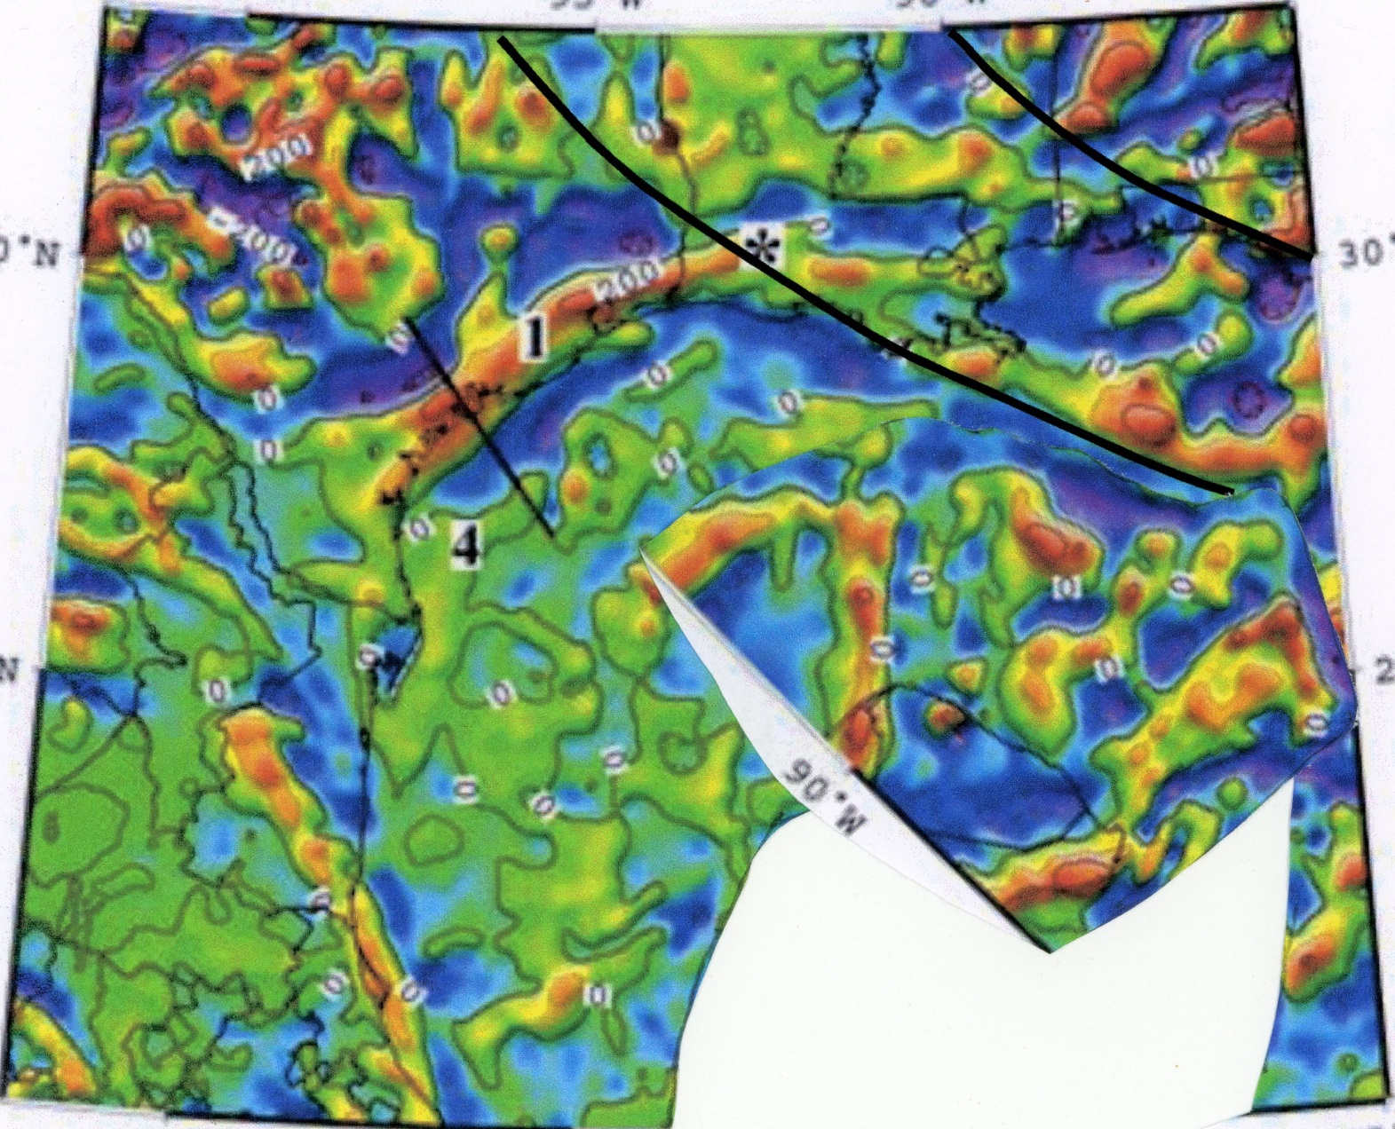
Reconstruction and faults in Mickus et al. (2009) figure.

Slide 14
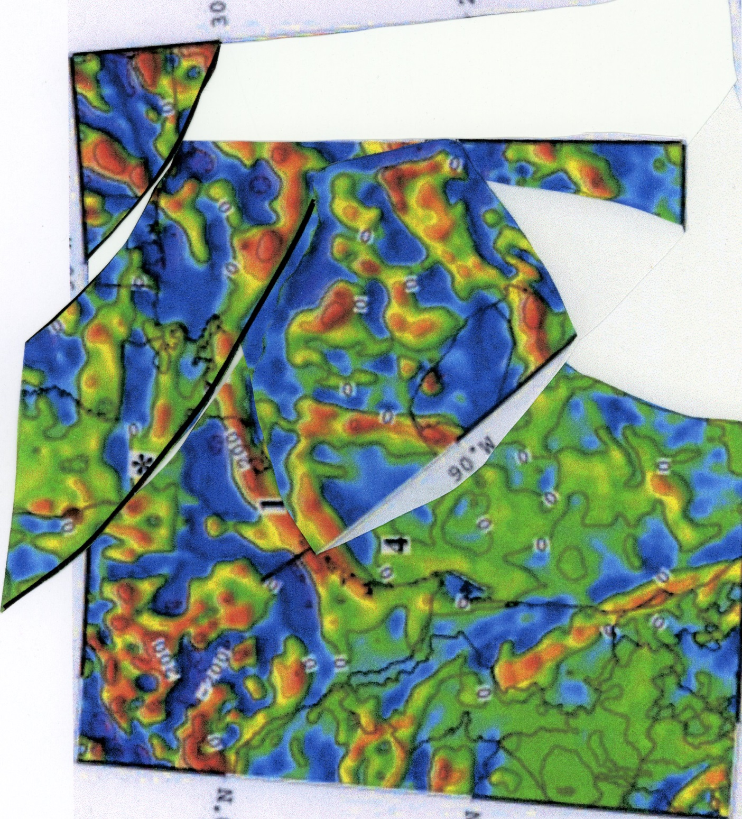
My interpretation of pre-rifting position of Yucatan and Northern GC (NGC) block between the faults. I simply slipped the Yucatan and NGC block together to achieve this fit.

Slide 15
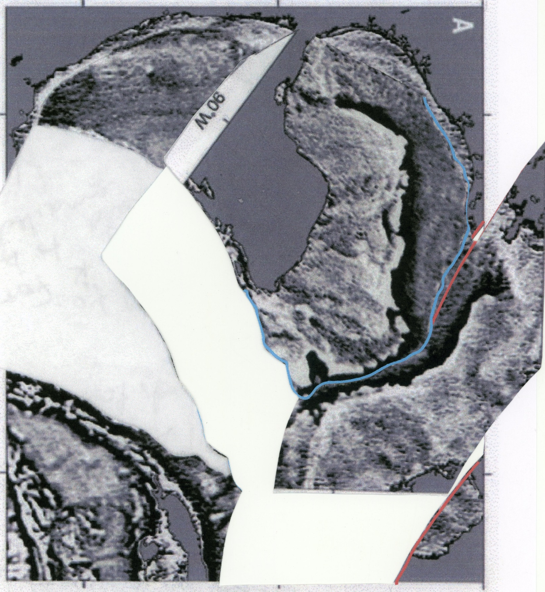
Reconstruction of the GOM gravity data accomplished with the same procedure as was followed for the magnetic data.

Slide 16
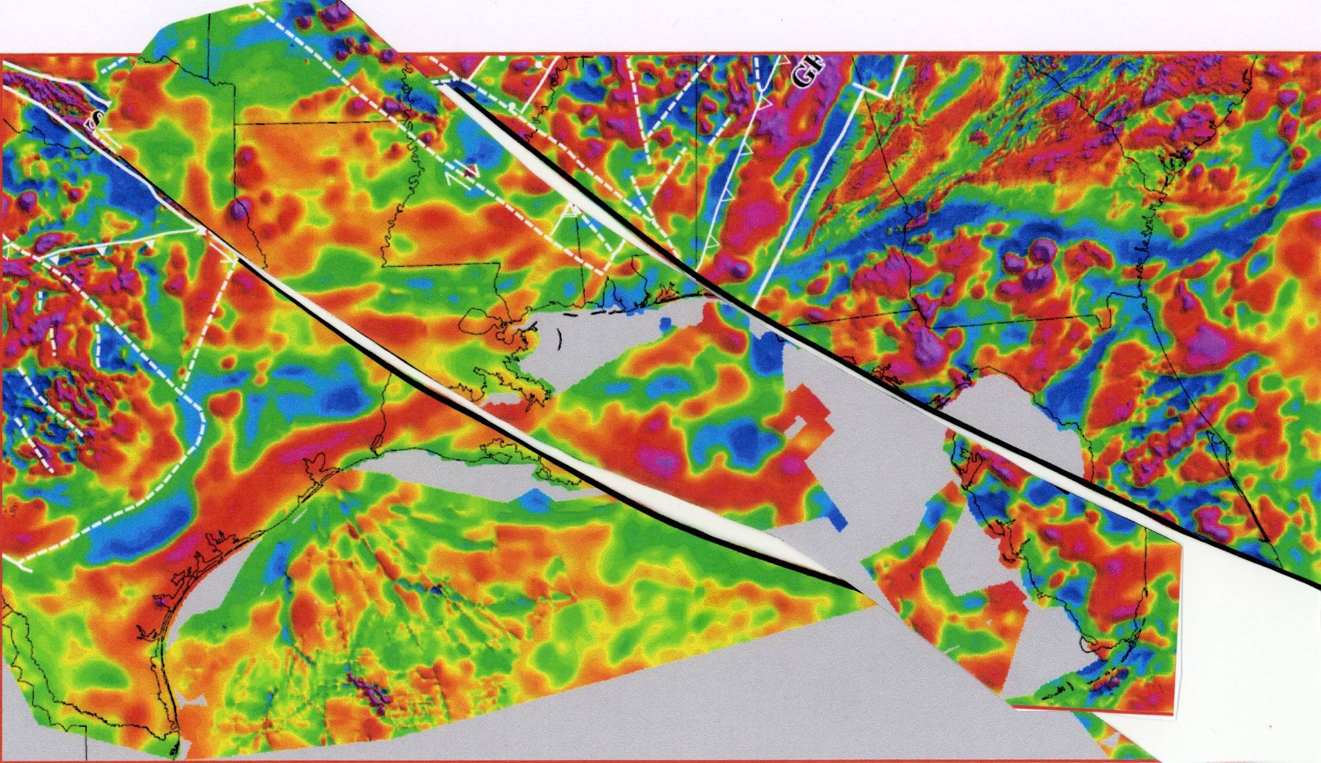
OF COURSE THIS DIDN’T EVER OVERLAP…IT IS JUST THAT THIS PRESENTLY THINNED SLAB IS EXTENDED (longer) IN ITS PRESENT DAY POSITION
YUCATAN IN HERE
No Yucatan data are in this dataset so only the NGC block is reconstructed to its pre-rift position.

Slide 17
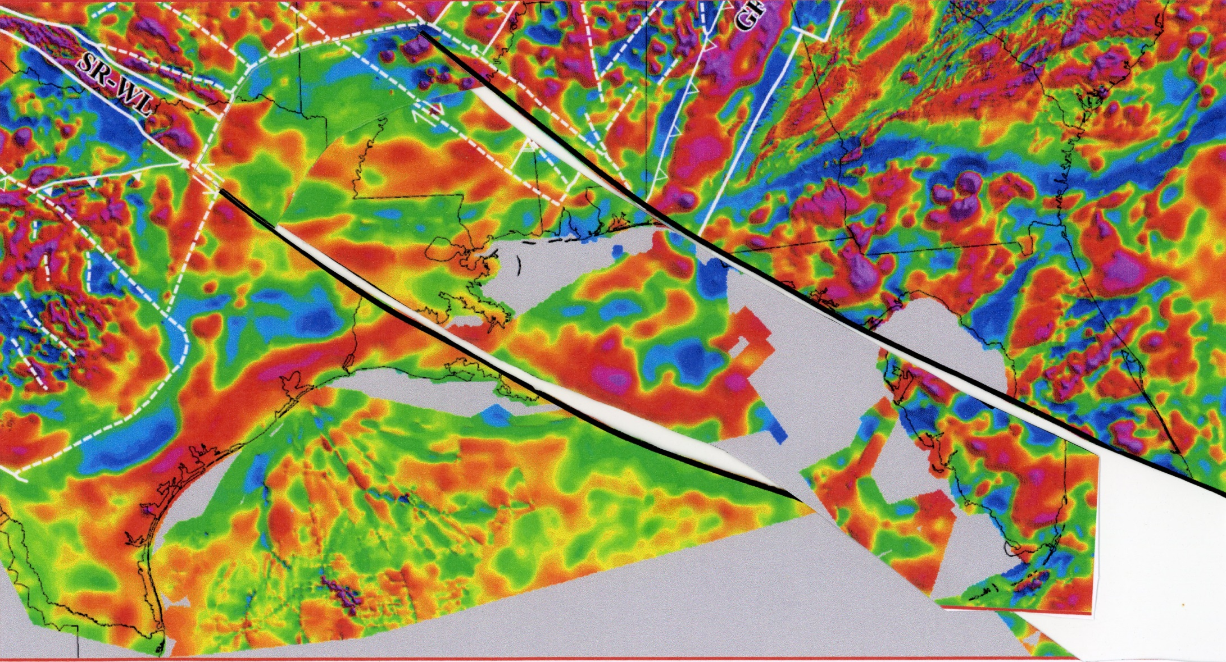
THE UPPER CRUST SOUTHEAST OF THIS LINE DEFORMS BY THIN SLAB FAULTING AND EXTENSION AS IN METAMORPHIC CORE COMPLEX FORMATION. (The “excess length” of the slab in the previous image has been trimmed.)
YUCATAN IN HERE
THESE TWO MOVE TOGETHER TOWARD THE SOUTHEAST
THIS AREA RIFTS

Slide 18
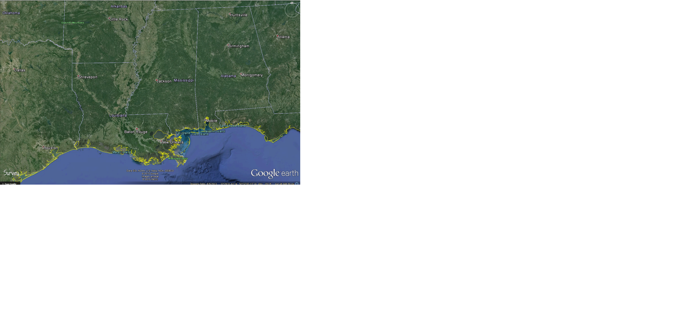
SABINE UPLIFT
NORTH LOUISIANA SALT BASIN
MONROE UPLIFT
ANGELINA – CALDWELL FLEXURE
LASALLE ARCH

Slide 19
NOTE SIMILARITY OF THE NORTHWESTERN AND NORTHEASTERN BOUNDARIES OF THE NORTHERN GULF OF MEXICO BASIN SHOWN HERE AND THOSE I PROPOSED IN THE PREVIOUS IMAGE
Zone of Abrupt Dislocation of Basement
PHOTO OF PART OF AN “OLD” BASEMENT MAP OF NORTH AMERICA

Slide 20
From Davis and Reynolds (1996)

Slide 21
N
S
Triassic – Jurassic extension with subsequent Mesozoic and Cenozoic sediment cover preventing the exposure of the metamorphic core even though there is uplift continuing to today.
From Kinsland (2009)

Slide 22
Note Sabine and Monroe Uplifts as (“thins.”)…”thins“ corrected to “thicks” post presentation…the uplifts are the yellow amongst the orange in northern Louisiana and southeastern Arkansas. Crust thins to south or southeast as thin slab rifting would predict.
Weisen Shen personal communication

Slide 23
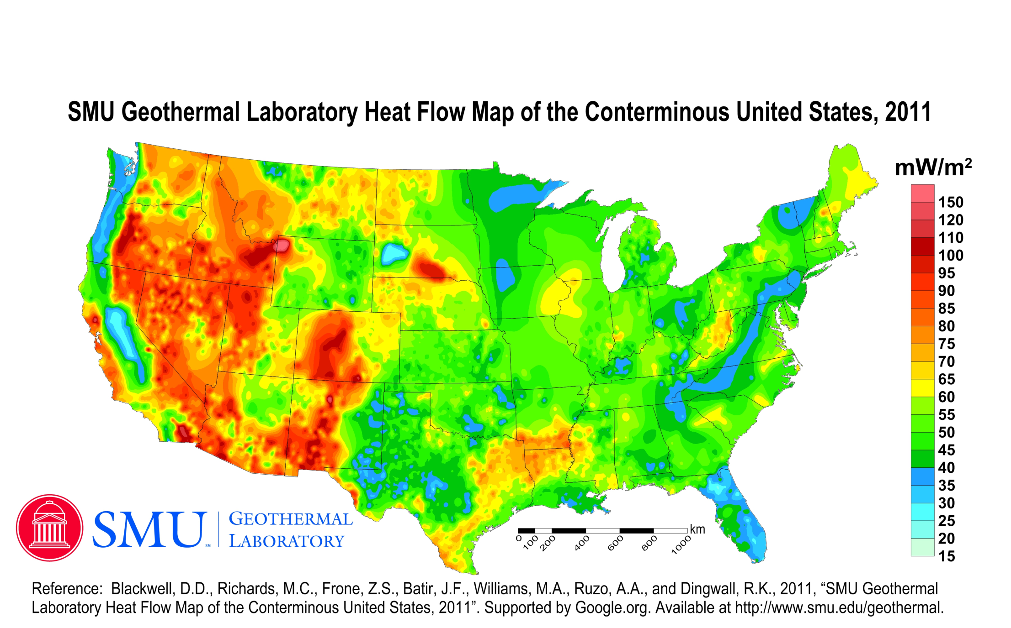


Slide 24
Many coincidences…Many questions!

Slide 25
THANKS FOR YOUR ATTENTION!
QUESTIONS?
glkinsland@louisiana.com

