Slide 1
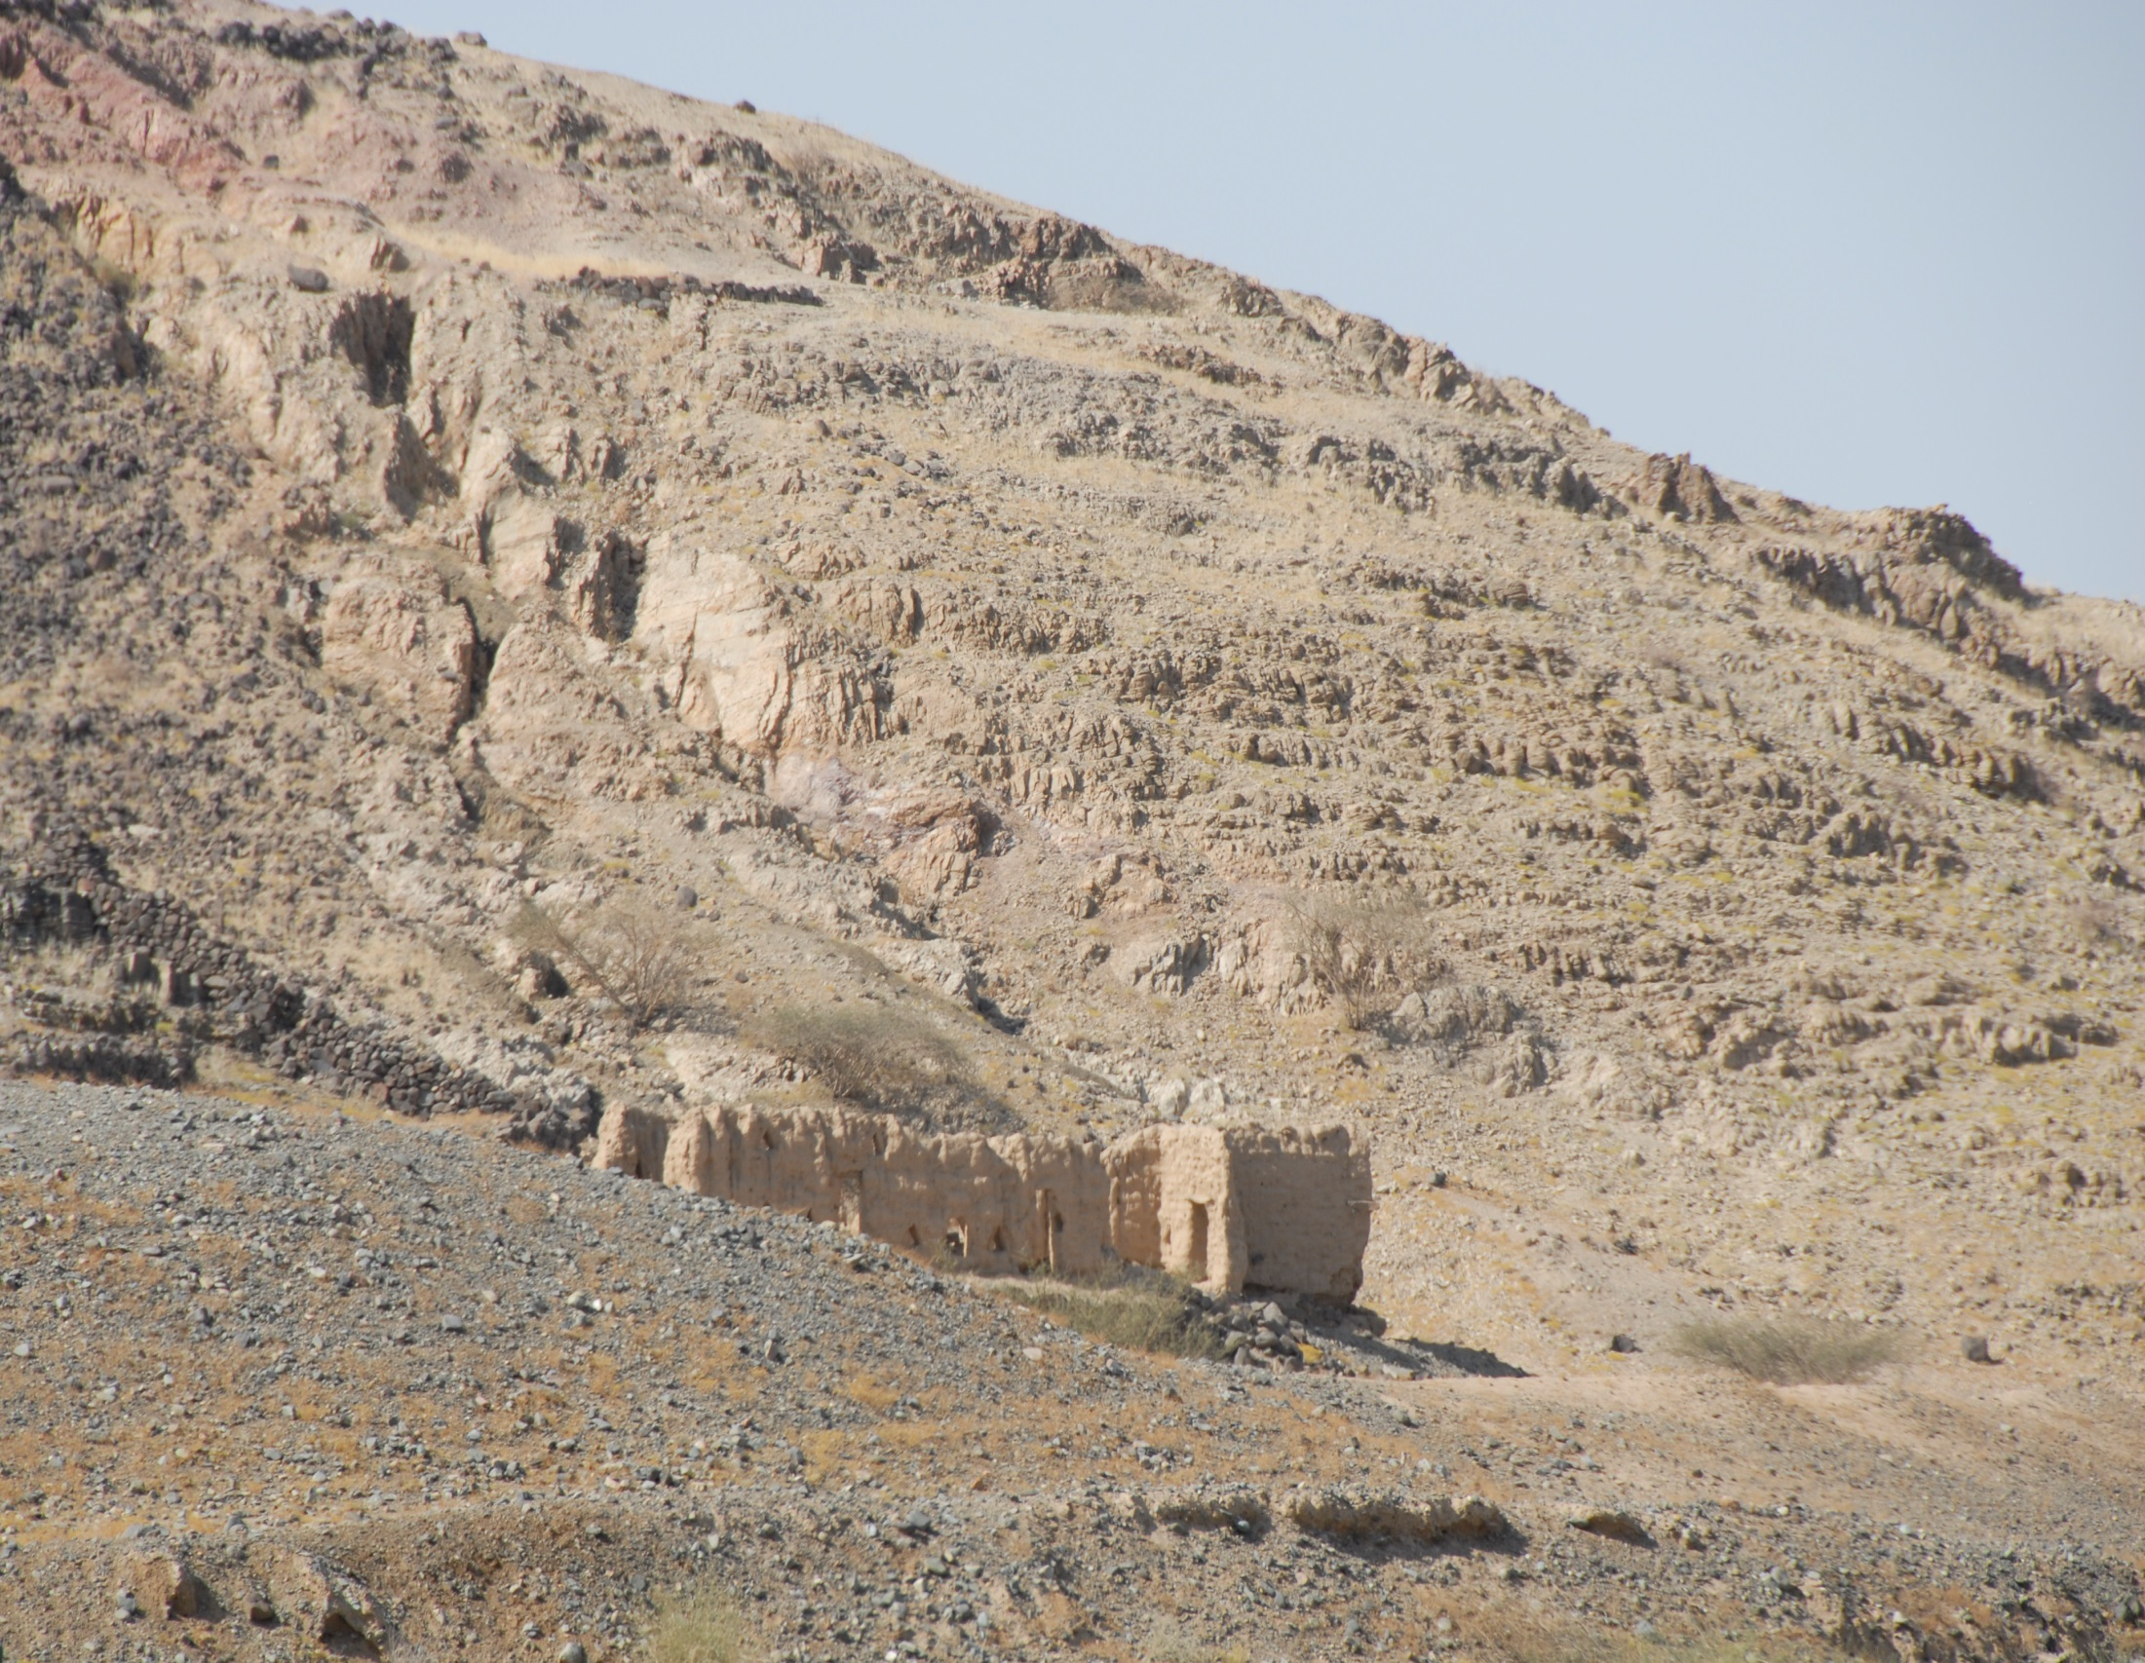
UNSUSTAINABLE MANAGEMENT OF GROUNDWATER RESOUCES IN ALLUVIAL AQUIFERS OF SAUDI ARABIA AND OTHER ARID REGIONS
Thomas M. Missimer
Florida Gulf Coast University
Geological Society of America Annual Meeting
Denver, Colorado
September, 27, 2016

Slide 2
Sustainability Issue
● In Saudi Arabia more than 8 million people live in wadi communities
● In the MENA region the number of people living in wadi valleys is more than 20 million
● Small-scale agriculture is the basic means of economic support for these people and groundwater is the only source of freshwater
●In the past, recharge of the alluvial aquifers by channel loss made the aquifer sustainable for the local population

Slide 3
Investigation at Wadi Qidayd
●A hydrogeologic investigation was conducted to assess channel loss recharge in Wadi Qidayd in western Saudi Arabia.
●Observations were made on the geology in abandoned wells, water levels were monitored, and geophysical profiles were made after a flood event.
●One dimensional HYDRUS modeling was conducted to assess recharge potential.

Slide 4
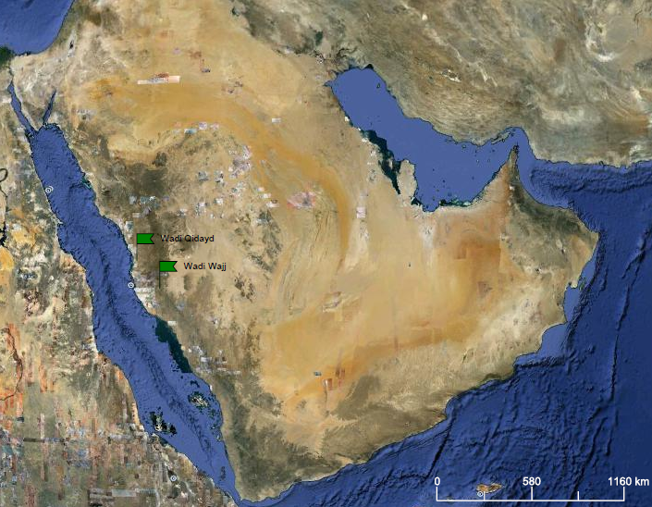
Arabian Gulf
Saudi Arabia
Jeddah
Red Sea
Indian Ocean

Slide 5
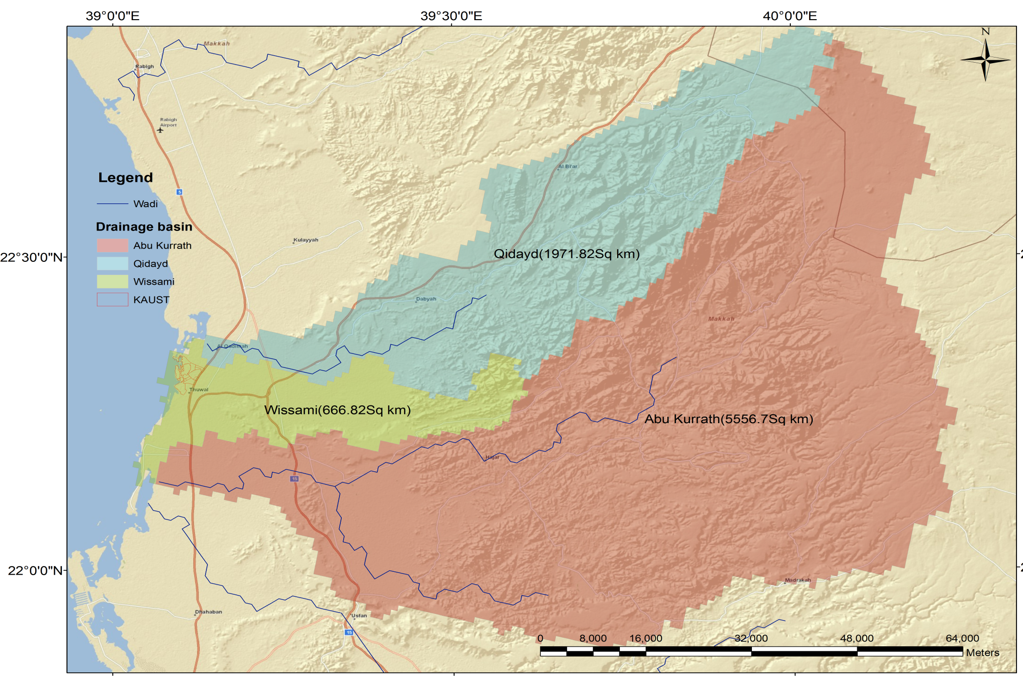
Sustainability Issue
Wadi Qidayd
● In Saudi Arabia more than 8 million people live in wadi communities
● In the MENA region the number of people affected is more than 20 million
● Small-scale agriculture is the basic means of economic support for these people

Slide 6
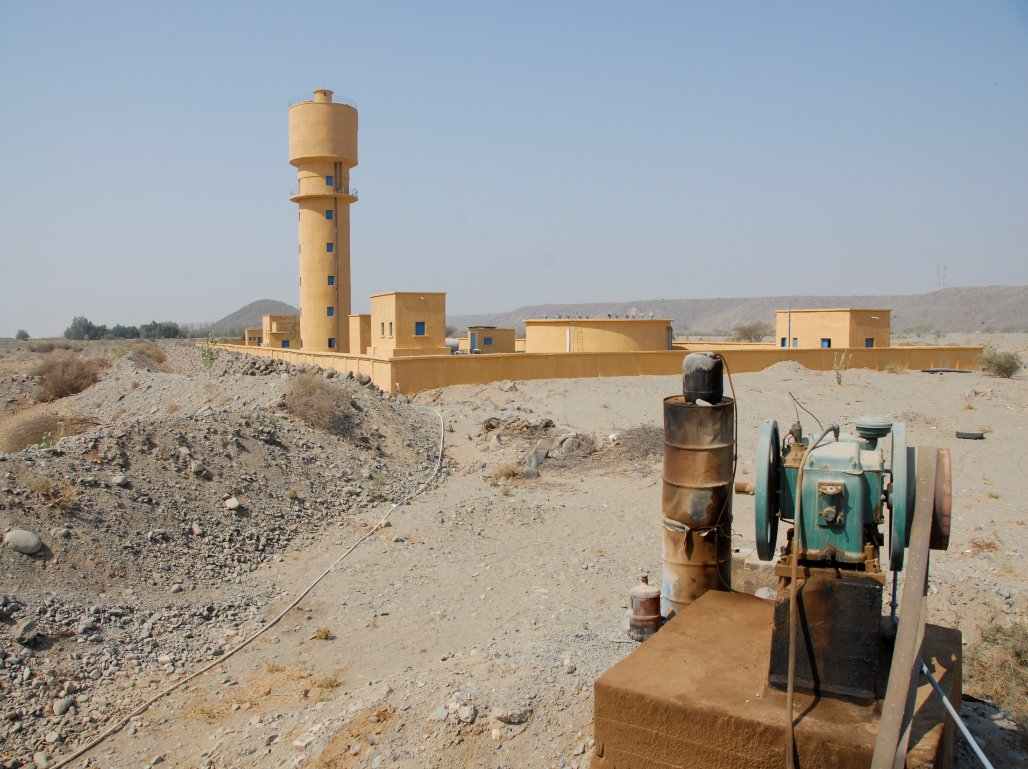
Abandoned Village Water Supply System
● In Saudi Ara

Slide 7
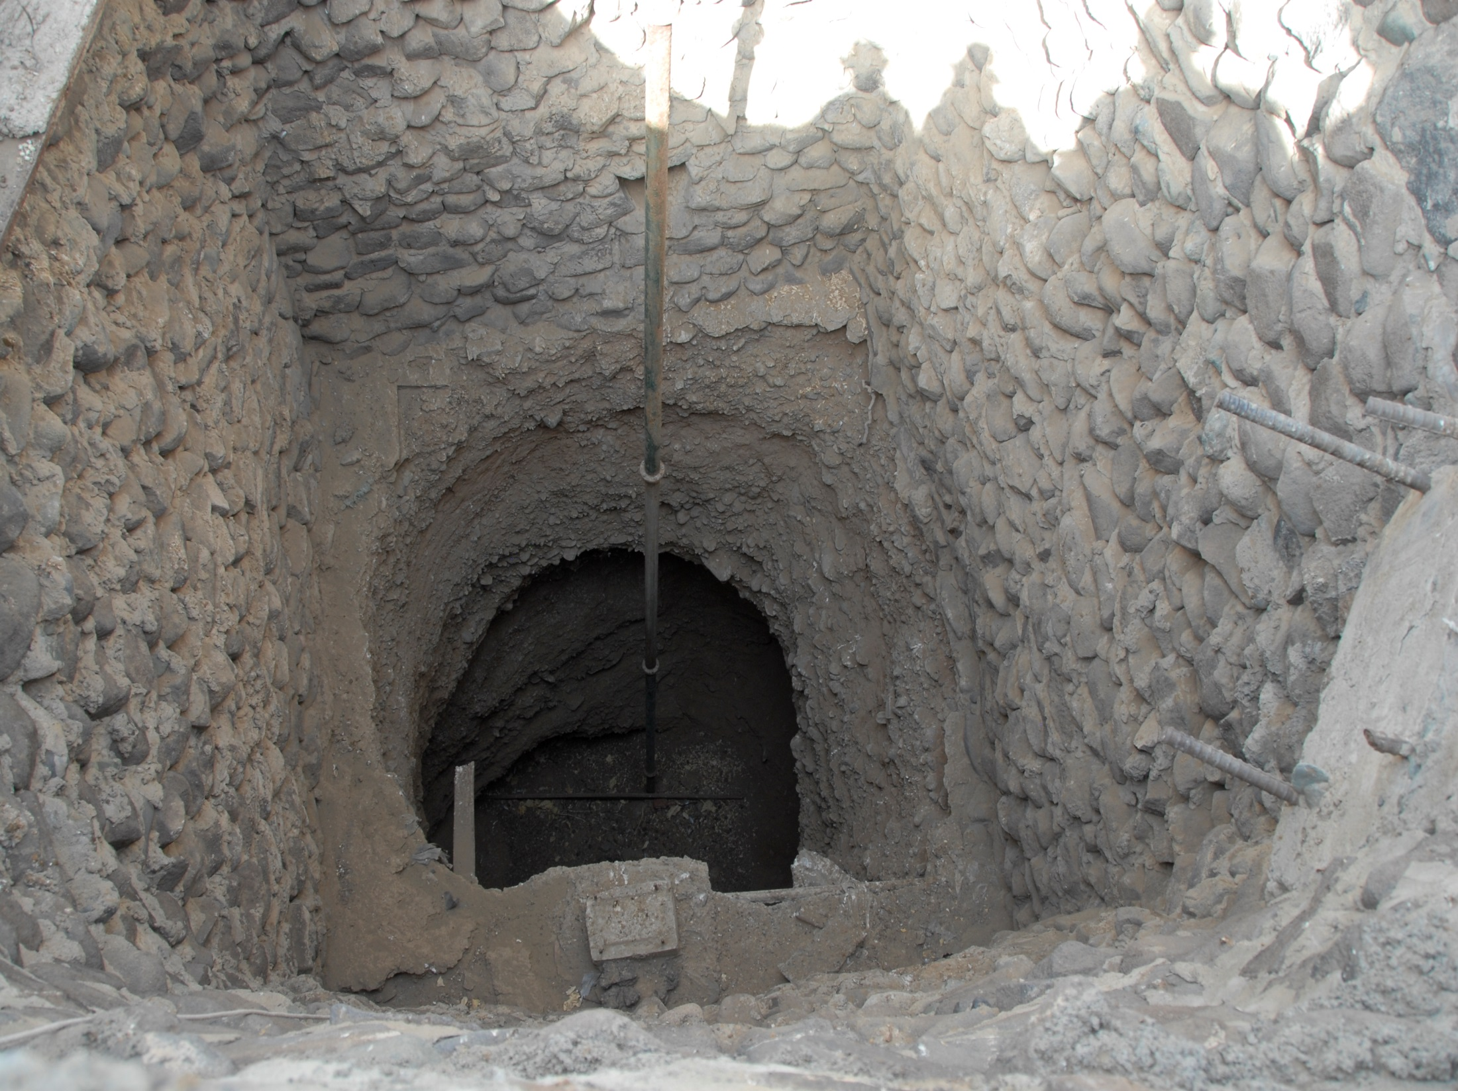
Hand-Dug Well-Dry
● In Saudi Ara

Slide 8
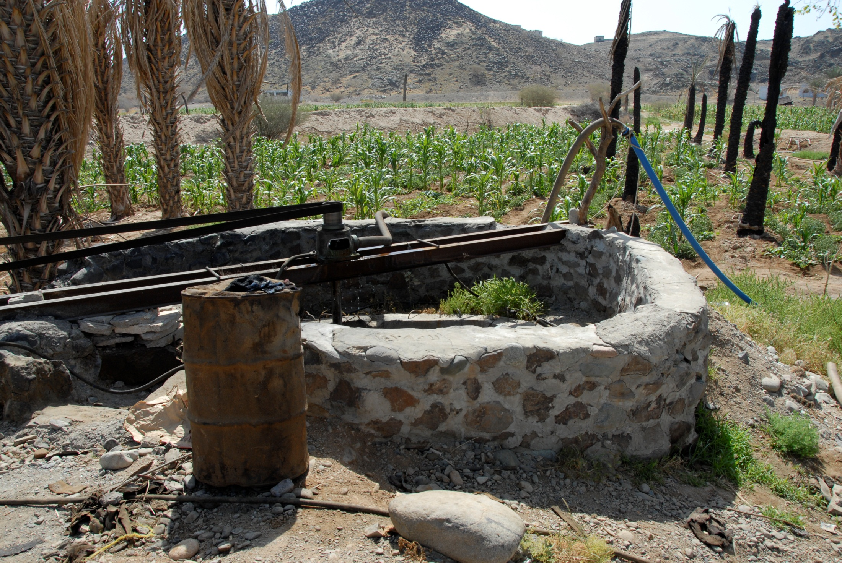
CONCLUSIONS (Cont’d)

Slide 9
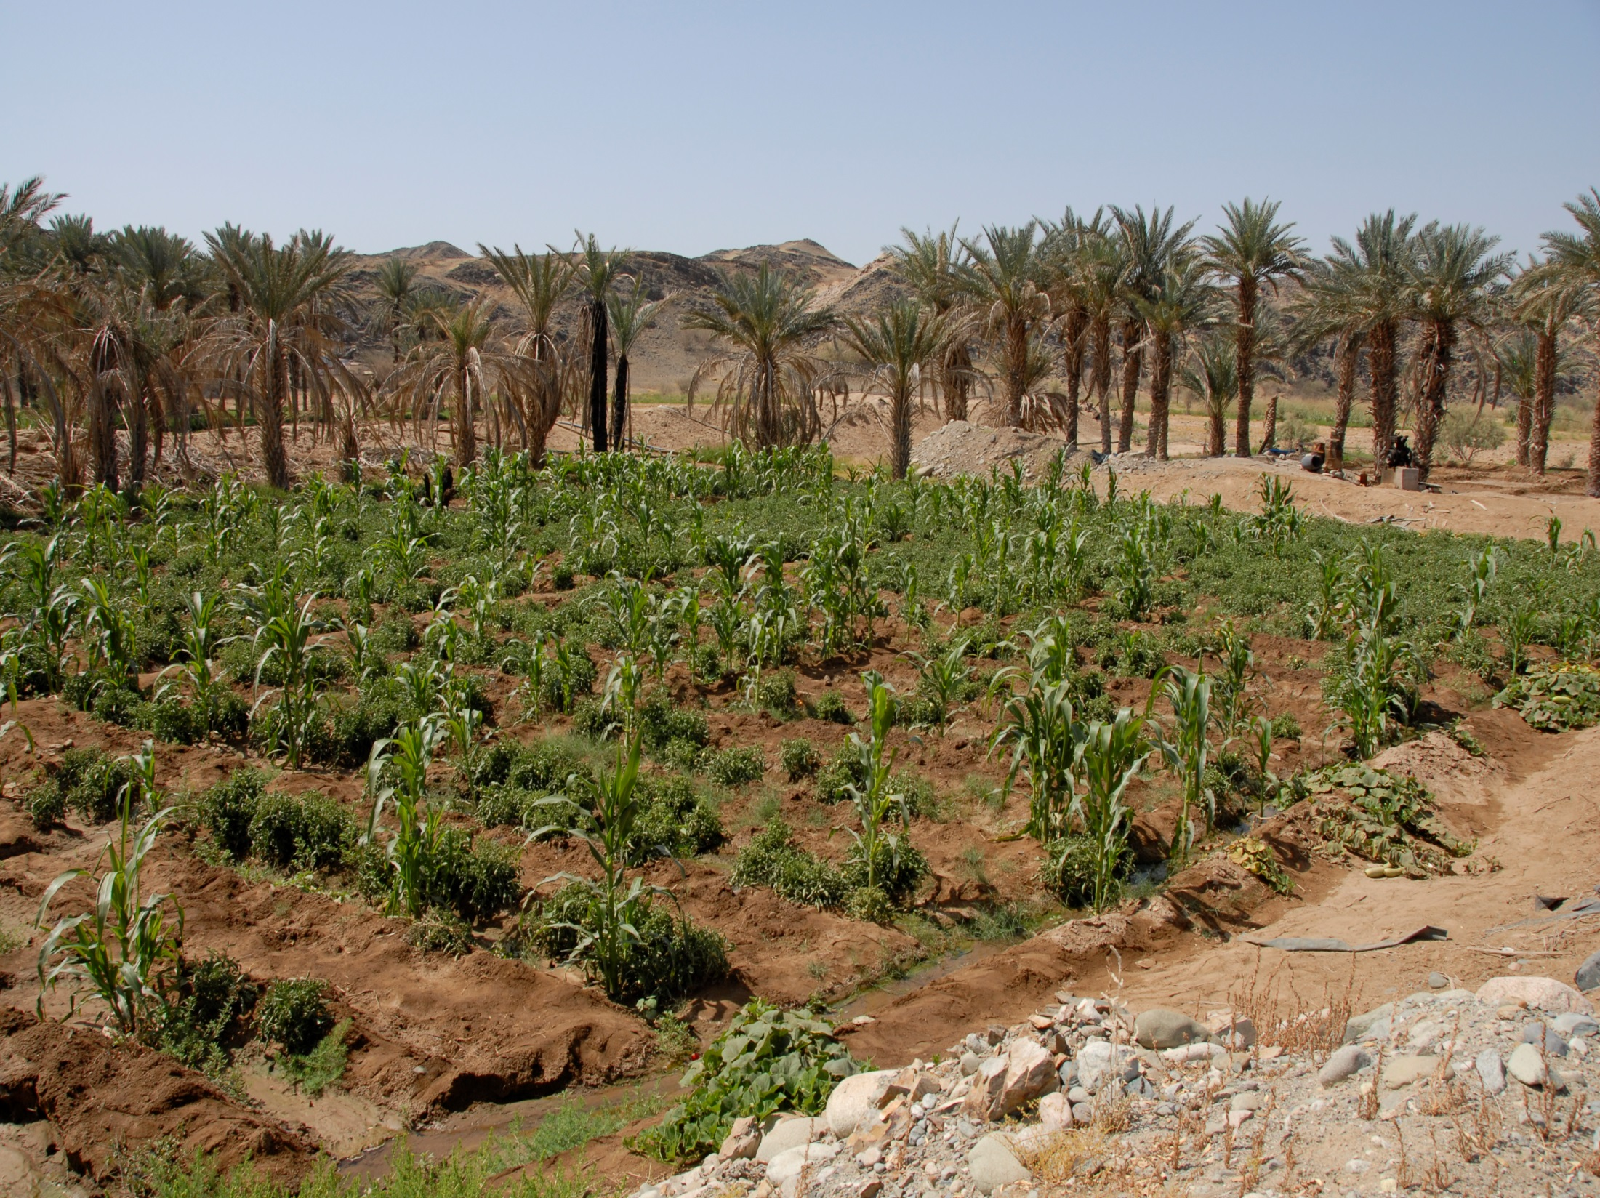
● In Saudi Arabia more than 8 million

Slide 10
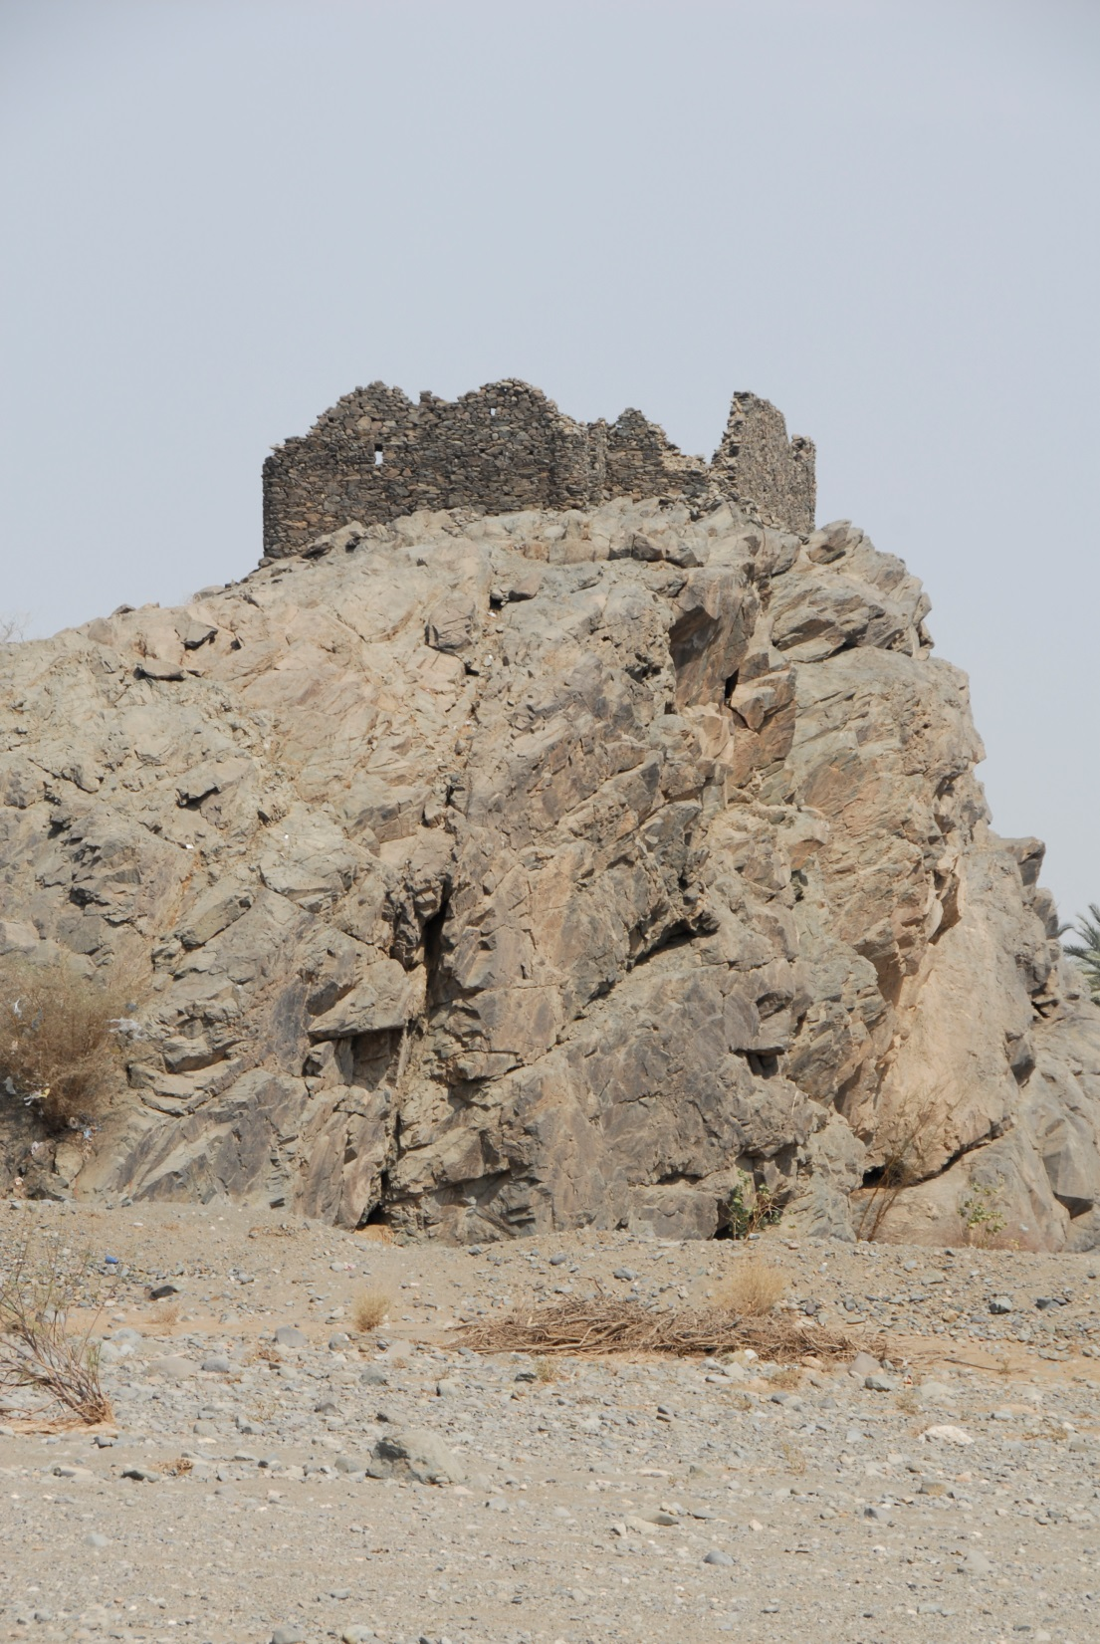
Historical Water Level Data
T. E. Lawrence recorded water levels in wells during WWI as he helped chase the Turks out of Saudi Arabia (1-3 m of fluctuation)

Slide 11
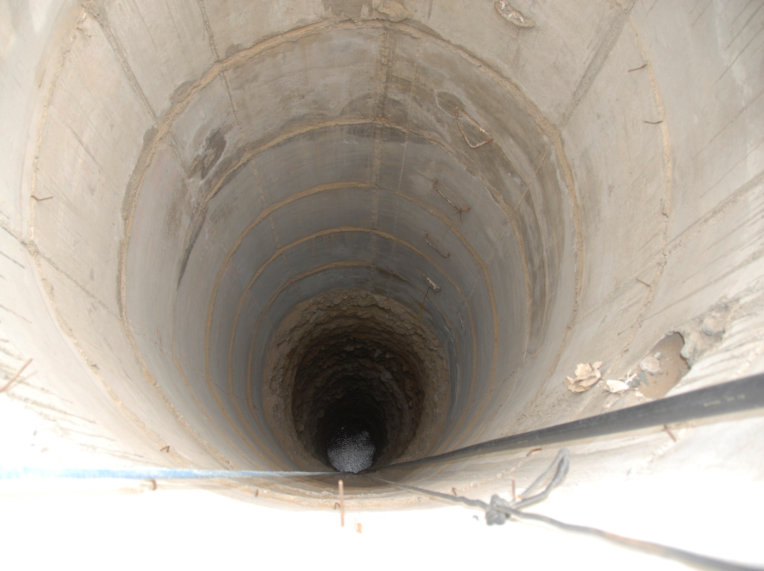
Historic Water Levels Dropped from 1-3 m during Historic Annual Fluctuation to 30 m or More Below Surface in Recent Years
● In Saudi Arabia more than 8 million

Slide 12
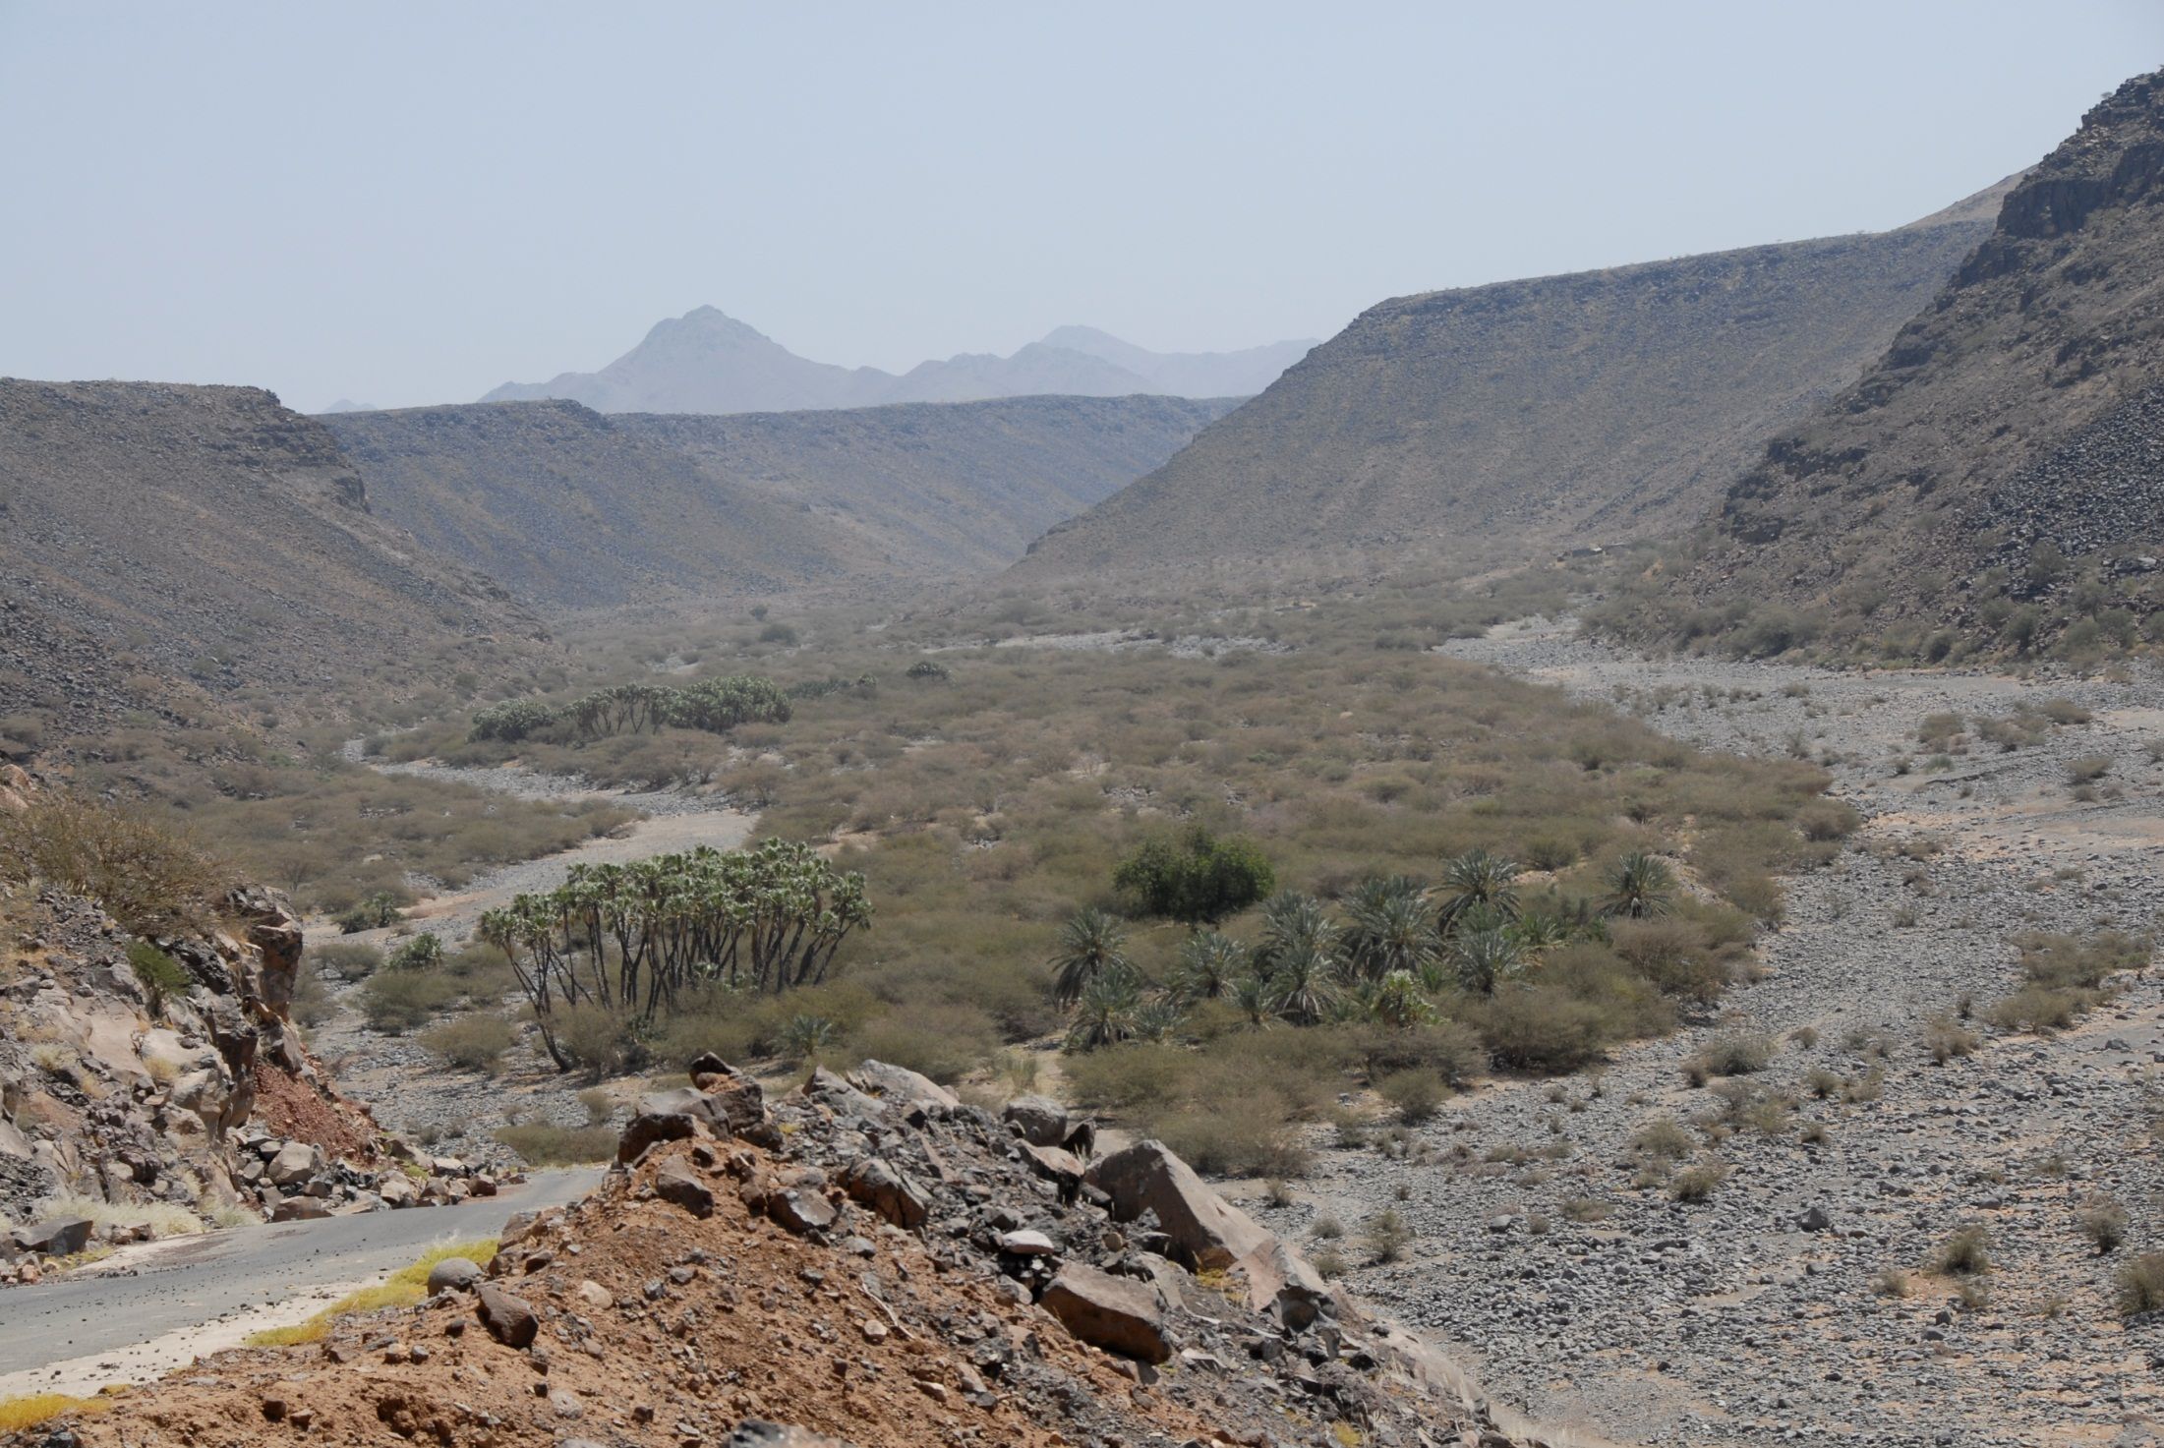
CONCLUSIONS (Cont’d)
Upper Wadi Incised into Pre-Cambrian
Distal and Middle Wadi Segments
Acacia

Slide 13
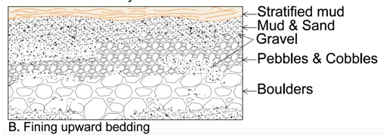
Typical Bedding in Alluvial Aquifers
In distal wadi regions between 1 and 5 of these beds occurs with the number of beds increasing in number and content of mud moving downstream.

Slide 14
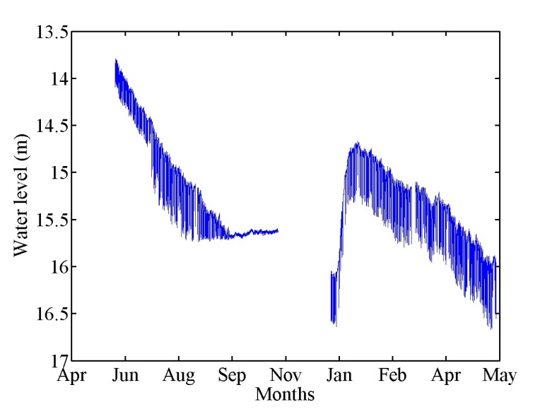
Water Levels Show No Effect of Storm Recharge
● In Saudi Ara

Slide 15
Reaction of Water Levels to a Storm Event Affecting the Middle Region of Wadi Qidayd
●Water levels continued to decline due to pumping in the area affected by the flood event.
●A sudden increase in water level was observed 12 days after the flood event with a return to rapid decline occurring quickly thereafter
●Geophysical profiles showed water level at the edge of the wadi was greater than at the center.

Slide 16
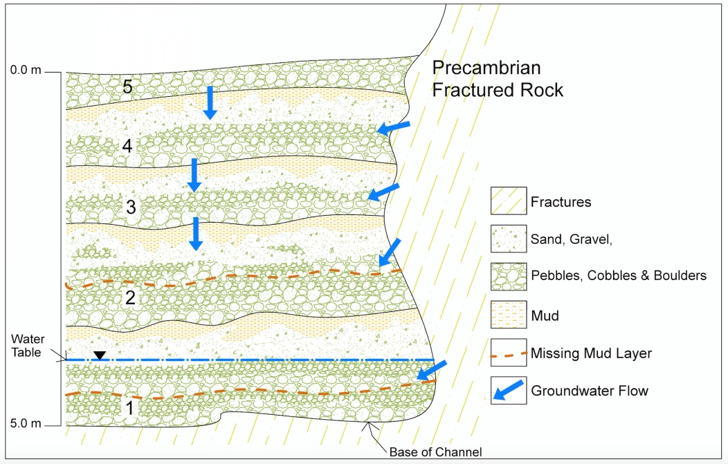
HYDRUS Modeling
HYDRUS modeling showed that water can penetrate downward only though 3 to 5 beds depending on the mud thickness.
Restriction of the wetted-front is caused by increased wetting, downstream deflection and plant water use (Acacia).

Slide 17
Recharge during Flooding Events No Longer Occurs
●Water no longer directly recharges the aquifer during flood events (does not reach the water table).
●Recharge is restricted to flow through fractured rocks at the perimeter of the wadi.
●The recharge rate is severely reduced.

Slide 18
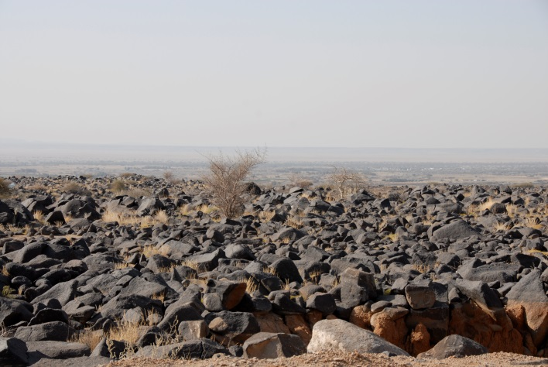
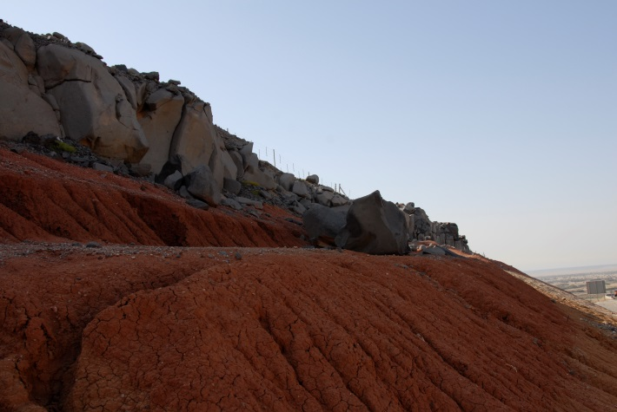
Rainfall is Trapped in Harrat Areas Bounding the Wadi
Water moves between the basalt boulders toward the wadi channel edge and moves downward in the fractured rocks.

Slide 19
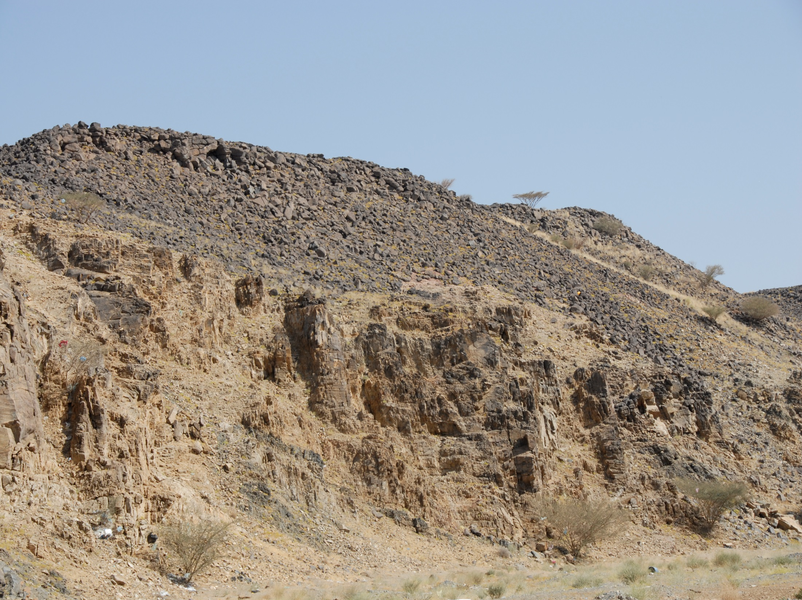
Runoff Drains through the Harrat Boulders to Recharge the Fractured Rock
● In Saudi Arabia more than 8 million
Basalt Boulders
Precambrian Fractured Rock
Wadi Channel Edge

Slide 20
Conclusions
●Over-pumping of the alluvial aquifer in Wadi Qidayd has changed the recharge mechanism of the system
●Channel loss (infiltration) is no longer the primary recharge mechanism in the middle and proximal segments of the wadi.
●Recharge now occurs at a diminished rate at the perimeter of the wadi where fractured rock intersects the wadi gravel beds.

Slide 21
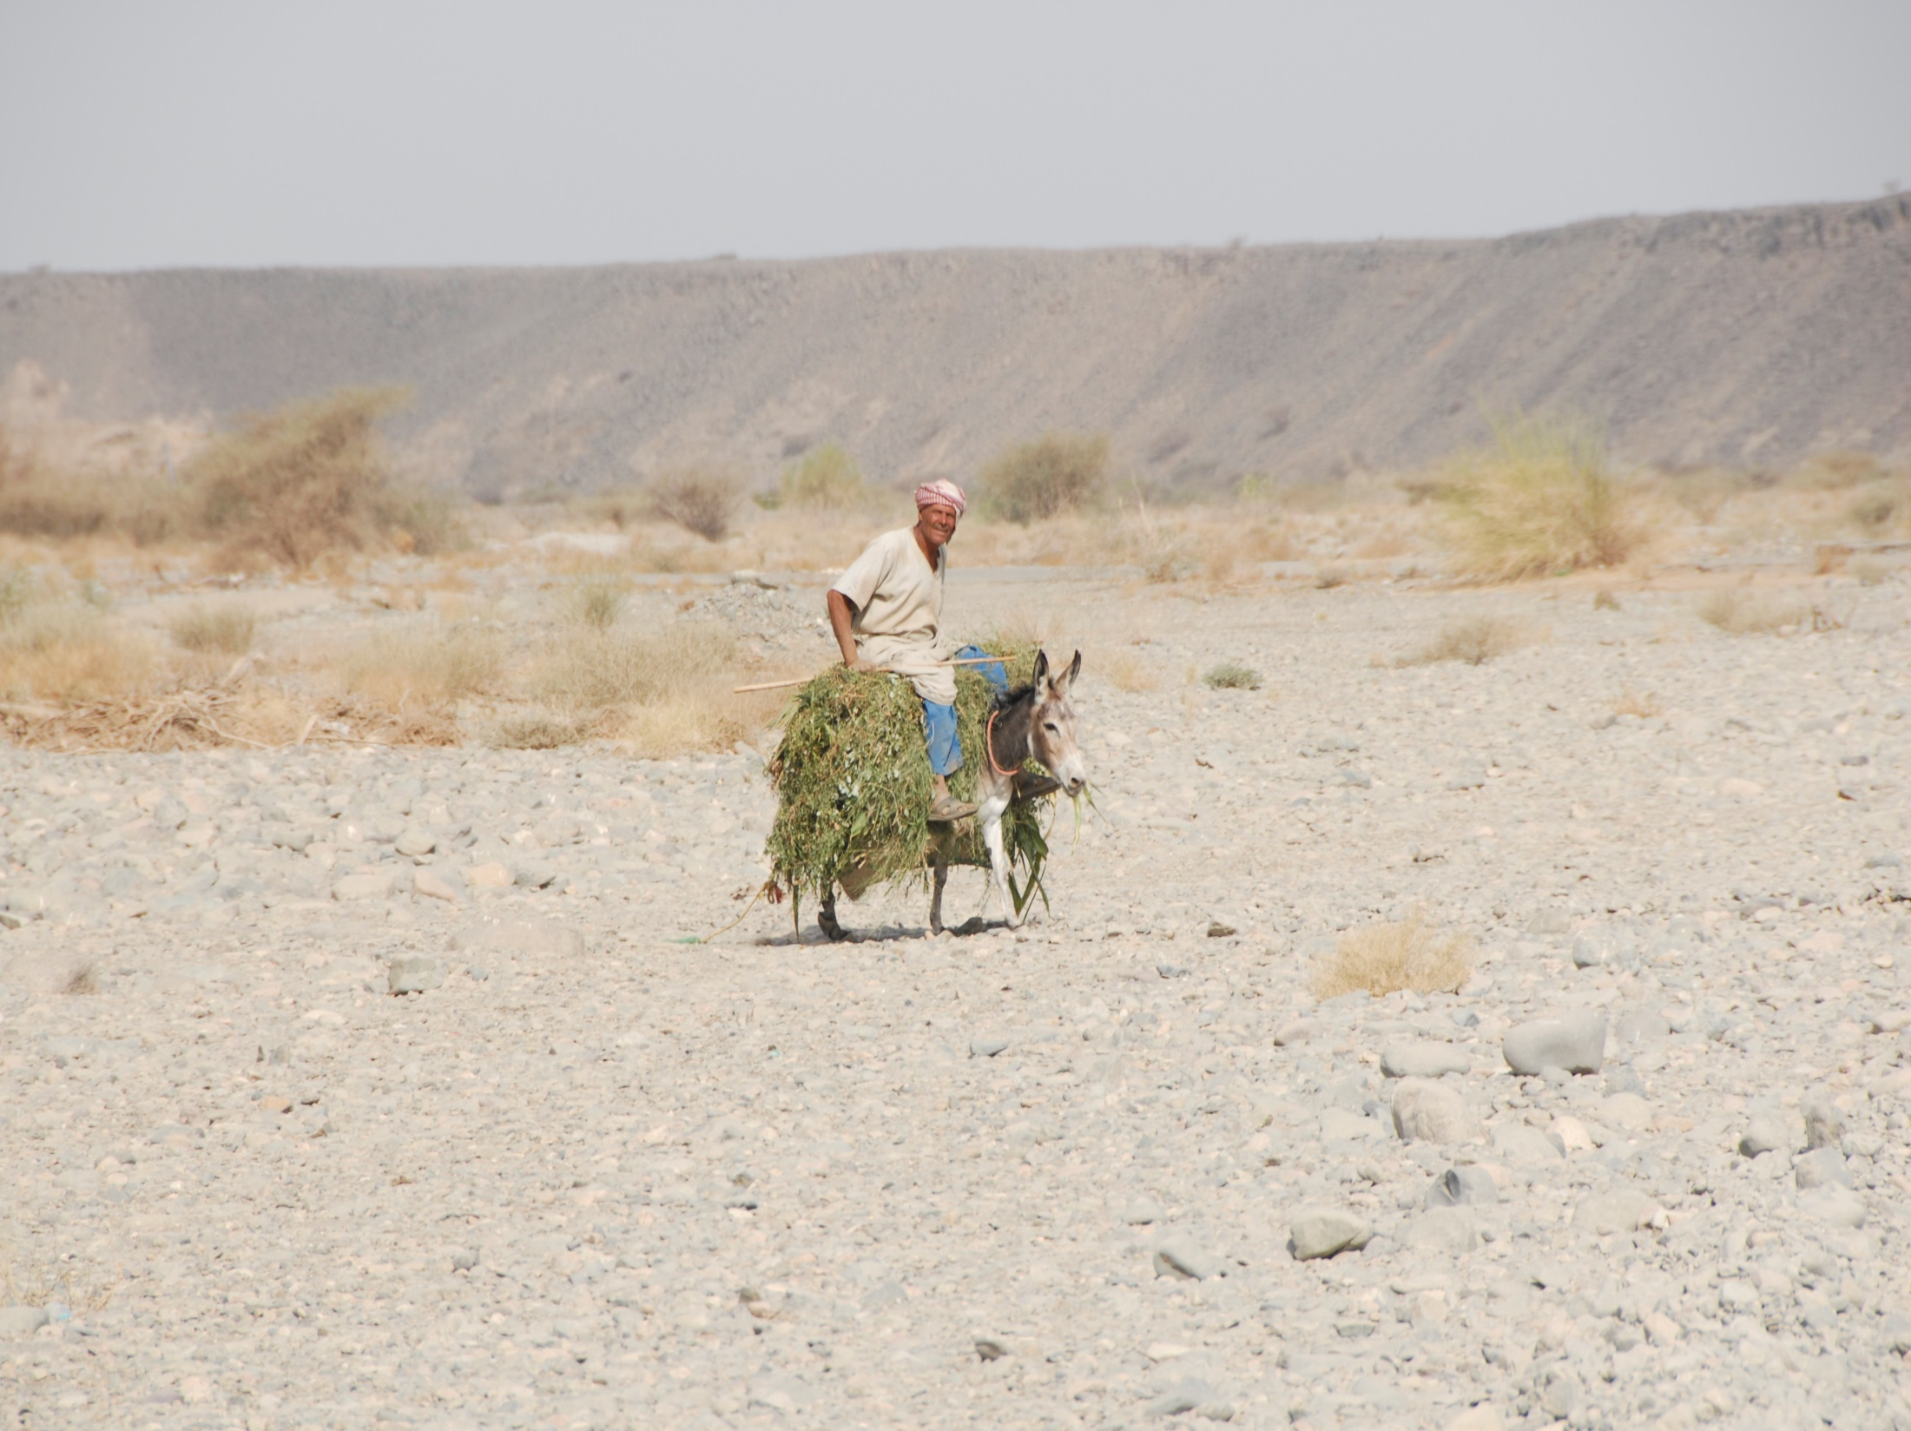
Questions?
● In Saudi Ara

