Slide 1
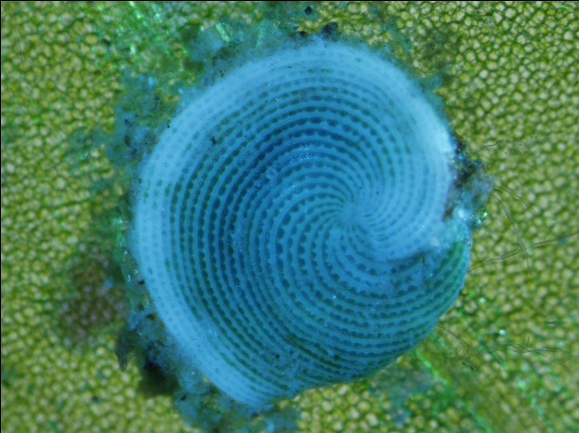
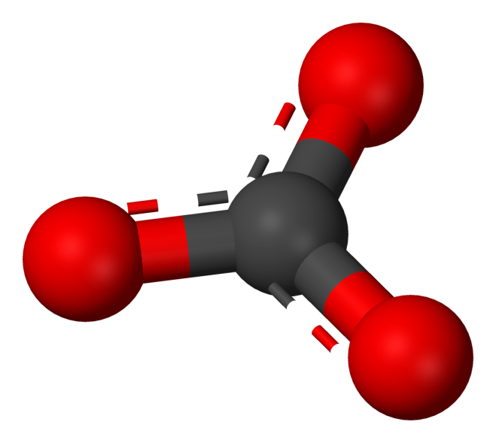

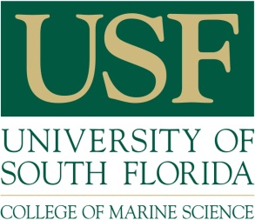
Abundance of Archaias angulatus on the west Florida coast indicates the influence of carbonate alkalinity over salinity
Sean Beckwith*
Pamela Hallock
GSA Annual Meeting – Sep. 25th, 2016
*Correspondence:
stbeckwith@mail.usf.edu
Notes:
“Good morning and thank you attending…”
“The story I’m going to tell today is that of finding a well-known species in an unusual environment..”

Slide 2
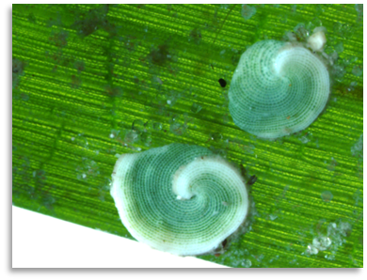
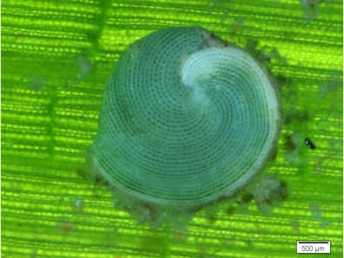
An important indicator species and carbonate sediment producer:
Archaias angulatus
Western Atlantic and Caribbean distribution
Mixed macroalgal-seagrass substrate
Depth: less than 1 m in relatively turbid coastal areas to over 20 m in clean, open-shelf or reef-margin habitats
Salinity: normal seawater, S = 30-36
Photos courtesy of Paul Carlson, FWC-FWRI
Notes:
“Archaias angulatus is widespread in the tropical & subtrop Western Atlantic from Caribbean down to Brazil…
“…and is also found to a lesser extent in the GOM.”
It is a L..B..F.. with a chlorophyte endo-symbiont.
The depth range of Archaias is from 1 to 20m.
Salinity tolerance is reported to be from 30-36.”
[MAIN POINT]
“Archaias angulatus is used as indicator sp. because of its symbiotic relationship which is similar to corals”
“In terms of sed prod… LBF’s: ½ % of global carb sediments.”
-------------
-----------------------
[It is eurytopic(tolerate wide range of habitats)]
[It thrives in quiet, nearshore and restricted…
most commonly on macroalgae and seagrass. ]

Slide 3
Motivation for this research
Dr. Paul Carlson, FWC-FWRI Seagrass Monitoring Program:
“…often found on seagrass blades”
No
seagrass
data
beyond
here
Notes:
1…“The Springs Coast…(highlighted in red)
…is an area of gradual relief… Shallow waters provide abundant space for seagrass habitat.
2…“Paul Carlson with Florida’s FWC wondered what they were finding so often on the blades of seagrass[animate] during the Seagrass Monitoring Program.”
“…contacted Pamela Hallock Muller who identified the species as…, and the idea for this study was born.”

Slide 4
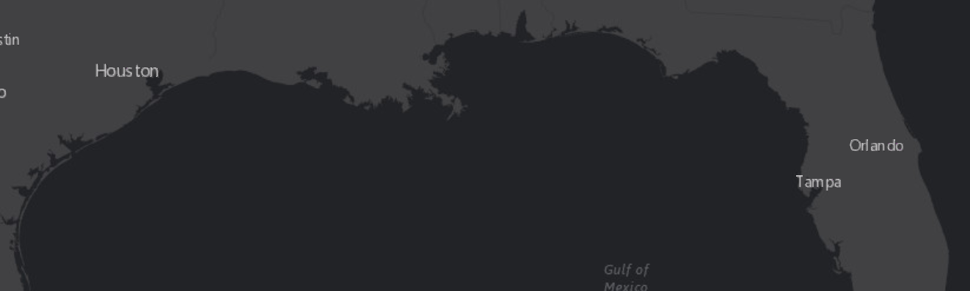

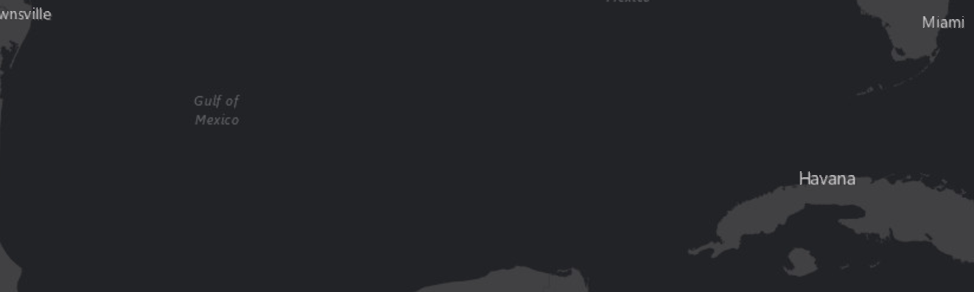
Historical records of Archaias angulatus in the GOM (Culver & Buzas, 1981)
Legend
Cushman, 1930
Bandy, 1956
Bock, 1976
Esri, HERE, DeLorme, MapmyIndia, © OpenStreetMap contributors, and the
GIS user community, Esri, HERE, MapmyIndia, © OpenStreetMap contributors,
and the GIS user community
Notes:
“Previous researchers [then click through the names] show presence of Archaias as far north as the panhandle, although Bandy,
who sampled extensively, reported that Archaias was not well represented in the assemblages of the northern areas…”
“The species is ALSO not well represented along the Pinellas County Coast…which we will look at in more detail”

Slide 5
Motivating question
Are differences in abundances of Archaias angulatus along the west Florida shelf associated with:
the underlying substrata, and
water chemistry related to the underlying substrata?
Notes:
“There is a very different geological regime between the Pinellas Peninsula and the Springs Coast just to the north, as shown by the coloration in this map.”
“Older limestones compose the Springs Coast to the north, siliciclastic sediments later covered the central portion, and younger limestone and sand mixtures are found in South Florida (not shown here).”
“And so the question was posed:
…Are differences between the Pinellas Coast and the Springs Coast associated with the underlying…”
[Read the 2 questions]

Slide 6
Methods
Four sampling sites
Environmental parameters from agencies
Coastal lithology (USGS)
Sea-surface temperature (NOAA)
Salinity (NOAA, SWFWMD)
Field sampling
Timing: January, May, September
Sediment samples
Water chemistry (sampled diurnally)
Notes:
“To capture diurnal and seasonal variations, sediment and water samples were taken at 4 sites in 3 seasons”
“I used environ params from agencies, such as… salinity data from NOAA and SWFWMD.”

Slide 7
Four sampling sites
Notes:
Study Site 1 is in the Middle Keys, an area far from terrestrial runoffs. “
Site 2 is in the lagoon of Fort Desoto.
Site 3: northern end of Pinellas County/(is also the) Southern edge of Springs Coast.
Site 4 is near the Weeki Wachee river in the heart of the Springs Coast. …and is few km offshore…
Weeki Wachee River is low in mineral content, high in carbonate content…”

Slide 8
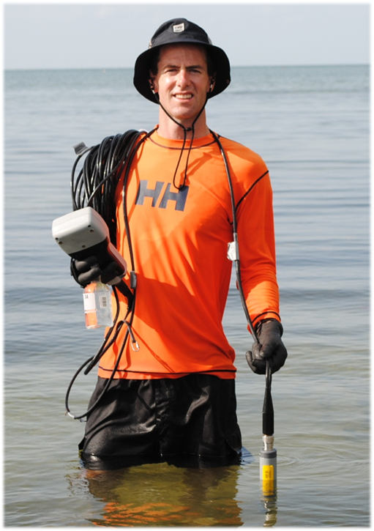
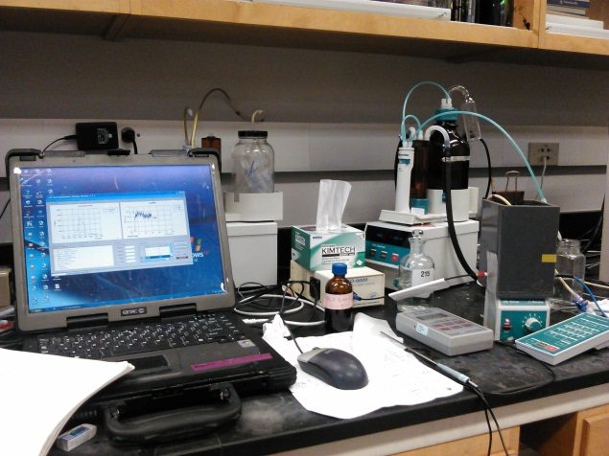
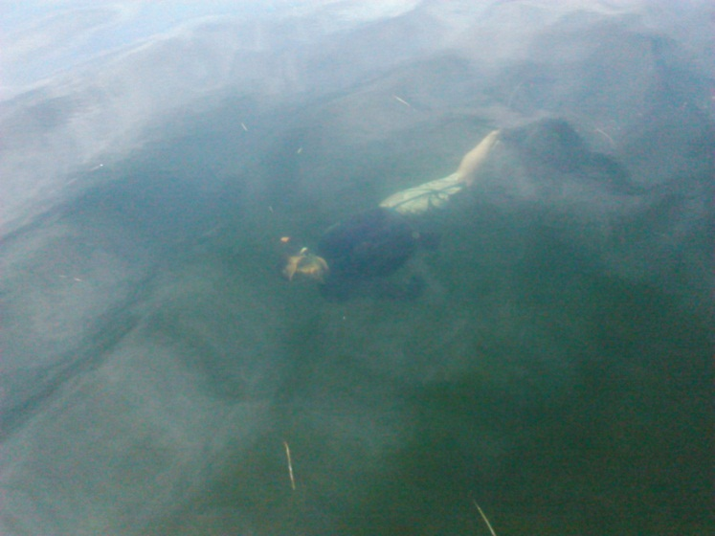
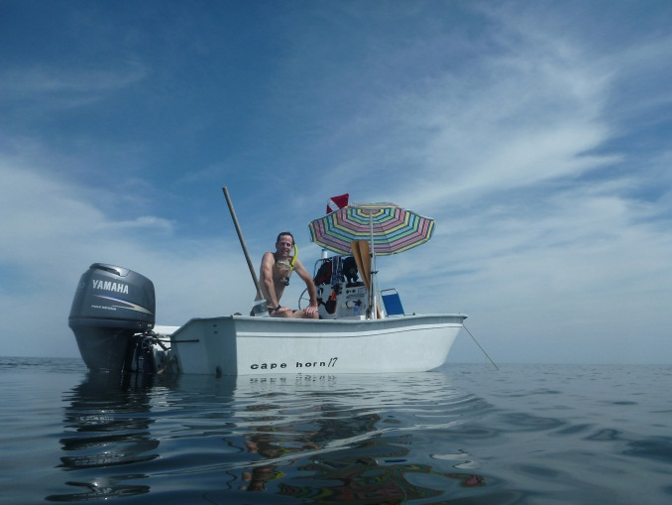
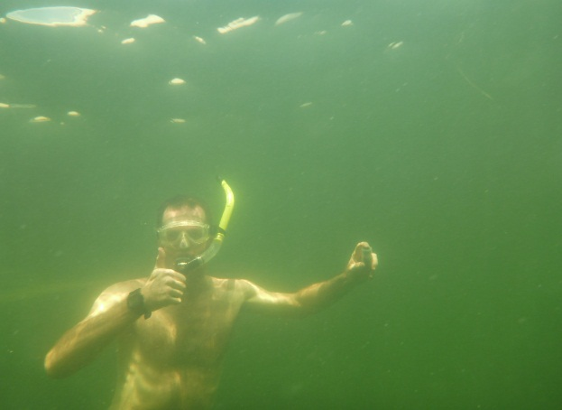
Field sampling
Temperature and Salinity in situ
Discrete bottle sampling for lab analysis of TA and DIC
Notes:
“One of the biggest questions concerning the presence of Archaias in the Springs Coast was water chemistry.”
“In order to calculate the parameters of the carbonate system, I measured…”

Slide 9
Carbonate system parameters measured or calculated
TA: Total Alkalinity
DIC: Dissolved Inorganic Carbon
Ω: Aragonite Saturation State
pH
Riverine TA contribution
Can discuss details later with anyone interested…
Notes:
[Add a descriptive picture?]
“Parameters that were measured or calculated include: …”
“And I would be happy to discuss these in more detail later.”
[NEXT SLIDE will explain some of these…]
---------------------------------------------------------------------------------------
“I’d like to review the main parameters of the carbonate-CO2 system…”
TA… DIC…
“CO2* is the most important difference between TA and DIC
Point out the “2” for CO₃…
“Keep in mind… 90:10:1…”
….overwhelmingly, Bicarbonate is the main player in the CARBONATE SYSTEM.”

Slide 10


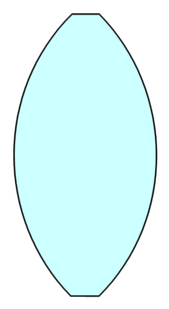
Biochemical effects on carbonate system parameters
Photosynthesis/Respiration
&
Calcification/Dissolution
TA: Total Alkalinity
DIC: Dissolved Inorganic Carbon
TA
DIC
Ω , pH
Controlling variables Descriptor variables
(Byrne, 2014)
Notes:
“To briefly describe the carbonate system…”
“Photosynthesis/Respiration and Calcification/Dissolution are the driving processes…
…and ratio of TA to DIC is like a lens through which additional changes occur. This ratio strongly influences the values of Omega (CaCO₃ saturation states) and pH.”
--------------------------------------------------------
“As described by Robert Byrne, TA&DIC are master controlling variables, while pH, Ω are master descriptor var.”

Slide 11
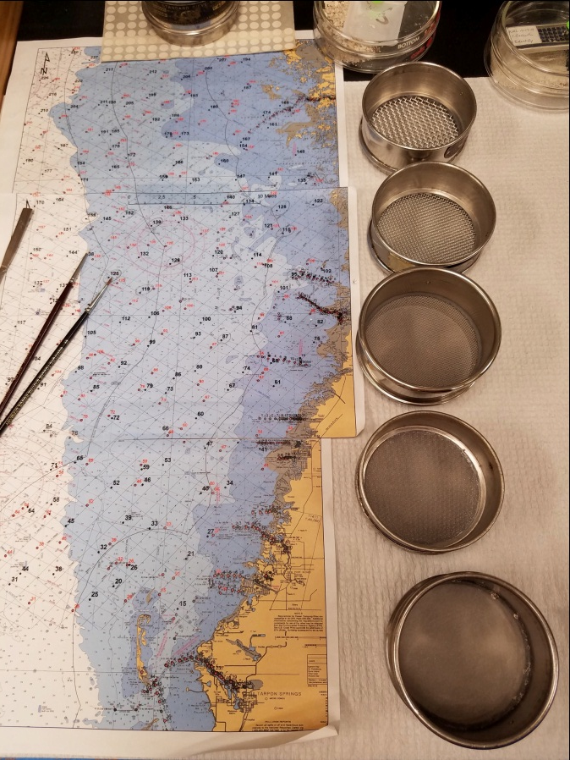
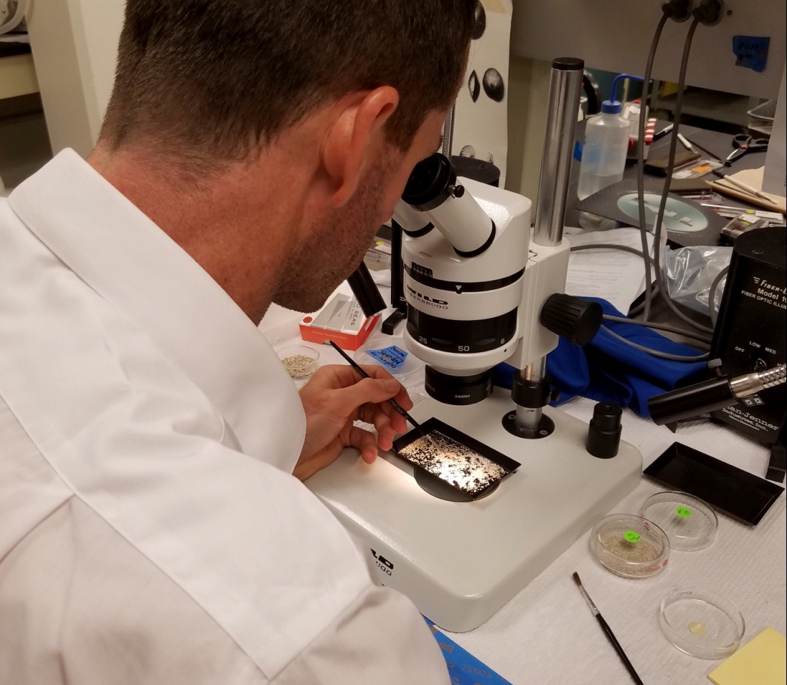
Sediment analysis methods
Intact Archaias picked from 1 mm and >2 mm fractions
Counted by Total and Live
Notes:
“Sediment samples PROVIDED BY FWC were sorted by grain size and analyzed in lab”
“I focused on intact adult Archaias ~ > 1mm…”
Total…Live…

Slide 12
Results
Environmental parameters
Abundances of Archaias angulatus
Carbonate chemistry parameters
Notes:
“Today I will highlight Environmental…”
…
…”

Slide 13
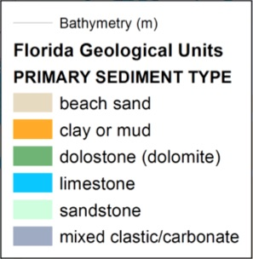
Coastal lithologies
Carbonate sediments predominate in Springs Coast and Florida Reef Tract
Siliciclastic sediments predominate in central west Florida
Notes:
“A contrast in lithology is seen between Pinellas Coast and …”
…The only purely carbonate substrata are Springs Coast and the Keys…”
“Older limestone in the north, siliciclastic sediments that came later in the central…, and a younger limestone and sand mixture to the south.”

Slide 14
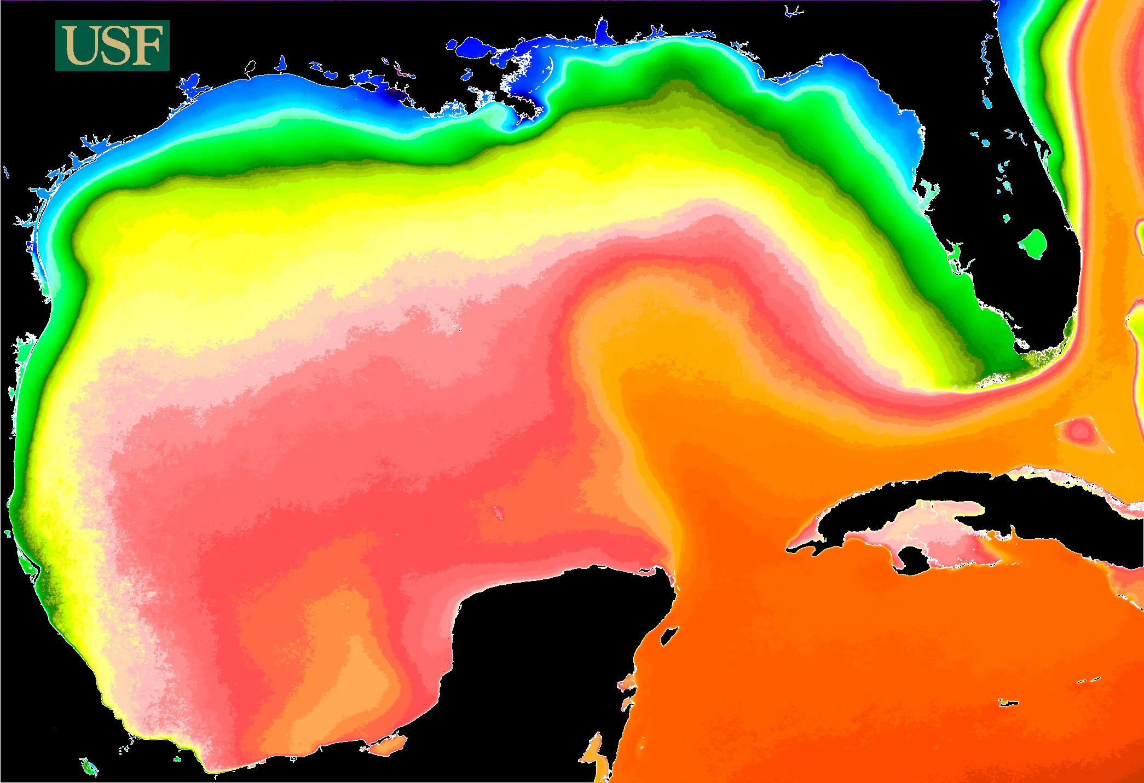
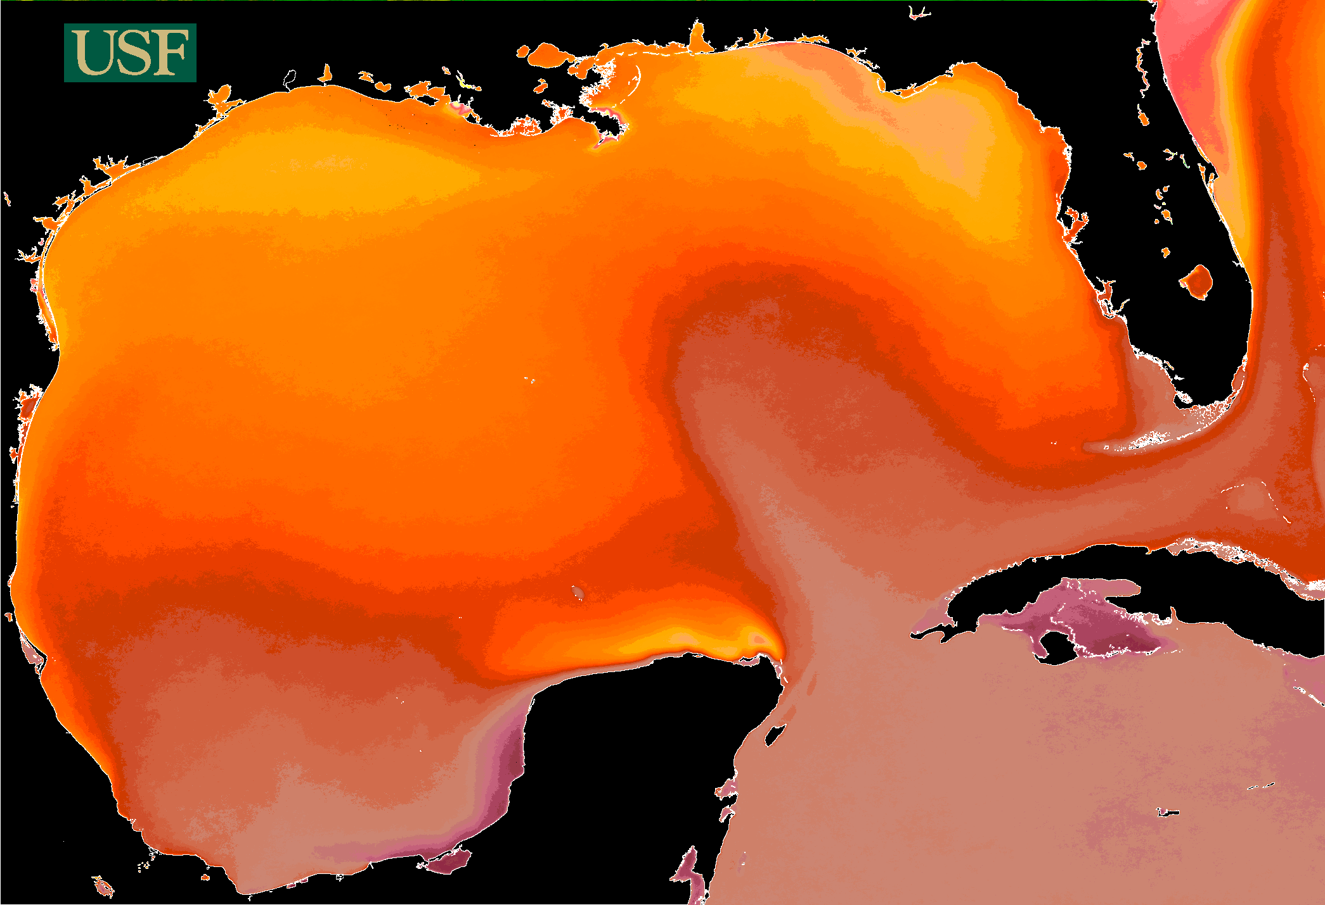

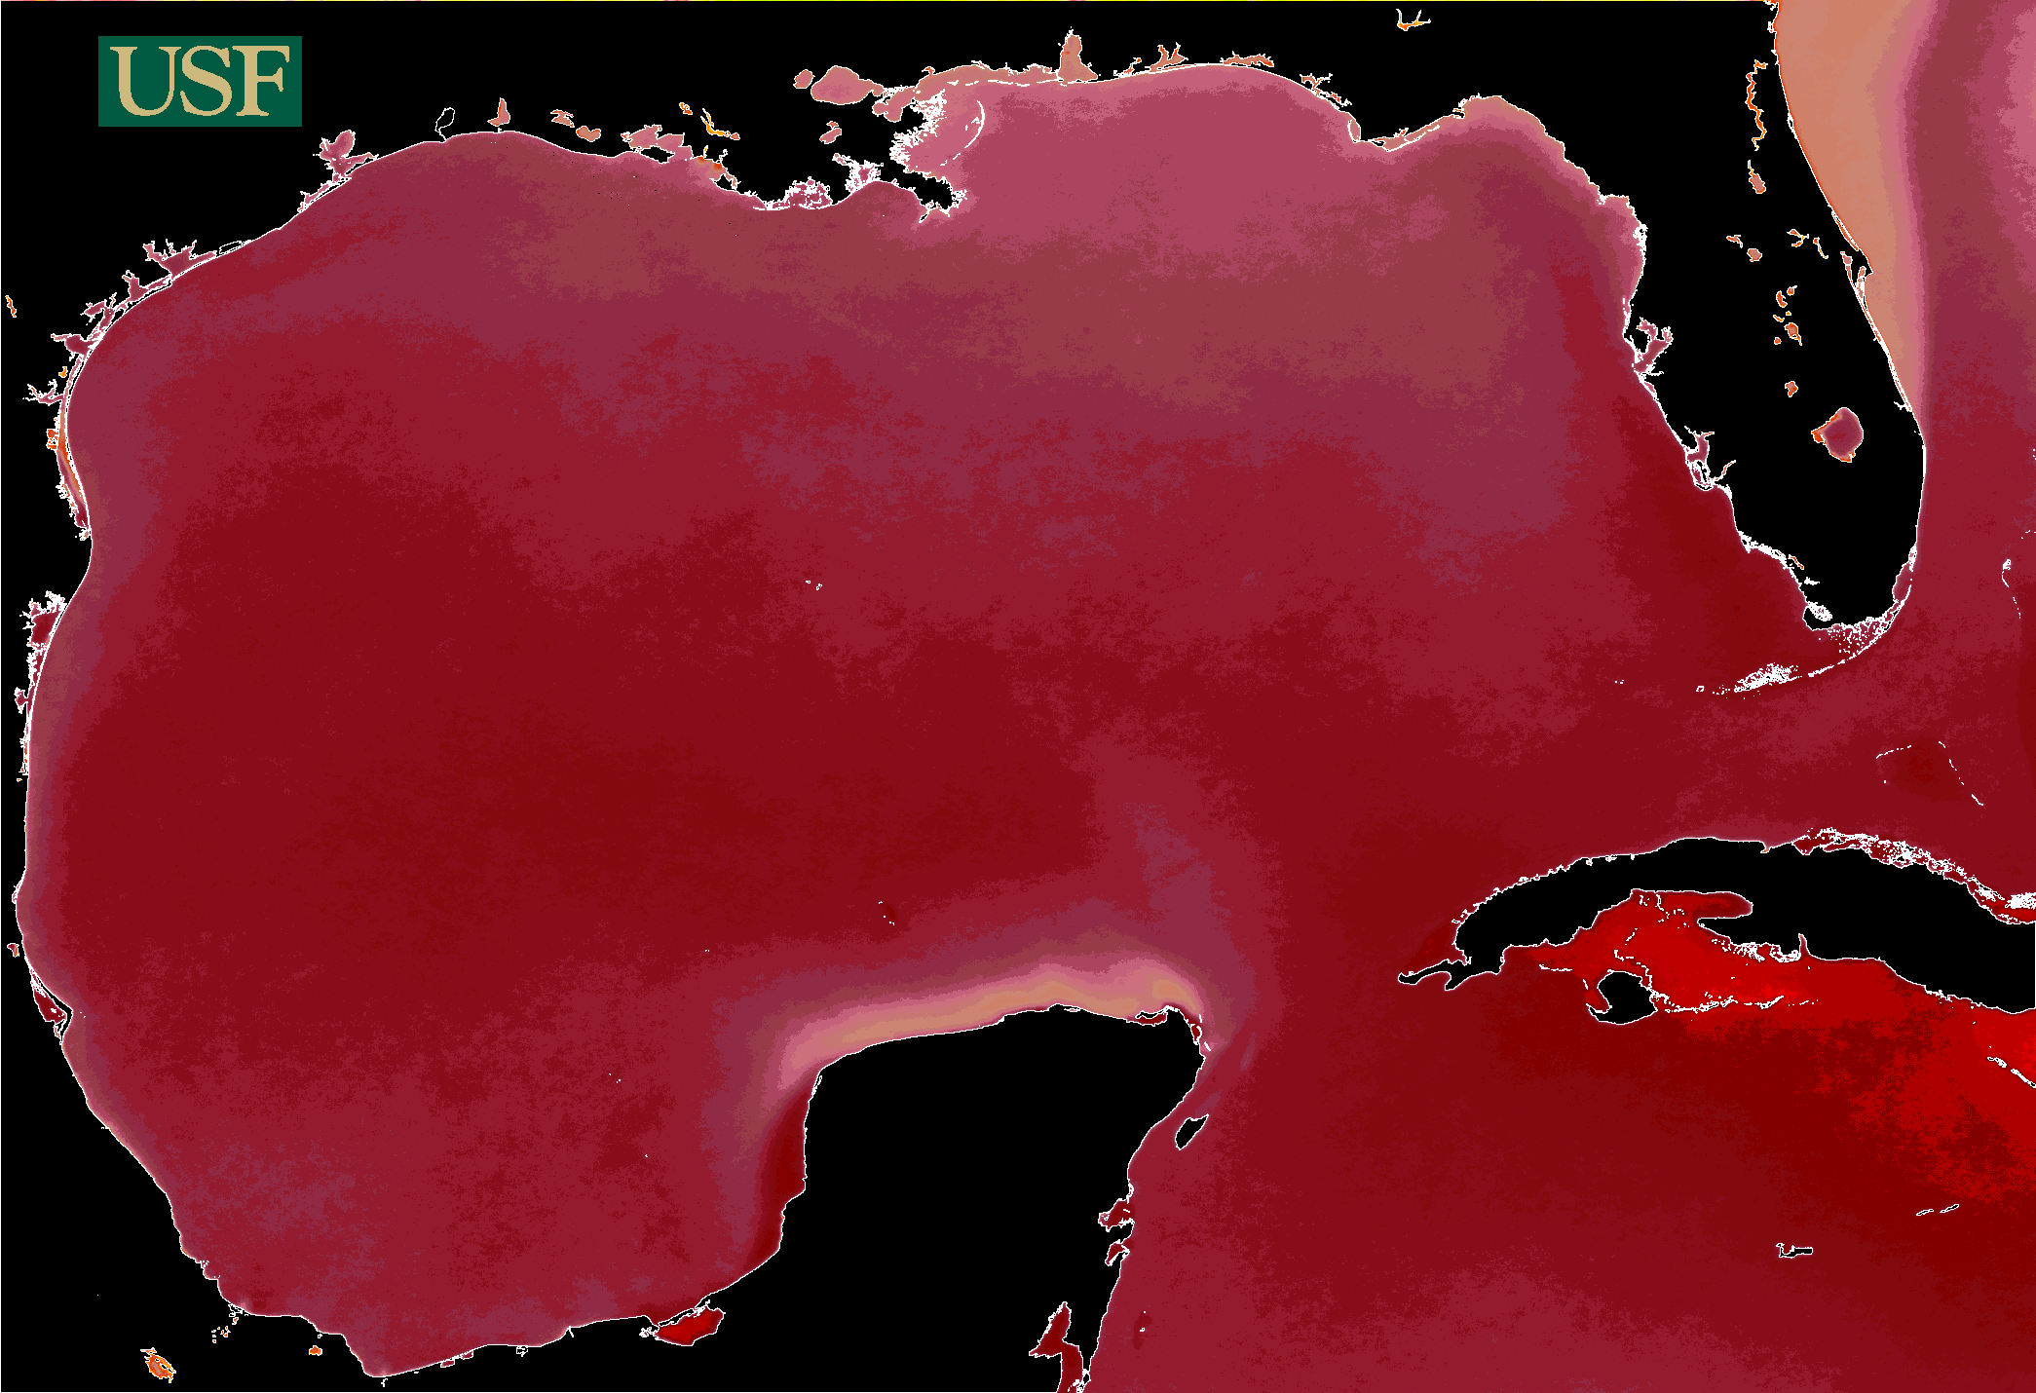
Sea surface temperatures – three seasons
January
May
September
Notes:
“Sampling 4 months apart was a good strategy for capturing change.”
“January lies between the darkest and coldest months.
May has increasing light and water temps.
Sept has some of the warmest water temps yet declining light intensity.”

Slide 15
Sea surface temperatures
Sea-surface salinities
Notes:
“Winter SST’s show a fairly substantial temp diff, especially between the Springs Coast and the Florida Keys.”
“Satellite-derived data shows low salinity… …HOWEVER, field msrments in 3 seasons SHOW even LOWER…Springs Coast
[…and HIGHER … around Fort Desoto and Tampa Bay.]

Slide 16
Archaias abundances plotted on 5-year mean winter salinity
Total Archaias (> 1mm)
Live Archaias (> 1mm)
Notes:
“Archaias distribution is shown here, with larger, darker circles representing higher abundance. “
“So, for the distribution of total Archaias tests (live or dead)… greatest abundance in middle… For Live, greatest is offshore (and seemingly healthiest) but the second greatest was near shore in less than 1m of water.
“More samples need to be analyzed…”

Slide 17
Carbonate Chemistry
TA (μmol/kg)
DIC (μmol/kg)
Ω_{(arag)}
pH
TA/DIC
Notes:
“I’m going to highlight the carbonate chemistry of the Weeki Wachee site mostly, …shown in red.”
“TA near 3000… DIC also…”
“Keys and FD show higher saturation states in winter and seem to be more affected by calc/dissolu in that season…”
“I’ve not shown error bars here, but the errors associate with CO2 system measurements are quite small…
“It’s the DIURNAL RANGE that can be large…

Slide 18
Normalized TA and DIC: calcification/dissolution vs. photosynthesis/respiration
Notes:
“…Looking more closely at the interaction of two key parameters,…
…in plots of normalized TA and DIC, a line with a slope of 2 represents the theoretical impact of a system dominated purely by calcification & dissolution. Likewise, a slope slightly less than zero represents the impact of a system dominated by photosynthesis & respiration.”
“Remember that the study sites increase from south to north, with Site 1 in the Florida Keys and Site 4 in the Springs Coast.”
“For Site 4, few samples were collected in winter and spring, so only the autumn linear regression is plotted.”
“In comparison to all other sites, the Springs Coast site shows a steep curve even in autumn, indicating dominance of calcif/dissol over photosyn/respira. Sites 1 and 3 show a steep curve only in winter. And, although only two winter samples were collected for the Springs Coast site, the slope in winter was the highest among any site.
“The main point is the water chemistry indicates that calcification/dissolution are dominant processes year-round in the Springs Coast.”

Slide 19
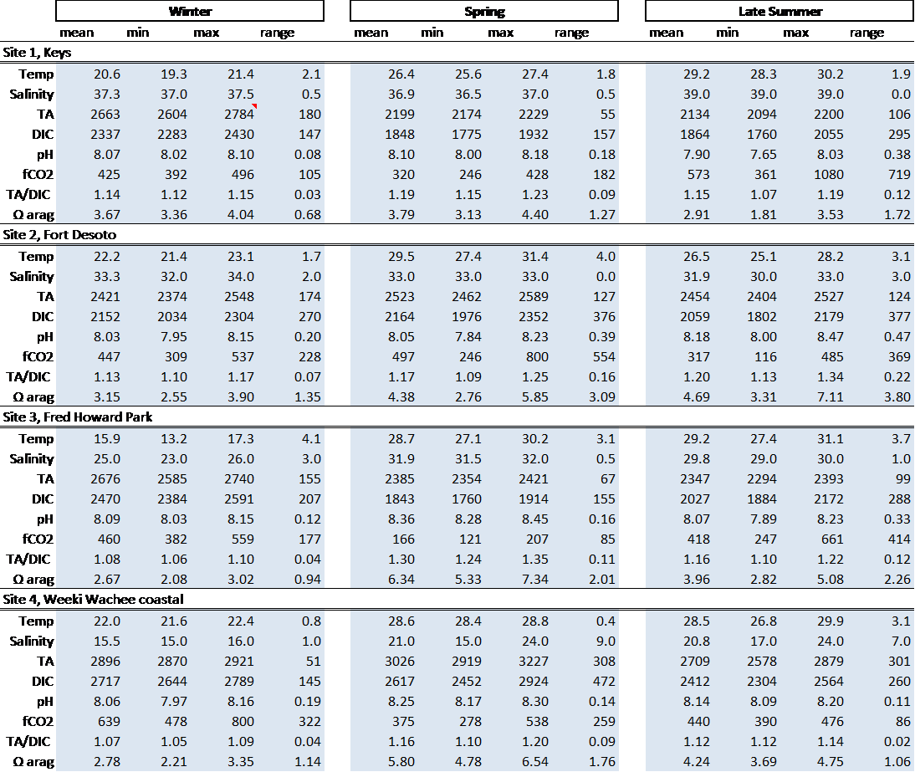
Water chemistry data for Weeki Wachee coastal area
Highest TA and DIC in every season among all sites
Above average pH and Ω among sampling sites
Notes:
“A lot of data was collected by sampling diurnally at four sites over 3 seasons…”
“To highlight Site 4 in the Springs Coast…”
“TA and DIC were much higher than for any other site.
“The pH and Saturation States were also among the highest, on average.”

Slide 20


Uniquely high TA at low salinity
TA vs. S: spring & autumn
(3 sites)
At Weeki Wachee: ΔnTA correlates negatively with tidal stage (r = -0.86, p = 0.001)
Eqn. 1) $TA=\frac{{TA}_{oce}−{TA}^{0}}{S_{oce}} ×S+{TA}^{0}$
ΔnTA = TA – TA’
Eqn. 2) $TA^{′}= \frac{{TA}_{oce}}{S_{oce}} ×S$
Notes:
“The relationship between salinity and TA …”
“Dashed line is a …”
“Sites 1,2,3 follow… However, Site 4, shows much higher TA at lower salinities and the TA actually increases with decreases in salinity.”
“In graph on right… NOAA tide stage data was paired with my samplings times”
[…EXPLAIN ΔnTA…] “…difference between TA normalized by accounting for freshwater contribution and by not accounting for…”
“At high tide, there is no additional contribution to the TA,
while at low tide, there is a very large contribution (1400 μmol/kg!).”

Slide 21
Discussion
Where are Archaias found and why?
Salinity versus alkalinity
Notes:
“Next, I will talk about where Archaias are found and why…”
“And salinity versus alkalinity.”

Slide 22
Where are Archaias found and why?
Abundant seagrass:
Regulates coastal pH and Ω
Shows resistance to Ocean Acidification
(Manzello et al., 2012; Okazaki et al., 2013)
Notes:
“Archaias are very dense in Keys… well known,
“In the 3 study sites to the north, Archaias was found 1) throughout the Springs Coast, 2) sparingly at Fred Howard Park, and 3) absent in the lagoons of Fort Desoto...
“There is dense seagrass in FD and FHP, as well, but the enormous area of seagrass…SC…is what’s impressive!”

Slide 23
Abundant population of Archaias despite…
Lowest temperatures
Lowest salinities
Notes:
“To recap, despite the lowest T and S, the Springs Coast has abundant populations of Archaias angulatus.”

Slide 24
Environmental requirements of Archaias angulatus
Generally accepted:
Warm (14-30 degrees)
Shallow (1 - 20 m)
Clear water
Normal marine salinities
Limited pollution
Recent work indicates revisions needed:
Temperature: Toomey (2013)
Salinity: this study
Notes:
“Based on the literature…it is generally accepted that Archaias requires
[warm, shallow, clear water of marine salinity with limited pollution…]”
“Heidi Toomey showed through experimentation that Archaias can live at much lower… for extended periods of time.”
“And The MOST INTERESTING DISCOVERY from this study is that Archaias angulatus is LIVING at salinities much lower than the published tolerance of this species.”

Slide 25
Major observations
Archaias abundance
Physical environments
Most abundant at Long Key site in seagrass beds
Abundant in Springs Coast seagrass beds
Rare to absent in seagrass beds in Tampa Bay region
Subtropical, normal marine salinity to slightly hypersaline, carbonate sediments
Temperate, hyposaline, carbonate bedrock, mixed quartz & shell sediments
Warm temperate, near normal marine salinity, sediments quartz sands with some shell
Notes:
[SKIP if running out of time…!]
“To summarize, …”

Slide 26
Major observations: water chemistry
Long Key site: water chemistries relatively well known and predictable
In the Springs Coast, total alkalinity (TA) increases with proximity to spring-fed riverine discharge
Near Tampa Bay, water chemistries were intermediate
Notes:
[ANNUNCIATE the 2nd point!]
“The water chemistry in the Florida Keys is relatively well known and predictable.”
“In the Springs Coast,…”
“TB region, …intermediate in terms of TA, saturation state, etc.”

Slide 27
Conclusions
Archaias common in Springs Coast (and Florida Bay)
Archaias rarely found along the coast off the Tampa Bay area
Notes:
“To conclude, …”
…”Archaias angulatus is common … SC … (and abundant in FL Bay.)”
…and is rarely…”
“Bathymetry, seagrass and carbonate seds and bedrock create ideal conditions in the Springs Coast…”

Slide 28
Further Questions
Are previously assumed salinity requirements of Archaias angulatus related to alkalinity?
II. Can high alkalinity freshwater compensate to some degree for reduced salinity/cooler winter temperatures?
III. What is the lower salinity threshold under elevated TA?
IV. Why are Archaias angulatus rare along the Tampa Bay area coastline?
Depth? Circulation? Turbidity?
Notes:
“This exploratory study creates many questions: …”
[READ the questions]

Slide 29
Acknowledgments
CMS-USF Chem Lab
Dr. Byrne’s Lab: Bo Yang, Nora Katie Douglas, Sherwood Liu
CMS-USF Nutrients Lab
Dr. Buck, William Abbott
CMS Foram Lab
Marshall Lester, Christian Gfatter
Field Sampling
Dustin Johnson, Erin Cuyler, Makenna Martin
Dr. Peebles
Keys Marine Lab staff: Cindy, Tom, Mike
Support
Cushman Foundation for Foraminiferal Research
Soul support
My wife, Mayumi Beckwith
Pam Hallock Muller
Friends, mentors at PCC
Additionally, I would like to thank:
Professors & Colleagues of CMS
Butch Ringlespaugh, Zach Ostroff, and many others (RS lab, COT, …)

Slide 30

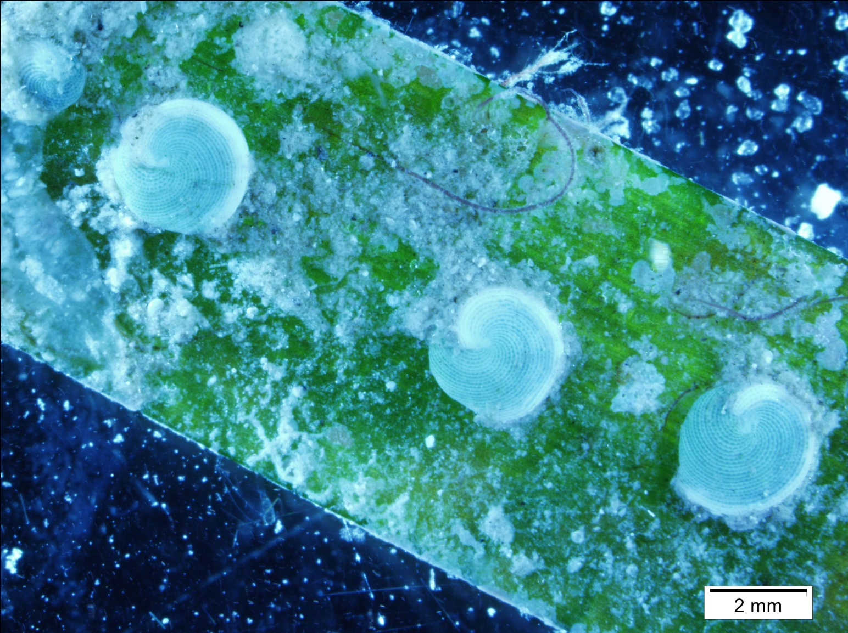
Thank You

Slide 31
Further Questions
Are previously assumed salinity requirements of Archaias angulatus related to alkalinity?
II. Can high alkalinity freshwater compensate to some degree for reduced salinity/cooler winter temperatures?
III. What is the lower salinity threshold under elevated TA?
IV. Why are Archaias angulatus rare along the Tampa Bay area coastline?
Depth? Circulation? Turbidity?
Notes:
QUESTIONS PLEASE…

